Slide 1
Adding Whole Grains to Your Menu
A Training Presentation for
Child and Adult Care Food
Program (CACFP) Operators

Slide 2
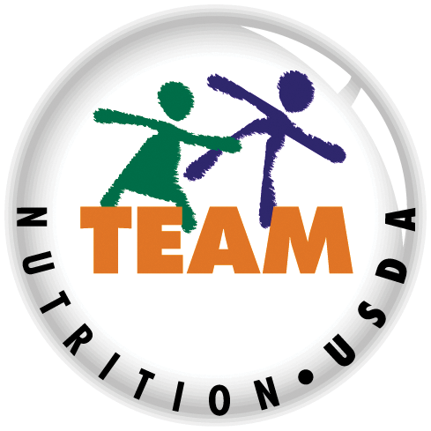


USDA’s Team Nutrition
An initiative of the USDA’s Food and Nutrition Service to support the USDA’s Child Nutrition Programs.
Aims to improve children’s lifelong eating and physical activity habits.
Provides nutrition education and training materials to State agencies, sponsoring organizations, and CACFP sites.
Team Nutrition is an initiative of the USDA Food and Nutrition Service that supports the Child Nutrition Programs, including the National School Lunch Program, the School Breakfast Program, and of course, the Child and Adult Care Food Program, or the CACFP.
The goal of Team Nutrition is to improve children's lifelong eating and physical activity habits through nutrition education based on the principles of the Dietary Guidelines for Americans and MyPlate.
It does so through training and technical assistance for those preparing and serving meals, providing nutrition education for children, and building support for healthier school and child care environments.
TeamNutrition.usda.gov
@TeamNutrition
Notes:
Team Nutrition is an initiative of the USDA Food and Nutrition Service that supports the Child Nutrition Programs, including the National School Lunch Program, the School Breakfast Program, and of course, the Child and Adult Care Food Program, or the CACFP.
The goal of Team Nutrition is to improve children's lifelong eating and physical activity habits through nutrition education based on the principles of the Dietary Guidelines for Americans and MyPlate.
It does so through training and technical assistance for those preparing and serving meals, providing nutrition education for children, and building support for healthier school and child care environments.

Slide 3
Let Us Know Who You Are!
I work for a…
?
Child care center
Family child care home
At-risk afterschool care center
Adult day care center
Sponsoring organization
Emergency shelter
School food authority
State agency
USDA Regional Office
Other
Before we get started, I want to know who has joined us today.
Please raise your hand if you work for:
a child care center [pause and wait for a show of hands],
a family child care home [pause and wait for a show of hands],
an at-risk afterschool care center [pause and wait for a show of hands],
a sponsoring organization [pause and wait for a show of hands],
an emergency shelter [pause and wait for a show of hands],
a school food authority [pause and wait for a show of hands],
a State agency [pause and wait for a show of hands],
A USDA Regional office [pause and wait for a show of hands], or
other [pause and wait for a show of hands].
Notes:
Before we get started, I want to know who has joined us today.
Please raise your hand if you work for:
a child care center [pause and wait for a show of hands],
a family child care home [pause and wait for a show of hands],
an at-risk afterschool care center [pause and wait for a show of hands],
a sponsoring organization [pause and wait for a show of hands],
an emergency shelter [pause and wait for a show of hands],
a school food authority [pause and wait for a show of hands],
a State agency [pause and wait for a show of hands],
A USDA Regional office [pause and wait for a show of hands], or
other [pause and wait for a show of hands].

Slide 4

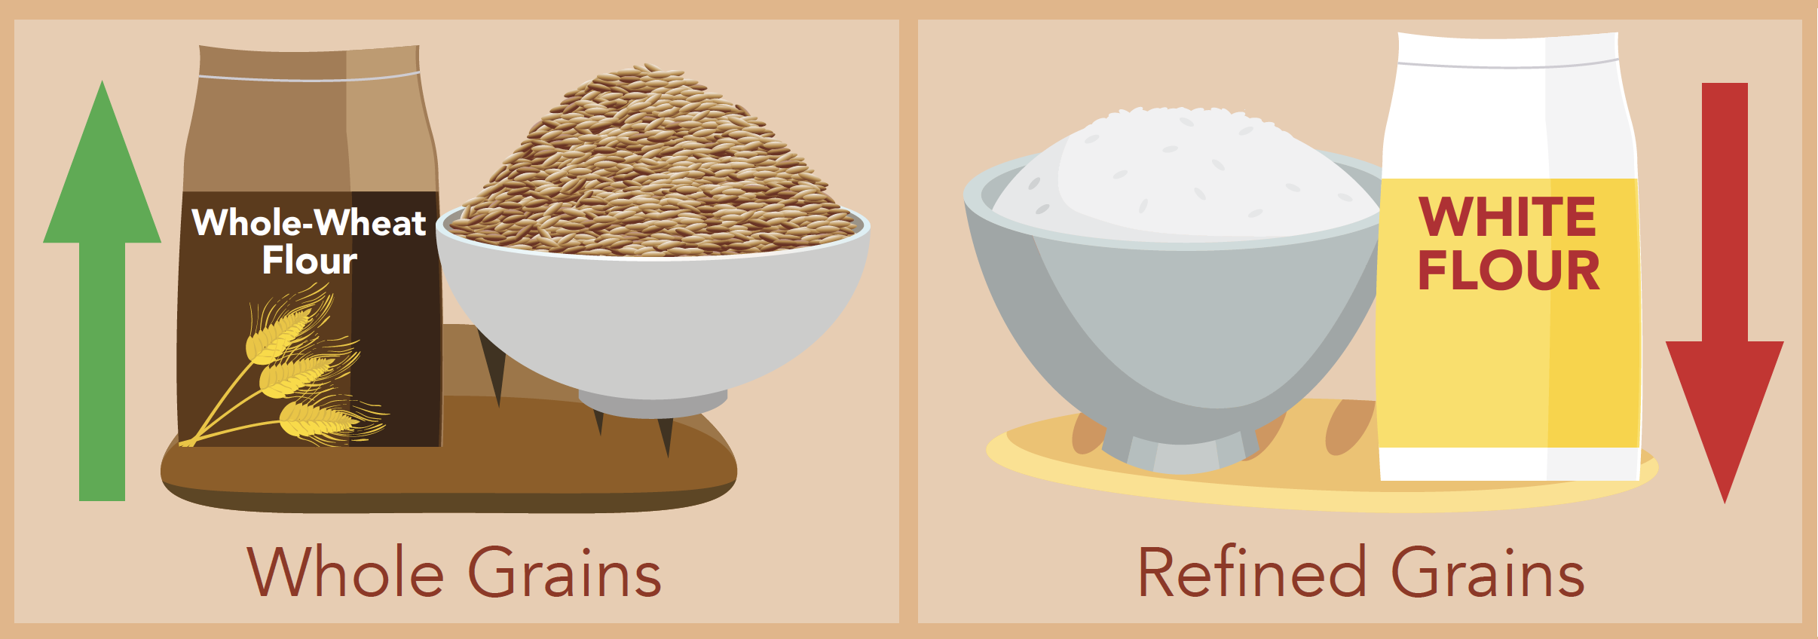
Adding Whole Grains To Your Menu
Kids ages 1 to 13 years old eat up to twice the amount of refined grains that they should, but not enough whole grains.
So, lets get started! Today’s topic is “Adding Whole Grains to Your Menu.” As many of you know, and as shown on the “Growing a Healthier Future With the CACFP” infographic on the screen, many Americans—including children—get up to twice the amount of refined grains that they should every day, but do not get enough whole grains. Many whole grains have vitamins, minerals, fiber, and other nutrients that help kids and adults stay healthy.
Notes:
So, lets get started! Today’s topic is “Adding Whole Grains to Your Menu.” As many of you know, and as shown on the “Growing a Healthier Future With the CACFP” infographic on the screen, many Americans—including children—get up to twice the amount of refined grains that they should every day, but do not get enough whole grains. Many whole grains have vitamins, minerals, fiber, and other nutrients that help kids and adults stay healthy.

Slide 5
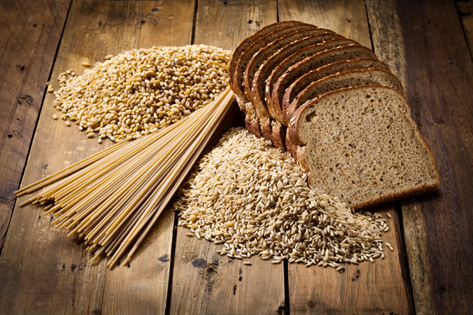
Whole Grains Make a Difference
In the CACFP, grains served at one meal or snack every day must be whole grain-rich
Whole grain-rich:
  At least half the grain ingredients in
  a food are whole-grain
  Any remaining grain ingredients
  are enriched, bran, or germ
Required for child and adult
meal patterns only
  Not required for infant meal pattern
Because whole grains are so healthy, the Child and Adult Care Food Program, or CACFP, requires that the grains served at one meal or snack every day must be whole grain-rich. In the CACFP, “whole grain-rich” means that at least half the grain ingredients in a food are whole grains, and any remaining ingredients are enriched, bran, or germ. This is very important, so I will say it again. In the CACFP, whole grain-rich means that at least half the grain ingredients in a food are whole-grain, and any remaining grains are enriched, bran or germ.
Some examples of whole-grain ingredients include “whole-wheat flour,” “whole-grain corn flour,” “cracked wheat,” and “whole-grain oat flour.”
Some examples of enriched grain ingredients are “enriched wheat flour,” “enriched white flour,” “enriched durum flour,” and “enriched rice flour”.
In the CACFP, the requirement for one whole grain-rich offering per day applies to children and adult participants only. There is no whole grain-rich requirement for infants.
Notes:
Because whole grains are so healthy, the Child and Adult Care Food Program, or CACFP, requires that the grains served at one meal or snack every day must be whole grain-rich. In the CACFP, “whole grain-rich” means that at least half the grain ingredients in a food are whole grains, and any remaining ingredients are enriched, bran, or germ. This is very important, so I will say it again. In the CACFP, whole grain-rich means that at least half the grain ingredients in a food are whole-grain, and any remaining grains are enriched, bran or germ.
Some examples of whole-grain ingredients include “whole-wheat flour,” “whole-grain corn flour,” “cracked wheat,” and “whole-grain oat flour.”
Some examples of enriched grain ingredients are “enriched wheat flour,” “enriched white flour,” “enriched durum flour,” and “enriched rice flour”.
In the CACFP, the requirement for one whole grain-rich offering per day applies to children and adult participants only. There is no whole grain-rich requirement for infants.

Slide 6

Common Whole Grain-Rich Foods
Foods
Oats (steel cut, old fashioned, quick cooking,
instant oatmeal, oat groats)
Brown rice
Wild rice
Quinoa
Bulgur
Cracked wheat
Teff
Whole wheat bread/buns/rolls
Entire wheat bread/buns/rolls
Graham bread/buns/rolls
Whole wheat macaroni/spaghetti
This slide lists some foods that are whole grain-rich. If you serve these foods, you know that what you are serving can be counted as whole grain-rich in the CACFP. These foods are just examples of some whole grain-rich foods, and there are other whole grain-rich foods that are not on this list. You can always contact your sponsoring organization or State agency if you have any questions or are not sure if an ingredient is whole grain-rich or not.
Whole grain-rich foods include:
oats, including steel-cut, old-fashioned, quick-cooking, instant oatmeal and oat groats;
brown rice;
wild rice;
quinoa;
bulgur, which is commonly used in Middle Eastern dishes; and
teff, which is used in some African dishes.
Additionally, foods with the following words on the package are considered whole grain-rich in the CACFP:
whole-wheat bread, whole-wheat buns, and whole-wheat rolls;
entire wheat bread, entire wheat buns, and entire wheat rolls;
graham bread, graham buns and graham rolls;
whole-wheat macaroni;
whole-wheat spaghetti;
whole-wheat vermicelli; and finally,
whole-wheat macaroni product.
Notes:
This slide lists some foods that are whole grain-rich. If you serve these foods, you know that what you are serving can be counted as whole grain-rich in the CACFP. These foods are just examples of some whole grain-rich foods, and there are other whole grain-rich foods that are not on this list. You can always contact your sponsoring organization or State agency if you have any questions or are not sure if an ingredient is whole grain-rich or not.
Whole grain-rich foods include:
oats, including steel-cut, old-fashioned, quick-cooking, instant oatmeal and oat groats;
brown rice;
wild rice;
quinoa;
bulgur, which is commonly used in Middle Eastern dishes; and
teff, which is used in some African dishes.
Additionally, foods with the following words on the package are considered whole grain-rich in the CACFP:
whole-wheat bread, whole-wheat buns, and whole-wheat rolls;
entire wheat bread, entire wheat buns, and entire wheat rolls;
graham bread, graham buns and graham rolls;
whole-wheat macaroni;
whole-wheat spaghetti;
whole-wheat vermicelli; and finally,
whole-wheat macaroni product.

Slide 7
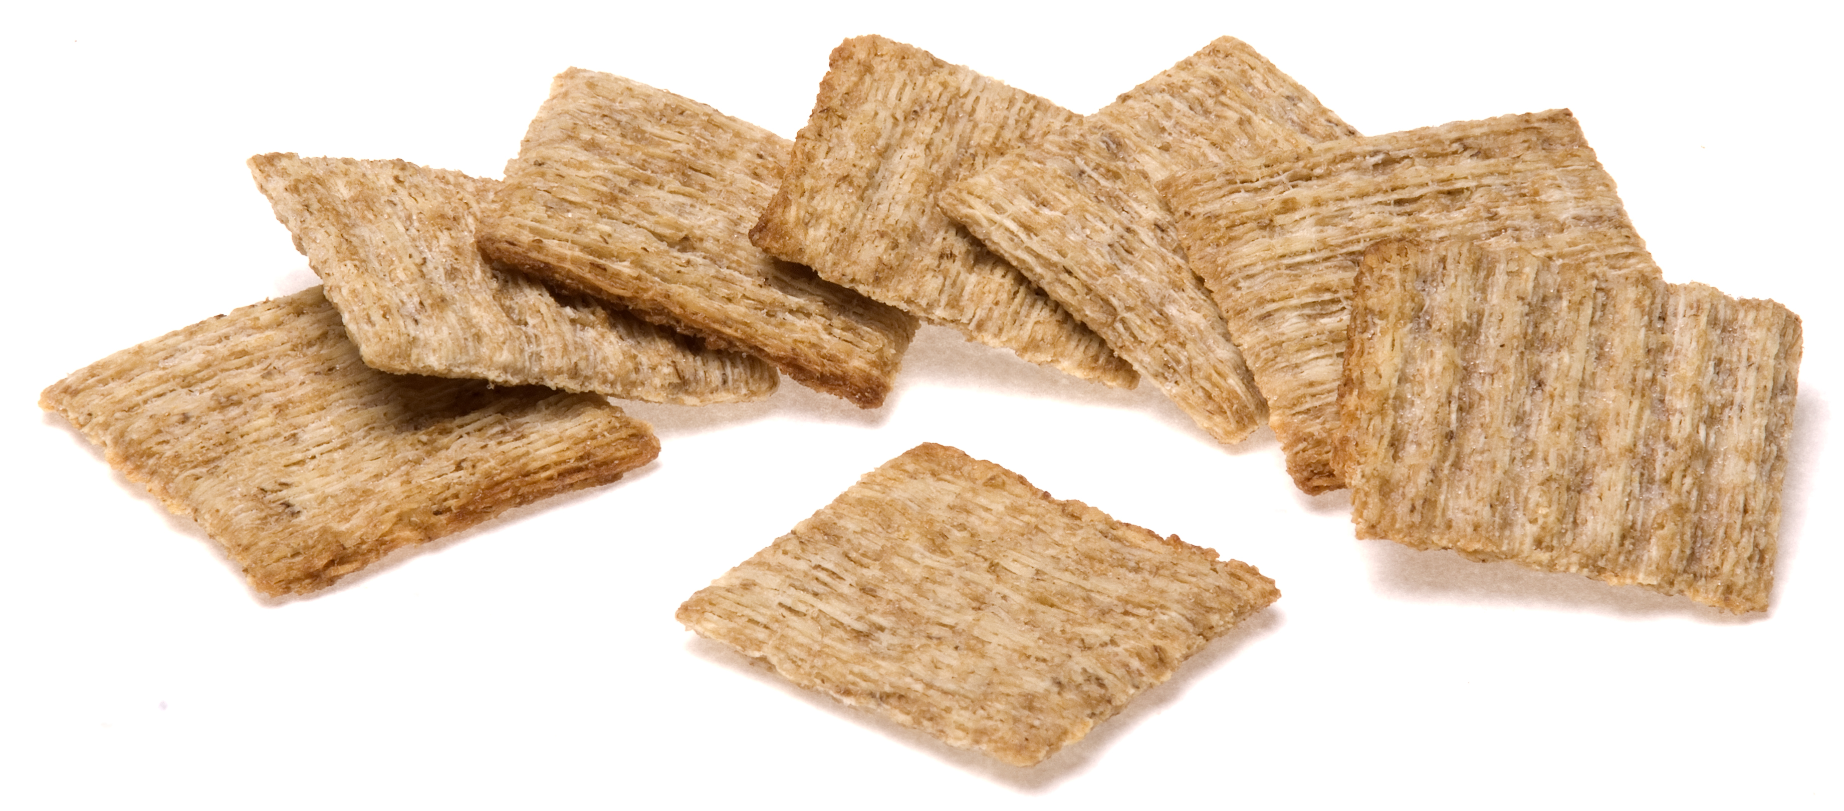
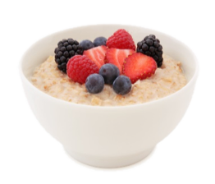
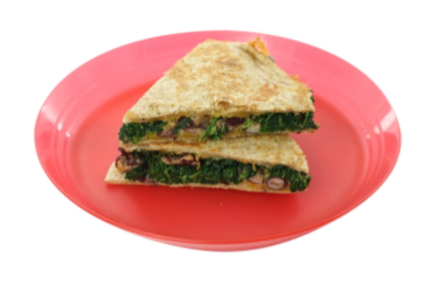
Whole Grain-Rich Requirement for the CACFP
Once per day, offer whole grain-rich foods at meals or snacks
Requirement applies to the day care center or home, not participant
You can serve whole grain-rich foods more than once a day
Portions served must meet the minimum serving size for the
age group
Again, at least once per day in the CACFP, one offering of grains must be whole grain-rich when you are serving adults or children. It doesn’t matter if you are serving the same group of kids or adults throughout the day, or if you are serving different groups of kids or adults, such as an morning group and afternoon group. If your site serves grains that day, whole grain-rich items must be served at least once. And of course, you can always serve whole grain-rich foods more than once per day.
You must serve enough whole grains to meet the minimum serving size for the age group. This is a very important point, so I will say it again. You must serve enough whole grains to meet the minimum serving size for the age group of your participants.
Notes:
Again, at least once per day in the CACFP, one offering of grains must be whole grain-rich when you are serving adults or children. It doesn’t matter if you are serving the same group of kids or adults throughout the day, or if you are serving different groups of kids or adults, such as an morning group and afternoon group. If your site serves grains that day, whole grain-rich items must be served at least once. And of course, you can always serve whole grain-rich foods more than once per day.
You must serve enough whole grains to meet the minimum serving size for the age group. This is a very important point, so I will say it again. You must serve enough whole grains to meet the minimum serving size for the age group of your participants.

Slide 8
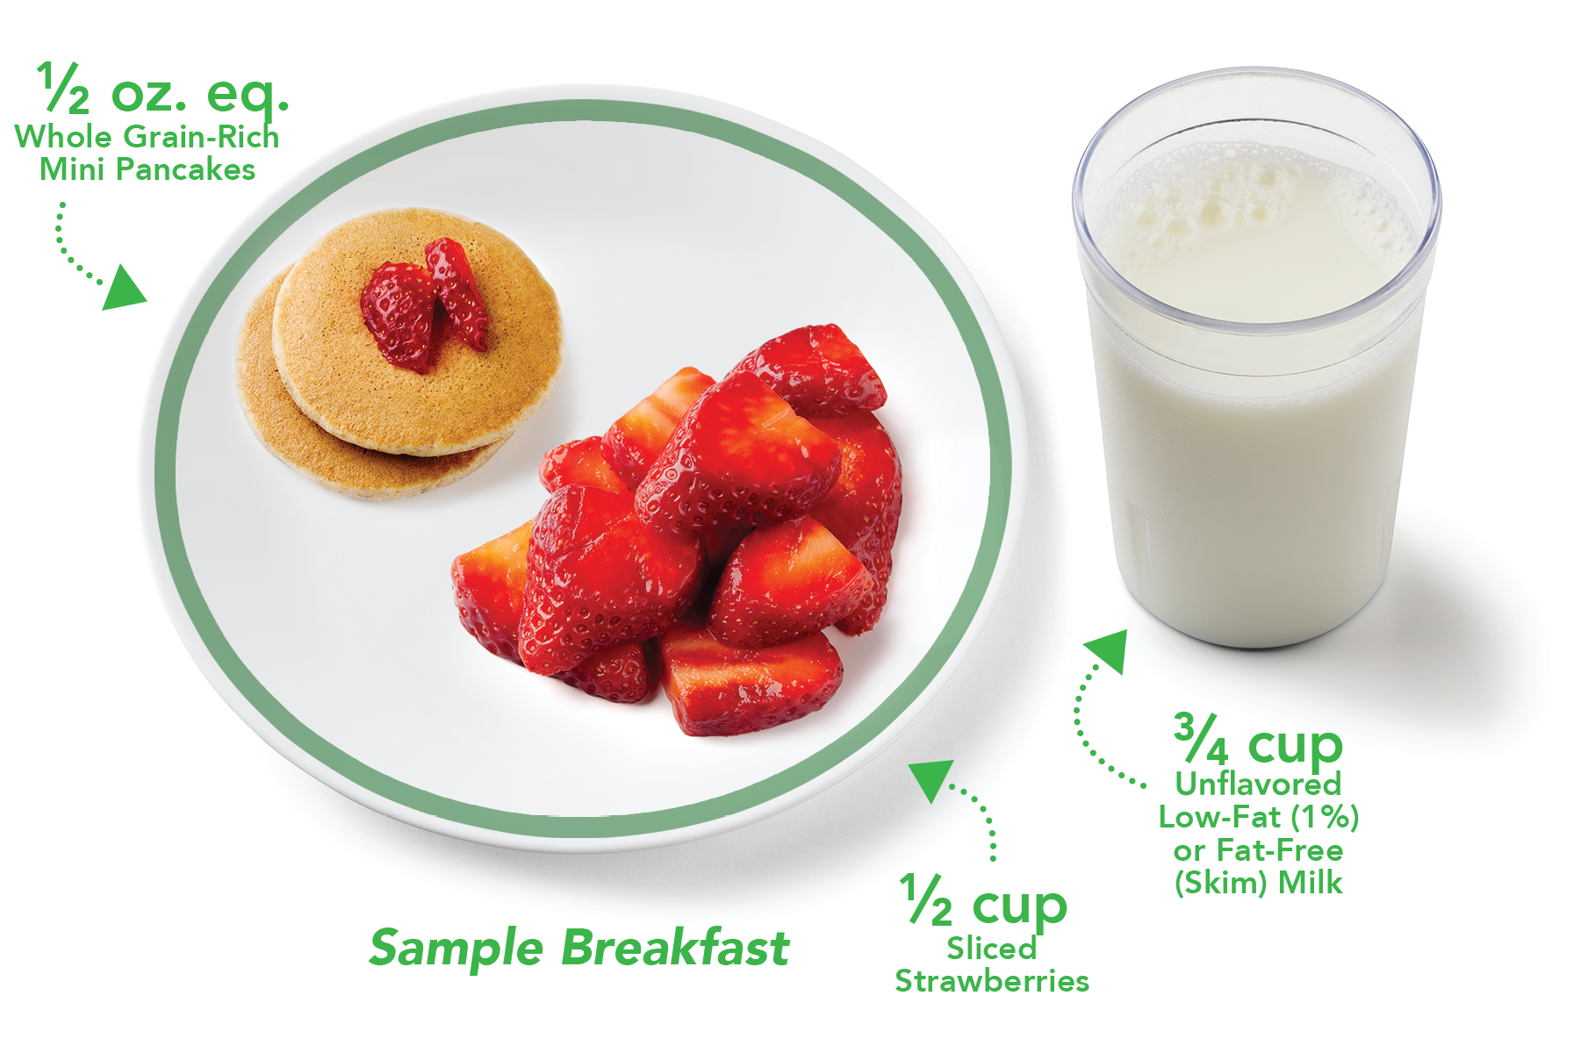

Minimum Serving Sizes
What is in a
Breakfast?
Milk (6 fl. oz. or ³/₄ cup)
Vegetables, Fruit, or Both (¹/₂ cup)
Grains (¹/₂ oz. eq.)
Optional: Meat/meat alternates may be served in place of the entire grains component up to
3 times per week at breakfast.
So, for example, 3 through 5 year olds are required to have at least a half (½) ounce equivalent of grains at breakfast. If you want to meet the whole grain-rich requirement at breakfast that day with this age group, you should serve enough of the whole grain-rich food to credit at least a half ounce equivalent of grains. You can serve more than a half ounce equivalent, but you must serve at least a half ounce equivalent of grains for a reimbursable breakfast.
For 3 through 5 year olds
Notes:
So, for example, 3 through 5 year olds are required to have at least a half (½) ounce equivalent of grains at breakfast. If you want to meet the whole grain-rich requirement at breakfast that day with this age group, you should serve enough of the whole grain-rich food to credit at least a half ounce equivalent of grains. You can serve more than a half ounce equivalent, but you must serve at least a half ounce equivalent of grains for a reimbursable breakfast.

Slide 9
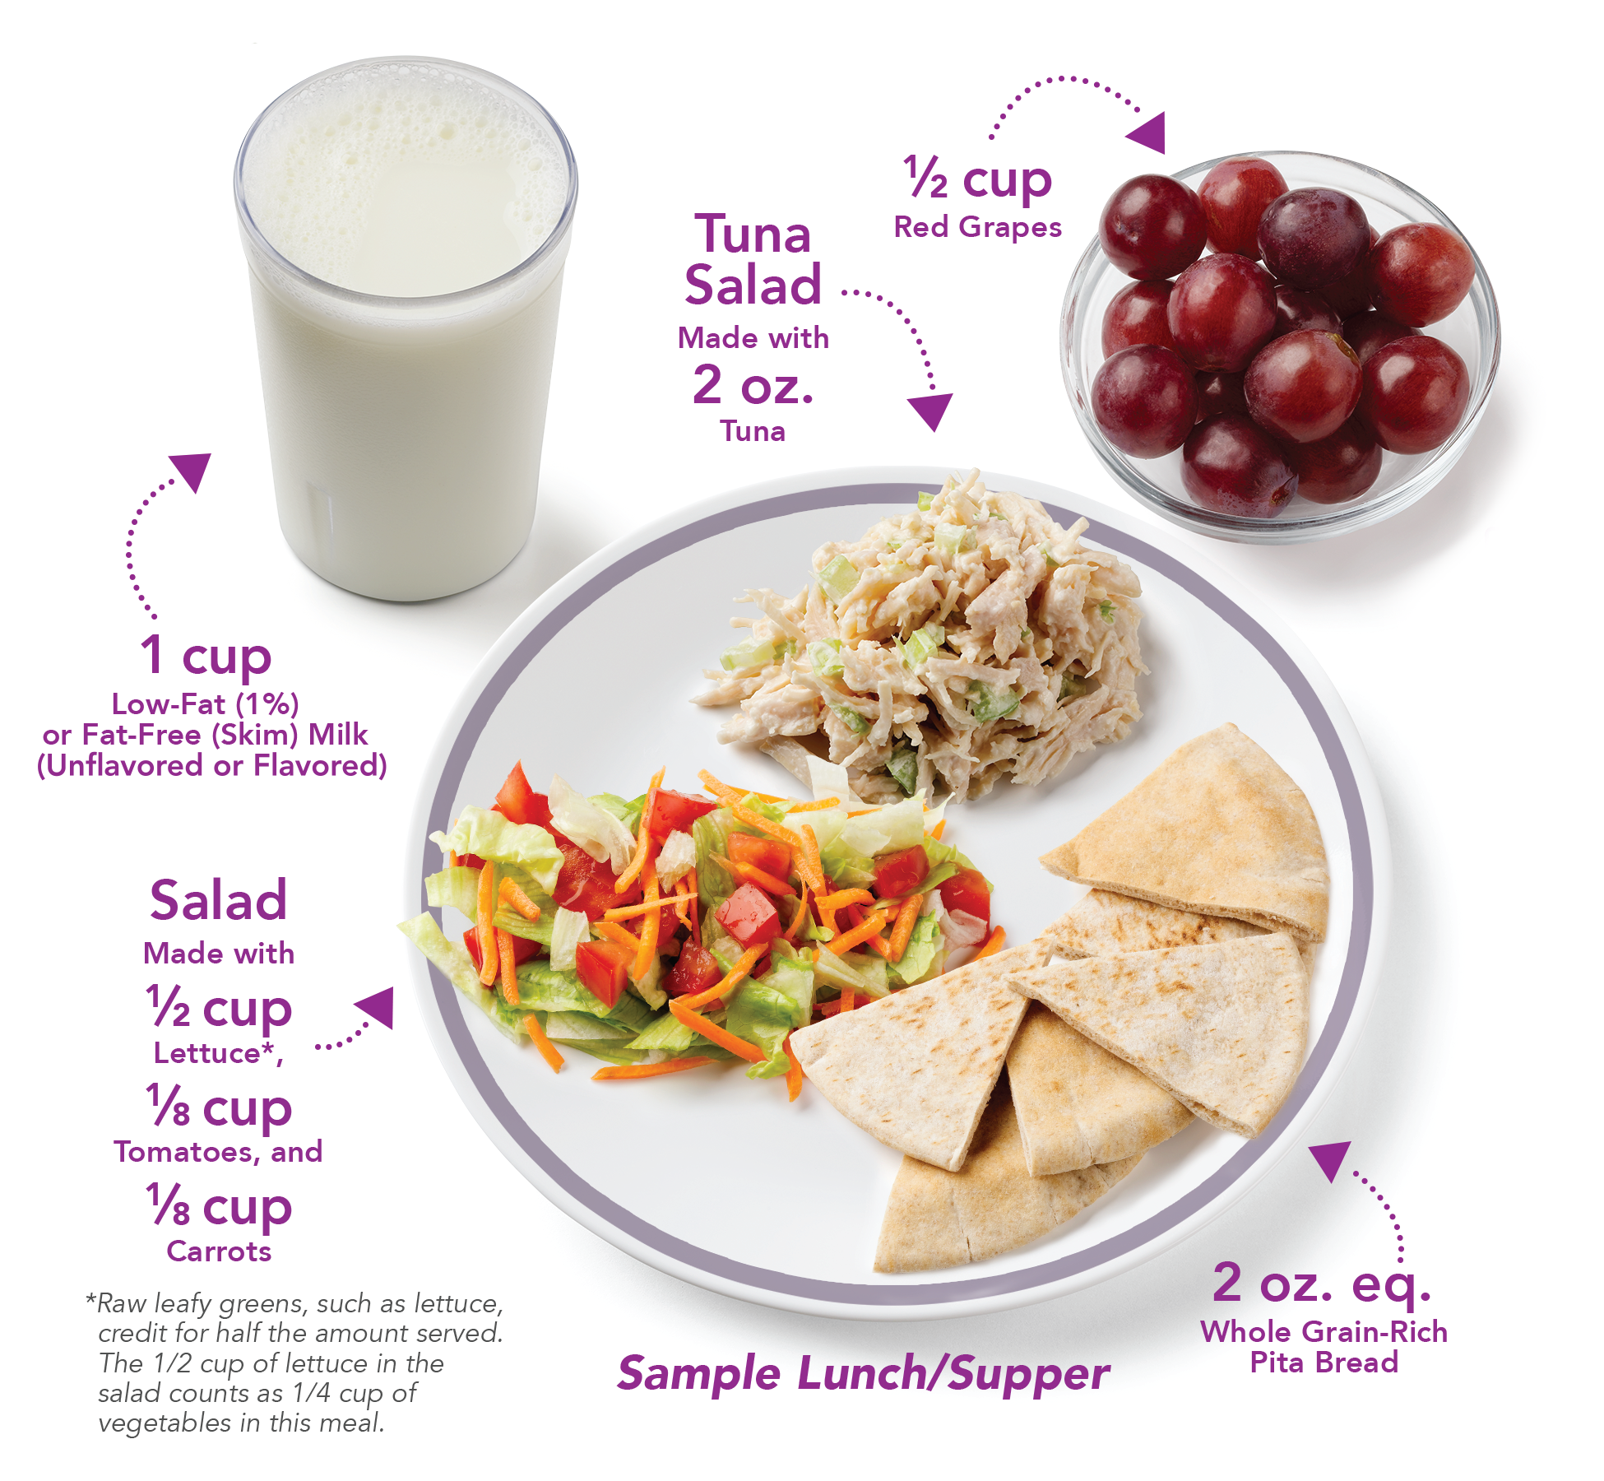

Minimum Serving Sizes
Another example might be for adult participants. Adults are required to have 2 ounce equivalents of grains at lunch and at supper. If you want to meet the whole grain-rich requirement for that day at lunch, and you are serving adult participants, you should serve enough of the whole grain-rich food to credit as 2 ounce equivalent of grains. You can serve more than 2 ounce equivalents, but you must serve at least 2 ounce equivalents of grains to adult participants for a reimbursable lunch or supper.
You may want to try offering whole grain-rich foods at different meals throughout the week, so that participants can see all the different ways that whole grain-rich foods can fit into the day. This might mean serving oatmeal at breakfast on Monday, serving quesadillas made with whole grain-rich tortillas at lunch on Tuesday, and serving whole grain-rich crackers at snack on Wednesday, etc.
What is in a
Lunch or Supper?
Milk (8 fl. oz. or 1 cup)
Meat/Meat Alternate (2 oz. eq.) Vegetables (¹/₂ cup)
Fruit (¹/₂ cup)
Grains (2 oz. eq.)
For Adults
Notes:
Another example might be for adult participants. Adults are required to have 2 ounce equivalents of grains at lunch and at supper. If you want to meet the whole grain-rich requirement for that day at lunch, and you are serving adult participants, you should serve enough of the whole grain-rich food to credit as 2 ounce equivalent of grains. You can serve more than 2 ounce equivalents, but you must serve at least 2 ounce equivalents of grains to adult participants for a reimbursable lunch or supper.
You may want to try offering whole grain-rich foods at different meals throughout the week, so that participants can see all the different ways that whole grain-rich foods can fit into the day. This might mean serving oatmeal at breakfast on Monday, serving quesadillas made with whole grain-rich tortillas at lunch on Tuesday, and serving whole grain-rich crackers at snack on Wednesday, etc.

Slide 10
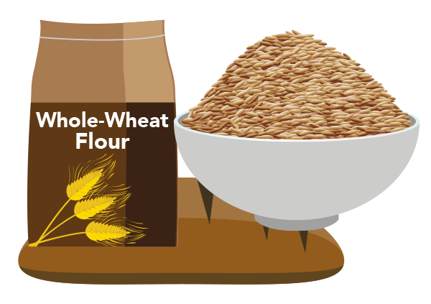
Try It Out!
Your child care center serves the same group of children for the entire day.
Today, you serve enriched toast at breakfast, brown rice at lunch, and yogurt and fruit at snack.
?
Does today’s menu meet the whole grain-rich requirement for the CACFP?
Yes
No
Let’s try a practice question!
Your child care center serves the same group of children for the entire day. Today, you serve enriched toast at breakfast, brown rice at lunch, and yogurt and fruit for snack. Does today’s menu meet the whole grain-rich requirement for the CACFP?
For this question, and all other practice questions today, assume that we are serving enough of the foods to meet minimum serving sizes.
Raise your hand if you think today’s menu meets the whole grain-rich requirement for the CACFP [pause and wait for a show of hands].
Raise your hand if you think today’s menu does not meet the whole grain-rich requirement for the CACFP [pause and wait for a show of hands].
Notes:
Let’s try a practice question!
Your child care center serves the same group of children for the entire day. Today, you serve enriched toast at breakfast, brown rice at lunch, and yogurt and fruit for snack. Does today’s menu meet the whole grain-rich requirement for the CACFP?
For this question, and all other practice questions today, assume that we are serving enough of the foods to meet minimum serving sizes.
Raise your hand if you think today’s menu meets the whole grain-rich requirement for the CACFP [pause and wait for a show of hands].
Raise your hand if you think today’s menu does not meet the whole grain-rich requirement for the CACFP [pause and wait for a show of hands].

Slide 11
Answer
Your child care center serves the same group of children for the entire day.
Today, you serve enriched toast at breakfast, brown rice at lunch, and yogurt and fruit at snack.
?
Does today’s menu meet the whole grain-rich requirement for the CACFP?
✓
Yes
No
Great job everyone! As many of you answered, the answer is yes, today’s menu meets the whole grain-rich requirement for the CACFP. This is because brown rice is a whole grain-rich food, so it counts as your one whole-grain rich offering for the day. In the CACFP, you need to serve whole grain-rich foods at one meal or snack per day, so serving brown rice at lunch ensures that your menu meets the whole grain-rich requirement in the CACFP.
If you had two different groups of children at your center during the day, such as a morning group and an afternoon group, this menu would still meet the whole grain-rich requirement in the CACFP of one offering of whole grain-rich foods per day. The requirement is one whole grain-rich offering per center or home per day, not one whole grain-rich offering per child.
Remember that you can certainly serve whole grain-rich foods more than once a day, and you can try including them at different meals and snacks throughout the week. That way, everyone will have a chance to try and enjoy whole grain-rich foods.
Notes:
Great job everyone! As many of you answered, the answer is yes, today’s menu meets the whole grain-rich requirement for the CACFP. This is because brown rice is a whole grain-rich food, so it counts as your one whole-grain rich offering for the day. In the CACFP, you need to serve whole grain-rich foods at one meal or snack per day, so serving brown rice at lunch ensures that your menu meets the whole grain-rich requirement in the CACFP.
If you had two different groups of children at your center during the day, such as a morning group and an afternoon group, this menu would still meet the whole grain-rich requirement in the CACFP of one offering of whole grain-rich foods per day. The requirement is one whole grain-rich offering per center or home per day, not one whole grain-rich offering per child.
Remember that you can certainly serve whole grain-rich foods more than once a day, and you can try including them at different meals and snacks throughout the week. That way, everyone will have a chance to try and enjoy whole grain-rich foods.

Slide 12

The Scoop on Snacks
What is in a
Snack?
Pick 2:
Milk (4 fl. oz. or ¹/₂ cup)
Meat/Meat Alternate (¹/₂ oz. eq.) Vegetables (¹/₂ cup)
Fruit (¹/₂ cup)
Grains (¹/₂ oz. eq.)
Now, let’s talk about snacks. As you know, a reimbursable snack in the CACFP needs to have foods from two different components.
The five components you can choose from at snacks are:
milk,
meat/meat alternate,
vegetables,
fruit, and
grains.
Notes:
Now, let’s talk about snacks. As you know, a reimbursable snack in the CACFP needs to have foods from two different components.
The five components you can choose from at snacks are:
milk,
meat/meat alternate,
vegetables,
fruit, and
grains.

Slide 13
If You Only Serve Snacks…
You are not required to serve a grain at snack
If you want to serve
a grain, it must be whole grain-rich
What is in a
Snack?
Pick 2:
Milk (4 fl. oz. or ¹/₂ cup)
Meat/Meat Alternate (¹/₂ oz. eq.) Vegetables (¹/₂ cup)
Fruit (¹/₂ cup)
Grains (¹/₂ oz. eq.)
Being able to choose two out of the five components means that grains are optional, but not required, at snack.
If your site only serves snack, meaning you do not serve breakfast, lunch, or supper, you are not required to serve whole grain-rich foods at snack. But, if you do decide to serve a grain at snack, and you do not serve any other CACFP meals, then your grain must be whole grain-rich.
Notes:
Being able to choose two out of the five components means that grains are optional, but not required, at snack.
If your site only serves snack, meaning you do not serve breakfast, lunch, or supper, you are not required to serve whole grain-rich foods at snack. But, if you do decide to serve a grain at snack, and you do not serve any other CACFP meals, then your grain must be whole grain-rich.

Slide 14
Sample Snack Ideas
Snack | Example 1 | Example 2 | Example 3
Milk |  |  | Low-fat (1%) milk
Meat/Meat Alternate | String cheese
Vegetables |  | Bean dip
Fruit | Apples |  | Fruit salad
Grains |  | Whole grain-rich crackers
Here are some examples of snacks that meet the whole grain-rich requirement in the CACFP.
As you can see, each one of these snacks includes foods from two different components.
In Example 1, you have string cheese from the meat/meat alternates component and apples from the fruit component.
In Example 2, you have bean dip from the vegetables component, and whole grain-rich crackers from the grains component.
In Example 3, you have low-fat (1%) milk from the milk component, and fruit salad from the fruit component.
As these examples show, you do not have to serve a grain at snack. But if you do serve grains at snack, and it’s the only grain you are serving that day, then it must be whole grain-rich. This is shown by Example 2: the bean dip and whole grain-rich crackers.
Notes:
Here are some examples of snacks that meet the whole grain-rich requirement in the CACFP.
As you can see, each one of these snacks includes foods from two different components.
In Example 1, you have string cheese from the meat/meat alternates component and apples from the fruit component.
In Example 2, you have bean dip from the vegetables component, and whole grain-rich crackers from the grains component.
In Example 3, you have low-fat (1%) milk from the milk component, and fruit salad from the fruit component.
As these examples show, you do not have to serve a grain at snack. But if you do serve grains at snack, and it’s the only grain you are serving that day, then it must be whole grain-rich. This is shown by Example 2: the bean dip and whole grain-rich crackers.

Slide 15

Try It Out!
?
Your afterschool program only serves snacks. It does not serve breakfast, lunch, or supper. Which snack(s) do not meet the whole grain-rich requirement in the CACFP?
Enriched muffin and low-fat (1%) milk
Whole-wheat toast and peanut butter
Applesauce and low-fat (1%) milk
Diced pears and whole
grain-rich mini bagels
What is in a
Snack?
Pick 2:
Milk (4 fl. oz. or ¹/₂ cup)
Meat/Meat Alternate (¹/₂ oz. eq.) Vegetables (¹/₂ cup)
Fruit (¹/₂ cup)
Grains (¹/₂ oz. eq.)
Now, let’s do a quick practice question!
Let’s say your afterschool program serves only snacks—so it does not serve breakfast, lunch, or supper. Which snack or snacks do not meet the whole grain-rich requirement in the CACFP?
Is it:
Enriched muffins and low-fat (1%) milk [pause and wait for a show of hands],
Whole-wheat toast and peanut butter [pause and wait for a show of hands],
Applesauce and low-fat (1%) milk [pause and wait for a show of hands], or
Diced pears and whole grain-rich mini bagels [pause and wait for a show of hands].
Notes:
Now, let’s do a quick practice question!
Let’s say your afterschool program serves only snacks—so it does not serve breakfast, lunch, or supper. Which snack or snacks do not meet the whole grain-rich requirement in the CACFP?
Is it:
Enriched muffins and low-fat (1%) milk [pause and wait for a show of hands],
Whole-wheat toast and peanut butter [pause and wait for a show of hands],
Applesauce and low-fat (1%) milk [pause and wait for a show of hands], or
Diced pears and whole grain-rich mini bagels [pause and wait for a show of hands].

Slide 16
Answer
Your afterschool program only serves snacks. It does not serve breakfast, lunch, or supper. Which snack(s) do not meet the whole grain-rich requirement in the CACFP?
?
✓
Enriched muffin and low-fat (1%) milk
Whole-wheat toast and peanut butter
Applesauce and low-fat (1%) milk
Diced pears and whole grain-rich mini-bagels
What is in a
Snack?
Pick 2:
Milk (4 fl. oz. or ¹/₂ cup)
Meat/Meat Alternate (¹/₂ oz. eq.) Vegetables (¹/₂ cup)
Fruit (¹/₂ cup)
Grains (¹/₂ oz. eq.)
Nice work everyone! The first snack, the enriched muffin and low-fat milk, does not meet the whole grain-rich requirement in the CACFP, because the grain item (the muffin) is enriched, not whole grain-rich. Because this is the only grain you are serving that day, it must be whole grain-rich.
Note that the third snack, the applesauce and low-fat milk, does not contain any grains. Because grains are optional at snack, it is okay for the snack to not have any grains, as long as it contains foods from two different components.
Notes:
Nice work everyone! The first snack, the enriched muffin and low-fat milk, does not meet the whole grain-rich requirement in the CACFP, because the grain item (the muffin) is enriched, not whole grain-rich. Because this is the only grain you are serving that day, it must be whole grain-rich.
Note that the third snack, the applesauce and low-fat milk, does not contain any grains. Because grains are optional at snack, it is okay for the snack to not have any grains, as long as it contains foods from two different components.

Slide 17

Grains at Breakfast, Lunch, or Supper
Required at meals:
  Breakfast
  Lunch
  Supper
If you only serve one meal per day, then grains served must be whole grain-rich
Although grains are optional at snack, they are required at meals, which are breakfast, lunch, and supper, in the CACFP.
This means that if your site only serves one meal a day, meaning you only serve breakfast, or only lunch, or only supper, then the grains you serve at that meal must be whole grain-rich.
Now, let’s take a closer look at breakfast…
Notes:
Although grains are optional at snack, they are required at meals, which are breakfast, lunch, and supper, in the CACFP.
This means that if your site only serves one meal a day, meaning you only serve breakfast, or only lunch, or only supper, then the grains you serve at that meal must be whole grain-rich.
Now, let’s take a closer look at breakfast…

Slide 18
Serving Meat/Meat Alternates at Breakfast
Required at breakfast:
  Milk
  Vegetables/fruit
  Grains
Can serve meat/meat alternates in place of grains up to three times per week
Must serve grains on days you do not serve meat/meat alternate
If you only serve breakfast, grains must be whole-grain rich
Reimbursable breakfasts in the CACFP must include milk, vegetables/fruit, and grains. You may also serve meat/meat alternates instead of grains up to three times per week.
If you only serve breakfast, meaning breakfast is the only CACFP meal you serve that day, and you want to serve meat/meat alternates in place of grains, you do not have to serve a grain at that meal.
On days you do not serve a meat/meat alternate, you must serve a grain. If breakfast is the only CACFP meal you serve that day, that grain must be whole grain-rich.
If you’d like more information on serving meat/meat alternates at breakfast, be sure to check out Team Nutrition’s “Serving Meat/Meat Alternates at Breakfast” worksheet, as well as the recording of the CACFP Halftime webinar on this topic.
Notes:
Reimbursable breakfasts in the CACFP must include milk, vegetables/fruit, and grains. You may also serve meat/meat alternates instead of grains up to three times per week.
If you only serve breakfast, meaning breakfast is the only CACFP meal you serve that day, and you want to serve meat/meat alternates in place of grains, you do not have to serve a grain at that meal.
On days you do not serve a meat/meat alternate, you must serve a grain. If breakfast is the only CACFP meal you serve that day, that grain must be whole grain-rich.
If you’d like more information on serving meat/meat alternates at breakfast, be sure to check out Team Nutrition’s “Serving Meat/Meat Alternates at Breakfast” worksheet, as well as the recording of the CACFP Halftime webinar on this topic.

Slide 19
Try It Out!
Your adult day care only serves breakfast, and only 3 days a week. Which breakfast does not meet the requirement for whole grain-rich in the CACFP?
?
Fat-free (skim) milk, eggs, fruit salad
Low-fat (1%) milk, enriched pancakes, sliced strawberries
Low-fat (1%) milk, oatmeal, blueberries
Fat-free (skim) milk, beans, cheese
Let’s try another practice question! Your adult day care only serves breakfast, and only does so three days a week. Which breakfast below does not meet the requirement for whole grain-rich in the CACFP?
Is it:
fat-free (skim) milk, eggs, and fruit salad [pause and wait for a show of hands];
low-fat (1%) milk, enriched pancakes, and sliced strawberries [pause and wait for a show of hands];
low-fat (1%) milk, oatmeal, and blueberries [pause and wait for a show of hands]; or
fat-free (skim) milk, beans, and cheese [pause and wait for a show of hands]?
Notes:
Let’s try another practice question! Your adult day care only serves breakfast, and only does so three days a week. Which breakfast below does not meet the requirement for whole grain-rich in the CACFP?
Is it:
fat-free (skim) milk, eggs, and fruit salad [pause and wait for a show of hands];
low-fat (1%) milk, enriched pancakes, and sliced strawberries [pause and wait for a show of hands];
low-fat (1%) milk, oatmeal, and blueberries [pause and wait for a show of hands]; or
fat-free (skim) milk, beans, and cheese [pause and wait for a show of hands]?

Slide 20
Answer
Your adult day care only serves breakfast, and only 3 days a week. Which breakfast does not meet the requirement for whole grain-rich in the CACFP?
?
Fat-free (skim) milk, eggs, fruit salad
Low-fat (1%) milk, enriched pancakes, sliced strawberries
Low-fat (1%) milk, oatmeal, blueberries
Fat-free (skim) milk, beans, cheese
✓
Nice work! The second breakfast of low-fat milk, enriched pancakes, and strawberries does not meet the whole grain-rich requirement in the CACFP. The pancakes are enriched, not whole grain-rich, and because this is the only grain your day care will serve today, the grain needs to be whole grain-rich.
Let’s look at the other options now.
The first breakfast includes milk, eggs, and fruit salad. There is no grain in this breakfast, because the egg, which is a meat alternate, is replacing the grain component. This breakfast still has the required milk component (low-fat milk), and the required vegetables/fruit component (fruit salad), so this breakfast meets the requirement for whole grain-rich in the CACFP and is reimbursable.
The third breakfast includes milk, oatmeal, and blueberries. Oatmeal is whole grain-rich, so this meets the CACFP requirement of at least one offering of whole grain-rich foods per day. This breakfast also has the required milk component (low-fat milk), and the required fruit component (blueberries) needed for a reimbursable breakfast in the CACFP.
Finally, the last breakfast on the list includes milk, beans, and cheese. In this breakfast, cheese, a meat alternate, is served in place of a grain. This breakfast still has the required milk component (low-fat milk) and the required vegetables/fruit component (beans) so this breakfast meets the requirement for whole grain-rich in the CACFP and is reimbursable as well.
Notes:
Nice work! The second breakfast of low-fat milk, enriched pancakes, and strawberries does not meet the whole grain-rich requirement in the CACFP. The pancakes are enriched, not whole grain-rich, and because this is the only grain your day care will serve today, the grain needs to be whole grain-rich.
Let’s look at the other options now.
The first breakfast includes milk, eggs, and fruit salad. There is no grain in this breakfast, because the egg, which is a meat alternate, is replacing the grain component. This breakfast still has the required milk component (low-fat milk), and the required vegetables/fruit component (fruit salad), so this breakfast meets the requirement for whole grain-rich in the CACFP and is reimbursable.
The third breakfast includes milk, oatmeal, and blueberries. Oatmeal is whole grain-rich, so this meets the CACFP requirement of at least one offering of whole grain-rich foods per day. This breakfast also has the required milk component (low-fat milk), and the required fruit component (blueberries) needed for a reimbursable breakfast in the CACFP.
Finally, the last breakfast on the list includes milk, beans, and cheese. In this breakfast, cheese, a meat alternate, is served in place of a grain. This breakfast still has the required milk component (low-fat milk) and the required vegetables/fruit component (beans) so this breakfast meets the requirement for whole grain-rich in the CACFP and is reimbursable as well.

Slide 21

Offer Versus Serve (OVS)
For at-risk afterschool or adult participants only
Can be used only at meals:
  Breakfast
  Lunch
  Supper
If counting OVS meal towards whole grain-rich requirement, all grains offered must be whole grain-rich
If your at-risk afterschool program, or adult day care program, serves breakfast, lunch, or supper using a type of meal service called “Offer Versus Serve” or “OVS,” and you want to meet the whole grain-rich requirement at the meal that uses OVS, then all the grains you offer at that meal must be whole grain-rich.
Notes:
If your at-risk afterschool program, or adult day care program, serves breakfast, lunch, or supper using a type of meal service called “Offer Versus Serve” or “OVS,” and you want to meet the whole grain-rich requirement at the meal that uses OVS, then all the grains you offer at that meal must be whole grain-rich.

Slide 22


Try It Out!
Your at-risk afterschool center serves supper using OVS, and also serves snack. You want to meet the CACFP whole grain-rich requirement at supper, and offer two options from the grains component: whole grain-rich rolls and enriched crackers.
?
Does offering these two options meet the whole grain-rich requirement in the CACFP?
Yes
No
Let’s do one last practice question. Your at-risk afterschool center serves supper using OVS, and also serves snack. You want to meet the CACFP whole grain-rich requirement at supper, and offer two options from the grains component: whole grain-rich rolls and enriched crackers.
Does offering these two options meet the whole grain-rich requirement in the CACFP?
Raise your hand if you think offering whole grain-rich rolls and enriched crackers at supper using OVS meets the whole grain-rich requirement in the CACFP [pause and wait for a show of hands].
Raise your hand if you think offering whole grain-rich rolls and enriched crackers at supper using OVS does not meet the whole grain-rich requirement in the CACFP [pause and wait for a show of hands].
Notes:
Let’s do one last practice question. Your at-risk afterschool center serves supper using OVS, and also serves snack. You want to meet the CACFP whole grain-rich requirement at supper, and offer two options from the grains component: whole grain-rich rolls and enriched crackers.
Does offering these two options meet the whole grain-rich requirement in the CACFP?
Raise your hand if you think offering whole grain-rich rolls and enriched crackers at supper using OVS meets the whole grain-rich requirement in the CACFP [pause and wait for a show of hands].
Raise your hand if you think offering whole grain-rich rolls and enriched crackers at supper using OVS does not meet the whole grain-rich requirement in the CACFP [pause and wait for a show of hands].

Slide 23
Answer
Your at-risk afterschool center serves supper using OVS, and also serves snack. You want to meet the CACFP whole grain-rich requirement at supper, and offer two options from the grains component: whole grain-rich rolls and enriched crackers.
?
Does offering these two options meet the whole grain-rich requirement in the CACFP?
Yes
No
✓
Nice work everyone! The answer is no, offering whole grain-rich rolls and enriched crackers at OVS lunch or supper does not meet the whole grain-rich requirement in the CACFP. When using OVS at meals that meet the whole grain-rich requirement in the CACFP, all grains offered must be whole grain-rich.
So, in this example, you could continue to serve the whole grain-rich rolls, and substitute the enriched crackers with whole grain-rich crackers or another whole grain-rich food (that is not a roll), to meet the CACFP whole grain-rich requirement.
For more information on Offer Versus Serve, you can check out Team Nutrition’s “Offer Versus Serve in the CACFP” worksheet as well as the recording of the CACFP Halftime webinar on that topic.
Notes:
Nice work everyone! The answer is no, offering whole grain-rich rolls and enriched crackers at OVS lunch or supper does not meet the whole grain-rich requirement in the CACFP. When using OVS at meals that meet the whole grain-rich requirement in the CACFP, all grains offered must be whole grain-rich.
So, in this example, you could continue to serve the whole grain-rich rolls, and substitute the enriched crackers with whole grain-rich crackers or another whole grain-rich food (that is not a roll), to meet the CACFP whole grain-rich requirement.
For more information on Offer Versus Serve, you can check out Team Nutrition’s “Offer Versus Serve in the CACFP” worksheet as well as the recording of the CACFP Halftime webinar on that topic.

Slide 24

Food(s) for Thought:
Whole Grain-Rich Breakfast Ideas
Oatmeal*
Whole Grain-Rich Pancakes
Whole Grain-Rich Waffles
Toast Made with Whole-Wheat Bread
Whole Grain-Rich Muffin
Whole Grain-Rich Cereal*
Whole Grain-Rich English Muffin, Bagel, or Biscuit
Finally, we will wrap up with some “food for thought” that gives you ideas of different whole grain-rich foods that you may serve as part of reimbursable meals and snacks in the CACFP. There are certainly other whole grain-rich foods that you could serve, and you may serve these foods at any meal or snack in the CACFP.
At breakfast, try serving:
oatmeal,
whole grain-rich pancakes,
whole grain-rich waffles,
toast made with whole-wheat bread,
whole grain-rich muffins,
whole grain-rich cereal, and
whole grain-rich English muffins, bagels, or biscuits, such as the Baking Powder Biscuits shown on this slide.
For the cereal and oatmeal, you will want to make sure that they meet the sugar limit for cereals in the CACFP of no more than 6 grams of sugar per dry ounce.
For more information on sugar limit for cereals in the CACFP, you can check out Team Nutrition’s “Choose Breakfast Cereals That Are Lower in Added Sugars” worksheet as well as the recording of the CACFP Halftime webinar on that topic.
*Must meet the sugar limit for cereals in the CACFP.
Notes:
Finally, we will wrap up with some “food for thought” that gives you ideas of different whole grain-rich foods that you may serve as part of reimbursable meals and snacks in the CACFP. There are certainly other whole grain-rich foods that you could serve, and you may serve these foods at any meal or snack in the CACFP.
At breakfast, try serving:
oatmeal,
whole grain-rich pancakes,
whole grain-rich waffles,
toast made with whole-wheat bread,
whole grain-rich muffins,
whole grain-rich cereal, and
whole grain-rich English muffins, bagels, or biscuits, such as the Baking Powder Biscuits shown on this slide.
For the cereal and oatmeal, you will want to make sure that they meet the sugar limit for cereals in the CACFP of no more than 6 grams of sugar per dry ounce.
For more information on sugar limit for cereals in the CACFP, you can check out Team Nutrition’s “Choose Breakfast Cereals That Are Lower in Added Sugars” worksheet as well as the recording of the CACFP Halftime webinar on that topic.

Slide 25
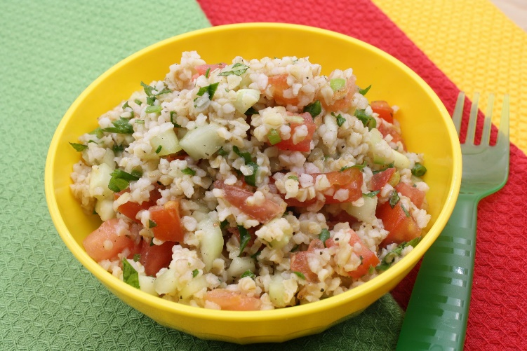
Food(s) for Thought:
Whole Grain-Rich Lunch/Supper Ideas
Whole Wheat Macaroni/Spaghetti
Whole Grain-Rich Pita Bread
or Pita Pocket
Whole-Wheat Bun or Roll
Whole Grain-Rich Pizza Crust
Whole Grain-Rich Tortilla
Brown Rice
Wild Rice
Quinoa
Bulgur
Some whole grain-rich items to include on your lunch or supper menus include:
whole wheat macaroni/spaghetti;
whole grain-rich pita bread or pita pockets;
whole wheat buns or rolls;
whole grain-rich pizza crust; and
whole grain-rich tortillas.
You could also try including some cooked whole grains such as
brown rice;
wild rice;
quinoa; and
bulgur, which is used to make a dish called tabbouleh that’s shown on the slide.
Notes:
Some whole grain-rich items to include on your lunch or supper menus include:
whole wheat macaroni/spaghetti;
whole grain-rich pita bread or pita pockets;
whole wheat buns or rolls;
whole grain-rich pizza crust; and
whole grain-rich tortillas.
You could also try including some cooked whole grains such as
brown rice;
wild rice;
quinoa; and
bulgur, which is used to make a dish called tabbouleh that’s shown on the slide.

Slide 26

Food(s) for Thought:
Whole Grain-Rich Snack Ideas
Whole Grain-Rich Crackers
Whole Grain-Rich Pita Wedges
Whole Grain-Rich Cereal Mix*
Whole Grain-Rich Pretzels
Rice Cakes Made with Brown Rice
Whole Grain-Rich Banana Bread
*Must meet the sugar limit for cereals in the CACFP.
Finally, at snack, you can serve:
whole grain-rich crackers;
whole grain-rich pita wedges;
whole grain-rich cereal mix;
whole grain-rich pretzels;
rice cakes made with brown rice; and
whole grain-rich banana bread.
Notes:
Finally, at snack, you can serve:
whole grain-rich crackers;
whole grain-rich pita wedges;
whole grain-rich cereal mix;
whole grain-rich pretzels;
rice cakes made with brown rice; and
whole grain-rich banana bread.

Slide 27

How To Order Print Copies
Resource Order Form at TeamNutrition.usda.gov.
FREE for those participating in a USDA’s Child Nutrition Program, while supplies last.
Sponsoring organizations and State agencies can also order in bulk by sending an email to:
TeamNutrition@usda.gov
For all participating in a Child Nutrition Program, such as the CACFP, Team Nutrition’s print materials are free to order.
If you would like to order Team Nutrition’s free materials in print, you can go to the “Resource Order Form” link on the Team Nutrition website to order print copies of the materials.
For bulk orders, you can email teamnutrition@usda.gov.
Notes:
For all participating in a Child Nutrition Program, such as the CACFP, Team Nutrition’s print materials are free to order.
If you would like to order Team Nutrition’s free materials in print, you can go to the “Resource Order Form” link on the Team Nutrition website to order print copies of the materials.
For bulk orders, you can email teamnutrition@usda.gov.

Slide 28
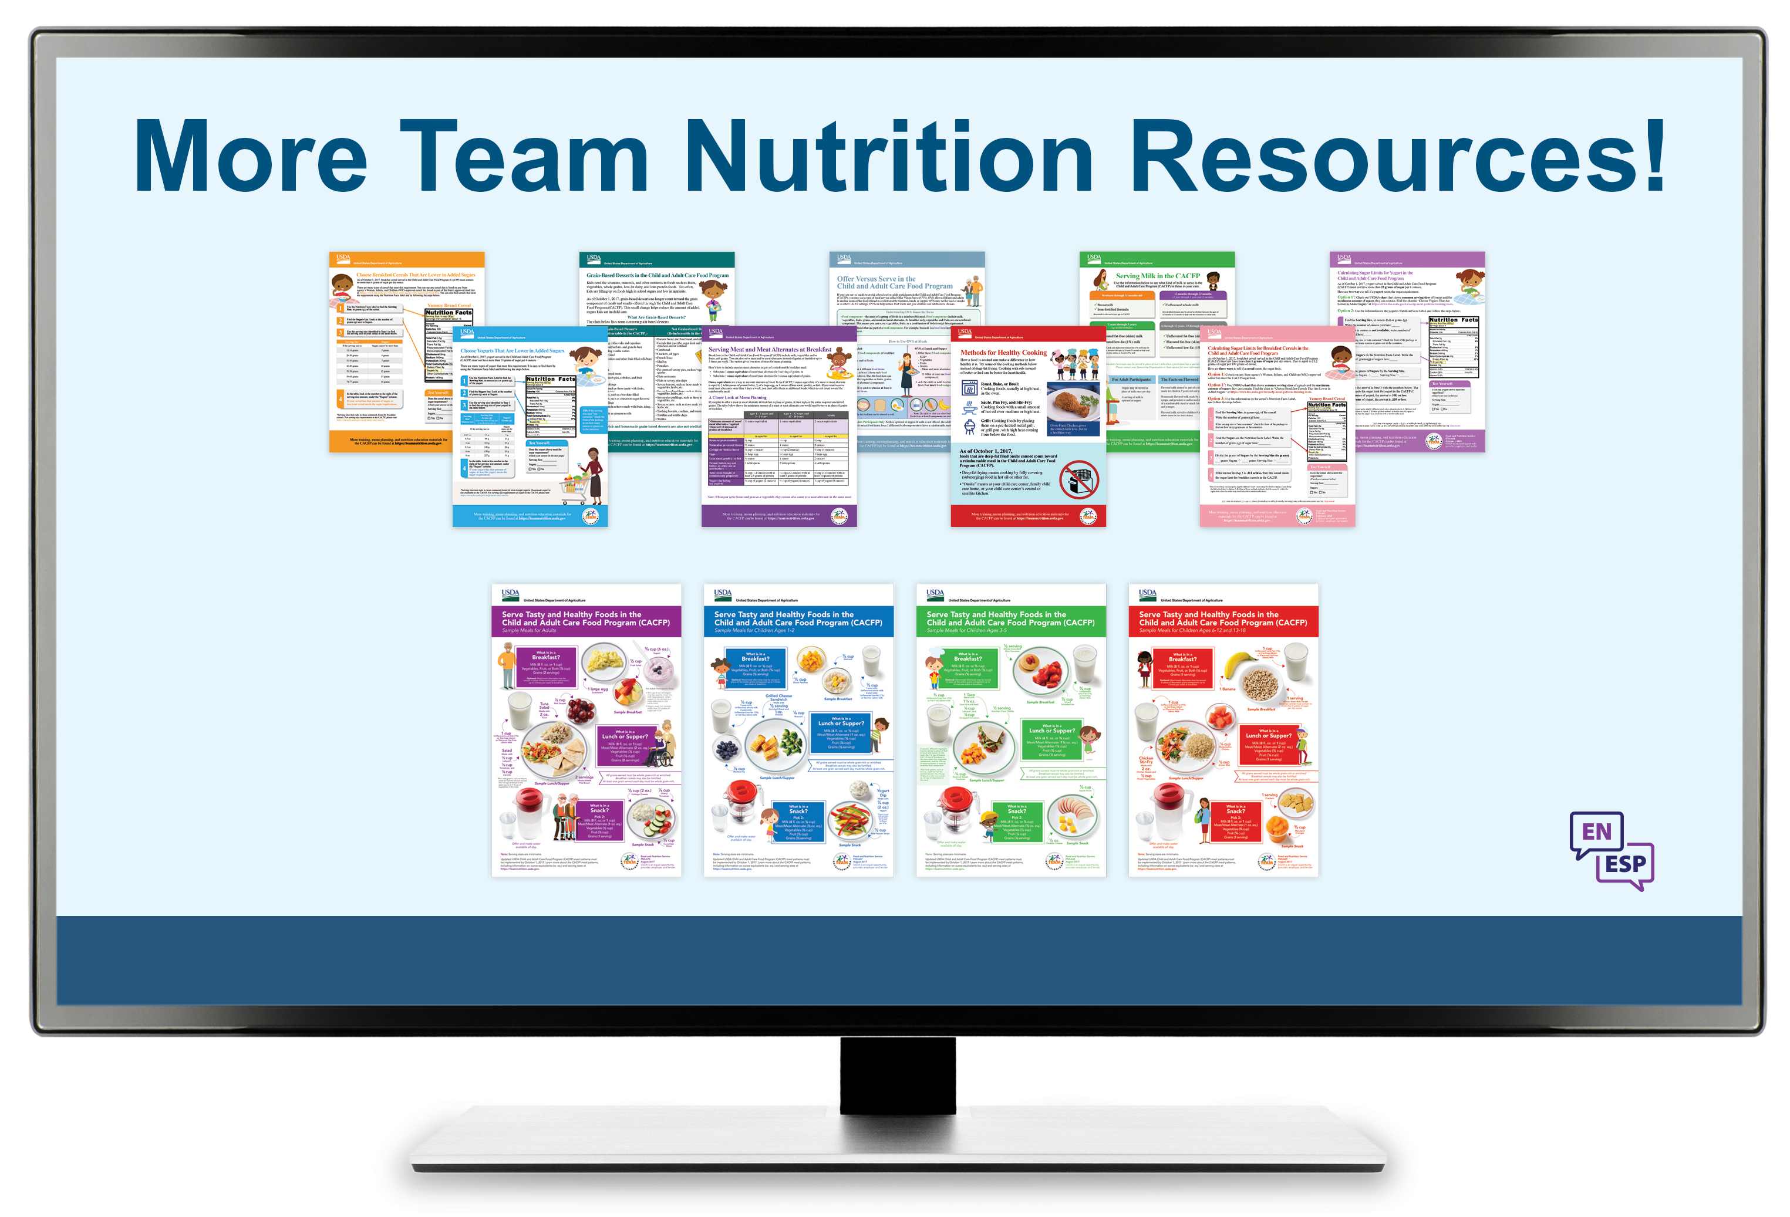
More Team Nutrition Resources
All Team Nutrition materials are available online from Team Nutrition’s website and are available for free download to anybody who is interested.
TeamNutrition.usda.gov
Notes:
All Team Nutrition materials are available online from Team Nutrition’s website and are available for free download to anybody who is interested.

Slide 29


Thank you!
These training slides were provided by U.S. Department of Agriculture's Team Nutrition. If you would like to learn more about Team Nutrition and additional resources available, please visit their website, subscribe to their monthly e-newsletter, connect with them via email at teamnutrition@usda.gov, and follow them on Twitter.
Thank you!
TeamNutrition.usda.gov
@TeamNutrition
TeamNutrition@usda.gov
USDA is an equal opportunity provider, employer, and lender.
Notes:
These training slides were provided by U.S. Department of Agriculture's Team Nutrition. If you would like to learn more about Team Nutrition and additional resources available, please visit their website, subscribe to their monthly e-newsletter, connect with them via email at teamnutrition@usda.gov, and follow them on Twitter.
Thank you!

