Slide 1
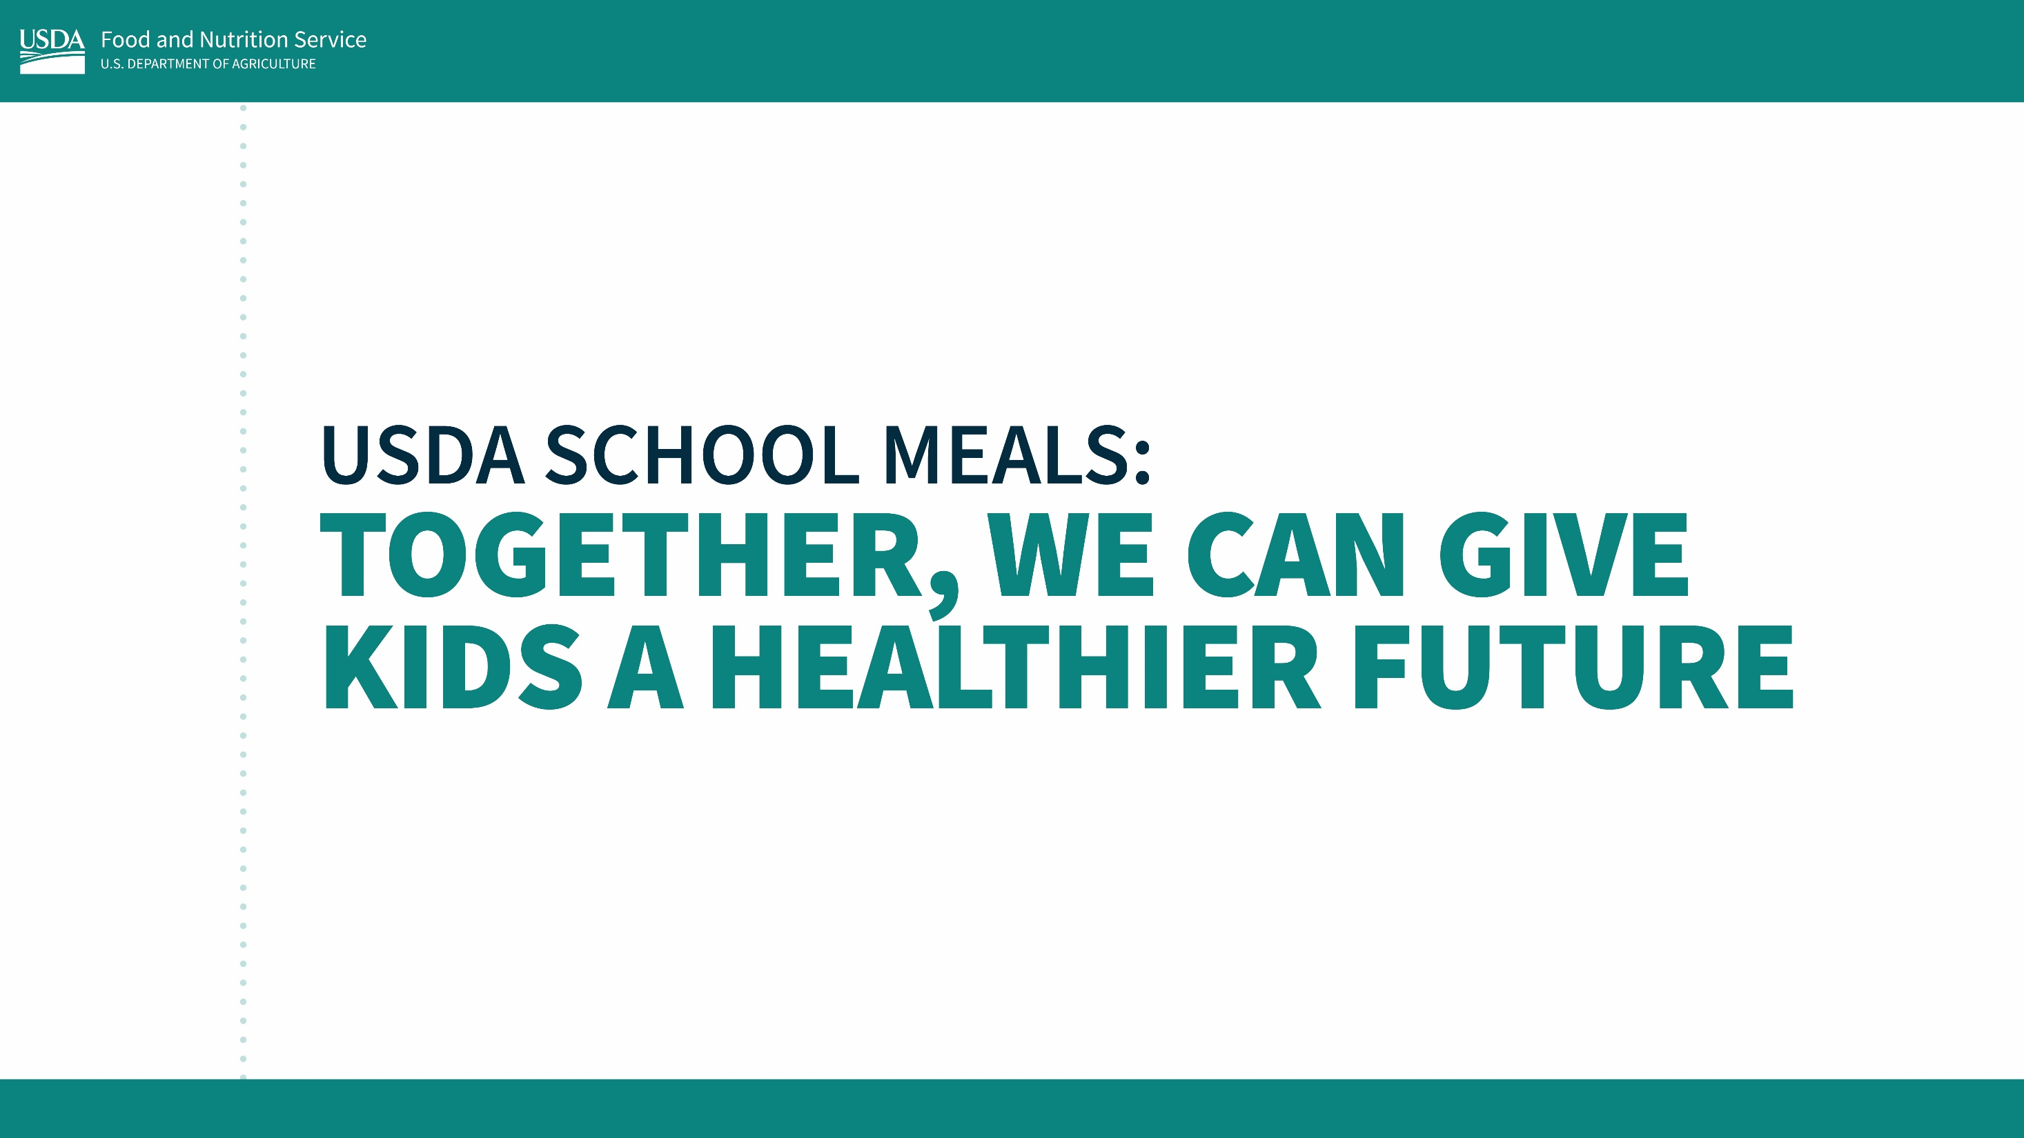

Slide 2

Why do school meals matter?
Good nutrition is critical to success in the classroom and beyond. But unfortunately, many children are not getting the nutrients they need. Most kids get too much sugar, sodium, and saturated fat — and not enough fruits, vegetables, and whole grains. As a result, diet-related diseases like diabetes and obesity are on the rise.
For children to grow and reach their full potential, it is critical that they
have access to nutritious foods and develop lifelong healthy dietary
habits. USDA school meal programs reach around 30 million
children each school day from all communities and
backgrounds across the country. Ensuring these
meals are highly nutritious is one of America’s best
opportunities to improve child health.

Slide 3
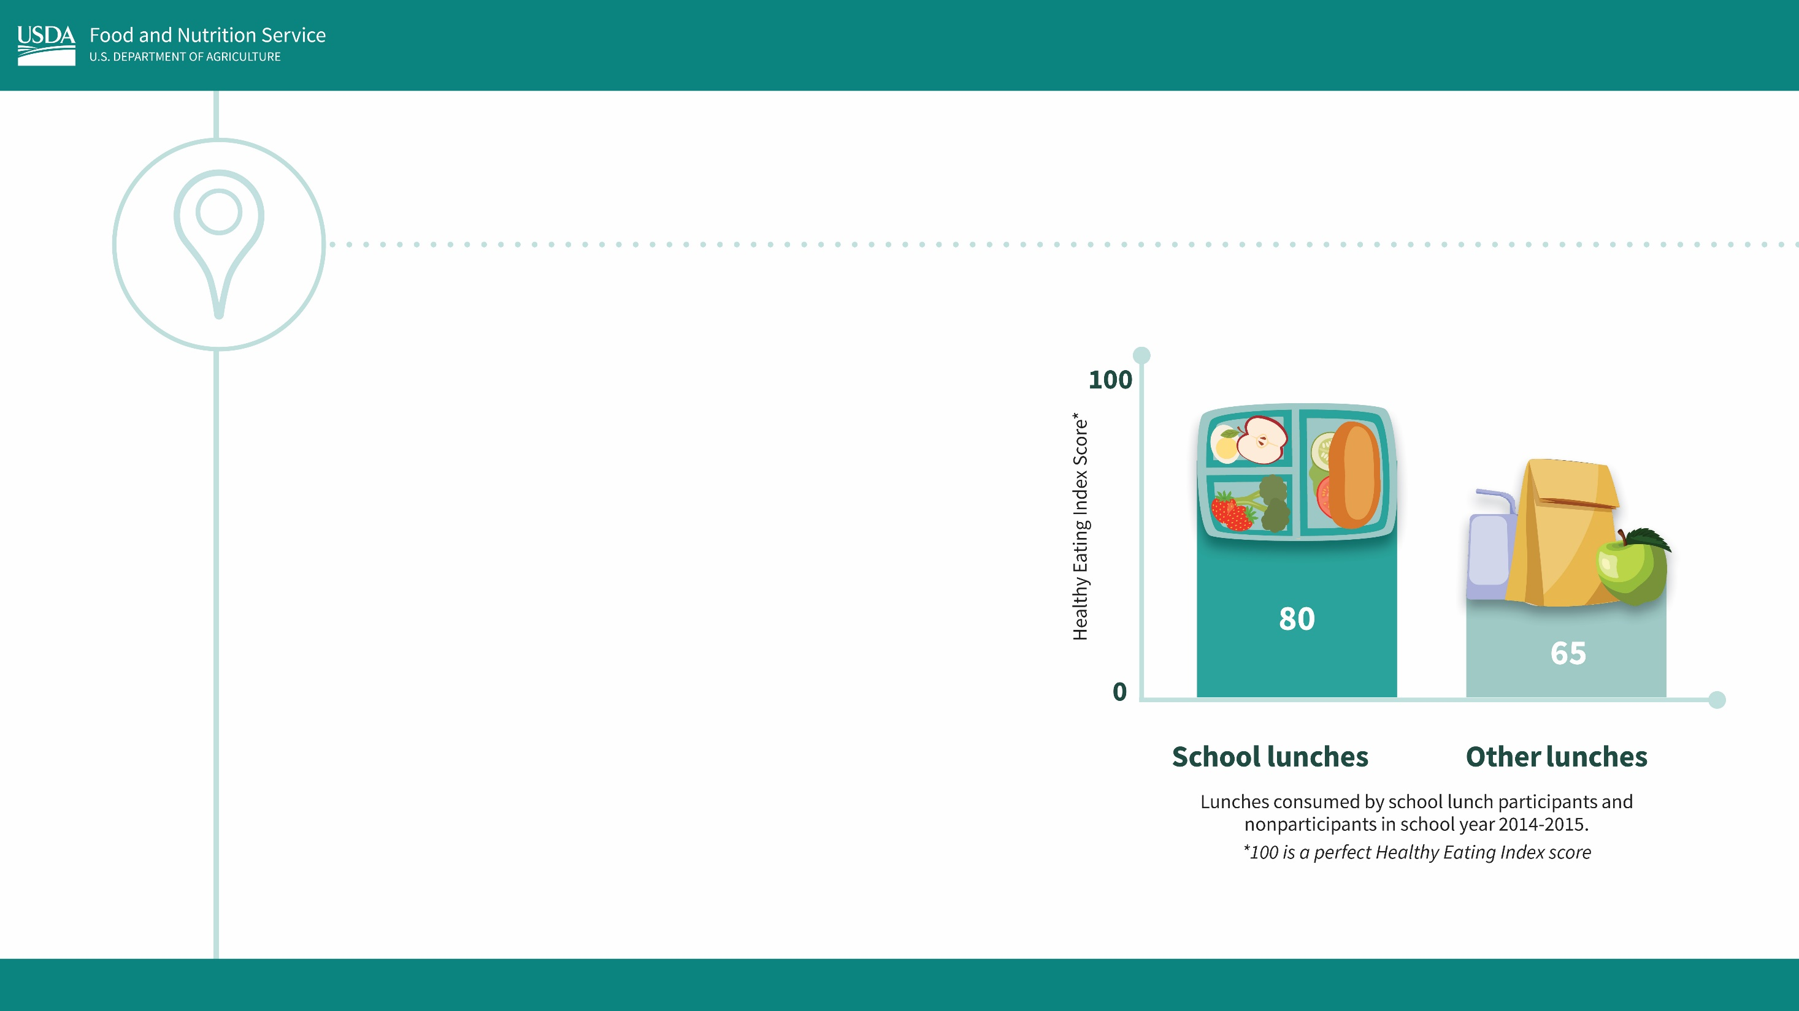
Where are we now?
Research shows that kids get their healthiest meals of the day from school. Thanks to the hard work and dedication of our many school meal partners, school nutrition has come a long way.
For example, the Healthy Eating Index score is a measure of how closely a meal meets the recommendations of the Dietary Guidelines for Americans. The average score of school lunches was found to be significantly higher than the average score of lunches from home or other places.

Slide 4
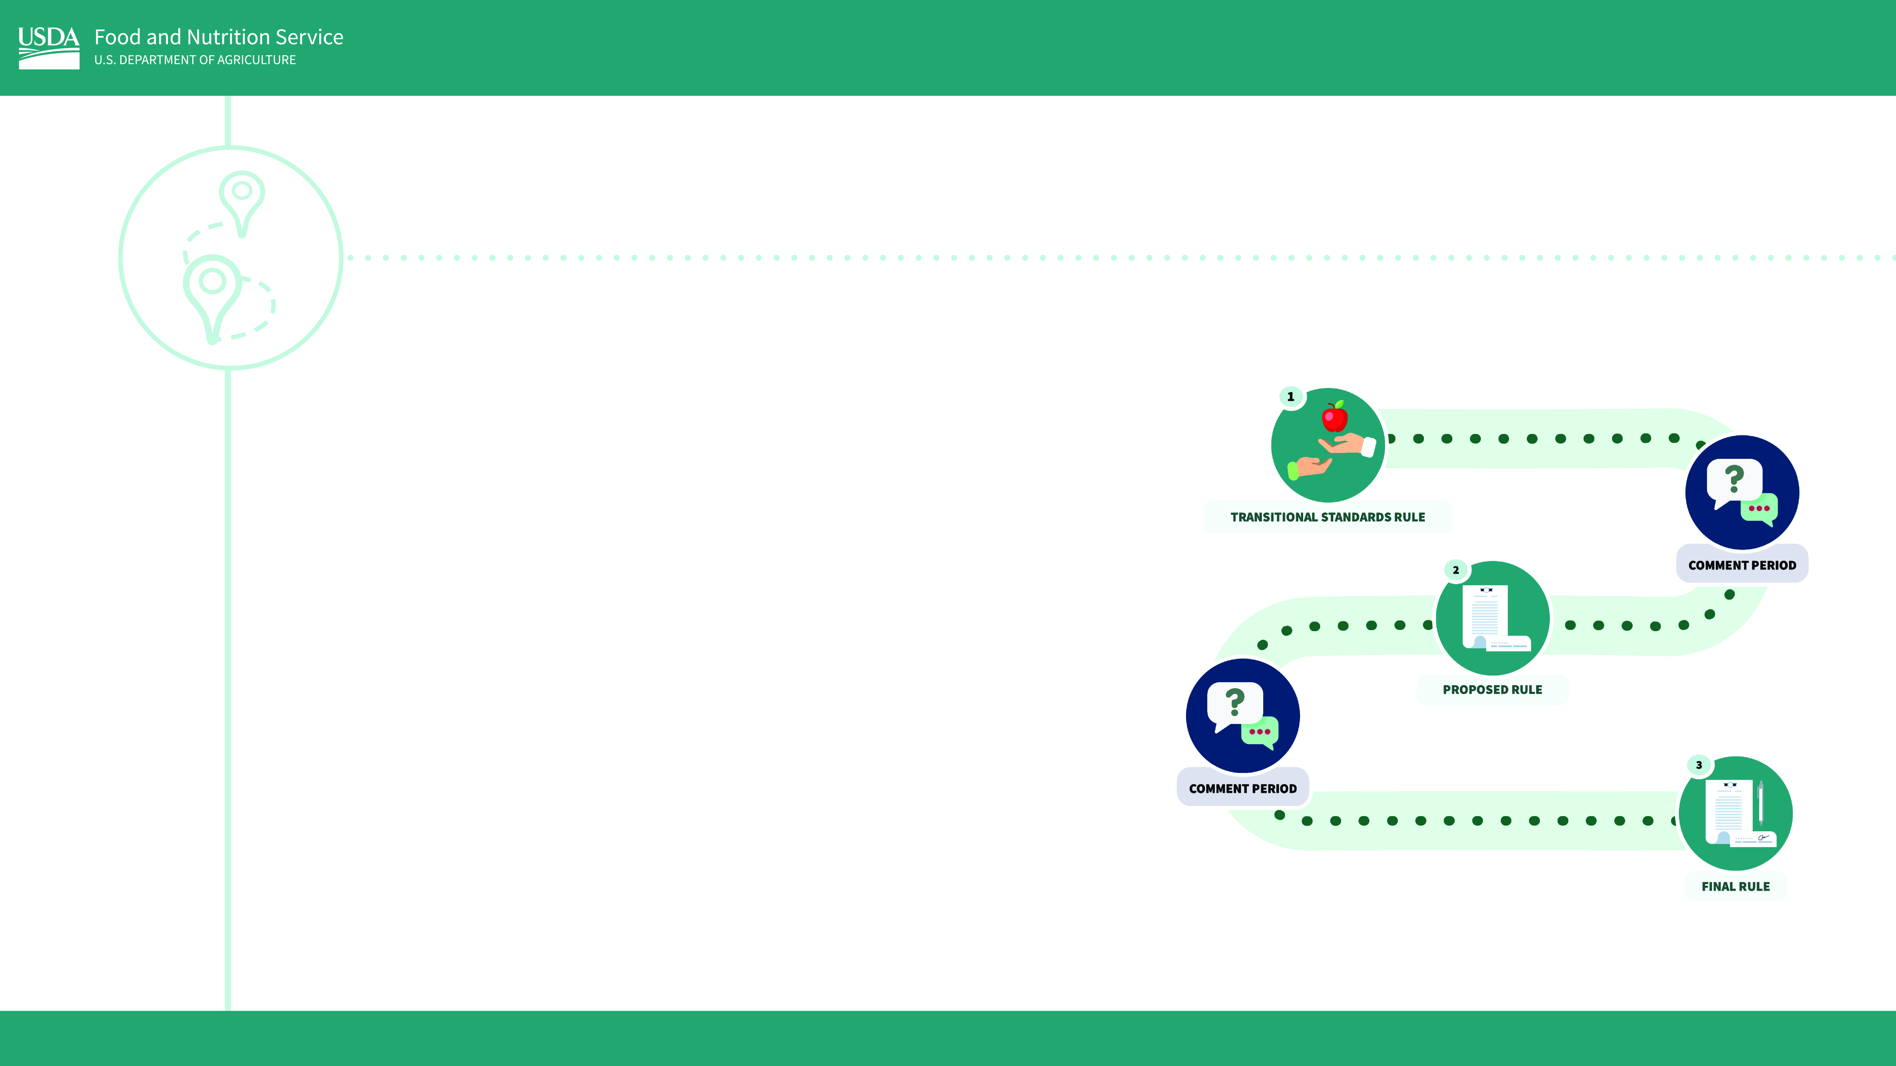
Where are we going?
Schools and state agencies showed heroic leadership during COVID to continue serving kids meals when they were desperately needed. And they continue to overcome enduring challenges even now, such as supply chain disruptions and high food costs.
While so much work has already gone into making school meals the healthiest meals in a day for most kids, the rates of children experiencing diet-related diseases are trending in the wrong direction.
USDA listened to our stakeholders who said they need ample time to plan for changes to the school nutrition standards. We’re getting to work now so we can work with our partners toward a gradual implementation while still making progress in the pressing goal of improving child health.

Slide 5

What can I do to help?
We all play an important role in supporting nutritious school meals and healthy futures for our children!
Administrators
School leaders can help boost school meal participation through efforts like investing in kitchen upgrades, extending the lunch period, and exploring the Community Eligibility Provision, which allows qualifying schools to provide all students free meals without collecting applications. They can champion the program by eating with students in the lunchroom and encouraging parents to do the same.
They can also support school nutrition professionals by providing resources, training, and professional support.

Slide 6

What can I do to help?
Educators
Teachers can model healthy eating habits for their students and encourage them to
explore new foods. They can also find fun ways to teach kids about nutrition and agriculture. Additionally, teachers can serve as a link between parents
and caregivers and their school nutrition team. FNS Team Nutrition provides grants and free menu planning and nutrition education resources for school nutrition professionals to engage students in exploring new foods.
Health Advocates
Public health and nutrition advocates serve as a critical link between nutrition scientists and school nutrition professionals, providing technical assistance, offering nutrition education, conducting research to inform future efforts, and sharing best practices on healthy school meals.

Slide 7

What can I do to help?
Parents and Caregivers
Parents and caregivers can eat a school meal with their child and serve their child’s favorite healthy foods from school at home. They can also support school meal programs by encouraging their kids to participate, volunteering in the cafeteria, and showing
appreciation for their school nutrition professionals’ commitment to
healthy school meals that students enjoy.
School Food Industry
School food producers and distributors can work closely with school nutrition partners to develop nutritious and appealing products for school meals and help educate the public about the importance of healthy eating. They can also provide resources and training on how to best serve their products, and how to expand the availability of healthy products beyond K-12 school markets.

Slide 8

What can I do to help?
School Nutrition Professionals
School nutrition professionals are the key to success for the school meal programs, with direct impact on kids every school day. They can continue to prepare, promote, and provide nutritious and appealing meals served with love and kindness!
USDA
USDA provides substantial support for school meals through kitchen equipment grants, nutrition education efforts, farm to school initiatives, supply chain assistance funds, the Healthy Meals Incentives initiative, and more. We continue to prioritize the school meal programs, seeking feedback from our partners to meaningfully invest in school meals and give our children the very best.

Slide 9





Stay in touch!
Follow us on Twitter @USDANutrition or subscribe to our newsletter to stay updated.

