Slide 1

Feeding Infants:
0-5 Months
A Training Presentation for
Child and Adult Care Food
Program (CACFP) Operators

Slide 2
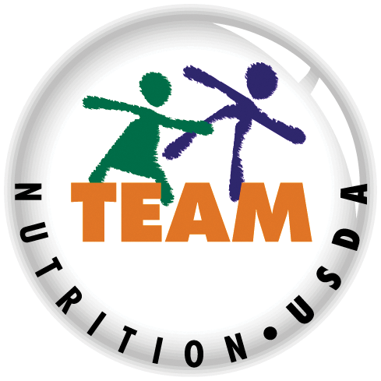


USDA’s Team Nutrition
An initiative of the USDA’s Food and Nutrition Service to support the USDA’s Child Nutrition Programs.
Aims to improve children’s lifelong eating and physical activity habits.
Provides nutrition education and training materials to State agencies, sponsoring organizations, and CACFP sites.
TeamNutrition.USDA.gov
@TeamNutrition
Notes:
Team Nutrition is an initiative of the USDA Food and Nutrition Service that supports the Child Nutrition Programs, including the National School Lunch Program, the School Breakfast Program, and of course, the Child and Adult Care Food Program, or the CACFP.
The goal of Team Nutrition is to improve children's lifelong eating and physical activity habits through nutrition education based on the principles of the Dietary Guidelines for Americans and MyPlate.
It does so through training and technical assistance for those preparing and serving meals, providing nutrition education for children, and building support for healthier school and child care environments.

Slide 3
Let Us Know Who You Are!
I work for a…
?
Child care center
Family child care home
At-risk afterschool care center
Adult day care center
Sponsoring organization
Emergency shelter
School food authority
State agency
USDA Regional Office
Other
Before we get started, I want to know who has joined us today.
Please raise your hand if you work for a:
child care center [pause and wait for a show of hands],
family child care home [pause and wait for a show of hands],
at-risk afterschool care center [pause and wait for a show of hands],
sponsoring organization [pause and wait for a show of hands],
emergency shelter [pause and wait for a show of hands],
school food authority [pause and wait for a show of hands],
State agency [pause and wait for a show of hands],
USDA Regional office [pause and wait for a show of hands],
or other [pause and wait for a show of hands].
Notes:
Before we get started, I want to know who has joined us today.
Please raise your hand if you work for a:
child care center [pause and wait for a show of hands],
family child care home [pause and wait for a show of hands],
at-risk afterschool care center [pause and wait for a show of hands],
sponsoring organization [pause and wait for a show of hands],
emergency shelter [pause and wait for a show of hands],
school food authority [pause and wait for a show of hands],
State agency [pause and wait for a show of hands],
USDA Regional office [pause and wait for a show of hands],
or other [pause and wait for a show of hands].

Slide 4
What is the CACFP Infant Meal Pattern?
 | 0-5 Months | 6-11 Months
Breakfast | 4-6 fl oz breastmilk or formula | 6-8 fl oz breastmilk or formula; 0-½ oz eq infant cereal; or 0-4 tbsp meat, fish, poultry, whole egg, cooked dry beans and peas; or 0-2 oz cheese; or 0-4 oz yogurt; or a combination 0-2 tbsp vegetable, fruit, or both
Abbreviations:
fl oz = fluid ounces ● tbsp = Tablespoon ● oz = ounces ● oz eq = ounce equivalents
Notes:
The CACFP infant meal pattern is broken up into two different age groups: 0 through 5 months and 6 through 11 months. This slide shows the two infant age groups, and the meal pattern at breakfast for each age group.
Trainer Note: the meal pattern for babies 0 through 5 months of age is focused on breastmilk and formula, but we know many infants are eating solid foods as they get older and are developmentally ready. This presentation focuses on breastmilk and infant formula. The U.S. Department of Agriculture's Team Nutrition presentation titled, "Feeding Infants: Starting with Solids" provides information on feeding babies solid foods when they are developmentally ready.

Slide 5
Infants 0-5 Months
 | 0-5 Months
Breakfast | 4-6 fl. oz. breastmilk or formula
Lunch or Supper | 4-6 fl. oz. breastmilk or formula
Snack | 4-6 fl. oz. breastmilk or formula
You can see here on the slide that babies 0 through 5 months of age must be offered a minimum of 4 to 6 fluid ounces of breastmilk or iron-fortified infant formula at breakfast, lunch or supper, and snack in your child care site.
According to the American Academy of Pediatrics, breastmilk is the best source of nutrition for babies, and is the only food healthy babies need for about the first 6 months of life.
Iron-fortified infant formula is a good alternative to breastmilk. Iron-fortified infant formula is infant formula that has iron added to it. In the CACFP infant meal pattern, a site must offer at least one iron-fortified infant formula.
The infant meal pattern lists minimum serving sizes of breastmilk, infant formula, and solid foods as a range of numbers, rather than one specific number. This takes into account that the amount of breastmilk or infant formula a baby consumes changes from feeding to feeding or day to day. As long as the baby is OFFERED the minimum required serving size of 4-6 fluid ounces at breakfast, lunch or supper, and snack then it can credit towards a reimbursable meal or snack. The baby does not have to finish the bottle.
Abbreviations:
fl oz = fluid ounces
Notes:
You can see here on the slide that babies 0 through 5 months of age must be offered a minimum of 4 to 6 fluid ounces of breastmilk or iron-fortified infant formula at breakfast, lunch or supper, and snack in your child care site.
According to the American Academy of Pediatrics, breastmilk is the best source of nutrition for babies, and is the only food healthy babies need for about the first 6 months of life.
Iron-fortified infant formula is a good alternative to breastmilk. Iron-fortified infant formula is infant formula that has iron added to it. In the CACFP infant meal pattern, a site must offer at least one iron-fortified infant formula.
The infant meal pattern lists minimum serving sizes of breastmilk, infant formula, and solid foods as a range of numbers, rather than one specific number. This takes into account that the amount of breastmilk or infant formula a baby consumes changes from feeding to feeding or day to day. As long as the baby is OFFERED the minimum required serving size of 4-6 fluid ounces at breakfast, lunch or supper, and snack then it can credit towards a reimbursable meal or snack. The baby does not have to finish the bottle.

Slide 6
Sample Breakfast Meal
4-6 fl oz
breastmilk or
infant formula
9:00 a.m.
2 fl oz
10:30 a.m.
4 fl oz
Notes:
You can claim reimbursement for a meal in the CACFP even if the baby eats at two different times in the day.
For example, Baby Jonathan showed signs of hunger at 9am so you offered him 4-6 fluid ounces of breastmilk. Jonathan showed signs of being full after 2 fluid ounces so you stopped the feeding. Later on that morning at 10:30am, he showed signs of hunger again so you offered him 4 fluid ounces. Even though there were two feeding sessions, you can still claim them as part of a reimbursable breakfast meal.
Make sure to store breastmilk to keep it from going bad between feedings. If a baby does not finish a bottle of breastmilk at a feeding, then you can store it in the refrigerator for up to 2 hours. Do not give the bottle to the baby after 2 hours. Always ask the baby's parents/guardians what they would like you to do with the leftover breastmilk.
If a baby does not finish a bottle of infant formula at a feeding, then throw away the infant formula that is left in the bottle. A baby’s saliva can introduce bacteria into the bottle which can make the infant formula go bad and make the baby sick.

Slide 7
Do I give a baby breastmilk or formula?
?
Speak with the baby’s parents/guardians.
They may choose to:
Use the iron-fortified infant formula you provide.
Decline the one you provide and bring their own iron-fortified infant formula.
Provide breastmilk or breastfeed at your site.
Provide breastmilk and supplement with the iron-fortified infant formula you provide.
Provide breastmilk and provide their own
iron-fortified infant formula.
You can claim the meal for reimbursement in any of these situations.
Deciding whether a baby should get breastmilk or infant formula is a decision that is made by the parents/guardians. Speak with the parents/guardians about the type of formula that you provide at your child care site. With that information, parents/guardians may choose to:
1. Use the iron-fortified infant formula you provide.
2. Decline the one you provide and bring their own iron-fortified infant formula.
3. Provide breastmilk or breastfeed at your site.
4. Provide breastmilk and supplement with the iron-fortified infant formula you provide.
5. Provide breastmilk and provide their own iron-fortified infant formula.
In any of these situations, you can still claim the breastmilk and/or iron-fortified infant formula as part of a reimbursable meal or snack.
Notes:
Deciding whether a baby should get breastmilk or infant formula is a decision that is made by the parents/guardians. Speak with the parents/guardians about the type of formula that you provide at your child care site. With that information, parents/guardians may choose to:
1. Use the iron-fortified infant formula you provide.
2. Decline the one you provide and bring their own iron-fortified infant formula.
3. Provide breastmilk or breastfeed at your site.
4. Provide breastmilk and supplement with the iron-fortified infant formula you provide.
5. Provide breastmilk and provide their own iron-fortified infant formula.
In any of these situations, you can still claim the breastmilk and/or iron-fortified infant formula as part of a reimbursable meal or snack.

Slide 8

Iron-Fortified Infant Formula
You must offer at least one iron-fortified infant formula that is regulated by the Food and Drug Administration.
In the CACFP infant meal pattern, a child care site must offer at least one iron-fortified infant formula that is regulated by the Food and Drug Administration, also known as the FDA. The FDA has strict nutrition and safety standards for infant formula to make sure infants are getting the nutrients they need for healthy growth. All infant formula sold in the United States are regulated by the FDA. If an infant formula is bought from a place online or in person outside of the United States, it is probably not regulated by the FDA and should not be used.
Iron-fortified infant formula is required in the CACFP for babies who are not breastfed or are partially breastfed. To make sure the iron-fortified infant formula you offer is creditable in the CACFP, you should look for “infant formula with iron” or a similar statement on the front of the formula package and make sure it contains 1 milligram of iron or more per 100 calories of formula when prepared using the label instructions. You can use the Nutrition Facts label as a guide to make sure the formula has enough iron. First look at the line that says “Calories” and make sure it says “100” or more. Then look at the line that says “iron”. This should have “1 milligram” or more listed.
If you have questions on if the iron-fortified infant formula you offer at your child care site is regulated by FDA or contains enough iron, please contact your sponsoring organization or State agency.
Notes:
In the CACFP infant meal pattern, a child care site must offer at least one iron-fortified infant formula that is regulated by the Food and Drug Administration, also known as the FDA. The FDA has strict nutrition and safety standards for infant formula to make sure infants are getting the nutrients they need for healthy growth. All infant formula sold in the United States are regulated by the FDA. If an infant formula is bought from a place online or in person outside of the United States, it is probably not regulated by the FDA and should not be used.
Iron-fortified infant formula is required in the CACFP for babies who are not breastfed or are partially breastfed. To make sure the iron-fortified infant formula you offer is creditable in the CACFP, you should look for “infant formula with iron” or a similar statement on the front of the formula package and make sure it contains 1 milligram of iron or more per 100 calories of formula when prepared using the label instructions. You can use the Nutrition Facts label as a guide to make sure the formula has enough iron. First look at the line that says “Calories” and make sure it says “100” or more. Then look at the line that says “iron”. This should have “1 milligram” or more listed.
If you have questions on if the iron-fortified infant formula you offer at your child care site is regulated by FDA or contains enough iron, please contact your sponsoring organization or State agency.

Slide 9

What if a Baby is Still Hungry?
Talk to the baby’s parents/guardians.
You can:
  Encourage them to bring
  in a back-up supply
  of breastmilk.
  Ask if they would like you to offer iron-fortified infant formula to their baby.
For babies whose parents/guardians send in breastmilk or formula, you may also want to talk to them about what you should do if their baby drinks all the breastmilk or formula they brought in, and is still hungry.
The parents/guardians may choose to bring in a back-up supply of breastmilk and ask you to store it in the refrigerator or freezer. Or, they may ask you to offer their baby the iron-fortified infant formula you have at the child care site. Or, the parents/guardians may choose to bring in their own iron-fortified infant formula. In all of these situations, the back-up supply of breastmilk and the iron-fortified infant formula can credit towards a reimbursable meal or snack.
Breastmilk and iron-fortified infant formula can be offered to a baby in the same meal. Offer the baby the breastmilk first. If the baby finishes the breastmilk and still shows signs that he or she is hungry, then offer the infant formula.
Notes:
For babies whose parents/guardians send in breastmilk or formula, you may also want to talk to them about what you should do if their baby drinks all the breastmilk or formula they brought in, and is still hungry.
The parents/guardians may choose to bring in a back-up supply of breastmilk and ask you to store it in the refrigerator or freezer. Or, they may ask you to offer their baby the iron-fortified infant formula you have at the child care site. Or, the parents/guardians may choose to bring in their own iron-fortified infant formula. In all of these situations, the back-up supply of breastmilk and the iron-fortified infant formula can credit towards a reimbursable meal or snack.
Breastmilk and iron-fortified infant formula can be offered to a baby in the same meal. Offer the baby the breastmilk first. If the baby finishes the breastmilk and still shows signs that they are hungry, then offer the infant formula.

Slide 10

Feed Babies On Demand
Feed a baby when they show signs of hunger:
Makes sucking noises
Sucks on hands, fingers, toes
Reaches for a bottle
Rooting
Crying is a late sign of hunger
Babies may get hungry at times outside of typical mealtimes and may eat smaller or larger amounts from day to day. For this reason, physicians and dietitians recommend that babies be fed on demand. Feeding a baby on demand means feeding a baby when they are hungry.
While a baby may not be able to say, “I’m hungry,” they can tell you they’re hungry through cues or signs. Listed on the slide here are just a few examples of hunger signs. A baby may make sucking noises; suck on their hands, fingers, and toes; reach for a bottle if it is near; and may root to tell you he or she is hungry.
Rooting is when a baby’s mouth, lips, cheek, or chin are touched, and the baby turns his head and opens his mouth. Rooting is a reflex that helps a baby find and grasp a nipple.
Many people think that babies will just cry when they are hungry. But, crying is actually a late sign of hunger. It can also mean other things besides hunger, such as wanting to be held or needing a diaper change.
Instead of waiting for a baby to cry, look for a baby’s earlier signs of hunger like the ones we just mentioned.
Notes:
Babies may get hungry at times outside of typical mealtimes and may eat smaller or larger amounts from day to day. For this reason, physicians and dietitians recommend that babies be fed on demand. Feeding a baby on demand means feeding a baby when they are hungry.
While a baby may not be able to say, “I’m hungry,” they can tell you they’re hungry through cues or signs. Listed on the slide here are just a few examples of hunger signs. A baby may make sucking noises; suck on their hands, fingers, and toes; reach for a bottle if it is near; and may root to tell you they are hungry.
Rooting is when a baby’s mouth, lips, cheek, or chin are touched, and the baby turns their head and opens their mouth. Rooting is a reflex that helps a baby find and grasp a nipple.
Many people think that babies will just cry when they are hungry. But, crying is actually a late sign of hunger. It can also mean other things besides hunger, such as wanting to be held or needing a diaper change.
Instead of waiting for a baby to cry, look for a baby’s earlier signs of hunger like the ones we just mentioned.

Slide 11

Try It Out!
These are all signs that a baby is hungry, except:
?
Choose one of the following:
Makes sucking noises
Seals lips together
Rooting
Sucks on hands
Okay, let's do a practice question!
These are all signs that a baby is hungry, except:
Makes sucking noises [pause and wait for a show of hands],
Seals lips together [pause and wait for a show of hands],
Rooting [pause and wait for a show of hands],
Or sucks on hands [pause and wait for a show of hands].
Which one of these does not mean the baby is hungry?
Notes:
Okay, let's do a practice question!
These are all signs that a baby is hungry, except:
Makes sucking noises [pause and wait for a show of hands],
Seals lips together [pause and wait for a show of hands],
Rooting [pause and wait for a show of hands],
Or sucks on hands [pause and wait for a show of hands].
Which one of these does not mean the baby is hungry?

Slide 12
Answer
These are all signs that a baby is hungry, except:
?
Choose one of the following:
Makes sucking noises
Seals lips together
Rooting
Sucks on hands
✓
Very good! The answer is, seals lips together. A baby may show signs of hunger by making sucking noises, rooting, or sucking on hands.
A baby may show that they are full by sealing his or her lips together.
Notes:
Very good! The answer is, seals lips together. A baby may show signs of hunger by making sucking noises, rooting, or sucking on hands.
A baby may show that they are full by sealing their lips together.

Slide 13
Reading Signs of Fullness
Stop a feeding when you see one or more of these signs:
Stops sucking or slows down sucking
Falls asleep
Turns head away
Seals lips together
No longer pays attention during
the feeding
Similar to showing signs of hunger, a baby will also show you different signs when he or she is full. Listed on the slide here are just a few examples of how a baby tells you he or she is full.
Let the baby stop eating if they stop sucking or slow down sucking, fall asleep, turn his head away, seals her lips together, and/or no longer is paying attention during the feeding. You will normally see more than one of these signs together. When you see these signs, it is time to stop the feeding.
Letting the baby stop eating when they are full helps the baby control how much he or she eats during a feeding. Later in life, this will be an important skill for the child to have. Babies usually consume enough food to grow and develop when being able to stop eating when they are full.
Notes:
Similar to showing signs of hunger, a baby will also show you different signs when they are full. Listed on the slide here are just a few examples of how a baby tells you they are full.
Let the baby stop eating if they stop sucking or slow down sucking, fall asleep, turn their head away, seals their lips together, and/or no longer is paying attention during the feeding. You will normally see more than one of these signs together. When you see these signs, it is time to stop the feeding.
Letting the baby stop eating when they are full helps the baby control how much they eat during a feeding. Later in life, this will be an important skill for the child to have. Babies usually consume enough food to grow and develop when being able to stop eating when they are full.

Slide 14
Try It Out!
These are all signs that a baby is full, except:
?
Choose one of the following:
Falls asleep
Seals lips together
Stops sucking or slows down sucking
Rooting
Okay, let’s try another practice question!
These are all signs that a baby is full, except:
Falls asleep [pause and wait for a show of hands],
Seals lips together [pause and wait for a show of hands],
Stops sucking or slows down [pause and wait for a show of hands],
Or rooting [pause and wait for a show of hands].
Which one of these does not mean the baby is hungry?
Notes:
Okay, let’s try another practice question!
These are all signs that a baby is full, except:
Falls asleep [pause and wait for a show of hands],
Seals lips together [pause and wait for a show of hands],
Stops sucking or slows down [pause and wait for a show of hands],
Or rooting [pause and wait for a show of hands].
Which one of these does not mean the baby is hungry?

Slide 15
Answer
These are all signs that a baby is full, except:
?
Choose one of the following:
Falls asleep
Seals lips together
Stops sucking or slows down sucking
Rooting
✓
Great job! The answer is rooting. A baby is hungry when they are rooting.
Rooting is when a baby’s mouth, lips, cheek, or chin are touched, and the baby turns his head and opens his mouth. Rooting is a reflex that helps a baby find and grasp a nipple.
A baby may show that they are full by falling asleep, sealing his or her lips together, and/or stops sucking or slows down sucking.
Notes:
Great job! The answer is rooting. A baby is hungry when they are rooting.
Rooting is when a baby’s mouth, lips, cheek, or chin are touched, and the baby turns their head and opens their mouth. Rooting is a reflex that helps a baby find and grasp a nipple.
A baby may show that they are full by falling asleep, sealing their lips together, and/or stops sucking or slows down sucking.

Slide 16

A Baby’s Usual Eating Habits
Offer the full minimum amount of breastmilk or infant formula when the baby is hungry.
Some babies may eat less than what you offer – that’s okay!
Never force a baby to finish
the bottle.
The CACFP infant meal pattern takes a baby’s usual eating habits into account. As long as all of the required amounts are offered to the baby, the meals and snacks are reimbursable in the CACFP. Some babies may eat less than what you offer them, and that’s okay! Never force a baby to finish what is in the bottle. Allow a baby to stop when they are full.
Again, just like the example with Baby Jonathan – we are following his usual eating habits. If you remember, Baby Jonathan showed signs of hunger at 9am so you offered him 4-6 fluid ounces of breastmilk. Jonathan showed signs of being full after 2 fluid ounces so you stopped the feeding. Later on that morning at 10:30am, he showed signs of hunger again so you offered him more. Even though there were two feeding sessions, you still claimed them as part of a reimbursable breakfast meal.
Notes:
The CACFP infant meal pattern takes a baby’s usual eating habits into account. As long as all of the required amounts are offered to the baby, the meals and snacks are reimbursable in the CACFP. Some babies may eat less than what you offer them, and that’s okay! Never force a baby to finish what is in the bottle. Allow a baby to stop when they are full.
Again, just like the example with Baby Jonathan – we are following his usual eating habits. If you remember, Baby Jonathan showed signs of hunger at 9am so you offered him 4-6 fluid ounces of breastmilk. Jonathan showed signs of being full after 2 fluid ounces so you stopped the feeding. Later on that morning at 10:30am, he showed signs of hunger again so you offered him more. Even though there were two feeding sessions, you still claimed them as part of a reimbursable breakfast meal.

Slide 17
Try It Out!
Baby Zoe is rooting and is making sucking noises. Marta, her child care provider, can tell Baby Zoe is hungry. Marta prepares a bottle containing 6 fl oz of breastmilk. Baby Zoe is full after eating 3 fl oz of breastmilk and does not finish her bottle.
?
Can Marta still claim the 3 fl oz of breastmilk as a reimbursable meal?
Yes
No
Let's try another practice question!
Baby Zoe is rooting and is making sucking noises. Marta, her child care provider, can tell Baby Zoe is hungry. Marta prepares a bottle containing 6 fl. oz. of breastmilk. Baby Zoe is full after eating 3 fl. oz of breastmilk and does not finish her bottle.
Can Marta still claim the 3 fl. oz. as part of a reimbursable meal? Yes or No?
Raise your hand if you think the answer is "yes" [pause and wait for a show of hands] or "no" [pause and wait for a show of hands].
Notes:
Let's try another practice question!
Baby Zoe is rooting and is making sucking noises. Marta, her child care provider, can tell Baby Zoe is hungry. Marta prepares a bottle containing 6 fl. oz. of breastmilk. Baby Zoe is full after eating 3 fl. oz of breastmilk and does not finish her bottle.
Can Marta still claim the 3 fl. oz. as part of a reimbursable meal? Yes or No?
Raise your hand if you think the answer is "yes" [pause and wait for a show of hands] or "no" [pause and wait for a show of hands].

Slide 18
Answer
Baby Zoe is rooting and is making sucking noises. Marta, her child care provider, can tell Baby Zoe is hungry. Marta prepares a bottle containing 6 fl oz of breastmilk. Baby Zoe is full after eating 3 fl oz of breastmilk and does not finish her bottle.
?
Can Marta still claim the 3 fl oz of breastmilk as a reimbursable meal?
✓
Yes
No
Great job! The answer is “yes”. Marta can claim the 3 fluid ounces as part of a reimbursable meal.
Notes:
Great job! The answer is “yes”. Marta can claim the 3 fluid ounces as part of a reimbursable meal.

Slide 19
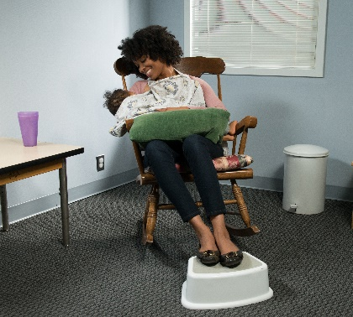
Breastfeeding On-Site
Offer mothers a clean, comfortable, and quiet place to breastfeed
their babies.
  Small room
  Corner of a classroom
  Office
The space may include:
  A pillow for mom to support baby
  A foot stool
  A comfortable chair
If possible, offer breastfeeding mothers a clean, comfortable, and quiet place to breastfeed her baby. This could be a space in a small room, or a corner of a classroom or office with a privacy screen or curtain.
To create a breastfeeding-friendly space at your child care site, consider including:
A Pillow for mom to support her baby
A stool
A comfortable chair, like a rocking chair in the space.
Having a designated breastfeeding-friendly area in your child care site is not required in the CACFP, but is a CACFP Best Practice.
If mom chooses to breastfeed at your child care site, you can claim it as part of a reimbursable meal or snack.
Notes:
If possible, offer breastfeeding mothers a clean, comfortable, and quiet place to breastfeed their babies. This could be a space in a small room, or a corner of a classroom or office with a privacy screen or curtain.
To create a breastfeeding-friendly space at your child care site, consider including:
A pillow for mom to support her baby
A stool
A comfortable chair, like a rocking chair in the space.
Having a designated breastfeeding-friendly area in your child care site is not required in the CACFP, but is a CACFP Best Practice.
If mom chooses to breastfeed at your child care site, you can claim it as part of a reimbursable meal or snack.

Slide 20
Try It Out!
Mom comes in around lunch to breastfeed her baby at your child care site. You don’t know how much breastmilk the baby had since she was breastfed.
?
Can you claim this as part of a reimbursable lunch?
Yes
No
Let's do one more practice question!
A mom comes in around lunch to breastfeed her baby at your child care site. You don’t know how much breastmilk the baby had since she was breastfed. Can you claim this as part of a reimbursable lunch? Yes or No?
Raise your hand if you think the answer is "yes" [pause and wait for a show of hands] or "no" [pause and wait for a show of hands].
Notes:
Let's do one more practice question!
A mom comes in around lunch to breastfeed her baby at your child care site. You don’t know how much breastmilk the baby had since she was breastfed. Can you claim this as part of a reimbursable lunch? Yes or No?
Raise your hand if you think the answer is "yes" [pause and wait for a show of hands] or "no" [pause and wait for a show of hands].

Slide 21
Answer
Mom comes in around lunch to breastfeed her baby at your child care site. You don’t know how much breastmilk the baby had since she was breastfed.
?
Can you claim this as part of a reimbursable lunch?
✓
Yes
No
The answer is "yes“, you can claim the breastmilk as part of a reimbursable lunch. If mom comes to breastfeed her baby on-site, at your child care site, then you can still claim this as part of a reimbursable meal or snack. When a mom breastfeeds on-site, you do not have to worry if the baby did or did not eat the full minimum amount or 4-6 fluid ounces at the meal or snack.
Follow your State agency or sponsoring organization’s instructions for how they would like for you to document this. This may mean you write “breastfed” or “mom on-site” on the infant menu.
Notes:
The answer is "yes“, you can claim the breastmilk as part of a reimbursable lunch. If mom comes to breastfeed her baby on-site, at your child care site, then you can still claim this as part of a reimbursable meal or snack. When a mom breastfeeds on-site, you do not have to worry if the baby did or did not eat the full minimum amount or 4-6 fluid ounces at the meal or snack.
Follow your State agency or sponsoring organization’s instructions for how they would like for you to document this. This may mean you write “breastfed” or “mom on-site” on the infant menu.

Slide 22
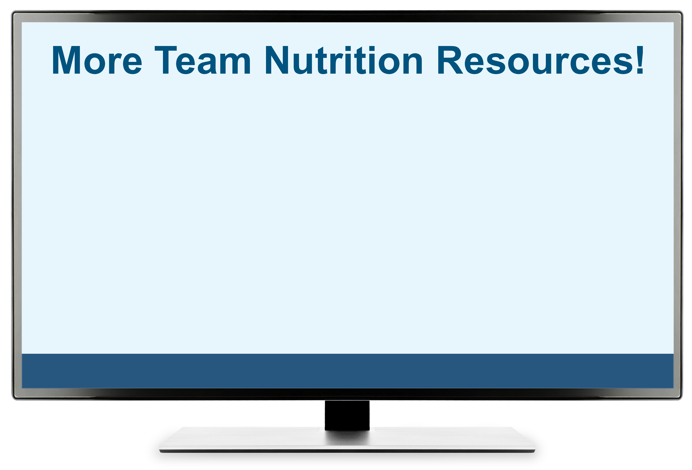
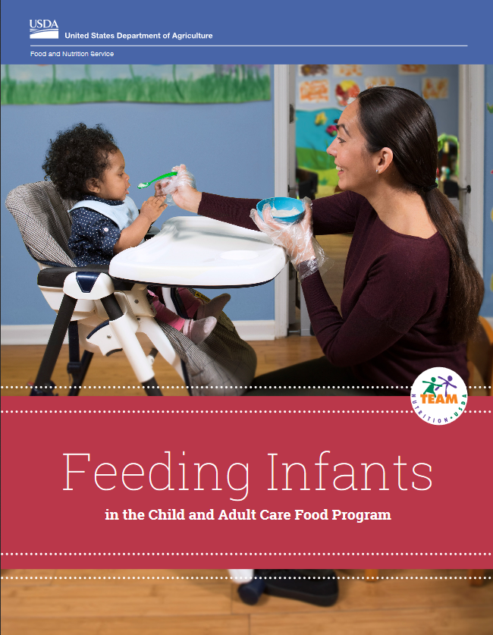


More Team Nutrition Resources!
All Team Nutrition materials are available online from Team Nutrition's website and are available for free download to anybody who is interested.
TeamNutrition.USDA.gov
Notes:
All Team Nutrition materials are available online from Team Nutrition's website and are available for free download to anybody who is interested.

Slide 23

How To Order Print Copies
Resource Order Form at TeamNutrition.USDA.gov.
FREE for those participating in a USDA's Child Nutrition Program, while supplies last.
Sponsoring organizations and State agencies can also order in bulk by sending an email to:
TeamNutrition@USDA.gov
Notes:
For all participating in a USDA's Child Nutrition Program, such as the CACFP, Team Nutrition’s print materials are free to order.
If you would like to order Team Nutrition’s free materials in print, click "Order Team Nutrition Resources“ on the Team Nutrition website.
For bulk orders, you can email TeamNutrition@USDA.gov.

Slide 24


Thank you!
These training slides were provided by U.S. Department of Agriculture's Team Nutrition. If you would like to learn more about Team Nutrition and additional resources available, please visit their website, subscribe to their monthly e-newsletter, connect with them via email at teamnutrition@usda.gov, and follow them on Twitter.
Thank you!
TeamNutrition.USDA.gov
@TeamNutrition
TeamNutrition@USDA.gov
USDA is an equal opportunity provider, employer, and lender.
Notes:
These training slides were provided by U.S. Department of Agriculture's Team Nutrition. If you would like to learn more about Team Nutrition and additional resources available, please visit their website, subscribe to their e-newsletter, connect with them via email at TeamNutrition@USDA.gov, and follow them on Twitter/X.
Thank you!

