Slide 1
Feeding Infants:
Starting with Solids
A Training Presentation for
Child and Adult Care Food
Program (CACFP) Operators

Slide 2
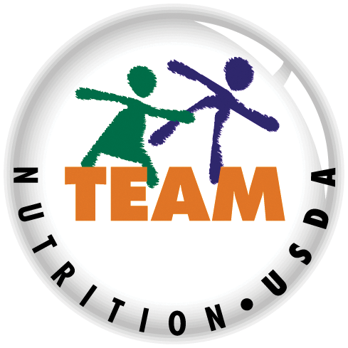


USDA’s Team Nutrition
An initiative of the USDA’s Food and Nutrition Service to support the USDA’s Child Nutrition Programs.
Aims to improve children’s lifelong eating and physical activity habits.
Provides nutrition education and training materials to State agencies, sponsoring organizations, and CACFP sites.
Team Nutrition is an initiative of the USDA Food and Nutrition Service that supports the Child Nutrition Programs, including the National School Lunch Program, the School Breakfast Program, and of course, the Child and Adult Care Food Program, or the CACFP.
The goal of Team Nutrition is to improve children's lifelong eating and physical activity habits through nutrition education based on the principles of the Dietary Guidelines for Americans and MyPlate.
It does so through training and technical assistance for those preparing and serving meals, providing nutrition education for children, and building support for healthier school and child care environments.
TeamNutrition.USDA.gov
@TeamNutrition
Notes:
Team Nutrition is an initiative of the USDA Food and Nutrition Service that supports the Child Nutrition Programs, including the National School Lunch Program, the School Breakfast Program, and of course, the Child and Adult Care Food Program, or the CACFP.
The goal of Team Nutrition is to improve children's lifelong eating and physical activity habits through nutrition education based on the principles of the Dietary Guidelines for Americans and MyPlate.
It does so through training and technical assistance for those preparing and serving meals, providing nutrition education for children, and building support for healthier school and child care environments.

Slide 3

Let Us Know Who You Are!
I work for a…
?
Before we get started, I want to know who has joined us today.
Please raise your hand if you work for a:
child care center [pause and wait for a show of hands],
family child care home [pause and wait for a show of hands],
at-risk afterschool care center [pause and wait for a show of hands],
sponsoring organization [pause and wait for a show of hands],
emergency shelter [pause and wait for a show of hands],
school food authority [pause and wait for a show of hands],
State agency [pause and wait for a show of hands],
USDA Regional office [pause and wait for a show of hands],
or other [pause and wait for a show of hands].
Child care center
Family child care home
At-risk afterschool care center
Adult day care center
Sponsoring organization
Emergency shelter
School food authority
State agency
USDA Regional Office
Other
Notes:
Before we get started, I want to know who has joined us today.
Please raise your hand if you work for a:
child care center [pause and wait for a show of hands],
family child care home [pause and wait for a show of hands],
at-risk afterschool care center [pause and wait for a show of hands],
sponsoring organization [pause and wait for a show of hands],
emergency shelter [pause and wait for a show of hands],
school food authority [pause and wait for a show of hands],
State agency [pause and wait for a show of hands],
USDA Regional office [pause and wait for a show of hands],
or other [pause and wait for a show of hands].

Slide 4
Developmental Readiness
Sits in a high chair with good head control.
Opens mouth when foods come their way or reaches for food.
Uses tongue
to move food from the spoon into their mouth to swallow the food without pushing it out.
As babies grow, we know they will eventually need to start eating solid foods in addition to breastmilk and/or formula. When we say “solid foods”, we mean foods that are safe and easy for a baby to eat once he or she is developmentally ready. Developmentally ready means the baby is showing a set of skills or abilities that mean he or she is ready to try solid foods. This usually happens when the baby is around 6 months or so, so it could be earlier or later than 6 months.
A baby is developmentally ready to start solid foods if he or she:
Opens his or her mouth when foods come his or her way or reaches for food.
Sits in a high chair with good head control.
Uses his or her tongue to move food from the spoon into his or her mouth. The tongue does not automatically push the food out of his or her mouth.
Keep in mind that all babies develop at their own rate. So for example, while one baby might be opening his mouth or reaching for food when he is five months old, another baby may not start doing so until she is six months old. That is okay! The CACFP infant meal pattern gives you the flexibility to feed each baby based on their developmental readiness, such as how well the baby can control his or her muscles. That way, as the child care provider, you can help ensure that babies get what they need to grow and be healthy.
Starting solid foods when a baby is developmentally ready is important because:
A baby is getting bigger and needs more calories and nutrients that can come from solid foods.
It gives a baby a chance to try different foods so he or she will like them at an early age and will continue to eat them as he or she gets older.
Notes:
As babies grow, we know they will eventually need to start eating solid foods in addition to breastmilk and/or formula. When we say “solid foods”, we mean foods that are safe and easy for a baby to eat once they are developmentally ready. Developmentally ready means the baby is showing a set of skills or abilities that mean they are ready to try solid foods. This usually happens when the baby is around 6 months or so, so it could be earlier or later than 6 months.
A baby is developmentally ready to start solid foods if they:
Sit in a high chair with good head control.
Open their mouth when foods come their way or reach for food.
Use their tongue to move food from the spoon into their mouth. The tongue does not automatically push the food out of their mouth.
Keep in mind that all babies develop at their own rate. So for example, while one baby might be opening their mouth or reaching for food when they are five months old, another baby may not start doing so until they are six months old. That is okay! The CACFP infant meal pattern gives you the flexibility to feed each baby based on their developmental readiness, such as how well the baby can control their muscles. That way, as the child care provider, you can help ensure that babies get what they need to grow and be healthy.
Starting solid foods when a baby is developmentally ready is important because:
A baby is getting bigger and needs more calories and nutrients that can come from solid foods.
It gives a baby a chance to try different foods so they will like them at an early age and will continue to eat them as they get older.

Slide 5

Feeding Solid Foods Too Early
Feeding solid foods before a baby is developmentally ready may increase the chance that they will:
  choke on the food.
  drink less breastmilk or infant formula than needed in order to grow.
  be overweight or obese later in life.
Feeding solid foods before a baby is developmentally ready may increase the chance that he or she will:
choke on the food.
drink less breastmilk or infant formula than needed in order to grow.
be overweight or obese later in life.
Feeding solid foods before a baby is ready:
does not help the baby sleep through the night.
does not make the baby eat fewer times in a day.
If parents report fussiness and/or sleeping problems as a reason for wanting to start solid foods early, encourage them to discuss their concerns with their baby’s health care provider. Sometimes ideas for other ways to calm or soothe a crying baby can be helpful. Crying does not always mean that the baby is hungry.
Notes:
Feeding solid foods before a baby is developmentally ready may increase the chance that they will:
choke on the food.
drink less breastmilk or infant formula than needed in order to grow.
be overweight or obese later in life.
Feeding solid foods before a baby is ready:
does not help the baby sleep through the night.
does not make the baby eat fewer times in a day.
If parents report fussiness and/or sleeping problems as a reason for wanting to start solid foods early, encourage them to discuss their concerns with their baby’s health care provider. Sometimes ideas for other ways to calm or soothe a crying baby can be helpful. Crying does not always mean that the baby is hungry.

Slide 6
Try It Out!
Baby Jonathan is 5½ months old. He can sit when his mom holds him tight, but he does not have good head and neck control.
?
Is Baby Jonathan developmentally ready for solid foods?
Yes
No
Let's try a practice question!
Baby Jonathan is 5 ½ months old. He can sit when his mom holds him tight, but he does not have good head and neck control. Is Baby Jonathan developmentally ready for solid foods?
Yes or No? Raise your hand if you think the answer is "yes" [pause and wait for a show of hands] or "no" [pause and wait for a show of hands].
Notes:
Let's try a practice question!
Baby Jonathan is 5 ½ months old. He can sit when his mom holds him tight, but he does not have good head and neck control. Is Baby Jonathan developmentally ready for solid foods?
Yes or No? Raise your hand if you think the answer is "yes" [pause and wait for a show of hands] or "no" [pause and wait for a show of hands].

Slide 7
Answer
Baby Jonathan is 5½ months old. He can sit when his mom holds him tight, but he does not have good head and neck control.
?
Is Baby Jonathan developmentally ready for solid foods?
Yes
No
✓
Great Job! The answer is “No”. Baby Jonathan is not developmentally ready to start solid foods. He is not able to sit up with good head control.
Notes:
Great Job! The answer is “No”. Baby Jonathan is not developmentally ready to start solid foods. He is not able to sit up with good head control.

Slide 8
Try It Out!
Baby Kara is 5½ months old. She can sit up on her own with little assistance, has good head control, and keeps reaching for food when it is near. When Baby Kara tried a bite of food she was able to move it to the back of her throat to swallow.
?
Is Baby Kara developmentally ready
for solid foods?
Yes
No
Okay, let's try another practice question.
Baby Kara is 5 ½ months old. She can sit up on her own with little assistance, has good head control, and keeps reaching for food when it is near. When Baby Kara tried a bite of food she was able to move it to the back of her throat to swallow. Is Baby Kara developmentally ready for solid foods?
Yes or No? Raise your hand if you think the answer is "yes" [pause and wait for a show of hands] or "no" [pause and wait for a show of hands].
Notes:
Okay, let's try another practice question.
Baby Kara is 5 ½ months old. She can sit up on her own with little assistance, has good head control, and keeps reaching for food when it is near. When Baby Kara tried a bite of food she was able to move it to the back of her throat to swallow. Is Baby Kara developmentally ready for solid foods?
Yes or No? Raise your hand if you think the answer is "yes" [pause and wait for a show of hands] or "no" [pause and wait for a show of hands].

Slide 9
Answer
Baby Kara is 5½ months old. She can sit up on her own with little assistance, has good head control, and keeps reaching for food when it is near. When Baby Kara tried a bite of food she was able to move it to the back of her throat to swallow.
?
Is Baby Kara developmentally ready
for solid foods?
✓
Yes
No
Great Job! The answer is “Yes”. Baby Kara is showing signs that she is developmentally ready for solid foods. She is sitting up with little assistance, has good head control, keeps reaching for solid foods, and swallows food without pushing it back out.
Notes:
Great Job! The answer is “Yes”. Baby Kara is showing signs that she is developmentally ready for solid foods. She is sitting up with little assistance, has good head control, keeps reaching for solid foods, and swallows food without pushing it back out.

Slide 10
Infant Meal Pattern
(breakfast, lunch, and supper)
Lunch or Supper | 0 through 5 Months | 6 through 11 Months
Breastmilk or Infant Formula | 4-6 fl oz breastmilk or formula | 6-8 fl oz breastmilk or formula
Grains or Meats/Meat Alternates, or a combination |  | 0-½ oz eq infant cereal; or 0-4 tbsp meat, fish, poultry, whole eggs, cooked dry beans or peas; or 0-2 oz cheese; or 0-4 oz cottage cheese; or 0-4 oz (½ cup) yogurt; or a combination of the above
Vegetables, Fruit, or both |  | 0-2 tbsp vegetable, fruit, or both
Notes:
As I mentioned, the CACFP infant meal pattern allows for solid foods starting around 6 months of age. The term “around” is used because as we just discussed not all babies are developmentally ready for solid foods at exactly 6 months of age. Some babies may be ready for solid foods at 5 months, others at 6½ months.
The amounts of solid foods listed in the infant meal pattern are provided as a range, such as 0­­–­2 ­tablespoons. This provides you with the flexibility to offer the right amount of solid foods based upon the baby’s developmental readiness. You would give 0 tablespoons of a food if the baby has not yet started eating solids. You might give the baby less than 1 tablespoon of a food if they just started eating solid foods. Once the baby has tried and accepted a certain food, you must offer the baby the full 2 tablespoons of the solid food.

Slide 11
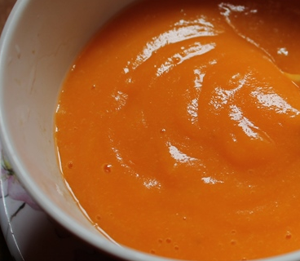
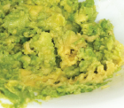
What Are Solid Foods?
Foods that are easy and safe for a baby to eat once they are is developmentally ready.
As a child care provider, start offering a baby solid foods after the parents have told you that the child is developmentally ready and is eating solid foods at home.
Again, solid foods are foods that are easy and safe for a baby to eat once he or she is developmentally ready, usually around 6 months of age. Solid foods can be pureed, mashed, ground, or finely chopped to allow a baby to swallow the food without choking.
Solid foods can be blended with cooking liquid or water to puree the food so the texture is appropriate for a younger baby. As the baby gets older, you can add less liquid to create a thicker texture. If you are cooking for one baby, you can use breastmilk or infant formula to change the texture of the food. For packaged foods, like iron-fortified infant cereal, follow the preparation directions on the package.
Pureed foods are foods that are blended to a very smooth texture.
Once a baby is used to pureed foods, mashed foods is a good texture to try next. Mashed foods are lumpier than pureed foods.
At around 8 months of age, the baby may be ready for new textures. Grind or finely chop or dice soft foods into small pieces, no larger than ½ inch or thin slices to avoid choking. Foods should be easy for the baby to chew and swallow.
Pureed
Mashed
Ground
Finely chopped
Notes:
As a child care provider, start offering a baby solid foods after the parents have told you that the child is developmentally ready and is eating solid foods at home.
Again, solid foods are foods that are easy and safe for a baby to eat once they are developmentally ready, usually around 6 months of age. Solid foods can be pureed, mashed, ground, or finely chopped to allow a baby to swallow the food without choking.
Solid foods can be blended with cooking liquid or water to puree the food so the texture is appropriate for a younger baby. As the baby gets older, you can add less liquid to create a thicker texture. If you are cooking for one baby, you can use breastmilk or infant formula to change the texture of the food. For packaged foods, like iron-fortified infant cereal, follow the preparation directions on the package.
Pureed foods are foods that are blended to a very smooth texture.
Once a baby is used to pureed foods, mashed foods is a good texture to try next. Mashed foods are lumpier than pureed foods.
At around 8 months of age, the baby may be ready for new textures. Grind or finely chop or dice soft foods into small pieces, no larger than ½ inch or thin slices to avoid choking. Foods should be easy for the baby to chew and swallow.

Slide 12
Try It Out!
A parent asks you to start serving their
5-month-old baby solid foods at your child care site, but you know the infant meal pattern age groups are 0 through
5 months and 6 through 11 months.
?
If you serve the baby solid foods at
5 months, can you still claim reimbursement for the meals and snacks?
Yes
No
Here is another practice question.
A parent asks you to start serving their 5-month-old baby solid foods at your child care site, but you know the infant meal pattern age groups are 0 through 5 months and 6 through 11 months. If you serve the baby solid foods when they are developmentally ready at 5 months, can you still claim reimbursement for his meals and snacks? Yes or No?
Raise your hand if you think the answer is "yes" [pause and wait for a show of hands] or "no" [pause and wait for a show of hands].
Notes:
Here is another practice question.
A parent asks you to start serving their 5-month-old baby solid foods at your child care site, but you know the infant meal pattern age groups are 0 through 5 months and 6 through 11 months. If you serve the baby solid foods when they are developmentally ready at 5 months, can you still claim reimbursement for the meals and snacks? Yes or No?
Raise your hand if you think the answer is "yes" [pause and wait for a show of hands] or "no" [pause and wait for a show of hands].

Slide 13
Answer
A parent asks you to start serving their
5-month-old baby solid foods at your child care site, but you know the infant meal pattern age groups are 0 through
5 months and 6 through 11 months.
?
If you serve the baby solid foods at
5 months, can you still claim reimbursement for the meals and snacks?
✓
Yes
No
Great job! The answer is “yes”. If the baby is developmentally ready to accept solid foods, then yes, you can claim reimbursement for solid foods at his meals and snacks, even if he is younger than 6 months old. As a general best practice, it is recommended to get a written note from the parent stating his or her baby can be served solid foods, but it is not required.
Notes:
Great job! The answer is “yes”. If the baby is developmentally ready to accept solid foods, then yes, you can claim reimbursement for solid foods at the meals and snacks, even if the baby is younger than 6 months old. As a general best practice, it is recommended to get a written note from the parent stating their baby can be served solid foods, but it is not required.

Slide 14

Solid Foods in the Infant Meal Pattern
iron-fortified dry
infant cereals
fish
poultry
meats
whole eggs
(yolk and whites)
cooked dry
beans or peas
cheese and
cottage cheese
yogurt
vegetables
fruits
ready-to-eat
cereals (snack only)
breads and crackers
(snack only)
The CACFP infant meal pattern for babies 6 through 11 months includes solid foods, such as:
iron-fortified dry infant cereals
fish
poultry
meats
whole eggs, including the egg yolk and egg white
cooked dry beans or peas
cheese and cottage cheese
yogurt
vegetables
fruits
ready-to-eat cereals at snack only
breads and crackers at snack only
Notes:
The CACFP infant meal pattern for babies 6 through 11 months includes solid foods, such as:
iron-fortified dry infant cereals
fish
poultry
meats
whole eggs, including the egg yolk and egg white
cooked dry beans or peas
cheese and cottage cheese
yogurt (including soy yogurt)
tofu
vegetables
fruits
ready-to-eat cereals at snack only
breads and crackers at snack only

Slide 15
Grains
Iron-fortified infant cereal
  Breakfast, lunch and supper, or snack
Breads
  Snack only
Crackers
  Snack only
Ready-to-eat cereals
  Snack only
  Must meet the sugar limit
  (6 grams per dry ounce)
Grains served must be made with enriched or whole-grain meal or flour. Ready-to-eat breakfast cereals and infant cereals that are fortified are also creditable. There is not a whole grain-rich requirement in the CACFP infant meal pattern.
Ready-to-eat cereals include flakes, rounds, and o-shaped cereals that older babies can pick up and eat. These cereals can only credit towards snacks, not meals. The cereal must not contain more than 6 grams of sugar per dry ounce of cereal and must be iron-fortified. Some ready-to-eat cereals may be a choking hazard. Choose cereals that dissolve easily in the mouth and do not include nuts, dried fruits, or other hard food items.
Almost all infant cereals meet the sugar limit, and there are many types of ready-to-eat cereal that meet this sugar limit as well.
Breads and crackers can be served at snack only.
Notes:
Grains served must be made with enriched or whole-grain meal or flour. Ready-to-eat breakfast cereals and infant cereals that are fortified are also creditable. There is not a whole grain-rich requirement in the CACFP infant meal pattern.
Ready-to-eat cereals include flakes, rounds, and o-shaped cereals that older babies can pick up and eat. These cereals can only credit towards snacks, not meals. The cereal must not contain more than 6 grams of sugar per dry ounce of cereal and must be iron-fortified. Some ready-to-eat cereals may be a choking hazard. Choose cereals that dissolve easily in the mouth and do not include nuts, dried fruits, or other hard food items.
Almost all infant cereals meet the sugar limit, and there are many types of ready-to-eat cereal that meet this sugar limit as well.
Breads and crackers can be served at snack only.

Slide 16
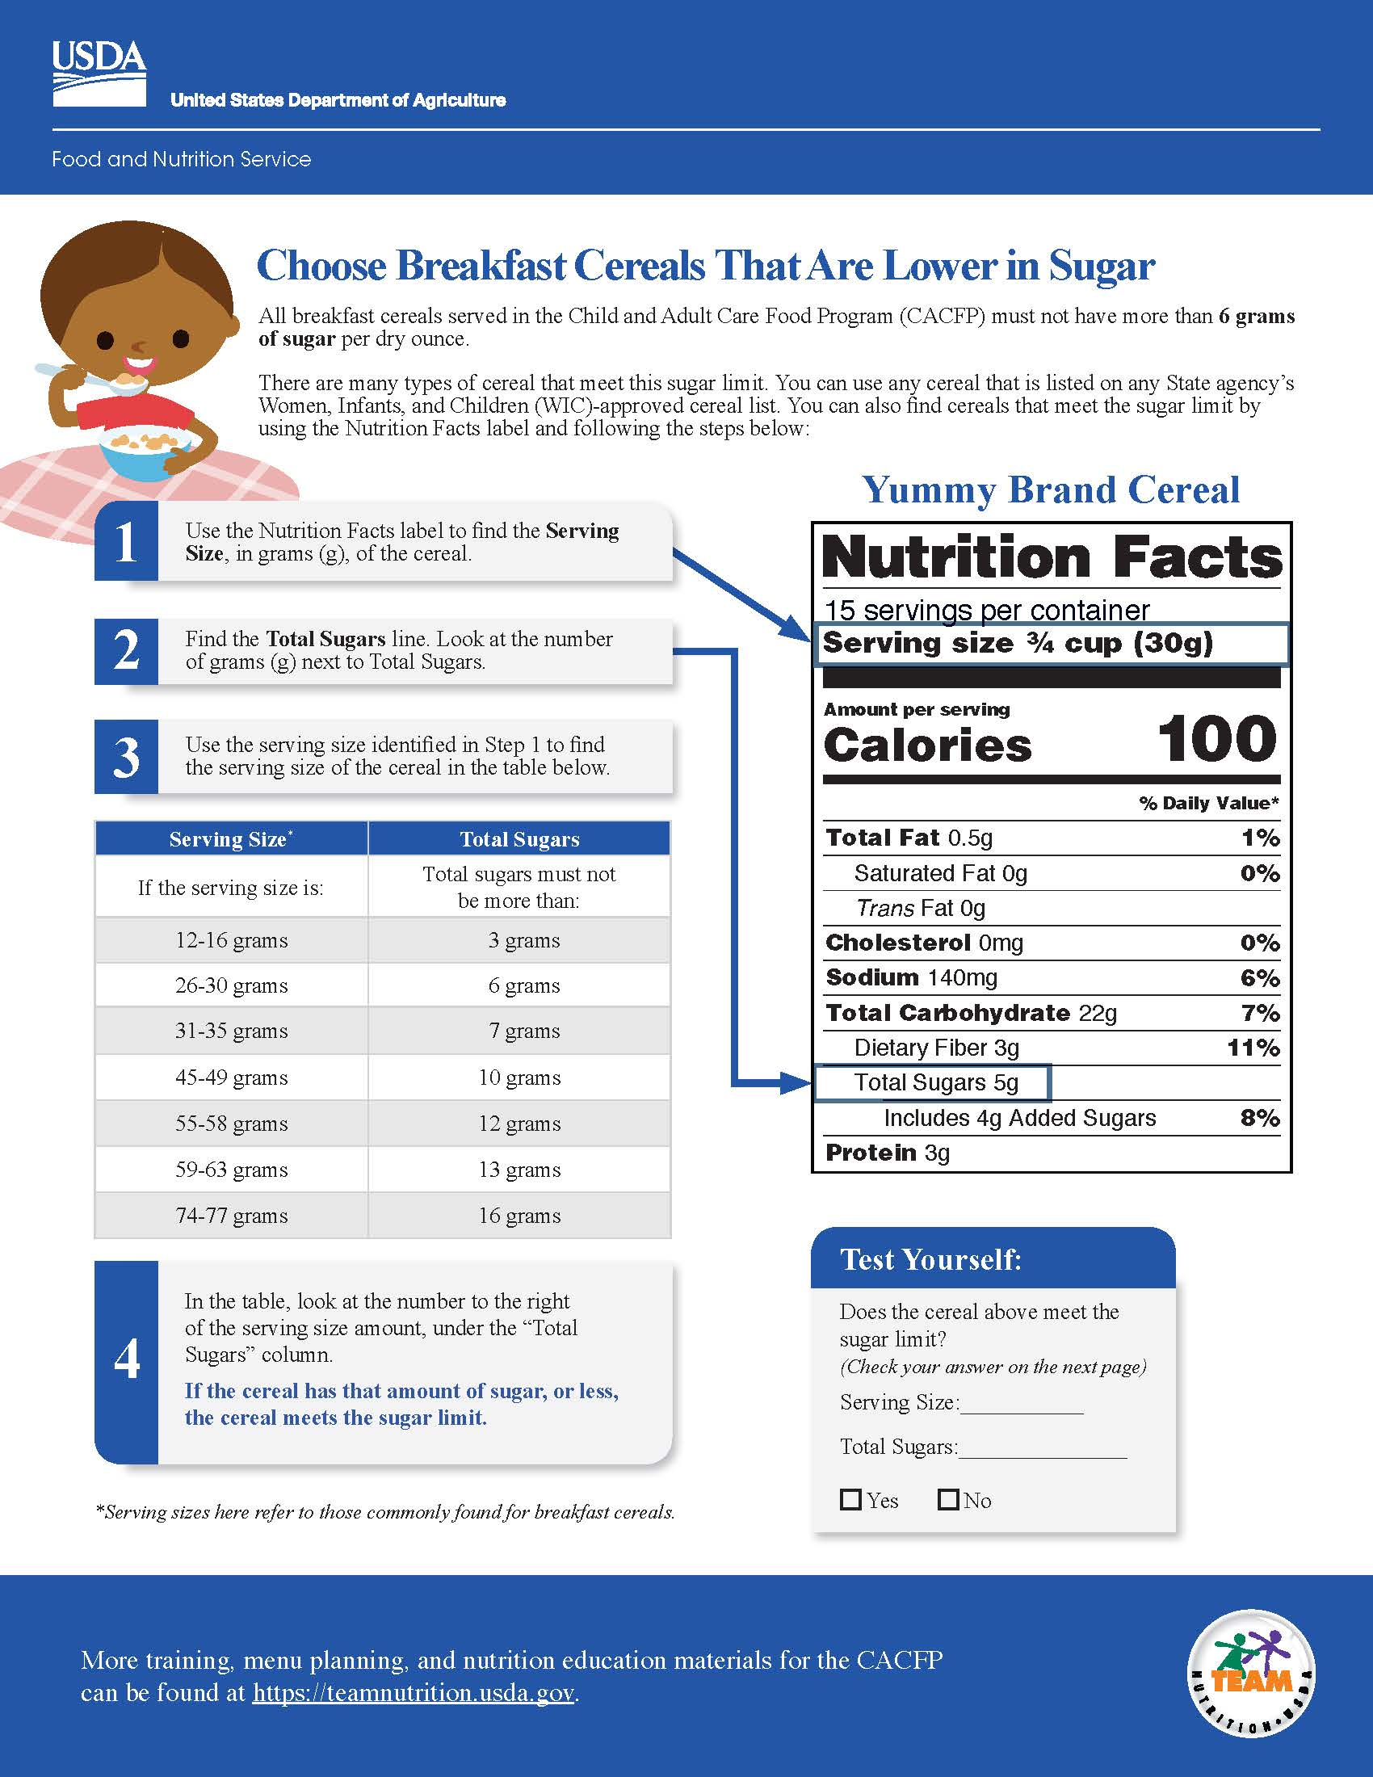
Choose Breakfast Cereals That Are
Lower in Sugars
fns.usda.gov/tn/meal-pattern-training-worksheets-cacfp
Notes:
There are a couple of ways to figure out if a cereal meets the sugar requirement. You can:
Use any cereal that is listed on any State agency’s Women, Infants, and Children (WIC)-approved cereal list, found as part of the State’s approved food lists.
Use the chart in USDA Team Nutrition’s training worksheet “Choose Breakfast Cereals That Are Lower in Sugar.” The worksheet can be found at the link provided on the slide.

Slide 17
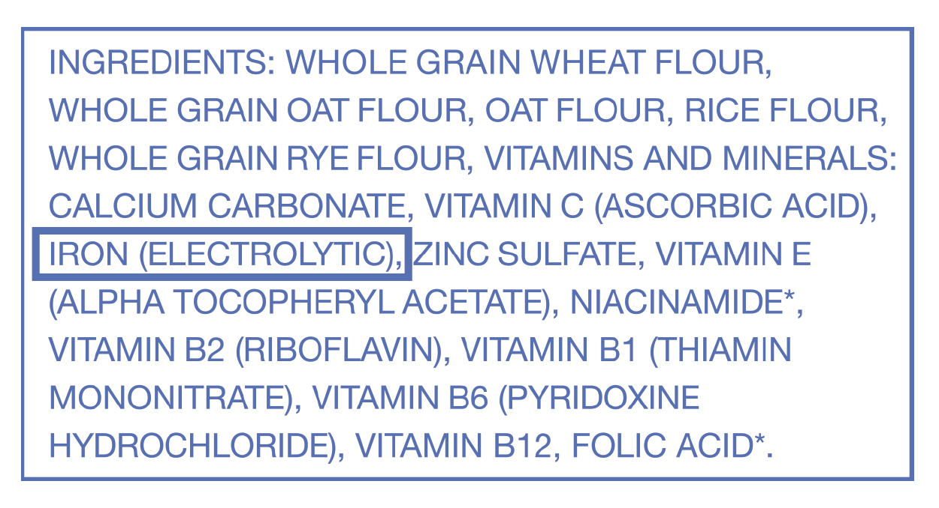
Iron-Fortified Infant Cereal
Infant cereal must be iron-fortified
Single and mixed-grain cereals are creditable
  Offer single grain first, then mixed-grain
To tell if an infant cereal is “iron-fortified”
  It may say “iron-fortified” on the package
  Look at the ingredient list
    Iron
    Ferric fumarate
    Electrolytic iron
    Iron (electrolytic)
Dry iron-fortified infant cereal is cereal that has iron added to it. Iron is an important nutrient for babies. Both single-grain infant cereal, such as wheat, oat, and barley, as well as mixed-grain infant cereal are creditable as long as they are iron-fortified. Babies should be given the single grain iron-fortified infant cereal first to make sure he or she does not have an allergic reaction. If the baby does not have a reaction, then mixed-grain iron-fortified infant cereal can be offered.
To tell if an infant cereal is “iron-fortified” look at the ingredient list on the back of the infant cereal package. As long as one of the ingredients listed is “iron,” “ferric fumarate,” “electrolytic iron,” or “iron (electrolytic),” then the cereal is iron-fortified. It may also say “iron-fortified” on the package.
Notes:
Dry iron-fortified infant cereal is cereal that has iron added to it. Iron is an important nutrient for babies. Both single-grain infant cereal, such as wheat, oat, and barley, as well as mixed-grain infant cereal are creditable as long as they are iron-fortified. Babies should be given the single grain iron-fortified infant cereal first to make sure they do not have an allergic reaction. If the baby does not have a reaction, then mixed-grain iron-fortified infant cereal can be offered.
To tell if an infant cereal is “iron-fortified” look at the ingredient list on the back of the infant cereal package. As long as one of the ingredients listed is “iron,” “ferric fumarate,” “electrolytic iron,” or “iron (electrolytic),” then the cereal is iron-fortified. It may also say “iron-fortified” on the package.

Slide 18

Meats and Meat Alternates
Meats and poultry
Fin fish and shellfish
Whole eggs
Beans and peas
Cheese
Cottage cheese
Yogurt (including soy yogurt)
  must meet the sugar limit
  (23 grams per 6 ounces)
Tofu
Meats and poultry, including beef, pork, lamb, veal, chicken, and turkey are creditable in the CACFP infant meal pattern. Similar to iron-fortified infant cereals, meats and poultry are good first foods for babies because they provide iron and zinc that babies need around 6 months of age.
Both fin fish and shellfish purchased from a commercial source may be offered to infants 6 through 11 months old when developmentally ready for solid foods. Home caught fish is only creditable if it meets State or local public health policies regarding food safety. According to the American Academy of Pediatrics, there is no evidence that waiting to introduce common allergens, such as fish or shellfish, beyond 4 to 6 months of age will prevent a food allergy. Remove any bones or shells and modify the texture of the fish and shellfish based upon the feeding skills of the baby.
In terms of meat alternates, whole eggs, including both the egg yolk and the egg white, must be served in order for it to be creditable.
Any cooked dry beans and peas, such as lentils, black beans, pinto beans, or chickpeas, may be served to babies who are developmentally ready to accept them. This includes canned beans and peas. Look for those labeled “reduced sodium.” Puree or mash beans and peas to avoid choking. Green peas are not considered a meat alternate.
Pasteurized cheeses are allowed under the infant meal pattern. However, cheese food, cheese spread, and cheese product are not creditable because they are generally higher in salt and lower in protein.
Store-bought low-fat, reduced-fat, and whole milk yogurts are creditable under the infant meal pattern. Homemade yogurts are not creditable. The yogurt must contain no more than 23 grams of sugar per 6 ounces of yogurt.
*Prepare foods so that they are the right shape, size, and texture.
Notes:
Meats and poultry, including beef, pork, lamb, veal, chicken, and turkey are creditable in the CACFP infant meal pattern requirements. Similar to iron-fortified infant cereals, meats and poultry are good first foods for babies because they provide iron and zinc that babies need around 6 months of age.
Both fin fish and shellfish purchased from a commercial source may be offered to infants 6 through 11 months old when developmentally ready for solid foods. Home caught fish is only creditable if it meets State or local public health policies regarding food safety. According to the American Academy of Pediatrics, there is no evidence that waiting to introduce common allergens, such as fish or shellfish, beyond 4 to 6 months of age will prevent a food allergy. Remove any bones or shells and modify the texture of the fish and shellfish based upon the feeding skills of the baby.
In terms of meat alternates, whole eggs, including both the egg yolk and the egg white, must be served in order for it to be creditable.
Any cooked dry beans and peas, such as lentils, black beans, pinto beans, or chickpeas, may be served to babies who are developmentally ready to accept them. This includes canned beans and peas. Look for those labeled “reduced sodium.” Puree or mash beans and peas to avoid choking. Green peas are not considered a meat alternate.
Pasteurized cheeses are allowed under the infant meal pattern. However, cheese food, cheese spread, and cheese product are not creditable because they are generally higher in salt and lower in protein.
Store-bought low-fat, reduced-fat, and whole milk yogurts, including soy yogurts, are creditable under the infant meal pattern. Homemade yogurts are not creditable. The yogurt must contain no more than 23 grams of sugar per 6 ounces of yogurt.
Tofu is also creditable as a meat alternate.

Slide 19
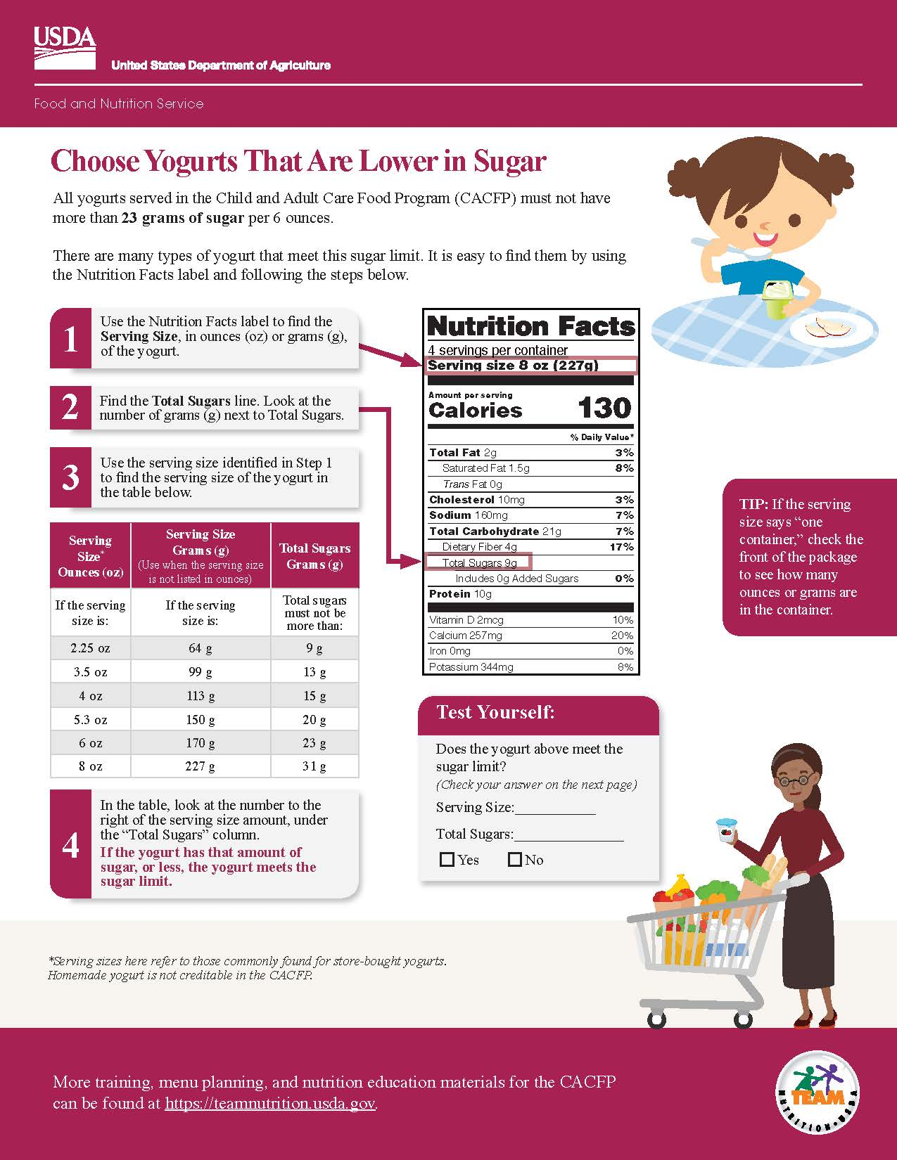
Choose Yogurts That Are Lower in Sugars
To help you identify yogurts with no more than 23 grams of sugar per 6 ounces, you can:
Use the chart in USDA Team Nutrition’s training worksheet “Choose Yogurts That Are Lower in Added Sugars.” The worksheet can be found at the link provided on the slide.
USDA's Team Nutrition also has a recorded CACFP Halftime: Thirty on Thursdays webinar available on this topic. If you would like to listen to the recording, the webinar can be found on the USDA Team Nutrition website at teamnutrition.usda.gov.
fns.usda.gov/tn/meal-pattern-training-worksheets-cacfp
Notes:
To help you identify yogurts with no more than 23 grams of sugar per 6 ounces, you can:
Use the chart in USDA Team Nutrition’s training worksheet “Choose Yogurts That Are Lower in Sugar.” The worksheet can be found at the link provided on the slide.

Slide 20
Vegetables and Fruits
All vegetables and fruits can be offered.
Fruit and vegetable juices are not creditable.
Includes 100% juice
All vegetables and fruits can be offered to babies. They contain important nutrients and fiber. To avoid choking, remember to cook and prepare vegetables and fruits to the appropriate texture. Remove all pits, seeds, skins, and peels before serving the food. Always cut vegetables and fruits into thin slices, and no larger than ½ inch, to prevent choking.
Fruit and vegetable juices, even 100% juice, are not creditable under the infant meal pattern.
*Prepare foods so that they are the right shape, size, and texture.
Notes:
All vegetables and fruits can be offered to babies. They contain important nutrients and fiber. To avoid choking, remember to cook and prepare vegetables and fruits to the appropriate texture. Remove all pits, seeds, skins, and peels before serving the food. Always cut vegetables and fruits into thin slices, and no larger than ½ inch, to prevent choking.
Fruit and vegetable juices, even 100% juice, are not creditable under the infant meal pattern requirements.

Slide 21
Tips for Feeding a Baby Solid Foods
If using jarred baby food, spoon some out and put it in another bowl.
Sit and talk to the baby during the feeding.
If ready, let the baby feed themselves.
Watch the baby during a feeding for signs of:
  Allergic reaction
  Choking
Throw away uneaten food.
Notes:
So far, we have talked about when to feed a baby solid foods and the types of solid foods that can be served to meet the CACFP infant meal pattern requirements. Now, let's talk about some of the important tips you need to remember when feeding a baby solid foods.
If using baby food from a jar, pouch, or other container, first put the baby food in a bowl or on a plate. Then, feed a baby with a spoon from the bowl or plate. If more food is needed from the container, use a clean spoon to move the food from the container onto the plate or bowl. This helps keep bacteria that can come from baby’s saliva out of the food container so that any leftover food can be stored safely.
Talk to the baby in a soft and encouraging voice. Keep good eye contact and smile. Games and other disruptions can be distracting or overwhelming to a baby.
When the baby is developmentally ready, let the baby try feeding themselves. Soft finger foods give the baby a chance to feed themselves without assistance. You can also let the baby try eating with a spoon. Monitor the baby during the meal for any signs of choking or allergic reactions.
Throw away uneaten food.
Remember, you are a role model for the baby. You can model how to eat new foods for the baby. Mealtimes provide a chance to show the baby how to use a spoon or fork to eat a small amount of food. Show your enjoyment of the food by smiling and using a positive tone of voice. If older children eat meals with the baby at your child care site, encourage them to also model good eating behaviors for the baby. This can help create a positive and encouraging eating environment.

Slide 22
Choking Prevention
Prepare foods so that they are the right shape, size, and texture:
Grind tough meat
Cook or steam food until soft
Food should be no larger than ½-inch pieces or thin slices or strips
Remove pits, seeds, skins, and peels from vegetables and fruit
Remove bones from meats, poultry, fish
When preparing foods for babies, make sure it is in a form that a baby can easily chew and swallow. Think of the shape, size, and texture when choosing foods. To prevent choking, you can:
Grind up tough meats.
Cook or steam food until it is soft.
Puree, mash, or finely chop foods into small pieces (no larger than 1/2 inch) or thin slices or strips (lengthwise).
Remove seeds, pits, tough skins, and peels from fruits and vegetables.
Remove all bones from fish, poultry (like chicken and turkey), and meat before cooking or serving.
Notes:
When preparing foods for babies, make sure it is in a form that a baby can easily chew and swallow. Think of the shape, size, and texture when choosing foods. To prevent choking, you can:
Grind up tough meats.
Cook or steam food until it is soft.
Puree, mash, or finely chop foods into small pieces (no larger than 1/2 inch) or thin slices or strips (lengthwise).
Remove pits, seeds, tough skins, and peels from fruits and vegetables.
Remove all bones from fish, poultry (like chicken and turkey), and meat before cooking or serving.

Slide 23
Parent Provided Meal Component
If a parent brings in… | You must offer…
Breastmilk | All other meal components
Iron-fortified infant formula | All other meal components
A solid food (for example pureed meat) | Iron-fortified infant formula All other meal components
Notes:
Parents may provide only one meal component as part of a reimbursable meal or snack.
For babies who are eating solid foods, there are two options to claim reimbursement. 1) If the parent provides breastmilk or a creditable infant formula for their baby, then your child care site must provide all other meal components in order for the meal to be reimbursable. 2) If the parent provides a solid food for their baby, like pureed meat, then your child care site must provide a creditable iron-fortified infant formula and all other meal components.

Slide 24
Try It Out!
You notice that a baby in your care is developmentally ready for solid foods, and the parents agree. The parents tell you that their baby has had pureed sweet potatoes at home, so you offer the baby some at child care. The baby takes one bite at lunch.
?
Can you claim the sweet potatoes as part of a reimbursable lunch?
Yes
No
Okay, let’s try one last practice question.
You notice that a baby in your care is developmentally ready for solid foods, and the parents agree. The parents tell you that they have had pureed sweet potatoes at home, so you offer the baby some at child care. The baby takes one bite at lunch. Can you claim the sweet potatoes as part of a reimbursable lunch? Yes or No?
Raise your hand if you think the answer is "yes" [pause and wait for a show of hands] or "no" [pause and wait for a show of hands].
Notes:
Okay, let’s try one last practice question.
You notice that a baby in your care is developmentally ready for solid foods, and the parents agree. The parents tell you that they have had pureed sweet potatoes at home, so you offer the baby some at child care. The baby takes one bite at lunch. Can you claim the sweet potatoes as part of a reimbursable lunch? Yes or No?
Raise your hand if you think the answer is "yes" [pause and wait for a show of hands] or "no" [pause and wait for a show of hands].

Slide 25
Answer
You notice that a baby in your care is developmentally ready for solid foods, and the parents agree. The parents tell you that their baby has had pureed sweet potatoes at home, so you offer the baby some at child care. The baby takes one bite at lunch.
?
Can you claim the sweet potatoes as part of a reimbursable lunch?
✓
Yes
No
The answer is “yes”. You can claim the sweet potatoes as part of a reimbursable lunch even if the baby only takes one bite. Remember, the amounts of solid foods listed in the infant meal pattern are provided as a range, such as 0­­–­2 ­tablespoons. This provides you with the flexibility to offer the right amount of solid foods based upon the baby’s developmental readiness. Since this baby just started eating solid foods and is getting used to it, they were done after one bite and that is okay.
Once the baby has been regularly eating a specific solid food, you would offer the baby the full 2 tablespoons of the solid food.
Notes:
The answer is “yes”. You can claim the sweet potatoes as part of a reimbursable lunch even if the baby only takes one bite. Remember, the amounts of solid foods listed in the infant meal pattern are provided as a range, such as 0­­–­2 ­tablespoons. This provides you with the flexibility to offer the right amount of solid foods based upon the baby’s developmental readiness. Since this baby just started eating solid foods and is getting used to it, they were done after one bite and that is okay.
Once the baby has been regularly eating a specific solid food, you would offer the baby the full 2 tablespoons of the solid food.

Slide 26
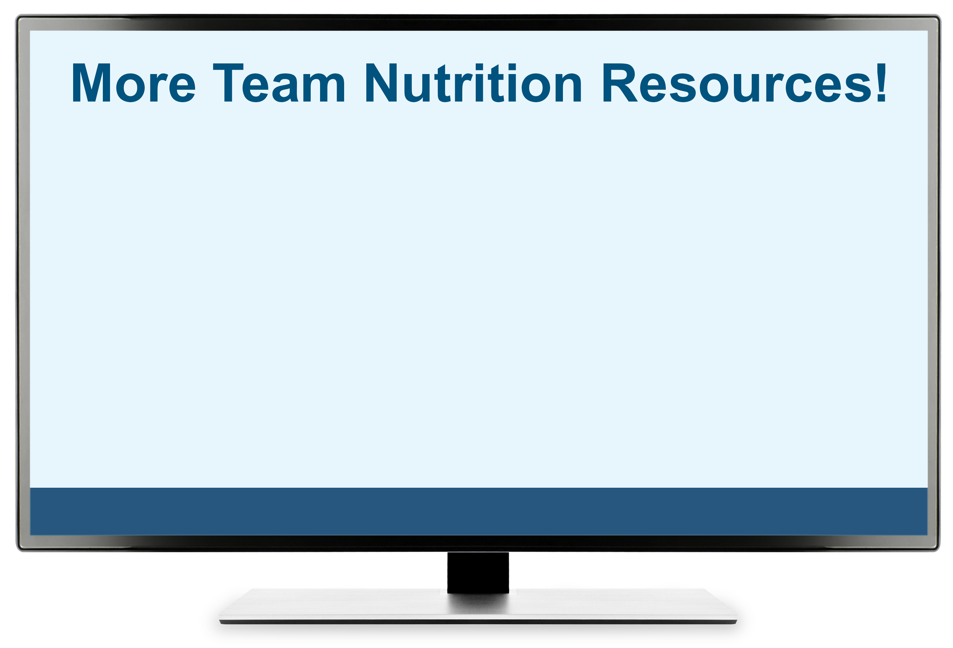
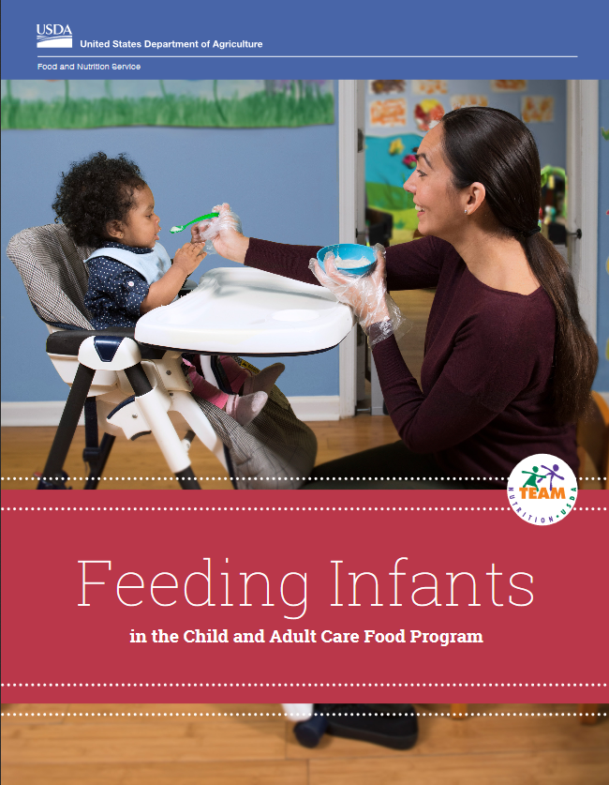
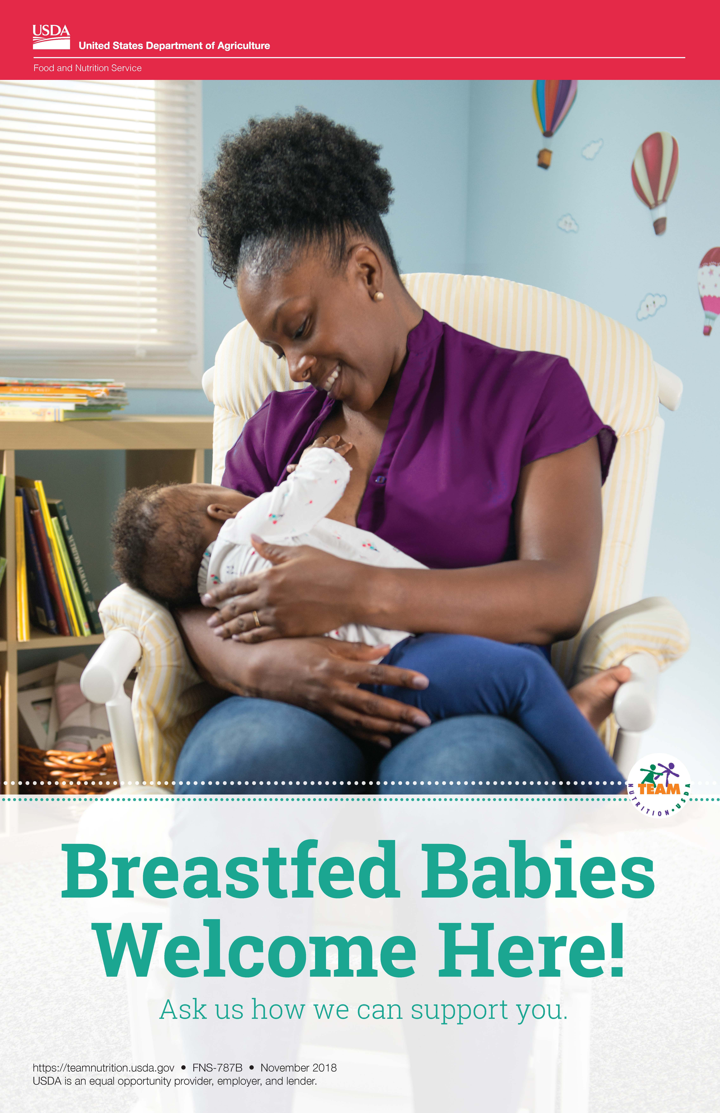
More Team Nutrition Resources
All Team Nutrition materials are available online from Team Nutrition’s website and are available for free download to anybody who is interested.
TeamNutrition.USDA.gov
Notes:
All Team Nutrition materials are available online from Team Nutrition’s website and are available for free download to anybody who is interested.

Slide 27

How To Order Print Copies
Resource Order Form at TeamNutrition.USDA.gov.
FREE for those participating in a USDA’s Child Nutrition Program, while supplies last.
Sponsoring organizations and State agencies can also order in bulk by sending an email to:
TeamNutrition@USDA.gov
For all participating in a Child Nutrition Program, such as the CACFP, Team Nutrition’s print materials are free to order.
If you would like to order Team Nutrition’s free materials in print, click “Order Team Nutrition Resources” on the Team Nutrition website.
For bulk orders, you can email teamnutrition@usda.gov.
Notes:
For all participating in a USDA’s Child Nutrition Program, such as the CACFP, Team Nutrition’s print materials are free to order.
If you would like to order Team Nutrition’s free materials in print, click “Order Team Nutrition Resources” on the Team Nutrition website.
For bulk orders, you can email TeamNutrition@USDA.gov.

Slide 28


Thank you!
These training slides were provided by U.S. Department of Agriculture's Team Nutrition. If you would like to learn more about Team Nutrition and additional resources available, please visit their website, subscribe to their monthly e-newsletter, connect with them via email at teamnutrition@usda.gov, and follow them on Twitter.
Thank you!
TeamNutrition.USDA.gov
@TeamNutrition
TeamNutrition@USDA.gov
USDA is an equal opportunity provider, employer, and lender.
Notes:
These training slides were provided by U.S. Department of Agriculture's Team Nutrition. If you would like to learn more about Team Nutrition and additional resources available, please visit their website, subscribe to their e-newsletter, connect with them via email at TeamNutrition@USDA.gov, and follow them on Twitter/X.
Thank you!

