Slide 1

How to Support Breastfeeding in the CACFP
A Training Presentation for
Child and Adult Care Food
Program (CACFP) Operators

Slide 2
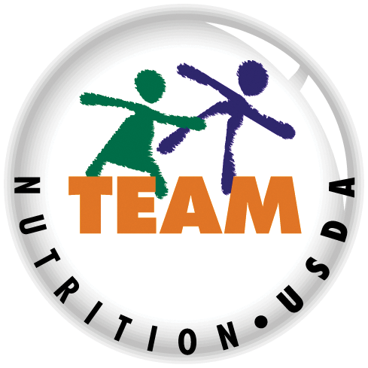


USDA’s Team Nutrition
An initiative of the USDA’s Food and Nutrition Service to support the USDA’s Child Nutrition Programs.
Aims to improve children’s lifelong eating and physical activity habits.
Provides nutrition education and training materials to State agencies, sponsoring organizations, and CACFP sites.
TeamNutrition.USDA.gov
@TeamNutrition
Notes:
Team Nutrition is an initiative of the USDA Food and Nutrition Service that supports the Child Nutrition Programs, including the National School Lunch Program, the School Breakfast Program, and of course, the Child and Adult Care Food Program, or the CACFP.
The goal of Team Nutrition is to improve children's lifelong eating and physical activity habits through nutrition education based on the principles of the Dietary Guidelines for Americans and MyPlate.
It does so through training and technical assistance for those preparing and serving meals, providing nutrition education for children, and building support for healthier school and child care environments.

Slide 3
Let Us Know Who You Are!
I work for a…
?
Before we get started, I want to know who has joined us today.
Please raise your hand if you work for a:
child care center [pause and wait for a show of hands],
family child care home [pause and wait for a show of hands],
at-risk afterschool care center [pause and wait for a show of hands],
sponsoring organization [pause and wait for a show of hands],
emergency shelter [pause and wait for a show of hands],
school food authority [pause and wait for a show of hands],
State agency [pause and wait for a show of hands],
USDA Regional office [pause and wait for a show of hands],
or other [pause and wait for a show of hands].
Child care center
Family child care home
At-risk afterschool care center
Adult day care center
Sponsoring organization
Emergency shelter
School food authority
State agency
USDA Regional Office
Other
Notes:
Before we get started, I want to know who has joined us today.
Please raise your hand if you work for a:
child care center [pause and wait for a show of hands],
family child care home [pause and wait for a show of hands],
at-risk afterschool care center [pause and wait for a show of hands],
sponsoring organization [pause and wait for a show of hands],
emergency shelter [pause and wait for a show of hands],
school food authority [pause and wait for a show of hands],
State agency [pause and wait for a show of hands],
USDA Regional office [pause and wait for a show of hands],
or other [pause and wait for a show of hands].

Slide 4
Benefits of Breastfeeding
Breastfed babies may have:
lower risk of asthma
fewer ear and
respiratory infections
lower risk of SIDS
fewer infections that cause vomiting and diarrhea
lower risk of becoming obese
and more!
Mothers who breastfeed may:
have less blood loss
after childbirth
feel more relaxed
have lower risk of ovarian and certain types of breast cancer
have lower risk of
Type 2 diabetes
and more!
Now, let's look more closely at today's topic - how to support breastfeeding in the CACFP. According to the American Academy of Pediatrics, breastmilk is the best source of nutrition for babies, and it is the only food healthy babies need for about the first 6 months of life. Additionally, the U.S. Department of Agriculture's Food and Nutrition Service Special Supplemental Nutrition Program for Women, Infants and Children (WIC) breastfeeding promotion and support campaign (https://wicbreastfeeding.fns.usda.gov/) encourages breastfeeding mothers to breastfeed as much as they can for as long as they can, exclusively for six months and up to a year if possible.
Mothers often choose to breastfeed because it benefits the baby, the mother, and the family. Breastfed babies may have:
lower risk of asthma.
fewer ear and lower respiratory infections.
lower risk of Sudden Infant Death Syndrome (SIDS).
lower risk of becoming obese.
fewer infections that cause vomiting and diarrhea.
Babies also taste different flavors in breastmilk based on what the mother eats. This may help babies accept new flavors from solid foods more easily.
Breastfeeding may help the mother:
have less blood loss after childbirth.
feel more relaxed.
have lower risk of ovarian and certain types of breast cancer.
have lower risk of Type 2 diabetes.
Skin-to-skin contact during breastfeeding may help moms and babies bond.
Lastly, breastfeeding can help the family financially. They may be able to save money because they do not have to buy infant formula, and they may miss less days or work or school since their baby may be sick less often.
Because of the many benefits associated with breastfeeding, mothers often choose to continue to breastfeed their baby when they return to work or school. Therefore, CACFP operators regularly care for breastfed babies. The updated CACFP infant meal pattern supports mothers who choose to continue to breastfeed when their baby is enrolled in child care.
Notes:
Now, let's look more closely at today's topic - how to support breastfeeding in the CACFP. According to the American Academy of Pediatrics, breastmilk is the best source of nutrition for babies, and it is the only food healthy babies need for about the first 6 months of life. Additionally, the U.S. Department of Agriculture's Food and Nutrition Service Special Supplemental Nutrition Program for Women, Infants and Children (WIC) breastfeeding promotion and support campaign (https://wicbreastfeeding.fns.usda.gov/) encourages breastfeeding mothers to breastfeed as much as they can for as long as they can, exclusively for six months and up to a year if possible.
Mothers often choose to breastfeed because it benefits the baby, the mother, and the family. Breastfed babies may have:
lower risk of asthma.
fewer ear and lower respiratory infections.
lower risk of Sudden Infant Death Syndrome (SIDS).
lower risk of becoming obese.
fewer infections that cause vomiting and diarrhea.
Babies also taste different flavors in breastmilk based on what the mother eats. This may help babies accept new flavors from solid foods more easily.
Breastfeeding may help the mother:
have less blood loss after childbirth.
feel more relaxed.
have lower risk of ovarian and certain types of breast cancer.
have lower risk of Type 2 diabetes.
Skin-to-skin contact during breastfeeding may help moms and babies bond.
Lastly, breastfeeding can help the family financially. They may be able to save money because they do not have to buy infant formula, and they may miss less days or work or school since their baby may be sick less often.
Because of the many benefits associated with breastfeeding, mothers often choose to continue to breastfeed their baby when they return to work or school. Therefore, CACFP operators regularly care for breastfed babies. The updated CACFP infant meal pattern requirements support mothers who choose to continue to breastfeed when their baby is enrolled in child care.

Slide 5

How the CACFP Meal Patterns Support Breastfeeding
  Provide reimbursement to CACFP operators if the mother breastfeeds on-site.
  Encourage mothers to supply breastmilk for their child while in child care.
  Offer a quiet, private area that is comfortable and sanitary for mothers who come to your child care site to breastfeed.
Notes:
The CACFP supports breastfeeding mothers by providing reimbursement for meals when mothers choose to breastfeed on-site, by encouraging mothers to supply breastmilk for their baby while in child care, and by promoting CACFP best practices, which includes offering a quiet, private, comfortable, sanitary area for mothers to breastfeed or pump when they come to the child care site.
Be sure to talk to breastfeeding mothers to see if they plan to breastfeed at pickup. If they do, ask if they would like you to wait to feed the baby if the baby is hungry right before pickup time. This can help make sure the baby is hungry enough to nurse once mom arrives.
Remember, when a mom nurses her baby at your child care site, the breastmilk that the baby gets from nursing can count towards a reimbursable meal or snack in the CACFP infant meal pattern. Breastmilk, whether the baby gets it from nursing or a bottle, credits at all meals and snacks for infants, and can also credit towards the fluid milk requirement for children over the age of 1 year. A written request from the parent does not have to be kept on file to serve the breastmilk to a child 1 year old or older.

Slide 6
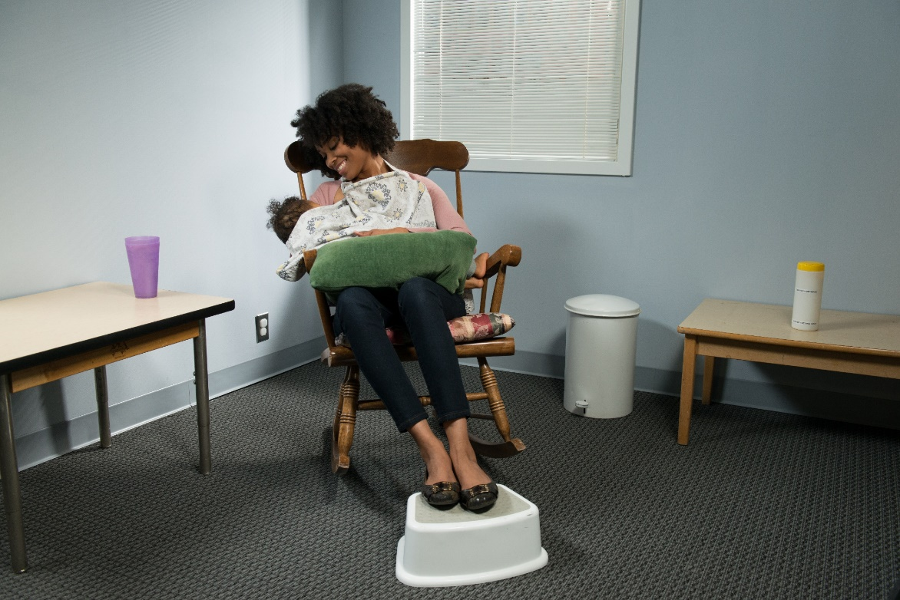
Creating a Breastfeeding-Friendly Environment
If possible, offer a quiet, comfortable place to breastfeed
or pump that includes:
  Drinking water
  Pillow
  Disinfectant wipes
  Table
  Electrical outlet
  Stool
  Comfortable chair
Notes:
As I mentioned earlier, the updated CACFP infant meal pattern allows a child care site to receive reimbursement for a meal or snack if the mother breastfeeds on-site. As a CACFP Best Practice, child care sites are encouraged to offer a quiet, private area that is comfortable and sanitary for mothers who come to the center or day care home to breastfeed or pump. The space could be a small room, the corner of a classroom, or an office with a privacy screen or curtain.
The space can include:
Drinking water, a sink to wash hands and pumping equipment as needed, a pillow to support the baby while feeding, disinfectant wipes to clean up before and after pumping, a table to place pumping equipment and other personal supplies, an electrical outlet for the breast pump, a foot stool to help support the mom’s back while nursing, and a comfortable chair.

Slide 7
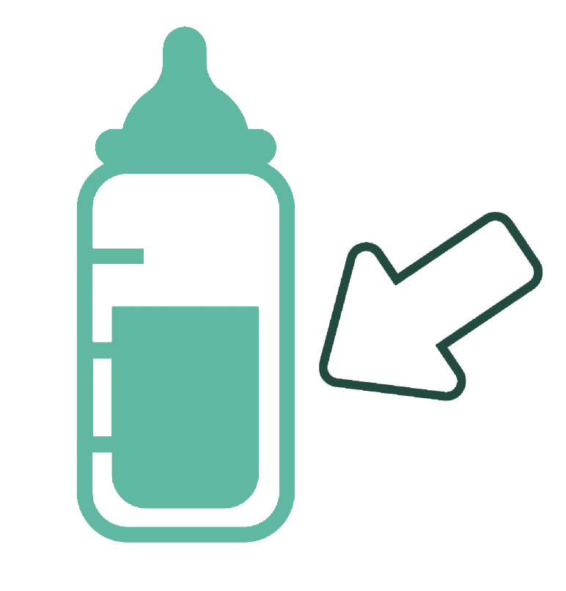
Receiving Breastmilk at the Child Care Site
Bottles should be labeled with:
  - Baby’s full name
  - Date the breastmilk was pumped and thawed
  Bottles containing breastmilk should be kept in the refrigerator or freezer until it is time to feed the baby
Jane
Doe
8/16/20
Thawed
8/29/20
If State child care licensing regulations or local health codes for handling and storing breastmilk are stricter, follow those regulations.
Notes:
Parents may have questions about how to safely bring breastmilk to the child care site. Ask parents to bring breastmilk to the child care site in a cooler with ice packs to keep it cold. The bottles or bags of breastmilk should be labeled with the baby's first name, last name, and the date the breastmilk was pumped. If the breastmilk was thawed at home, then the bottle should be labeled with the date it was thawed.
However, if State child care licensing regulations or local health codes for handling and storing breastmilk, including labeling of bottles, are stricter, then follow those regulations.
The breastmilk should be kept in the refrigerator until it is time to feed the baby. It is recommended that bottles be placed at the back of the refrigerator where the temperature is usually colder and not on the door of the refrigerator where the temperature can be affected by opening and closing the refrigerator door.
Some parents may also supply frozen breastmilk. How you handle the frozen breastmilk will depend on whether or not it will be fed to the baby in your care on the day you receive it or if the parent is providing it as a back-up supply. If it will be used the same day, you can place it in the refrigerator to thaw. If it is being provided as a back-up supply and will be used on days when baby wants more to eat than what he or she usually consumes, then it can be placed in the freezer.

Slide 8
Storing Breastmilk at
Your Child Care Site (Continued)
If your State or local
authorities have stricter
regulations, follow those.
Guidance | Countertop 77 °F (25 °C) or colder (room temperature) | Refrigerator 40 °F (4 °C) | Freezer 0 °F (-18 °C) or colder
Freshly pumped breastmilk | Do not use after 4 hours | Do not use after 4 days | Within 6 months is best. Do not use after 12 months.
Thawed breastmilk | Do not use after 1–2 hours | Do not use after 1 day (24 hours) | Never refreeze thawed breastmilk
Leftover from a feeding (baby did not finish the bottle) | Do not use after 2 hours after the baby is finished feeding. | Do not use after 2 hours after the baby is finished feeding. | Do not use after 2 hours after the baby is finished feeding.
Notes:
You want to make sure you properly receive and store breastmilk at your child care site. The breastmilk should be transported in a cooler with ice packs. If you are putting the breastmilk in the refrigerator, make sure the refrigerator is at or below 40 degrees Fahrenheit (which is about 4 degrees Celsius).
Child care sites participating in the CACFP can keep freshly pumped breastmilk in the refrigerator for up to 4 days from the time it was pumped.
These storage times and temperatures here are consistent with recommendations from the American Academy of Pediatrics and the Centers for Disease Control and Prevention.
If your State or local authorities have stricter regulations for storing food, including breastmilk, please be sure to follow those regulations.
For more information, see Policy Memo CACFP 11-2023: "Feeding Infants and Meal Pattern Requirements in the Child and Adult Care Food Program; Questions and Answers (Revised September 2023)."
Now, let's do a practice question!

Slide 9
Try It Out!
How long can child care sites participating in the CACFP store freshly pumped breastmilk in the refrigerator?
?
1 day (24 hours)
6 months
4 days
It cannot be stored
Notes:
Let's try out a practice question. How long can child care sites participating in the CACFP store freshly pumped breastmilk in the refrigerator?
Raise you hand if you think child care sites can store freshly pumped breastmilk in the refrigerator for:
1 day or 24 hours [pause and wait for a show of hands],
6 months? [pause and wait for a show of hands],
4 days? [pause and wait for a show of hands],
or it cannot be stored? [pause and wait for a show of hands].

Slide 10
Answer
How long can child care sites participating in the CACFP store freshly pumped breastmilk in the refrigerator?
?
1 day (24 hours)
6 months
4 days
It cannot be stored
✓
Great job, the correct answer is C. CACFP centers and homes can store freshly pumped breastmilk in the refrigerator for 3 days or 72 hours. As I mentioned earlier this guidance may be different than what parents follow at home. These guidelines are specific to the CACFP.
We encourage you to have discussions with parents about how they would like you to handle breastmilk that can no longer be served based on CACFP breastmilk storage guidelines. Again, the parents may ask you return it to them so they can feed it to the baby at a later date or they may ask you to discard it
Notes:
Great job, the correct answer is 4 days. CACFP centers and homes can store freshly pumped breastmilk in the refrigerator for 4 days.
We encourage you to have discussions with parents about how they would like you to handle breastmilk that can no longer be served based on breastmilk storage guidelines.

Slide 11
Storing Breastmilk at
Your Child Care Site (Continued )
If your State or local
authorities have stricter
regulations, follow those.
Guidance | Countertop 77 °F (25 °C) or colder (room temperature) | Refrigerator 40 °F (4 °C) | Freezer 0 °F (-18 °C) or colder
Freshly pumped breastmilk | Do not use after 4 hours | Do not use after 4 days | Within 6 months is best. Do not use after 12 months.
Thawed breastmilk | Do not use after 1–2 hours | Do not use after 1 day (24 hours) | Never refreeze thawed breastmilk
Leftover from a feeding (baby did not finish the bottle) | Do not use after 2 hours after the baby is finished feeding. | Do not use after 2 hours after the baby is finished feeding. | Do not use after 2 hours after the baby is finished feeding.
Notes:
If you are placing the bottles of breastmilk you accepted from the parent in the freezer you want to make sure the freezer temperature is at or below 0 degrees Fahrenheit, which is -18 degrees Celsius. Child care sites participating in the CACFP can keep freshly pumped breastmilk in the freezer up to about 6 months, but do not use after 12 months. Whether you are storing the freshly pumped breastmilk in the refrigerator or the freezer you want to make sure that it is properly labeled with the baby’s full name and date it was pumped.
However, if State child care licensing regulations or local health codes for handling and storing breastmilk, including labeling of bottles, are stricter, then follow those regulations.

Slide 12
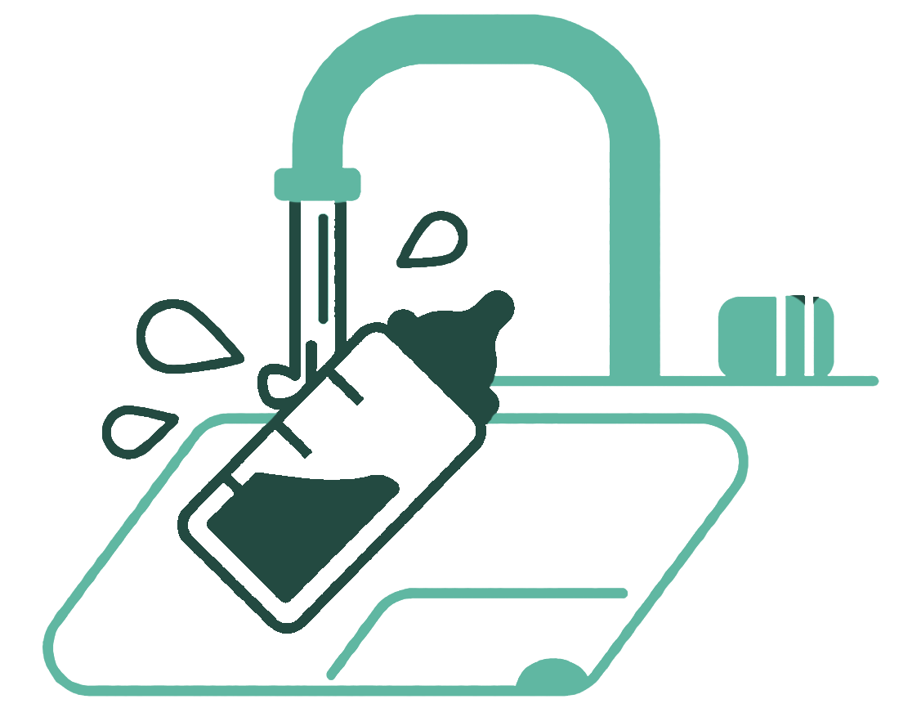


Thawing Frozen Breastmilk
Only thaw the amount of breastmilk
needed for one feeding.
You can thaw frozen breastmilk:
In the refrigerator overnight
In a container of warm water
Under warm running water
When thawing breastmilk at your child care site, only thaw the amount of breastmilk needed for one feeding to prevent or reduce waste. You can always thaw more breastmilk if the baby is showing signs of hunger. However, remember that breastmilk that has been stored in the freezer for 12 months or more should not be used.
Frozen breastmilk can be thawed by placing it in the refrigerator overnight, in a container of warm water, or under warm running water.
Breastmilk should not be thawed at room temperature or by mixing the frozen breastmilk with warm, freshly pumped breastmilk.
Lastly, never thaw or heat breastmilk by placing it in boiling water or heating in a microwave. Heating the breastmilk in this way damages some of the important nutrients in the breastmilk. Using these methods can also cause the breastmilk to become very hot and this could burn the baby, even if the bottle feels cool to the touch.
Never thaw frozen breastmilk:
  At room temperature
  By mixing the frozen breastmilk with warm breastmilk
  By placing in boiling water
  By heating in a microwave
Notes:
When thawing breastmilk at your child care site, only thaw the amount of breastmilk needed for one feeding to prevent or reduce waste. You can always thaw more breastmilk if the baby is showing signs of hunger. However, remember that breastmilk that has been stored in the freezer for 12 months or more should not be used.
Frozen breastmilk can be thawed by placing it in the refrigerator overnight, in a container of warm water, or under warm running water.
Breastmilk should not be thawed at room temperature or by mixing the frozen breastmilk with warm, freshly pumped breastmilk.
Lastly, never thaw or heat breastmilk by placing it in boiling water or heating in a microwave. Heating the breastmilk in this way damages some of the important nutrients in the breastmilk. Using these methods can also cause the breastmilk to become very hot and this could burn the baby, even if the bottle feels cool to the touch.

Slide 13
Storing Breastmilk at
Your Child Care Site (Continued).
If your State or local
authorities have stricter
regulations, follow those.
Guidance | Countertop 77 °F (25 °C) or colder (room temperature) | Refrigerator 40 °F (4 °C) | Freezer 0 °F (-18 °C) or colder
Freshly pumped breastmilk | Do not use after 4 hours | Do not use after 4 days | Within 6 months is best. Do not use after 12 months.
Thawed breastmilk | Do not use after 1–2 hours | Do not use after 1 day (24 hours) | Never refreeze thawed breastmilk
Leftover from a feeding (baby did not finish the bottle) | Do not use after 2 hours after the baby is finished feeding. | Do not use after 2 hours after the baby is finished feeding. | Do not use after 2 hours after the baby is finished feeding.
Notes:
Thawed breastmilk can remain at room temperature for no more than 1 to 2 hours, or in the refrigerator for up to 1 day (24 hours). The bottle of thawed breastmilk should be labeled with the baby’s full name, the date the breastmilk was pumped, and the date the breastmilk was thawed.
However, if State child care licensing regulations or local health codes for handling and storing breastmilk, including labeling of bottles, are stricter, then follow those regulations.
Regardless of how the breastmilk was thawed, never refreeze breastmilk.

Slide 14
Try It Out!
A bottle of breastmilk should be labeled with the baby’s full name and the date(s) the breastmilk was pumped and thawed.
?
True
False
Okay, time for another quick practice question.
True or False? A bottle of breastmilk should be labeled with the baby's full name and the date(s) the breastmilk was pumped or thawed.
Notes:
Okay, time for another quick practice question.
True or False? A bottle of breastmilk should be labeled with the baby's full name and the date(s) the breastmilk was pumped or thawed.

Slide 15
Answer
A bottle of breastmilk should be labeled with the baby’s full name and the date(s) the breastmilk was pumped and thawed.
?
✓
True
False
If State child care licensing regulations or local health codes for handling and storing breastmilk are stricter, follow those regulations.
A bottle should always be labeled with the baby’s full name and date the breastmilk was pumped. However, if State child care licensing regulations or local health codes for handling and storing breastmilk, including labeling of bottles, are stricter, then follow those regulations.
If the breastmilk is being thawed, the label should be updated with the date the breastmilk was taken out of the freezer and thawed.
Notes:
A bottle should always be labeled with the baby’s full name and date the breastmilk was pumped. However, if State child care licensing regulations or local health codes for handling and storing breastmilk, including labeling of bottles, are stricter, then follow those regulations.
If the breastmilk is being thawed, the label should be updated with the date the breastmilk was taken out of the freezer and thawed.

Slide 16
Try It Out!
How can a child care provider safely thaw frozen breastmilk?
?
Place the bottle in boiling water
Place in refrigerator, thaw overnight
Thaw at room temperature,
up to 4 hours
Heat in the microwave
Since you all are doing such a great job, we are going to do another practice question.
Notes:
Since you all are doing such a great job, we are going to do another practice question.

Slide 17
Answer
How can a child care provider safely thaw frozen breastmilk?
?
Place the bottle in boiling water
Place in refrigerator, thaw overnight
Thaw at room temperature,
up to 4 hours
Heat in the microwave
✓
Great job, the correct answer is place in the refrigerator, thaw overnight. The child care provider could also place the frozen breastmilk under warm running water or place the bottle in a container of warm water.
When preparing a bottle of breastmilk for a feeding, do not place the bottle in the microwave or in a pan of boiling water. The heat can damage important nutrients in the milk and hot breastmilk can burn the baby.
You also want to be mindful of how long breastmilk, whether it's freshly pumped, taken out of the refrigerator, or thawed, can remain at room temperature. Remember our chart from earlier, breastmilk that has been thawed can be left out at room temperature for no more than 1-2 hours. If it is put in the refrigerator after it has been thawed, then it is good for up to 24 hours.
Notes:
Great job, the correct answer is place in the refrigerator, thaw overnight. The child care provider could also place the frozen breastmilk under warm running water or place the bottle in a container of warm water.
When preparing a bottle of breastmilk for a feeding, do not place the bottle in the microwave or in a pan of boiling water. The heat can damage important nutrients in the milk and hot breastmilk can burn the baby.
You also want to be mindful of how long breastmilk, whether it's freshly pumped, taken out of the refrigerator, or thawed, can remain at room temperature. Remember our chart from earlier, breastmilk that has been thawed can be left out at room temperature for no more than 1-2 hours. If it is put in the refrigerator after it has been thawed, then it is good for up to 24 hours.

Slide 18
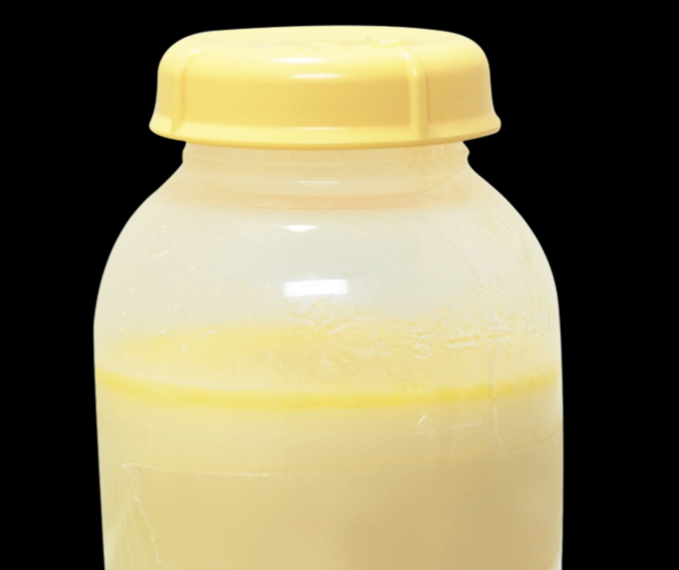
Feeding the Breastfed Baby
  Bottles should remain in the refrigerator until it is time to feed the baby.
  Feed a baby when they show signs of hunger.
  Gently swirl the breastmilk if needed. Do not shake.
Bottles of breastmilk should remain in the refrigerator until it is time to feed the baby. Babies should be fed when they show signs of being hungry. Talk with the parents about what signs their baby may show when he or she is hungry.
You may notice that breastmilk does not look or smell like infant formula. Breastmilk may look slightly blue, yellow, or even green in color and it may look thinner than formula. Breastmilk usually looks thin when the creamy part of the breastmilk has risen to the top, as shown in the circle on the slide.
If you see this separation, gently swirl the bottle to mix the layers. Do not shake. Shaking the breastmilk can destroy important nutrients in the breastmilk.
Notes:
Bottles of breastmilk should remain in the refrigerator until it is time to feed the baby. Babies should be fed when they show signs of being hungry. Talk with the parents about what signs their baby may show when they are hungry.
You may notice that breastmilk does not look or smell like infant formula. Breastmilk may look slightly blue, yellow, or even green in color and it may look thinner than formula. Breastmilk usually looks thin when the creamy part of the breastmilk has risen to the top, as shown in the circle on the slide.
If you see this separation, gently swirl the bottle to mix the layers. Do not shake. Shaking the breastmilk can destroy important nutrients in the breastmilk.

Slide 19
Preparing a Bottle of Breastmilk
A bottle of breastmilk does not have to be warmed before a feeding. If it is, it can be placed:
  under warm running water, or
  in a container of warm water
Never put infant cereal or other foods or beverages in the bottle.
You do not have to warm the bottle of breastmilk before serving it to the baby. However, if the baby prefers warm breastmilk be sure to warm it properly. The bottle of breastmilk can be warmed by placing it under warm running water or placing it in container of warm water immediately before serving. If you are serving the baby a bottle that has been warmed, make sure it is not too hot.
Do not put infant cereal or other food in the bottle. According to the American Academy of Pediatrics, putting cereal in the bottle can be a choking hazard. It can also cause the baby to gain weight too quickly. If infant cereal is mixed with breastmilk or infant formula, the child care site cannot claim the infant cereal or the breastmilk or infant formula in the bottle unless this practice is supported by a medical statement signed by the baby’s health care provider. The statement must be kept on file in a secure location at the child care site.
Notes:
You do not have to warm the bottle of breastmilk before serving it to the baby. However, if the baby prefers warm breastmilk be sure to warm it properly. The bottle of breastmilk can be warmed by placing it under warm running water or placing it in container of warm water immediately before serving. If you are serving the baby a bottle that has been warmed, make sure it is not too hot.
Do not put infant cereal or other food in the bottle. According to the American Academy of Pediatrics, putting cereal in the bottle can be a choking hazard. It can also cause the baby to gain weight too quickly. If infant cereal is mixed with breastmilk or infant formula, the child care site cannot claim the infant cereal or the breastmilk or infant formula in the bottle unless this practice is supported by a medical statement signed by the baby’s health care provider. The statement must be kept on file in a secure location at the child care site.
.

Slide 20

Bottle Feeding the Breastfed Baby
Hold the baby during feeding.
Brush the bottle’s nipple across the baby's upper lip.
Use a slow flow bottle
nipple and hold the bottle mostly sideways.
We have talked about storing breastmilk and preparing bottles, now let’s talk about how to bottle feed the breastfed baby.
Always hold the baby during feeding.
Do not prop the bottle up on a pillow or other item for the baby to feed him or herself. Propping a bottle may cause choking or suffocation, as well as ear infections and tooth decay.
Hold the baby in the cradle of your arm, so that he or she is almost upright.
This helps keep the baby secure and also lets you see if the baby is showing signs of hunger and fullness. This position can also help prevent the baby from choking or from getting too much liquid at once.
Once you have the baby positioned correctly, brush the nipple of the bottle across the baby’s upper lip.
Wait for the baby’s mouth to open before feeding.
It can be helpful to use a slow flow bottle nipple and hold the bottle mostly sideways.
This helps the baby control how much he or she eats and can reduce spit ups.
Notes:
We have talked about storing breastmilk and preparing bottles, now let’s talk about how to bottle feed the breastfed baby.
Always hold the baby during feeding.
Do not prop the bottle up on a pillow or other item for babies to feed themselves. Propping a bottle may cause choking or suffocation, as well as ear infections and tooth decay.
Hold the baby in the cradle of your arm, so that they are almost upright.
This helps keep the baby secure and also lets you see if the baby is showing signs of hunger and fullness. This position can also help prevent the baby from choking or from getting too much liquid at once.
Once you have the baby positioned correctly, brush the nipple of the bottle across the baby’s upper lip.
Wait for the baby’s mouth to open before feeding.
It can be helpful to use a slow flow bottle nipple and hold the bottle mostly sideways.
This helps the baby control how much they eat and can reduce spit ups.

Slide 21

Bottle Feeding the Breastfed Baby (Continued)
Burp the baby during natural breaks in the feeding.
Switch which arm you use to hold the baby throughout
the feeding.
Stop the feeding when the baby shows signs of fullness.
Notes:
Remember to burp the baby during the feeding. Burping can occur during natural breaks in the feeding or at the end of the feeding.
This can be done by gently patting or rubbing the baby’s back while they are resting on your shoulder or sitting on your lap.
It is also helpful to switch which arm you use to hold the baby.
Every so often during a feeding, switch the baby from one arm to the other so the baby has different things to look at. This can also help the baby continue to enjoy feeding on both sides; something that is important when breastfeeding.
Lastly, stop the feeding when the baby shows signs of fullness.
It is important to remember that babies feeding habits change and they may not always finish all of the breastmilk in the bottle. If the baby does not drink all of the breastmilk during the feeding, the leftover breastmilk should be discarded within 1-2 hours after the feeding or handled according to the parents wishes.

Slide 22
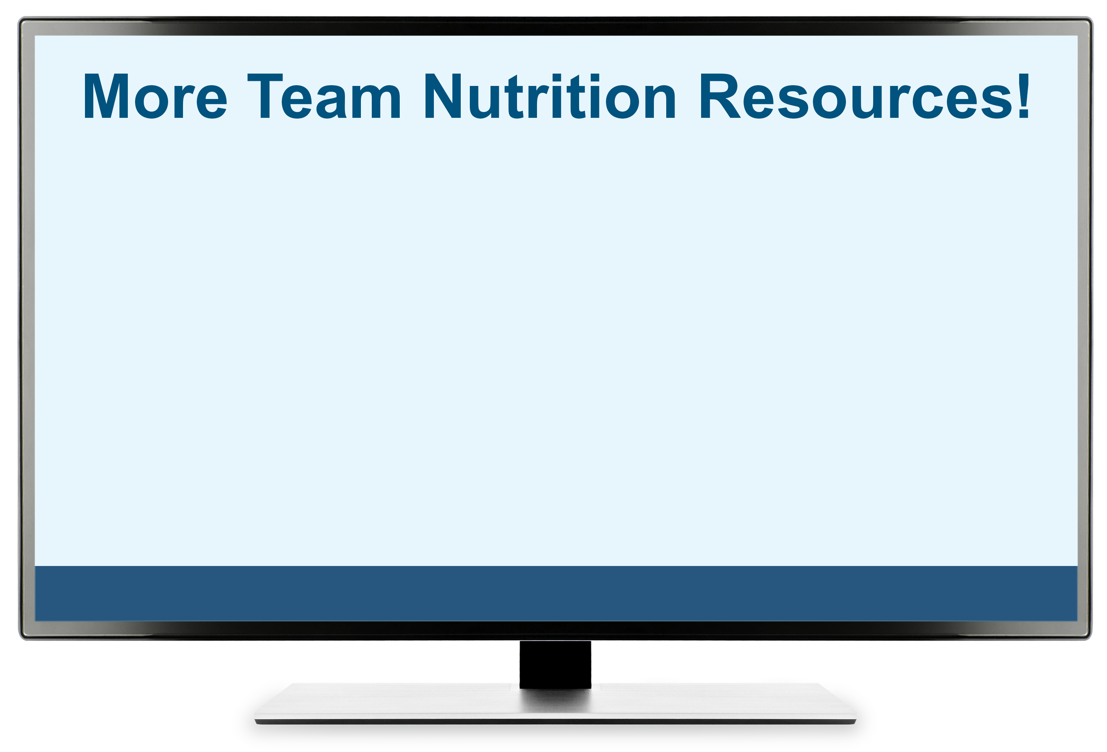
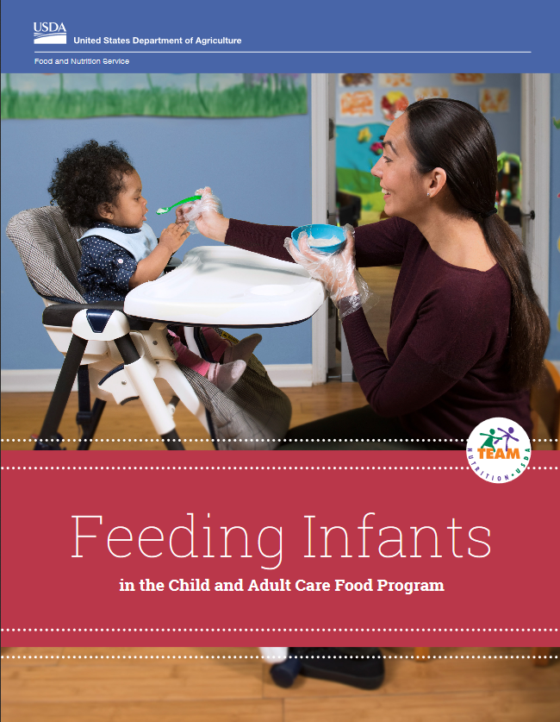

More Team Nutrition Resources
All Team Nutrition materials are available online from Team Nutrition’s website and are available for free download to anybody who is interested.
TeamNutrition.USDA.gov
Notes:
All Team Nutrition materials are available online from Team Nutrition’s website and are available for free download to anybody who is interested.

Slide 23

How To Order Print Copies
Resource Order Form at TeamNutrition.USDA.gov.
FREE for those participating in a USDA's Child Nutrition Program, while supplies last.
Sponsoring organizations and State agencies can also order in bulk by sending an email to:
TeamNutrition@USDA.gov
Notes:
For all participating in a USDA's Child Nutrition Program, such as the CACFP, Team Nutrition’s print materials are free to order.
If you would like to order Team Nutrition’s free materials in print, click "Order Team Nutrition Resources" on the Team Nutrition website.
For bulk orders, you can email teamnutrition@usda.gov.

Slide 24


Thank you!
These training slides were provided by U.S. Department of Agriculture's Team Nutrition. If you would like to learn more about Team Nutrition and additional resources available, please visit their website, subscribe to their monthly e-newsletter, connect with them via email at teamnutrition@usda.gov, and follow them on Twitter.
Thank you!
TeamNutrition.USDA.gov
@TeamNutrition
TeamNutrition@USDA.gov
USDA is an equal opportunity provider, employer, and lender.
Notes:
These training slides were provided by U.S. Department of Agriculture's Team Nutrition. If you would like to learn more about Team Nutrition and additional resources available, please visit their website, subscribe to their e-newsletter, connect with them via email at TeamNutrition@USDA.gov, and follow them on Twitter/X.
Thank you!

