Slide 1

Serving Snacks in the CACFP
A Training Presentation for
Child and Adult Care Food
Program (CACFP) Operators

Slide 2



USDA’s Team Nutrition
An initiative of the USDA’s Food and Nutrition Service to support the USDA’s Child Nutrition Programs.
Aims to improve children’s lifelong eating and physical activity habits.
Provides nutrition education and training materials to State agencies, sponsoring organizations, and CACFP sites.
TeamNutrition.usda.gov
@TeamNutrition
Notes:
Team Nutrition is an initiative of the USDA Food and Nutrition Service that supports the Child Nutrition Programs, including the National School Lunch Program, the School Breakfast Program, and of course, the Child and Adult Care Food Program, or the CACFP.
It does so through training and technical assistance for those preparing and serving meals, providing nutrition education for children, and building support for healthier school and child care environments.

Slide 3

Let Us Know Who You Are!
I work for a…
Child care center
Family child care home
At-risk afterschool care center
Adult day care center
Sponsoring organization
Emergency shelter
School food authority
State agency
USDA Regional Office
Other
Notes:
Before we get started, I want to know who has joined us today.
Please raise your hand if you work for
a child care center [pause and wait for a show of hands],
a family child care home [pause and wait for a show of hands],
an at-risk afterschool care center [pause and wait for a show of hands],
an adult day care center [pause and wait for a show of hands],
a sponsoring organization [pause and wait for a show of hands],
an emergency shelter [pause and wait for a show of hands],
a school food authority [pause and wait for a show of hands],
a State agency [pause and wait for a show of hands],
a USDA Regional office [pause and wait for a show of hands], or
other [pause and wait for a show of hands].

Slide 4
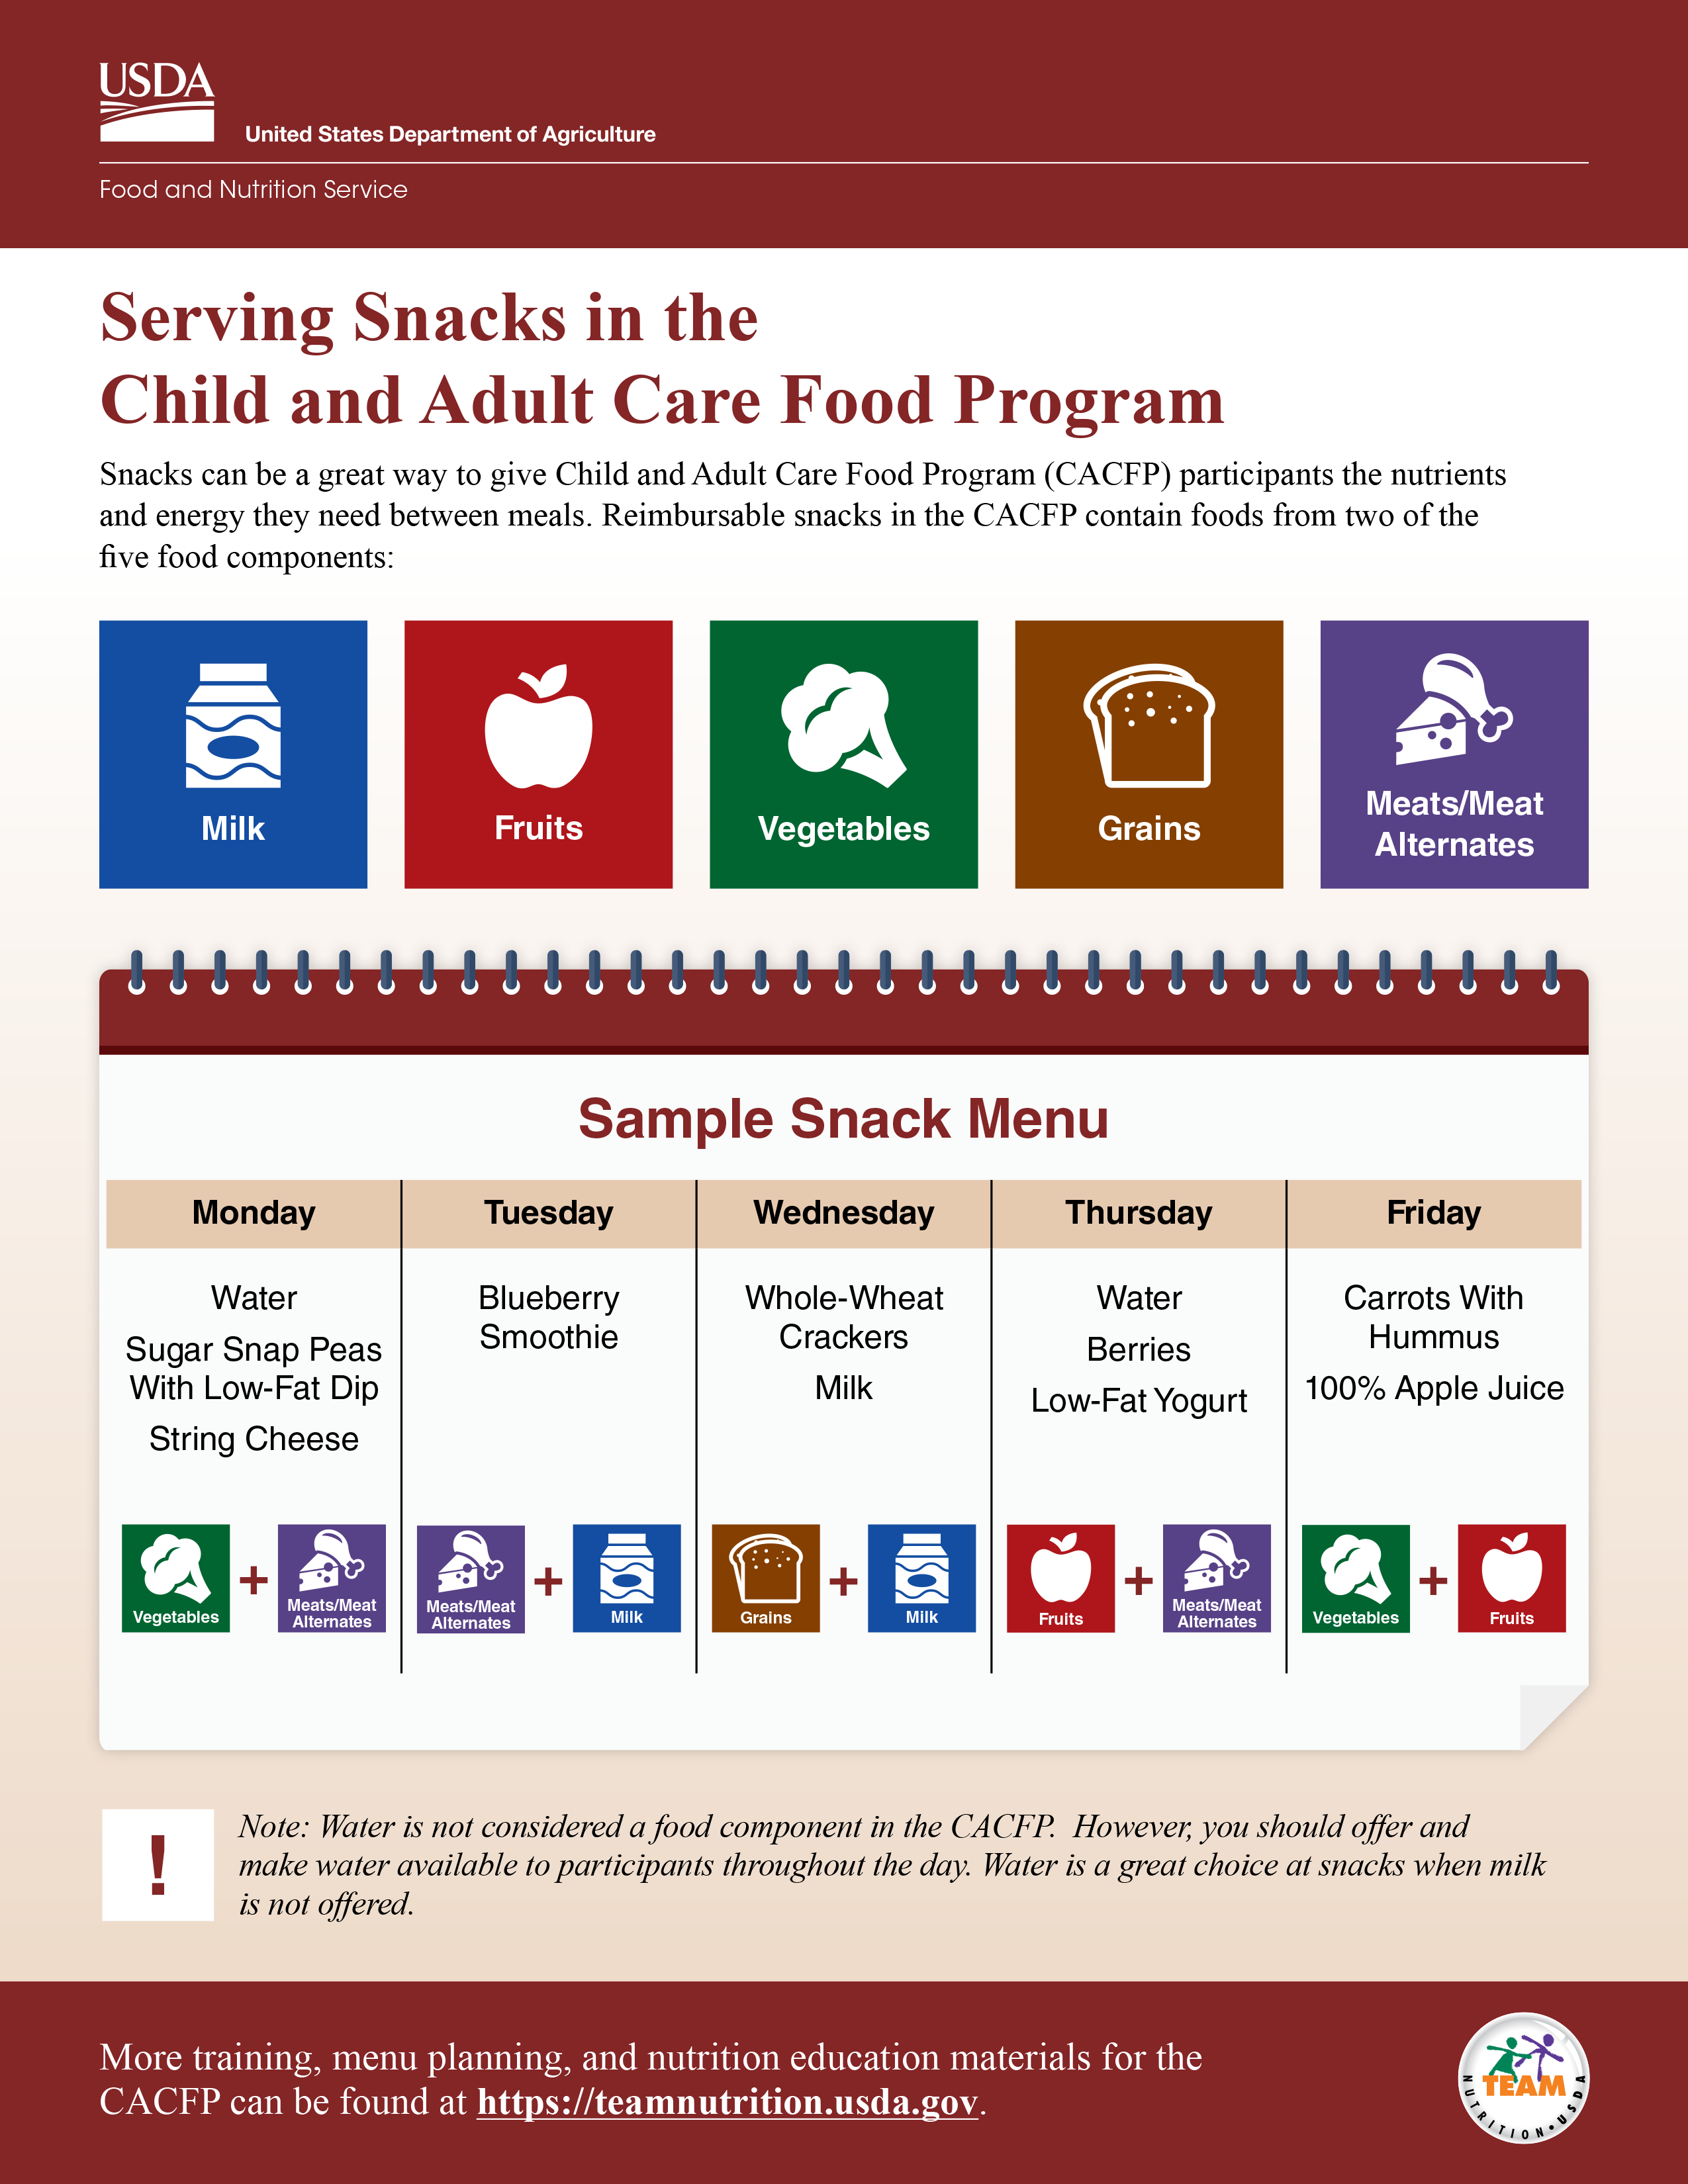







Serving Snacks in the CACFP
Sample Snack Menu
Monday | Tuesday | Wednesday | Thursday | Friday
Water Sugar Snap Peas With Low-Fat Dip String Cheese | Blueberry Smoothie | Whole-Wheat Crackers Milk | Water Berries Low-Fat Yogurt | Carrots With Hummus 100% Apple Juice
fns.usda.gov/tn/serving-snacks-cacfp
Notes:
Let’s get started! The information we are covering today comes from the USDA Team Nutrition initiative “Serving Snacks in the CACFP” training worksheet.
You can download the worksheet from the web address on the screen, if you’d like. You can also download the worksheet by scanning the QR code on the screen. To do this, open the camera or QR code reader on your smartphone if you have one and point your device at the QR code on the screen to scan. It will then either take you directly to the worksheet webpage or ask you to click the pop-up notification to take you to the worksheet webpage. Click the pop-up notification, if one appears, and you should be taken to the worksheet.
Or, you can also just follow along with the pictures shown on the slides.

Slide 5
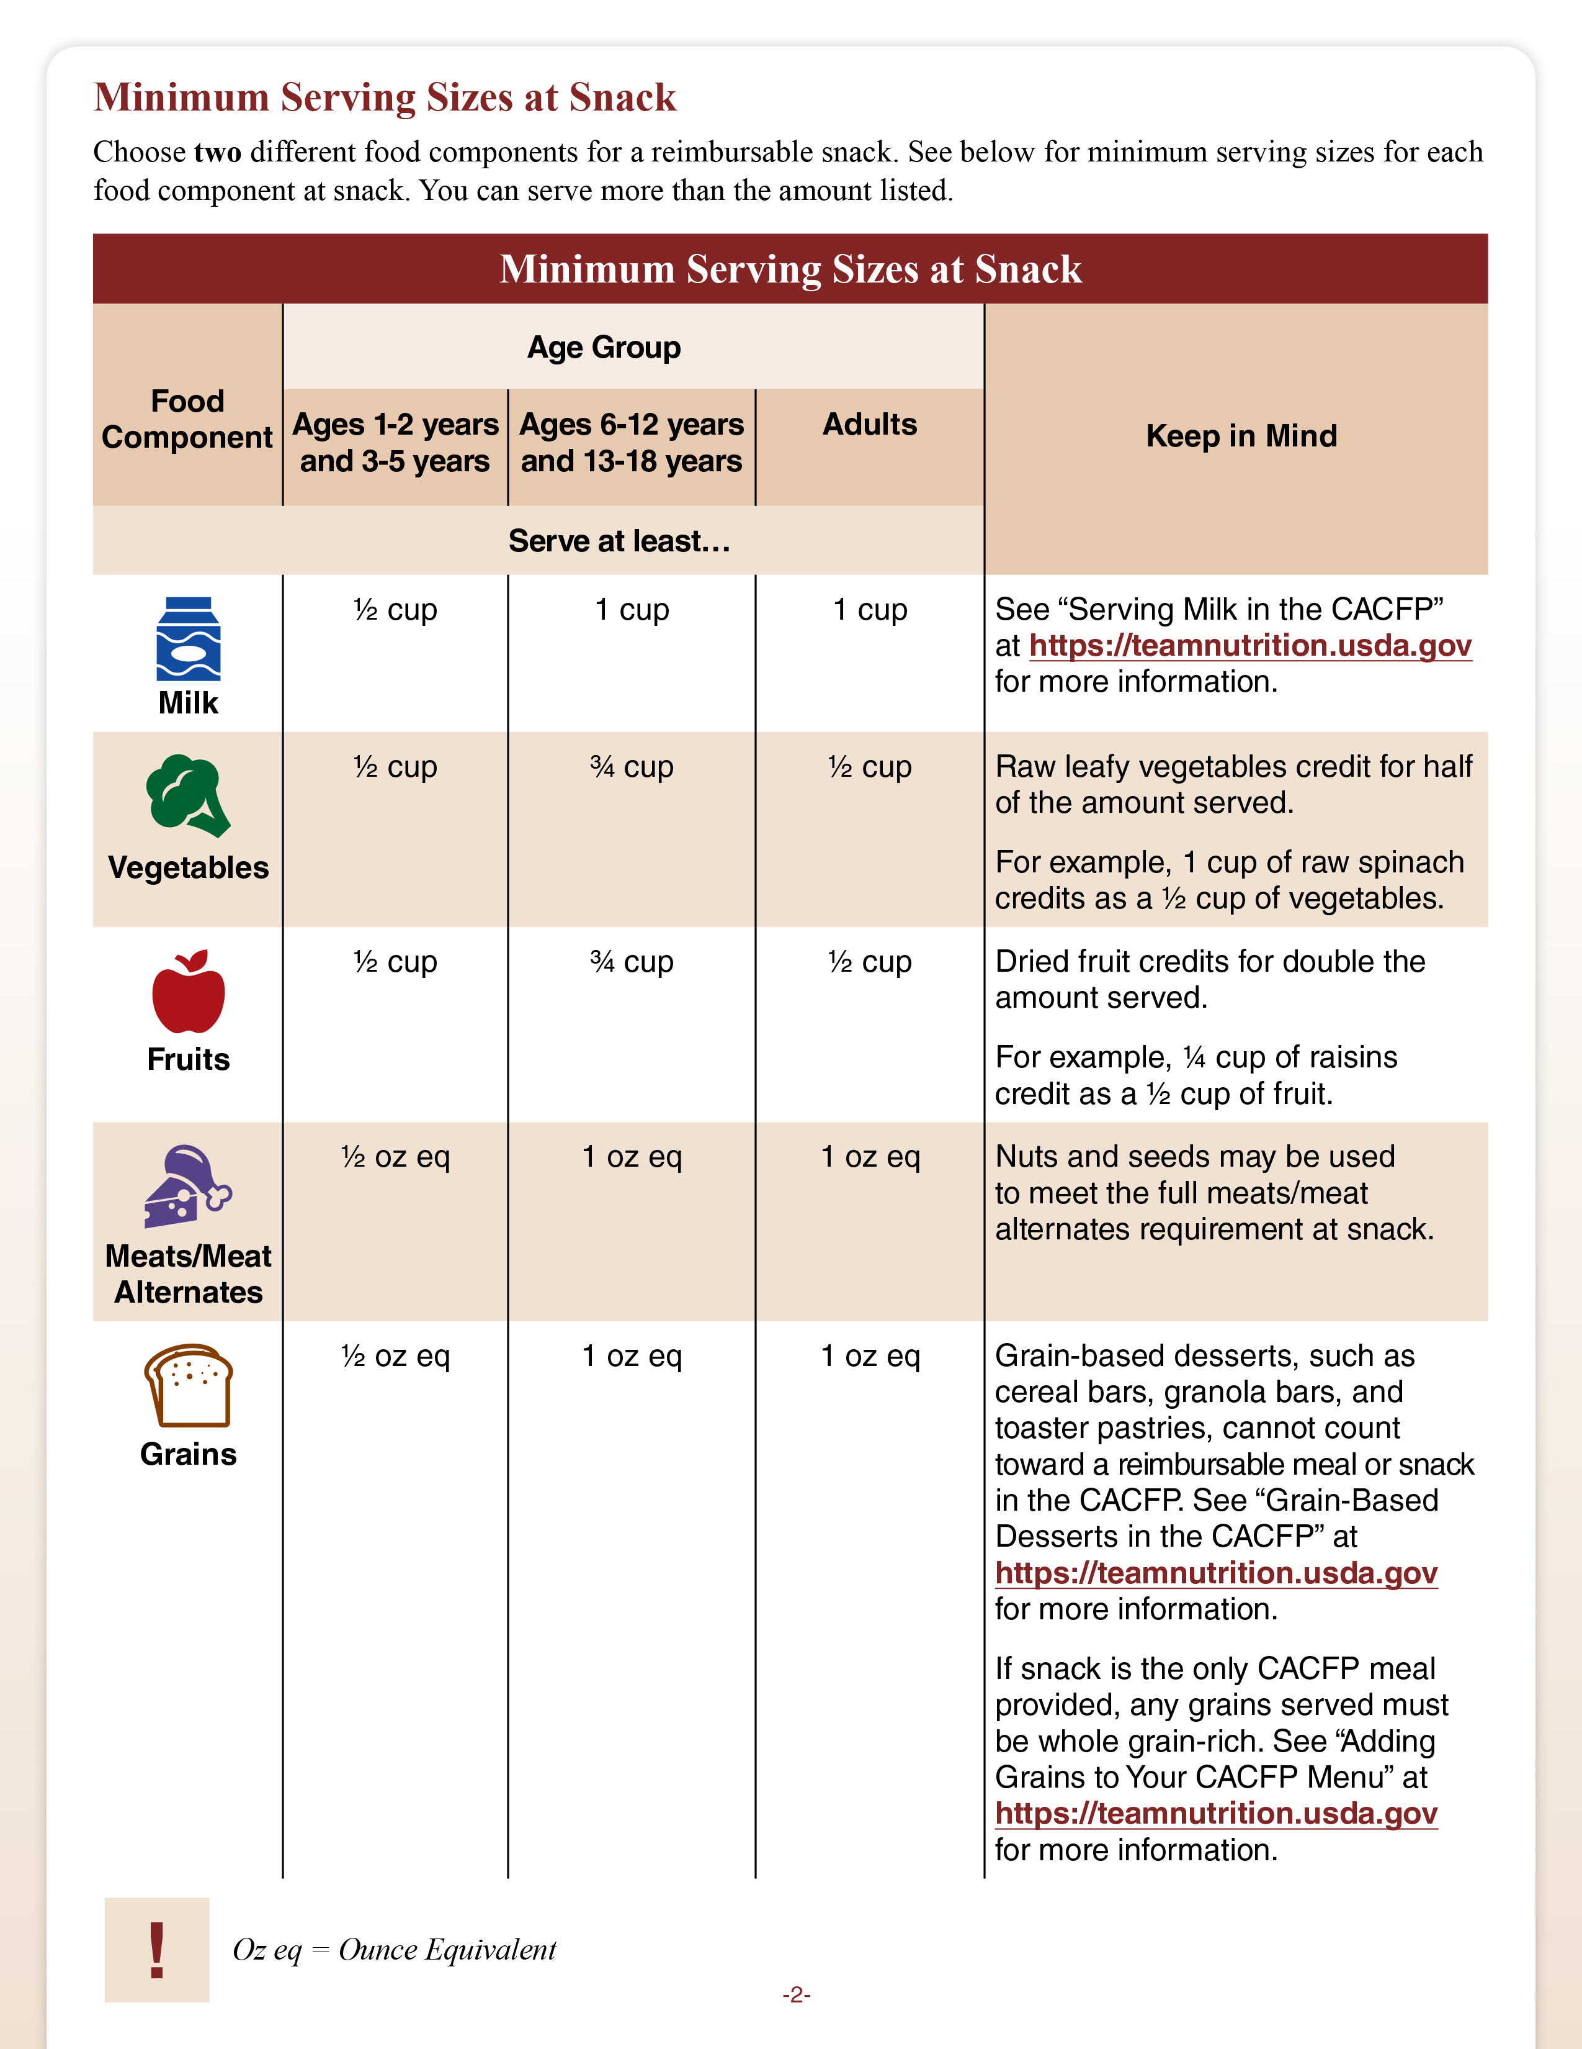
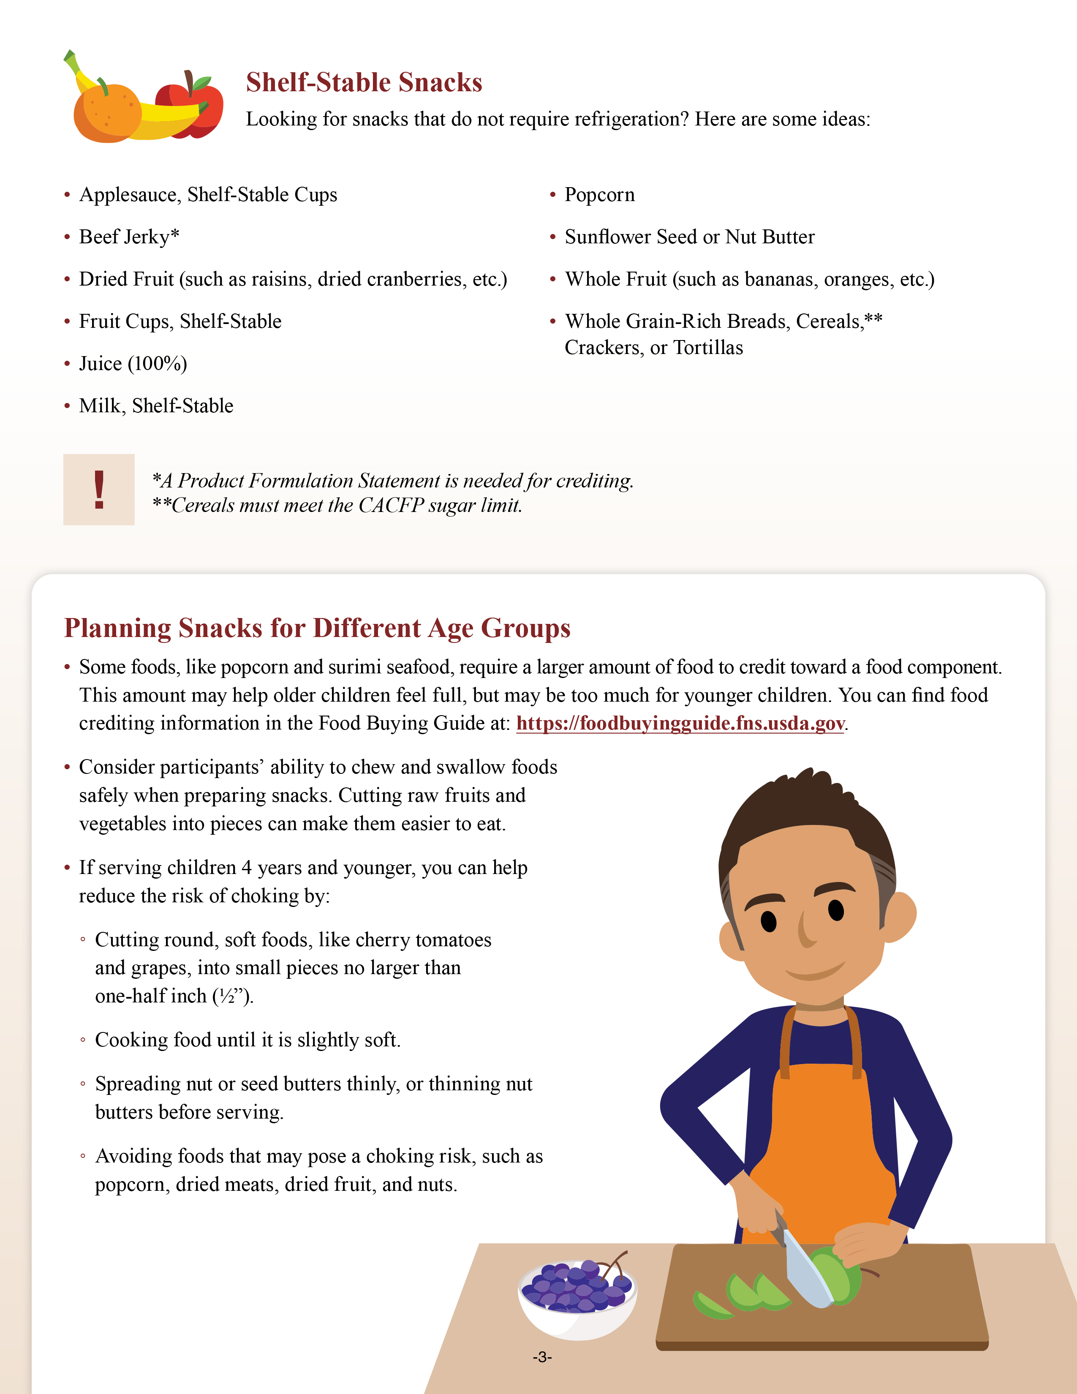
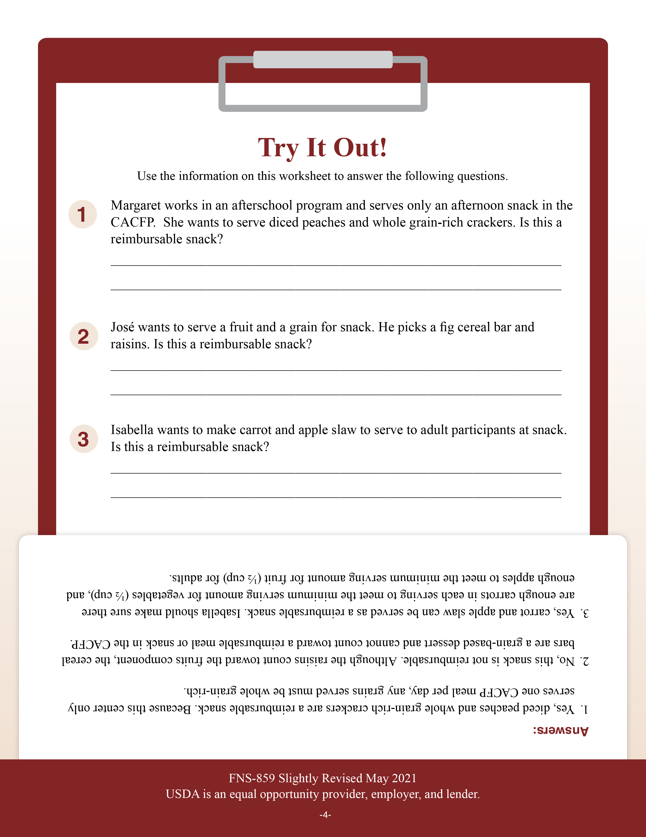
Serving Snacks in the CACFP (Cont.)
fns.usda.gov/team-nutrition/cacfp-meal-pattern-training-worksheets
Notes:
This slide shows the 4-page “Serving Snacks in the CACFP” worksheet.
The first page of the worksheet shows the five CACFP meal components and provides a sample 1-week snack menu.
The second page of the worksheet shows the minimum serving sizes for snack for the different age groups as well as adult program participants.
The third page provides tips to keep in mind when planning meals, such as suggestions for providing shelf-stable foods, texture modifications, and preparing foods to reduce the risk of choking.
The last page provides a “Try It Out!” section that gives you the opportunity to apply the knowledge you’ve learned from the worksheet.
We will go into this in greater detail throughout this presentation, so you may want to have the worksheet in front of you as we go along. Again, you can find the worksheet by going to the URL on the screen.

Slide 6
Serving Snacks in the CACFP (Cont.)
Promote intake of nutrient-dense foods.
Must contain food from two of the five meal components.
  Milk
  Fruits
  Vegetables
  Grains
  Meats/Meat Alternates
Must serve at least the minimum amount required for the age of the participant.
Notes:
Snacks can help kids and adults get the nutrition they need throughout the day from milk, fruits, vegetables, whole grains, and lean meats and meat alternates.
Reimbursable snacks in the CACFP must contain foods from two of the five meal components: milk, fruits, vegetables, grains, and meats/meat alternates.
Within each meal component are individual food items. For example, broccoli is a food item in the vegetables component.
In addition to needing foods from two different meal components, there are also different amounts required for each age group. These minimum serving sizes are shown on page 2 of the worksheet.
We will go through these now.

Slide 7
Required Snack Amounts in the CACFP
Children 1 through 5 Years of Age
½ cup
½ cup
½ cup
½ oz eq
½ oz eq
oz eq = ounce equivalent
Pick two meal components for a reimbursable snack.
Notes:
When serving a snack to a child 1 through 5 years of age, the minimum amounts required are ½ cup of milk, ½ cup of fruits, ½ cup of vegetables,
½ ounce equivalent (oz eq) of grains, and ½ ounce equivalent (oz eq) of meats/meat alternates. Again, you can pick any 2 out of these 5 meal components to make a reimbursable snack.

Slide 8
Required Snack Amounts in the CACFP (Cont.)
Children 6 through 18 Years of Age
1 cup
¾ cup
¾ cup
1 oz eq
1 oz eq
oz eq = ounce equivalent
Pick two meal components for a reimbursable snack.
Notes:
When serving a snack to a child 6 through 18 years of age, the minimum amounts required are 1 cup of milk, ¾ cup of fruits, ¾ cup of vegetables,
1 ounce equivalent (oz eq) grains, and 1 ounce equivalent (oz eq) of meats/meat alternates.
Just like with the 1 through 5 year olds, you can pick any 2 out of these
5 meal components to make a reimbursable snack.

Slide 9
Required Snack Amounts in the CACFP (Continued)
Adults
1 cup
½ cup
½ cup
1 oz eq
1 oz eq
oz eq = ounce equivalent
Pick two meal components for a reimbursable snack.
Notes:
When serving a snack to an adult participant, the minimum amounts required are 1 cup of milk, ½ cup of fruits, ½ cup of vegetables, 1 ounce equivalent
(oz eq) grains, and 1 ounce equivalent (oz eq) of meats/meat alternates.
Remember, you must pick two of these meal components to serve. The amounts listed for each age group are minimums. You must serve at least the minimum required amount for each age group to meet the meal pattern requirement. You can serve more but you cannot serve less.
The minimum serving sizes for each age group can be found on page 2 of the worksheet.

Slide 10



Sample Snack Combinations
Notes:
Because snacks in the CACFP are made up of only two different meal components, you can serve a variety of snack combinations throughout the week, month, and year.
One combination you could serve at snack might be a fruit and grain, such as strawberries and waffles. For each fruit and grain item, you want to make sure you are meeting the minimum serving requirements of each component for the age of the participant you are serving.

Slide 11
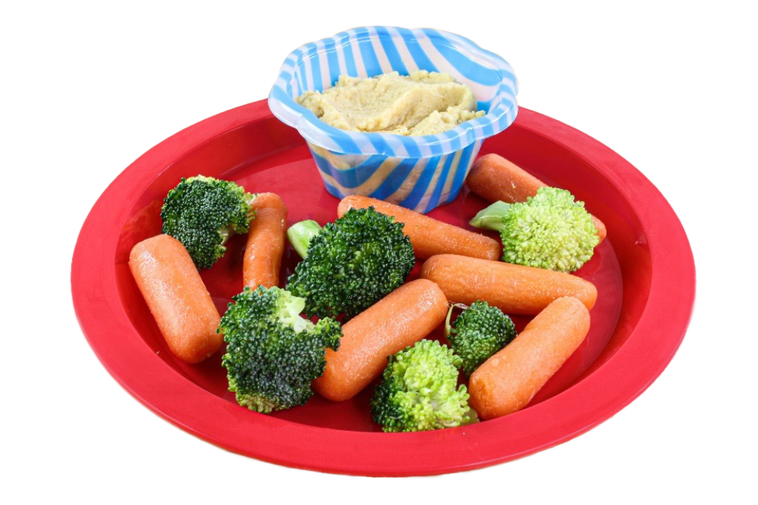
Sample Snack Combinations (Cont.)
Notes:
Another combination you could try might be a meat/meat alternate and a vegetable, such as yogurt or hummus dip and fresh vegetables.
Now, let's take a closer look at each of the five meal components.

Slide 12
Serving Milk in the CACFP
1 through 5 years of Age ½ cup
6 through 18 years of Age 1 cup
Adults
1 cup
The type of milk served must be included on all printed menus. This includes listing the fat content (low-fat [1%] or fat-free [skim]) and whether the milk is flavored.
Notes:
The first meal component we are going to look at is milk. The type and amount of milk you may serve depends on the age of the participant. Children
1 through 5 years of age should receive at least ½ cup of milk, children
6 through 18 years of age and adults should receive at least 1 cup of milk. All milk served in the CACFP must be pasteurized fluid milk that meets State and local standards.
It is also important to remember that the type of milk served must be included on all printed menus. This includes listing the fat content, such as low-fat
(1%) milk or fat-free (skim) milk, and whether the milk is flavored.

Slide 13
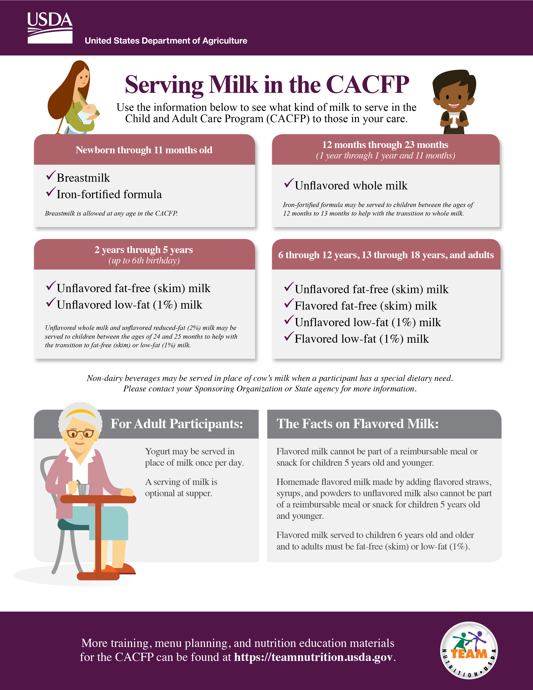

Serving Milk in the CACFP (Cont.)
Other Creditable Types of Milk
Lactose-reduced milk
Lactose-free milk
Buttermilk
Acidified milk
Ultra-High Temperature (UHT) milk
Goat’s milk
  Must meet State standards
fns.usda.gov/tn/serving-milk-cacfp
Notes:
As a reminder, in the CACFP, creditable milk for children two years of age and older and adults includes lactose-reduced milk, lactose-free milk, buttermilk, acidified milk, and ultra-high temperature (UHT) milk, which is often referred to as shelf-stable milk.
Additionally, goat’s milk may be served in place of cow’s milk if it meets State standards for fluid milk. If goat’s milk meets State standards, no additional documentation is needed.
For more information on the types of milk allowed, see the worksheet “Serving Milk in the CACFP” located at the web address on the slide.

Slide 14

The Milk Component at Snack
Things
to
Remember
You cannot serve milk and juice as a snack.
Milk used to make smoothies can credit at snack.
Milk used to make foods other than smoothies do not credit at snack.
  Example: milk in soups does not credit.
Canned milk or powdered milk may credit in special situations.
Notes:
When serving milk as a snack in the CACFP there are a few things you need to remember.
If you serve milk as one of the components at snack, you may not serve juice as the other component.
Milk used to make smoothies can credit at snack. However, milk used as an ingredient in foods other than smoothies, such as cream soups or dips, cannot credit toward a reimbursable meal or snack in the CACFP.
Lastly, canned milk or powdered milk may credit toward a reimbursable meal or snack in special situations. Contact your State agency or sponsoring organization for more information.

Slide 15
Try It Out!
You are serving a snack to 4-year-olds. Which snack is not reimbursable?
½ cup of milk* and ½ cup peaches
½ cup milk* and ½ cup 100% juice
½ cup milk* and ½ oz eq whole
grain-rich crackers
½ cup milk* and ½ oz eq string cheese
*The type of milk served is appropriate for the age of the child.
Notes:
Let's practice planning a snack with milk with this practice question. You may want to use the chart on page 2 of the “Serving Snacks in the CACFP” worksheet to help you answer this question.
This question says, “You are serving a snack to 4-year-olds. Which snack
is not reimbursable?” Assume you are serving the correct type of milk for the age of the child.
Raise your hand if you think the answer is:
½ cup of milk and ½ cup of peaches [pause and wait for a show of hands],
½ cup milk and ½ cup 100% juice [pause and wait for a show of hands],
½ cup milk and ½ oz eq whole grain-rich crackers [pause and wait for a show of hands], or
½ cup milk and ½ oz eq string cheese [pause and wait for a show of hands].

Slide 16

Answer
You are serving a snack to 4-year-olds. Which snack is not reimbursable?
½ cup of milk* and ½ cup peaches
½ cup milk* and ½ cup 100% juice
½ cup milk* and ½ oz eq whole
grain-rich crackers
½ cup milk* and ½ oz eq string cheese
*The type of milk served is appropriate for the age of the child.
Notes:
Great job everyone, the answer is ½ cup milk and ½ cup 100% juice. You cannot serve milk and juice together as a reimbursable snack.
All of the other snack options shown on the slide could be served as a reimbursable snack for a child 1 through 5 years of age. They contain two different meal components and provide the correct serving amounts.
Now, let’s talk about fruits and vegetables at snack.

Slide 17
Serving Vegetables and Fruits at Snack
1 through 5 years of Age ½ cup
6 through 18 years of Age ¾ cup
Adults
½ cup
Notes:
If you are serving vegetables at snack, children 1 through 5 years of age should receive at least a ½ cup of vegetables, children 6 through 18 years of age should receive at least a ¾ cup of vegetables, and adults should receive at least a ½ cup of vegetables.
These minimum serving amounts for vegetables can also be found on page 2 of the worksheet.
To meet the CACFP meal pattern requirements, you can serve fresh, frozen, dried, commercially canned vegetables and fruits, and 100% full-strength vegetable or fruit juice. When serving canned vegetables, choose low-sodium or no-added salt options. Try not to offer vegetables that are in cream sauces or gravies. For added flavor, try seasoning vegetables with herbs and spices.

Slide 18
Serving Vegetables and Fruits at Snack (Cont.)
1 through 5 years of Age ½ cup
6 through 18 years of Age ¾ cup
Adults
½ cup
Notes:
Fruits and vegetables are two separate components at CACFP lunches, suppers, and snacks. This allows a lot of flexibility and creativity when it comes to menu planning. It also increases the amount of vegetables and fruits you can offer program participants.
As shown on the slide and on page 2 of the worksheet, if you are serving fruits as part of a reimbursable snack, children 1 through 5 years of age should receive at least a ½ cup of fruit, children 6 through 18 years of age should receive at least a ¾ cup of fruit, and adults should receive at least a ½ cup of fruit.
When serving canned fruits try to choose fruits that are canned in water or juice instead of in syrup.

Slide 19
Serving Vegetables and Fruits at Snack (Cont.)
Vegetables and fruits credit toward the meal pattern based on volume served.
The smallest amount of vegetables or fruits that can credit is ⅛ cup or 2 tablespoons.
Notes:
Vegetables and fruits credit toward the meal pattern based on volume served. For example, if you serve a ½ cup of apples, that would count as a ½ cup of fruit. If you serve a ¼ cup of sliced cucumbers, that would count as a ¼ cup of vegetables.
The smallest amount of vegetables and fruits that can credit at any CACFP meal or snack for children and adult participants is an ⅛ cup (2 tablespoons). A serving of vegetables or fruits that is less than an ⅛ cup may not credit toward a reimbursable meal or snack for children and adult participants.
There are some exceptions to this rule.

Slide 20
Serving Vegetables and Fruits at Snack (Continued)
Exceptions:
Raw leafy green vegetables credit for half of the amount served.
  1 cup of raw spinach credits as ½ cup of vegetables.
Dried vegetables and fruits credit as twice the amount served.
  ½ cup of dehydrated mushrooms credits as
  1 cup of vegetables.
  ¼ cup of raisins credits as ½ cup of fruit.
Notes:
Raw, leafy green vegetables credit for half of the amount served. For example, 1 cup of raw spinach credits as ½ cup of vegetables.
Dried vegetables and fruits credit as twice the amount served. For example,
½ cup of dehydrated mushrooms credit as 1 cup of vegetables and ¼ cup of raisins credit as ½ cup of fruit.

Slide 21
Serving Vegetables and Fruits at Snack (Cont.)
To credit vegetables or fruits toward a reimbursable meal or snack you must be able to recognize it in the item you are serving.
Exceptions:
Pasta made from
100% vegetable flour
Vegetables and fruits included in smoothies
Notes:
To credit vegetables and fruits toward a reimbursable meal or snack you must be able to recognize it in the item you are serving. For example, pureed pumpkin in pumpkin bread or applesauce in a muffin is not creditable because you cannot see the pureed pumpkin or applesauce in the baked item.
However, if the muffin contained applesauce and raisins, then both the applesauce and raisins may credit toward the fruit component. Since the raisins in the muffin are a recognizable fruit, you can credit both the raisins and the applesauce toward the fruit component.
Be aware, there are two exceptions to this rule. Pasta made from 100% vegetable flour credits as a vegetable even if it is not served with another vegetable. Vegetables and fruits included in smoothies may credit toward the vegetable or fruit component as juice.

Slide 22
Serving Vegetables and Fruits at Snack (Cont.)
Things
to
Remember
You may only serve 100% full-strength vegetable
or fruit juice once per day.
You may not serve both 100% full-strength vegetable
or fruit juice and milk together as a reimbursable snack.
Legumes (beans, peas, and lentils) can credit as meats/meat alternates or vegetables, however, they cannot credit as both in the same meal or snack.
Fruits and vegetables canned in the home may not count as part of a reimbursable meal or snack.
Condiments, such as fruit jams and ketchup, cannot count toward a reimbursable meal or snack.
Notes:
There are a few other things you need to remember when serving vegetables and fruits at snack.
If you serve juice at snack, you may not count fruit or vegetable juice as part of a reimbursable breakfast, lunch, or supper the same day. You may only serve juice once per day. Additionally, you may not serve both 100%
full-strength vegetable or fruit juice and milk together as a reimbursable snack.
Legumes, (beans, peas, and lentils) can credit as meats/meat alternates or vegetables, however, they cannot credit as both a meat/meat alternate and a vegetable in the same meal or snack. If you choose to serve two different cooked legumes at a meal or snack you may choose to credit one as a meat alternate and the other as a vegetable, if you serve the minimum creditable amount of each. For example, you can serve roasted garbanzo beans and roasted soybeans and credit one as a vegetable and the other as a meat/meat alternate.
Fruits and vegetables canned in the home may not credit as part of a reimbursable meal or snack.
Lastly, condiments, such as fruit jams and ketchup, cannot count toward a reimbursable meal or snack.

Slide 23
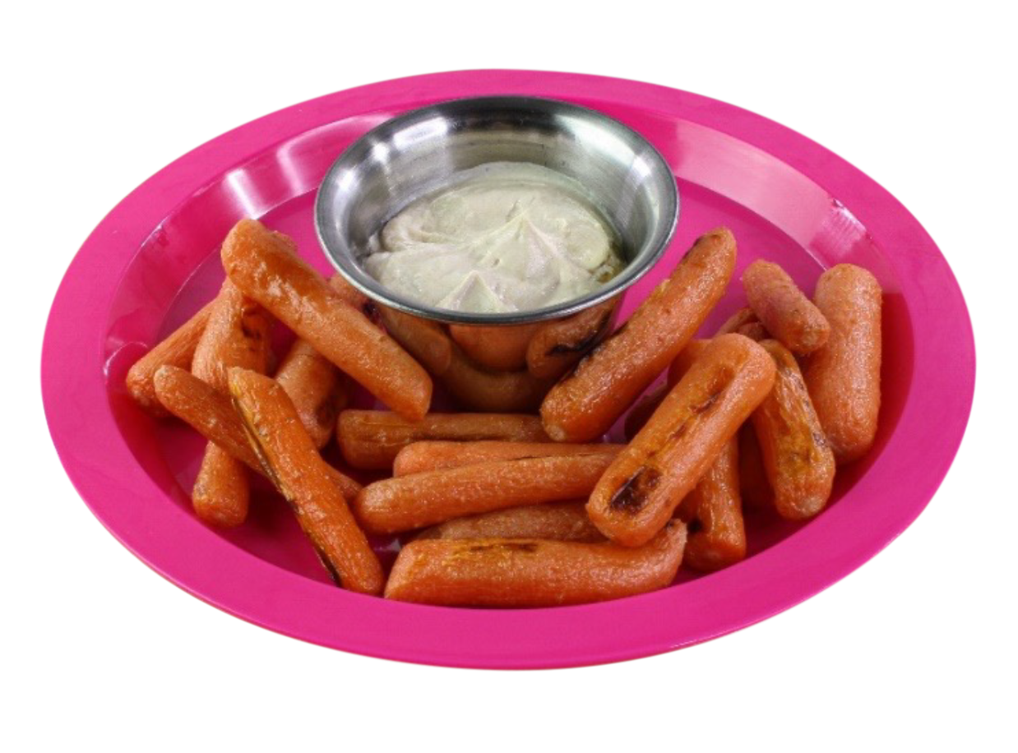
Try It Out!
You are serving a snack to 9-year-olds. Which snack is not reimbursable?
¾ cup orange juice and ¾ cup baked carrot fries
¾ baked sweet potato and ¾ cup apple juice
¾ cup watermelon and ¾ cup cucumber slices
¾ cup cherry tomatoes
and ½ cup peaches
Notes:
Now, let's practice planning a snack containing fruits and vegetables. You may want to use the chart on page 2 of the “Serving Snacks in the CACFP” worksheet to help you answer this question.
This question says, “You are serving a snack for 9-year-olds. Which snack
is not reimbursable?”
Raise your hand if you think the answer is:
¾ cup orange juice and ¾ cup baked carrot fries [pause and wait for a show of hands],
¾ cup baked sweet potato and ¾ cup apple juice [pause and wait for a show of hands],
¾ cup watermelon and ¾ cup cucumber slices [pause and wait for a show of hands], or
¾ cup cherry tomatoes and ½ cup of peaches [pause and wait for a show of hands].

Slide 24

Try It Out!
You are serving a snack to 9-year-olds. Which snack is not reimbursable?
¾ cup orange juice and ¾ cup baked carrot fries
¾ baked sweet potato and ¾ cup apple juice
¾ cup watermelon and ¾ cup cucumber slices
¾ cup cherry tomatoes
and ½ cup peaches
Notes:
Great job everyone, the answer is ¾ cup cherry tomatoes and ½ cup peaches. This snack does not meet the meal pattern requirement for a child 6 through 18 years of age, because it does not provide the minimum amount of fruits. You would need to serve at least ¾ cup of cherry tomatoes and at least ¾ cup of peaches.
All of the other snack options shown on the slide could be served as a reimbursable snack for a child 6 through 18 years of age. They contain two different meal components and provide the correct serving amounts.
Now, let’s talk about serving meats and meat alternates at snack.

Slide 25
Serving Meats and Meat Alternates at Snack
1 through 5 years of Age ½ oz eq
6 through 18 years of Age 1 oz eq
Adults
1 oz eq
oz eq = ounce equivalent
Notes:
Meats and meat alternates include meats, poultry, fish, eggs, legumes (beans, peas, and lentils), nuts and nut butters, soy, and products made from milk such as cheese, yogurt, and cottage cheese. Meats and meat alternates are measured by weight and use ounce equivalents (oz eq) as the unit of measure.
When serving meats or meat alternates at snack, children 1 through 5 years of age should receive at least a ½ ounce equivalent (oz eq) of meats/meat alternates. Children 6 through 18 years of age and adults should receive at least 1 ounce equivalent (oz eq) of meats/meat alternates.

Slide 26
Serving Meats and Meat Alternates at Snack (Cont.)
Meats/meat alternates are measured as oz eq.
The smallest amount of meats/meat alternates that can credit toward a reimbursable meal or snack is a ¼ oz eq.
Use the “Food Buying Guide for Child Nutrition Programs” to see the amount of meats/meat alternates needed to meet meal pattern requirements.
Notes:
Again, meats/meat alternates are measured as ounce equivalents (oz eq).
The smallest amount of meats/meat alternates that can credit toward a reimbursable meal or snack is a ¼ ounce equivalent (oz eq). Use the “Food Buying Guide for Child Nutrition Programs” to see the amount of meats/meat alternates needed to meet the meal pattern requirements. For some foods, you may need to serve more or less than 1 ounce of the food to credit as
1 ounce equivalent (oz eq). For instance, it takes 4 ounces (oz) of yogurt to make up 1 ounce equivalent (oz eq) of a meat alternate. In contrast, you only need to serve a ¼ cup of cottage cheese for 1 ounce equivalent (oz eq) of a meat alternate.
For some meats/meat alternates, you may need a Child Nutrition label (CN label) or Product Formulation Statement (PFS) to see how much you need to credit toward a reimbursable snack.

Slide 27
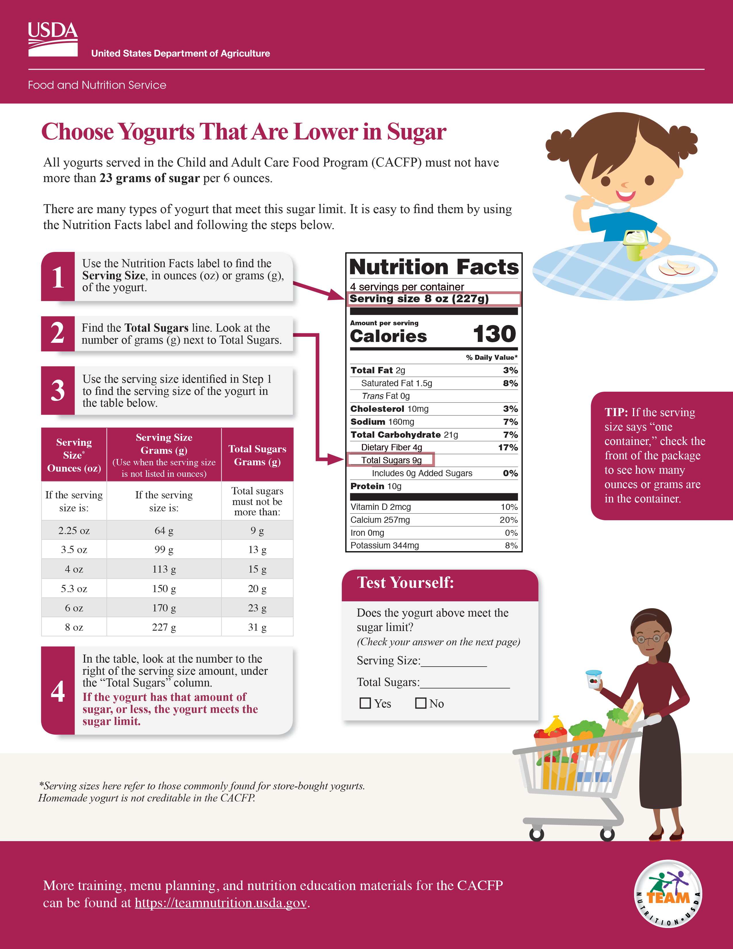

Serving Meats and Meat Alternates at Snack (Cont.)
Things
to
Remember
Nuts and seeds can be used to meet the entire
meats/meat alternates requirement at snack.
Yogurt served as part of a reimbursable meal or
snack must be:
  store-bought (commercially prepared)
  made from cow’s milk or soymilk
  contain no more than 23 grams of total sugars per 6 ounces.
Legumes (beans, peas, and lentils) can credit as meats/meat alternates or vegetables.
fns.usda.gov/tn/choose-yogurts-are-lower-sugar
Notes:
There are a few things you need to remember when serving meats/meat alternates at snack.
At snack, nuts and seeds can be used to meet the entire meats/meat alternates requirement.
Yogurts that are part of a reimbursable meal or snack must be store-bought (commercially prepared), made from cow’s milk or soymilk, and contain no more than 23 grams of total sugars per 6 ounces. For more information on serving yogurts, see the Team Nutrition training worksheet, “Choose Yogurts That Are Lower in Sugar” on the Team Nutrition website at the web address shown on the slide.
Again, legumes (beans, peas, and lentils) can credit as meats/meat alternates or vegetables but not as both in the same meal or snack. Some beans and peas such as lima beans, green peas, snap peas, and string beans are fresh, immature beans and peas. They can credit toward a reimbursable meal or snack as a vegetable, but not as a meat/meat alternate.

Slide 28
Serving Meats and Meat Alternates at Snack (Cont.)
Things
to
Remember
Pasta made from 100% legume flour must be offered with additional meats/meat alternates.
Cheese that is part of a reimbursable meal or snack must:
  be pasteurized natural or processed cheese.
  have a CN label or PFS if it is a cheese sauce.
Imitation cheese and cheese product cannot count toward a reimbursable meal or snack.
Notes:
If you are crediting pasta made from 100% legume flour as a meat/meat alternate, you must offer it with additional meats/meat alternates.
Lastly, cheese that is part of a reimbursable meal or snack must be pasteurized natural or processed cheese. Cheese sauce can be part of a reimbursable meal or snack if it has a Child Nutrition label (CN label) or Product Formulation Statement (PFS). You may not serve imitation cheese or cheese product as part of a reimbursable meal or snack.

Slide 29
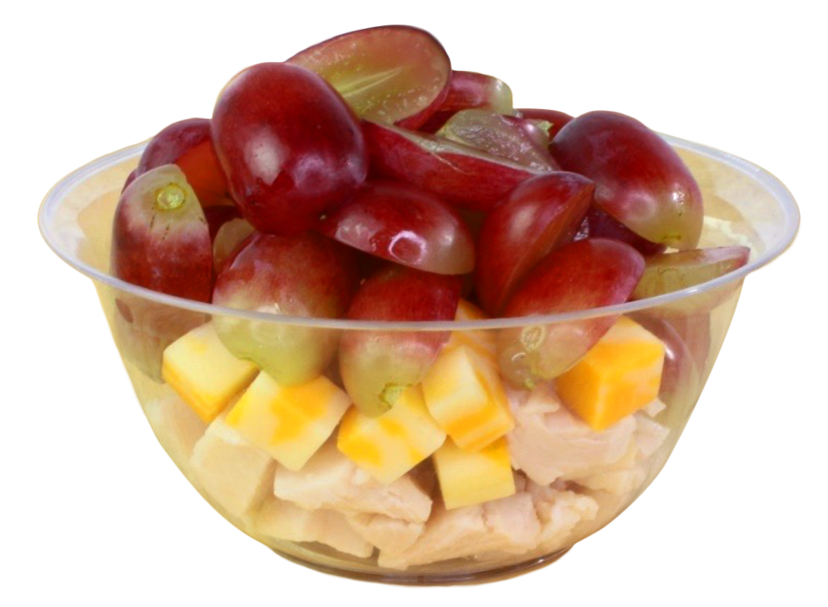
Try It Out!
You are serving a snack to an adult. Which snack is not reimbursable?
Chicken and cheese snack cup with grapes (1 oz eq m/ma and ½ cup fruit)
¾ oz eq yogurt and ½ cup mixed fruit
1 oz eq hummus and ½ cup snap peas
1 oz eq (2 Tbsp) almond butter
and ½ cup apple slices
Notes:
Let's do another practice question. You may want to use the chart on page 2 of the “Serving Snacks in the CACFP” worksheet to help you answer this question.
This question says, “You are serving a snack to an adult participant. Which snack is not reimbursable?”
Raise your hand if you think the answer is:
Chicken and cheese snack cup with grapes (made with 1 oz eq m/ma and ½ cup fruit) [pause and wait for a show of hands],
¾ oz eq yogurt and ½ cup mixed fruit [pause and wait for a show of hands],
1 oz eq hummus and ½ cup snap peas [pause and wait for a show of hands], or
1 oz eq (2 Tbsp) almond butter and ½ cup apple slices [pause and wait for a show of hands].

Slide 30

Answer
You are serving a snack to an adult. Which snack is not reimbursable?
Chicken and cheese snack cup with grapes (1 oz eq m/ma and ½ cup fruit)
¾ oz eq yogurt and ½ cup mixed fruit
1 oz eq hummus and ½ cup snap peas
1 oz eq (2 Tbsp) almond butter
and ½ cup apple slices
Notes:
Great job everyone, the correct answer is ¾ ounce equivalent yogurt and
½ cup of mixed fruit. This snack does not provide the minimum serving amount for each meal component. You need to serve at least 1 oz eq meats/meat alternates.
All of the other snack options shown on the slide could be served as a reimbursable snack for an adult. They contain two different meal components and provide the correct serving amounts.
Now, let’s talking about serving grains at snack.

Slide 31

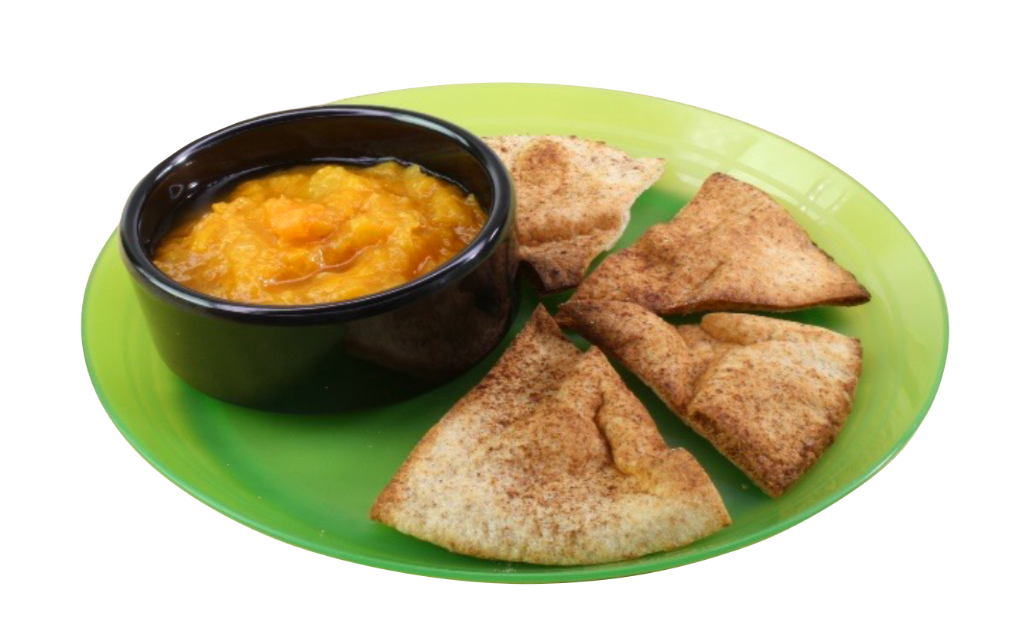

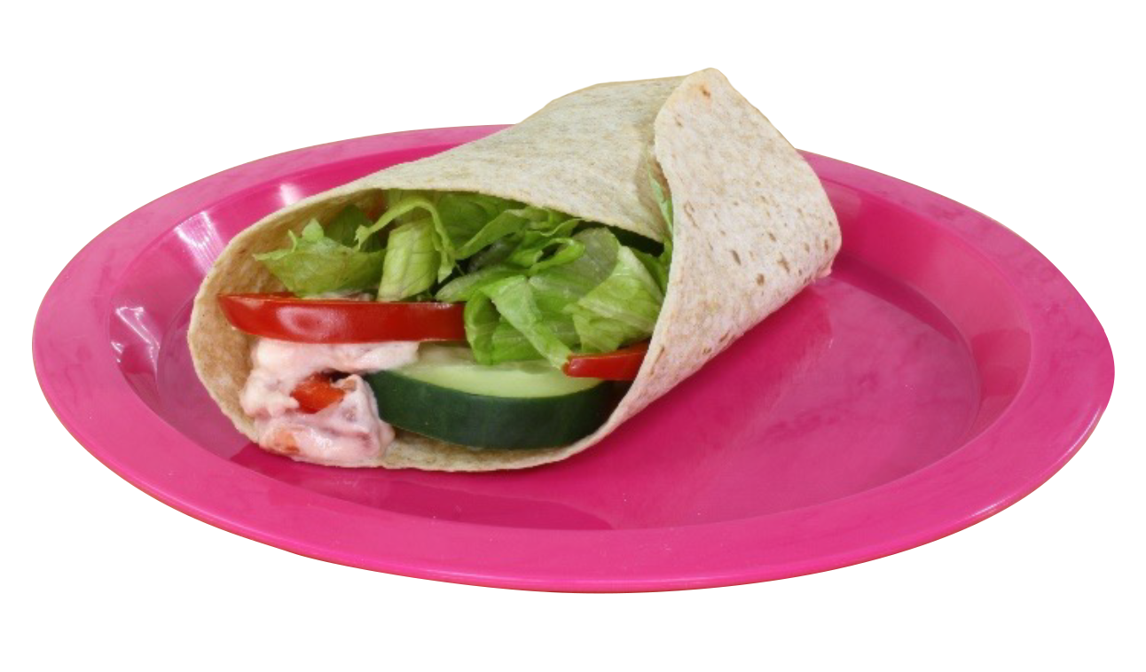
Serving Grains at Snack
Notes:
Grains served in the CACFP must be enriched, fortified, or whole grain-rich. Whole grain-rich means that at least half the grain ingredients in the food are whole grains and any remaining grains are enriched grains, bran, or germ.

Slide 32
Serving Grains at Snack (Cont.)
1 through 5 years of Age ½ oz eq
6 through 18 years of Age 1 oz eq
Adults
1 oz eq
oz eq = ounce equivalent
Notes:
Children 1 through 5 years of age must receive at least ½ ounce equivalent (oz eq) grains, and children 6 through 18 years of age and adults must receive at least 1 ounce equivalent (oz eq) grains.
These minimum serving amounts for grains can also be found on page 2 of the worksheet.

Slide 33
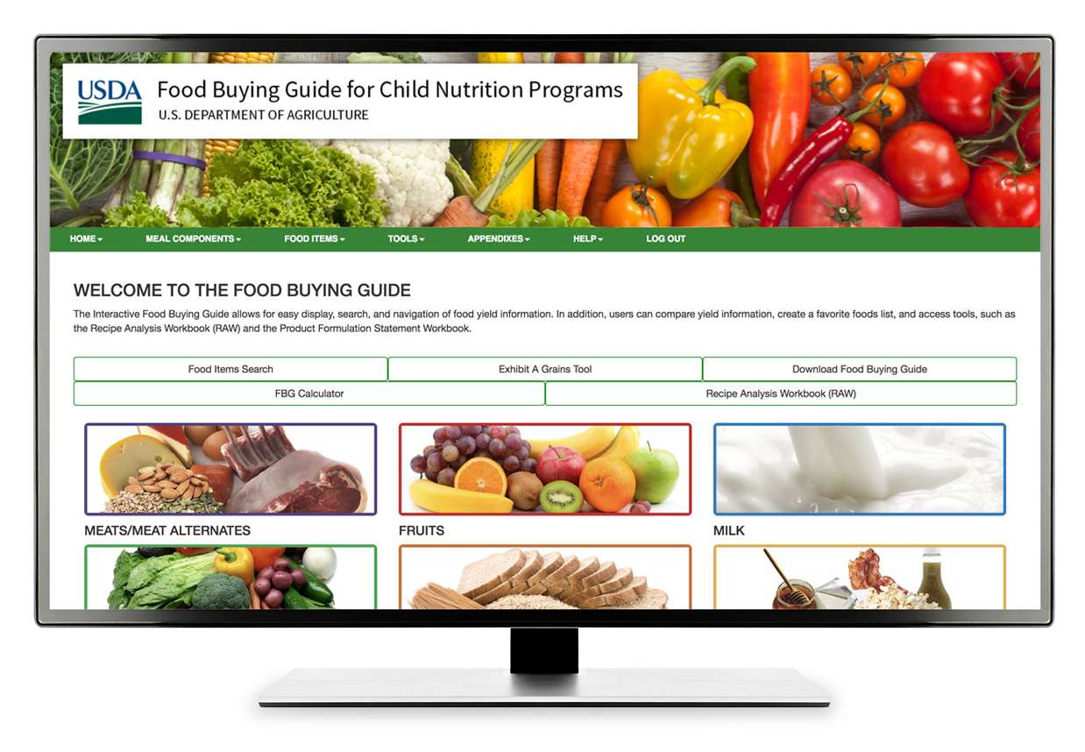
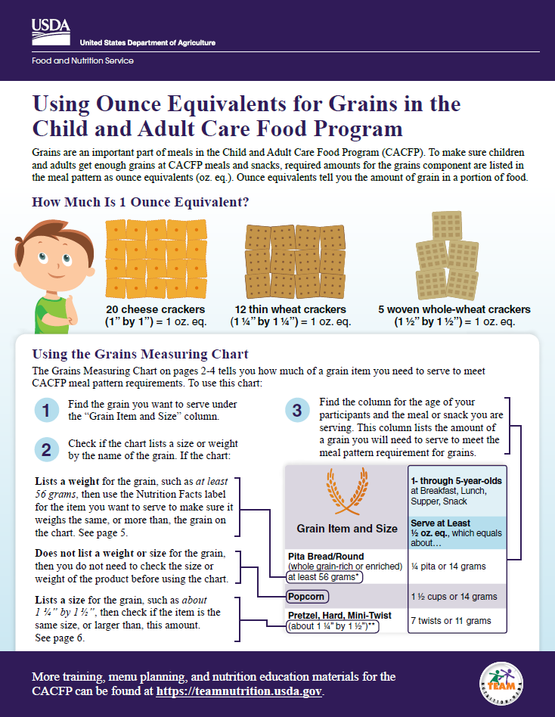
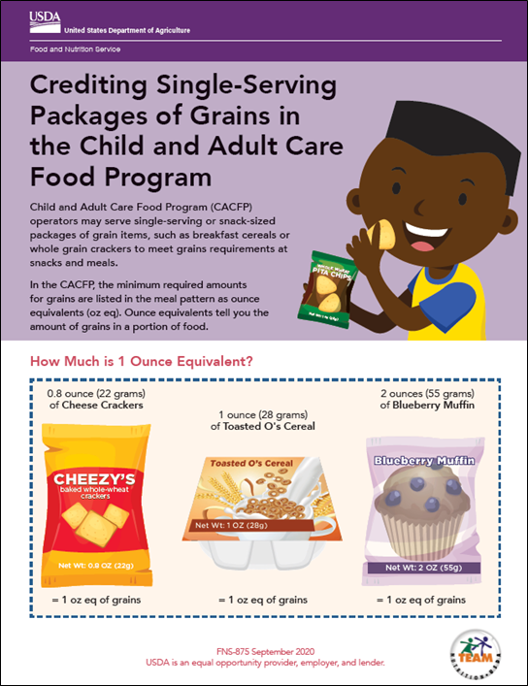
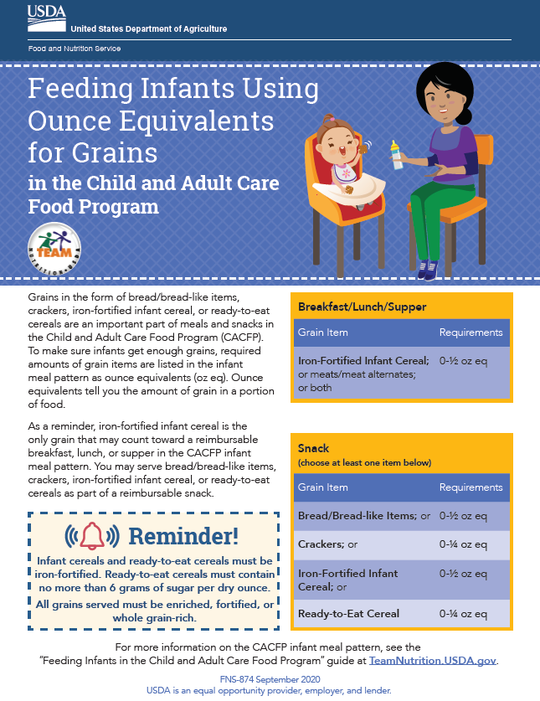
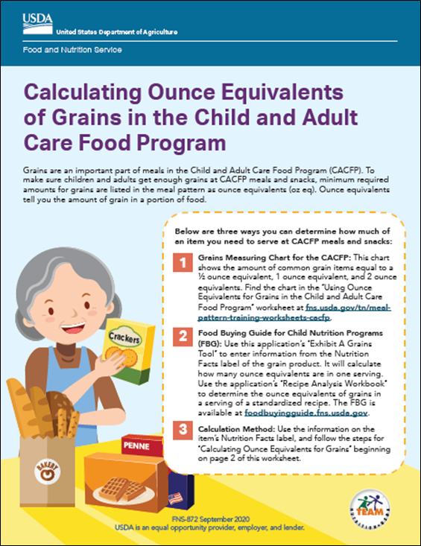
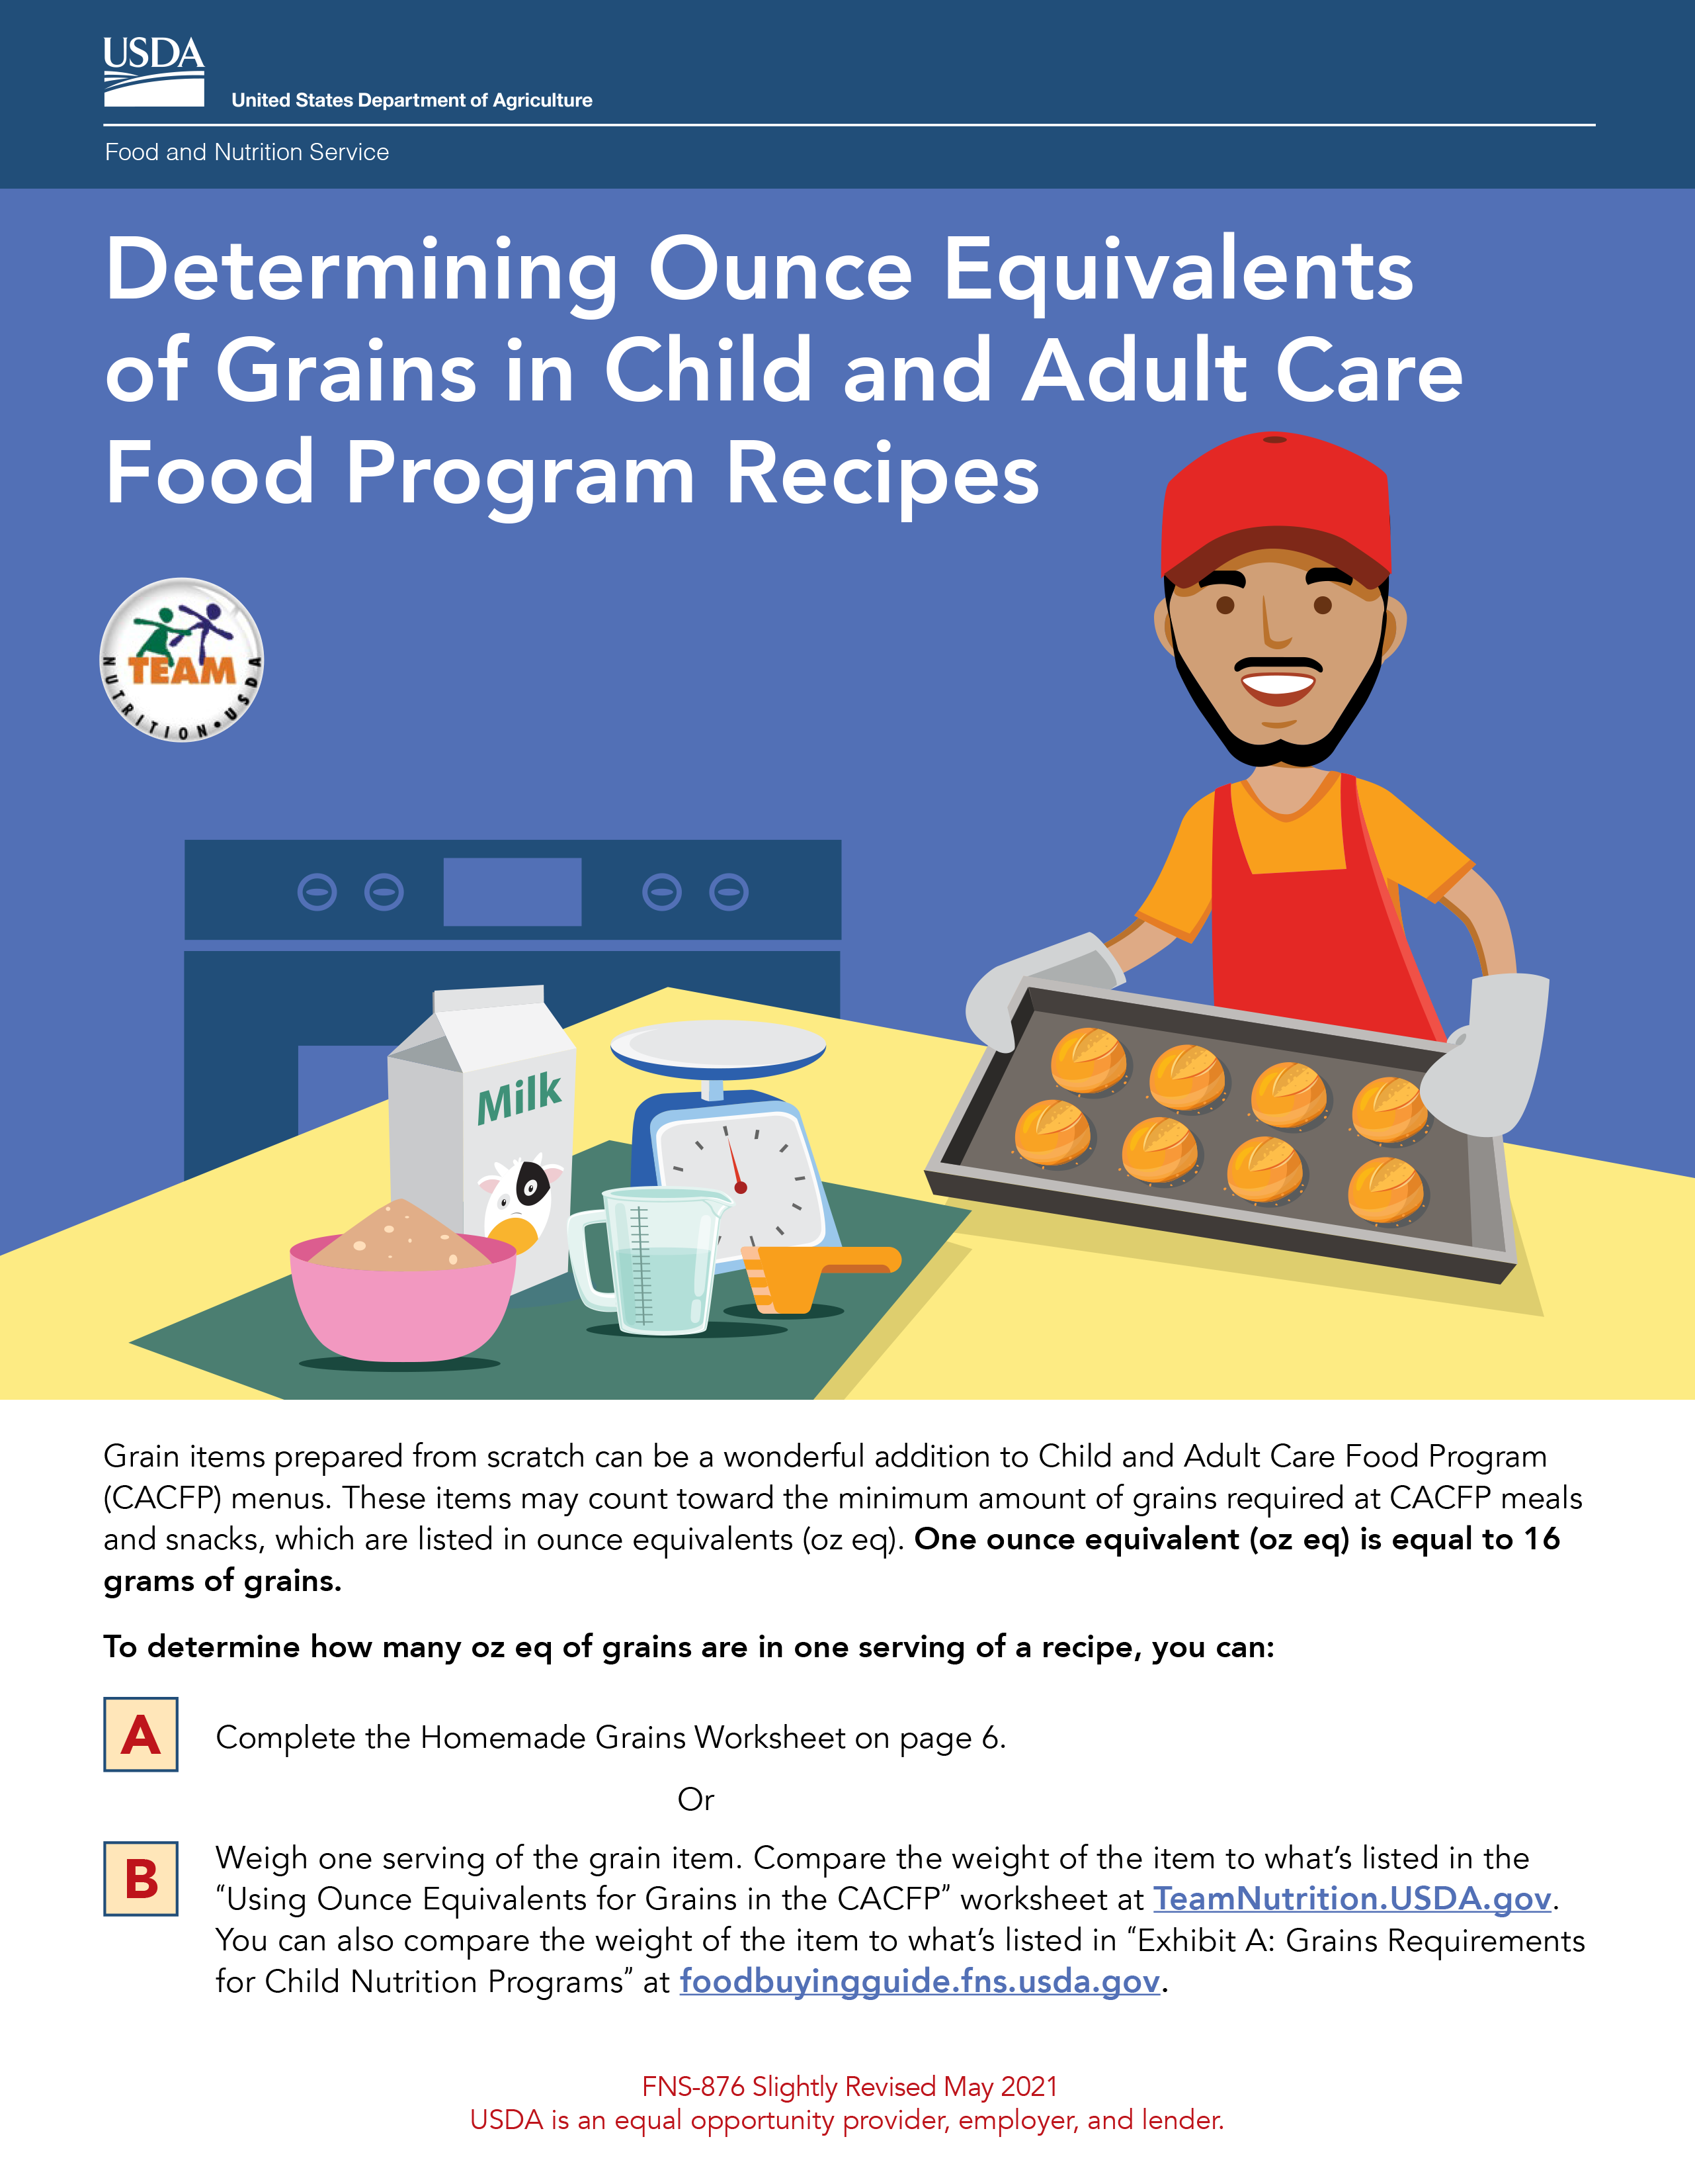


Team Nutrition CACFP Grains Oz Eq Resources Webpage
fns.usda.gov/tn/grains-ounce-equivalents-resources-cacfp
Notes:
The meal pattern lists required amounts for the grains component as ounce equivalents (oz eq).
Ounce equivalents tell you the amount of grain in a portion of food. For example, 1 ounce equivalent (oz eq) of grains equals 3 cups of popcorn,
½ of a bagel that weighs 56 grams, or 8 saltine-type crackers. To help you identify the amount of grains to serve using ounce equivalents, check out the Team Nutrition “CACFP Grains Ounce Equivalents Resources” webpage at
the web address on the slide.

Slide 34
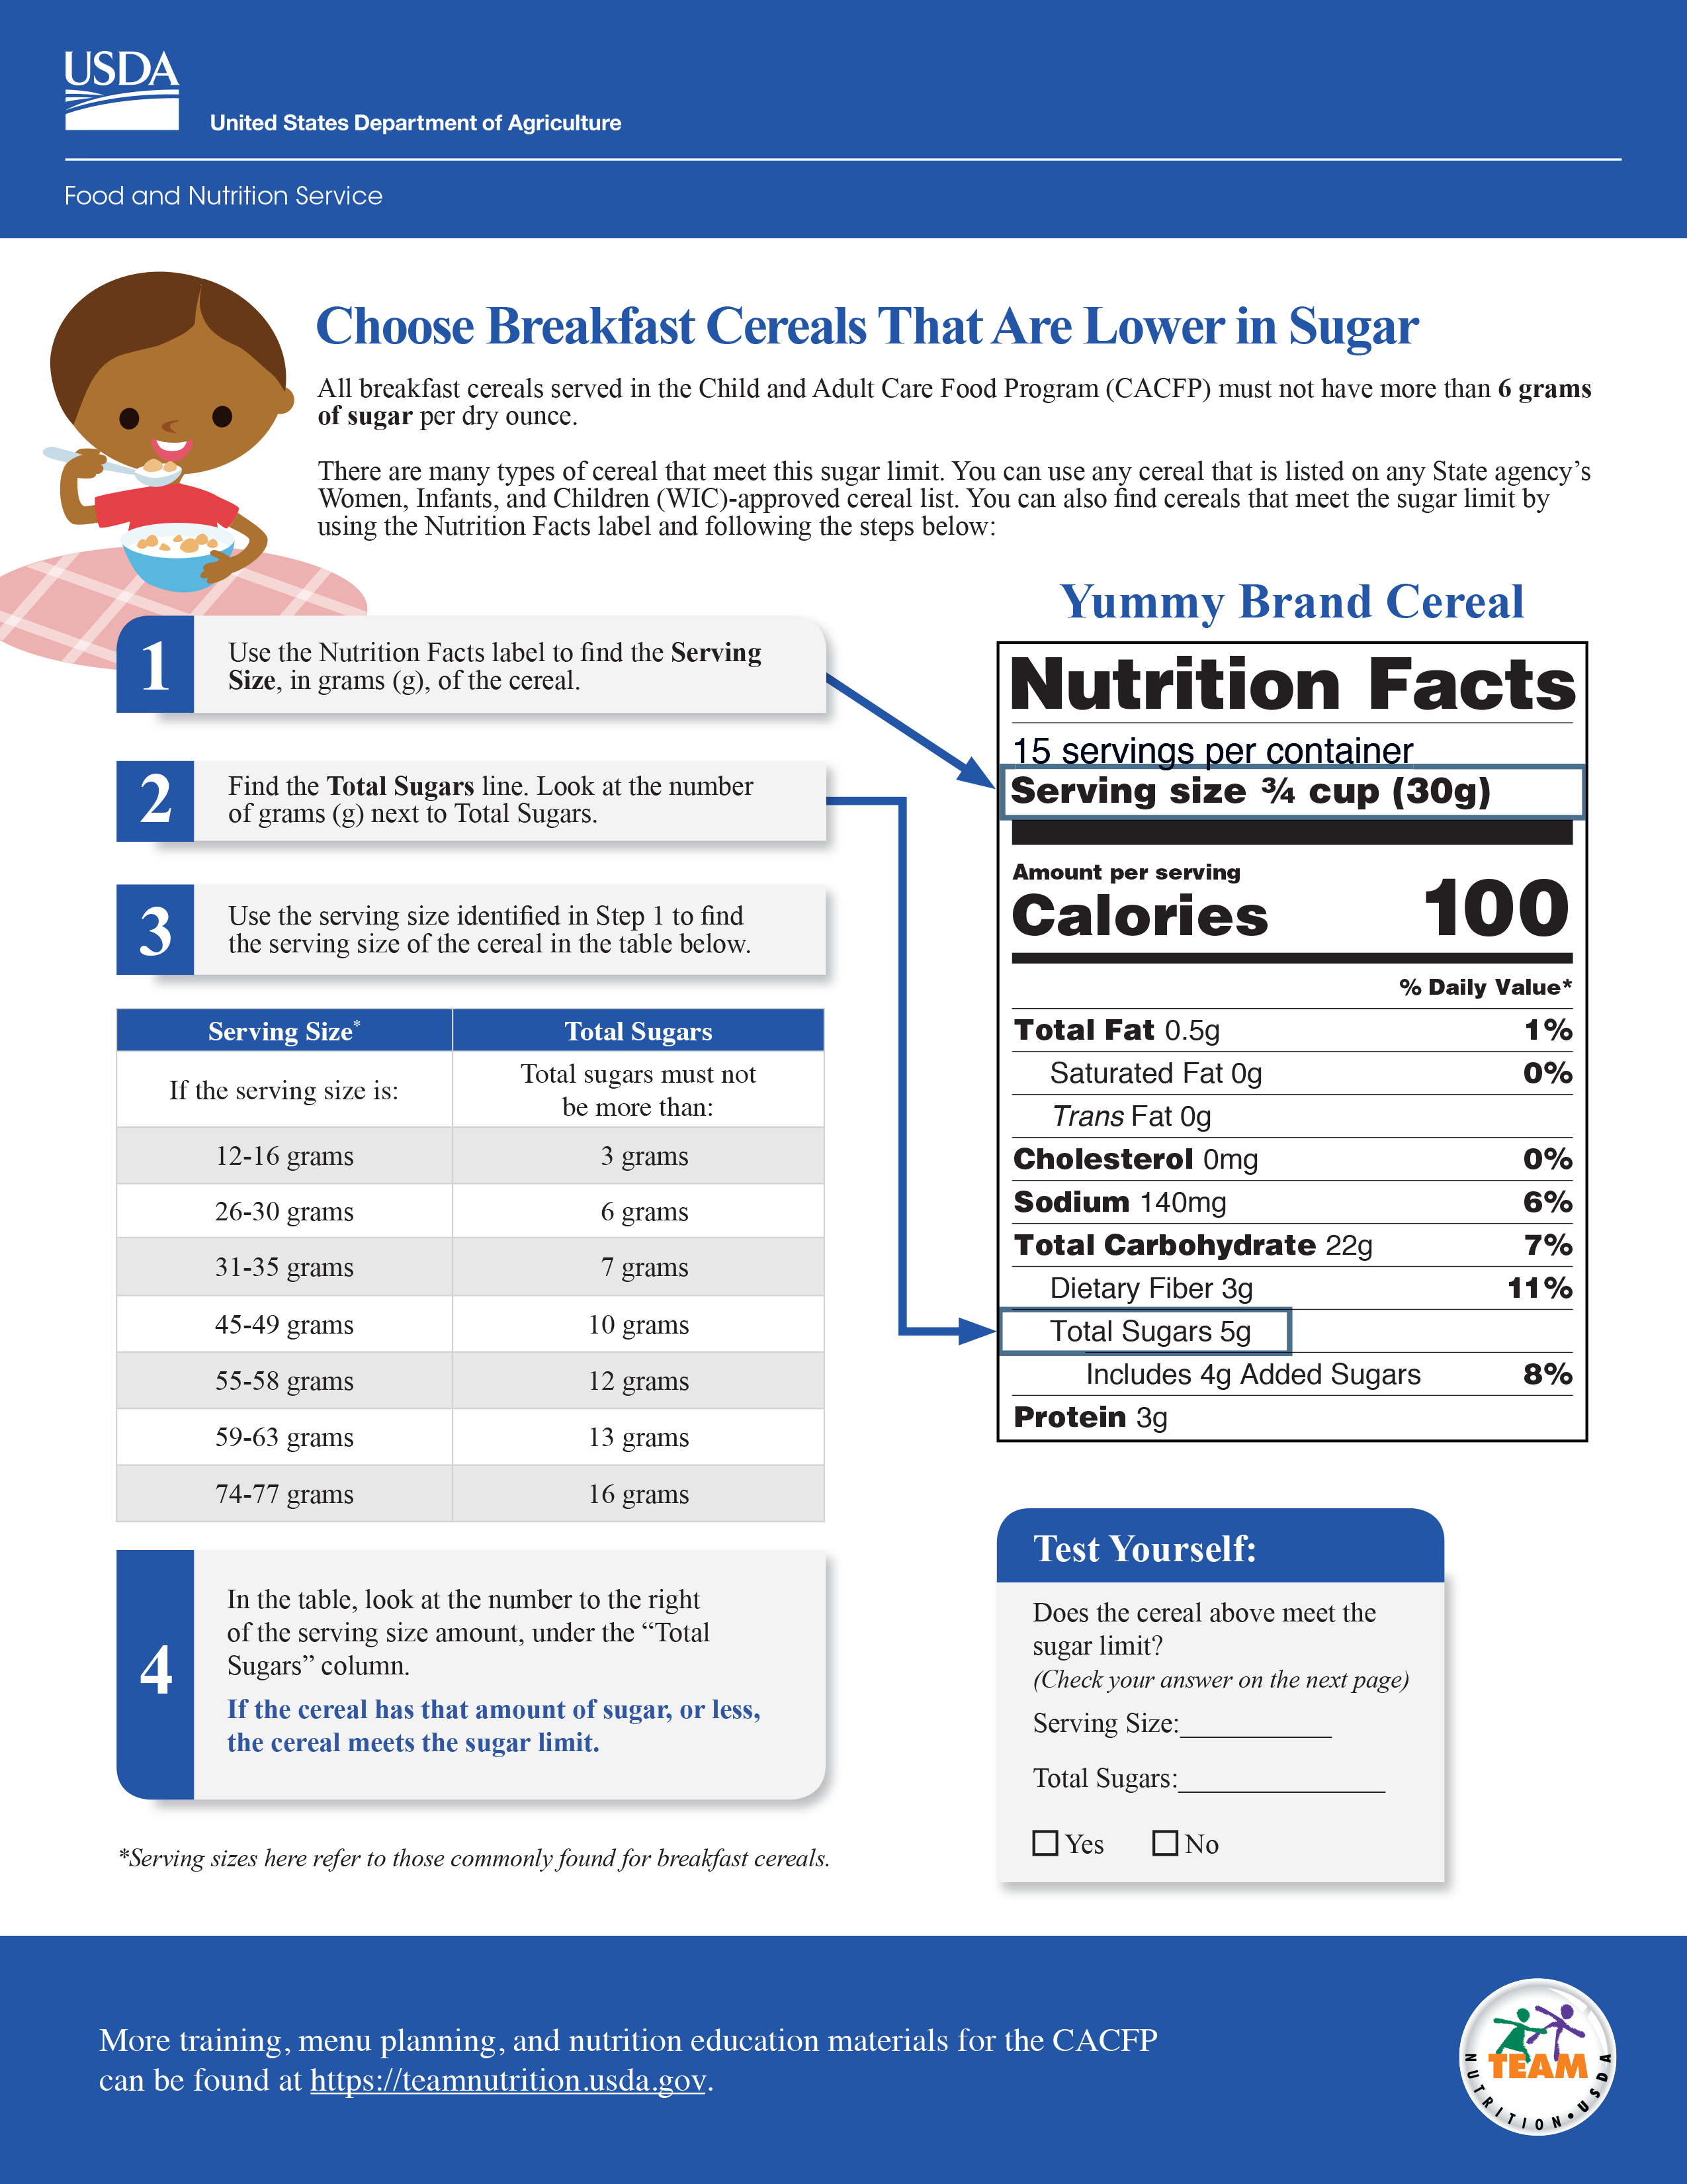
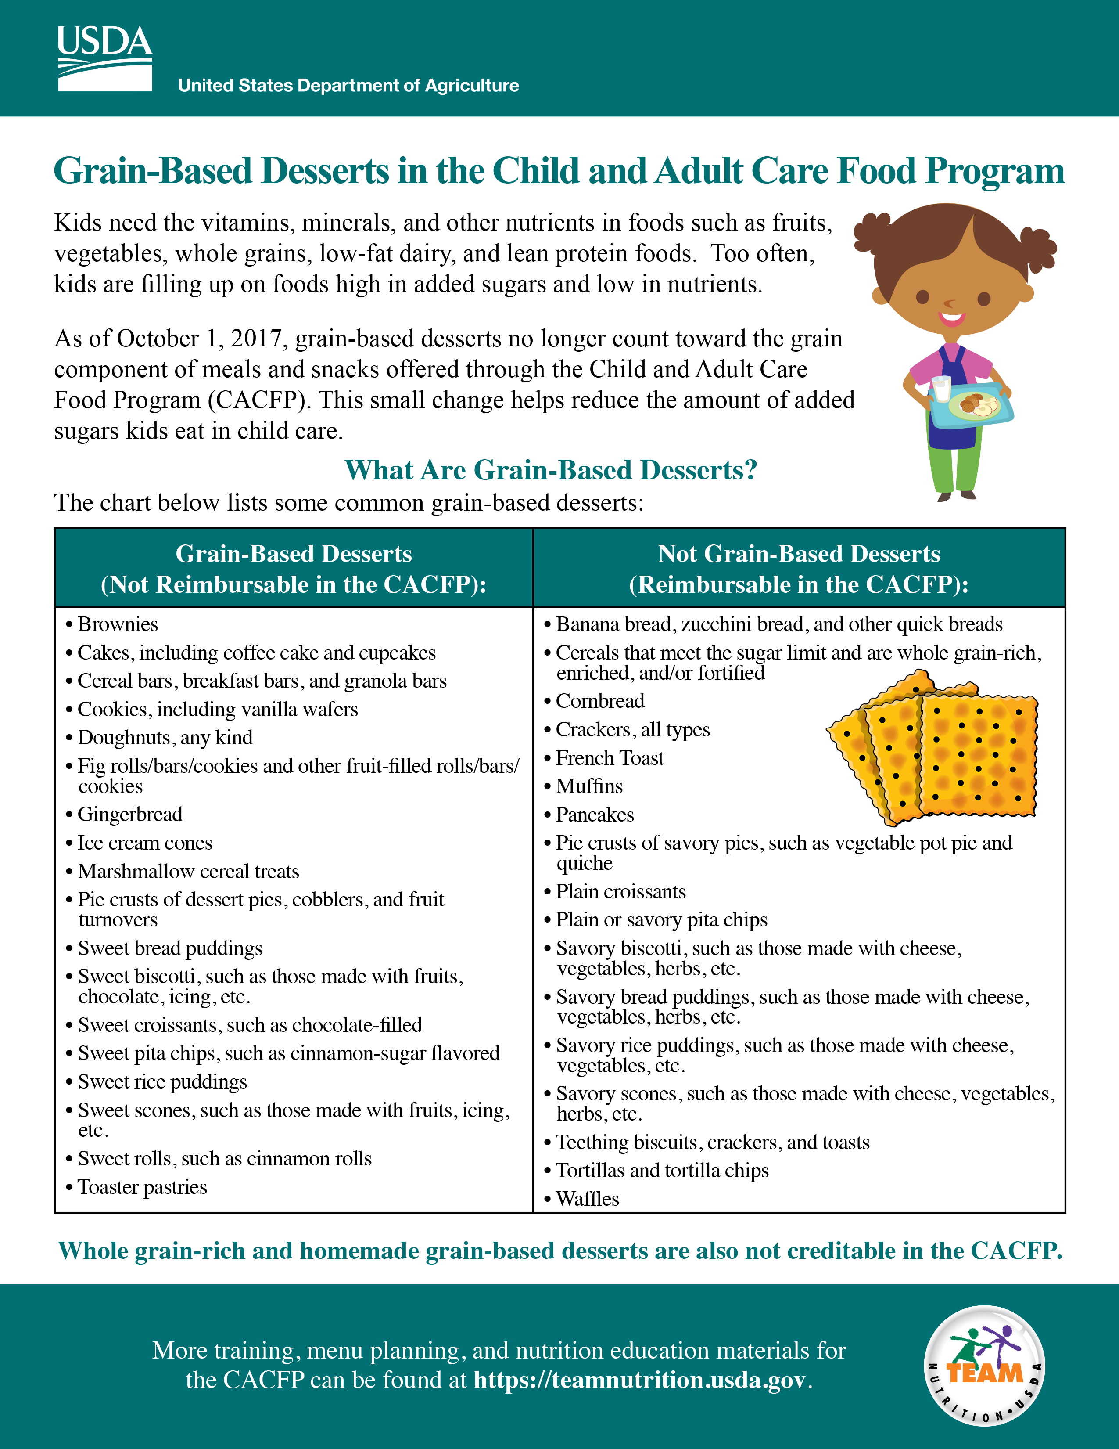


Serving Grains at Snack (Continued)
Things
to
Remember
Grain-based desserts are not creditable in the CACFP.
To credit toward a reimbursable meal or snack, cereals must contain no more than 6 grams of total sugars per dry ounce.
fns.usda.gov/tn/choose-breakfast-cereals-are-lower-sugar
fns.usda.gov/tn/grain-based-desserts-cacfp
Notes:
There are a few things you need to remember when serving grains at snack.
Grain-based desserts do not credit toward the grains requirement in the CACFP. Some common grain-based desserts are cookies, cakes, cinnamon buns, and cereal bars.
Also, to credit cereal toward a reimbursable snack, cereals must contain no more than 6 grams of total sugars per dry ounce.
For more information on these topics, see the Team Nutrition training worksheets, “Choose Breakfast Cereals That Are Lower in Sugar” and “Grain-Based Desserts in the Child and Adult Care Food Program” at the web address on the slide.

Slide 35
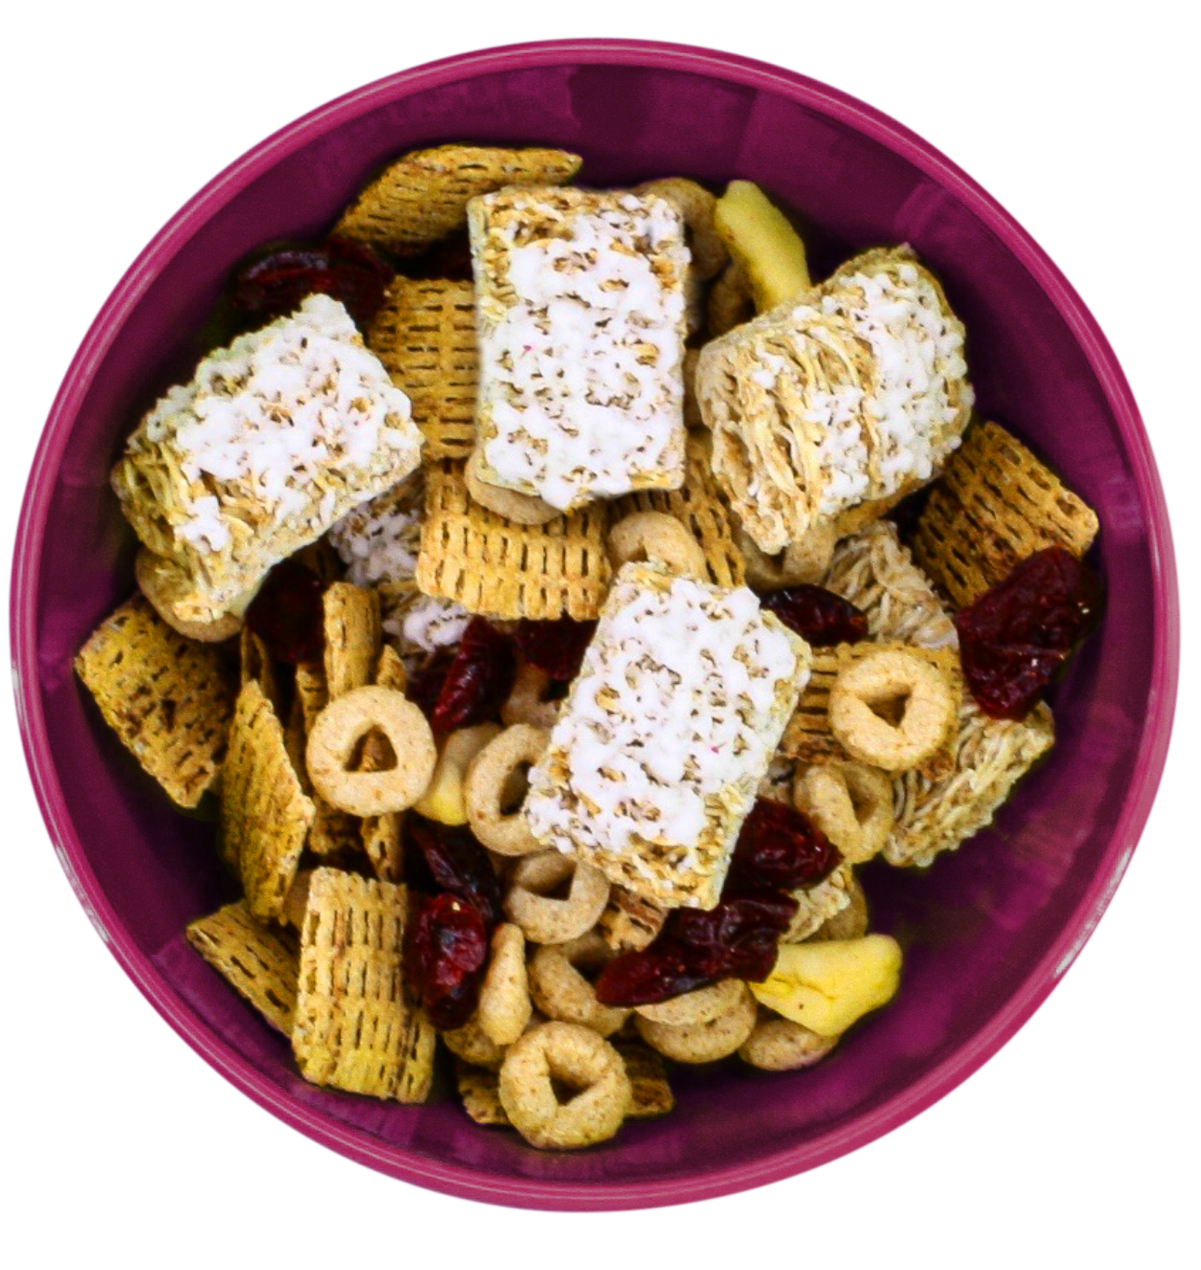
Try It Out!
You are serving a snack for the participants in your center. Which snack is not reimbursable?
Strawberry jam and whole
grain-rich crackers
Yogurt and dried fruit and cereal snack mix (whole grain-rich)
Orange slices and enriched crackers
Fruit salsa and whole
grain-rich pita chips
Notes:
Let’s do one last practice question. You may want to use the chart on page 2 of the “Serving Snacks in the CACFP” worksheet to help you answer this question.
This question says, “You are serving a snack for the participants in your center. Which snack is not reimbursable?”
Raise your hand if you think the answer is:
Strawberry jam and whole grain-rich crackers [pause and wait for a show of hands],
Yogurt and dried fruit and cereal snack mix (made with whole grain-rich cereals) [pause and wait for a show of hands],
Orange slices and enriched crackers [pause and wait for a show of hands], or
Fruit salsa and whole grain-rich pita chips [pause and wait for a show of hands].

Slide 36

Answer
You are serving a snack for the participants in your center. Which snack is not reimbursable?
Strawberry jam and whole
grain-rich crackers
Yogurt and dried fruit and cereal
snack mix (whole grain-rich)
Orange slices and enriched crackers
Fruit salsa and whole
grain-rich pita chips
Notes:
Great job everyone, the snack combination that cannot be served as part of reimbursable snack is the strawberry jam and enriched crackers. Strawberry jam is a condiment and does not credit toward the fruit component.
All of the other snack options shown on the slide could be served as a reimbursable snack for the participants in your care. Be sure to serve the correct amount for the age of the participant.

Slide 37
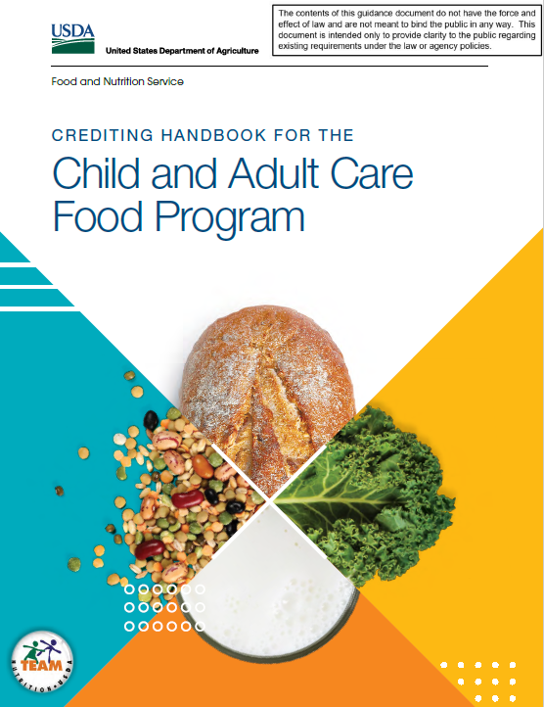



Other Crediting Information
fns.usda.gov/tn/crediting-handbook-child-and-adult-care-food-program
fns.usda.gov/tn/food-buying-guide-for-child-nutrition-programs
Notes:
For more information on crediting foods in the CACFP, see the “Crediting Handbook for the Child and Adult Care Food Program” and the “Food Buying Guide for Child Nutrition Programs” at the web addresses on the slide (fns.usda.gov/tn/crediting-handbook-child-and-adult-care-food-program and fns.usda.gov/tn/food-buying-guide-for-child-nutrition-programs.)
The “Crediting Handbook for the Child and Adult Care Food Program” provides information on which foods credit toward a reimbursable meal or snack.
The “Food Buying Guide for Child Nutrition Programs” helps you know the amount of food you need to buy for your menus. It also helps you determine the specific contribution each food makes toward meal pattern requirements.

Slide 38
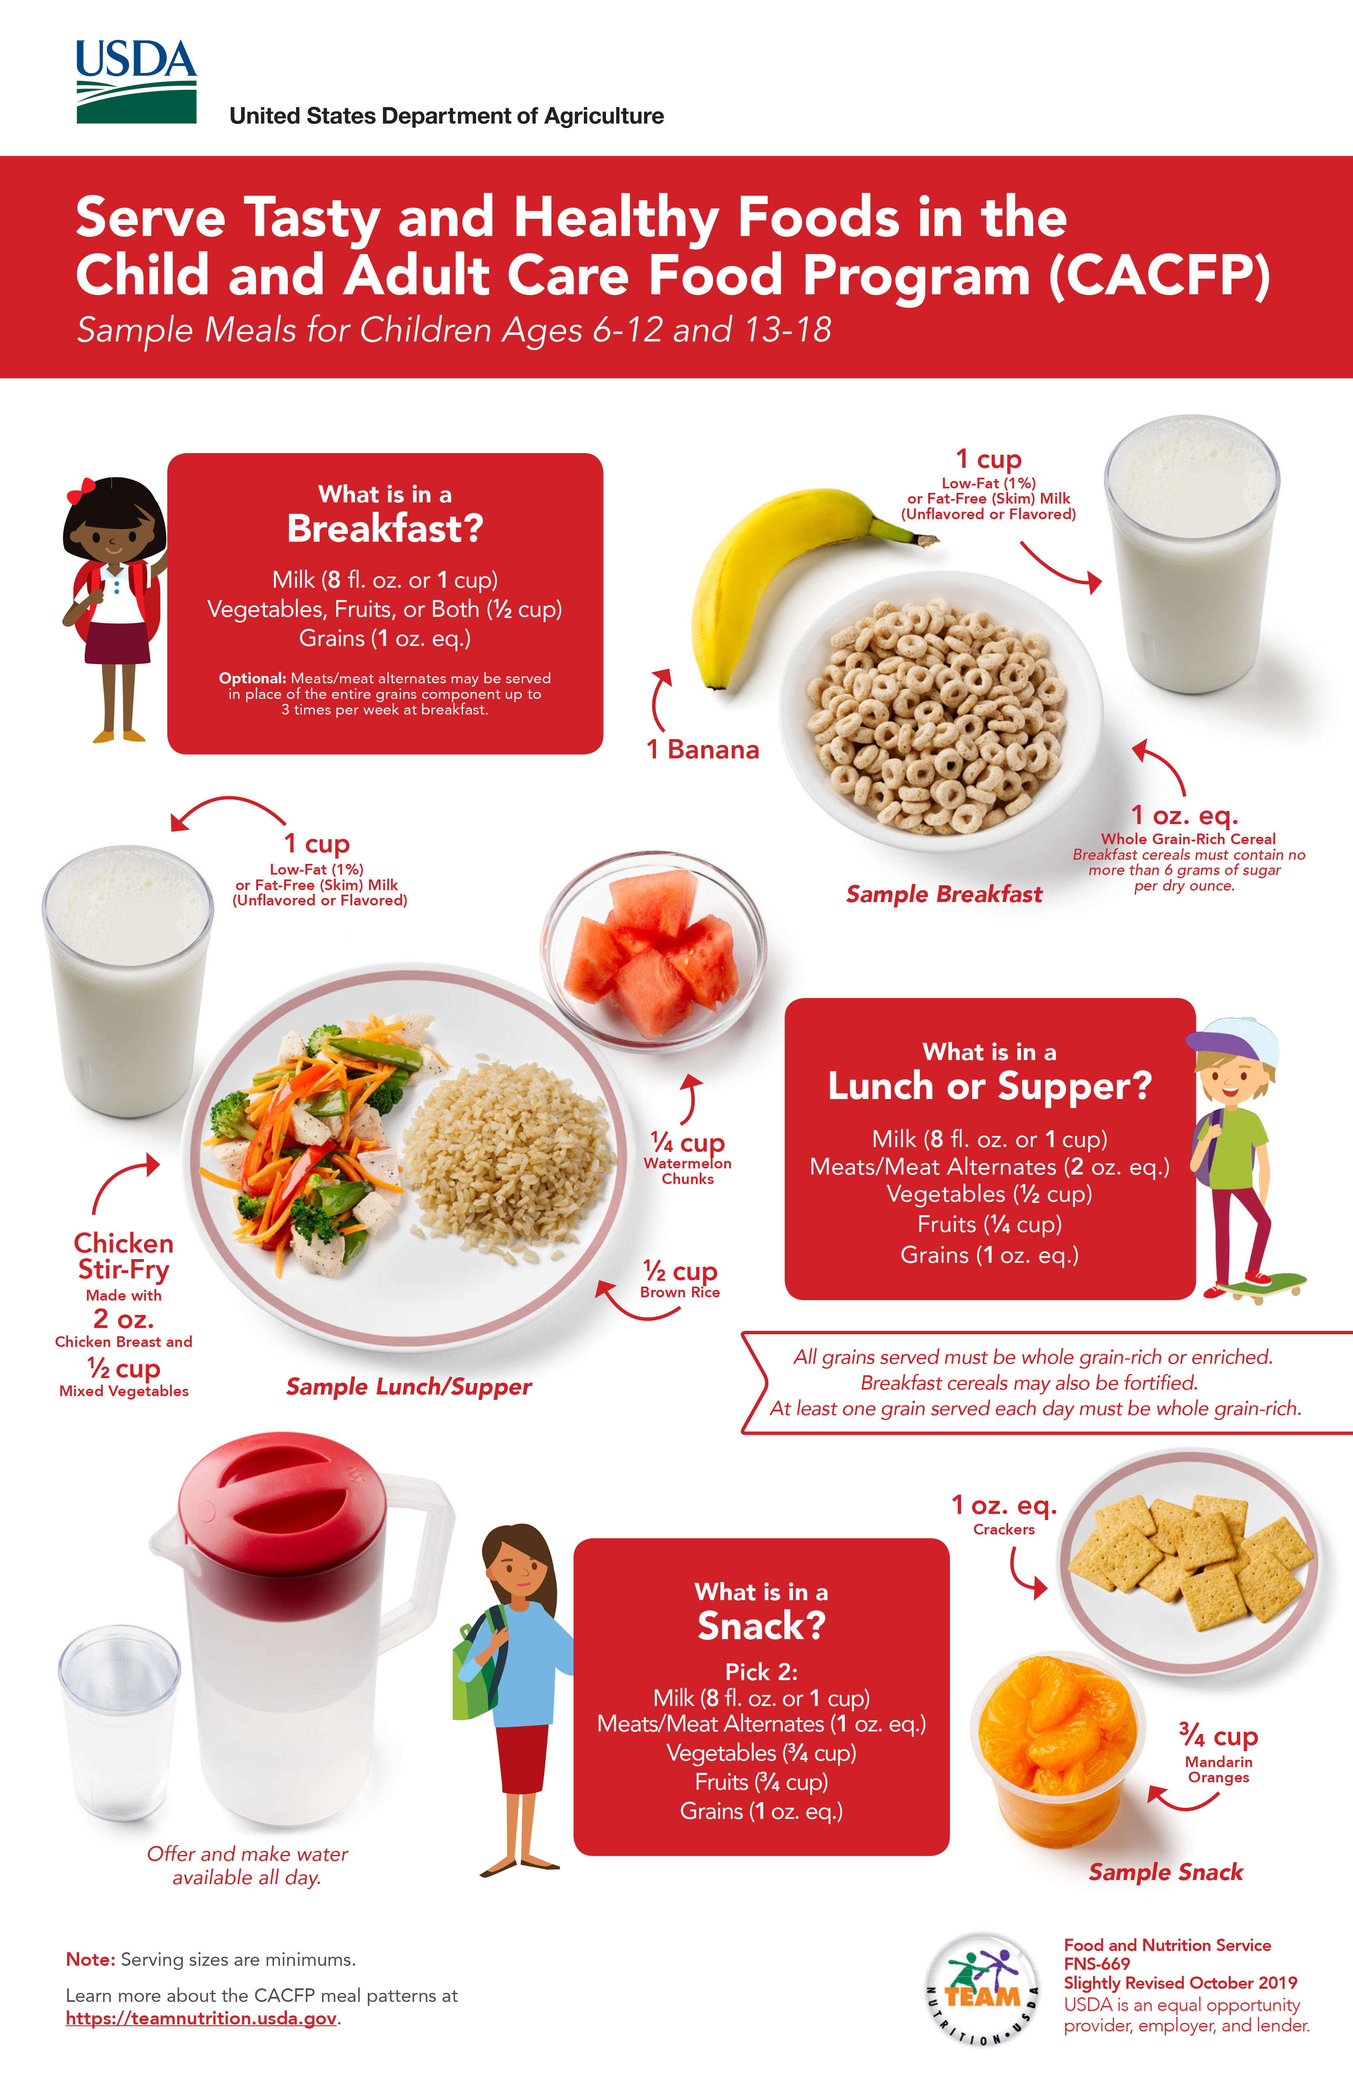

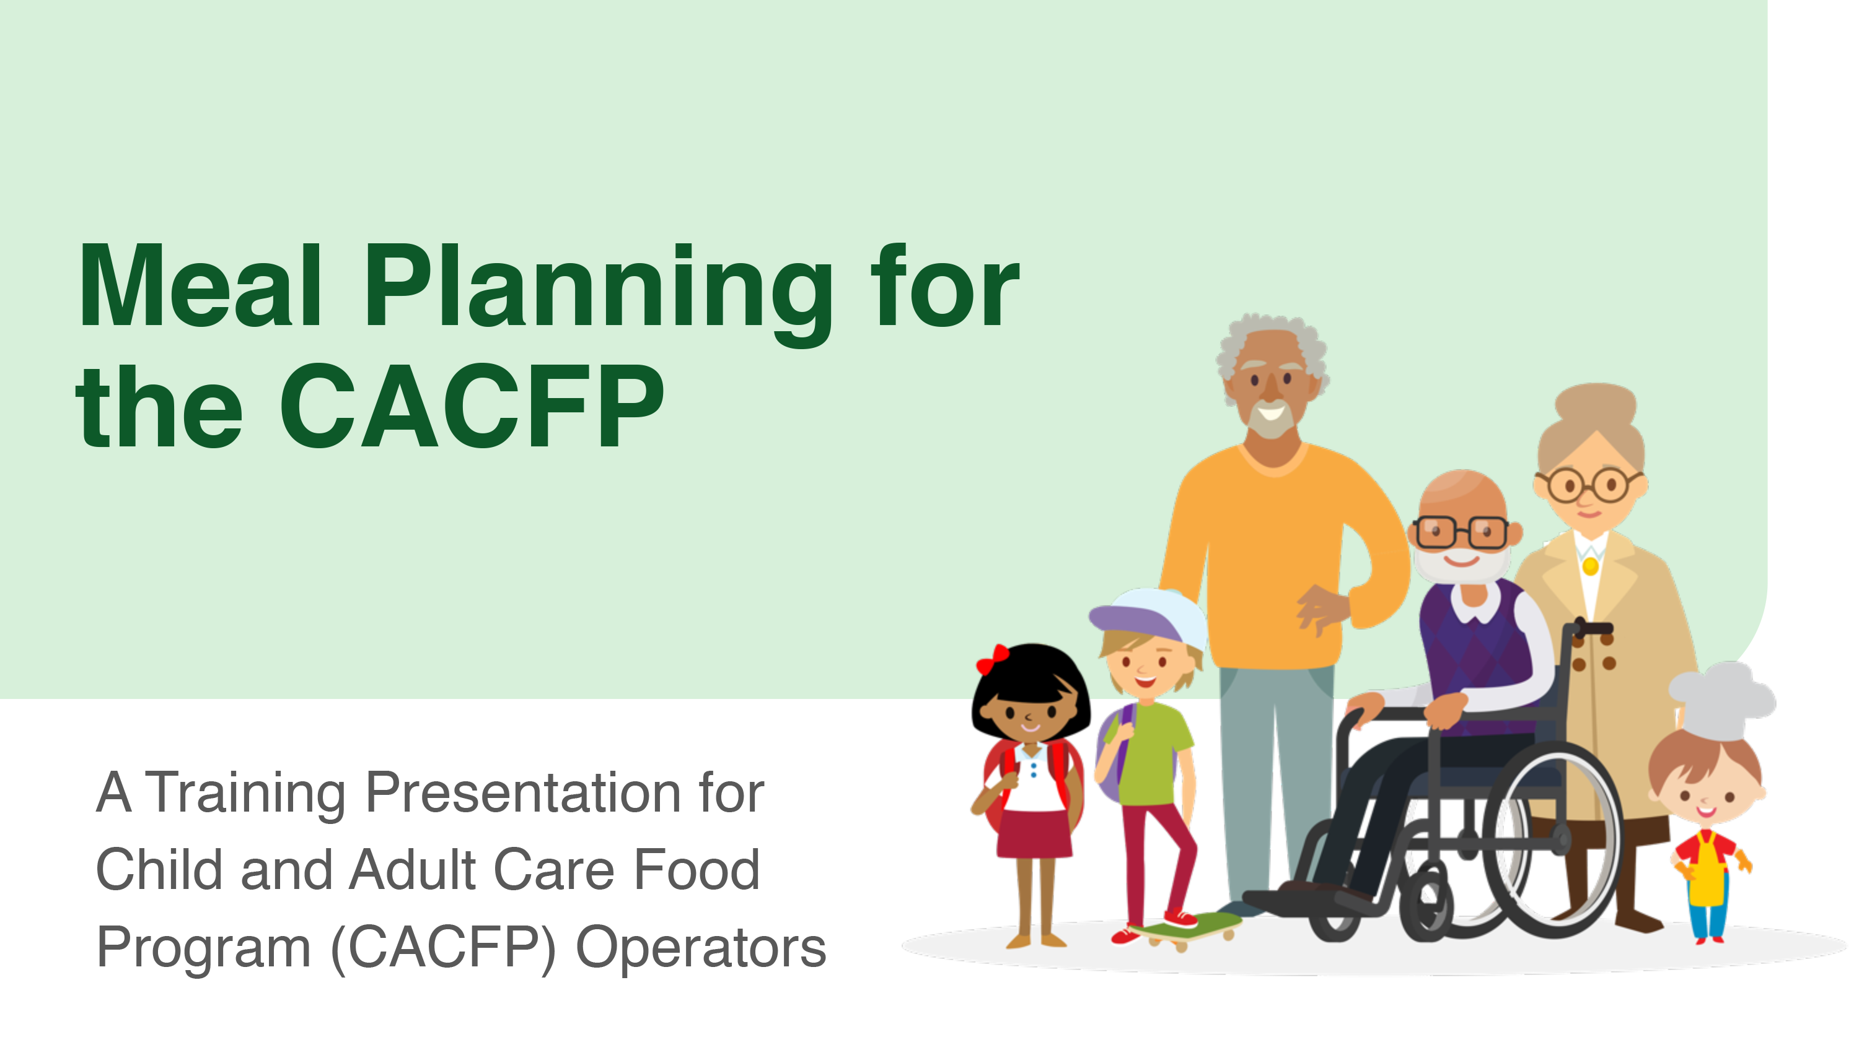


More Team Nutrition Resources!
Training Worksheets
Training Toolkits
Posters
Training Slides
CACFP Grains Oz Eq Resources
TeamNutrition.usda.gov
Notes:
All Team Nutrition materials are available online from Team Nutrition’s website and are available for free download to anybody who is interested. You can also find many other resources for the CACFP on Team Nutrition’s website.

Slide 39
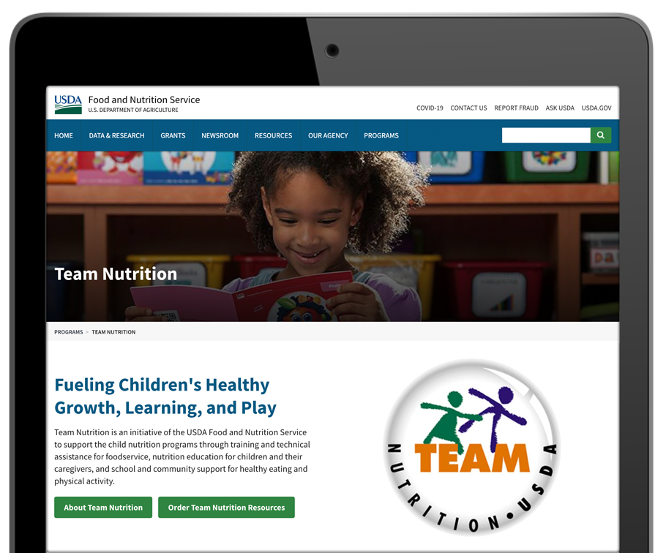

How To Order Print Copies
Resource Order Form at TeamNutrition.usda.gov.
FREE for those participating
in a USDA Child Nutrition Program, while supplies last.
Sponsoring organizations and State agencies can also order in bulk by sending an email to:
TeamNutrition@usda.gov
Notes:
For all participating in a Child Nutrition Program, such as the Child and Adult Care Food Program, Team Nutrition’s print materials are free to order.
If you would like to order Team Nutrition’s free materials in print, you can go to the “Resource Order Form” link on the Team Nutrition website to order print copies of the materials.
For bulk orders, you can email TeamNutrition@usda.gov.

Slide 40




Thank you!
TeamNutrition.usda.gov
@TeamNutrition
TeamNutrition@usda.gov
USDA is an equal opportunity provider, employer, and lender.
Notes:
These training slides were provided by U.S. Department of Agriculture's Team Nutrition. If you would like to learn more about Team Nutrition and additional resources available, please visit their website, subscribe to their monthly
e-newsletter, connect with them via email at TeamNutrition@usda.gov, and follow them on Twitter.
Thank you!

