Slide 1

Meal Planning for the CACFP
A Training Presentation for
Child and Adult Care Food
Program (CACFP) Operators

Slide 2



USDA’s Team Nutrition
An initiative of the USDA’s Food and Nutrition Service to support the USDA’s Child Nutrition Programs.
Aims to improve children’s lifelong eating and physical activity habits.
Provides nutrition education and training materials to State agencies, sponsoring organizations, and CACFP sites.
Team Nutrition is an initiative of the USDA Food and Nutrition Service that supports the Child Nutrition Programs, including the National School Lunch Program, the School Breakfast Program, and of course, the Child and Adult Care Food Program, or the CACFP.
The goal of Team Nutrition is to improve children's lifelong eating and physical activity habits through nutrition education based on the principles of the Dietary Guidelines for Americans and MyPlate.
It does so through training and technical assistance for those preparing and serving meals, providing nutrition education for children, and building support for healthier school and child care environments.
TeamNutrition.usda.gov
@TeamNutrition
Notes:
Team Nutrition is an initiative of the USDA Food and Nutrition Service that supports the Child Nutrition Programs, including the National School Lunch Program, the School Breakfast Program, and of course, the Child and Adult Care Food Program, or the CACFP.
The goal of Team Nutrition is to improve children's lifelong eating and physical activity habits through nutrition education based on the principles of the Dietary Guidelines for Americans and MyPlate.
It does so through training and technical assistance for those preparing and serving meals, providing nutrition education for children, and building support for healthier school and child care environments.

Slide 3
Let Us Know Who You Are!
I work for a…
?
Child care center
Family child care home
At-risk afterschool care center
Adult day care center
Sponsoring organization
Emergency shelter
School food authority
State agency
USDA Regional Office
Other
Before we get started, I want to know who has joined us today.
Please raise your hand if you work for:
a child care center [pause and wait for a show of hands],
a family child care home [pause and wait for a show of hands],
an at-risk afterschool care center [pause and wait for a show of hands],
a sponsoring organization [pause and wait for a show of hands],
an emergency shelter [pause and wait for a show of hands],
a school food authority [pause and wait for a show of hands],
a State agency [pause and wait for a show of hands],
a USDA Regional office [pause and wait for a show of hands], or
other [pause and wait for a show of hands].
Notes:
Before we get started, I want to know who has joined us today.
Please raise your hand if you work for:
a child care center [pause and wait for a show of hands],
a family child care home [pause and wait for a show of hands],
an at-risk afterschool care center [pause and wait for a show of hands],
a sponsoring organization [pause and wait for a show of hands],
an emergency shelter [pause and wait for a show of hands],
a school food authority [pause and wait for a show of hands],
a State agency [pause and wait for a show of hands],
a USDA Regional office [pause and wait for a show of hands], or
other [pause and wait for a show of hands].

Slide 4
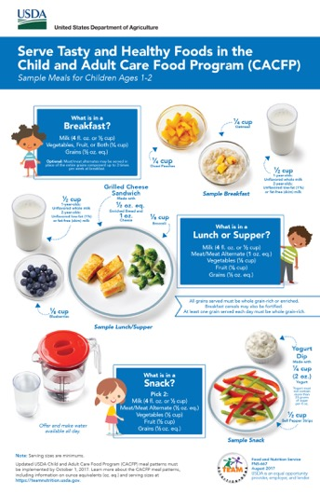
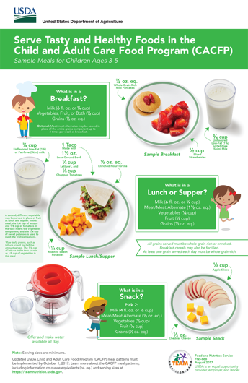
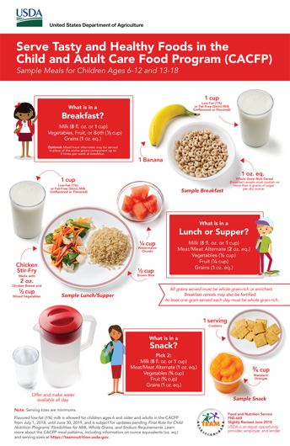
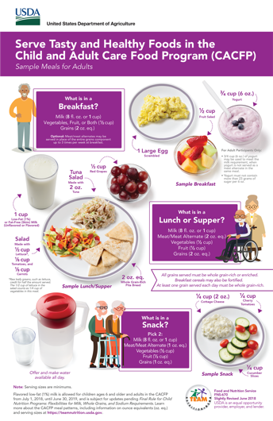
Meal Planning for the CACFP
So, lets get started!
Today’s topic is “Meal Planning for the CACFP,” and we will cover how the CACFP meal pattern can help you plan tasty, healthy, and appealing meals for the child and adult participants in your program. Many of the examples shown today come from the four posters in the “Serve Tasty and Healthy Foods in the CACFP” poster series, which are available on the Team Nutrition website.
Notes:
So, lets get started!
Today’s topic is “Meal Planning for the CACFP,” and we will cover how the CACFP meal pattern can help you plan tasty, healthy, and appealing meals for the child and adult participants in your program. Many of the examples shown today come from the four posters in the “Serve Tasty and Healthy Foods in the CACFP” poster series, which are available on the Team Nutrition website.

Slide 5

Growing a Healthier Future With the CACFP Infographic
As many of you know, the updates to the CACFP meal pattern that was released in April 2016 were the first major changes to the nutrition standards since the program began in 1968. These updates will help make sure children and adults served by the CACFP have even more access to healthier meals and snacks throughout their days. These healthier meals and snacks will help kids get the nutrition they need to learn, grow, and play.
For adults, these updated guidelines also help make sure the adults being served in the program stay healthy and help cultivate a culture of wellness. Team Nutrition created the “Growing a Healthier Future With the CACFP infographic” that you see on the screen to highlight how the foods served in the CACFP can have a positive impact on the health of the children and adults you serve.
Notes:
As many of you know, the updates to the CACFP meal pattern that was released in April 2016 were the first major changes to the nutrition standards since the program began in 1968. These updates will help make sure children and adults served by the CACFP have even more access to healthier meals and snacks throughout their days. These healthier meals and snacks will help kids get the nutrition they need to learn, grow, and play.
For adults, these updated guidelines also help make sure the adults being served in the program stay healthy and help cultivate a culture of wellness. Team Nutrition created the “Growing a Healthier Future With the CACFP infographic” that you see on the screen to highlight how the foods served in the CACFP can have a positive impact on the health of the children and adults you serve.

Slide 6


Fueling Up With Veggies (Continued)
Fewer than 10% of 4 to 8 year old kids eat enough vegetables.
As shown on the infographic, right now less than 10 percent of 4 to 8 year old kids get enough vegetables. The CACFP meal pattern separates vegetables and fruits into two different food components at lunch, supper, and snack, which gives more opportunities to introduce and serve vegetables to children and adults throughout the day.
Notes:
As shown on the infographic, right now less than 10 percent of 4 to 8 year old kids get enough vegetables. The CACFP meal pattern separates vegetables and fruits into two different food components at lunch, supper, and snack, which gives more opportunities to introduce and serve vegetables to children and adults throughout the day.

Slide 7
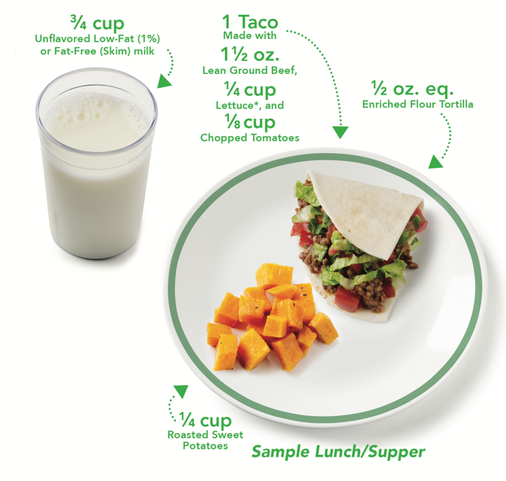

Fueling Up With Veggies
What is in a
Lunch or Supper?
Milk (6 fl. oz. or ³/₄ cup)
Meat/Meat Alternate (1 ¹/₂ oz. eq.)
Vegetables (¹/₄ cup)
Fruit (¹/₄ cup)
Grains (¹/₂ cup)
To increase the amount of vegetables you serve to your participants, you can also serve a second vegetable in place of fruit. Here, you can see that the lettuce and the tomatoes in the taco meet the minimum ¼ cup of vegetables required for 3 through 5 year olds at lunch and supper. Instead of fruit, a roasted sweet potatoes are served. This is a great way to offer more vegetables to your participants throughout the day.
Minimum Serving Sizes Shown for Children 3-5
Notes:
To increase the amount of vegetables you serve to your participants, you can also serve a second vegetable in place of fruit. Here, you can see that the lettuce and the tomatoes in the taco meet the minimum ¼ cup of vegetables required for 3 through 5 year olds at lunch and supper. Instead of fruit, a roasted sweet potatoes are served. This is a great way to offer more vegetables to your participants throughout the day.

Slide 8
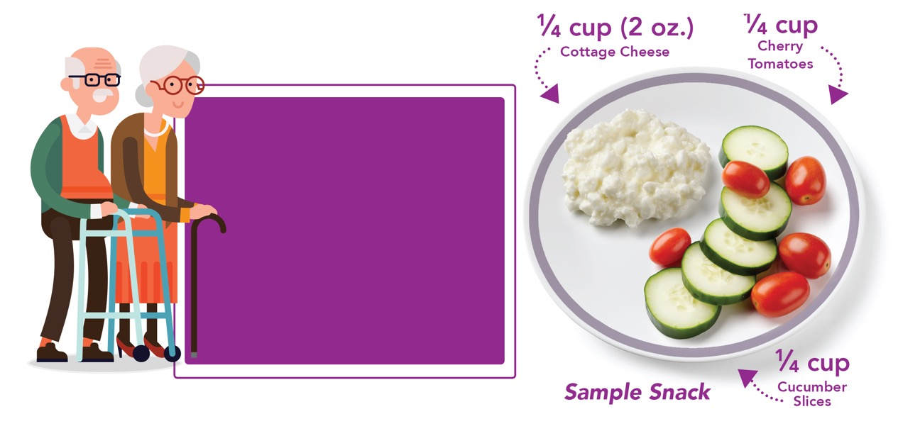
Fueling Up With Veggies (Continued)
What is in a
Snack?
Pick 2:
Milk (8 fl. oz. or 1 cup)
Meat/Meat Alternate (1 oz. eq.)
Vegetables (¹/₂ cup)
Fruit (¹/₂ cup)
Grains (1 oz. eq.)
Minimum Serving Sizes Shown for Adults
You may also combine different vegetables to meet the minimum serving size requirements. For example, for adults, if you are serving vegetables at snack, the minimum serving size is half a cup. So you could serve a quarter cup of cherry tomatoes and a quarter cup of cucumber slices are served to meet the half cup requirement.
Notes:
You may also combine different vegetables to meet the minimum serving size requirements. For example, for adults, if you are serving vegetables at snack, the minimum serving size is half a cup. So you could serve a quarter cup of cherry tomatoes and a quarter cup of cucumber slices are served to meet the half cup requirement.

Slide 9
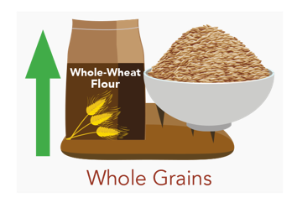
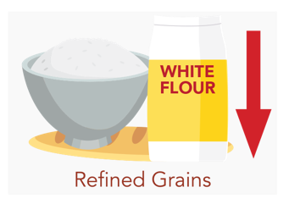
Starting Kids Early With Whole Grains
Kids ages 1 to 13 years old get up to twice the amount of refined grains that they should, but not enough whole grains.
Let’s take a closer look at whole grains. Kids ages 1 to 13 years old get up to twice the amount of refined grains that they should, but not enough whole grains. Whole grains have nutrients and fiber that both adults and kids need for energy and to stay healthy.
The CACFP meal pattern requires that at least one offering of grains every day be whole grain-rich. Foods that are 100 whole-grain, or have at least 50% whole grain, and the remaining grains are enriched, are whole grain-rich.
Notes:
Let’s take a closer look at whole grains. Kids ages 1 to 13 years old get up to twice the amount of refined grains that they should, but not enough whole grains. Whole grains have nutrients and fiber that both adults and kids need for energy and to stay healthy.
The CACFP meal pattern requires that at least one offering of grains every day be whole grain-rich. Foods that are 100 whole-grain, or have at least 50% whole grain, and the remaining grains are enriched, are whole grain-rich.

Slide 10
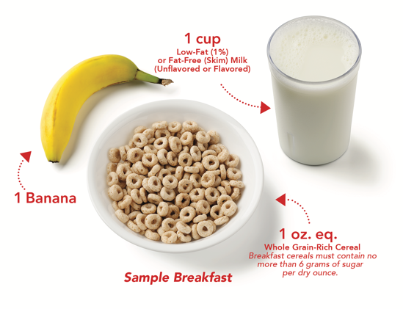
Starting Kids Early With Whole Grains
(Continued)
Minimum Serving Sizes
Shown for Children Ages 1-2
Minimum Serving Sizes Shown for Children Ages 6-12 and 13-18
You can serve whole grains at breakfast, such whole grain-rich ready-to-eat cereals, whole grain-rich cooked cereal such as oatmeal, and whole-wheat toast, or whole grain-rich bagels. Cereals served in the CACFP must meet the sugar limit of no more than 6 grams of sugar per dry ounce.
Notes:
You can serve whole grains at breakfast, such whole grain-rich ready-to-eat cereals, whole grain-rich cooked cereal such as oatmeal, and whole-wheat toast, or whole grain-rich bagels. Cereals served in the CACFP must meet the sugar limit of no more than 6 grams of sugar per dry ounce.

Slide 11
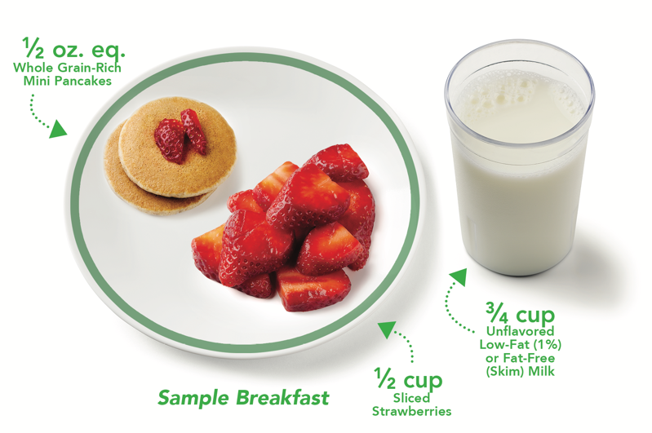
Starting Kids Early With Whole Grains (Continued)
Remember that some grain items commonly served at breakfast may also be whole grain-rich, such as pancakes and waffles.
*Minimum Serving Sizes Shown for Children Ages 3-5
Notes:
Remember that some grain items commonly served at breakfast may also be whole grain-rich, such as pancakes and waffles.

Slide 12
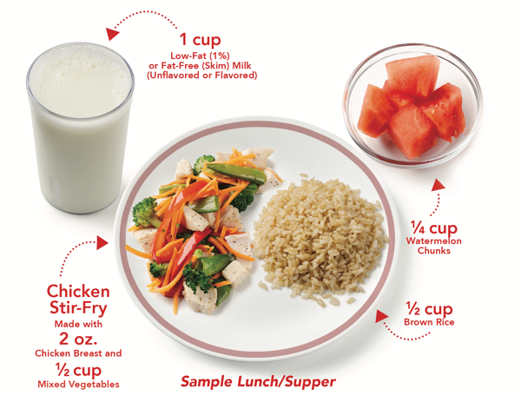
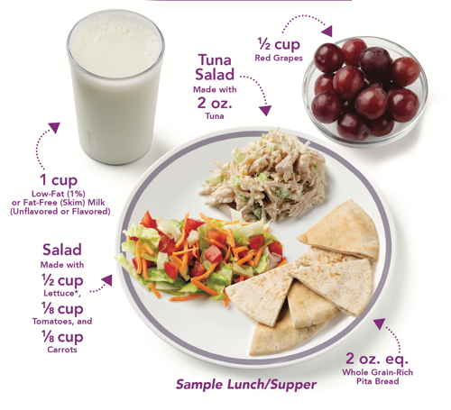
Starting Kids Early With Whole Grains (Continued)
You can also serve whole grain-rich foods at lunch and supper, such as brown rice or pita bread. Whole grain-rich mini bagels, whole grain-rich crackers, and whole grain-rich tortillas can also be great choices at snack.
Minimum Serving Sizes Shown for Children Ages 6-12 and 13-18
Minimum Serving Sizes
Shown for Adults
Notes:
You can also serve whole grain-rich foods at lunch and supper, such as brown rice or pita bread. Whole grain-rich mini bagels, whole grain-rich crackers, and whole grain-rich tortillas can also be great choices at snack.

Slide 13
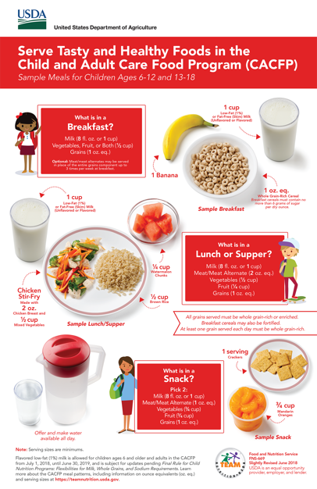
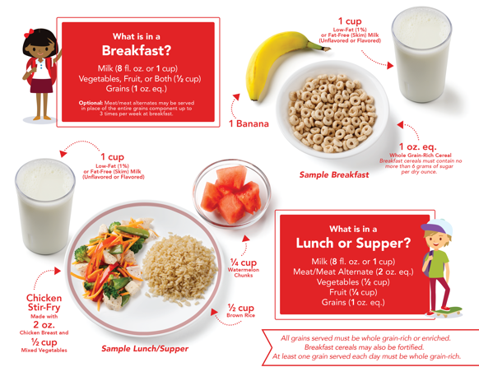
Starting Kids Early With Whole Grains (Continued)
If you serve grain items at your CACFP site, the items must be whole grain-rich once per day. Of course, you can serve whole grain-rich items more than once per day. For example, you can serve whole grain-rich cereal at breakfast, and then brown rice, which is a whole grain, is served at lunch.
Try to serve whole grains at different meals throughout the week for variety, such as whole-wheat spaghetti at lunch on Monday, whole-wheat toast at breakfast on Tuesday, and whole grain-rich crackers at snack on Wednesday.
For those of you serving different groups of participants throughout the day, such as a morning group and an afternoon group, this will also help make sure that all participants get a chance to try and enjoy whole grains throughout the week.
*Minimum Serving Sizes Shown
for Children Ages 6-12 and 13-18
Notes:
If you serve grain items at your CACFP site, the items must be whole grain-rich once per day. Of course, you can serve whole grain-rich items more than once per day. For example, you can serve whole grain-rich cereal at breakfast, and then brown rice, which is a whole grain, is served at lunch.
Try to serve whole grains at different meals throughout the week for variety, such as whole-wheat spaghetti at lunch on Monday, whole-wheat toast at breakfast on Tuesday, and whole grain-rich crackers at snack on Wednesday.
For those of you serving different groups of participants throughout the day, such as a morning group and an afternoon group, this will also help make sure that all participants get a chance to try and enjoy whole grains throughout the week.

Slide 14

True or False:
I may serve whole grain-rich foods at breakfast, lunch, supper, or snack.
?
True
False
Let’s try a practice question. Is the following statement true or false?
“I may serve whole grain-rich foods at breakfast, lunch, supper, or snack in the CACFP.”
Raise your hand if you think the answer is true [pause and wait for a show of hands].
Raise your hand if you think the answer is false [pause and wait for a show of hands].
Notes:
Let’s try a practice question. Is the following statement true or false?
“I may serve whole grain-rich foods at breakfast, lunch, supper, or snack in the CACFP.”
Raise your hand if you think the answer is true [pause and wait for a show of hands].
Raise your hand if you think the answer is false [pause and wait for a show of hands].

Slide 15
True or False:
I may serve whole grain-rich foods at breakfast, lunch, supper or snack.
?
✓
True
False
Whole grain-rich foods should be served at least once per day in the CACFP. This can be at breakfast, lunch, supper, or snack.
Try serving whole grain-rich foods at different meals throughout the week, such as brown rice for lunch on Monday, oatmeal for breakfast on Tuesday, and whole grain-rich mini-bagels at snack on Wednesday.
As a best practice, you can serve whole grain-rich foods twice or more per day.
Nice work! The answer is true. If you are serving grains at your CACFP site, those grains should be whole grain-rich at least once per day. This can be at breakfast, lunch, supper, or snack.
Try serving whole grain-rich foods at different meals throughout the week, such as brown rice for lunch on Monday, oatmeal for breakfast on Tuesday, whole grain-rich mini-bagels at snack on Wednesday.
This gives everyone a chance to try whole grains, and see that whole grains can fit into the day in many different ways.
As a best practice, you can serve whole grain-rich foods twice or more per day.
Notes:
Nice work! The answer is true. If you are serving grains at your CACFP site, those grains should be whole grain-rich at least once per day. This can be at breakfast, lunch, supper, or snack.
Try serving whole grain-rich foods at different meals throughout the week, such as brown rice for lunch on Monday, oatmeal for breakfast on Tuesday, whole grain-rich mini-bagels at snack on Wednesday.
This gives everyone a chance to try whole grains, and see that whole grains can fit into the day in many different ways.
As a best practice, you can serve whole grain-rich foods twice or more per day.

Slide 16
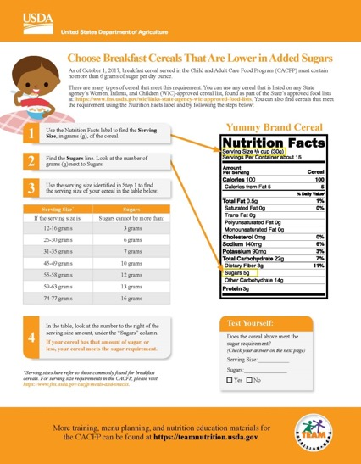
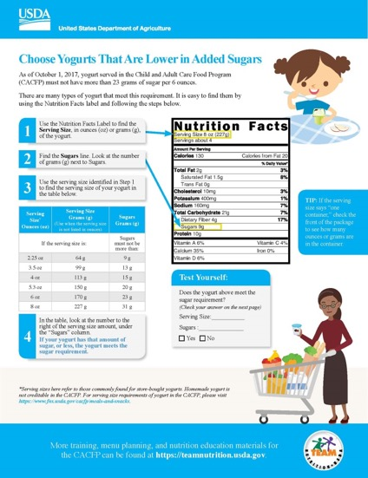

Lowering Added Sugars
fns.usda.gov/cacfp-halftime-thirty-thursdays-training-webinar-series
Let’s look at sugar limits for cereal and yogurt in the CACFP.
Cereals served in the CACFP must have no more than 6 grams of sugar per dry ounce.
Yogurts served in the CACFP must have no more than 23 grams of sugar per 6 ounces.
Team Nutrition has two worksheets with accompanying training webinars on how to find cereals and yogurts that meet these sugar limits. The titles of the webinars and worksheets are “Choose Breakfast Cereals That Are Lower in Added Sugars” and “Choose Yogurts That Are Lower in Added Sugars.” You can go to the web address on the slide to see these worksheets and webinars.
You can also contact your State agency or sponsoring organization.
Notes:
Let’s look at sugar limits for cereal and yogurt in the CACFP.
Cereals served in the CACFP must have no more than 6 grams of sugar per dry ounce.
Yogurts served in the CACFP must have no more than 23 grams of sugar per 6 ounces.
Team Nutrition has two worksheets with accompanying training webinars on how to find cereals and yogurts that meet these sugar limits. The titles of the webinars and worksheets are “Choose Breakfast Cereals That Are Lower in Added Sugars” and “Choose Yogurts That Are Lower in Added Sugars.” You can go to the web address on the slide to see these worksheets and webinars.
You can also contact your State agency or sponsoring organization.

Slide 17

Lowering Added Sugars At Breakfast
Grain-based desserts such as toaster pastries, donuts, cereal bars, etc. may not be served as part of a reimbursable meal or snack in the CACFP. This gives you the chance to serve other foods that provide participants with the nutrients needed for good health.
One example of this might be to serve meat and meat alternates in place of grain items at breakfast up to three times per week. Some meat/meat alternates you could serve as part of a reimbursable breakfast include be eggs, yogurt, turkey sausage, cheese, and peanut and soy butter.
You may serve meat/meat alternates in place of grains up to three times per week, no matter how many times per week your center or home is open.
*Yogurt must not contain more than 23 grams of sugar per 6 oz.
Notes:
Grain-based desserts such as toaster pastries, donuts, cereal bars, etc. may not be served as part of a reimbursable meal or snack in the CACFP. This gives you the chance to serve other foods that provide participants with the nutrients needed for good health.
One example of this might be to serve meat and meat alternates in place of grain items at breakfast up to three times per week. Some meat/meat alternates you could serve as part of a reimbursable breakfast include be eggs, yogurt, turkey sausage, cheese, and peanut and soy butter.
You may serve meat/meat alternates in place of grains up to three times per week, no matter how many times per week your center or home is open.

Slide 18
True or False:
I may serve eggs at breakfast as part of reimbursable meal.
?
True
False
Let’s try another practice question. Is the following statement true or false?
“I may serve eggs at breakfast as part of a reimbursable meal in the CACFP.”
Raise your hand if you think the answer is true [pause and wait for a show of hands].
Raise your hand if you think the answer is false [pause and wait for a show of hands].
Notes:
Let’s try another practice question. Is the following statement true or false?
“I may serve eggs at breakfast as part of a reimbursable meal in the CACFP.”
Raise your hand if you think the answer is true [pause and wait for a show of hands].
Raise your hand if you think the answer is false [pause and wait for a show of hands].

Slide 19
True or False: (Example 2)
I may serve eggs at breakfast as part of reimbursable meal.
?
The answer is true! Eggs can be served at breakfast as part of a reimbursable meal. Eggs are a meat alternate, and meat and meat alternates can be served in place of grains up to three times a week at breakfast.
Other meat and meat alternates that you could serve at breakfast include yogurt, cottage cheese and other cheeses, lean meats, peanut butter, and more.
✓
True
False
Eggs are a meat alternate, and meat and meat alternates may be served in place of grains up to three times per week at breakfast.
You may also serve yogurt, cottage cheese, cheese, lean meats, and peanut butter.
For more information, watch the recorded CACFP Halftime: Thirty on Thursdays webinar on
“Serving Meat and Meat Alternates at Breakfast” at https://www.fns.usda.gov/tn/halftime-cacfp-thirty-thursdays-training-webinar-series.
Notes:
The answer is true! Eggs can be served at breakfast as part of a reimbursable meal. Eggs are a meat alternate, and meat and meat alternates may be served in place of grains up to three times a week at breakfast.
Other meat and meat alternates that you could serve at breakfast include yogurt, cottage cheese and other cheeses, lean meats, peanut butter, and more.
Team Nutrition offers a training worksheet as well as a webinar on this topic. For more information, see “Serving Meat and Meat Alternates at Breakfast” at the link shown on the screen.

Slide 20
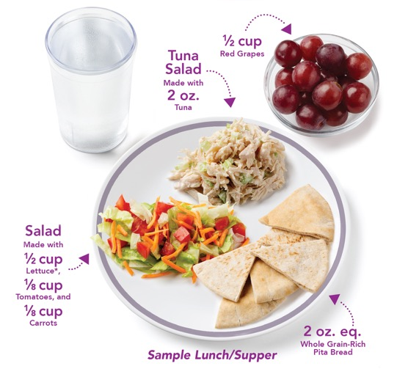
For Adult Participants Only
Milk is optional at supper only
Required components at supper are
  Vegetables
  Fruit
  Grains
  Meat/meat alternates
Water should be offered and made available throughout the day
The CACFP meal pattern has flexibilities that apply to only to adult participants. At supper only, milk is optional, not required.
This means that the required components, at supper only, and only for adults are:
vegetables,
fruit,
grains, and
meat/meat alternate.
Water should be offered and made available throughout the day.
Notes:
The CACFP meal pattern has flexibilities that apply to only to adult participants. At supper only, milk is optional, not required.
This means that the required components, at supper only, and only for adults are:
vegetables,
fruit,
grains, and
meat/meat alternate.
Water should be offered and made available throughout the day.

Slide 21

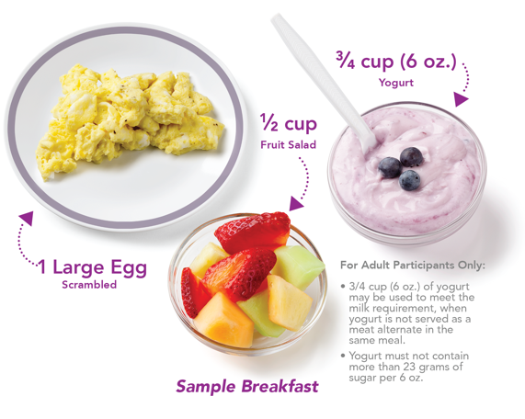
For Adult Participants Only (Continued)
Yogurt can be served in place of milk once per day.
If you are serving yogurt in place of milk, the yogurt cannot also count as a meat alternate in the same meal.
What is in a
Breakfast?
Milk (8 fl. oz. or 1 cup)
Vegetables, Fruit, or Both (¹/₂ cup)
Grains (2 oz. eq.)
Optional: Meat/meat alternates may be served in place of the entire grains component up to
3 times per week at breakfast.
Additionally, for adults only, yogurt may be served in place of milk once per day.
For example, the required components at breakfast are:
milk,
vegetables/fruit, and
grains.
You could serve a breakfast with yogurt replacing the milk component, fruit salad for the vegetables/fruit component, and eggs (a meat alternate) replacing the grains component.
This example has yogurt replacing milk at breakfast, but yogurt can replace milk at lunch and supper as well.
When yogurt is served in place of milk, the yogurt cannot be counted as a meat alternate in the same meal.
Notes:
Additionally, for adults only, yogurt may be served in place of milk once per day.
For example, the required components at breakfast are:
milk,
vegetables/fruit, and
grains.
You could serve a breakfast with yogurt replacing the milk component, fruit salad for the vegetables/fruit component, and eggs (a meat alternate) replacing the grains component.
This example has yogurt replacing milk at breakfast, but yogurt can replace milk at lunch and supper as well.
When yogurt is served in place of milk, the yogurt cannot be counted as a meat alternate in the same meal.

Slide 22

Best Practices in Menu Planning
Balance
Variety
Contrast
Color
Eye Appeal
You can use the CACFP meal pattern to meet many aspects of best practices in menu planning, such as:
balance,
variety,
contrast,
color, and
eye appeal.
Notes:
You can use the CACFP meal pattern to meet many aspects of best practices in menu planning, such as:
balance,
variety,
contrast,
color, and
eye appeal.

Slide 23
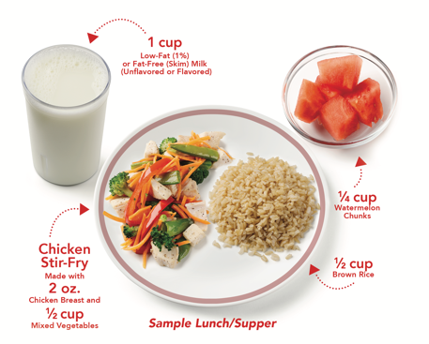
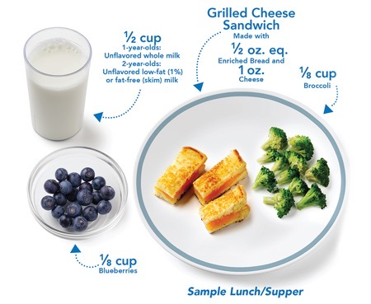
Balance
Use whole grain-rich foods to provide balance to strong flavors
Serve “heavier” dishes with lighter sides
Many whole grain-rich foods are great for providing balance to strong flavors.
Whole-wheat bread with chili, whole grain-rich crackers or pita bread with hummus and other flavorful dips, and brown rice with stir-fry, are all examples of how whole grains can be used to balance flavors in a meal. This will help make sure that the meal does not have too many strong flavors.
Balance also means serving heavier dishes and entrees with lighter side items. One example might be a grilled cheese sandwich, which tends to be on the heavier side, with fresh blueberries and steamed broccoli to lighten up the meal.
*Minimum Serving Sizes Shown
for Children Ages 6-12 and 13-18
*Minimum Serving Sizes Shown for Children Ages 1-2
Notes:
Many whole grain-rich foods are great for providing balance to strong flavors.
Whole-wheat bread with chili, whole grain-rich crackers or pita bread with hummus and other flavorful dips, and brown rice with stir-fry, are all examples of how whole grains can be used to balance flavors in a meal. This will help make sure that the meal does not have too many strong flavors.
Balance also means serving heavier dishes and entrees with lighter side items. One example might be a grilled cheese sandwich, which tends to be on the heavier side, with fresh blueberries and steamed broccoli to lighten up the meal.

Slide 24
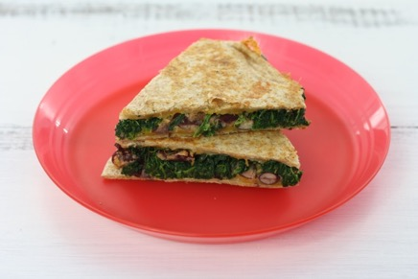
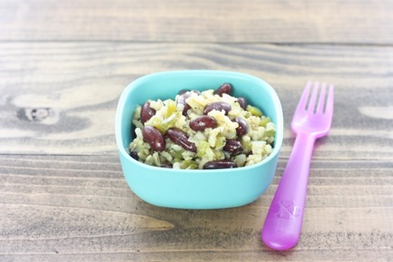
Variety
Offer variety with:
Whole Grains
Meat/meat alternates at breakfast
Cooking methods
Serving whole grain-rich foods once per day means that you can offer variety throughout the week by:
serving different kind of whole grain-rich foods,
serving whole grain-rich foods at different meals or snacks during the week, and
preparing whole grain-rich foods in different ways.
Some examples include using whole grain-rich tortillas to make quesadillas or using brown rice to make red beans and rice.
Serving meat and meat alternates at breakfast up to three times per week can also help you add variety to the menu.
Different cooking methods can be used to add variety. For example, just as the whole grains are prepared in different ways, you can also try serving vegetables prepared in different ways, such as raw, roasted, steamed, or broiled, throughout the week.
You can also serve a vegetable by itself, such as a side of roasted broccoli, or with other foods, such as the spinach in the quesadilla.
Notes:
Serving whole grain-rich foods once per day means that you can offer variety throughout the week by:
serving different kind of whole grain-rich foods,
serving whole grain-rich foods at different meals or snacks during the week, and
preparing whole grain-rich foods in different ways.
Some examples include using whole grain-rich tortillas to make quesadillas or using brown rice to make red beans and rice.
Serving meat and meat alternates at breakfast up to three times per week can also help you add variety to the menu.
Different cooking methods can be used to add variety. For example, just as the whole grains are prepared in different ways, you can also try serving vegetables prepared in different ways, such as raw, roasted, steamed, or broiled, throughout the week.
You can also serve a vegetable by itself, such as a side of roasted broccoli, or with other foods, such as the spinach in the quesadilla.

Slide 25
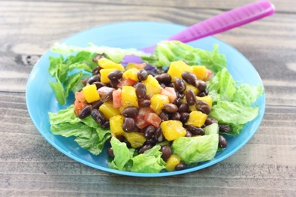


Color
Add color to your meals with fruits and vegetables.
Top oatmeal or pancakes with fruit.
Serve colorful fruit and vegetables at snacks and meals.
Vegetables and fruit can be used to add color, contrast, and eye appeal.
Try adding some color to your meals with a pop of fresh, colorful fruit, such as a topping for pancakes or hot and cold cereals.
Or, you could mix and match different colors in a fruit and veggie-filled Tropical Bean Salad, serve vegetables and fruits as a side dish like Gingered Carrots, or use fun, colorful vegetables in a chicken dish or stew like Chicken Ratatouille.
Notes:
Vegetables and fruit can be used to add color, contrast, and eye appeal.
Try adding some color to your meals with a pop of fresh, colorful fruit, such as a topping for pancakes or hot and cold cereals.
Or, you could mix and match different colors in a fruit and veggie-filled Tropical Bean Salad, serve vegetables and fruits as a side dish like Gingered Carrots, or use fun, colorful vegetables in a chicken dish or stew like Chicken Ratatouille.

Slide 26
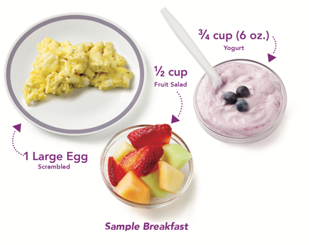
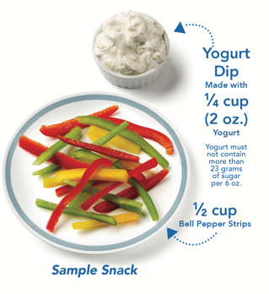
Contrast
Serve different textures, temperatures, and tastes
Examples:
  Crispy raw vegetables with creamy yogurt dip
  Scrambled eggs with yogurt and fruit
Add contrast to textures to your meals and snacks by serving different tastes, textures, and temperatures. This could include pairing crunchy vegetables with a smooth, creamy yogurt dip.
You can also add contrast in textures, temperatures and tastes by serving savory scrambled eggs, which are warm, with yogurt and fruit, which are cold. The fruit chunks also adds a nice “bite” and difference in texture from the softer eggs and yogurt.
*Minimum Serving Sizes
Shown for Adults
*Minimum Serving Sizes
Shown for Children Ages 1-2
Notes:
Add contrast to textures to your meals and snacks by serving different tastes, textures, and temperatures. This could include pairing crunchy vegetables with a smooth, creamy yogurt dip.
You can also add contrast in textures, temperatures and tastes by serving savory scrambled eggs, which are warm, with yogurt and fruit, which are cold. The fruit chunks also adds a nice “bite” and difference in texture from the softer eggs and yogurt.

Slide 27


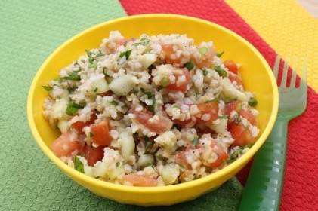
Eye Appeal
Cut or arrange foods into different shapes
Include space on the plate
Use different types of bowls, cups, plates, etc.
Finally, since we “eat with our eyes”, add eye appeal to meals by cutting or arranging foods into different shapes, leaving space between foods as you are putting them on a plate, and using different kinds and colors of serving containers, plates, cups, bowls, spoons, etc.
On this slide, you see that the Baked Cod Ole’, Mashed Whipped Potatoes, and Tabbouleh are arranged on plates or in and bowls of different sizes and colors, and paired with colorful utensils and placemats, all of which can help show off the food and add visual appeal.
Notes:
Finally, since we “eat with our eyes”, add eye appeal to meals by cutting or arranging foods into different shapes, leaving space between foods as you are putting them on a plate, and using different kinds and colors of serving containers, plates, cups, bowls, spoons, etc.
On this slide, you see that the Baked Cod Ole’, Mashed Whipped Potatoes, and Tabbouleh are arranged on plates or in and bowls of different sizes and colors, and paired with colorful utensils and placemats, all of which can help show off the food and add visual appeal.

Slide 28
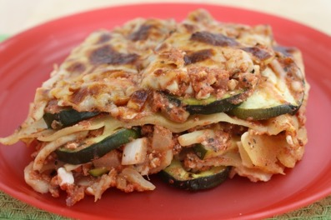
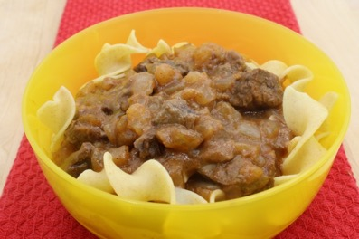

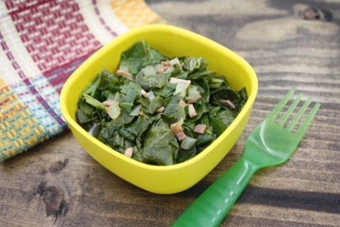


Standardized Recipes for the CACFP
fns.usda.gov/cacfp-recipes
Team Nutrition developed a series of 40 standardized recipes especially for CACFP settings. These recipes come in yields of 6, 25, and 50 servings, and include crediting information. Many of the dishes and sides shown and mentioned on the previous slides, as well as the ones shown on this slide, can be found on this webpage.
Notes:
Team Nutrition developed a series of 40 standardized recipes especially for CACFP settings. These recipes come in yields of 6, 25, and 50 servings, and include crediting information. Many of the dishes and sides shown and mentioned on the previous slides, as well as the ones shown on this slide, can be found on this webpage.

Slide 29
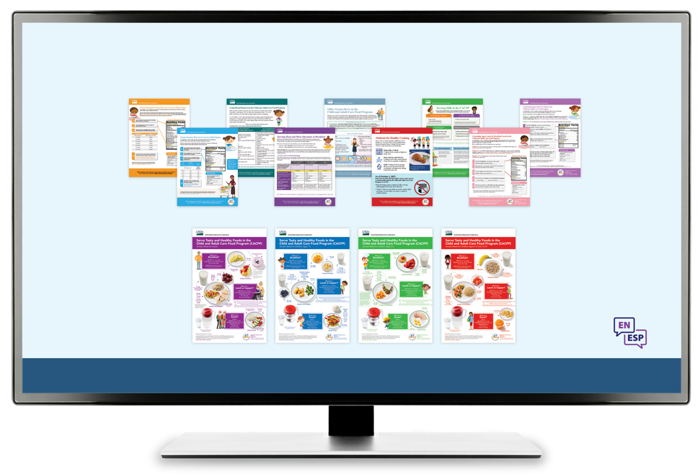
More Team Nutrition Resources!
All Team Nutrition materials are available online from Team Nutrition’s website and are available for free download to anybody who is interested.
TeamNutrition.usda.gov
Notes:
All Team Nutrition materials are available online from Team Nutrition’s website and are available for free download to anybody who is interested.

Slide 30

How To Order Print Copies
Resource Order Form at TeamNutrition.usda.gov.
FREE for those participating in a Child Nutrition Program, while supplies last.
Sponsoring organizations and State agencies can also order in bulk by sending an email to:
TeamNutrition@usda.gov
For all participating in a Child Nutrition Program, such as the CACFP, Team Nutrition’s print materials are free to order.
If you would like to order Team Nutrition’s free materials in print, you can go to the “Resource Order Form” link on the Team Nutrition website to order print copies of the materials.
For bulk orders, you can email teamnutrition@usda.gov.
Notes:
For all participating in a Child Nutrition Program, such as the CACFP, Team Nutrition’s print materials are free to order.
If you would like to order Team Nutrition’s free materials in print, you can go to the “Resource Order Form” link on the Team Nutrition website to order print copies of the materials.
For bulk orders, you can email teamnutrition@usda.gov.

Slide 31


Thank you!
These training slides were provided by U.S. Department of Agriculture's Team Nutrition. If you would like to learn more about Team Nutrition and additional resources available, please visit their website, subscribe to their monthly e-newsletter, connect with them via email at teamnutrition@usda.gov, and follow them on Twitter.
Thank you!
TeamNutrition.usda.gov
@TeamNutrition
TeamNutrition@usda.gov
USDA is an equal opportunity provider, employer, and lender.
Notes:
These training slides were provided by U.S. Department of Agriculture's Team Nutrition. If you would like to learn more about Team Nutrition and additional resources available, please visit their website, subscribe to their monthly e-newsletter, connect with them via email at teamnutrition@usda.gov, and follow them on Twitter.
Thank you!

