Slide 1

Methods for
Healthy Cooking
A Training Presentation for
Child and Adult Care Food Program (CACFP) Operators

Slide 2



USDA’s Team Nutrition
An initiative of the USDA’s Food and Nutrition Service to support the USDA’s Child Nutrition Programs.
Aims to improve children’s lifelong eating and physical activity habits.
Provides nutrition education and training materials to State agencies, sponsoring organizations, and CACFP sites.
As you may know, Team Nutrition is an initiative of the USDA Food and Nutrition Service that supports the Child Nutrition Programs, including the National School Lunch Program, the School Breakfast Program, and of course, the Child and Adult Care Food Program, or the CACFP.
The goal of Team Nutrition is to improve children's lifelong eating and physical activity habits through nutrition education based on the principles of the Dietary Guidelines for Americans and MyPlate.
It does so through training and technical assistance for those preparing and serving meals, providing nutrition education for children, and building support for healthier school and child care environments.
TeamNutrition.usda.gov
@TeamNutrition
Notes:
As you may know, Team Nutrition is an initiative of the USDA Food and Nutrition Service that supports the Child Nutrition Programs, including the National School Lunch Program, the School Breakfast Program, and of course, the Child and Adult Care Food Program, or the CACFP.
The goal of Team Nutrition is to improve children's lifelong eating and physical activity habits through nutrition education based on the principles of the Dietary Guidelines for Americans and MyPlate.
It does so through training and technical assistance for those preparing and serving meals, providing nutrition education for children, and building support for healthier school and child care environments.

Slide 3
Let Us Know Who You Are!
I work for a…
?
Child care center
Family care home
At-risk afterschool care center
Adult day care center
Sponsoring organization
Emergency shelter
School food authority
State agency
USDA Regional Office
Other
Before we get started, I want to know who has joined us today.
Please raise your hand if you work for:
a child care center [pause and wait for a show of hands],
a family child care home [pause and wait for a show of hands],
an at-risk afterschool care center [pause and wait for a show of hands],
a sponsoring organization [pause and wait for a show of hands],
an emergency shelter [pause and wait for a show of hands],
a school food authority [pause and wait for a show of hands],
a State agency [pause and wait for a show of hands],
A USDA Regional office [pause and wait for a show of hands], or
other [pause and wait for a show of hands].
Notes:
Before we get started, I want to know who has joined us today.
Please raise your hand if you work for:
a child care center [pause and wait for a show of hands],
a family child care home [pause and wait for a show of hands],
an at-risk afterschool care center [pause and wait for a show of hands],
a sponsoring organization [pause and wait for a show of hands],
an emergency shelter [pause and wait for a show of hands],
a school food authority [pause and wait for a show of hands],
a State agency [pause and wait for a show of hands],
A USDA Regional office [pause and wait for a show of hands], or
other [pause and wait for a show of hands].

Slide 4
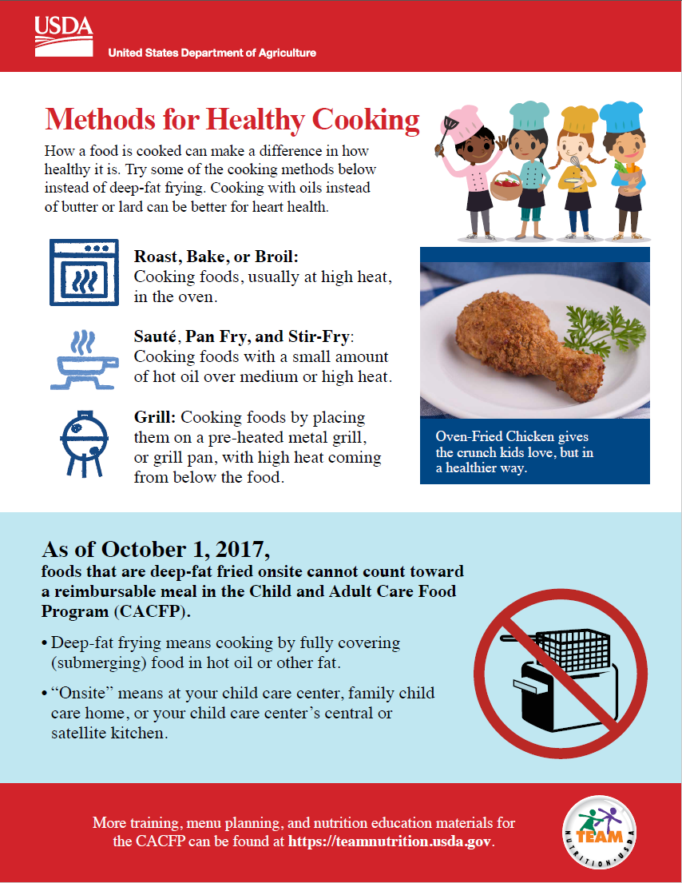

Methods for Healthy Cooking worksheet
So, lets get started! The worksheet we are talking about today is Methods for Healthy Cooking. It is important to remember that how a food is cooked can affect how healthy it is. To help reinforce this information we will explore a variety of cooking methods and recipes that can be used to create nutritious meals and snacks that reflect regional food preferences and flavors.
Please have this worksheet in front of you so you can follow along with us.
So, lets get started! As you can see on the screen, today we will discuss “Methods for Healthy Cooking.” It is important to remember that how a food is cooked can affect how healthy it is. To help reinforce this information we will explore a variety of cooking methods and recipes that can be used to create nutritious meals and snacks that reflect regional food preferences and flavors in the CACFP.
fns.usda.gov/team-nutrition/cacfp-meal-pattern-training-worksheets
Notes:
So, lets get started! As you can see on the screen, today we will discuss “Methods for Healthy Cooking.” It is important to remember that how a food is cooked can affect how healthy it is. To help reinforce this information we will explore a variety of cooking methods and recipes that can be used to create nutritious meals and snacks that reflect regional food preferences and flavors in the CACFP.

Slide 5


Methods for Healthy Cooking
Methods for Healthy Cooking
How a food is cooked can make a difference in how healthy it is. Try some of the cooking methods below instead of deep-fat frying. Cooking with oils instead of butter or lard can be better for heart health.
Roast, Bake, or Broil: Cooking foods, usually at high heat, in the oven.
Sauté, Pan Fry, and Stir-Fry: Cooking foods with a small amount of hot oil over medium or high heat.
Grill: Cooking foods by placing them on a pre-heated metal grill, or grill pan, with high heat coming from below the food.
Oven-Fried Chicken gives the crunch kids love, but in a healthier way.
This worksheet has two pages. The top of the first page provides information on methods for healthy cooking that can be used to prepare meals and snacks in the CACFP, such as roasting, sautéing and grilling. We will go into these methods in more detail in just a little bit.
Notes:
This worksheet has two pages. The top of the first page provides information on methods for healthy cooking that can be used to prepare meals and snacks in the CACFP, such as roasting, sautéing and grilling. We will go into these methods in more detail in just a little bit.

Slide 6
Methods for Healthy Cooking (part 1)
Foods that are deep-fat fried onsite cannot count toward a reimbursable meal in the Child and Adult Care Food Program (CACFP).
The bottom of the first page states the policy that deep-fat frying foods onsite is not allowed in the CACFP. It also provides a definition for the terms “deep-fat frying” and “onsite”.
Let’s take a closer look at those definitions.
Notes:
The bottom of the first page states the policy that deep-fat frying foods onsite is not allowed in the CACFP. It also provides a definition for the terms “deep-fat frying” and “onsite”.
Let’s take a closer look at those definitions.

Slide 7
Methods for Healthy Cooking (part 2)
Deep-fat frying means cooking by fully covering (submerging) food in hot oil or other fat.
In the CACFP, deep-fat frying is defined as "cooking by fully covering or submerging food in hot oil or other fat.”
Notes:
In the CACFP, deep-fat frying is defined as "cooking by fully covering or submerging food in hot oil or other fat.”

Slide 8
Methods for Healthy Cooking (part 3)
“Onsite” means at your child care center, family child care home, or your child care center’s central or satellite kitchen.
The term “onsite” means the child or adult care center, family child or adult care home, and other settings where CACFP participants are served. Onsite also includes central or satellite kitchens.
Notes:
The term “onsite” means the child or adult care center, family child or adult care home, and other settings where CACFP participants are served. Onsite also includes central or satellite kitchens.

Slide 9

Try It Out!
Foods that are deep-fat fried onsite cannot count toward a reimbursable meal in the CACFP. Which settings are defined as onsite?
?
Child or adult care center
Satellite or central kitchen
Family child care home
All of the above
Let’s try a practice question. As we just discussed, foods that are deep-fat friend onsite cannot count toward a reimbursable meal or snack in the CACFP.
Which settings are defined as onsite? Raise your hand if you think onsite means:
child or adult care center [pause and wait for a show of hands],
satellite or central kitchen [pause and wait for a show of hands],
family child care home [pause and wait for a show of hands], or
all of the above.
Notes:
Let’s try a practice question. As we just discussed, foods that are deep-fat friend onsite cannot count toward a reimbursable meal or snack in the CACFP.
Which settings are defined as onsite? Raise your hand if you think onsite means:
child or adult care center [pause and wait for a show of hands],
satellite or central kitchen [pause and wait for a show of hands],
family child care home [pause and wait for a show of hands], or
all of the above.

Slide 10
Answer
Foods that are deep-fat fried onsite cannot count toward a reimbursable meal in the CACFP. Which settings are defined as “onsite”?
?
Child or adult care center
Satellite or central kitchen
Family child care home
All of the above
✓
Great job! The correct answer is D, all of the above.
Child and adult care centers, family child care homes, and any central or satellite kitchens affiliated with the center or home all meet the definition of “onsite".
Foods that are deep-fat friend onsite also may not count toward reimbursable meals and snacks at emergency shelters, at-risk afterschool programs, or any other CACFP sites.
Notes:
Great job! The correct answer is D, all of the above.
Child and adult care centers, family child care homes, and any central or satellite kitchens affiliated with the center or home all meet the definition of “onsite".
Foods that are deep-fat friend onsite also may not count toward reimbursable meals and snacks at emergency shelters, at-risk afterschool programs, or any other CACFP sites.

Slide 11
Which foods may be served as part of a reimbursable meal in the CACFP?
Food | Reimbursable?
Packaged par-fried or flash-fried foods purchased from a grocery store (such as par-fried frozen potatoes). | Yes, if heated onsite by baking, microwaving, or another method that is not deep-fat frying. Compare foods and choose those lower in saturated fats.
Fried food from a restaurant or vendor. | Yes, if reheated onsite by baking, microwaving, or another method that is not deep-fat frying. Try to switch to healthier options.
Pan-fried foods prepared at the child care center or family child care home. | Yes, the food is not covered with oil when pan-frying.
Fried foods prepared at a child care center’s central kitchen. | No.
Stir-fried or sautéed foods prepared at the child care center or family child care home. | Yes, the food is not covered with oil when stir-frying or sautéing.
Okay, now let’s turn to the second page of the worksheet. At the top of the page you will see a simple chart that you can use to help determine if the item you want to serve at your CACFP site can be counted as part of a reimbursable meal or snack, based on how or where it is prepared.
Notes:
Okay, now let’s turn to the second page of the worksheet. At the top of the page you will see a simple chart that you can use to help determine if the item you want to serve at your CACFP site can be counted as part of a reimbursable meal or snack, based on how or where it is prepared.

Slide 12
Which foods may be served as part of a reimbursable meal in the CACFP?
Food | Reimbursable?
Packaged par-fried or flash-fried foods purchased from a grocery store (such as par-fried frozen potatoes). | Yes, if heated onsite by baking, microwaving, or another method that is not deep-fat frying. Compare foods and choose those lower in saturated fats.
Fried food from a restaurant or vendor. | Yes, if reheated onsite by baking, microwaving, or another method that is not deep-fat frying. Try to switch to healthier options.
Pan-fried foods prepared at the child care center or family child care home. | Yes, the food is not covered with oil when pan-frying.
Fried foods prepared at a child care center’s central kitchen. | No.
Stir-fried or sautéed foods prepared at the child care center or family child care home. | Yes, the food is not covered with oil when stir-frying or sautéing.
The first row of this chart mentions serving foods that have been pre-fried, such as par-fried or flash-fried items. It is important to know that packaged foods that have been par-fried or flash-fried, such as French fries or chicken nuggets, can be served as part of a reimbursable meal or snack as long as they are heated onsite by a method other than deep-fat frying, such as baking or microwaving.
The CACFP meal pattern does not place a limit on the amount of pre-fried foods a site may serve each week. However, as an optional CACFP Best Practice, aim to serve purchased pre-fried foods once a week or less.
Notes:
The first row of this chart mentions serving foods that have been pre-fried, such as par-fried or flash-fried items. It is important to know that packaged foods that have been par-fried or flash-fried, such as French fries or chicken nuggets, can be served as part of a reimbursable meal or snack as long as they are heated onsite by a method other than deep-fat frying, such as baking or microwaving.
The CACFP meal pattern does not place a limit on the amount of pre-fried foods a site may serve each week. However, as an optional CACFP Best Practice, aim to serve purchased pre-fried foods once a week or less.

Slide 13
Which foods may be served as part of a reimbursable meal in the CACFP?
(part 1)
Food | Reimbursable?
Packaged par-fried or flash-fried foods purchased from a grocery store (such as par-fried frozen potatoes). | Yes, if heated onsite by baking, microwaving, or another method that is not deep-fat frying. Compare foods and choose those lower in saturated fats.
Fried food from a restaurant or vendor. | Yes, if reheated onsite by baking, microwaving, or another method that is not deep-fat frying. Try to switch to healthier options.
Pan-fried foods prepared at the child care center or family child care home. | Yes, the food is not covered with oil when pan-frying.
Fried foods prepared at a child care center’s central kitchen. | No.
Stir-fried or sautéed foods prepared at the child care center or family child care home. | Yes, the food is not covered with oil when stir-frying or sautéing.
On the second row of the chart, you will see that deep-fat fried foods from a restaurant or vendor can be served as part of a reimbursable CACFP meal or snack. However, if you need to reheat the items onsite, you must use a method other than deep-fat frying.
Although fried foods from a restaurant or vendor may be served, we encourage you to have discussions with your vendor about healthier cooking options for foods such as baking, grilling, or roasting.
Let’s try another practice question.
Notes:
On the second row of the chart, you will see that deep-fat fried foods from a restaurant or vendor can be served as part of a reimbursable CACFP meal or snack. However, if you need to reheat the items onsite, you must use a method other than deep-fat frying.
Although fried foods from a restaurant or vendor may be served, we encourage you to have discussions with your vendor about healthier cooking options for foods such as baking, grilling, or roasting.
Let’s try another practice question.

Slide 14
Try It Out!
Deep-fat fried foods from a vendor or restaurant are reimbursable in the CACFP. How can they be reheated “onsite”?
?
Baking
Microwaving
Deep-fat frying
Both Baking and Microwaving
Let’s try another practice question. As we just discussed, deep-fat fried foods from a vendor or restaurant may be served as part of a reimbursable meal or snack in the CACFP.
How may foods be reheated onsite to be served as part of a reimbursable meal? Raise your hand if you think foods may be reheated by:
Baking [pause and wait for a show of hands],
Microwaving [pause and wait for a show of hands],
Deep-fat frying [pause and wait for a show of hands], or
Both baking and microwaving.
Notes:
Let’s try another practice question. As we just discussed, deep-fat fried foods from a vendor or restaurant may be served as part of a reimbursable meal or snack in the CACFP.
How may foods be reheated onsite to be served as part of a reimbursable meal? Raise your hand if you think foods may be reheated by:
Baking [pause and wait for a show of hands],
Microwaving [pause and wait for a show of hands],
Deep-fat frying [pause and wait for a show of hands], or
Both baking and microwaving.

Slide 15
Answer
Deep-fat fried foods from a vendor or restaurant are reimbursable in the CACFP. How can they be reheated “onsite”?
?
Baking
Microwaving
Deep-fat frying
Both Baking and Microwaving
✓
Nice work! The correct answer is “Baking and Microwaving.” Although deep-fat fried foods from a vendor or restaurant can be served as part of a reimbursable meal in the CACFP, to reheat the foods onsite, you must use a method other than deep-fat frying such as baking, microwaving, roasting, or pan-frying.
Notes:
Nice work! The correct answer is “Baking and Microwaving.” Although deep-fat fried foods from a vendor or restaurant can be served as part of a reimbursable meal in the CACFP, to reheat the foods onsite, you must use a method other than deep-fat frying such as baking, microwaving, roasting, or pan-frying.

Slide 16
Which foods may be served as part of a reimbursable meal in the CACFP?
(part 2)
Food | Reimbursable?
Packaged par-fried or flash-fried foods purchased from a grocery store (such as par-fried frozen potatoes). | Yes, if heated onsite by baking, microwaving, or another method that is not deep-fat frying. Compare foods and choose those lower in saturated fats.
Fried food from a restaurant or vendor. | Yes, if reheated onsite by baking, microwaving, or another method that is not deep-fat frying. Try to switch to healthier options.
Pan-fried foods prepared at the child care center or family child care home. | Yes, the food is not covered with oil when pan-frying.
Fried foods prepared at a child care center’s central kitchen. | No.
Stir-fried or sautéed foods prepared at the child care center or family child care home. | Yes, the food is not covered with oil when stir-frying or sautéing.
Now, lets take a look at rows 3 and 5 on the chart.
Pan-fried, stir-fried, or sautéed foods prepared at the CACFP site, such as child care centers and family child care homes, as well as satellite and central kitchens, may be served as part of a reimbursable meal or snack in the CACFP as long as the food is not fully covered or submerged in hot oil or fat during the cooking or reheating process.
Notes:
Now, lets take a look at rows 3 and 5 on the chart.
Pan-fried, stir-fried, or sautéed foods prepared at the CACFP site, such as child care centers and family child care homes, as well as satellite and central kitchens, may be served as part of a reimbursable meal or snack in the CACFP as long as the food is not fully covered or submerged in hot oil or fat during the cooking or reheating process.

Slide 17
Try It Out!
Pan-fried, sautéed, and stir-fried food items are reimbursable in the CACFP.
?
True
False
Let’s try another practice question.
Raise your hand if you think pan-fried, sautéed, and stir-fried foods may be served as part of a reimbursable meal or snack in the CACFP [pause and wait for a show of hands].
Raise your hand if you think pan-friend, sautéed, and stir-fried foods may not be served as part of a reimbursable meal or snack in the CACFP [pause and wait for a show of hands].
Notes:
Let’s try another practice question.
Raise your hand if you think pan-fried, sautéed, and stir-fried foods may be served as part of a reimbursable meal or snack in the CACFP [pause and wait for a show of hands].
Raise your hand if you think pan-friend, sautéed, and stir-fried foods may not be served as part of a reimbursable meal or snack in the CACFP [pause and wait for a show of hands].

Slide 18
Answer
Pan-fried, sautéed, and stir-fried food items are reimbursable in the CACFP.
?
✓
True
False
Great, the correct answer is true! Pan-fried, sautéed, and stir-fried foods may be served as part of a reimbursable meal or snack in the CACFP because the food is not fully covered or submerged in hot oil or fat during the cooking or reheating process.
Notes:
Great, the correct answer is true! Pan-fried, sautéed, and stir-fried foods may be served as part of a reimbursable meal or snack in the CACFP because the food is not fully covered or submerged in hot oil or fat during the cooking or reheating process.

Slide 19
Which foods may be served as part of a reimbursable meal in the CACFP?
(part 3)
Food | Reimbursable?
Packaged par-fried or flash-fried foods purchased from a grocery store (such as par-fried frozen potatoes). | Yes, if heated onsite by baking, microwaving, or another method that is not deep-fat frying. Compare foods and choose those lower in saturated fats.
Fried food from a restaurant or vendor. | Yes, if reheated onsite by baking, microwaving, or another method that is not deep-fat frying. Try to switch to healthier options.
Pan-fried foods prepared at the child care center or family child care home. | Yes, the food is not covered with oil when pan-frying.
Fried foods prepared at a child care center’s central kitchen. | No.
Stir-fried or sautéed foods prepared at the child care center or family child care home. | Yes, the food is not covered with oil when stir-frying or sautéing.
Finally, we know the meal pattern states that deep-fat frying onsite is not allowable in the CACFP. As mentioned earlier, the definition of “onsite” also includes a site’s central or satellite kitchen. Therefore, foods may not be served as part of a reimbursable meal or snack in that have been deep-fat fried at a central or satellite kitchen the CACFP.
Notes:
Finally, we know the meal pattern states that deep-fat frying onsite is not allowable in the CACFP. As mentioned earlier, the definition of “onsite” also includes a site’s central or satellite kitchen. Therefore, foods may not be served as part of a reimbursable meal or snack in that have been deep-fat fried at a central or satellite kitchen the CACFP.

Slide 20
Try It Out!
A center’s satellite kitchen provides French fries that are deep-fat fried.
Is this meal reimbursable?
?
Yes
No
Let’s try another practice question. A center’s satellite kitchen provides French fries that are deep-fat fried.
Raise your hand if you think this meal is reimbursable in the CACFP [pause and wait for a show of hands].
Raise your hand if you think this meal is not reimbursable in the CACFP [pause and wait for a show of hands].
Notes:
Let’s try another practice question. A center’s satellite kitchen provides French fries that are deep-fat fried.
Raise your hand if you think this meal is reimbursable in the CACFP [pause and wait for a show of hands].
Raise your hand if you think this meal is not reimbursable in the CACFP [pause and wait for a show of hands].

Slide 21
Answer
A center’s satellite kitchen provides French fries that are deep-fat fried.
Is this meal reimbursable?
?
Yes
No
✓
Nice work everyone! The answer is no, this meal is not reimbursable because the satellite kitchen is considered “onsite.” Therefore, the French fries should have been reheated/cooked using a method other than deep-fat frying in order for the meal to be reimbursable in the CACFP.
Notes:
Nice work everyone! The answer is no, this meal is not reimbursable because the satellite kitchen is considered “onsite.” Therefore, the French fries should have been reheated/cooked using a method other than deep-fat frying in order for the meal to be reimbursable in the CACFP.

Slide 22

Try It Out!
Try It Out!
Now let’s focus on the bottom half of the 2nd page of the worksheet. Here you will find a list of yummy recipes that can be used at your site. These recipes use healthy cooking methods such as baking, sautéing, and stir-frying.
Find these yummy recipes at: fns.usda.gov/tn/team-nutrition-recipes-and-cookbook-toolkit. Circle the ones you plan to try.
Try: Oven-Fried Chicken
Italian Garden Salsa with
Crunchy Chicken Tenders
Try: Baked Tortilla Chips
Corn Toasties
Try: Bean and Rice Burritos
15-Minute Enchiladas
Turkey Tostadas
Try: Chicken Fiesta Taco Bake
Delicious Tacos
Eagle Pizza
Try: Oven-Fried Fish
Roasted Fish Crispy Slaw Wrap
Try: Delicious Oven French Fries
Tasty Tots
Notes:
Now let’s focus on the bottom half of the 2nd page of the worksheet. Here you will find a list of yummy recipes that can be used at your site. These recipes use healthy cooking methods such as baking, sautéing, and stir-frying.

Slide 23

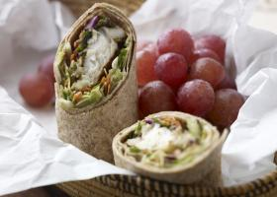
Roast, Bake, or Broil
Cooking foods, usually at high heat, in the oven.
Oven-Fried Chicken
Roasted Fish Crispy Slaw Wrap
Let’s go back to the first page and take a closer look at some healthy cooking methods listed, such as roasting, baking, and broiling. These techniques involve cooking foods at high heat in the oven and can be used to cook foods that might traditionally be deep-fat fried.
For an example of baking, take a look at the Oven-Fried Chicken recipe. The Oven-Fried Chicken is seasoned with spices, coated in crushed corn flakes, and then baked in the oven to provide all of the crunch and flavor you need.
The Roasted Fish Crispy Slaw Wrap is prepared by roasting. It uses a combination of fresh vegetables that overflow with color and texture, roasted spicy fish, and a burst of citrus, all served neatly wrapped in a whole-wheat tortilla.
fns.usda.gov/tn/team-nutrition-recipes-and-cookbook-toolkit
Notes:
Let’s go back to the first page and take a closer look at some healthy cooking methods listed, such as roasting, baking, and broiling. These techniques involve cooking foods at high heat in the oven and can be used to cook foods that might traditionally be deep-fat fried.
For an example of baking, take a look at the Oven-Fried Chicken recipe. The Oven-Fried Chicken is seasoned with spices, coated in crushed corn flakes, and then baked in the oven to provide all of the crunch and flavor you need.
The Roasted Fish Crispy Slaw Wrap is prepared by roasting. It uses a combination of fresh vegetables that overflow with color and texture, roasted spicy fish, and a burst of citrus, all served neatly wrapped in a whole-wheat tortilla.

Slide 24
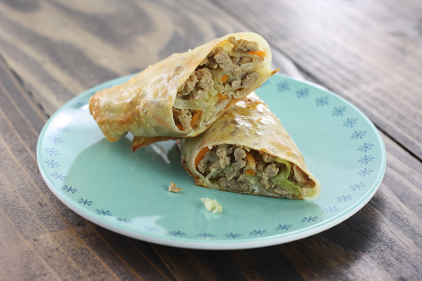

Roast, Bake, or Broil (cont.)
Cooking foods, usually at high heat, in the oven.
Baked Egg Rolls
Baked Batatas and Apples
Another great recipe for CACFP participants are Baked Egg Rolls. Baked Egg Rolls are fun to make and eat. Dough is wrapped around a mixture of lightly seasoned ground beef, green cabbage, and carrots and then baked.
For a new side dish, try Baked Batatas and Apples. This combination of apples and sweet potatoes create a sweet-savory dish that both kids and adults will enjoy.
fns.usda.gov/tn/team-nutrition-recipes-and-cookbook-toolkit
Notes:
Another great recipe for CACFP participants are Baked Egg Rolls. Baked Egg Rolls are fun to make and eat. Dough is wrapped around a mixture of lightly seasoned ground beef, green cabbage, and carrots and then baked.
For a new side dish, try Baked Batatas and Apples. This combination of apples and sweet potatoes create a sweet-savory dish that both kids and adults will enjoy.

Slide 25
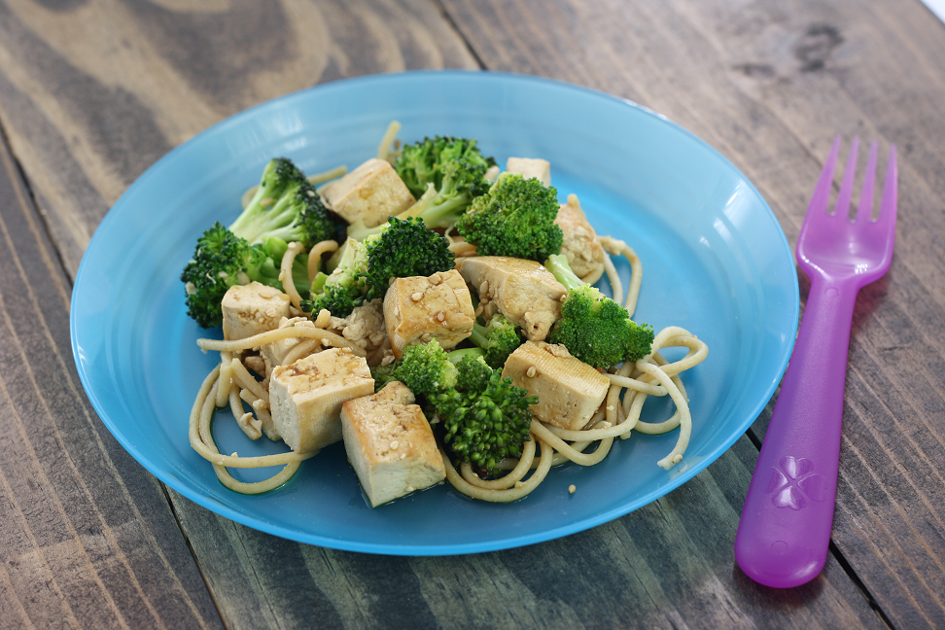
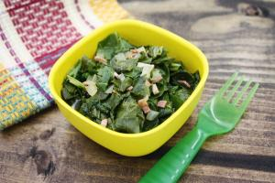
Sauté, Pan Fry, and Stir-Fry
Cooking foods with a small amount of hot oil over medium or high heat.
Sautéed Tofu and Broccoli
Other healthy cooking methods include sautéing, pan-frying, and stir-frying. Each of these cooking techniques involve cooking foods in a small amount of hot oil over medium or high heat.
For great tasting recipes that reflect regional and cultural food preferences, try Sautéed Tofu and Broccoli or Collard Greens.
The Baked Egg Rolls, Baked Apples and Batatas, Sautéed Tofu and Broccoli, and Collard Greens recipes are part of USDA Team Nutrition’s multicultural recipe collection. There are 40 recipes in the collection and they include many of the healthy cooking methods we have discussed today.
This recipe collection was designed to meet program operators’ request for new CACFP recipes that reflect a variety of cultures. All of the recipes in this collection are standardized and available in yields of 6, 25, and 50 servings. They also include a crediting statement for the 3 through 5 year old meal pattern.
Collard Greens
fns.usda.gov/tn/team-nutrition-recipes-and-cookbook-toolkit
Notes:
Other healthy cooking methods include sautéing, pan-frying, and stir-frying. Each of these cooking techniques involve cooking foods in a small amount of hot oil over medium or high heat.
For great tasting recipes that reflect regional and cultural food preferences, try Sautéed Tofu and Broccoli or Collard Greens.
The Baked Egg Rolls, Baked Apples and Batatas, Sautéed Tofu and Broccoli, and Collard Greens recipes are part of USDA Team Nutrition’s multicultural recipe collection. There are 40 recipes in the collection and they include many of the healthy cooking methods we have discussed today.
This recipe collection was designed to meet program operators’ request for new CACFP recipes that reflect a variety of cultures. All of the recipes in this collection are standardized and available in yields of 6, 25, and 50 servings. They also include a crediting statement for the 3 through 5 year old meal pattern.

Slide 26
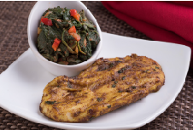

Grill
Cooking foods by placing them on a pre-heated metal grill, or grill pan, with high heat coming from below the food.
The final healthy cooking method listed on the front of the worksheet is grilling. Grilling involves cooking foods by placing them on a pre-heated metal grill or grill pan with heat coming from below the food. This cooking method is best used for meats and vegetables.
fns.usda.gov/tn/team-nutrition-recipes-and-cookbook-toolkit
Notes:
The final healthy cooking method listed on the front of the worksheet is grilling. Grilling involves cooking foods by placing them on a pre-heated metal grill or grill pan with heat coming from below the food. This cooking method is best used for meats and vegetables.

Slide 27
Try It Out!
All of the following are acceptable ways to prepare foods onsite, except:
?
Grilling
Pan-frying
Deep-fat frying
Baking
Let’s try one last practice question.
Raise your hand if you think all of the following are acceptable ways to prepare foods for a reimbursable meal onsite, expect:
Grilling [pause and wait for a show of hands],
Pan-frying [pause and wait for a show of hands],
Deep-fat frying [pause and wait for a show of hands], or
Baking [pause and wait for a show of hands].
Notes:
Let’s try one last practice question.
Raise your hand if you think all of the following are acceptable ways to prepare foods for a reimbursable meal onsite, expect:
Grilling [pause and wait for a show of hands],
Pan-frying [pause and wait for a show of hands],
Deep-fat frying [pause and wait for a show of hands], or
Baking [pause and wait for a show of hands].

Slide 28
Answer
All of the following are acceptable ways to prepare foods onsite, except:
?
Grilling
Pan-frying
Deep-fat frying
Baking
✓
Nice work everyone! The correct answer is deep-fat frying. As we have discussed, deep-fat frying onsite is not allowed in the CACFP, but grilling, pan-frying and baking are all acceptable ways to prepare foods for a reimbursable meal onsite.
Notes:
Nice work everyone! The correct answer is deep-fat frying. As we have discussed, deep-fat frying onsite is not allowed in the CACFP, but grilling, pan-frying and baking are all acceptable ways to prepare foods for a reimbursable meal onsite.

Slide 29

Team Nutrition Resources
All Team Nutrition materials are available online from Team Nutrition’s website and are available for free download to anybody who is interested.
TeamNutrition.usda.gov
Notes:
All Team Nutrition materials are available online from Team Nutrition’s website and are available for free download to anybody who is interested.

Slide 30

How To Order Print Copies
Resource Order Form at TeamNutrition.usda.gov.
FREE for those participating in a USDA’s Child Nutrition Program, while supplies last.
Sponsoring organizations and State agencies can also order in bulk by sending an email to:
TeamNutrition@usda.gov
For all participating in a Child Nutrition Program, such as the CACFP, Team Nutrition’s print materials are free to order.
If you would like to order Team Nutrition’s free materials in print, you can go to the “Resource Order Form” link on the Team Nutrition website to order print copies of the materials.
For bulk orders, you can email teamnutrition@usda.gov.
Notes:
For all participating in a Child Nutrition Program, such as the CACFP, Team Nutrition’s print materials are free to order.
If you would like to order Team Nutrition’s free materials in print, you can go to the “Resource Order Form” link on the Team Nutrition website to order print copies of the materials.
For bulk orders, you can email teamnutrition@usda.gov.

Slide 31


Thank you!
These training slides were provided by U.S. Department of Agriculture's Team Nutrition. If you would like to learn more about Team Nutrition and additional resources available, please visit their website, subscribe to their monthly e-newsletter, connect with them via email at teamnutrition@usda.gov, and follow them on Twitter.
Thank you!
TeamNutrition.usda.gov
@TeamNutrition
TeamNutrition@usda.gov
USDA is an equal opportunity provider, employer, and lender.
Notes:
These training slides were provided by U.S. Department of Agriculture's Team Nutrition. If you would like to learn more about Team Nutrition and additional resources available, please visit their website, subscribe to their monthly e-newsletter, connect with them via email at teamnutrition@usda.gov, and follow them on Twitter.
Thank you!

