Slide 1

Offer Versus Serve in the CACFP
A Training Presentation for
Child and Adult Care Food Program (CACFP) Operators

Slide 2
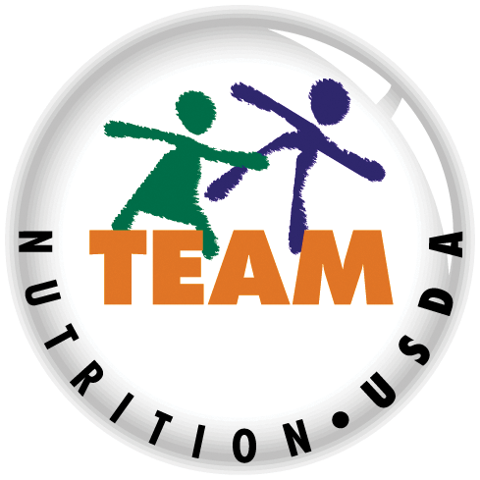


USDA’s Team Nutrition
An initiative of the USDA’s Food and Nutrition Service to support the USDA’s Child Nutrition Programs.
Aims to improve children’s lifelong eating and physical activity habits.
Provides nutrition education and training materials to State agencies, sponsoring organizations, and CACFP sites.
Team Nutrition is an initiative of the USDA Food and Nutrition Service that supports the Child Nutrition Programs, including the National School Lunch Program, the School Breakfast Program, and of course, the Child and Adult Care Food Program, or the CACFP.
The goal of Team Nutrition is to improve children's lifelong eating and physical activity habits through nutrition education based on the principles of the Dietary Guidelines for Americans and MyPlate.
It does so through training and technical assistance for those preparing and serving meals, providing nutrition education for children, and building support for healthier school and child care environments.
TeamNutrition.usda.gov
@TeamNutrition
Notes:
Team Nutrition is an initiative of the USDA Food and Nutrition Service that supports the Child Nutrition Programs, including the National School Lunch Program, the School Breakfast Program, and of course, the Child and Adult Care Food Program, or the CACFP.
The goal of Team Nutrition is to improve children's lifelong eating and physical activity habits through nutrition education based on the principles of the Dietary Guidelines for Americans and MyPlate.
It does so through training and technical assistance for those preparing and serving meals, providing nutrition education for children, and building support for healthier school and child care environments.

Slide 3
Let Us Know Who You Are!
I work for a…
Before we get started, I want to know who has joined us today.
Please raise your hand if you work for:
a child care center [pause and wait for a show of hands],
a family child care home [pause and wait for a show of hands],
an at-risk afterschool care center [pause and wait for a show of hands],
a sponsoring organization [pause and wait for a show of hands],
an emergency shelter [pause and wait for a show of hands],
a school food authority [pause and wait for a show of hands],
a State agency [pause and wait for a show of hands],
a USDA Regional office [pause and wait for a show of hands], or
other [pause and wait for a show of hands].
?
Child care center
Family child care home
At-risk afterschool care center
Adult day care center
Sponsoring organization
Emergency shelter
School food authority
State agency
USDA Regional Office
Other
Notes:
Before we get started, I want to know who has joined us today.
Please raise your hand if you work for:
a child care center [pause and wait for a show of hands],
a family child care home [pause and wait for a show of hands],
an at-risk afterschool care center [pause and wait for a show of hands],
a sponsoring organization [pause and wait for a show of hands],
an emergency shelter [pause and wait for a show of hands],
a school food authority [pause and wait for a show of hands],
a State agency [pause and wait for a show of hands],
a USDA Regional office [pause and wait for a show of hands], or
other [pause and wait for a show of hands].

Slide 4
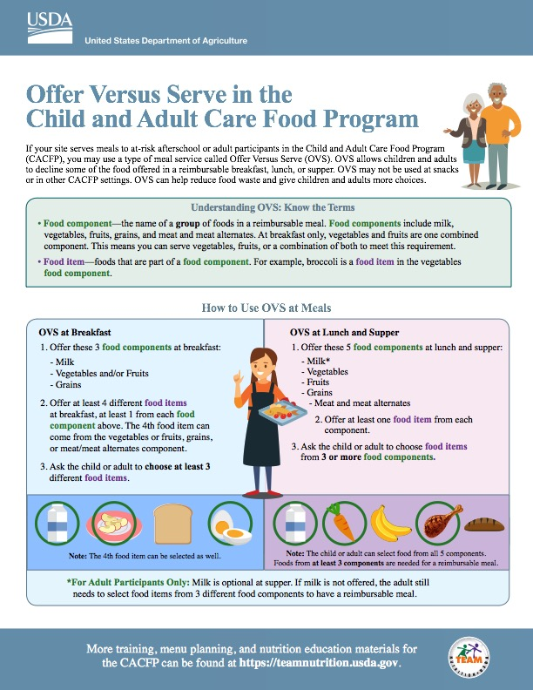
Offer Versus Serve in the CACFP
So, lets get started! As you can see on the screen, today we will discuss Offer Versus Serve in the CACFP. Offer Versus Serve, also known as OVS, is an optional type of meal service that can only be used with at-risk afterschool and adult participants at breakfast, lunch, and supper.
fns.usda.gov/team-nutrition/cacfp-meal-pattern-training-worksheets
Notes:
So, lets get started! As you can see on the screen, today we will discuss Offer Versus Serve in the CACFP. Offer Versus Serve, also known as OVS, is an optional type of meal service that can only be used with at-risk afterschool and adult participants at breakfast, lunch, and supper.

Slide 5

Offer Versus Serve in the CACFP
If your site serves meals to at-risk afterschool or adult participants in the Child and Adult Care Food Program (CACFP), you may use a type of meal service called Offer Versus Serve (OVS). OVS allows children and adults to decline some of the food offered in a reimbursable breakfast, lunch, or supper. OVS may not be used at snacks or in other CACFP settings. OVS can help reduce food waste and give children and adults more choices.
The top of the worksheet on page 1 explains what Offer Versus Serve is and which participants can be served using this style of meal service.
As mentioned, Offer Versus Serve or OVS is an optional style of meal service that can be used to serve meals to at-risk afterschool and adult participants in the CACFP. Optional means that you do not have to use this type of meal service, but you can use it if you want.
OVS can be used at breakfast, lunch, and supper only. It cannot be used at snack. It cannot be used in other CACFP settings such as child care centers and family day care homes that do not serve at-risk afterschool participants or adults.
OVS may benefit those sites that serve at-risk afterschool or adult participants by helping to reduce food waste and give children and adults more food choices.
fns.usda.gov/team-nutrition/cacfp-meal-pattern-training-worksheets
Notes:
The top of the worksheet on page 1 explains what Offer Versus Serve is and which participants can be served using this style of meal service.
As mentioned, Offer Versus Serve or OVS is an optional style of meal service that can be used to serve meals to at-risk afterschool and adult participants in the CACFP. Optional means that you do not have to use this type of meal service, but you can use it if you want.
OVS can be used at breakfast, lunch, and supper only. It cannot be used at snack. It cannot be used in other CACFP settings such as child care centers and family day care homes that do not serve at-risk afterschool participants or adults.
OVS may benefit those sites that serve at-risk afterschool or adult participants by helping to reduce food waste and give children and adults more food choices.

Slide 6
Offer Versus Serve in the CACFP continued
Offer Versus Serve in the CACFP
Understanding OVS: Know the Terms
Food component—the name of a group of foods in a reimbursable meal. Food components include milk, vegetables, fruits, grains, and meat and meat alternates. At breakfast only, vegetables and fruits are one combined component. This means you can serve vegetables, fruits, or a combination of both to meet this requirement.
There are two terms we use often when we talk about OVS. The terms are "Food Component" and "Food Items". These terms are listed in the first green box at the top of the worksheet.
A “food component” is the name of a group of foods in a reimbursable meal. Examples of food components include milk, vegetables, fruits, grains, and meat/ meat alternates. These are all separate components, except for at breakfast only. At breakfast only, fruits and vegetables are one combined component, which means you can serve vegetables, fruits, or a combination of both.
Notes:
There are two terms we use often when we talk about OVS. The terms are "Food Component" and "Food Items". These terms are listed in the first green box at the top of the worksheet.
A “food component” is the name of a group of foods in a reimbursable meal. Examples of food components include milk, vegetables, fruits, grains, and meat/ meat alternates. These are all separate components, except for at breakfast only. At breakfast only, fruits and vegetables are one combined component, which means you can serve vegetables, fruits, or a combination of both.

Slide 7
Offer Versus Serve in the CACFP continued
Offer Versus Serve in the CACFP
Understanding OVS: Know the Terms
Food item—foods that are part of a food component. For example, broccoli is a food item in the vegetables food component.
Another term we use often when we talk about OVS is “Food Item”. A food item is part of a food component. For example, broccoli is a food item in the Vegetables food component.
Notes:
Another term we use often when we talk about OVS is “Food Item”. A food item is part of a food component. For example, broccoli is a food item in the Vegetables food component.

Slide 8
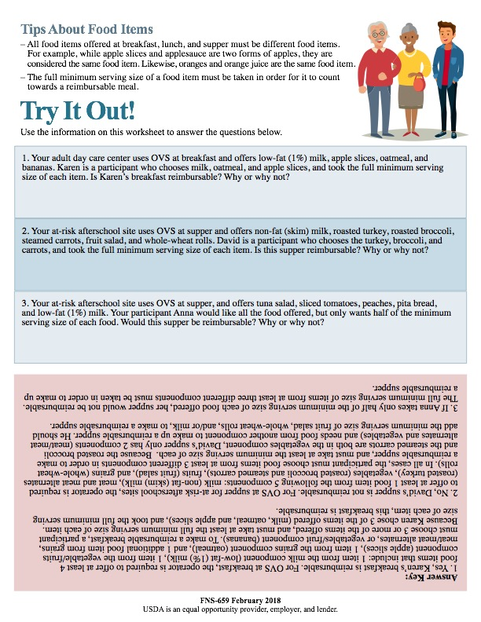
Offer Versus Serve in the CACFP continued.
Offer Versus Serve in the CACFP
Tips About Food Items
All food items offered at breakfast, lunch, and supper must be different food items. For example, while apple slices and applesauce are two forms of apples, they are considered the same food item. Likewise, oranges and orange juice are the same food item.
The full minimum serving size of a food item must be taken in order for it to count towards a reimbursable meal.
On the second page of the worksheet, there are two additional tips about food items. As you can see, these two tips say that:
All food items offered at breakfast, lunch, and supper must be different food items. For example, because apple slices and applesauce are two forms of apples, they are considered the same food item. Another example would be oranges and orange juice.
The full minimum serving size of a food item must be taken in order for it to count towards a reimbursable meal. For example, the minimum serving size of vegetables at lunch for adults is ½ cup. So, an adult participant must take at least ½ cup of vegetables for it to count towards a reimbursable meal.
Notes:
On the second page of the worksheet, there are two additional tips about food items. As you can see, these two tips say that:
All food items offered at breakfast, lunch, and supper must be different food items. For example, because apple slices and applesauce are two forms of apples, they are considered the same food item. Another example would be oranges and orange juice.
The full minimum serving size of a food item must be taken in order for it to count towards a reimbursable meal. For example, the minimum serving size of vegetables at lunch for adults is ½ cup. So, an adult participant must take at least ½ cup of vegetables for it to count towards a reimbursable meal.

Slide 9


How to Use OVS at Breakfast
OVS at Breakfast
Now, let’s go back to the first page of the worksheet and talk about how to serve breakfast using OVS.
At breakfast, you must offer these three food components: milk, vegetables and/or fruit, and grains. You must offer at least four food items.
Remember that a food item is a food that falls within a food component. So this means that at breakfast, you must offer at least one food item from the milk component, one food item from the vegetables/fruit component, and one food item from the grains component.
The other food item or items can come from the vegetables or fruits, grains, or meat/meat alternates component. The child or adult participant must choose at least three different food items.
Let's take a closer look at the example illustrated here. Here, you are offering 4 food items: milk, apple slices, toast, and eggs.
You can offer more than 4 food items, but you must offer at least 4 food items at breakfast. And, as we mentioned before, you must offer enough of the food to meet the minimum serving size required of each component. For instance, if you are offering milk to 6-12 year olds, you must offer at least 1 cup or 8 fluid ounces of milk to each participant since that is the minimum amount of milk required for that age group.
A participant can choose 3 or more food items to make up a reimbursable breakfast. In this example, she chose milk, apple slices, and eggs for her breakfast. This breakfast is reimbursable because she chose at least 3 food items, and enough of each item to meet the minimum serving size for the component.
If she had chosen all four food items: milk, apples, eggs, and toast, and taken the minimum serving size required for at least three of these items, then that breakfast would also be reimbursable.
Offer these 3 food components at breakfast:
Milk
Vegetables and/or Fruits
Grains
Offer at least 4 different food items at breakfast, at least 1 from each food component above. The 4th food item can come from the vegetables or fruits, grains, or meat/meat alternates component.
Ask the child or adult to choose at least 3 different food items.
Note: The 4th food item can be selected as well.
Notes:
Now, let’s go back to the first page of the worksheet and talk about how to serve breakfast using OVS.
At breakfast, you must offer these three food components: milk, vegetables and/or fruit, and grains. You must offer at least four food items.
Remember that a food item is a food that falls within a food component. So this means that at breakfast, you must offer at least one food item from the milk component, one food item from the vegetables/fruit component, and one food item from the grains component.
The other food item or items can come from the vegetables or fruits, grains, or meat/meat alternates component. The child or adult participant must choose at least three different food items.
Let's take a closer look at the example illustrated here. Here, you are offering 4 food items: milk, apple slices, toast, and eggs.
You can offer more than 4 food items, but you must offer at least 4 food items at breakfast. And, as we mentioned before, you must offer enough of the food to meet the minimum serving size required of each component. For instance, if you are offering milk to 6-12 year olds, you must offer at least 1 cup or 8 fluid ounces of milk to each participant since that is the minimum amount of milk required for that age group.
A participant can choose 3 or more food items to make up a reimbursable breakfast. In this example, she chose milk, apple slices, and eggs for her breakfast. This breakfast is reimbursable because she chose at least 3 food items, and enough of each item to meet the minimum serving size for the component.
If she had chosen all four food items: milk, apples, eggs, and toast, and taken the minimum serving size required for at least three of these items, then that breakfast would also be reimbursable.

Slide 10
Try It Out!
Your adult day care center uses OVS at breakfast.
You offer low-fat (1%) milk, apple slices, oatmeal, and bananas. Karen is a participant who chooses the milk, apple slices, and oatmeal. She took the full minimum serving size of each item.
?
Is Karen’s breakfast reimbursable?
Yes
No
Let’s try a practice question. Your adult day care center uses OVS at breakfast.
You are a program operator and offer 4 food items:
low-fat (1%) milk,
apple slices,
oatmeal, and
bananas.
Karen is a participant, and she chooses milk, apple slices, and oatmeal. She took the full minimum serving size of each item.
Raise your hand if you think Karen’s breakfast is reimbursable [pause and wait for a show of hands].
Raise your hand if you think Karen’s breakfast is not reimbursable [pause and wait for a show of hands].
Notes:
Let’s try a practice question. Your adult day care center uses OVS at breakfast.
You are a program operator and offer 4 food items:
low-fat (1%) milk,
apple slices,
oatmeal, and
bananas.
Karen is a participant, and she chooses milk, apple slices, and oatmeal. She took the full minimum serving size of each item.
Raise your hand if you think Karen’s breakfast is reimbursable [pause and wait for a show of hands].
Raise your hand if you think Karen’s breakfast is not reimbursable [pause and wait for a show of hands].

Slide 11
Answer
Your adult day care center uses OVS at breakfast.
You offer milk, apple slices, oatmeal, and bananas. Karen is a participant who chooses the milk, apple slices, and oatmeal. She took the full minimum serving size of each item.
?
Is Karen’s breakfast reimbursable?
✓
Yes
No
Great job, everyone! The answer to this question is “yes”. Karen’s breakfast is reimbursable.
We know Karen’s breakfast is reimbursable because when using OVS at breakfast you must offer at least 4 food items including:
one item from the milk component. In this example it is the low-fat (1%) milk.
At least one item from the vegetable/fruit component. In this example you offered two items from this component: apple slices and bananas, and
At least one item from the grains component. In this example it is the oatmeal.
For the breakfast to be reimbursable, Karen needed to take at least 3 of the 4 food items offered and at least the full minimum serving size of each item, which she did. By choosing the milk, apple slices, and oatmeal and taking the full minimum serving size of each item, Karen’s breakfast is reimbursable.
Notes:
Great job, everyone! The answer to this question is “yes”. Karen’s breakfast is reimbursable.
We know Karen’s breakfast is reimbursable because when using OVS at breakfast you must offer at least 4 food items including:
one item from the milk component. In this example it is the low-fat (1%) milk.
At least one item from the vegetable/fruit component. In this example you offered two items from this component: apple slices and bananas, and
At least one item from the grains component. In this example it is the oatmeal.
For the breakfast to be reimbursable, Karen needed to take at least 3 of the 4 food items offered and at least the full minimum serving size of each item, which she did. By choosing the milk, apple slices, and oatmeal and taking the full minimum serving size of each item, Karen’s breakfast is reimbursable.

Slide 12


Try It Out!
Your adult day care center uses OVS at breakfast.
You offer low-fat (1%) milk, apple slices, oatmeal, and bananas. Victor is a participant who chooses the milk, apple slices, and bananas. He took the full minimum serving size of each item.
?
Is Victor’s breakfast reimbursable?
Yes
No
Let’s try another practice question. In this question, you are still offering:
low-fat (1%) milk,
apple slices,
oatmeal, and
bananas
at your adult day care center.
Victor, an adult participant at your center, chooses:
milk,
apple slices, and
bananas.
He took the full minimum serving size of each item.
Raise your hand if you think Victor’s breakfast is reimbursable [pause and wait for a show of hands].
Raise your hand if you think Victor’s breakfast is not reimbursable [pause and wait for a show of hands].
Notes:
Let’s try another practice question. In this question, you are still offering:
low-fat (1%) milk,
apple slices,
oatmeal, and
bananas
at your adult day care center.
Victor, an adult participant at your center, chooses:
milk,
apple slices, and
bananas.
He took the full minimum serving size of each item.
Raise your hand if you think Victor’s breakfast is reimbursable [pause and wait for a show of hands].
Raise your hand if you think Victor’s breakfast is not reimbursable [pause and wait for a show of hands].

Slide 13
Answer
Your adult day care center uses OVS at breakfast.
You offer low-fat (1%) milk, apple slices, oatmeal, and bananas. Victor is a participant who chooses the milk, apple slices, and bananas. He took the full minimum serving size of each item.
?
Is Victor’s breakfast reimbursable?
✓
Yes
No
Nice work everyone! The answer is yes, Victor’s breakfast is reimbursable.
For a reimbursable breakfast, the operator must offer at least 4 food items from the 3 required food components. The participant can choose any combination of the food items as long as s/he takes at least 3 items, and takes the full minimum serving size of the items.
In this question, Victor the participant chose 3 different items: milk, apple slices, and bananas, and took the minimum serving size of each. Therefore, his breakfast is reimbursable. If he had taken the minimum serving size of all 4 foods that were offered, that breakfast would be reimbursable as well.
Notes:
Nice work everyone! The answer is yes, Victor’s breakfast is reimbursable.
For a reimbursable breakfast, the operator must offer at least 4 food items from the 3 required food components. The participant can choose any combination of the food items as long as s/he takes at least 3 items, and takes the full minimum serving size of the items.
In this question, Victor the participant chose 3 different items: milk, apple slices, and bananas, and took the minimum serving size of each. Therefore, his breakfast is reimbursable. If he had taken the minimum serving size of all 4 foods that were offered, that breakfast would be reimbursable as well.

Slide 14

How to Use OVS at Lunch and Supper
Now, let’s talk about how to use OVS to serve lunch and supper. At lunch and supper you must offer these five food components:
milk,
vegetables,
fruits,
grains, and
meat and meat alternates.
As you see, at lunch and supper, vegetables and fruits are separate food components. This is different from breakfast, where vegetables and fruits are one combined component.
In OVS, you must offer at least one food item from each of the five food components at lunch and supper.
Let's take a closer look at the example shown on page 1 of the worksheet. In this example, foods from all the components are offered:
Milk
Carrots from the vegetable component
Bananas from the fruit component
Turkey from the meat/meat alternates component and
A dinner roll from the grains component.
You can offer more than one food in each component, but you must offer at least one food from each component. And, as we mentioned before, you must offer enough of the food to meet the minimum serving size required of each component.
A participant can choose foods from 3 or more components to make up a reimbursable lunch or supper. In this example, she chose:
milk from the milk component,
carrots from the vegetables component, and
turkey from the meat/meat alternates component.
This lunch or supper is reimbursable because she choose foods from at least three different food components.
Something to note under this section of the worksheet and on this slide is the asterisk or star next to “milk”. Please note that for adult participants only, milk is optional at supper. If milk is not offered, the participant still needs to select food items from at least 3 different food components for a reimbursable meal.
OVS at Lunch and Supper
Offer these 5 food components at lunch and supper:
Milk*
Vegetables
Fruits
Grains
Meat and meat alternates
Offer at least one food item from each component.
Ask the child or adult to choose food items from 3 or more food components.
Note: The child or adult can select food from all 5 components. Foods from at least
3 components are needed for a reimbursable meal.
*For Adult Participants Only: Milk is optional at supper. If milk is not offered, the adult still needs to select food items from 3 different food components to have a reimbursable meal.
Notes:
Now, let’s talk about how to use OVS to serve lunch and supper. At lunch and supper you must offer these five food components:
milk,
vegetables,
fruits,
grains, and
meat and meat alternates.
As you see, at lunch and supper, vegetables and fruits are separate food components. This is different from breakfast, where vegetables and fruits are one combined component.
In OVS, you must offer at least one food item from each of the five food components at lunch and supper.
Let's take a closer look at the example shown on page 1 of the worksheet. In this example, foods from all the components are offered:
Milk
Carrots from the vegetable component
Bananas from the fruit component
Turkey from the meat/meat alternates component and
A dinner roll from the grains component.
You can offer more than one food in each component, but you must offer at least one food from each component. And, as we mentioned before, you must offer enough of the food to meet the minimum serving size required of each component.
A participant can choose foods from 3 or more components to make up a reimbursable lunch or supper. In this example, she chose:
milk from the milk component,
carrots from the vegetables component, and
turkey from the meat/meat alternates component.
This lunch or supper is reimbursable because she choose foods from at least three different food components.
Something to note under this section of the worksheet and on this slide is the asterisk or star next to “milk”. Please note that for adult participants only, milk is optional at supper. If milk is not offered, the participant still needs to select food items from at least 3 different food components for a reimbursable meal.

Slide 15

Try It Out!
Your adult day care center uses OVS at lunch.
You offer low-fat (1%) milk, carrots, bananas, turkey, and dinner rolls. Emma is a participant who chooses the milk, carrots, bananas, and turkey. She took the full minimum serving size of each item.
?
Is Emma’s lunch reimbursable?
Yes
No
Ok, let’s try another practice question. You work at an adult day care center and you want to use OVS at lunch. You offer:
low-fat (1%) milk
carrots
bananas
turkey and
dinner rolls.
Emma, an adult participant at your center, chooses:
milk
carrots
bananas and
turkey.
She took the full minimum serving size of each item.
Raise your hand if you think Emma’s lunch is reimbursable [pause and wait for a show of hands].
Raise your hand if you think Emma’s lunch is not reimbursable [pause and wait for a show of hands].
Notes:
Ok, let’s try another practice question. You work at an adult day care center and you want to use OVS at lunch. You offer:
low-fat (1%) milk
carrots
bananas
turkey and
dinner rolls.
Emma, an adult participant at your center, chooses:
milk
carrots
bananas and
turkey.
She took the full minimum serving size of each item.
Raise your hand if you think Emma’s lunch is reimbursable [pause and wait for a show of hands].
Raise your hand if you think Emma’s lunch is not reimbursable [pause and wait for a show of hands].

Slide 16
Answer
Your adult day care center uses OVS at lunch.
You offer low-fat (1%) milk, carrots, bananas, turkey, and dinner rolls. Emma is a participant who chooses the milk, carrots, bananas, and turkey. She took the full minimum serving size of each item.
?
Is Emma’s lunch reimbursable?
✓
Yes
No
Nice work everyone! The answer is yes, Emma’s lunch is reimbursable.
For OVS at lunch or supper, you are required to offer at least 1 food item from each of the 5 food components, with the food components being:
milk,
meat/meat alternates,
vegetables,
fruits, and
grains.
In this example, you offered:
low-fat (1%) milk for the milk component,
carrots from the vegetable component,
bananas from the fruit component,
turkey from the meat/meat alternate component, and
dinner rolls from the grains component.
The participant must choose at least 3 different food components in order to make a reimbursable lunch and must take the minimum serving size of each. Here, Emma chose food from 4 different food components:
milk from the milk component,
carrots from the vegetables component,
bananas from the fruit component, and
turkey from the meat/meat alternates component.
Therefore, her lunch is reimbursable.
Notes:
Nice work everyone! The answer is yes, Emma’s lunch is reimbursable.
For OVS at lunch or supper, you are required to offer at least 1 food item from each of the 5 food components, with the food components being:
milk,
meat/meat alternates,
vegetables,
fruits, and
grains.
In this example, you offered:
low-fat (1%) milk for the milk component,
carrots from the vegetable component,
bananas from the fruit component,
turkey from the meat/meat alternate component, and
dinner rolls from the grains component.
The participant must choose at least 3 different food components in order to make a reimbursable lunch and must take the minimum serving size of each. Here, Emma chose food from 4 different food components:
milk from the milk component,
carrots from the vegetables component,
bananas from the fruit component, and
turkey from the meat/meat alternates component.
Therefore, her lunch is reimbursable.

Slide 17
Try It Out!
Your adult day care center uses OVS at lunch.
You offer low-fat (1%) milk, carrots, bananas, turkey, and dinner rolls. Deborah is a participant who chooses food from all five of the food components. She took the full minimum serving size of each item.
?
Is Deborah’s lunch reimbursable?
Yes
No
Let’s try another practice question. Again, your adult day care center wants to use OVS at lunch. You offer:
low-fat (1%) milk,
carrots,
bananas,
turkey, and
dinner rolls.
Deborah is a participant who chooses everything that is offered, meaning she took:
milk,
carrots,
banana,
turkey, and
dinner rolls.
She took the full minimum serving size of each item.
Raise your hand if you think Deborah’s lunch is reimbursable [pause and wait for a show of hands].
Raise your hand if you think Deborah’s lunch is not reimbursable [pause and wait for a show of hands].
Notes:
Let’s try another practice question. Again, your adult day care center wants to use OVS at lunch. You offer:
low-fat (1%) milk,
carrots,
bananas,
turkey, and
dinner rolls.
Deborah is a participant who chooses everything that is offered, meaning she took:
milk,
carrots,
banana,
turkey, and
dinner rolls.
She took the full minimum serving size of each item.
Raise your hand if you think Deborah’s lunch is reimbursable [pause and wait for a show of hands].
Raise your hand if you think Deborah’s lunch is not reimbursable [pause and wait for a show of hands].

Slide 18
Answer
Your adult day care center uses OVS at lunch.
You offer low-fat (1%) milk, carrots, bananas, turkey, and dinner rolls. Deborah is a participant who chooses food from all five of the food components. She took the full minimum serving size of each item.
?
Is Deborah’s lunch reimbursable?
✓
Yes
No
Great job! The answer is yes, Deborah’s lunch is reimbursable.
Again, when using OVS at lunch or supper in the CACFP, the participant must choose at least 3 out of the 5 different food components in order to make a reimbursable lunch or supper, and must take the minimum serving size of each. Deborah chose items from all 5 food components, so her lunch is reimbursable.
Notes:
Great job! The answer is yes, Deborah’s lunch is reimbursable.
Again, when using OVS at lunch or supper in the CACFP, the participant must choose at least 3 out of the 5 different food components in order to make a reimbursable lunch or supper, and must take the minimum serving size of each. Deborah chose items from all 5 food components, so her lunch is reimbursable.

Slide 19

Try It Out!
Your at-risk afterschool site uses OVS at supper.
You offer fat-free (skim) milk, roasted turkey, roasted broccoli, steamed carrots, fruit salad, and whole-wheat rolls. David is a participant who chooses the turkey, broccoli, and carrots, and took the full minimum serving size of each item.
?
Is David’s supper reimbursable?
Yes
No
Ok! One last practice question. This one is about supper.
Your at-risk afterschool center uses OVS at supper. You offer:
fat-free (skim) milk,
roasted turkey,
roasted broccoli,
steamed carrots,
fruit salad, and
whole-wheat rolls.
David is a participant who chooses the turkey, broccoli, and carrots, and took the full minimum serving size of each item.
Raise your hand if you think David’s supper is reimbursable [pause and wait for a show of hands].
Raise your hand if you think David’s supper is not reimbursable [pause and wait for a show of hands].
Notes:
Ok! One last practice question. This one is about supper.
Your at-risk afterschool center uses OVS at supper. You offer:
fat-free (skim) milk,
roasted turkey,
roasted broccoli,
steamed carrots,
fruit salad, and
whole-wheat rolls.
David is a participant who chooses the turkey, broccoli, and carrots, and took the full minimum serving size of each item.
Raise your hand if you think David’s supper is reimbursable [pause and wait for a show of hands].
Raise your hand if you think David’s supper is not reimbursable [pause and wait for a show of hands].

Slide 20
Answer
Your at-risk afterschool site uses OVS at supper.
You offer fat-free (skim) milk, roasted turkey, roasted broccoli, steamed carrots, fruit salad, and whole-wheat rolls. David is a participant who chooses the turkey, broccoli, and carrots, and took the full minimum serving size of each item.
?
Is David’s supper reimbursable?
Yes
No
✓
Nice work! The answer to this question is no, David’s supper is not reimbursable.
For OVS at lunch or supper at at-risk afterschool sites, you are required to offer at least one food item from each of the five food components:
milk,
meat/meat alternates,
vegetables,
fruits, and
grains.
In this example, you offered:
fat-free (skim) milk for the milk component,
roasted turkey from the meat/meat alternate component,
two food items from the vegetable component: roasted broccoli and steamed carrots,
fruit salad from the fruit component, and
whole-wheat rolls from the grains component.
The participant must choose at least 3 different food components in order to make a reimbursable supper and must take the minimum serving size of each. David took:
roasted broccoli,
steamed carrots, and
milk.
Because the roasted broccoli and steamed carrots are both part of the vegetable component, David’s supper only has two food components (meat/meat alternates and vegetables) and needs food from another component to make up a reimbursable supper. He should add the minimum serving amount of fruit salad, whole-wheat rolls, and/or milk to make a reimbursable supper.
Notes:
Nice work! The answer to this question is no, David’s supper is not reimbursable.
For OVS at lunch or supper at at-risk afterschool sites, you are required to offer at least one food item from each of the five food components:
milk,
meat/meat alternates,
vegetables,
fruits, and
grains.
In this example, you offered:
fat-free (skim) milk for the milk component,
roasted turkey from the meat/meat alternate component,
two food items from the vegetable component: roasted broccoli and steamed carrots,
fruit salad from the fruit component, and
whole-wheat rolls from the grains component.
The participant must choose at least 3 different food components in order to make a reimbursable supper and must take the minimum serving size of each. David took:
roasted broccoli,
steamed carrots, and
milk.
Because the roasted broccoli and steamed carrots are both part of the vegetable component, David’s supper only has two food components (meat/meat alternates and vegetables) and needs food from another component to make up a reimbursable supper. He should add the minimum serving amount of fruit salad, whole-wheat rolls, and/or milk to make a reimbursable supper.

Slide 21
Wait a Second!
So right now, you might be saying, “wait a second!” In the first example, Karen was able to take two fruits (apple slices and a banana) and a grain (oatmeal) for breakfast and it was a reimbursable meal, so why couldn’t David take two vegetables and roasted turkey for a reimbursable supper?
Let’s take a look at the chart on the first page of the worksheet again. OVS at breakfast is different from OVS at lunch and supper. At breakfast only, the participant must choose at least 3 food items (not food components) to make a reimbursable meal. So, even though apple slices and bananas are from the same food component, Karen’s breakfast is still reimbursable because she chose three food items: the apple slices, a banana, and oatmeal.
This is different from OVS at lunch and supper. At OVS lunch and supper, the participant must choose food items from 3 or more food components. So, in the example with David, you offered:
milk,
turkey,
broccoli,
steamed carrots,
fruit salad, and whole-wheat rolls.
David chose turkey, carrots, and broccoli. By doing so, he chose foods from only 2 different food components, and he needs foods from 3 different components for a reimbursable lunch or supper.
OVS at Breakfast
OVS at Lunch and Supper
Offer these 3 food components at breakfast:
Milk
Vegetables and/or Fruits
Grains
Offer at least 4 different food items at breakfast,
at least 1 from each food component above. The 4th food item can come from the vegetables or fruits, grains, or meat/meat alternates component.
Ask the child or adult to choose at least 3 different food items.
Offer these 5 food components at lunch and supper:
Milk*
Vegetables
Fruits
Grains
Meat and meat alternates
Offer at least one food item from each component.
Rectangle
Ask the child or adult to choose food items from 3 or more food components.
Note: The 4th food item can be selected as well.
Note: The child or adult can select food from all 5 components.
Foods from at least 3 components are needed for a reimbursable meal.
*For Adult Participants Only: Milk is optional at supper. If milk is not offered, the adult still needs to select
food items from 3 different food components to have a reimbursable meal.
Notes:
So right now, you might be saying, “wait a second!” In the first example, Karen was able to take two fruits (apple slices and a banana) and a grain (oatmeal) for breakfast and it was a reimbursable meal, so why couldn’t David take two vegetables and roasted turkey for a reimbursable supper?
Let’s take a look at the chart on the first page of the worksheet again. OVS at breakfast is different from OVS at lunch and supper. At breakfast only, the participant must choose at least 3 food items (not food components) to make a reimbursable meal. So, even though apple slices and bananas are from the same food component, Karen’s breakfast is still reimbursable because she chose three food items: the apple slices, a banana, and oatmeal.
This is different from OVS at lunch and supper. At OVS lunch and supper, the participant must choose food items from 3 or more food components. So, in the example with David, you offered:
milk,
turkey,
broccoli,
steamed carrots,
fruit salad, and whole-wheat rolls.
David chose turkey, carrots, and broccoli. By doing so, he chose foods from only 2 different food components, and he needs foods from 3 different components for a reimbursable lunch or supper.

Slide 22
Try It Out!
Try It Out!
Use the information on this worksheet to answer the questions below.
Your adult day care center uses OVS at breakfast and offers low-fat (1%) milk, apple slices, oatmeal, and bananas. Karen is a participant who chooses milk, oatmeal, and apple slices, and took the full minimum serving size of each item. Is Karen’s breakfast reimbursable? Why or why not?
Your at-risk afterschool site uses OVS at supper and offers non-fat (skim) milk, roasted turkey, roasted broccoli, steamed carrots, fruit salad, and whole-wheat rolls. David is a participant who chooses the turkey, broccoli, and carrots, and took the full minimum serving size of each item. Is this supper reimbursable? Why or why not?
Your at-risk afterschool site uses OVS at supper, and offers tuna salad, sliced tomatoes, peaches, pita bread, and low-fat (1%) milk. Your participant Anna would like all the food offered, but only wants half of the minimum serving size of each food. Would this supper be reimbursable? Why or why not?
On the second page of the worksheet, there are three scenario-based questions that you can use to check your understanding and knowledge. We have already answered the first two together during this webinar. The last scenario-based question is there for you to practice what we’ve learned today. The answer key is provided, so you can check your answers.
Notes:
On the second page of the worksheet, there are three scenario-based questions that you can use to check your understanding and knowledge. We have already answered the first two together during this webinar. The last scenario-based question is there for you to practice what we’ve learned today. The answer key is provided, so you can check your answers.

Slide 23
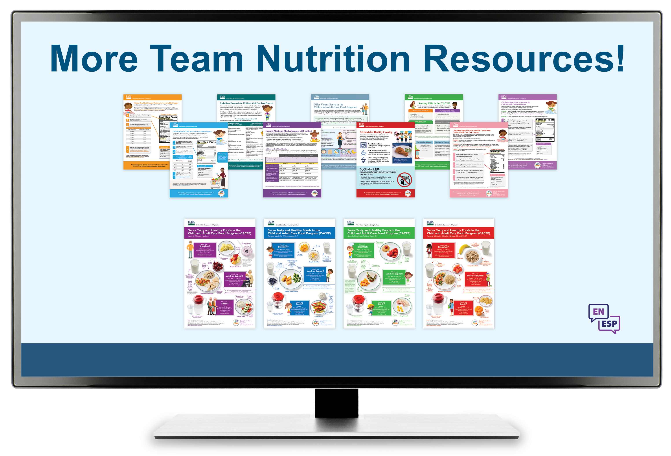
More Team Nutrition Resources
All Team Nutrition materials are available online from Team Nutrition’s website and are available for free download to anybody who is interested.
TeamNutrition.usda.gov
Notes:
All Team Nutrition materials are available online from Team Nutrition’s website and are available for free download to anybody who is interested.

Slide 24

How To Order Print Copies
Resource Order Form at TeamNutrition.usda.gov.
FREE for those participating in a USDA’s Child Nutrition Program, while supplies last.
Sponsoring organizations and State agencies can also order in bulk by sending an email to:
TeamNutrition@usda.gov
For all participating in a Child Nutrition Program, such as the CACFP, Team Nutrition’s print materials are free to order.
If you would like to order Team Nutrition’s free materials in print, you can go to the “Resource Order Form” link on the Team Nutrition website to order print copies of the materials.
For bulk orders, you can email teamnutrition@usda.gov.
Notes:
For all participating in a Child Nutrition Program, such as the CACFP, Team Nutrition’s print materials are free to order.
If you would like to order Team Nutrition’s free materials in print, you can go to the “Resource Order Form” link on the Team Nutrition website to order print copies of the materials.
For bulk orders, you can email teamnutrition@usda.gov.

Slide 25


Thank you!
These training slides were provided by U.S. Department of Agriculture's Team Nutrition. If you would like to learn more about Team Nutrition and additional resources available, please visit their website, subscribe to their monthly e-newsletter, connect with them via email at teamnutrition@usda.gov, and follow them on Twitter.
Thank you!
TeamNutrition.usda.gov
@TeamNutrition
TeamNutrition@usda.gov
USDA is an equal opportunity provider, employer, and lender.
Notes:
These training slides were provided by U.S. Department of Agriculture's Team Nutrition. If you would like to learn more about Team Nutrition and additional resources available, please visit their website, subscribe to their monthly e-newsletter, connect with them via email at teamnutrition@usda.gov, and follow them on Twitter.
Thank you!

