Slide 1

Serving Milk in the CACFP
A Training Presentation for
Child and Adult Care Food Program (CACFP) Operators

Slide 2



USDA’s Team Nutrition
An initiative of the USDA’s Food and Nutrition Service to support the USDA’s Child Nutrition Programs.
Aims to improve children’s lifelong eating and physical activity habits.
Provides nutrition education and training materials to State agencies, sponsoring organizations, and CACFP sites.
Team Nutrition is an initiative of the USDA Food and Nutrition Service that supports the Child Nutrition Programs, including the National School Lunch Program, the School Breakfast Program, and of course, the Child and Adult Care Food Program, or the CACFP.
The goal of Team Nutrition is to improve children's lifelong eating and physical activity habits through nutrition education based on the principles of the Dietary Guidelines for Americans and MyPlate.
It does so through training and technical assistance for those preparing and serving meals, providing nutrition education for children, and building support for healthier school and child care environments.
TeamNutrition.usda.gov
@TeamNutrition
Notes:
Team Nutrition is an initiative of the USDA Food and Nutrition Service that supports the Child Nutrition Programs, including the National School Lunch Program, the School Breakfast Program, and of course, the Child and Adult Care Food Program, or the CACFP.
The goal of Team Nutrition is to improve children's lifelong eating and physical activity habits through nutrition education based on the principles of the Dietary Guidelines for Americans and MyPlate.
It does so through training and technical assistance for those preparing and serving meals, providing nutrition education for children, and building support for healthier school and child care environments.

Slide 3

Let Us Know Who You Are!
I work for a…
?
Child care center
Family child care home
At-risk afterschool care center
Adult day care center
Sponsoring organization
Emergency shelter
School food authority
State agency
USDA Regional Office
Other
Before we get started, I want to know who has joined us today.
Please raise your hand if you work for:
a child care center [pause and wait for a show of hands],
a family child care home [pause and wait for a show of hands],
an at-risk afterschool care center [pause and wait for a show of hands],
a sponsoring organization [pause and wait for a show of hands],
an emergency shelter [pause and wait for a show of hands],
a school food authority [pause and wait for a show of hands],
a State agency [pause and wait for a show of hands],
a USDA Regional office [pause and wait for a show of hands], or
other [pause and wait for a show of hands].
Notes:
Before we get started, I want to know who has joined us today.
Please raise your hand if you work for:
a child care center [pause and wait for a show of hands],
a family child care home [pause and wait for a show of hands],
an at-risk afterschool care center [pause and wait for a show of hands],
a sponsoring organization [pause and wait for a show of hands],
an emergency shelter [pause and wait for a show of hands],
a school food authority [pause and wait for a show of hands],
a State agency [pause and wait for a show of hands],
a USDA Regional office [pause and wait for a show of hands], or
other [pause and wait for a show of hands].

Slide 4
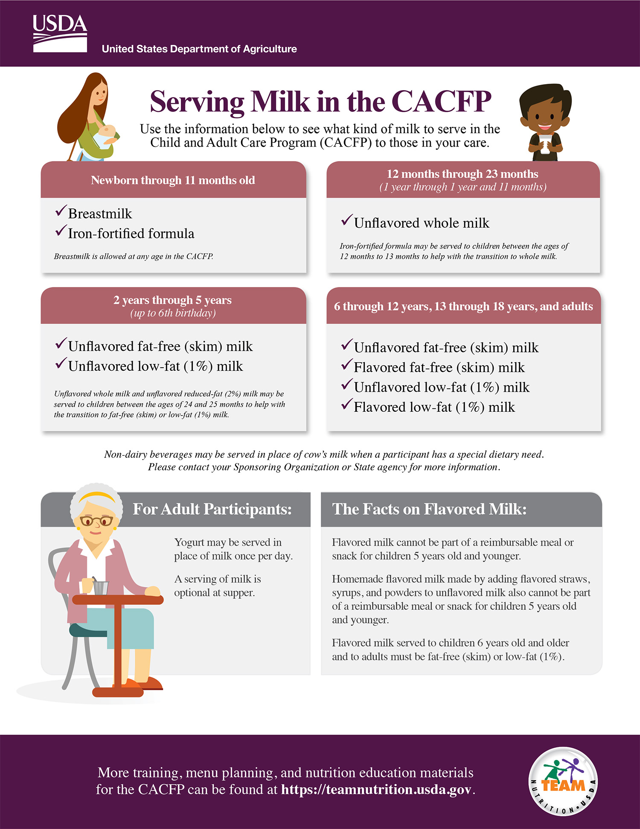
Serving Milk in the CACFP
Our topic today is “Serving Milk in the CACFP.” You can follow along with Team Nutrition’s “Serving Milk in the CACFP” worksheet.
Notes:
Our topic today is “Serving Milk in the CACFP.” You can follow along with Team Nutrition’s “Serving Milk in the CACFP” worksheet.

Slide 5
Serving Milk in the CACFP
The first page of Team Nutrition’s worksheet provides an overview of the milk requirements for participants of different ages in the CACFP.
Notes:
The first page of Team Nutrition’s worksheet provides an overview of the milk requirements for participants of different ages in the CACFP.

Slide 6
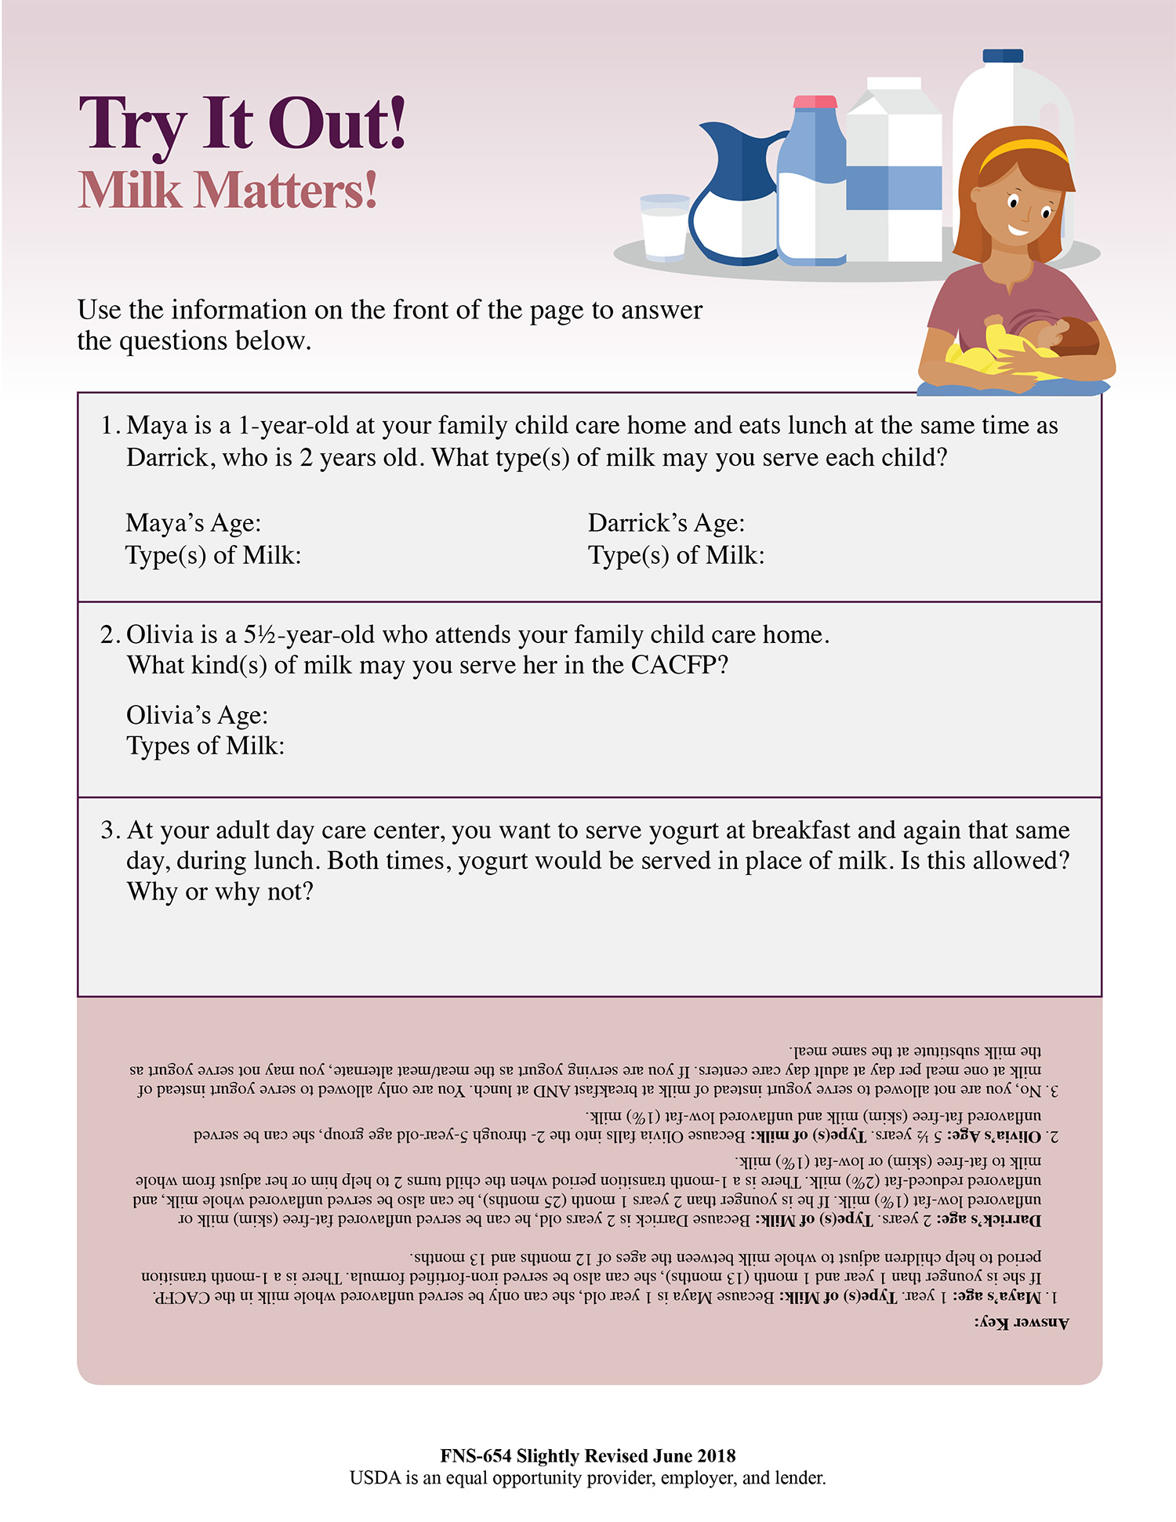
Serving Milk in the CACFP
The second page includes some scenario-based questions to help you practice and apply what you have learned.
Notes:
The second page includes some scenario-based questions to help you practice and apply what you have learned.

Slide 7
Serving Milk in the CACFP
Newborn through 11 months old
12 months through 23 months (1 year through 1 year and 11 months)
Breastmilk Iron-fortified formula Breastmilk is allowed at any age in the CACFP.
Unflavored whole milk Iron-fortified formula may be served to children between the ages of 12 months to 13 months to help with the transition to whole milk.
2 years through 5 years (up to 6th birthday)
6 through 12 years, 13 through 18 years, and adults
Unflavored fat-free (skim) milk Unflavored low-fat (1%) milk Unflavored whole milk and unflavored reduced-fat (2%) milk may be served to children between the ages of 24 and 25 months to help with the transition to fat-free (skim) or low-fat (1%) milk.
Unflavored fat-free (skim) milk Flavored fat-free (skim) milk Unflavored low-fat (1%) milk Flavored low-fat (1%) milk
Non-dairy beverages may be served in place of cow’s milk when a participant has a special dietary need. Please contact your Sponsoring Organization or State agency for more information.
Let’s start by taking a closer look at the milk requirements for each age group in the CACFP.
For infants, which is ages birth through 11 months, breastmilk and iron-fortified formula are allowed. Although it is not explicitly stated in the meal pattern for each age group, please note that breastmilk is also allowed at any age in the CACFP.
Notes:
Let’s start by taking a closer look at the milk requirements for each age group in the CACFP.
For infants, which is ages birth through 11 months, breastmilk and iron-fortified formula are allowed. Although it is not explicitly stated in the meal pattern for each age group, please note that breastmilk is also allowed at any age in the CACFP.

Slide 8
Serving Milk in the CACFP
Newborn through 11 months old
12 months through 23 months (1 year through 1 year and 11 months)
Breastmilk Iron-fortified formula Breastmilk is allowed at any age in the CACFP.
Unflavored whole milk Iron-fortified formula may be served to children between the ages of 12 months to 13 months to help with the transition to whole milk.
2 years through 5 years (up to 6th birthday)
6 through 12 years, 13 through 18 years, and adults
Unflavored fat-free (skim) milk Unflavored low-fat (1%) milk Unflavored whole milk and unflavored reduced-fat (2%) milk may be served to children between the ages of 24 and 25 months to help with the transition to fat-free (skim) or low-fat (1%) milk.
Unflavored fat-free (skim) milk Flavored fat-free (skim) milk Unflavored low-fat (1%) milk Flavored low-fat (1%) milk
Non-dairy beverages may be served in place of cow’s milk when a participant has a special dietary need. Please contact your Sponsoring Organization or State agency for more information.
Children ages 12 through 23 months may be served unflavored whole milk as part of reimbursable meals and snacks in the CACFP. To help with the transition from infant formula to whole milk, iron-fortified formula may also be served between the ages of 12 and 13 months. Breastmilk can also be served to this age group, or to any age group, in the CACFP.
If you are serving breastmilk to children 12 months old or older, remember that the amount of breastmilk served to the child must meet the fluid milk requirement for that age group. If not enough breastmilk is provided, then the remaining amount must be “made up” with the appropriate type of milk for the child’s age.
For example, 1 through 2 year olds must be served at least 4 ounces of whole milk at breakfast. If the mother only brings in 2 ounces of breastmilk for her 1- year-old at breakfast, then at least 2 ounces of unflavored whole milk must be served in order to meet the minimum required 4 fluid ounces of milk. The two milks do not need to be mixed in the same cup.
As a reminder, if breastmilk is provided, the center or day care home must provide all the other required meal components in order for the meal to be reimbursable.
Notes:
Children ages 12 through 23 months may be served unflavored whole milk as part of reimbursable meals and snacks in the CACFP. To help with the transition from infant formula to whole milk, iron-fortified formula may also be served between the ages of 12 and 13 months. Breastmilk can also be served to this age group, or to any age group, in the CACFP.
If you are serving breastmilk to children 12 months old or older, remember that the amount of breastmilk served to the child must meet the fluid milk requirement for that age group. If not enough breastmilk is provided, then the remaining amount must be “made up” with the appropriate type of milk for the child’s age.
For example, 1 through 2 year olds must be served at least 4 ounces of whole milk at breakfast. If the mother only brings in 2 ounces of breastmilk for her 1- year-old at breakfast, then at least 2 ounces of unflavored whole milk must be served in order to meet the minimum required 4 fluid ounces of milk. The two milks do not need to be mixed in the same cup.
As a reminder, if breastmilk is provided, the center or day care home must provide all the other required meal components in order for the meal to be reimbursable.

Slide 9
Serving Milk in the CACFP
Newborn through 11 months old
12 months through 23 months (1 year through 1 year and 11 months)
Breastmilk Iron-fortified formula Breastmilk is allowed at any age in the CACFP.
Unflavored whole milk Iron-fortified formula may be served to children between the ages of 12 months to 13 months to help with the transition to whole milk.
2 years through 5 years (up to 6th birthday)
6 through 12 years, 13 through 18 years, and adults
Unflavored fat-free (skim) milk Unflavored low-fat (1%) milk Unflavored whole milk and unflavored reduced-fat (2%) milk may be served to children between the ages of 24 and 25 months to help with the transition to fat-free (skim) or low-fat (1%) milk.
Unflavored fat-free (skim) milk Flavored fat-free (skim) milk Unflavored low-fat (1%) milk Flavored low-fat (1%) milk
Non-dairy beverages may be served in place of cow’s milk when a participant has a special dietary need. Please contact your Sponsoring Organization or State agency for more information.
For children 2 through 5 years old, you may serve unflavored fat-free (skim) milk and unflavored low-fat (1%) milk. To help children get used to the taste of fat-free or low-fat milk when they turn two, unflavored whole milk and unflavored reduced-fat (2%) milk may be served to the child between the ages of 2 years and 2 years and 1 month, or 25 months.
You can mix whole milk with low-fat or fat-free milk during this transition period. Slowly reduce the amount of whole or reduced-fat milk while increasing the amount of low-fat or fat-free milk in the cup. This gradual change will help the child adjust to the taste of low-fat or fat-free milk.
Notes:
For children 2 through 5 years old, you may serve unflavored fat-free (skim) milk and unflavored low-fat (1%) milk. To help children get used to the taste of fat-free or low-fat milk when they turn two, unflavored whole milk and unflavored reduced-fat (2%) milk may be served to the child between the ages of 2 years and 2 years and 1 month, or 25 months.
You can mix whole milk with low-fat or fat-free milk during this transition period. Slowly reduce the amount of whole or reduced-fat milk while increasing the amount of low-fat or fat-free milk in the cup. This gradual change will help the child adjust to the taste of low-fat or fat-free milk.

Slide 10
Serving Milk in the CACFP
Newborn through 11 months old
12 months through 23 months (1 year through 1 year and 11 months)
Breastmilk Iron-fortified formula Breastmilk is allowed at any age in the CACFP.
Unflavored whole milk Iron-fortified formula may be served to children between the ages of 12 months to 13 months to help with the transition to whole milk.
2 years through 5 years (up to 6th birthday)
6 through 12 years, 13 through 18 years, and adults
Unflavored fat-free (skim) milk Unflavored low-fat (1%) milk Unflavored whole milk and unflavored reduced-fat (2%) milk may be served to children between the ages of 24 and 25 months to help with the transition to fat-free (skim) or low-fat (1%) milk.
Unflavored fat-free (skim) milk Flavored fat-free (skim) milk Unflavored low-fat (1%) milk Flavored low-fat (1%) milk
Non-dairy beverages may be served in place of cow’s milk when a participant has a special dietary need. Please contact your Sponsoring Organization or State agency for more information.
Finally, children ages 6 through 12 years, 13 through 18 years, and adult participants may be served:
unflavored fat-free (skim) milk;
flavored fat-free (skim) milk;
unflavored low-fat (1%) milk; or
flavored low-fat (1%) milk.
As a reminder, in the CACFP, the following types of milk are also creditable, meaning may be served as part of a reimbursable meal, for children two years and older and adult participants:
low-fat or fat-free lactose reduced milk;
low-fat or fat-free lactose free milk;
low-fat or fat-free buttermilk; or low-fat or fat-free acidified milk.
All milk must be pasteurized fluid milk that meets State and local standards.
Notes:
Finally, children ages 6 through 12 years, 13 through 18 years, and adult participants may be served:
unflavored fat-free (skim) milk;
flavored fat-free (skim) milk;
unflavored low-fat (1%) milk; or
flavored low-fat (1%) milk.
As a reminder, in the CACFP, the following types of milk are also creditable, meaning may be served as part of a reimbursable meal, for children two years and older and adult participants:
low-fat or fat-free lactose reduced milk;
low-fat or fat-free lactose free milk;
low-fat or fat-free buttermilk; or
low-fat or fat-free acidified milk.
All milk must be pasteurized fluid milk that meets State and local standards.

Slide 11
Serving Milk in the CACFP
Non-dairy beverages may be served in place of cow’s milk when a participant has a special dietary need.
Please contact your Sponsoring Organization or State agency for more information.
We know that there might be times where non-dairy beverages may need to be served. We encourage you to work with your sponsoring organization or State agency to determine what non-dairy beverages may be served as part of a reimbursable meal or snack in the CACFP.
Notes:
We know that there might be times where non-dairy beverages may need to be served. We encourage you to work with your sponsoring organization or State agency to determine what non-dairy beverages may be served as part of a reimbursable meal or snack in the CACFP.

Slide 12

Serving Milk in the CACFP
For Adult Participants:
Yogurt may be served in place of milk once per day. A serving of milk is optional at supper.
When serving adult participants, milk is optional at supper and yogurt may be served in place of milk once per day. If yogurt is served in place of milk, it may not also count toward the meat/meat alternate component of the meal. These flexibilities may be used for adult participants only.
Notes:
When serving adult participants, milk is optional at supper and yogurt may be served in place of milk once per day. If yogurt is served in place of milk, it may not also count toward the meat/meat alternate component of the meal. These flexibilities may be used for adult participants only.

Slide 13
Serving Milk in the CACFP.
The Facts on Flavored Milk:
Flavored milk cannot be part of a reimbursable meal or snack for children 5 years old and younger. Homemade flavored milk made by adding flavored straws, syrups, and powders to unflavored milk also cannot be part of a reimbursable meal or snack for children 5 years old and younger. Flavored milk served children 6 years old and older and to adults must be fat-free (skim) or low-fat (1%).
Additionally, keep in mind that flavored milk may not be part of a reimbursable meal or snack for children 5 years old and younger, whether the flavored milk is store-bought or homemade with flavored straws, powders, or syrups.
Flavored milk served to children 6 years and older and adult participants must be fat-free (skim) or low fat (1%).
Notes:
Additionally, keep in mind that flavored milk may not be part of a reimbursable meal or snack for children 5 years old and younger, whether the flavored milk is store-bought or homemade with flavored straws, powders, or syrups.
Flavored milk served to children 6 years and older and adult participants must be fat-free (skim) or low fat (1%).

Slide 14

Serving Milk in the CACFP
Maya is a 1-year-old at your family child care home and eats lunch at the same time as Darrick, who is 2 years old. What type(s) of milk may you serve each child?
Maya’s Age:
Type(s) of Milk:
Darrick’s Age:
Type(s) of Milk:
Olivia is a 5½-year-old who attends your family child care home.
What kind(s) of milk may you serve her in the CACFP?
Olivia’s Age:
Type(s) of Milk:
At your adult day care center, you want to serve yogurt at breakfast and again that same day, during lunch. Both times, yogurt would be served in place of milk.
Is this allowed? Why or why not?
Let’s do a practice question! The first question will be shown on the screen, or you can follow along on the second page of the worksheet.
Notes:
Let’s do a practice question! The first question will be shown on the screen, or you can follow along on the second page of the worksheet.

Slide 15
Try It Out!
Maya is one year old. What type(s) of milk can she be served as part of a reimbursable meal or snack?
?
Maya is a one-year-old at your child care.
What type(s) of milk may you serve her as part of a reimbursable meal or snack in the CACFP?
Raise your hand if you think you may serve her:
Flavored fat-free (skim) milk [pause and wait for a show of hands],
Unflavored whole milk [pause and wait for a show of hands], or
Unflavored low-fat (1%) milk [pause and wait for a show of hands].
Newborn through 11 months old
12 months through 23 months (1 year through 1 year and 11 months)
Breastmilk Iron-fortified formula Breastmilk is allowed at any age in the CACFP.
Unflavored whole milk Iron-fortified formula may be served to children between the ages of 12 months to 13 months to help with the transition to whole milk.
2 years through 5 years (up to 6th birthday)
6 through 12 years, 13 through 18 years, and adults
Unflavored fat-free (skim) milk Unflavored low-fat (1%) milk Unflavored whole milk and unflavored reduced-fat (2%) milk may be served to children between the ages of 24 and 25 months to help with the transition to fat-free (skim) or low-fat (1%) milk.
Unflavored fat-free (skim) milk Flavored fat-free (skim) milk Unflavored low-fat (1%) milk Flavored low-fat (1%) milk
Flavored Fat-Free
(Skim) Milk
Unflavored Whole Milk
Unflavored Low-Fat
(1%) Milk
Non-dairy beverages may be served in place of cow’s milk when a participant has a special dietary need. Please contact your Sponsoring Organization or State agency for more information.
Notes:
Maya is a one-year-old at your child care.
What type(s) of milk may you serve her as part of a reimbursable meal or snack in the CACFP?
Raise your hand if you think you may serve her:
Flavored fat-free (skim) milk [pause and wait for a show of hands],
Unflavored whole milk [pause and wait for a show of hands], or
Unflavored low-fat (1%) milk [pause and wait for a show of hands].

Slide 16
Answer
Maya is one year old. What type(s) of milk can she be served as part of a reimbursable meal or snack?
?
Newborn through 11 months old
12 months through 23 months (1 year through 1 year and 11 months)
Breastmilk Iron-fortified formula Breastmilk is allowed at any age in the CACFP.
Unflavored whole milk Iron-fortified formula may be served to children between the ages of 12 months to 13 months to help with the transition to whole milk.
2 years through 5 years (up to 6th birthday)
6 through 12 years, 13 through 18 years, and adults
Unflavored fat-free (skim) milk Unflavored low-fat (1%) milk Unflavored whole milk and unflavored reduced-fat (2%) milk may be served to children between the ages of 24 and 25 months to help with the transition to fat-free (skim) or low-fat (1%) milk.
Unflavored fat-free (skim) milk Flavored fat-free (skim) milk Unflavored low-fat (1%) milk Flavored low-fat (1%) milk
Flavored Fat-Free
(Skim) Milk
Unflavored Whole Milk
Unflavored Low-Fat
(1%) Milk
✓
Non-dairy beverages may be served in place of cow’s milk when a participant has a special dietary need. Please contact your Sponsoring Organization or State agency for more information.
Notes:
Nice work everyone! The answer is unflavored whole milk.

Slide 17
Serving Milk in the CACFP.
Newborn through 11 months old
12 months through 23 months (1 year through 1 year and 11 months)
Breastmilk Iron-fortified formula Breastmilk is allowed at any age in the CACFP.
Unflavored whole milk Iron-fortified formula may be served to children between the ages of 12 months to 13 months to help with the transition to whole milk.
2 years through 5 years (up to 6th birthday)
6 through 12 years, 13 through 18 years, and adults
Maya is a 1-year-old at your family child care home and eats lunch at the same time as Darrick, who is 2 years old. What type(s) of milk may you serve each child?
Unflavored fat-free (skim) milk Unflavored low-fat (1%) milk Unflavored whole milk and unflavored reduced-fat (2%) milk may be served to children between the ages of 24 and 25 months to help with the transition to fat-free (skim) or low-fat (1%) milk.
Unflavored fat-free (skim) milk Flavored fat-free (skim) milk Unflavored low-fat (1%) milk Flavored low-fat (1%) milk
Maya’s Age: 1
Type(s) of Milk: Unflavored whole milk
Darrick’s Age:
Type(s) of Milk:
Non-dairy beverages may be served in place of cow’s milk when a participant has a special dietary need. Please contact your Sponsoring Organization or State agency for more information.
Olivia is a 5½-year-old who attends your family child care home.
What kind(s) of milk may you serve her in the CACFP?
Olivia’s Age:
Type(s) of Milk:
At your adult day care center, you want to serve yogurt at breakfast and again that same day, during lunch. Both times, yogurt would be served in place of milk.
Is this allowed? Why or why not?
Maya is one year old, which puts her in the 12 through 23 months age group listed on the worksheet. As you can see on the chart, children between the ages of 12 through 23 months should be served unflavored whole milk as part of a reimbursable meal or snack in the CACFP.
Notes:
Maya is one year old, which puts her in the 12 through 23 months age group listed on the worksheet. As you can see on the chart, children between the ages of 12 through 23 months should be served unflavored whole milk as part of a reimbursable meal or snack in the CACFP.

Slide 18
Serving Milk in the CACFP.
Maya is a 1-year-old at your family child care home and eats lunch at the same time as Darrick, who is 2 years old. What type(s) of milk may you serve each child?
Maya’s Age: 1
Type(s) of Milk: Unflavored whole milk
Darrick’s Age:
Type(s) of Milk:
Olivia is a 5½-year-old who attends your family child care home.
What kind(s) of milk may you serve her in the CACFP?
Olivia’s Age:
Type(s) of Milk:
At your adult day care center, you want to serve yogurt at breakfast and again that same day, during lunch. Both times, yogurt would be served in place of milk.
Is this allowed? Why or why not?
Let’s try another practice question. This question is also on the second page of the worksheet, or you can follow along on the screen.
Notes:
Let’s try another practice question. This question is also on the second page of the worksheet, or you can follow along on the screen.

Slide 19
Try It Out!
Darrick is 2 years old. What type(s) of milk can he be served as part of a reimbursable meal?
?
Newborn through 11 months old
12 months through 23 months (1 year through 1 year and 11 months)
Breastmilk Iron-fortified formula Breastmilk is allowed at any age in the CACFP.
Unflavored whole milk Iron-fortified formula may be served to children between the ages of 12 months to 13 months to help with the transition to whole milk.
2 years through 5 years (up to 6th birthday)
6 through 12 years, 13 through 18 years, and adults
Unflavored fat-free (skim) milk Unflavored low-fat (1%) milk Unflavored whole milk and unflavored reduced-fat (2%) milk may be served to children between the ages of 24 and 25 months to help with the transition to fat-free (skim) or low-fat (1%) milk.
Unflavored fat-free (skim) milk Flavored fat-free (skim) milk Unflavored low-fat (1%) milk Flavored low-fat (1%) milk
Choose all that apply:
Unflavored Fat-Free
(Skim) Milk
Unflavored Whole Milk
Unflavored Low-Fat
(1%) Milk
Non-dairy beverages may be served in place of cow’s milk when a participant has a special dietary need. Please contact your Sponsoring Organization or State agency for more information.
Notes:
Darrick is a two-year-old at your child care.
What type(s) of milk may you serve him as part of a reimbursable meal or snack in the CACFP?
Raise your hand if you think you may serve him:
Unflavored fat-free (skim) milk [pause and wait for a show of hands],
Unflavored whole milk [pause and wait for a show of hands], or
Unflavored low-fat (1%) milk [pause and wait for a show of hands].

Slide 20
Answer
Darrick is 2 years old. What type(s) of milk can he be served as part of a reimbursable meal?
?
Newborn through 11 months old
12 months through 23 months (1 year through 1 year and 11 months)
Breastmilk Iron-fortified formula Breastmilk is allowed at any age in the CACFP.
Unflavored whole milk Iron-fortified formula may be served to children between the ages of 12 months to 13 months to help with the transition to whole milk.
2 years through 5 years (up to 6th birthday)
6 through 12 years, 13 through 18 years, and adults
Unflavored fat-free (skim) milk Unflavored low-fat (1%) milk Unflavored whole milk and unflavored reduced-fat (2%) milk may be served to children between the ages of 24 and 25 months to help with the transition to fat-free (skim) or low-fat (1%) milk.
Unflavored fat-free (skim) milk Flavored fat-free (skim) milk Unflavored low-fat (1%) milk Flavored low-fat (1%) milk
Choose all that apply:
✓
Unflavored Fat-Free
(Skim) Milk
Unflavored Whole Milk
Unflavored Low-Fat
(1%) Milk
Non-dairy beverages may be served in place of cow’s milk when a participant has a special dietary need. Please contact your Sponsoring Organization or State agency for more information.
✓
Notes:
Nice work everyone! The answer is unflavored fat-free (skim) milk and
unflavored low-fat (1%) milk.

Slide 21
Serving Milk in the CACFP.
Newborn through 11 months old
12 months through 23 months (1 year through 1 year and 11 months)
Breastmilk Iron-fortified formula Breastmilk is allowed at any age in the CACFP.
Unflavored whole milk Iron-fortified formula may be served to children between the ages of 12 months to 13 months to help with the transition to whole milk.
2 years through 5 years (up to 6th birthday)
6 through 12 years, 13 through 18 years, and adults
Maya is a 1-year-old at your family child care home and eats lunch at the same time as Darrick, who is 2 years old. What type(s) of milk may you serve each child?
Unflavored fat-free (skim) milk Unflavored low-fat (1%) milk Unflavored whole milk and unflavored reduced-fat (2%) milk may be served to children between the ages of 24 and 25 months to help with the transition to fat-free (skim) or low-fat (1%) milk.
Unflavored fat-free (skim) milk Flavored fat-free (skim) milk Unflavored low-fat (1%) milk Flavored low-fat (1%) milk
Maya’s Age:
Type(s) of Milk:
Darrick’s Age: 1
Type(s) of Milk: Unflavored skim (fat-free) milk; Unflavored low-fat (1%) milk.
Non-dairy beverages may be served in place of cow’s milk when a participant has a special dietary need. Please contact your Sponsoring Organization or State agency for more information.
Olivia is a 5½-year-old who attends your family child care home.
What kind(s) of milk may you serve her in the CACFP?
Olivia’s Age:
Type(s) of Milk:
At your adult day care center, you want to serve yogurt at breakfast and again that same day, during lunch. Both times, yogurt would be served in place of milk.
Is this allowed? Why or why not?
Because Darrick is 2 years old, he is part of the 2 through 5 years age group listed on the worksheet. As you can see on the chart, children between the ages of 2 through 5 years may be served unflavored skim (fat-free) milk or unflavored low-fat (1%) milk as part of a reimbursable meal or snack in the CACFP.
Notes:
Because Darrick is 2 years old, he is part of the 2 through 5 years age group listed on the worksheet. As you can see on the chart, children between the ages of 2 through 5 years may be served unflavored skim (fat-free) milk or unflavored low-fat (1%) milk as part of a reimbursable meal or snack in the CACFP.

Slide 22
Try It Out!
Maya turned 1 year old
2 days ago. Can you serve iron-fortified formula as part of a reimbursable meal?
?
Newborn through 11 months old
12 months through 23 months (1 year through 1 year and 11 months)
Breastmilk Iron-fortified formula Breastmilk is allowed at any age in the CACFP.
Unflavored whole milk Iron-fortified formula may be served to children between the ages of 12 months to 13 months to help with the transition to whole milk.
2 years through 5 years (up to 6th birthday)
6 through 12 years, 13 through 18 years, and adults
Unflavored fat-free (skim) milk Unflavored low-fat (1%) milk Unflavored whole milk and unflavored reduced-fat (2%) milk may be served to children between the ages of 24 and 25 months to help with the transition to fat-free (skim) or low-fat (1%) milk.
Unflavored fat-free (skim) milk Flavored fat-free (skim) milk Unflavored low-fat (1%) milk Flavored low-fat (1%) milk
Yes
No
Non-dairy beverages may be served in place of cow’s milk when a participant has a special dietary need. Please contact your Sponsoring Organization or State agency for more information.
Let’s go back to the first practice question about Maya, who is one year old. Let’s say Maya had her first birthday two days ago.
May you serve her iron-fortified formula as part of a reimbursable meal or snack in the CACFP?
Raise your hand if you think you may serve Maya iron-fortified formula as part of a reimbursable meal or snack [pause and wait for a show of hands].
Raise your hand if you think you may not serve Maya iron-fortified formula as part of a reimbursable meal or snack [pause and wait for a show of hands].
Notes:
Let’s go back to the first practice question about Maya, who is one year old. Let’s say Maya had her first birthday two days ago.
May you serve her iron-fortified formula as part of a reimbursable meal or snack in the CACFP?
Raise your hand if you think you may serve Maya iron-fortified formula as part of a reimbursable meal or snack [pause and wait for a show of hands].
Raise your hand if you think you may not serve Maya iron-fortified formula as part of a reimbursable meal or snack [pause and wait for a show of hands].

Slide 23
Answer
Maya turned 1 year old
2 days ago. Can you serve iron-fortified formula as part of a reimbursable meal?
?
Newborn through 11 months old
12 months through 23 months (1 year through 1 year and 11 months)
Breastmilk Iron-fortified formula Breastmilk is allowed at any age in the CACFP.
Unflavored whole milk Iron-fortified formula may be served to children between the ages of 12 months to 13 months to help with the transition to whole milk.
2 years through 5 years (up to 6th birthday)
6 through 12 years, 13 through 18 years, and adults
Unflavored fat-free (skim) milk Unflavored low-fat (1%) milk Unflavored whole milk and unflavored reduced-fat (2%) milk may be served to children between the ages of 24 and 25 months to help with the transition to fat-free (skim) or low-fat (1%) milk.
Unflavored fat-free (skim) milk Flavored fat-free (skim) milk Unflavored low-fat (1%) milk Flavored low-fat (1%) milk
✓
Yes
No
Non-dairy beverages may be served in place of cow’s milk when a participant has a special dietary need. Please contact your Sponsoring Organization or State agency for more information.
Nice work! The answer is yes, you may serve Maya iron-fortified formula as part of a reimbursable meal or snack in the CACFP.
Notes:
Nice work! The answer is yes, you may serve Maya iron-fortified formula as part of a reimbursable meal or snack in the CACFP.

Slide 24
Serving Milk in the CACFP
12 months through 23 months (1 year through 1 year and 11 months)
Unflavored whole milk Iron-fortified formula may be served to children between the ages of 12 months to 13 months to help with the transition to whole milk.
Maya may be served iron-fortified formula because of the transition period for children 12 to 13 months old in the CACFP. In the CACFP, iron-fortified formula may be served to children between the ages of 12 to 13 months to help them gradually adjust to the taste of whole milk. Because Maya turned one two days ago, she is between the ages of 12 and 13 months, so she may be served iron-fortified formula during this transition period.
Notes:
Maya may be served iron-fortified formula because of the transition period for children 12 to 13 months old in the CACFP. In the CACFP, iron-fortified formula may be served to children between the ages of 12 to 13 months to help them gradually adjust to the taste of whole milk. Because Maya turned one two days ago, she is between the ages of 12 and 13 months, so she may be served iron-fortified formula during this transition period.

Slide 25
Serving Milk in the CACFP
Maya is a 1-year-old at your family child care home and eats lunch at the same time as Darrick, who is 2 years old. What type(s) of milk may you serve each child?
Maya’s Age:
Type(s) of Milk:
Darrick’s Age:
Type(s) of Milk:
Olivia is a 5½-year-old who attends your family child care home.
What kind(s) of milk may you serve her in the CACFP?
Olivia’s Age:
Type(s) of Milk:
At your adult day care center, you want to serve yogurt at breakfast and again that same day, during lunch. Both times, yogurt would be served in place of milk.
Is this allowed? Why or why not?
Let’s try another practice question. This is the second question listed on the “Serving Milk in the CACFP” training worksheet.
Olivia is a 5 ½ year old who attends your family child care home.
What kind(s) of milk may you serve her as part of a reimbursable meal or snack in the CACFP
Notes:
Let’s try another practice question. This is the second question listed on the “Serving Milk in the CACFP” training worksheet.
Olivia is a 5 ½ year old who attends your family child care home.
What kind(s) of milk may you serve her as part of a reimbursable meal or snack in the CACFP?

Slide 26
Try It Out!
What kind(s) of milk may you serve to Olivia?
?
Raise your hand if you think you may serve Olivia, who is 5 ½ years old:
Unflavored whole milk [pause and wait for a show of hands],
Unflavored fat-free (skim) milk [pause and wait for a show of hands],
Flavored fat-free (skim) milk [pause and wait for a show of hands], or
Unflavored low-fat (1%) milk [pause and wait for a show of hands].
Raise your hand if you think you may serve Olivia, who is 5 ½ years old:
Unflavored whole milk [pause and wait for a show of hands],
Unflavored fat-free (skim) milk [pause and wait for a show of hands],
Flavored fat-free (skim) milk [pause and wait for a show of hands], or
Unflavored low-fat (1%) milk [pause and wait for a show of hands].
Newborn through 11 months old
12 months through 23 months (1 year through 1 year and 11 months)
Breastmilk Iron-fortified formula Breastmilk is allowed at any age in the CACFP.
Unflavored whole milk Iron-fortified formula may be served to children between the ages of 12 months to 13 months to help with the transition to whole milk.
2 years through 5 years (up to 6th birthday)
6 through 12 years, 13 through 18 years, and adults
Choose all that apply:
Unflavored fat-free (skim) milk Unflavored low-fat (1%) milk Unflavored whole milk and unflavored reduced-fat (2%) milk may be served to children between the ages of 24 and 25 months to help with the transition to fat-free (skim) or low-fat (1%) milk.
Unflavored fat-free (skim) milk Flavored fat-free (skim) milk Unflavored low-fat (1%) milk Flavored low-fat (1%) milk
Unflavored Whole Milk
Unflavored Fat-Free
(Skim) Milk
Flavored Fat-Free
(Skim) Milk
Unflavored Low-Fat
(1%) Milk
Non-dairy beverages may be served in place of cow’s milk when a participant has a special dietary need. Please contact your Sponsoring Organization or State agency for more information.
Notes:
Raise your hand if you think you may serve Olivia, who is 5 ½ years old:
Unflavored whole milk [pause and wait for a show of hands],
Unflavored fat-free (skim) milk [pause and wait for a show of hands],
Flavored fat-free (skim) milk [pause and wait for a show of hands], or
Unflavored low-fat (1%) milk [pause and wait for a show of hands].

Slide 27
Answer
What kind(s) of milk may you serve to Olivia?
?
Nice work! You may serve Olivia unflavored fat-free (skim) milk or unflavored low-fat (1%) milk as part of a reimbursable CACFP meal or snack.
Newborn through 11 months old
12 months through 23 months (1 year through 1 year and 11 months)
Breastmilk Iron-fortified formula Breastmilk is allowed at any age in the CACFP.
Unflavored whole milk Iron-fortified formula may be served to children between the ages of 12 months to 13 months to help with the transition to whole milk.
2 years through 5 years (up to 6th birthday)
6 through 12 years, 13 through 18 years, and adults
Choose all that apply:
Unflavored Whole Milk
Unflavored Fat-Free
(Skim) Milk
Flavored Fat-Free
(Skim) Milk
Unflavored Low-Fat
(1%) Milk
Unflavored fat-free (skim) milk Unflavored low-fat (1%) milk Unflavored whole milk and unflavored reduced-fat (2%) milk may be served to children between the ages of 24 and 25 months to help with the transition to fat-free (skim) or low-fat (1%) milk.
Unflavored fat-free (skim) milk Flavored fat-free (skim) milk Unflavored low-fat (1%) milk Flavored low-fat (1%) milk
✓
✓
Non-dairy beverages may be served in place of cow’s milk when a participant has a special dietary need. Please contact your Sponsoring Organization or State agency for more information.
Notes:
Nice work! You may serve Olivia unflavored fat-free (skim) milk or unflavored low-fat (1%) milk as part of a reimbursable CACFP meal or snack.

Slide 28
Serving Milk in the CACFP
Newborn through 11 months old
12 months through 23 months (1 year through 1 year and 11 months)
Breastmilk Iron-fortified formula Breastmilk is allowed at any age in the CACFP.
Unflavored whole milk Iron-fortified formula may be served to children between the ages of 12 months to 13 months to help with the transition to whole milk.
2 years through 5 years (up to 6th birthday)
6 through 12 years, 13 through 18 years, and adults
Maya is a 1-year-old at your family child care home and eats lunch at the same time as Darrick, who is 2 years old. What type(s) of milk may you serve each child?
Unflavored fat-free (skim) milk Unflavored low-fat (1%) milk Unflavored whole milk and unflavored reduced-fat (2%) milk may be served to children between the ages of 24 and 25 months to help with the transition to fat-free (skim) or low-fat (1%) milk.
Unflavored fat-free (skim) milk Flavored fat-free (skim) milk Unflavored low-fat (1%) milk Flavored low-fat (1%) milk
Maya’s Age:
Type(s) of Milk:
Darrick’s Age:
Type(s) of Milk:
Non-dairy beverages may be served in place of cow’s milk when a participant has a special dietary need. Please contact your Sponsoring Organization or State agency for more information.
Olivia is a 5½-year-old who attends your family child care home.
What kind(s) of milk may you serve her in the CACFP?
Olivia’s Age: 5 1/2
Type(s) of Milk: Unflavored skim (fat-free) milk; Unflavored low-fat (1%) milk.
At your adult day care center, you want to serve yogurt at breakfast and again that same day, during lunch. Both times, yogurt would be served in place of milk.
Is this allowed? Why or why not?
This is because Olivia is 5 ½ years old, which puts her in the 2 through 5 years old age group on the worksheet. Children between the ages of 2 through 5 years may be served unflavored fat-free (skim) milk or unflavored low-fat (1%) milk as part of a reimbursable meal in the CACFP.
Notes:
This is because Olivia is 5 ½ years old, which puts her in the 2 through 5 years old age group on the worksheet. Children between the ages of 2 through 5 years may be served unflavored fat-free (skim) milk or unflavored low-fat (1%) milk as part of a reimbursable meal in the CACFP.

Slide 29
Try It Out!
Olivia is 5½ years old. Can you serve lactose-free fat-free (skim) or lactose-free low-fat (1%) milk to her as part of a reimbursable meal or snack?
?
Newborn through 11 months old
12 months through 23 months (1 year through 1 year and 11 months)
Breastmilk Iron-fortified formula Breastmilk is allowed at any age in the CACFP.
Unflavored whole milk Iron-fortified formula may be served to children between the ages of 12 months to 13 months to help with the transition to whole milk.
2 years through 5 years (up to 6th birthday)
6 through 12 years, 13 through 18 years, and adults
Unflavored fat-free (skim) milk Unflavored low-fat (1%) milk Unflavored whole milk and unflavored reduced-fat (2%) milk may be served to children between the ages of 24 and 25 months to help with the transition to fat-free (skim) or low-fat (1%) milk.
Unflavored fat-free (skim) milk Flavored fat-free (skim) milk Unflavored low-fat (1%) milk Flavored low-fat (1%) milk
Yes
No
Non-dairy beverages may be served in place of cow’s milk when a participant has a special dietary need. Please contact your Sponsoring Organization or State agency for more information.
What if Olivia was lactose intolerant? May you serve her fat-free lactose-free milk or low-fat lactose-free milk as part of a reimbursable meal or snack in the CACFP?
Raise your hand if you think you may serve Oliva fat-free lactose-free milk or low-fat lactose-free milk as part of a reimbursable meal or snack in the CACFP [pause and wait for a show of hands].
Raise your hand if you think you may not serve Oliva fat-free lactose-free milk or low-fat lactose-free milk as part of a reimbursable meal or snack in the CACFP [pause and wait for a show of hands].
Notes:
What if Olivia was lactose intolerant? May you serve her fat-free lactose-free milk or low-fat lactose-free milk as part of a reimbursable meal or snack in the CACFP?
Raise your hand if you think you may serve Oliva fat-free lactose-free milk or low-fat lactose-free milk as part of a reimbursable meal or snack in the CACFP [pause and wait for a show of hands].
Raise your hand if you think you may not serve Oliva fat-free lactose-free milk or low-fat lactose-free milk as part of a reimbursable meal or snack in the CACFP [pause and wait for a show of hands].

Slide 30
Answer
Olivia is 5½ years old. Can you serve lactose-free fat-free (skim) or lactose-free low-fat (1%) milk to her as part of a reimbursable meal or snack?
?
Great job everyone! The answer is yes, you may serve Olivia lactose-free fat-free (skim) or lactose-free low-fat (1%) milk as part of a reimbursable meal in the CACFP. Lactose-free and reduced-lactose milks are reimbursable in the CACFP.
Newborn through 11 months old
12 months through 23 months (1 year through 1 year and 11 months)
Breastmilk Iron-fortified formula Breastmilk is allowed at any age in the CACFP.
Unflavored whole milk Iron-fortified formula may be served to children between the ages of 12 months to 13 months to help with the transition to whole milk.
2 years through 5 years (up to 6th birthday)
6 through 12 years, 13 through 18 years, and adults
Unflavored fat-free (skim) milk Unflavored low-fat (1%) milk Unflavored whole milk and unflavored reduced-fat (2%) milk may be served to children between the ages of 24 and 25 months to help with the transition to fat-free (skim) or low-fat (1%) milk.
Unflavored fat-free (skim) milk Flavored fat-free (skim) milk Unflavored low-fat (1%) milk Flavored low-fat (1%) milk
✓
Yes
No
Non-dairy beverages may be served in place of cow’s milk when a participant has a special dietary need. Please contact your Sponsoring Organization or State agency for more information.
Notes:
Great job everyone! The answer is yes, you may serve Olivia lactose-free fat-free (skim) or lactose-free low-fat (1%) milk as part of a reimbursable meal in the CACFP. Lactose-free and reduced-lactose milks are reimbursable in the CACFP.

Slide 31
Serving Milk in the CACFP
Maya is a 1-year-old at your family child care home and eats lunch at the same time as Darrick, who is 2 years old. What type(s) of milk may you serve each child?
Maya’s Age:
Type(s) of Milk:
Darrick’s Age:
Type(s) of Milk:
Olivia is a 5½-year-old who attends your family child care home.
What kind(s) of milk may you serve her in the CACFP?
Olivia’s Age:
Type(s) of Milk:
At your adult day care center, you want to serve yogurt at breakfast and again that same day, during lunch. Both times, yogurt would be served in place of milk.
Is this allowed? Why or why not?
Let’s do one last practice question. This question is the last one listed on page two of the worksheet.
Notes:
Let’s do one last practice question. This question is the last one listed on page two of the worksheet.

Slide 32
Try It Out!
At your adult day care center, you want to serve yogurt at breakfast and again that day during lunch. Both times, yogurt would be served in place of milk.
?
Is this allowed?
Yes
No
At your adult day care center, you want to serve yogurt at breakfast and again that day during lunch. Both times, yogurt would be served in place of milk. Is this allowed?
Raise your hand if you think you may serve yogurt in place of milk at both breakfast and lunch in the same day [pause and wait for a show of hands]?
Raise your hand if you think you may serve not yogurt in place of milk at both breakfast and lunch in the same day [pause and wait for a show of hands]?
Notes:
At your adult day care center, you want to serve yogurt at breakfast and again that day during lunch. Both times, yogurt would be served in place of milk. Is this allowed?
Raise your hand if you think you may serve yogurt in place of milk at both breakfast and lunch in the same day [pause and wait for a show of hands]?
Raise your hand if you think you may serve not yogurt in place of milk at both breakfast and lunch in the same day [pause and wait for a show of hands]?

Slide 33
Answer
At your adult day care center, you want to serve yogurt at breakfast and again that day during lunch. Both times, yogurt would be served in place of milk.
?
Is this allowed?
Yes
No
✓
Nice work everyone! The answer is no, you may not serve yogurt in place of milk twice in the same day.
Notes:
Nice work everyone! The answer is no, you may not serve yogurt in place of milk twice in the same day.

Slide 34
Serving Milk in the CACFP
For Adult Participants:
Yogurt may be served in place of milk once per day. A serving of milk is optional at supper.
Maya is a 1-year-old at your family child care home and eats lunch at the same time as Darrick, who is 2 years old. What type(s) of milk may you serve each child?
Maya’s Age:
Type(s) of Milk:
Darrick’s Age:
Type(s) of Milk:
Olivia is a 5½-year-old who attends your family child care home.
What kind(s) of milk may you serve her in the CACFP?
Olivia’s Age:
Type(s) of Milk:
At your adult day care center, you want to serve yogurt at breakfast and again that same day, during lunch. Both times, yogurt would be served in place of milk.
Is this allowed? Why or why not?
No, you may only serve milk INSTEAD of yogurt once per day,
to adult participants only.
As shown on the first page of the worksheet, as well as on the screen, yogurt may be served in place of milk only once per day, and only to adult participants. You may not serve yogurt in place of milk when serving reimbursable meals or snacks to infant or child participants.
Notes:
As shown on the first page of the worksheet, as well as on the screen, yogurt may be served in place of milk only once per day, and only to adult participants. You may not serve yogurt in place of milk when serving reimbursable meals or snacks to infant or child participants.

Slide 35
Serving Milk in the CACFP
Answer Key:
1. Maya’s age: 1 year. Type(s) of Milk: Because Maya is 1 year old, she can only be served unflavored whole milk in the CACFP. If she is younger than 1 year and 1 month (13 months), she can also be served iron-fortified formula. There is a 1-month transition period to help children adjust to whole milk between the ages of 12 months and 13 months. Darrick’s age: 2 years. Type(s) of Milk: Because Darrick is 2 years old, he can be served unflavored fat-free (skim) milk or unflavored low-fat (1%) milk. If he is younger than 2 years 1 month (25 months), he can also be served unflavored
If you would like to practice these questions again later, or use them in a training with others, an answer key can be found at the bottom of page 2.
Notes:
If you would like to practice these questions again later, or use them in a training with others, an answer key can be found at the bottom of page 2.

Slide 36
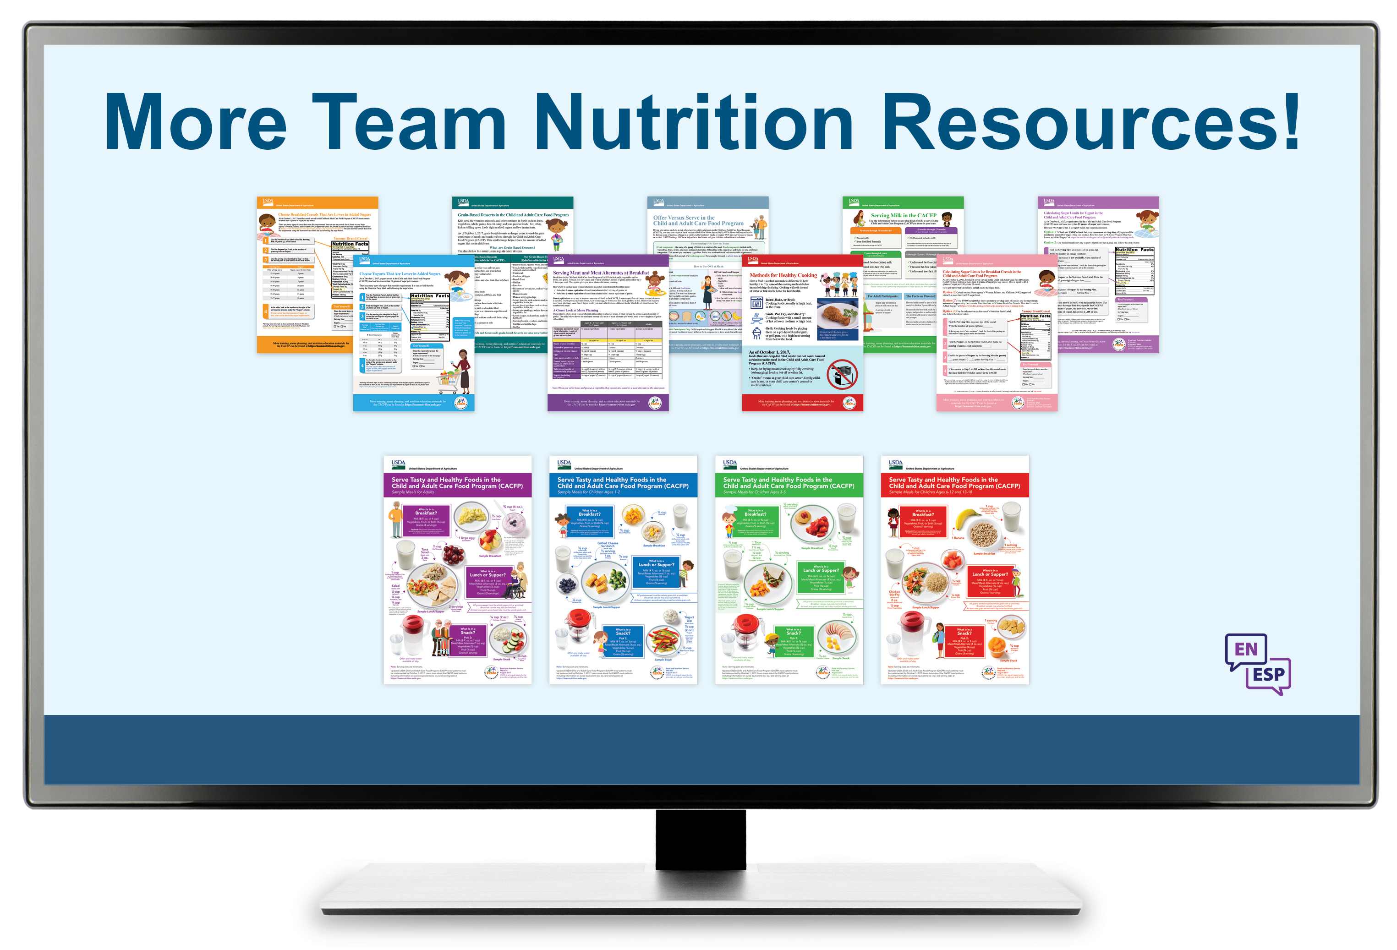
Team Nutrition Resources
All Team Nutrition materials are available online from Team Nutrition’s website and are available for free download to anybody who is interested.
TeamNutrition.usda.gov
Notes:
All Team Nutrition materials are available online from Team Nutrition’s website and are available for free download to anybody who is interested.

Slide 37
How To Order Print Copies
Resource Order Form at TeamNutrition.usda.gov.
FREE for those participating in a USDA’s Child Nutrition Program, while supplies last.
Sponsoring organizations and State agencies can also order in bulk by sending an email to:
TeamNutrition@usda.gov
For all participating in a Child Nutrition Program, such as the CACFP, Team Nutrition’s print materials are free to order.
If you would like to order Team Nutrition’s free materials in print, you can go to the “Resource Order Form” link on the Team Nutrition website to order print copies of the materials.
For bulk orders, you can email teamnutrition@usda.gov.
Notes:
For all participating in a Child Nutrition Program, such as the CACFP, Team Nutrition’s print materials are free to order.
If you would like to order Team Nutrition’s free materials in print, you can go to the “Resource Order Form” link on the Team Nutrition website to order print copies of the materials.
For bulk orders, you can email teamnutrition@usda.gov.

Slide 38




Thank you!
TeamNutrition.usda.gov
@TeamNutrition
TeamNutrition@usda.gov
These training slides were provided by U.S. Department of Agriculture's Team Nutrition. If you would like to learn more about Team Nutrition and additional resources available, please visit their website, subscribe to their monthly e-newsletter, connect with them via email at teamnutrition@usda.gov, and follow them on Twitter.
Thank you!
USDA is an equal opportunity provider, employer, and lender.
Notes:
These training slides were provided by U.S. Department of Agriculture's Team Nutrition. If you would like to learn more about Team Nutrition and additional resources available, please visit their website, subscribe to their monthly e-newsletter, connect with them via email at teamnutrition@usda.gov, and follow them on Twitter.
Thank you!

