Slide 1
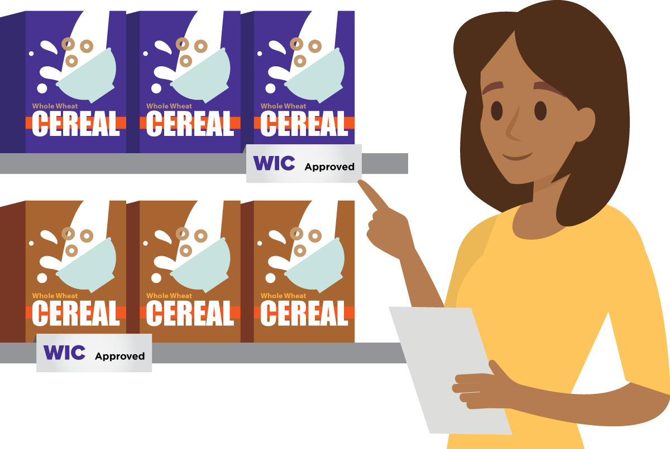
Using the Special Supplemental Nutrition Program for Women, Infants, and Children
(WIC) Food Lists to
Identify Grains for the CACFP
A Training Presentation for
Child and Adult Care Food
Program (CACFP) Operators

Slide 2
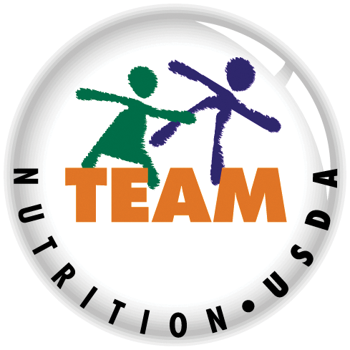


USDA’s Team Nutrition
An initiative of the USDA’s Food and Nutrition Service to support the USDA’s Child Nutrition Programs.
Aims to improve children’s lifelong eating and physical activity habits.
Provides nutrition education and training materials to State agencies, sponsoring organizations, and CACFP sites.
TeamNutrition.usda.gov
@TeamNutrition
Notes:
Team Nutrition is an initiative of the USDA Food and Nutrition Service that supports the Child Nutrition Programs, including the National School Lunch Program, the School Breakfast Program, and of course, the Child and Adult Care Food Program, or the CACFP.
It does so through training and technical assistance for those preparing and serving meals, providing nutrition education for children, and building support for healthier school and child care environments.

Slide 3
Let Us Know Who You Are!
I work for a…
?
Child care center
Family child care home
At-risk afterschool care center
Adult day care center
Sponsoring organization
Emergency shelter
School food authority
State agency
USDA Regional Office
Other
Notes:
Before we get started, I want to know who has joined us today.
Please raise your hand if you work for:
a child care center [pause and wait for a show of hands],
a family child care home [pause and wait for a show of hands],
an at-risk afterschool care center [pause and wait for a show of hands],
an adult day care center
a sponsoring organization [pause and wait for a show of hands],
an emergency shelter [pause and wait for a show of hands],
a school food authority [pause and wait for a show of hands],
a State agency [pause and wait for a show of hands],
a USDA Regional Office [pause and wait for a show of hands], or
other [pause and wait for a show of hands].

Slide 4
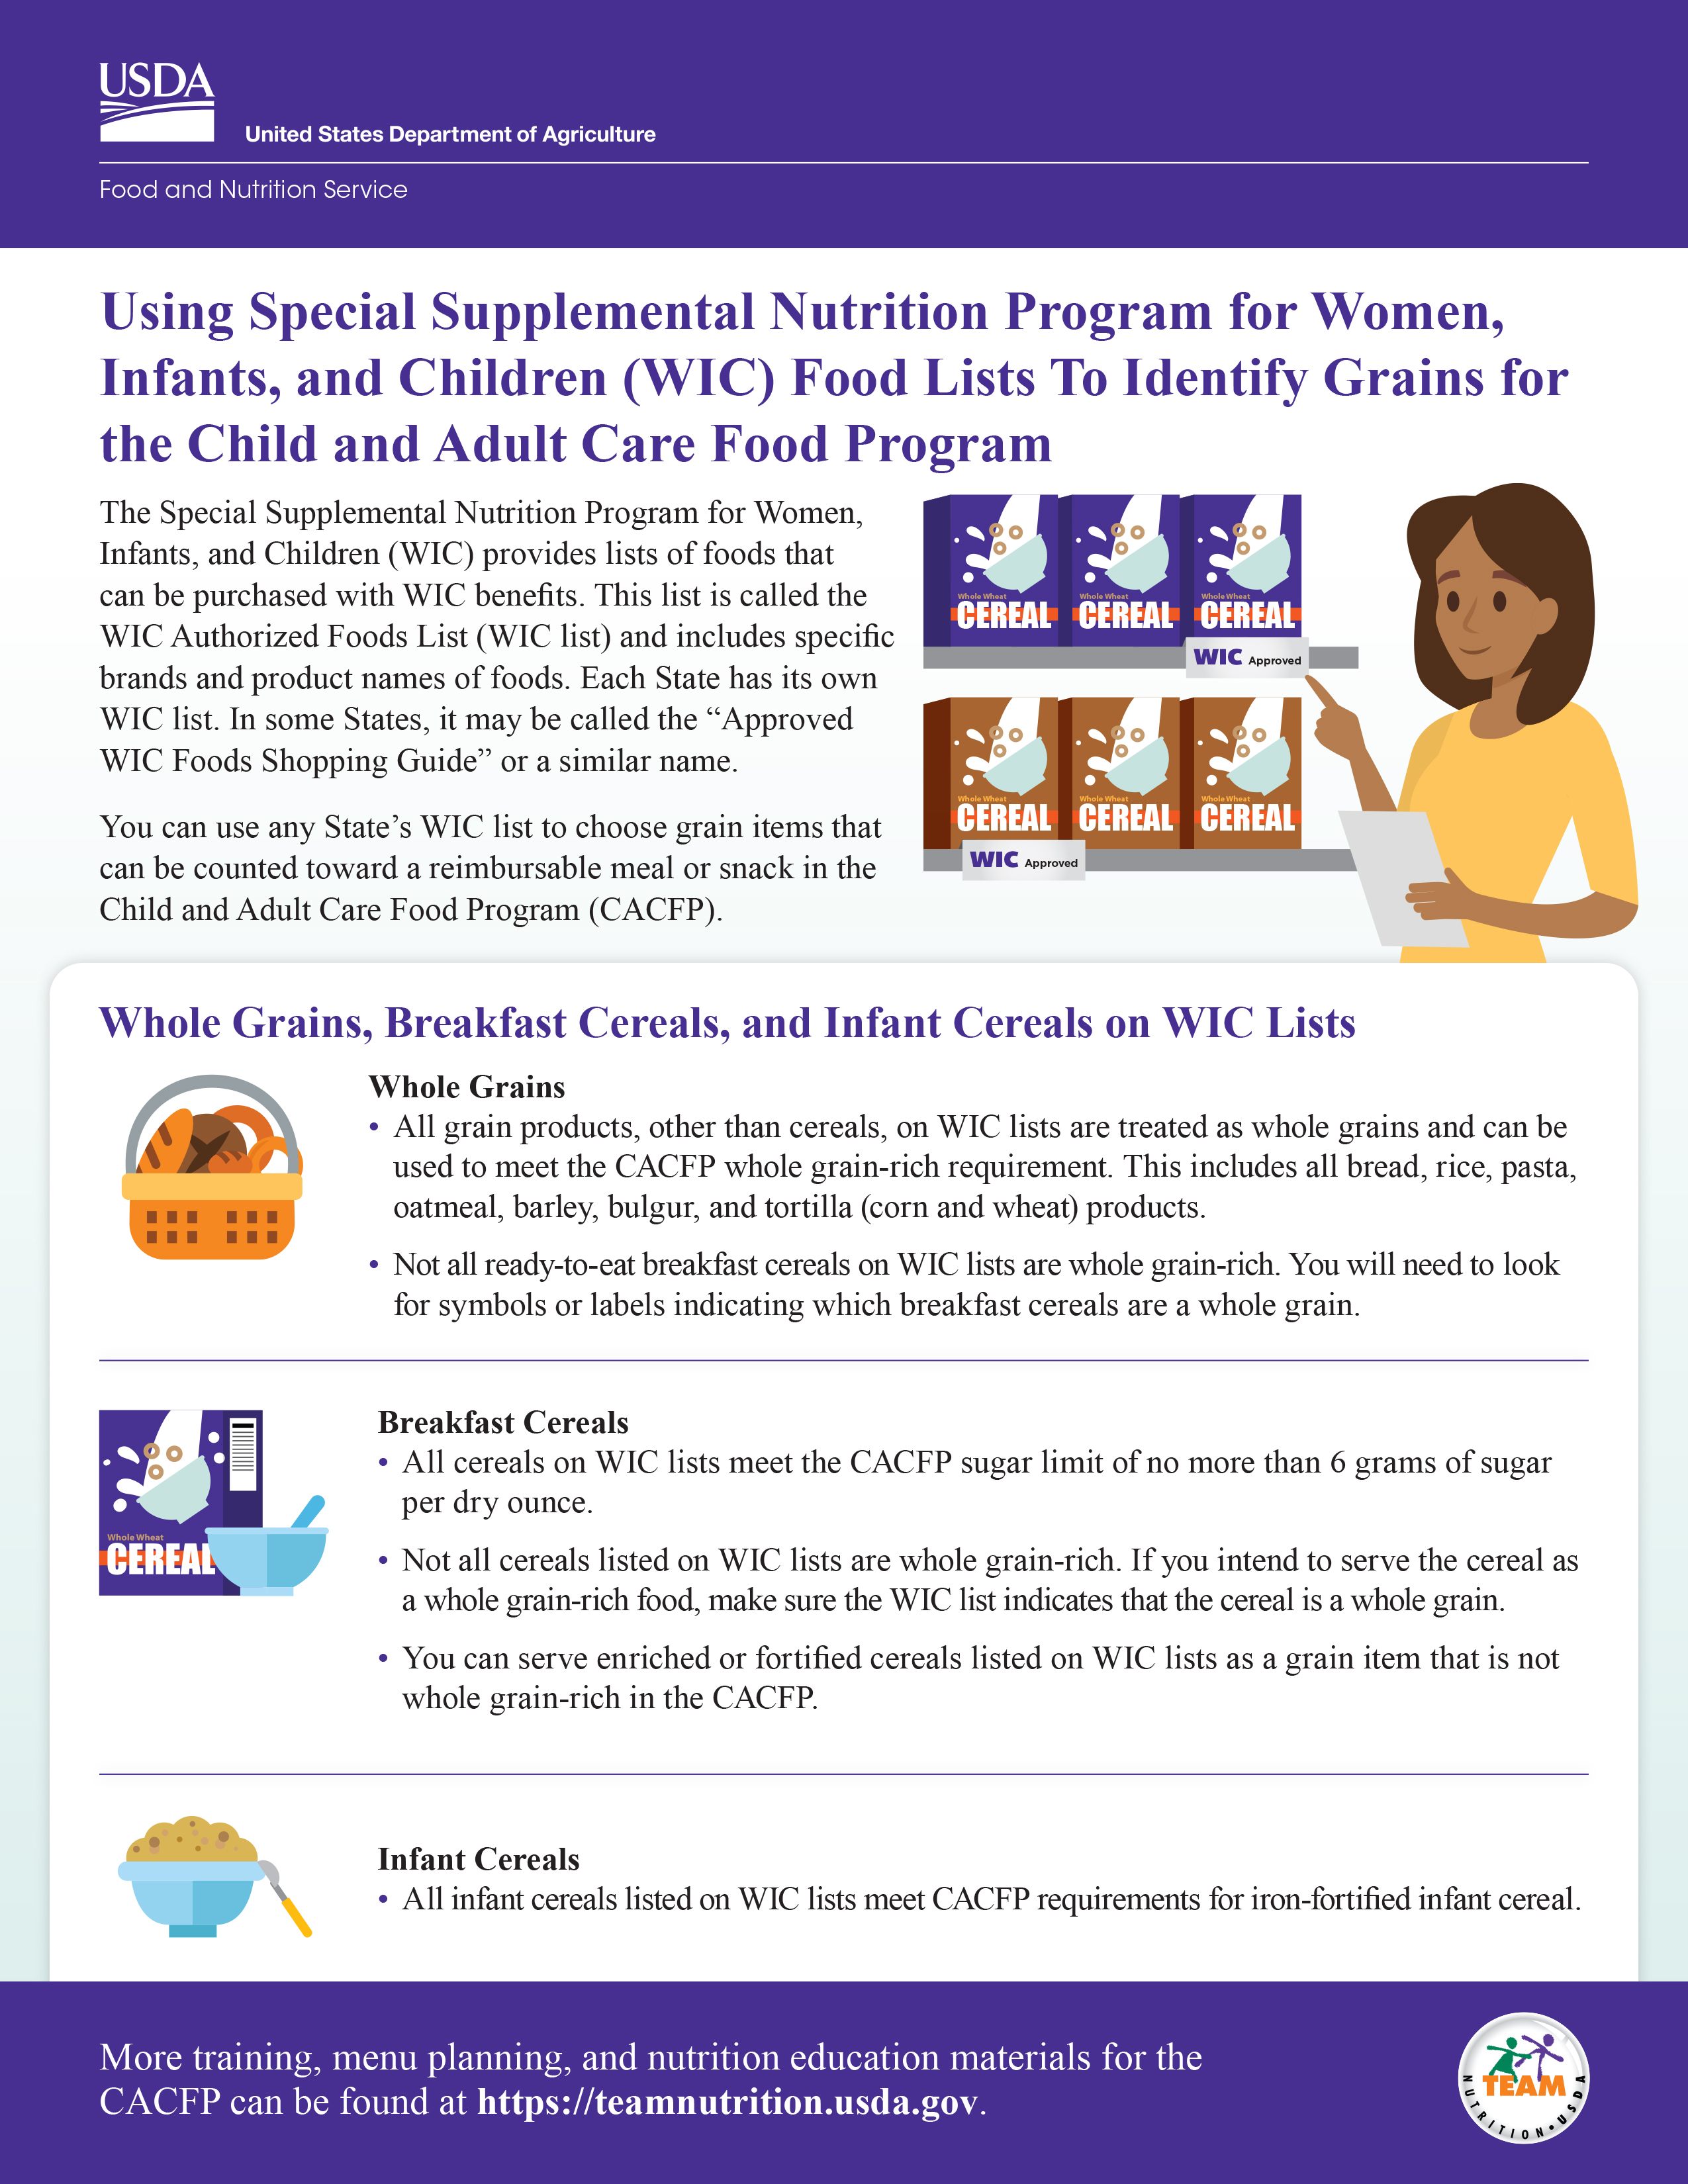
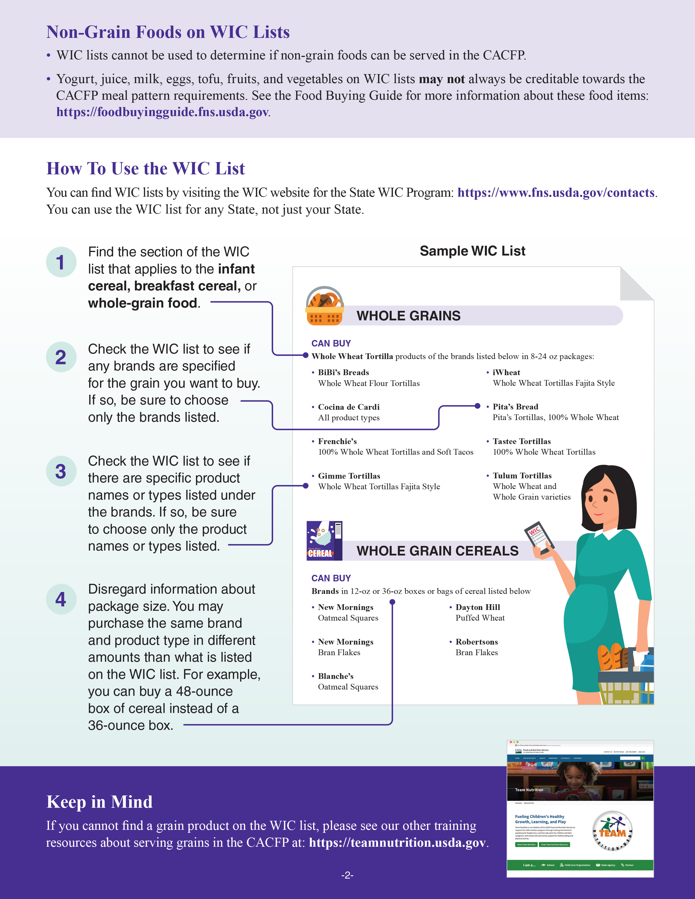
Using the WIC Food Lists to Identify Grains for the CACFP
https://www.fns.usda.gov/tn/meal-pattern-training-worksheets-cacfp
Notes:
So, let’s get started! Today we will discuss how to use the Special Supplemental Nutrition Program for Women, Infants, and Children, or “WIC,” Food Lists to Identify Grains for the CACFP. The USDA’s Team Nutrition initiative has created a worksheet on this topic. You can download the worksheet from the web address on the screen, if you’d like. You can also follow along with the pictures shown on the slides.

Slide 5
What is the Grains Requirement in the CACFP?
A whole grain-rich item must be offered at least once per day for children and adults.
The whole grain-rich requirement does not apply to infants.
All remaining grains throughout the day can be:
Whole grain-rich
Enriched
Fortified
Made with bran or germ
Notes:
Before we talk about the WIC food lists, let’s talk about grains in the CACFP meal pattern. Grains are required at breakfast, lunch, and supper, and are optional at snack.
A whole grain-rich item must be offered at least once per day for children and adults. There is not a whole grain-rich requirement for infants.
In the CACFP, whole grain-rich foods contain at least 50% whole grains and the remaining grains in the food are enriched, fortified, or made with bran or germ. Foods that are 100% whole grain are also whole grain-rich.
Again, whole grain-rich foods are required only one time per day. The rest of the grains you offer throughout the day can be whole grain-rich, enriched, fortified, or made with bran or germ.

Slide 6
Foods Are Whole Grain-Rich in the CACFP If…
The food is found on any State agency’s WIC-approved whole grain food list.
OR
It is listed as “whole wheat,” “entire wheat,” or “graham” (certain foods only).
OR
The food has an FDA-approved whole-grain health claim.
The food meets the whole grain-rich criteria for the School Meals Programs.
OR
You have proper documentation from a manufacturer or a standardized recipe that shows whole grains are the main ingredient by weight.
OR
The food meets criteria listed in the Rule of Three.
Notes:
There are many different ways to tell if a food is whole grain-rich in the CACFP. You can use any one of the methods that are written here. The food does not have to meet all the methods to be considered whole grain-rich. Check with your State agency or sponsoring organization if you have any questions about which methods you can or should be using.
Some methods you can use to tell if a food is whole grain-rich in the CACFP include:
If the food is found on any State agency’s WIC-approved whole-grains list, or marked as a whole-grain food on the WIC list. This does not have to be your State; it can be listed on any State’s WIC-approved foods list. We will talk about this method in a lot more detail during today’s training.
OR
If a certain food, including bread, rolls, buns, macaroni, spaghetti or vermicelli are labeled “whole wheat, entire wheat, or graham” such as “whole-wheat rolls, entire wheat bread, or graham buns.”
OR
If a food has something called an FDA (US Food and Drug Administration) approved whole-grain health claim.
OR
If it’s considered whole grain-rich in the School Meals Programs, such as the National School Lunch Program or School Breakfast Program.
OR
If you have proper documentation from a manufacturer, or a standardized recipe that shows that whole grains are the main grain ingredient by weight.
OR
Finally, if the ingredients in the food meet the criteria listed in the Rule of Three.

Slide 7
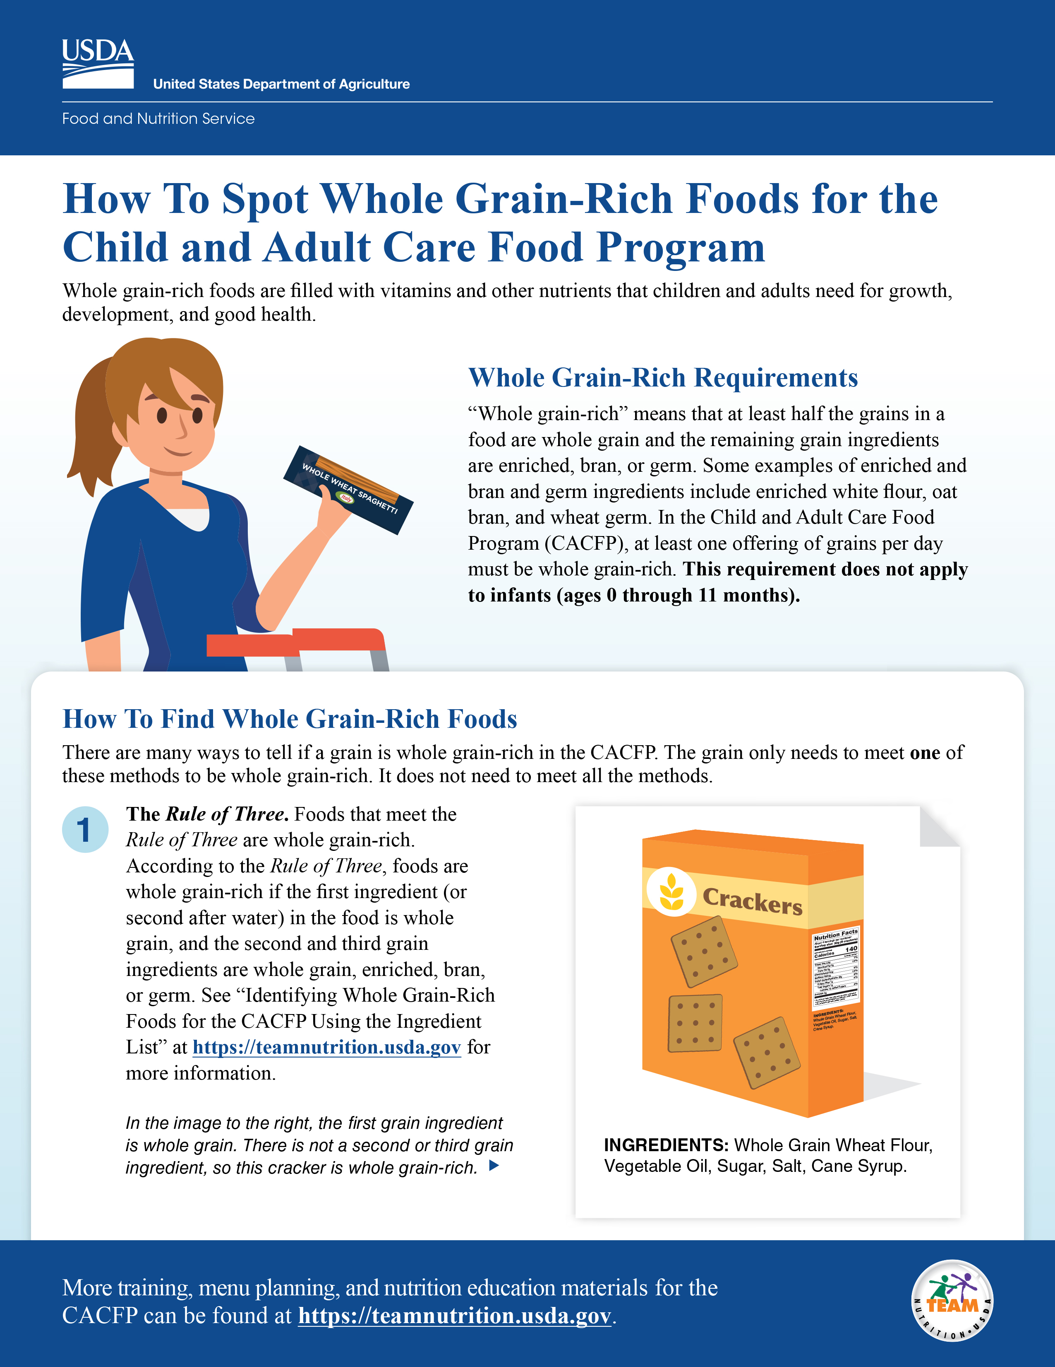
Today’s Training
Additional Resources
fns.usda.gov/team-nutrition/cacfp-meal-pattern-training-worksheets
Notes:
Again, for today’s training we will be focusing on one method to identify whole grain-rich foods, and that’s the method that uses the WIC Food Lists. As I just mentioned, there is an optional accompanying worksheet that can be used with today’s training, and that’s shown on the left.
For those of you who want more information on the other methods for identifying whole grain-rich items in the CACFP, Team Nutrition also has a worksheet that lists and explains these methods. This is shown on the right side of this slide.
You can find both of these worksheets, along with several others, at the web address shown at the bottom of this screen.

Slide 8
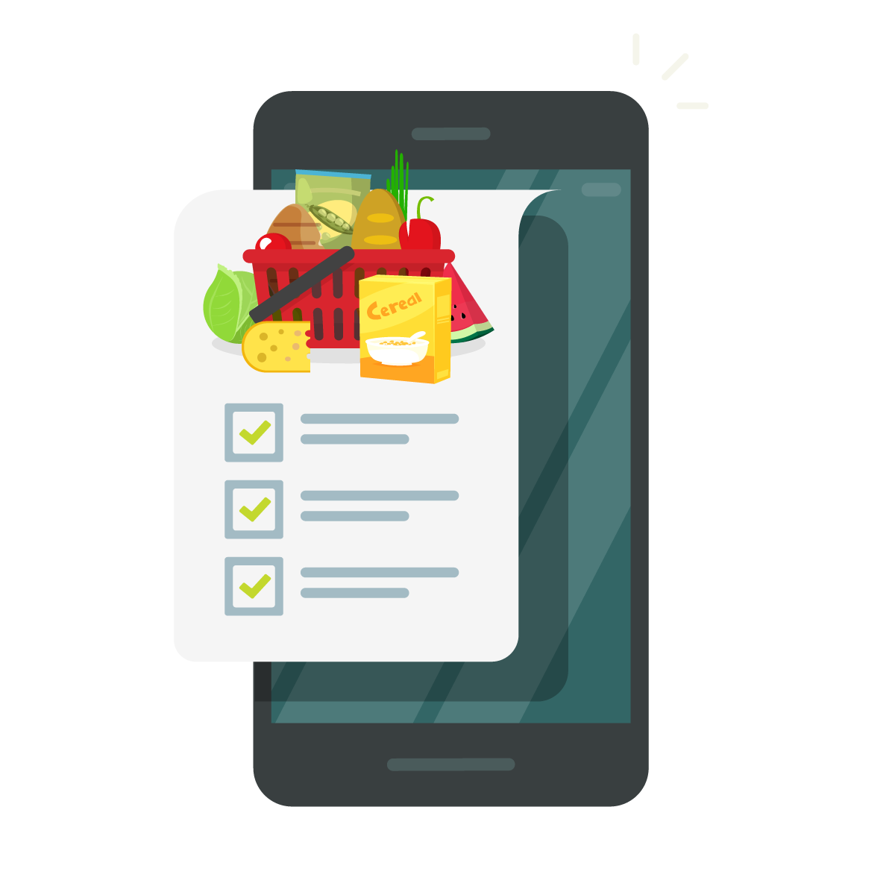
What is a WIC Food List (WIC List)?
Provides a list of foods that can be purchased with WIC benefits.
Includes specific brands and product names of foods.
Each State has its own WIC approved food list.
  Must meet minimum Federal WIC requirements.
You can use ANY State agency’s WIC list to choose grain items to serve in the CACFP.
Notes:
The Special Supplemental Nutrition Program for Women, Infants, and Children, known as WIC, provides federal grants to States for supplemental foods, health care referrals, and nutrition education for low-income pregnant, breastfeeding, and non-breastfeeding postpartum women, and to infants and children up to age five who are at nutritional risk.
WIC authorizes food lists that meet minimum Federal WIC requirements and can be purchased with WIC benefits.
This list is called the WIC Authorized Foods List or WIC list. It includes specific brands and product names of foods. Each State has its own WIC list and in some States it may be called the “Approved WIC Foods Shopping Guide” or a similar name.
You can use any State agency’s WIC list to choose grain items that can count towards a reimbursable meal or snack in the CACFP, such as whole grain-rich breads, pastas, rice, and tortillas. The WIC list can also be used to find breakfast cereals and infant cereals that meet the CACFP sugar limit.
Some States may require that you only use your State's list, so if you are not sure, please check with your State agency or sponsoring organization to see which State’s WIC list to use before purchasing those grain items.

Slide 9
Try It Out!
Bob works in State A and finds State B’s WIC list. Can he use State B’s WIC list to identify whole-grain rich items he can offer at his child care site in State A?
?
Yes
No
Notes:
Now, let’s do a quick practice question.
Bob works in State A and finds State B’s WIC list. Can he use State B’s WIC list to identify whole grain-rich items he can offer at his child care site in State A? Yes or No?
Raise your hand if you think Bob can use State B’s WIC list to identify whole grain-rich items he can offer at his child care site in State A [pause for a show of hands].
Raise your hand if you do not think Bob can use State B’s WIC list to identify whole grain-rich items he can offer at his child care site in State A [pause for a show of hands].

Slide 10
Try It Out!
Answer
Bob works in State A and finds State B’s WIC list. Can he use State B’s WIC list to identify whole-grain rich items he can offer at his child care site in State A?
?
Yes
No
Yes. You can use ANY State agency’s WIC list to choose grain items to serve in the CACFP.
Notes:
Great job, everyone!
Yes, Bob can use State B’s WIC list even though he works in State A. In the CACFP you can use any State agency’s WIC list to choose grain items to serve in the CACFP.
However, before Bob purchases grain items from State B’s WIC list, he checks with his State agency first.
Remember, some States may require that you only use your State's list, so if you are not sure, please check with your State agency or sponsoring organization to see which States WIC list to use before purchasing those grain items.

Slide 11
Categories on a WIC List
Categories will vary among State WIC lists. They may include:
Whole Grains
Breakfast Cereals
Infant Cereals
Notes:
A WIC list may include several different sections or categories. The sections or categories you want to pay attention to when choosing foods for the CACFP are “whole grains”, “breakfast cereals,” and “infant cereals.”
WIC lists include some, but not all, of the cereals and whole grain-rich items that can be served in the CACFP.
Remember, some grains also may not credit towards reimbursable meals and snacks for infants in the CACFP. This includes grains such as pastas, rice, and cereals like oatmeal.
Now, let’s go into each one of these sections listed on the slide. Let’s start with whole grains.

Slide 12
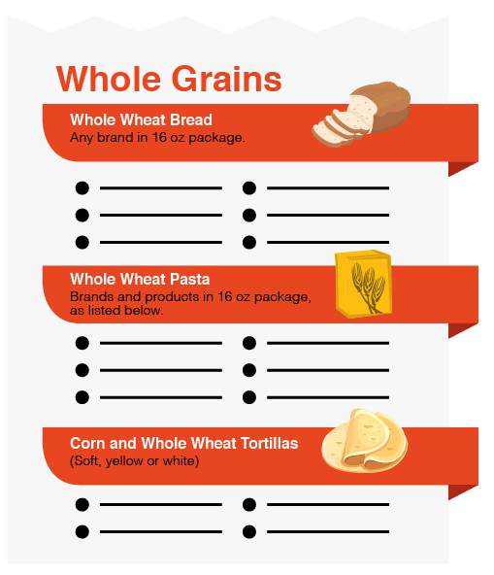
Whole Grains on a WIC List
All grain products on WIC lists, except some breakfast cereals, can be used to meet CACFP whole grain-rich requirements.
Examples:
Bread
Rice
Pasta
Tortillas
Some breakfast cereals may not be whole grain-rich.
Notes:
All grain products on WIC lists, except for breakfast cereals, are treated as whole grains and can be used to meet CACFP whole grain-rich requirements. This includes all bread, rice, pasta, oatmeal, barley, tortilla and corn and wheat products.
Not all breakfast cereals listed on WIC lists are whole grain-rich. Some States use symbols to indicate which cereals are whole grain-rich, while other States use symbols to show which cereals are not whole grain-rich. Check to see what different symbols might mean before using the WIC list to purchase cereal.

Slide 13

Breakfast Cereals on a WIC List
Sugar Limit in the CACFP
ALL cereals on WIC lists meet the CACFP sugar limit.
Cereals may not contain more than 6 grams of sugar per dry ounce.
Whole Grain-Rich in the CACFP
Not all cereals listed on WIC lists are whole grain-rich.
Enriched or fortified cereals listed can be served as a grain item.
Notes:
Now, let’s talk about breakfast cereals in the CACFP. As you know, there is a sugar limit for breakfast cereals of no more than 6 grams of sugar per dry ounce of cereal in the CACFP. WIC has the same sugar limit for cereal so any cereal listed on a WIC list also meets the CACFP sugar limit for cereal.
However, as we mentioned, not all cereals are whole grain-rich.
If you would like to count a breakfast cereal as a whole grain-rich item then there are two things you need to consider – the sugar limit AND determining if the breakfast cereal is marked as a whole grain-rich item on the WIC list.
Again, ALL cereals on WIC lists meet the CACFP sugar limit of no more than 6 grams of sugar per dry ounce. So, any breakfast cereal on a WIC list can be offered as part of a reimbursable meal in the CACFP. However, if you want to serve the breakfast cereal as a whole grain-rich item, then make sure it is marked as a whole grain-rich item on the WIC list.
If it is not marked as a whole grain-rich item on the WIC list, but the breakfast cereal is enriched or fortified, it can still be served as a grain item, just not as a whole grain-rich item.
Remember, WIC lists include some, but not all, of the cereals and whole grain-rich items that are creditable in the CACFP.

Slide 14
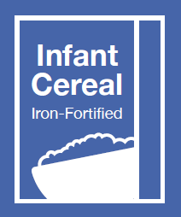
Infant Cereals on a WIC List
ALL infant cereals on a WIC list are creditable in the CACFP.
Notes:
The last category we will discuss on the WIC list is infant cereals.
All infant cereals listed on WIC lists meet the CACFP requirements for iron-fortified infant cereal. These infant cereals can be served as part of a reimbursable meal or snack when infants are developmentally ready.

Slide 15
Non-Grain Foods on WIC Lists
WIC lists may include other foods, such as:
Juice
Milk
Eggs
Tofu
Fruits
Vegetables
Yogurt
DISREGARD
Notes:
If you are familiar with a WIC list already, you know that they may include other foods, such as:
Juice
Milk
Eggs
Tofu
Fruits
Vegetables, and
Yogurt
Some of these foods may be creditable in the CACFP, but you may need more information than what is written on the WIC list to decide. You can disregard these sections when using the WIC list to purchase foods for the CACFP.

Slide 16
Non-Grain Foods on WIC Lists
Non-Grain Foods on WIC Lists
WIC lists cannot be used to determine whether non-grain foods can be served in the CACFP.
Yogurt, juice, milk, eggs, tofu, fruits, and vegetables on WIC lists may not always be creditable towards the CACFP meal pattern requirements. See the Food Buying Guide for more information about these food items.
https://foodbuyingguide.fns.usda.gov.
Notes:
Page 2 of the worksheet also lists these categories and foods on the WIC list that you can ignore or disregard.
For more information about yogurt, juice, milk, eggs, tofu, fruits, and vegetables, check out the Food Buying Guide for Child Nutrition Programs at the web address shown at the bottom of this screen.

Slide 17
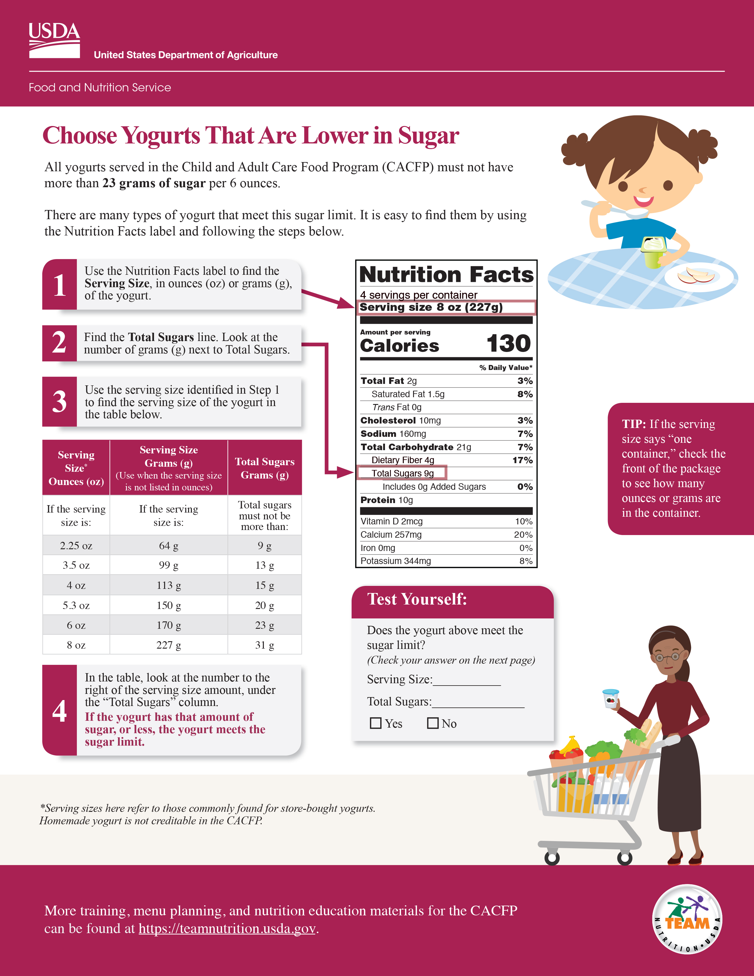
Sugar Limits for Yogurt
WIC lists may not be used to find yogurts that meet the CACFP sugar limit.
See “Choose Yogurts That Are Lower in Sugar” training worksheet for CACFP.
https://www.fns.usda.gov/tn/meal-pattern-training-worksheets-cacfp
Notes:
Additionally, WIC and CACFP have different sugar limits for yogurt. As you know, there is a sugar limit of no more than 23 grams of sugar per 6 ounces in the CACFP. The sugar limit for yogurt in WIC is different. Therefore, the WIC list CANNOT be used to find yogurts that meet the CACFP sugar limit.
To determine if a yogurt meets the sugar limit of 23 grams of sugar per 6 ounces, you can check out the USDA Team Nutrition worksheet titled, “Choose Yogurts That Are Lower in Sugar” and the recorded CACFP Halftime: Thirty on Thursdays webinar on this topic. These can be found on the Team Nutrition website at the address shown at the bottom of the screen.

Slide 18

Try It Out!
Sonia wants to find yogurts that are creditable in the CACFP. Should she
use her State’s WIC list?
?
Yes
No
Notes:
Let’s do another practice question.
Sonia wants to find yogurts that are creditable in the CACFP. Should she use her State’s WIC list?
Raise your hand if you think Sonia can use her State’s WIC list to find yogurts that meet the sugar limit in the CACFP [pause for a show of hands].
Now, raise your hand if you think Sonia cannot use her State’s WIC list to find yogurts that meet the sugar limit in the CACFP [pause for a show of hands].

Slide 19
Try It Out!
Answer
Sonia wants to find yogurts that are creditable in the CACFP. Should she
use her State’s WIC list?
?
Yes
No
No. Sonia should not use the WIC list to find yogurts that are creditable in the CACFP. WIC and CACFP have different sugar limits for yogurt. The WIC list cannot be used to find creditable yogurts for the CACFP.
Notes:
You all are correct, the answer is “No.” Sonia should not use the WIC list to find yogurts that are creditable in the CACFP. WIC and CACFP have different sugar limits for yogurt. The WIC list cannot be used to find creditable yogurts for the CACFP.

Slide 20
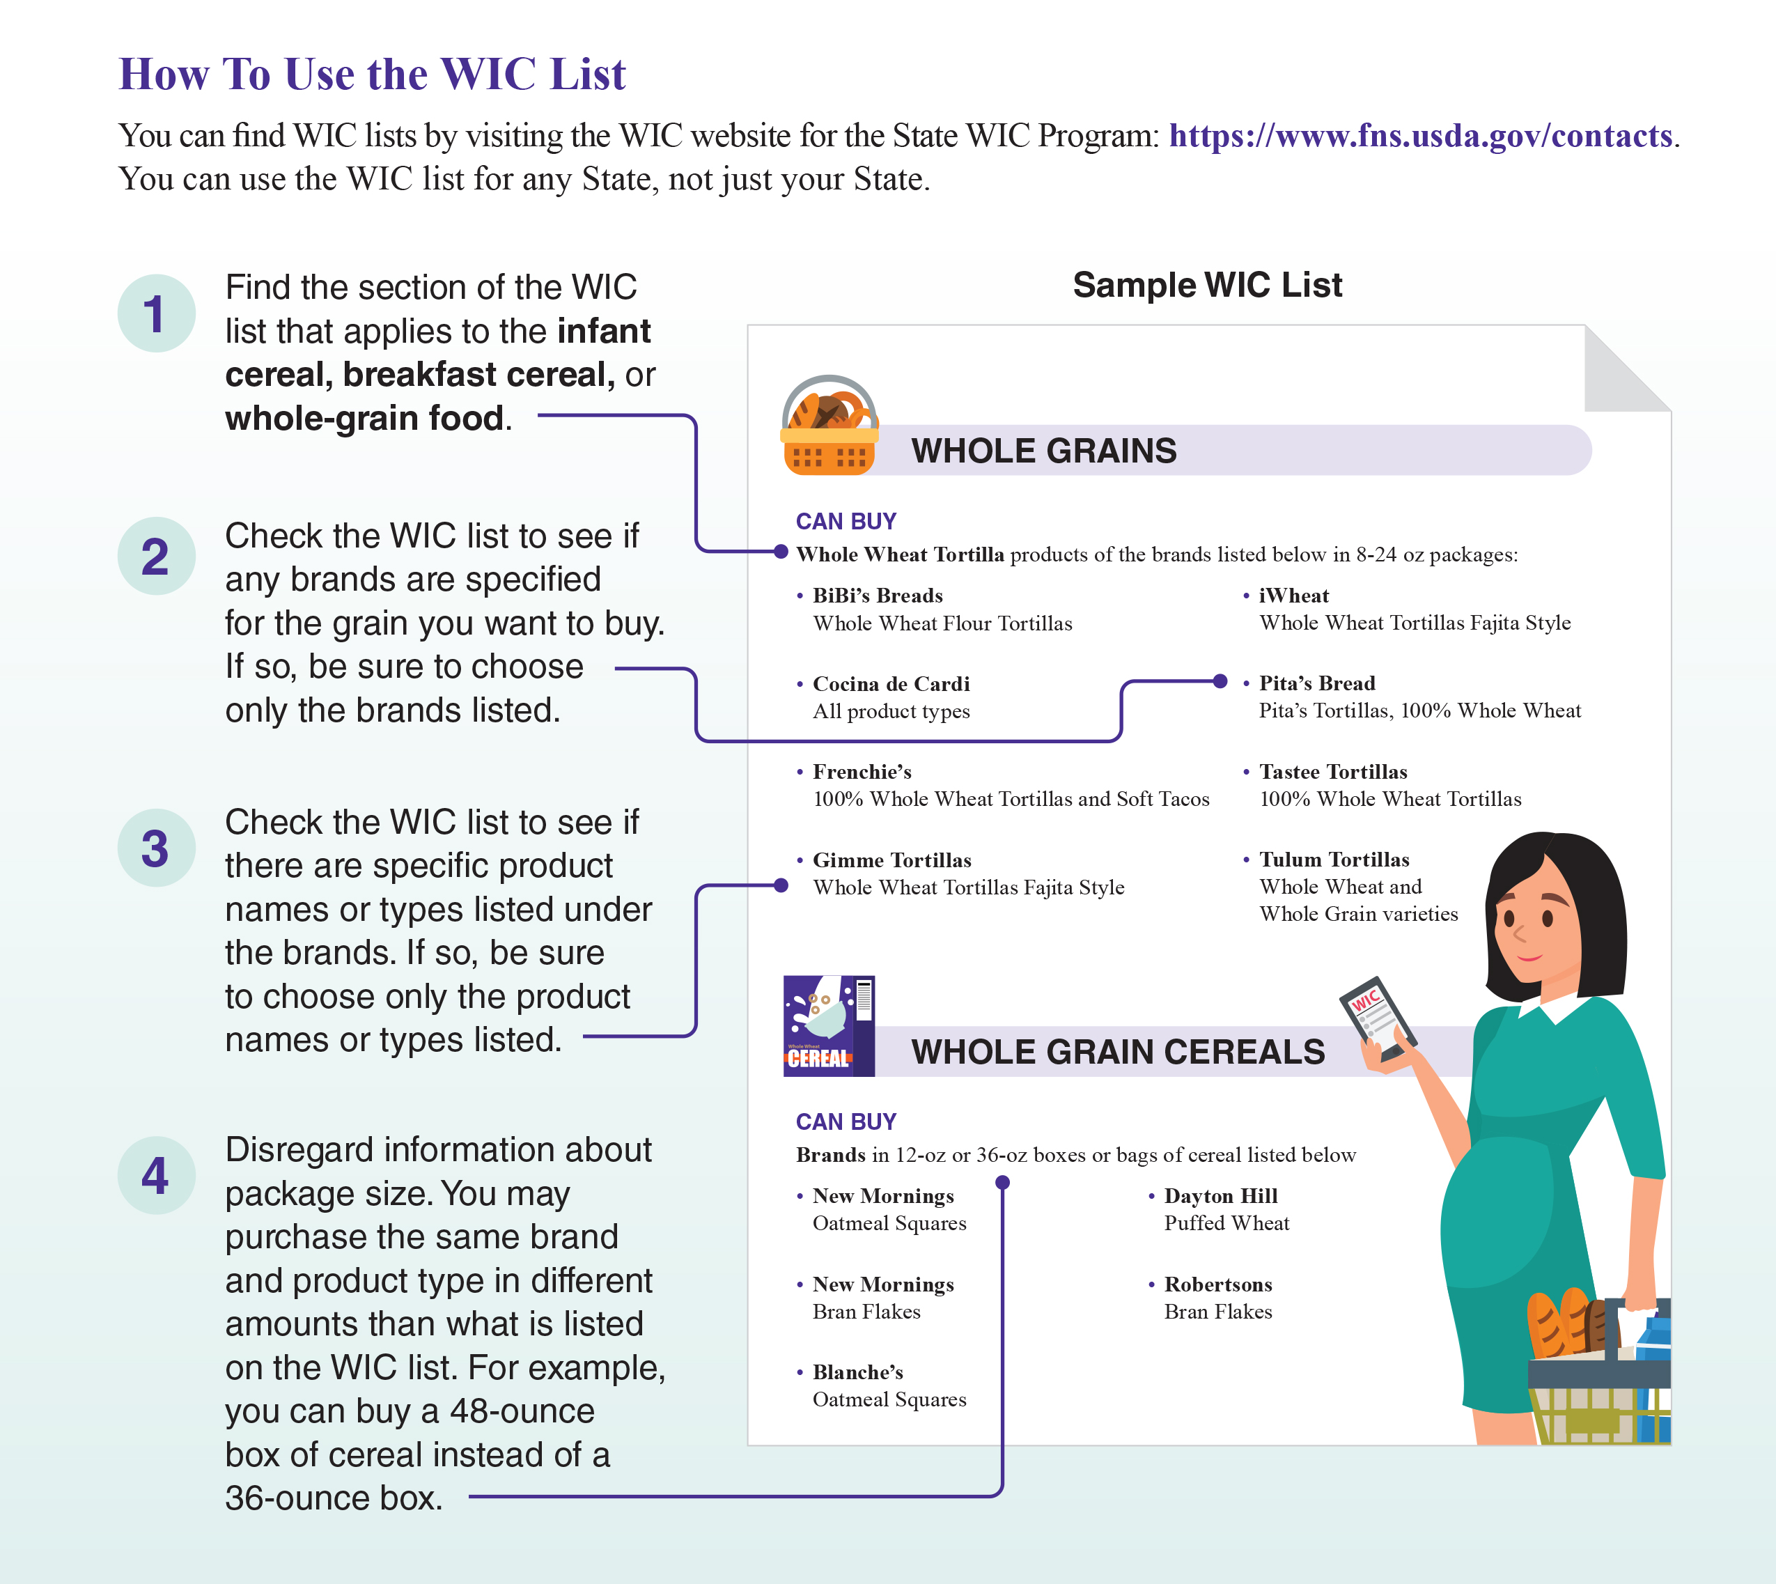
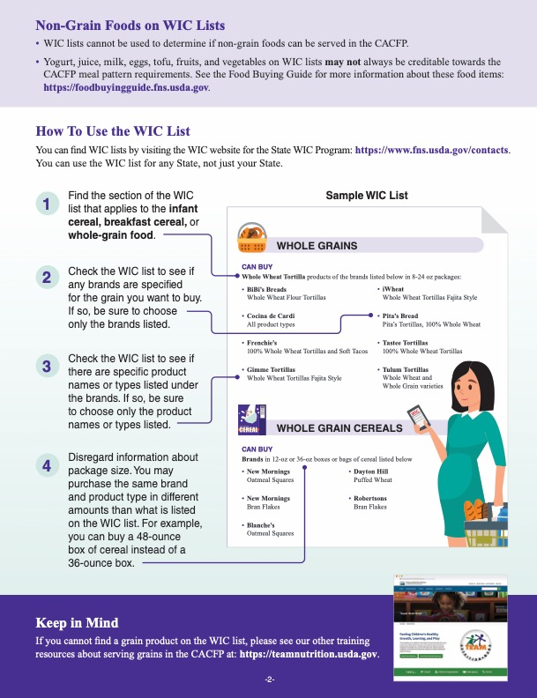
How to Use the WIC List
Notes:
Now, let’s take a closer look at how to use the WIC list to find grains for the CACFP. If you have the worksheet in front of you, you can follow along on page 2. You can also follow along using the pictures on the slide.

Slide 21
Choose a WIC List
You can find WIC lists by
visiting the WIC website for
the State WIC Program: https://www.fns.usda.gov/contacts.
You can use the WIC list for any State, not just your State.
Notes:
First, find any State’s WIC list you want to use. Websites for each State can be found at the website link on the slide. As mentioned earlier, check with your State agency or sponsoring organization before using another State’s WIC list.

Slide 22
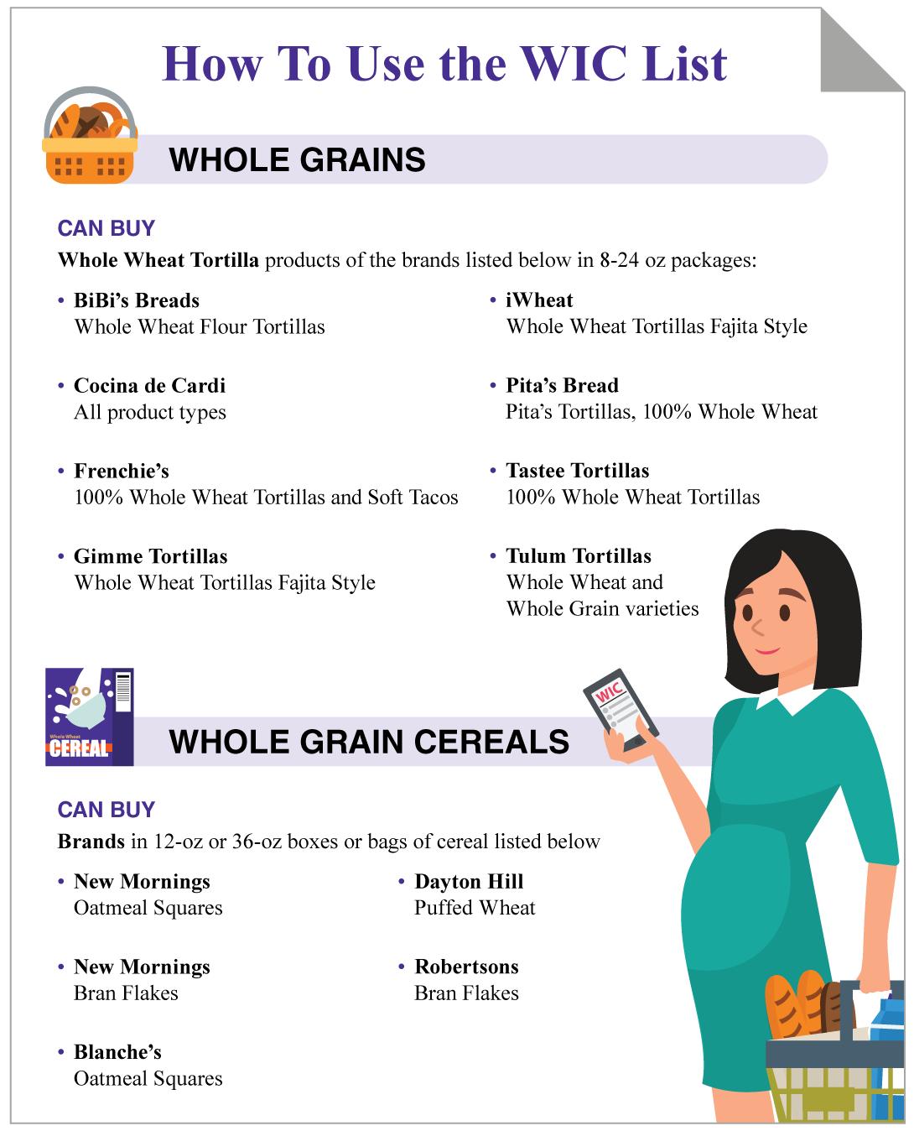
Find the Grain Item
1
Find the section of the WIC list that applies to the infant cereal, breakfast cereal, or whole-grain food.
Notes:
Remember that the WIC list can only be used to find whole-grain foods, breakfast cereals, and infant cereals that can be served in the CACFP. So, after you’re chosen your WIC list, find the section of the WIC list for the grain you want to buy.

Slide 23
Check the Brand
2
Check the WIC list to see if any brands are specified for the grain you want to buy. If so, be sure to choose only the brands listed.
Notes:
Next, check the WIC list to see if any brands are specified for the item you want to buy. If so, be sure to choose only the brands listed.

Slide 24
Check the Product Type
3
Check the WIC list to see if there are specific product names or types listed under the brands. If so, be sure to choose only the product names or types listed.
Notes:
Check the WIC list to see if there are specific product names or types listed under the brands such as a “fajita-style tortillas,” “100% whole wheat bread,” etc. Make sure both the brands and product names you buy match what is on the WIC list.

Slide 25
Disregard the Package Size
Disregard information about package size. You may purchase the same brand and product type in amounts that are different than what is listed on the WIC list.
For example, you can buy a 48-ounce box of cereal instead of a 36-ounce box.
4
Notes:
If the WIC list states a certain package size, you do not have to purchase that package size for the CACFP. For example, if the WIC list says you must buy a 48-ounce box of cereal, you may purchase that same cereal in a 12-ounce box, 24-ounce box, etc., and serve it in the CACFP.

Slide 26
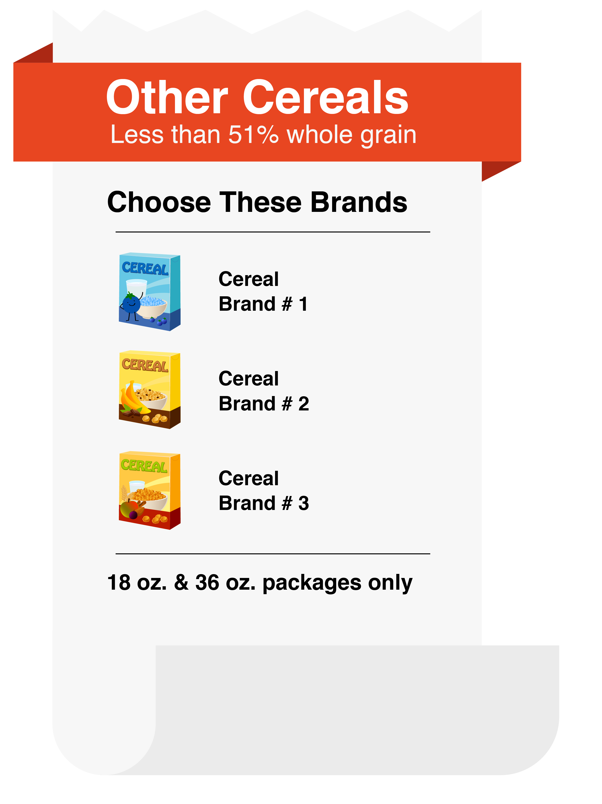
Breakfast Cereals on the WIC List
All breakfast cereals meet the CACFP sugar limit.
Not all breakfast cereals are whole grain-rich.
Disregard information about the package size.
Disregard information listed under “cannot buy,” “not WIC approved,” “do not buy,” etc.
DISREGARD THIS
Notes:
Now, let’s focus on finding breakfast cereals for the CACFP using the WIC list. Remember, all cereals on any State’s WIC list meet the CACFP sugar limit for cereals. But, not all cereals listed on WIC lists are whole-grain. So, if you want to serve a cereal as your whole grain-rich item, make sure you choose a cereal that is marked as whole grain on the WIC list.
As we just mentioned, many WIC lists include information about package sizes, especially for breakfast cereals. Again, you can disregard this information. It does not apply to the CACFP.
You can also disregard information listed under headings such as “Cannot Buy,” “Not WIC Approved, and “Do Not Buy.” These warnings do not apply to the crediting of grains in the CACFP.

Slide 27
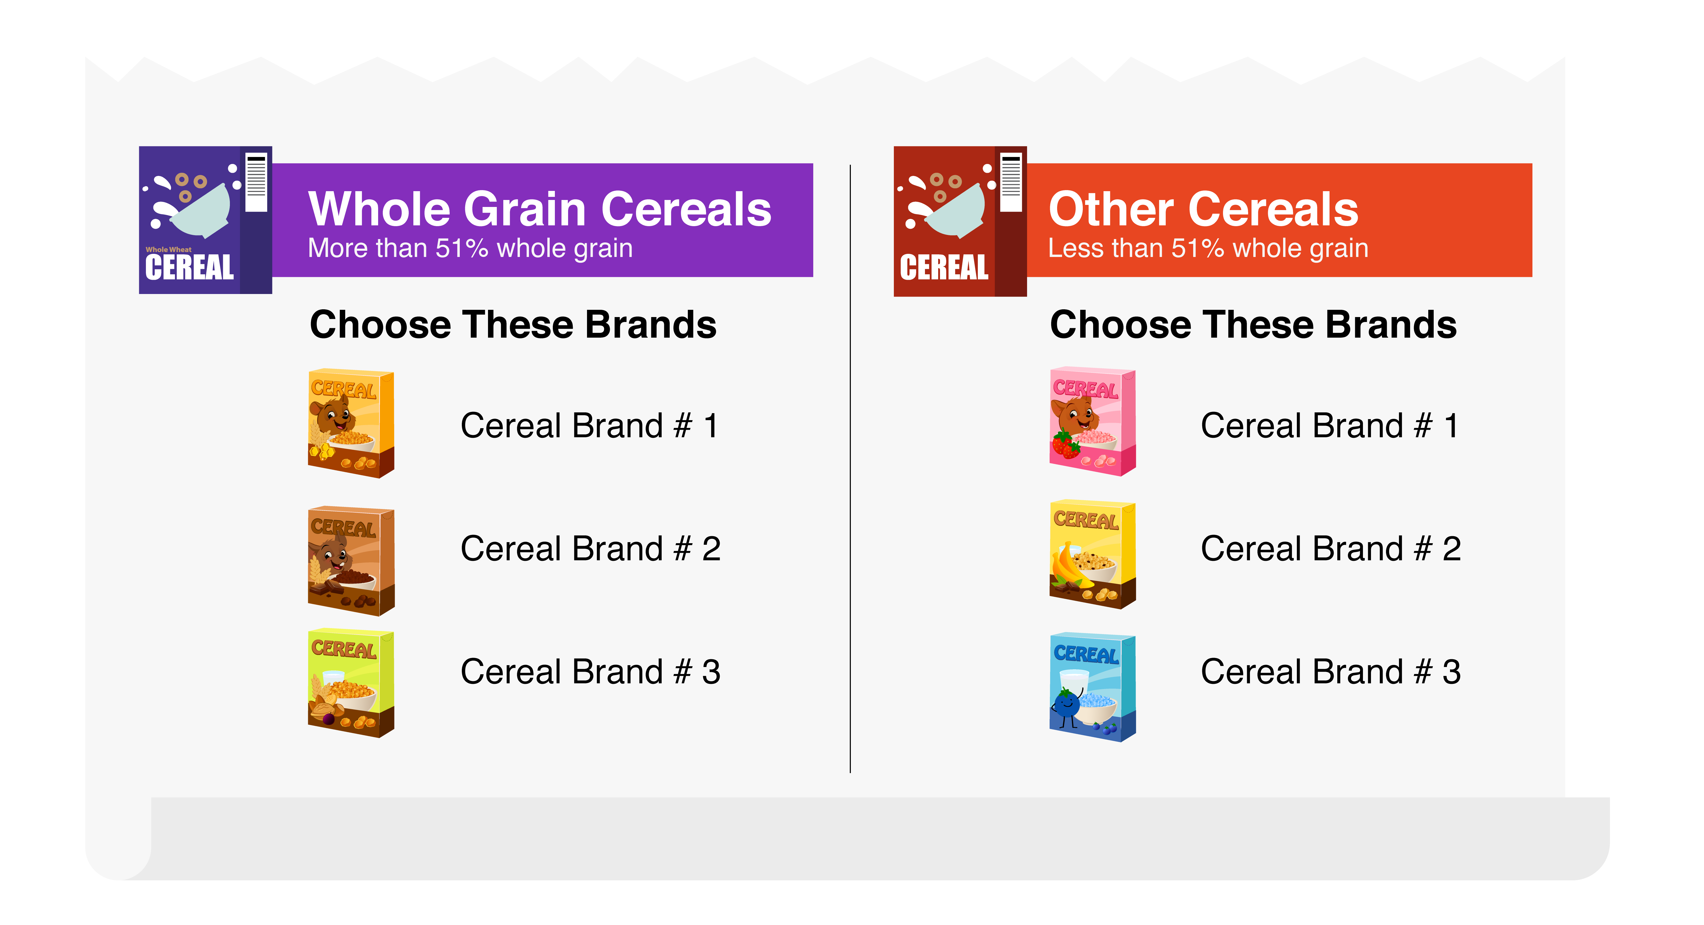
Let’s Take a Closer Look!
Marked as whole grain
Not marked as whole grain
Notes:
Let’s take a look at the “Breakfast Cereal” section of this WIC list.
On the left, the breakfast cereals listed are marked as “whole grain cereals”. If you choose to use this WIC list, the cereals listed under this section can count as your whole grain-rich item.
On the right, you see additional breakfast cereals but these are marked as “other cereals,” NOT as whole grain cereals. If you choose to use this WIC list, you can serve these breakfast cereals to fulfill the grains component at a meal or snack, but you cannot claim it as a whole grain-rich item for that day.

Slide 28
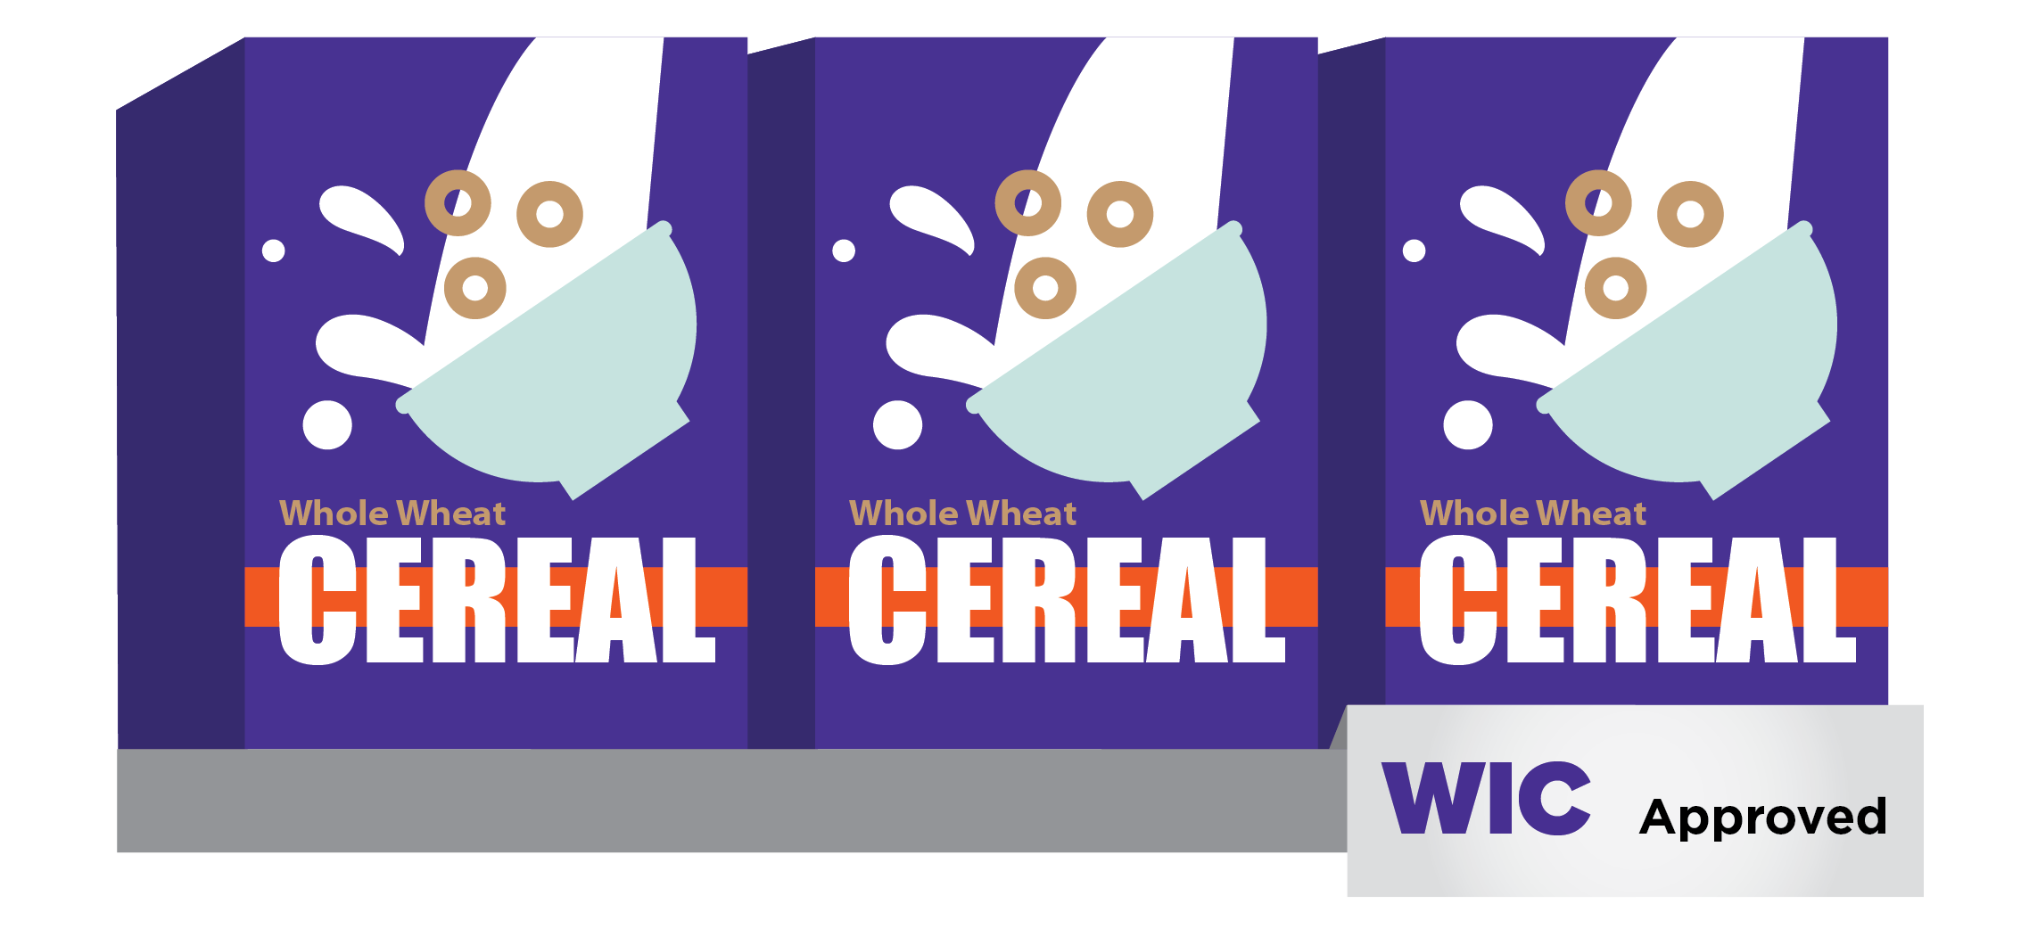
Try It Out!
Elena wants to serve a whole grain-rich breakfast cereal. Can she pick any cereal from her State’s WIC list?
?
Yes
No
Notes:
Let’s practice.
Elena wants to serve a whole grain-rich breakfast cereal. Can she pick any cereal from her State’s WIC list? Yes or No?
Raise your hand if you think Elena can pick any cereal from her State’s WIC list to serve as a whole grain-rich breakfast cereal [pause for a show of hands].
Now, raise your hand if you do not think Elena can pick any cereal from her State’s WIC list to serve as a whole grain-rich breakfast cereal [pause for a show of hands].

Slide 29
Try It Out!
Answer
Elena wants to serve a whole grain-rich breakfast cereal. Can she pick any cereal from her State’s WIC list?
?
No. Not all breakfast cereals listed on WIC lists are whole grain. Elena should select a breakfast cereal that is specifically marked or listed as whole grain on the WIC list. Whole grain cereals listed on WIC lists are considered whole grain-rich in the CACFP.
Yes
No
Notes:
Great job! The answer is “No.” Not all breakfast cereals listed on WIC lists are whole grain. Elena should select a breakfast cereal that is specifically marked or listed as whole grain on the WIC list. Whole grain cereals listed on WIC lists are considered whole grain-rich in the CACFP.

Slide 30
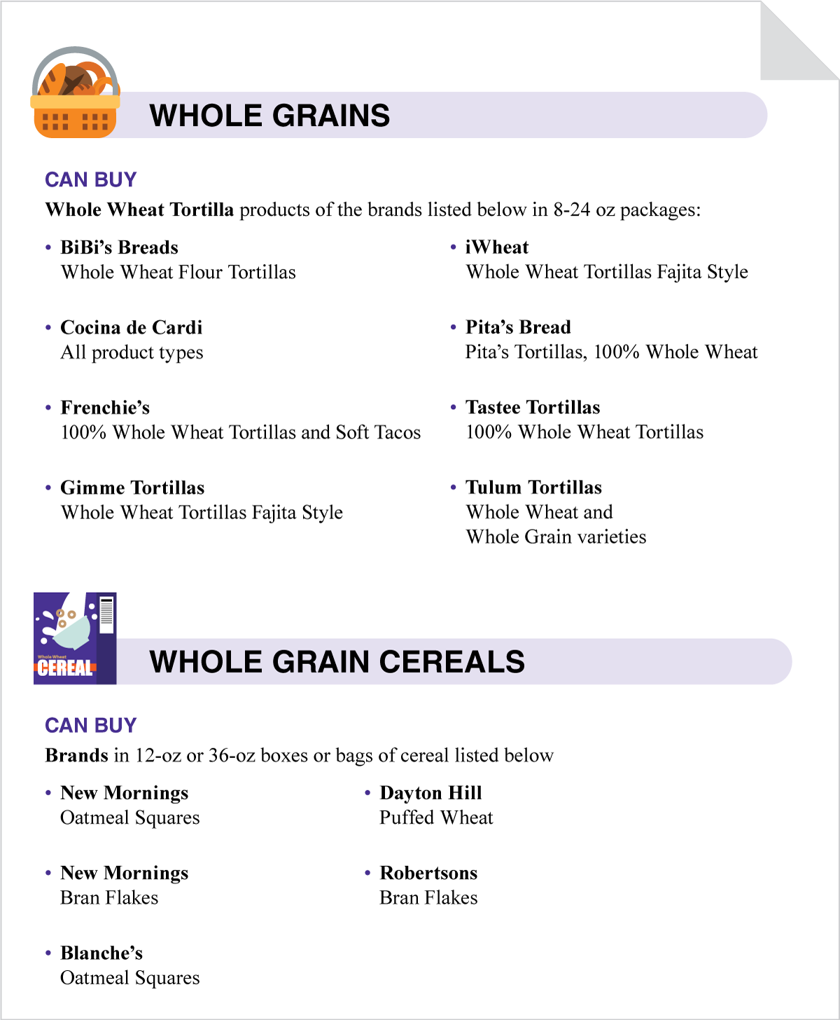
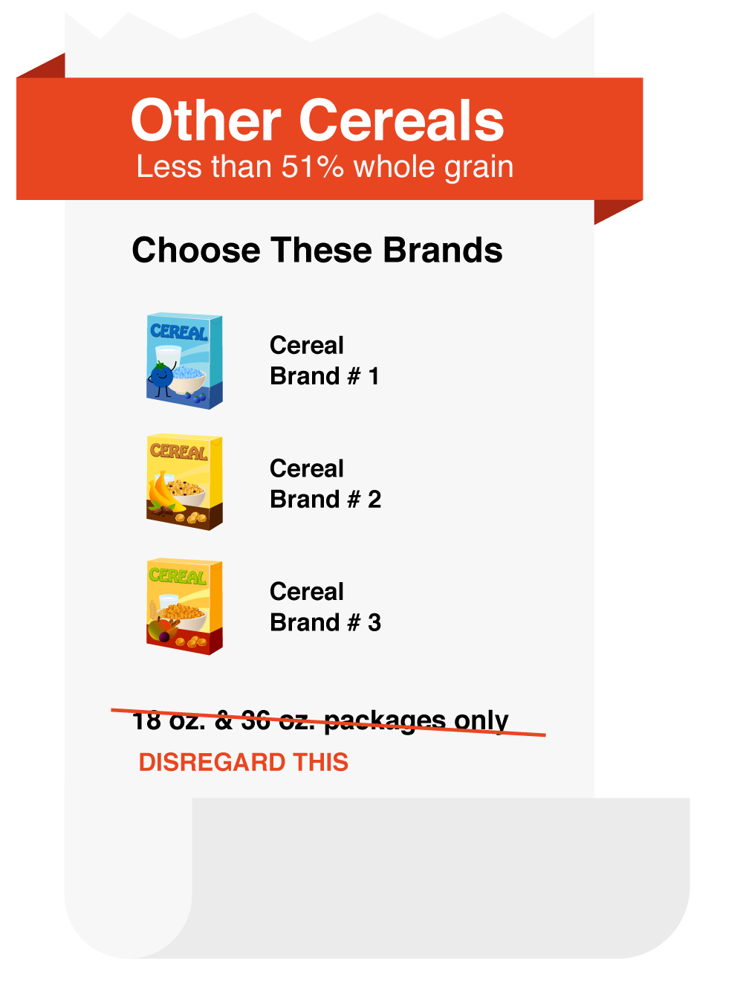
Disregard the Package Size
Disregard information about package size.
Notes:
As we mentioned, many WIC lists include information about package sizes, such as “Brands in 12 – 36 ounce box or bag of cereal.” You can disregard this information. It does not apply to the CACFP.

Slide 31
Try It Out!
Juan sees “Buy 16 ounces” next to Brand C Infant Cereal on his State’s WIC list. His store only offers Brand C Infant Cereal in 24-ounce boxes. Can he buy the 24-ounce box and serve the cereal as part of a reimbursable infant meal?
?
Yes
No
Notes:
Okay, one last practice question before we wrap up.
Juan sees “Buy 16 ounces” next to Brand C Infant Cereal on his State’s WIC list. His store only offers Brand C Infant Cereal in 24-ounce boxes. Can he buy the 24-ounce box and serve the cereal as part of a reimbursable infant meal?
Raise your hand if you think Juan can buy the 24-ounce box and serve the iron-fortified infant cereal as part of a reimbursable infant meal [pause for a show of hands].
Now, raise your hand if you do not think Juan can buy the 24-ounce box and serve the iron-fortified infant cereal as part of a reimbursable infant meal [pause for a show of hands].

Slide 32
Try It Out!
Answer
Juan sees “Buy 16 ounces” next to Brand C Infant Cereal on his State’s WIC list. His store only offers Brand C Infant Cereal in 24-ounce boxes. Can he buy the 24-ounce box and serve the cereal as part of a reimbursable infant meal?
?
Yes
No
Yes. When using the WIC list to choose creditable foods in the CACFP, you do not need to pay attention to the size of the package.
Notes:
Nice work, everyone! The answer is “Yes.” Juan can buy the 24-ounce box of cereal and serve it as part of a reimbursable infant meal. When using the WIC list to choose creditable foods in the CACFP, you do not need to pay attention to the size of the package.

Slide 33
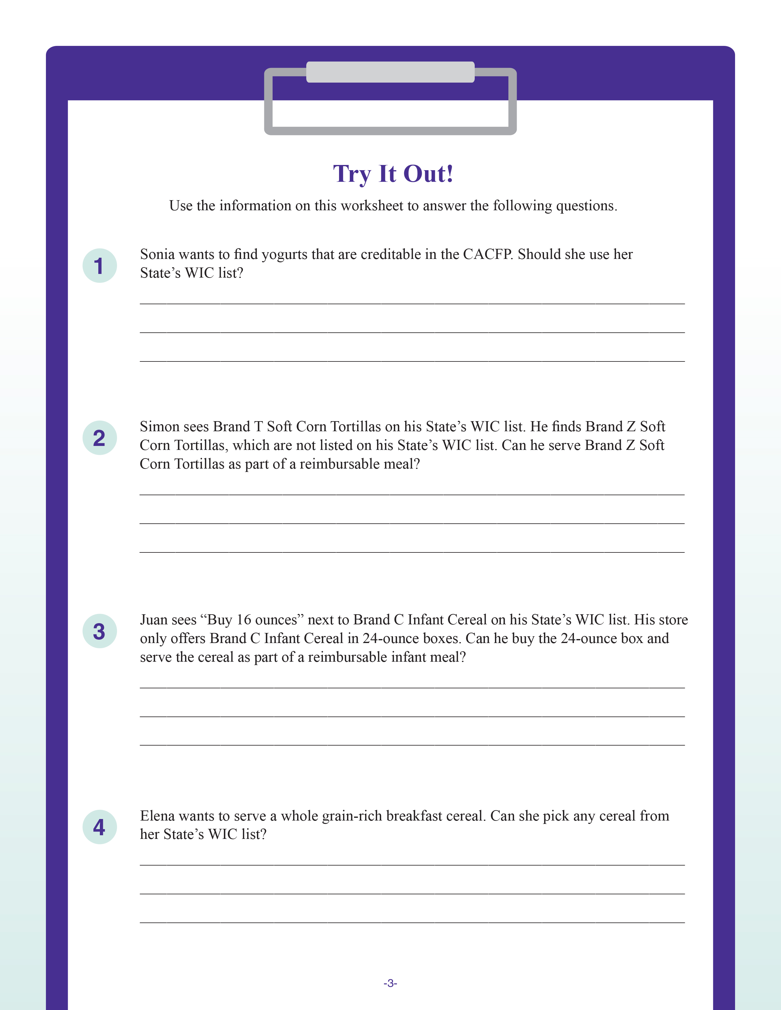
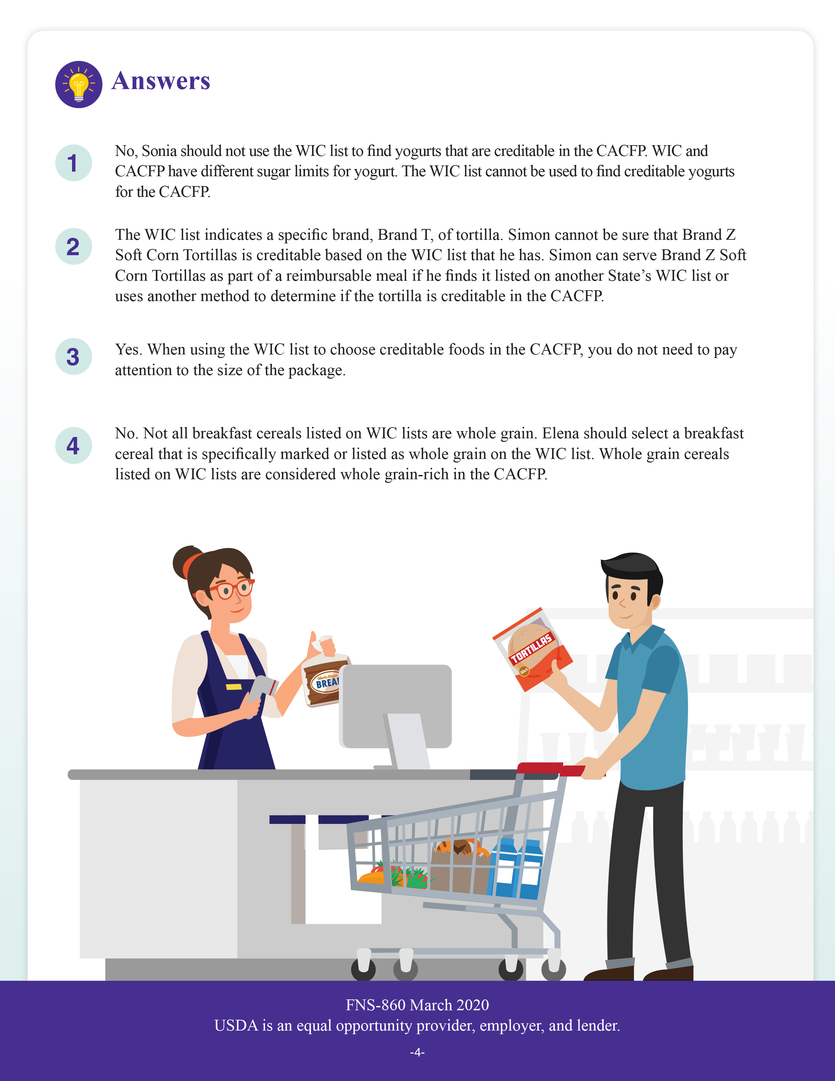
Great job everyone!
Notes:
Great job everyone! For more Try It Out! questions, or to review some of the ones we looked at today, you can look at page 3 of the worksheet. The answer key is on page 4 of the worksheet.

Slide 34

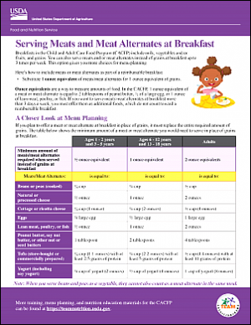
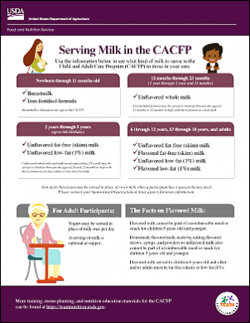
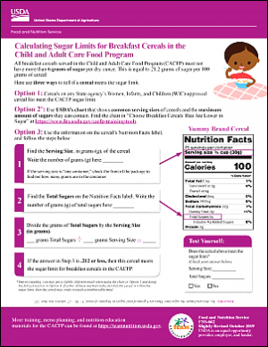
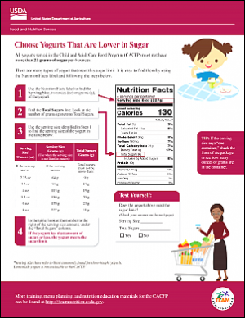
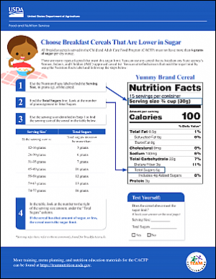
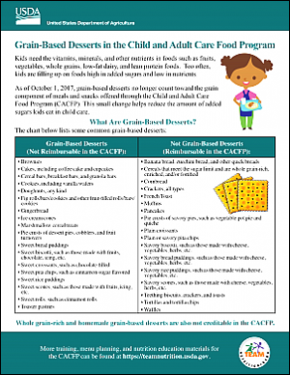
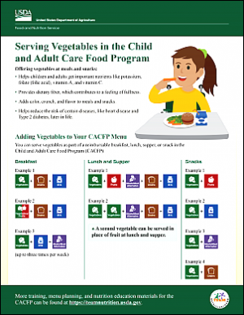
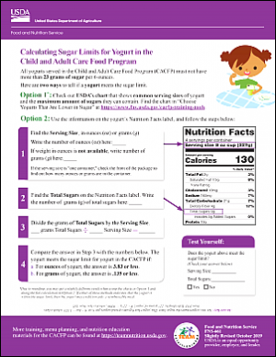
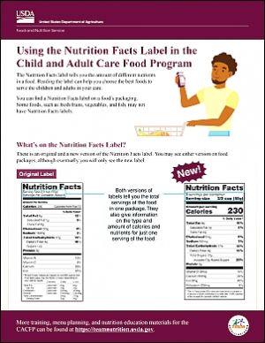
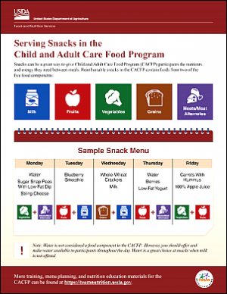
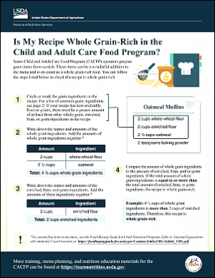
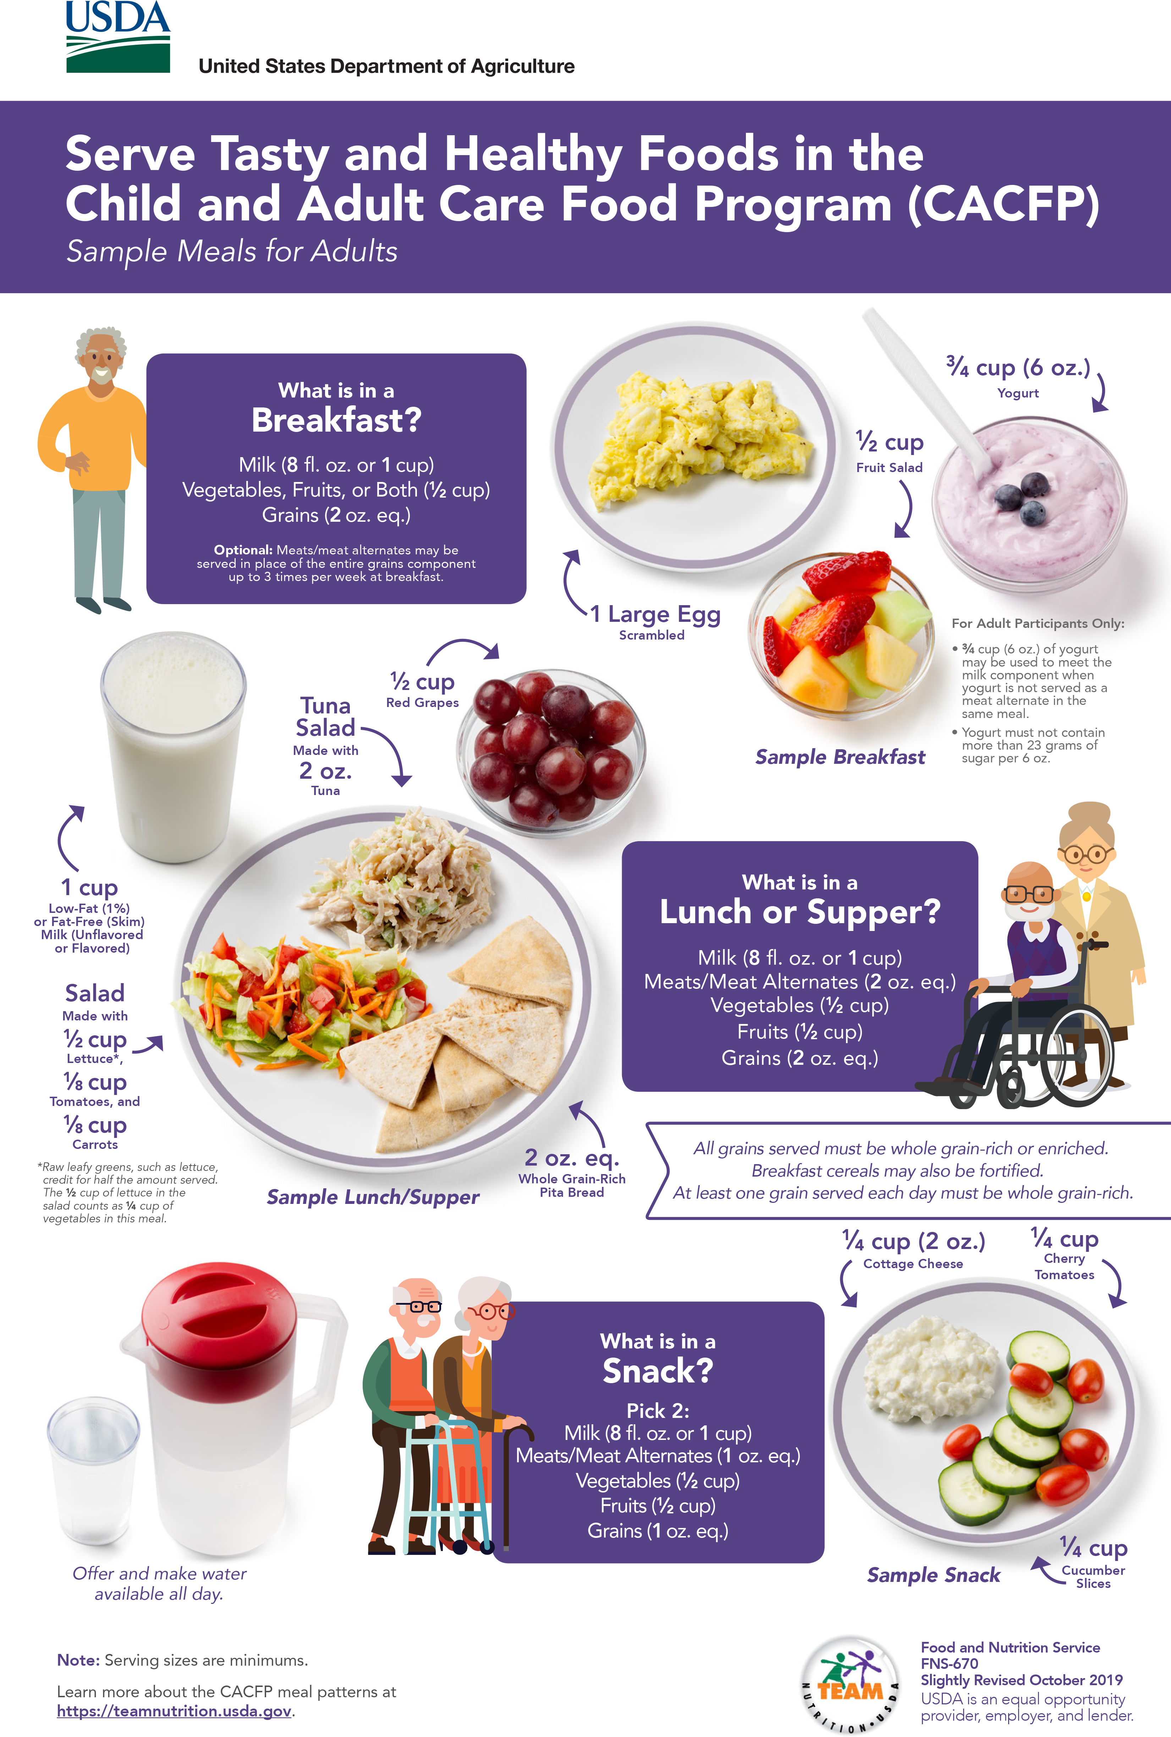
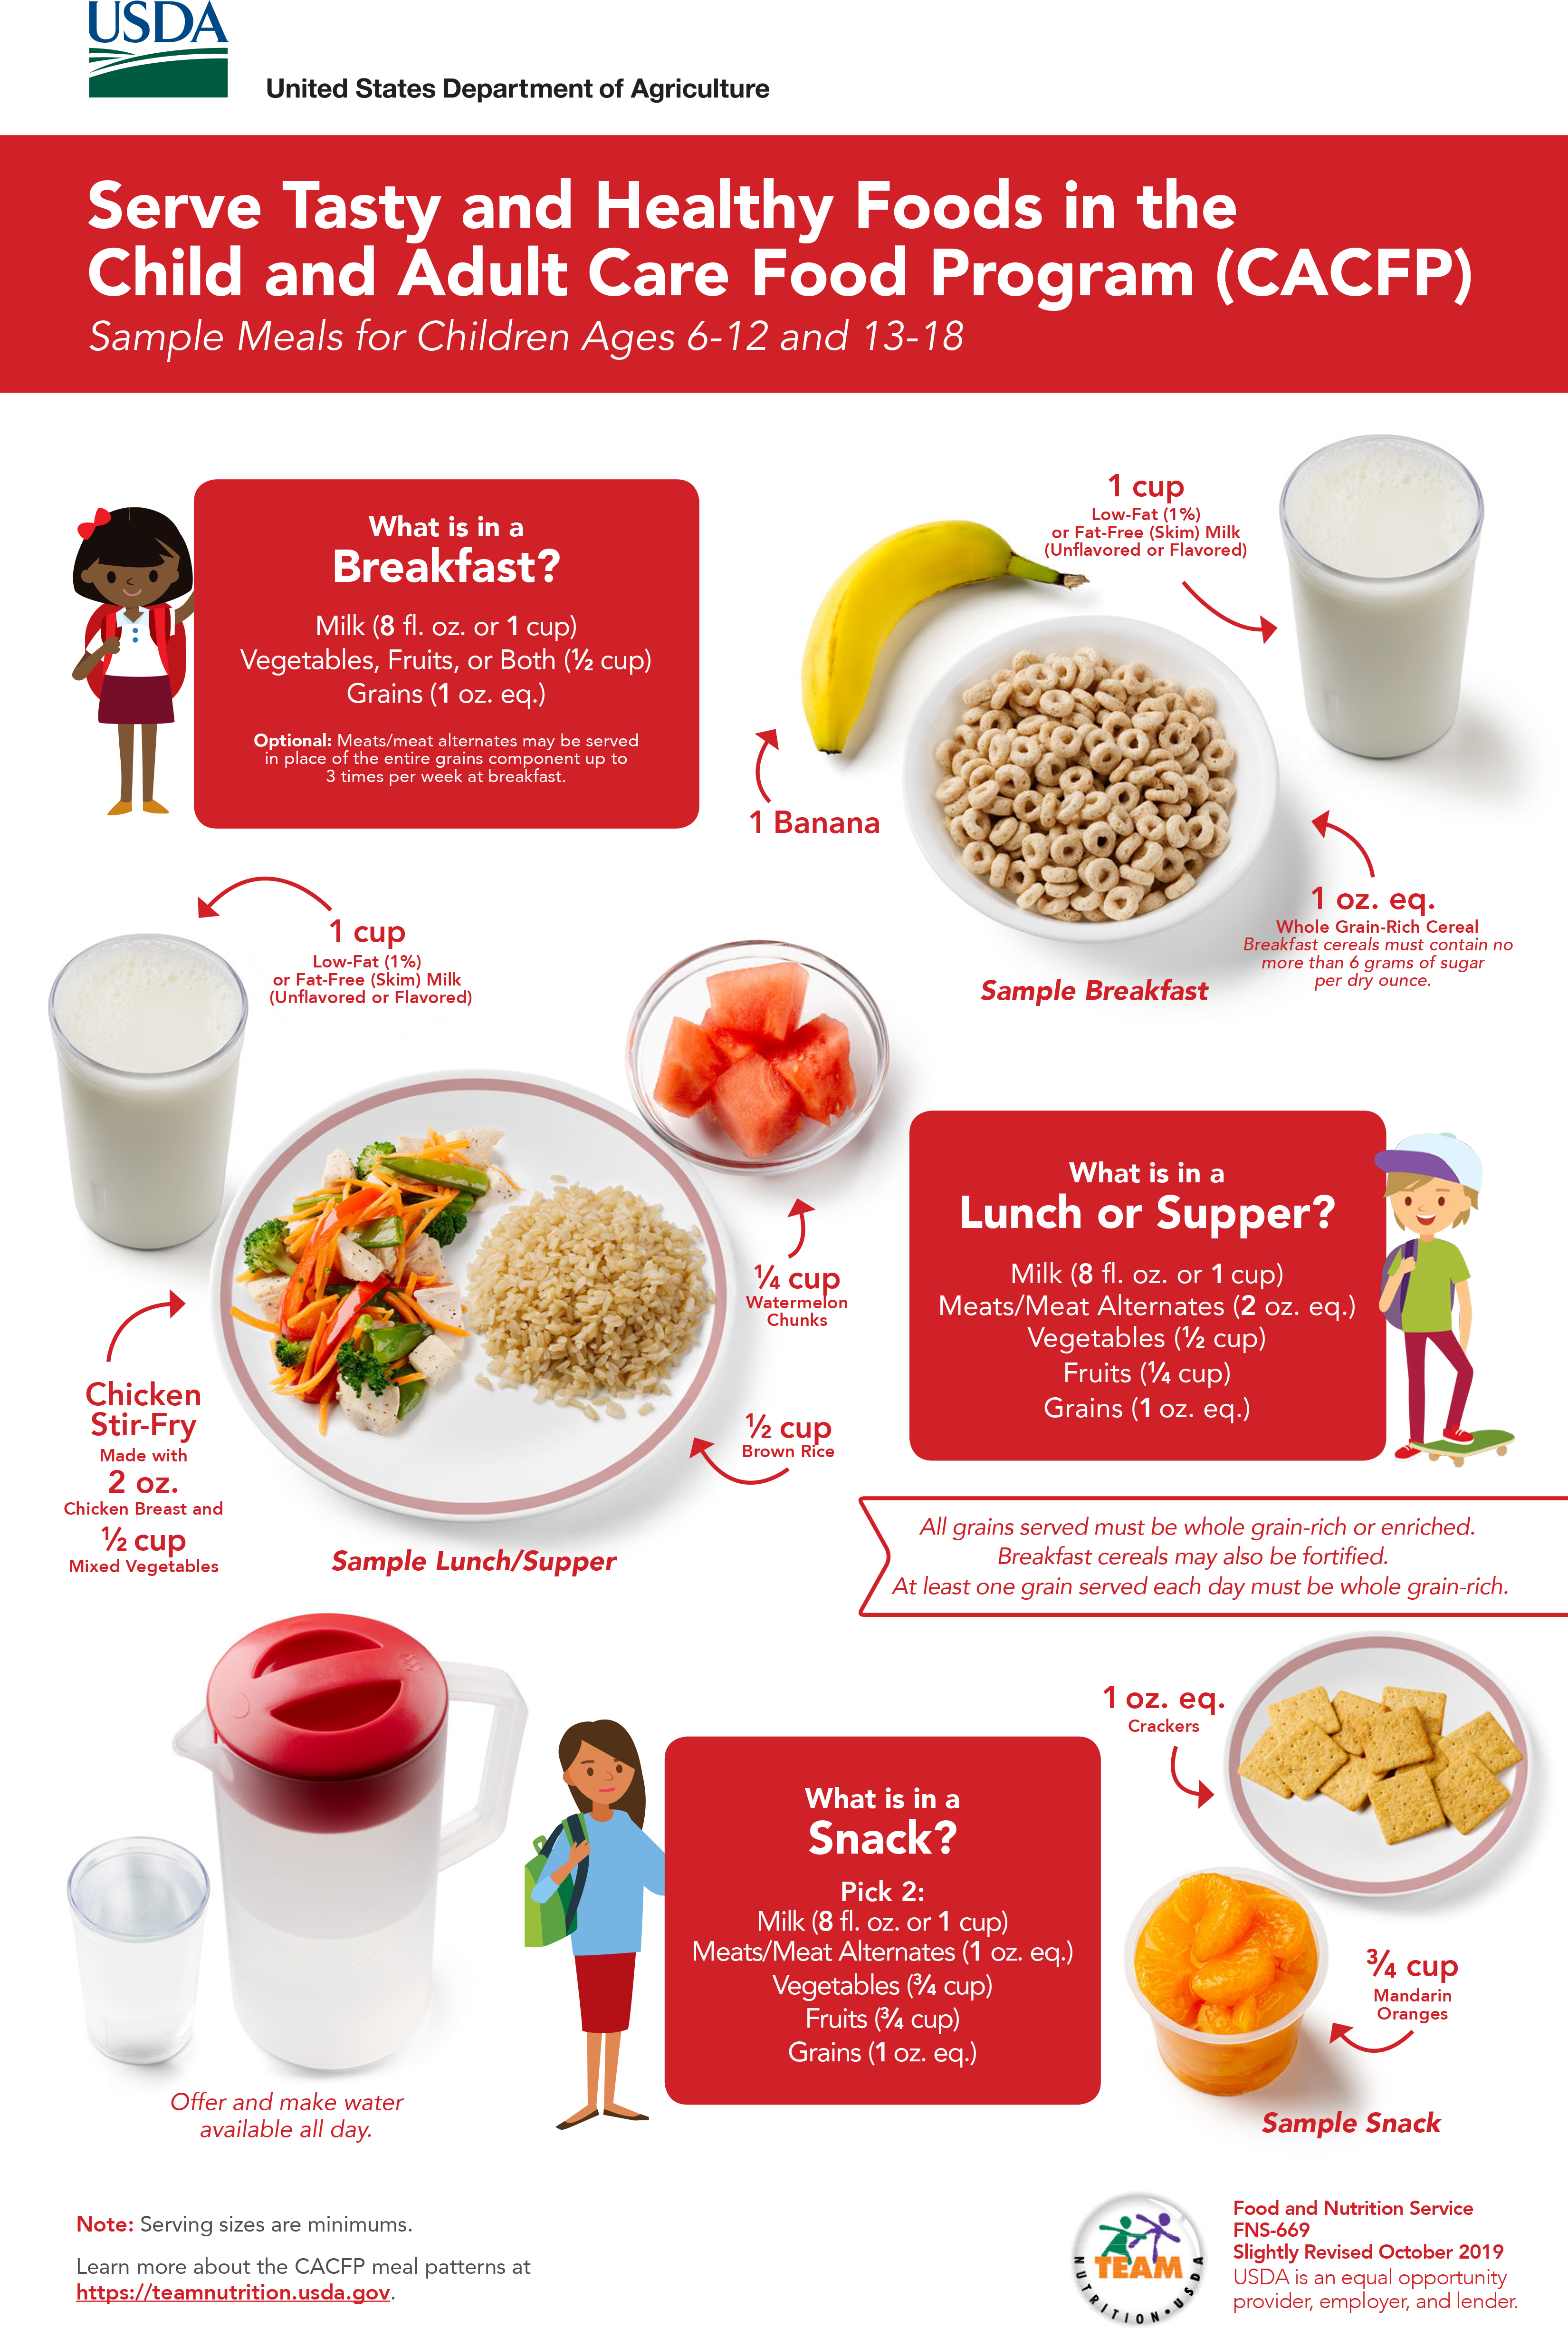
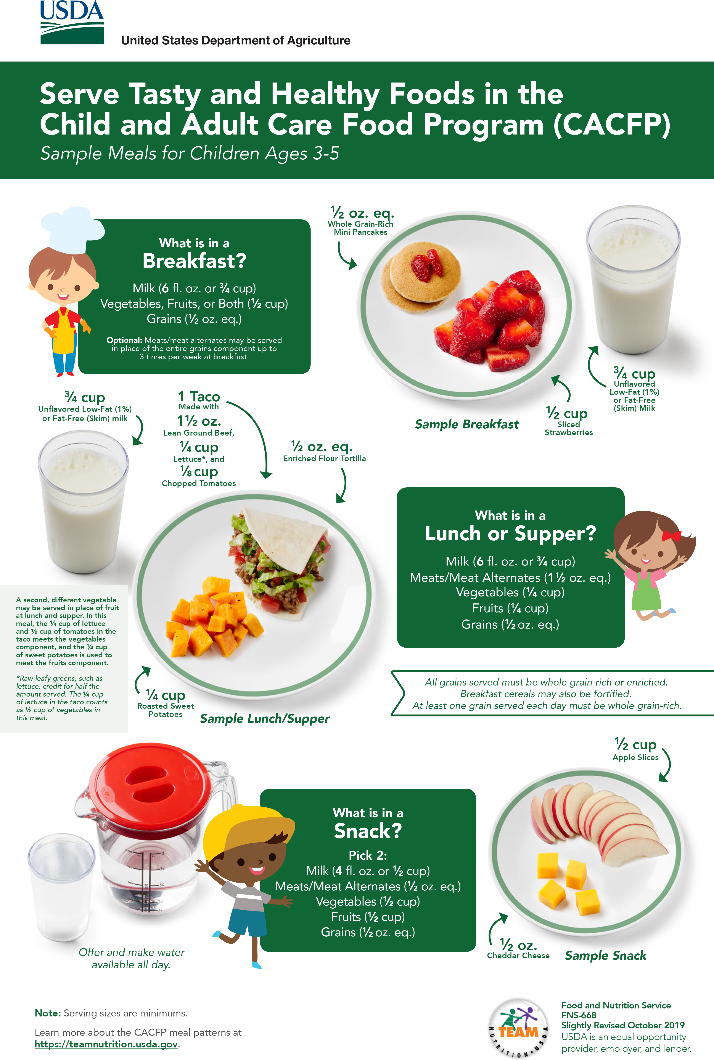
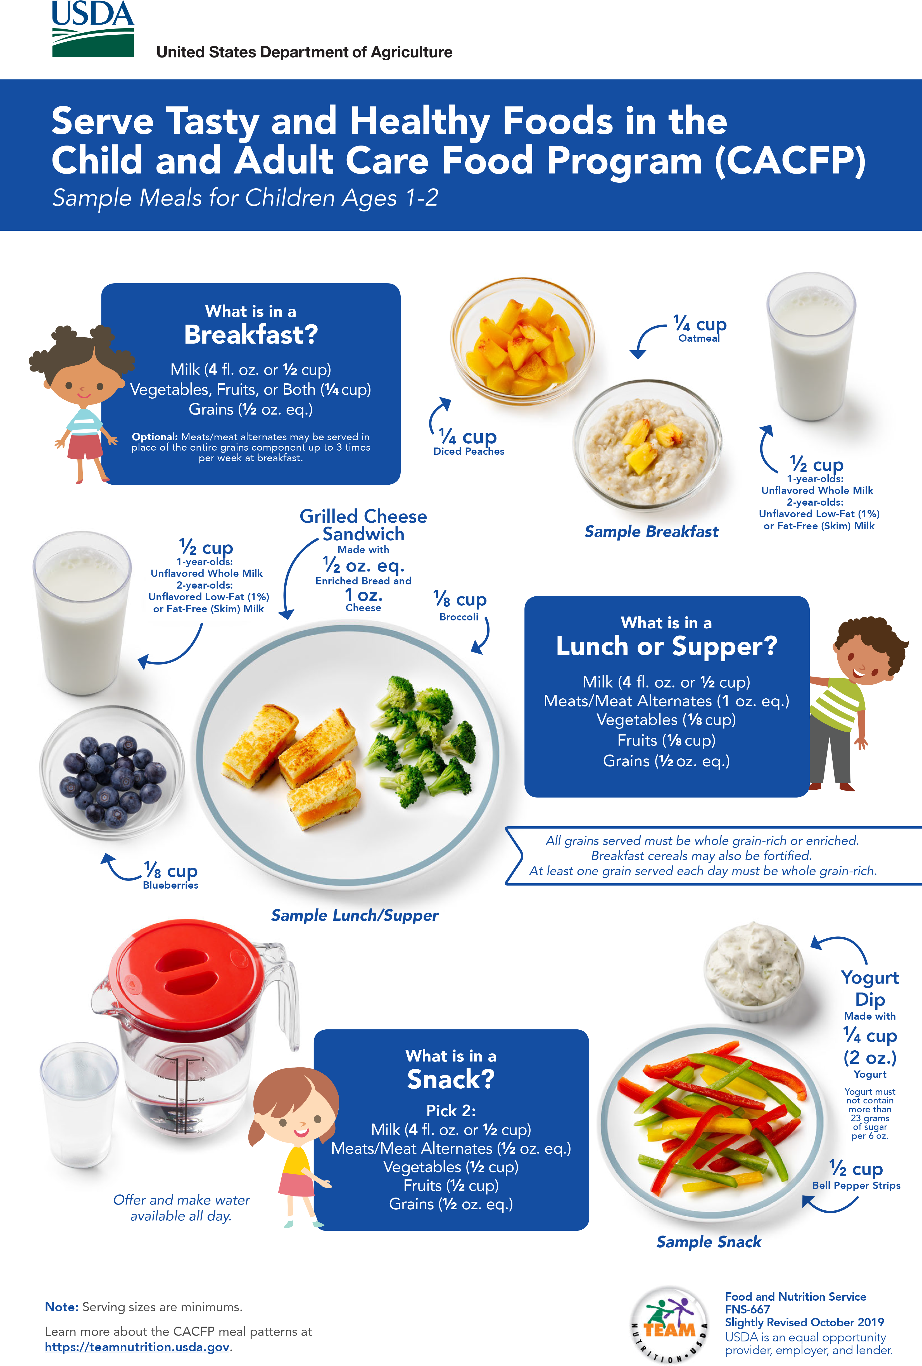
More Team Nutrition Resources!
TeamNutrition.usda.gov
Notes:
All Team Nutrition materials are available online from Team Nutrition’s website and are available for free download to anybody who is interested.

Slide 35
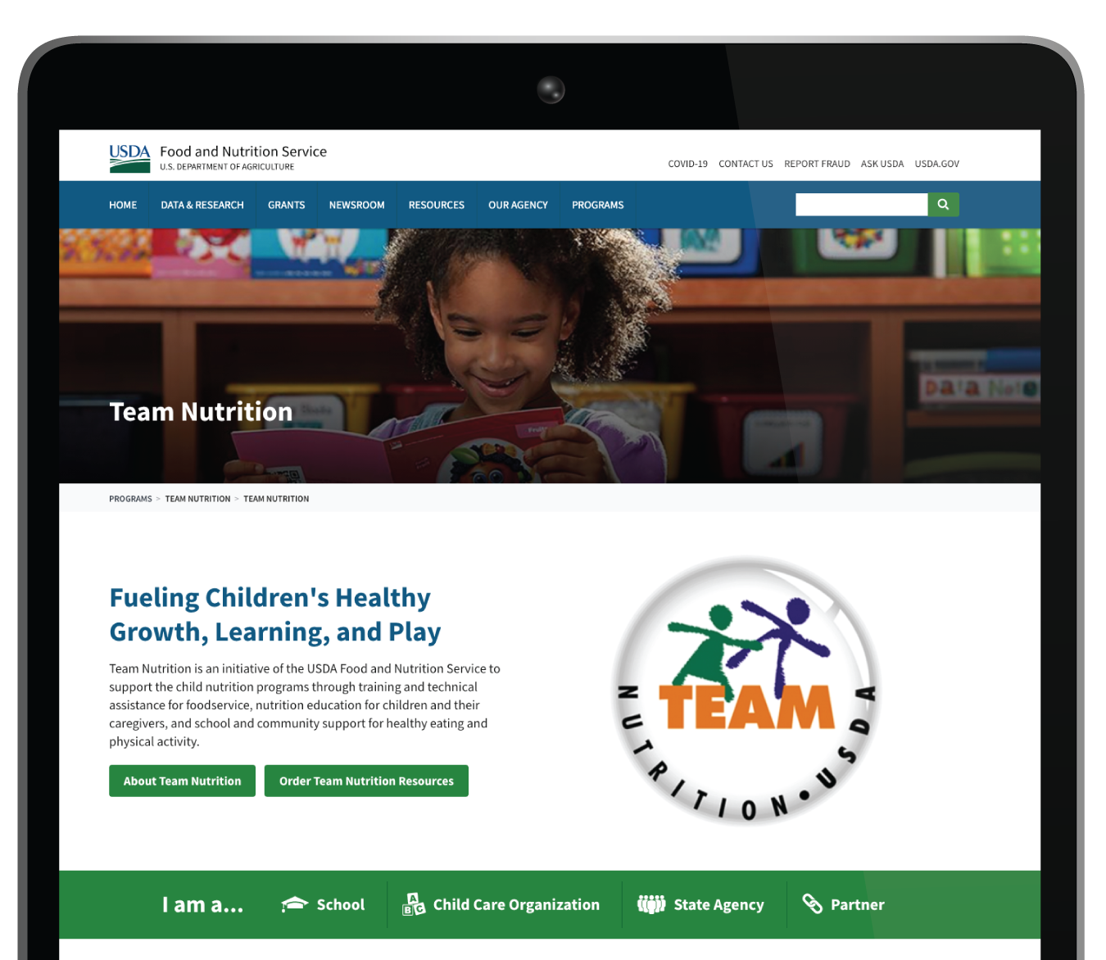

How To Order Print Copies
Resource Order Form at TeamNutrition.usda.gov.
FREE for those participating in a Child Nutrition Program, while supplies last.
Sponsoring organizations and State agencies can also order in bulk by sending an email to:
TeamNutrition@usda.gov
Notes:
For all participating in a Child Nutrition Program, such as the CACFP, Team Nutrition’s print materials are free to order.
If you would like to order Team Nutrition’s free materials in print, you can go to the “Resource Order Form” link on the Team Nutrition website to order print copies of the materials.
For bulk orders, you can email teamnutrition@usda.gov.

Slide 36


Thank you!
TeamNutrition.usda.gov
@TeamNutrition
TeamNutrition@usda.gov
USDA is an equal opportunity provider, employer, and lender.
Notes:
These training slides were provided by U.S. Department of Agriculture's Team Nutrition. If you would like to learn more about Team Nutrition and additional resources available, please visit their website, subscribe to their e-newsletter, connect with them via email at teamnutrition@usda.gov, and follow them on Twitter.
Thank you!

