Slide 1

Mealtimes With Toddlers in the CACFP
A Training Presentation for
Child and Adult Care Food
Program (CACFP) Operators

Slide 2



USDA’s Team Nutrition
An initiative of the USDA’s Food and Nutrition Service to support the USDA’s Child Nutrition Programs.
Aims to improve children’s lifelong eating and physical activity habits.
Provides nutrition education and training materials to State agencies, sponsoring organizations, and CACFP sites.
TeamNutrition.usda.gov
@TeamNutrition
Notes:
Team Nutrition is an initiative of the USDA Food and Nutrition Service that supports the Child Nutrition Programs, including the National School Lunch Program, the School Breakfast Program, and of course, the Child and Adult Care Food Program, or the CACFP.
It does so through training and technical assistance for those preparing and serving meals, providing nutrition education for children, and building support for healthier school and child care environments.

Slide 3
Let Us Know Who You Are!
I work for a…
?
Child care center
Family child care home
At-risk afterschool care center
Adult day care center
Sponsoring organization
Emergency shelter
School food authority
State agency
USDA Regional Office
Other
Notes:
Before we get started, I want to know who has joined us today.
Please raise your hand if you work for:
a child care center [pause and wait for a show of hands],
a family child care home [pause and wait for a show of hands],
an at-risk afterschool care center [pause and wait for a show of hands],
a sponsoring organization [pause and wait for a show of hands],
an emergency shelter [pause and wait for a show of hands],
a school food authority [pause and wait for a show of hands],
a State agency [pause and wait for a show of hands],
a USDA Regional office [pause and wait for a show of hands], or
other [pause and wait for a show of hands].

Slide 4
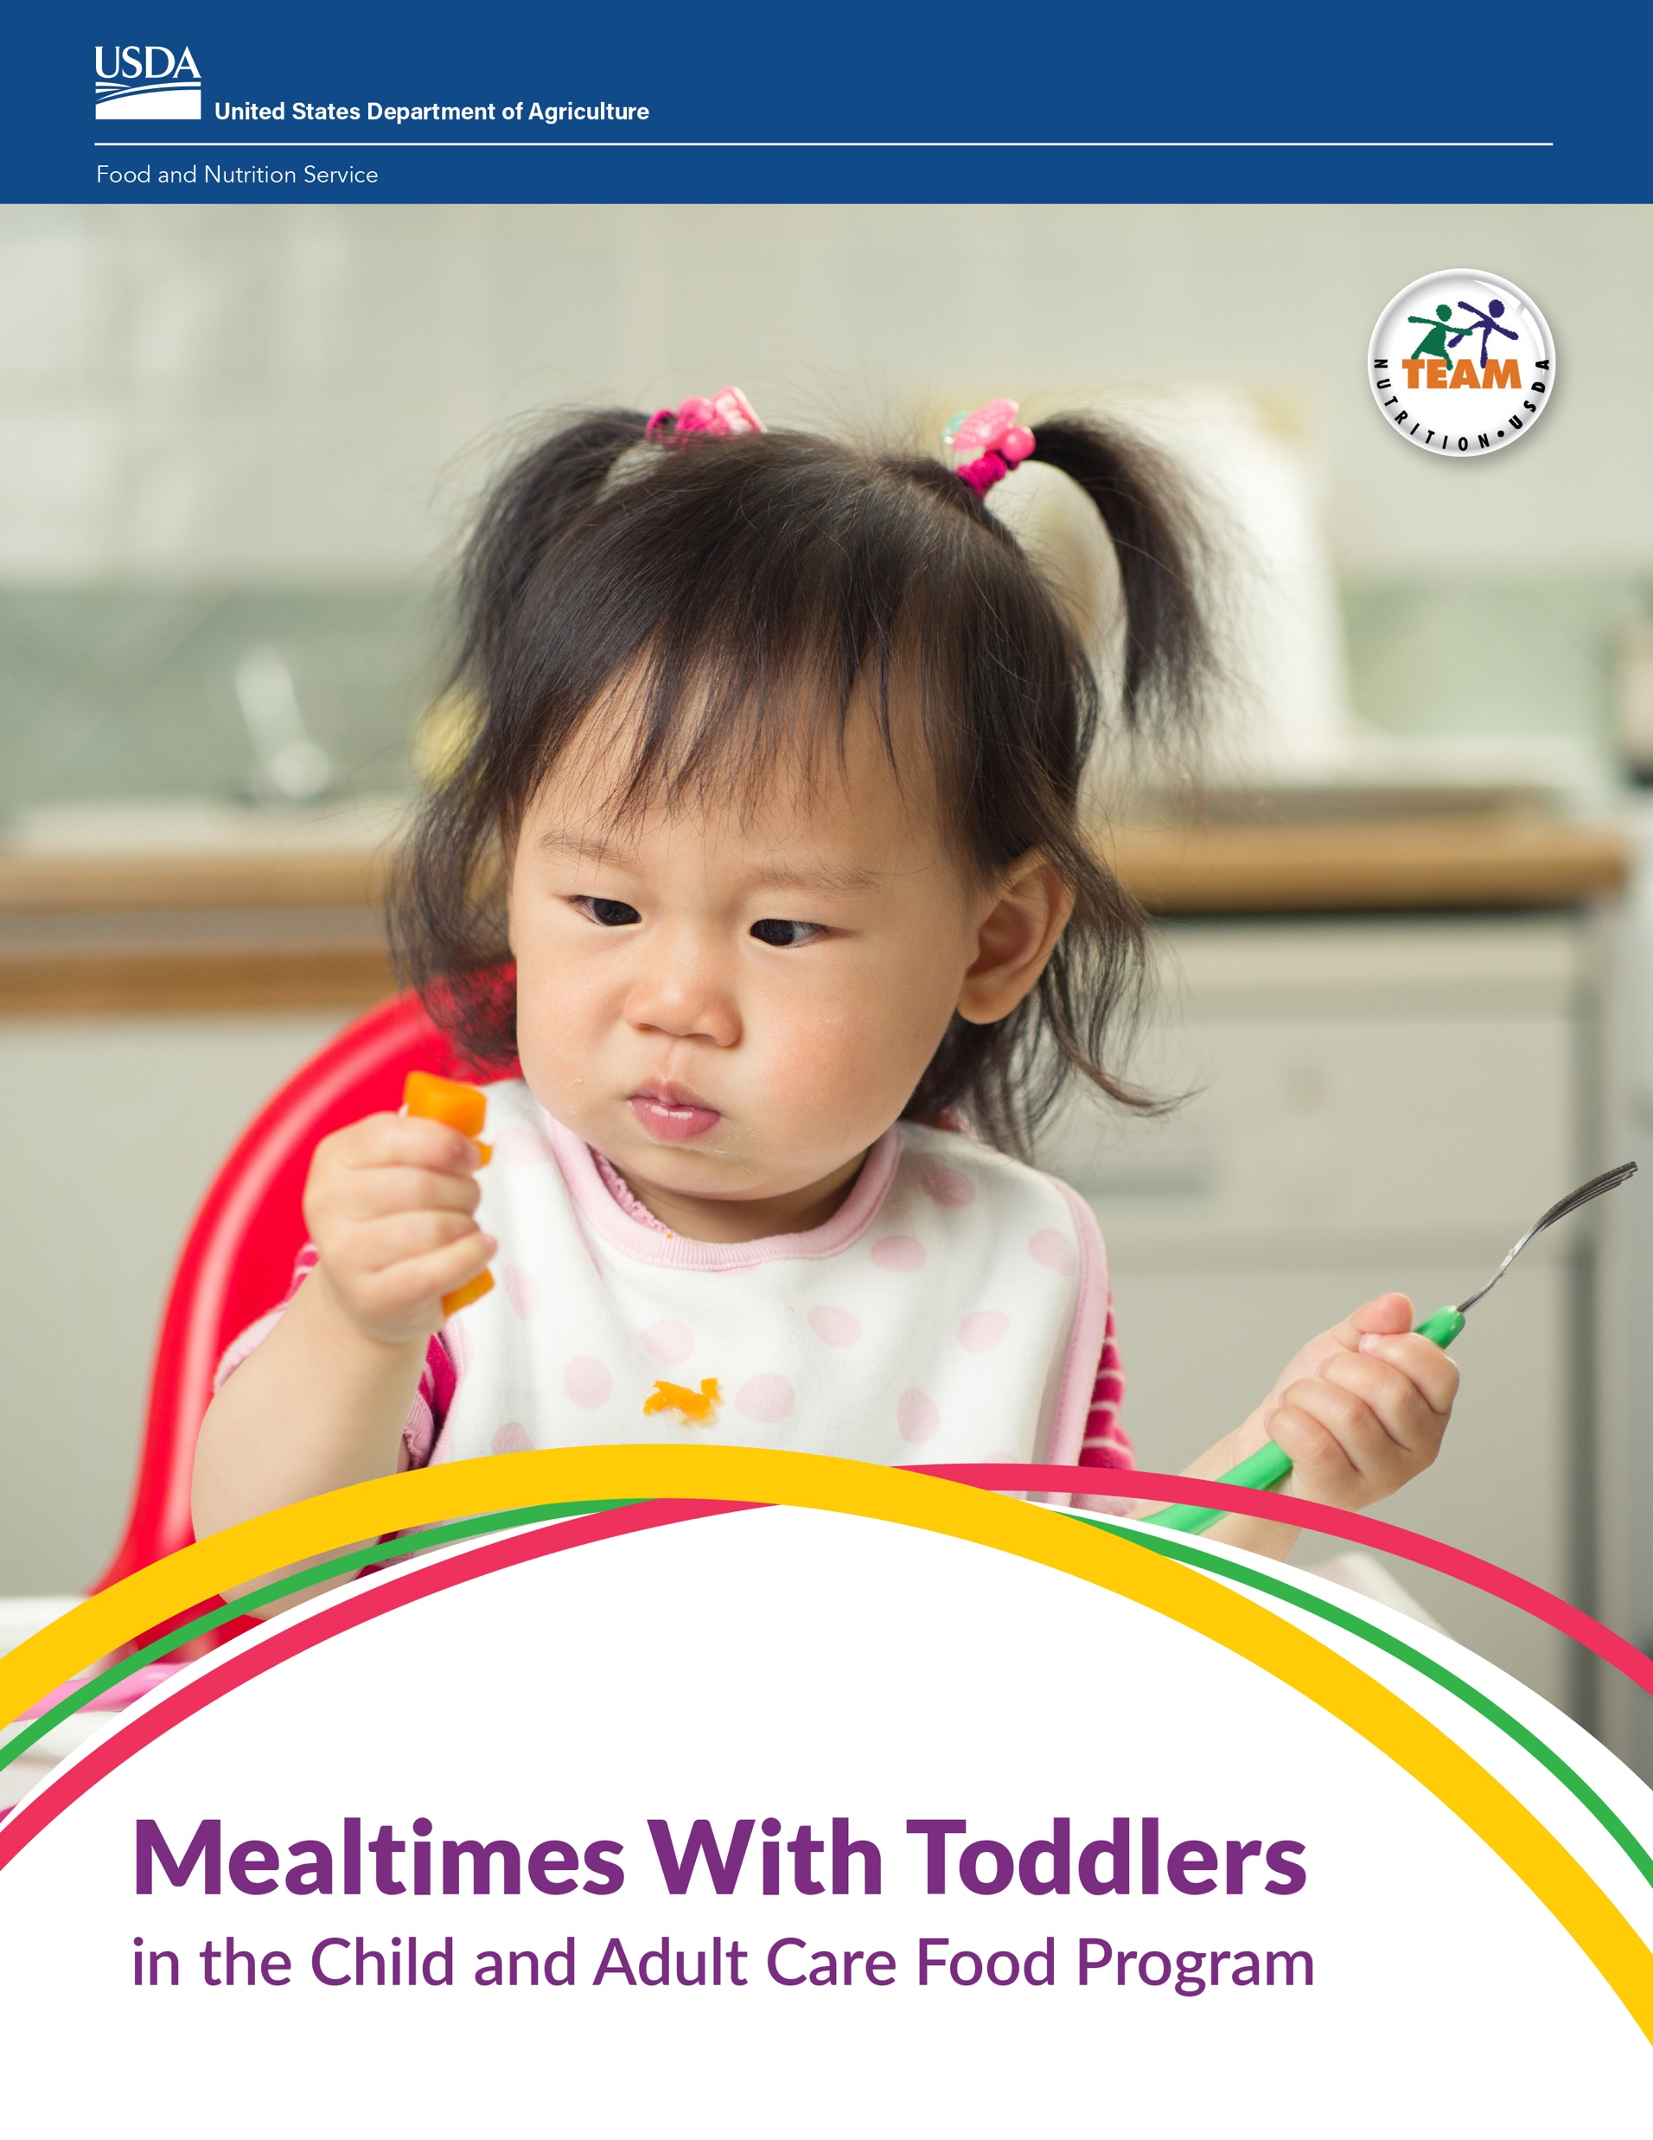
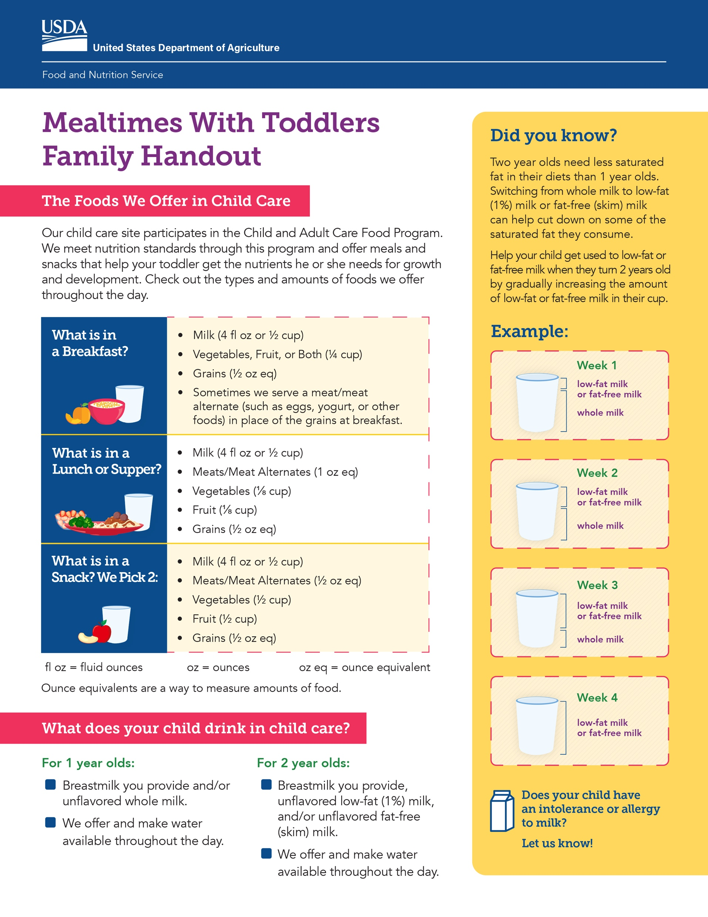
Mealtimes With Toddlers in the CACFP
1
Assist Children in Learning How to Feed Themselves
2
Encourage Children to Try New Foods
3
Choose the Right Type of Milk to Serve Children in the CACFP
CACFP Operator Booklet
Family Handout
Videos
Notes:
Today, we will talk about mealtimes with toddlers, or children who are 1 through 2 years old. Toddlers are growing and developing quickly. They are learning about themselves and the world around them, even at mealtimes.
All of the information you hear today is from Team Nutrition’s “Mealtimes With Toddlers in the Child and Adult Care Food Program” resource materials. This resource includes an 8-page booklet for CACFP operators, a 2-page handout for parents and families of toddlers, and 3 short videos.

Slide 5
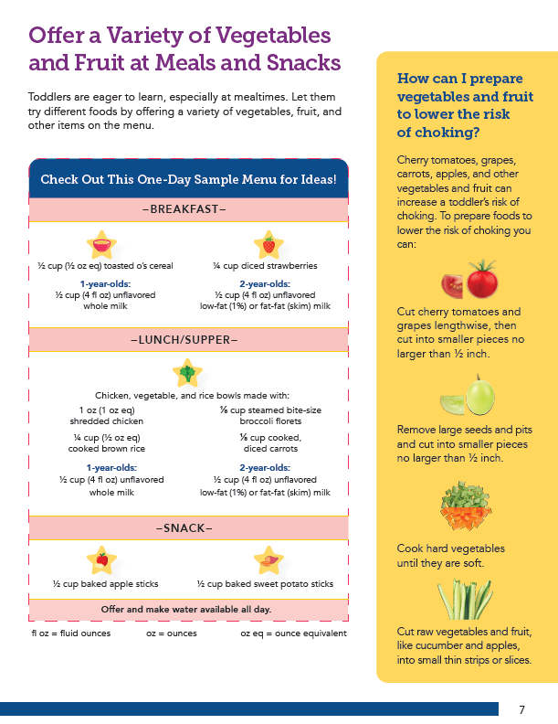
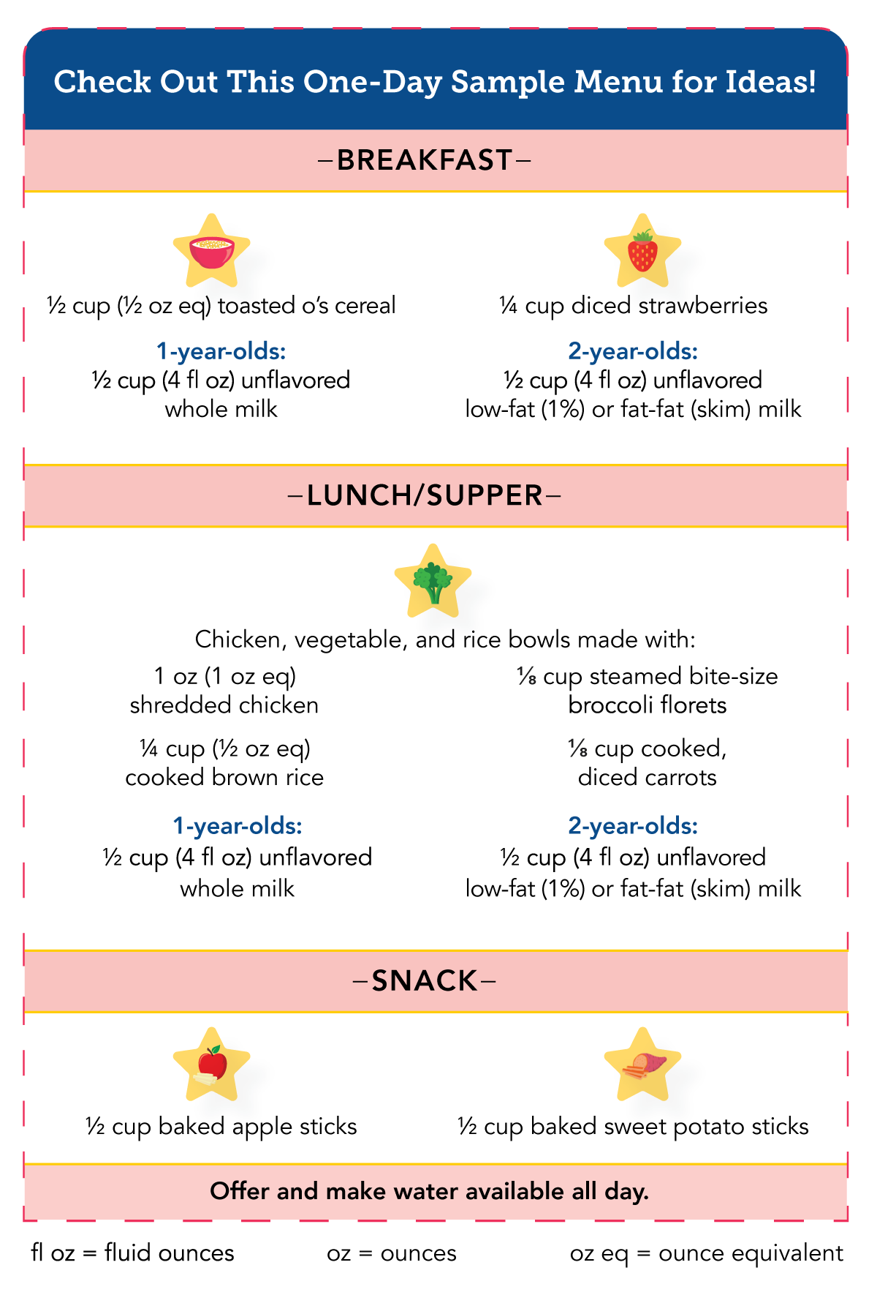
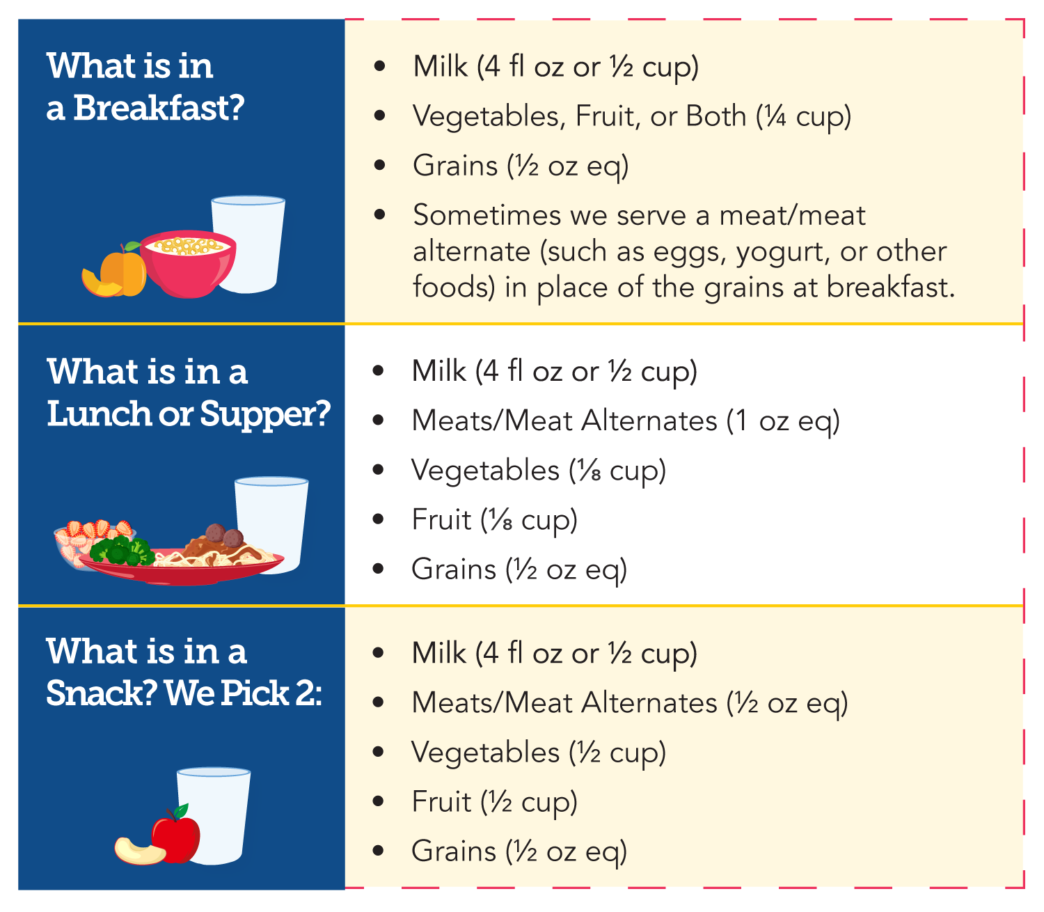
CACFP Meal Pattern for Children
1 through 2 Years Old
Notes:
Let’s start by taking a look at the CACFP meal pattern requirements for toddlers. The meal pattern tells us what meal components should be in a reimbursable meal, and the minimum amount to serve from each component. Toddlers should follow the meal pattern for children 1 through 2 years old.
You can find the meal pattern on page 1 of the family handout, as shown on the left of the screen. You can find a sample one-day menu with breakfast, lunch/supper and snack for toddlers on page 7 of the Operator Booklet, as shown on the right side of the screen.

Slide 6


CACFP Meal Pattern for Children 1-2 Years
Milk (4 fl oz or ½ cup)
Vegetables, Fruits, or Both (¼ cup)
Grains (½ oz eq)
Sometimes we serve a meat/meat alternate (such as eggs, yogurt, or other foods) in place of the grains at breakfast.
TeamNutrition.USDA.gov
Notes:
As shown on the family handout, as well as the slide here, a reimbursable breakfast in the CACFP includes at least ½ cup, or 4 fluid ounces, of milk, ¼ cup vegetables, fruits, or both, and ½ oz eq of grains. You also have the option to serve meats/meat alternates in place of the entire grains component up to three times per week at breakfast.

Slide 7

CACFP Meal Pattern for Children 1-2 Years
Milk (4 fl oz or ½ cup)
Meats/Meat Alternates (1 oz eq)
Vegetables (⅛ cup)
Fruits (⅛ cup)
Grains (½ oz eq)
TeamNutrition.USDA.gov
Notes:
At Lunch and Supper, you must offer at least a ½ cup of milk, 1 oz eq of meats/meat alternates, ⅛ cup of vegetables, ⅛ cup of fruits, and ½ oz eq of grains.

Slide 8

CACFP Meal Pattern for Children 1-2 Years
Milk (4 fl oz or ½ cup)
Meats/Meat Alternates (½ oz eq)
Vegetables (½ cup)
Fruits (½ cup)
Grains (½ oz eq)
TeamNutrition.USDA.gov
Notes:
CACFP snacks are made up of two different food components. This means a reimbursable snack should have any two of the following options for children 1 through 2 years old:
½ cup of milk,
½ oz eq meats/meat alternates,
½ cup vegetables,
½ cup fruits, or
½ oz eq grains.
We will practice putting this information into practice to create and identify reimbursable meals and snacks in a bit. But first, let’s first talk about how we can help toddlers learn how to feed themselves.

Slide 9

Self-Feeding With Assistance
Help toddlers learn to feed themselves by:
Offering foods in bite-size pieces that are easier to pick up with their fingers.
Using tables, chairs, forks, spoons, bowls, and plates designed for children.
Modeling how to use a spoon or fork at mealtimes.
Allowing toddlers to practice eating with spoons and forks at mealtimes.
Notes:
Toddlers are excited to learn new skills. You can help toddlers become more independent while still providing supervision and support at meals and snacks. You’ll be helping them develop important skills that they’ll use for life.
You can help toddlers learn to feed themselves by:
Offering foods in bite-size pieces that are easier to pick up with their fingers.
Using tables, chairs, forks, spoons, bowls, and plates designed for children
Modeling how to use a spoon or fork at mealtimes, and
Allowing toddlers to practice eating with spoons and forks at meals and snacks.
These skills will develop at different times and ages for each toddler.

Slide 10

Cut Down on the Mess
Meals with toddlers can be messy. Cut down on the mess by:
Putting a towel, paper, or mat under the children’s chairs.
Using rubber bibs with pockets (if available).
Letting children continue practicing feeding themselves.
Teaching children to clean up the mess.
Notes:
Also, as we all know, meals with toddlers can be messy. Some ways you can try to cut down on messes include:
Putting a towel or mat under the children’s chairs. This will catch food and spills that fall to the ground.
You can use rubber bibs with pockets that can help catch the food, if you have them available.
Let children continue to practice feeding themselves. As they strengthen their skills and get better at feeding themselves, they will hopefully start creating less of a mess.
You can also teach children how to clean up their messes.

Slide 11

Encourage Toddlers to Try New Foods
You can encourage 1- through
2-year-olds to try new foods by:
Talking about food outside of mealtimes.
Offering a new food with a food they like.
Talking about the taste, texture, smell, and color of the food at mealtime.
Notes:
In addition to encouraging children to feed themselves, you may want to encourage them to try new foods. Introducing toddlers to new foods allows them to experience new textures. Softer foods, lumpy foods, and crunchy foods can help toddlers strengthen their chewing skills. It can also help them get used to new foods and textures early in life, so they are more accepting of new foods as they get older.
You can encourage 1- through 2-year-olds to try new foods by:
Introducing a new food outside of mealtimes through reading, gardening, and food activities.
Offering a new food with a food they like.
Talking about the taste, texture, smell, and color of the food at meals and snacks.

Slide 12

Teachers and Toddlers Can Encourage Each Other
Plan where toddlers sit around the table.
Show by example that a new food tastes good by eating foods together with the children.
https://www.choosemyplate.gov/startsimpleapp
Notes:
Providers and toddlers can also encourage each other to try new foods. For example, you can strategically plan where toddlers sit around the table. Toddlers who need more help can sit closer to you. Toddlers who need a bit more encouragement can sit next to children who are more adventurous eaters.
As the provider, you can show by example that a new food tastes good by eating same foods together with the children.
Are you nervous to try new foods yourself? That’s okay! You can go on your own taste adventure! Set a personal goal to try a few new vegetables and fruits at home.
To help you with that goal, check out USDA’s Start Simple with MyPlate mobile app to help set your personal goals and stick with them! Find more information at the link on the slide.

Slide 13
Choosing the Right Type of Milk
Required
Required
Optional
Notes:
As mentioned earlier, milk is required at breakfast, lunch and supper for toddlers. Milk is optional at snack.
The type of milk required in the CACFP is differs based on the child’s age. Let’s take a closer look at the requirements now.

Slide 14



Fluid Milk Requirements in the CACFP for 1 Year Olds
Birth to 12 months
12 to 13 months
13 months to 2 years
Breastmilk
Iron-fortified infant formula
Whole milk
Breastmilk
Iron-fortified infant formula
Breastmilk
Whole milk
Notes:
As shown on page 5 of the Operator Booklet, you can offer breastmilk and/or iron-fortified infant formula to infants from birth up until they turn 12 months, or 1 year old.
For children 12 to 13 months old, you can offer breastmilk, iron-fortified infant formula, and/or unflavored whole milk. During this one-month transition period, you can try mixing or serving breastmilk or formula and whole milk at the same meal to let the child get used to the flavor of whole milk. Start with serving small amounts of whole milk and increase day by day, or week by week, until the child is drinking only whole milk by the time he or she turns 13 months.
For children 13 months to 2 years old, you can offer breastmilk and/or unflavored whole milk.

Slide 15

Nutritionally Equivalent Non-Dairy Beverages
You may serve milk substitutes that are nutritionally equivalent to cow’s milk without a medical statement.
Example: some unflavored soy milks
If a milk substitute is not nutritionally equivalent to cow’s milk, a signed medical statement is required.
There is no fat requirement.
Non-dairy milk substitutes must be unflavored.
Notes:
You may serve non-dairy milk beverages or milk substitutes that are nutritionally equivalent to cow’s milk, without a medical statement. Some examples might include certain brands or types of soy milks. Please contact your Sponsoring Organization or State agency for more information.
There is no fat requirement for nutritionally equivalent non-dairy beverages. As with cow’s milk for toddlers, the non-dairy milk substitutes must be unflavored.

Slide 16

Toddler Formulas
Called “transition formulas,” “toddler formulas,” or “toddler milks.”
Most children do not need formula once they turn 1 year.
Children usually do not need them unless for a medical reason.
A signed medical statement is needed before serving.
Notes:
Also, some of you may have seen or heard of products known as “toddler formulas,” “transition formulas,” or “toddler milks.”
Most children do not need formula once they turn 1 year, unless it’s for a medical reason. A signed medical statement is needed before serving the “toddler formula” as part of a reimbursable CACFP meal or snack.

Slide 17


Fluid Milk Requirements in the CACFP for 2 Year Olds
24 to 25 months
2 through 5 years
Breastmilk
Whole milk
Reduced fat (2%) milk
Low-fat (1%) milk
Fat-free (skim) milk
Breastmilk
Low-fat (1%) milk
Fat-free (skim) milk
Note: Offer only unflavored milk
Notes:
Once a child turns 2 years, you can offer:
Breastmilk, unflavored whole milk, unflavored reduced-fat (2%) milk, unflavored low-fat (1%) milk, and unflavored fat-free (skim) milk from 24 to 25 months of age.
After a child turns 25 months, you may offer breastmilk, unflavored low-fat milk, and unflavored fat-free milk as part of a reimbursable meal or snack.
This information is listed on page 6 of the Operator Booklet.

Slide 18
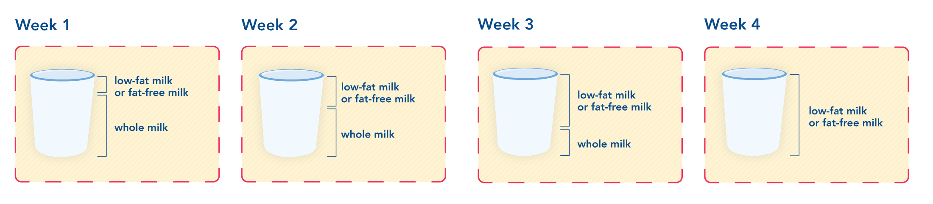
Transition Period for Two-Year-Olds
Notes:
Just like there is a transition period for 1-year-olds to get used to whole milk, the CACFP meal pattern also has a transition period for 2-year-olds to get used to low-fat or fat-free milk. This transition period occurs from the time the child turns 2 years (24 months) until she or he turns 2 years 1 month (25 months).
During that time, you can serve whole milk, reduced-fat (2%) milk, low-fat (1%) milk or fat-free (skim) milk. Breastmilk can also be served at any age in the CACFP. During this one-month transition period, you can try mixing or serving low-fat or fat-free milk and whole milk at the same meal to let the child get used to the flavor of low-fat milk. Start with serving small amounts of lower-fat milk and increase day by day, or week by week, until the child is drinking only low-fat or fat-free milk by the time he or she turns 25 months.

Slide 19
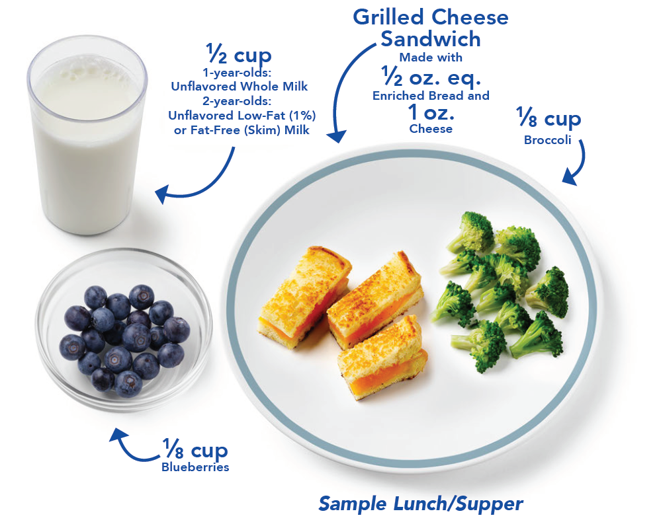
Try It Out!
Maya is 1½ years old. What type(s) of milk can she be served as part of a reimbursable meal or snack?
?
Flavored Fat-Free (Skim) Milk
Unflavored
Whole Milk
Unflavored
Low-Fat (1%) Milk
Notes:
Let‘s put all of this information into practice with a quick knowledge check. You can refer to pages 5 and 6 of the Operator Booklet to help you answer this question.
The question says “Maya is one and a half years old. What type(s) of milk may you serve her as part of a reimbursable meal or snack?”
Raise your hand if you think Maya can have:
Flavored fat-free milk [pause and wait for a show of hands];
B. Unflavored whole milk, [pause and wait for a show of hands]; and/or
C. Unflavored low-fat milk.

Slide 20
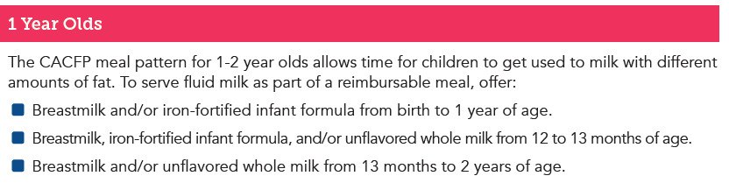
Try It Out!
Answer
Maya is 1½ years old. What type(s) of milk can she be served as part of a reimbursable meal or snack?
?
Flavored Fat-Free (Skim) Milk
Unflavored
Whole Milk
Unflavored
Low-Fat (1%) Milk
Notes:
Great job! The correct answer is “B. Unflavored Whole Milk.” Additionally, breastmilk may also be served at any age.
Again, this information can be found on page 5 of the Operator Booklet.

Slide 21
Try It Out!
Darrick is 2½ years old. What type(s) of milk can he be served as part of a reimbursable meal?
?
Choose all that apply:
Unflavored
Low-Fat (1%) Milk
Unflavored Whole Milk
Unflavored
Fat-Free (Skim) Milk
Notes:
Let’s try another question.
Darrick is two and a half years old. What type(s) of milk can he be served as part of a reimbursable meal?
Raise your hand if you think Darrick can have:
Unflavored low-fat milk [pause and wait for a show of hands];
B. Unflavored whole milk [pause and wait for a show of hands]; and/or
C. Unflavored fat-free milk [pause and wait for a show of hands].

Slide 22
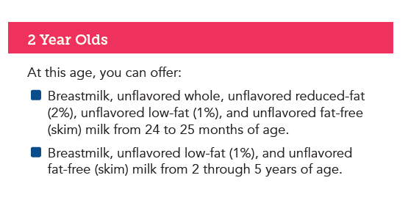
Try It Out!
Answer
Darrick is 2½ years old. What type(s) of milk can he be served as part of a reimbursable meal?
?
The correct answers are:
Unflavored
Low-Fat (1%) Milk
Unflavored Whole Milk
Unflavored
Fat-Free (Skim) Milk
Notes:
Great job! The correct answers are:
A. Unflavored low-fat milk and
C. Unflavored fat-free milk.
You can find this information on the top of page 6 of the Operator Booklet.
Additionally, breastmilk may also be served as part of a reimbursable meal.
Wonderful job, everyone!

Slide 23
Offer a Variety of Vegetables and Fruit at Meals and Snacks
Required
Required
Optional
Notes:
Toddlers are eager to learn, especially at mealtimes. In addition to milk, let them try different foods by offering a variety of vegetables and fruit at breakfast, lunch, supper and snack.
As shown on the Family Handout, vegetables and/or fruit are required at CACFP breakfast. Vegetables and fruits are required at lunch/supper. Vegetables and fruits are optional at snack.

Slide 24
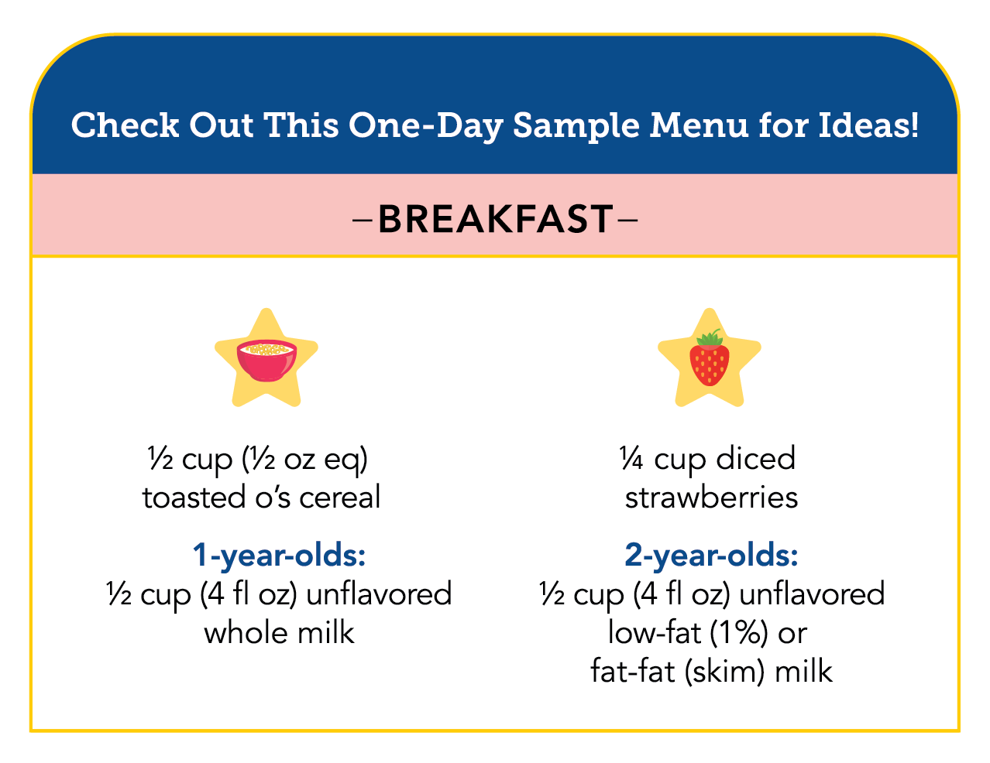





Offer a Variety of Vegetables and Fruits at Breakfast
Milk (4 fl oz or ½ cup)
Vegetables, Fruits, or Both (¼ cup)
Grains (½ oz eq)
Sometimes we serve a meat/meat alternate (such as eggs, yogurt, or other foods) in place of the grains at breakfast.
Notes:
At breakfast, vegetables are a combined component with fruits. This means you may count vegetables, fruits, or a combination of vegetables and fruit, as part of a reimbursable breakfast in the CACFP. You must offer at least ¼ cup of vegetables/fruits at breakfast.
You can find a sample one-day menu on page 7 of the Operator Booklet. This sample menu is shown on the right side of the slide. Let’s take a closer look now at how the sample breakfast meets the meal pattern requirements.
In this sample menu, this breakfast includes ½ cup of unflavored whole milk for 1-year-olds, and ½ cup of low-fat or fat-free milk for 2- year-olds.
To meet the vegetables/fruit component, this breakfast includes ¼ cup of strawberries, which is a fruit.
To meet the grains component, this breakfast offers ½ cup of toasted o’s cereal.

Slide 25
Try It Out!
Which breakfasts are reimbursable?
Choose all that apply:
Milk, roasted, diced sweet potatoes, enriched waffle pieces
Milk, diced peaches, oatmeal
Milk, mashed avocados, fruit salad, whole
grain-rich English
muffin pieces
Milk, cottage cheese, whole grain-rich bagel pieces
?
Milk (4 fl oz or ½ cup)
Vegetables, Fruit, or Both (¼ cup)
Grains (½ oz eq)
Sometimes we serve a meat/meat alternate (such as eggs, yogurt, or other foods) in place of the grains at breakfast.
Notes:
Ok, so let’s put everything into practice with this “Try It Out!” question.
Look at the four breakfast options on the screen. Assume there is enough of each item to meet minimum amounts required for each component. Which breakfasts are reimbursable in the CACFP?
Note that I said “breakfasts”—so this means more than one breakfast listed here will be reimbursable.
Raise your hand if you think the answer is:
Milk, roasted, diced sweet potatoes, and enriched waffle pieces [pause and wait for a show of hands];
Milk, diced peaches, and oatmeal [pause and wait for a show of hands];
Milk, mashed avocados, fruit salad, and whole grain-rich English muffin pieces [pause and wait for a show of hands];
Milk, cottage cheese, and whole grain-rich bagel pieces [pause and wait for a show of hands].

Slide 26
Try It Out!
Answer
Which breakfasts are reimbursable?
The correct answers are:
Milk, roasted, diced sweet potatoes, enriched waffle pieces
Milk, diced peaches, oatmeal
Milk, mashed avocados, fruit salad, whole
grain-rich English
muffin pieces
Milk, cottage cheese, whole grain-rich bagel pieces
?
Vegetables
Milk (4 fl oz or ½ cup)
Vegetables, Fruit, or Both (¼ cup)
Grains (½ oz eq)
Sometimes we serve a meat/meat alternate (such as eggs, yogurt, or other foods) in place of the grains at breakfast.
Fruits
Vegetables
Fruits
No Vegetables
No Fruits
Notes:
Great job everyone! Let’s go through this together now:
Breakfast A is reimbursable, because you have milk from the milk component, sweet potatoes, which are a vegetable, from the vegetables/fruits component, and waffles from the grains component.
Breakfast B is reimbursable, because you have milk from the milk component, peaches, which are a fruit, from the vegetables/fruit component, and oatmeal from the grains component.
Breakfast C is reimbursable, because you have milk from the milk component, avocados, which are a vegetable, and fruit salad, which are made up of fruits, from the vegetables/fruit component, and the English muffin from the grains component.
Breakfast D is NOT reimbursable because you don’t have a fruit or a vegetable. You have milk from the milk component, a bagel from the grains component, and cottage cheese as an “extra” or “additional” item. However, this breakfast does not have a vegetable or a fruit, so it is not reimbursable.
Nice work everyone! Let’s talk about vegetables and fruits at lunch and supper.

Slide 27

Offer a Variety of Vegetables and Fruits at Lunch and Supper
Milk (4 fl oz or ½ cup)
Meats/Meat Alternates (1 oz eq)
Vegetables (⅛ cup)
Fruits (⅛ cup)
Grains (½ oz eq)
Notes:
At lunch and supper, at least one vegetable is required and you must offer at least ⅛ cup of vegetables and ⅛ cup of fruit. OR, you may also serve a second, different vegetable, in place of a fruit.
Let’s look at the lunch/supper sample menu on page 7 of the Operator Booklet again. This menu is shown on the right side of the screen.
In this sample menu, this lunch/supper includes ½ cup of unflavored whole milk for 1-year-olds, and ½ cup of low-fat or fat-free milk for 2- year-olds.
To meet the meats/meat alternates component, this meal includes 1 oz of shredded chicken.
To meet the vegetables component, this lunch/supper includes ⅛ cup of broccoli.
To meet the fruit component, this lunch/supper offers a second, different vegetable-- ⅛ cup of diced carrots--- in place of fruit.
Let’s try another practice question now.

Slide 28
Try It Out!
Which lunch/suppers are reimbursable?
Choose all that apply:
Milk, spaghetti with meatballs, steamed broccoli, sliced strawberries
Milk, spaghetti with meatballs, steamed broccoli, roasted squash
Milk, spaghetti with meatballs, steamed broccoli, roasted broccoli
Milk, spaghetti with meatballs, sliced strawberries, applesauce
?
Milk (4 fl oz or ½ cup)
Meats/Meat Alternates (1 oz eq)
Vegetables (⅛ cup)
Fruits (⅛ cup)
Grains (½ oz eq)
Notes:
Look at the four lunch/supper options on the screen. Assume there is enough of each item to meet minimum amounts required for each component. Which meals are reimbursable in the CACFP?
Note that I said “meals”—so this means more than one meal listed here will be reimbursable.
Raise your hand if you think the answer is:
Milk, spaghetti with meatballs, steamed broccoli, sliced strawberries [pause and wait for a show of hands];
Milk, spaghetti with meatballs, steamed broccoli, roasted squash [pause and wait for a show of hands];
Milk, spaghetti with meatballs, steamed broccoli, roasted broccoli [pause and wait for a show of hands]; and/or
Milk, spaghetti with meatballs, sliced strawberries, applesauce [pause and wait for a show of hands].

Slide 29
Try It Out!
Answer
Which lunch/suppers are reimbursable?
The correct answers are:
Milk, spaghetti with meatballs, steamed broccoli, sliced strawberries
Milk, spaghetti with meatballs, steamed broccoli, roasted squash
Milk, spaghetti with meatballs, steamed broccoli, roasted broccoli
Milk, spaghetti with meatballs, sliced strawberries, applesauce
?
Vegetables
& Fruit
Vegetables
& Vegetables
Milk (4 fl oz or ½ cup)
Meats/Meat Alternates (1 oz eq)
Vegetables (⅛ cup)
Fruits (⅛ cup)
Grains (½ oz eq)
Only One
Vegetable
(Broccoli)
Two Fruits
Notes:
Great job everyone!! Let’s go through this together now:
Meal A is reimbursable, because you have milk from the milk component, meatballs from the meats/meat alternates component, spaghetti from the grains component, steamed broccoli from the vegetables component, and sliced strawberries from the fruit component.
Meal B is reimbursable, because you have milk from the milk component, meatballs from the meats/meat alternate component, spaghetti from the grains component, steamed broccoli from the vegetables component, and roasted squash, which is a second, different vegetable from the broccoli, in place of the fruit component.
Meal C is NOT reimbursable, because you have milk from the milk component, meatballs from the meats/meat alternate component, spaghetti from the grains component, but only one vegetable--broccoli. Even though you are serving them two different ways--one steamed, one roasted--they are still the same food so you cannot count one as a vegetable to be served in place of fruit.
Meal D is NOT reimbursable because you have milk from the milk component, meatballs from the meats/meat alternate component, spaghetti from the grains component, but no vegetables. You must serve at least one vegetable as part of a reimbursable meal in the CACFP.
Great job everyone! Now, let’s look at vegetables and fruits at snack.

Slide 30

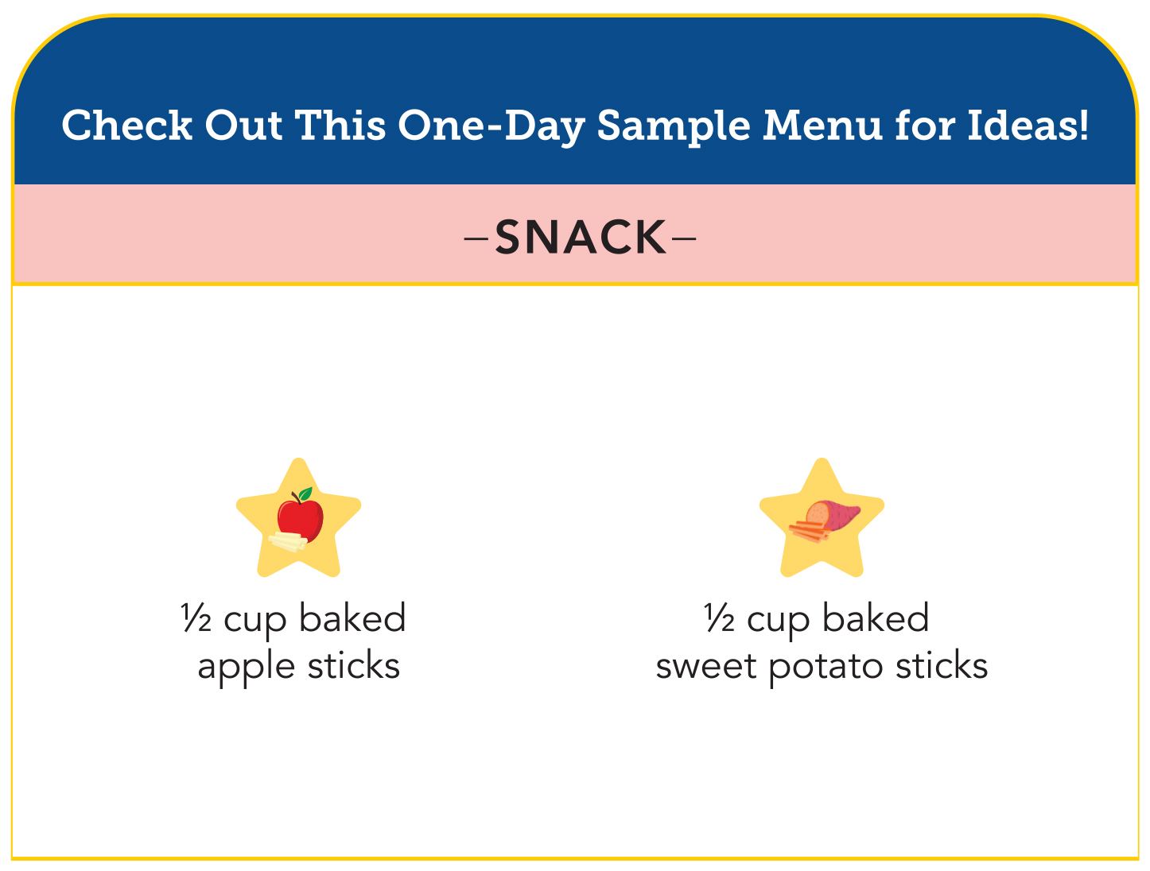
Offer a Variety of Vegetables and Fruit at Snack
Milk (4 fl oz or ½ cup)
Meats/Meat Alternates (½ oz eq)
Vegetables (½ cup)
Fruits (½ cup)
Grains (½ oz eq)
Notes:
At snacks, vegetables and fruits are optional, meaning they are not required. Snack in the CACFP must have foods from two different components. Examples of reimbursable snacks are a snack with vegetables and grains, or a snack that includes fruit and milk, or that includes grains and meat alternate.
As an optional CACFP best practice, we encourage you to offer a fruit or vegetable at every snack you serve. This helps to expose these young children to a variety of vegetables and fruit throughout the week.
If you serve a vegetable at snack, you must offer at least ½ cup. And, if you choose to serve a fruit at snack, you must offer at least ½ cup.
Looking at the snack in the sample menu on page 7 of the Operator Booklet, we see that this snack has foods from two different components:
baked apple slices from the fruits component, and sweet potatoes from the vegetables component. Because we have foods from two different components, this snack is reimbursable in the CACFP.

Slide 31
Try It Out!
Which snacks are reimbursable?
Choose all that apply:
Bananas, yogurt, water
Watermelon cubes and orange juice
Red pepper strips and milk
Grilled cheese sandwiches (made with enriched bread and cheddar cheese) and water
?
Milk (4 fl oz or ½ cup)
Meats/Meat Alternates
(½ oz eq)
Vegetables (½ cup)
Fruits (½ cup)
Grains (½ oz eq)
Notes:
Let’s do one last Try It Out, and this one will focus on snacks. As we mentioned earlier, reimbursable snacks have foods from any two of the five components. Water is not a component, but we encourage you to serve water with snacks when milk or 100% juice are not served.
Look at the four snack options on your screen. Assume there is enough of each food in the snack to meet minimum serving requirements. Which snacks are reimbursable in the CACFP?
Note that I said “snacks”—so this means more than one snack will be reimbursable. Raise your hand if you think the answer is:
A) Bananas, yogurt, water [pause and wait for a show of hands];
B) Watermelon cubes and orange juice [pause and wait for a show of hands];
C) Red pepper strips and milk [pause and wait for a show of hands]; and/or
D) Grilled cheese sandwiches (made with enriched bread and cheddar cheese) and water

Slide 32
Try It Out!
Answer
Which snacks are reimbursable?
Choose all that apply:
Bananas, yogurt, water
Watermelon cubes and orange juice
Red pepper strips and milk
Grilled cheese sandwiches (made with enriched bread and cheddar cheese) and water
Fruits
Meat Alternates
?
Two
Fruits
Milk (4 fl oz or ½ cup)
Meats/Meat Alternates
(½ oz eq)
Vegetables (½ cup)
Fruits (½ cup)
Grains (½ oz eq)
Vegetables
Milk
Grains
Meat Alternates
Notes:
Great job everyone!! Let’s go through this together now:
Snack A is reimbursable, because you have bananas from the fruit component, and yogurt from the meats/meat alternates component.
Snack B is NOT reimbursable, because you are offering two items from one component. Watermelon cubes and orange juice are both part of the fruit component. Serve an item from another component, such as vegetables, to make this a reimbursable snack.
Snack C is reimbursable, because you have red pepper strips from the vegetables component, and milk from the milk component.
Snack D is reimbursable because you have the bread from the grilled cheese sandwich that counts toward the grains component, and cheese from the meats/meat alternates component.
Nice work everyone!

Slide 33




Reduce the Risk of Choking
Cut cherry tomatoes and grapes lengthwise, then cut into smaller pieces no larger than ½ inch.
Cook hard vegetables, like carrots until they are soft.
Remove large seeds and pits from fruits like cherries. Cut fruit into smaller pieces no larger than ½ inch.
Cut raw vegetables and fruit like cucumber and apples, into small thin strips or thin slices.
Notes:
Now, we will talk briefly about choking prevention. As we know, choking prevention is so important at this age, as children under the age of 4 are at a high risk for choking.
Cherry tomatoes, grapes, carrots, apples, and other vegetables and fruits can increase a toddler’s risk of choking. There are ways you can prepare these foods to lower this risk. You can:
Cut cherry tomatoes and grapes lengthwise, then cut into smaller pieces no larger than ½ inch.
Cook hard vegetables, like carrots, until they are soft.
Remove large seeds and pits from fruits, and cut into smaller pieces no larger than ½ inch.
Cut raw vegetables and fruit, like cucumber and apples, into small thin strips or thin slices.
This information can be found on pages 3 and 7 of the Operator Booklet.

Slide 34
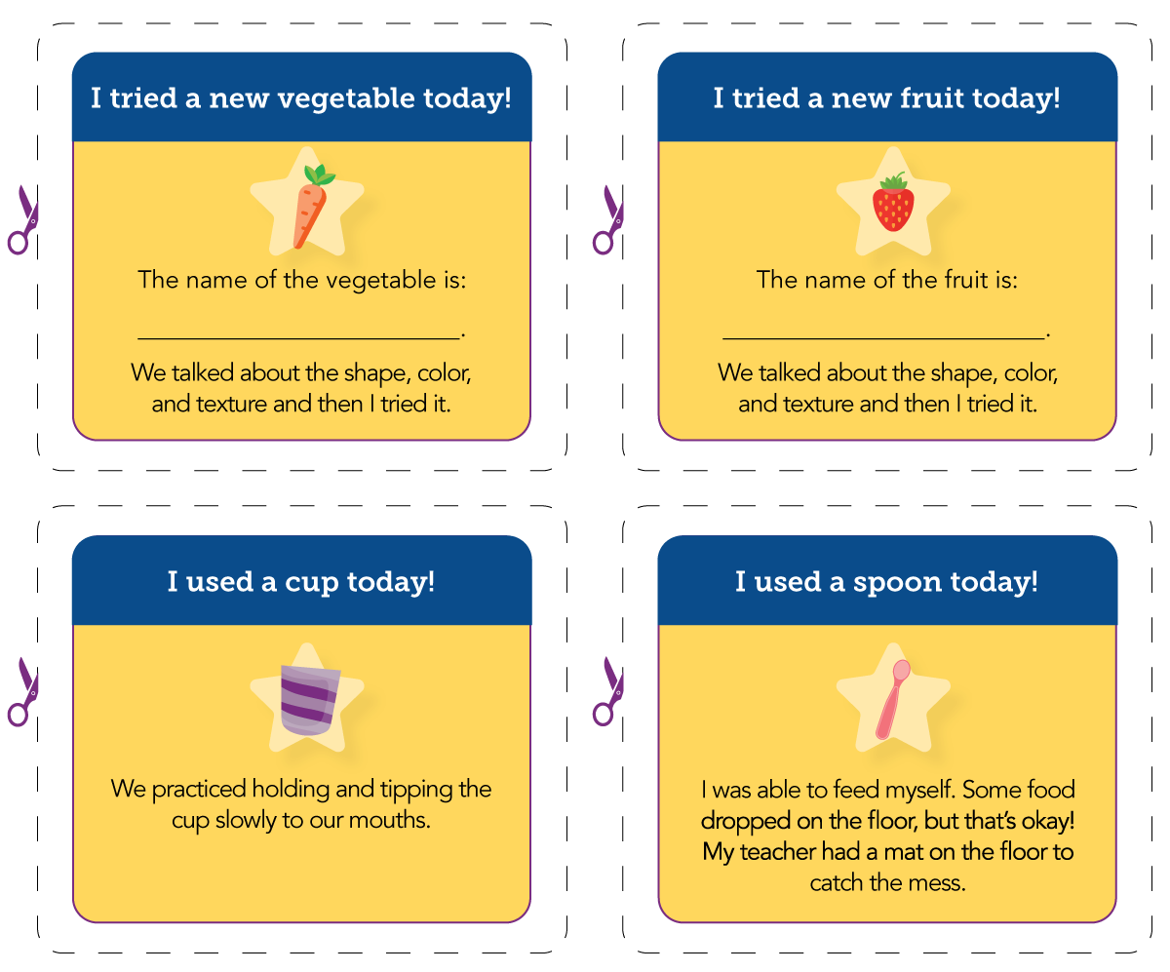
Celebrating Toddler Successes
Eating a new vegetable or fruit.
Learning to drink from a cup.
Using a spoon or fork at mealtime.
Notes:
Finally, we all know that communicating with parents is so important, and that includes celebrating their young child’s successes, new skills, and experiences, such as trying a new vegetable or fruit, learning how to drink from a cup, or using utensils at mealtimes and snacks. Consider sending families emails, letters, or certificates mentioning these milestones when they occur. This can help strengthen communication between child cares and families, and also encourage families to help their children practice these skills at home. The Mealtimes with Toddlers operator booklet also includes sample badges that you can print out or copy and give or send home with toddlers to celebrate their successes.
And, as mentioned before, the Mealtimes With Toddlers two-page family handout provides further information on how you can share this information with parents and families of the toddlers in your care.

Slide 35

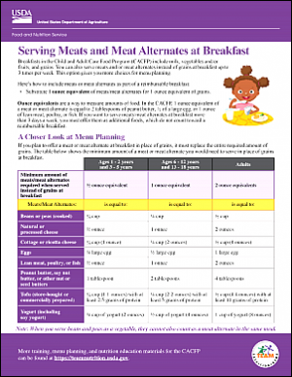
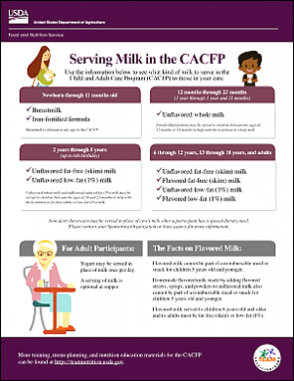
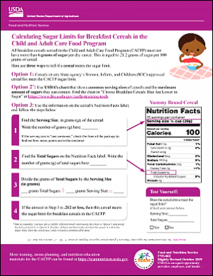
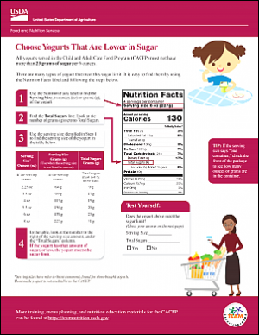
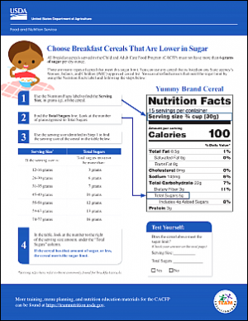
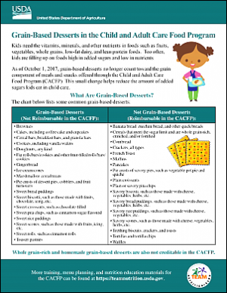
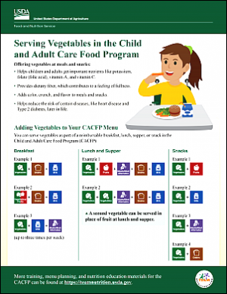
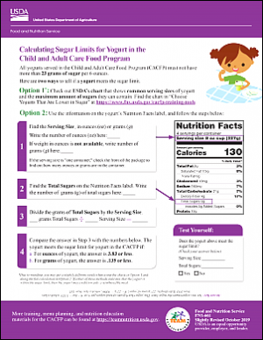
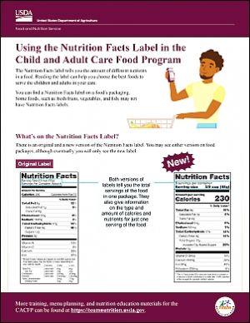
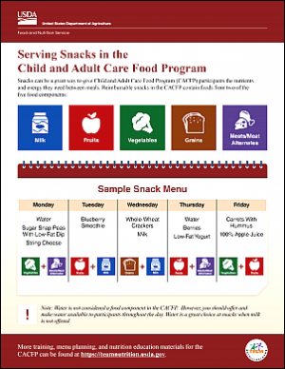
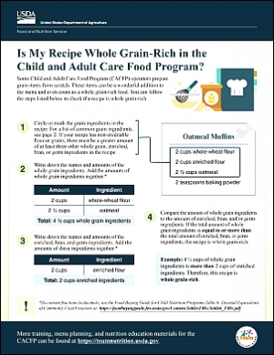
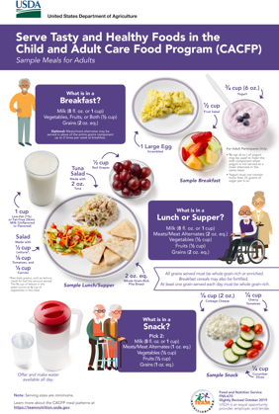
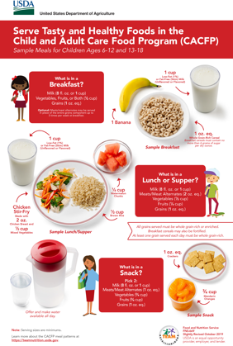
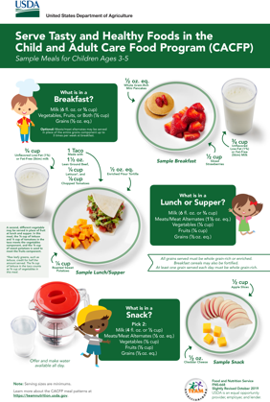
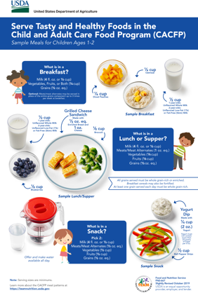
More Team Nutrition Resources!
TeamNutrition.usda.gov
Notes:
All Team Nutrition materials are available online from Team Nutrition’s website and are available for free download to anybody who is interested.

Slide 36
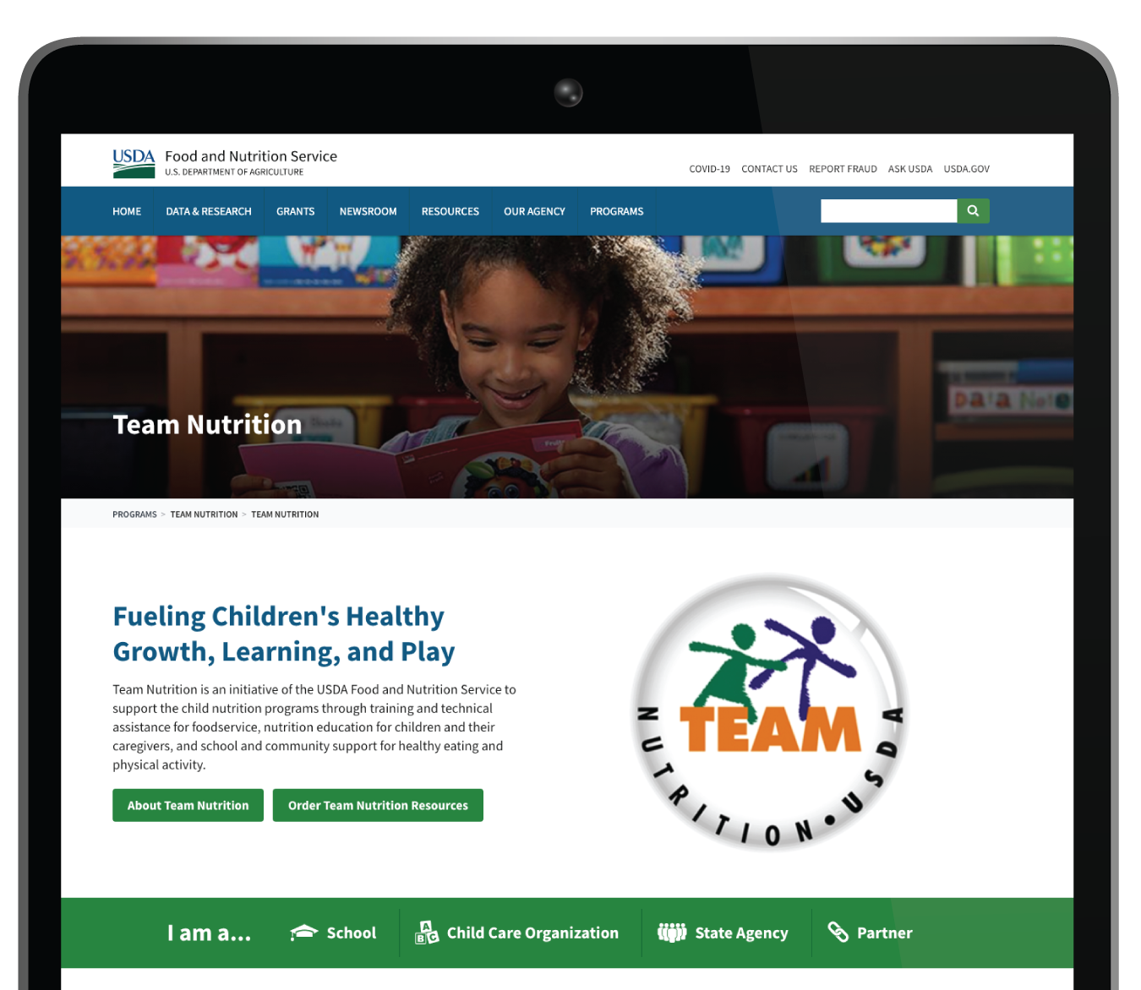

How To Order Print Copies
Resource Order Form at TeamNutrition.usda.gov.
FREE for those participating in a Child Nutrition Program, while supplies last.
Sponsoring organizations and State agencies can also order in bulk by sending an email to:
TeamNutrition@usda.gov
Notes:
For all participating in a Child Nutrition Program, such as the CACFP, Team Nutrition’s print materials are free to order.
If you would like to order Team Nutrition’s free materials in print, you can go to the “Resource Order Form” link on the Team Nutrition website to order print copies of the materials.
For bulk orders, you can email TeamNutrition@usda.gov.

Slide 37


Thank you!
TeamNutrition.usda.gov
@TeamNutrition
TeamNutrition@USDA.gov
USDA is an equal opportunity provider, employer, and lender.
Notes:
These training slides were provided by U.S. Department of Agriculture's Team Nutrition. If you would like to learn more about Team Nutrition and additional resources available, please visit their website, subscribe to their monthly e-newsletter, connect with them via email at TeamNutrition@usda.gov, and follow them on Twitter.
Thank you!

