Slide 1

Using Ounce Equivalents for Grains in the CACFP
A Training Presentation for
Child and Adult Care Food
Program (CACFP) Operators

Slide 2



USDA’s Team Nutrition
An initiative of the USDA’s Food and Nutrition Service to support the USDA’s Child Nutrition Programs.
Aims to improve children’s lifelong eating and physical activity habits.
Provides nutrition education and training materials to State agencies, sponsoring organizations, and CACFP sites.
Speaker notes:
Team Nutrition is an initiative of the USDA Food and Nutrition Service that supports the Child Nutrition Programs, including the National School Lunch Program, the School Breakfast Program, and of course, the Child and Adult Care Food Program, or the CACFP.
It does so through training and technical assistance for those preparing and serving meals, providing nutrition education for children, and building support for healthier school and childcare environments.
TeamNutrition.usda.gov
@TeamNutrition
Notes:
Team Nutrition is an initiative of the USDA Food and Nutrition Service that supports the Child Nutrition Programs, including the National School Lunch Program, the School Breakfast Program, and of course, the Child and Adult Care Food Program, or the CACFP.
It does so through training and technical assistance for those preparing and serving meals, providing nutrition education for children, and building support for healthier school and child care environments.

Slide 3
Let Us Know Who You Are!
I work for a…
Child care center
Family child care home
At-risk afterschool care center
Adult day care center
Sponsoring organization
Emergency shelter
School food authority
State agency
USDA Regional Office
Other
?
Speaker notes:
Before we get started, I want to know who has joined us today.
Please raise your hand if you work for:
a childcare center [pause and wait for a show of hands],
a family childcare home [pause and wait for a show of hands],
an at-risk afterschool care center [pause and wait for a show of hands],
a sponsoring organization [pause and wait for a show of hands],
an emergency shelter [pause and wait for a show of hands],
a school food authority [pause and wait for a show of hands],
a State agency [pause and wait for a show of hands],
A USDA Regional office [pause and wait for a show of hands], or
other [pause and wait for a show of hands].
Notes:
Before we get started, I want to know who has joined us today.
Please raise your hand if you work for:
a child care center [pause and wait for a show of hands],
a family child care home [pause and wait for a show of hands],
an at-risk afterschool care center [pause and wait for a show of hands],
a sponsoring organization [pause and wait for a show of hands],
an emergency shelter [pause and wait for a show of hands],
a school food authority [pause and wait for a show of hands],
a State agency [pause and wait for a show of hands],
A USDA Regional office [pause and wait for a show of hands], or
other [pause and wait for a show of hands].

Slide 4
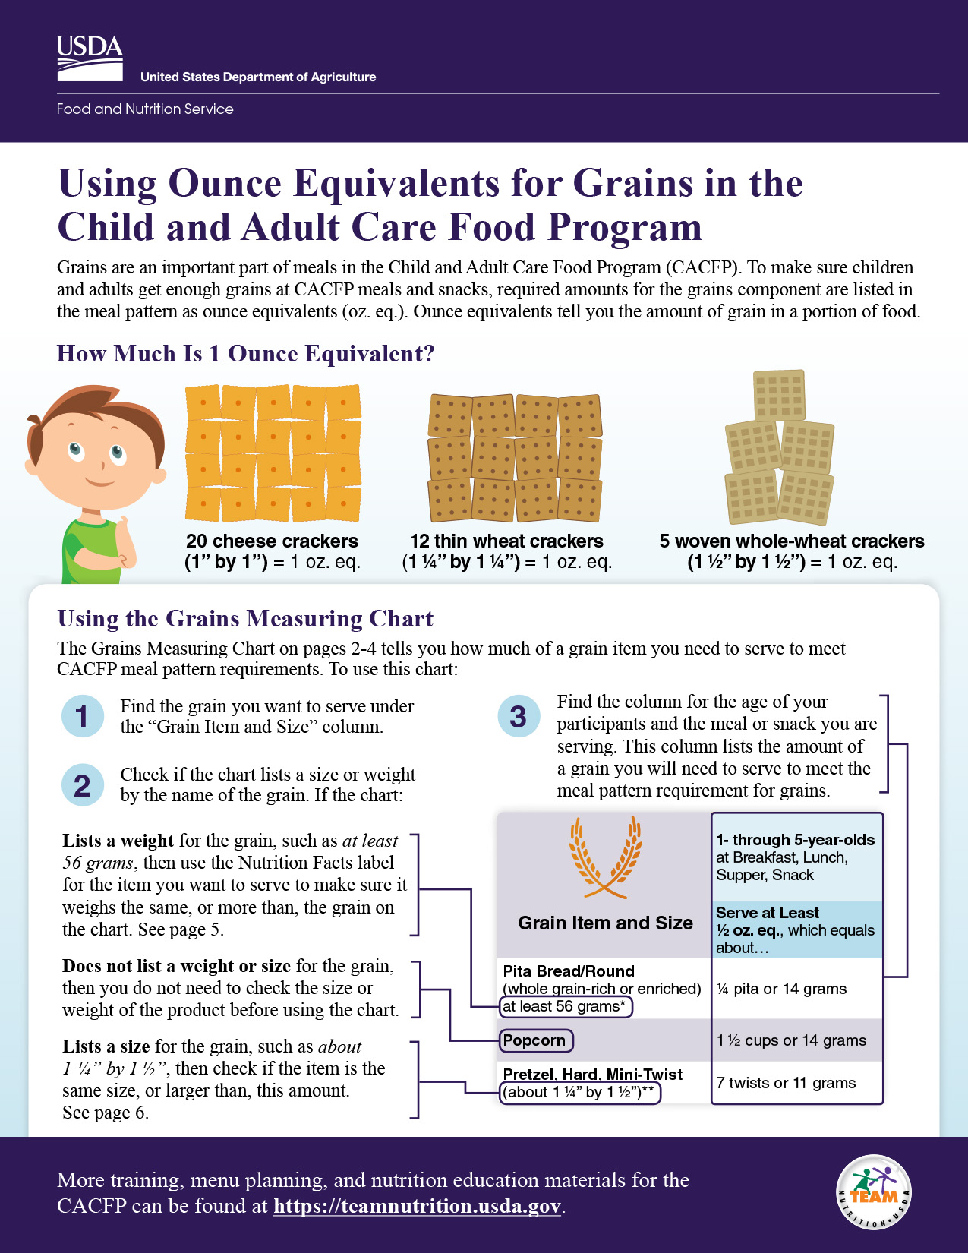
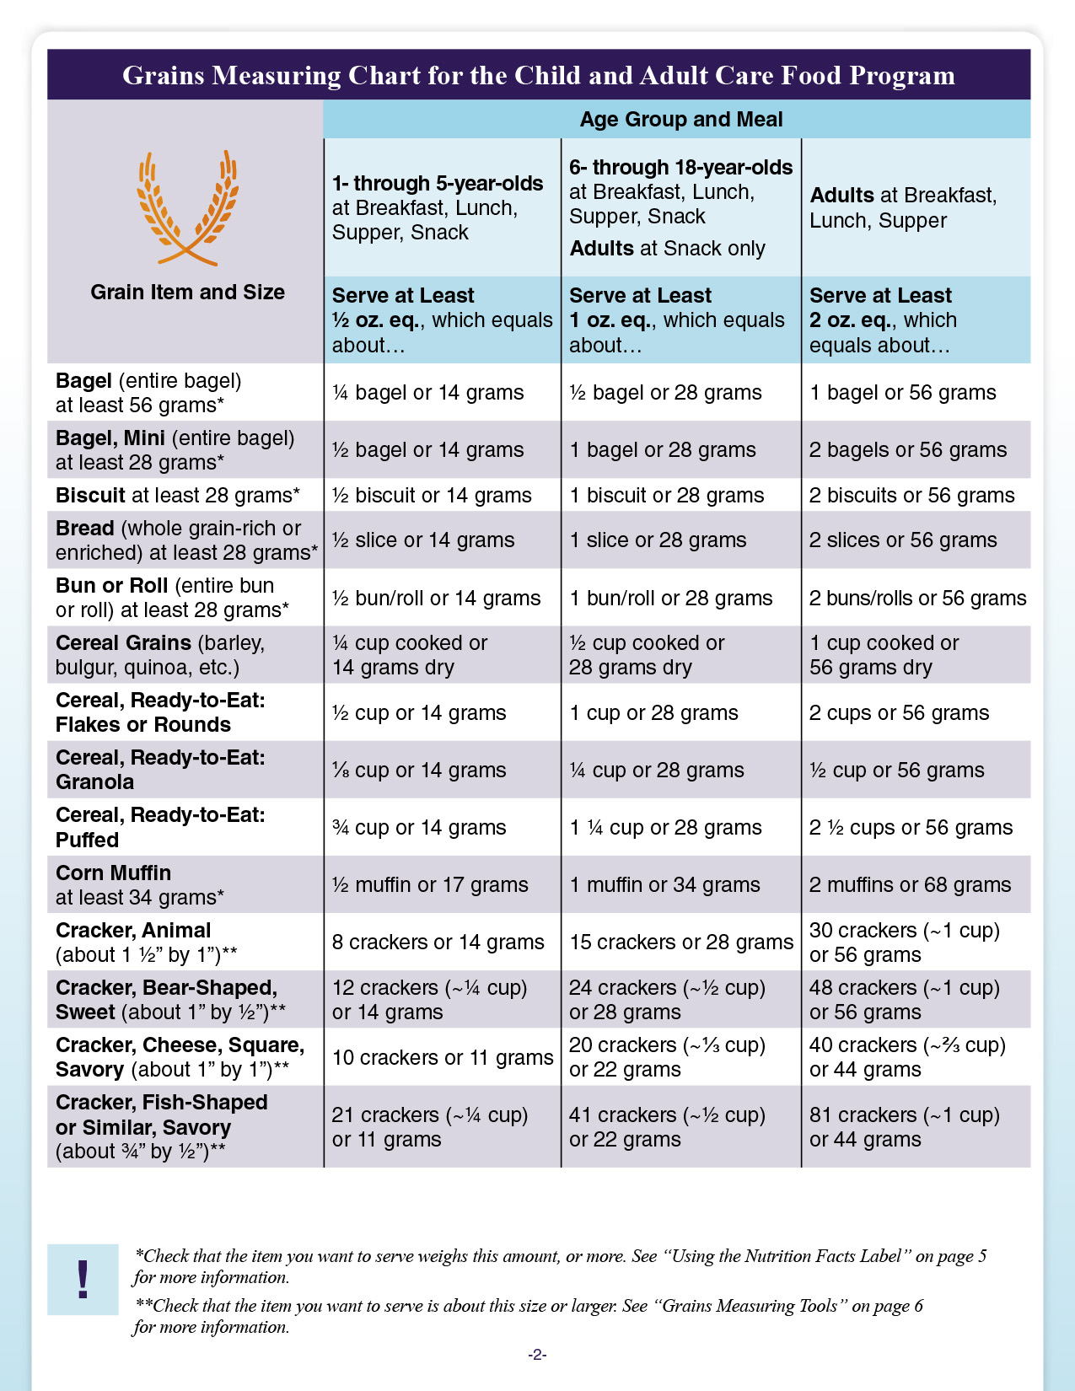
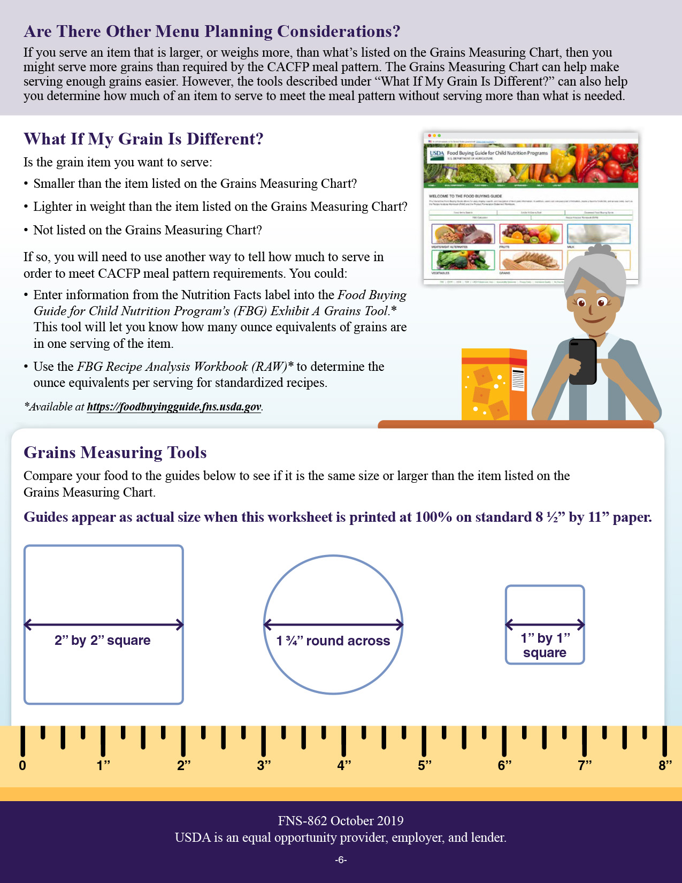

Using Ounce Equivalents for Grains in the CACFP Worksheet
Speaker notes:
So, let’s get started! Today we will discuss how to use ounce equivalents for grains in the CACFP. The USDA’s Team Nutrition initiative has created a worksheet on “Using Ounce Equivalents for Grains in the CACFP.” You can download the worksheet from the web address on the screen, if you’d like. You can also just follow along with the pictures shown on the slides.
fns.usda.gov/team-nutrition/cacfp-meal-pattern-training-worksheets
Notes:
So, let’s get started! Today we will discuss how to use ounce equivalents for grains in the CACFP. The USDA’s Team Nutrition initiative has created a worksheet on “Using Ounce Equivalents for Grains in the CACFP.” You can download the worksheet from the web address on the screen, if you’d like. You can also just follow along with the pictures shown on the slides.

Slide 5
How Much Is 1 Ounce Equivalent?
Speaker notes:
In the CACFP, grains are measured in units we call “ounce equivalents.”
One-ounce equivalent of grains is the amount of food you need to make up 16 grams of grains.
As you see on the screen, not all crackers contain the same amount of grain per cracker. In today’s marketplace, we have big crackers, small crackers, thick crackers, thin crackers, fish-shaped crackers, bear crackers, a lot of different types of crackers. It takes different amounts of different types of crackers to provide 16 grams of grains or 1-ounce equivalent.
For example, 20 small cheese crackers contains 16 grams of grain. So, 20 small cheese crackers equals 1-ounce equivalent.
Twelve (12) thin wheat crackers contain 16 grams of grains and equals 1-ounce equivalent.
Finally, five (5) woven whole-wheat crackers are needed to provide 16 grams of grains, or 1-ounce equivalent of grains.
Notice you need more of the smaller crackers to get 16 grams of grains, and you need fewer of the larger crackers to get 16 grams of grains.
How Much Is 1 Ounce Equivalent?
20 cheese crackers
(1” by 1”) = 1 oz. eq.
12 thin wheat crackers
(1 ¼” by 1 ¼”) = 1 oz. eq.
5 woven whole-wheat crackers
(1 ½” by 1 ½”) = 1 oz. eq.
fns.usda.gov/team-nutrition/cacfp-meal-pattern-training-worksheets
Notes:
In the CACFP, grains are measured in units we call “ounce equivalents.”
One ounce equivalent of grains is the amount of food you need to make up 16 grams of grains.
As you see on the screen, not all crackers contain the same amount of grain per cracker. In today’s marketplace, we have big crackers, small crackers, thick crackers, thin crackers, fish-shaped crackers, bear crackers, a lot of different types of crackers. It takes different amounts of different types of crackers to provide 16 grams of grains or 1 ounce equivalent.
For example, 20 small cheese crackers contains 16 grams of grain. So, 20 small cheese crackers equals 1 ounce equivalent.
Twelve (12) thin wheat crackers contain 16 grams of grains and equals 1 ounce equivalent.
Finally, five (5) woven whole-wheat crackers are needed to provide 16 grams of grains, or 1 ounce equivalent of grains.
Notice you need more of the smaller crackers to get 16 grams of grains, and you need fewer of the larger crackers to get 16 grams of grains.

Slide 6
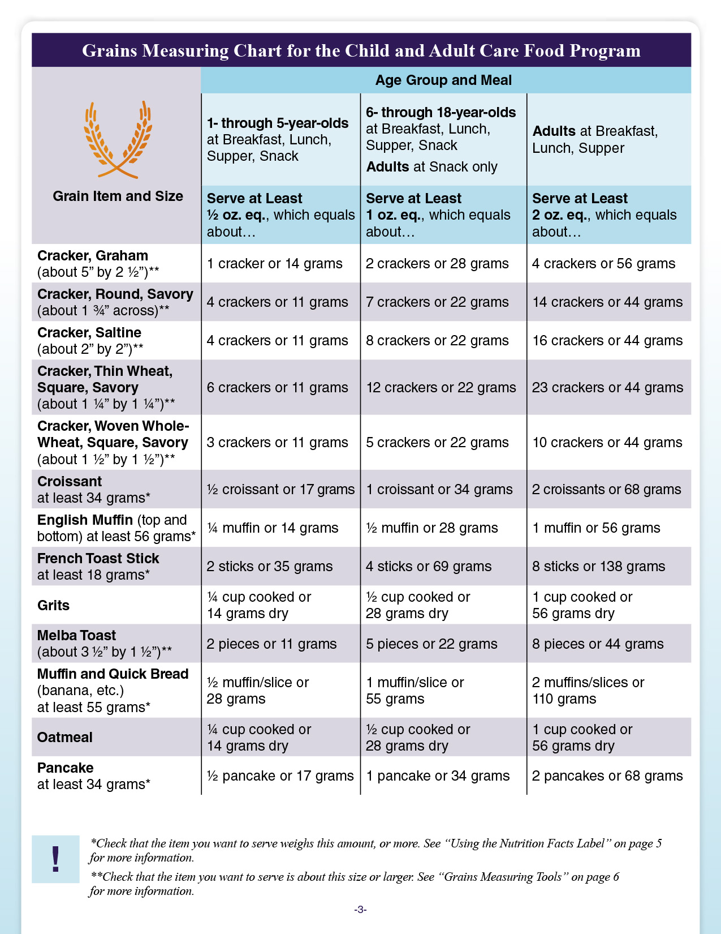
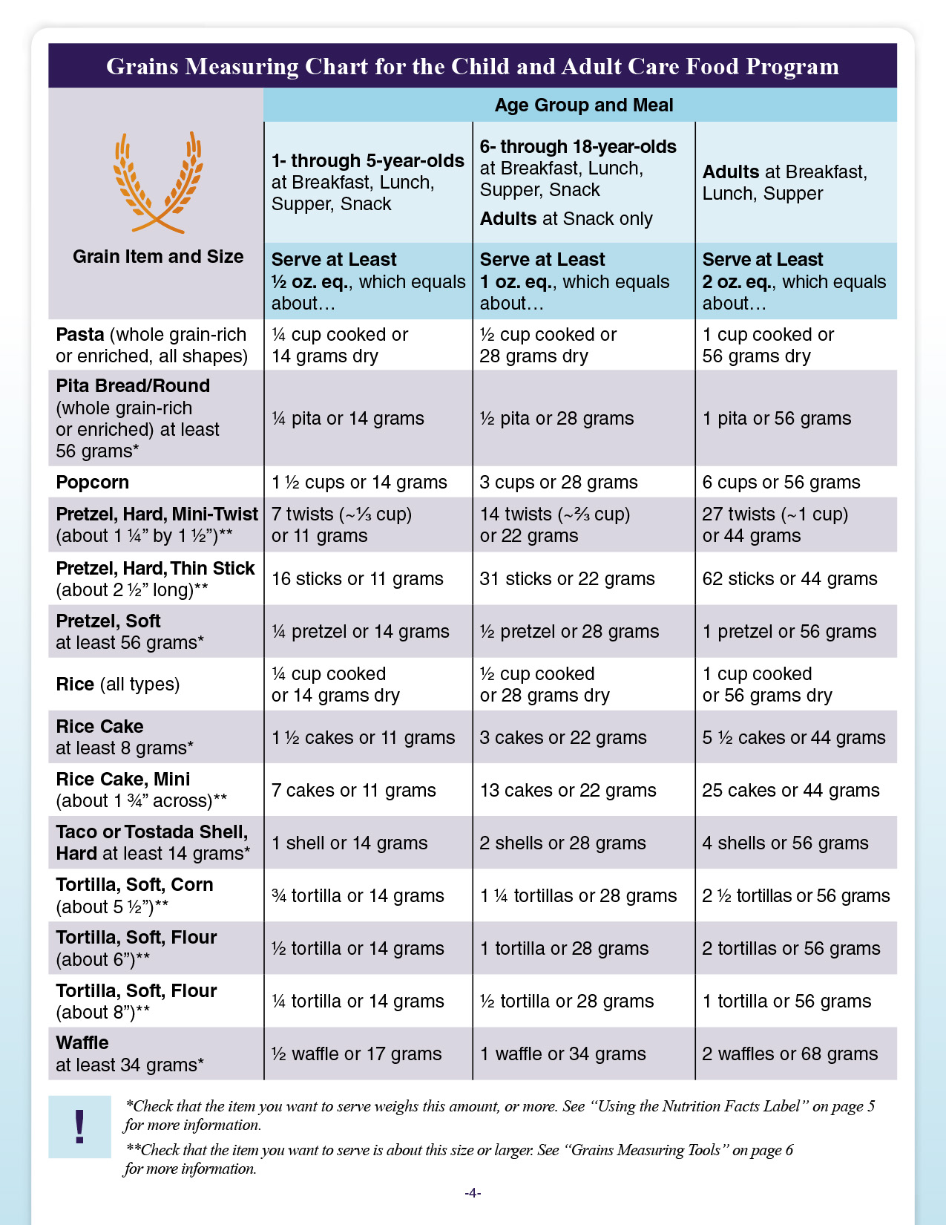
Grains Measuring Chart for the
Child and Adult Care Food Program
Speaker notes:
Pages 2 through 4 of the worksheet includes the Grains Measuring Chart. This chart includes household measures of over 40 common grain items, listed in alphabetical order.
fns.usda.gov/team-nutrition/cacfp-meal-pattern-training-worksheets
Notes:
Pages 2 through 4 of the worksheet includes the Grains Measuring Chart. This chart includes household measures of over 40 common grain items, listed in alphabetical order.

Slide 7
Grains Measuring Chart for the
Child and Adult Care Food Program (Continued)
Speaker notes:
You can find the names of the grain items in the first column of your chart.
fns.usda.gov/team-nutrition/cacfp-meal-pattern-training-worksheets
Notes:
You can find the names of the grain items in the first column of your chart.

Slide 8
CACFP meals and snacks: grains required for 1- through 5-year-olds
Grains Measuring Chart for the Child and Adult Care Food Program
Grain Item and Size | Age Group and Meal | Age Group and Meal | Age Group and Meal
Grain Item and Size | 1- through 5-year-olds at Breakfast, Lunch, Supper, Snack | 6- through 18-year-olds at Breakfast, Lunch, Supper, Snack Adults at Snack only | Adults at Breakfast, Lunch, Supper
Grain Item and Size | Serve at Least ½ oz. eq., which equals about… | Serve at Least 1 oz. eq., which equals about… | Serve at Least 2 oz. eq., which equals about…
Pasta (whole grain-rich or enriched, all shapes) | ¼ cup cooked or 14 grams dry | ½ cup cooked or 28 grams dry | 1 cup cooked or 56 grams dry
Pita Bread/Round (whole grain-rich or enriched) at least 56 grams* | ¼ pita or 14 grams | ½ pita or 28 grams | 1 pita or 56 grams
Popcorn | 1 ½ cups or 14 grams | 3 cups or 28 grams | 6 cups or 56 grams
Pretzel, Hard, Mini-Twist (about 1 ¼” by 1 ½”)** | 7 twists (~⅓ cup) or 11 grams | 14 twists (~⅔ cup) or 22 grams | 27 twists (~1 cup) or 44 grams
Speaker notes:
Each item is listed with the amount of the item you need to make up a ½ ounce equivalent of grains, which is the minimum amount of grains required for 1- through 5-year-olds at all CACFP meals and snacks. This is shown on the second column of each chart.
Notes:
Each item is listed with the amount of the item you need to make up a ½ ounce equivalent of grains, which is the minimum amount of grains required for 1- through 5-year-olds at all CACFP meals and snacks. This is shown on the second column of each chart.

Slide 9
CACFP meals and snacks: grains required for 6- through 18-year-olds
Grains Measuring Chart for the Child and Adult Care Food Program
Grain Item and Size | Age Group and Meal | Age Group and Meal | Age Group and Meal
Grain Item and Size | 1- through 5-year-olds at Breakfast, Lunch, Supper, Snack | 6- through 18-year-olds at Breakfast, Lunch, Supper, Snack Adults at Snack only | Adults at Breakfast, Lunch, Supper
Grain Item and Size | Serve at Least ½ oz. eq., which equals about… | Serve at Least 1 oz. eq., which equals about… | Serve at Least 2 oz. eq., which equals about…
Pasta (whole grain-rich or enriched, all shapes) | ¼ cup cooked or 14 grams dry | ½ cup cooked or 28 grams dry | 1 cup cooked or 56 grams dry
Pita Bread/Round (whole grain-rich or enriched) at least 56 grams* | ¼ pita or 14 grams | ½ pita or 28 grams | 1 pita or 56 grams
Popcorn | 1 ½ cups or 14 grams | 3 cups or 28 grams | 6 cups or 56 grams
Pretzel, Hard, Mini-Twist (about 1 ¼” by 1 ½”)** | 7 twists (~⅓ cup) or 11 grams | 14 twists (~⅔ cup) or 22 grams | 27 twists (~1 cup) or 44 grams
Speaker notes:
Each item is also listed with the amount you need to make up 1- ounce equivalent of grains, which is the minimum amount of grains that 6 through 18- year- old need at meals and snacks.
If you choose to serve grains to adult participants as part of a CACFP snack, you must serve at least one- ounce equivalent of grains as well.
Notes:
Each item is also listed with the amount you need to make up 1- ounce equivalent of grains, which is the minimum amount of grains that 6- through 18-year-olds need at meals and snacks.
If you choose to serve grains to adult participants as part of a CACFP snack, you must serve at least one- ounce equivalent of grains as well.

Slide 10
CACFP meals and snacks: grains required for adults
Grains Measuring Chart for the Child and Adult Care Food Program
Grain Item and Size | Age Group and Meal | Age Group and Meal | Age Group and Meal
Grain Item and Size | 1- through 5-year-olds at Breakfast, Lunch, Supper, Snack | 6- through 18-year-olds at Breakfast, Lunch, Supper, Snack Adults at Snack only | Adults at Breakfast, Lunch, Supper
Grain Item and Size | Serve at Least ½ oz. eq., which equals about… | Serve at Least 1 oz. eq., which equals about… | Serve at Least 2 oz. eq., which equals about…
Pasta (whole grain-rich or enriched, all shapes) | ¼ cup cooked or 14 grams dry | ½ cup cooked or 28 grams dry | 1 cup cooked or 56 grams dry
Pita Bread/Round (whole grain-rich or enriched) at least 56 grams* | ¼ pita or 14 grams | ½ pita or 28 grams | 1 pita or 56 grams
Popcorn | 1 ½ cups or 14 grams | 3 cups or 28 grams | 6 cups or 56 grams
Pretzel, Hard, Mini-Twist (about 1 ¼” by 1 ½”)** | 7 twists (~⅓ cup) or 11 grams | 14 twists (~⅔ cup) or 22 grams | 27 twists (~1 cup) or 44 grams
Speaker notes:
And finally, each grain item in this chart is listed with the amount of an item you need to make up 2-ounce equivalents of grains. Two ounce equivalents of grains is the minimum amount of grains required for adult participants at breakfast, lunch, and supper.
As I mentioned, this chart has over 40 grain items that might be commonly served in the CACFP. If you want to serve a grain item that is not listed on this chart, we will talk about other tools you can use at the end of today’s session.
This chart is designed to grab-and-go, so that someone could just pick it up and start using it. For those who might like instructions, we also include steps on how to use the chart on page one of the worksheet. So, let’s take a look at page one now.
Notes:
And finally, each grain item in this chart is listed with the amount of an item you need to make up 2- ounce equivalents of grains. Two oz eq of grains is the minimum amount of grains required for adult participants at breakfast, lunch, and supper.
As I mentioned, this chart has over 40 grain items that might be commonly served in the CACFP. If you want to serve a grain item that is not listed on this chart, we will talk about other tools you can use at the end of today’s session.
This chart is designed to grab-and-go, so that someone could just pick it up and start using it. For those who might like instructions, we also include steps on how to use the chart on page one of the worksheet. So, let’s take a look at page one now.

Slide 11
Using the Grains Measuring Chart
Using the Grains Measuring Chart
The Grains Measuring Chart on pages 2-4 tells you how much of a grain item you need to serve to meet CACFP meal pattern requirements. To use this chart:
1
Find the grain you want to serve under the “Grain Item and Size” column.
3
Find the column for the age of your participants and the meal or snack you are serving. This column lists the amount of a grain you will need to serve to meet the meal pattern requirement for grains.
2
Check if the chart lists a size or weight by the name of the grain. If the chart:
Grain Item and Grain | 1- through 5-year-olds at Breakfast, Lunch, Supper, Snack
Grain Item and Size | Serve at Least ½ oz. eq., which equals about…
Pita Bread/Round (whole grain-rich or enriched) at least 56 grams* | ¼ pita or 14 grams
Popcorn | 1 ½ cups or 14 grams
Pretzel, Hard, Mini-Twist (about 1 ¼” by 1 ½”)** | 7 twists or 11 grams
Lists a weight for the grain, such as at least
56 grams, then use the Nutrition Facts label for the item you want to serve to make sure it weighs the same, or more than, the grain on
the chart. See page 5.
Does not list a weight or size for the grain,
then you do not need to check the size or weight of the product before using the chart.
Lists a size for the grain, such as about
1 ¼” by 1 ½”, then check if the item is the same size, or larger than, this amount.
See page 6.
Speaker notes:
You can find directions on how to use the chart on the bottom of the first page.
Notes:
You can find directions on how to use the chart on the bottom of the first page.

Slide 12
Find the grain you want to serve under the “Grain Item and Size” column.
1
Grains Measuring Chart for the Child and Adult Care Food Program
Grain Item and Size | Age Group and Meal | Age Group and Meal | Age Group and Meal
Grain Item and Size | 1- through 5-year-olds at Breakfast, Lunch, Supper, Snack | 6- through 18-year-olds at Breakfast, Lunch, Supper, Snack Adults at Snack only | Adults at Breakfast, Lunch, Supper
Grain Item and Size | Serve at Least ½ oz. eq., which equals about… | Serve at Least 1 oz. eq., which equals about… | Serve at Least 2 oz. eq., which equals about…
Pasta (whole grain-rich or enriched, all shapes) | ¼ cup cooked or 14 grams dry | ½ cup cooked or 28 grams dry | 1 cup cooked or 56 grams dry
Pita Bread/Round (whole grain-rich or enriched) at least 56 grams* | ¼ pita or 14 grams | ½ pita or 28 grams | 1 pita or 56 grams
Popcorn | 1 ½ cups or 14 grams | 3 cups or 28 grams | 6 cups or 56 grams
Pretzel, Hard, Mini-Twist (about 1 ¼” by 1 ½”)** | 7 twists (~⅓ cup) or 11 grams | 14 twists (~⅔ cup) or 22 grams | 27 twists (~1 cup) or 44 grams
Speaker notes:
To use the chart, the first step is to “Find the grain you want to serve under the “Grain Item and Size” column.”
Notes:
To use the chart, the first step is to “Find the grain you want to serve under the “Grain Item and Size” column.”

Slide 13
Sample snack for 10-year-olds
1
Find the grain you want to serve under the “Grain Item and Size” column.
Grains Measuring Chart for the Child and Adult Care Food Program
Grain Item and Size | Age Group and Meal | Age Group and Meal | Age Group and Meal
Grain Item and Size | 1- through 5-year-olds at Breakfast, Lunch, Supper, Snack | 6- through 18-year-olds at Breakfast, Lunch, Supper, Snack Adults at Snack only | Adults at Breakfast, Lunch, Supper
Grain Item and Size | Serve at Least ½ oz. eq., which equals about… | Serve at Least 1 oz. eq., which equals about… | Serve at Least 2 oz. eq., which equals about…
Pasta (whole grain-rich or enriched, all shapes) | ¼ cup cooked or 14 grams dry | ½ cup cooked or 28 grams dry | 1 cup cooked or 56 grams dry
Pita Bread/Round (whole grain-rich or enriched) at least 56 grams* | ¼ pita or 14 grams | ½ pita or 28 grams | 1 pita or 56 grams
Popcorn | 1 ½ cups or 14 grams | 3 cups or 28 grams | 6 cups or 56 grams
Pretzel, Hard, Mini-Twist (about 1 ¼” by 1 ½”)** | 7 twists (~⅓ cup) or 11 grams | 14 twists (~⅔ cup) or 22 grams | 27 twists (~1 cup) or 44 grams
Step 1
Speaker notes:
Let’s say you want to serve popcorn at snack to 10-year-olds at your afterschool site. The first step is to find “popcorn” in the Grains Measuring Chart.
Notes:
Let’s say you want to serve popcorn at snack to 10-year-olds at your afterschool site.
The first step is to find “popcorn” in the Grains Measuring Chart.

Slide 14
Check if the chart lists a size or weight by the name of the grain. If the chart:
2
Lists a weight for the grain, such as at least 56 grams, then use the Nutrition Facts label for the item you want to serve to make sure it weighs the same, or more than, the grain on the chart. See page 5.
Does not list a weight or size for the grain, then you do not need to check the size or weight of the product before using the chart.
Lists a size for the grain, such as about
1 ¼” by 1 ½”, then check if the item is
the same size, or larger than, this amount. See page 6.
Pita Bread/Round (whole grain-rich or enriched) at least 56 grams*
Popcorn
Pretzel, Hard, Mini-Twist (about 1 ¼” by 1 ½”)**
Step 2
Speaker notes:
After you find the item you want to serve, check and see if there is a size or weight by the name of the grain item.
Popcorn does not have a size or weight listed by the name, so you don’t need to first verify that the popcorn we want to serve weighs a certain amount or is a certain size. You can move on to the next step.
Notes:
After you find the item you want to serve, check and see if there is a size or weight by the name of the grain item.
Popcorn does not have a size or weight listed by the name, so you don’t need to first verify that the popcorn we want to serve weighs a certain amount or is a certain size. You can move on to the next step.

Slide 15
Find the column for the age of your participants and the meal or snack you are serving.
3
Grains Measuring Chart for the Child and Adult Care Food Program
Grain Item and Size | Age Group and Meal | Age Group and Meal | Age Group and Meal
Grain Item and Size | 1- through 5-year-olds at Breakfast, Lunch, Supper, Snack | 6- through 18-year-olds at Breakfast, Lunch, Supper, Snack Adults at Snack only | Adults at Breakfast, Lunch, Supper
Grain Item and Size | Serve at Least ½ oz. eq., which equals about… | Serve at Least 1 oz. eq., which equals about… | Serve at Least 2 oz. eq., which equals about…
Pasta (whole grain-rich or enriched, all shapes) | ¼ cup cooked or 14 grams dry | ½ cup cooked or 28 grams dry | 1 cup cooked or 56 grams dry
Pita Bread/Round (whole grain-rich or enriched) at least 56 grams* | ¼ pita or 14 grams | ½ pita or 28 grams | 1 pita or 56 grams
Popcorn | 1 ½ cups or 14 grams | 3 cups or 28 grams | 6 cups or 56 grams
Pretzel, Hard, Mini-Twist (about 1 ¼” by 1 ½”)** | 7 twists (~⅓ cup) or 11 grams | 14 twists (~⅔ cup) or 22 grams | 27 twists (~1 cup) or 44 grams
Step 3
Speaker notes:
The third step is to find the column for the age of your participants and the meal or snack you are serving.
If you want serve popcorn to 10-year-olds at snack, look for the 6- through 18-year-olds column, and follow that column all the way down to the popcorn row.
Notes:
The third step is to find the column for the age of your participants and the meal or snack you are serving.
If you want serve popcorn to 10-year-olds at snack, you will look for the 6- through 18-year-olds column and follow that column all the way down to the popcorn row.

Slide 16
Find the column for the age of your participants and the meal or snack you are serving. (continued)
3
Find the column for the age of your participants and the meal or snack you are serving.
Grains Measuring Chart for the Child and Adult Care Food Program
Grain Item and Size | Age Group and Meal | Age Group and Meal | Age Group and Meal
Grain Item and Size | 1- through 5-year-olds at Breakfast, Lunch, Supper, Snack | 6- through 18-year-olds at Breakfast, Lunch, Supper, Snack Adults at Snack only | Adults at Breakfast, Lunch, Supper
Grain Item and Size | Serve at Least ½ oz. eq., which equals about… | Serve at Least 1 oz. eq., which equals about… | Serve at Least 2 oz. eq., which equals about…
Pasta (whole grain-rich or enriched, all shapes) | ¼ cup cooked or 14 grams dry | ½ cup cooked or 28 grams dry | 1 cup cooked or 56 grams dry
Pita Bread/Round (whole grain-rich or enriched) at least 56 grams* | ¼ pita or 14 grams | ½ pita or 28 grams | 1 pita or 56 grams
Popcorn | 1 ½ cups or 14 grams | 3 cups or 28 grams | 6 cups or 56 grams
Pretzel, Hard, Mini-Twist (about 1 ¼” by 1 ½”)** | 7 twists (~⅓ cup) or 11 grams | 14 twists (~⅔ cup) or 22 grams | 27 twists (~1 cup) or 44 grams
Speaker notes:
The popcorn row and the 6- through 18-year-old column intersect at 3 cups. This tells us that we need to serve 3 cups of popcorn to meet the minimum amount of grains required for 6- through 18-year-olds at snack in the CACFP.
Notes:
The popcorn row and the 6- through 18-year-old column intersect at 3 cups. This tells us that we need to serve 3 cups of popcorn to meet the minimum amount of grains required for 6- through 18-year-olds at snack in the CACFP.

Slide 17
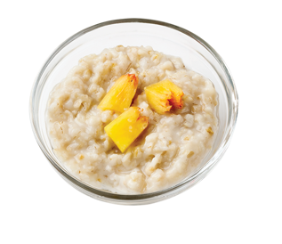
Try It Out!
You want to serve oatmeal to 4-year-olds at breakfast. How many cups of cooked oatmeal do you need to serve to meet the minimum required amounts of grains in the CACFP?
Speaker notes:
Let’s practice using the Grains Measuring chart with this question now.
Look at the Grains Measuring Chart in the worksheet or on the screen. Let’s say you want to serve oatmeal to 4-year-olds at breakfast. How many cups of cooked oatmeal do you need to serve to meet minimum required amounts of grains at breakfast in the CACFP?
Raise your hand if you think you need to serve at least:
One (1) cup of cooked oatmeal [pause and wait for a show of hands];
Two (2) cups of cooked oatmeal [pause and wait for a show of hands];
One-fourth (¼) cup of cooked oatmeal [pause and wait for a show of hands]; or
One-half (½) cup of cooked oatmeal [pause and wait for a show of hands].
?
Grains Measuring Chart for the Child and Adult Care Food Program
Grain Item and Size | Age Group and Meal | Age Group and Meal | Age Group and Meal
Grain Item and Size | 1- through 5-year-olds at Breakfast, Lunch, Supper, Snack | 6- through 18-year-olds at Breakfast, Lunch, Supper, Snack Adults at Snack only | Adults at Breakfast, Lunch, Supper
Grain Item and Size | Serve at Least ½ oz. eq., which equals about… | Serve at Least 1 oz. eq., which equals about… | Serve at Least 2 oz. eq., which equals about…
Grits | ¼ cup cooked or 14 grams dry | ½ cup cooked or 28 grams dry | 1 cup cooked or 56 grams dry
Melba Toast (about 3 ½” by 1 ½”)** | 2 pieces or 11 grams | 5 pieces or 22 grams | 8 pieces or 44 grams
Muffin and Quick Bread (banana, etc.) at least 55 grams* | ½ muffin/slice or 28 grams | 1 muffin/slice or 55 grams | 2 muffins/slices or 110 grams
Oatmeal | ¼ cup cooked or 14 grams dry | ½ cup cooked or 28 grams dry | 1 cup cooked or 56 grams dry
Pancake at least 34 grams* | ½ pancake or 17 grams | 1 pancake or 34 grams | 2 pancakes or 68 grams
1 cup
2 cups
¼ cup
½ cup
Notes:
Let’s practice using the Grains Measuring chart with this question now.
Take a look at the Grains Measuring Chart in the worksheet or on the screen. Let’s say you want to serve oatmeal to 4-year-olds at breakfast. How many cups of cooked oatmeal do you need to serve to meet minimum required amounts of grains at breakfast in the CACFP?
Raise your hand if you think you need to serve at least:
One (1) cup of cooked oatmeal [pause and wait for a show of hands];
Two (2) cups of cooked oatmeal [pause and wait for a show of hands];
One-fourth (¼) cup of cooked oatmeal [pause and wait for a show of hands]; or
One-half (½) cup of cooked oatmeal [pause and wait for a show of hands].

Slide 18
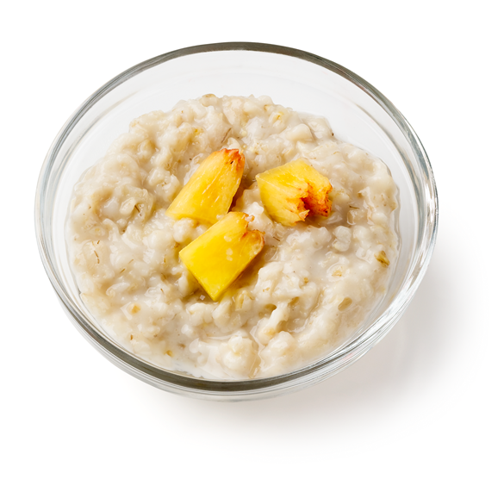
Answer
You want to serve oatmeal to 4-year-olds at breakfast. How many cups of cooked oatmeal do you need to serve to meet the minimum required amounts of grains in the CACFP?
?
Speaker notes:
Nice work everyone! The answer is ¼ cup cooked oatmeal. You need to serve at least a ¼ cup of cooked oatmeal to each 4-year-old in order to meet the minimum required amount of grains at breakfast for 4-year-olds in the CACFP.
1 cup
2 cups
¼ cup
½ cup
✓
¼ cup
Notes:
Nice work everyone! The answer is ¼ cup cooked oatmeal. You need to serve at least a ¼ cup of cooked oatmeal to each 4-year-old in order to meet the minimum required amount of grains at breakfast for 4-year-olds in the CACFP.

Slide 19
Grains Measuring Chart
Grains Measuring Chart for the Child and Adult Care Food Program
Grain Item and Size | Age Group and Meal | Age Group and Meal | Age Group and Meal
Grain Item and Size | 1- through 5-year-olds at Breakfast, Lunch, Supper, Snack | 6- through 18-year-olds at Breakfast, Lunch, Supper, Snack Adults at Snack only | Adults at Breakfast, Lunch, Supper
Grain Item and Size | Serve at Least ½ oz. eq., which equals about… | Serve at Least 1 oz. eq., which equals about… | Serve at Least 2 oz. eq., which equals about…
Grits | ¼ cup cooked or 14 grams dry | ½ cup cooked or 28 grams dry | 1 cup cooked or 56 grams dry
Melba Toast (about 3 ½” by 1 ½”)** | 2 pieces or 11 grams | 5 pieces or 22 grams | 8 pieces or 44 grams
Muffin and Quick Bread (banana, etc.) at least 55 grams* | ½ muffin/slice or 28 grams | 1 muffin/slice or 55 grams | 2 muffins/slices or 110 grams
Oatmeal | ¼ cup cooked or 14 grams dry | ½ cup cooked or 28 grams dry | 1 cup cooked or 56 grams dry
Pancake at least 34 grams* | ½ pancake or 17 grams | 1 pancake or 34 grams | 2 pancakes or 68 grams
Step 1
Speaker notes:
Let’s look at how we got that answer. First, we find the food we want to serve, which is oatmeal.
Step 2 shows us that the oatmeal does not have any weights or sizes next to it, so we don’t need to check the size of the oatmeal to know that we can use the chart.
Our next step is to find the age of our participants and the meal. We are serving 4-year-olds at breakfast, so we follow the 1- through 5-year-olds column down to the oatmeal row.
If you look at where the 1- though 5-year-olds column meets the oatmeal row, it tells us that we need to serve a ¼ cup of cooked oatmeal to meet the ½ ounce equivalent required of grains at breakfast for this age group.
Now, as we mentioned, the popcorn and the oatmeal do not have any weights or sizes listed next to it. However, some items on this chart have weights or sizes listed next to them. So, let’s take a closer look at how you would use this chart for those types of foods.
Notes:
Let’s take a look at how we got that answer. First, we find the food we want to serve, which is oatmeal.
Step 2 shows us that the oatmeal does not have any weights or sizes next to it, so we don’t need to check the size of the oatmeal to know that we can use the chart.
Our next step is to find the age of our participants and the meal. We are serving 4-year-olds at breakfast, so we follow the 1- through 5-year-olds column down to the oatmeal row.
If you look at where the 1- though 5-year-olds column meets the oatmeal row, it tells us that we need to serve a ¼ cup of cooked oatmeal to meet the ½ ounce equivalent required of grains at breakfast for this age group.
Now, as we mentioned, the popcorn and the oatmeal do not have any weights or sizes listed next to it. However, some items on this chart have weights or sizes listed next to them. So, let’s take a closer look at how you would use this chart for those types of foods.

Slide 20
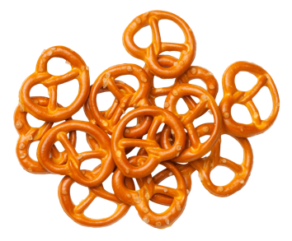
Grains Measuring Chart for the CACFP
1
Find the grain you want to serve under the “Grain Item and Size” column.
Grains Measuring Chart for the Child and Adult Care Food Program
Grain Item and Size | Age Group and Meal | Age Group and Meal | Age Group and Meal
Grain Item and Size | 1- through 5-year-olds at Breakfast, Lunch, Supper, Snack | 6- through 18-year-olds at Breakfast, Lunch, Supper, Snack Adults at Snack only | Adults at Breakfast, Lunch, Supper
Grain Item and Size | Serve at Least ½ oz. eq., which equals about… | Serve at Least 1 oz. eq., which equals about… | Serve at Least 2 oz. eq., which equals about…
Pasta (whole grain-rich or enriched, all shapes) | ¼ cup cooked or 14 grams dry | ½ cup cooked or 28 grams dry | 1 cup cooked or 56 grams dry
Pita Bread/Round (whole grain-rich or enriched) at least 56 grams* | ¼ pita or 14 grams | ½ pita or 28 grams | 1 pita or 56 grams
Popcorn | 1 ½ cups or 14 grams | 3 cups or 28 grams | 6 cups or 56 grams
Pretzel, Hard, Mini-Twist (about 1 ¼” by 1 ½”)** | 7 twists (~⅓ cup) or 11 grams | 14 twists (~⅔ cup) or 22 grams | 27 twists (~1 cup) or 44 grams
Step 1
Speaker notes:
The first step is the same; we find our food in the chart. Let’s look at mini-twist hard pretzels now. They are sometimes also called “tiny twists,” and an example of these pretzels are shown on the screen.
Notes:
The first step is the same; we find our food in the chart. Let’s take a look at mini-twist hard pretzels now. They are sometimes also called “tiny twists,” and an example of these pretzels are shown on the screen.

Slide 21
Check if the chart lists a size or weight by the name of the grain. If the chart:
2
Lists a weight for the grain, such as at least 56 grams, then use the Nutrition Facts label for the item you want to serve to make sure it weighs the same, or more than, the grain on the chart. See page 5.
Does not list a weight or size for the grain, then you do not need to check the size or weight of the product before using the chart.
Lists a size for the grain, such as about
1 ¼” by 1 ½”, then check if the item is
the same size, or larger than, this amount. See page 6.
Pita Bread/Round (whole grain-rich or enriched) at least 56 grams*
Popcorn
Pretzel, Hard, Mini-Twist (about 1 ¼” by 1 ½”)**
Step 2
Speaker notes:
Step 2 tells us that if the chart lists a size by the grain item’s name, then we need to make sure the grain item we want to serve is the same size, or larger than, the size listed on the Grains Measuring Chart. In this case, our pretzel must be at least 1 ¼” long by 1 ½” wide.
So, how can you tell the size of the pretzel you want to serve?
Page 6 of the worksheet provides more information about measuring and sizes, so let’s look at page 6 now.
Notes:
Step 2 tells us that if the chart lists a size by the grain item’s name, then we need to make sure the grain item we want to serve is the same size, or larger than, the size listed on the Grains Measuring Chart. In this case, our pretzel must be at least 1 ¼” long by 1 ½” wide.
So, how can you tell the size of the pretzel you want to serve?
Page 6 of the worksheet provides more information about measuring and sizes, so let’s take a look at page 6 now.

Slide 22
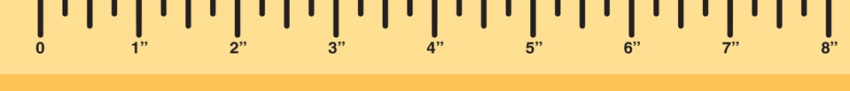
Grains Measuring Tools
Grains Measuring Tools
Compare your food to the guides below to see if it is the same size or larger than the item listed on the Grains Measuring Chart.
Guides appear as actual size when this worksheet is printed at 100% on standard 8 ½” by 11” paper.
2” by 2” square
1 ¾” round across
1” by 1”
square
Speaker notes:
The bottom of page 6 has a section called “Grains Measuring Tools” that you can use to see if your item is the same size, or larger than, what’s listed on the Grains Measuring Chart.
Notes:
The bottom of page 6 has a section called “Grains Measuring Tools” that you can use to see if your item is the same size, or larger than, what’s listed on the Grains Measuring Chart.

Slide 23
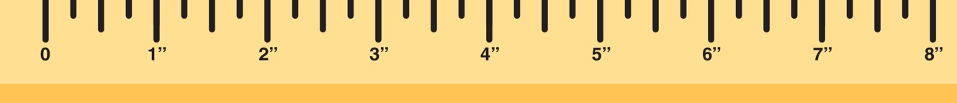
Grains Measuring Tools (2)
Grains Measuring Tools
Compare your food to the guides below to see if it is the same size or larger than the item listed on the
Grains Measuring Chart.
Guides appear as actual size when this worksheet is printed at 100% on standard 8 ½” by 11” paper.
2” by 2” square
1 ¾” round across
1” by 1”
square
¼ inch
¾ inch
½ inch
Speaker notes:
You will see that there are some shapes for common sizes of crackers and other grains, such as circles and squares, as well as a ruler at the bottom.
Notes:
You will see that there are some shapes for common sizes of crackers and other grains, such as circles and squares, as well as a ruler at the bottom.

Slide 24
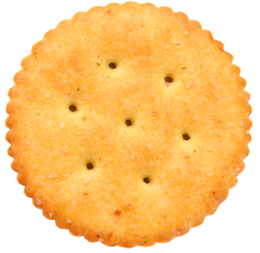

Grains Measuring Tools (3)
Grains Measuring Tools
Compare your food to the guides below to see if it is the same size or larger than the item listed on the
Grains Measuring Chart.
Guides appear as actual size when this worksheet is printed at 100% on standard 8 ½” by 11” paper.
Option 2
2” by 2” square
1” by 1”
square
Option 1
Speaker notes:
If you had a grain item that matches the shapes in the Grains Measuring Tools, such as a round cracker, you could measure the item with the ruler on the bottom, as shown on the screen with the cracker labeled “Option 1.”
You could also place the grain item over the shape to see if the item was the same size or larger, as you see with the cracker labeled “Option 2.” Either method of measuring would be correct.
Notes:
If you had a grain item that matches the shapes in the Grains Measuring Tools, such as a round cracker, you could measure the item with the ruler on the bottom, as shown on the screen with the cracker labeled “Option 1.”
You could also place the grain item over the shape to see if the item was the same size or larger, as you see with the cracker labeled “Option 2.” Either method of measuring would be correct.

Slide 25
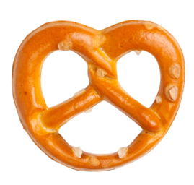
Grains Measuring Tools (4)
Grains Measuring Tools
Compare your food to the guides below to see if it is the same size or larger than the item listed on the
Grains Measuring Chart.
Guides appear as actual size when this worksheet is printed at 100% on standard 8 ½” by 11” paper.
2” by 2” square
1 ¾” round across
1” by 1”
square
~1 ½” across
Speaker notes:
The grain item in our example is pretzels, and because there is no pretzel shape in the Grains Measuring Tools, we will use the ruler at the bottom to measure our pretzel.
Let’s look at the pretzel now. The ruler shows us that this pretzel is about 1 ½ inches across.
Notes:
The grain item in our example is pretzels, and because there is no pretzel shape in the Grains Measuring Tools, we will use the ruler at the bottom to measure our pretzel.
Let’s take a look at the pretzel now. The ruler shows us that this pretzel is about 1 ½ inches across.

Slide 26

Grains Measuring Tools (5)
Grains Measuring Tools
Compare your food to the guides below to see if it is the same size or larger than the item listed on the
Grains Measuring Chart.
Guides appear as actual size when this worksheet is printed at 100% on standard 8 ½” by 11” paper.
2” by 2” square
1 ¾” round across
1” by 1”
square
~1 ½” tall
Speaker notes:
Let’s rotate the pretzel to see how “tall” it is. This ruler shows that the pretzel is 1 ½ inches tall as well.
Now we know that the pretzel measures 1 ½ inches wide by 1 ½ inches tall.
Notes:
Let’s rotate the pretzel to see how “tall” it is. This ruler shows that the pretzel is 1 ½ inches tall as well.
Now we know that the pretzel measures 1 ½ inches wide by 1 ½ inches tall.

Slide 27
Try It Out!
Is this pretzel the same size or larger than the hard mini-twist pretzel listed in the Grains Measuring Chart?
?
This pretzel measures 1 ½” by 1 ½”.
1 ½”
Yes, this pretzel is the same size or larger.
No, this pretzel is not the same size or larger.
1 ½”
Speaker notes:
Now that we have measured the pretzel, let’s try another practice question.
Take at the Grains Measuring Chart in your worksheet. Is this 1 ½ inch by 1 ½ inch pretzel the same size or larger than the hard mini-twist pretzel listed in the Grains Measuring Chart?
Raise your hand if you think yes, this pretzel is the same size or larger than the pretzel listed in the Grains Measuring Chart [pause and wait for a show of hands].
Raise your hand if you think no, this pretzel is not the same size or larger than the pretzel listed in the Grains Measuring Chart [pause and wait for a show of hands].
Notes:
Now that we have measured the pretzel, let’s try another practice question.
Take a look at the Grains Measuring Chart in your worksheet. Is this 1 ½ inch by 1 ½ inch pretzel the same size or larger than the hard mini-twist pretzel listed in the Grains Measuring Chart?
Raise your hand if you think yes, this pretzel is the same size or larger than the pretzel listed in the Grains Measuring Chart [pause and wait for a show of hands].
Raise your hand if you think no, this pretzel is not the same size or larger than the pretzel listed in the Grains Measuring Chart [pause and wait for a show of hands].

Slide 28
Answer
Is this pretzel the same size or larger than the hard mini-twist pretzel listed in the Grains Measuring Chart?
?
This pretzel measures 1 ½” by 1 ½”.
Pita Bread/Round (whole grain-rich or enriched) at least 56 grams*
Popcorn
Pretzel, Hard, Mini-Twist (about 1 ¼” by 1 ½”)**
1 ½”
✓
Yes, this pretzel is the same size or larger.
No, this pretzel is not the same size or larger.
1 ½”
Speaker notes:
Nice work everyone! The answer is yes, this pretzel is larger than the ones listed on the chart. The Grains Measuring Chart says that hard mini-twist pretzels must measure at least 1 ¼ inch by 1 ½ inches.
The pretzel in our example measures 1 ½ inches by 1 ½ inches, which is larger than 1 ¼ inches by 1 ½ inches.
So, now we know that we can use the Grains Measuring Chart to see how many pretzels to serve.
Notes:
Nice work everyone! The answer is yes, this pretzel is larger than the ones listed on the chart. The Grains Measuring Chart says that hard mini-twist pretzels must measure at least 1 ¼ inch by 1 ½ inches.
The pretzel in our example measures 1 ½ inches by 1 ½ inches, which is larger than 1 ¼ inches by 1 ½ inches.
So, now we know that we can use the Grains Measuring Chart to see how many pretzels to serve.

Slide 29

Find the column for the age of your participants and the meal or snack you are serving-continued.
3
Find the column for the age of your participants and the meal or snack you are serving.
Grains Measuring Chart for the Child and Adult Care Food Program
Grain Item and Size | Age Group and Meal | Age Group and Meal | Age Group and Meal
Grain Item and Size | 1- through 5-year-olds at Breakfast, Lunch, Supper, Snack | 6- through 18-year-olds at Breakfast, Lunch, Supper, Snack Adults at Snack only | Adults at Breakfast, Lunch, Supper
Grain Item and Size | Serve at Least ½ oz. eq., which equals about… | Serve at Least 1 oz. eq., which equals about… | Serve at Least 2 oz. eq., which equals about…
Pasta (whole grain-rich or enriched, all shapes) | ¼ cup cooked or 14 grams dry | ½ cup cooked or 28 grams dry | 1 cup cooked or 56 grams dry
Pita Bread/Round (whole grain-rich or enriched) at least 56 grams* | ¼ pita or 14 grams | ½ pita or 28 grams | 1 pita or 56 grams
Popcorn | 1 ½ cups or 14 grams | 3 cups or 28 grams | 6 cups or 56 grams
Pretzel, Hard, Mini-Twist (about 1 ¼” by 1 ½”)** | 7 twists (~⅓ cup) or 11 grams | 14 twists (~⅔ cup) or 22 grams | 27 twists (~1 cup) or 44 grams
Step 1
Speaker notes:
Now that we know we can use the Grains Measuring Chart with this pretzel, our last step is to find the column for the age of your participants and the meal or snack you are serving. Let’s try another practice question with that now.
Notes:
Now that we know we can use the Grains Measuring Chart with this pretzel, our last step is to find the column for the age of your participants and the meal or snack you are serving. Let’s try another practice question with that now.

Slide 30

Try It Out!
You want to serve pretzels to 8-year-olds at snack.
How many mini-twist hard pretzels do you need to serve to meet the minimum required amounts of grains at snack in the CACFP?
?
Grains Measuring Chart for the Child and Adult Care Food Program
Grain Item and Size | Age Group and Meal | Age Group and Meal | Age Group and Meal
Grain Item and Size | 1- through 5-year-olds at Breakfast, Lunch, Supper, Snack | 6- through 18-year-olds at Breakfast, Lunch, Supper, Snack Adults at Snack only | Adults at Breakfast, Lunch, Supper
Grain Item and Size | Serve at Least ½ oz. eq., which equals about… | Serve at Least 1 oz. eq., which equals about… | Serve at Least 2 oz. eq., which equals about…
Pasta (whole grain-rich or enriched, all shapes) | ¼ cup cooked or 14 grams dry | ½ cup cooked or 28 grams dry | 1 cup cooked or 56 grams dry
Pita Bread/Round (whole grain-rich or enriched) at least 56 grams* | ¼ pita or 14 grams | ½ pita or 28 grams | 1 pita or 56 grams
Popcorn | 1 ½ cups or 14 grams | 3 cups or 28 grams | 6 cups or 56 grams
Pretzel, Hard, Mini-Twist (about 1 ¼” by 1 ½”)** | 7 twists (~⅓ cup) or 11 grams | 14 twists (~⅔ cup) or 22 grams | 27 twists (~1 cup) or 44 grams
7 twists
11 twists
14 twists
27 twists
Speaker notes:
Look at the Grains Measuring Chart in the worksheet or on the screen.
Let’s say you want to serve pretzels to 8-year-olds at snack. How many mini-twist hard pretzels do you need to serve to meet the minimum required amount of grains at snack in the CACFP?
Raise your hand if you think you need to serve at least:
7 twists [pause and wait for a show of hands];
11 twists [pause and wait for a show of hands];
14 twists [pause and wait for a show of hands]; or
27 twists [pause and wait for a show of hands].
Notes:
Look at the Grains Measuring Chart in the worksheet or on the screen.
Let’s say you want to serve pretzels to 8-year-olds at snack. How many mini-twist hard pretzels do you need to serve to meet the minimum required amount of grains at snack in the CACFP?
Raise your hand if you think you need to serve at least:
7 twists [pause and wait for a show of hands];
11 twists [pause and wait for a show of hands];
14 twists [pause and wait for a show of hands]; or
27 twists [pause and wait for a show of hands].

Slide 31

Answer
You want to serve pretzels to 8-year-olds at snack.
How many mini-twist hard pretzels do you need to serve to meet the minimum required amounts of grains at snack in the CACFP?
?
Speaker notes:
Nice work everyone! We need to serve 14 mini-twist hard pretzels to meet the minimum amount required for grains for 8-year-olds at snacks in the CACFP.
7 twists
11 twists
14 twists
27 twists
✓
14 twists
Notes:
Nice work everyone! We need to serve 14 mini-twist hard pretzels to meet the minimum amount required for grains for 8-year-olds at snacks in the CACFP.

Slide 32
Find the column for the age of your participants and the meal or snack you are serving - continued.
3
Find the column for the age of your participants and the meal or snack you are serving.
Grains Measuring Chart for the Child and Adult Care Food Program
Grain Item and Size | Age Group and Meal | Age Group and Meal | Age Group and Meal
Grain Item and Size | 1- through 5-year-olds at Breakfast, Lunch, Supper, Snack | 6- through 18-year-olds at Breakfast, Lunch, Supper, Snack Adults at Snack only | Adults at Breakfast, Lunch, Supper
Grain Item and Size | Serve at Least ½ oz. eq., which equals about… | Serve at Least 1 oz. eq., which equals about… | Serve at Least 2 oz. eq., which equals about…
Pasta (whole grain-rich or enriched, all shapes) | ¼ cup cooked or 14 grams dry | ½ cup cooked or 28 grams dry | 1 cup cooked or 56 grams dry
Pita Bread/Round (whole grain-rich or enriched) at least 56 grams* | ¼ pita or 14 grams | ½ pita or 28 grams | 1 pita or 56 grams
Popcorn | 1 ½ cups or 14 grams | 3 cups or 28 grams | 6 cups or 56 grams
Pretzel, Hard, Mini-Twist (about 1 ¼” by 1 ½”)** | 7 twists (~⅓ cup) or 11 grams | 14 twists (~⅔ cup) or 22 grams | 27 twists (~1 cup) or 44 grams
Speaker notes:
Let’s look at how we got that answer. First, we found the food we want to serve, which was listed as “pretzel, hard, mini-twist.”
Step 2 showed us that the pretzel had a measurement next to it, so we made sure our pretzel was the same size or larger than the measurement on the chart. Because our pretzels were larger, we knew we could use the Grains Measuring Chart to see how many pretzels we needed to meet the minimum amount of grains required at CACFP meals and snacks.
Our last step was to find the age of our participants and the meal. We are serving 8-year-olds at snack, and 8-year-olds fall into the age group of 6- through 18-year-olds. We follow the 6- through 18-year-olds column down to the pretzel, hard, mini-twist row.
If you look at where the 6- though 18-year-olds column meets the pretzel row, it tells us that we need to serve 14 hard mini-twist pretzels to meet the minimum amount of grains required at snacks for this age group.
Nice work everyone!
Step 1
Notes:
Let’s take a look at how we got that answer. First, we found the food we want to serve, which was listed as “pretzel, hard, mini-twist.”
Step 2 showed us that the pretzel had a measurement next to it, so we made sure our pretzel was the same size or larger than the measurement on the chart. Because our pretzels were larger, we knew we could use the Grains Measuring Chart to see how many pretzels we needed to meet the minimum amount of grains required at CACFP meals and snacks.
Our last step was to find the age of our participants and the meal. We are serving 8-year-olds at snack, and 8-year-olds fall into the age group of 6- through 18-year-olds. We follow the 6- through 18-year-olds column down to the pretzel, hard, mini-twist row.
If you look at where the 6- though 18-year-olds column meets the pretzel row, it tells us that we need to serve 14 hard mini-twist pretzels to meet the minimum amount of grains required at snacks for this age group.
Nice work everyone!

Slide 33
Find the column for the age of your participants and the meal or snack you are serving-continued
1
Find the grain you want to serve under the “Grain Item and Size” column.
Grains Measuring Chart for the Child and Adult Care Food Program
Grain Item and Size | Age Group and Meal | Age Group and Meal | Age Group and Meal
Grain Item and Size | 1- through 5-year-olds at Breakfast, Lunch, Supper, Snack | 6- through 18-year-olds at Breakfast, Lunch, Supper, Snack Adults at Snack only | Adults at Breakfast, Lunch, Supper
Grain Item and Size | Serve at Least ½ oz. eq., which equals about… | Serve at Least 1 oz. eq., which equals about… | Serve at Least 2 oz. eq., which equals about…
Pasta (whole grain-rich or enriched, all shapes) | ¼ cup cooked or 14 grams dry | ½ cup cooked or 28 grams dry | 1 cup cooked or 56 grams dry
Pita Bread/Round (whole grain-rich or enriched) at least 56 grams* | ¼ pita or 14 grams | ½ pita or 28 grams | 1 pita or 56 grams
Popcorn | 1 ½ cups or 14 grams | 3 cups or 28 grams | 6 cups or 56 grams
Pretzel, Hard, Mini-Twist (about 1 ¼” by 1 ½”)** | 7 twists (~⅓ cup) or 11 grams | 14 twists (~⅔ cup) or 22 grams | 27 twists (~1 cup) or 44 grams
Speaker notes:
So far, we’ve talked about what you do if you have a grain that doesn’t have a weight or measurement next to it, like our popcorn and oatmeal, as well as what you if it has a measurement next to it, like the mini-twist hard pretzels.
Now, let’s talk about what to do if you find your item in Step 1, and the item has a weight next to it, like pita bread.
Notes:
So far, we’ve talked about what you do if you have a grain that doesn’t have a weight or measurement next to it, like our popcorn and oatmeal, as well as what you if it has a measurement next to it, like the mini-twist hard pretzels.
Now, let’s talk about what to do if you find your item in Step 1, and the item has a weight next to it, like pita bread.

Slide 34
Check if the chart lists a size or weight by the name of the grain. If the chart: -continued.
2
Check if the chart lists a size or weight
by the name of the grain. If the chart:
Lists a weight for the grain, such as at least 56 grams, then use the Nutrition Facts label for the item you want to serve to make sure it weighs the same, or more than, the grain on the chart. See page 5.
Does not list a weight or size for the grain, then you do not need to check the size or weight of the product before using the chart.
Lists a size for the grain, such as about
1 ¼” by 1 ½”, then check if the item is
the same size, or larger than, this amount. See page 6.
Pita Bread/Round (whole grain-rich or enriched) at least 56 grams*
Popcorn
Pretzel, Hard, Mini-Twist (about 1 ¼” by 1 ½”)**
Step 2
Speaker notes:
Going back to the front page of your worksheet, Step 2 tells us that if the chart lists a minimum weight by the grain, such as “at least 56 grams,” then we need to use the Nutrition Facts label for the item to make sure that item weighs the same, or more than, the grain on the chart.
Notes:
Going back to the front page of your worksheet, Step 2 tells us that if the chart lists a minimum weight by the grain, such as “at least 56 grams,” then we need to use the Nutrition Facts label for the item to make sure that item weighs the same, or more than, the grain on the chart.

Slide 35
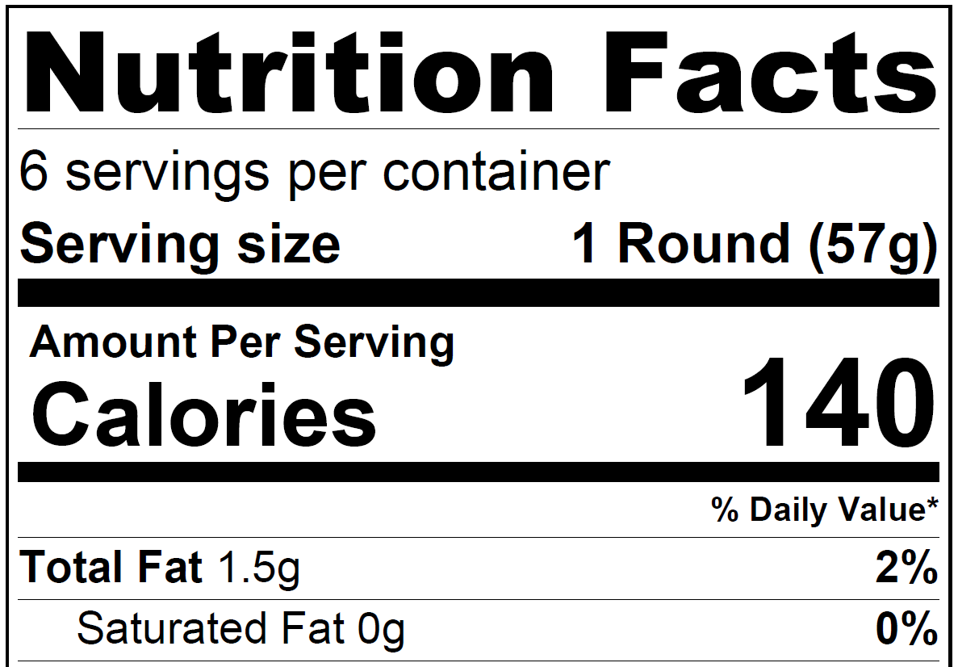
Brand P Pita Rounds
1 Serving =
57 Grams (g)
Speaker notes:
When we look at the Nutrition Facts Label, we will be looking at the information in the “Serving size” line.
This label for Brand P pita bread rounds shows us that one serving of Brand P pita rounds weighs 57 grams.
Notes:
When we look at the Nutrition Facts Label, we will be looking at the information in the “Serving size” line.
This label for Brand P pita bread rounds shows us that one serving of Brand P pita rounds weighs 57 grams.

Slide 36
Brand P Pita Rounds (2)
Brand P Pita Rounds
1 Serving =
57 Grams (g)
1 Serving =
1 Pita Round
1 Pita Round = 57 Grams
Speaker notes:
This label also shows us that there is one pita round in one serving.
Therefore, we know that one Brand P pita round weighs 57 grams.
Notes:
This label also shows us that there is one pita round in one serving.
Therefore, we know that one Brand P pita round weighs 57 grams.

Slide 37
Try It Out!
Does one Brand P pita round weigh the same or more than the pita bread listed in the Grains Measuring Chart?
?
Brand P Pita Rounds
Yes, one Brand P pita round weighs the same or more.
No, one Brand P pita does not weigh the same or more.
Speaker notes:
Now that we know that one pita round weighs 57 grams, we can compare the weight of one pita round to the weight listed next to the pita bread in the chart. Let’s do that now, as a practice question.
Look at the Grains Measuring Chart and find Pita Bread.
Now, look at the Nutrition Facts label for Brand P pita rounds on the screen. Does one Brand P pita round weigh the same, or more than, the pita bread listed in the Grains Measuring Chart?
Raise your hand if you think yes, one Brand P pita round weighs the same or more than the pita bread listed in the Grains Measuring Chart [pause and wait for a show of hands].
Raise your hand if you think no, one Brand P pita round does not weigh the same or more than the pita bread listed in the Grains Measuring Chart [pause and wait for a show of hands].
Notes:
Now that we know that one pita round weighs 57 grams, we can compare the weight of one pita round to the weight listed next to the pita bread in the chart. Let’s do that now, as a practice question.
Take a look at the Grains Measuring Chart and find Pita Bread.
Now, look at the Nutrition Facts label for Brand P pita rounds on the screen. Does one Brand P pita round weigh the same, or more than, the pita bread listed in the Grains Measuring Chart?
Raise your hand if you think yes, one Brand P pita round weighs the same or more than the pita bread listed in the Grains Measuring Chart [pause and wait for a show of hands].
Raise your hand if you think no, one Brand P pita round does not weigh the same or more than the pita bread listed in the Grains Measuring Chart [pause and wait for a show of hands].

Slide 38
Answer
Does one Brand P pita round weigh the same or more than the pita bread listed in the Grains Measuring Chart?
?
Brand P Pita Rounds
✓
Yes, one Brand P pita round weighs the same or more.
No, one Brand P pita does not weigh the same or more.
Speaker notes:
Nice work everyone! Yes, one Brand P pita round weighs the same or more than the pita bread listed in the chart.
Notes:
Nice work everyone! Yes, one Brand P pita round weighs the same or more than the pita bread listed in the chart.

Slide 39
Brand P Pita Rounds (3)
Brand P Pita Rounds
Pita Bread/Round (whole grain-rich or enriched) at least 56 grams*
Popcorn
Pretzel, Hard, Mini-Twist (about 1 ¼” by 1 ½”)**
Speaker notes:
We know the answer is yes because the weight by the pita bread in the chart is “at least 56 grams.” The Nutrition Facts label for Brand P pita rounds tells us that 1 pita round weighs 57 grams.
Because one Brand P pita round weighs more than the pita listed in the Grains Measuring Chart, we know we can use the chart to tell us how many Brand P pita rounds to serve in order to meet CACFP meal pattern requirements.
Notes:
We know the answer is yes because the weight by the pita bread in the chart is “at least 56 grams.” The Nutrition Facts label for Brand P pita rounds tells us that 1 pita round weighs 57 grams.
Because one Brand P pita round weighs more than the pita listed in the Grains Measuring Chart, we know we can use the chart to tell us how many Brand P pita rounds to serve in order to meet CACFP meal pattern requirements.

Slide 40
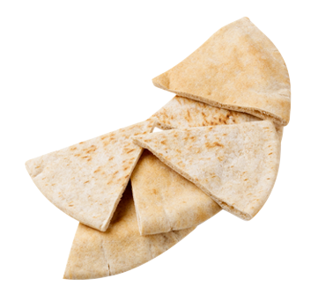
Find the column for the age of your participants and the meal or snack you are serving - continued
3
Find the column for the age of your participants and the meal or snack you are serving.
Grains Measuring Chart for the Child and Adult Care Food Program
Grain Item and Size | Age Group and Meal | Age Group and Meal | Age Group and Meal
Grain Item and Size | 1- through 5-year-olds at Breakfast, Lunch, Supper, Snack | 6- through 18-year-olds at Breakfast, Lunch, Supper, Snack Adults at Snack only | Adults at Breakfast, Lunch, Supper
Grain Item and Size | Serve at Least ½ oz. eq., which equals about… | Serve at Least 1 oz. eq., which equals about… | Serve at Least 2 oz. eq., which equals about…
Pasta (whole grain-rich or enriched, all shapes) | ¼ cup cooked or 14 grams dry | ½ cup cooked or 28 grams dry | 1 cup cooked or 56 grams dry
Pita Bread/Round (whole grain-rich or enriched) at least 56 grams* | ¼ pita or 14 grams | ½ pita or 28 grams | 1 pita or 56 grams
Popcorn | 1 ½ cups or 14 grams | 3 cups or 28 grams | 6 cups or 56 grams
Pretzel, Hard, Mini-Twist (about 1 ¼” by 1 ½”)** | 7 twists (~⅓ cup) or 11 grams | 14 twists (~⅔ cup) or 22 grams | 27 twists (~1 cup) or 44 grams
Step 1
Speaker notes:
Now that we’ve checked that Brand P pita rounds weigh the same or more than the pita bread listed in the Grains Measuring Chart, the last step is to find the column for the age of your participants and the meal or snack you are serving.
Notes:
Now that we’ve checked that Brand P pita rounds weigh the same or more than the pita bread listed in the Grains Measuring Chart, the last step is to find the column for the age of your participants and the meal or snack you are serving.

Slide 41
Try It Out!
You want to serve pita bread to 3-year-olds at lunch.
How many Brand P pita rounds do you need to serve to meet the minimum required amounts of grains in the CACFP?
?
Grains Measuring Chart for the Child and Adult Care Food Program
Grain Item and Size | Age Group and Meal | Age Group and Meal | Age Group and Meal
Grain Item and Size | 1- through 5-year-olds at Breakfast, Lunch, Supper, Snack | 6- through 18-year-olds at Breakfast, Lunch, Supper, Snack Adults at Snack only | Adults at Breakfast, Lunch, Supper
Grain Item and Size | Serve at Least ½ oz. eq., which equals about… | Serve at Least 1 oz. eq., which equals about… | Serve at Least 2 oz. eq., which equals about…
Pasta (whole grain-rich or enriched, all shapes) | ¼ cup cooked or 14 grams dry | ½ cup cooked or 28 grams dry | 1 cup cooked or 56 grams dry
Pita Bread/Round (whole grain-rich or enriched) at least 56 grams* | ¼ pita or 14 grams | ½ pita or 28 grams | 1 pita or 56 grams
Popcorn | 1 ½ cups or 14 grams | 3 cups or 28 grams | 6 cups or 56 grams
Pretzel, Hard, Mini-Twist (about 1 ¼” by 1 ½”)** | 7 twists (~⅓ cup) or 11 grams | 14 twists (~⅔ cup) or 22 grams | 27 twists (~1 cup) or 44 grams
¼ pita round
½ pita round
1 pita round
2 pita rounds
Speaker notes:
Look at the Grains Measuring Chart in your worksheet or on the screen. Let’s say you want to serve pita bread to 3-year-olds at lunch. How many Brand P pita rounds do you need to serve to meet the minimum required amount of grains at lunch in the CACFP?
Raise your hand if you think you need to serve at least:
One-fourth (¼) of a pita round [pause and wait for a show of hands];
One-half (½) of a pita round [pause and wait for a show of hands];
One (1) pita round [pause and wait for a show of hands]; or
Two (2) pita rounds [pause and wait for a show of hands].
Notes:
Look at the Grains Measuring Chart in your worksheet or on the screen. Let’s say you want to serve pita bread to 3-year-olds at lunch. How many Brand P pita rounds do you need to serve to meet the minimum required amount of grains at lunch in the CACFP?
Raise your hand if you think you need to serve at least:
One-fourth (¼) of a pita round [pause and wait for a show of hands];
One-half (½) of a pita round [pause and wait for a show of hands];
One (1) pita round [pause and wait for a show of hands]; or
Two (2) pita rounds [pause and wait for a show of hands].

Slide 42
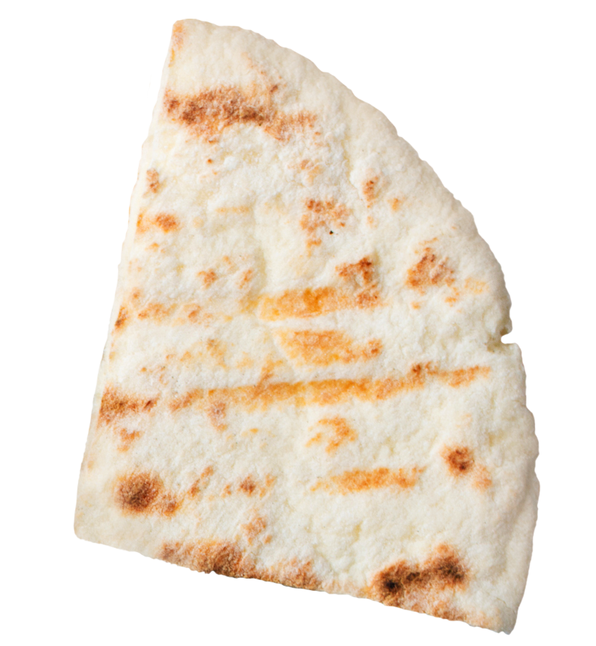
Answer
You want to serve pita bread to 3-year-olds at lunch.
How many Brand P pita rounds do you need to serve to meet the minimum required amounts of grains in the CACFP?
?
✓
¼ pita round
½ pita round
1 pita round
2 pita rounds
¼ pita round
Speaker notes:
Nice work everyone! We need to serve one-fourth of a Brand P pita round to meet the minimum amount required for grains for 3-year-olds at lunch in the CACFP.
Notes:
Nice work everyone! We need to serve one-fourth of a Brand P pita round to meet the minimum amount required for grains for 3-year-olds at lunch in the CACFP.

Slide 43
Use the Grains Measuring Chart to find the minimum grains required at CACFP meals and snacks
Grains Measuring Chart for the Child and Adult Care Food Program
Grain Item and Size | Age Group and Meal | Age Group and Meal | Age Group and Meal
Grain Item and Size | 1- through 5-year-olds at Breakfast, Lunch, Supper, Snack | 6- through 18-year-olds at Breakfast, Lunch, Supper, Snack Adults at Snack only | Adults at Breakfast, Lunch, Supper
Grain Item and Size | Serve at Least ½ oz. eq., which equals about… | Serve at Least 1 oz. eq., which equals about… | Serve at Least 2 oz. eq., which equals about…
Pasta (whole grain-rich or enriched, all shapes) | ¼ cup cooked or 14 grams dry | ½ cup cooked or 28 grams dry | 1 cup cooked or 56 grams dry
Pita Bread/Round (whole grain-rich or enriched) at least 56 grams* | ¼ pita or 14 grams | ½ pita or 28 grams | 1 pita or 56 grams
Popcorn | 1 ½ cups or 14 grams | 3 cups or 28 grams | 6 cups or 56 grams
Pretzel, Hard, Mini-Twist (about 1 ¼” by 1 ½”)** | 7 twists (~⅓ cup) or 11 grams | 14 twists (~⅔ cup) or 22 grams | 27 twists (~1 cup) or 44 grams
Speaker notes:
To get our answer, we found the food we want to serve, which was listed as “pita bread/round.”
Step 2 showed us that the pita bread had a weight of “at least 56 grams” next to it, so we made sure the pita bread we wanted to serve was the same weight, or heavier than, the weight listed in the chart. Because the pita bread we wanted to serve was heavier than the one listed in the Grains Measuring Chart, we knew we could use the Grains Measuring Chart to see how much of the pita bread we needed to meet the minimum amount of grains required at CACFP meals and snacks.
Our last step was to find the age of our participants and the meal. We are serving 3-year-olds at lunch, so we would choose the 1- through 5-year-olds column. We follow the 1- through 5-year-olds column down to the pita bread/round row.
If you look at where the 1- though 5-year-olds column meets the pita bread/round row, it tells us that we need to serve ¼, or a quarter, of the pita bread round to meet the minimum amount of grains required at snacks for this age group.
Notes:
To get our answer, we found the food we want to serve, which was listed as “pita bread/round.”
Step 2 showed us that the pita bread had a weight of “at least 56 grams” next to it, so we made sure the pita bread we wanted to serve was the same weight, or heavier than, the weight listed in the chart. Because the pita bread we wanted to serve was heavier than the one listed in the Grains Measuring Chart, we knew we could use the Grains Measuring Chart to see how much of the pita bread we needed to meet the minimum amount of grains required at CACFP meals and snacks.
Our last step was to find the age of our participants and the meal. We are serving 3-year-olds at lunch, so we would choose the 1- through 5-year-olds column. We follow the 1- through 5-year-olds column down to the pita bread/round row.
If you look at where the 1- though 5-year-olds column meets the pita bread/round row, it tells us that we need to serve ¼, or a quarter, of the pita bread round to meet the minimum amount of grains required at snacks for this age group.

Slide 44
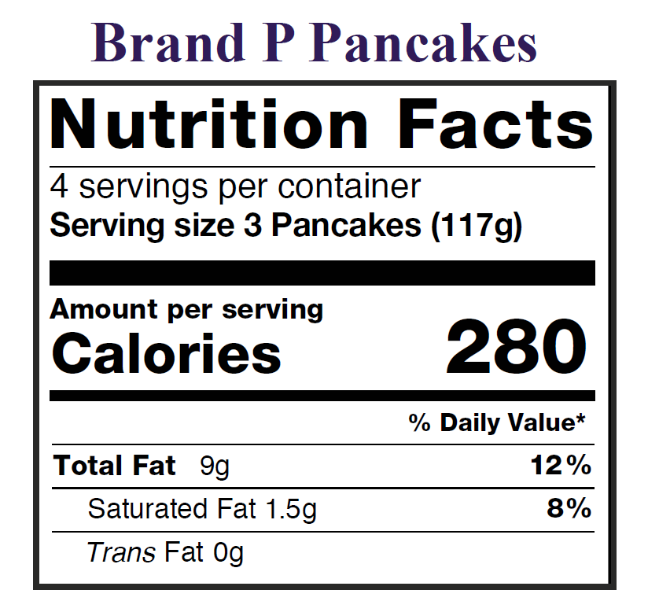
Brand P Pancakes
Speaker notes:
So, with the Brand P Pita Bread, we saw that 1 pita round was one serving, and that one pita round weighed 57 grams.
But sometimes, the Nutrition Facts label will list more than one item as a serving, such as "2 taco shells" or "3 pancakes.”
Page 5 of the worksheet looks at what to do when that happens, so let's look at page 5 now.
Notes:
So, with the Brand P Pita Bread, we saw that 1 pita round was one serving, and that one pita round weighed 57 grams.
But sometimes, the Nutrition Facts label will list more than one item as a serving, such as "2 taco shells" or "3 pancakes.”
Page 5 of the worksheet looks at what to do when that happens, so let's take a look at page 5 now.

Slide 45
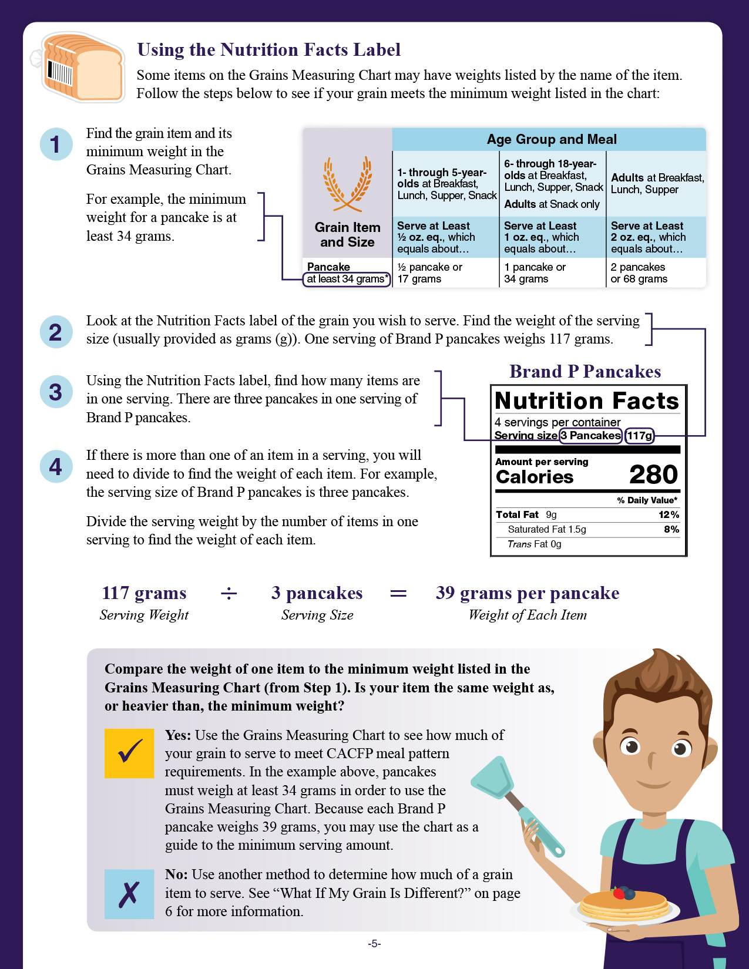
Using the Nutrition Facts Label
0
1
Find the grain item and its minimum weight in the Grains Measuring Chart.
For example, the minimum weight for a pancake is at least 34 grams.
Grain Item and Size | Age Group and Meal | Age Group and Meal | Age Group and Meal
Grain Item and Size | 1- through 5-year-olds at Breakfast, Lunch, Supper, Snack | 6- through 18-year-olds at Breakfast, Lunch, Supper, Snack Adults at Snack only | Adults at Breakfast, Lunch, Supper
Grain Item and Size | Serve at Least ½ oz. eq., which equals about… | Serve at Least 1 oz. eq., which equals about… | Serve at Least 2 oz. eq., which equals about…
Pancake at least 34 grams* | ½ pancake or 17 grams | 1 pancake or 34 grams | 2 pancakes or 68 grams
Speaker notes:
The first step on page 5 is the same as the first step on page 1: Find the grain item and its minimum weight in the Grains Measuring Chart.
Note that on page 5, the example we are using here is pancakes, so we look at the row that says “pancakes” and find the minimum weight of “at least 34 grams.”
Notes:
The first step on page 5 is the same as the first step on page 1: Find the grain item and its minimum weight in the Grains Measuring Chart.
Note that on page 5, the example we are using here is pancakes, so we look at the row that says “pancakes” and find the minimum weight of “at least 34 grams.”

Slide 46
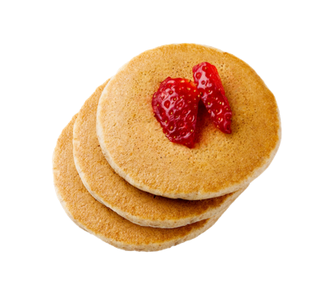
Using the Nutrition Facts Label (Continued)
2
Look at the Nutrition Facts label of the grain you wish to serve. Find the weight of the serving size (usually provided as grams (g)).
Brand P Pancakes
Weight of 1
1 Serving =
117 Grams (g)
Speaker notes:
The second step is the look at the weight of the serving size for the pancakes we want to serve. On Nutrition Facts labels, the weight listed is usually for one serving of the food. Looking at the label for Brand P pancakes, we see that 1 serving of Brand P pancakes weighs 117 grams.
Notes:
The second step is the look at the weight of the serving size for the pancakes we want to serve. On Nutrition Facts labels, the weight listed is usually for one serving of the food. Looking at the label for Brand P pancakes, we see that 1 serving of Brand P pancakes weighs 117 grams.

Slide 47
Use the Nutrition Facts label to find the serving size
3
Using the Nutrition Facts label, find how many items are in one serving.
Brand P Pancakes
Weight of 1
1 Serving =
117 Grams (g)
Number of Items
in 1 Serving =
3 Pancakes
Speaker notes:
Our next step is to look at how many items are in one serving. Looking at this Nutrition Facts label, we see that there are 3 pancakes in 1 serving of Brand P pancake.
Notes:
Our next step is to look at how many items are in one serving. Looking at this Nutrition Facts label, we see that there are 3 pancakes in 1 serving of Brand P pancakes.

Slide 48
How to find the weight of an item
4
If there is more than one of an item in a serving, you will need to divide to find the weight of each item.
Divide the serving weight by the number of items in one serving to find the weight of each item.
÷
=
117 grams
Serving Weight
3 pancakes
Serving Size
39 grams per pancake
Weight of Each Item
Speaker notes:
On page 4, Step 4 tells us that if we have more than one of an item in a serving, you will need to divide to find how much one item weighs.
Because 1 serving of Brand P pancakes has 3 pancakes, we know we will need to divide to find out the weight of one pancake.
We know from Step 3 that one serving weighs 117 grams. We also know that there are 3 pancakes in one serving, so we divide 117 by 3 to find the weight of one pancake. When we do, we find that one Brand P pancake weighs 39 grams.
Notes:
On page 4, Step 4 tells us that if we have more than one of an item in a serving, you will need to divide to find how much one item weighs.
Because 1 serving of Brand P pancakes has 3 pancakes, we know we will need to divide to find out the weight of one pancake.
We know from Step 3 that one serving weighs 117 grams. We also know that there are 3 pancakes in one serving, so we divide 117 by 3 to find the weight of one pancake. When we do, we find that one Brand P pancake weighs 39 grams.

Slide 49
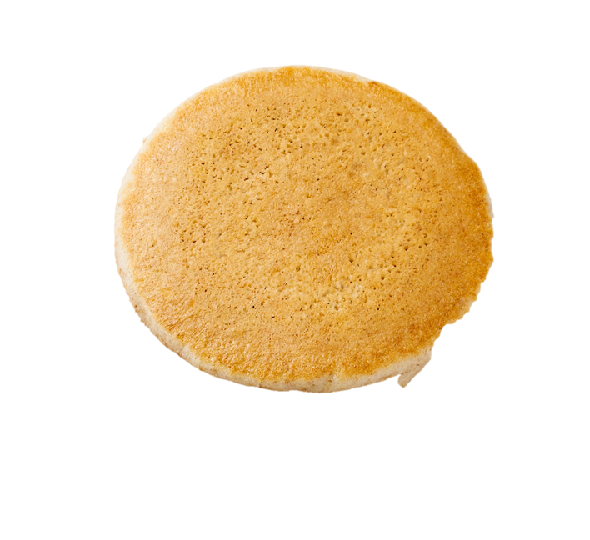
Compare the weight of one item to the minimum weight listed in the Grains Measuring Chart (from Step 1).
Grain Item and Size | 1- through 5-year-olds at Breakfast, Lunch, Supper, Snack
Grain Item and Size | Serve at Least ½ oz. eq., which equals about…
Pancake at least 34 grams* | ½ pancake or 17 grams
39 grams per pancake
Speaker notes:
Now that we know the weight of one pancake, we can compare that weight to the weight of the pancake listed in the Grains Measuring Chart.
Notes:
Now that we know the weight of one pancake, we can compare that weight to the weight of the pancake listed in the Grains Measuring Chart.

Slide 50
Try It Out!
Is one Brand P pancake the same weight or heavier than the weight of the pancake listed in the chart?
?
Grain Item and Size | 1- through 5-year-olds at Breakfast, Lunch, Supper, Snack
Grain Item and Size | Serve at Least ½ oz. eq., which equals about…
Pancake at least 34 grams* | ½ pancake or 17 grams
Yes, one Brand P pancake is the same weight or heavier.
No, one Brand P pancake is not the same weight or heavier.
39 grams per pancake
Speaker notes:
Ok everyone, one last practice question! Look at the Grains Measuring Chart in your worksheet, or on the screen in front of you. Is one Brand P pancake the same weight or heavier than the weight of the pancake listed in the Grains Measuring Chart?
Raise your hand if you think yes, one Brand P pancake is the same weight or heavier than the weight of the pancake listed in the Grains Measuring Chart [pause and wait for a show of hands].
Raise your hand if you think no, one Brand P pancake is not the same weight or heavier than the pancake listed in the Grains Measuring Chart [pause and wait for a show of hands].
Ok everyone, one last practice question! Look at the Grains Measuring Chart in your worksheet, or on the screen in front of you.
Is one Brand P pancake the same weight or heavier than the weight of the pancake listed in the Grains Measuring Chart?
Raise your hand if you think yes, one Brand P pancake is the same weight or heavier than the weight of the pancake listed in the Grains Measuring Chart [pause and wait for a show of hands].
Raise your hand if you think no, one Brand P pancake is not the same weight or heavier than the pancake listed in the Grains Measuring Chart [pause and wait for a show of hands].
Notes:
Ok everyone, one last practice question! Look at the Grains Measuring Chart in your worksheet, or on the screen in front of you.
Is one Brand P pancake the same weight or heavier than the weight of the pancake listed in the Grains Measuring Chart?
Raise your hand if you think yes, one Brand P pancake is the same weight or heavier than the weight of the pancake listed in the Grains Measuring Chart [pause and wait for a show of hands].
Raise your hand if you think no, one Brand P pancake is not the same weight or heavier than the pancake listed in the Grains Measuring Chart [pause and wait for a show of hands].

Slide 51
Answer
Is one Brand P pancake the same weight or heavier than the weight of the pancake listed in the chart?
?
Grain Item and Size | 1- through 5-year-olds at Breakfast, Lunch, Supper, Snack
Grain Item and Size | Serve at Least ½ oz. eq., which equals about…
Pancake at least 34 grams* | ½ pancake or 17 grams
✓
Yes, one Brand P pancake is the same weight or heavier.
No, one Brand P pancake is not the same weight or heavier.
39 grams per pancake
Speaker notes:
Nice work everyone! The answer is yes, one Brand P pancake is the same weight or heavier than the weight of the pancake listed in the chart.
We know this because one Brand P pancake weighs 39 grams. The Grains Measuring Chart lists pancakes with a minimum weight of 34 grams.
39 is bigger than 34, so we know that that one Brand P pancake is heavier than the minimum weight for pancakes listed in the chart.
Notes:
Nice work everyone! The answer is yes, one Brand P pancake is the same weight or heavier than the weight of the pancake listed in the chart.
We know this because one Brand P pancake weighs 39 grams. The Grains Measuring Chart lists pancakes with a minimum weight of 34 grams.
39 is bigger than 34, so we know that that one Brand P pancake is heavier than the minimum weight for pancakes listed in the chart.

Slide 52

Using the Nutrition Facts Label
Compare the weight of one item to the minimum weight listed in the Grains Measuring Chart (from Step 1). Is your item the same weight as, or heavier than, the minimum weight?
✓
Yes: Use the Grains Measuring Chart to see how much of your grain to serve to meet CACFP meal pattern requirements.
Speaker notes:
If the weight of the item you want to serve is the same weight, or heavier than, what’s listed in the Grains Measuring Chart, you can use the Grains Measuring Chart to see how much of that item you need to serve to meet CACFP meal pattern requirements.
Notes:
If the weight of the item you want to serve is the same weight, or heavier than, what’s listed in the Grains Measuring Chart, you can use the Grains Measuring Chart to see how much of that item you need to serve to meet CACFP meal pattern requirements.

Slide 53
Find the column for the age of your participants and the meal or snack you are serving.
Grain Item and Size | Age Group and Meal | Age Group and Meal | Age Group and Meal
Grain Item and Size | 1- through 5-year-olds at Breakfast, Lunch, Supper, Snack | 6- through 18-year-olds at Breakfast, Lunch, Supper, Snack Adults at Snack only | Adults at Breakfast, Lunch, Supper
Grain Item and Size | Serve at Least ½ oz. eq., which equals about… | Serve at Least 1 oz. eq., which equals about… | Serve at Least 2 oz. eq., which equals about…
Pancake at least 34 grams* | ½ pancake or 17 grams | 1 pancake or 34 grams | 2 pancakes or 68 grams
Speaker notes:
So now, we proceed the same way we did with all other examples. Let’s say you want to serve Brand P pancakes to adult participants at breakfast. You would find the Adults at Breakfast column, and then follow that column down to the pancake row.
If you look at where the adults at breakfast, lunch, and supper column meets the pancake row, it tells us that we need to serve 2 pancakes in order to meet the minimum amount of grains required at breakfast for adult participants.
Notes:
So now, we proceed the same way we did with all other examples. Let’s say you want to serve Brand P pancakes to adult participants at breakfast. You would find the Adults at Breakfast column, and then follow that column down to the pancake row.
If you look at where the adults at breakfast, lunch, and supper column meets the pancake row, it tells us that we need to serve 2 pancakes in order to meet the minimum amount of grains required at breakfast for adult participants.

Slide 54
Find the column for the age of your participants and the meal or snack you are serving-continued.
Find the column for the age of your participants
and the meal or snack you are serving.
Adults at Meals
Grain Item and Size | Age Group and Meal | Age Group and Meal | Age Group and Meal
Grain Item and Size | 1- through 5-year-olds at Breakfast, Lunch, Supper, Snack | 6- through 18-year-olds at Breakfast, Lunch, Supper, Snack Adults at Snack only | Adults at Breakfast, Lunch, Supper
Grain Item and Size | Serve at Least ½ oz. eq., which equals about… | Serve at Least 1 oz. eq., which equals about… | Serve at Least 2 oz. eq., which equals about…
Pancake at least 34 grams* | ½ pancake or 17 grams | 1 pancake or 34 grams | 2 pancakes or 68 grams
Adults at Snack
Speaker notes:
Very quickly, I just wanted to point out that Adults have different requirements for grain amounts at snack versus meals.
If you want to serve grains at snack to adult participants, you need to serve at least 1 oz eq of grains. So, you would look at the middle column of the chart.
If you want to serve grains at breakfast, lunch, or supper to adult participants, you need to serve at least 2-ounce equivalents of grains. So, you’d look at the column on the right side of the chart.
This is different from the other age groups, where the minimum amount of grains required is the same for meals as it is for snacks.
Notes:
Very quickly, I just wanted to point out that Adults have different requirements for grain amounts at snack versus meals.
If you want to serve grains at snack to adult participants, you need to serve at least 1 oz eq of grains. So, you would look at the middle column of the chart.
If you want to serve grains at breakfast, lunch, or supper to adult participants, you need to serve at least 2- ounce equivalents of grains. So, you’d look at the column on the right side of the chart.
This is different from the other age groups, where the minimum amount of grains required is the same for meals as it is for snacks.

Slide 55
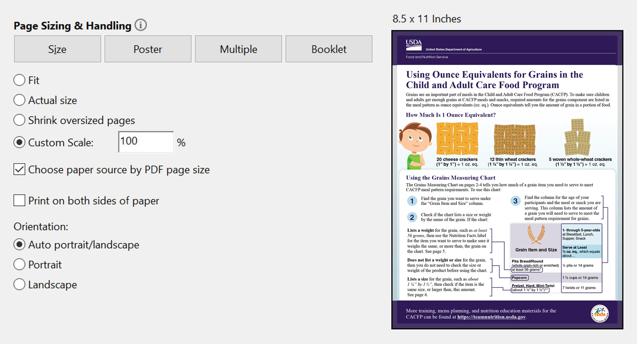
Printing the Worksheet
Speaker notes:
One more thing to note about this worksheet: if you need to print this worksheet, please make sure you print this worksheet at 100% on 8.5 inch by 11-inch paper so that the measuring guides are accurate. In other words, printing at 100% on 8.5 inch by 11-inch paper ensures that that the ruler on the bottom measures 8 inches, and that the squares and circles above the ruler are accurate as well.
Notes:
One more thing to note about this worksheet: if you need to print this worksheet, please make sure you print this worksheet at 100% on 8.5 inch by 11 -inch paper so that the measuring guides are accurate. In other words, printing at 100% on 8.5 inch by 11- inch paper ensures that that the ruler on the bottom actually measures 8 inches, and that the squares and circles above the ruler are accurate as well.

Slide 56
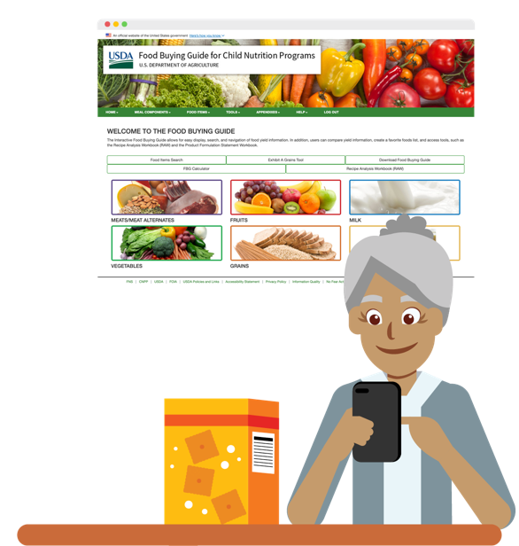
Un “Charted” Territory
Use a different tool if:
Your item is not listed or
Your item is smaller or lighter than what’s listed on the Grains Measuring Chart or
You don’t know the size of an item or
You are serving a grain item to meet
part of the grains requirement.
Speaker notes:
Finally, although there are many times you could use this worksheet, there are times that this worksheet may not be appropriate for determining grains ounce equivalents. In those cases, you will need to use another tool, which I will discuss on the next slide.
Times you might need to use another tool instead of this chart are:
when an item you want to serve is not listed on the chart,
when an item you want to serve is smaller or lighter than what’s listed in the chart, or
if you don’t know the size or dimensions of the grain you want to serve. So, let’s say you see a new type of cracker that’s on sale, and you want to serve it. But because you’ve never served it before, you don’t have one on hand that you can measure.
You may also want to use a different tool if you are serving a grain item to meet part of the grains requirement—such as if you wanted to serve ¼ oz eq, or ¾ oz eq or 1 ½ oz eq, because this chart only lists amounts for ½ oz eq, 1 oz eq , and 2 oz eq of grains.
Additionally, while you could use the chart with grain items that are larger or heavier than what’s listed on the charts, if you wanted to serve exactly what was required in the CACFP meal patterns, that might be another time that you’d choose to use a different tool.
Notes:
Finally, although there are many times you could use this worksheet, there are times that this worksheet may not be appropriate for determining grains ounce equivalents. In those cases, you will need to use another tool, which I will discuss on the next slide.
Times you might need to use another tool instead of this chart are:
when an item you want to serve is not listed on the chart,
when an item you want to serve is smaller or lighter than what’s listed in the chart, or
if you don’t know the size or dimensions of the grain you want to serve. So, let’s say you see a new type of cracker that’s on sale, and you want to serve it. But because you’ve never served it before, you don’t have one on hand that you can measure.
You may also want to use a different tool if you are serving a grain item to meet part of the grains requirement—such as if you wanted to serve ¼ oz eq, or ¾ oz eq or 1 ½ oz eq, because this chart only lists amounts for ½ oz eq, 1 oz eq , and 2 oz eq of grains.
Additionally, while you could use the chart with grain items that are larger or heavier than what’s listed on the charts, if you wanted to serve exactly what was required in the CACFP meal patterns, that might be another time that you’d choose to use a different tool.

Slide 57
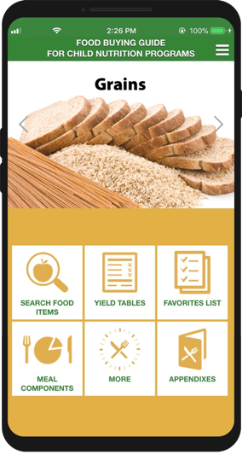
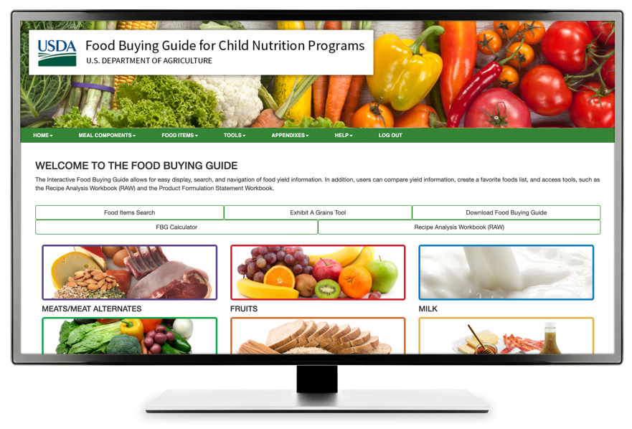
Team Nutrition’s Exhibit A Grains Tool
Speaker notes:
One tool you could use is Team Nutrition’s Exhibit A Grains Tool, which is part of the Food Buying Guide for Child Nutrition Programs. This tool is available from the web-based interactive version of the Food Buying Guide that you can access from your laptop or desktop computer and shown in the middle of the screen.
The Exhibit A Grains Tool is also available as part of the Food Buying Guide app that you can download from the Google Play or the Apple App store for your mobile devices.
Exhibit A Grains Tool
foodbuyingguide.fns.usda.gov
Notes:
One tool you could use is Team Nutrition’s Exhibit A Grains Tool, which is part of the Food Buying Guide for Child Nutrition Programs. This tool is available from the web-based interactive version of the Food Buying Guide that you can access from your laptop or desktop computer and shown in the middle of the screen.
The Exhibit A Grains Tool is also available as part of the Food Buying Guide app that you can download from the Google Play or the Apple App store for your mobile devices.

Slide 58
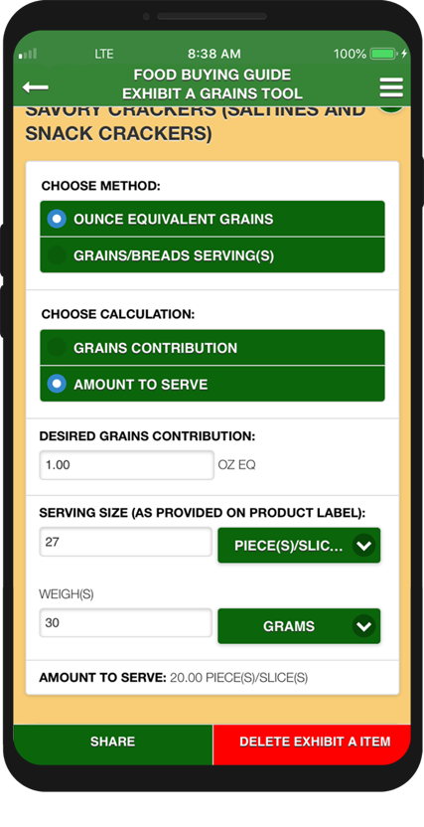
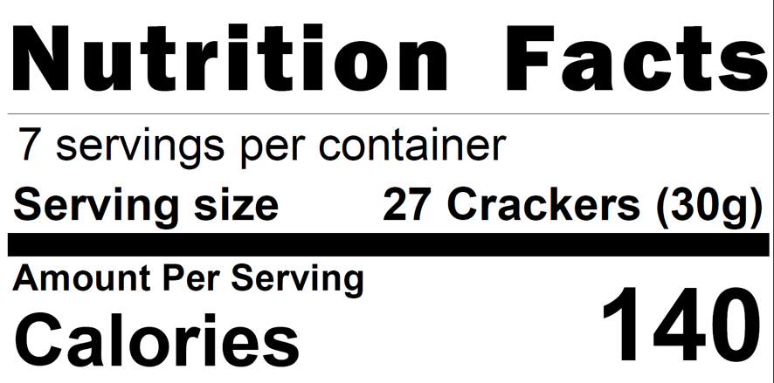
Exhibit A Grains Tool
Speaker notes:
The Exhibit A Grains Tool asks you to look at an item’s Nutrition Facts label and enter information about the serving size in order to calculate how much of a grain item to serve.
Notes:
The Exhibit A Grains Tool asks you to look at an item’s Nutrition Facts label and enter information about the serving size in order to calculate how much of a grain item to serve.

Slide 59

Exhibit A Grains Tool to the Rescue!
Webinar Recording Available at fns.usda.gov/tn/exhibit-grains-tool-rescue
Speaker notes:
The Food Buying Guide has training videos on how to use the Exhibit A Grains Tool. You can find it under the “Help” section of the Food Buying Guide.
Additionally, the “Exhibit A Grains Tool to the Rescue” webinar recording gives details on how to use this tool. This recording is available at the web address you see on the screen.
Notes:
The Food Buying Guide has training videos on how to use the Exhibit A Grains Tool. You can find it under the “Help” section of the Food Buying Guide.
Additionally, the “Exhibit A Grains Tool to the Rescue” webinar recording gives details on how to use this tool. This recording is available at the web address you see on the screen.

Slide 60
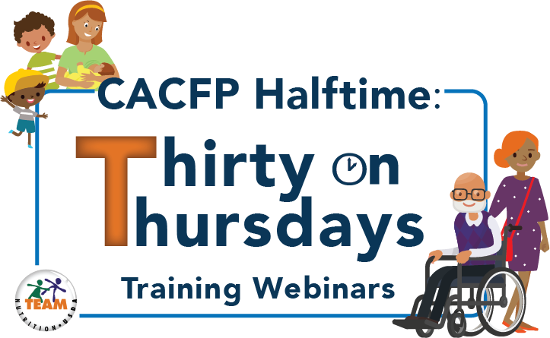
In-Grained: Easy Tools to
Determine Serving Amounts
fns.usda.gov/tn/halftime-cacfp-thirty-thursdays-training-webinar-series
Speaker notes:
Team Nutrition also has a 30-minute recorded webinar on how to use the “Using Ounce Equivalents for Grains in the CACFP” worksheet. The webinar is available in English and in Spanish. Today’s training slides are based off that webinar. You can find the webinar at the web address listed on the screen.
Notes:
Team Nutrition also has a 30-minute recorded webinar on how to use the “Using Ounce Equivalents for Grains in the CACFP” worksheet. The webinar is available in English and in Spanish. Today’s training slides are based on that webinar. You can find the webinar at the web address listed on the screen.

Slide 61
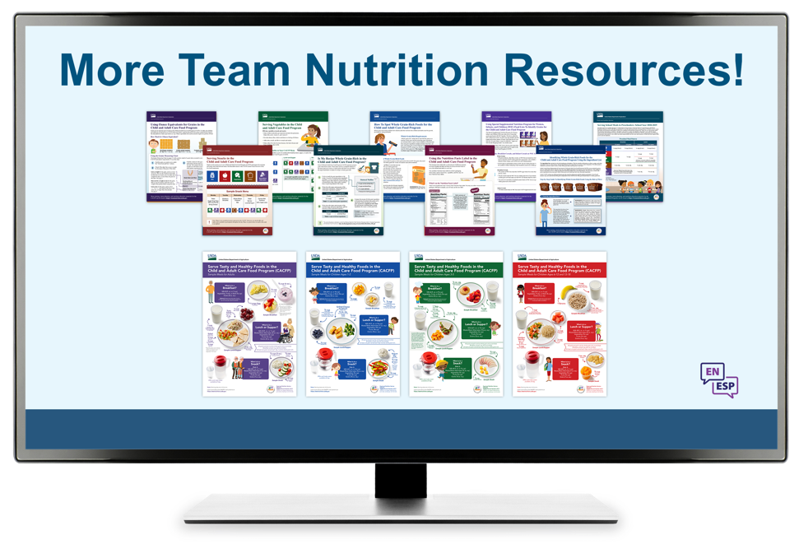
Team Nutrition Resources
Speaker notes:
All Team Nutrition materials are available online from Team Nutrition’s website and are available for free download to anybody who is interested.
TeamNutrition.usda.gov
Notes:
All Team Nutrition materials are available online from Team Nutrition’s website and are available for free download to anybody who is interested.

Slide 62
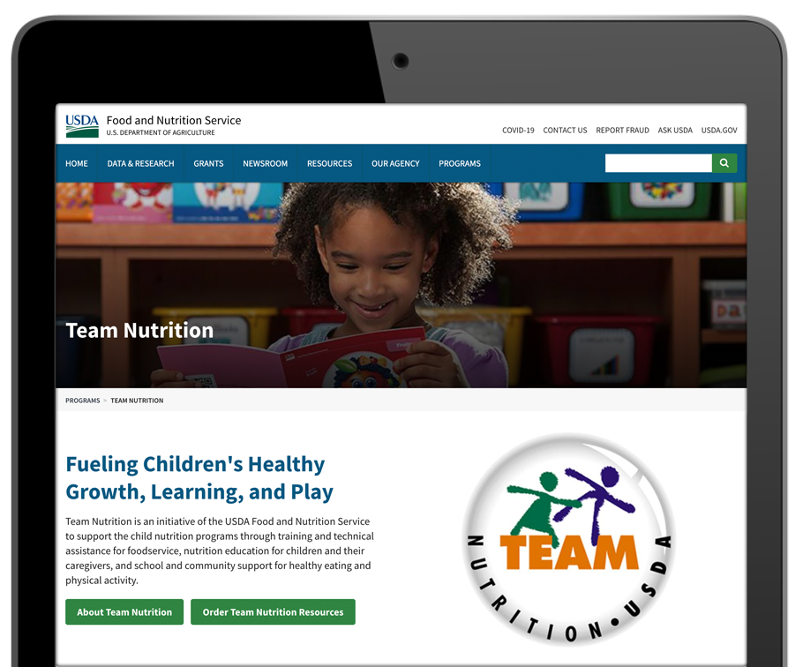

How To Order Print Copies
Resource Order Form at TeamNutrition.usda.gov.
FREE for USDA’s Child Nutrition Program Operators, while supplies last.
Sponsoring organizations and State agencies can also order in bulk by sending an email to:
TeamNutrition@usda.gov
Speaker notes:
For program operators in a Child Nutrition Program, such as the Child and Adult Care Food Program, Team Nutrition’s print materials are free to order.
If you would like to order Team Nutrition’s free materials in print, you can go to the “Resource Order Form” link on the Team Nutrition website to order print copies of the materials.
For bulk orders, you can email teamnutrition@usda.gov.
Notes:
For program operators in a Child Nutrition Program, such as the Child and Adult Care Food Program, Team Nutrition’s print materials are free to order.
If you would like to order Team Nutrition’s free materials in print, you can go to the “Resource Order Form” link on the Team Nutrition website to order print copies of the materials.
For bulk orders, you can email teamnutrition@usda.gov.

Slide 63



Thank you!
TeamNutrition.usda.gov
@TeamNutrition
TeamNutrition@usda.gov
Speaker notes:
These training slides were provided by U.S. Department of Agriculture's Team Nutrition. If you would like to learn more about Team Nutrition and additional resources available, please visit their website, subscribe to their e-newsletter, connect with them via email at teamnutrition@usda.gov, and follow them on Twitter.
Thank you!
USDA is an equal opportunity provider, employer, and lender.
Notes:
These training slides were provided by U.S. Department of Agriculture's Team Nutrition. If you would like to learn more about Team Nutrition and additional resources available, please visit their website, subscribe to their e-newsletter, connect with them via email at teamnutrition@usda.gov, and follow them on Twitter.
Thank you!

