Slide 1
Buy Smart, Save Smart
Take Home Training
Credit: 0.5 Hours
Codes: 2400, 2410, 2600
Notes:
Note to instructor: Welcome participants to this training session.

Slide 2



Objectives
  Review the Food Safety Modernization Act (FSMA) rules followed by reputable vendors.
  Describe the Buy American Provision procurement requirements and exceptions.
  Apply fresh produce cost saving measures in school meal operations.
Notes:
Note to instructor: Review the learning objectives with the participants.

Slide 3

Buy Smart
Notes:
Buying safe is an important consideration in your HACCP-based food safety plan. It is important to buy from a supplier who is reputable and handles food safely.

Slide 4
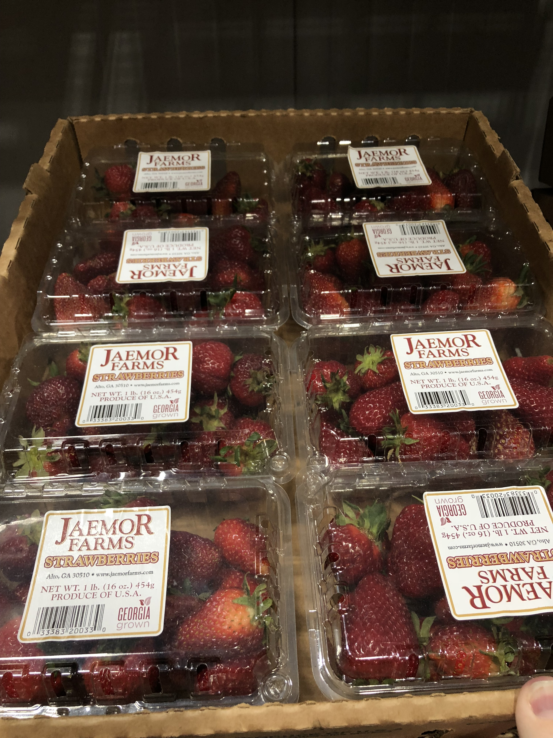
Vendor Options
Global and Local Sources
  Distributors
    Broad Line
    Produce Specific
Local and Regional Sources
  Produce Cooperatives
  Food Hubs
  Direct from the Farm
  School Gardens
Notes:
Today, schools have lots of options for purchasing fresh produce – both in terms of product form and source. Traditionally, raw produce has been purchased in a form where it is clean and minimally trimmed. Labor-saving, pre-cut produce has gained in popularity over the years. Precut produce is washed, then chopped, cut, sliced or diced, and packaged. Districts may be buying produce from one vendor, or a combination of vendors. You may not think of your school garden as a vendor because students and staff are involved in growing and harvesting the food. However, all the requirements for ensuring produce safety should be followed just like any other vendor. Let’s take a closer look at our vendor options.

Slide 5
Types of Vendors
Types of vendors supplying fresh fruits and vegetables to your school nutrition program:
  Broad Line Distributor
  Produce Distributor
  Produce Cooperative
  Food Hub
  Direct from the Farm
  Farmer’s Market
  School Garden
Notes:
Broadline distributors carry multiple products – from fresh apples to canned peaches. These distributors and those that specialize in fresh produce are a “one stop shop” for variety and year round availability because they are buying what is on the market around the country and around the globe. Just about every product is in season somewhere.

Slide 6
Buying Local Produce from a Distributor
Indicate your interest in buying local produce in the solicitation.
  Use geographic preference, note local purchasing goals in the introduction, or use specifications.
Distributors may supply local produce without asking because local products in season are often available at lower prices.
Distributors may buy from food hubs/cooperatives.
  Make sure backhauling procedures incorporate measures to prevent cross-contamination.
6
Notes:
The buyer has the responsibility to ensure that food is purchased from a safe, reputable source. To offer the safest product to their customers, both types of distributors may require farms that sell produce to them to provide verification that they follow food safety practices, such as, Good Agricultural Practices (GAPs) and/or Good Handling Practices (GHPs) by requiring annual food safety audits.

Slide 7
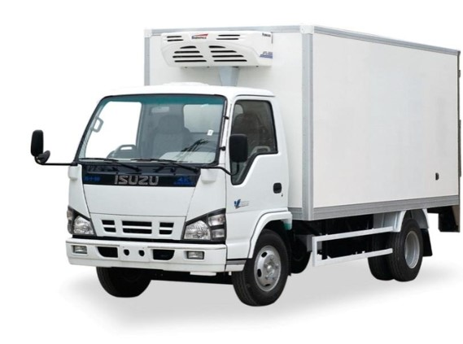
Food Safety Practices
Produce Distributors (including cooperatives and food hubs)
Must adhere to FSMA rules including:
    Current Good Manufacturing Practices (cGMP)
    Food Traceability
    Intentional Adulteration (Food Defense)
    Sanitary Transportation
Notes:
The Food Safety Modernization Act for fresh produce, also known as the Produce Safety Rule, is now final. Safety criteria for farms are defined and provide preventive controls for growing, harvesting, and transporting product. Some exemptions do apply for small farm operations, so it is important to ask your vendor about their food safety assurance requirements. Distributors may purchase from GAPs audited farms; farms with food safety plans, but no GAPs audit; farms that do not have food safety plans, or a combination. If GAPs documentation is important to you, ask for produce only from those farms by including food safety language, such as: “verification of GAP audit”, in your bid documents. Distributors want to meet their customers’ food safety requirements.
Link to FSMA - https://www.fda.gov/food/food-safety-modernization-act-fsma/fsma-final-rule-preventive-controls-human-food

Slide 8
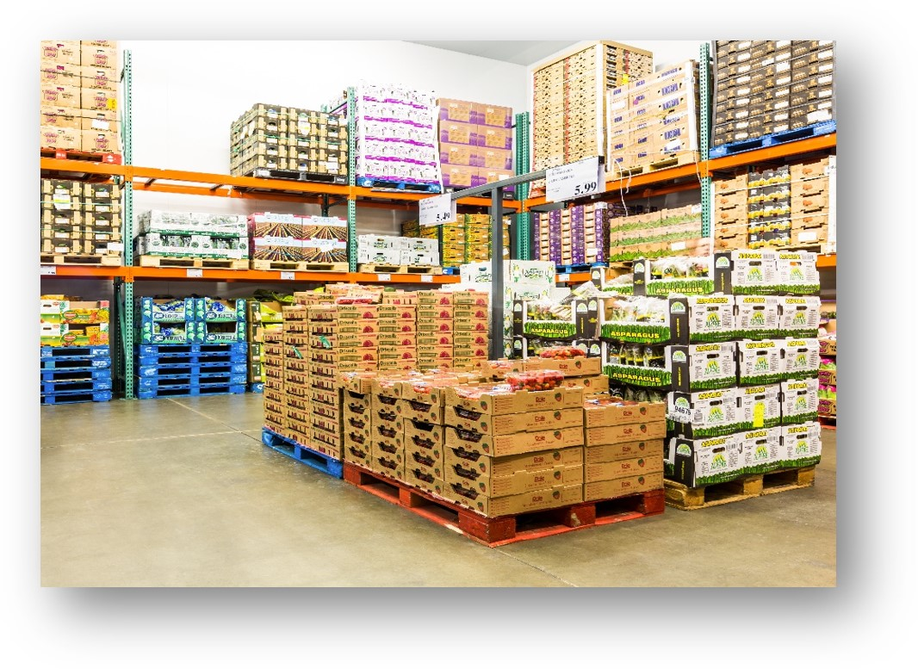
Food Safety Practices- cGMPs
Current Good Manufacturing Practices (cGMP)
  Written food safety plan includes:
    Identified hazards with preventive controls
    Monitoring and corrective actions
    Verification procedures
    Supply chain program
    Product recall system
Notes:
To maintain food safety while the product is in their custody, suppliers also follow a food safety plan for handling produce in their warehouse and distributing it to customers. The plan includes personal hygiene practices, avoiding time and temperature abuse, product traceability and preventing cross contamination. School nutrition buyers should ask all produce distributors about food safety practices and require documentation of both the supplier’s food safety practices and any Good Agricultural Practices (GAPs) documentation from their suppliers or growers.
https://www.fda.gov/food/food-safety-modernization-act-fsma/fsma-final-rule-preventive-controls-human-food

Slide 9
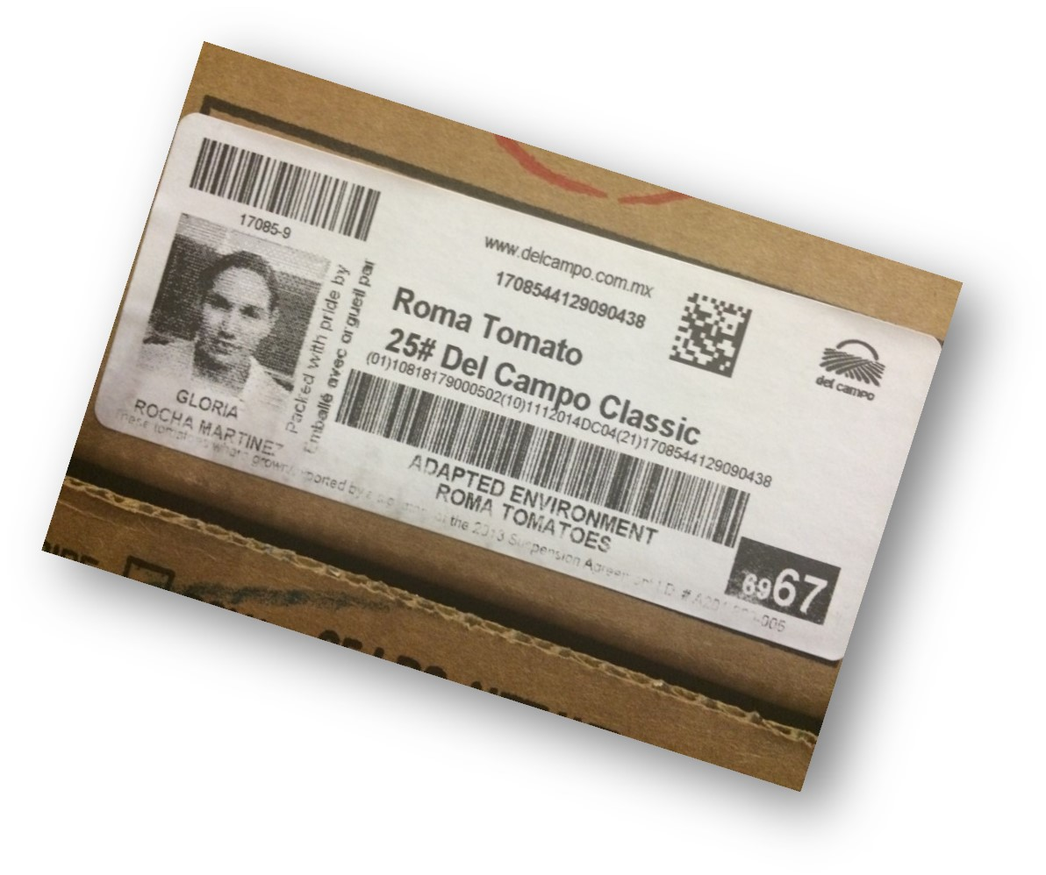
Food Safety Practices- Traceability
Food Traceability (New)
  Food Traceability List (FTL)
    Includes cucumbers, fresh herbs, leafy greens, melons, peppers, sprouts,
    tomatoes, tropical tree fruits, and all
    precut fruit and vegetables
  Create product traceability lot code
  Provide electronic, sortable spreadsheet upon FDA request
Notes:
Do you only get your produce from one source? Probably not! Today, many school districts have multiple sources for produce. Every participant at every step in the food chain from farm to fork should be able to trace the product one step back and one step forward, even school gardens.
Schools should maintain purchasing records for all produce vendors. When multiple vendors are used, such as a distributor, local farm, and school garden, you should make every effort not to co-mingle produce in storage. For example, do not put the leftover apples from your local farm in the same box as 30 apples leftover from the distributor, even if you are trying to save space in the refrigerator. Central kitchens should also have a system of tracing product distributed within the school district, so products served at different locations may be tracked.
https://www.fda.gov/food/food-safety-modernization-act-fsma/fsma-proposed-rule-food-traceability

Slide 10
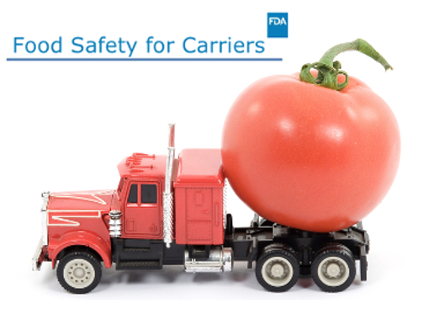
Food Safety Practices- Transportation
Sanitary Transportation Rule
  Proper refrigeration
  Cleaning between loads
  Prevent cross contamination and allergen cross contact
Notes:
School district purchasing agents, and/or school nutrition program directors and managers should be aware of the sanitary transportation rule, which outlines refrigeration standards, cleaning practices, and methods to avoid cross-contamination and allergen cross contact.
School district purchasing agents, and/or school nutrition program directors and managers, may wish to plan a site visit to observe and discuss farm food safety practices, including transportation. It will be helpful to discuss your expectations for transport vehicles, delivery times, packaging materials, and handling of product returns.
https://www.fda.gov/food/food-safety-modernization-act-fsma/fsma-final-rule-mitigation-strategies-protect-food-against-intentional-adulteration

Slide 11
Buyer Recommendations
A smart buyer will:
  Require a letter of food safety assurances or guarantee from all food vendors.
    Submit letters with bid documents
    Request applicable food safety certification documentation
  Visit your supplier to observe food safety practices.
  Determine food product liability insurance requirements and documentation.

Slide 12
Buyer Recommendations, Cont.
A smart buyer will:
  Request Good Agricultural Practices or food safety documentation.
    May require third-party GAP certification
    May require signed checklist
  Make farm visits to review Good Agricultural Practices or food safety documentation.
  Determine food product liability insurance requirements and documentation.

Slide 13
Liability Insurance
Types of insurance
  Food product liability
  General farm liability
  Commercial business liability
  Automobile
Understand exclusions
Bodily injury does not include transmission of bacteria, viruses, parasites, or other foodborne hazards
Notes:
Buyers, distributors, and producers should understand the difference between food product liability and general farm liability insurance coverage. Product liability covers risks associated with the sale of products away from the farm. In the event of a foodborne illness complaint, the food product liability insurance would cover customer claims should there be legal action.
General farm insurance provides coverage only for on-farm activities in case a worker or visitor on the farm is injured or other farm related events. Farmers may think their general farm liability protects them against lawsuit claims from foodborne illness cases, but it does not.
Most distributors carry food product liability insurance in addition to other coverage. When purchasing local foods, document the farmer’s necessary liability insurance required by your district’s procurement plan. You may need to talk to your school district’s attorney to find out the district requirements. Lower coverage requirements for local procurement may be an option to reduce the financial burden to small farm operations.

Slide 14
Buy American Provision
Notes:
The Buy American Provision is something school nutrition staff need to be aware of, which supports the mission of the child nutrition programs: to serve children nutritious meals and support American agriculture.

Slide 15

Buy American
Provision requires nutrition operators to:
  Purchase to the maximum extent practicable, domestic commodity or product that is processed domestically using 51% U.S. grown foods by weight or volume.
Notes:
The Buy American provision is outlined in a provision added to the National School Lunch Act, requiring school food authorities (SFAs) to purchase, to the maximum extent practicable, domestic commodities or products.
The National School Lunch Act defines “domestic commodity or product” as an agricultural commodity that is produced in the U.S. and a food product that is processed in the U.S. substantially using agricultural commodities produced in the U.S.
Report language accompanying the legislation noted that “substantially means over 51% from American products.” Therefore, over 51% of the final processed product (by weight or volume) must consist of agricultural commodities that were grown domestically.
Thus, for foods that are unprocessed, agricultural commodities must be domestic, and for foods that are processed, they must be processed domestically using domestic agricultural food components that are comprised of over 51% domestically grown items, by weight or volume as determined by the SFA.

Slide 16
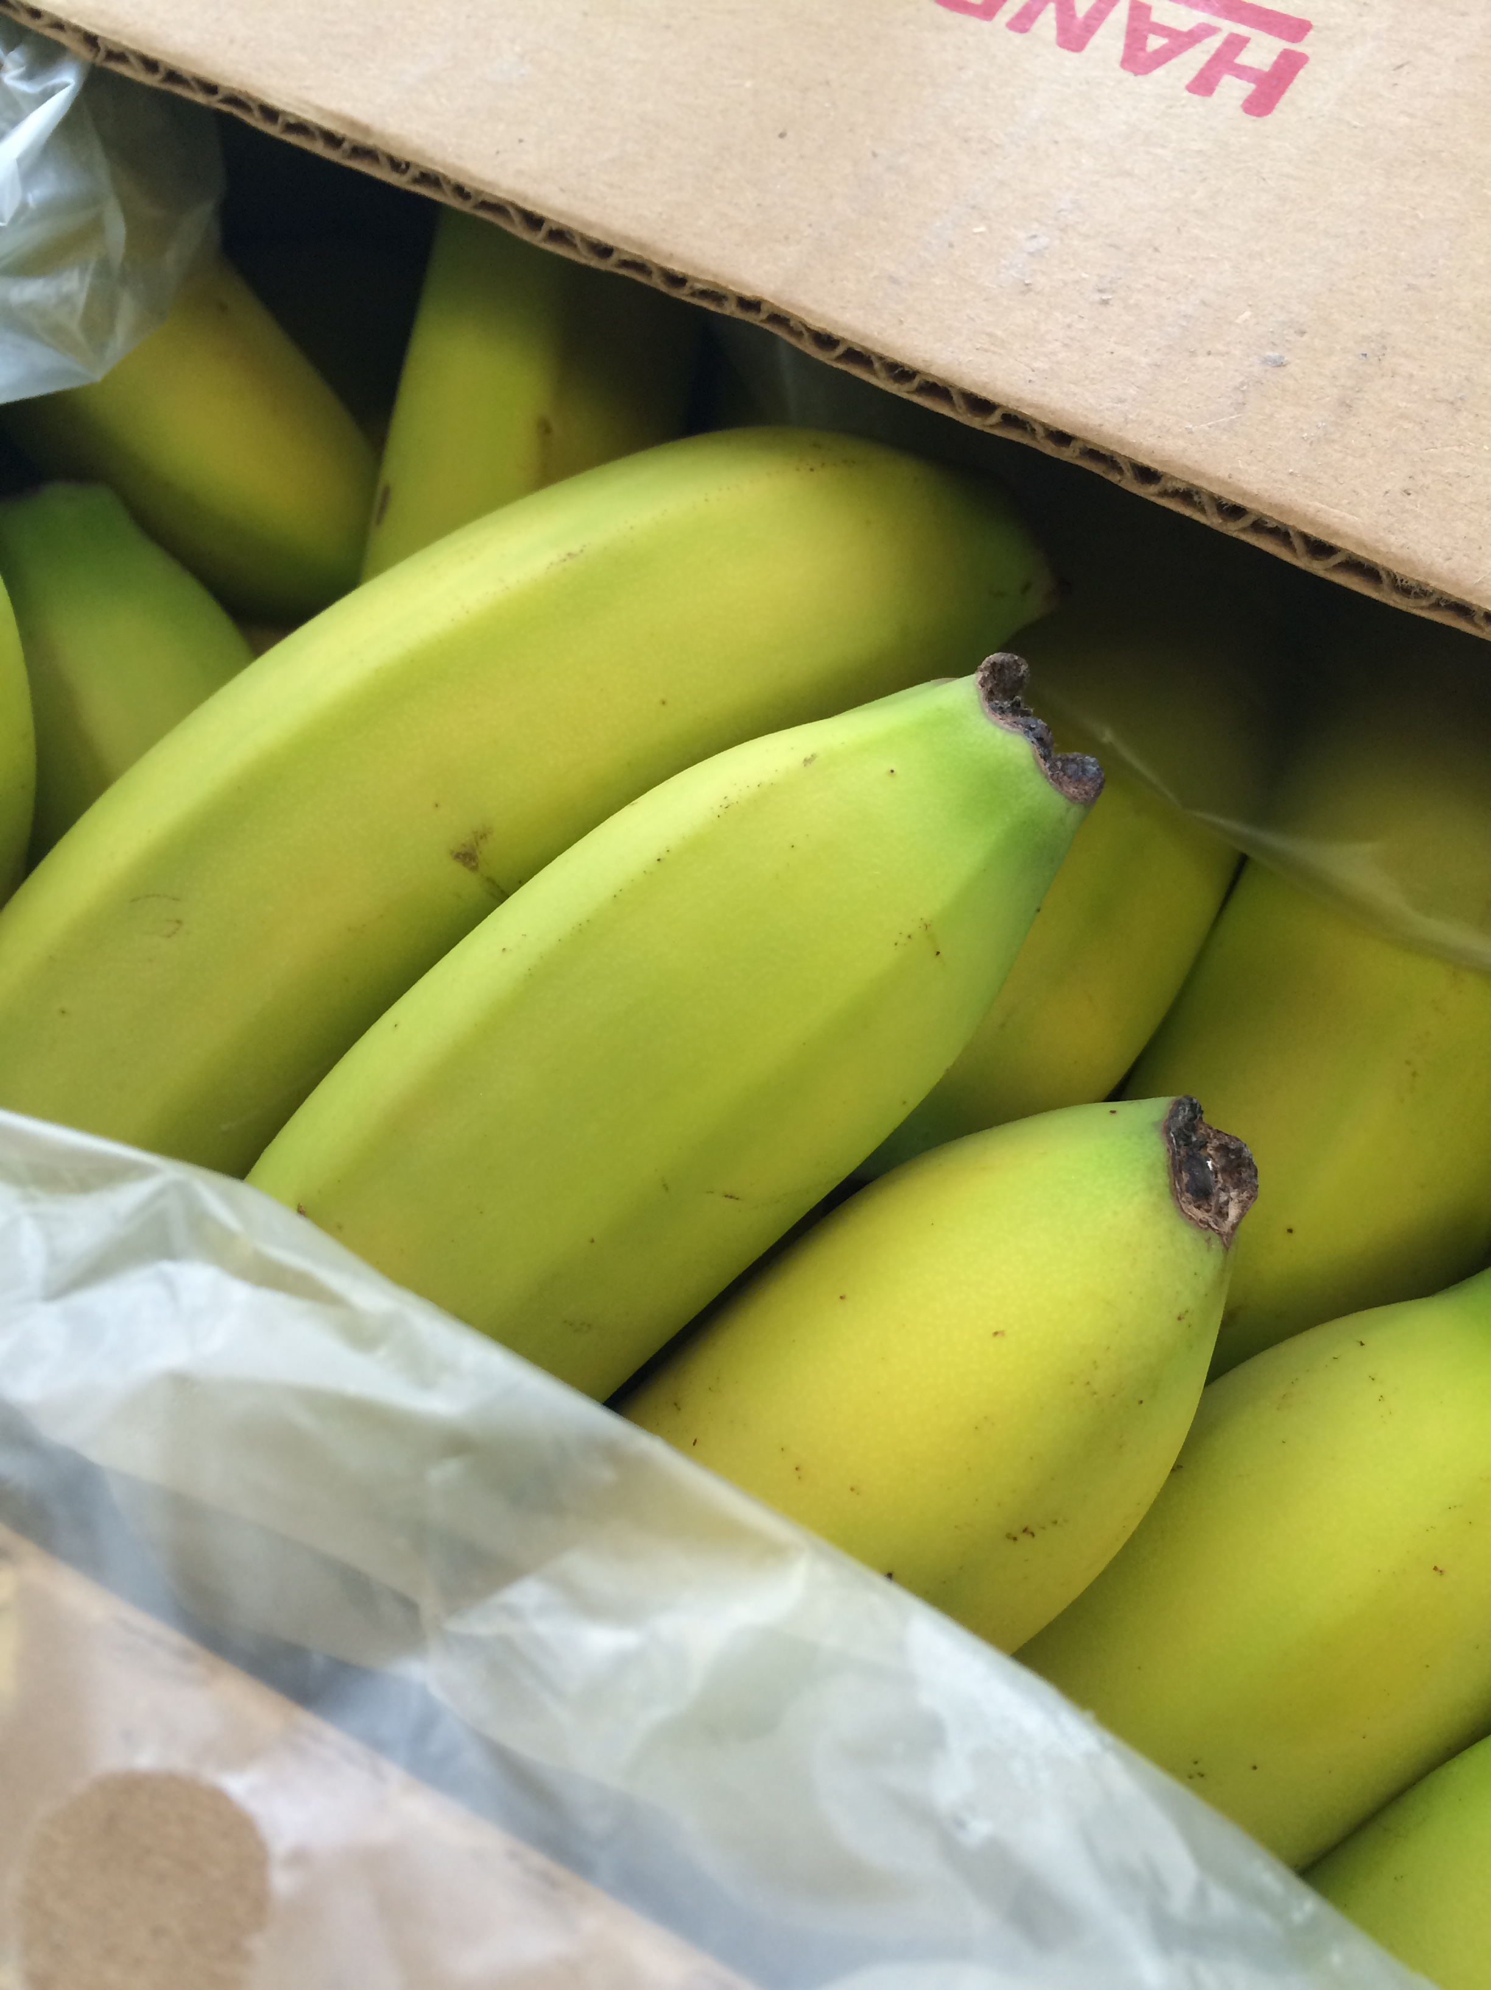
Buy American Exceptions
Provision exceptions:
  Domestic product is determined to be cost prohibitive.
  Product is not domestically grown in sufficient quantities & in satisfactory quality.
Notes:
The Buy American provision applies to SFAs located in the 48 contiguous United States and is one of the procurement standards these SFAs must comply with when purchasing commercial food products served in the school meals programs.
The exceptions to the Buy American Provision include commodities where the domestic product is cost prohibitive, or isn’t grown domestically, or in sufficient quantities, or of satisfactory quality.

Slide 17
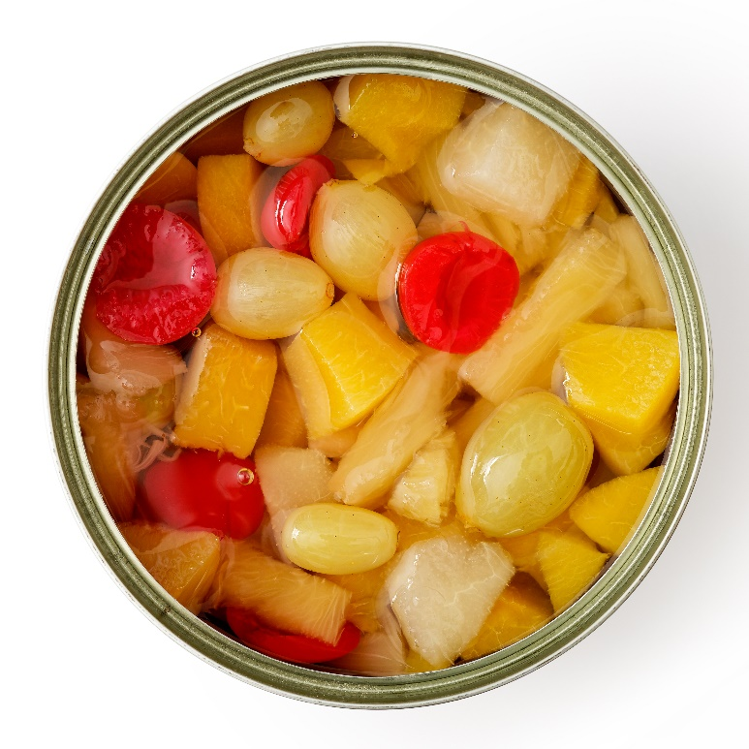
Buy American – Would you buy it?
Canned Fruit
Processed and Packed in the U.S.
California Style
USDA Approved
Buy American provision
Notes:
Note to instructor: ask your participants if they’d buy the product shown.
Answer: It’s unclear where the fruit was produced. Although the product was processed and packed in the U.S., 51% or more of the product must have been grown domestically, unless it meets the exceptions to the Buy American Provision.

Slide 18
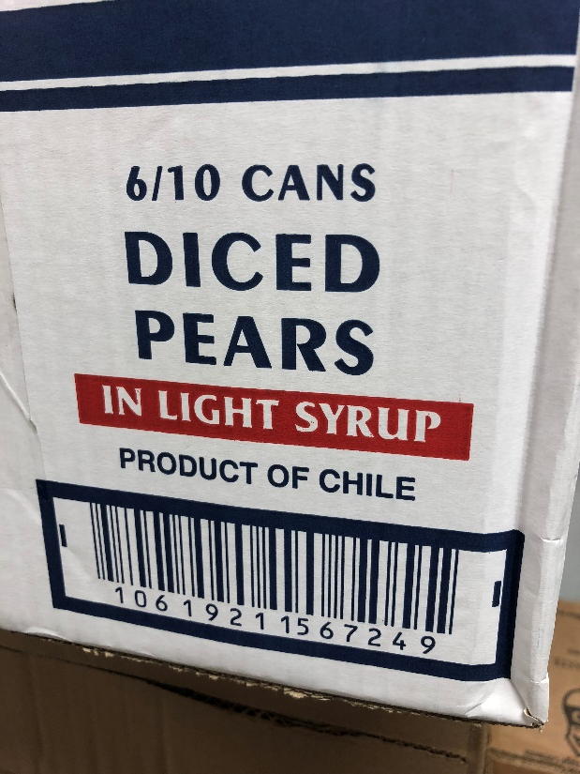
Buy American – Would you buy this?
Canned Fruit
100% Imported fruit & juice
Buy American provision
Notes:
Note to instructor: ask your participants if they’d buy the product shown.
Answer: Probably not, it depends on whether the fruit is grown domestically or not. If the fruit isn’t grown in the U.S., then you are able to buy canned fruit under the Buy American Provision exceptions.

Slide 19
Buy American – Would you buy it, now?
Canned Fruit
100% Imported fruit & juice
$32.00 per case
Note: 100% USA fruit & juice
$34.00 per case
Buy American provision
Notes:
Note to instructor: ask your participants if they’d buy the product shown.
Answer: The cost of the domestic fruit is not so high as to be cost prohibitive, you must buy the 100% USA fruit & juice under the Buy American Provision.
But what else could you do? Substitute menu item, ask if you are soliciting bids for this product at the best time of year! Maybe later or earlier in season price and availability would change.

Slide 20
Buy American – and now?
Canned Fruit
100% Imported fruit & juice
$32.00 per case
Note: 100% USA fruit & juice
$49.00 per case
Buy American provision
Notes:
Note to instructor: ask your participants if they’d buy the product shown.
Answer: It’s possible that $49 per case is cost prohibitive in your operations- in this case, you could purchase the imported fruit & juice under the Buy American Provision.

Slide 21
Buy American – What about this?
Juice
51% Water,
49% Imported juice concentrate
Buy American provision
Notes:
Note to instructor: ask your participants if they’d buy the product shown.
Answer:

Slide 22
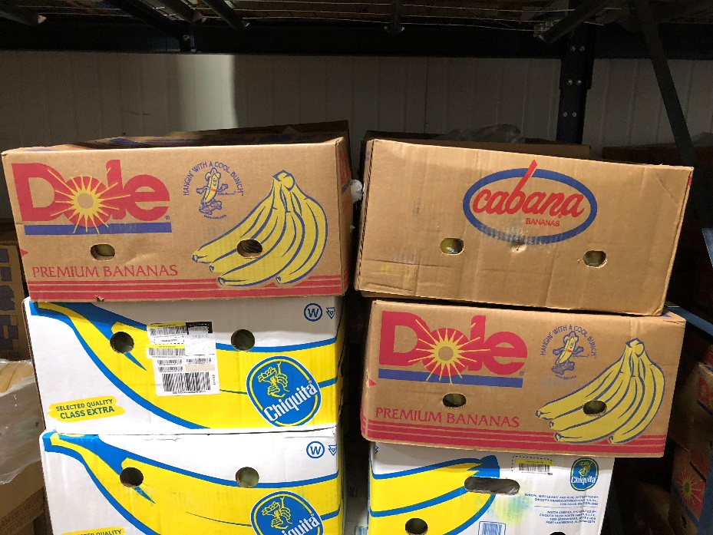
Buy American – How about this?
Fresh Fruit
Imported bananas
Buy American provision
Notes:
Note to instructor: ask your participants if they’d buy the product shown.
Answer: yes, because bananas aren’t grown in sufficient quantity domestically, making them an exception to the Buy American Provision.

Slide 23
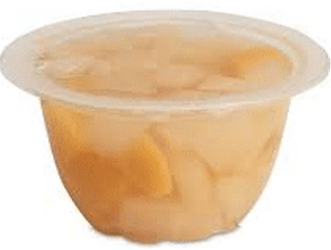
Buy American – And this?
Mixed Fruit Cups
Water – 28.3%
USA peaches – 23.05%
USA pears – 28.8%
Imported pear juice – 14%
Buy American provision
Notes:
Note to instructor: ask your participants if they’d buy the product shown.
Answer: yes, the USA peaches and pears account for 51.85% of the final product, which is more than 51% and meets the Buy American Provision.

Slide 24
Save Smart
Notes:
Understanding the Buy American requirements, as well as other smart buying practices will provide benefits to your operations, like cost savings and waste reduction.

Slide 25
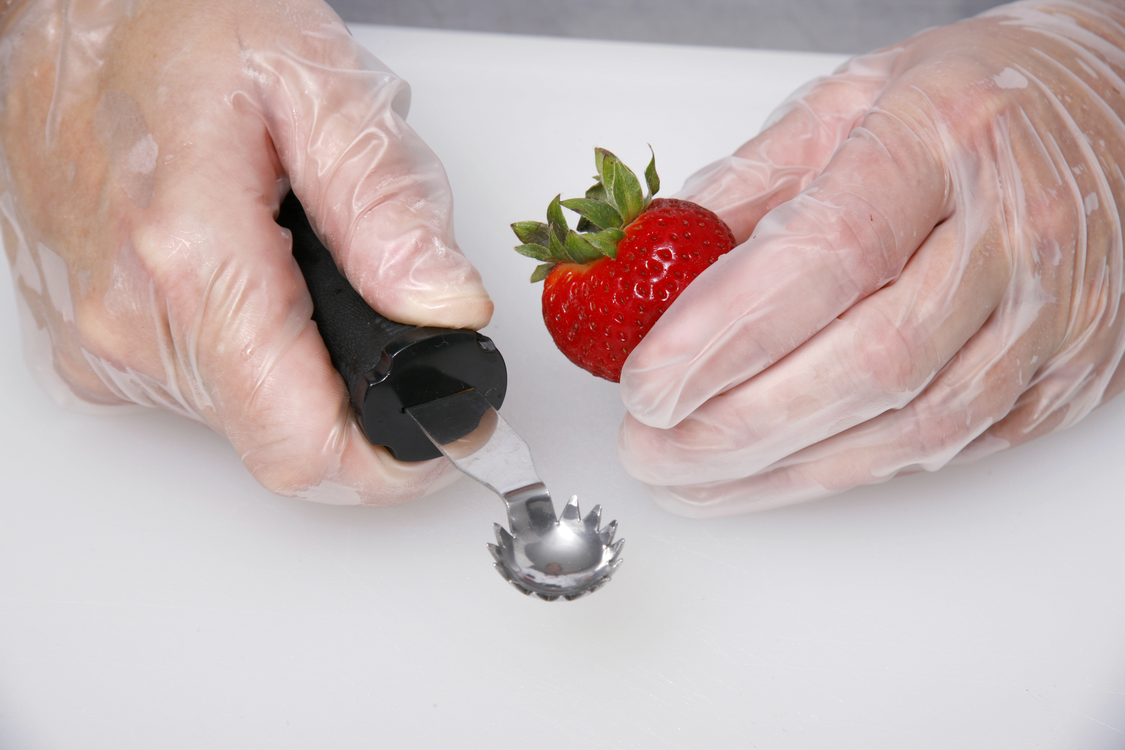
Save Smart
Maximize product shelf life or yield through:
  Conducting product receiving inspections.
  Utilizing the correct tool/equipment.
  Applying the recommended culinary techniques or cooking method.
Notes:
Maximizing shelf life is an important way that you can save costs and reduce waste. Some tips to do this include:
Check your products when receiving them to make sure they meet your specifications, including quality and condition defects.
Use the right tool for the job. Making sure that you’re using the right tool may help maximize yield- reducing unnecessary product waste and ensuring that usable product isn’t discarded or overlooked.
Use the proper culinary techniques and cooking methods. Like the right tool, this can help minimize waste and maximize yield.

Slide 26
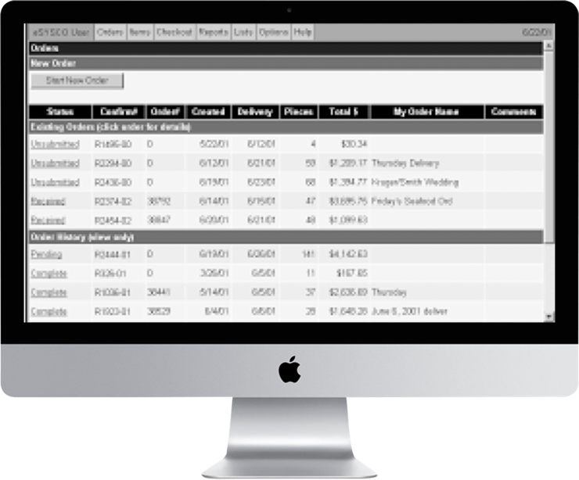
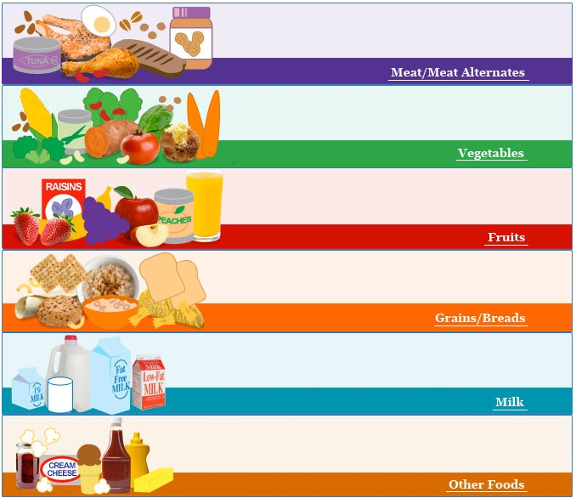
As Purchased to Edible Portion
As Purchased to Edible Portion – Know the Yield!
  USDA Food Buying Guide
    Cantaloupe, peeled and diced (.56/lb)
    Cucumber, diced (.98/lb)
    Romaine, diced (.65/lb)
    Watermelon, peeled and diced (.61/lb)
Notes:
But how do we know what the yield is? For starters, you can look in the Food Buying Guide.
As an example, you should get a minimum of 65% or .65 edible portion out of a head of romaine. That leaves an expected loss of about 35%. I can’t tell you how much money everyday is lost on the cutting room floor in school kitchens, because the school chef doesn’t know the standard, and no one has taught them how to calculate as purchased to edible portion. They simply use more product and the director wonders why their food cost is out of control. Well fear no longer, because in a minute, we are about to calculate together.

Slide 27
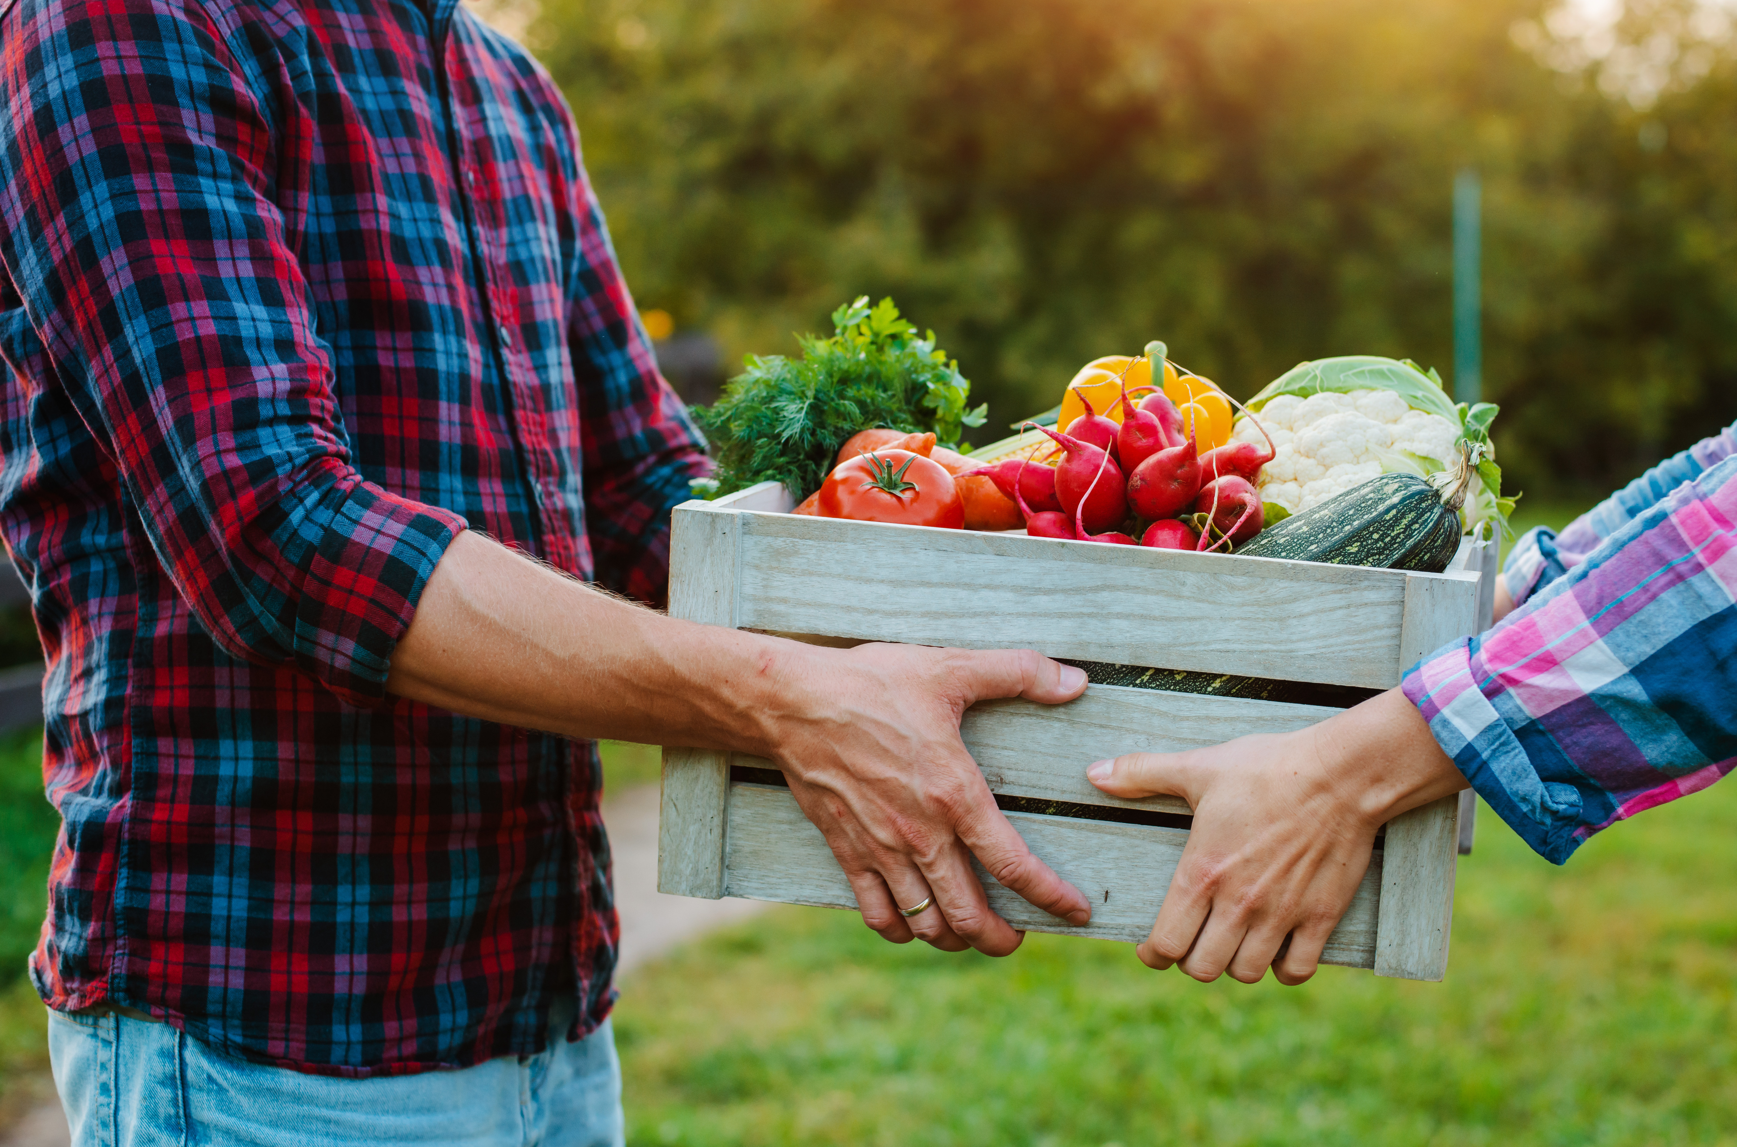
Conclusion
The buying smart, and in accordance with the Buy American provision, may help school nutrition operations keep students safe.
Notes:
Ensuring you buy from safe and reputable vendors is important to minimize food safety risks in your operations. It’s also important to understand and comply with the Buy American Provision as a school nutrition professional, and buying smart can help minimize waste and promote cost savings in your operations.

