Slide 1
Food Safety Overview
Take Home Training
Credit: 0.25
Hours Codes: 2620
Notes:
Note to instructor: Welcome participants to this training session.

Slide 2

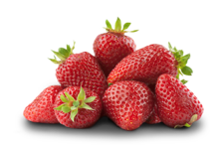

Objectives
  Provide a brief overview of the food safety system in the United States.
  Understand the food safety hazards associated with fresh produce.
  Identify which foodborne illnesses are typically associated with produce.
Notes:
Note to instructor: Review the learning objectives with the participants.

Slide 3
The Fundamentals
What is Food Safety?
Conditions and practices that prevent unintentional contamination of food
Unintentional contamination may result from food safety hazards
A food safety hazard is a biological, chemical, or physical property that may cause a food to be unsafe for human consumption
Notes:
Food Safety refers to conditions or practices that prevent the unintentional contamination of food, which may result in foodborne illness. Unintentional contamination may be the result of a specific food safety hazard. Food safety hazards are broadly classified as biological, chemical, or physical properties that may cause a food to be unsafe for human consumption.

Slide 4

The Why Behind Food Safety
Video from the California Leafy Greens Marketing Agreement (LGMA)
https://www.youtube.com/watch?v=VN56_ZEavaA&t=26s
Notes:
Here is a video from the California Leafy Greens Marketing Agreement (LGMA) that highlights the why behind food safety.
This video provides a ten-year update on 2 E-coli infection survivors who met with farmers in California and shared their stories about the impact that eating contaminated spinach had on their lives. This meeting led to changes in food safety training in the industry that continue today. It features Lauren (Bush),Rylee (Gustafson), and California leafy greens farmer Dan (Sutton).
Sources and additional info below
https://www.youtube.com/watch?v=VN56_ZEavaA&t=26s

Slide 5

Food Safety Hazards & Produce
Notes:
Now let's discuss food safety hazards and produce.

Slide 6
Food Safety Hazards
Biological
Results in illness
Physical
Results in injury
Food Safety Hazards
Chemical
Results in poisoning
Notes:
True food safety hazards are those that result in injury or illness.
Physical food safety hazards may result in bodily injury.
Chemical food safety hazards may result in poisoning.
Biological food safety hazards may result in illness.
We will discuss each type of food safety hazard in more detail.

Slide 7
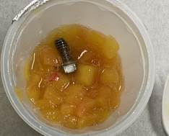
Physical Hazards
  Naturally occurring
    Pits, shells, seeds, bones, etc.
  Added: Foreign materials
    Glass, plastic, wood, metal, stones, personal items, etc.
    Risks: Traumatic injury
    Choking, damaged teeth/gums, laceration, etc.
Notes:
Physical hazards may be naturally occurring (such as pits, shells, or seeds) or foreign to the produce (such as glass, plastic, wood). It is important to understand that these hazards may cause immediate traumatic injury!
Train your staff to look for and remove physical hazards during receiving, preparation, and service. If you have a farmer or supplier that frequently provides you with food that has physical hazards, give them a call and discuss your expectations and how they can improve their processes. Field debris is commonly harvested along with produce in the fields but should be filtered out before it ever reaches your back-door.

Slide 8
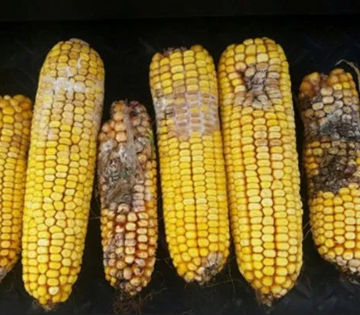
Chemical Hazards
  Naturally occurring
    Mycotoxins: Aflatoxins (e.g., corn products), Patulin (e.g., apple juice)
    Toxic mushroom species
  Added
    Environmental contaminants (e.g., pesticides, fertilizers)
    Risks: Acute poisoning or chronic illness
Notes:
Chemical hazards may be naturally occurring or may be added at any point along the farm to fork continuum. High levels of a chemical hazard can result in rapid onset of acute illness. Low levels can result in chronic illness.
NATURAL
Mycotoxins are poisonous chemical compounds produced by certain fungi, or molds, that are capable of causing disease and death in humans. Patulin (patch-oo-lin) is a type of mycotoxin that may grow in a variety of foods, including apples and pears. However, the rotten parts of these fruits are typically visible and, due to processing and consumption practices, not eaten, with the exception of apple juice. Thermal processing, such as pasteurization, does not destroy patulin. FDA has established an action level for patulin in apple juice of 50 PPB.
Toxic mushroom species are associated with numerous varieties of wild mushrooms. Unknown varieties of mushrooms or mushrooms from unapproved sources shouldn’t be served. If you have questions about the source of your mushrooms talk with your supplier and/or your local health department.
Added chemical hazards: These include environmental contaminants such as pesticides and fertilizers. An important tip and control measure to keep in mind with this type, is to follow the instructions on the label of the product.
Sources and additional info below
Arsenic & patulin contamination case
https://www.nytimes.com/2020/11/10/us/apple-juice-arsenic.html
Image:
Corn ears infected with mycotoxin and aflatoxin. Photo: G. Roth, Pennsylvania State University
https://www.agfax.com/2018/08/31/corn-harvest-aflatoxin-shows-its-dirty-face-dtn/

Slide 9
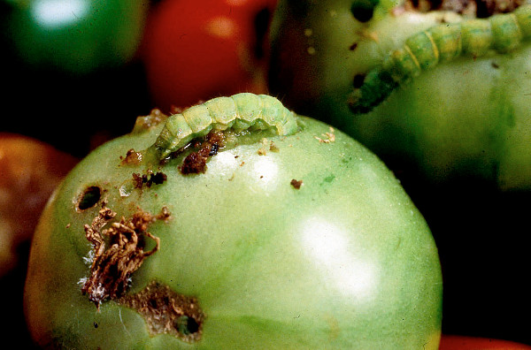
Pesticides
  Any substance intended to control, destroy, or repel a pest
  Pests include:
    Insects
    Rodents
    Weeds
    Fungi
Integrated pest management is the most effective strategy for controlling pests and preventing pest damage.
Notes:
People often consider pesticides to be a chemical of concern when talking about produce. A pesticide is any substance intended to control, destroy, or repel a pest. Examples of pests common to produce include insects, rodents, weeds, and fungi.
Integrated Pest Management is the most effective strategy for controlling pests and preventing pest damage. IPM is based on scientific research and focuses on long-term prevention of pests or their damage by managing the ecosystem. The most effective, long-term way to manage pests is by using a combination of methods that work better together than separately. Approaches for managing pests are often grouped in the following control categories: Biological, cultural, mechanical and physical, and chemical. Chemical control is the use of pesticides.
http://www.ipm.ucdavis.edu/GENERAL/whatisipm.html
Sources and additional info below
Image: http://aggie-horticulture.tamu.edu/vegetable/problem-solvers/tomato-problem-solver/insect-pests/ (tomato fruit worm)

Slide 10



Pesticide Residues
Any pesticide that remains in or on a food is called a residue.
EPA: Establishes maximum tolerance levels
FDA: Enforces maximum tolerance levels
USDA: Monitors and produces data
Notes:
The EPA reviews the scientific data on all pesticide products before they can be registered (or licensed) for use. If a product is intended for use on food crops, EPA also establishes a tolerance that limits the amount of pesticide residues that can legally remain in or on food for humans and animals that is sold in the United States.
Through the Pesticide Residue Monitoring Program, the FDA enforces EPA tolerance levels for fruits and vegetables.
The USDA Agricultural Marketing Service administers the Pesticide Data Program (PDP), a national pesticide residue database program. Data collected through the PDP enable the EPA to assess dietary exposure, provide guidance for the FDA and government agencies to make informed decisions, and supports the global marketing of U.S. agricultural products.
Additional information on pesticides will be provided in the resources page. If parents have concerns you can point them to these resources.
Sources and additional info below
https://www.ams.usda.gov/datasets/pdp

Slide 11
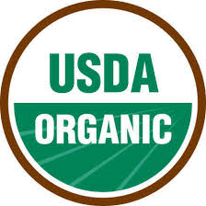
Organic Produce
What is Organic?
Grown without the use of pesticides, synthetic fertilizers, sewage sludge, genetically modified organisms, or ionizing radiation. The USDA offers a variety of resources on organic agriculture.
Is organic produce safer than conventional produce?
  There is no difference in the microbiological safety of organic and conventional produce.
  Data indicates that pesticide residues do not pose a food safety risk.
In 2020, 30% of the samples tested had no detectable pesticide residue, and over 99 percent of the samples tested had residues below the tolerances established by the EPA.
Notes:
Speaking of Pesticides, What is Organic and how is it different from conventionally grown produce?
Organic is a labeling term that indicates that the food or other agricultural product has been produced through approved methods. These methods integrate cultural, biological, and mechanical practices that foster cycling of resources, promote ecological balance, and conserve biodiversity. Synthetic fertilizers, sewage sludge, irradiation, and genetic engineering may not be used.
Organic does not mean safe to eat without washing!
Research has shown that washing produce (under running water) has been shown to be effective as reducing pesticide levels. Peeling fruit is an option, but that reduces some of the nutritional content. The health benefits of eating fruits and vegetables far outweighs any potential health risk from pesticides.
Current data indicates that pesticide residues do not pose a food safety risk. There is no difference in the microbiological safety of organic versus conventionally grown produce.
Sources and additional info below
References & new quote:
https://www.ams.usda.gov/sites/default/files/media/2020PDPAnnualSummary.pdf (Released January 2022)
http://pubs.acs.org/doi/abs/10.1021/acs.jafc.7b03118
Old quote:
Briefing Room Q&A, 2013 PDP Annual Summary
http://www.ams.usda.gov/sites/default/files/media/PDP%202013%20Annual%20Summary%20Q%26As.pdf

Slide 12
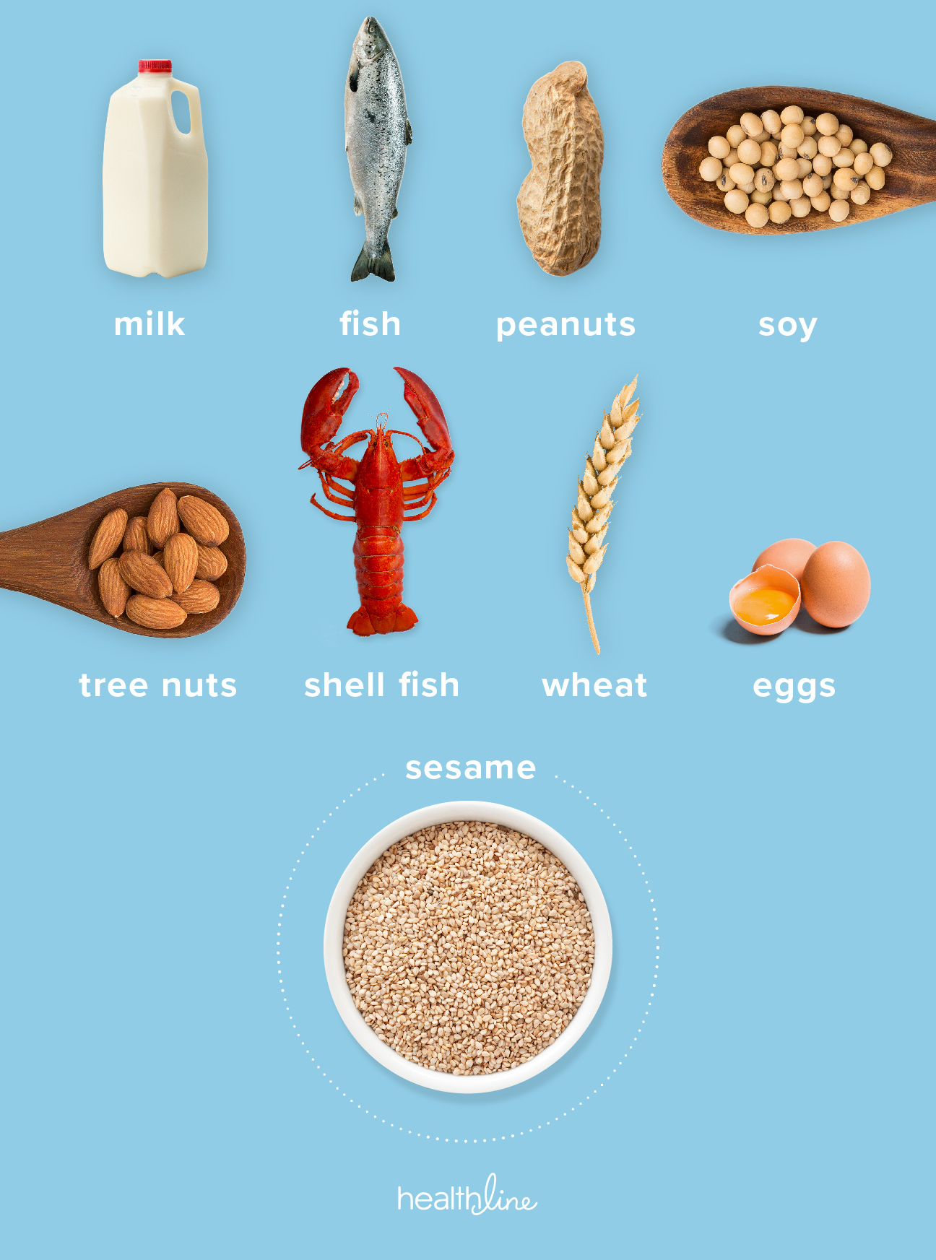
Food Allergens
9 major food allergens account for over 90% of food allergic reactions in the U.S.
An estimated 8% of children (1 in 13) are affected by food allergies
Over 15% of school-aged children with food allergies have experienced a reaction at school
An estimated 20-25% of severe and potentially life-threatening reactions (anaphylaxis) reported at schools involved children with no previous food allergy diagnosis
Notes:
Food allergies are a growing concern for schools and can be considered a “chemical hazard”. A food allergy occurs when the immune system responds to a harmless food as if it were a threat. The response may be mild, or in rare cases it can be associated with the severe and life-threatening reaction called anaphylaxis.
Effective January 1, 2023, sesame has been added as the 9th major food allergen per the FASTER Act of 2021. 9 major food allergens ac count for over 90% of all allergic reactions in the United States (and the most serious ones): milk, eggs, fish, crustacean shellfish, wheat, soy, peanuts, tree nuts, and sesame. An estimated 8% of children (1 in 13) are affected by food allergies. Over 15% of school-aged children with food allergies have experienced a reaction at school. An estimated 20-25% of severe and potentially life-threatening reactions (anaphylaxis) at schools involved children with no previous food allergy diagnosis
Schools should have a food allergy management plan to address this risk. It’s important to know your school’s protocol when an allergic reaction occurs in order to be able to react quickly.
Sources and additional info below
Image:
https://www.healthline.com/health-news/sesame-allergies-are-more-common-than-you-may-think#Sesame-is-seemingly-everywhere
References:
https://theicn.org/september-2022
https://www.foodallergy.org/resources/facts-and-statistics https://www.cdc.gov/healthyschools/foodallergies/index.htm
http://www.scientificamerican.com/article/climate-change-extends-allergy-season/

Slide 13
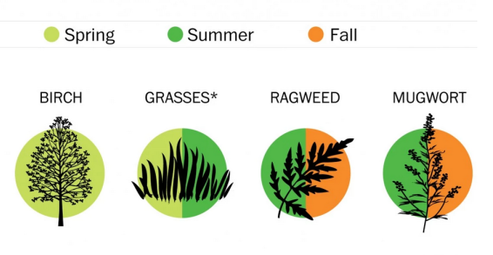
Oral Allergy Syndrome (OAS)
A type of food allergy with symptoms affecting the lips, mouth, and throat
Commonly affects people with hay fever (caused by tree pollen allergy) who eat certain raw fruits and vegetables
Peeling or cooking the food may reduce the effects
Notes:
A food allergy occurs when the immune system responds to the proteins in a harmless food as if it were a threat. The response may be mild, or in rare cases it can be associated with the severe and life-threatening reaction called anaphylaxis. The most common food allergens include tree nuts, soy, fish, peanuts, shellfish, eggs, wheat, and dairy.
Oral allergy syndrome (OAS) is an allergy to certain raw fruits and vegetables, such as apples, cherries, kiwis, celery, tomatoes, and green peppers. OAS occurs mostly in people with hay fever, especially spring hay fever due to birch pollen and late summer hay fever due to ragweed pollen. Eating the raw food causes an itchy, tingling sensation in the mouth, lips, and throat. It can also cause swelling of the lips, tongue, and throat; watery, itchy eyes; runny nose; and sneezing. Many people who experience OAS when eating a certain food raw have no symptoms when the same food is cooked due to the natural proteins being destroyed during the cooking process.
Sources and additional info below
Image: http://www.scientificamerican.com/article/climate-change-extends-allergy-season/
References:
https://www.chop.edu/conditions-diseases/oral-allergy-syndrome-oas#:~:text=Oral%20Allergy%20Syndrome%20%28OAS%29%201%20Causes%20of%20oral,cases%2C%20OAS%20does%20not%20require%20medical%20treatment.%20
https://www.aaaai.org/Tools-for-the-Public/Conditions-Library/Allergies/Oral-allergy-syndrome-(OAS)
https://www.cbsnews.com/news/find-relief-from-pollen-seasonal-allergies-hay-fever/
Images/infographics:
https://media.snacksafely.com/wp-content/uploads/2015/09/table-768x807.png
https://www.allergyeasy.com/wp-content/uploads/2015/01/2015-1_Oral-Allergy-Syndrome_OAS.jpeg
https://www.slideserve.com/aira/eosinophilic-esophagitis-an-allergy-perspective

Slide 14
Biological Hazards
Bacteria
Viruses
Parasites
Notes:
Biological hazards include bacterial, viral, and parasitic microorganisms. When it comes to produce, biological hazards pose the greatest risk to food safety so we will discuss these in more detail. The FSMA produce safety rule, is based on controlling biological hazards during the growing, harvesting, and packing of produce on the farm.
Bacteria: Exist independent of a host and can replicate using their own DNA and cellular systems. Although cooking may destroy the vegetative cells of foodborne bacteria to acceptable levels, spores of spore-forming bacteria can survive cooking and grow if food is not properly cooled or held at proper temperatures after cooking. The toxins produced by vegetative cells of these pathogens may not be destroyed to safe levels by reheating. Post-cook recontamination with vegetative cells of bacteria is also a major concern for foodservice operators to keep in mind.
Viruses: Need a living cell or host to multiply. Norovirus is one of the most common types and is directly related to contamination from human feces. Cooking as a control for viruses may be ineffective because many foodborne viruses tend to exhibit heat resistance under lab conditions that exceed cooking temperature requirements.
Parasites: Are usually animal host specific but can infect humans in their life cycles. Parasitic infections are commonly associated with untreated water or contaminated food. Like viruses, parasites do not grow in food, so control is focused on preventing their introduction and/or destroying the parasites, which can be done through adequate cooking.

Slide 15
Common Foodborne Illnesses
Salmonellosis
Norovirus Infection
E. coli 0157:H7 Infection
Onset time: 6 - 48 hours
Symptoms: Diarrhea, fever, abdominal cramps, vomiting
Duration: 4 - 7 days
Onset time: 12 - 48 hours
Symptoms: Nausea, vomiting, abdominal cramps, diarrhea, fever, headache
Duration: 12 - 60 hours
Onset time: 6 - 48 hours
Symptoms: Severe (bloody) diarrhea, abdominal cramps, vomiting; potential kidney failure
Duration: 1 - 8 days
Listeriosis
Cyclosporiasis
Campylobacteriosis
Onset time: 9 - 48 hours GI illness; 2 -6 weeks invasive disease
Symptoms: Fever, muscle aches, nausea, diarrhea; premature delivery or stillbirth (if pregnant)
Duration: Variable
Onset time: 1 - 14 days; typically at least 1 week
Symptoms: Watery diarrhea, loss of appetite, weight loss, abdominal cramps, nausea, vomiting, fatigue
Duration: May be remitting/ relapsing over weeks/months
Onset time: 2 - 5 days
Symptoms: Diarrhea (may be bloody), abdominal cramps, fever, vomiting
Duration: 2 - 10 days
Notes:
Here are some of the common foodborne illnesses that have been associated with fresh produce. Refer to FDA organism sheet provided in notebooks.
Under the bacteria category (which are shown in yellow) illnesses are commonly caused by Salmonella, E-coli, Listeria and Campylobacter. Under the virus category (in blue), illness is often caused by Norovirus and under the parasite category (shown in purple), Cyclospora is the most common cause of illness.

Slide 16
Biological Hazards
Factors that Influence Microbial Growth
Notes:
FDA’s Risk Assessment used for the Produce Safety Rule indicated that Biological Food Safety Hazards were the most likely to be responsible for foodborne outbreaks associated with fresh produce so we will discuss these in more detail.

Slide 17
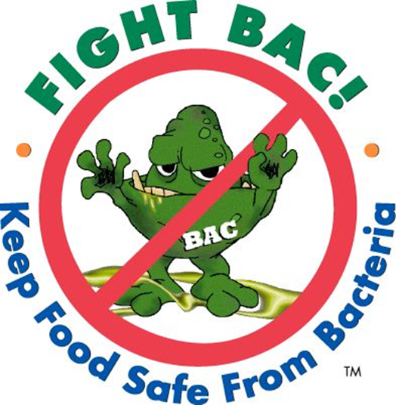
Factors That Influence Microbial Growth
Bacteria need six conditions
to grow in food.
  Food
  Acidity
  Time
  Temperature
  Oxygen
  Moisture
Notes:
The acronym “FAT TOM” can be used to help you remember the factors that influence microbial growth. These include, food, acidity, time, temperature, oxygen, and moisture. Just like people, bacteria have different preferences for their environment. Some bacteria thrive in really cold temperatures, others may die if it gets too cold.
Much of the food science and food safety research has focused on determining the growth preferences of specific bacteria and the development of practices and strategies to prevent their growth by controlling specific parameters. We will discuss the parameters of FAT TOM.

Slide 18
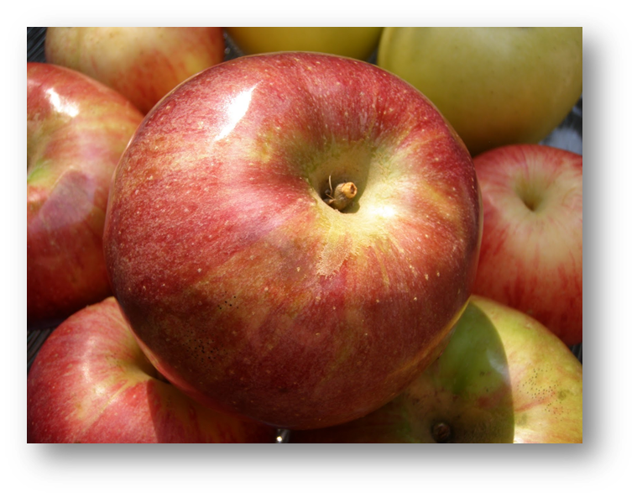
Plant Characteristics
  Surface topography
    Wax layers
    Cell walls
  Physical damage
    Unintentional
    Intentional
A nutritious food source is critical for bacterial growth.
Notes:
A nutritive food source is critical for bacterial growth. Bacteria generally like high protein sources; however, produce can provide bacteria with the nutrients they need to grow.
In general, pathogens will survive, but not grow on uninjured outer surfaces of fresh produce, due in part to the protective character of the plant's natural barriers, such as wax layers and cell walls. In some cases, pathogen levels will decline on the outer surface. Post-harvest, growth on intact produce surfaces is uncommon because the availability of nutrients and moisture is limited.
Damage to the protective epidermal barrier by physical damage (bruising, punctures), or degradation by plant pathogens (bacteria or fungi), will significantly enhance survival of foodborne pathogens.
Processing fresh produce into fresh-cut products increases the risk of bacterial growth and contamination by breaking the natural exterior barrier of the produce. If present, microorganisms can be transferred from surface of intact fruit to internal tissues. Injured cells and released cell fluids provide a nourishing environment for microbial growth. The potential for pathogens to survive or grow in fresh cut fruits and vegetables is increased by the high moisture and nutrient content, the absence of a lethal process (e.g., heat) during production to eliminate pathogens, and the potential for temperature abuse during processing, storage, and transport.

Slide 19
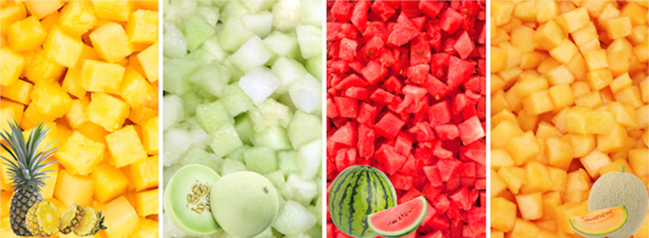
Fresh-Cut Produce
Fresh-cut, by definition, indicates that the plant’s protective cell layers are injured.
The natural exterior barrier is broken.
Notes:
In the case of produce that is processed into fresh-cut products, the plant’s protective cell layers are injured [the natural exterior barrier is broken]. The potential for pathogens to survive or grow in fresh-cut fruits and vegetables is increased by three factors: 1) the high moisture and nutrient content 2) the absence of a lethal process during production to eliminate pathogens (e.g., heat) 3) the potential for temperature abuse and fluctuation during other steps In the supply chain. We will have an entire session on fresh-cut produce to expand on this in more detail.

Slide 20
Time/Temperature Control for Safety (TCS) Food
Requires time / temperature control to limit pathogen growth or toxin formation
Acidity (pH) and moisture (a_{w}) content determine if a food is TCS.
The FDA Food Code lists raw seed sprouts, cut melons, cut leafy greens, and cut tomatoes as TCS foods.
a_{w} ≤ .85
pH < 4.6
≤41⁰F / 4 Hours
Food Safety
Note: Values shown in image are general.
Notes:
A food that requires time, temperature, or a combination of both to limit pathogen growth is knows as a Time/Temperature Control for Safety (TCS) food. Determination of whether a particular food falls into the TCS category depends on its acidity (pH) and water activity (level of moisture available for microbes to utilize).
Typically the lower the pH the more acidic the food is and the less likely it is to support microbial growth. At the same time, a lower water activity indicates that there is not a lot of moisture available and the food is less likely to support microbial growth.
The FDA Food Code specifically lists raw seed sprouts, cut melons, cut leafy greens, and cut tomatoes as TCS foods because they have very favorable growth conditions and have been implicated in multiple food borne illness outbreaks. TCS foods should be held at a temperature of 41 degrees F or less. If kept out of temperature control these foods should be consumed within 4 hours or discarded.

Slide 21
Oxygen Requirements
Different types of bacteria need different levels of oxygen to grow.
  Anaerobic cells cannot tolerate oxygen.
  Aerobic cells require oxygen.
  Facultative anaerobes can grow with or without oxygen. Most foodborne pathogens are facultative anaerobes.
Notes:
Different types of bacteria also need different levels of oxygen to grow.
Anaerobic bacteria cannot tolerate oxygen. Clostridium botulinum thrives in low-oxygen environments. This bacterium is always a concern for home food preservation and canning. If canned food is not processed properly to kill even the spore formers, botulism toxin can form in the lack of oxygen.
Aerobic bacteria require oxygen to survive. Facultative anaerobes can survive with or without oxygen. Most food borne pathogens are facultative anaerobes.

Slide 22
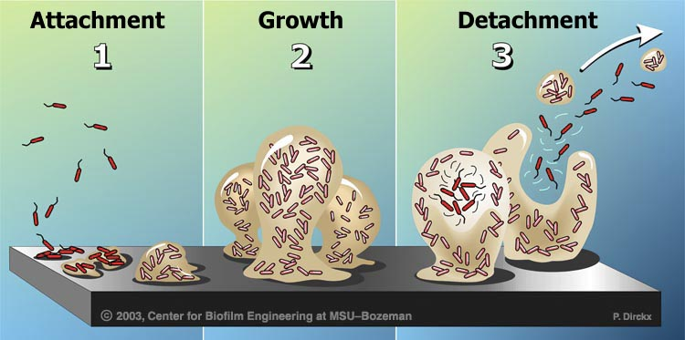
Biofilms
A biofilm is a colony of microorganisms that is attached to a surface within a thin (slime) layer made up of extracellular polymeric substances (EPSs).
Biofilms enable microorganisms to survive and adapt in adverse environmental conditions using a cooperative method of growth.
Notes:
A biofilm is a colony of microorganisms that is attached to a surface within a (slime) layer made up of extracellular polymeric substances (EPSs) (proteins, nucleic acids, polysaccharides etc.)
Biofilms enable microorganisms to survive and adapt in adverse environmental conditions using a cooperative method of growth.
Sources and additional info below
https://www.ift.org/news-and-publications/food-technology-magazine/issues/2017/september/columns/food-safety-and-quality-removing-and-preventing-biofilms
https://www.food-safety.com/articles/7810-biofilm-a-contemporary-challenge-to-food-safety
https://biologydictionary.net/biofilm/

Slide 23
Biofilms, Cont.
Some bacteria can form biofilms on surfaces of food, equipment, and facilities
Biofilms are a public health challenge and risk since they can:
  Be difficult to remove
  Be resistant to agents used to clean
  Lead to food contamination and spoilage
  Lead to transmission and poor treatment of disease
  Lead to corrosion/damage of surfaces in food facilities
Any surface that combines an abundance of moisture and nutrients is susceptible to biofilm formation if microorganisms are present.
Notes:
Some species of bacteria, including foodborne pathogens (Listeria monocytogenes, Escherichia coli, Campylobacter jejuni, and Salmonella etc.) are capable of forming biofilms on surfaces of food, equipment, and facilities.
Biofilms are a major public health challenge and hazard because they can:
be more difficult to remove than individual planktonic cells (suspended in media)
highly resistant agents used to clean (cleaning, sanitizing, and disinfecting)
lead to food contamination and spoilage (e.g. certain enzymes associated with biofilms of Pseudomonas spp. and Bacillus spp. may create unpleasant smells and bitter tastes)
lead to transmission and poor treatment of disease (play a key role in increasing antimicrobial resistance. It’s estimated that they can withstand 10 to 1,000 times higher antimicrobial doses and can be a higher food safety risk since infections or illnesses related to biofilms are often difficult to treat due to greater drug tolerance)
lead to corrosion/damage of surfaces in food facilities (e.g. metal surfaces in pipes and tanks, which ultimately result in loss of food production surfaces and overall efficiency as well as financial loss)
Any surface that combines an abundance of moisture and nutrients is susceptible to biofilm formation if microorganisms are present.
Sources and additional info below
https://www.ift.org/news-and-publications/food-technology-magazine/issues/2017/september/columns/food-safety-and-quality-removing-and-preventing-biofilms
https://www.food-safety.com/articles/7810-biofilm-a-contemporary-challenge-to-food-safety
https://biologydictionary.net/biofilm/

Slide 24
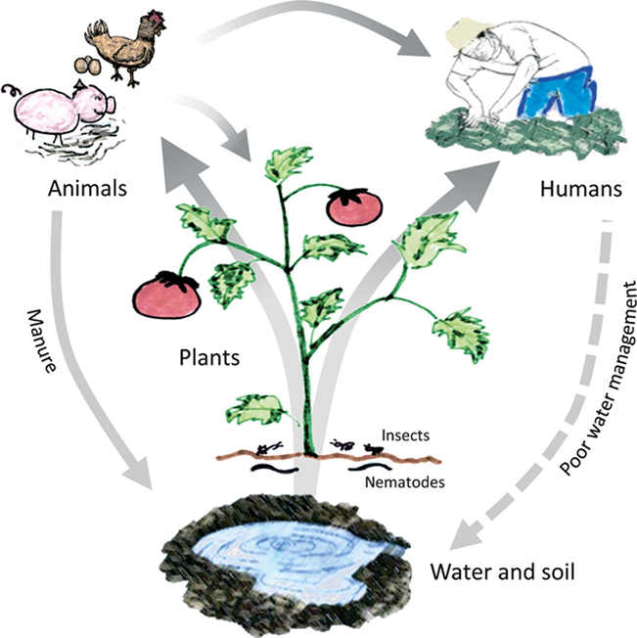
Internalization
Occurs when bacteria infiltrate the produce
Pre-Harvest
Bacteria can be taken into the plant via the root system
Physical damage (wounds, cuts, bruises etc.) can create harborage sites for bacteria to infiltrate
Quick tip:
Good Agricultural Practices are critical!
Notes:
Internalization can occur throughout the farm to fork chain and an example is in the pre-harvest stage when bacteria can be taken into the plant via the
root system. Physical damage including wounds, cuts, and bruises can create harborage sites on the surface of the plant leading to infiltration into the
underlying plant tissue.
If pathogens are on the exterior surface of the produce there is a higher chance they will be removed during processing. It is when pathogens are
internalized that the real trouble begins, as they cannot be removed by rinsing and most produce does not undergo a kill step. Good Agricultural
Practices are critical to help prevent the introduction of pathogens altogether!
Sources and additional info below
https://www.academia.edu/21473328/Internalization_of_Pathogens_in_Produce

Slide 25
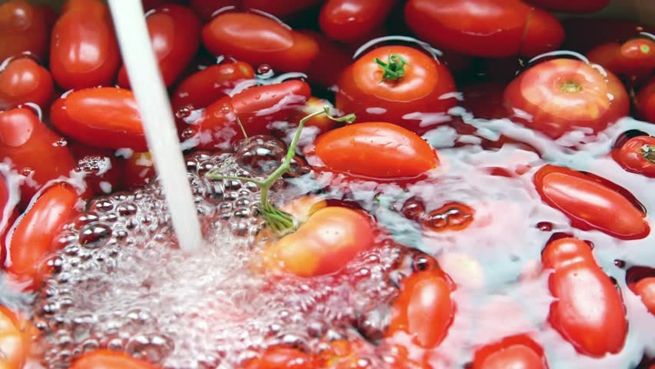
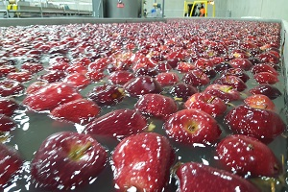
Internalization, Cont.
Occurs when bacteria infiltrate the produce
Post-Harvest
Bacteria may move from the outer surface to the internal tissue through stem scars and areas with physical damage (wounds etc.)
Studies on tomatoes and apples revealed that when produce is immersed in cooler water, the differential can lead to intake of water along with any bacteria present on the surface or in the wash water.
Quick tip:
Wash water temperature should be maintained at 10°F warmer than the produce being washed
Notes:
Bacteria may move from the outer surface to the internal tissue through stem scars and areas with physical damage (wounds etc.)
Studies on tomatoes and apples have shown that when produce is immersed in cooler water (during fluming and washing etc), the differential in temperature can lead to intake of water along with any bacteria present on the surface of the produce or in the wash water.
Quick tip:
To reduce the likelihood of infiltration, wash water temperature should be maintained at 10°F warmer than the pulp temperature of any produce being washed

Slide 26
Foodborne Outbreaks
What’s causing illness?
Notes:
We will now review foodborne outbreaks.

Slide 27
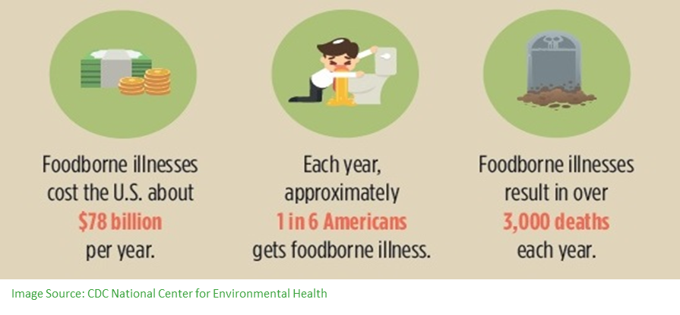

Foodborne Illness and Outbreaks
Foodborne illness:
Results from eating
contaminated food
Foodborne outbreak: Two or more persons experience a similar illness after ingestion of a common food and analysis implicates the food as the source of the illness
Notes:
Foodborne illness is any illness that results from the consumption of contaminated food. A foodborne outbreak refers to an incident in which two or more persons experience a similar illness after ingestion of a common food, and epidemiologic analysis implicates the food as the source of the illness. Less than 4% of all foodborne illness outbreaks reported to the CDC are associated with schools.

Slide 28
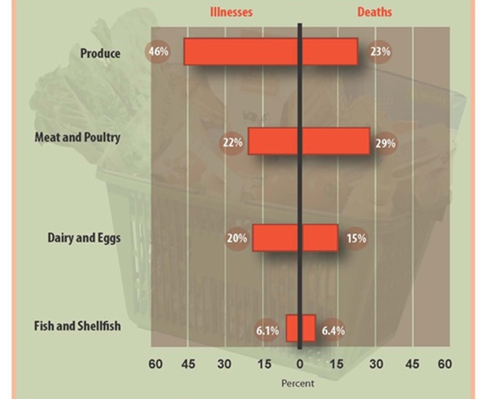
CDC Attribution Estimates, 1998 – 2008
Contribution of Different Food Categories to Estimated Domestically-Acquired Illnesses and Deaths, 1998-2008
https://www.cdc.gov/foodborneburden/attribution/attribution-1998-2008.html
Notes:
The CDC analyzed all reported outbreaks from 1998-2008 to determine which foods could be attributed to the outbreaks. A total of 4,589 outbreaks were analyzed. The pie chart on the slide illustrates that produce was estimated to account for 46% of all the outbreaks. That is almost half!
Sources and additional info below
References:
https://www.cdc.gov/foodborneburden/attribution/index.html
https://www.cdc.gov/foodborneburden/attribution/attribution-1998-2008.html
https://wwwnc.cdc.gov/eid/article/18/10/12-0833-f3
https://wwwnc.cdc.gov/eid/article/18/10/12-0833_article
Painter JA, et al. Attribution of foodborne illnesses, hospitalizations, and deaths to food commodities by using outbreak data, United States, 1998–2008. Emerg Infect Dis [Internet]. 2013 Mar [January 31, 2013].

Slide 29

Recent Multistate Foodborne Outbreak
Associated With Produce
May 2022
Hepatitis A Virus
Linked to fresh, organic strawberries
https://www.fda.gov/food/outbreaks-foodborne-illness/public-health-advisories-investigations-foodborne-illness-outbreaks
Notes:
To further reinforce the importance of food safety and produce, I will briefly highlight a recent multistate foodborne outbreak associated with produce. The good news is that there weren't many linked to produce in 2022 compared to previous years.
These investigations are conducted by FDA along with CDC, state and local partners. When information is publicly shared about these foodborne illness investigations, they may be ongoing and in a variety of stages.
Beginning in late March until early May 2022, there was a multistate outbreak of Hepatitis A illnesses. Traceback indicated that fresh, organic strawberries were the likely source of the outbreak since 11 of 16 affected individuals reported that they ate the strawberries during interviews. As of August 2022, CDC reports that there was 19 reported cases and 13 hospitalizations in 4 states and no deaths. There was a recall of fresh, organic strawberries branded as Fresh Kampo and HEB within a specific date range. Eventually the products were past their shelf life and no longer available for purchase in stores but in case they were frozen for later use, customers were also advised not to keep or use any remaining product.
Sources and additional info below
https://www.fda.gov/food/outbreaks-foodborne-illness/outbreak-investigation-hepatitis-virus-strawberries-may-2022
https://www.fda.gov/food/outbreaks-foodborne-illness/investigations-foodborne-illness-outbreaks
https://www.cdc.gov/foodsafety/outbreaks/lists/outbreaks-list.html?CDC_AA_refVal=https%3A%2F%2Fwww.cdc.gov%2Ffoodsafety%2Foutbreaks%2Fmultistate-outbreaks%2Foutbreaks-list.html
… | Flickr

Slide 30

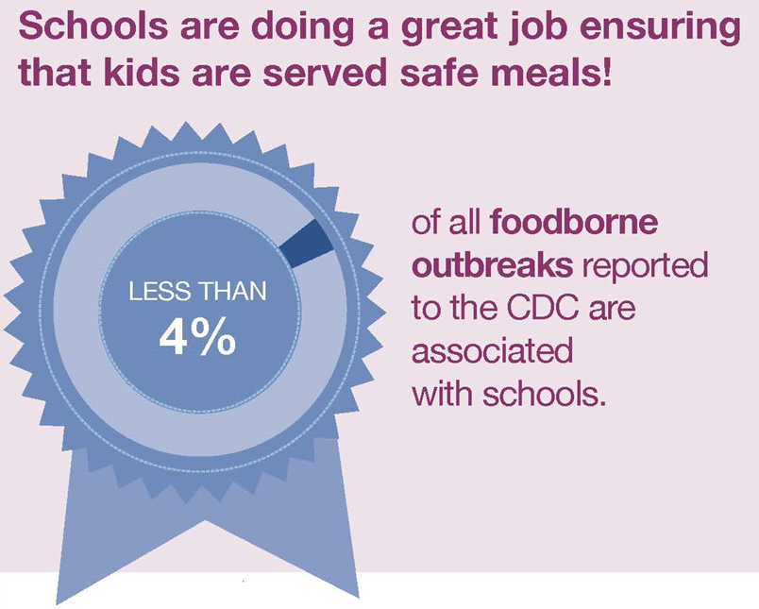
Food Safety in Schools
However, foodborne outbreaks do occur. Outbreaks in schools have more illnesses than outbreaks in non-institutional settings.
https://fns-prod.azureedge.us/sites/default/files/foodsafetyschools_infographic.pdf
Notes:
Schools are great at ensuring safe and nutritious meals are served to students. Keep in mind, however, that there are some foodborne outbreaks in schools and when they do occur [in schools and other institutional settings], they tend to have more illnesses (i.e. higher numbers of people affected per outbreak) compared to outbreaks in non-institutional settings [such as restaurants].
Newspaper clippings: Here are some headlines from different foodborne outbreaks that occurred in schools. As you look at this, consider some of the potential consequences related to an outbreak linked to the school nutrition program.
Sources and additional info below
https://www.fns.usda.gov/ofs/school-associated-foodborne-outbreak-data

Slide 31
Classroom Question By Show of Hands
The majority of foodborne illnesses associated with outbreaks in schools are caused by which of these foodborne pathogens?
  Salmonella
  Norovirus
  E. coli
  Hepatitis A virus
  Staphylococcus aureus
Notes:
Note to instructor: Ask your participants the question, which will segue into a discussion of norovirus on the next slide.
Sources and additional info below
https://www.fns.usda.gov/ofs/school-associated-foodborne-outbreak-data
https://www.cdc.gov/foodsafety/foodborne-germs.html

Slide 32
State Reported Foodborne Outbreaks in Schools, 2000 - 2010
122 foodborne outbreaks and 7,603 foodborne illnesses
*STEC includes pathogenic and non-pathogenic Shiga-toxin producing E. coli
https://www.fns.usda.gov/ofs/school-associated-foodborne-outbreak-data
Notes:
States report foodborne outbreaks to the Centers for Disease Control and Prevention (CDC). The USDA Food and Nutrition Service Office of Food Safety obtained the data involving outbreaks in school settings from the CDC from 2000-2010. The data was analyzed and it was found that Norovirus accounted for 56.4% (over half!) of all foodborne illness outbreaks in schools. Now you may be wondering, what is the leading cause of those outbreaks?
Norovirus outbreaks often involved RTE foods that had been handled by an ill foodservice and Salmonella outbreaks often involved undercooked foods such as poultry and raw produce (tomatoes).
Sources and additional info below
https://www.fns.usda.gov/ofs/school-associated-foodborne-outbreak-data
The other category (10.1%) includes Staphylococcus aureus (4.2%; n = 320), Campylobacter spp. (1.7%; n = 132), chemicals (1.5%; n = 115), Shigella sonnei (1.4%; n = 104), Bacillus spp. (1.0%; n = 79), heavy metals (0.3%; n = 21), and hepatitis A (0.03%; n = 2)
Source: Venuto, M., Garcia, K., Halbrook, B. (2015) Analyses of the Contributing Factors Associated With Foodborne Outbreaks in School Settings (2000-2010). Journal of Environmental Health, 77(7), 16-20.

Slide 33
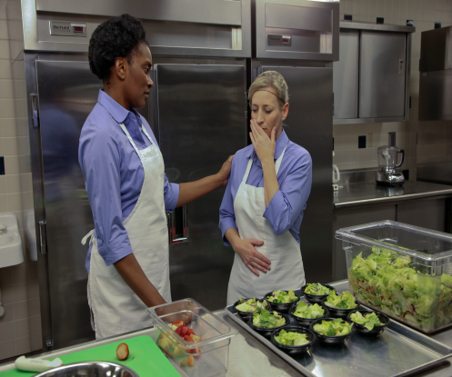

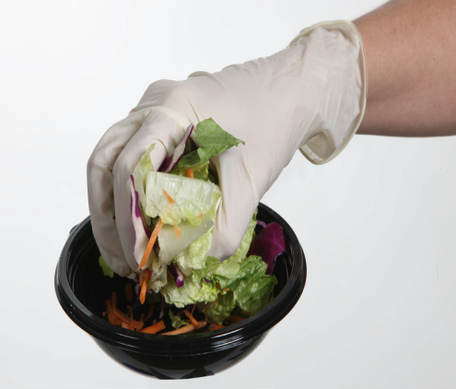
Norovirus Prevention Strategies
Excluding ill food employees
Following proper handwashing procedures
Avoiding bare hand contact with RTE foods
Notes:
Remember that over half of all foodborne illness outbreaks in schools were caused by Norovirus.
The best way to prevent Norovirus and the spread of illness is by demonstrating good employee health and hygiene. This includes, not coming to work when sick, washing hands often, and not touching ready-to-eat foods such as produce with bare hands.
Sources and additional info below
Images: The Institute of Child Nutrition (ICN). Employee Health and Personal Hygiene for Child Nutrition Professionals.

Slide 34

Conclusion
Produce safety is important and food safety hazards can be minimized.
Notes:
Produce safety is important and food safety hazards can be minimized. It may require a bit more time, thought, and effort, but it will be well worth it in the end when your school can be confident that you are serving healthy, safe food!

