Slide 1
Growing Food Safely
Take Home Training
Credit: 0.5 Hours Codes: 2600, 2620
Notes:
Notes to instructor: Welcome participants to this training session.

Slide 2

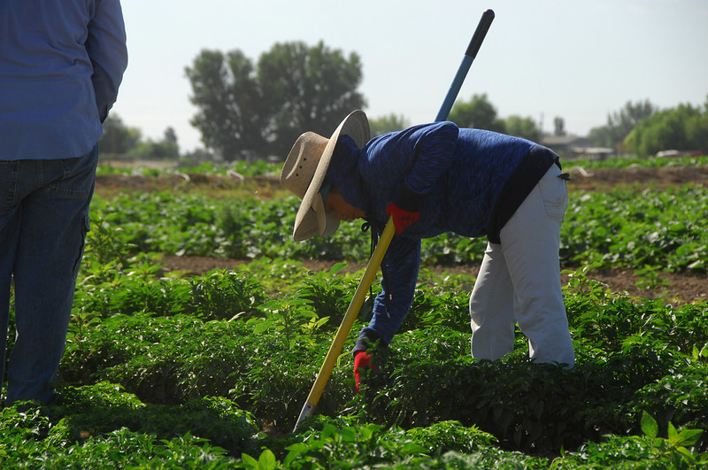
Objectives
Identify on the farm best growing practices for fresh produce to reduce the risk of foodborne illness.​
Recognize previously voluntary growing practices and Good Agricultural Practices are now required by the Food Safety Modernization Act (FSMA).
Notes:
Notes to instructor: Review the learning objectives with the participants.

Slide 3

Good Agricultural Practices
(GAPs)
Notes:
GAPs are based on the Food and Drug Administration’s Guide to Minimize Microbial Food Safety Hazards for Fresh Fruits and Vegetables. This guidance document (also known as the GAPs guidance) addresses microbial food safety hazards and good agricultural practices common to the growing, harvesting, washing, sorting, packing and transporting of fruits and vegetables.

Slide 4
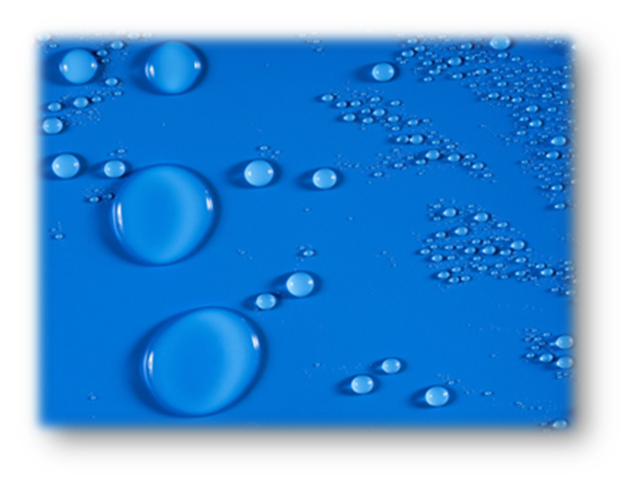
Classroom Question By Show of Hands #1
Of all the areas of potential foodborne contamination, which of the following has had the largest impact on pathogen transfer?​
  Water​
  Soil​
  Hygiene​
  Compost​
  Equipment
Notes:
Note to instructor: ask your participants the question on the slide.
Answer: Hygiene has had the “most” impact on pathogen transferal. Think Norovirus which can be easily transferred from someone who is infected to food, water, and surfaces and from person-to-person.
Then Water, Soil (which includes compost) then Equipment (utensils and packing equipment).

Slide 5
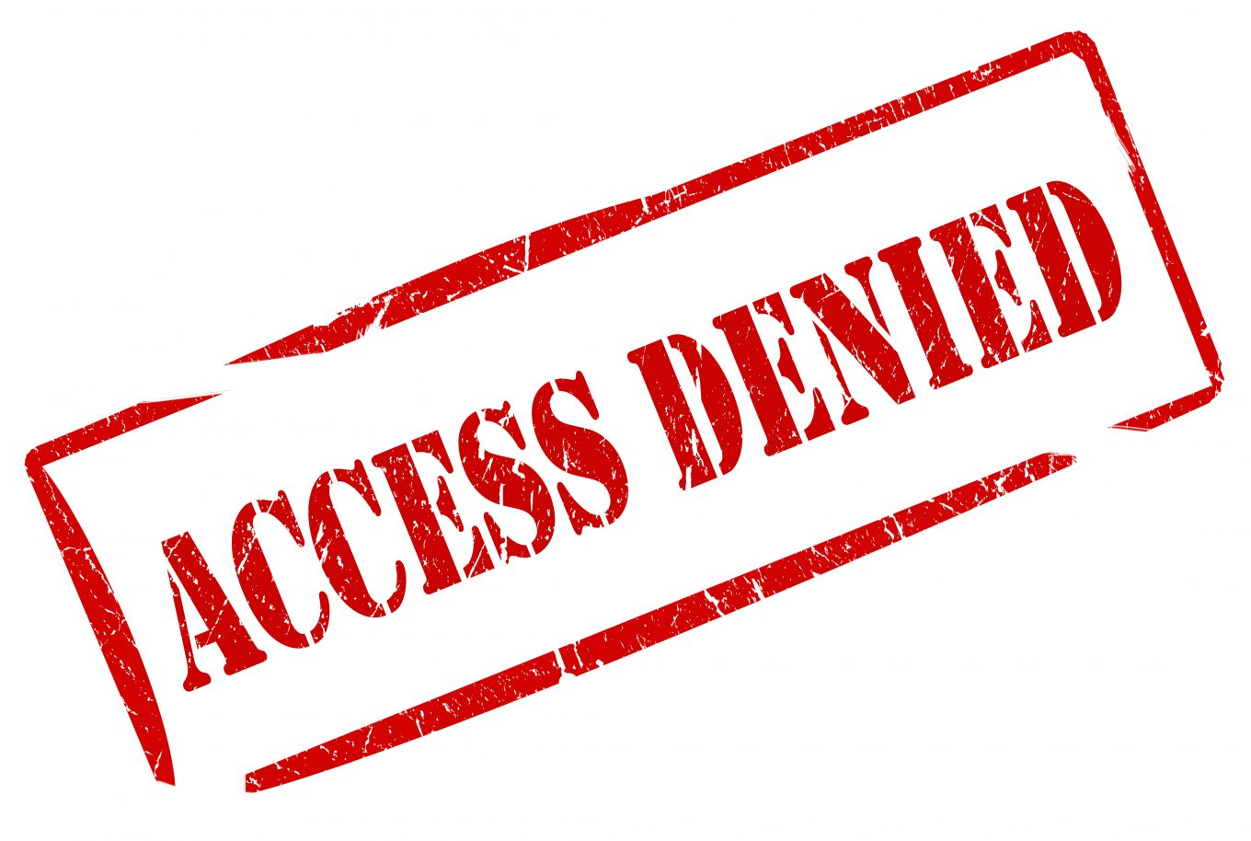
Classroom Question By Show of Hands #2
What are the top 3 reasons a food might be recalled?
Defective, adulterated, contaminated
Misbranded, under weight, under size
Mislabeled, allergen, immature
Notes:
Note to instructor: ask your participants the question on the slide.
Answer: the correct answer is the first.
Defective – adulterated – contaminated
Food recalls protect the public from products that may cause injury, illness or even death. There are actually 5 reasons. Food products are recalled to remove them from the marketplace because there is reason to believe the products may be defective, adulterated, contaminated, misbranded or mislabeled.

Slide 6
Classroom Question By Show of Hands #3
What is the most common cause of food ​recalls?
Listeria
Salmonella
Food packaging
Presence of undeclared allergens
Notes:
Note to instructor: ask your participants the question on the slide.
Answer: #4 presence of undeclared allergens is the most common cause of food recalls (per FDA’s 2019 results).
Food can also be recalled if there are any biological, physical, or chemical hazards found in the food.
https://www.statista.com/statistics/947726/leading-causes-of-food-recalls-us/

Slide 7
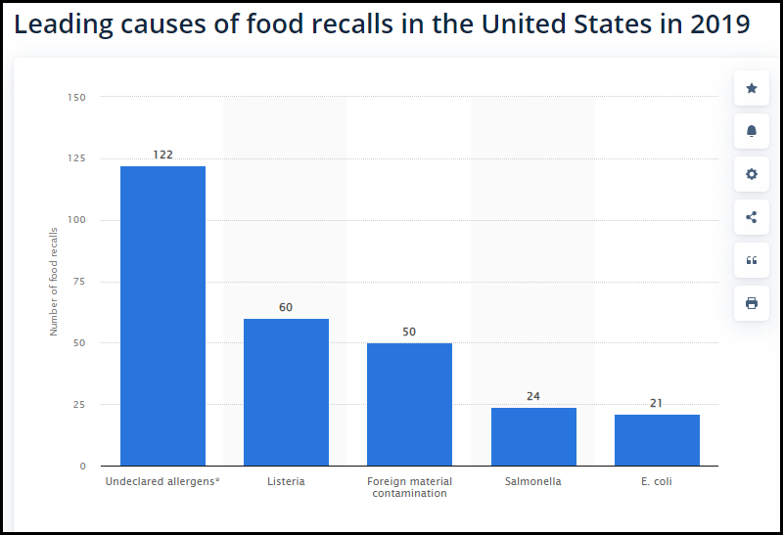
Causes of Food Recalls
What is the most common cause of food ​recalls?
Notes:
Here we can see more information about the prevalence of undeclared allergens in food recalls in 2019. Undeclared allergens are responsible for about twice as many recalls as listeria.

Slide 8

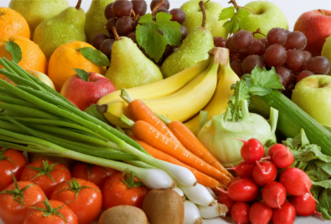
A New Era of Produce Safety
FSMA Produce Safety Rule
Standards for the Growing, Harvesting, Packing, and Holding of Produce for Human Consumption
(21 CFR 112)
Notes:
Certain farms are required to follow the The Produce Safety Rule as part of the FDA Food Safety Modernization Act (FSMA) that was passed by President Obama on January 4, 2011. This rule includes all the GAP principles we will cover in this presentation.
There will be some farms who are exempt based on their size and/or income and what they grow. The important thing to know is that there will be no “master list” of farms who are required to comply as a farm’s status may change. In addition, farms are not required to register with the FDA.
This regulation focuses on setting the first-ever federal regulatory standards for the production, harvest, and handling of fruits and vegetables, in an effort to prevent microbial contamination and reduce foodborne illnesses associated with fresh produce. The Produce Safety Rule was made available publicly on November 13, 2015
FDA has finalized seven major rules to implement FSMA,
Worker health, hygiene, and training
Agricultural water, both for production and post-harvest uses
Biological soil amendments (e.g., compost, manure)
Domesticated and wild animals
Equipment, tools, buildings, and sanitation
Production of sprouts*

Slide 9
Crops Covered Under the Rule
All fruit and berries such as apples, strawberries, cherries, and stone fruit
All lettuces and greens such as romaine, iceberg, cabbage and leafy greens; herbs
All melons such as cantaloupe, honeydews, variety melons and watermelons
Vegetables such as tomato, summer squash, broccoli, cabbage, onions, etc.
Notes:
If you grow, pack, process, or sell fresh produce, this regulation may apply. There are some exemptions
Summarized from the FDA, Produce Safety Rule:
Almonds, apples, apricots, apriums, Artichokes-globe-type, Asian pears, avocados, babacos, bananas, Belgian endive, blackberries, blueberries, boysenberries, Brazil nuts, broad beans, broccoli, Brussels sprouts, burdock, cabbages, Chinese cabbages (Bok Choy, mustard, and Napa), cantaloupes, carambolas, carrots, cauliflower, celeriac, celery, chayote fruit, cherries (sweet), chestnuts, chicory (roots and tops), citrus (such as clementine, grapefruit, lemons, limes, mandarin, oranges, tangerines, tangors, and uniq fruit), cowpea beans, cress-garden, cucumbers, curly endive, currants, dandelion leaves, fennel-Florence, garlic, genip, gooseberries, grapes, green beans, guavas, herbs (such as basil, chives, cilantro, oregano, and parsley), honeydew, huckleberries, Jerusalem artichokes, kale, kiwifruit, kohlrabi, kumquats, leek, lettuce, lychees, macadamia nuts, mangos, other melons (such as Canary, Crenshaw and Persian), mulberries, mushrooms, mustard greens, nectarines, onions, papayas, parsnips, passion fruit, peaches, pears, peas, peas-pigeon, peppers (such as bell and hot), pine nuts, pineapples, plantains, plums, plumcots, quince, radishes, raspberries, rhubarb, rutabagas, scallions, shallots, snow peas, soursop, spinach, sprouts (such as alfalfa and mung bean), strawberries, summer squash (such as patty pan, yellow and zucchini), sweetsop, Swiss chard, taro, tomatoes, turmeric, turnips (roots and tops), walnuts, watercress, watermelons, and yams.

Slide 10
Crops Not Covered Under the Rule
Why would some crops not be covered under the rule?
Notes:
Note to instructor: ask your participants “Why are some crops not covered under the rule?”
The next slide provides the answer.

Slide 11
Rarely Consumed Raw Crops
Rarely Consumed Raw:​
Fruits such as sour “tart” cherries
Vegetables; all beans, beets, ginger root, chickpeas, lentils, collards, eggplants, potatoes, pumpkins, winter squash, sweet potatoes, horseradish, water chestnuts, okra,​ rhubarb, etc.
Grains, including sweet corn
Notes:
Why are some crops not covered under the rule? Crops that aren’t covered are those that aren’t typically consumed raw.
The rule does not apply to certain specified produce commodities that are rarely consumed raw. You can find the list of produce not covered by the regulation in §112.2.
The rule does not apply to produce that is used for personal or on-farm consumption, or that is not a Raw Agricultural Commodity (RAC).
The rule provides an exemption for produce that receives commercial processing that adequately reduces the presence of microorganisms of public health significance (e.g., via a “kill step”) as long as certain disclosures are made and written assurances are received, with appropriate documentation.
The rule does not cover produce farms that have an average annual value of produce sold during the previous 3-year period of $25,000* or less.
The rule provides a qualified exemption and modified requirements for farms that meet two requirements: (1) the farm must have food sales averaging less than $500,000* per year during the previous 3 years; and (2) the farm’s sales to qualified end-users must exceed sales to others.
Good to Know: Now, more than 94 percent of Montmorency tart cherries consumed in the U.S. are grown in the U.S. In fact, two-thirds of the U.S. Montmorency tart cherries are grown in Michigan – the Cherry Capital of the World. Utah, Washington, New York, Wisconsin and Pennsylvania are other prominent Montmorency tart cherry-producing states.

Slide 12

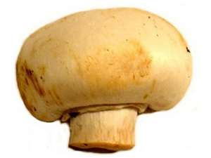

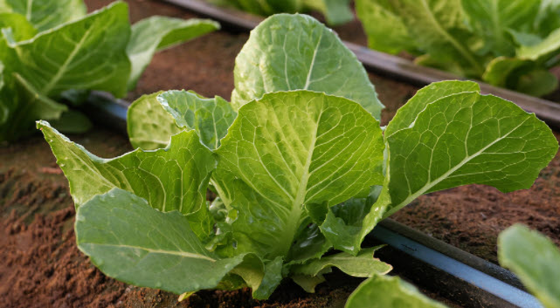
USDA Fresh Audit Types
USDA GAP&GHP Audit
Harmonized GAP Audit
Group GAP
Mushroom GAP
Arizona (LGMA)
California (LGMA)
Notes:
Food safety audits are organized activities that aim to evaluate the level of food safety management system of a food business in the pursuit of protecting public health.
Food safety audits focus on key areas of an operation such as a food safety management system, food storage, food preparation, sanitation, facility design, and employee hygiene.
To ensure a food safety management system is comprehensive enough to address all potential risks and hazards and continuously monitor their critical control. Establish a system that does not need much micromanagement and can be easily understood by everyone.
Resources:
AMS has updated the USDA GAP checklist. Version 3.0 of the checklist becomes effective August 1, 2022. The Part 6 – Distribution Center has been removed and Part 7 - Preventive Food Defense Procedures has been moved to Part 5.
The USDA GAP audit.
The Produce GAPs Harmonization Initiative is an all-industry effort that develops food safety GAPs standards and audit checklists for pre-harvest and post-harvest operations that are applicable to all fresh produce commodities, all sizes of on-farm operations, and all regions in the United States. The Initiative is a collaborative effort on the part of growers, shippers, produce buyers, government agencies, audit organizations, and other stakeholders.

Slide 13
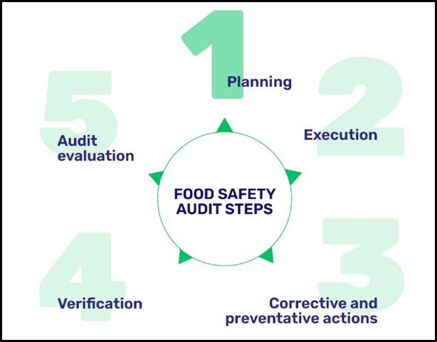
Audit Steps
Notes:
Audits have 5 important steps:
Step 1 – Plan the audit, review all the parts of the audit-In this step, an auditor or an audit team must identify the clear objective of the food safety audit process. This step narrows down the key areas that are needed to be evaluated in the auditing process.
Step 2 – Request and Execute the audit (reviews the whole plan) An onsite verification would involve the review of your process operations, sanitation conditions, food safety practices, food safety management system, and documentation.
Step 3 – Analyze the areas that need attention by corrective actions not just what will be done but show how it will reduce or prevent future findings-In this stage of an audit process, the auditor evaluates your preparedness to address breaches in standards through properly established preventive and corrective actions.
Step 4 – Verification, review findings and corrective \actions - assess whether the preventive and corrective actions are appropriate as well as effective. Verification procedures are commonly conducted by reviewing documents where any corrective action has been recorded and the results after applying them.
Stem 5 – Evaluate the findings to address “root” problem. Evaluating the audit process ensures that it is still on track and that the objectives are being met.

Slide 14
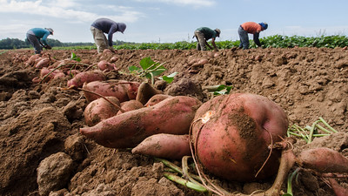
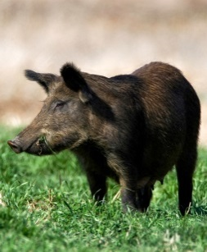
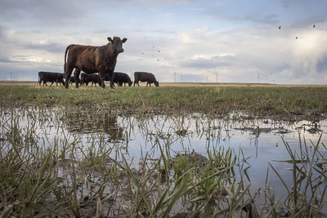
How Contamination is Spread
Humans
Soil
Produce
Buildings Equipment Tools
Animals
Water
Notes:
The key to GAPs is understanding all the potential sources of contamination and developing specific strategies targeted to each source to reduce the risk of contamination.
For produce we are most concerned about biological food safety hazards spreading through these routes of contamination. The graphic shown illustrates possible avenues that may spread contamination, including humans, animals, water, soil, and building equipment.
Remember, anything that comes in contact with ready to eat product has the potential to contaminate it.

Slide 15
GAP Major Areas
T r a c e a b i l i t y
Hygiene
Facilities
Production Practices
Transportation
Product Handling
T r a c e a b i l i t y
T r a c e a b i l i t y
T r a c e a b i l i t y
Notes:
GAPS that are based on the FDA Guidance Document have many areas that are similar. The actual titles may be different, but the information is very close. These are the 5 main areas from the checklist that we will be using. We’ll talk about each of these areas over the next few slides.

Slide 16
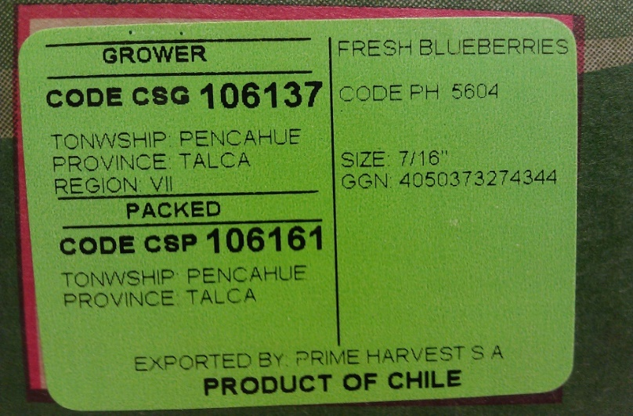
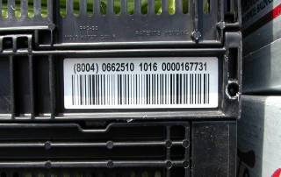
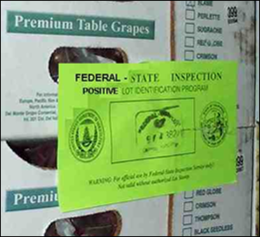
Traceability
One step forward, one step back
  Bar Coding
  Sequential Numbering – Positive Lot Id (PLI)
Product Recall – Successful “mock”
Notes:
Traceability encircles all scopes of a food safety audit. Traceability means that food items, including produce, can be traced back to its source. The ability to trace a product, one step forward and one step back is critical in the event of a food recall. There are often many steps in a food supply chain, so each group including growers, distributors, and packing houses, are responsible for knowing where they got the product from, and where they sent the product to.
Growers should maintain a recordkeeping system with date of harvest, farm location; the field where produce was harvested, the pack date, and who handled the produce from farm to receiver. Buyers should be aware that in some cases produce is repacked with produce from several farms before being distributed. This is a common practice with tomatoes since they are repacked to meet customers’ color requirements. This process makes traceability more difficult.
The fresh produce industry is aware of the traceability and recall concerns of buyers. In recent years, large produce growers and distributors have implemented electronic bar code tracking to improve traceability. Some industry trade groups are developing technologies (such as bar codes, stamps, stickers, tags, etc.) to identify the source of produce and software to assist retailers in providing more accurate traceability to the grower/packer level.
These are stickers or markings that reflect a company’s compliance with traceback, which is a major area of food safety. Notice these markings next time you do receiving of product in your cooler.

Slide 17
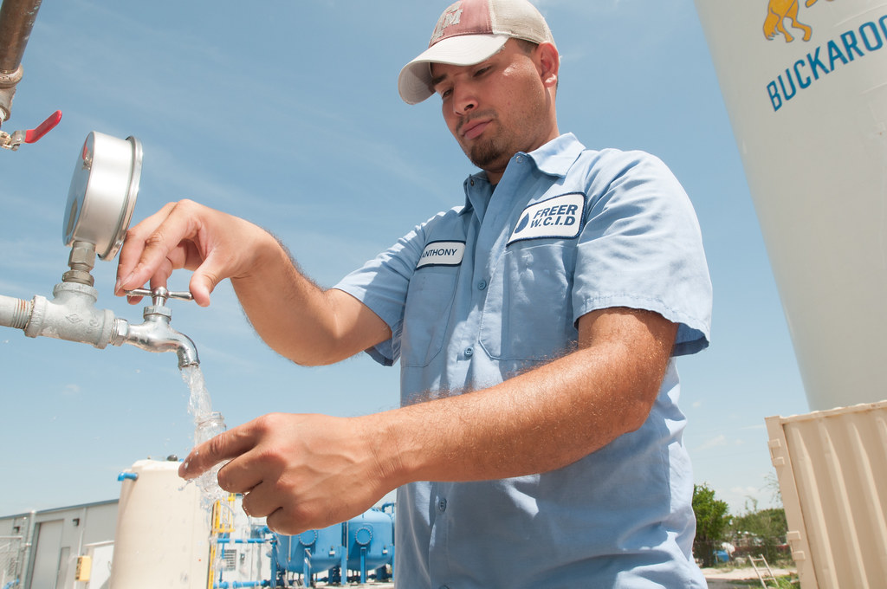
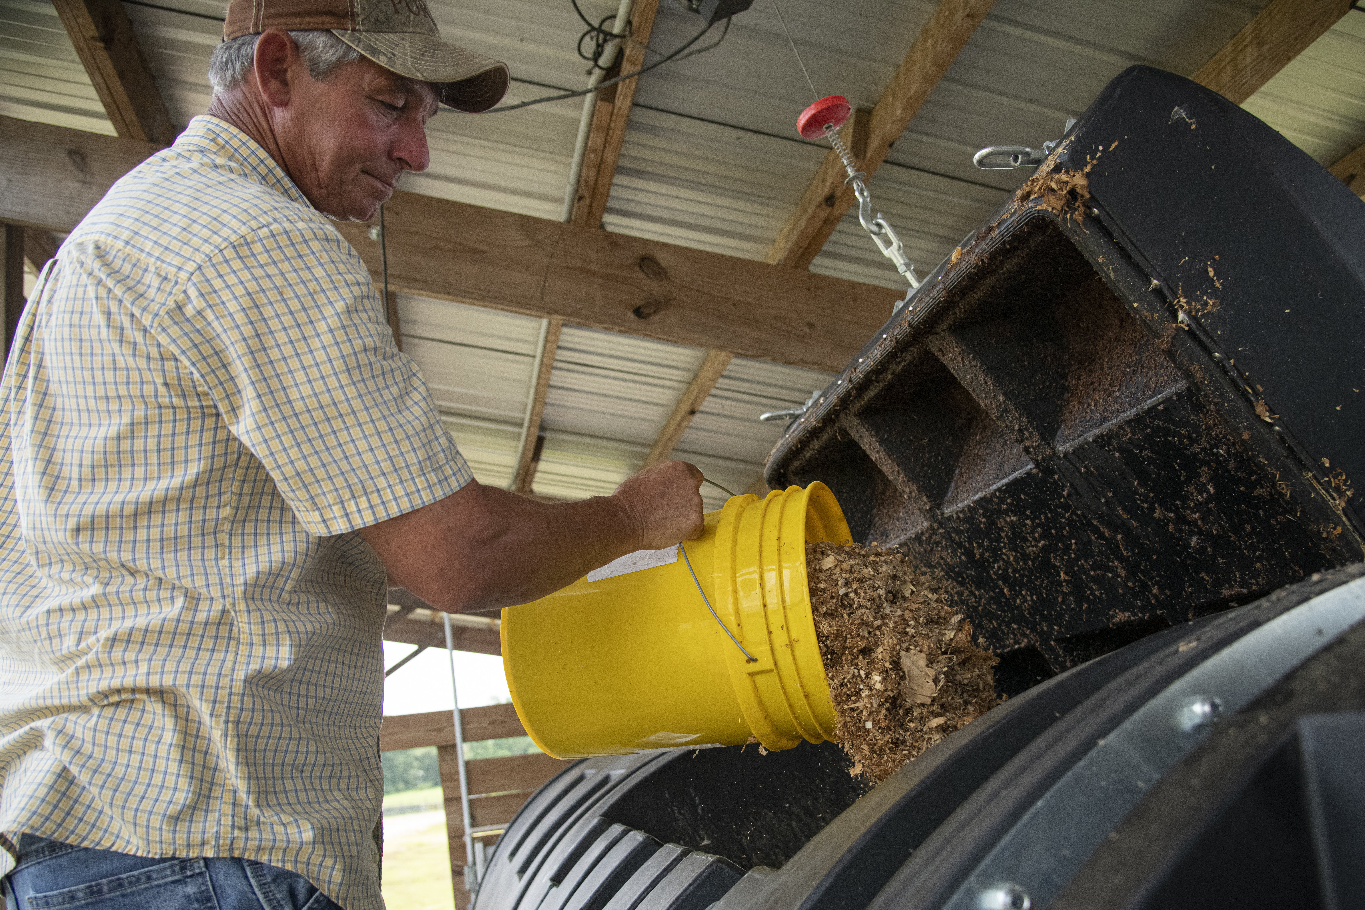
USDA GAP Audit
Reduce contamination risks using:
Worker training programs​
Water monitoring, testing, treatment
Manure and compost management​
Wildlife and animal monitoring ​
Sanitation programs
Notes:
The management of an establishment must ensure that all individuals who manufacture, process, pack, or hold food are qualified to perform their assigned duties.
Each individual engaged in manufacturing, processing, packing, or holding food (including temporary and seasonal personnel) or in the supervision thereof must:
Be a qualified individual as that term is defined in § 117.3—i.e., have the education, training, or experience (or a combination thereof) necessary to manufacture, process, pack, or hold clean and safe food as appropriate to the individual’s assigned duties
Receive training in the principles of food hygiene and food safety, including the importance of employee health and personal hygiene, as appropriate to the food, the facility and the individual’s assigned duties.
The goal of GAP audits is to reduce the risks through interventions like
Worker training programs
Water monitoring, testing, and treatment
Manure and compost management
Wildlife and animal monitoring
Sanitation programs

Slide 18
Water
Notes:
The first GAPs principle relates to water quality. The quality of water, how and when it is used, and the characteristics of the crop influence the potential for water to contaminate produce. Grower practices should protect and maintain water quality.
This is voluntary! But Most growers have incorporated these food safety “guidelines”.

Slide 19
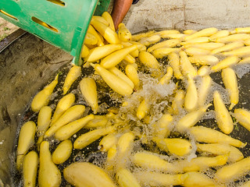

Sources of Contamination
Water
  Can carry and spread human pathogens, contaminating entire fields of large amounts of produce.
Production Contamination Sources
  Irrigation, crop sprays, frost protection, flood events
Postharvest Contamination Sources
  Fluming, cooling, washing, waxing, cleaning
Notes:
Practices that reduce the risk of contamination from agricultural water include: ensuring that wells are properly constructed and protected, treating water, and using application methods that avoid or reduce water-to-produce contact, such as drip irrigation, low volume sprays or underground irrigation. Agricultural water sources must also be tested for microbial quality, using tests for indicators of fecal contamination such as E. coli. Records of these water tests must be maintained, and frequency of testing is based on risk.
If the water does not meet these criteria, corrective actions are required as soon as practicable, but no later than the following year. Farmers with agricultural water that does not initially meet the microbial criteria have additional flexibility by which they can meet the criteria and then be able to use the water on their crops.

Slide 20
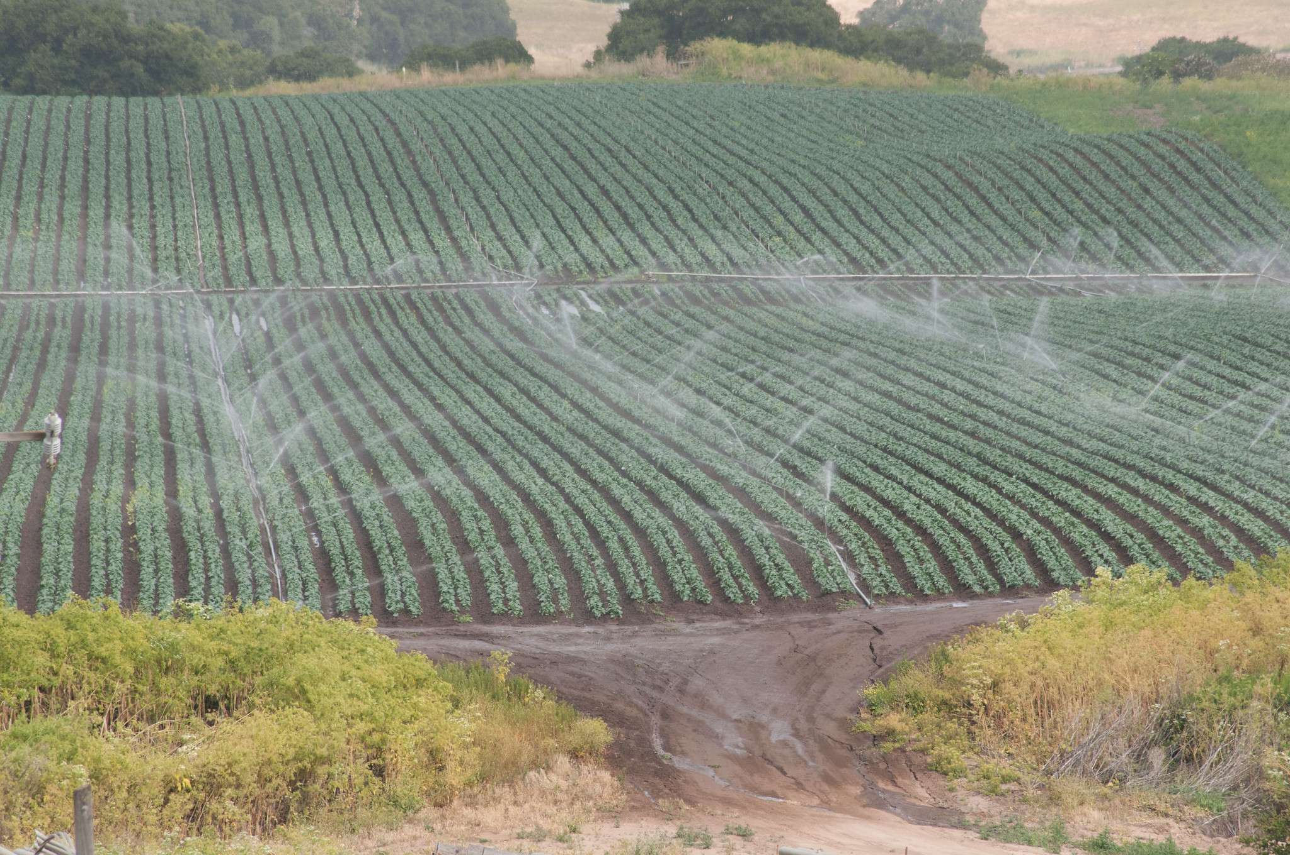
FSMA - Agricultural Water
Definition:
“Water intended to, or is likely to, contact covered produce or food contact surfaces”. All agricultural water must be safe and of adequate sanitary quality for its intended use.”
Applies to farms covered by the FMSA rule
Notes:
Agricultural water includes water used for irrigation, cooling, frost protection, application of fertilizers and pesticides or other pre-harvest purposes. Typical sources of agricultural water include municipal water, wells, rivers, streams, irrigation ditches, open canals, lakes, ponds and reservoirs. In some areas, agricultural water comes from surface waters, rivers, streams, and canals that travel some distance before reaching the produce field. Growers do not have control over factors that affect surface waters such as animal production, manure runoff, rainfall amounts, and septic system leakage. Water is sometimes used when harvesting produce, such as baby lettuces, to keep the product hydrated. Water used to wash produce must be meet drinking water quality requirements.
During GAP audits, growers are asked how and when water is used, and for what crop (s). Auditors will look for potential sources of contamination in and around the water source and ask to review records. If the water is from a municipal water source, a copy of the municipality tests or certification of the quality is acceptable as verification of water quality.

Slide 21
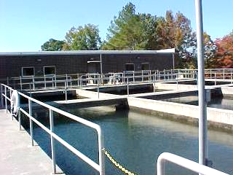
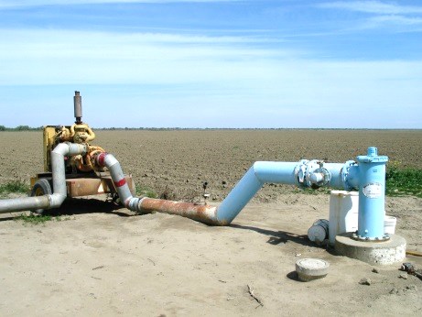
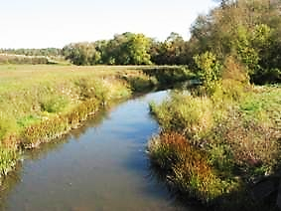
Probability of Contamination
  Lower Risk
  Higher Risk
  Public Source
  Ground
  Surface
  Treated
  Protected
  Open to Environment
Notes:
Testing determined by water assessment for intended use!
Agricultural water typically comes from three sources: public/municipal water, ground water from wells (capped or uncapped), and surface water. Using water that has been tested to verify that it is free of contamination is the lowest risk water you can use.
Ground water (e.g., well) is generally believed to be less likely than surface water to be contaminated with pathogens. As water filters through layers of soil, clay and rock, the microbial load is reduced before it reaches the aquifer.
Surface water includes rivers, streams, lakes, ponds, springs, manmade reservoirs and any water source that is open to the environment. The quality of water drawn from surface water sources can vary greatly. This is particularly true for surface waters that are subject to contamination events such as water run-off from upstream livestock operations or wastewater discharge.
Contamination of surface waters may be permanent, cyclical, or intermittent - for instance, water contamination issues are more prevalent in warmer months when water usage is high and temperatures are favorable for the growth of bacteria. All surface water used during the production of fresh produce should be tested for quantified generic E.coli.
Water Testing:
Municipal water: Test results are acquired from the local water authority annually or tested by the operation at least annually.
Well water: Tested one time during the growing season, if fecal coliforms are present, further actions are required.
Surface water – test quarterly – in warm climates CA,FL, TX and others when used year-round. Test 3 times during the growing season in Northern climates NY, PA, MI – first at planting, second at peak use, third at or near harvest
All post harvest water must meet the microbial standards for drinking water. For the purposes of USDA GAP audits, this is NO detectable generic E. coli.
Drinking water requirements – Defined by the EPA with limits set for microbial and chemical contaminants.

Slide 22
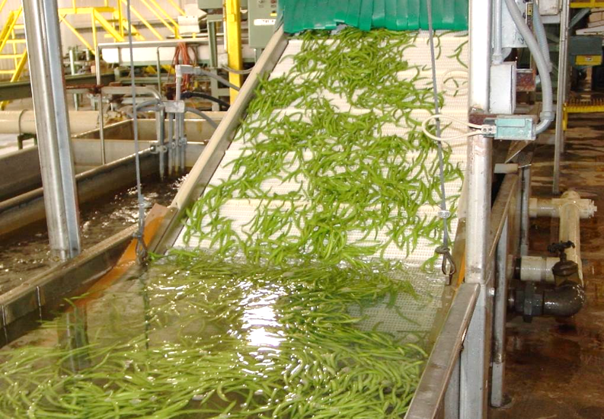
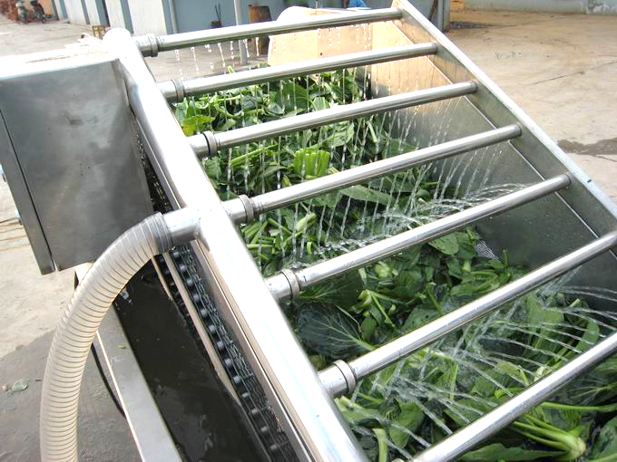
Postharvest Water
Every food safety risk in the field cannot be eliminated.
Postharvest water has the potential to spread contamination widely.
Notes:
Get’s the field heat out of the newly harvested product, this chills the product which will stop (or slow down) rather quickly, the maturing process- this will increase shelf life.
If a contamination event happens in the field, it could spread through postharvest water contact such as washing and cooling.
Postharvest water quality must be managed to reduce cross-contamination risks. This may include the addition of appropriate sanitizers or other treatment methods.
Controlling postharvest water quality reduces food safety risks, but also reduces risks from plant pathogens that could lead to postharvest rot and quality deterioration.
Human pathogens are easily spread through water, so controlling water through appropriate sanitation practices reduces risks.

Slide 23
Humans
Notes:
Principle three is worker health and hygiene, and training. Just as foodservice workers’ health, hygiene and training are essential to your food safety program, field workers’ personal hygiene is critical to the farm’s food safety program. GAPs require that field workers follow food safety practices that are similar to food service employee food safety practices. These practices include training workers on how and when to properly wash hands. Workers should also be trained to not handle produce when they are ill.
This is voluntary! But Most growers have incorporated these food safety “guidelines”.

Slide 24
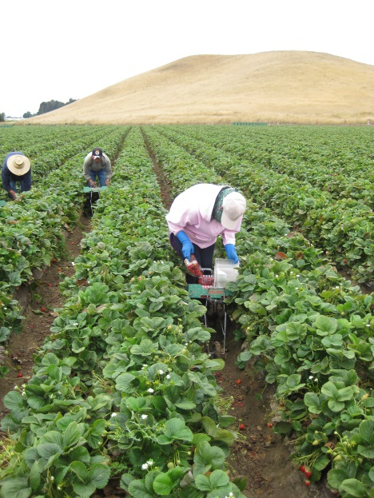
Sources of Contamination: Workers
Workers can spread pathogens to produce by directly handling fruits and vegetables.
Improper health and hygiene practices
    Lack of training and hand washing
    Lack of adequate toilet facilities
  Illness or injury
    Working while sick
    Injuries that result in blood
    contacting fresh produce
Notes:
If field workers are required to wear gloves, the workers must remove their gloves, wash their hands and put on new gloves every time that their gloves have been contaminated.
Clean, well-maintained toilet and handwashing facilities should be provided for field workers, close to where they are working.
These workers should only eat or smoke in designated areas.
Training helps workers recognize a food safety risk when they see it and encourages them to do something about it. Records should be kept of all training sessions. Training and verifying that workers are following good hygiene practices can reduce the risk for a foodborne outbreak.

Slide 25
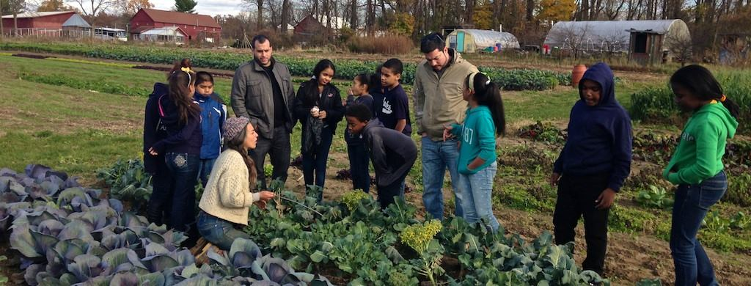
Sources of Contamination: Visitors
    Visitors should be trained in food safety practices.
Notes:
Workers who directly contact produce through activities such as harvesting and packing have the highest potential for contaminating produce.
However, others on the farm, such as visitors, office staff, and volunteers, can also contaminate produce.
It’s important that anyone in these environments should be trained on food safety basics to minimize food safety hazards.

Slide 26
Soil
Notes:
GAPs principle four is the use of manure and/or compost as soil amendments.
Since pathogens can survive in the soil, it is important to maximize the time between applying raw manure and planting and harvesting to minimize the risk of produce contamination.

Slide 27
Sources of Contamination: Soil Amendments
Soil Amendments:
Any chemical, biological, or physical materials intentionally added to the soil to improve and support plant growth and development.
Examples:
Fertilizers
Stabilized compost
Manure
Non-fecal animal byproducts
Peat moss
Perlite
Vegetable waste
Sewage sludge biosolids
Table waste
Agricultural tea and yard trimmings
Notes:
Soil amendments are any material added to soil to improve its physical and chemical properties, they include composted manure, raw manure, and municipal biosolids.
Recordkeeping is important for all soil amendment applications. Document what, where, when, how, and how much was applied. For compost, the composting process including monitoring time, temperatures, and turnings should also be documented. If purchase composted manure, ask for documentation providing the process used and the test results that show the process effectively controlled the pathogens. The Cooperative Extension is a great resource for proper composting procedures.
Manure and compost are common soil amendments. The final rule requires that untreated biological soil amendments of animal origin, such as raw manure, must be applied in a manner that does not contact covered produce during application and minimizes the potential for contact with covered produce after application.

Slide 28
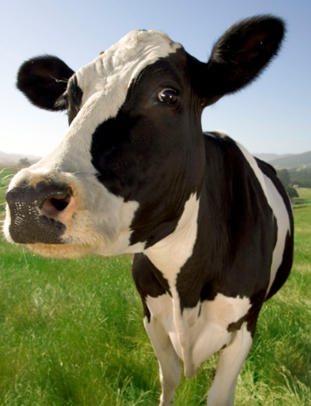
Manure & Compost
Risk assessment – if and when raw manure or biosolids are appropriate to use
Commodity-specific guidance
Raw manure:
  2 weeks prior to planting
  120/90 days prior to harvest
Product Covered:
Soil Contact (yes/no)
Notes:
If manure is not handled properly, pathogens could be introduced into the soil or onto the plant or produce. Farmers should keep logs to document how manure or compost is handled and when it is applied. Logs are reviewed during audits to ensure that the farm is following recommended composting procedures. Use of raw manure is of greater risk than composted or aged manure.
The location of stored manure on a farm is a concern because runoff after a rain could cause pathogens to spread to crops in fields. Farmers need to consider where they store manure to prevent runoff from reaching crops. Stored manure piles should be covered to help prevent spread into crop areas by the wind.

Slide 29
Animals
Notes:
Principle five is wildlife and animal management. Wild and domestic animals are a food safety concern because animal feces can be a source of pathogens. Animals can spread contamination around fields as they move. Farmers should use methods to limit or prevent wild or domestic animals from entering produce fields, such as fences or noise deterrents.

Slide 30
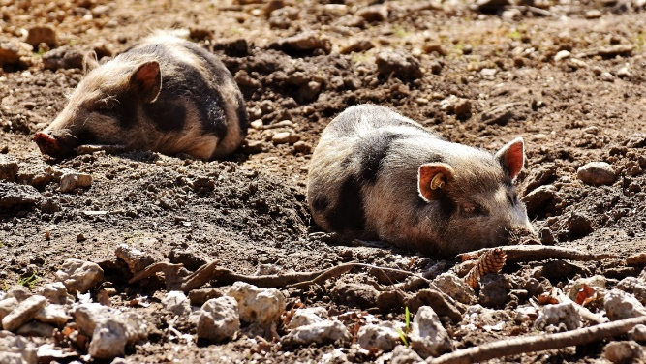
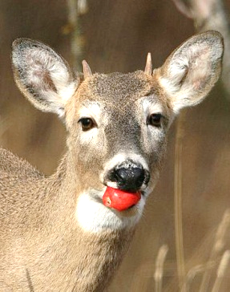
Sources of Contamination: Animals
  Domestic and wild animals can carry and transmit human pathogens to produce.
  May result in direct fecal contamination of crops and fields.
  Animal feeding, rooting, and movement
  Animals can contaminate water sources
  Manure run-off can contaminate fields
Notes:
Both domestic animals (e.g., cattle, chickens, pigs, family pets) and wild animals (e.g., deer, geese, wild pigs) can carry pathogens in their feces and spread contamination by tracking feces through the field as they move.
It is important to monitor and document animal activity in the field and to conduct field assessments prior to harvest. Growers should train workers to monitor for animal activity in production fields. Farmers and workers should be diligent to monitor and prevent animal activity in the fields, especially near harvest time in order to avoid harvesting crops that may have been contaminated by animal feces.
Produce can be contaminated directly by feces or through cross-contamination from water or wildlife movement.

Slide 31
Buildings, Equipment, and Tools
Notes:
Any surface that touches produce is a potential source of contamination. Such surfaces include equipment, belts, rollers, brushes, tables, bins, sinks, tools, and the hands of workers. Surfaces that contact produce should be easily cleaned and sanitized.
This is voluntary! But Most growers have incorporated these food safety “guidelines”.

Slide 32
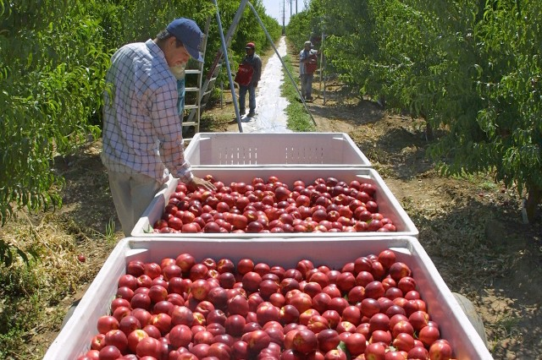
Sources of Contamination: Equipment
Continue produce safety practices by keeping things clean during harvest and postharvest handling.
Consider everything that touches, or impacts produce:
  Picking and packing containers
  Packing equipment
  Packing area (open or closed environment)
  Hands and clothing
  Buildings (i.e., coolers, storage areas)
  Transport vehicles
Notes:
What are some potential food safety and sanitation risks do you see in this photo?
Person touching produce? Gloves? Bins in contact with produce? Cleaned? Various materials and people have access to our produce.
Produce can be transported from the field to the packing area or from the farm to market. No matter where the produce is going, it needs to be transported in a way that reduces the risks of contamination. Keeping produce safe during transportation is important and often the last step in delivering safe produce to the customer.
Keeping your delivery vehicle free of dirt, debris, and pets will reduce contamination risks and send the message that you care about all aspects of food safety from the field to the final customer. Maintaining the cold chain with refrigeration may also be important to some farms. If transportation vehicles have refrigeration units, they should be monitored and properly maintained to make sure they hold produce at the appropriate temperature. Even if you do not have a vehicle with an automatic temperature monitor and refrigeration unit, you can still apply practices that keep the vehicle at an optimal temperature to protect the produce during transport. Properly cleaned, packed, and temperature-controlled cargo areas will help minimize produce contamination, loss, and damage in transit.

Slide 33
Produce Distributors
Notes:
Produce is transported from the farm, through the supply chain, to your back door. Produce travels on trucks, ships, trains, and planes during distribution. Preventing cross contamination and maintaining temperatures for quality and safety are top priorities.

Slide 34
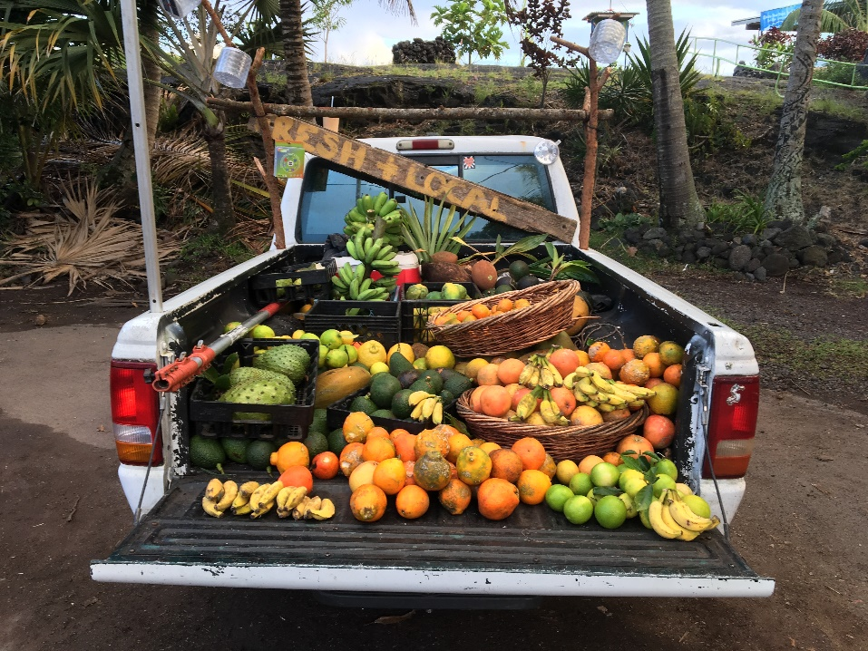
Distributors
Produce Distributors (including cooperatives and food hubs) must adhere to FSMA rules including:
  Current Good Manufacturing Practices (cGMP)
  Food Traceability
  Food Defense
  (intentional contamination)
  Sanitary Transportation
Notes:
Produce should be protected from potential contamination by workers while loading and unloading the product. Trucks should be loaded to prevent damage to fresh produce. If the outer skin of produce is broken, it becomes more susceptible to contaminants. Vehicles should be clean and operators should be aware of what was transported previously. A vehicle that recently transported chickens, for example, would not a good vehicle for transporting produce as there could be contaminants remaining in the truck bed. Good quality, intact produce is most resistant to microbial contamination and growth. Maintaining temperatures that promote optimum product quality also helps to reduce the risk of microbial hazards.
Distributors must adhere to cGMPs, traceability, food defense, and sanitary transportation requirements.
An audit service for produce distribution centers was announced on March 21, 2022, and will be effective June 1, 2022.

Slide 35
GAP Audit/Certification
Notes:
Most buyers require farmers to pass a GAPs audit in order to sell product to their company because they want to make sure that they are purchasing safe food. The U.S. Department of Agriculture (USDA) and many private third- party audit companies provide GAPs audits.
If your district buys from an organization that requires farmers to obtain a GAPs audit, then your district does not have to review the audit forms and document that on farm food safety practices are being followed although, it doesn’t hurt. Districts that purchase directly from the farm may choose to require a GAPs audit. If you are purchasing produce through a distributor, the distributor usually requires farms to have a GAPs audit, and will have verification available for you to review.

Slide 36
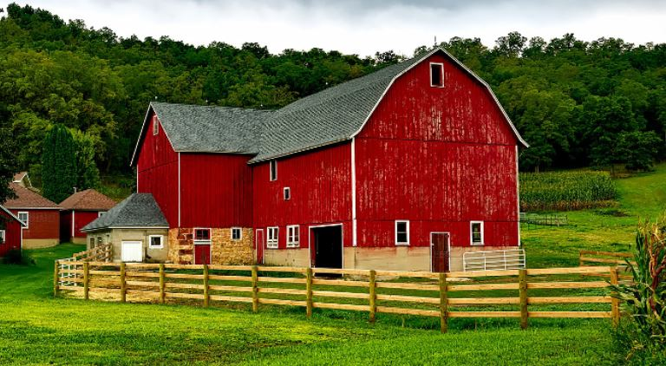
Buying From GAP Certified Producers
Must I buy from a GAP certified producer?
There is NO federal requirement that child nutrition operations purchase from GAP certified producers.
Many growers use GAP practices but have not gotten the certification.
You can conduct an informal audit to make sure that you are comfortable with the producer’s food safety (good agricultural) practices and plans.
Notes:
The Produce Rule applies to covered farms doing covered activities on covered produce. Each of these terms has a specific definition in the Produce Rule. Therefore, if what you are doing on your farm does not fit these terms, then you are likely exempt from the rule.
A covered farm is one that annually gross more than $25,000 in sales of produce, averaged across a rolling three-year period, and adjusted for inflation (with 2011 as the baseline year). · This means that farms with $25,000 or less in annual gross produce sales (based on a rolling average of three years’ worth of sales and adjusted for inflation), are not covered by the Produce Rule.
A covered activity means growing, harvesting, packing, or holding covered produce on a farm. These definitions – of farm, harvesting, packing, etc. – are the same for both the Preventive Controls Rule and the Produce Rule. · This means that the rules only apply to activities within the definitions of “growing, harvesting, packing, and holding.” These rules do not apply to other activities on a farm (e.g. making cheese, or other value-adding processing activities), though those activities may be subject to other FSMA regulations, including the Preventive Controls Rule.

Slide 37


Locating GAP Audited Growers
https://www.ams.usda.gov/services/auditing/gap-ghp
Find a USDA Gap-Certified Company
By Location
By Commodity
By Company Name
By Audit Type, Commodity, Location and Company
Notes:
Finding a “Local” grower can be as easy as entering the area you are in and then the commodity you wish to purchase.
State, Address, Company name

Slide 38
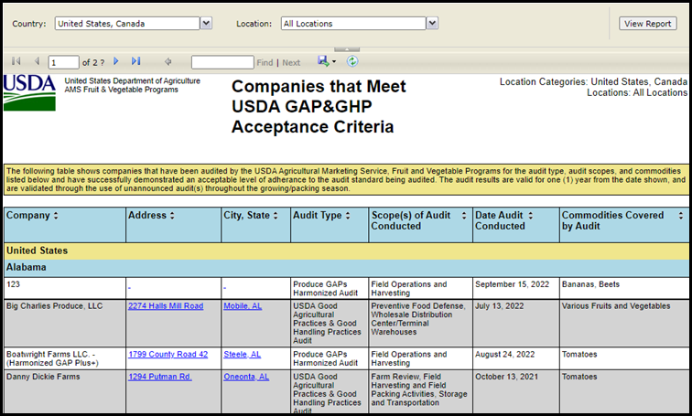
Locating GAP Audited Growers, Cont.
Notes:
USDA AMS also has ways for you to identify what GHP (Good Handling Practices) are met by different companies.

Slide 39
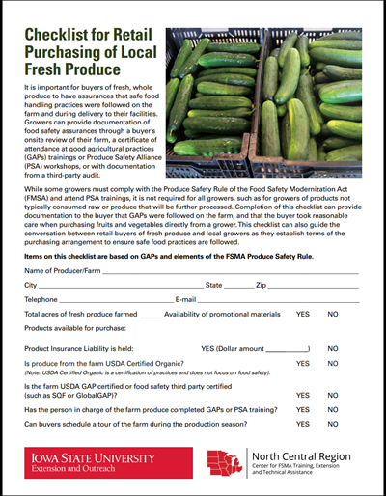
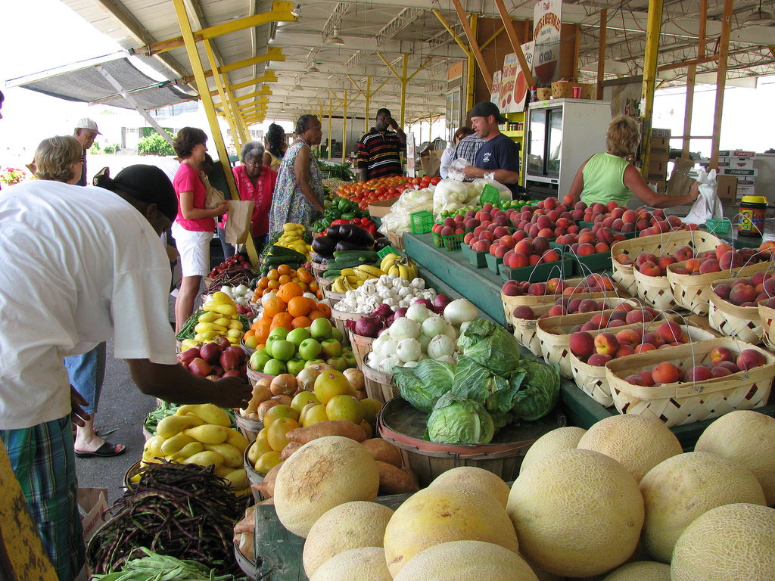
Buying Local Checklist
https://store.extension.iastate.edu/product/Checklist‐for‐Retail‐Purchasing‐of‐Local‐Produce
Notes:
Local farmers who are not GAPs audited, but who want to sell product to the schools, may opt to conduct a self-audit of their farm using one of the checklists, such as the assessment tool available from Iowa State University.
Self-assessment checklists, like the one developed by Iowa State University Extension, are designed to foster a conversation about food safety between the farmer and the buyer. School districts may give the checklist to the farmer, or make a site visit to the farm, and talk through the questions like an interview. It consists of five major areas based on Food and Drug Administration’s (FDA) eight GAP principles. Visiting the farm and discussing GAPs will help the farmers to understand the importance of farm to fork safety for your schools, and may also help to strengthen your relationship.

Slide 40
Summary
Identified on the farm best growing practices for fresh produce to reduce the risk of foodborne illness.​
Reviewed previously voluntary growing practices and Good Agricultural Practices that are now required by the FSMA.
Notes:
FSMA - If you grow, pack, process, or sell fresh produce, this regulation may apply.
These guidelines can be applied to anyone growing fresh produce for consumption.
Identify on the farm best growing practices for fresh produce to reduce the risk of food borne illness.​
Recognize previously voluntary growing practices and Good Agricultural Practices are now required by the Food Safety Modernization Act (FSMA).

