Slide 1
Quality and Condition
Take Home Training
Credit: 1 Hour Codes: 2400, 2410, 2600, 2620
Notes:
Note to instructor: Welcome participants to this training session.

Slide 2




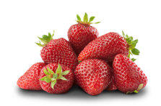
Objectives
Define and explain the difference between quality and condition defects.
Understand the relationship between defects/grade and cost.
Differentiate between cosmetic defects, defects that impact taste, and defects that are food safety concerns.
Notes:
Note to instructor: Review the learning objectives with the participants.

Slide 3

Making the Grade
Notes:
Your specifications may include grades, so you need to understand what the grades mean in order to write good specifications to get the product you desire.

Slide 4
Grades
Recognized by the fruit, vegetable, nut, and specialty crop industry as an essential element in resolving disputes of product quality.
Promote efficiency in marketing and procurement.
A common language for trading where the commodity cannot be readily displayed or examined by the prospective buyers.
Available at no cost on the USDA Grades and Standards website.
Notes:
The Agricultural Marketing Service (AMS) develops descriptions for fresh produce quality and condition called U.S. Grade Standards. This uniform language is used to describe measurable quality and condition defects or absence of defects.
Grade standards help the buyer and the seller. Clearly defined “terms” allow you to know what you are buying without seeing the product.
The buyer knows what he/she is getting for the money. The seller doesn’t have to worry about produce being returned and having unhappy customers. Plus, the seller can demand a higher price for better quality produce.
Resources:
https://www.ams.usda.gov/grades-standards
Special photo guides, models, color standards, and other visual interpretative guides are available for reference to specific U.S. Grade Standards. More information about visual aids >

Slide 5

Quality
Notes:
Quality defects occur during the growing process or as the product was being packed, but do not get worse with time.

Slide 6
What Does Quality Mean?
The standard of something as measured against other things of a similar kind; the degree of excellence of something; a distinctive attribute or characteristic possessed by someone or something.
Reputable symbols of the quality and integrity of American agricultural products.
Common language.
Official grade standards and processed product standards are developed, maintained and interpreted by USDA’s Agricultural Marketing Service.
Quality Defects
Notes:
The USDA grade shields, official seals and labels are reputable symbols of the quality and integrity of American agricultural products. Large-volume buyers such as grocery stores, military institutions, restaurants, and even foreign governments use the quality grades as a common “language," making business transactions easier.
The USDA shields and labels assure consumers that the products they buy have gone through a rigorous review process by highly-skilled graders & auditors that follow the official grade standards and process standards are developed, maintained and interpreted by USDA’s Agricultural Marketing Service.

Slide 7
Communication
Clearly defined “terms” allow you to know what you are buying without seeing the product.
Communication
At the farmers’ market or grocery store you can select the exact piece of produce you plan to buy, decide if it meets your standards, and if you are willing to pay the price charged.
Purchasing in bulk and making advance orders, you will NOT see the produce before you decide to buy.
Quality standards allow you to communicate directly with industry using common language that is “standard” throughout the produce life cycle.
Notes:
When you go to the grocery or farmers market to select produce you can see exactly what you are getting. You browse the appearance and determine the quality and condition based on sight and what you are looking for. You do not have this benefit when ordering for your school nutrition programs. You have a list from which to select and hope for the best when it arrives. By learning the common language, you can communicate and specify the quality and condition of the items you are purchasing, and you have the common language to communicate things if they are not what you expected or specified.

Slide 8


Defects
Quality defects are permanent factors that affect produce that will not change.
Commonly referred to as “Grade” defects.
Directly determine the “U.S. grade designated”.
Examples:
Scars, misshapen, undersize.
Notes:
Quality defects occur prior to harvest. The shape/size of a strawberry will not change after harvest for example. These things happened during the growing and development of the produce and will never change. The defects are referred to as quality defects and they directly determine the grade assigned. Typically, quality defects have no impact on the taste or nutritional value of the item. Quality defects are usually visual driven defects and can be function driven defects depending on the end use of the product. Lets look at some common quality defects.

Slide 9
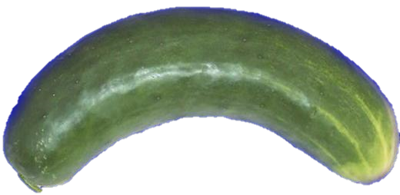
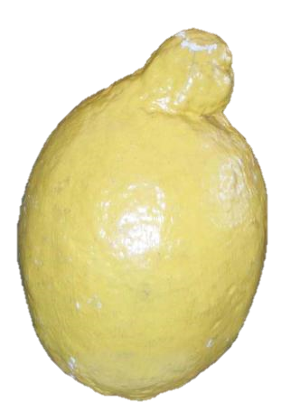
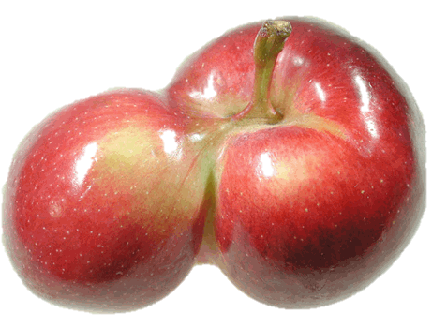
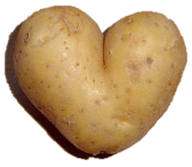
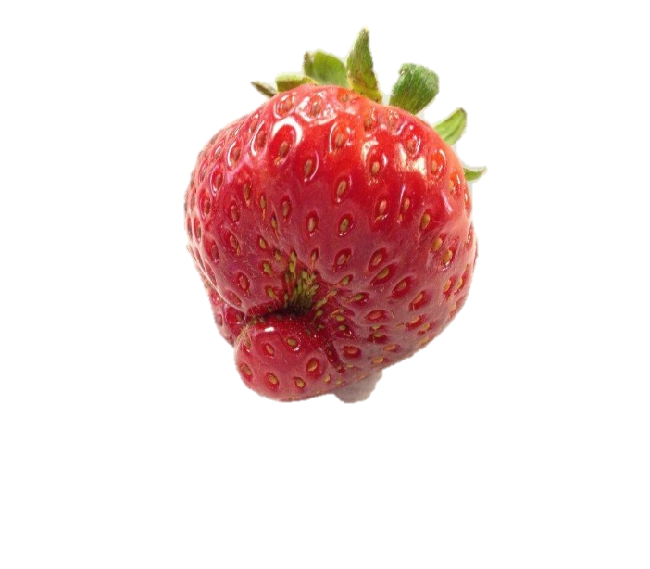
Quality: Misshapen
Notes:
Produce shape may be altered because it is grown outside in uncertain conditions. It is difficult to control Mother Nature and her armies of insects, excess sun, rain, etc. Quality defects do not get worse over time. This cucumber will not get any more crooked, nor will it suddenly become straight.
Are you ever going to see a cucumber that crooked in a case that you get from your distributor? The farmer, the processor, or the distributor sorts products during grading and packing. For example, all the crooked cucumbers might be separated out from the cucumbers that make the highest grades. They might all get sold at a much lower price to someone who can use them even though they are crooked, maybe to a company that makes vegetable juice or who will run them all through a machine to chop or dice them.
Quality defects related to shape do not affect safety or taste. When your specifications state the apple must meet U.S. No. 1 requirements, the apple in the picture on this slide does not make the grade. It will taste exactly the same as a U.S. Extra Fancy apple. However, it may not fit through your fruit sectioning equipment. If you are planning to make applesauce, it may be acceptable.
The cost of misshapen produce should be at a cheaper rate since stores and markets usually want the best looking fruit. You can state that your school will accept misshapen produce at a reduced rate if you are not serving the produce whole. For example slicing the cucumber for a salad.

Slide 10
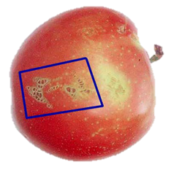
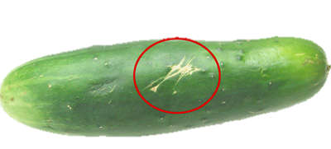
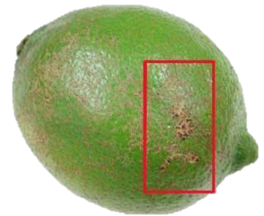
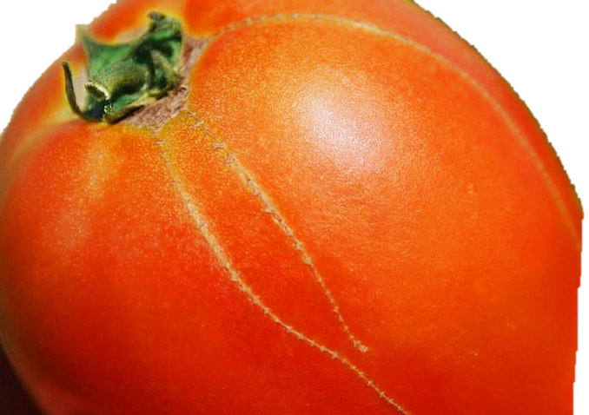
Quality: Scars
Notes:
The following quality defect is referred to as “scars” Notice the circled areas on the cucumber, lime, tomato and apple. What do you see? What would you do if this was the produce you received?
The USDA standards specify the size and/or depth of scars before the product is not a US No. 1.
This scar did not happen in the box; it happened in the field. When immature fruits or vegetables are injured, or the skin or rind gets a scrape on it, the fruit or vegetable will try to heal itself. Just like when you get a scrape, your body may scar during the healing process. The scars will not get bigger.
What is the food safety concern of scarred produce? In general, scars do not cause a food safety issue and are simply unsightly and can be removed by peeling. Again, this is only affecting the look of the produce and not actually the edibility, so the price should be lower. If a scar penetrates the skin/rind it would then become a skin break or cut, which would be evaluated differently.
Think about the end use of the item, if you are slicing the cucumber, will anyone see the scar? What about making salsa, or slicing tomato's, will the scar affect the appearance after you have prepared it for end use?

Slide 11
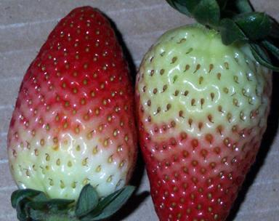
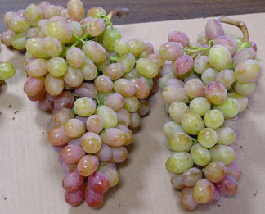
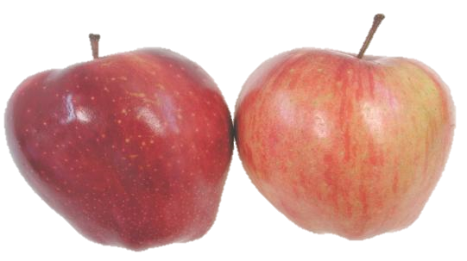
Quality: Poorly Colored
Notes:
Color is also a quality defect if the produce does not have the color considered to be characteristic of that particular product. The color requirement depends on the variety and the grade. Color defects do not affect product safety.
Strawberries must have three-fourths or more of the surface area a pink or red color to be considered a high grade. That means there might be a lot of white color (25%) on your U.S. No. 1 strawberries. Is that okay with you? What if you want your strawberries to be all red? Could you write that in your specifications? Keep in mind that anytime you ask your supplier to sort or pack your produce in a specific way, you will pay more.
Lower grade strawberries may have more white color on the surface. If you specify a lower grade strawberry, such as U.S. No. 2, you may receive strawberries that are mostly white or are misshapen. However, a U.S. No. 2 strawberry may be completely acceptable to use if you are slicing and placing them in fresh fruit cups.
These grapes are supposed to be red grapes. They would be considered poorly colored and not U.S. No. 1 by inspectors. However, would you still eat them? They may have a great taste and could be served with fresh red apple slices for contrasting color.
Both of these apples are probably acceptable in your school meals program. The well- colored red apple in this photo may grade higher and cost more just because it is considered to be “more red” according to the grade standards. Again, the intended use is key when you consider appearance and quality defects.
This is different than the color which can be indicative of ripeness. These fruits are of a poorly colored quality- meaning that these colors will not improve as the produce ages. The cost of this produce should be reduced but you need to consider that even if it’s at a reduced rate will the students eat the fruit even though it doesn’t look like it should? There is no use in receiving poorly colored produce if it will go uneaten.
What is the issue with poorly colored produce?
There is no food safety risk, but most varieties of strawberries will not be as sweet as ones that are nearly full red. Most varieties of table grapes with low color berries may be a bit sourer, however there are varieties that do not get as much color in hot weather as in cold weather. The sweetness of grapes is dependent on the soluble solids, which has a minimum in the USDA standards. We will discuss the use of Apple color in a few more slides.

Slide 12
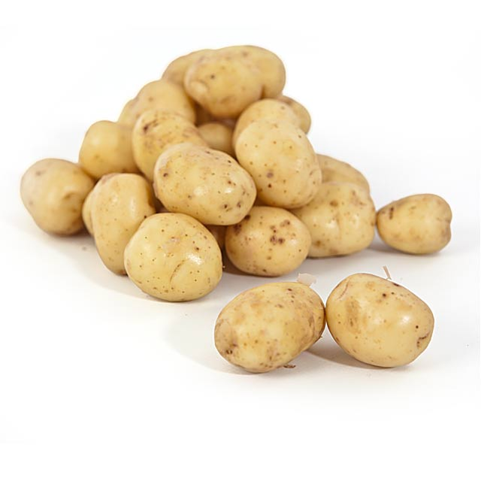
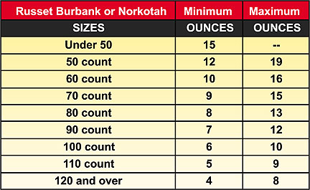
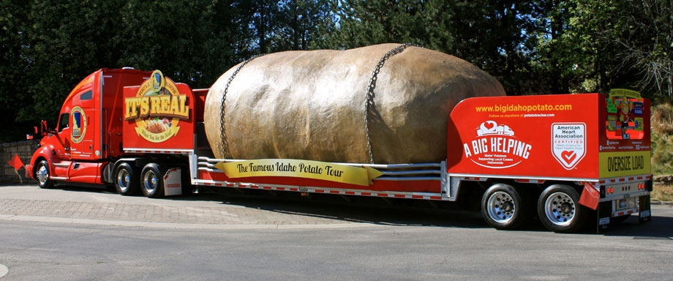
Quality: Size
Many products have a minimum/maximum size
U.S. No.1, 1 7/8 inches in diameter
Notes:
Before we talk about condition defects, I want to point out that many times size is also a part of Grade Standards. For example, a U.S. No.1., Potato has a minimum of 1-7/8th inches in diameter. This minimum can also be designated by the customer to be larger or smaller in diameter or weight. When ordering, size can be designated, but it may affect the price. Larger potatoes are generally more expensive, except for the specialty sizes such as B’s or C’s, which have a minimum and maximum diameter. Size in conjunction with Grade U.S. No.1., 100 size must meet - not less than 6 or more than 10 ounces in weight.

Slide 13
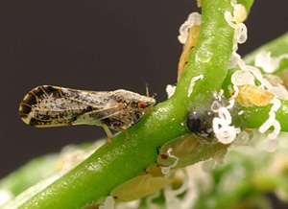
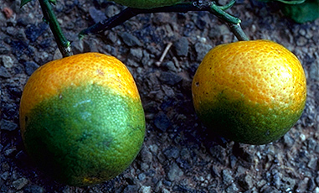
Plant Diseases Affecting “Quality”
Citrus Greening - 2005
Asian citrus psyllid - feeds on the leaves and stems
It is a bacterial disease that has wiped out much of Florida’s citrus industry in the past decade.
Fruit is green, misshapen, has a bitter taste and is not suitable for human consumption.
Notes:
Citrus greening is spread primarily by gnat-sized insects called Asian citrus psyllids (Diaphorina citri Kuwayama).
These invasive pests transmit the disease to citrus trees and other host plants when they feed on the leaves and stems.
Causative agents are motile bacteria, (they can move on their own once plant in infected) The disease is vectored and transmitted by the Asian citrus psyllid
huánglóngbìng; (who-nun-long-bing) literally: "yellow dragon disease"; or HLB- is a disease of citrus caused by the vector-transmitted pathogen Candidatus Liberibacter spp.

Slide 14

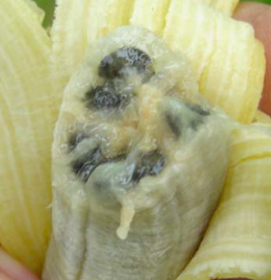
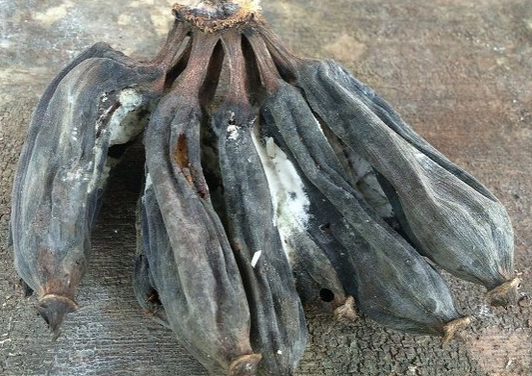
Plant Diseases Affecting “Quality” Cont.
Fusarium Wilt Bananas
A bacterial plant disease wiped; out the Gros Michel variety.
Cavendish variety now being affected.
Notes:
Discussion about plant disease
Panama disease is a plant disease of the roots of banana plants. Panama disease, or Fusarium wilt of bananas is caused by the soilborne fungus.
It is a type of fusarium wilt, caused by the fungal pathogen Fusarium oxysporum f. sp. cubense (Foc). The pathogen is resistant to fungicide and cannot be controlled chemically.
In the 1950s a deadly strain of the fungus causing Fusarium Wilt (Panama disease) wiped out almost all banana plantations in Central and South America-Gros Michel variety. The Cavendish variety was resistant to the type of Fusarium that was causing Fusarium Wilt and widely planted across the globe to take the place of affected species. The fungus has mutated and now the Cavendish variety is susceptible to the fungus. Fusarium wilt disease cannot be treated with the application of fungicides or other chemical treatments, leading to widespread loss of banana plants.
There are no US grades for Bananas, this is where common language comes into play. While a grade standard does not exist, you can apply the same terms to a product with quality and condition defects. The fungus is not harmful to humans and not a food safety concern.

Slide 15

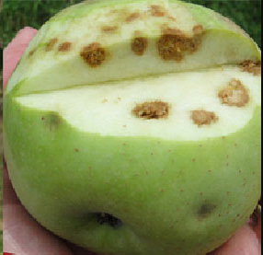
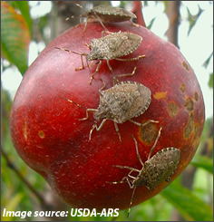
Insects Affecting “Quality”
Brown Marmorated Stink Bug
Injury not immediately noticed at harvest.
Insect sting at indentation site.
Underlying flesh appears as brown corked areas.
Affects price of unaffected apples.
Notes:
Discussion about insects
There are 4 types of injury that appear similar, Hail, Stink bug, Bitter pit and Apple maggot. Annually there is 37 MILLION in damage to apples in MD, PA, VA, WV, That’s 18% of total crop affected. Injury does not express itself immediately on the fruit which makes detection difficult. An apple recently fed upon by the stink bug will likely be harvested and stored without blemish, only to find the same fruit with very high levels of fruit damage after its removal from cold storage. Many times, the exterior appearance of the fruit will not revel the internal damage. It is important to cut samples of fruit to examine interior quality.
For all commodities, report damage by insects as a quality defect if the insects are dead. If insects are alive, score it as a condition defect. When both dead and
live insects are present in the sample, score as a condition defect. In most cases if dead insects are found in cases of produce it is likely they were present at harvest and packing. If live insects are discovered, it is probable the infestation occurred during storage and shipment. The live insects are more likely to cause condition defects because the produce can not heal itself once harvested.
Depending on the insect, the presence of either live or dead may pose a food safety threat.

Slide 16

Condition
Notes:
Condition defects worsen over time and occur during picking, packing, and shipping, or after the growing process.

Slide 17
What is a condition defect?
Condition is the relative degree of soundness or preservation of a product and includes, but is not necessarily limited to, its firmness, or stages of:
Condition Defects
ripeness,
decay,
shriveling,
or any other progressive factor which affects its marketability.
Notes:
Condition defects reduce shelf life, become a vector for the introduction of pathogens and will only continue to degrade the consume-ability of the produce.
Developing or progressive factors.
Condition defects are defects that will progressively get worse. Condition defects occur after harvest. These defects usually occur in transit or storage and are considered separately from quality defects. A product may fail to meet the grade assigned but only due to the condition defects that affect them.

Slide 18
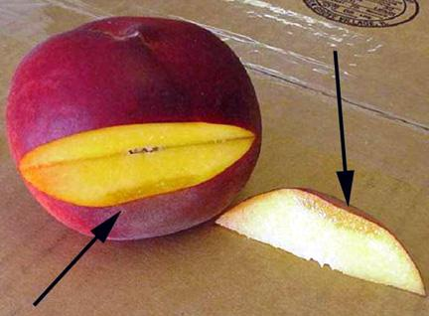
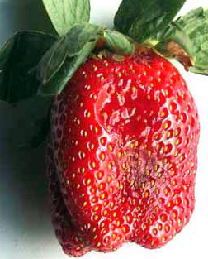
Condition: Bruising
DEPTH
AREA
Notes:
Now we are going to talk about condition defects. The first example of a condition defect is bruising.
A farmer has to pick the product, put it in a container, process it, and put it on a truck, airplane, or train to get to you. Through these steps, the product may get bumped, banged, or dropped and bruised.
Condition defects may get progressively worse over time—either between the point at which it is graded and when the produce gets to you, or after the produce gets to you and is stored in the refrigerator. Remember, quality defects will not get worse over time, but condition defects will. Bruises may get softer or bigger over time, or may change the taste or texture of the product.
Bruised spots present ideal conditions for microbial growth and, therefore, can present a food safety risk. Bruises can serve as an entryway for surface microorganisms. Once microorganisms (including pathogens) are internalized they cannot be removed and microbes will thrive in the nutrients provided by the flesh of the produce.
Current FDA food safety guidance for consumers is to cut away damaged or bruised areas before preparing/eating, but cutting out and throwing away the bruised produce will cost you more money because you will need to purchase more product to reach your desired yield.

Slide 19
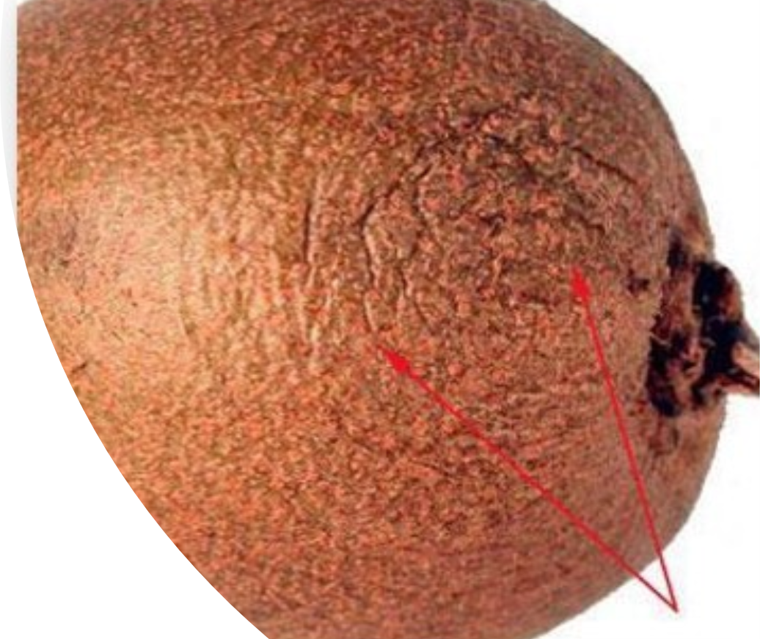
Condition: Shriveling
Shriveling, another condition factor is caused by loss of moisture.
The longer produce is held in storage, it loses moisture causing it to shrivel.
Products become flabby or wilted as a result of shriveling.
Exposure to cold temperature can also cause some products to shrivel.
Notes:
Shriveling is our third condition defect. Produce contains a lot of water—for example, watermelon is 95% water. As produce gets older, it loses moisture and it starts to shrivel.
One reason produce might shrivel is due to temperature fluctuations. If you have ever taken plums out of the refrigerator to ripen and then placed them back in the refrigerator, they shrivel up. Maintaining the cold chain helps to prevent dehydration and shriveling.
You may be tempted to soak produce in water or ice water to “crisp” it. This practice is not recommended because certain fruits and vegetables are susceptible to infiltration of surface microorganisms during soaking or submersion. This is especially true of tomatoes.

Slide 20
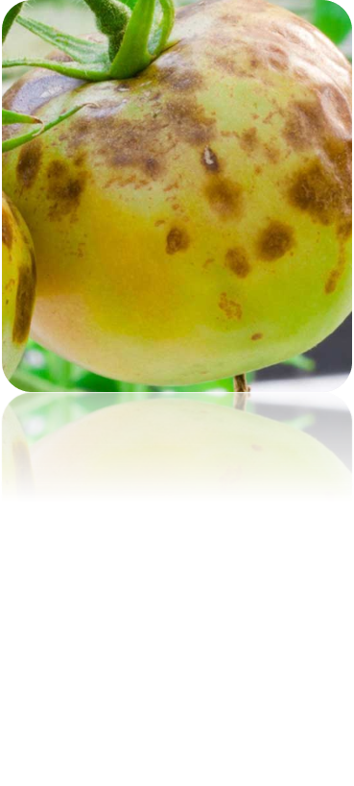
Condition: Discoloration
Discoloration will usually progress.
They may be caused by a multitude of factors.
Low temperatures
Rubbing
Bruising
Storage with something that might cause discoloration.
Notes:
Discoloration may indicate that spoilage is near or that the product has been damaged. If this is the case, then there is potential that microbes could thrive in these areas and gain entrance to the produce where they’ll have access to nutrients. If you accept discolored produce, are you able to use the product right away? Be careful because this defect gets worse with time, and you may have to end up throwing away produce.
This condition defect is called surface discoloration. Has anybody ever seen a potato like this one? What would happen if you stored it for a few days and then decided to use it? The brown spots will be bigger. It may even be brown inside and soft. It will definitely deteriorate more quickly than a potato without surface discoloration.

Slide 21
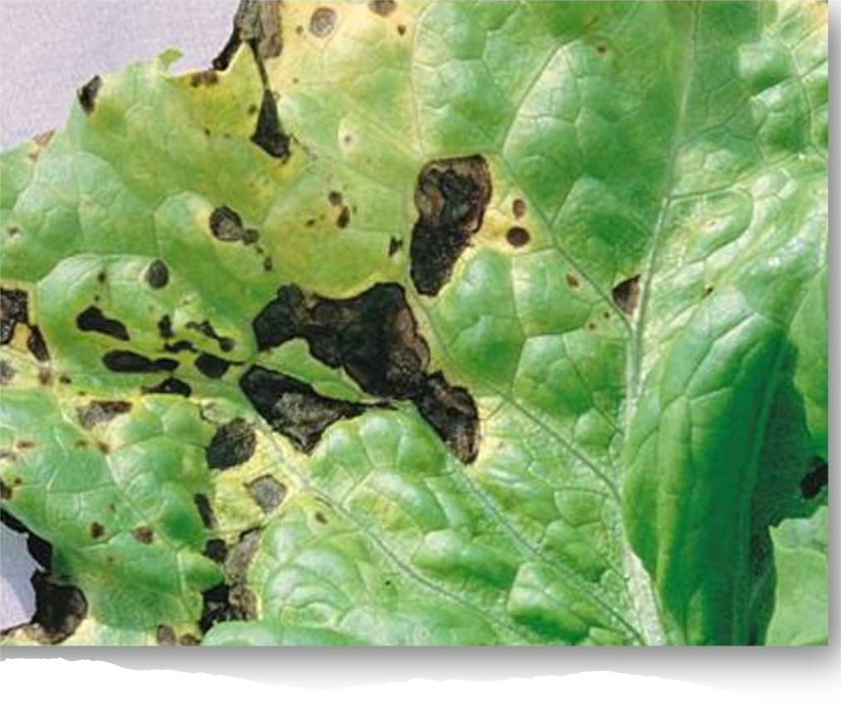
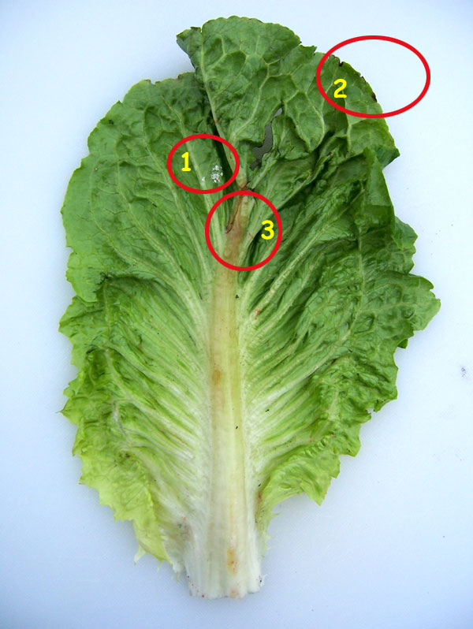
Condition: Discoloration, Cont.
Notes:
What is the food safety risk of condition discoloration?
Discoloration may indicate that spoilage is near or that the product has been damaged. If this is the case, then there is potential that microbes could thrive in these areas and gain entrance to the produce where they’ll have access to nutrients. If you accept discolored produce, are you able to use the product right away? Be careful because this defect gets worse with time, and you may have to end up throwing away produce.
http://www.ipt.us.com/produce-inspection-resources/inspectors-blog/defect-identification/romaine-rib-discoloration

Slide 22
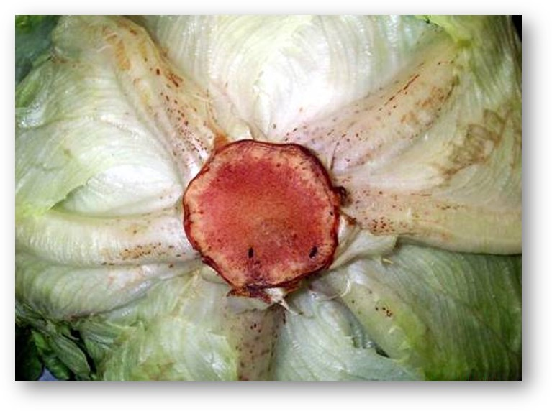
Condition: Russet Spotting
This occurs over time, especially when lettuce is stored with fruits that generate ethylene, a natural ripening agent.
Two well known ethylene emitters are apples and bananas.
Don’t store lettuce in the same refrigeration unit as either of these, as Russet Spotting will result.
Notes:
How do you score Russet Spotting?
1 spot on 3 or more leaves
More than 5 spots on 1 leaf
Is russet spotting a quality or condition issue?
There is no condition issue, it’s just unsightly. According to scientific studies, russet spotting is strictly a visual defect. Even if this defect doesn’t present a safety hazard, we should be careful to avoid this as the students are likely to throw away spotted lettuce instead of eating it.
If the product goes uneaten then no money will be saved by accepting this defect.

Slide 23
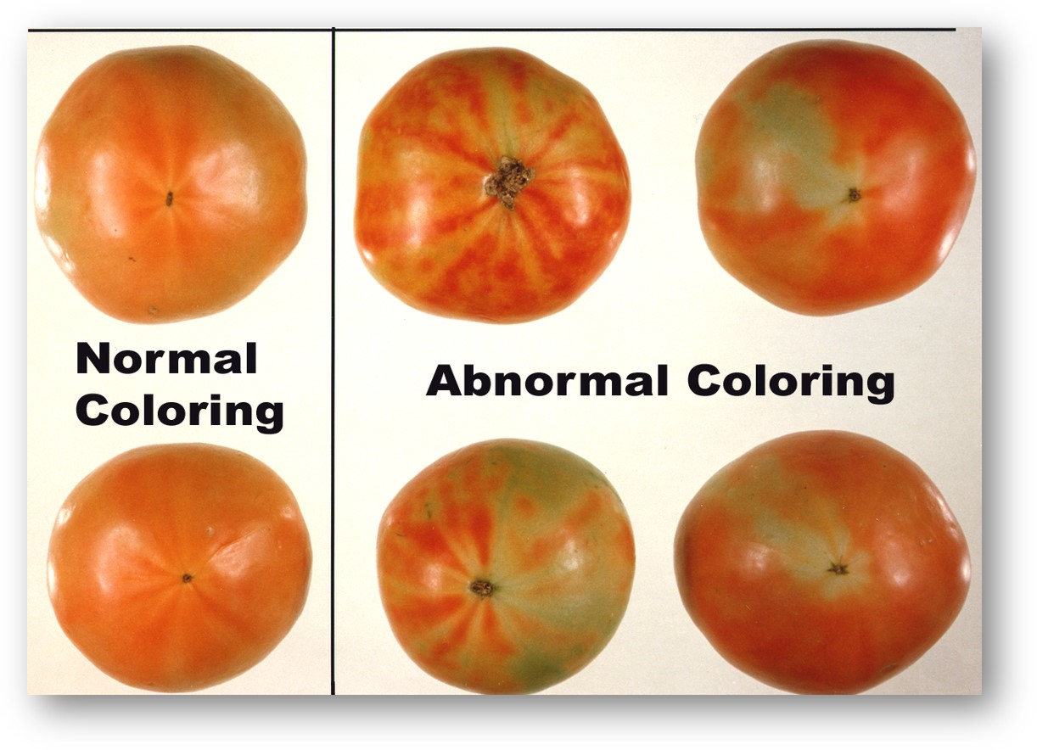
Condition: Abnormal Color
During the ripening process tomatoes will typically begin to ripen from the blossom end first, and progress to the walls and shoulders.
Abnormal color differs from well colored requirements of the grade.
Abnormal color typically has no impact on food safety. It will affect the taste and texture of the fruit.
Notes:
Blotchy ripening, yellow shoulder, gray wall, and internal whitening all produce similar symptoms in tomato fruit and may in fact be different symptoms of the same disorder. All four disorders result in uneven ripening of tomato fruit. ‘Blotchy ripening’ usually refers to the disorder when parts of the fruit surface remain green, yellow, or orange and do not ripen. ‘Yellow shoulder’ is the term used when the discoloration occurs on the “shoulders” of the fruit, surrounding the stem. ‘Gray wall’ is the term used when the outer fruit walls turn brown or gray and collapse, compared to ‘internal whitening’, which refers to when the outer and inner fruit walls become white and corky.
Severe cases of blotchy ripening and yellow shoulder are most often associated with factors that limit the supply of potassium to maturing fruit. These factors include waterlogged and/or compacted soils, below-optimal potassium application rates, above-optimal nitrogen application rates, excessive application of potassium competitors, excessively large or dense canopies, and environmental conditions described in the next section.

Slide 24
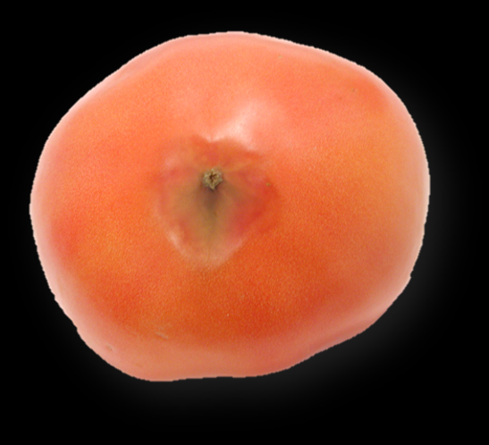
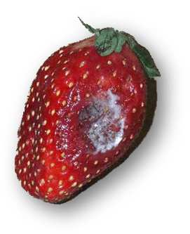
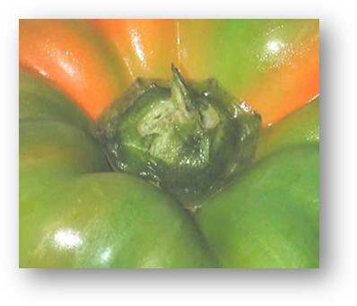
Condition: Decay
Early – approximately 10% or less of the surface or specimens affected.
Moderate – approximately 11 to 25% of the surface or specimen affected.
Advanced – approximately 26% or more of the surface or specimen affected.
Notes:
The last condition defect that we are going to discuss is decay. No matter how large or small the area of decay, it will be scored decayed and the grade will be affected.
Decay worsens rapidly. Decay may happen in storage and transit. You may open a case of produce and find decay. If there are two to three pieces of fruit with evidence of decay in the case, you are probably not going to want to refuse everything. However, do remove the decayed fruits or vegetables immediately because decay spreads. It is realistic to expect some decay. Every U.S. grade standard, even the highest grades, have a very small tolerance for decay (usually 1-2 percent). However if one third of the box is decayed, or even 5 percent (or whatever number you decide in your specification), then you should not accept the product and call the distributor.
Here we see decay on the blossom end of a tomato, on the stem and calyx of a sweet pepper and on the side of a strawberry. Depending on the severity and location of the decayed area, some specimens may still be able to be used after all the decay is trimmed away. As an example, the pepper walls and calyx may still be useable. For the other three, they should be discarded.
From a food safety perspective, a decayed spot is like a bruise and can serve as an entry point for microbes. Microbes can also thrive in the decaying areas. Decay usually results in a loss of the whole piece of produce so upon receiving the produce your staff needs to look at the product, all layers and every container and if decay is encountered the containers should be reworked to remove decayed product and possible credit or product return should be discussed with supplier.

Slide 25
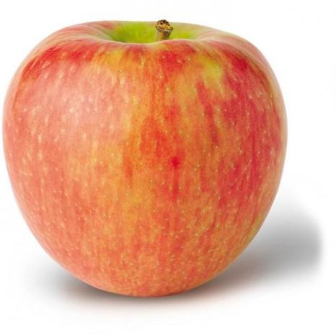
Condition: Decay, Cont.
Apples
Firm
Firm ripe
Ripe
Over-ripe
Determine firmness:
Chewing Test
Cutting
Pressure Test
Notes:
The following is the common language used to describe most commodities with a firmness requirement:
This listing comes specifically from the Apple inspection instructions.
“Hard” means apples with a tenacious flesh and starchy flavor.
“Firm” means apples with a tenacious flesh but which are becoming crisp with a slightly starchy flavor, except the Delicious variety.
“Firm ripe” means apples with crisp flesh
“Ripe” means apples with mealy flesh and soon to become soft for the variety.
“Over-ripe” is a Condition defect scorable against ALL grades.
For most commodities, the following common language is used to describe firmness; (hard, firm, firm-ripe, ripe and over-ripe) as an example for apples. Every commodity that has a U.S. Standard for grade there is a companion book called the Inspection Instructions. In the inspection instructions for covered commodities, you will find a section that provides firmness language specific to that commodity, if firmness is a requirement of the grade.

Slide 26
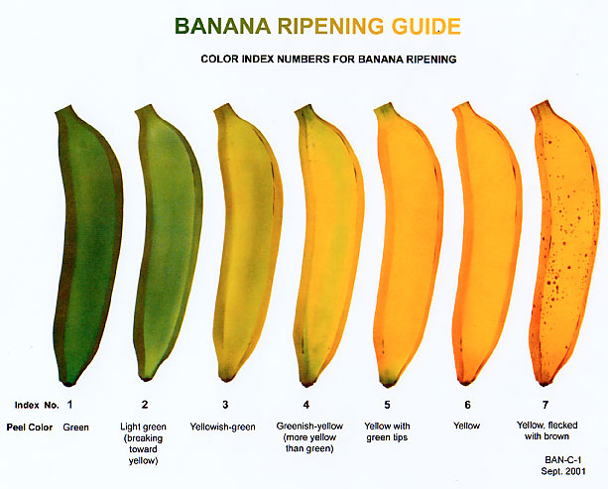
Condition: Color
Notes:
These are universal terms for color in bananas. Suppliers usually use the numbers for providing orders. Use these number when you order. Bananas should not be stored in to cool a place, such as a refrigerator. They are tropical and will turn greyish and start breaking down quickly. The index number will increase every 24-48 hours if bananas are left in the carton they are received in with the plastic bag overwrap.
For most commodities, the following common language is used to describe color; (green, light green, yellowish-green, greenish-yellow, yellow) as an example for lettuces. Every commodity that has a U.S. Standard for grade there is a companion book called the Inspection Instructions. In the inspection instructions for covered commodities, you will find a section that provides color language specific to that commodity, if color is a requirement of the grade.

Slide 27

Condition: Internal Quality
The U.S. No. 1 Grade for Cantaloupes requires the following for internal quality:
Good internal quality
9% soluble solids which is measured using a hand refractometer.
Notes:
Internal quality can be a confusing term. Internal quality is not a factor of quality, it is a condition factor. The condition of a product can affect the internal quality. Good internal quality means the measure of the internal condition of the product only, such as soluble solids for sweetness, and mealy texture in apples.
Products such as cantaloupes, table grapes, and watermelons have specific guidelines and instructions in determining soluble solids in their respective commodity inspection instructions.
It is rare but not unheard of that you receive a load of the above commodities that are just not as sweet as you would expect. In these cases, it is wise to perform an internal quality check of the soluble solids using a hand refractometer following the procedures in each instruction.

Slide 28
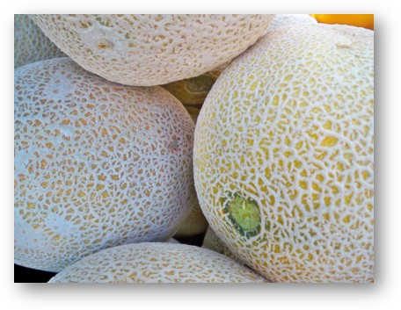
Condition: Ripeness
Cantaloupes
Hard
Firm
Ripe & Firm
Overripe
Ground Color
Dark Green
Light Green
Turning Yellow
Notes:
All U.S. grades for cantaloups require cantaloups to be not overripe or soft or wilted.
Soft or Overripe means that the flesh of the cantaloup is breaking down. Care should be exercised not to confuse bruises with soft or overripe cantaloups. Bruises typically only affect an isolated area, while soft or overripe generally affects most of the flesh of the cantaloup. Soft or overripe cantaloups are not permitted in any grade and shall be scored as serious damage.
Wilted means that the cantaloup is somewhat flabby, spongy, pliable, and the flesh is not breaking down as with soft. Wilted cantaloups are not permitted in any grade and shall be scored as serious damage.
For cantaloupes, ripeness and firmness go hand in hand. Soft or wilted cantaloupes can be food safety concerns as the breakdown of rind can permit the entrance of pathogens.
Cantaloups change from green to lighter or yellow color as the maturity and the firmness advances. The following terms shall be used to describe the ground color of cantaloups: Dark green, light green, turning, and yellow. In describing ground color, consider the predominating color of the cantaloup even though varying degrees of color may be present.
Ground color is not to be confused with ground spot. The ground spot is the location on the melon that was resting on the ground and can be typically identified by a slightly different color from the rest of the melon.

Slide 29

Conclusion
Including grade standards in your specifications can ensure you get what you want, which may minimize costs and reduce waste.
Notes:
Now that you know about grading standards, talk to your distributors about the quality and condition you expect of the produce they deliver. Include this information in your specifications. Document poor quality and condition of produce on vendor complaint forms and reject poor quality and condition produce that does not meet your specifications.

