Slide 1
Receiving and Storage
Take Home Training
Credit: 1 hour, 30 minutes Codes: 2520, 2620, 2600
Notes:
Note to instructor: Welcome participants to this training session.

Slide 2



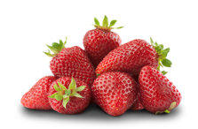
Objectives
Recognize how proper storage techniques can improve shelf life.
Understand the impact of storage conditions such as temperature, humidity, and ethylene on produce safety and freshness.
Notes:
Note to instructor: Review the learning objectives with the participants.

Slide 3

Receiving
Notes:
Knowing what to do when receiving produce is important for school nutrition programs to make sure that what they get meets their needs.

Slide 4

Receiving Produce
Check produce BEFORE the truck leaves
Verify quantity
Check temperature
Evaluate quality & condition
Cut for internal defects & ripeness
Check dates of fresh-cut products
Check marked weights
Check all sections of containers
Notes:
Always check the quantity of the produce that is delivered against the produce order, not just the invoice. Do not sign the invoice until all items are accounted for.
Checking temperature will give you the pulse of the load. Top, middle and bottom of load and back, middle and front of the load. Check temperatures of fresh-cut produce. The temperatures of those products affect both the safety and quality. Remember, cut melons, cut tomatoes and cut leafy greens must be received at or below 41 °F. All produce should be kept cool; warm temperatures hasten quality deterioration of products.
The produce size, quality or grade and appearance and condition, variety or type, and quantity should be reviewed to make sure you are getting what you ordered based on your specifications. For some products, the size is based on the number or count that can fit into the case.
For example, there are 125 apples in a box labeled “125 count.” The quality, grade and appearance must be checked at receiving. The produce will not get better looking as time goes on.
Do not accept if tipped or shifted – product may have had contact with the insanitary floor.

Slide 5
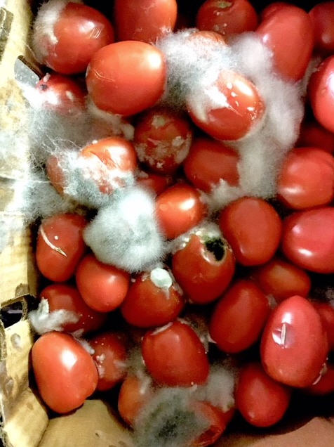

Tips for Receiving Produce
Take action if produce does not meet specifications.
Train staff to receive and store your specified produce.
Do not accept poor quality fresh fruits and vegetables.
Notes:
If you receive produce that does not meet standards identified on the specifications, send it back. Accepting poor quality produce will reduce the eye appeal of fresh fruits and vegetables on your serving line. Plus, your food cost will increase as you throw out poor quality produce that you are unable to serve. The only way to know if it meets your specification is to inspect it thoroughly. Don’t be pressured by delivery personnel who are in a rush. Remember, the food is still in the custody of the vendor until the invoice is signed.
If you are a manager or supervisor, it is your job to make sure that the staff responsible for receiving knows feel empowered, know what the standards are, and what to do if they think a delivered product needs to be rejected. If your staff is uncomfortable or unsure of how to tell when something should be rejected, retraining may be necessary. Explain that poor product quality not only affects customer service, but also the bottom line, and their ability to provide a quality meal.
You will be surprised by the changes in your future orders.

Slide 6
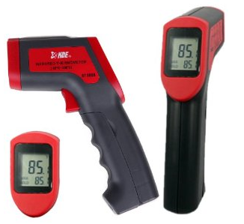
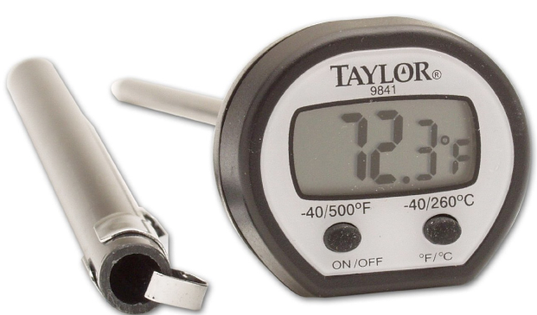
Receiving: Temperature
Infrared temperature readings may only register
surface temperature.
Notes:
There are different types of thermometers that can be used. An infrared thermometer checks surface temperatures, which may be best for delicate produce like strawberries. Take temperatures with an infrared thermometer at several points. While this thermometer will not provide an accurate reading of the product’s internal temperature, it can serve as a screening tool and help avoid issues related to cross contamination from the thermometer. If you use a calibrated bimetallic-stemmed or probe thermometer, to test the temperature of pre-cut, or pre-washed produce, do not piece the bag. Instead, hold two bags close together, or lay one on top of the other, and place the thermometer sensor between the two bags. Be sure to record temperatures.
A truck may be loaded and the refrigeration unit on for a few hours before the driver leaves for deliveries
The internal temperature of the “product” may be significantly different from the “surface”
It is not as important that whole items, such as apples, oranges, or vegetables be at or below 41°F. Produce distributors store product under commodity specific temperatures and humidity conditions. They may store some produce at 45°F, and some of it at 55°F, depending on the product. It is not necessary to check product temperatures on every case of these produce items, because temperatures above 41°F will not affect food safety. Bananas, for example, develop chilling injury, so are usually held at 55 degrees in produce warehouses. They are stored in plastic inside the box to keep them from getting too cold.
When everything is delivered on the same truck, the ambient temperature in the truck may not be at 41°F or below when it arrives. The temperature will change every time the truck door is opened. If the ambient temperature is not at or below 41˚ F, the product is probably acceptable, so it is not necessary to reject the whole load. However, make sure that the temperature of your fresh cut products are at 41°F or below when they arrive at your back door.
“BEST PRACTICE”
Check the actual temperature of the product itself

Slide 7
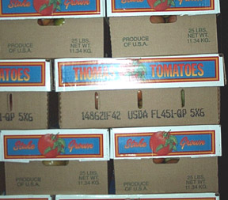
Receiving: Tip #1
Check carton
weights.
(25 lb. NET WT)
Notes:
This carton should weigh MORE than 25lbs. (net wt. means content)
This is a case of Florida tomatoes, and the size is 5x6. Is that what you ordered?

Slide 8
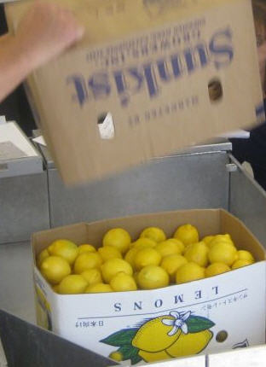
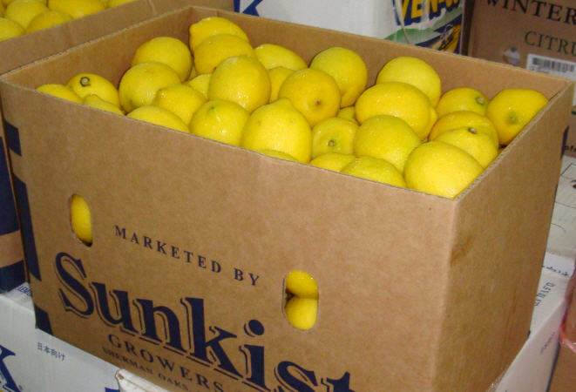
Receiving: Tip #2
Open cartons from bottom to inspect contents.
Notes:
Check all sections of the cartons, top and bottom. Flip cases to check All portions of the container.
If you receive produce that does not meet standards identified on the specifications, send it back. Accepting poor quality produce will reduce the eye appeal of fresh fruits and vegetables on your serving line. Plus, your food cost will increase as you throw out poor quality produce that you are unable to serve. The only way to know if it meets your specification is to inspect it thoroughly. Don’t be pressured by delivery personnel who are in a rush. Remember, the food is still in the custody of the vendor until the invoice is signed.
If you are a manager or supervisor, it is your job to make sure that the staff responsible for receiving knows what the standards are, and what to do if they think a delivered product needs to be rejected. If your staff is uncomfortable or unsure of how to tell when something should be rejected, retraining may be necessary. Explain that poor product quality not only affects customer service, but also the bottom line, and their ability to provide a quality meal.
TAKE PHOTOS

Slide 9
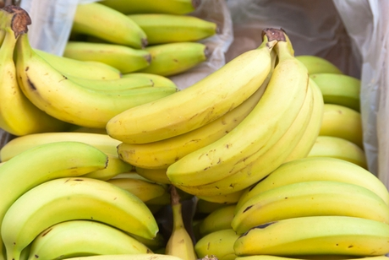
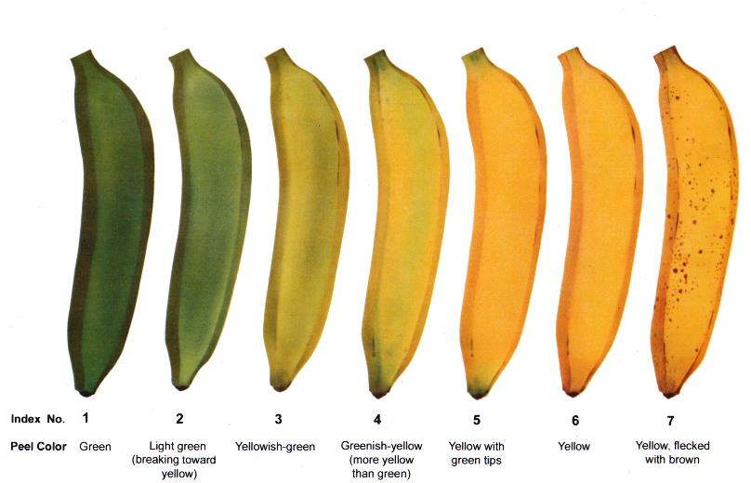
Receiving: Tip #3
Check color
Color is an indication of ripeness
Notes:
Some produce, especially fruits, release ethylene gas to help ripen the fruit.
Ethylene is an odorless, colorless gas. Have you ever ripened an avocado or a pear at home by putting it in a paper bag with a ripe banana? The pear will ripen because the banana is naturally releasing ethylene gas.
Color of many commodities is an indication of ripeness, (that’s why ethylene is introduced)
Bananas - yellow
Tomatoes – red
Hass Avocados – darken

Slide 10
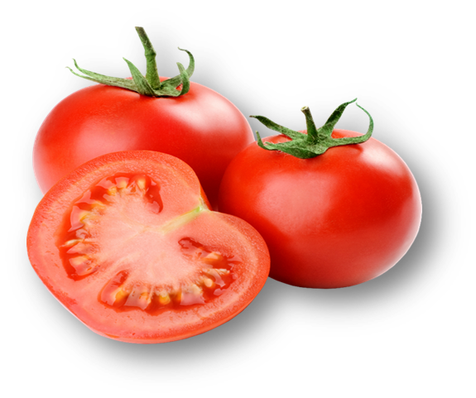
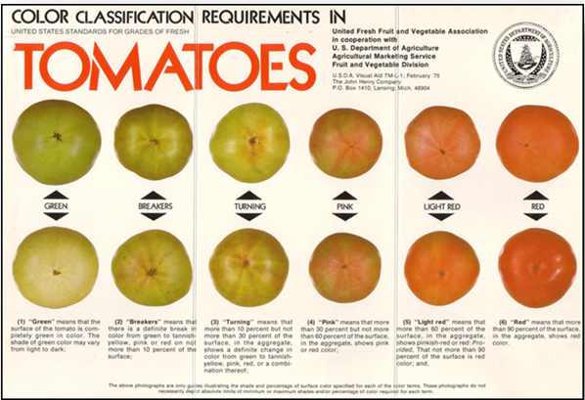
Receiving: Tip #4
Check color
Color is an indication of ripeness
Notes:
Tomatoes ripen from the inside out and from the blossom end up (Generally).

Slide 11
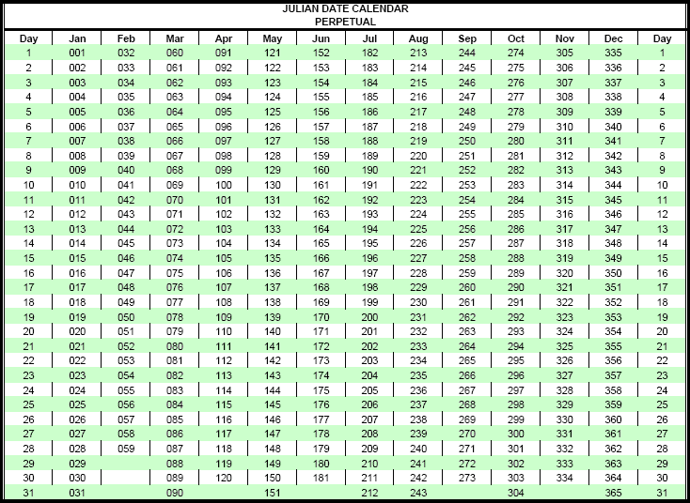
Receiving: Tip #5
Julian Calendar Date: Mark Cartons
001 = Jan 1st
Notes:
It is important to write the date you received each produce delivery on every item or case.
This practice will help you with FIFO (First In; First Out) inventory rotation and tracking the product in the event of a food recall, or in case there are any questions.
Helpful hint: (Mark the receive date using a Julian date) example- January 1 would be 001, January 15 would be 015. This is useful because a quick glance at the receipt date on carton/packaging to see that the lowest number has been in the cooler longest.
Used for receiving date, does not get confused with a (expiration or use by date). Train all kitchen staff to recognize as received date (especially for any recall)

Slide 12

Storage
Notes:
Now, we’re going to talk about storing produce. In particular, optimal storage location for temperature and conditions to give you the longest shelf-life possible on your products and allow for proper product traceability.
The shelf life of fresh fruits and vegetables depends on the condition in which it was received, and how the produce is stored in your kitchen. Each produce item has specific storage recommendations to maintain quality. Generally, there are two storage location categories: refrigerated storage, or dry storage, which is at room temperature. Some produce, like apples, may be stored in the refrigerator or at room temperature, although storing apples at room temperature will hasten deterioration. Apples may last five times longer in the refrigerator.

Slide 13
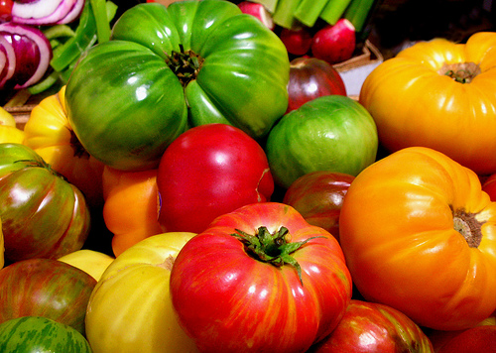
Ethylene / Ripeness
  Ethylene is “introduced” to ensure “uniform” ripening of:
  Avocados
  Bananas
  Mangoes
  Tomatoes
Notes:
Some produce, especially fruits, release ethylene gas to help ripen the fruit. Ethylene is an odorless, colorless gas. Have you ever ripened an avocado or a pear at home by putting it in a paper bag with a ripe banana? The pear will ripen because the banana is naturally releasing ethylene gas. Commercially, ethylene gas is introduced to uniformly ripen avocados, bananas, mangoes, and tomatoes.
“Normally” you wouldn’t want to receive containers with various colors which is an indication of various stages of ripeness.
(These are heirloom, just an example of color variations.)
It is used to “kick start” the “natural” ripening process.
Product is warm, then gassed.

Slide 14
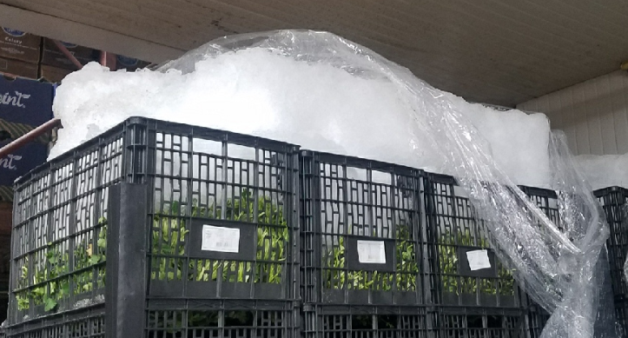

Storage
Does produce need to be refrigerated?
At what temperature? Ethylene producer or ethylene
sensitive?
The best way to improve shelf life of produce is to receive in good condition and store properly.
Notes:
A common problem in storage is keeping the ethylene producers and the ethylene sensitive produce in the same area.
Build-up of the chemical compound “Ethylene gas” will cause them to go OFF.
Commercially, ethylene gas is introduced only to uniformly ripen avocados, bananas, mangoes, and tomatoes.
Unfortunately, ethylene gas may damage other produce, particularly vegetables.
Some examples of damage that can be caused by ethylene gas—
russet spotting on lettuce,
bitter taste in carrots,
yellowing of broccoli, cucumber, and spinach,
and an overall decreased shelf life.
Bottom line, some produce release ethylene and some have varying degrees of sensitivity to it, so storing them together has an effect.

Slide 15
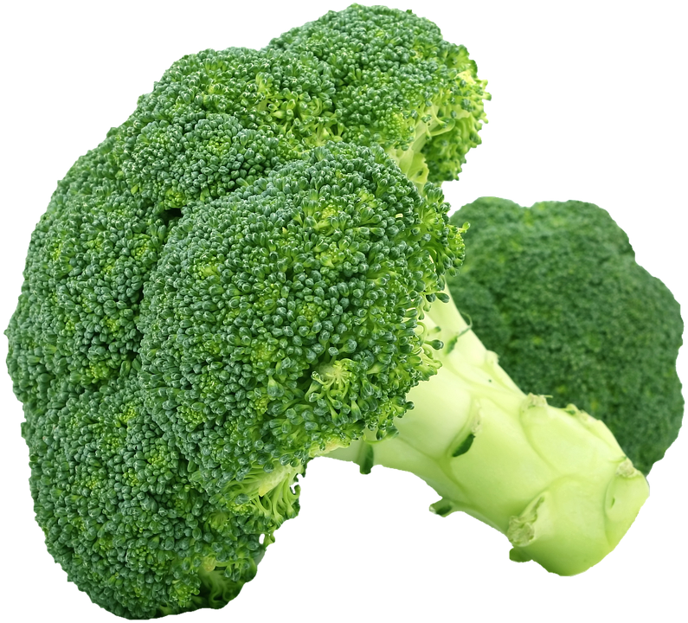
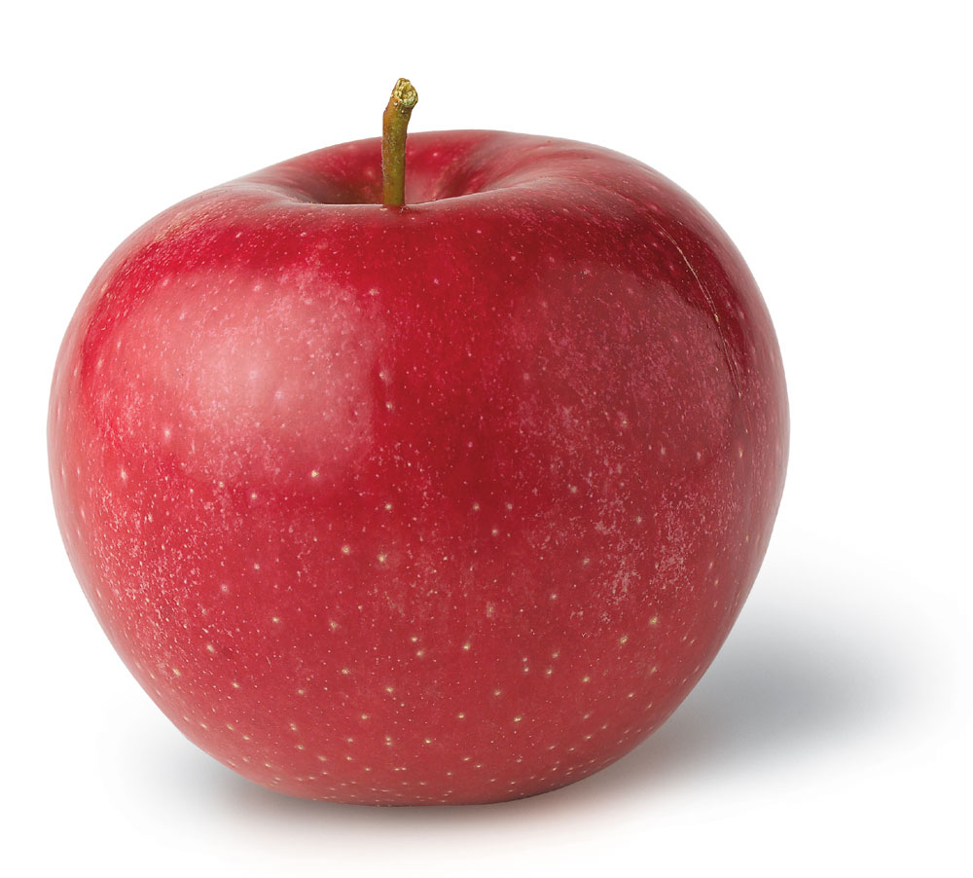
Separate
Ethylene Sensitive
Ethylene Producer
Notes:
Try to separate ethylene producers from ethylene sensitive product.
Ethylene acts like a ripening hormone and can speed spoilage.
Fruits and vegetables don’t play well together.
So don’t store them together in a refrigerator drawer or next to each other in dry storage.
An airtight plastic bag is the worst choice for storing vegetables. And don’t pack veggies tightly together, either; they need space for air circulation, or they’ll spoil faster.

Slide 16
Ethylene Sensitivity
Ethylene Sensitive | Ethylene Producers
Broccoli | Apples
Cabbage | Avocados
Cauliflower | Bananas
Leafy Greens | Melons
Lettuce | Pears
 | Stone Fruits
 | Tomatoes
 | Squash
Notes:
F&V ideally should be stored separately. Fruits release ethylene, which speeds the ripening process of vegetables. Fruits are also very susceptible to picking up odors of nearby vegetables.
Effects of elevated ethylene levels are cumulative. Some effects of high levels of ethylene are:
Decay
Russet spotting
Yellowing
Odor
Wilting
Rind breakdown of citrus, and loss of crunch (apples)

Slide 17
Refrigerate
Apples | Broccoli
Cabbage | Carrots
Cauliflower | Celery
Corn | Cucumbers *
Fresh-cut | Grapes
Green Beans * | Lettuce
Oranges * | Peppers *
Spinach | Strawberries
* Ideal to store at 45-50°F
Notes:
Produce items are dependent on the correct temperatures for safety reasons. Leafy greens, cut tomatoes, cut melons, and other fresh cut produce should be stored in the refrigerator.
Berries, carrots, cauliflower, broccoli, fresh herbs, lettuce, peppers, and mushrooms will also last longer in cooler temperatures. Tomatoes, onions, garlic, watermelon, potatoes, and winter squash can be stored in dry and cool storage locations. Tropical fruits, such as bananas or mangos, and pitted fruits, such as peaches, should be stored at room temperatures in designated locations. Potatoes become sugary and mealy, and tomatoes lose their signature acidic bite when stored below approximately 50 °F. Potatoes should be stored in a dark area to prevent greening. The skin of bananas will turn very dark in the refrigerator. Although the inside is delicious, the outside is very unappealing. Un-ripened fruits ripen, very slowly under refrigeration, so the bottom line is not to put everything in the cooler or refrigerator.

Slide 18
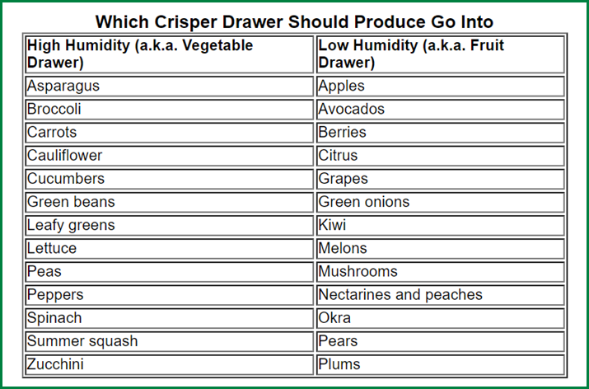
Refrigerate, Cont.
Notes:
Apples if bought local and received Hard to Firm, do not need to be kept cool for approximately 5 – 7 days. (If you have the space to store in dry storage)
If apples are from any type of storage, you need to refrigerate. (all apples from a distributor)
Store ethylene-sensitive fruits and vegetables, like asparagus, broccoli, cauliflower, citrus, cucumbers, eggplant, green beans, greens (like chard and spinach), lettuces, parsley, peppers, raspberries, squash, strawberries, and sweet potatoes in the same areas.
Most of your vegetables should go in the high humidity area of storage.
Most of your fruits should go in the low humidity area of storage.
Many vegetables and fruits require temperatures around 32 degrees Fahrenheit with a relative humidity of 95 %. You will want to store asparagus, apples, beets, broccoli, Brussels sprouts, cabbage, carrots, cauliflower, celery, collards, corn, grapes, kale, leeks, lettuce, parsley, parsnips, pears, peas, radishes, rhubarb, rutabagas and spinach in these conditions.
A few fruits and vegetables require cool temperatures between 40 and 50 Fahrenheit with high humidity for their storage. You can store snap beans, cucumbers, eggplant, cantaloupe, watermelon, peppers, potatoes and tomatoes for one to three weeks, on average, in these conditions.
Be careful of freezing or causing freezing injury. Freezing of plant cells will have a devastating effect – Plant cells will collapse and never recover; this destroys product.

Slide 19
Dry Storage
Store at 55-65°F
Bananas | Garlic
Onions | Potatoes
Pumpkins | Tomatoes
Sweet Potatoes | Watermelons
Winter Squash
Notes:
Garlic and onions keep up to seven months if stored at 32 Fahrenheit with 65 to 70 percent humidity. Grains, flour, cereals, pasta, herbs and spices, sugar, salt, coffee, tea and nuts should also be stored in dry, low humidity locations.
Dry Storage means, that these products don’t ALWAYS need to go in the cooler.
Depends on many factors.
Dry Storage means that the product is “Not refrigerated” but not kept too warm, 55 to 65 degrees is ok.

Slide 20
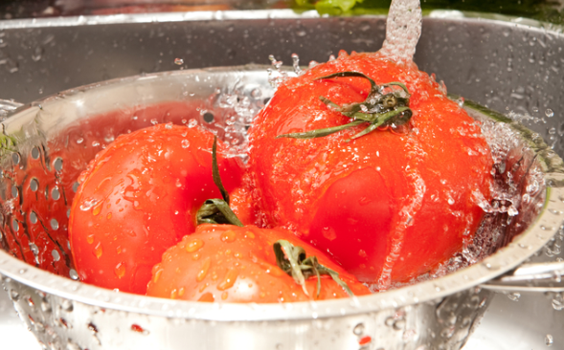

Storage: Tip
Do not wash fresh fruits and vegetables before storing them.
Dampness encourages bacterial growth, so WAIT TO WASH!
Notes:
Washing fruits or vegetables before storing them makes them more likely to spoil, because dampness encourages bacteria growth.
BEST PRACTICE is always, wash right before using.

Slide 21
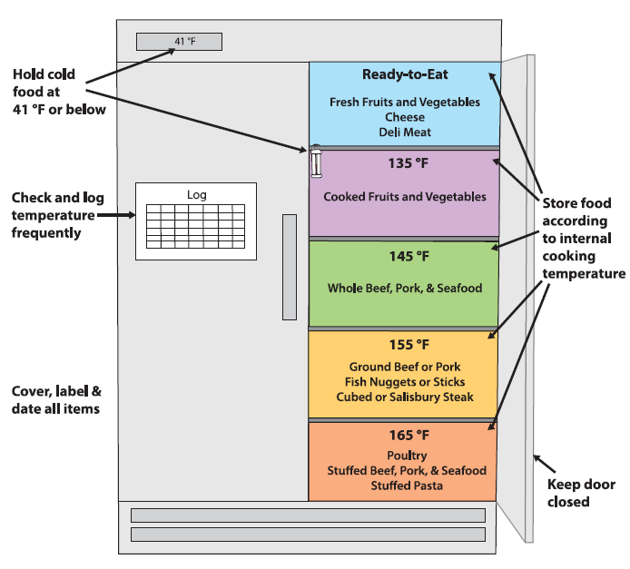
How to Properly Store Foods
Ready to Eat
Product
Fully Cooked
and Leftovers
Iced or Wet
Notes:
No matter where produce is stored, it should be at least 6 inches above the floor. Always store produce in a way that prevents cross contamination. For example, store fresh produce above raw meats, poultry, and eggs as there will not be a kill step by cooking for the fruits and vegetables. Be sure all food storage areas are kept secure and access is limited to foodservice personnel in order to avoid giving access to anyone who might intentionally contaminate the food.
Try to separate ethylene producers from ethylene sensitive product.
Keep any “Iced” or “Wet” commodity either on bottom shelf or place in container that will prevent leakage (bus pan)

Slide 22
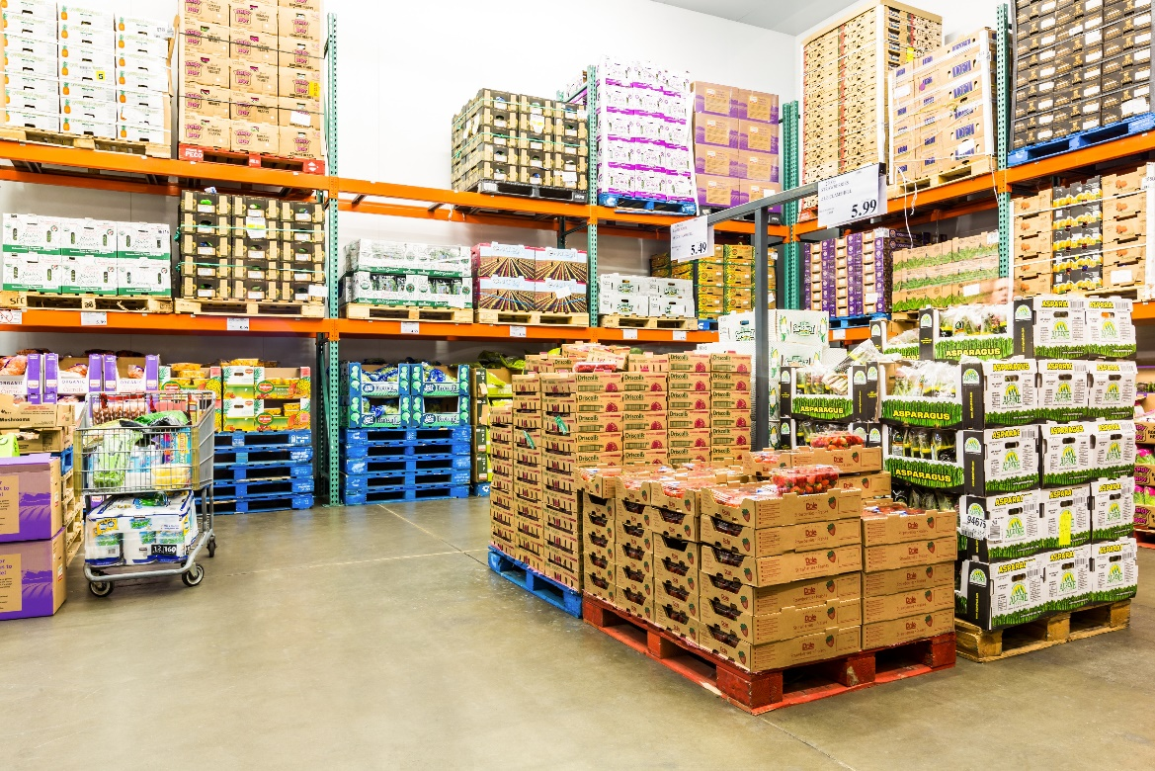
Conclusion
Proper receiving and storage practices ensure you what you receive meets your needs and increase shelf-life and prevent spoilage.

