Slide 1
Safe Preparation and Service
Take Home Training
Credit: 1 Hour
Codes: 2620, 2200, 2600
Notes:
Note to instructor: Welcome participants to this training session.

Slide 2


Objectives
Categorize fruit and vegetable cycle menu items into HACCP processes.
Identify food safety practices in the preparation and service of fresh produce in child nutrition programs.
Apply effective culinary methods and marketing strategies to increase student consumption of fruits and vegetables.
2
Notes:
Note to instructor: Review the learning objectives with the participants.

Slide 3
HACCP Menu Category
  Process 1: Ready-to-Eat (RTE)
135°F
Fruit, Precut, Bagged*
Leafy Greens, All varieties
Melons, Fresh, Cut, All varieties
Tomatoes, Fresh, Cut
Vegetables, Precut, Bagged*
0 trips
Temperature
Danger Zone
41°F
CONTROL STEPS
Receiving, Storing, Preparing, Holding, Serving
  *Receive and hold at or below 41°F,
  based on package label.
Notes:
Fresh produce is a raw agricultural product that is not always cooked; therefore there is often no “kill step” to eliminate any harmful microorganisms that might be present. This makes proper preparation, handling and service of fresh produce critical to food safety. No matter how nutritious a food is, if it causes someone to become sick, it won’t be healthy! Some children may not have fully developed immune systems capable of fighting off foodborne pathogens.
Schools participating in FNS nutrition assistance programs have been implementing food safety programs based on HACCP principles since 2005. With the passage of the Healthy Hunger Free Kids Act of 2010, food safety regulations were expanded to include all locations within the school where food is prepared, stored, or served.

Slide 4
Process 1: Non-TCS Examples
Fruit, Canned
Fruit, Dried
Fruit, Fresh (except cut melons)
Fruit Cups, Canned
Fruit Cups, Frozen
Fruit, Juice, Shelf Stable
Vegetables, Fresh (except leafy greens and sliced tomatoes)
  Follow manufacturer’s instructions.
  Best practice is to always use temperature control.
4
Notes:
Not all produce is considered by the FDA to be “Time and/or Temperature Control for Safety” (TCS) Foods. While time and temperature control may not be required, the longer that some produce, like strawberries, are held at room temperature, the quicker they will lose moisture, quality, and shelf life.
Cut melons, cut leafy greens, raw seed sprouts, and cut tomatoes are all considered TCS Foods that should all be maintained at 41F or less. If held out of temperature control they should be consumed within 4 hours or discarded. These items are considered high risk by the FDA because they have been associated with multiple foodborne illness outbreaks.

Slide 5
Process 2: Same Day Service
135°F
1
trip
Fruit, Hot
Vegetables, Hot
Temperature
Danger Zone
41°F
CONTROL STEPS
Receiving, Storing, Preparing, Cooking/Reheating for Hot Holding, Serving
Notes:
Same day service? The preparation step is cooking, and the food is immediately served hot. This could be something like cooked apples or roasted broccoli. Complex? Think of something that you might prepare in steps. Do you cook dry beans a day ahead for your chili? Perhaps you prepare taco or burrito filling a day in advance of serving those entrees, and you reheat it before assembling and serving. That would be complex. Remember that this is specific to how you prepare meals at your school. And it will change when you make changes to your processes

Slide 6
Process 3: Complex
135°F
≥ 2
trips
Fruit, Hot Cooked, Cooled, Reheated
Vegetables, Hot Cooked, Cooled, Reheated
Temperature
Danger Zone
41°F
CONTROL STEPS
Receiving, Storing, Preparing, Cooking, Cooling, Reheating, Hot Holding, Serving
Notes:
For the complex category, think of something that you might prepare in steps. Do you cook dry beans a day ahead for your chili? Perhaps you prepare taco or burrito filling a day in advance of serving those entrees, and you reheat it before assembling and serving. That would be complex. Also, remember that this is specific to how you prepare meals at your school. And it will change when you make changes to your processes.

Slide 7

Food Safety – Reduce the Risks
Notes:
Many of you likely have participated in food safety training before and may have received a food safety certification. You are probably also familiar with following standard operating procedures (SOPs) and have tasks in your jobs related to your school’s food safety program.

Slide 8
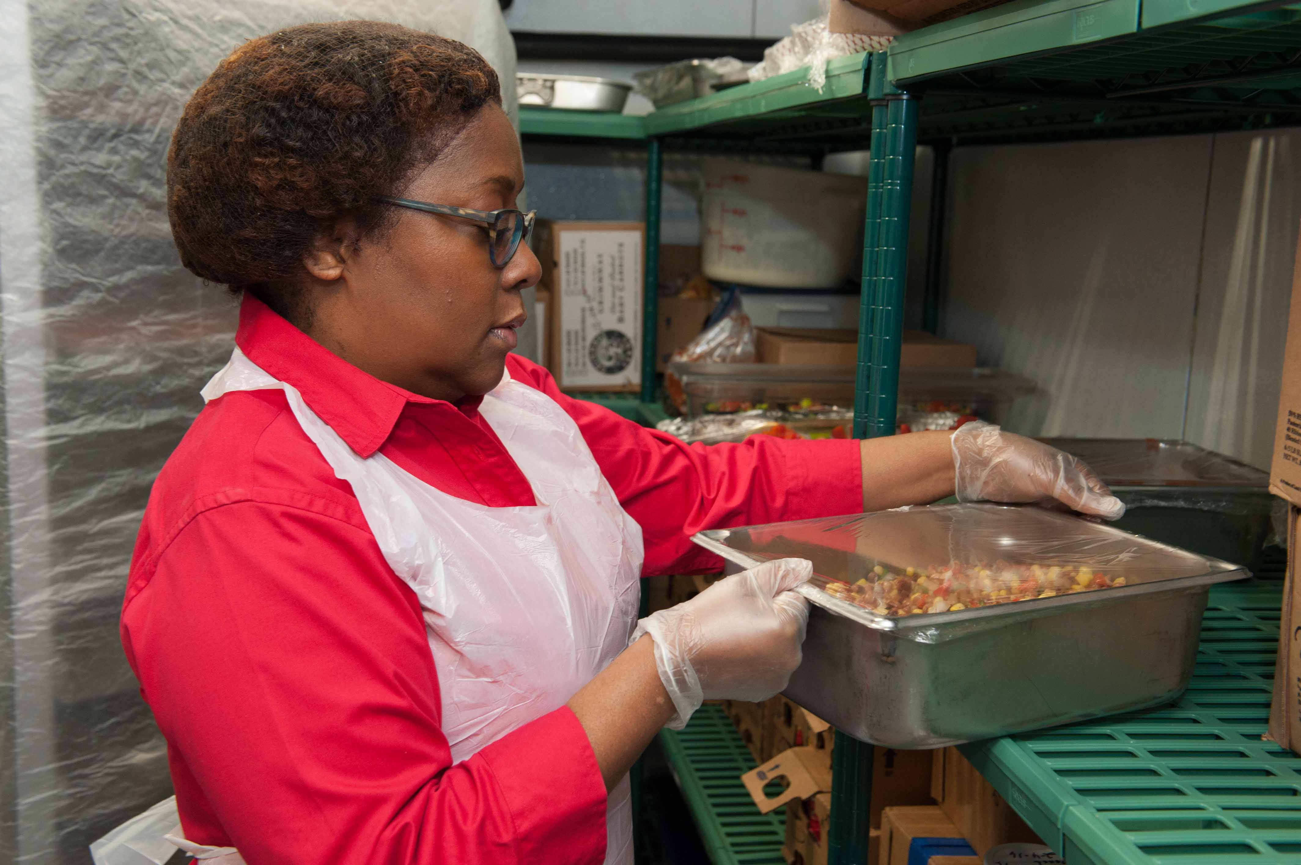
Reduce the Risks – Storing
  Monitor refrigerated storage at least daily
  Date mark and rotate stock
    First In; First Out (FIFO)
    First Expired; First Out (FEFO)
  Ensure traceability system is up-to-date
  Prevent cross contamination
    Store ready to eat above raw meats, poultry, and shell eggs
    Keep foods covered
    Repair leaks
Notes:
You can reduce food safety risks by using best practices for storage.
It is important to maintain traceability in case of a hold or recall on produce. When you receive the produce, you should make sure that the date received is marked on the box and in your records.
First In; First Out, sometimes referred to as FIFO is an inventory rotation system based on using the oldest item in storage first. For most products, this practice holds true. However, fresh produce depends on the condition in which it was received. Local farmers will generally harvest and deliver product within a day or two, whereas the wholesale production system is set up to allow for greater length of time between farm to foodservice. Thus, it may be possible that strawberries delivered by a local distributor to your school on Thursday will not last as long as the strawberries delivered on Tuesday by your local farmer. In this situation, you should plan to use the ripest and most perishable fruits and vegetables first. This type of rotation is known as First Expired; First Out or FEFO.
Always store produce in a way that prevents cross contamination. For example, store fresh produce above raw meats, poultry, and eggs as there will not be a kill step by cooking for the fruits and vegetables and you don’t want raw meats to drip on the ready-to-eat produce.

Slide 9
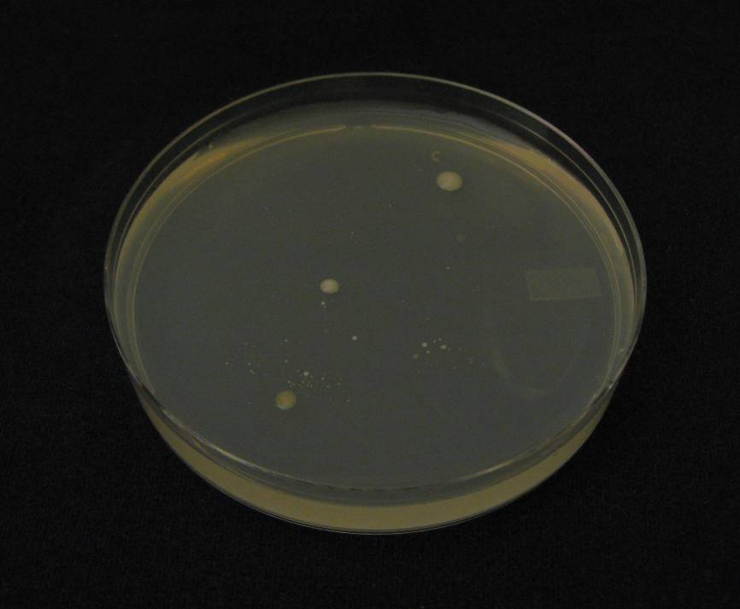
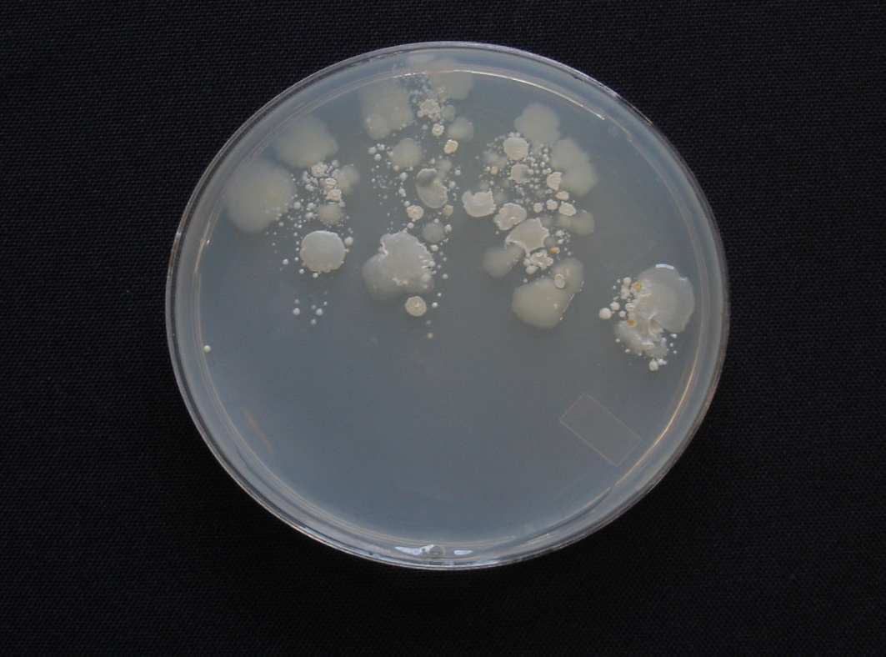
Reduce the Risks – Food Preparation
WASH YOUR HANDS!
Microorganisms from hands washed for the recommended 20 seconds
Microorganisms from unwashed hands after using the restroom
Source: Iowa State University Extension Service
Notes:
STOP – Did you wash your hands? Handwashing is the number one practice to help prevent the spread of germs. In addition, if you practice good hand hygiene, you can keep yourself healthy too.
It is important to think about when and how hands are washed.
These plates clearly show why a practicing good handwashing technique is so important. These petri dishes were prepared by swabbing unwashed and washed hands and introducing the swabs onto the bacterial growth medium in the petri dish. The petri dish to your left has few microorganisms as handwashing reduced the number, whereas the dish to the right with unwashed hands shows many colonies of bacteria growing.

Slide 10
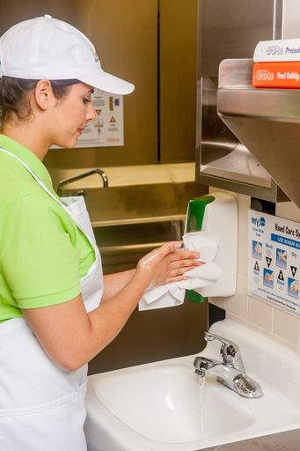
Handwashing Study
Fast Food and Full-Service Restaurants Comparison Study
Are hands washed properly?
Are hands washed when required?
Are handwashing facilities conveniently located?
Are supplies available?
Source: Boyer, M., Williams, L. Otto, J., Lando, A., Dawood, N., & Liggans, G. (2021). Handwashing Observations In Fast-Food and Full-Service Restaurants . Journal of Food Protection, Vol 84, No. 6, 1016 – 1022
Notes:
Managers should invest time in work simplification methods and schedule work to help employees streamline the flow of tasks and reduce the number of times required for hand washing. Employees should organize their work space and be mindful of how often they are changing tasks that would require hand washing. For example, by having two people in the dish room – one to load soiled trays, and one to unload clean dishware, you can remove the need for repeated handwashing.
Remember, wash your hands when they are soiled, in between tasks, after using the restroom, and before starting work. Even if you washed your hands in the restroom, they should be washed again in the kitchen before starting your next task if you have touched door handles or other surfaces that may be contaminated.
https://pubmed.ncbi.nlm.nih.gov/33465242/

Slide 11
Handwashing Study - Findings
Fast Food and Full-Service Restaurants Comparison Study
Observation | Fast-Food (n=425) | Full-Service (n=396)
Hands washed properly | 55% | 43%
Hands wash when required | 57% | 78%
Conveniently located handwashing facilities | 80% | 70%
Are supplies available? | 88.7% | 78.5%
Notes:
The findings from a 2021 study address the questions raised in the previous slide. The results compare the handwashing practices and environments of fast-food and full-service restaurants. It’s clear that there’s still work to be done to improve in all of the areas, from actually washing hands, to making sure the facilities are conveniently located and that supplies are available.
https://pubmed.ncbi.nlm.nih.gov/33465242/

Slide 12
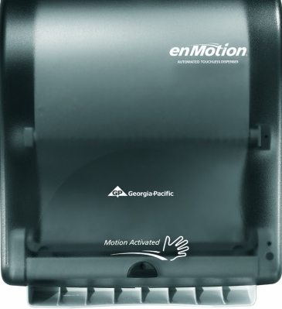

Cues Promote Handwashing
Simple cues may increase handwashing
  Control group: Towel not presented
  Intervention group: Towel presented
Source: Ford, E.W., Boyer, B.T., Menachemi, N. & Huerta T.R. (2014). Increasing hand washing with a simple visual cue. American Journal of Public Health, 10, 1851 – 1856
12
Notes:
Simple things, like making sure towels and soap are present, may encourage you and your staff to use proper handwashing practices.
https://www.ncbi.nlm.nih.gov/pmc/articles/PMC4167083/

Slide 13
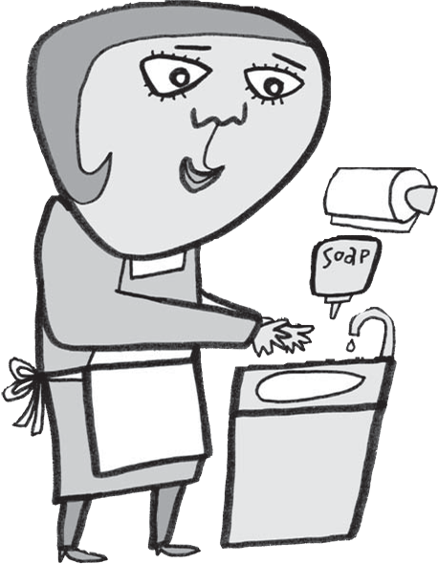
Reduce the Risks - Handwashing
  Findings:
  Over 97,000 handwashing opportunities in the 10-week study.
  Towel presented group used greater volume of towels and soap than control group.
  Increase in both products indicated complete handwashing with stimulus applied.
Source: Ford, E.W., Boyer, B.T., Menachemi, N. & Huerta T.R. (2014). Increasing hand washing with a simple visual cue. American Journal of Public Health, 10, 1851 – 1856
13
Notes:
A 2014 study tested how visual cues affect hand washing. This was tested by setting automated towel dispensers in public bathrooms to present a towel either with or without activation by users. Both towel and soap use was higher when the towel presented without user activation. This suggests that a visual cue can increase hand-washing compliance in public facilities.

Slide 14
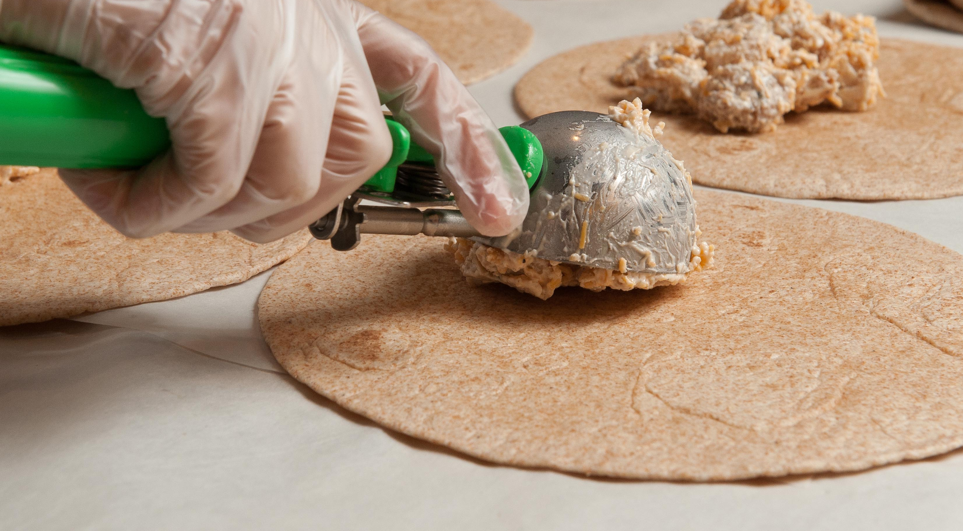
Bare-Hand Contact
  Avoid bare-hand contact by:
  Properly wearing single-use gloves
  Using utensils & deli paper
  Dispensing equipment
Notes:
Glove usage is important to keep food safe. The use of disposable gloves is not a substitute for handwashing, and hands need to be clean before putting gloves on them.
The 2017 FDA Food Code discourages bare-hand contact with RTE food and recommends the use of suitable utensils, deli tissues, single-use gloves, or dispensing equipment when handling these food items.
Gloves should be changed with the same frequency as you would wash your hands. Anything that can contaminate your hands will contaminate the gloves as well.

Slide 15

Reduce the Risks – Gloves
  Workers wearing gloves when handwashing should occur were less likely to wash their hands at that point than workers who were not wearing gloves at that point.
  - CDC
15
Notes:
The Environmental Health Specialists Network interviewed and watched food workers to collect data on their food-handling practices, including handwashing.
One of the key findings is that “Workers wearing gloves when handwashing should occur were less likely to wash their hands at that point than workers who were not wearing gloves at that point.”
http://www.cdc.gov/nceh/ehs/ehsnet/plain_language/food-worker-handwashing-restaurant-factors.htm

Slide 16
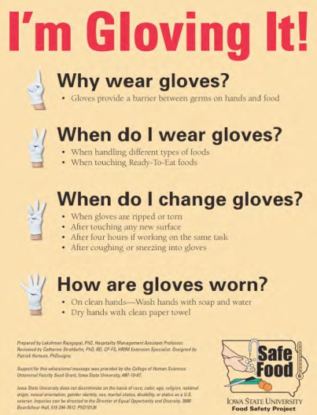
Glove Use
  Findings:
  Cross contamination most frequent non-compliant behavior.
  Treatment group non-compliance – almost 25%
  Control group non-compliance – 70%
  Compliance decreased during high traffic periods.
  Proper glove use knowledge was high.
Source: Rajagopal, L. & Strohbehn, C.H. (2013) Observational Assessment of Glove Use Behaviors among Foodservice Workers in a University Dining Setting: Testing a Visual Intervention Tool. Food Protection Trends, 33(5), 315-324
16
Notes:
A 2013 study assessed knowledge and behaviors related to glove use by college and university dining hall student workers through a knowledge assessment and observed for a 2-hour work period to determine compliance with Food Code recommendations on glove behaviors.
An intervention flyer based on a social-marketing approach and limited-text, I’m Gloving It!, that addressed the How, Why and When of proper glove use was included in the training for the treatment group.
Knowledge was fairly high, with 90% or more correct responses given for 6 of the 10 items.
However, observational data showed non-compliance with Food Code recommendations in both groups, although non-compliance was lower in the treatment group, suggesting that the intervention was successful. Managers employing multiple generations and cultures in their workplaces should consider use of similar interventions to reach staff of diverse characteristics.

Slide 17
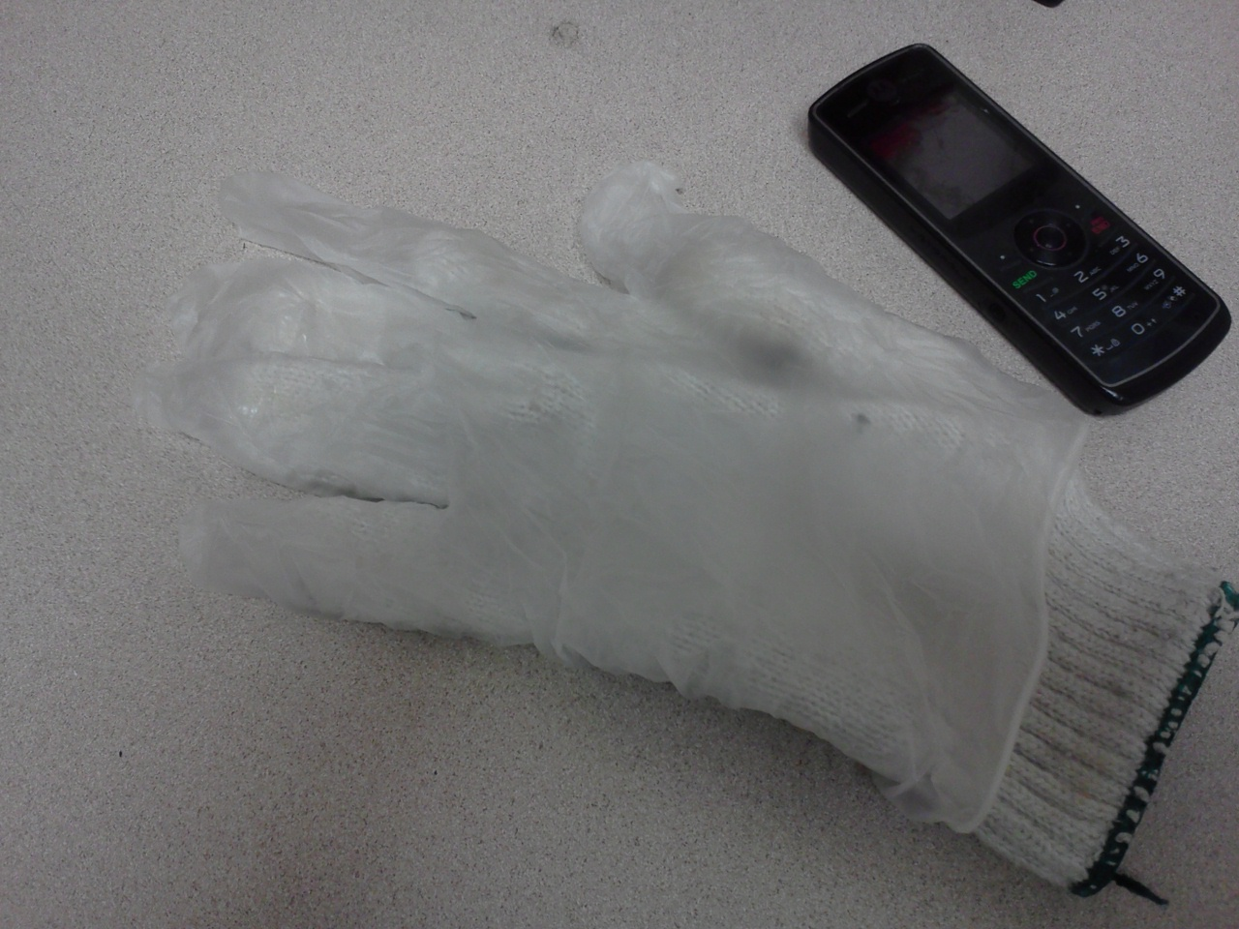
Contaminated Gloves
Foodborne outbreaks (2006 – 2016) implicated contaminated gloves or glove cross contamination.
16%
17
Notes:
Although gloves (single-use and reusable) can be an effective tool to prevent cross-contamination of RTE foods from hands, improver glove use can actually increase this risk.
In studies by the CDC Environmental Health Service (EHS-Net) and others between 2006 and 2016, around 16 percent of foodborne outbreaks implicated contaminated gloves or glove cross-contamination as a contributory cause.
https://www.food-safety.com/articles/6258-the-need-for-a-glove-use-management-system-in-retail-foodservice#References –

Slide 18
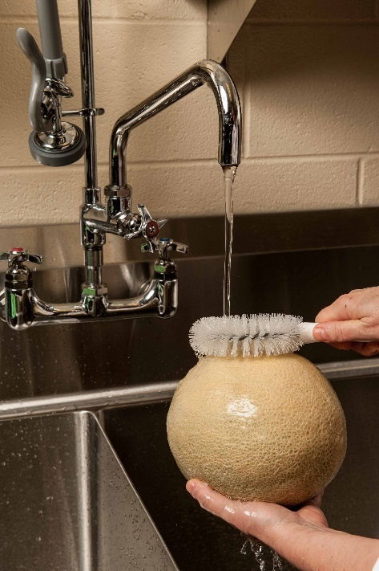
Reduce the Risks – Fresh Produce
Handling fresh produce
  Wash under running water before
    cutting, peeling, eating or cooking
  Scrub using a vegetable brush
    Melons, potatoes, etc.
  Identify designated produce sink
  Do NOT wash ready-to-eat produce
  Never use unapproved chemicals
  Commercial produce wash is not required
Notes:
Fresh produce may become cross contaminated from many surfaces including equipment, storage containers, packages, and your hands. Make sure food contact surfaces are cleaned and sanitized before and after each use. Start with cleaned and sanitized equipment, cutting boards and knives. Avoid cross contaminating produce with other foods such as meat, poultry, or eggs.
Use food grade storage containers and avoid single use plastic ware more than once. Be aware of what your gloves touch as you are working. Gloves can become contaminated, just like your hands. Change gloves often and wash your hands before putting on a new pair. Wash your hands and change your gloves whenever they are contaminated or torn. As another control step, consider designating cutting boards and knives in the kitchen to be used only for fresh produce preparation. They could even be color-coded green for produce!
Remember that you have already purchased, received, and stored fresh produce properly to maintain its safety. All of those efforts are useless if you contaminate it again when you are ready to prepare or serve it. Develop and follow procedures to prevent contamination as produce flows through the “back of the house,” or your kitchen. Train and observe staff to make sure that fresh produce is being handled and prepared safely. Discard all fresh produce that may be contaminated. When in doubt, throw it out.

Slide 19
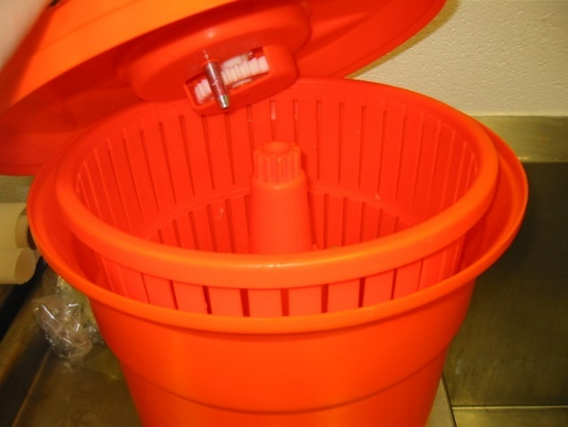
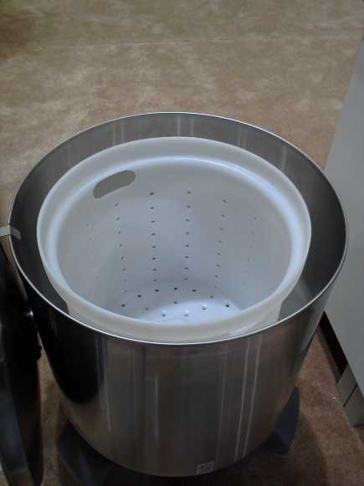

Reduce the Risks – Washing and Drying
Remove excess moisture to improve quality and safety by:
  Draining in colander or perforated pan
  Drying with disposable paper towel
  Air drying in clean, perforated pan
  Using a commercial salad spinner
Hey, Leafy Greens; Want to go for a spin?
Notes:
After washing fresh produce, it’s important to remove excess moisture. Removing excess moisture helps improve the quality and minimizes food safety risks.
Some ways you can remove excess moisture are:
Drain the produce in colander or perforated pan
Dry the produce with disposable paper towel
Air dry the produce in clean, perforated pan
Use a commercial salad spinner

Slide 20
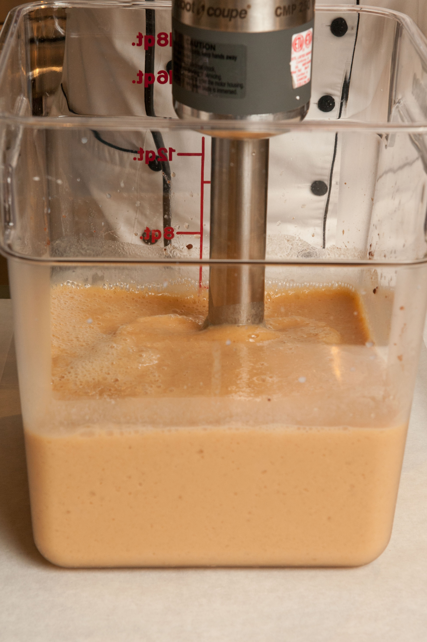
Reduce the Risks – Equipment
Use Approved Equipment
  Cutting boards, knifes
  Food storage containers
  Food processors/blenders
    Manual
    Mechanical
Notes:
Equipment should meet the Occupational Safety and Health Administration (OSHA) and Federal Food, Drug, and Cosmetic Act standards through approved, private, third-party evaluation, testing, and certification.
The non-profit American National Standards Institute (ANSI) is responsible for maintaining public health food equipment and environmental standards based on the FD&C Act since 1918.
OSHA maintains the Nationally Recognized Testing Laboratories (NRTL)
Organizations may include:
Edison Testing Laboratories – (ETL)
Edison Testing Laboratories – (ETL Sanitation Listed)
National Sanitation Foundation (NSF)
Underwriters Laboratories (UL)
Underwriters Laboratories Solutions (Sanitation) (EPH)

Slide 21
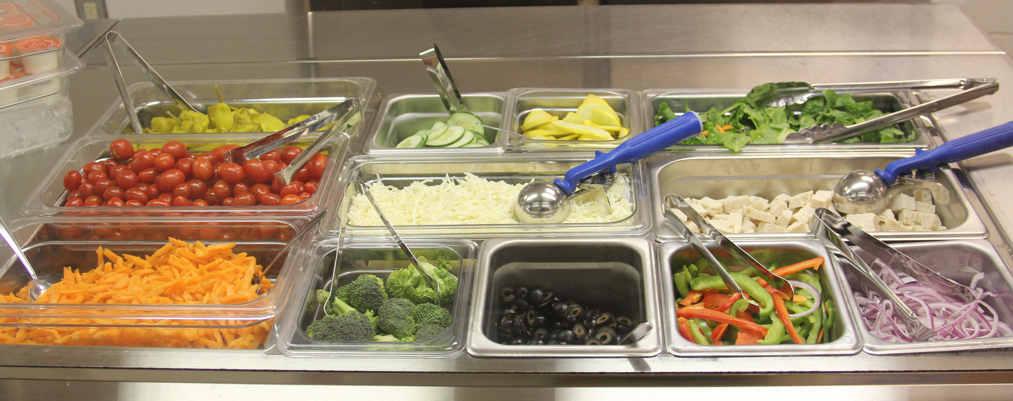
Reduce the Risks – Holding and Serving
  Monitor time and temperature during holding and serving.
  Maintain chopped and/or RTE leafy greens, cut melons and cut tomatoes at or below 41°F.
  Practice good personal hygiene & prevent cross contamination.
Notes:
Throughout the flow of food, appropriate temperatures for fresh produce should be maintained for both safety and quality. They should be monitored and documented during receiving, storage, preparation, and service.
How should you handle leftover produce?
It will vary according to local and state food safety regulations. If leftover produce has been prepared but not served; without any possible customer contact, it may be stored for later use. When self-service is available customers may directly contaminate food or the service utensils which can cause cross contamination. Leftover produce from a self-service operation should be discarded. Remember, produce is fragile and perishable. Do not serve produce of questionable quality as these may be indicators of safety as well as reduced customer appeal and satisfaction.
If refrigeration units are not available, use ice or ice packs as a way to keep produce chilled on the serving line. When using ice, make sure that it touches the bottom of the pan holding the produce. Do not place produce directly on the ice because the ice could be contaminated. Prewrapped or pre-packaged produce may be placed directly on ice.

Slide 22
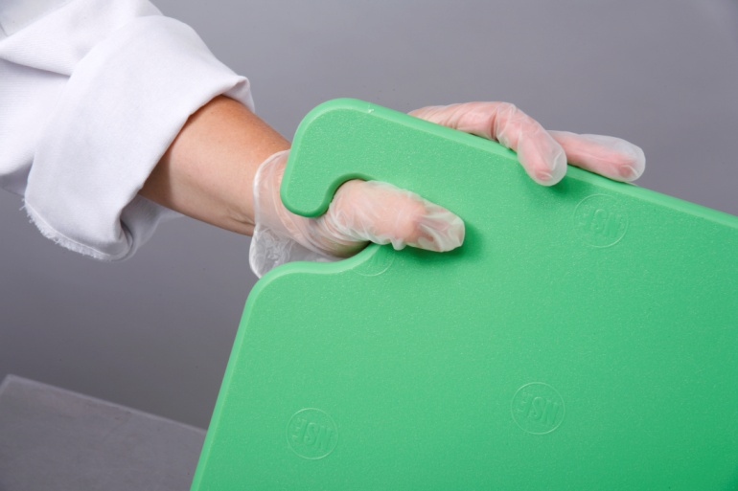
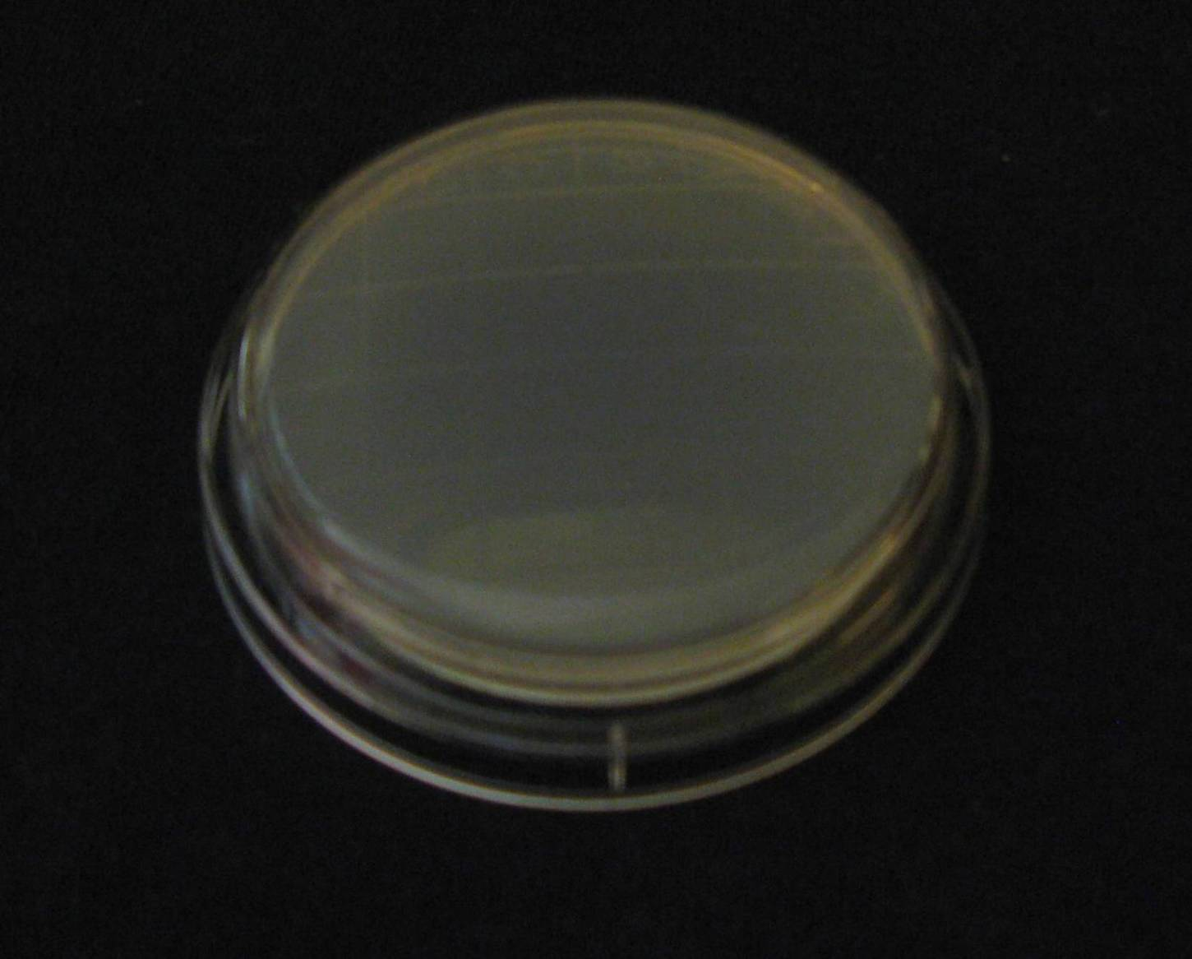
Reduce the Risks - Cleaning and Sanitizing
Source: Iowa State University
Extension Service
A clean and sanitized cutting board shows no sign of microorganisms
22
Notes:
To prevent cross contamination, all food contact surfaces need to be cleaned and sanitized properly. The only way to know if your sanitizer is killing germs is to test it with the appropriate test strip. Chlorine, quaternary ammonia, and iodine are all effective if used at the correct concentration, temperature, and for the right amount of immersion time. This petri dish was prepared by swabbing a clean and sanitized cutting board. Very little microbial growth was present after proper cleaning and sanitizing!

Slide 23
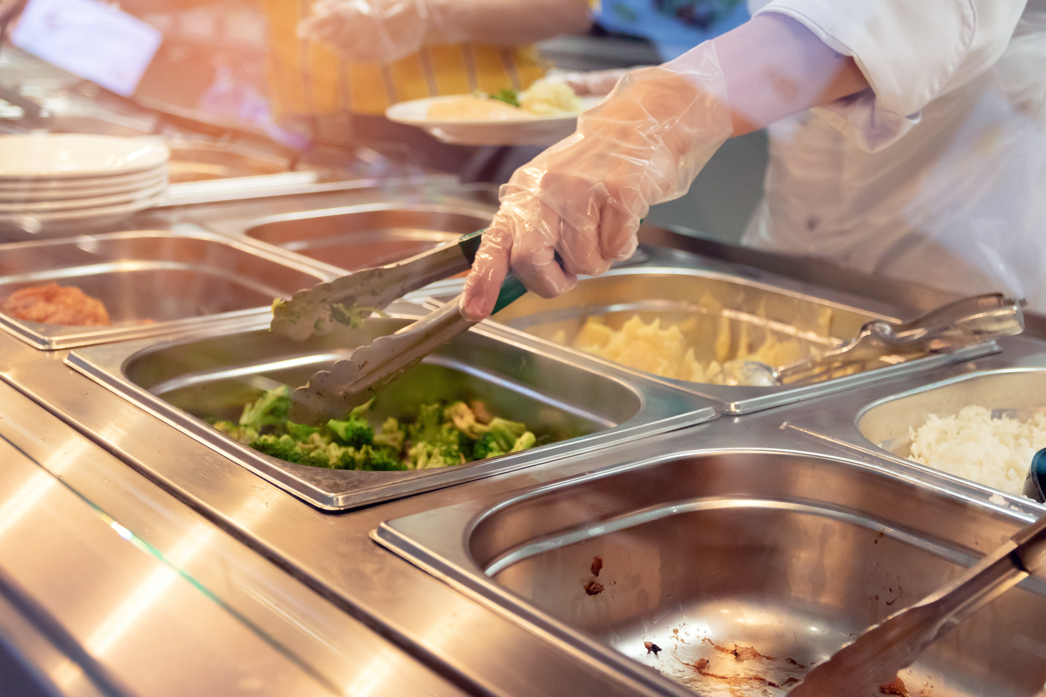
Conclusion
Safe preparation and storage practices are critical when you are handling ready-to-eat foods like produce.
Notes:
You can help make sure you keep your students safe by using best practices for preparation and service, and remembering to wash your hands!

