Slide 1
Farm to School
Safely Sourcing Local Foods
Take Home Training
Credit: 1 Hour
Codes: 1230, 2600
Notes:
Note to instructor: Welcome participants to this training session.
This session will provide the tools you need to safely and confidently source and serve local produce in your cafeterias while complying with federal procurement regulations and food safety guidelines.

Slide 2



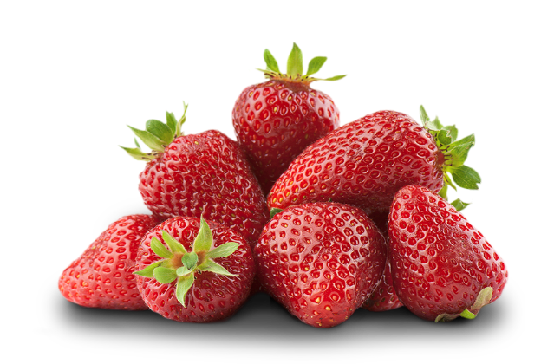
Objectives
  Understand the concept of farm to school and food safety practices to employ.
  Learn how to use geographic preference to procure local food when writing specifications.
  Understand how robust farm to school programs can mitigate supply chain disruptions.
Notes:
Note to instructor: Review the learning objectives with the participants.

Slide 3
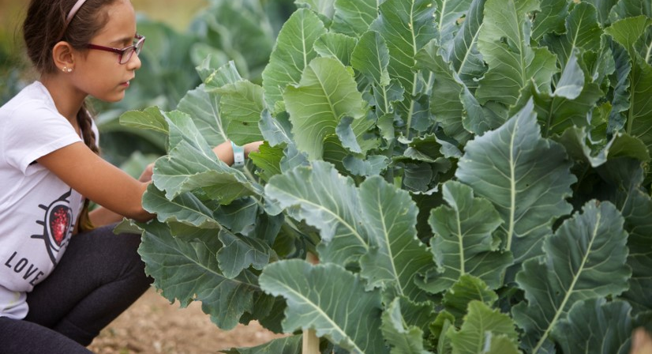

What is Farm to School?
Efforts including:
Bringing locally or regionally produced foods into child nutrition programs (i.e., School cafeterias)
Hands-on learning activities
The integration of food-related education into school curriculum
Notes:
The term ‘farm to school’ is generally understood to include efforts to bring local foods into the child nutrition programs and to teach children about where their food comes from – this includes children participating in the National School Lunch and Breakfast programs, the Child and Adult Care Food Program, and the Summer Food Service Program.
Farm to school efforts encompass a variety of experiences including activities that bring locally or regionally produced foods into school cafeterias, and food-related education into the school curriculum. Schools may be doing some of these already and not even realize that they are doing farm to school!
Today, we will focus on the first type of activity I mentioned, bringing locally or regionally produced foods into school cafeterias. However, it’s important to mention that farm to school includes activities in the classroom as well, and food safety should not be overlooked or neglected with foods used for taste tests, hands-on learning activities, or other activities that may not take place in the cafeteria.

Slide 4
Poll
Classroom Question By Show of Hands
Does your school nutrition program use produce acquired through a
farm to school program?
Yes
No
Not sure
Notes:
Note to instructor: Ask your participants the question on the slide to segue into the discussion on the next slide about the benefits of farm to school in school nutrition programs.

Slide 5
Why Farm to School?
Fresh, tasty food
Willingness to try new foods
Increased consumption of fruits and vegetables
Improved knowledge and awareness regarding gardening, agriculture and healthy eating
Increased program awareness and participation
Creates markets for farmers, local economic benefit
Helps meet meal pattern requirements
Notes:
Reasons that Farm to School may be used in school nutrition programs are noted on the slide.
Food that comes from a local farm or school garden may be fresher since it has less distance to travel and there could be fewer steps involved in moving it from the field to the cafeteria. Farm to school also helps connect students to their food through educational activities, which can stimulate interest in trying new foods, including fruit and vegetables, as well as generating interest in where their food comes from. Remember, farm to school includes activities like farm visits and school gardening too!
Farm to school benefits also extend beyond the school, as the “farm” part of farm to school can also see positive outcomes from the relationship with the school. The school market may be a key untapped resource for many farmers, so strengthening the relationship with local farms can generate more income for local producers, so those dollars are re-injected back into the community. Finally, farm to school can help meet meal pattern requirements, and buying local satisfies the Buy American provision.

Slide 6
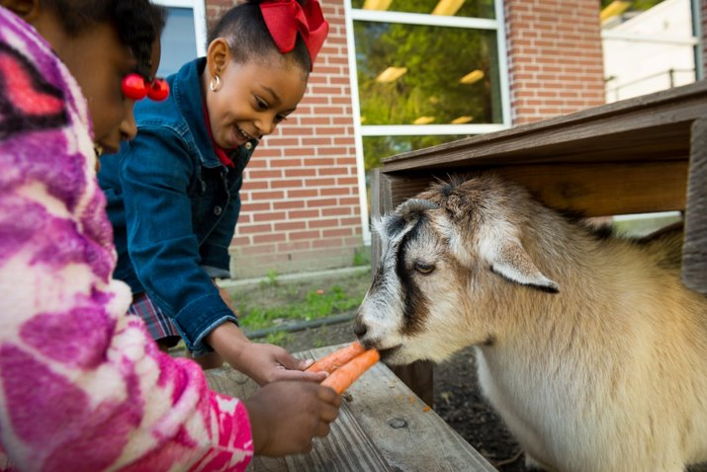

Defining Local
School Food Authorities define “local”
  Within a radius
  Within a county
  Within a state
  Within a region
  Could change depending on:
  Season
  Product
  Special events
For example, “grown in New York,” “Grown within a 100-mile radius of the school district,” “Grown within New York or any bordering State.”
Notes:
It’s important to note that for the purposes of Farm to School, FNS does not define “local.” The definition of local is up to the discretion of the School Food Authority and can even change within the SFA depending on factors such as the growing season, desired product, or special events. Common definitions of local include food produced within a state or particular radius, but can even be as small as within the county or as large as within a multi-state region, such as within any neighboring state.

Slide 7
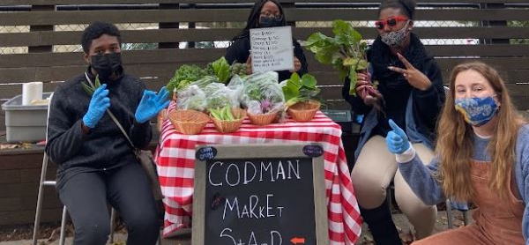
Where to Find Local Foods
Through distributors
Through Food Service Management Companies
From food processors
Through DoD Fresh
From individual producers
From producer co-ops/food hubs
From school gardens
Notes:
SFAs can look for local foods in a variety of places. “Direct market channels” are the arrangement that often comes to mind when we hear the term “farm to school,” and can include purchases directly from a school’s own garden or farm, a community garden, or directly from a producer.
Intermediated markets refer to schools buying from producers THROUGH a broker of sorts. There are a few common scenarios we see. Some might fall in the “value chain” and some might look more like traditional commodity markets. For example, a school’s broadline distributor might offer local options. Schools can get local foods through the USDA Foods program, or the DoD Fresh program. Food hubs, processors, manufacturers or even grocery stores can be other intermediated channels that schools may use to buy local food.
One of the advantages of farm to school is the comparatively short supply chain, particularly in direct market channels. This can have benefits for food safety because you can collaborate with farmers or school garden personnel to observe food production and harvesting in action. Additionally, USDA has observed that SFAs with strong farm to school programs found it easier to adapt or modify their operations to address challenges related to food supply chain disruptions during the COVID-19 pandemic. The resiliency and safety of farm to school are two big reasons to explore local procurement as an option.

Slide 8

Farm to School and Produce Safety
Notes:
By now you may have started to make some connections on your own between the benefits of farm to school and produce safety. As I’ve mentioned, one of the big advantages to farm to school from a produce safety perspective is the relatively short, transparent supply chain. Next, I’ll discuss whether there are any federal requirements about farm to school, then go into what to look for from a produce safety perspective when you are planning farm to school activities.

Slide 9
Important
USDA Requirements
USDA has no rules prohibiting school garden or local produce from being served in school cafeterias.
Schools determine their own food safety standards for all vendors.
Notes:
Often, people want to know what the federal rules are that pertain to local produce. Food safety is critical when it comes to procuring produce. All vendors, whether local or not, must follow applicable laws surrounding their businesses. There are no federal food safety requirements that preclude the use of local produce in school nutrition programs. Schools may develop their own food safety protocols and rules, and establish their own vendor requirements, in accordance with state and local regulations. This means that school gardens and local farms can be approved food sources for school meal programs, and USDA encourages them as such!
In school gardens, USDA encourages a food safety plan or protocols that follow evidence-based steps to reduce food safety risk, but USDA does not require school gardens to be GAP certified by a third party. Instead, USDA emphasizes basic safe gardening & harvest considerations that should be taken into account when growing for human consumption. The reason for your participation in Produce Safety University is to learn about the risks associated with fresh produce and how to mitigate them.

Slide 10
Local Foods and Food Safety
Good Agricultural Practices
GAPs are food safety best practices, not a federal requirement for school gardens or local farms
  A school may choose to make this a part of their food safety policy, but it’s not federally required
  Food from local farms or school gardens is not inherently riskier than food from other sources
  Consult an expert!
Notes:
Good Agricultural Practices, or GAPs, are a set of voluntary practices that farmers can use to ensure they follow science-based food safety practices when growing, harvesting, and handling produce. Farmers can receive a third-party audit to ensure that they are following GAPs, and this is typically referred to as “GAP Certification.” There are NO federal requirements requiring schools to serve GAP-certified produce. A school may choose to make that a part of their food safety policy, but it’s not federally required.
There is nothing inherently more dangerous about serving food from a garden or local farm than from your distributor or other sources. In fact, because of the transparency of the short supply chain from a school garden to cafeteria or local farm to cafeteria, this produce has the potential to be very safe!
LASTLY, if you operate or partner with a school garden and you are not sure if your garden is safe, bring in an expert. There are many great garden food safety websites and tutorials online that can help you dig in. School gardens across the country have developed protocols and manuals that you can review. Cooperative extensions, local nonprofits, or your local health department can come provide you with some feedback on your garden food safety practices. Joining us for Produce Safety University is another way to learn from experts to gain the knowledge to reduce risks, ask questions, and find out where to learn more if you are still unsure. More information on GAPs are available in the Growing Food Safely and Food Safety presentations.

Slide 11
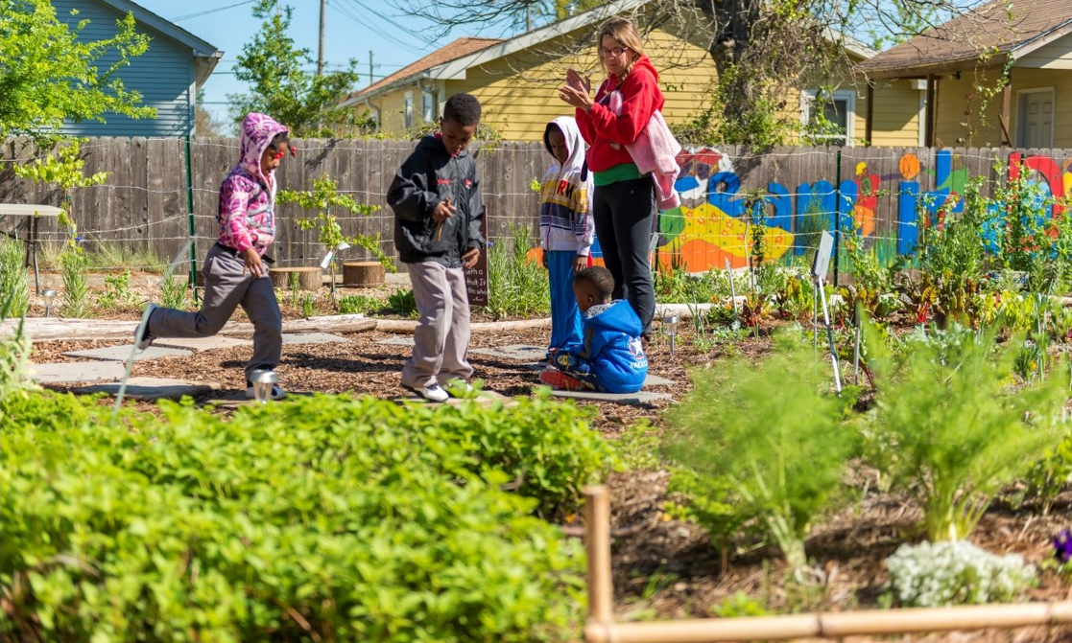
Potential Food Safety Risks in Farm to School
Design
Soil
Water source
Growing
Harvesting
Washing
Storage and Preparation
(same for other products)
Training
Documentation
State and Local Regulations
Notes:
You may remember the Food Safety and Fresh Produce presentation where we discussed sources of contamination. The three major areas of contamination when referring to farm and garden food safety are biological, chemical, and physical. If this sounds familiar, that’s because it’s the same as with a Hazard Analysis and Critical Control Point, or HACCP, plan.
We’re going to discuss some of the biological, chemical, and physical food safety risks associated with each of the key risk areas identified here. If you operate a school garden, you can take measures to mitigate these risks, and if you go on a farm visit you can keep an eye out and request documentation for how the producer mitigates these risk factors.
We will not cover any unique ways that local produce should be stored and prepared, since schools should follow their existing school food safety plans based on HACCP principles and treat local produce just like they would any other. Ideally the protocols and practices you follow in each of these areas should form the basis of your farm to school program’s food safety plan. Remember we went over some of these concepts in the GAPs presentation, therefore some of the content may sound familiar and you may already have great notes on this topic!

Slide 12
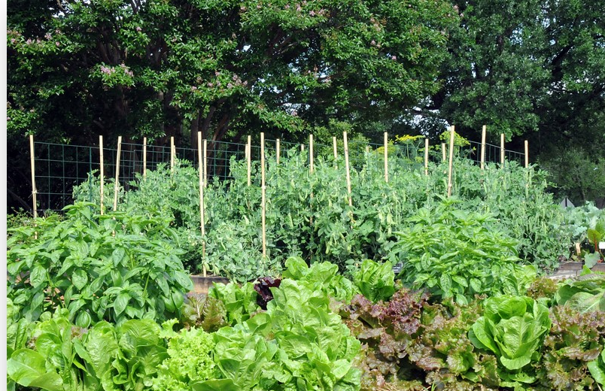
Design
Garden goals (if applicable)
Site
Size
Soil and beds
Crops and livestock
Keeping pests out
Other structures and spaces
Notes:
If you receive local produce from a farm, you won’t have as much control over the design of the growing environment as if you were designing your own school garden, but there are still some design cues you can look for when visiting a farm so you can tell whether the farmer is taking appropriate steps to mitigate risk. It’s also possible the school garden was originally designed without school nutrition in mind, but you can work with the school staff who lead the school garden initiative to help them refine an existing garden. Even if garden produce is used for taste tests or other classroom activities and not school meals, produce safety is still important!
Whether it’s your school garden or a local farm, livestock and other animals such as pets should be kept separate from produce growing for consumption and animals should be kept down slope (to prevent issues from runoff). The area should be free of overhead trees and tree limbs where animal droppings can contaminate the garden. Chicken wire may be present to deter rabbits, deer, squirrels, and other small animals from the garden.
Plants should be accessible without having to walk over other plants, to reduce any contamination from footwear. The growing area should have adequate access to a safe, tested water supply. The location must be away from dumpsters, underground tanks or other underground sources of contamination, and any area near a facility that houses livestock. Active compost piles should be kept away from plants so there’s no cross contamination.
If you are starting a school garden, it’s important to keep design in mind from the very start of the project. The design of the garden should reflect the garden goals and uses, space available, and food safety. What is the ultimate goal? Is it for educational purposes, rainwater collection, showcasing native plants, growing for taste tests, or production so that items can be used in the cafeteria? Is it a salsa garden or an herb garden? It’s a good idea for the cafeteria staff to get involved at this planning stage so that the items growing in the garden complement the food you’re serving in your cafeteria, or so that you can adjust your menu to align with what’s growing in the garden.
Once the purpose is established, then the location, size, crops etc. can be decided on. A good practice is to separate produce grown for consumption in the school cafeteria with produce that’s more for “hands-on” student engagement, to prevent any cross contamination.

Slide 13
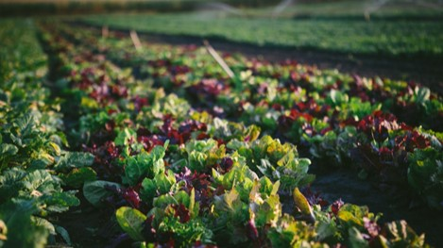

Soil
Free of biological and chemical contaminants
Soil testing
  Lead and other contaminants
  Nutrient status
Compost must be fully cured compost
Natural or organic soil amendments
Notes:
First up: Soil! Soil should be free from contaminants – the main concerns here are biological (such as manure that hasn’t been properly composted and may contain harmful parasites, viruses or bacteria) and chemical (containing harmful metals or substances). If plants grow right into the ground, the soil must be tested too (who knows what structures were once built there). Ask your farmer or garden coordinator where the soil came from, and if it is has been tested! You can ask for records of your farmer or gardener’s testing history. Donated soil in your school garden is great, but you should be aware of what it’s comprised of. Cooperative extension can typically help you get your soil tested in your own gardens. Laboratory testing should be conducted at least every 10 years for raised beds. Testing will determine your soil’s nutrient status as well as identify possible carcinogenic or heavy metal contaminants. Testing should occur more frequently if you have added new soil to the ground/raised beds or notice stunted growth among plants.
If compost is used in the soil, it must be fully cured compost. Fully cured compost means compost has passed the active decomposing period and is now stable with lower levels of microbial activity. Otherwise, it runs the risk of containing harmful biological contaminants. If using manure, it should be composted for at least 120 days to a year, depending on the crops. Commercially prepared compost should follow these requirements. Vermicompost (compost from worms!) is safe if proper composting procedures are followed and it can be a suitable alternative to consider. If an operation has questions regarding proper composting procedures, contact the Cooperative Extension Service in your state. Most Extension Services have developed proper composting procedures and have this type of information readily available.
In general, we advise avoiding the use of chemical pesticides, fertilizers or herbicides. We recommend using natural or organic soil amendments to reduce the risk to human health. When using any soil amendments in your school garden, be sure to follow the instructions on the label.
A note on lead (note: pronounce Led)– if your district or municipality has lead concerns or is located in an older industrial city- checking your soil for lead on an annual basis for the first few years is recommended. If using a municipal source of water that has lead concerns – checking the soil for lead is recommended as lead will build up in soil before it will accumulate in plants. Another way of explaining this is when considering lead health concerns- the way that produce (and not all produce does) accumulates lead is through lead in the soil – and checking the soil is the best way to mediate those concerns. Lead does not absorb through skin.

Slide 14

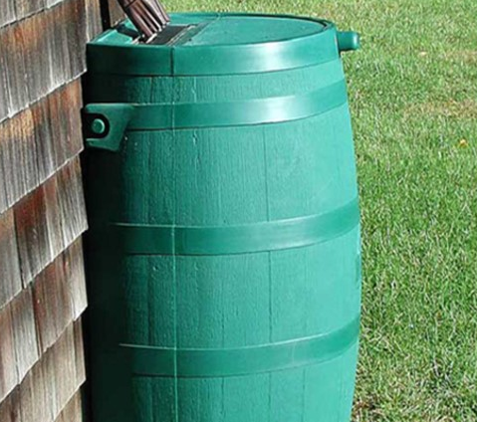
Water
Municipal/tap water is tested for safety regularly!
Surface water not recommended
Rain barrel is acceptable in school gardens
  Water the roots, not the leaves
Notes:
You can ask your farmer about the water source used to water produce. Water from a public source is tested regularly and the safest possible source. If you have any concerns, you can ask the municipality for water records. Groundwater is a good source, as it is protected from contaminants, but surface water from sources such as ponds is not recommended because it is open to the environment and susceptible to contamination.
Rain barrel water is fine for school gardens, but plants should be watered at the roots, not the leaves, when using rain barrel water. Test the water regularly and clean the barrel regularly – it’s easy for contaminants such as bird droppings to get into rain barrels. You should also not use rain barrel water for handwashing, washing produce, or drinking.
As mentioned a moment ago, test soil for lead, not water. Lead shows up in soil first and plants do not uptake lead directly from water.

Slide 15
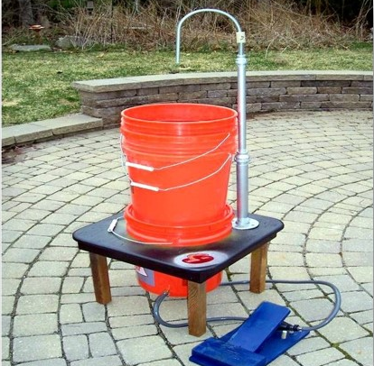
Harvesting
Create and follow a harvest protocol
Healthy harvesters
Wash hands
Use clean harvest tools
Observe, then harvest
Harvest into clean, food grade containers – keep off ground
Avoid washing - shower
Proper storage/cooling
Document everything!
Notes:
Having strong harvest protocols are important. Your local farm may use a checklist to emphasize procedures harvesters must follow in order to minimize contamination. School gardens can use a checklist for the same purpose, to ensure that your harvested produce will have a designated place to be stored/used in the cafeteria. When visiting a farm, consider timing your visit and coordinating with the farmer, so that you can witness their harvesting practices firsthand. Here are some procedures to keep an eye out for.
Harvesters should not participate if they have been sick in the past two or so days. Alternate tasks, such as recording the types of produce harvested, are still appropriate.
Handwashing is probably the most important step in ensuring a safe harvest. Handwashing stations may be somewhere in the open where you can see this step in action, but the hand wash space may also be located in a bathroom or other clean handwash space. If harvesters need to clean their hands, it’s worth the time to send them back to wash.
Just like hands, harvest tools should be washed properly before harvest to remove any contaminants.
Harvesters should survey the garden and produce for harvesting and avoid any contaminated produce, such as tomatoes with bird droppings or squirrel bites taken out of it.
All produce should be harvested into properly cleaned, food grade containers. And they should be kept off the ground – you don’t want a harvest tote on the counter that was set down in bird droppings in the garden!
It’s safer not to introduce water to produce, since moisture can encourage the growth of contaminants. Many produce varieties store better without being washed. For particularly dirty items, be sure to wash them with potable water and remember, shower is better than bath (rinsing or spraying the product is safer than dunking it in a tub, since contaminants can remain in the tub).
When that produce is delivered to the cafeteria, it’s good to start the proper storage and cooling process defined in your food safety plan based on HACCP principles.
Finally, it’s good to document the harvest (for example, using entries for date, harvesters, products, and quantities) so you can trace back to the harvest if there’s ever an issue. Produce Safety University includes a mock recall activity where you’ll have a chance to put the lessons about tracking and documenting food received into action!
Before we move on, I’d like to add one final reminder about the connection between the GAPs described here and Tom’s presentation earlier where he covered GAPs in detail. Tim’s session materials, like all of the PSU presentations, are available in your binder for your future reference!

Slide 16
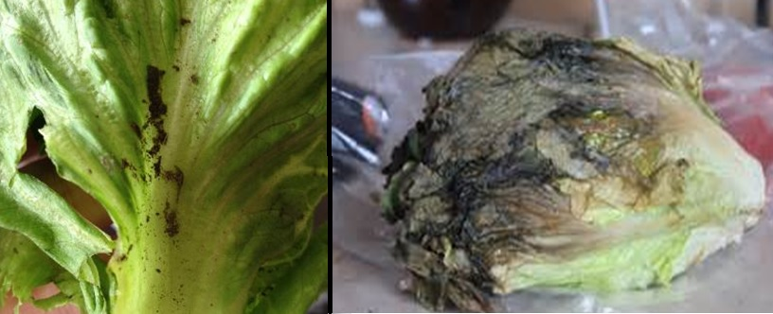
Know Your Produce!
Know the difference between dirty and rotting
Some dirt is expected
Washing in kitchens encouraged over field washing
Shower is better than bath
Soil can contain beneficial bacteria!
Notes:
Rotten VS. garden fresh – what is the primary difference between these two pictures of lettuce? Especially if you have a school garden, training kitchen staff to tell the difference between dirty versus rotting produce is critical to success and not wasting products.
One has some dirt- a normal expected outcome of growing in soil- and the other head is rotten. This may seem basic to everyone in this session, but if your staff is not used to receiving produce that hasn’t passed through a packing house, they might not be used to seeing soil on products and reject them.
Soil on product does not mean the produce is contaminated. Make sure your staff is trained on what is “dirty” because it was grown in the soil and actually “rotten or rotting.” USDA encourages schools to wash in kitchens as you have complete control over food safety environment. It is not recommended to “field wash” though harvesters can brush dirt and soil off the product before packing in containers or disposable paper bags.
Take home point- soil does not mean reject! Make sure your staff have a relatively convenient way to properly clean off soil without clogging up your sink. And remember – shower is better than bath!
One last fact about soil on food - in healthy balanced soil there is beneficial bacteria that contributes to our overall health!

Slide 17
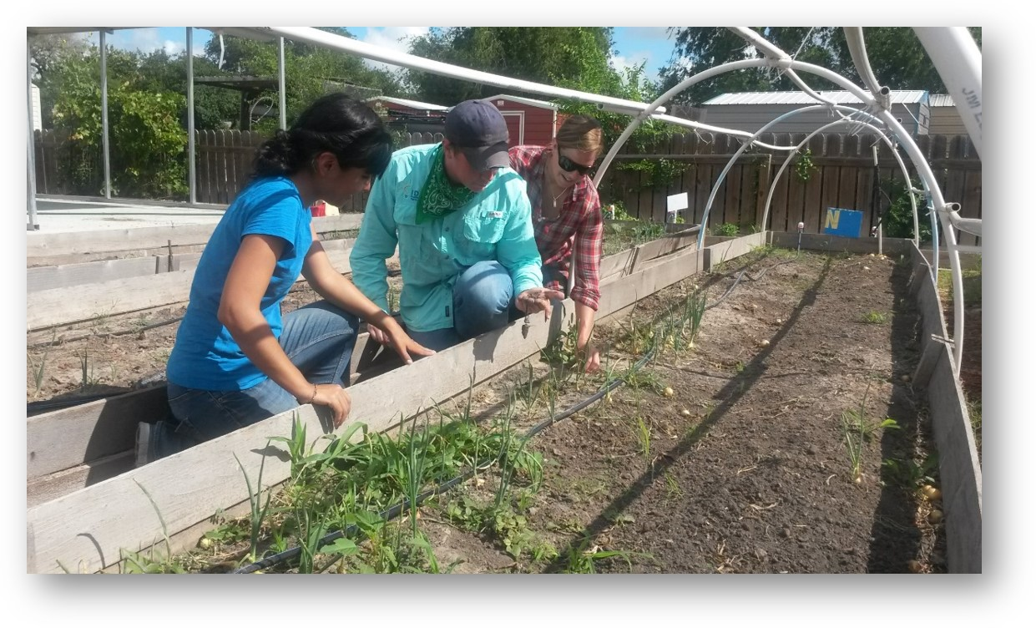

Training
Farm employees
Volunteers
Students
Teachers
Harvesters
Cafeteria Staff
Custodial Staff
Notes:
We’ve alluded that good training is key to a successful food safety program. Everyone can play a part in growing safe produce, as long as they know their part. When working with a local producer, you can request documentation and training logs for employees. Make sure that trainings are recent and regular. You can also check for posted signage and any checklists, as well as watching workers in action to see for yourself whether they are consistent about following food safety practices.
With school gardens, make sure that someone on your garden team is responsible for training garden stakeholders. Students can actually help design trainings and create signage to remind everyone of good food safety practices. They can also help police themselves – someone’s role in the harvest can be to watch for hands that need to be re-washed after touching a face or animal, for example!

Slide 18
Documentation
Request documentation demonstrating that:
Good food safety practices are followed
Stakeholders have been trained
Soil and water sources are safe
Harvest containers are cleaned and sanitized regularly
Harvest details (products, harvesters, pounds, etc.)
Important
Notes:
Having a garden food safety plan & protocols in place, and training garden stakeholders, is a good start – but good documentation can ensure that the plan, protocols, and trainings are being followed!
What does this documentation look like? It could take the form of checklists, photos documenting practices, training logs, or whiteboards. You can request documentation from your farmers and school garden staff. Documentation applies to all aspects of the production cycle, including soil and water testing, training, and harvest details.

Slide 19
Local Procurement
Notes:
In the final few slides, I will discuss briefly how you can incorporate local purchasing into your farm to school program. Tom and Chef Cyndie will present on specification writing later in PSU, so we won’t cover all the details of specification writing at this time. I will limit my discussion to how to incorporate local into a solicitation without running afoul of federal regulations. Note that when local food arrives at your cafeteria, it should follow your food safety plan just like produce from any other source.

Slide 20
How To Write Specifications for Local Food
DO
  Use product specifications
  Use additional requirements to determine vendor responsiveness
DO NOT
  Use local as a product specification
  Use language like:
    “This RFP is restricted to producers within the State.”
    “We are soliciting bids from producers within a 150-mile radius”
Links to the Regulations and Q&A Policy Memo
2011-9843.pdf (govinfo.gov)
https://www.fns.usda.gov/cn/procurement-geographic-preference-qas
https://www.fns.usda.gov/cn/procurement-geographic-preference-qas-%E2%80%93-part-ii
Notes:
When writing specifications for local food, it’s important to keep in mind what is and is not allowed. The most important note is that you cannot use local as a product specification. Again, it is not permitted to write “local” or your definition of local in a specification. Language such as “This RFP is restricted to producers within the State” is not allowed either.
With the current regulations and guidance, using local as a product specification is seen as limiting competition. Many have misinterpreted the geographic preference rule as allowing schools to use local as a specification, however the language included in the Final Rule, Geographic Preference Option for the Procurement of Unprocessed Agricultural Products in Child Nutrition Programs, indicates that local cannot be used as a specification. The preamble of the Final Rule states, “A geographic preference is not a procurement set-aside for bidders located in the specified geographic area, guaranteeing them a certain level or percentage of business. In addition, including a geographic preference in a procurement does not preclude a bidder from outside the specified geographic area from competing for, and possibly being awarded, the contract subject to the geographic preference.” Additionally, FNS issued a Q&A Policy memo, which is linked in the slide, in 2011 that clarified that “the exclusion of all non-locally grown agricultural products is not a preference but rather a requirement of bidding and therefore is overly restrictive.” We will further discuss geographic preference in just a few slides.

Slide 21

Criteria for Local Foods Specifications
Potential Specifications, Requirements, and Evaluation Criteria to Target Local Products
  Varieties unique to the region
  Freshness (e.g., delivered within 48 hours)
  Size of farm
  Harvest techniques
  Crop diversity
  Origin labeling
  Able to provide cafeteria or class visits
Notes:
You may be wondering, if I can’t specify local in my procurement, how can I ensure I get a local product? School Food Authorities have several ways to communicate the values we commonly associate with local, without requiring local.
Each of the elements listed on this slide could be used as product specifications or technical requirements as long as they do not overly limit competition. Let’s look at a few examples:
Particular varieties unique to the region –If I’m in Sonoma County in California and I issue a solicitation for a Gravenstein apple, chances are it’s going to come from a local vendor, because Sonoma is the center of Gravenstein production in the U.S.
Freshness (e.g., delivered within 48 hours) – Requiring product to be delivered with 48 hours of harvest serves a dual purpose—you get really fresh produce, and you also increase the chances that the product will be local.
Size of farm – Include as a specification, requirement, or evaluation criterion a limit on the size of the farm you’d like the food to come from.
Farm Practices – You can require that specific farm practices are utilized, such as crop rotation or integrated pest management practices.
Harvest techniques – You can require that crops be harvested by hand.
Crop diversity – Farms that raise a certain number of crops or livestock.
Origin labeling – If you’re developing a contract with a distributor, you can require that they include farm of origin or county of origin labeling.
Able to provide farm visits or class visits – You can also require that farmers or vendors participate in educational activities, something local vendors are more likely to be able to do than non-local vendors.

Slide 22
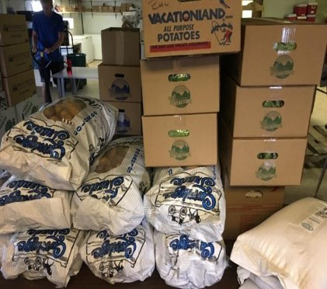
Writing Specifications for Local Food
Be flexible
Don’t include unnecessary requirements
Consider what a vendor new to the school food market might not know
  Condition upon receipt of product
  Food safety needs
  Size uniformity
Notes:
The specifications and requirements listed on the previous slide actively work to target or identify local products. There are also more subtle considerations to keep in mind when seeking to buy local products. To the extent that it is reasonable for you, be flexible. This might mean broadening the usual requirements you use to allow for, perhaps, a little bit of cosmetic damage (especially for items that will be processed before they are served).
Do not include unnecessary requirements that might be burdensome for a smaller operation. For example, if you usually require all produce to be delivered in a refrigerated truck but the solicitation you’re working on is just for apples, perhaps the apples do not need to be kept cold during transport, and that is something you can remove from your solicitation.
Finally, remember to include as much detail as possible about the factors that are non-negotiable for you. For example, you may be caught off guard when a farmer delivers unwashed lettuce. If you want a washed product or uniform size, you need to be explicit about your needs. In addition, not all small farmers are familiar with the US grading system, so instead of just saying US Grade No. 1, perhaps you can include information about what Grade 1 actually means for the particular product you are buying.
Be clear and detailed, be as flexible as is reasonable for you, and don’t use jargon or include unnecessary requirements.

Slide 23
Specifications for Local Food and Geography
Geographic Preference
  Schools may express a preference for local food
    It’s a preference, not a requirement or specification!
    Can be used for all procurement methods
    Can only be used with certain products
      “Unprocessed agricultural products” that retain their inherent character
        NOT heating, cooking, or canning
Notes:
Finally, one of the most powerful tools in the local procurement toolkit is geographic preference. As previously mentioned, geographic preference refers to a specific provision in the 2008 Farm Bill that allowed schools to include a preference for local products in their solicitations. Note that geographic preference is NOT a requirement or specification.
Furthermore, while geographic preference can be used regardless of procurement method, it can only be used for certain products. Geographic preference is only permissible for “unprocessed agricultural products” that retain their inherent character. Some examples of what is considered “unprocessed” are cooling, refrigerating, or freezing; peeling, slicing, dicing, cutting, chopping, shucking, and grinding; drying and dehydrating; washing, packaging, vacuum packing, and bagging; and adding preservatives to prevent oxidation. Not allowed are heating, cooking, or canning, which change the inherent character of the product.
To incorporate a geographic preference into your procurement process, you need first to settle on a definition of local. This decision is important because the statute only applies to local agricultural products. You also need to determine how much preference to apply to these products. Usually, that preference will show up in your solicitation as a fixed preference or a percentage preference.

Slide 24
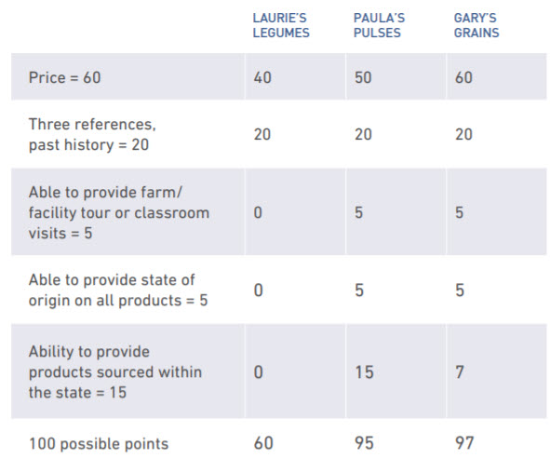

Geographic Preference Solicitation Example
Paula’s Pulses sources 75% within the state = 15 points
Gary’s Grains can source 55% within the state = 7 points
Laurie’s legumes cannot guarantee any products within the state = 0 points
Notes:
You can also consider using a tiered approach wherein vendors receive a higher or lower score based on the degree to which they satisfy your criteria. For example, you could indicate that vendors who are able to supply 70% or greater local products will receive a 15-point advantage while vendors who can supply 50–69% local products will receive a 7-point advantage.
The example on this slide demonstrates what the evaluation might look like for bids received in response to a tiered approach. A school district issues a request for proposals for beans and grains and makes it clear that bids will be evaluated using a 100-point system. Fifteen preference points will be awarded to vendors able to provide over 70% of the requested items from within the state, 7 points for 50-69% and 5 points for 25-49%. Points for local sourcing will be included along with other evaluation factors.
Paula’s Pulses can source 75% of their products from within the state, earning them 15 points in the scoring process in the local products category. Gary’s Grains can source 55%, earning them 7 points, and Laurie’s Legumes is unable to guarantee any products from within the state, so they receive 0 points in the local preference category. Gary’s Grains wins the contract. Remember, this is only an example, and there are many ways to structure a tiered approach depending on your goals!

Slide 25
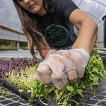
What to Include in Your Specifications
  Define local
  Determine the procurement method to use
  Decide how much preference local products will receive
  Be very clear in the solicitation how the preference will be applied
Notes:
Remember an RFP or IFB cannot contain language stating that only agricultural products grown within a certain state will be accepted. Language like that is considered overly restrictive because it is stated as a requirement, not a preference. And even when stating a preference, it is overly restrictive to indicate a preference for products grown within five miles of your school district when only one farm exists within five miles of your district, because such a requirement would be considered an unreasonable limit on competition. If many farms existed within five miles of your school district, it would not be considered an unreasonable limit on competition. You have to use your best judgment.

Slide 26
USDA Farm to School Specialists
USDA Regions
https://www.fns.usda.gov/cfs/usda-farm-school-staff
Andrea Alma​
Allison Bell ​
Mountain Plains Regional Office
(MPRO))​
SM.fn.MPRO.F2S@usda.gov ​
Sarah Elliott​
Angela Rupchock-Schafer​
Midwest Regional Office​
(MWRO)
SM.FN.MWFarmtoschool@usda.gov
Katina Kefalas​
Northeast Regional Office ​
(NERO)​
SM.Fn.NE.F2S@usda.gov​
Kari Kramer​
Kendra Vandree​
Western Regional Office ​
(WRO) ​
SM.FN.WRO.F2CNP@usda.gov ​
Nicole Zammit​
Kelsey Porter​
Mid-Atlantic Regional Office
(MARO) ​
SM.FN.MA-Farm2CN@usda.gov ​
Lissa Ong​
Bernadette Lorenzo​
Southeast Regional Office ​
(SERO)​
SM.fn.SEROCFS@usda.gov​
Chantal Beard​
Melissa Campbell​
Southwest Regional Office ​
(SWRO)​
SM.FN.SW-Schools@usda.gov ​
Notes:
Regional Specialists: Moving on, each USDA FNS region has two Farm to School Specialists who are experts in all things Farm to school.
They have experience in a variety of farm to school topics. You can reach out to our regional specialists at any time with your questions. If you’re not sure – reach out anyway!

Slide 27
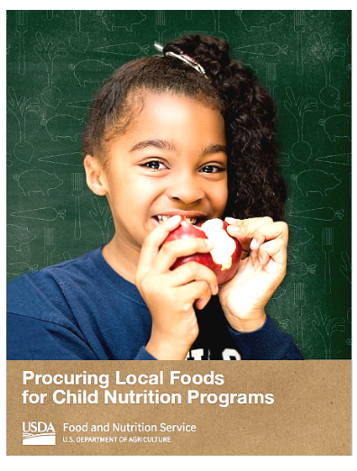
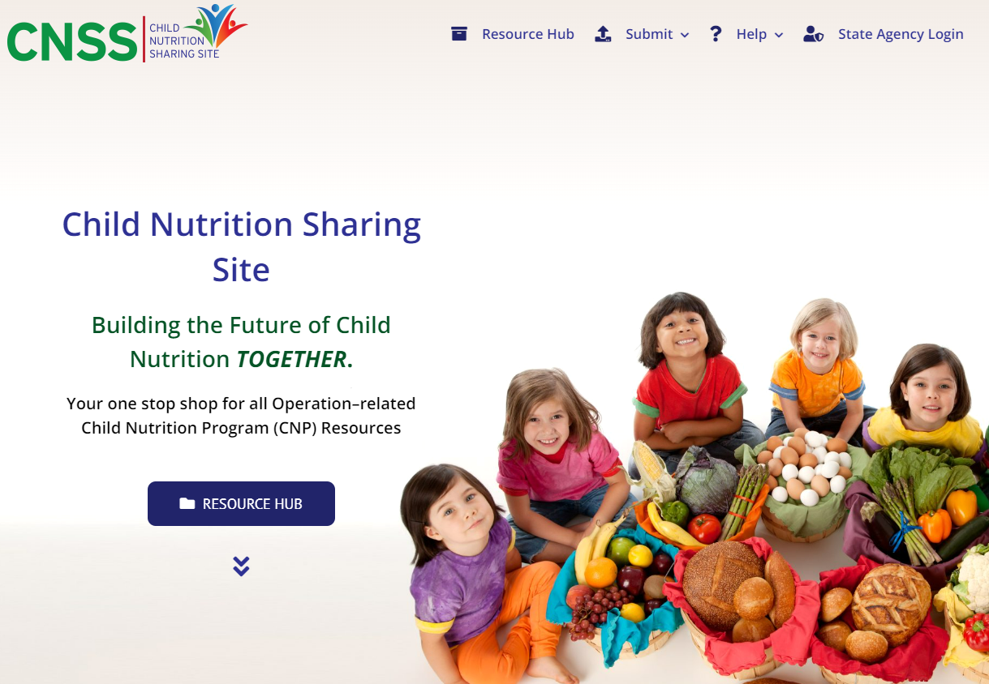
Resources
Procuring Local Foods for Child Nutrition Programs Guide
www.fns.usda.gov/f2s/procuring-local-foods
ICN Child Nutrition Sharing Site
https://theicn.org/cnss/resources
Notes:
Here are some other resources.
The USDA Procuring Local Foods for Child Nutrition Programs Guide provides an overview of federal procurement principles and covers a host of topics related to sourcing and purchasing local foods for state agencies and child nutrition program operators. This guide highlights the variety of mechanisms schools can use to purchase local products while staying in accordance with federal procurement regulations. The guide features examples of how to target local foods when conducting both formal and informal procurements, use the geographic preference option, and use the USDA Foods and DoD Fresh Programs to enhance local purchasing.
The Institute of Child Nutrition (ICN) Child Nutrition Sharing Site (CNSS) is an online information center providing Child Nutrition Program operators with a means for sharing effective resources related to program operation.
This collaboration between the ICN and USDA/FNS gives child nutrition professionals access to resources that support current Federal regulations, policies, and guidance.
All resources uploaded to the Child Nutrition Sharing Site (CNSS), categorized under “Farm to School,” are evaluated on the following criteria by USDA Farm to School staff. Resources that include videos, webinars, scripts, or any type of audio, are viewed, listened to, and reviewed in order to determine if they can be listed as a resource within CNSS. Feel free to submit a resource, or access the resource database!

Slide 28
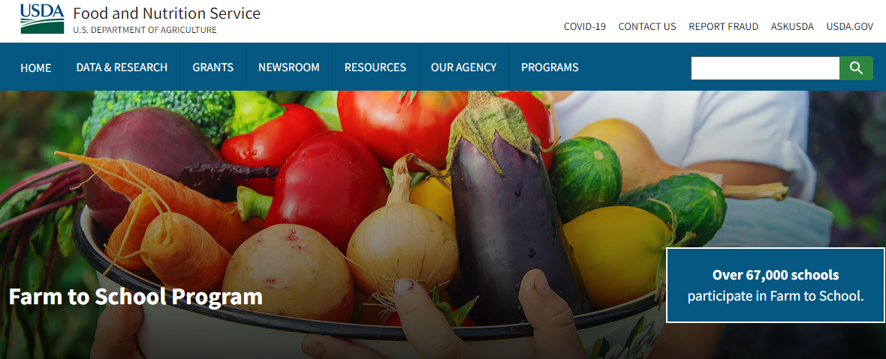
Community Food Systems Division
Visit our website!
www.fns.usda.gov/f2s/farm-to-school
Notes:
I hope I’ve piqued your interest and improved your confidence in including more local produce in your meal programs. The Community Food Systems Division is a valuable resource for farm to school. Not only do we provide resources through our website, but CFSD Farm to School Regional Specialists are available in each FNS region to act as a technical assistance resource. You can access our resources and identify your Farm to School Regional Specialists on our website, fns.usda.gov/cfs, the URL included on this slide. We hope you will take some time to explore our website!

