Slide 1
Feeding Infants in the CACFP
Lesson 9
Creditable Infant Foods: Part 1
Notes:
Information in this lesson comes from Chapter 6: Feeding Solid Foods in the Feeding Infants in the Child and Adult Care Food Program guide. This lesson covers solid foods that are creditable towards a reimbursable meal and snack in the infant meal pattern requirements.
Learning Objectives
At the end of this lesson, participants should be able to:
Identify solid foods that are creditable as part of a reimbursable infant meal or snack in the CACFP infant meal pattern requirements.
Lesson Description
The Creditable Infant Foods: Part 1 lesson takes approximately 25 minutes to deliver. If the pre-test and post-test are administered, total session time will be approximately 30 minutes.
Welcome and Trainer Introduction
Welcome participants to the training and introduce yourself by providing:
Your name
Your position title
Your experience with the CACFP, infant nutrition, and/or child care

Slide 2
Agenda
Reimbursable Infant Meals and Snacks
Solid Foods
Meal Components
Summary
Notes:
In this lesson, you will learn about solid foods that are creditable towards a reimbursable meal and snack in the infant meal pattern.

Slide 3
Pre-Test #1
1
Yes or No?
A parent asks you to start serving solid foods to their 5-month-old baby at your child care site, but you know the infant meal pattern age groups are 0 through 5 months and 6 through 11 months. If you serve the baby solid foods at 5 months, can you still claim reimbursement for the baby’s meals and snacks?
Notes:
Yes or No?
A parent asks you to start serving solid foods to their 5-month-old baby at your child care site, but you know the infant meal pattern age groups are 0 through 5 months and 6 through 11 months. If you serve the baby solid foods at 5 months, can you still claim reimbursement for the baby’s meals and snacks?
Trainer Note: You can conduct the pre-test as a group activity or distribute a paper test. There are three question slides.
For a group activity, ask participants what they think the answer is for each question.
Do not give the answer.
Tell participants that the answer to each question will be provided during the lesson and the answers will be provided at the end of the lesson in the post-test slides.
For paper-based testing, distribute the pre-test and pencils. Tell participants how much time they have to complete the assessment.
If you will not administer the test, skip the slide.

Slide 4
Pre-Test #2
2
Yes or No?
You notice that a baby in your care is developmentally ready for solid foods, and the parents agree. The parents tell you that they have fed their baby eggs at home, so you offer the baby whole eggs (yolk and egg white), finely chopped at child care. The baby takes one bite at lunch.
Can you claim the eggs as part of a reimbursable lunch?
Notes:
Yes or No?
You notice that a baby in your care is developmentally ready for solid foods, and the parents agree. The parents tell you that they have fed their baby eggs at home, so you offer the baby whole eggs (yolk and egg white), finely chopped at child care. The baby takes one bite at lunch.
Can you claim the eggs as part of a reimbursable lunch?
Trainer Note: The answer to the question will be provided in the content of the lesson and is provided in the post-test slide.

Slide 5
Pre-Test #3
3
Which foods are creditable in the infant meal pattern and can be offered to infants around 6 through 11 months?
Choose all that apply.
Peach cobbler baby food dessert
Pureed carrots
Finely chopped baked chicken
Granola bar
Notes:
Which foods are creditable in the infant meal pattern and can be offered to infants around 6 through 11 months?
Choose all that apply.
Peach cobbler baby food dessert
Pureed carrots
Finely chopped baked chicken
Granola bar
Trainer Note: The answer to the question will be provided in the content of the lesson and is provided in the post-test slide.

Slide 6
Reimbursable Infant Meals and Snacks
Meal components:
    Breastmilk or iron-fortified infant formula
    Meats and meat alternates
    Vegetables and fruits
    Grains
A meal or snack is reimbursable as long as all required meal components are offered during the day.
Creditable foods count towards the infant meal pattern requirements for a reimbursable meal or snack.
Notes:
Before we get started, let’s define meal components, a reimbursable infant meal or snack, and a creditable food.
Each meal and snack in the infant meal pattern is made up of meal components: breastmilk or iron-fortified infant formula, meats and meat alternates, vegetables and fruits, and grains.
A meal or snack is reimbursable as long as all required meal components are offered to the baby during the course of the day.
Babies do not need to eat the entire meal offered for the meal to be reimbursable.
Creditable foods are those that may be counted towards meeting the CACFP infant meal pattern requirements for a reimbursable meal or snack.
Creditable foods include: iron-fortified infant cereals, meats, fish, beans, peas, eggs, yogurt (including soy yogurt), tofu, cheese, fruits, and vegetables.
At snack, creditable options include breads and crackers, and ready-to-eat cereals.
Turn to Appendix F: Infant Foods List on page 149 in the Feeding Infants in the Child and Adult Care Food Program guide for a list of creditable and non-creditable foods. Note that the list is not all-inclusive.
Trainer Note: These definitions were provided in Lesson 1 and serve as a review.

Slide 7
Solid Foods
Infant Meal Pattern
Breakfast | 0 through 5 Months | 6 though 11 Months
Breastmilk or infant formula | 4–6 fl oz breastmilk or formula | 6–8 fl oz breastmilk or formula
Grains or meats/meat alternates, or a combination |  | 0–½ oz eq infant cereal; or 0–4 tbsp meat, fish, poultry, whole eggs, cooked dry beans or peas; or 0–2 oz cheese; or 0–4 oz cottage cheese; or 0–4 oz (½ cup) yogurt; or a combination of the above
Vegetables, fruit, or both |  | 0–2 tbsp vegetable, fruit, or both
Notes:
Trainer Note: The following concepts were introduced in Lesson 1 and serve as a review before you discuss foods that can credit towards a reimbursable meal or snack.
The CACFP infant meal pattern allows for solid foods starting around 6 months of age. The term “around” is used because not all babies are developmentally ready for solid foods at exactly 6 months of age. Some babies may be ready for solid foods at 5 months, others at 6½ months.
The amounts of solid foods listed in the infant meal pattern are provided as a range, such as 0–2 tablespoons. This provides the flexibility to offer the right amount of solid foods based on a baby’s developmental readiness. You might offer a baby less than 1 tablespoon of a food if a baby just started eating solid foods. Once the baby has tried and accepted a certain food, you would then offer, them the full 2 tablespoons of the solid food.

Slide 8
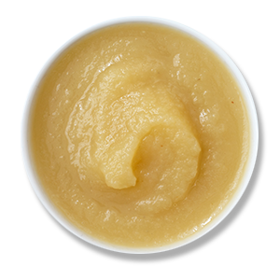
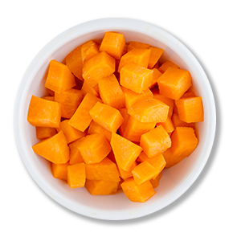
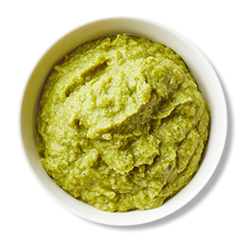
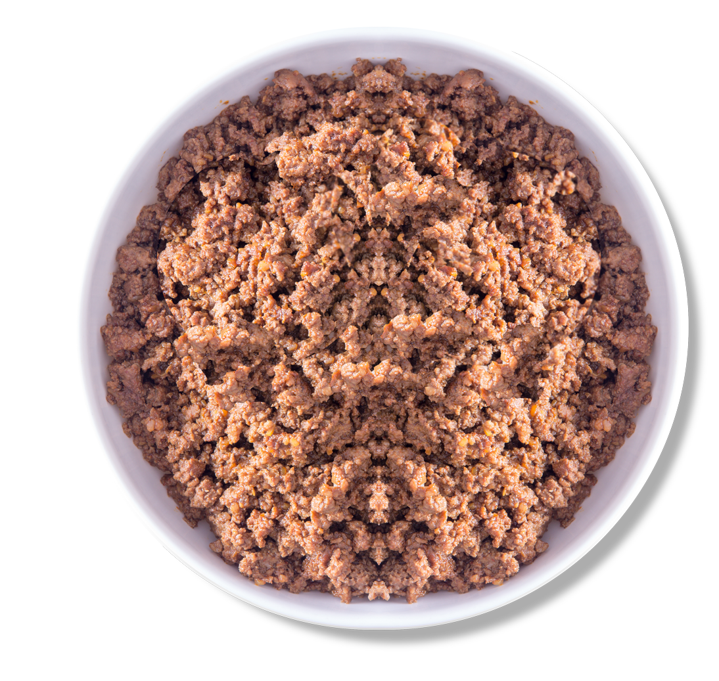
What Are Solid Foods?
Solid foods are foods that are easy to digest and safe for a baby to eat once they are developmentally ready.
Finely
Chopped
Pureed
Mashed
Ground
Notes:
Solid foods are foods that are easy to digest and safe for a baby to eat once they are developmentally ready, usually around 6 months of age. Solid foods can be pureed, mashed, ground, or finely chopped to allow a baby to swallow the food without choking.
As a child care provider, you can start offering a baby solid foods after the parents have told you that the child is developmentally ready and is eating solid foods at home.

Slide 9
Solid Foods in the Infant Meal Pattern
Babies Ages 6 through 11 Months
Notes:
For babies 6 through 11 months, the CACFP infant meal pattern includes solid foods, such as: iron-fortified infant cereals, meats, fish, beans, peas, eggs, yogurt (including soy yogurt), tofu, cheese, fruits, and vegetables. At snack, creditable options include breads and crackers, and ready-to-eat cereals.

Slide 10
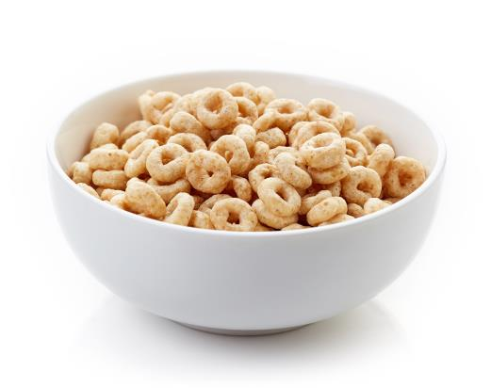
Grains
Iron-fortified infant cereal
  Breakfast, lunch and supper, or snack
Breads
  Snack only
Crackers
  Snack only
Ready-to-eat cereals
  Snack only
  Must meet the sugar limit (6 grams per dry ounce)
  Iron-fortified
Notes:
Grains in the infant meal pattern include:
Iron-fortified dry infant cereal
Breads and crackers (creditable only if offered as a snack, not with a meal)
Ready-to-eat cereals (creditable only if offered as a snack, not with a meal)
Grains served must be made with enriched or whole-grain meal or flour. Ready-to-eat breakfast cereals and infant cereals that are iron-fortified are also creditable. There is no whole grain-rich requirement in the CACFP infant meal pattern.
Ready-to-eat cereals include flakes, rounds, and puffed cereals that older babies can pick up and eat.
Ready-to-eat cereals are creditable only towards snacks, not meals.
For a ready-to-eat cereal to be creditable the amount of sugar must be no more than 6 grams of sugar per dry ounce of cereal and the cereal must be iron-fortified.
Almost all infant cereals meet the sugar limit, and there are many types of ready-to-eat cereal that meet this sugar limit, too.
Some ready-to-eat cereals may be a choking hazard. When purchasing cereals, choose ones that dissolve easily in the mouth and do not include nuts, dried fruits, or other hard food items.

Slide 11
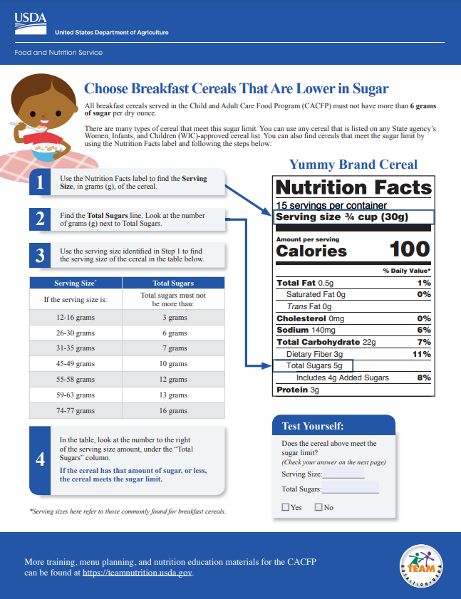
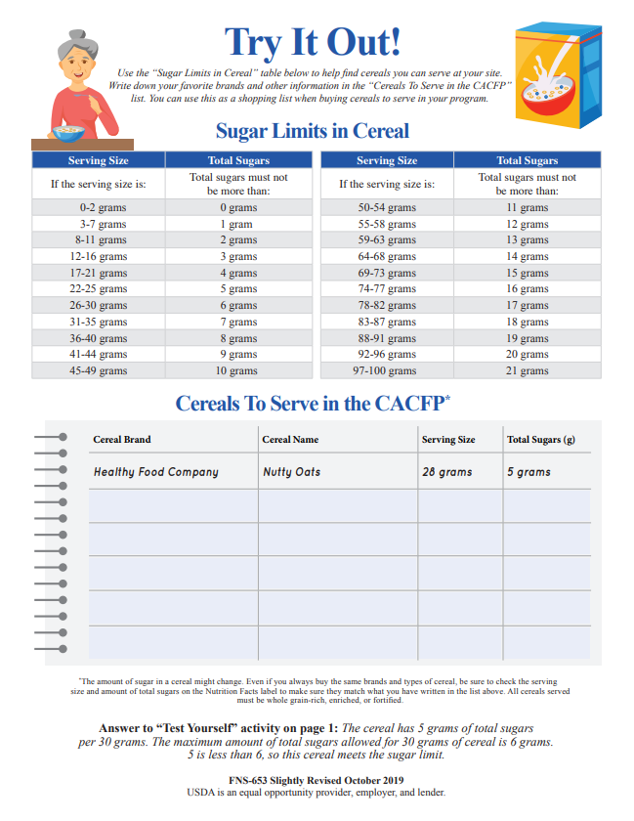
Choose Breakfast Cereals That Are Lower in Sugar
Notes:
There are a couple of ways to determine if a cereal meets the sugar limit.
Use any cereal that is listed on any State agency’s Special Supplemental Nutrition Program for Women, Infants, and Children (WIC)-approved cereal list, found as part of the State’s approved food lists.
Use Team Nutrition’s training worksheet titled, Choose Breakfast Cereals That Are Lower in Sugar. This training worksheet can be found at TeamNutrition.USDA.gov.
Trainer Note: If you include Lesson 10: Creditable Infant Foods: Part 2 in this training session, tell participants that you will discuss the sugar requirement in more detail in the next lesson.

Slide 12
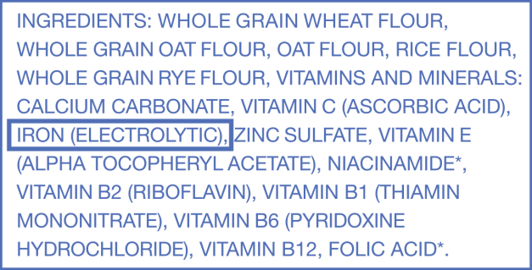
Iron-Fortified Infant Cereal
Infant cereal must be iron-fortified.
Single and mixed-grain cereals are creditable.
    Offer single grain first, then mixed-grain.
How to tell if an infant cereal is “iron-fortified”:
  Look for “Iron-Fortified” on the package.
    Look at the ingredient list for:
        Iron
        Ferric Fumarate
        Electrolytic Iron
        Iron (Electrolytic)
Notes:
Dry iron-fortified infant cereal is cereal that has iron added to it. Iron is an important nutrient for babies.
Both single-grain infant cereal, such as wheat, oat, and barley, as well as mixed-grain infant cereal are creditable as long as they are iron-fortified.
Babies should be given the single grain iron-fortified infant cereal first to make sure they do not have an allergic reaction. If the baby does not have a reaction, then mixed-grain iron-fortified infant cereal can be offered.
You can tell if an infant cereal is “iron-fortified” by looking at the package. The cereal package may say “iron-fortified”.
Also, look at the ingredient list on the back of the cereal package. As long as one of the ingredients listed is “iron,” “ferric fumarate,” “electrolytic iron,” or “iron (electrolytic),” then the cereal is iron-fortified.

Slide 13


Meat and Meat Alternates
  Meats and poultry
  Fin fish
  Shellfish
  Whole eggs
  (yolk and egg white)
  Beans and peas
  Cheese
  Cottage cheese
  Yogurt (including soy yogurt)
    Must meet the sugar limit (23 grams per 6 ounces)
  Tofu
Notes:
Meats and poultry, including: beef, pork, lamb, veal, chicken, and turkey, are creditable in the CACFP infant meal pattern. Like iron-fortified infant cereals, meats and poultry are good first foods for babies because they provide iron and zinc that babies need starting around 6 months of age.
Fin fish and shellfish purchased from a commercial source may be offered to babies 6 through 11 months old when they are developmentally ready for solid foods.
Home caught fish is only creditable if it meets State or local public health policies regarding food safety.
According to the American Academy of Pediatrics, there is no evidence that waiting to introduce common allergens, such as fish or shellfish, beyond 4 to 6 months of age will prevent a food allergy.
Remove any bones or shells and modify the texture of the fish and shellfish based upon the feeding skills of the baby.
Meat Alternates
Eggs, beans and peas, cheese, cottage cheese, yogurt (including soy yogurt), and tofu are creditable as meat alternates.
The whole egg, including both the egg yolk and the egg white, must be served in order for it to be creditable.
Any cooked dry beans and peas, such as lentils, black beans, pinto beans, or chickpeas, may be served to babies who are developmentally ready to eat them. This includes canned beans and peas.
Look for those labeled “reduced sodium.”
Puree or mash beans and peas to avoid choking.
Green peas are not considered a meat alternate.
Pasteurized cheeses are allowed in the infant meal pattern.
Cheese food, cheese spread, and cheese product are not creditable because they are generally higher in salt and lower in protein.
Store-bought low-fat, reduced-fat, and whole milk yogurts are creditable in the infant meal pattern.
To be creditable, the yogurt must contain no more than 23 grams of sugar per 6 ounces of yogurt. This includes soy yogurt.
Homemade yogurts are not creditable.

Slide 14
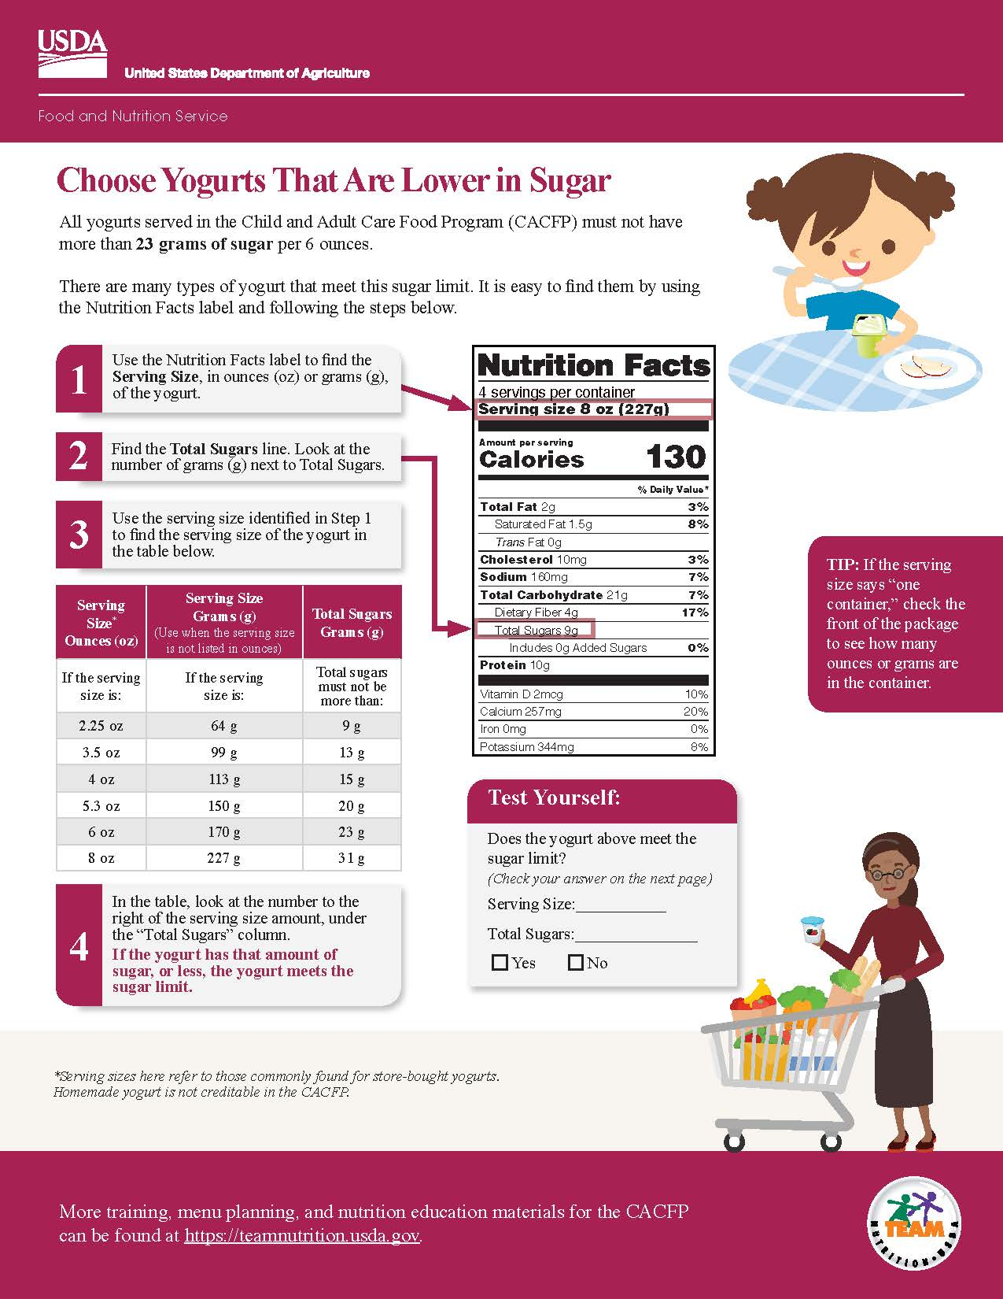
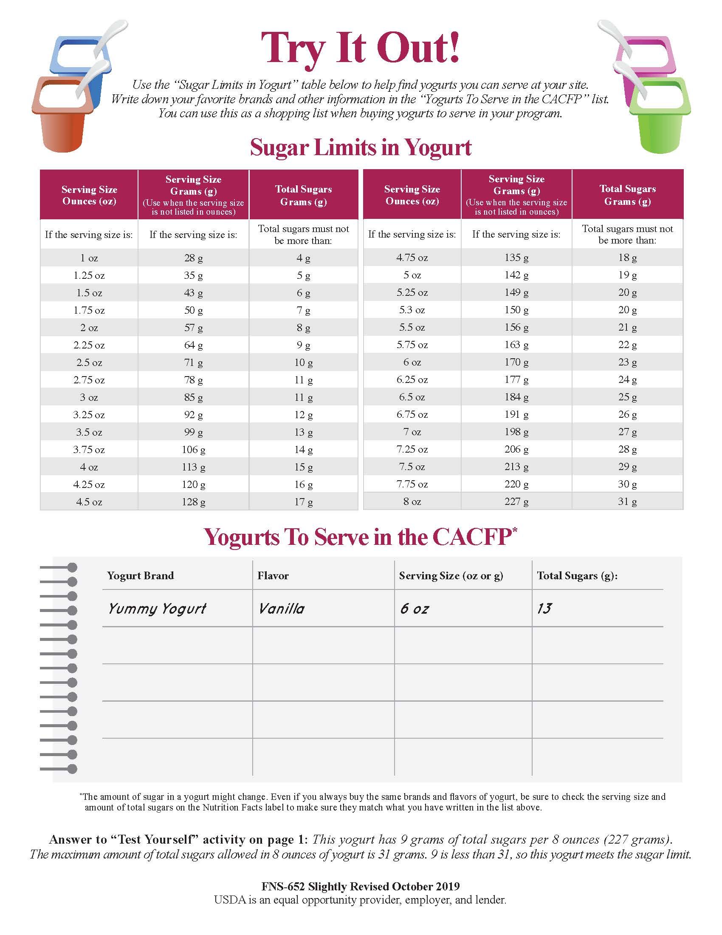
Choose Yogurts That Are Lower in Sugar
Notes:
To determine if a yogurt meets the sugar requirement of no more than 23 grams of sugar per 6 ounces, you can use the chart in Team Nutrition’s training worksheet titled, Choose Yogurts That Are Lower in Sugar. This training worksheet can be accessed at TeamNutrition.USDA.gov.
Trainer Note: If you include Lesson 10: Creditable Infant Foods: Part 2 in this training session, tell participants that you will discuss the sugar requirement in more detail in the next lesson.

Slide 15

Vegetables and Fruits
  All vegetables and fruits can be offered.
  Fruit and vegetable juices are not creditable.
    This includes 100% juice.
Notes:
All vegetables and fruits can be offered to babies but fruit and vegetable juices, including 100% juice, are not creditable in the infant meal pattern.
Vegetables and fruits contain important nutrients and fiber.
To avoid choking, you should:
Cook and prepare vegetables and fruits to the appropriate texture for the baby’s feeding skills.
Remove all pits, seeds, skins, and peels before serving the food.
Cut vegetables and fruits into thin slices or small pieces (no larger than ½ inch).

Slide 16

#1 Which Food Is Not Creditable?
X
Peach Cobbler
Dessert
Whole Egg
(white and yolk)
Cooked
Red Peppers
Notes:
Trainer Note: This slide and the next two slides are designed to “test” participants’ understanding of foods that are creditable. In each slide there are three illustrations of solid foods. Ask participants which food they think is not creditable towards a reimbursable meal or snack in the infant meal pattern.
Allow for several responses before providing the answer and explanation for why the food is not creditable.
To reveal the “X” over the food that is not creditable, click your mouse or press the “Enter” key on your keyboard.
Answer: Peach cobbler dessert. Grain-based desserts are not creditable. Baby food desserts, like cobblers, are considered grain-based desserts. These foods are high in saturated fats and added sugars.

Slide 17
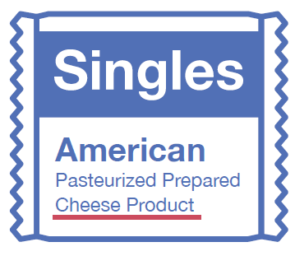
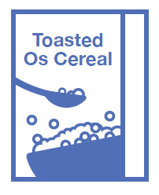
#2 Which Food Is Not Creditable?
X
Cheese Product
Fin Fish
Ready-to-Eat
Cereal
Notes:
Trainer Note: Ask participants which food they think is not creditable towards a reimbursable meal or snack in the infant meal pattern.
Allow for several responses before providing the answer and explanation for why the food is not creditable.
To reveal the “X” over the food that is not creditable, click your mouse or press the “Enter” key on your keyboard.
Answer: Pasteurized cheese product. Cheese product, cheese food, and cheese spread are not creditable because they are generally higher in salt and lower in protein.

Slide 18
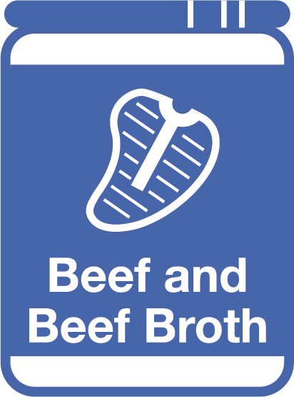

#3 Which Food Is Not Creditable?
X
Beef and Beef Broth
Strawberries
Freeze-Dried
Yogurt Snacks
Notes:
Trainer Note: Ask participants which food they think is not creditable towards a reimbursable meal or snack in the infant meal pattern.
Allow for several responses before providing the answer and explanation for why the food is not creditable.
To reveal the “X” over the food that is not creditable, click your mouse or press the “Enter” key on your keyboard.
Answer: Freeze-dried yogurt. Yogurt products, such as freeze-dried yogurt snacks, frozen yogurt, and yogurt bars are not creditable.

Slide 19
Summary
A meal or snack is reimbursable as long as all required meal components are offered during the day.
Infant meal pattern allows for solid foods starting around 6 months of age, when the baby is developmentally ready.
To be creditable:
  Ready-to-eat cereal—No more than 6 grams of sugar per dry ounce
  Yogurt—No more than 23 grams of sugar per 6 ounces
Refer to Appendix F for creditable and non-creditable foods.
Notes:
Trainer Note: Review the key concepts covered in the lesson. Allow participants to ask questions.
Reimbursable meals and snacks
A meal or snack is reimbursable as long as all required meal components are offered to the baby during the course of the day.
Babies do not need to eat the entire meal offered for the meal to be reimbursable.
Solid foods
The CACFP infant meal pattern allows for solid foods starting around 6 months of age, when the baby is developmentally ready.
Creditable solid foods include: iron-fortified infant cereals, meats, fish, beans, peas, eggs, yogurt (including soy yogurt), tofu, cheese, fruits, and vegetables.
At snack, creditable options include breads and crackers, and ready-to-eat cereals.
Cereals
To be creditable, ready-to-eat breakfast cereals and infant cereals must be:
Made with enriched or whole-grain meal or flour,
Iron-fortified, and
Contain no more than 6 grams of sugar per dry ounce.
Ready-to-eat cereals are creditable towards snacks only, not meals.
Yogurt
To be creditable, store-bought yogurt must contain no more than 23 grams of sugar per 6 ounces.
Homemade yogurt is not creditable.
Remember, Appendix F: Infant Foods List on page 149 in the Feeding Infants in the Child and Adult Care Food Program guide contains a list of creditable and non-creditable foods.

Slide 20
Post-Test #1
1
3
2
Yes or No?
A parent asks you to start serving solid foods to their 5-month-old baby at your child care site, but you know the infant meal pattern age groups are 0 through 5 months and 6 through 11 months. If you serve the baby solid foods at 5 months, can you still claim reimbursement for the baby’s meals and snacks?
Yes
Notes:
Yes or No?
A parent asks you to start serving solid foods to their 5-month-old baby at your child care site, but you know the infant meal pattern age groups are 0 through 5 months and 6 through 11 months. If you serve the baby solid foods at 5 months, can you still claim reimbursement for the baby’s meals and snacks?
Answer: Yes
Trainer Note: You can conduct the post-test as a group activity or distribute a paper test. There are three question slides.
For a group activity, ask participants what they think the answer is for each question. Allow time for multiple responses before you give the answer.
To reveal the answer, click your mouse or press the “Enter” key on your keyboard.
For paper-based testing, distribute the post-test and pencils. Tell participants how much time they have to complete the assessment.
After you have collected the tests, you can show participants the answers.
If you will not administer the test, skip the slide.

Slide 21
Post-Test #2
3
2
Yes or No?
You notice that a baby in your care is developmentally ready for solid foods, and the parents agree. The parents tell you that they have fed their baby eggs at home, so you offer the baby whole eggs (yolk and egg white), finely chopped at child care. The baby takes one bite at lunch.
Can you claim the eggs as part of a reimbursable lunch?
Yes
Notes:
Yes or No?
You notice that a baby in your care is developmentally ready for solid foods, and the parents agree. The parents tell you that they have fed their baby eggs at home, so you offer the baby whole eggs (yolk and egg white), finely chopped at child care. The baby takes one bite at lunch.
Can you claim the eggs as part of a reimbursable lunch?
Answer: Yes
Trainer Note: Click your mouse or press the “Enter” key on your keyboard to reveal the answer.

Slide 22
Post-Test #3
3
Which foods are creditable in the infant meal pattern and can be offered to infants around 6 through 11 months?
Choose all that apply.
Peach cobbler baby food dessert
Pureed carrots
Finely chopped baked chicken
Granola bar
Which foods are creditable in the infant meal pattern and can be offered to infants around 6 through 11 months?
Choose all that apply.
Peach cobbler baby food dessert
Pureed carrots
Finely chopped baked chicken
Granola bar
Notes:
Which foods are creditable in the infant meal pattern and can be offered to infants around 6 through 11 months?
Choose all that apply.
Peach cobbler baby food dessert
Pureed carrots
Finely chopped baked chicken
Granola bar
Answers: B, C
Trainer Note: Click your mouse or press the “Enter” key on your keyboard to reveal the answers.

Slide 23




Presentation End
To learn more about the CACFP
or access materials, visit:
TeamNutrition.USDA.gov
In accordance with Federal civil rights law and U.S. Department of Agriculture (USDA) civil rights regulations and policies, the USDA, its Agencies, offices, and employees, and institutions participating in or administering USDA programs are prohibited from discriminating based on race, color, national origin, religion, sex, gender identity (including gender expression), sexual orientation, disability, age, marital status, family/parental status, income derived from a public assistance program, political beliefs, or reprisal or retaliation for prior civil rights activity, in any program or activity conducted or funded by USDA (not all bases apply to all programs). Remedies and complaint filing deadlines vary by program or incident.
Persons with disabilities who require alternative means of communication for program information (e.g., Braille, large print, audiotape, American Sign Language, etc.) should contact the responsible Agency or USDA’s TARGET Center at (202) 720-2600 (voice and TTY) or contact USDA through the Federal Relay Service at (800) 877-8339. Additionally, program information may be made available in languages other than English.
To file a program discrimination complaint, complete the USDA Program Discrimination Complaint Form, AD-3027, found online at http://www.ascr.usda.gov/complaint_filing_cust.htmland at any USDA office or write a letter addressed to USDA and provide in the letter all of the information requested in the form. To request a copy of the complaint form, call (866) 632-9992. Submit your completed form or letter to USDA by: (1) mail: U.S. Department of Agriculture, Office of the Assistant Secretary for Civil Rights, 1400 Independence Avenue, SW, Washington, D.C. 20250-9410; (2) fax: (202) 690-7442; or (3) email: program.intake@usda.gov.
USDA is an equal opportunity provider, employer, and lender.
United States Department of Agriculture – Food and Nutrition Service – November 2019 – Slightly Revised April 2024 – FNS-785

