Slide 1

Feeding Infants in the CACFP
Lesson 3
Creating a Breastfeeding-Friendly Environment in a Child Care Site
Notes:
Information in this lesson comes from Chapter 2: Feeding the Breastfed Baby in the Feeding Infants in the Child and Adult Care Food Program guide. This lesson describes the benefits of breastfeeding and suggests ways participants can support breastfeeding mothers.
Learning Objectives
At the end of this lesson, participants should be able to:
Describe the benefits of breastfeeding for babies, mothers, and their families.
List at least three ways to support breastfeeding mothers.
Lesson Description
The Creating a Breastfeeding-Friendly Environment in a Child Care Site lesson takes approximately 20 minutes to deliver. If the pre-test and post-test are administered, the total session time will be approximately 25 minutes.
Welcome and Trainer Introduction
Welcome participants to the training and introduce yourself by providing:
Your name
Your position title
Your experience with the CACFP, infant nutrition, and/or child care

Slide 2


Agenda
Why Support Breastfeeding?
CACFP Supports Breastfeeding Families
Creating a Breastfeeding-Friendly Environment
Communicating With Parents
Summary
Notes:
In this lesson, you will learn about the benefits of breastfeeding for babies, mothers, and their families, as well as ways to support breastfeeding mothers at your child care site.

Slide 3
Pre-Test
1
All of the following statements about the benefits of breastfeeding are true, except which one?
Breastmilk helps a baby’s immune system fight infections, like ear infections.
Mothers that breastfeed may have a lower risk of Type 2 diabetes.
Families cannot help with feeding a breastfed baby.
Babies taste different flavors in breastmilk, which may help babies accept new flavors later when they start eating solid foods.
Notes:
All of the following statements about the benefits of breastfeeding are true, except which one?
Breastmilk helps a baby’s immune system fight infections, like ear infections.
Mothers that breastfeed may have a lower risk of Type 2 diabetes.
Families cannot help with feeding a breastfed baby.
Babies taste different flavors in breastmilk, which may help babies accept new flavors later when they start eating solid foods.
Trainer Note: You can conduct the pre-test as a group activity or distribute a paper test. There are two question slides.
For a group activity, ask participants what they think the answer is for each question.
Do not give the answer.
Tell participants that the answer to each question will be provided at the end of the lesson in the post-test slides.
For paper-based testing, distribute the pre-test and pencils. Tell participants how much time they have to complete the assessment.
If you will not administer the test, skip the slide.

Slide 4
Pre-Test
2
A child care provider can support breastfeeding mothers by doing all of the following, except which one?
Let a mother breastfeed in the bathroom.
Share information about the Special Supplemental Nutrition Program for Women, Infants, and Children (WIC).
Display the Breastfed Babies Welcome Here! poster and message graphic at the child care site.
Encourage mothers to continue breastfeeding even when they go back to work or school.
Notes:
A child care provider can support breastfeeding mothers by doing all of the following, except which one?
Let a mother breastfeed in the bathroom.
Share information about the Special Supplemental Nutrition Program for Women, Infants, and Children (WIC).
Display the Breastfed Babies Welcome Here! poster and message graphic at the child care site.
Encourage mothers to continue breastfeeding even when they go back to work or school.
Trainer Note: The answer to the question is provided in the post-test slide.

Slide 5

Why Support Breastfeeding?
Breastmilk helps a baby’s immune system fight infections.
Mothers may have lower risk of Type 2 diabetes.
Changes in breastmilk taste may help baby accept new flavors.
And more!
Notes:
Breastmilk is the best source of nutrition for babies. It is the only food healthy babies need for about the first 6 months of their lives. Breastmilk is easy to digest and helps keep babies healthy by boosting the baby’s immune system.
Breastmilk helps a baby’s immune system fight infections.
Mothers that breastfeed may have a lower risk of Type 2 diabetes.
A mother’s breastmilk is made for her baby and contains just the right amounts of nutrients. As the baby grows and changes, the mother’s breastmilk also changes. This helps the baby get the nutrients he or she needs to stay healthy and grow.
Babies taste different flavors in breastmilk, which may help babies accept new flavors later when they start eating solid foods.
Breastmilk is still important for babies even after they start eating solid foods. If a mother chooses to give her baby breastmilk, let her know that she is welcome to breastfeed at your child care site.
These are just some of the benefits of breastfeeding. There are more! Turn to Table 4: Benefits of Breastfeeding for Babies, Mothers, and Families on page 21 in the Feeding Infants in the Child and Adult Care Food Program guide to see a full list of benefits for babies, mothers, and families.

Slide 6
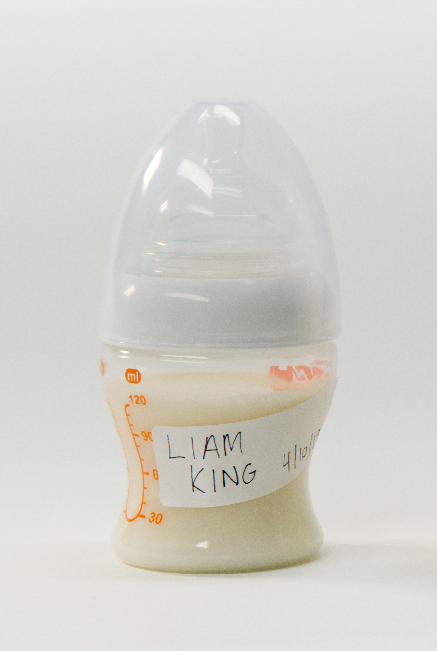
CACFP Supports Breastfeeding Families
Breastmilk can be claimed as part of a reimbursable meal or snack when:
    Pumped breastmilk is offered.
    Mother breastfeeds her baby at the child care site.
  Breastmilk can credit towards the fluid milk component at any age.
CACFP Best Practice
Offer mothers a clean, quiet place to breastfeed their baby.
Notes:
Breastmilk can be claimed as part of a reimbursable meal or snack when:
Pumped breastmilk is offered. If a parent provides pumped breastmilk for the baby, the meal is still reimbursable as long as you provide all other required food components.
Mother breastfeeds her child at the child care site. You may claim that breastfeeding session as part of a reimbursable meal or snack as long as you provide all other required food components.
Breastmilk can credit towards the fluid milk component at any age. For infants and children age 1 year and older, breastmilk can be used to meet the CACFP fluid milk component of a meal or snack. A written request from the parent is not required.
CACFP Best Practice
Offer mothers a clean, quiet place to breastfeed their baby. This is not a requirement in the CACFP, but it is considered a best practice. A welcoming environment for breastfeeding mothers can help them breastfeed longer.
Trainer Note: The following slides will give ideas on how to create a breastfeeding‐friendly environment.

Slide 7

Video: Supporting Breastfeeding Mothers in a Child Care Site
https://www.fns.usda.gov/tn/feeding-infants-supporting-breastfeeding-mothers-child-care-site-cacfp-trainers-tools
Notes:
Next, we will watch a short video that describes how you can support breastfeeding mothers.
Trainer Note: The Supporting Breastfeeding Mothers in a Child Care Site video is linked in the PowerPoint slide. Runtime is 3 minutes and 02 seconds.
There are a few options for playing the video.
1. The video is linked in the PowerPoint presentation. You can use your mouse to select the USDA image on the slide and click on your mouse or touchpad to start the video.
2. You can play the video from the USB drive provided with this trainer’s guide. Or,
3. If you have an internet connection, you can play the video directly from the USDA Team Nutrition website at https://www.fns.usda.gov/tn/feeding-infants-supporting-breastfeeding-mothers-child-care-site-cacfp-trainers-tools.
Trainer Note: After the video plays, advance to the next slide for a discussion activity.

Slide 8
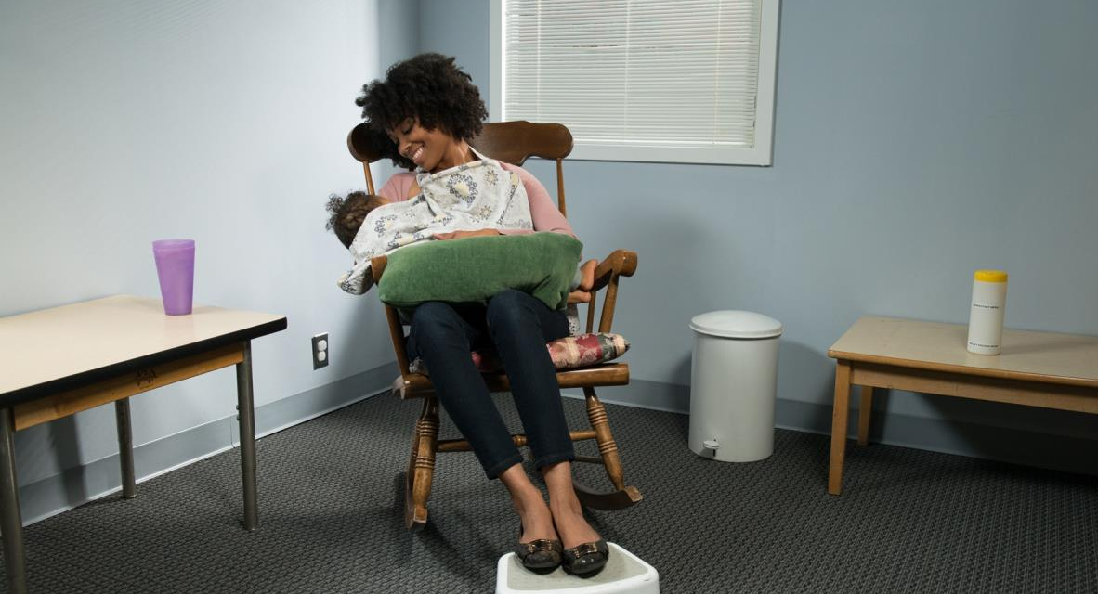
A Breastfeeding Friendly Environment
What Can It Look Like?
Notes:
Trainer Note: You can do this activity in small groups or pairs. Ask participants to share what they currently provide breastfeeding mothers at their child care site and what they might do differently to support breastfeeding mothers. Tell participants that they have 2 or 3 minutes to talk about the topic. After the 2 or 3 minutes ask participants to share their ideas. You can ask for a volunteer to write participants’ suggestions on chart paper or a whiteboard.
Suggestions include:
Offer a welcoming space for the mother to breastfeed her baby that is:
Private, quiet
Comfortable
Clean
Items to include in the space:
Comfortable chair (rocking chair)
Stool for mom’s feet to help support her back while nursing
Pillow to support the baby
Table to place pumping equipment on if mom chooses to pump breastmilk
Electrical outlet for the breast pump
Sink for mom to wash her hands and pumping equipment
Disinfectant wipes
Drinking water for mom
Tell mothers they can breastfeed their baby at your child care site.
Display the Breastfed Babies Welcome Here! poster and message graphic.
Offer mom a copy of Breastfed Babies Welcome Here! A Mother’s Guide.
A breastfeeding space does not have to be a separate room. A small space, like a rocking chair in the corner of the infant classroom, having a privacy screen or barrier available, director's office, etc., can be offered to a breastfeeding mother if a separate room is not available. It is important to make breastfeeding mothers feel welcome.
Trainer Note: Refer participants to Chapter 2 on page 20 in their Feeding Infants in the Child and Adult Care Food Program guide for information about supporting families of breastfed babies. Tell participants that the Breastfed Babies Welcome Here! A Mother's Guide, poster, and message graphic are available for free download and in print at https://www.fns.usda.gov/tn/breastfed-babies-welcome-here.

Slide 9


Communicating With Parents
Breastfed Babies Welcome Here! A Mother’s Guide
https://www.fns.usda.gov/tn/breastfed-babies-welcome-here
Special Supplemental Nutrition Program for Women, Infants, and Children (WIC)
https://www.fns.usda.gov/wic/women-infants-and-children-wic
Notes:
To start a conversation and support breastfeeding, you can:
Display the Breastfed Babies Welcome Here! poster and message graphic to let families know your child care site is breastfeeding-friendly.
Offer parents a copy of Breastfed Babies Welcome Here! A Mother’s Guide.
Encourage mothers to continue breastfeeding even when they go back to work or school. Let mothers know that your child care site will support their breastfeeding efforts.
Share information about Special Supplemental Nutrition Program for Women, Infants, and Children (WIC) resources for breastfeeding mothers.

Slide 10


Summary
Breastfeeding has many benefits for babies, mothers, and families.
Support breastfeeding mothers:
    Create a welcoming space to breastfeed.
    Share Breastfed Babies Welcome Here! kit
    Share Special Supplemental Nutrition Program for Women, Infants, and Children (WIC) resources
Notes:
Trainer Note: Briefly review the key points covered in the lesson. Allow participants to ask questions.
Breastfeeding has many benefits for babies, mothers, and families.
Breastmilk helps a baby’s immune system to fight infections.
Mothers that breastfeed may have a lower risk of Type 2 diabetes.
Babies taste different flavors in breastmilk, which may help babies accept new flavors later when they start eating solid foods.
Remember, a full list of benefits can be found in Table 4: Benefits of Breastfeeding for Babies, Mothers, and Families on page 21 in the Feeding Infants in the Child and Adult Care Food Program guide.
We can support breastfeeding mothers by:
Creating a welcoming space for mothers to breastfeed their baby.
Encouraging mothers to continue breastfeeding after they return to work or school.
Displaying the Breastfed Babies Welcome Here! poster and message graphic to let families know your child care site is breastfeeding-friendly.
Sharing information about breastfeeding:
Breastfed Babies Welcome Here! kit
https://www.fns.usda.gov/tn/breastfed-babies-welcome-here
Special Supplemental Nutrition Program for Women, Infants, and Children (WIC) resources
https://www.fns.usda.gov/wic/women-infants-and-children-wic

Slide 11
Post-Test
1
All of the following statements about the benefits of breastfeeding are true, except which one?
Breastmilk helps a baby’s immune system fight infections, like ear infections.
Mothers that breastfeed may have a lower risk of Type 2 diabetes.
Families cannot help with feeding a breastfed baby.
Babies taste different flavors in breastmilk, which may help babies accept new flavors later when they start eating solid foods.
All of the following statements about the benefits of breastfeeding are true, except which one?
Breastmilk helps a baby’s immune system fight infections, like ear infections.
Mothers that breastfeed may have a lower risk of Type 2 diabetes.
Families cannot help with feeding a breastfed baby.
Babies taste different flavors in breastmilk, which may help babies accept new flavors later when they start eating solid foods.
Notes:
All of the following statements about the benefits of breastfeeding are true, except which one?
Breastmilk helps a baby’s immune system fight infections, like ear infections.
Mothers that breastfeed may have a lower risk of Type 2 diabetes.
Families cannot help with feeding a breastfed baby.
Babies taste different flavors in breastmilk, which may help babies accept new flavors later when they start eating solid foods.
Answer: C
Trainer Note: You can conduct the post-test as a group activity or distribute a paper test. There are two question slides.
For a group activity, ask participants what they think the answer is for each question. Allow time for multiple responses before you give the answer.
To reveal the answer, click your mouse or press the “Enter” key on your keyboard.
For paper-based testing, distribute the post-test and pencils. Tell participants how much time they have to complete the assessment.
After you have collected the tests, you can show participants the answers.
If you will not administer the test, skip the slide.

Slide 12
Post-Test
2
A child care provider can support breastfeeding mothers by doing all of the following, except which one?
Let a mother breastfeed in the bathroom.
Share information about the Special Supplemental Nutrition Program for Women, Infants, and Children (WIC).
Display the Breastfed Babies Welcome Here! poster and message graphic at the child care site.
Encourage mothers to continue breastfeeding even when they go back to work or school.
A child care provider can support breastfeeding mothers by doing all of the following, except which one?
Let a mother breastfeed in the bathroom.
Share information about the Special Supplemental Nutrition Program for Women, Infants, and Children (WIC).
Display the Breastfed Babies Welcome Here! poster and message graphic at the child care site.
Encourage mothers to continue breastfeeding even when they go back to work or school.
Notes:
A child care provider can support breastfeeding mothers by doing all of the following, except which one?
Let a mother breastfeed in the bathroom.
Share information about the Special Supplemental Nutrition Program for Women, Infants, and Children (WIC).
Display the Breastfed Babies Welcome Here! poster and message graphic at the child care site.
Encourage mothers to continue breastfeeding even when they go back to work or school.
Answer: A
Trainer Note: Click your mouse or press the “Enter” key on your keyboard to reveal the answer.

Slide 13




Presentation End
To learn more about the CACFP
or access materials, visit:
https://teamnutrition.usda.gov
In accordance with Federal civil rights law and U.S. Department of Agriculture (USDA) civil rights regulations and policies, the USDA, its Agencies, offices, and employees, and institutions participating in or administering USDA programs are prohibited from discriminating based on race, color, national origin, religion, sex, gender identity (including gender expression), sexual orientation, disability, age, marital status, family/parental status, income derived from a public assistance program, political beliefs, or reprisal or retaliation for prior civil rights activity, in any program or activity conducted or funded by USDA (not all bases apply to all programs). Remedies and complaint filing deadlines vary by program or incident.
Persons with disabilities who require alternative means of communication for program information (e.g., Braille, large print, audiotape, American Sign Language, etc.) should contact the responsible Agency or USDA’s TARGET Center at (202) 720-2600 (voice and TTY) or contact USDA through the Federal Relay Service at (800) 877-8339. Additionally, program information may be made available in languages other than English.
To file a program discrimination complaint, complete the USDA Program Discrimination Complaint Form, AD-3027, found online at http://www.ascr.usda.gov/complaint_filing_cust.html and at any USDA office or write a letter addressed to USDA and provide in the letter all of the information requested in the form. To request a copy of the complaint form, call (866) 632-9992. Submit your completed form or letter to USDA by: (1) mail: U.S. Department of Agriculture, Office of the Assistant Secretary for Civil Rights, 1400 Independence Avenue, SW, Washington, D.C. 20250-9410; (2) fax: (202) 690-7442; or (3) email: program.intake@usda.gov.
USDA is an equal opportunity provider, employer, and lender.
United States Department of Agriculture – Food and Nutrition Service – November 2019 – FNS-785

