Slide 1
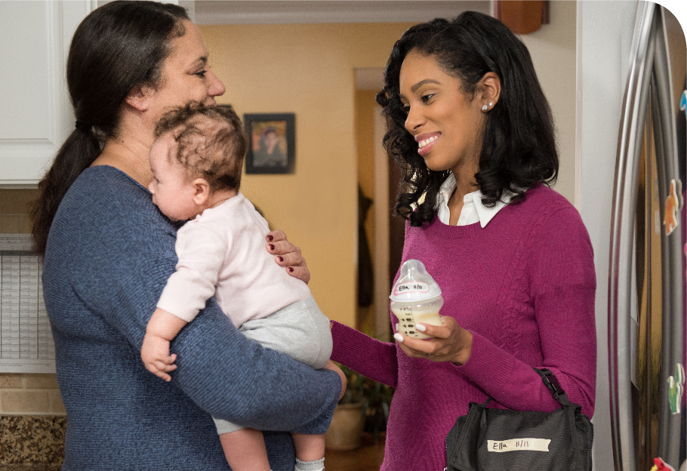
Feeding Infants in the CACFP
Lesson 4
Storing and Handling Breastmilk in a Child Care Site
Notes:
Information in this lesson comes from Chapter 2: Feeding the Breastfed Baby and Chapter 4: Handling and Storing Breastmilk and Infant Formula in the Feeding Infants in the Child and Adult Care Food Program guide. This lesson provides participants with information about how to properly store and handle breastmilk at a child care site.
Trainer Note: Your State's child care licensing regulations or local health codes on storing and handling breastmilk may be stricter than what is covered during this lesson. Consider speaking with your State's child care licensing specialists to help clarify your State-specific regulations on this topic prior to the training.
Learning Objectives
At the end of this lesson, participants should be able to:
Describe how to safely store breastmilk.
Identify how to prepare breastmilk for feeding.
Lesson Description
The Storing and Handling Breastmilk in a Child Care Site lesson takes approximately 22 minutes to deliver. If the pre-test and post-test are administered, total session time will be approximately 28 minutes.
Welcome and Trainer Introduction
Welcome participants to the training and introduce yourself by providing:
Your name
Your position title
Your experience with the CACFP, infant nutrition, and/or child care

Slide 2
Agenda
Introduction
Storing and Handling Breastmilk
Communicating With Parents
Summary
Notes:
In this lesson, you will learn best practices for handling and storing breastmilk at a child care site and ways you can communicate with parents about how to transport breastmilk.

Slide 3
Pre-Test
1
True or False?
Bottles of breastmilk can be served cold from the refrigerator and do not have to be warmed.
Notes:
True or False?
Bottles of breastmilk can be served cold from the refrigerator and do not have to be warmed.
Trainer Note: You can conduct the pre-test as a group activity or distribute a paper test. There are three question slides.
For a group activity, ask participants what they think the answer is for each question.
Do not give the answer.
Tell participants that the answer to each question will be provided at the end of the lesson in the post-test slides.
For paper-based testing, distribute the pre-test and pencils. Tell participants how much time they have to complete the assessment.
If you will not administer the test, skip the slide.

Slide 4
Pre-Test
2
Fresh breastmilk can be refrigerated at 40 ºF (or below) for up to _____ hours.
24
36
48
72
Notes:
Fresh breastmilk can be refrigerated at 40 °F (or below) for up to _____ hours.
24
36
48
72
Trainer Note: The answer to the question is provided in the post-test slide.

Slide 5
Pre-Test
3
You can safely thaw a container of breastmilk using all of these methods, except which one?
Under warm running water
In a container of warm water
In a microwave
In a refrigerator overnight
Notes:
You can safely thaw a container of breastmilk using all of these methods, except which one?
Under warm running water
In a container of warm water
In a microwave
In a refrigerator overnight
Trainer Note: The answer to the question is provided in the post-test slide.

Slide 6
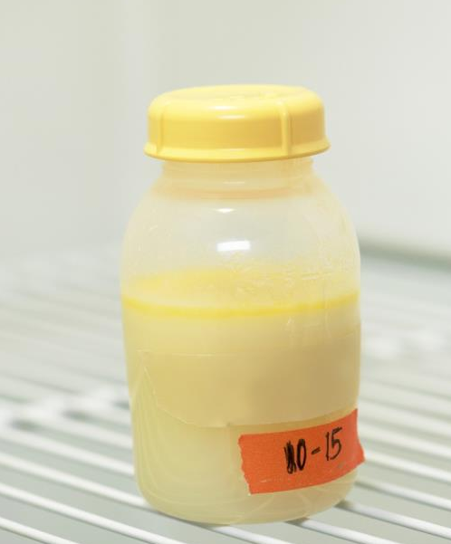
Breastmilk—Look and Smell
It may look different each day.
Color can change based on what mother eats or baby needs.
A blue, yellow, or green color is normal.
It is thinner than infant formula, especially if the fat has separated.
Notes:
Breastmilk is the best source of nutrition for babies. It is the only food healthy babies need for about the first 6 months of their lives. Breastmilk is easy to digest and helps keep babies healthy by boosting the baby’s immune system.
Breastmilk may look different from day to day, and that is okay! The color of breastmilk can change based on what the mother eats and what the baby needs. It is normal for breastmilk to look slightly blue, yellow, or even green in color. Breastmilk may look thinner than infant formula, especially if the fat, or creamy part, has separated from the breastmilk and has risen to the top of the bottle.
Proper storage and handling of breastmilk will help ensure breastfed babies have food available when they are hungry and will help preserve the important nutrients in the breastmilk.

Slide 7

Video: Handling and Storing Breastmilk and Infant Formula in a Child Care Site
https://www.fns.usda.gov/tn/feeding-infants-handling-and-storing-breastmilk-and-infant-formula-cacfp-trainers-tools
Notes:
Next, we will watch a short video that describes best practices for handling and storing breastmilk and infant formula.
Trainer Note: The Handling and Storing Breastmilk and Infant Formula in a Child Care Site video is linked in the PowerPoint slide. Runtime is 2 minutes and 34 seconds.
There are a few options for playing the video.
The video is linked in the PowerPoint presentation. You can use your mouse to select the USDA image on the slide and click on your mouse or touchpad to start the video.
You can play the video from the USB drive provided with this trainer’s guide. Or,
If you have an internet connection, you can play the video directly from the USDA Team Nutrition website at https://www.fns.usda.gov/tn/feeding-infants-handling-and-storing-breastmilk-and-infant-formula-cacfp-trainers-tools.
Trainer Note: After the video plays, advance to the next slide.

Slide 8
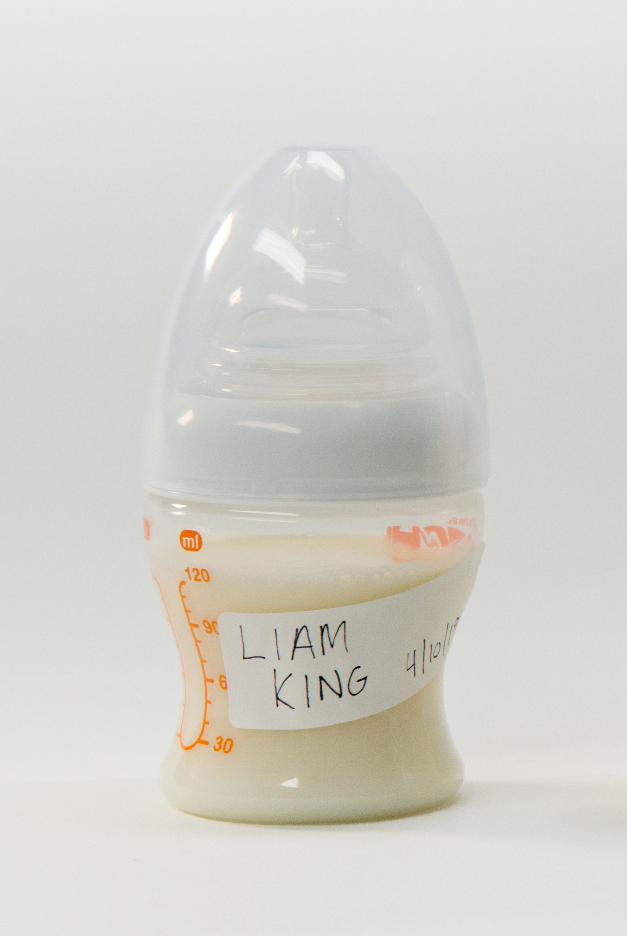
Best Practices for Handling Fresh Breastmilk
Do not accept or use an unlabeled bottle.
Keep refrigerated until needed for a feeding.
Cool fresh breastmilk in the refrigerator before mixing
with cold breastmilk.
Use within 2 hours after baby has finished feeding.
Before feeding, check bottle:
  Name matches baby.
  Fresh breastmilk is not older than 3 days (72 hours).
  Thawed breastmilk is not older than 24 hours.
If State or local authorities, including child care licensing, have stricter health and safety regulations for handling and storing breastmilk, then follow those regulations.
Notes:
Trainer Note: This is a good time to pass around the supplemental materials: various types of bottles, labeled with and without babies’ full name and date. Discuss the best practices for handling fresh breastmilk.
Do not accept an unlabeled bottle from a parent.
Do not use an unlabeled bottle.
Keep breastmilk refrigerated until it is time to feed the baby.
Bottles can be served cold from the refrigerator and do not have to be warmed. If you choose to warm a bottle, hold it under warm running water or place the bottle in a bowl of warm water.
If breastmilk is pumped at the child care site, this breastmilk can be served with refrigerated breastmilk during a feeding. If you want to serve them together in one bottle, the freshly pumped breastmilk should be cooled in the refrigerator before it is mixed with the refrigerated breastmilk.
Check the name and date on a bottle before you feed the baby.
Make sure the name matches the baby’s name.
Do not use fresh breastmilk that has been in the refrigerator for more than 72 hours (3 days).
Thawed breastmilk stored in the refrigerator must be used within 24 hours.
Do not use the unused breastmilk left in the bottle 2 hours after the baby has finished a feeding.
Trainer Note: Tell participants that if their State or local authorities, including child care licensing, have stricter health and safety regulations for handling and storing breastmilk, then follow those regulations.
Trainer Note: Child care providers participating in the Child and Adult Care Food Program may only store breastmilk in the refrigerator for 3 days (72 hours). This is stricter than the guidelines for storing breastmilk at home. Breastmilk may be stored in the refrigerator at home for up to 4 days.

Slide 9
Maximum Storage time and Temperature for Breastmilk at a Child Care Site
Table 5
 | Countertop 77 °F or Colder (25 °C) | Refrigerator 40 °F (4 °C) | Freezer 0 °F or colder (-18 °C)
Freshly Pumped Breastmilk | Do not use after 4 hours | Do not use after 3 days (72 hours) | Within 6 months is best. Do not use after 12 months.
Thawed Breastmilk | Do not use after 1–2 hours | Do not use after 1 day (24 hours) | Never refreeze thawed breastmilk.
Leftover from a feeding (baby did not finish the bottle) | Do not use after 2 hours after the baby is finished feeding.
*In the CACFP, you may only store breastmilk in the refrigerator at a child care site for no longer than 3 days (72 hours). This is stricter than home storage.
If State or local authorities, including child care licensing, have stricter health and safety regulations for handling and storing breastmilk, then follow those regulations.
Notes:
Turn to Table 5: Maximum Storage Time and Temperature for Breastmilk at a Child Care Site on page 44 in your Feeding Infants in the Child and Adult Care Food Program guide to learn more about proper temperature and storage times.
Trainer Note: If State or local authorities, including child care licensing, have stricter health and safety regulations for handling and storing breastmilk, participants should follow those regulations.

Slide 10
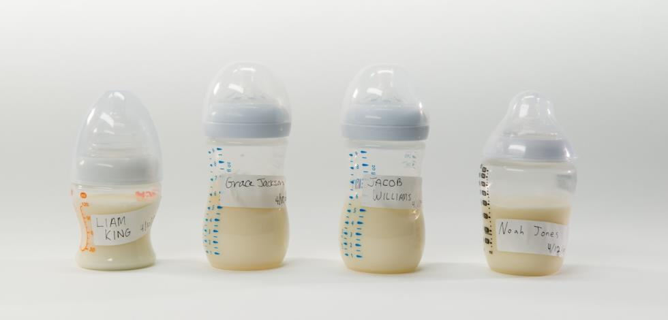
Best Practices for Storing Fresh Breastmilk
Store at back of refrigerator.
Refrigerate at 40 ⁰F (or below).
If State or local authorities, including child care licensing, have stricter health and safety regulations for handling and storing breastmilk, then follow those regulations.
Notes:
Here are some best practices for storing breastmilk at a child care site.
Store breastmilk in the back of the refrigerator where the temperature is always cold. The front of the refrigerator can be warmer because the door is opened frequently.
Refrigerate breastmilk at 40 °F (or below) for up to 72 hours (3 days) from the date the breastmilk was pumped.
If it is past the 3-day mark, ask the parents what they want you to do with the breastmilk.
Trainer Note: If State or local authorities, including child care licensing, have stricter health and safety regulations for handling and storing breastmilk, participants should follow those regulations.

Slide 11
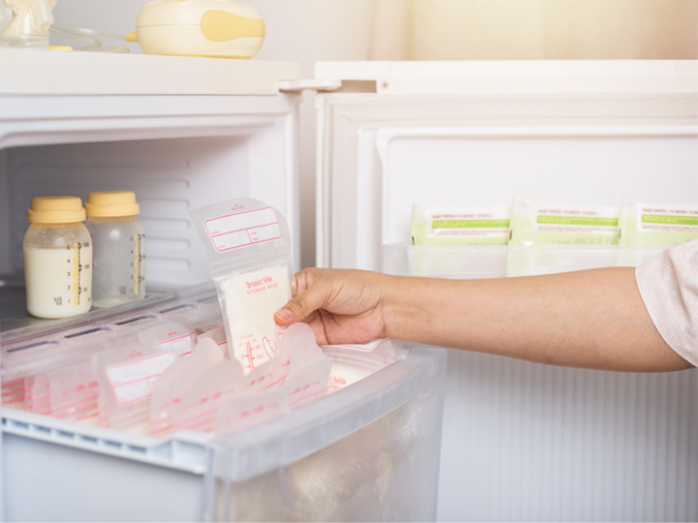
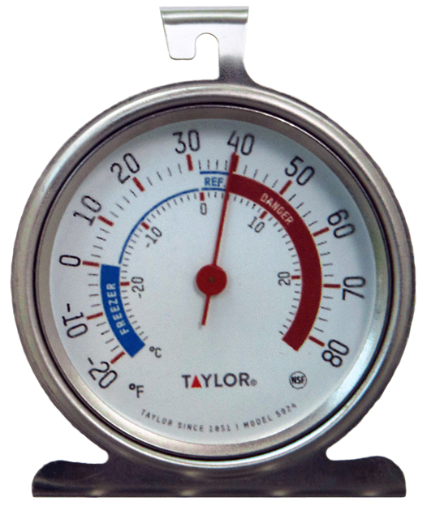
Best Practices for Storing Fresh Breastmilk
Let’s Practice!
Notes:
Trainer Note: Tell participants that the breastmilk in the picture is stored in a refrigerator at 40 °F. The bottles and some of the breastmilk bags have been in the refrigerator for 4 days. Ask participants what they think is correct or incorrect about how the breastmilk is stored.
Answers:
Correct storage:
The refrigerator temperature is 40 °F. Breastmilk should be refrigerated at 40 °F (or below).
Incorrect storage:
Breastmilk bottle and bags are not properly labeled. Containers should be labeled with the baby’s full name and the date the breastmilk was pumped.
In the CACFP, breastmilk should not be stored in the refrigerator for longer than 3 days.
Refrigerate breastmilk for up to 72 hours (3 days) from the date the breastmilk was pumped.
If it is past the 3-day mark, you should ask parents what they want you to do with the breastmilk.
Breastmilk should not be stored in the door compartment or at the front of the refrigerator. Breastmilk should be stored in the back of the refrigerator where the temperature is always cold.
Trainer Note: If State or local authorities, including child care licensing, have stricter health and safety regulations for handling and storing breastmilk, participants should follow those regulations.

Slide 12
Preparing Breastmilk for Feeding
Thaw amount needed for one feeding.
  Refrigerator
  Warm water
Write date thawed on bottle.
Do not:
    Thaw at room temperature.
    Mix with warm breastmilk.
    Place in boiling water.
  Do not heat in a microwave!
Thawed
6/9/20
If State or local authorities, including child care licensing, have stricter health and safety regulations for handling and storing breastmilk, then follow those regulations.
Notes:
Here are some best practices for thawing breastmilk.
To prevent or reduce waste, thaw only the amount of breastmilk that is needed for one feeding.
Thaw additional breastmilk if the infant is hungry and shows signs of wanting more.
Thaw the container of breastmilk in the refrigerator overnight, under warm running water, or in a container of warm water.
Write the date the milk was thawed on the bottle or container.
Do not thaw breastmilk by placing it at room temperature; mixing it with warm breastmilk, placing the bottle in boiling water, or heating the bottle in a microwave.
The breastmilk may become very hot when heated in a microwave, which could burn the baby even though the bottle may feel cool. Also, heating damages some of the important nutrients in breastmilk.
Trainer Note: If State or local authorities, including child care licensing, have stricter health and safety regulations for handling and storing breastmilk, participants should follow those regulations.

Slide 13




Communicating With Parents
Start a conversation!
Refrigerate or Freeze
Provide Minimum Amount for Baby’s Age
0 through 5 Months
  4–6 fl. oz. / Meal
  4–6 fl. oz. / Snack
Suzie Tan
6/9/20
6 through 11 Months
  6–8 fl. oz. / Meal
  2–4 fl. oz. / Snack
Notes:
Let’s talk about the information you can share with parents about how to prepare and safely transport labeled breastmilk to the child care site to prevent spoilage and waste.
Label each bottle with the baby’s full name and the date the breastmilk was pumped.
Refrigerate or freeze breastmilk.
If possible, fill bottles with at least the minimum amount of breastmilk required in the CACFP infant meal pattern.
For breakfast, lunch, and supper:
Babies 0 through 5 months need 4 to 6 fluid ounces
Babies 6 through 11 months need 6 to 8 fluid ounces
For snack:
Babies 0 through 5 months need 4 to 6 fluid ounces
Babies 6 through 11 months need 2 to 4 fluid ounces
Bring bottles of breastmilk in smaller amounts (1 to 2 fluid ounces) to reduce waste in case the baby wants more after a feeding.

Slide 14
Minimum Serving Size of Breastmilk
Minimum Amount of Breastmilk Required in the CACFP Infant Meal Pattern
If the baby usually drinks less than the minimum amount of breastmilk required in the CACFP, parents can make a bottle with only the amount the baby usually drinks in one feeding to prevent or reduce waste.
0 through 5 Months
  4–6 fl. oz. / Meal
  4–6 fl. oz. / Snack
6 through 11 Months
  6–8 fl. oz. / Meal
  2–4 fl. oz. / Snack
Notes:
By sharing with parents the amount of breastmilk their baby consumes each day, you can help families know the amount of breastmilk they should bring each day to the child care site.
If the baby usually drinks less than the minimum amount of breastmilk required in the CACFP, parents can make a bottle with only the amount of breastmilk the baby usually drinks in one feeding to prevent or reduce waste.
Transporting breastmilk in a cooler with an ice pack to keep it cold will also help prevent waste.

Slide 15
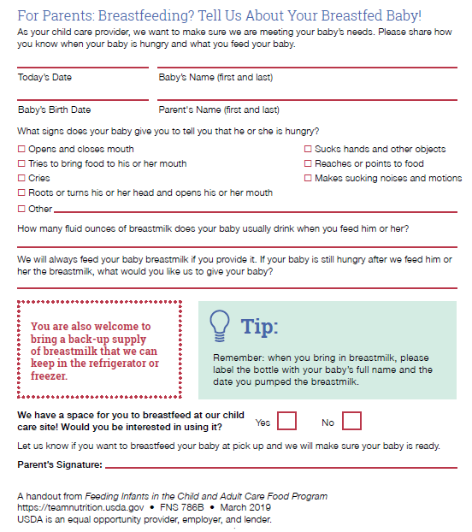
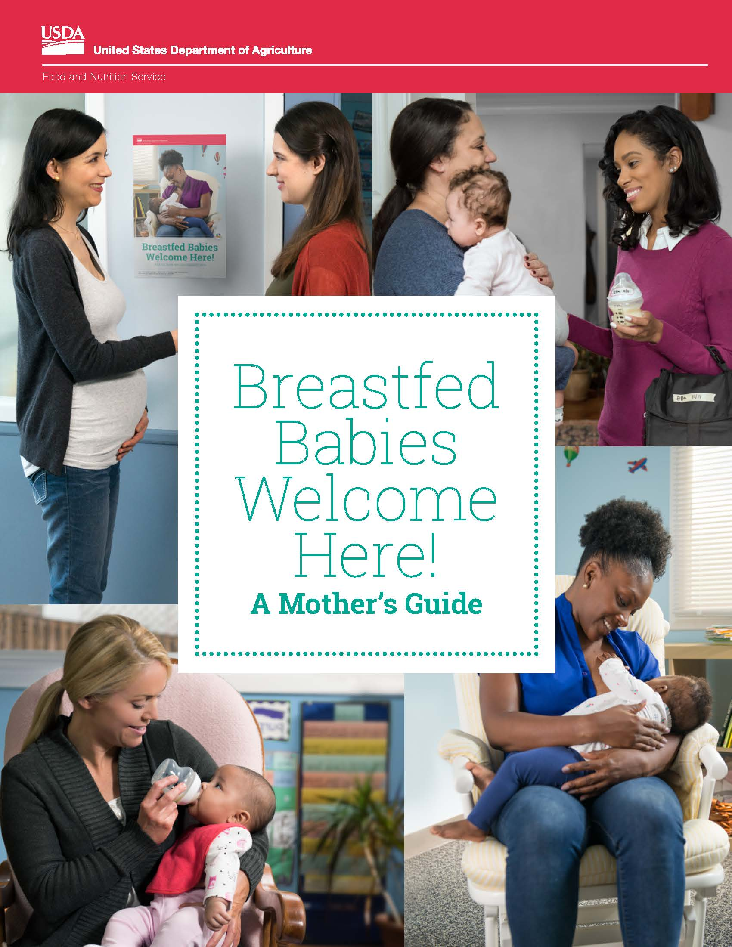
Communicating With Parents
Notes:
Trainer Note: Discuss the information that child care providers can share with parents. Refer participants to the For Parents: Breastfeeding? Tell Us About Your Breastfed Baby! handout on page 26 in their Feeding Infants in the Child and Adult Care Food Program guide. They can use the handout to start a conversation with parents about how much breastmilk their baby usually drinks and what parents want the child care provider to do when the baby is still hungry but there is no more breastmilk. Tell participants that the handout is available for free download from the USDA Team Nutrition website at https://teamnutrition.usda.gov.
Trainer Note: Tell participants that information on storing and transporting breastmilk to a child care site can also be shared with breastfeeding mothers through USDA's Team Nutrition Breastfed Babies Welcome Here! A Mother’s Guide resource found at https://www.fns.usda.gov/tn/breastfed-babies-welcome-here.

Slide 16
Summary
Breastmilk is best source of nutrition for babies.
Know how to properly store and handle fresh and frozen breastmilk.
Refer to Table 5 in your guide for storage requirements.
Start a conversation with parents!
    Share best practices for bringing breastmilk to the child care site.
    Breastfed Babies Welcome Here! A Mother's Guide
    For Parents: Breastfeeding? Tell Us About Your Breastfed Baby! (page 26)
  https://www.fns.usda.gov/tn/breastfed-babies-welcome-here
Notes:
Trainer Note: Briefly review the key points covered in the lesson. Allow participants to ask questions.
Breastmilk is the best source of nutrition for babies.
Know how to properly handle and store fresh and frozen breastmilk.
Refer to Table 5: Maximum Storage Time and Temperature for Breastmilk at a Child Care Site on page 44 in the Feeding Infants in the Child and Adult Care Food Program guide for the maximum storage time and temperature for breastmilk at your child care site.
Provide parents with information about how to safely bring labeled breastmilk to the child care site to help prevent spoilage and waste.
Share resources:
Breastfed Babies Welcome Here! A Mother's Guide
For Parents: Breastfeeding? Tell Us About Your Breastfed Baby! handout

Slide 17
Post-Test
1
True or False?
Bottles of breastmilk can be served cold from the refrigerator and do not have to be warmed.
True
True or False?
Bottles of breastmilk can be served cold from the refrigerator and do not have to be warmed.
Notes:
True or False?
Bottles of breastmilk can be served cold from the refrigerator and do not have to be warmed.
Answer: True
Trainer Note: You can conduct the post-test as a group activity or distribute a paper test. There are three question slides.
For a group activity, ask participants what they think the answer is for each question. Allow time for multiple responses before you give the answer.
To reveal the answer, click your mouse or press the “Enter” key on your keyboard.
For paper-based testing, distribute the post-test and pencils. Tell participants how much time they have to complete the assessment.
After you have collected the tests, you can show participants the answers.
If you will not administer the test, skip the slide.

Slide 18
Post-Test
2
Fresh breastmilk can be refrigerated at 40 ºF (or below) for up to _____ hours.
24
36
48
72
Fresh breastmilk can be refrigerated at 40 ºF (or below) for up to _____ hours.
24
36
48
72*
* 72 hours (3 days). Per policy memorandum CACFP 02-2018: Feeding Infants and Meal Pattern Requirements in the Child and Adult Care Food Program; Questions and Answers, this is the storage time for breastmilk in a child care setting.
Notes:
Fresh breastmilk can be refrigerated at 40 °F (or below) for up to _____ hours.
24
36
48
72
Answer: D*
* 72 hours (3 days). Per policy memorandum CACFP 02-2018: Feeding Infants and Meal Pattern Requirements in the Child and Adult Care Food Program; Questions and Answers, this is the storage time for breastmilk in a child care setting.
Trainer Note: If State child care licensing regulations or local health codes for labeling and storing bottles of infant formula are stricter, child care providers should follow those regulations.
Trainer Note: Click your mouse or press the “Enter” key on your keyboard to reveal the answer.

Slide 19
Post-Test
3
You can safely thaw a container of breastmilk using all of these methods, except which one?
Under warm running water
In a container of warm water
In a microwave
In a refrigerator overnight
You can safely thaw a container of breastmilk using all of these methods, except which one?
Under warm running water
In a container of warm water
In a microwave
In a refrigerator overnight
Notes:
You can safely thaw a container of breastmilk using all of these methods, except which one?
Under warm running water
In a container of warm water
In a microwave
In a refrigerator overnight
Answer: C
Trainer Note: Click your mouse or press the “Enter” key on your keyboard to reveal the answer.

Slide 20

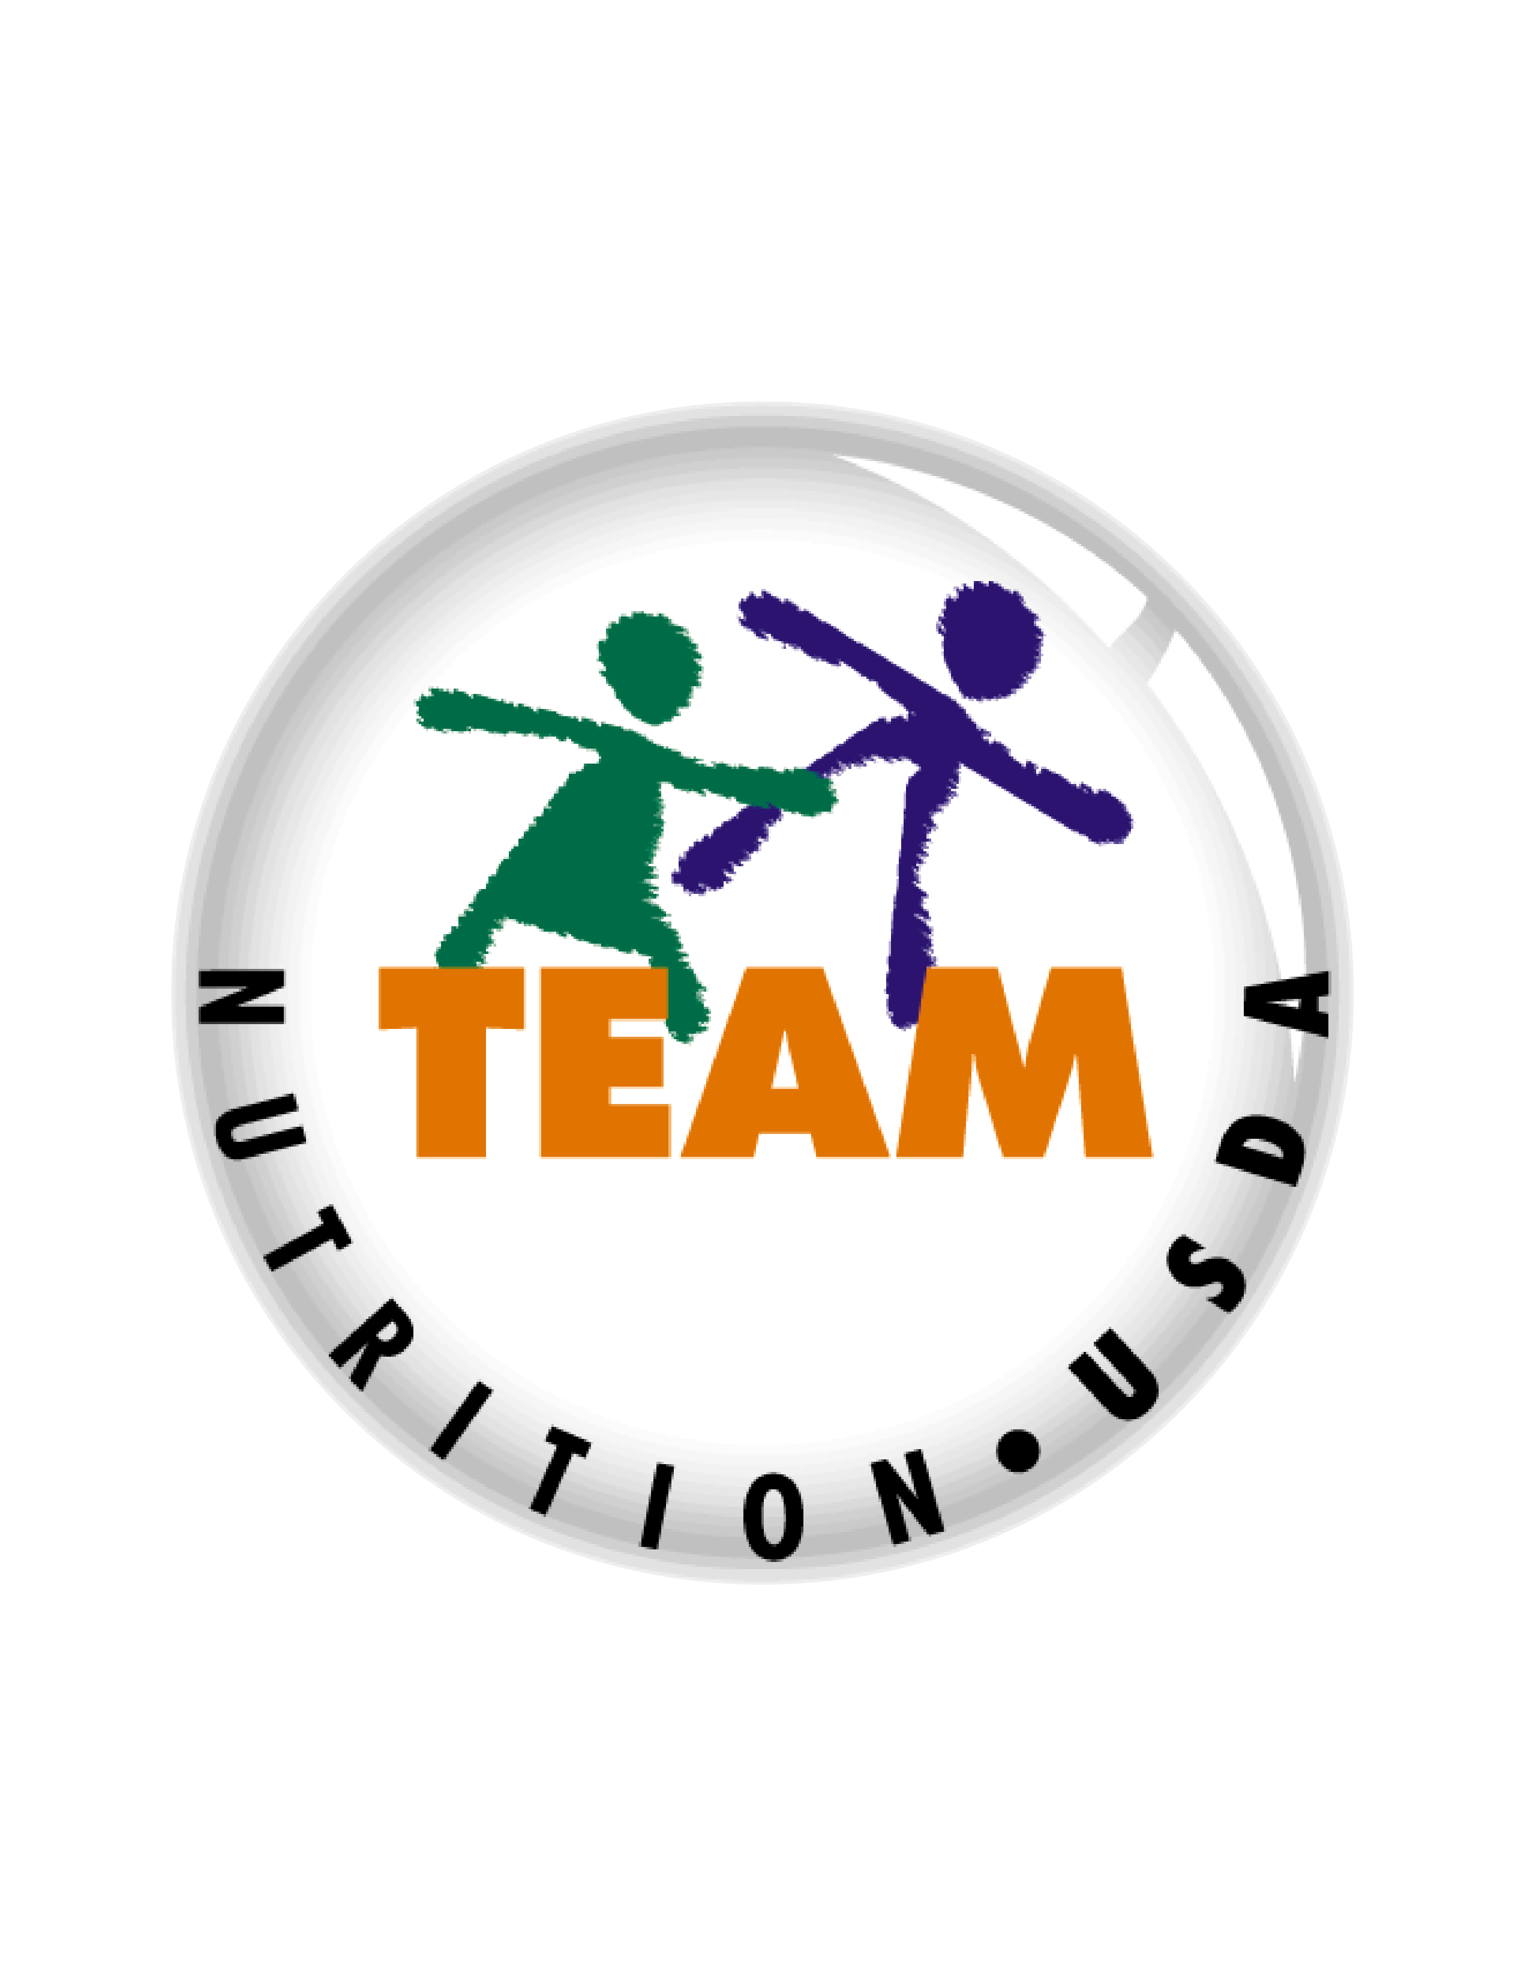


Presentation End
To learn more about the CACFP
or access materials, visit:
https://teamnutrition.usda.gov
In accordance with Federal civil rights law and U.S. Department of Agriculture (USDA) civil rights regulations and policies, the USDA, its Agencies, offices, and employees, and institutions participating in or administering USDA programs are prohibited from discriminating based on race, color, national origin, religion, sex, gender identity (including gender expression), sexual orientation, disability, age, marital status, family/parental status, income derived from a public assistance program, political beliefs, or reprisal or retaliation for prior civil rights activity, in any program or activity conducted or funded by USDA (not all bases apply to all programs). Remedies and complaint filing deadlines vary by program or incident.
Persons with disabilities who require alternative means of communication for program information (e.g., Braille, large print, audiotape, American Sign Language, etc.) should contact the responsible Agency or USDA’s TARGET Center at (202) 720-2600 (voice and TTY) or contact USDA through the Federal Relay Service at (800) 877-8339. Additionally, program information may be made available in languages other than English.
To file a program discrimination complaint, complete the USDA Program Discrimination Complaint Form, AD-3027, found online at http://www.ascr.usda.gov/complaint_filing_cust.html and at any USDA office or write a letter addressed to USDA and provide in the letter all of the information requested in the form. To request a copy of the complaint form, call (866) 632-9992. Submit your completed form or letter to USDA by: (1) mail: U.S. Department of Agriculture, Office of the Assistant Secretary for Civil Rights, 1400 Independence Avenue, SW, Washington, D.C. 20250-9410; (2) fax: (202) 690-7442; or (3) email: program.intake@usda.gov.
USDA is an equal opportunity provider, employer, and lender.
United States Department of Agriculture – Food and Nutrition Service – November 2019 – FNS-785

