Slide 1
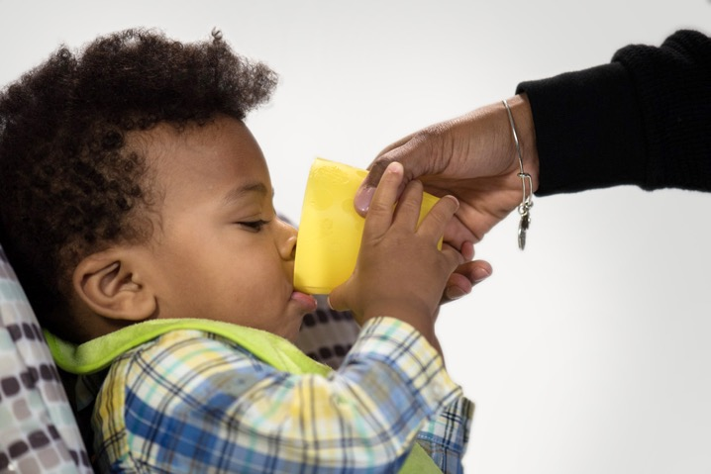
Feeding Infants in the CACFP
Lesson 6
Bottle Feeding and Introducing a Cup
Notes:
Information in this lesson comes from Chapter 5: Feeding a Baby Using a Bottle and Cup in the Feeding Infants in the Child and Adult Care Food Program guide. This lesson describes best practices for bottle feeding and introducing a cup.
Learning Objectives
At the end of this lesson, participants should be able to:
Describe the proper way to bottle feed.
State when a child should switch from a bottle to a cup.
List beverages that are appropriate to serve babies in a bottle or cup.
Lesson Description
The Bottle Feeding and Introducing a Cup lesson takes approximately 20 minutes to deliver. If the pre-test and post-test are administered, total session time will be approximately 25 minutes.
Welcome and Trainer Introduction
Welcome participants to the training and introduce yourself by providing:
Your name
Your position title
Your experience with the CACFP, infant nutrition, and/or child care.

Slide 2
Agenda
Bottle Feeding
Introducing a Cup
Communicating With Parents
Summary
Notes:
In this lesson, you will learn best practices for bottle feeding and introducing a cup.

Slide 3
Pre-Test
2
1
True or False?
It is okay to prop the bottle up on a pillow or other items for the baby to feed himself or herself.
Notes:
True or False?
It is okay to prop the bottle up on a pillow or other items for the baby to feed himself or herself.
Trainer Note: You can conduct the pre-test as a group activity or distribute a paper test. There are two question slides.
For a group activity, ask participants what they think the answer is for each question.
Do not give the answer.
Tell participants that the answers will be provided at the end of the lesson in the post-test slides.
For paper-based testing, distribute the pre-test and pencils. Tell participants how much time they have to complete the assessment.
If you will not administer the test, skip the slide.

Slide 4
Pre-Test
2
A 19-month-old baby is enrolled at your child care site and is still drinking from a bottle even though he is developmentally ready to drink from a cup. What are some issues that may come from using a bottle at this age?
Because it is easier to drink from a bottle than a cup, the child may drink so much milk that he is not hungry for other foods.
Drinking from a bottle regularly may lead to tooth decay.
Not drinking from a cup may mean that some important feeding skills may not develop or may be delayed.
All of the above.
Notes:
A 19-month-old enrolls at your child care site and is still drinking from a bottle even though he is developmentally ready to drink from a cup. What are some issues that may come from using a bottle at this age?
Because it is easier to drink from a bottle than a cup, the child may drink so much milk that he is not hungry for other foods.
Drinking from a bottle regularly may lead to tooth decay.
Not drinking from a cup may mean that some important feeding skills may not develop or may be delayed.
All of the above.
Trainer Note: The answer to the question is provided in the post-test slide.

Slide 5
Bottle Feeding
What Should Babies Drink?
What should babies age 0–11 months drink?
Breastmilk and iron-fortified infant formula
These are the only liquids that are creditable in the CACFP.
Do not put cereal in a bottle.
What is the recommended age at which you can offer a baby water to drink?
Around 6 months when a baby is developmentally ready to start eating solid foods
Notes:
Trainer Note: This slide has two animations.
You can present this learning activity where participants use Chapter 5: Feeding a Baby Using a Bottle and Cup in their Feeding Infants in the Child and Adult Care Food Program guide to find the answer to the following question. You can do this as a small group activity or in pairs. Allow participants 2–3 minutes to locate the answer in their guides. When the 2–3 minutes is over, ask volunteers to give their answer(s) to each question. Answers can be found in Table 7: What Should Babies Drink? on page 55 in the Feeding Infants in the Child and Adult Care Food Program guide.
Question: What should babies age 0–11 months drink?
Answer: Breastmilk and/or iron-fortified infant formula
Trainer Note: Tell participants that they should never put cereal in a bottle. If cereal is mixed in a bottle with breastmilk or infant formula, then the breastmilk or formula would not be creditable.
Question: What is the recommended age at which you can offer a baby water?
Answer: Around 6 months when a baby is developmentally ready to start to eating solid foods.
Breastmilk and/or iron-fortified infant formula are the only liquids that can be offered to a baby as part of a reimbursable meal or snack. Juice, cow's milk, goat's milk, sodas, sports drinks, sugar water, fruit drinks, tea, and coffee are not creditable as part of a reimbursable meal or snack for infants.
Trainer Note: If participants have questions about offering juice, cow’s milk, or other beverages to a baby refer them to Table 7: What Should Babies Drink? on page 55 in their Feeding Infants in the Child and Adult Care Food Program guide.

Slide 6

Transitioning Baby From Formula to Unflavored Whole Milk
1-month transition time to unflavored whole milk
The CACFP allows for a transition time between 12–13 months of age.
Notes:
The CACFP allows a transition time between 12 and 13 months to help babies get used to unflavored whole milk.
During this 1-month transition time, you can offer breastmilk, iron-fortified formula, and/or unflavored whole milk and still claim it as part of a reimbursable meal.
Breastmilk may be used to meet the fluid milk component in the meal pattern for children at any age. Mothers may breastfeed onsite or parents can provide pumped breastmilk for their child. If a parent wants the child (1 year old or older) to be served breastmilk in place of fluid milk, a written request by the parent is not required.

Slide 7
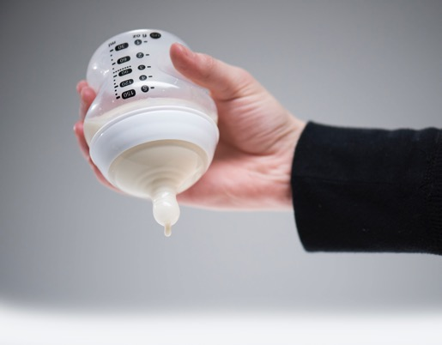
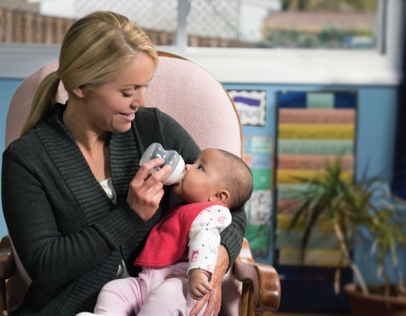
Prevent Choking When Bottle Feeding
Drops from nipple should follow each other closely; not a stream.
Hold baby almost upright.
Notes:
Let’s discuss best practices for feeding a baby to prevent choking.
There are things you can do before feeding a baby a bottle to help prevent choking. You can:
1. Hold the bottle upside down over a sink or other container.
Make sure falling drops from the nipple follow each other closely but don’t fall in a stream.
A stream means the opening in the nipple is too big and could allow the liquid to come out too quickly; increasing the chance that the baby could choke.
2. Hold the baby almost upright.

Slide 8

Prevent Choking When Bottle Feeding
Hold the baby almost upright to:
Keep baby secure.
Help prevent baby from choking or getting too much liquid at once.
See if baby is showing signs of hunger or fullness.
Never prop a bottle with a pillow or other item.
This can lead to tooth decay and possibly cause choking.
Notes:
Holding the baby almost upright:
Keeps the baby secure.
Can help prevent the baby from choking or getting too much liquid at once.
Helps you see if the baby is showing signs of hunger or fullness.
Never prop a bottle with a pillow or other item. This can lead to tooth decay and possibly cause choking.

Slide 9
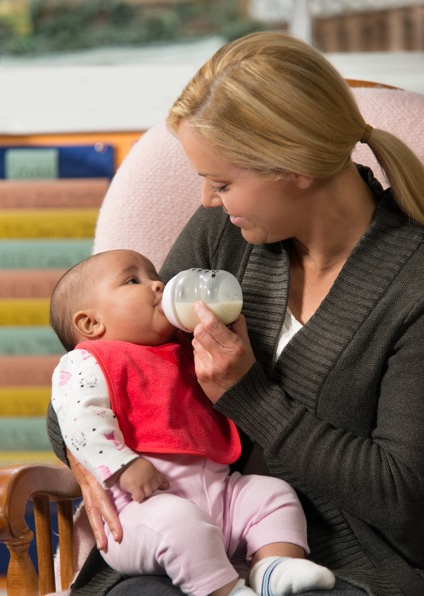
How To Bottle Feed
Hold bottle mostly sideways, not straight up.
Hold baby during feeding.
Switch which arm you use to hold the baby.
Burp during natural breaks or at end of feeding.
Use a slow flow bottle nipple.
Brush nipple of bottle across baby’s upper lip.
Notes:
When feeding a baby a bottle, remember to:
Hold the bottle mostly sideways, not straight up.
Make sure the tip of the nipple is filled with breastmilk or infant formula and not air. This will lower the amount of air the baby swallows.
Holding the bottle mostly sideways is used in paced bottle feeding.
Hold the baby during feeding.
Feed a baby while he or she is awake.
Do not prop the bottle up on a pillow or other item for the baby to feed himself or herself. Propping a bottle may cause choking or suffocation, as well as ear infections and tooth decay.
Hold the baby in the cradle of your arm, so that he or she is almost upright.
This keeps the baby secure, helps you see if the baby is showing signs of hunger or fullness, and it can help prevent the baby from choking or getting too much liquid at once.
Switch which arm you use to hold the baby.
Every so often when feeding a bottle, switch the baby from one arm to the other so the baby has different things to look at. This can also help the baby continue to enjoy feeding on both sides; something that is important when breastfeeding.
Burp during natural breaks in the feeding or at the end of the feeding.
Burp the baby by gently patting or rubbing the baby’s back while he or she is resting on your shoulder or sitting on your lap.
Use a slow flow bottle nipple.
This helps the baby control how much he or she eats and can reduce spit ups.
Brush the nipple of the bottle across the baby’s upper lip.
Wait for the baby’s mouth to open before feeding.
Trainer Note: Refer participants to Chapter 5: Feeding a Baby Using a Bottle and Cup in their Feeding Infants in the Child and Adult Care Food Program guide for best practices for feeding a baby a bottle.

Slide 10
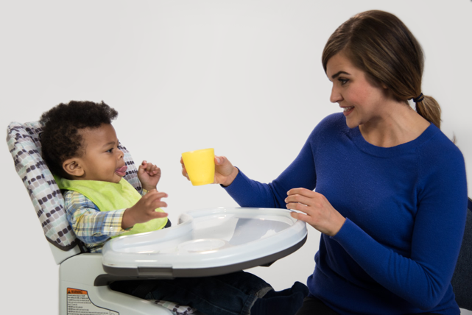
Introducing a Cup
A child drinking from a bottle beyond 18 months may:
Be more likely to develop tooth decay.
Not get enough solid foods.
Not get enough nutrients.
Not develop or may be delayed in developing feeding skills.
Baby uses a cup no later than 18 months of age.
Notes:
Many babies are able to drink small amounts from a cup held by another person around 6 months of age or later. Babies are usually developmentally ready to drink from a cup when they can sit without support and seal their lower lip on the rim of the cup.
It is recommended that babies stop using a bottle entirely and use only cups no later than 18 months, or as developmentally appropriate. Children still drinking from a bottle beyond 18 months of age may:
Be more likely to develop tooth decay.
Drink so much milk that they don’t eat enough solid foods.
Not get enough nutrients.
Not develop or may delay the development of important feeding skills.
Cups with lids that help prevent spilling, such as sippy cups, should only be used as a training tool to help a baby learn to drink from a cup.

Slide 11
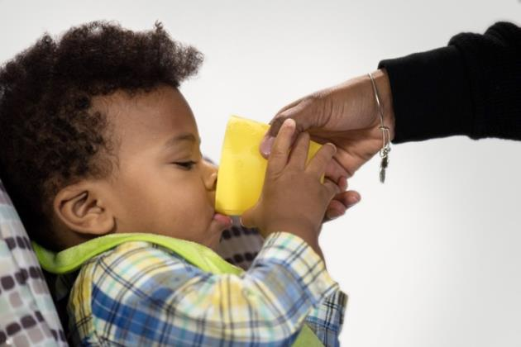

Ways To Transition a Baby to a Cup
Start small with 2–3 fluid ounces.
Place baby in high chair.
Hold cup for baby:
  Let baby drink slowly.
  Tilt cup slightly.
Allow baby to practice drinking with a cup before you stop bottle feeding.
Introduce a cup at mealtimes when other children are drinking from cups.
Notes:
Let’s discuss some ways you can help a baby learn to drink from a cup.
Start with small amounts (2 to 3 fluid ounces) of breastmilk or infant formula in a cup.
Make sure the baby is seated in a high chair during a feeding or hold the baby.
This can lower the baby's risk of choking.
It can also help prevent another child from drinking from the same cup.
Hold the cup for the baby.
Let the baby drink very slowly by tilting the cup slightly.
Introduce a cup in place of a bottle at mealtime when older children may be drinking from cups.
Allow the baby to practice drinking from a cup before you stop using a bottle completely.

Slide 12
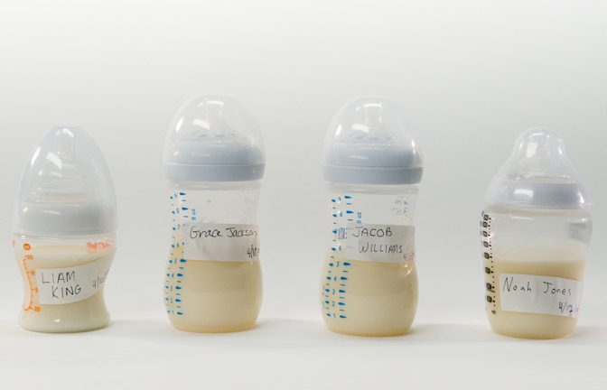
Preventing Babies From Drinking From the Wrong Bottle or Cup
Do not allow a baby to carry a bottle or cup around.
Clearly label each bottle and cup with child’s full name.
Send all bottles and cups home with parent(s) who brought them.
Notes:
It is important to prevent babies from drinking from the wrong bottle or cup.
Do not let babies or children carry around bottles or cups.
If a baby drops a bottle:
Pick it up immediately.
Place it out of reach of other children.
Clean up any spilled breastmilk or formula with soap and water.
Clearly label each cup with the baby’s or child’s full name.
If possible, give each baby and child his or her own distinct looking cup.
At the end of the day, send all bottles and cups home with the parent who brought them.
Although the risk of transmission of HIV or other diseases is small if a baby or child drinks from another baby’s bottle or cup of breastmilk, you must inform the parents of both babies of the incident and follow guidance from the Centers for Disease Control and Prevention (CDC).
Trainer Note: Refer participants to the “How to Prevent Babies or Children From Drinking Another Child’s Bottle (or Cup)” topic on page 53 in their Feeding Infants in the Child and Adult Care Food Program guide for information about what they should do if a baby or child accidentally drinks from the wrong bottle or cup of breastmilk.

Slide 13

Communicating With Parents
Not sure how to transition your baby from a bottle to a cup?
Ask us how we can help!
Notes:
Start conversations with parents about what babies should drink and ways to introduce a cup. One way to start a conversation is to use bite-size nutrition messages in your child care site’s social media page, tweets, emails, bulletin boards, flyers, food menus, or other parent communication systems.
Sample message:
“Not sure how to transition your baby from a bottle to a cup? Ask us how we can help!”

Slide 14
Summary
Breastmilk and iron-fortified infant formula are the only reimbursable liquids in the CACFP.
  The CACFP allows a transition time between 12–13 months to unflavored whole milk.
Ways to prevent a baby from choking when feeding the baby a bottle:
  Make sure falling drops from nipple follow each other closely.
  Hold baby almost upright.
A baby is developmentally ready to drink from a cup when can:
  Sit without support.
  Seal lower lip on the rim of the cup.
A baby should drink only from a cup no later than 18 months.*
Start a conversation with bite-sized nutrition messages!
* As developmentally appropriate.
Notes:
Trainer Note: Review the key concepts covered in the lesson. Allow participants to ask questions.
Breastmilk and iron-fortified infant formula are the only liquids that can be offered to a baby as part of a reimbursable meal or snack.
The CACFP allows a transition time between 12 and 13 months to help babies get used to unflavored whole milk.
During that 1-month transition time, you can offer breastmilk, iron-fortified formula, and/or unflavored whole milk and still claim it as part of a reimbursable meal.
Ways to prevent a baby from choking when feeding the baby a bottle include:
Before feeding the baby, hold the bottle upside down over a sink or other container.
Make sure falling drops from the nipple follow each other closely but do not fall in a stream.
Hold baby almost upright.
This can help prevent the baby from choking or getting too much liquid at once.
Holding a baby almost upright also helps you see if the baby is showing signs of hunger or fullness.
Chapter 5: Feeding a Baby Using a Bottle and Cup in your Feeding Infants in the Child and Adult Care Food Program guide contains best practices for feeding a baby a bottle and cup.
Babies are usually developmentally ready to drink from a cup when they can sit without support and seal their lower lip on the rim of the cup.
It is important for a baby to learn to drink from a cup before the age of 18 months or as developmentally appropriate. Children still drinking from a bottle beyond 18 months of age may:
Be more likely to develop tooth decay.
Drink so much milk that they do not eat enough solid foods and not get enough nutrients.
Not develop or may delay the development of important feeding skills.
One way to start a conversation with parents about what their baby should drink and ways to introduce a cup is to use bite-size nutrition messages in your child care site’s social media page, tweets, emails, bulletin boards, flyers, food menus, or other parent communication systems.

Slide 15
Post-Test
2
1
True or False?
It is okay to prop the bottle up on a pillow or other items for the baby to feed himself or herself.
False
Notes:
True or False?
It is okay to prop the bottle up on a pillow or other items for the baby to feed himself or herself.
Answer: False
Never prop a bottle with a pillow or other item. This can lead to tooth decay and possibly cause choking.
Trainer Note: You can conduct the post-test as a group activity or distribute a paper test. There are two question slides.
For a group activity, ask participants what they think the answer is for each question. Allow time for multiple responses before you give the answer.
To reveal the answer, click your mouse or press the “Enter” key on your keyboard.
For paper-based testing, distribute the post-test and pencils. Tell participants how much time they have to complete the assessment.
After you have collected the tests, you can show participants the answers.
If you will not administer the test, skip the slide.

Slide 16
Post-Test
2
A 19-month-old baby is enrolled at your child care site and is still drinking from a bottle even though he is developmentally ready to drink from a cup. What are some issues that may come from using a bottle at this age?
Because it is easier to drink from a bottle than a cup, the child may drink so much milk that he is not hungry for other foods.
Drinking from a bottle regularly may lead to tooth decay.
Not drinking from a cup may mean that some important feeding skills may not develop or may be delayed.
All of the above.
A 19-month-old baby is enrolled at your child care site and is still drinking from a bottle even though he is developmentally ready to drink from a cup. What are some issues that may come from using a bottle at this age?
Because it is easier to drink from a bottle than a cup, the child may drink so much milk that he is not hungry for other foods.
Drinking from a bottle regularly may lead to tooth decay.
Not drinking from a cup may mean that some important feeding skills may not develop or may be delayed.
All of the above.
Notes:
A 19-month-old baby is enrolled at your child care site and is still drinking from a bottle even though he is developmentally ready to drink from a cup. What are some issues that may come from using a bottle at this age?
Because it is easier to drink from a bottle than a cup, the child may drink so much milk that he is not hungry for other foods.
Drinking from a bottle regularly may lead to tooth decay.
Not drinking from a cup may mean that some important feeding skills may not develop or may be delayed.
All of the above.
Answer: D
Trainer Note: Click your mouse or press the “Enter” key on your keyboard to reveal the answer.

Slide 17

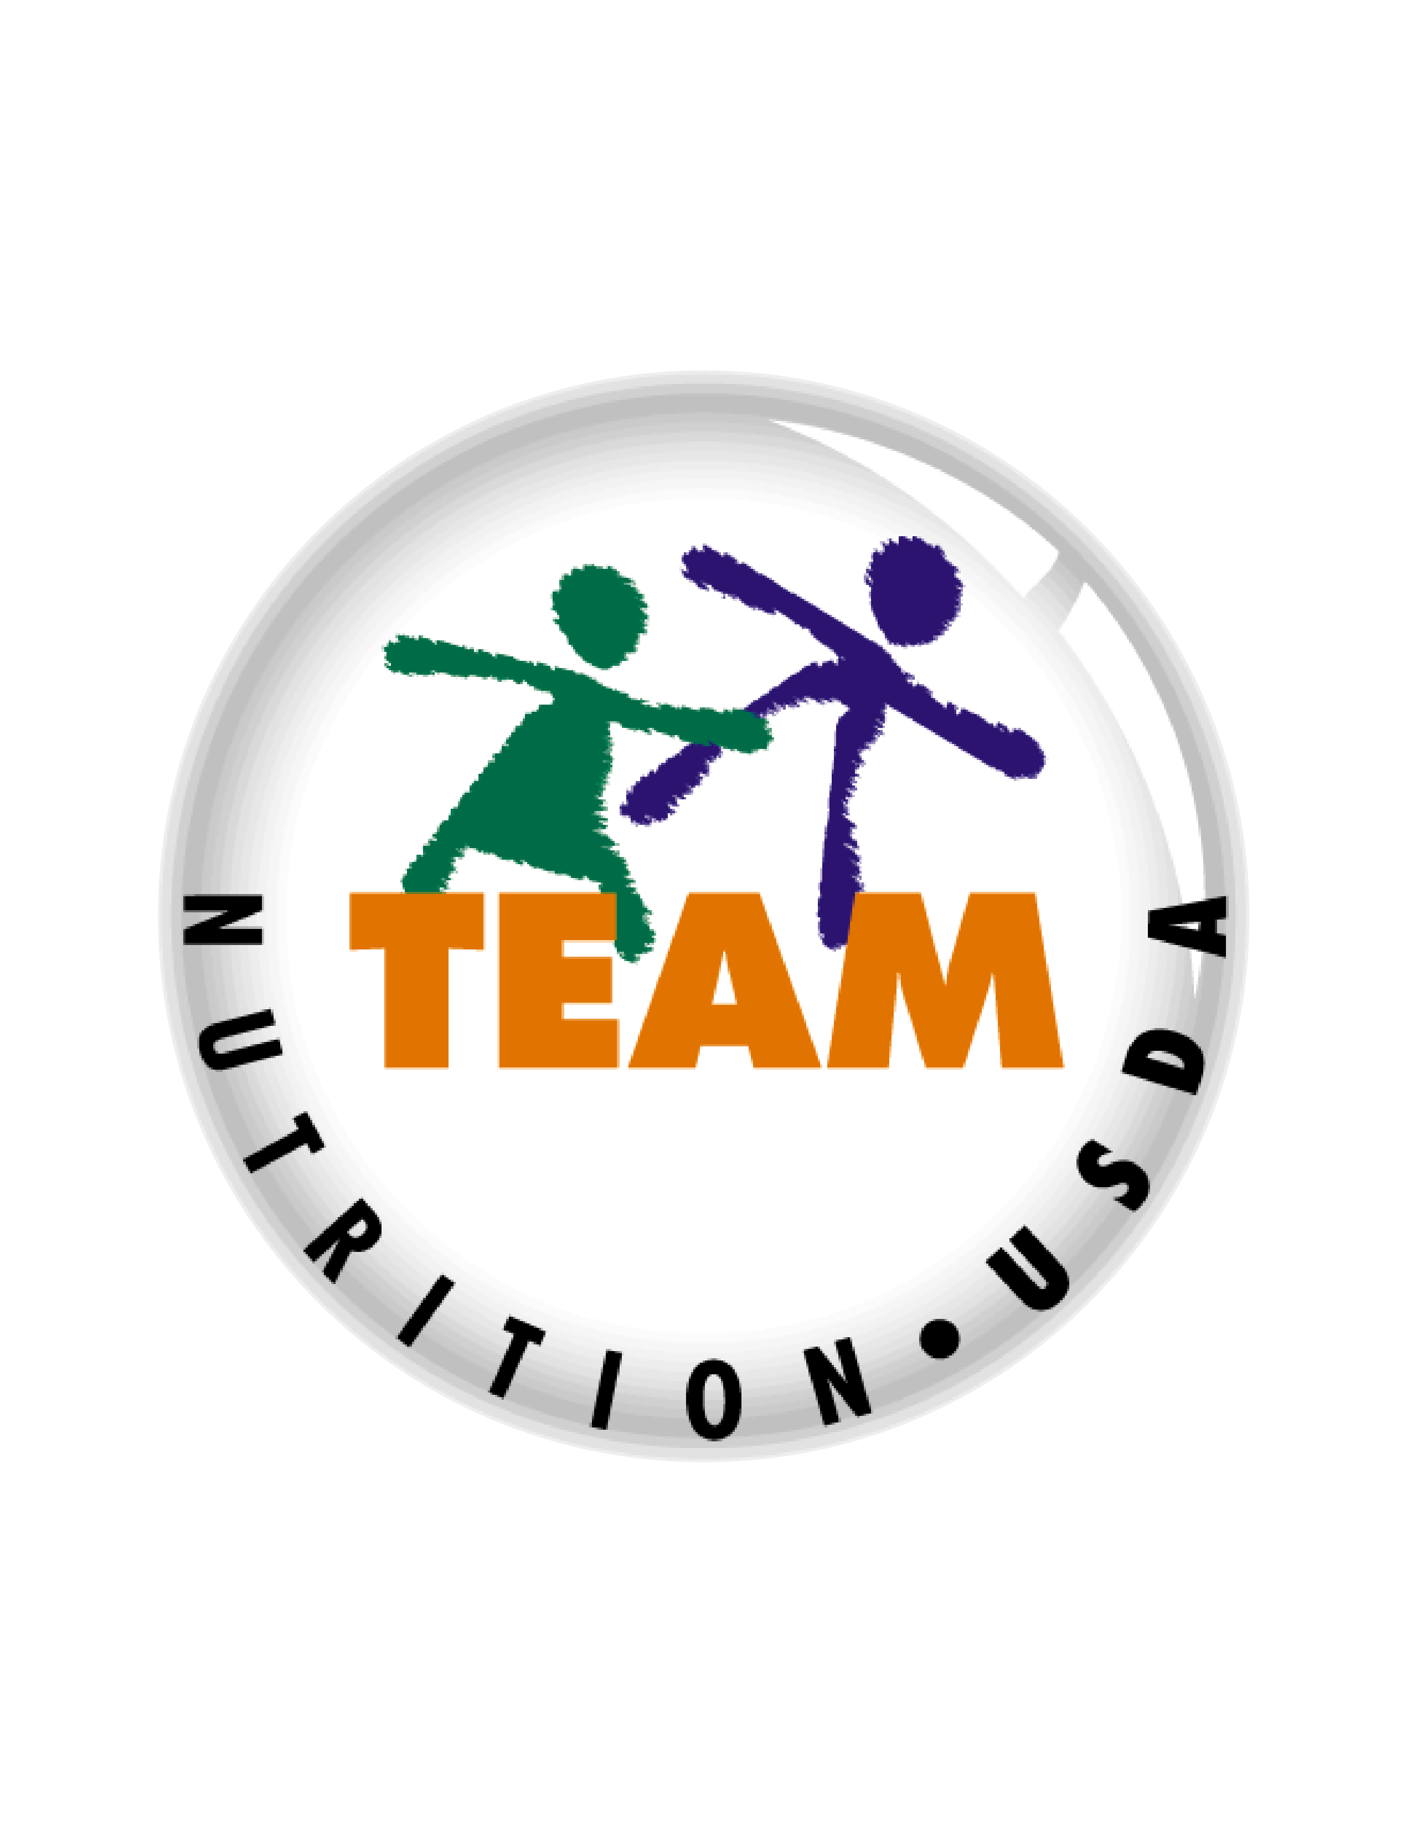
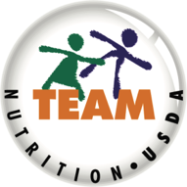

Presentation End
To learn more about the CACFP
or access materials, visit:
https://teamnutrition.usda.gov
In accordance with Federal civil rights law and U.S. Department of Agriculture (USDA) civil rights regulations and policies, the USDA, its Agencies, offices, and employees, and institutions participating in or administering USDA programs are prohibited from discriminating based on race, color, national origin, religion, sex, gender identity (including gender expression), sexual orientation, disability, age, marital status, family/parental status, income derived from a public assistance program, political beliefs, or reprisal or retaliation for prior civil rights activity, in any program or activity conducted or funded by USDA (not all bases apply to all programs). Remedies and complaint filing deadlines vary by program or incident.
Persons with disabilities who require alternative means of communication for program information (e.g., Braille, large print, audiotape, American Sign Language, etc.) should contact the responsible Agency or USDA’s TARGET Center at (202) 720-2600 (voice and TTY) or contact USDA through the Federal Relay Service at (800) 877-8339. Additionally, program information may be made available in languages other than English.
To file a program discrimination complaint, complete the USDA Program Discrimination Complaint Form, AD-3027, found online at http://www.ascr.usda.gov/complaint_filing_cust.html and at any USDA office or write a letter addressed to USDA and provide in the letter all of the information requested in the form. To request a copy of the complaint form, call (866) 632-9992. Submit your completed form or letter to USDA by: (1) mail: U.S. Department of Agriculture, Office of the Assistant Secretary for Civil Rights, 1400 Independence Avenue, SW, Washington, D.C. 20250-9410; (2) fax: (202) 690-7442; or (3) email: program.intake@usda.gov.
USDA is an equal opportunity provider, employer, and lender.
United States Department of Agriculture – Food and Nutrition Service – November 2019 – FNS-785

