Slide 1
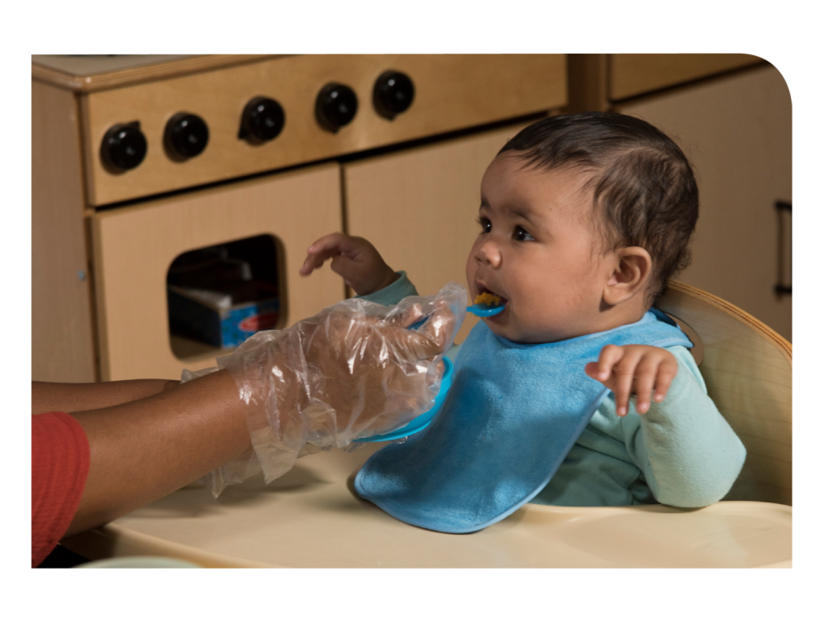
Feeding Infants in the CACFP
Lesson 7
Developmental Readiness for Solid Foods
Notes:
Information in this lesson comes from Chapter 1: Giving Babies a Healthy Start With the CACFP and Chapter 6: Feeding Solid Foods in the Feeding Infants in the Child and Adult Care Food Program guide. This lesson provides participants with information about babies’ developmental readiness for eating solid foods.
Learning Objectives
At the end of this lesson, participants should be able to:
Describe when a baby is developmentally ready to start eating solid foods.
Lesson Description
The Developmental Readiness for Solid Foods lesson takes approximately 18 minutes to deliver. If the pre-test and post-test are administered, the total session time will be approximately 22 minutes.
Welcome and Trainer Introduction
Welcome participants to the training and introduce yourself by providing:
Your name
Your position title
Your experience with the CACFP, infant nutrition, and/or child care

Slide 2
Agenda
Establishing Healthy Eating Habits
Developmental Readiness
Communicating With Parents
Summary
Notes:
This lesson provides information about babies’ developmental readiness for solid foods and ways to communicate with parents about when their baby may be ready to start eating solid foods.

Slide 3
Pre-Test
1
True or False?
Babies are always ready for solid foods at exactly 6 months of age.
Notes:
True or False?
Babies are always ready for solid foods at exactly 6 months of age.
Trainer Note: You can conduct the pre-test as a group activity or distribute a paper test. There are two question slides.
For a group activity, ask participants what they think the answer is for each question.
Do not give the answer.
Tell participants that the answers will be provided at the end of the lesson in the post-test slides.
For paper-based testing, distribute the pre-test and pencils. Tell participants how much time they have to complete the assessment.
If you will not administer the test, skip the slide.

Slide 4
Pre-Test
2
Which statement best describes why a baby should not be fed solid foods before he or she is developmentally ready?
A baby may choke on the food.
A baby may drink less breastmilk or infant formula than needed in order to grow.
A baby may be overweight or obese later in life.
All of the above.
Notes:
Which statement best describes why a baby should not be fed solid foods before he or she is developmentally ready?
A baby may choke on the food.
A baby may drink less breastmilk or infant formula than needed in order to grow.
A baby may be overweight or obese later in life.
All of the above.
Trainer Note: The answer to the question is provided in the post-test slide.

Slide 5
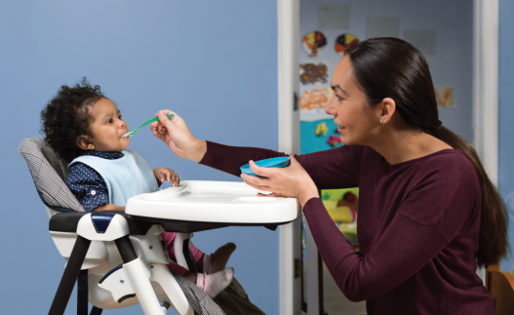
Establishing Healthy Eating Habits
Taste preferences and eating habits form early in life.
Babies change from:
Sucking and swallowing to chewing solid foods.
Relying on others to feed them to learning to feed themselves.
Feeding babies the right foods at right times helps them:
Enjoy new tastes and textures.
Get the nutrition they need.
Avoid choking.
Notes:
Taste preferences and eating habits are formed early in a child’s life, making your child care site an important part of children’s experiences with food. As a child care provider, you support the development of children’s eating habits and can help them get a healthy start.
During the first year of life, infants’ mouths change from being able to only suck and swallow breastmilk or infant formula to being able to chew solid foods. Babies also go from relying on you to feed them to starting to learn how to feed themselves.
As babies continue to grow, they can eat different kinds of foods. Feeding babies the right foods at the right times helps them enjoy new tastes and textures, get the nutrition they need, and avoid choking.
All babies develop at their own rate. The foods that are fed to a baby at different times during their first year are based on the baby’s developmental readiness. Readiness for solid foods is related to how well the baby can control his or her muscles. Although age and size are often related to developmental readiness, these should not be used as the only factors in deciding what and how to feed a baby.

Slide 6

Video: Developmental Readiness for Solid Foods
https://www.fns.usda.gov/tn/feeding-infants-developmental-readiness-solid-foods-cacfp-trainers-tools
Notes:
Next, we will watch a short video that describes the developmental skills that indicate a baby may be ready to eat solid foods.
Trainer Note: The Developmental Readiness for Solid Foods video is linked in the PowerPoint slide. Runtime is 1 minute and 56 seconds.
There are a few options for playing the video:
The video is linked in the PowerPoint presentation. You can use your mouse to select the USDA image on the slide and click on your mouse or touchpad to start the video.
You can play the video from the USB drive provided with this trainer’s guide. Or,
If you have an internet connection, you can play the video directly from the USDA Team Nutrition website at https://www.fns.usda.gov/tn/feeding-infants-developmental-readiness-solid-foods-cacfp-trainers-tools
Trainer Note: After the video plays, summarize the information presented or ask participants the following question.
What developmental skills indicate that a baby may be ready to eat solid foods?
Sits in a high chair with good head control.
Opens mouth when foods come his or her way.
Reaches for food.
Uses tongue to move food from spoon into his or her mouth; baby has lost the reflex to spit out a spoon or any food put in his or her mouth.

Slide 7


Communicating With Parents
Feeding solid foods before a baby is developmentally ready:
  May increase chance of choking.
  Baby may drink less breastmilk or formula needed to grow.
  Baby may be overweight or obese later in life.
Adding cereal to baby’s bottle does not help baby:
  Sleep through the night.
  Eat fewer times in a day.
Notes:
Share with parents that feeding a baby solid foods before he or she is developmentally ready, may increase the chance that the baby will choke on the food, drink less breastmilk or infant formula than is needed to grow, or may be overweight or obese later in life. Feeding solid foods before a baby is ready, which includes adding infant cereal to the baby’s bottle, does not help the baby sleep through the night or make the baby eat fewer times in a day.

Slide 8
Communicating With Parents
Start a conversation!
Talk with parents about developmental readiness for solid foods:
  Can baby sit in a high chair with good head control?
  Can baby use his or her tongue to move food from spoon to mouth?
  Does baby show interest in food?
Handout to share with parents:
For Parents: Is Your Baby Ready for Solid Foods? (page 12)
  https://teamnutrition.usda.gov
Notes:
Let’s discuss some ways to communicate with parents about a baby’s readiness for solid foods.
Talk with the baby’s parent(s) if you feel that the baby is developmentally ready to start eating solid foods.
Serve solid foods once the parents tell you the baby is developmentally ready and eating solid foods at home.
If a baby is not developmentally ready but parents think the baby should start solid foods, explain that the baby is not ready for solid foods if he or she:
Needs help holding his or her head up.
Cannot sit on his or her own without support throughout feeding.
Isn’t interested in food when it is offered or it is close by.
Use parent handouts to start a conversation:
For Parents: Is Your Baby Ready for Solid Foods? on page 12 in the Feeding Infants in the Child and Adult Care Food Program guide.
This handout is available for free download from the USDA Team Nutrition website at https://teamnutrition.usda.gov.
It is the parents’ decision when their baby is ready for solid foods.

Slide 9

Communicating With Parents
Scenario
Baby Emily still needs help holding her head up. She does not seem interested when food is around her. Emily’s mom wants to start feeding her solid foods, but you do not think Emily is ready.
What can you do?
Notes:
Let’s practice with this scenario.
Scenario: Baby Emily still needs help holding her head up. She does not seem interested when food is around her. Emily’s mom wants to start feeding her solid foods, but you do not think Emily is ready. What can you do?
Think about the communication tools in the Feeding Infants in the Child and Adult Care Food Program guide that can help you talk to parents. An example is the parent handout discussed earlier in this lesson: For Parents: Is Your Baby Ready for Solid Foods? on page 12 of the guide.
Trainer Note: Present the scenario and ask participants what they would do in this situation. You can do this activity in small groups or in pairs. Tell participants that they have 1 or 2 minutes to discuss the scenario after you read it out loud. At the end of the 1 or 2 minutes, ask participants to share their ideas. Correct any misunderstanding of developmental readiness for solid foods.

Slide 10
Summary
Developmental readiness for solid foods:
    Sits in high chair with good head control.
    Opens mouth when food comes his or her way.
    Reaches for food.
    Uses tongue to move food from the spoon into his or her mouth.
Feeding babies the right foods when they are developmentally ready helps them:
  Enjoy new tastes and textures.
  Get the nutrition they need.
  Avoid choking.
  Start a conversation!
  For Parents: Is Your Baby Ready for Solid Foods? (page 12)
  https://teamnutrition.usda.gov
Notes:
Trainer Note: Review the key concepts covered in the lesson. Allow participants to ask questions.
Developmental skills that indicate a baby’s readiness for solid foods:
Sits in high chair with good head control.
Opens mouth when food comes his or her way.
Reaches for food.
Uses tongue to move food from the spoon into his or her mouth.
Feeding babies the right foods when they are developmentally ready helps them:
Enjoy new tastes and textures.
Get the nutrition they need.
Avoid choking.
To start a conversation with parents, share the For Parents: Is Your Baby Ready for Solid Foods? handout.

Slide 11
Post-Test
1
True or False?
Babies are always ready for solid foods at exactly 6 months of age.
False
Notes:
True or False?
Babies are always ready for solid foods at exactly 6 months of age.
Answer: False
Babies are developmentally ready for solid foods when they can:
Sit in a high chair with good head control.
Open his or her mouth when food is near.
Reach for food.
Use his or her tongue to move food from the spoon into his or her mouth.
You can start offering a baby solid foods when his or her parents tell you the baby is developmentally ready and is eating solid foods at home. This is usually around 6 months of age. Talking with the baby's parents is key to knowing when to start feeding solid foods and if a baby has any food allergies or intolerances.
Trainer Note: You can conduct the post-test as a group activity or distribute a paper test. There are two question slides.
For a group activity, ask participants what they think the answer is for each question. Allow time for multiple responses before you give the answer.
To reveal the answer, click your mouse or press the “Enter” key on your keyboard.
For paper-based testing, distribute the post-test and pencils. Tell participants how much time they have to complete the assessment.
After you have collected the tests you can show participants the answers.
If you will not administer the test, skip the slide.

Slide 12
Post-Test
2
Which statement best describes why a baby should not be fed solid foods before he or she is developmentally ready?
A baby may choke on the food.
A baby may drink less breastmilk or infant formula than needed in order to grow.
A baby may be overweight or obese later in life.
All of the above.
Which statement best describes why a baby should not be fed solid foods before he or she is developmentally ready?
A baby may choke on the food.
A baby may drink less breastmilk or infant formula than needed in order to grow.
A baby may be overweight or obese later in life.
All of the above.
Notes:
Which statement best describes why a baby should not be fed solid foods before he or she is developmentally ready?
A baby may choke on the food.
A baby may drink less breastmilk or infant formula than needed in order to grow.
A baby may be overweight or obese later in life.
All of the above.
Answer: D
Trainer Note: Click your mouse or press the “Enter” key on your keyboard to reveal the answer.

Slide 13

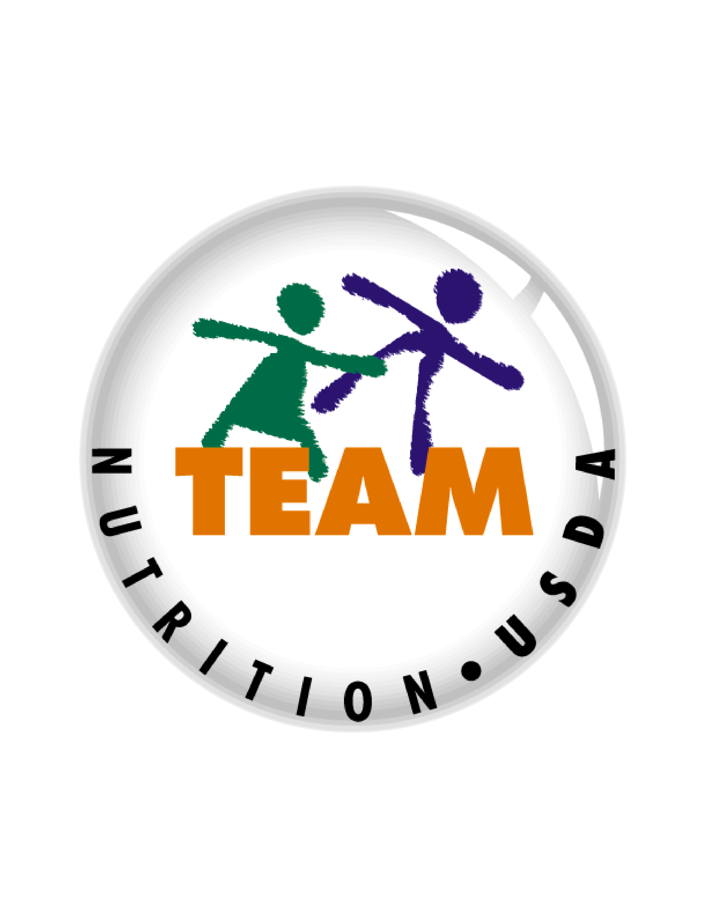


Presentation End
To learn more about the CACFP
or access materials, visit:
https://teamnutrition.usda.gov
In accordance with Federal civil rights law and U.S. Department of Agriculture (USDA) civil rights regulations and policies, the USDA, its Agencies, offices, and employees, and institutions participating in or administering USDA programs are prohibited from discriminating based on race, color, national origin, religion, sex, gender identity (including gender expression), sexual orientation, disability, age, marital status, family/parental status, income derived from a public assistance program, political beliefs, or reprisal or retaliation for prior civil rights activity, in any program or activity conducted or funded by USDA (not all bases apply to all programs). Remedies and complaint filing deadlines vary by program or incident.
Persons with disabilities who require alternative means of communication for program information (e.g., Braille, large print, audiotape, American Sign Language, etc.) should contact the responsible Agency or USDA’s TARGET Center at (202) 720-2600 (voice and TTY) or contact USDA through the Federal Relay Service at (800) 877-8339. Additionally, program information may be made available in languages other than English.
To file a program discrimination complaint, complete the USDA Program Discrimination Complaint Form, AD-3027, found online at http://www.ascr.usda.gov/complaint_filing_cust.html and at any USDA office or write a letter addressed to USDA and provide in the letter all of the information requested in the form. To request a copy of the complaint form, call (866) 632-9992. Submit your completed form or letter to USDA by: (1) mail: U.S. Department of Agriculture, Office of the Assistant Secretary for Civil Rights, 1400 Independence Avenue, SW, Washington, D.C. 20250-9410; (2) fax: (202) 690-7442; or (3) email: program.intake@usda.gov.
USDA is an equal opportunity provider, employer, and lender.
United States Department of Agriculture – Food and Nutrition Service – November 2019 – FNS-785

