Slide 1
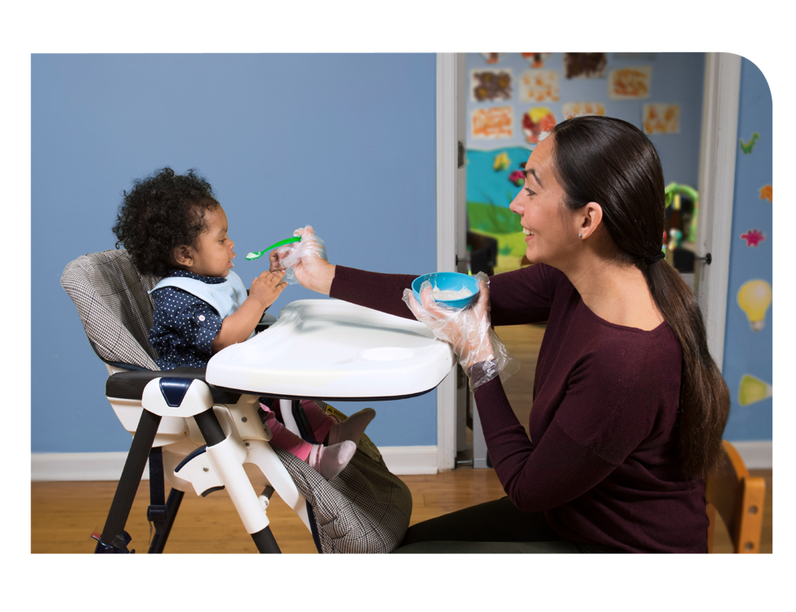
Feeding Infants in the CACFP
Lesson 8
Infant Feeding Skills and
Modifying Food Textures
Notes:
Information in this lesson comes from Chapter 6: Feeding Solid Foods, Chapter 7: Buying and Preparing Baby Foods, and Chapter 9: Choking Prevention in the Feeding Infants in the Child and Adult Care Food Program guide. This lesson provides participants best practices for preparing baby foods and how to prevent choking.
Trainer Note: It is recommended that this lesson be taught with Lesson 7: Developmental Readiness for Solid Foods.
Learning Objectives
At the end of this lesson, participants should be able to:
Explain how to prepare foods to lower choking risk.
Lesson Description
The Infant Feeding Skills and Modifying Food Textures lesson takes approximately 20 minutes to deliver. If the pre-test and post-test are administered, total session time will be approximately 25 minutes.
Welcome and Trainer Introduction
Welcome participants to the training and introduce yourself by providing:
Your name
Your position title
Your experience with the CACFP, infant nutrition, and/or child care

Slide 2
Agenda
Feeding Skills
Preparing Foods To Prevent Choking
Communicating With Parents
Summary
Notes:
In this lesson, you will learn about best practices for preparing baby foods to prevent choking. We will also discuss the importance of communicating with parents about their baby’s development as well as the foods and textures parents are introducing at home.

Slide 3
Pre-Test
3
2
1
All of the following finger foods are creditable in the CACFP infant meal pattern and can be prepared the right way to avoid choking, except which one?
  Small strips of bread
  Finely chopped strawberries
  Chunks of peanut butter
  Finely chopped whole eggs (yolk and egg white)
Notes:
All of the following finger foods are creditable in the CACFP infant meal pattern and can be prepared the right way to avoid choking, except which one?
Small strips of bread
Finely chopped strawberries
Chunks of peanut butter
Finely chopped whole eggs (yolk and egg white)
Trainer Note: You can conduct the pre-test as a group activity or distribute a paper test. There are three question slides.
For a group activity, ask participants what they think the answer is for each question.
Do not give the answer.
Tell participants that the answer to each question will be provided during the lesson and the answers will be provided at the end of the lesson in the post-test slides.
For paper-based testing, distribute the pre-test and pencils. Tell participants how much time they have to complete the assessment.
If you will not administer the test, skip the slide.

Slide 4
Pre-Test
3
2
Which is a best practice for preparing baby foods?
Choose all that apply.
Modify the texture by pureeing, mashing, grinding, or finely chopping.
Cut round foods into short strips (lengthwise) rather than round pieces.
Remove pits, seeds, skins, and tough peels from fruits and vegetables.
All of the above.
Notes:
Which is a best practice for preparing baby foods?
Choose all that apply.
Modify the texture by pureeing, mashing, grinding, or finely chopping.
Cut round foods into short strips (lengthwise) rather than round pieces.
Remove pits, seeds, skins, and tough peels from fruits and vegetables.
All of the above.
Trainer Note: The answer to the question will be provided in the content of the lesson and is provided in the post-test slide.

Slide 5
Pre-Test
3
To prepare foods that can be easily chewed by a baby, cut soft foods into small pieces: no larger than ______ or into thin slices or strips.
1/2 inch
2/3 inch
3/4 inch
1 inch
Notes:
To prepare foods that can be easily chewed by a baby, cut soft foods into small pieces: no larger than ______ or into thin slices or strips.
1/2 inch
2/3 inch
3/4 inch
1 inch
Trainer Note: The answer to the question will be provided in the content of the lesson and is provided in the post-test slide.

Slide 6
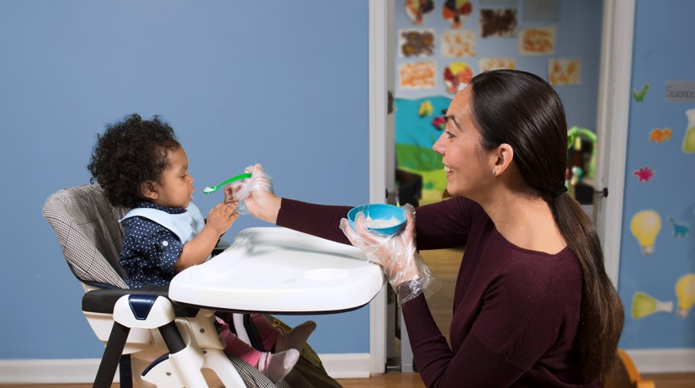
Developmental Readiness
The infant meal pattern includes solid foods for babies when they are developmentally ready.
Notes:
As a reminder from Lesson 7: Developmental Readiness for Solid Foods, the CACFP infant meal pattern includes solid foods for babies who are ages 6 through 11 months. But not all babies are ready for solid foods at exactly 6 months. Babies develop at their own rate. Foods fed to a baby are based on the baby’s developmental readiness and feeding skills. Readiness for solid foods is related to how well the baby can control his or her muscles and digest certain foods. A baby’s feeding skills are a good clue of what food textures the baby may be ready to eat.
After introducing purees, babies should progress to new textures, from a puree with some soft lumps up to thicker mashed foods to soft, chopped solid foods.
It is important to continue introducing new textures so that babies continually build the chewing and feeding skills that will eventually allow them to eat table foods.
This also helps the baby get used to the feel of different textures of foods in his or her mouth.
At around 8 to 12 months, babies develop a pincer grasp to feed themselves small, soft pieces of food.

Slide 7
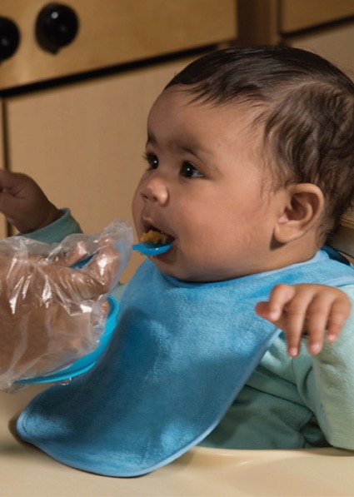
What Is a Feeding Skill?
Baby can:
Suck/swallow.
Move food from spoon to back of mouth and swallow.
Pick up pieces of food with hands.
Pick up pieces of food with fingers.
Notes:
Babies are born with feeding skills that allow them to drink breastmilk or infant formula. As babies get older, they develop new skills to eventually help them feed themselves with your supervision. Offering babies different textures of food as they get older helps them learn or strengthen different feeding skills.
Feeding skills include when a baby can:
Suck/swallow.
Move food from spoon to back of mouth and swallow.
Pick up pieces of food with hands.
Pick up pieces of food with fingers.

Slide 8

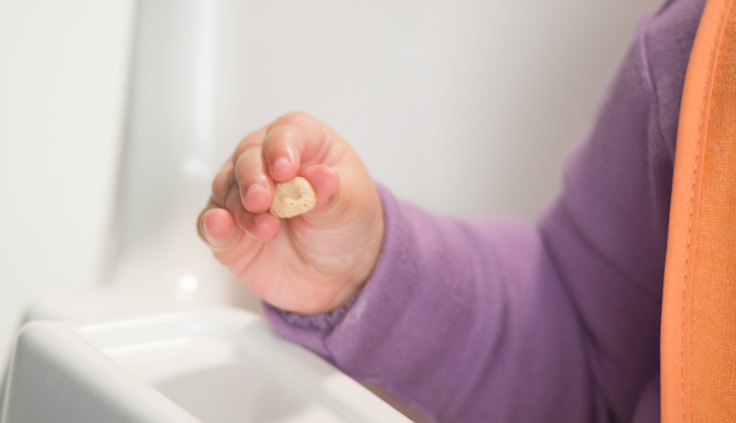
Feeding Skills
Palmar Grasp
Pincer Grasp
What feeding skills indicate that a baby may be ready to try new food textures?
Notes:
Shown on the slide are feeding skills that may indicate a baby is ready to try different foods.
What foods do you think a baby with the palmar grasp, shown on the left, may be ready to try?
Palmar grasp—when a baby uses his or her whole hand to pick up larger pieces of food or objects.
Baby may be ready to try strips of bread or crackers.
What foods do you think a baby with the pincer grasp, shown on the right, may be ready to try?
Pincer grasp—when a baby begins to use his or her thumb and index finger to pick up smaller pieces of food or objects.
Baby may be ready to try ready-to-eat cereals, such as whole grain cereal O’s.

Slide 9
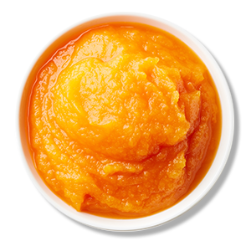

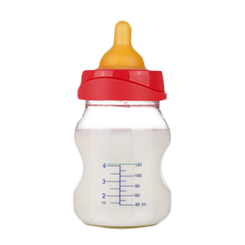

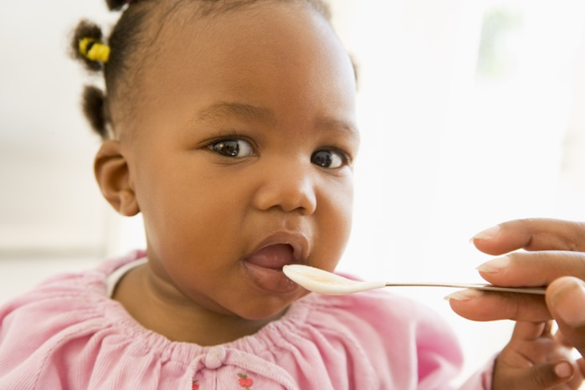
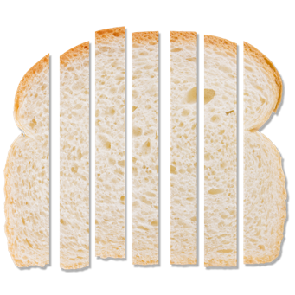
Which Food Texture Is Best?
Notes:
Trainer Note: This slide has 2 animations.
When serving food, make sure it is in a form that a baby can easily swallow and/or chew based on the baby’s feeding skills.
Trainer Note: Click through the three baby images and ask participants to choose which food is best for each feeding skill.
Answers:
First baby (suck/swallow): Breastmilk or iron-fortified infant formula
Second baby (move food from spoon to back of mouth and swallow): pureed, soft cooked foods such as pureed carrots or sweet potatoes
Third baby (pick up pieces of foods with hands or fingers): thin slices or small pieces (no larger than ½ inch) of bread

Slide 10
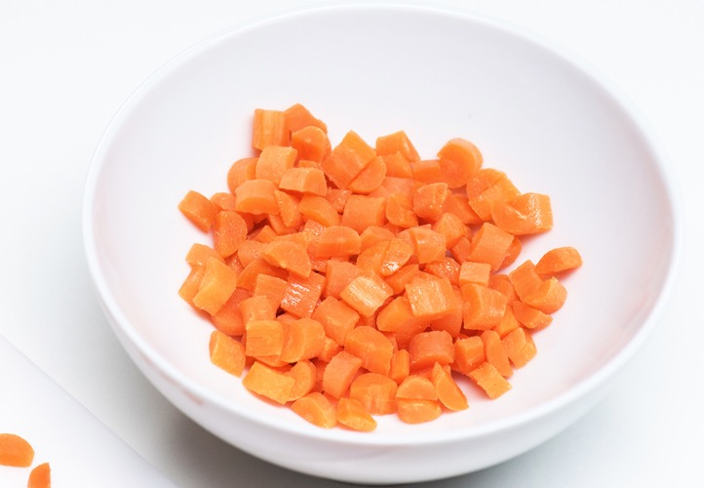
Preparing Foods To Prevent Choking
Cook foods until they are soft.
Notes:
Introducing new food textures, as the baby is developmentally ready, builds the baby’s skills while reducing the risk of choking. Some foods are harder for babies to eat and present a choking risk.
To prevent choking:
Cook or steam foods until they are soft enough to easily pierce with a fork.

Slide 11
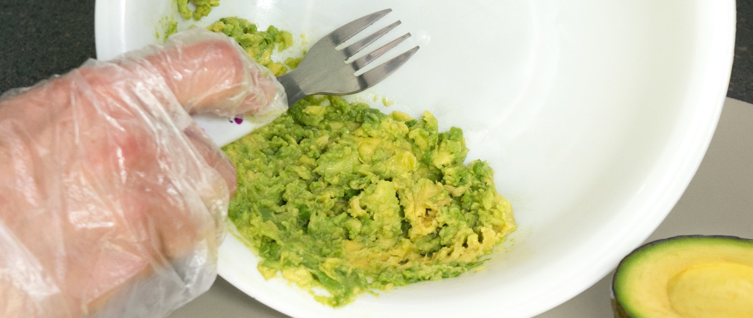
Preparing Foods To Prevent Choking
Modify texture by pureeing, mashing, grinding, or finely chopping.
Notes:
Modify the texture by pureeing, mashing, grinding, or finely chopping.

Slide 12
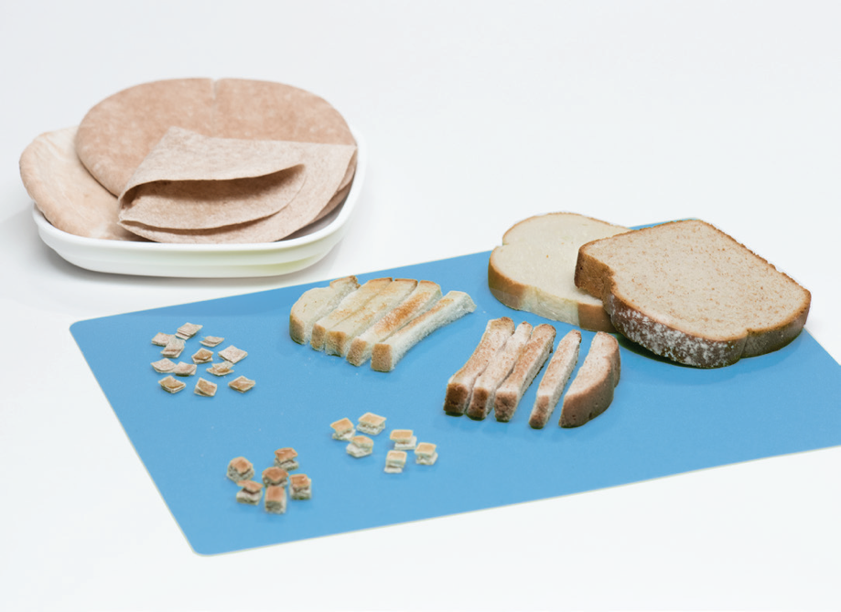
Preparing Foods To Prevent Choking
Cut foods into thin slices or small pieces no larger than ½ inch.
Notes:
Cut foods into thin slices or small pieces (no larger than ½ inch).
Do not feed foods or pieces of food that are the size or shape of a small marble. Foods this size can be swallowed whole and could get caught in a baby’s throat.
Cut round foods into short strips (lengthwise) rather than round pieces.
Cut grapes and cherry tomatoes into quarters.
Remove pits, seeds, and tough skins or peels from ripe fruit and cut into small pieces.
Avoid serving small, sticky, or hard foods that are difficult to chew or are easy to swallow whole.
For example, chunks of nut or seed butters are sticky and pose a choking risk.
Nut and seed butters are also not creditable towards a reimbursable meal or snack under the infant meal pattern.
Trainer Note: Tell participants that a full list of ways to reduce the risk of choking can be found in Chapter 9: Choking Prevention on page 114 in the Feeding Infants in the Child and Adult Care Food Program guide.

Slide 13

Communicating With Parents
Start a conversation!
Handouts to use to start a conversation:
      For Parents: Is Your Baby Ready for Solid Foods? (page 12)
      For Parents: What Is Your Baby Eating? Let Us Know! (page 63)
      For Parents: Varying Your Baby’s Veggies (page 88)
  https://teamnutrition.usda.gov
Notes:
Talk with parents about their baby’s development as well as the foods and textures parents are introducing at home.
You can use handouts from the Feeding Infants in the Child and Adult Care Food Program guide to help you start a conversation. Examples of handouts you can use include:
For Parents: Is Your Baby Ready for Solid Foods? (page 12)
For Parents: What Is Your Baby Eating? Let Us Know! (page 63)
For Parents: Varying Your Baby’s Veggies (page 88)
These handouts, and more, are available for free download from the USDA Team Nutrition website at https://teamnutrition.usda.gov.

Slide 14
Summary
CACFP infant meal pattern includes solid foods for babies that are developmentally ready.
Modify foods to match baby’s feeding skills and lower baby’s risk of choking.
Notes:
Trainer Note: Review the key points covered in the lesson. Allow participants to ask questions.
The CACFP infant meal pattern includes solid foods for babies that are developmentally ready (around 6 months).
When serving solid foods, make sure they are in a form that a baby can easily swallow and chew based on the baby’s feeding skills.
When babies are developmentally ready for solid foods, textures can progress from thin purees to thicker purees and mashed foods to larger pieces of soft solid foods they can feed themselves with a palmar grasp.
At around 8 to 12 months, babies develop a pincer grasp to feed themselves small, soft pieces of food.

Slide 15
Post-Test
3
2
1
All of the following finger foods are creditable in the CACFP infant meal pattern and can be prepared the right way to avoid choking, except which one?
  Small strips of bread
  Finely chopped strawberries
  Chunks of peanut butter
  Finely chopped whole eggs (yolk and egg white)
All of the following finger foods are creditable in the CACFP infant meal pattern and can be prepared the right way to avoid choking, except which one?
  Small strips of bread
  Finely chopped strawberries
  Chunks of peanut butter
  Finely chopped whole eggs (yolk and egg white)
Notes:
All of the following finger foods are creditable in the CACFP infant meal pattern and can be prepared the right way to avoid choking, except which one?
Small strips of bread
Finely chopped strawberries
Chunks of peanut butter
Finely chopped whole eggs (yolk and egg white)
Answer: C
Trainer Note: You can conduct the post-test as a group activity or distribute a paper test. There are three question slides.
For a group activity, ask participants what they think the answer is for each question. Allow time for multiple responses before you give the answer.
To reveal the answer, click your mouse or press the “Enter” key on your keyboard.
For paper-based testing, distribute the post-test and pencils. Tell participants how much time they have to complete the assessment.
After you have collected the tests, you can show participants the answers.
If you will not administer the test, skip the slide.

Slide 16
Post-Test
3
2
1
Which is a best practice for preparing baby foods?
Choose all that apply.
Modify the texture by pureeing, mashing, grinding, or finely chopping.
Cut round foods into short strips (lengthwise) rather than round pieces.
Remove pits, seeds, skins, and tough peels from fruits and vegetables.
All of the above.
Which is a best practice for preparing baby foods?
Choose all that apply.
Modify the texture by pureeing, mashing, grinding, or finely chopping.
Cut round foods into short strips (lengthwise) rather than round pieces.
Remove pits, seeds, skins, and tough peels from fruits and vegetables.
All of the above.
Notes:
Which is a best practice for preparing baby foods?
Choose all that apply.
Modify the texture by pureeing, mashing, grinding, or finely chopping.
Cut round foods into short strips (lengthwise) rather than round pieces.
Remove pits, seeds, skins, and tough peels from fruits and vegetables.
All of the above.
Answer: D
Trainer Note: Click your mouse or press the “Enter” key on your keyboard to reveal the answers.

Slide 17
Post-Test
3
To prepare foods that can be easily chewed by a baby, cut soft foods into small pieces: no larger than ______ or into thin slices or strips.
1/2 inch
2/3 inch
3/4 inch
1 inch
To prepare foods that can be easily chewed by a baby, cut soft foods into small pieces: no larger than ______ or into thin slices or strips.
1/2 inch
2/3 inch
3/4 inch
1 inch
Notes:
To prepare foods that can be easily chewed by a baby, cut soft foods into small pieces: no larger than ______ or into thin slices or strips.
1/2 inch
2/3 inch
3/4 inch
1 inch
Answer: A
Trainer Note: Click your mouse or press the “Enter” key on your keyboard to reveal the answers.

Slide 18




Presentation End
To learn more about the CACFP
or access materials, visit:
https://teamnutrition.usda.gov
In accordance with Federal civil rights law and U.S. Department of Agriculture (USDA) civil rights regulations and policies, the USDA, its Agencies, offices, and employees, and institutions participating in or administering USDA programs are prohibited from discriminating based on race, color, national origin, religion, sex, gender identity (including gender expression), sexual orientation, disability, age, marital status, family/parental status, income derived from a public assistance program, political beliefs, or reprisal or retaliation for prior civil rights activity, in any program or activity conducted or funded by USDA (not all bases apply to all programs). Remedies and complaint filing deadlines vary by program or incident.
Persons with disabilities who require alternative means of communication for program information (e.g., Braille, large print, audiotape, American Sign Language, etc.) should contact the responsible Agency or USDA’s TARGET Center at (202) 720-2600 (voice and TTY) or contact USDA through the Federal Relay Service at (800) 877-8339. Additionally, program information may be made available in languages other than English.
To file a program discrimination complaint, complete the USDA Program Discrimination Complaint Form, AD-3027, found online at http://www.ascr.usda.gov/complaint_filing_cust.html and at any USDA office or write a letter addressed to USDA and provide in the letter all of the information requested in the form. To request a copy of the complaint form, call (866) 632-9992. Submit your completed form or letter to USDA by: (1) mail: U.S. Department of Agriculture, Office of the Assistant Secretary for Civil Rights, 1400 Independence Avenue, SW, Washington, D.C. 20250-9410; (2) fax: (202) 690-7442; or (3) email: program.intake@usda.gov.
USDA is an equal opportunity provider, employer, and lender.
United States Department of Agriculture – Food and Nutrition Service – November 2019 – FNS-785

