Slide 1
Feeding Infants in the CACFP
Lesson 10
Creditable Infant Foods: Part 2
Notes:
Information in this lesson comes from Chapter 6: Feeding Solid Foods in the Feeding Infants in the Child and Adult Care Food Program guide. This lesson covers sugar limits for ready-to-eat cereal and yogurt in the CACFP, what to do when parents provide a meal component, and accommodating a baby’s special dietary needs.
Learning Objectives
At the end of this lesson, participants should be able to:
Determine if a ready-to-eat cereal and yogurt meet the CACFP sugar limit.
Describe a parent-provided meal component in the CACFP.
Describe how to accommodate an infant that has special dietary needs.
Lesson Description
The Creditable Infant Foods: Part 2 lesson takes approximately 20 minutes to deliver. If the pre-test and post-test are administered, total session time will be approximately 25 minutes. If your training session includes all 10 lessons, you can play the Feeding Babies Game Show game at the conclusion of this lesson. Playing the game will add approximately 30 minutes to the total training time.
Welcome and Trainer Introduction
Welcome participants to the training and introduce yourself by providing:
Your name
Your position title
Your experience with the CACFP, infant nutrition, and/or child care

Slide 2
Agenda
Sugar Limit for Ready-to-Eat Cereal
Sugar Limit for Yogurt
Parent-Provided Meal Component
Accommodating Special Dietary Needs
Communicating With Parents
Summary
Notes:
In this lesson, you will learn how to determine if ready-to-eat cereals and yogurts meet the CACFP sugar limit to be creditable towards a reimbursable meal or snack, what to do when parents provide one meal component, and how to accommodate a baby with special dietary needs.

Slide 3
Pre-Test #1
1
Yes or No?
The ready-to-eat cereal you are serving at snack contains 8 grams of sugar per dry ounce. Is this cereal creditable as part of a reimbursable snack for infants?
Notes:
Yes or No?
The ready-to-eat cereal you are serving at snack contains 8 grams of sugar per dry ounce. Is this cereal creditable as part of a reimbursable snack for infants?
Trainer Note: You can conduct the pre-test as a group activity or distribute a paper test. There are three question slides.
For a group activity, ask participants what they think the answer is for each question.
Do not give the answer.
Tell participants that the answers will be provided at the end of the lesson in the post-test slides.
For paper-based testing, distribute the pre-test and pencils. Tell participants how much time they have to complete the assessment.
If you will not administer the test, skip the slide.

Slide 4
Pre-Test #2
2
Yes or No?
The yogurt you are serving at lunch contains 24 grams of sugar per 6 ounces. Is this yogurt creditable?
Notes:
Yes or No?
The yogurt you are serving at lunch contains 24 grams of sugar per 6 ounces. Is this yogurt creditable?
Trainer Note: The answer to the question is provided in the post-test slide.

Slide 5
Pre-Test #3
3
A parent wants to provide food for her baby while the baby is at your child care site. How many meal components can the parent provide that you can claim as part of a reimbursable meal?
1 creditable meal component
2 creditable meal components
3 creditable meal components
4 creditable meal components
Notes:
A parent wants to provide food for her baby while the baby is at your child care site. How many meal components can the parent provide that you can claim as part of a reimbursable meal?
1 creditable meal component
2 creditable meal components
3 creditable meal components
4 creditable meal components
Trainer Note: The answer to the question is provided in the post-test slide.

Slide 6
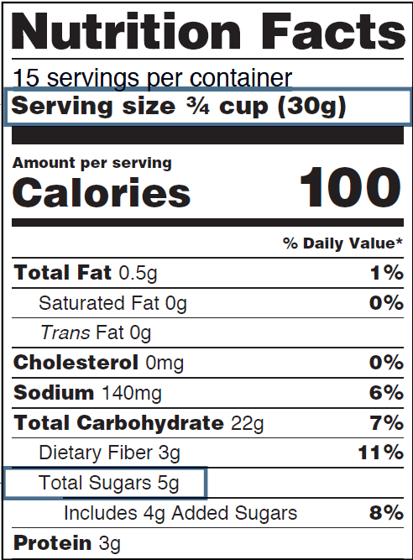
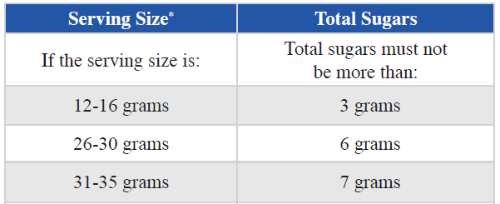
How Can I Tell if a Cereal Has 6 Grams of Sugar or Less?
Let’s Practice!
Find Serving Size in grams (g).
Find the amount of Total Sugars in grams (g).
Use the table in the training worksheet to find the allowable sugar amount.
Notes:
Ready-to-eat cereals include flakes, rounds, and puffed cereals that older babies can pick up and eat. These cereals can only credit towards snacks, not meals. For a ready-to-eat cereal to be creditable, the amount of sugar must be no more than 6 grams of total sugars per dry ounce of cereal.
Nearly all infant cereals meet the sugar limit of 6 grams of total sugars per dry ounce. There are many types of ready-to-eat cereals that meet this sugar limit too. If you are unsure if the cereal you want to purchase is creditable, there are a couple of ways you can determine if it is creditable.
You can:
Use any cereal that is listed on any State agency's Special Supplemental Nutrition Program for Women, Infants, and Children (WIC)-approved food list, or
Use Team Nutrition’s training worksheet titled, Choose Breakfast Cereals That Are Lower in Sugar. The training worksheet can be found at TeamNutrition.USDA.gov.
Let’s take a closer look at the worksheet and walk through the steps together.
Use the Nutrition Facts label to find the Serving Size, in grams (g), of the cereal.
Find the Total Sugars line. Look at the number of grams (g) next to Total Sugars.
Use the serving size identified in Step 1 to find the serving size of the cereal in the table.
In the table, look at the number to the right of the serving size amount (the Total Sugars column). If the cereal has that amount of sugar, or less, then the cereal meets the sugar requirement.
Trainer Note: The Nutrition Facts label states serving size in grams, not in dry ounces. Participants do not need to do a conversion of grams to ounces. They can use the table on the first (or second) page of the worksheet to compare serving size in grams to the amount of sugar in grams.
Let’s look at the Yummy Brand cereal on the worksheet. Does this cereal meet the CACFP sugar limit?
Trainer Note: Walk through the steps again if needed.
Answer: The cereal does meet the sugar limit. The cereal has 5 grams of sugar per 30 grams. The maximum amount of sugar allowed for 30 grams of cereal is 6 grams. Five grams are less than 6, so this cereal meets the sugar requirement.
Trainer Note: If time permits, and you have empty cereal containers, have participants practice the steps using the Nutrition Facts labels on the empty containers and the worksheet. You can do the activity in small groups or pairs. Distribute the empty containers and tell participants how much time they have to complete the activity. When time is up, ask each group or pair to share its findings.

Slide 7
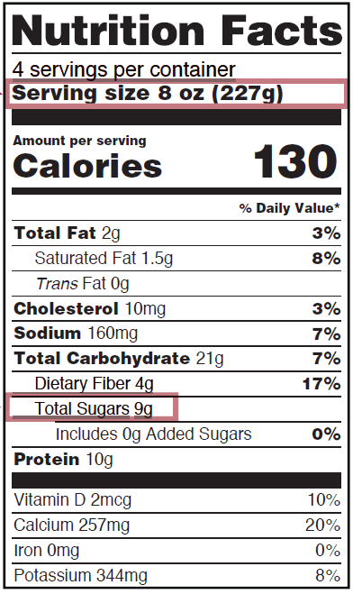
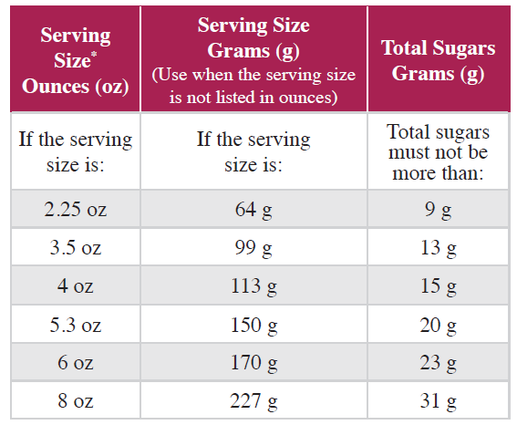
How Can I Tell if a Yogurt Has 23 Grams of Sugar or Less?
Let’s Practice!
Find Serving Size in grams (g).
Find amount of Total Sugars in grams (g).
Use the table in the training worksheet to find the allowable sugar amount.
Notes:
Use Team Nutrition’s training worksheet, Choose Yogurts That Are Lower in Sugar. This training worksheet can be found at TeamNutrition.USDA.gov. The steps you can use to determine if a yogurt has 23 grams of sugar or less per 6 ounces are very similar to those you used to determine the sugars in the ready-to-eat cereal example. You can use the table on the worksheet to compare the serving size in ounces (or grams) to the amount of sugar in grams.
Let’s walk through the steps on this worksheet together:
Use the Nutrition Facts label to find the Serving Size, in ounces, of the yogurt.
Find the Total Sugars line. Look at the number of grams (g) next to Total Sugars.
Use the serving size identified in Step 1 to find the serving size of the yogurt in the table.
In the table, look at the number to the right of the serving size amount (the Total Sugars column). If the yogurt has that amount of sugar, or less, then the yogurt meets the sugar requirement.
So, does the yogurt on the worksheet meet the CACFP sugar limit?
Trainer Note: Walk through the steps again if needed.
Answer: The yogurt does meet the sugar limit. This yogurt has 9 grams of sugar per 8 ounces (227 grams). The maximum amount of sugar allowed in 8 ounces of yogurt is 31 grams. Nine is less than 31, so this yogurt is creditable.
Trainer Note: If time permits, and you have empty yogurt containers, have participants practice the steps using the Nutrition Facts labels on empty containers and the worksheet. You can do the activity in small groups or pairs. Distribute the empty containers and tell participants how much time they have to complete the activity. When time is up, ask each group or pair to share its findings.

Slide 8

Parent-Provided Meal Component
Parents can provide one creditable meal component to count toward a reimbursable meal or snack.
Parent: breastmilk or creditable iron-fortified infant formula
You: all other meal components
Parent: one creditable solid food
You: creditable iron-fortified infant formula
and
all other meal components
Notes:
Parents may bring in one creditable meal component for their baby that can count towards a reimbursable meal or snack in the CACFP. For the meal or snack to be reimbursable, the child care provider must offer the baby all of the other meal components.
For babies who are eating solid foods, there are two options to claim reimbursement:
If the parent provides breastmilk or a creditable infant formula for the baby, then the child care site must provide all other the meal components in order for the meal or snack to be reimbursable.
If the parent provides a creditable solid food for the baby, then the child care site must provide a creditable iron-fortified infant formula and all other solid meal components in order for the meal or snack to be reimbursable.
Trainer Note: This information was covered in Lesson 1.

Slide 9

Accommodating Special Dietary Needs
Food allergies or intolerances
Religious reasons
Look for substitutions within the same meal component.
Notes:
As a child care site participating in the CACFP, you must make substitutions to meals for babies with special dietary needs.
If the food you offer does not meet the needs of a baby with a disability due to special dietary needs, then another food item within the same meal component can be substituted by you or the parents. You should always try to find a substitution. However, if the baby's health care provider writes a medical statement that notes that the baby cannot eat any foods in a meal component, then you do not have to serve that meal component.
A parent may request a food substitution for a food allergy, food intolerance, or for religious reasons. Here are some examples.
Food allergy or intolerance: If a baby in your care cannot eat peaches, you can provide another fruit such as apples, pears, or bananas as part of the reimbursable meal.
Religious reasons: If parents do not want their baby to eat pork, then a different meat or meat alternate can replace the pork for that meal. In this case, the meal would still be reimbursable.
It is recommended to have a parent’s note and signature on file showing that this request was made. A medical statement is not needed.

Slide 10
Medical Statement
The medical statement must include the following:
Name of food(s) to be avoided,
Explanation of how the food(s) affects the baby, and
Signature of the baby’s health care provider on the form.
Recommendations for substitutions of foods can be included.
Keep the medical statement on file in a secure location at your child care site.
Notes:
If a substitution is due to a disability or special dietary need, the parent(s) must provide a medical statement from the baby’s health care provider.
The medical statement must include the following:
Name of the food(s) to be avoided,
Explanation of how the food(s) affects the baby, and
Signature of the baby's health care provider on the form.
Recommended substitutions of food(s) can be included on the medical statement.
Always keep the medical statement on file in a secure location at your child care site.

Slide 11


Communicating With Parents
Start a conversation!
For Parents: What Is Your Baby Eating? Let Us Know! (page 63)
For Parents: Varying Your Baby’s Veggies (page 88)
  TeamNutrition.USDA.gov
Notes:
Remember, communication tools are available in your Feeding Infants in the Child and Adult Care Food Program guide.
Handouts are a great way to start a conversation with parents about their baby. You can use:
For Parents: What Is Your Baby Eating? Let Us Know! on page 63 to find out what foods a baby is eating at home and also learn about any foods the baby cannot eat because of food allergies, intolerances, or religious reasons.
For Parents: Varying Your Baby’s Veggies on page 88 to encourage parents to keep offering vegetables to their baby at home. A food may need to be offered more than 10 times before the baby might like it.
Trainer Note: Tell participants the handouts are available for free download from the USDA Team Nutrition website at https://teamnutrition.usda.gov.

Slide 12
Summary
Refer to:
  Training Worksheet: Choose Breakfast Cereals That Are Lower in Sugar
    Training Worksheet: Choose Yogurts That Are Lower in Sugar
Parents can provide one creditable meal component.
Offer food substitutions for babies with special dietary needs.
Substitutions due to disability or special dietary needs require a signed medical statement.
Start a conversation!
  For Parents: What Is Your Baby Eating? Let Us Know! (page 63)
  For Parents: Varying Your Baby’s Veggies (page 88)
  TeamNutrition.USDA.gov
Notes:
Trainer Note: Review the key points in the lesson. Allow participants to ask questions.
There are sugar limits in the CACFP for ready-to-eat cereal and yogurt.
For a ready-to-eat cereal to be creditable, the amount of sugar must be no more than 6 grams of sugar per dry ounce of cereal.
Use the worksheet Choose Breakfast Cereals That Are Lower in Sugar to determine if a cereal meets the sugar limit.
For a yogurt to be creditable, the amount of sugar must be no more than 23 grams of sugar per 6 ounces.
Use the worksheet Choose Yogurts That Are Lower in Sugar to determine if a yogurt meets the sugar limit.
Parents can provide one creditable meal component to count towards a reimbursable meal or snack.
Operators participating in the CACFP must make substitutions to meals for babies with special dietary needs.
If a substitution is due to a disability or special dietary need, the parent(s) must provide a signed medical statement from the baby’s health care provider.
The medical statement must include:
Name of the food(s) to be avoided,
Explanation of how the food(s) affects the baby, and
Signature of the baby's health care provider on the form.
Start a conversation!
Use handouts to find out what foods a baby:
Is eating at home.
Cannot eat because of food allergies, intolerances, or religious reasons.
Encourage parents to keep offering vegetables to their baby at home. A food may need to be offered more than 10 times before the baby might like it.

Slide 13
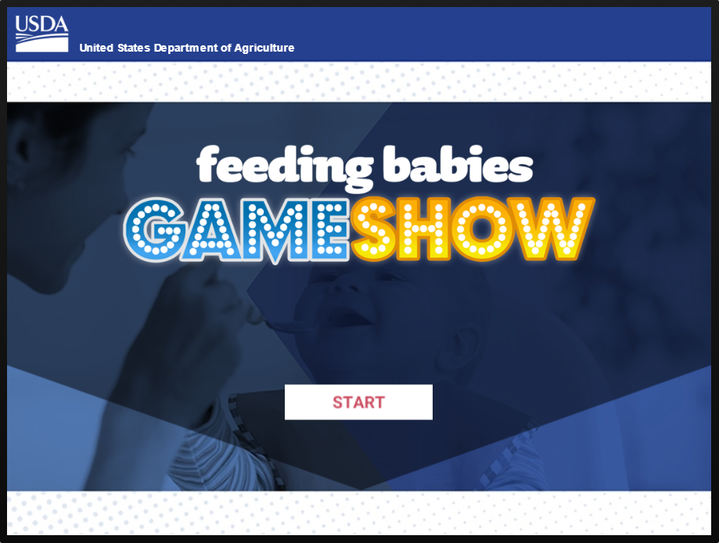
Feeding Babies Game Show
Notes:
Trainer Note: If your training included all 10 lessons, you can now play the Feeding Babies Game Show digital interactive game.
There are a few options for playing the game:
You can use your mouse to select the game on the slide or press “Enter” on your keyboard to start the game.
If you have an internet connection, you can play the game directly from the USDA Team Nutrition website at TeamNutrition.USDA.gov.
If you will not play the game, use your mouse to select any part of the screen outside of the game image. This will advance the slide to the first post-test question.
Trainer Note: The Feeding Babies Game Show digital interactive game can be played during any combination of lessons, but questions posed may not have been covered during the training. However, playing the game can be an opportunity for participants to become familiar with the Feeding Infants in the Child and Adult Care Food Program guide by encouraging them to find the answers to the questions in the guide.

Slide 14
Post-Test #1
1
Yes or No?
The ready-to-eat cereal you are serving at snack contains 8 grams of sugar per dry ounce. Is this cereal creditable as part of a reimbursable snack for infants?
No
Notes:
Yes or No?
The ready-to-eat cereal you are serving at snack contains 8 grams of sugar per dry ounce. Is this cereal creditable as part of a reimbursable snack for infants?
Answer: No
Trainer Note: You can conduct the post-test as a group activity or distribute a paper test. There are three question slides.
For a group activity, ask participants what they think the answer is for each question. Allow time for multiple responses before you give the answer.
To reveal the answer, click your mouse or press the “Enter” key on your keyboard.
For paper-based testing, distribute the post-test and pencils. Tell participants how much time they have to complete the assessment.
After you have collected the tests, you can show participants the answers.
If you will not administer the test, skip the slide.

Slide 15
Post-Test #2
2
Yes or No?
The yogurt you are serving at lunch contains 24 grams of sugar per 6 ounces. Is this yogurt creditable?
No
Notes:
Yes or No?
The yogurt you are serving at lunch contains 24 grams of sugar per 6 ounces. Is this yogurt creditable?
Answer: No
Trainer Note: Click your mouse or press the “Enter” key on your keyboard to reveal the answer.

Slide 16
Post-Test #3
3
A parent wants to provide food for her baby while the baby is at your child care site. How many meal components can the parent provide that you can claim as part of a reimbursable meal?
1 creditable meal component
2 creditable meal components
3 creditable meal components
4 creditable meal components
A parent wants to provide food for her baby while the baby is at your child care site. How many meal components can the parent provide that you can claim as part of a reimbursable meal?
1 creditable meal component
2 creditable meal components
3 creditable meal components
4 creditable meal components
Notes:
A parent wants to provide food for her baby while the baby is at your child care site. How many meal components can the parent provide that you can claim as part of a reimbursable meal?
1 creditable meal component
2 creditable meal components
3 creditable meal components
4 creditable meal components
Answer: A
Trainer Note: Click your mouse or press the “Enter” key on your keyboard to reveal the answer.

Slide 17




Presentation End
To learn more about the CACFP
or access materials, visit:
TeamNutrition.USDA.gov
In accordance with Federal civil rights law and U.S. Department of Agriculture (USDA) civil rights regulations and policies, the USDA, its Agencies, offices, and employees, and institutions participating in or administering USDA programs are prohibited from discriminating based on race, color, national origin, religion, sex, gender identity (including gender expression), sexual orientation, disability, age, marital status, family/parental status, income derived from a public assistance program, political beliefs, or reprisal or retaliation for prior civil rights activity, in any program or activity conducted or funded by USDA (not all bases apply to all programs). Remedies and complaint filing deadlines vary by program or incident.
Persons with disabilities who require alternative means of communication for program information (e.g., Braille, large print, audiotape, American Sign Language, etc.) should contact the responsible Agency or USDA’s TARGET Center at (202) 720-2600 (voice and TTY) or contact USDA through the Federal Relay Service at (800) 877-8339. Additionally, program information may be made available in languages other than English.
To file a program discrimination complaint, complete the USDA Program Discrimination Complaint Form, AD-3027, found online at http://www.ascr.usda.gov/complaint_filing_cust.htmland at any USDA office or write a letter addressed to USDA and provide in the letter all of the information requested in the form. To request a copy of the complaint form, call (866) 632-9992. Submit your completed form or letter to USDA by: (1) mail: U.S. Department of Agriculture, Office of the Assistant Secretary for Civil Rights, 1400 Independence Avenue, SW, Washington, D.C. 20250-9410; (2) fax: (202) 690-7442; or (3) email: program.intake@usda.gov.
USDA is an equal opportunity provider, employer, and lender.
United States Department of Agriculture – Food and Nutrition Service – November 2019 – Slightly Revised April 2024 – FNS-785

