Slide 1
Crediting Single-Serving Packages of Grains in the CACFP
A Training Presentation for
Child and Adult Care Food
Program (CACFP) Operators

Slide 2



USDA’s Team Nutrition
An initiative of the USDA’s Food and Nutrition Service to support the USDA’s Child Nutrition Programs.
Aims to improve children’s lifelong eating and physical activity habits.
Provides nutrition education and training materials to State agencies, sponsoring organizations, and CACFP sites.
TeamNutrition.usda.gov
@TeamNutrition
Notes:
Team Nutrition is an initiative of the USDA Food and Nutrition Service that supports the Child Nutrition Programs, including the National School Lunch Program, the School Breakfast Program, and of course, the Child and Adult Care Food Program, or the CACFP.
It does so through training and technical assistance for those preparing and serving meals, providing nutrition education for children, and building support for healthier school and child care environments.

Slide 3
Let Us Know Who You Are!
I work for a…
?
Child care center
Family child care home
At-risk afterschool care center
Adult day care center
Sponsoring organization
Emergency shelter
School food authority
State agency
USDA Regional Office
Other
Notes:
Before we get started, I want to know who has joined us today.
Please raise your hand if you work for:
a child care center [pause and wait for a show of hands],
a family child care home [pause and wait for a show of hands],
an at-risk afterschool care center [pause and wait for a show of hands],
an adult day care center [pause and wait for a show of hands],
a sponsoring organization [pause and wait for a show of hands],
an emergency shelter [pause and wait for a show of hands],
a school food authority [pause and wait for a show of hands],
a State agency [pause and wait for a show of hands],
A USDA Regional office [pause and wait for a show of hands], or
other [pause and wait for a show of hands].

Slide 4
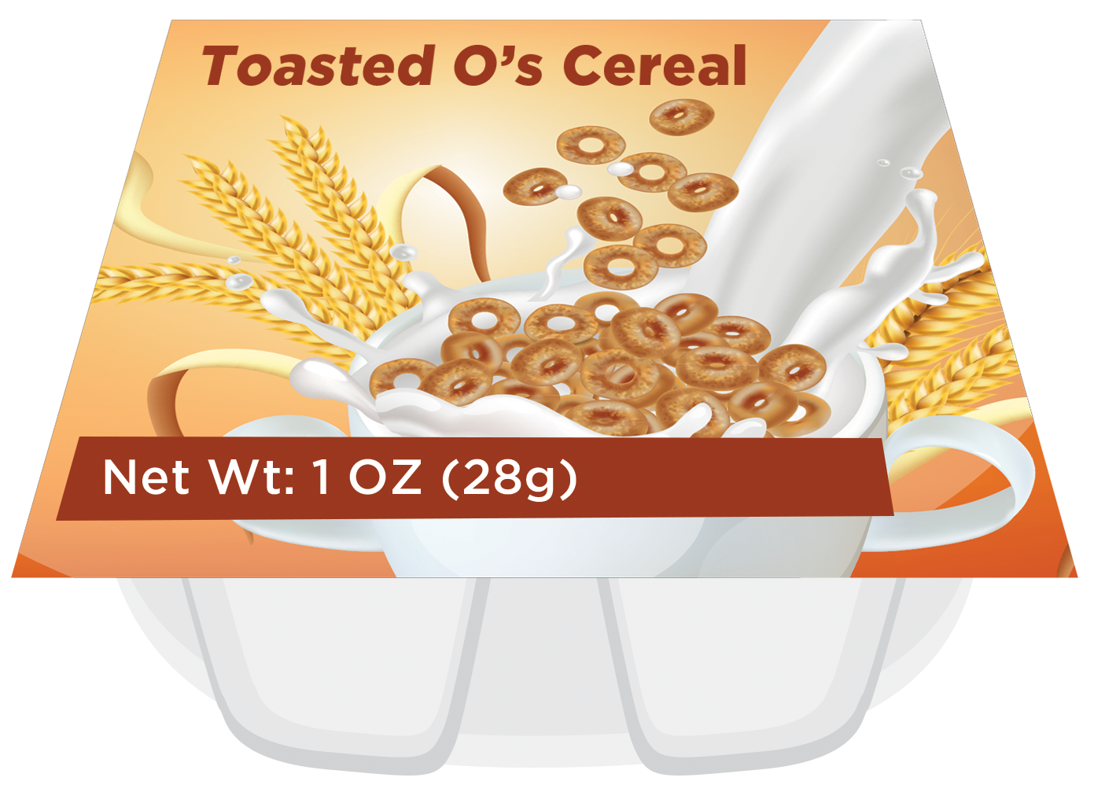
How Much is One Oz Eq of Grains?
0.8 ounce (22 grams)
of Cheese Crackers
2 ounces (55 grams)
of Blueberry Muffin
1 ounce (28 grams)
of Toasted O's Cereal
= 1 oz eq of grains
= 1 oz eq of grains
= 1 oz eq of grains
1 ounce equivalent (oz eq) = 16 grams of grains
Notes:
So, let’s get started! As many of you might know, as of October 1, 2021, amounts of grains at CACFP meals and snacks must be measured using a unit of measure known as “ounce equivalents (oz eq).”
During the COVID-19 public health emergency, some State agencies may have opted into School Year 2021-2022 meal pattern waivers. Additional information on these waivers is available at: https://www.fns.usda.gov/disaster/pandemic/cn-2021-22-waivers-and-flexibilities.
One ounce equivalent of grains is the amount of food you need to provide 16 grams of grains. Not all grain items contain the same amount of grain per item, so you might need more, or less, of a grain item to get 16 grams of grains. For example, 0.8 ounces of savory crackers, such as cheese crackers, or whole-wheat crackers, contain 16 grams of grains. So, you need to serve a package of crackers that weighs 0.8 ounces in order to provide 1 ounce equivalent of grains.
However, it takes 1 ounce of Toasted O’s cereal to provide 16 grams of grains. So, you need to serve a package of Toasted O’s cereal that weighs 1 ounce in order to provide 1 ounce equivalent of grains.
It takes 2 ounces of a blueberry muffin to provide 16 grams of grains. So, your package of blueberry muffins needs to weigh 2 ounces in order to provide 1 ounce equivalent of grains.

Slide 5
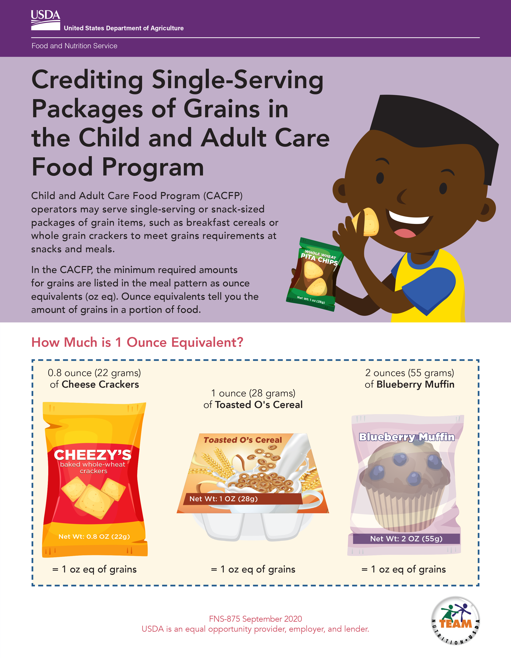
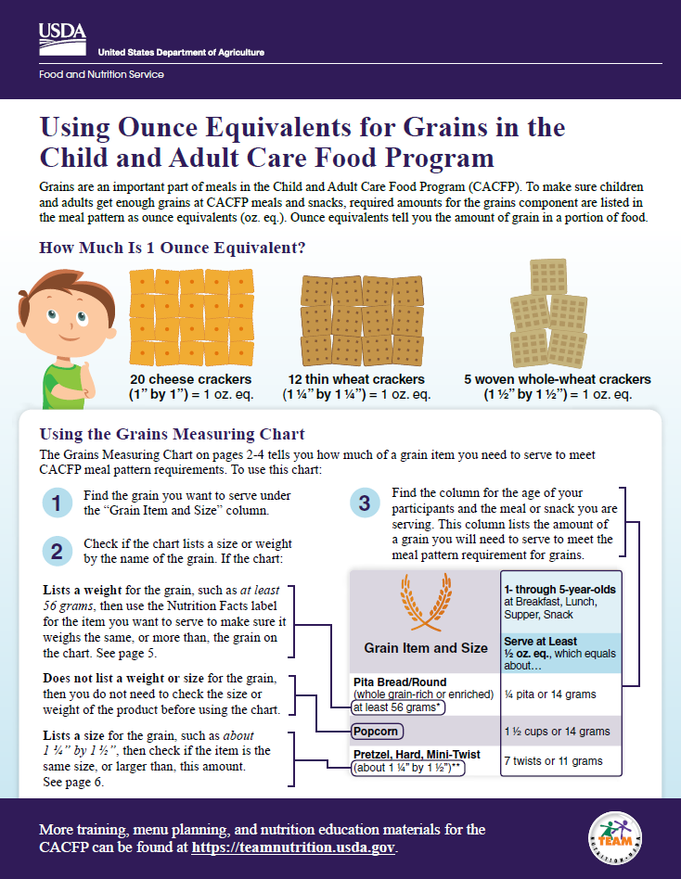
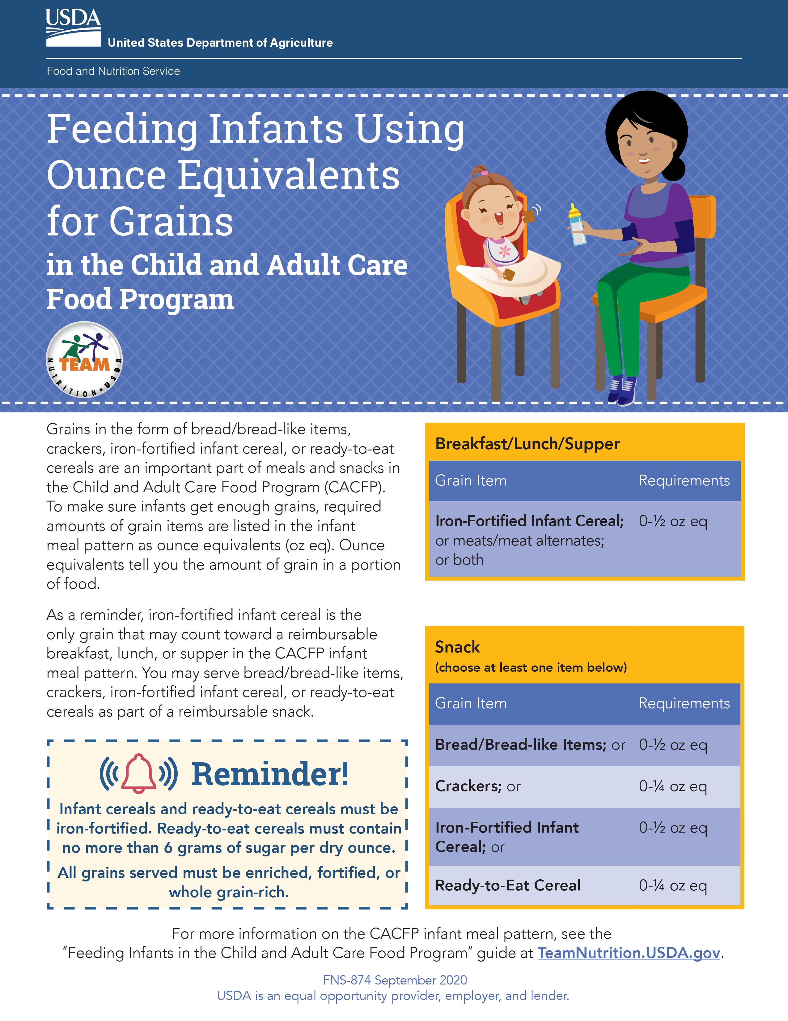
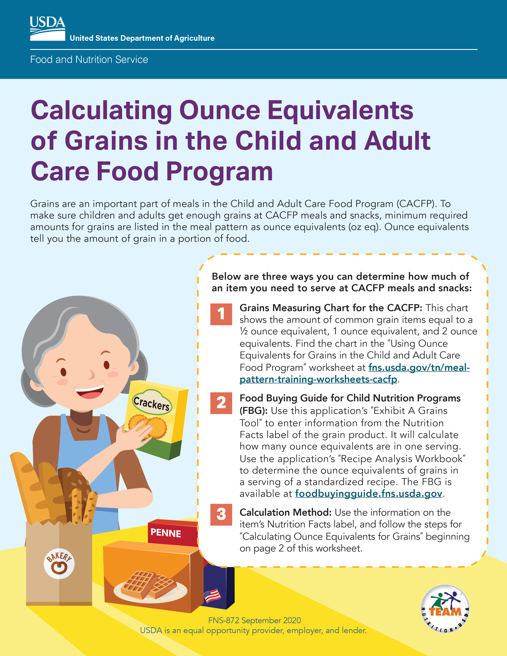
Team Nutrition Grains Oz Eq Resources
Notes:
Today we will talk about how to meet minimum ounce equivalents requirements when serving single-serving packages of grains in the CACFP. The USDA’s Team Nutrition initiative has created a training worksheet on this topic called, “Crediting Single-Serving Packages of Grains in the CACFP.” This worksheet is shown on the left of your slide. This worksheet is for CACFP operators who want to serve single-serving, or individually wrapped, packages of grains as part of a reimbursable CACFP meal or snack. These packages may also be commonly known as “snack packs."
Team Nutrition does have other worksheets to show how grain items that are not sold as single-serving packages can be used to meet minimum grains ounce equivalents requirements in the CACFP. You can see these worksheets on the right side of the slide, and we will show you how to find these worksheets and other tools at the end of today’s presentation.

Slide 6
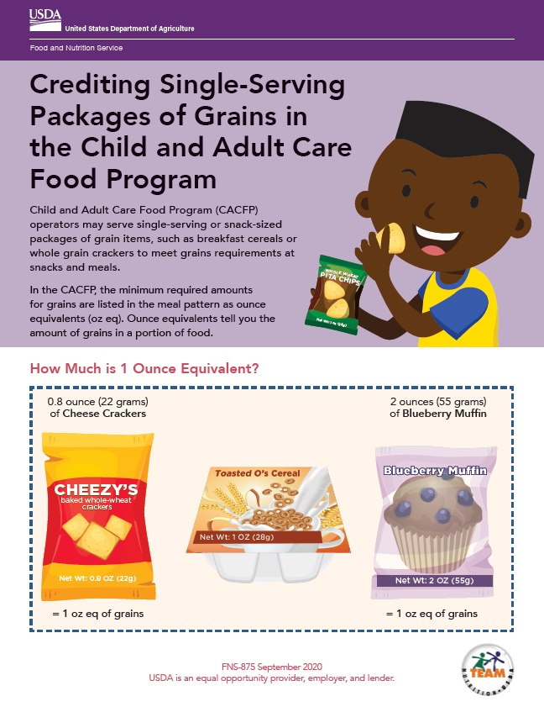

Crediting Single-Serving Packages of Grains in the CACFP
fns.usda.gov/tn/crediting-single-serving-packages-grains-cacfp
Notes:
Let’s take a closer look at the “Crediting Single-Serving Packages of Grains in the CACFP” worksheet. You can download the worksheet from the web address on the slide, if you’d like. You can also download the worksheet by scanning the QR code on the screen. To do this, open the camera or QR code reader on your smartphone if you have one and point your device at the QR code on the screen to scan. It will then either take you directly to the worksheet webpage or ask you to click the pop-up notification to take you to the worksheet webpage. Click the pop-up notification, if one appears, and you should be taken to the worksheet.
Or, you can also just follow along with the pictures shown on the slides.
The first page of this worksheet starts out with an explanation and examples of amounts of grain items you need to make up 1 ounce equivalent of grains.

Slide 7
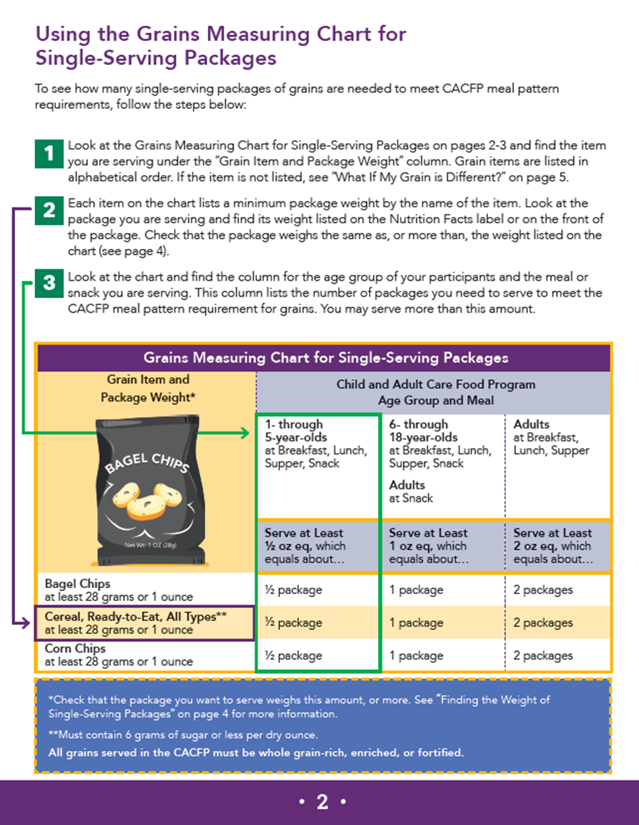
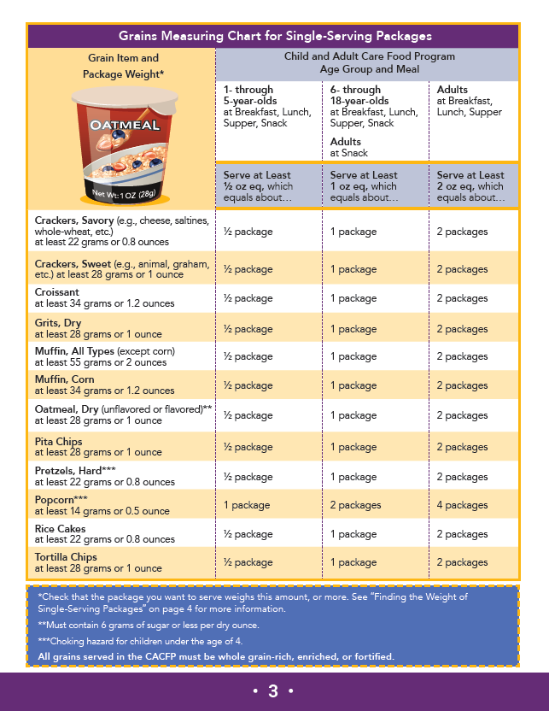
Crediting Single-Serving Packages of Grains in the CACFP continued
fns.usda.gov/tn/crediting-single-serving-packages-grains-cacfp
Notes:
Pages 2 and 3 of the worksheet includes the Grains Measuring Chart for Single Serving Packages, which we will refer to as the “Grains Measuring Chart” for the rest of this presentation.

Slide 8
Grains Measuring Chart for Single-Serving Packages
Child and Adult Care Food Program
Age Group and Meal
Grain Item and Package Weight* | Child and Adult Care Food Program Age Group and Meal | Child and Adult Care Food Program Age Group and Meal | Child and Adult Care Food Program Age Group and Meal
 | 1- through 5-year-olds at Breakfast, Lunch, Supper, Snack | 6- through 18-year-olds at Breakfast, Lunch, Supper, Snack Adults at Snack | Adults at Breakfast, Lunch, Supper
 | Serve at Least ½ oz eq, which equals about… | Serve at Least 1 oz eq, which equals about… | Serve at Least 2 oz eq, which equals about…
Crackers, Savory (e.g., cheese, saltines, whole-wheat, etc.) at least 22 grams or 0.8 ounces | ½ package | 1 package | 2 packages
Crackers, Sweet (e.g., animal, graham, etc.) at least 28 grams or 1 ounce | ½ package | 1 package | 2 packages
Croissant at least 34 grams or 1.2 ounces | ½ package | 1 package | 2 packages
Grits, Dry at least 28 grams or 1 ounce | ½ package | 1 package | 2 packages
Muffin, All Types (except corn) at least 55 grams or 2 ounces | ½ package | 1 package | 2 packages
Muffin, Corn at least 34 grams or 1.2 ounces | ½ package | 1 package | 2 packages
Oatmeal, Dry (unflavored or flavored)** at least 28 grams or 1 ounce | ½ package | 1 package | 2 packages
Notes:
The Grains Measuring Chart contains grain items that might commonly be served as single-serving packages at CACFP meals and snacks. This includes single-serving boxes or bowls of cereal, individually wrapped
muffins, snack-sized bags of pretzels, popcorn and more. Items are listed in alphabetical order.

Slide 9
Grains Measuring Chart for Single-Serving Packages Continued
Child and Adult Care Food Program
Age Group and Meal
Grain Item and Package Weight* | Child and Adult Care Food Program Age Group and Meal | Child and Adult Care Food Program Age Group and Meal | Child and Adult Care Food Program Age Group and Meal
 | 1- through 5-year-olds at Breakfast, Lunch, Supper, Snack | 6- through 18-year-olds at Breakfast, Lunch, Supper, Snack Adults at Snack | Adults at Breakfast, Lunch, Supper
 | Serve at Least ½ oz eq, which equals about… | Serve at Least 1 oz eq, which equals about… | Serve at Least 2 oz eq, which equals about…
Crackers, Savory (e.g., cheese, saltines, whole-wheat, etc.) at least 22 grams or 0.8 ounces | ½ package | 1 package | 2 packages
Crackers, Sweet (e.g., animal, graham, etc.) at least 28 grams or 1 ounce | ½ package | 1 package | 2 packages
Croissant at least 34 grams or 1.2 ounces | ½ package | 1 package | 2 packages
Grits, Dry at least 28 grams or 1 ounce | ½ package | 1 package | 2 packages
Muffin, All Types (except corn) at least 55 grams or 2 ounces | ½ package | 1 package | 2 packages
Muffin, Corn at least 34 grams or 1.2 ounces | ½ package | 1 package | 2 packages
Oatmeal, Dry (unflavored or flavored)** at least 28 grams or 1 ounce | ½ package | 1 package | 2 packages
Notes:
Next to the list of grain items, you will find the number of packages needed for a ½ ounce equivalent of grains, which is the minimum amount of grains required at meals and snacks for children ages 1 through 5 years old.

Slide 10
Grains Measuring Chart for Single-Serving Packages Continued
Child and Adult Care Food Program
Age Group and Meal
Grain Item and Package Weight* | Child and Adult Care Food Program Age Group and Meal | Child and Adult Care Food Program Age Group and Meal | Child and Adult Care Food Program Age Group and Meal
 | 1- through 5-year-olds at Breakfast, Lunch, Supper, Snack | 6- through 18-year-olds at Breakfast, Lunch, Supper, Snack Adults at Snack | Adults at Breakfast, Lunch, Supper
 | Serve at Least ½ oz eq, which equals about… | Serve at Least 1 oz eq, which equals about… | Serve at Least 2 oz eq, which equals about…
Crackers, Savory (e.g., cheese, saltines, whole-wheat, etc.) at least 22 grams or 0.8 ounces | ½ package | 1 package | 2 packages
Crackers, Sweet (e.g., animal, graham, etc.) at least 28 grams or 1 ounce | ½ package | 1 package | 2 packages
Croissant at least 34 grams or 1.2 ounces | ½ package | 1 package | 2 packages
Grits, Dry at least 28 grams or 1 ounce | ½ package | 1 package | 2 packages
Muffin, All Types (except corn) at least 55 grams or 2 ounces | ½ package | 1 package | 2 packages
Muffin, Corn at least 34 grams or 1.2 ounces | ½ package | 1 package | 2 packages
Oatmeal, Dry (unflavored or flavored)** at least 28 grams or 1 ounce | ½ package | 1 package | 2 packages
Notes:
The chart also shows the number of packages you need to serve 1 oz eq of grains, which is the minimum amount of grains required for 6- through 18-year-olds at all CACFP meals and snacks. If you are serving grains to adult participants as part of a reimbursable snack, you must serve at least 1 oz eq of grains as well.

Slide 11
Grains Measuring Chart for Single-Serving Packages Continued
Child and Adult Care Food Program
Age Group and Meal
Grain Item and Package Weight* | Child and Adult Care Food Program Age Group and Meal | Child and Adult Care Food Program Age Group and Meal | Child and Adult Care Food Program Age Group and Meal
 | 1- through 5-year-olds at Breakfast, Lunch, Supper, Snack | 6- through 18-year-olds at Breakfast, Lunch, Supper, Snack Adults at Snack | Adults at Breakfast, Lunch, Supper
 | Serve at Least ½ oz eq, which equals about… | Serve at Least 1 oz eq, which equals about… | Serve at Least 2 oz eq, which equals about…
Crackers, Savory (e.g., cheese, saltines, whole-wheat, etc.) at least 22 grams or 0.8 ounces | ½ package | 1 package | 2 packages
Crackers, Sweet (e.g., animal, graham, etc.) at least 28 grams or 1 ounce | ½ package | 1 package | 2 packages
Croissant at least 34 grams or 1.2 ounces | ½ package | 1 package | 2 packages
Grits, Dry at least 28 grams or 1 ounce | ½ package | 1 package | 2 packages
Muffin, All Types (except corn) at least 55 grams or 2 ounces | ½ package | 1 package | 2 packages
Muffin, Corn at least 34 grams or 1.2 ounces | ½ package | 1 package | 2 packages
Oatmeal, Dry (unflavored or flavored)** at least 28 grams or 1 ounce | ½ package | 1 package | 2 packages
Notes:
For adult participants at breakfast, lunch, and supper, the minimum grains requirement is 2 oz eq of grains. This is also shown on the chart.

Slide 12
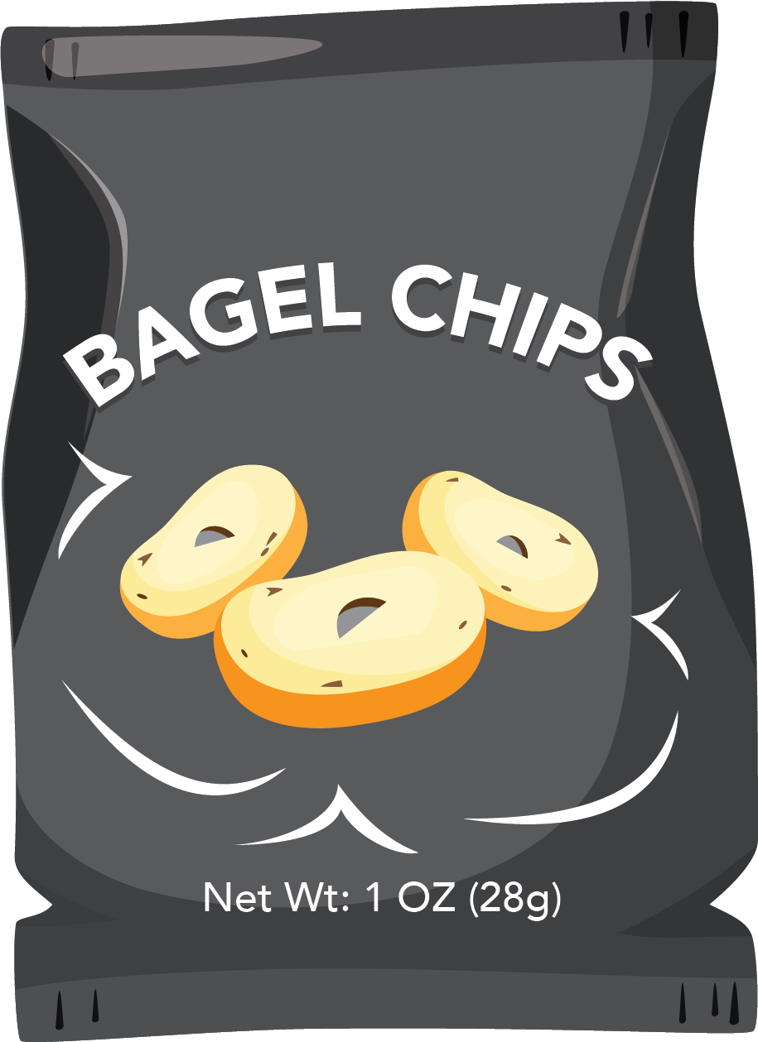
Grains Measuring Chart for Single-Serving Packages on page 2
1
Look at the Grains Measuring Chart for Single-Serving Packages on pages 2-3 and find the item you are serving under the “Grain Item and Package Weight” column. Grain items are listed in alphabetical order. If the item is not listed, see “What If My Grain is Different?” on page 5.
2
Each item on the chart lists a minimum package weight by the name of the item. Look at the package you are serving and find its weight listed on the Nutrition Facts label or on the front of the package. Check that the package weighs the same as, or more than, the weight listed on the chart (see page 4).
3
Look at the chart and find the column for the age group of your participants and the meal or snack you are serving. This column lists the number of packages you need to serve to meet the CACFP meal pattern requirement for grains. You may serve more than this amount.
Grains Measuring Chart for Single-Serving Packages
Grain Item and Package Weight* | Child and Adult Care Food Program Age Group and Meal | Child and Adult Care Food Program Age Group and Meal | Child and Adult Care Food Program Age Group and Meal
 | 1- through 5-year-olds at Breakfast, Lunch, Supper, Snack | 6- through 18-year-olds at Breakfast, Lunch, Supper, Snack Adults at Snack | Adults at Breakfast, Lunch, Supper
 | Serve at Least ½ oz eq, which equals about… | Serve at Least 1 oz eq, which equals about… | Serve at Least 2 oz eq, which equals about…
Bagel Chips at least 28 grams or 1 ounce | ½ package | 1 package | 2 packages
Cereal, Ready-to-Eat, All Types** at least 28 grams or 1 ounce | ½ package | 1 package | 2 packages
Child and Adult Care Food Program
Age Group and Meal
Notes:
Instructions on how to use these charts are on page 2 of the worksheet, so let’s take a closer look at those instructions now.

Slide 13
Look at the Grains Measuring Chart and find the item to serve under the “Grain Item and Package Weight” column.
Step
1
Grains Measuring Chart for Single-Serving Packages
Grain Item and Package Weight* | Child and Adult Care Food Program Age Group and Meal | Child and Adult Care Food Program Age Group and Meal | Child and Adult Care Food Program Age Group and Meal
 | 1- through 5-year-olds at Breakfast, Lunch, Supper, Snack | 6- through 18-year-olds at Breakfast, Lunch, Supper, Snack Adults at Snack | Adults at Breakfast, Lunch, Supper
 | Serve at Least ½ oz eq, which equals about… | Serve at Least 1 oz eq, which equals about… | Serve at Least 2 oz eq, which equals about…
Bagel Chips at least 28 grams or 1 ounce | ½ package | 1 package | 2 packages
Cereal, Ready-to-Eat, All Types** at least 28 grams or 1 ounce | ½ package | 1 package | 2 packages
Corn Chips at least 28 grams or 1 ounce | ½ package | 1 package | 2 packages
Child and Adult Care Food Program
Age Group and Meal
Notes:
The first step is to find the item under the “Grain Item and Package Weight” column. This column is outlined in purple on the slide.

Slide 14
Look at the Grains Measuring Chart and find the item to serve under the “Grain Item and Package Weight” column.
Step
1
Grains Measuring Chart for Single-Serving Packages
Grain Item and Package Weight* | Child and Adult Care Food Program Age Group and Meal | Child and Adult Care Food Program Age Group and Meal | Child and Adult Care Food Program Age Group and Meal
 | 1- through 5-year-olds at Breakfast, Lunch, Supper, Snack | 6- through 18-year-olds at Breakfast, Lunch, Supper, Snack Adults at Snack | Adults at Breakfast, Lunch, Supper
 | Serve at Least ½ oz eq, which equals about… | Serve at Least 1 oz eq, which equals about… | Serve at Least 2 oz eq, which equals about…
Bagel Chips at least 28 grams or 1 ounce | ½ package | 1 package | 2 packages
Cereal, Ready-to-Eat, All Types** at least 28 grams or 1 ounce | ½ package | 1 package | 2 packages
Corn Chips at least 28 grams or 1 ounce | ½ package | 1 package | 2 packages
Child and Adult Care Food Program
Age Group and Meal
Notes:
So, for example, lets say we want to serve ready-to-eat cereal, such as toasted O’s cereal. We would find “Cereal, Ready to Eat, All Types” in the chart. This is outlined in purple on the slide.

Slide 15
Each item on the chart lists a minimum package weight by the name of the item.
Step
2
Grains Measuring Chart for Single-Serving Packages
Grain Item and Package Weight* | Child and Adult Care Food Program Age Group and Meal | Child and Adult Care Food Program Age Group and Meal | Child and Adult Care Food Program Age Group and Meal
 | 1- through 5-year-olds at Breakfast, Lunch, Supper, Snack | 6- through 18-year-olds at Breakfast, Lunch, Supper, Snack Adults at Snack | Adults at Breakfast, Lunch, Supper
 | Serve at Least ½ oz eq, which equals about… | Serve at Least 1 oz eq, which equals about… | Serve at Least 2 oz eq, which equals about…
Bagel Chips at least 28 grams or 1 ounce | ½ package | 1 package | 2 packages
Cereal, Ready-to-Eat, All Types** at least 28 grams or 1 ounce | ½ package | 1 package | 2 packages
Corn Chips at least 28 grams or 1 ounce | ½ package | 1 package | 2 packages
Child and Adult Care Food Program
Age Group and Meal
Notes:
Step 2 mentions that each item on the chart lists a minimum package weight by the name of the item. For ready-to-eat cereal, the minimum weight is 28 grams or 1 ounce, as shown in the purple rectangle.
This means that the package of cereal we want to serve needs to weigh at least 28 grams or 1 ounce, in order for us to use this chart. So, let’s take a look at the cereal we want to serve and see if there is a weight written on the package.

Slide 16
(continued): Look at the package you are serving and find its weight on the Nutrition Facts label or front of the package.
Step
2
Notes:
To do that, we can look at the front or top of the package—most of the time, this is where you will find the weight of the package. Here, we see that this package of cereal weighs 1 ounce or 28 grams. This is circled in purple.

Slide 17
(continued): Look at the package you are serving and find its weight on the Nutrition Facts label or front of the package.
Step
2
Bagel Chips
at least 28 grams or 1 ounce
Cereal, Ready-to-Eat, All Types**
at least 28 grams or 1 ounce
Corn Chips
at least 28 grams or 1 ounce
Notes:
Now that we know the weight of our package, we can compare it to the minimum weight written in the Grains Measuring Chart.
This package of cereal weighs 1 ounce, or 28 grams. The Grains Measuring Chart says the package of cereal must weigh at least 28 grams or 1 ounce in order to use the Grains Measuring Chart.
Because this package of cereal is the same weight as the weight on the chart, this means we can use the Grains Measuring Chart to determine how many packages to serve at CACFP meals and snacks.
Let’s do that now.

Slide 18
Look at the chart and find the column for the age group of your participants and the meal or snack you are serving.
Step
3
Grains Measuring Chart for Single-Serving Packages
Grain Item and Package Weight* | Child and Adult Care Food Program Age Group and Meal | Child and Adult Care Food Program Age Group and Meal | Child and Adult Care Food Program Age Group and Meal
 | 1- through 5-year-olds at Breakfast, Lunch, Supper, Snack | 6- through 18-year-olds at Breakfast, Lunch, Supper, Snack Adults at Snack | Adults at Breakfast, Lunch, Supper
 | Serve at Least ½ oz eq, which equals about… | Serve at Least 1 oz eq, which equals about… | Serve at Least 2 oz eq, which equals about…
Bagel Chips at least 28 grams or 1 ounce | ½ package | 1 package | 2 packages
Cereal, Ready-to-Eat, All Types** at least 28 grams or 1 ounce | ½ package | 1 package | 2 packages
Corn Chips at least 28 grams or 1 ounce | ½ package | 1 package | 2 packages
Child and Adult Care Food Program
Age Group and Meal
Notes:
In order to see how much to serve, we look at Step 3. Step 3 asks us to find the column for the age group of the participants and the meal or snack you are serving.
Let’s say we want to serve this cereal at breakfast to 4-year-olds. We would find the column for 1- through 5-year-olds, which is outlined in purple on the slide in front of you. Where this column intersects with, or meets, the “Cereal” row, that tells us that we need to serve at least ½ of this package to each 4-year-old in order to meet minimum requirements in the CACFP.
Remember that ½ a package is the minimum, so you can definitely serve the entire package to the 4-year-old as well. Some sponsoring organizations and providers will often split up packages of single-serving grains and serve one package to more than one child.

Slide 19
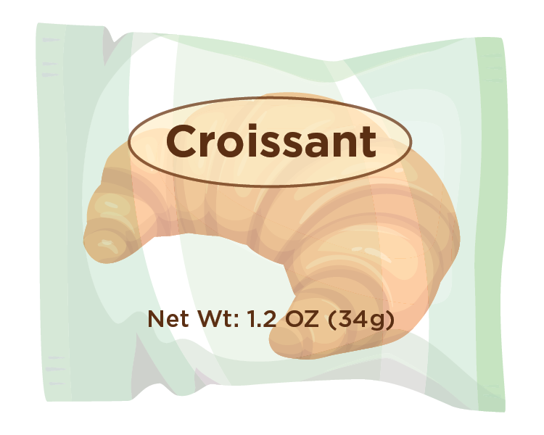
Try It Out!
You want to serve croissants at breakfast to 3-year-olds at your child care center. You find packages of
Brand C croissants.
Look at the package and find where the weight of the package is written.
?
Can you use the Grains Measuring Chart to determine how many packages of Brand C croissants to serve?
Yes
No
Brand C Croissant
Crackers, Sweet (e.g., animal, graham,
etc.) at least 28 grams or 1 ounce
Croissant
at least 34 grams or 1.2 ounces
Grits, Dry
at least 28 grams or 1 ounce
Muffin, All Types (except corn)
at least 55 grams or 2 ounces
Muffin, Corn
at least 34 grams or 1.2 ounces
Notes:
Let’s practice using the Grains Measuring Chart with this practice question now.
Take a look at the Grains Measuring Chart on the slide. Let’s say you want to serve croissants at breakfast to 3-year-olds at your child care center. You find packages of Brand C croissants, which are shown on the slide.
Look at the package and find where the weight of the package is written.
Can you use the Grains Measuring Chart to determine how many packages of Brand C croissants to serve? You can look at the Grains Measuring Chart on pages 2-3 of the worksheet, or look at the information on the slide.
Raise your hand if you think, “Yes, you can use the Grains Measuring Chart to determine how many packages of Brand C Croissants to serve” [pause and wait for a show of hands].
Raise your hand if you think, “No, you cannot use Grains Measuring Chart to determine how many packages of Brand C Croissants to serve” [pause and wait for a show of hands].

Slide 20
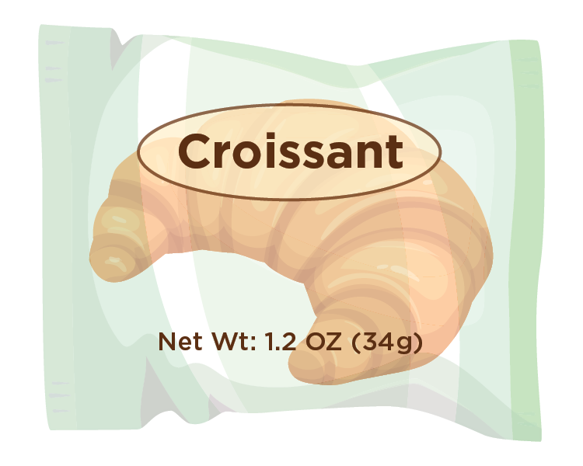
Answer
Yes, you can use the Grains Measuring Chart to determine how many packages of Brand C croissants to serve.
Look at the package and find where the weight of the package is written.
?
Can you use the Grains Measuring Chart to determine how many packages of Brand C croissants to serve?
✓
Yes
No
Brand C Croissant
Crackers, Sweet (e.g., animal, graham,
etc.) at least 28 grams or 1 ounce
Croissant
at least 34 grams or 1.2 ounces
Grits, Dry
at least 28 grams or 1 ounce
Muffin, All Types (except corn)
at least 55 grams or 2 ounces
Muffin, Corn
at least 34 grams or 1.2 ounces
Notes:
The answer is Yes! You can use the Grains Measuring Chart to determine how many packages of Brand C croissants to serve. To get this answer, first we find “Croissant” in the Grains Measuring Chart. Croissants are listed on the chart, on page 3 of the worksheet. This is also shown on the right side of the slide. Under “Croissant,” the minimum weight of “at least 34 grams or 1.2 ounces” is listed. This tells us that packages of croissants need to weigh at least 34 grams or 1.2 ounces in order to use the Grains Measuring Chart.
Now, let’s look at the front of the croissant package in the middle of the slide. The front of the package shows us that each package weighs 1.2 oz, or 34 grams. This package weighs the same amount as the weight in the chart, so now we know we can use the Grains Measuring Chart to see how many packages to serve.

Slide 21
Try It Out!
How many packages of Brand C croissants do you need to serve to meet grains requirements for
3-year-olds at breakfast?
?
Brand C Croissant
 | 1- through 5-year-olds at Breakfast, Lunch, Supper, Snack | 6- through 18-year-olds at Breakfast, Lunch, Supper, Snack Adults at Snack | Adults at Breakfast, Lunch, Supper
 | Serve at Least ½ oz eq, which equals about… | Serve at Least 1 oz eq, which equals about… | Serve at Least 2 oz eq, which equals about…
Crackers, Savory (e.g., cheese, saltines, whole-wheat, etc.) at least 22 grams or 0.8 ounces | ½ package | 1 package | 2 packages
Crackers, Sweet (e.g., animal, graham, etc.) at least 28 grams or 1 ounce | ½ package | 1 package | 2 packages
Croissant at least 34 grams or 1.2 ounces | ½ package | 1 package | 2 packages
¼ package
½ package
1.2 packages
2 packages
Notes:
Now that we know we can use the Grains Measuring Chart to figure out how many Brand C croissants to serve, let’s do another practice question. Take a look at your Grains Measuring Chart, and tell me how many packages of Brand C croissants you need to serve in order to meet the grains requirement for 3-year-olds at breakfast. Croissants are listed in the Grains Measuring Chart on page 3 of the worksheet.
Raise your hand if you think you need to serve at least:
¼ package [pause and wait for a show of hands],
½ package [pause and wait for a show of hands],
1.2 packages [pause and wait for a show of hands], or
2 packages [pause and wait for a show of hands].

Slide 22
Answer
How many packages of Brand C croissants do you need to serve to meet grains requirements for
3-year-olds at breakfast?
?
Brand C Croissant
¼ package
½ package
1.2 packages
2 packages
✓
Notes:
Nice work, everyone! The answer is ½ package! You need to serve at least ½ package of Brand C croissants to meet grains requirements for 3-year-olds at breakfast. Let’s take a look at how we got that answer.

Slide 23
Grains Measuring Chart for Single-Serving Packages
Grain Item and Package Weight* | Child and Adult Care Food Program Age Group and Meal | Child and Adult Care Food Program Age Group and Meal | Child and Adult Care Food Program Age Group and Meal
 | 1- through 5-year-olds at Breakfast, Lunch, Supper, Snack | 6- through 18-year-olds at Breakfast, Lunch, Supper, Snack Adults at Snack | Adults at Breakfast, Lunch, Supper
 | Serve at Least ½ oz eq, which equals about… | Serve at Least 1 oz eq, which equals about… | Serve at Least 2 oz eq, which equals about…
Crackers, Savory (e.g., cheese, saltines, whole-wheat, etc.) at least 22 grams or 0.8 ounces | ½ package | 1 package | 2 packages
Crackers, Sweet (e.g., animal, graham, etc.) at least 28 grams or 1 ounce | ½ package | 1 package | 2 packages
Croissant at least 34 grams or 1.2 ounces | ½ package | 1 package | 2 packages
Grits, Dry at least 28 grams or 1 ounce | ½ package | 1 package | 2 packages
Muffin, All Types (except corn) at least 55 grams or 2 ounces | ½ package | 1 package | 2 packages
Muffin, Corn at least 34 grams or 1.2 ounces | ½ package | 1 package | 2 packages
Oatmeal, Dry (unflavored or flavored)** at least 28 grams or 1 ounce | ½ package | 1 package | 2 packages
Child and Adult Care Food Program
Age Group and Meal
Notes:
First, we find “Croissant” in the Grains Measuring Chart, again, on page 3 of the worksheet. This row is outlined in green on the slide.
Then, we find the age group and meal we are serving. Because we are serving 3-year-olds at breakfast, we can use the column for 1- through 5-year-olds at breakfast, lunch, supper and snack. This column is outlined in purple on the slide.
Where the green “Croissant” row and purple “1- through 5-year-olds” column meet, that tells us we need to serve at least ½ a package of croissants to meet minimum grains requirements in the CACFP. Again, remember that ½ a package is the minimum—so you can serve more than half a package.
Nice work, everyone!

Slide 24
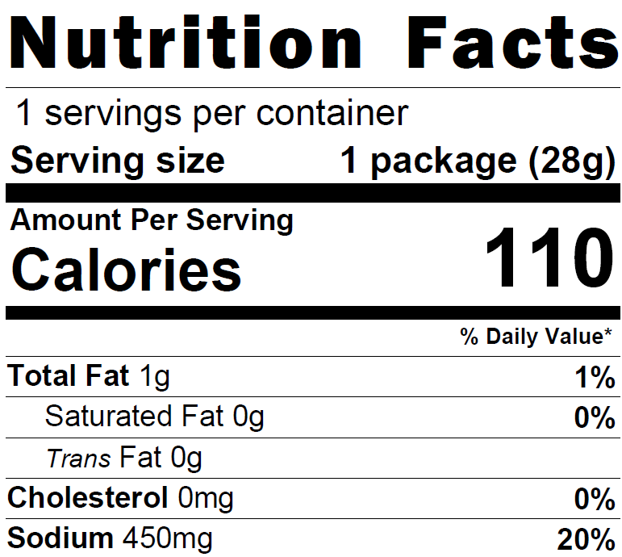
Using the Nutrition Facts Label
Brand P Hard Pretzels
Notes:
Many times, single-serving packages will have the weight of the package written on the front of it, like the breakfast cereal we looked at earlier, the package of croissants we just looked at, or this bag of Brand P pretzels shown on the slide.
Sometimes, you can also use the Nutrition Facts label to find the weight of the package. The Nutrition Facts label for Brand P hard pretzels is shown on the right side of the slide.

Slide 25
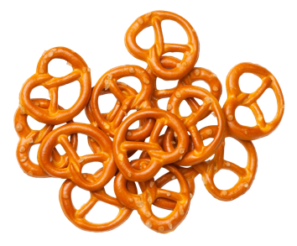
Using the Nutrition Facts Label Continued
Brand P Hard Pretzels
Notes:
To use the Nutrition Facts label to find the weight of the package, first, lets look at the Serving Size line. The serving size should say “1 package,” as shown in the purple rectangle on the slide. Sometimes, instead of “1 package,” it might say “1 bag,” “1 pouch,” “1 container,” etc.
If the Serving size is less than 1 package, such as “½ package” or “¼ package”, then you will need to take additional steps, or use another method, to determine how many packages of that item to serve.

Slide 26
Using the Nutrition Facts Label Continued
Brand P Hard Pretzels
Notes:
Once you’ve verified that the package size is “1 package,” look at the weight written next to it on the Nutrition Facts label. For example, we know that this package of pretzels weighs 28 grams, which is outlined in green on the slide.
Now that we’ve found the weight of the package, let’s make sure we can use the Grains Measuring Chart to see how many packages of these pretzels to serve.
Let’s do that together now with another practice question.

Slide 27
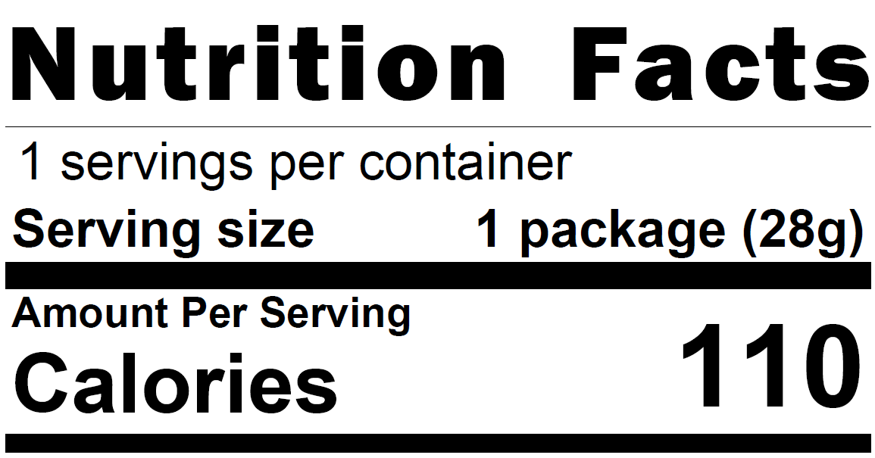
Try It Out!
You want to serve packages of Brand P hard pretzels at snack to 8-year-olds.
The Nutrition Facts label for a package of Brand P hard pretzels is shown on the right.
?
Can you use the Grains Measuring Chart to determine how many packages of Brand P hard pretzels to serve?
Yes
No
Brand P Hard Pretzels
Pita Chips
at least 28 grams or 1 ounce
Pretzels, Hard***
at least 22 grams or 0.8 ounces
Popcorn***
at least 14 grams or 0.5 ounce
Notes:
The question says “You want to serve packages of Brand P hard pretzels at snack to 8-year-olds.”
The Nutrition Facts label for a package of Brand P hard pretzels is shown on the right of the slide, along with the Grains Measuring Chart.
Looking at the information on the Nutrition Facts label, can you use the Grains Measuring Chart to determine how many packages of Brand P hard pretzels to serve?
Raise your hand if you think, “Yes, you can use the Grains Measuring Chart to determine how many packages of Brand P hard pretzels to serve” [pause and wait for a show of hands].
Raise your hand if you think, “No, you cannot use the Grains Measuring Chart to determine how many packages of Brand P hard pretzels to serve” [pause and wait for a show of hands].

Slide 28
Answer
Yes, you can use the Grains Measuring Chart to determine how many packages of Brand P pretzels to serve.
?
Can you use the Grains Measuring Chart to determine how many packages of Brand P hard pretzels to serve?
✓
Yes
No
Brand P Hard Pretzels
Pita Chips
at least 28 grams or 1 ounce
Pretzels, Hard***
at least 22 grams or 0.8 ounces
Popcorn***
at least 14 grams or 0.5 ounce
.
Notes:
The answer is Yes! You can use the Grains Measuring Chart to determine how many packages of Brand P Pretzels to serve. To get this answer, first we find “Pretzels, Hard” in the Grains Measuring Chart. This is listed on page 3 of the worksheet. This is also shown on the right side of the slide.
Under “Pretzels, Hard,” the minimum weight of “at least 22 grams or 0.8 ounces” is listed. This tells us that packages of hard pretzels need to weigh at least 22 grams or 0.8 ounces in order to use the Grains Measuring Chart.
Now, let’s look at the Nutrition Facts label for Brand P hard pretzels in the middle of the screen. This Nutrition Facts label tells us that 1 package weighs 28 grams. Twenty-eight grams is more than 22 grams, so we know we can use the Grains Measuring Chart to determine how many packages of pretzels to serve.

Slide 29
Try It Out!
How many packages of Brand P hard pretzels do you need to serve to meet grains requirements for
8-year-olds at snack?
?
Brand P Hard Pretzels
Grain Item and Package Weight* | 1- through 5-year-olds at Breakfast, Lunch, Supper, Snack | 6- through 18-year-olds at Breakfast, Lunch, Supper, Snack Adults at Snack | Adults at Breakfast, Lunch, Supper
 | Serve at Least ½ oz eq, which equals about… | Serve at Least 1 oz eq, which equals about… | Serve at Least 2 oz eq, which equals about…
Crackers, Savory (e.g., cheese, saltines, whole-wheat, etc.) at least 22 grams or 0.8 ounces | ½ package | 1 package | 2 packages
Pita Chips at 28 grams or 1 ounce | ½ package | 1 package | 2 packages
Pretzels, Hard*** at least 22 grams or 0.8 ounces | ½ package | 1 package | 2 packages
¼ package
½ package
1 package
2 packages
Notes:
Now that we know we can use the Grains Measuring Chart to figure out how many Brand P hard pretzels to serve, let’s do another practice question. Take a look at your Grains Measuring Chart, and tell me how many packages of Brand P hard pretzels you need to serve in order to meet the grains requirement for 8-year-olds at snack. Hard pretzels are listed in the Grains Measuring Chart on page 3 of the worksheet. The chart is also shown on the slide.
Raise your hand if you think you need to serve at least:
¼ package [pause and wait for a show of hands],
½ package [pause and wait for a show of hands],
1 package [pause and wait for a show of hands], or
2 packages [pause and wait for a show of hands].

Slide 30
Answer
How many packages of Brand P hard pretzels do you need to serve to meet grains requirements for
8-year-olds at snack?
?
Brand P Hard Pretzels
¼ package
½ package
1 package
2 packages
✓
Notes:
Nice work, everyone! The answer is 1 package. You need to serve at least 1 package of Brand P hard pretzels to meet grains requirements for 8-year-olds at snack. Let’s take a look at how we got that answer.

Slide 31
Grains Measuring Chart for Single-Serving Packages (6-18)
Grain Item and Package Weight* | Child and Adult Care Food Program Age Group and Meal | Child and Adult Care Food Program Age Group and Meal | Child and Adult Care Food Program Age Group and Meal
 | 1- through 5-year-olds at Breakfast, Lunch, Supper, Snack | 6- through 18-year-olds at Breakfast, Lunch, Supper, Snack Adults at Snack | Adults at Breakfast, Lunch, Supper
 | Serve at Least ½ oz eq, which equals about… | Serve at Least 1 oz eq, which equals about… | Serve at Least 2 oz eq, which equals about…
Crackers, Savory (e.g., cheese, saltines, whole-wheat, etc.) at least 22 grams or 0.8 ounces | ½ package | 1 package | 2 packages
Pita Chips at least 28 grams or 1 ounce | ½ package | 1 package | 2 packages
Pretzels, Hard*** at least 22 grams or 0.8 ounces | ½ package | 1 package | 2 packages
Popcorn*** at least 14 grams or 0.5 ounce | 1 package | 2 packages | 4 packages
Rice Cakes at least 22 grams or 0.8 ounces | ½ package | 1 package | 2 packages
Child and Adult Care Food Program
Age Group and Meal
Notes:
First, we find “Pretzels, Hard” in the Grains Measuring Chart on page 3 of the worksheet. This row is outlined in green on the slide.
Then, we find the age group and meal we are serving. Because we are serving 8-year-olds at snack, we can use the column for 6- through 18-year-olds at breakfast, lunch, supper and snack. This column is outlined in purple on the slide.
Where the green “Pretzels” row and the purple “6- through 18-year-olds” column meet, that tells us we need to serve at least 1 package of pretzels to meet minimum grains requirements in the CACFP. Again, remember that 1 package is the minimum—so you can serve more than 1 package.
Nice work, everyone!

Slide 32
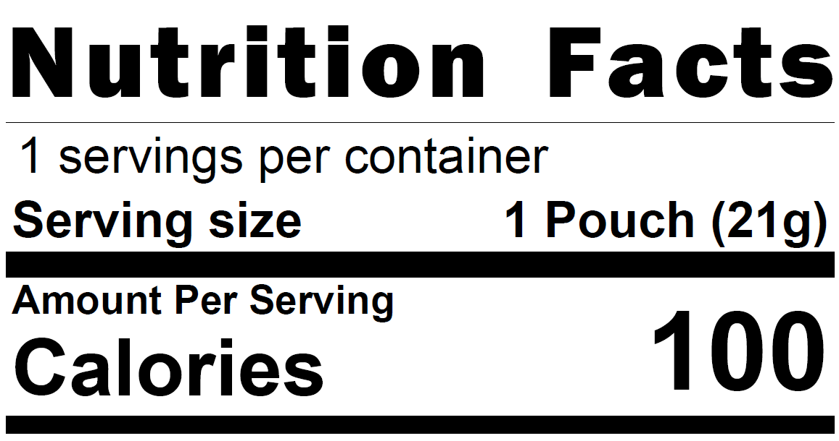
Try It Out!
You want to serve Brand S savory crackers at supper to adult participants.
The Nutrition Facts label for a package of Brand S savory crackers is shown on the right.
?
Can you use the Grains Measuring
Chart to determine how many packages of Brand S savory crackers to serve?
Yes
No
Brand S Savory Crackers
Crackers, Savory (e.g., cheese, saltines, whole-wheat, etc.)
at least 22 grams or 0.8 ounces
Crackers, Sweet (e.g., animal, graham, etc.) at least 28 grams
or 1 ounce
Croissant
at least 34 grams or 1.2 ounces
Notes:
Okay, one last practice question before we wrap up. Our last question says, “You want to serve Brand S savory crackers at supper to adult participants. The Nutrition Facts label for a package of Brand S savory crackers is shown on the right. Can you use the Grains Measuring Chart to determine how many packages of Brand S savory crackers to serve?”
You can look at the Grains Measuring Chart on pages 2-3 of the worksheet, or look at the information on the slide.
Raise your hand if you think, “Yes, you can use the Grains Measuring Chart to determine how many packages of Brand S savory crackers to serve” [pause and wait for a show of hands].
Raise your hand if you think, “No, you cannot use the Grains Measuring Chart to determine how many packages of Brand S savory crackers to serve” [pause and wait for a show of hands].

Slide 33
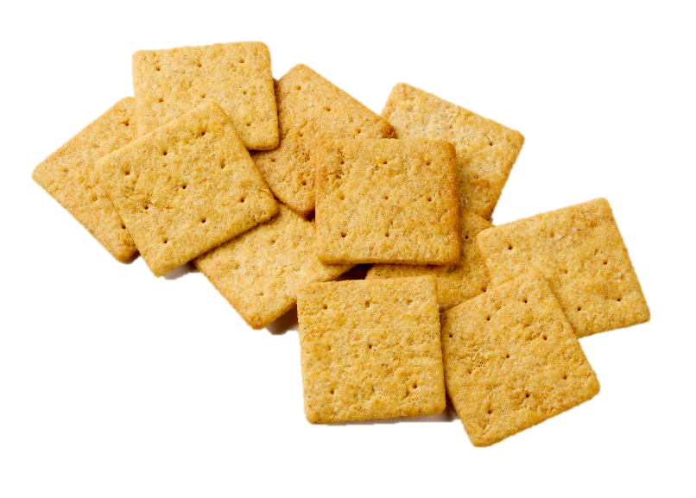
Answer
No, you cannot use the Grains Measuring Chart to determine how many packages of Brand S savory crackers to serve to adult participants.
?
Can you use the Grains Measuring
Chart to determine how many packages of Brand S savory crackers to serve?
Yes
No
✓
Brand S Savory Crackers
Crackers, Savory (e.g., cheese,
saltines, whole-wheat, etc.)
at least 22 grams or 0.8 ounces
Crackers, Sweet (e.g., animal,
graham, etc.) at least 28 grams
or 1 ounce
Croissant
at least 34 grams or 1.2 ounces
.
Notes:
The answer is no, you cannot use the Grains Measuring Chart to determine how many packages of Brand S savory crackers to serve. To get this answer, first we find “Crackers, Savory” in the Grains Measuring Chart. This is listed on page 3 of the worksheet. This is also shown on the right side of the slide.
Looking at the Nutrition Facts label for Brand S Savory Crackers, which is in the middle of the slide, we see that 1 package or pouch weighs 21 grams. Twenty-one grams is less than 22 grams, so we know we cannot use the Grains Measuring chart to determine how many crackers to serve. We will need to use another tool to determine how many packages of these crackers to serve.

Slide 34
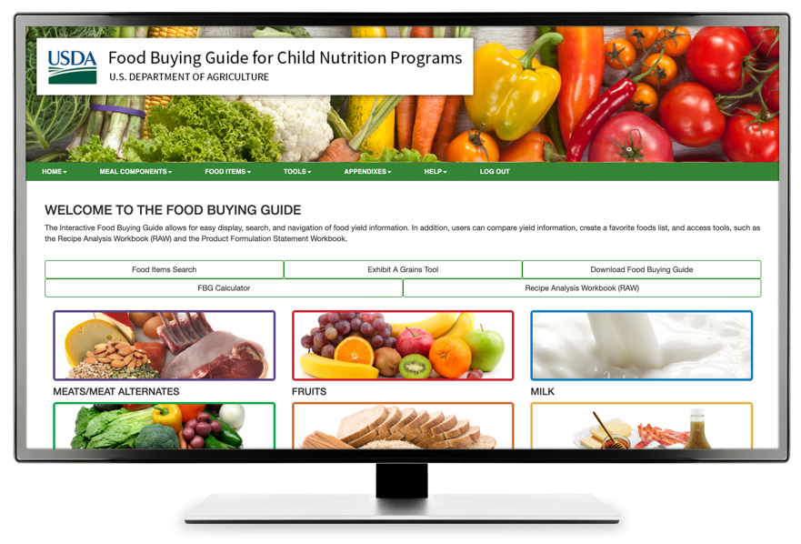
What if My Grain is Different?
Use a different tool if:
The package is smaller or lighter
than what’s listed on the Grains Measuring Chart,
The serving size is less than
1 package (e.g., ¼, ½, etc.),
The weight of one package is not listed,
The item you are serving is not listed
on the Grains Measuring Chart, or
You are serving a grain to meet part of the grains requirement.
Exhibit A Grains Tool
Notes:
You might be wondering what tools you could use instead of this “Crediting Single-Serving Packages of Grains” worksheet. We will talk about these tools in just a second, but first, let’s talk about when we would want to use other tools. You might want to use other tools if:
The package is smaller or lighter than what’s listed on the Grains Measuring Chart for Single-Serving packages, like the example we just did with the Brand S Savory crackers, or
The serving size on the Nutrition Facts label is less than 1 package, such as ¼, ½, and you cannot find the weight of the package listed on the package, or
The item you are serving is not listed on the Grains Measuring Chart, or
You want to serve a grain to meet part of the grains requirement, such as ¼ oz eq or ¾ oz eq.
Additionally, while you could use the chart with grain items that are larger or heavier than what’s listed on the chart, if you wanted to serve exactly what was required in the CACFP meal pattern, that might be another time that you’d choose to use a different tool.
So, what are these tools?

Slide 35
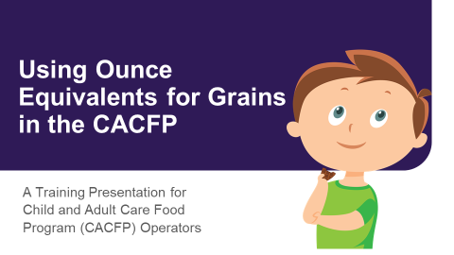

What if My Grain is Different? Continued
Use a different tool if:
The package is smaller or lighter
than what’s listed on the Grains Measuring Chart,
The serving size is less than
1 package (e.g., ¼, ½, etc.),
The weight of one package is not listed,
The item you are serving is not listed
on the Grains Measuring Chart, or
You are serving a grain to meet part of the grains requirement.
fns.usda.gov/tn/using-ounce-
equivalents-grains-cacfp
Notes:
One of the tools is the “Using Ounce Equivalents for Grains in the CACFP” worksheet, which lists over 40 grain items that might be commonly served in the CACFP, including a variety of crackers, breads, etc.
You can use this worksheet for items that are in single-serving packages, as well as in larger packages. There is also a recorded CACFP Halftime webinar that shows you how to use this worksheet, as well as a slide deck that you can download and use for future trainings.

Slide 36

What if My Grain is Different? Continued
Use a different tool if:
The package is smaller or lighter
than what’s listed on the Grains Measuring Chart,
The serving size is less than
1 package (e.g., ¼, ½, etc.),
The weight of one package is not listed,
The item you are serving is not listed
on the Grains Measuring Chart, or
You are serving a grain to meet part of the grains requirement.
fns.usda.gov/tn/calculating-ounce-
equivalents-grains-cacfp
Notes:
You could also use Team Nutrition’s “Calculating Ounce Equivalents of Grains in the CACFP” worksheet, as shown on the slide. This worksheet shows you how to use the information from the item’s Nutrition Facts label to hand-calculate the amount of the item, such as number of crackers, slices of bread, etc. you need to serve to meet minimum required amounts of grains in the CACFP.

Slide 37
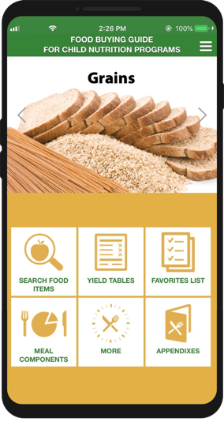

What if My Grain is Different? Continued
Use a different tool if:
The package is smaller or lighter
than what’s listed on the Grains Measuring Chart,
The serving size is less than
1 package (e.g., ¼, ½, etc.),
The weight of one package is not listed,
The item you are serving is not listed
on the Grains Measuring Chart, or
You are serving a grain to meet part of the grains requirement.
Exhibit A Grains Tool
foodbuyingguide.fns.usda.gov
Notes:
Finally, you could also use the “Exhibit A Grains Tool.” This tool is part of the “Food Buying Guide for Child Nutrition Programs” and will calculate the amount of grains you need to serve to meet minimum amounts of grains in the CACFP, based on the information on the item’s Nutrition Facts label.
Team Nutrition has two recorded webinars on how to use this tool, and there are also guides and tutorials within the tool that show you how to use it.

Slide 38
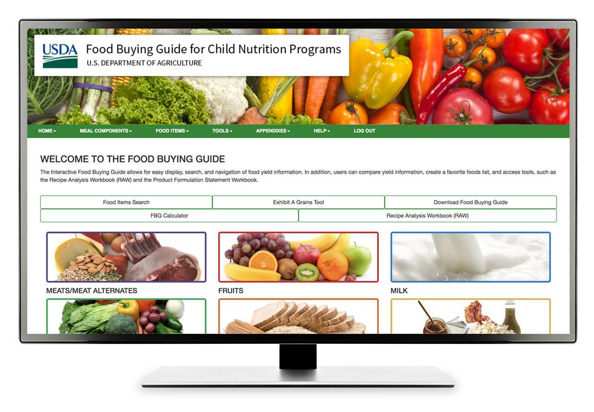
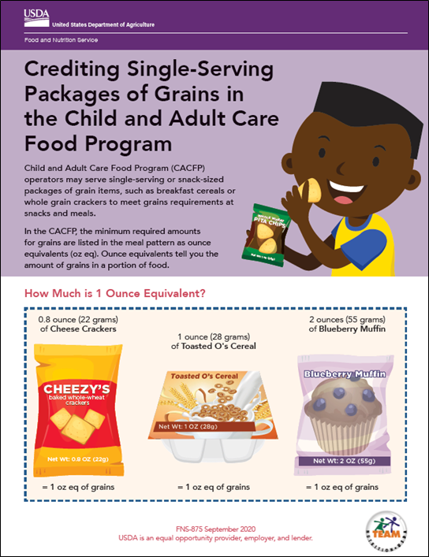
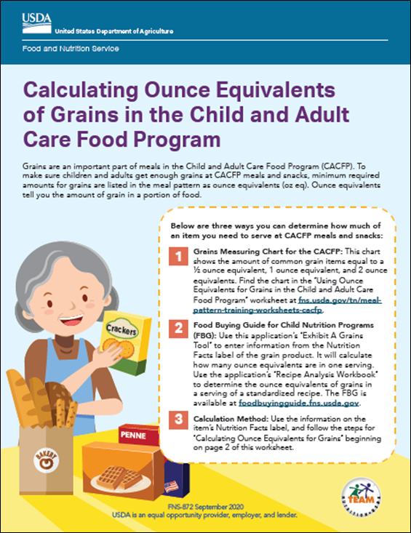
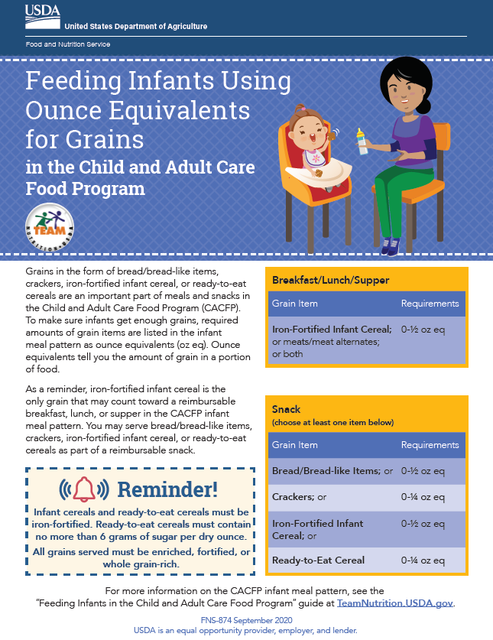
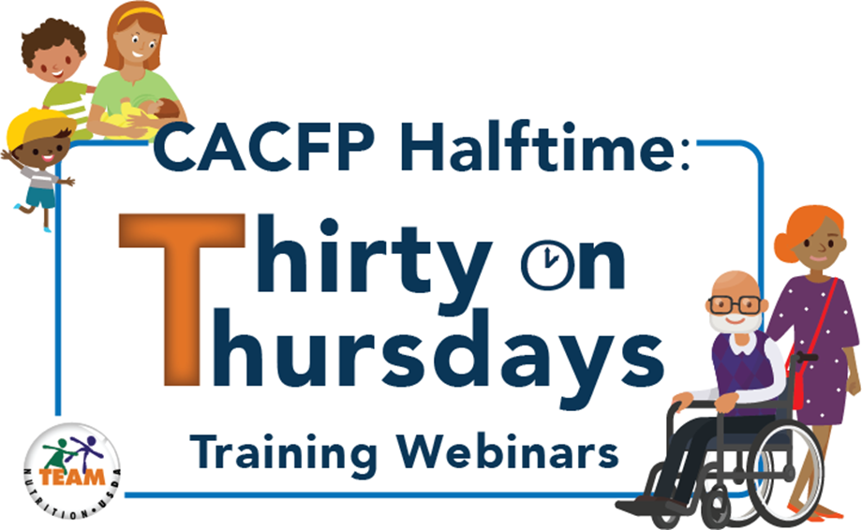

Team Nutrition CACFP Grains Oz Eq Resources Webpage
fns.usda.gov/tn/grains-ounce-equivalents-resources-cacfp
Notes:
You can find these resources on Team Nutrition’s “CACFP Grains Ounce Equivalents Resources” webpage. The web address is shown on the bottom of the slide.

Slide 39
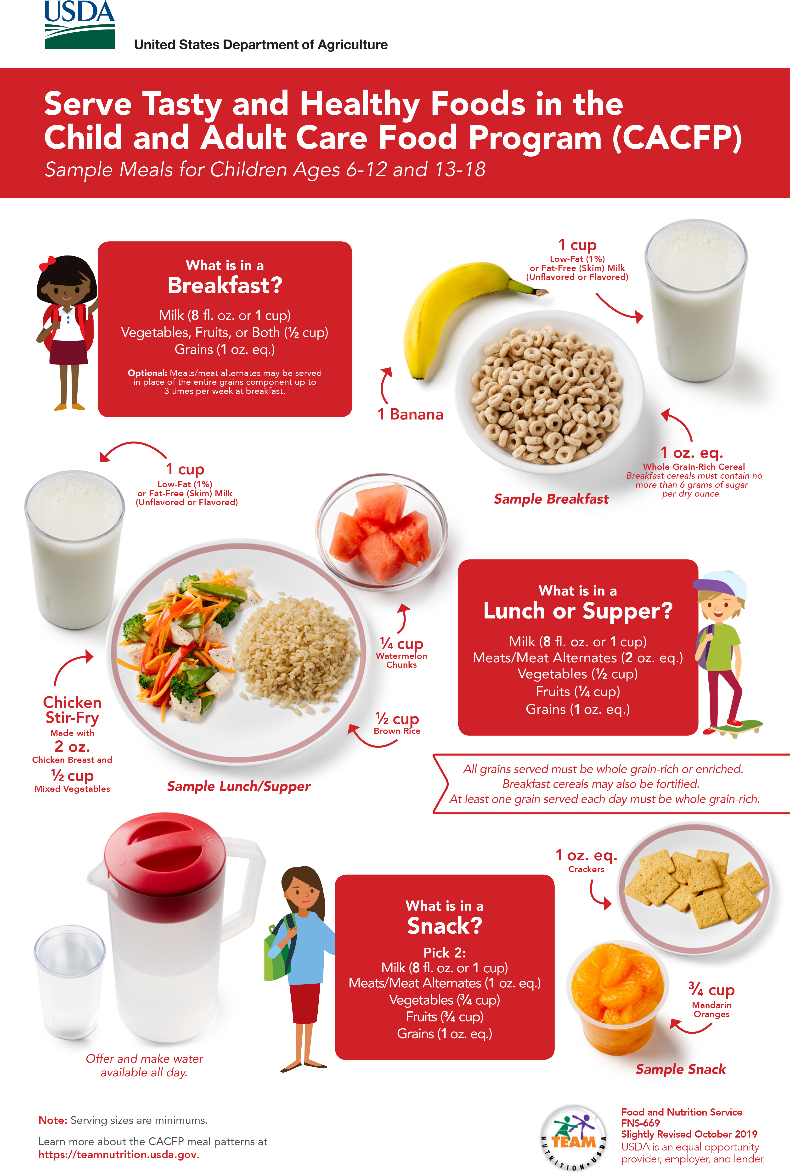

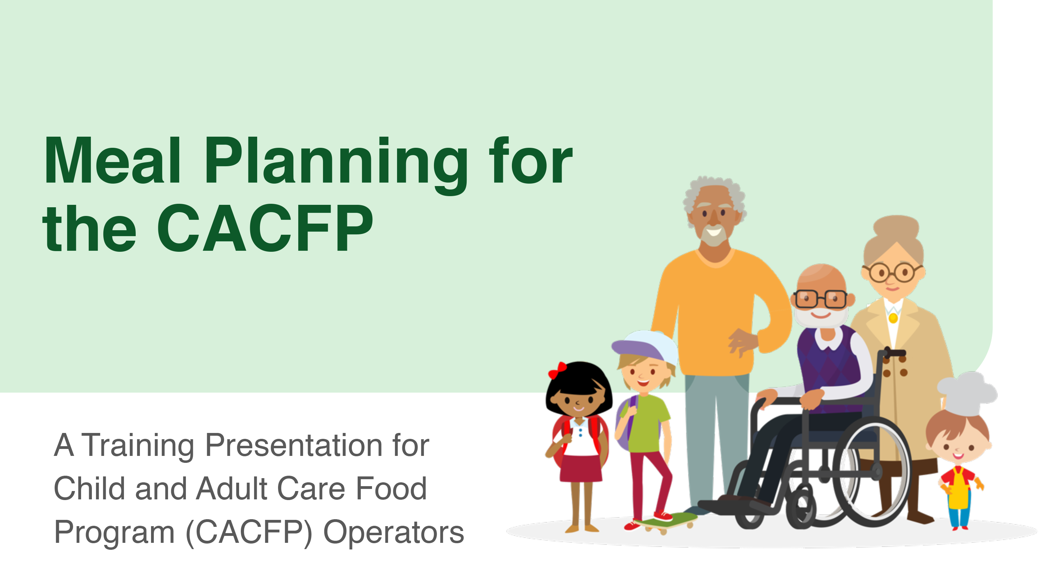
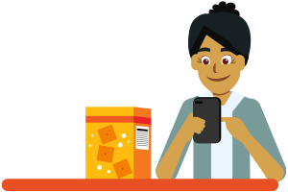

More Team Nutrition Resources!
Training Worksheets
Training Toolkits
Posters
Training Slides
CACFP Grains Oz Eq Resources
TeamNutrition.usda.gov
Notes:
All Team Nutrition materials are available online from Team Nutrition’s website and are available for free download to anybody who is interested. You can also find many other resources for the CACFP on Team Nutrition’s website.

Slide 40
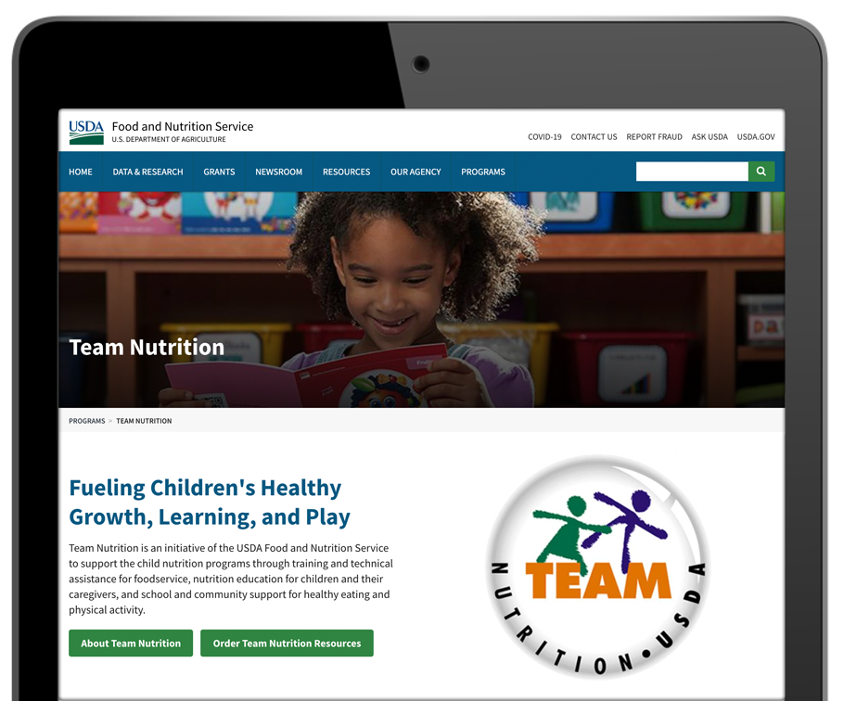

How To Order Print Copies
Resource Order Form at TeamNutrition.usda.gov.
FREE for those participating in a USDA Child Nutrition Program, while supplies last.
Sponsoring organizations and State agencies can also order in bulk by sending an email to:
TeamNutrition@usda.gov
Notes:
For program operators in a Child Nutrition Program, such as the Child and Adult Care Food Program, Team Nutrition’s print materials are free to order.
If you would like to order Team Nutrition’s free materials in print, you can go to the “Resource Order Form” link on the Team Nutrition website to order print copies of the materials.
For bulk orders, you can email TeamNutrition@usda.gov.

Slide 41




Thank you!
TeamNutrition.usda.gov
@TeamNutrition
TeamNutrition@usda.gov
USDA is an equal opportunity provider, employer, and lender.
Notes:
These training slides were provided by U.S. Department of Agriculture's Team Nutrition. If you would like to learn more about Team Nutrition and additional resources available, please visit their website, subscribe to their e-newsletter, connect with them via email at TeamNutrition@usda.gov, and follow them on Twitter.
Thank you!

