Slide 1

Identifying Whole Grain-Rich Foods for the CACFP Using the Ingredient List
Part 1
A Training Presentation for
Child and Adult Care Food
Program (CACFP) Operators

Slide 2



USDA’s Team Nutrition
An initiative of the USDA’s Food and Nutrition Service to support the USDA’s Child Nutrition Programs.
Aims to improve children’s lifelong eating and physical activity habits.
Provides nutrition education and training materials to State agencies, sponsoring organizations, and CACFP sites.
TeamNutrition.USDA.gov
@TeamNutrition
Notes:
Team Nutrition is an initiative of the USDA Food and Nutrition Service that supports the Child Nutrition Programs, including the National School Lunch Program, the School Breakfast Program, and of course, the Child and Adult Care Food Program, or the CACFP.
The goal of Team Nutrition is to improve children's lifelong eating and physical activity habits through nutrition education based on the principles of the Dietary Guidelines for Americans and MyPlate.
It does so through training and technical assistance for those preparing and serving meals, providing nutrition education for children, and building support for healthier school and child care environments.

Slide 3
Let Us Know Who You Are!
I work for a…
?
Child care center
Family child care home
At-risk afterschool care center
Adult day care center
Sponsoring organization
Emergency shelter
School food authority
State agency
USDA Regional Office
Other
Notes:
Before we get started, I want to know who has joined us today.
Please raise your hand if you work for:
a child care center [pause and wait for a show of hands],
a family child care home [pause and wait for a show of hands],
an at-risk afterschool care center [pause and wait for a show of hands],
a sponsoring organization [pause and wait for a show of hands],
an emergency shelter [pause and wait for a show of hands],
a school food authority [pause and wait for a show of hands],
a State agency [pause and wait for a show of hands],
a USDA Regional office [pause and wait for a show of hands], or
other [pause and wait for a show of hands].

Slide 4
Whole Grain-Rich Requirements for the CACFP
Anatomy of a Grain
Grains served at one meal or snack every day must be whole grain-rich
Required for child and adult meal patterns only
Whole grain-rich means:
At least half the grain ingredients are whole-grain
Remaining grain ingredients are enriched, bran, or germ
Endosperm
Bran
Germ
Notes:
So, let’s get started! Today’s topic is “Identifying Whole Grain-Rich Foods for the CACFP Using the Ingredient List.”
As many of you know, in the CACFP, grains served during at least one snack or meal every day must be whole grain-rich. This applies only to children and adults in the CACFP. You are not required to serve infants whole grain-rich foods, but you are welcome to serve them to infants as well, if you’d like.
The term “whole grain-rich” means at least half the grain ingredients are whole-grain ingredients, and the remaining grain ingredients are enriched grains, bran, or germ.
Whole-grain ingredients have all parts of the grain kernel intact. This means that the nutrients that are naturally in the bran and germ are still in the food.
Enriched grain ingredients mean the bran and germ are removed during processing, and then some vitamins and minerals are added back in.

Slide 5
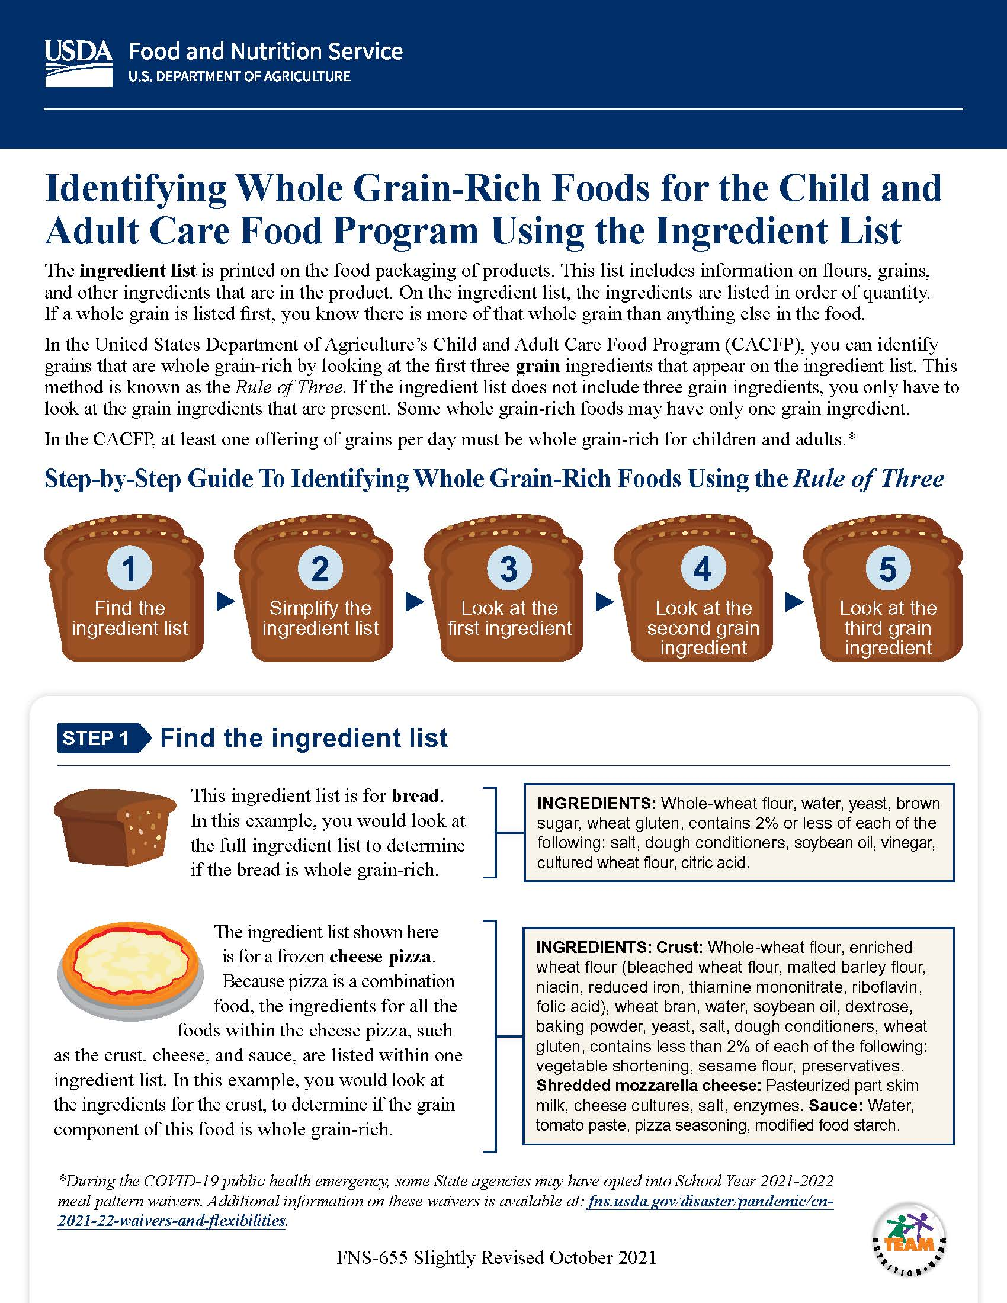
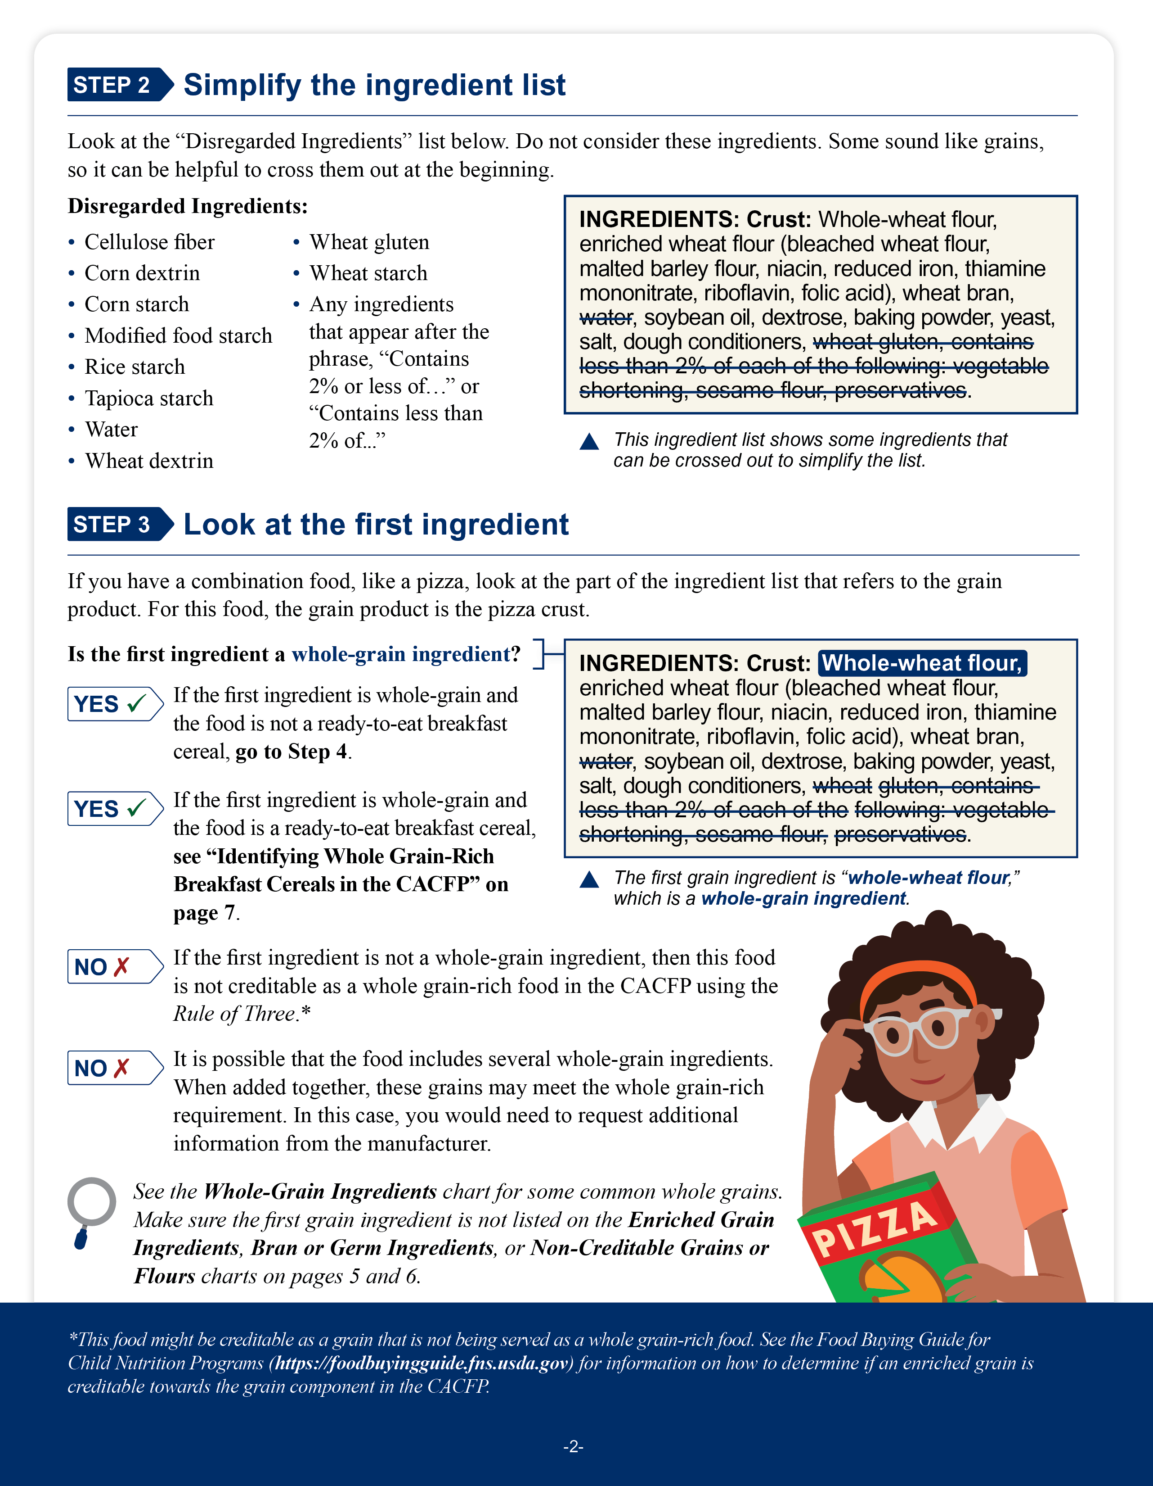
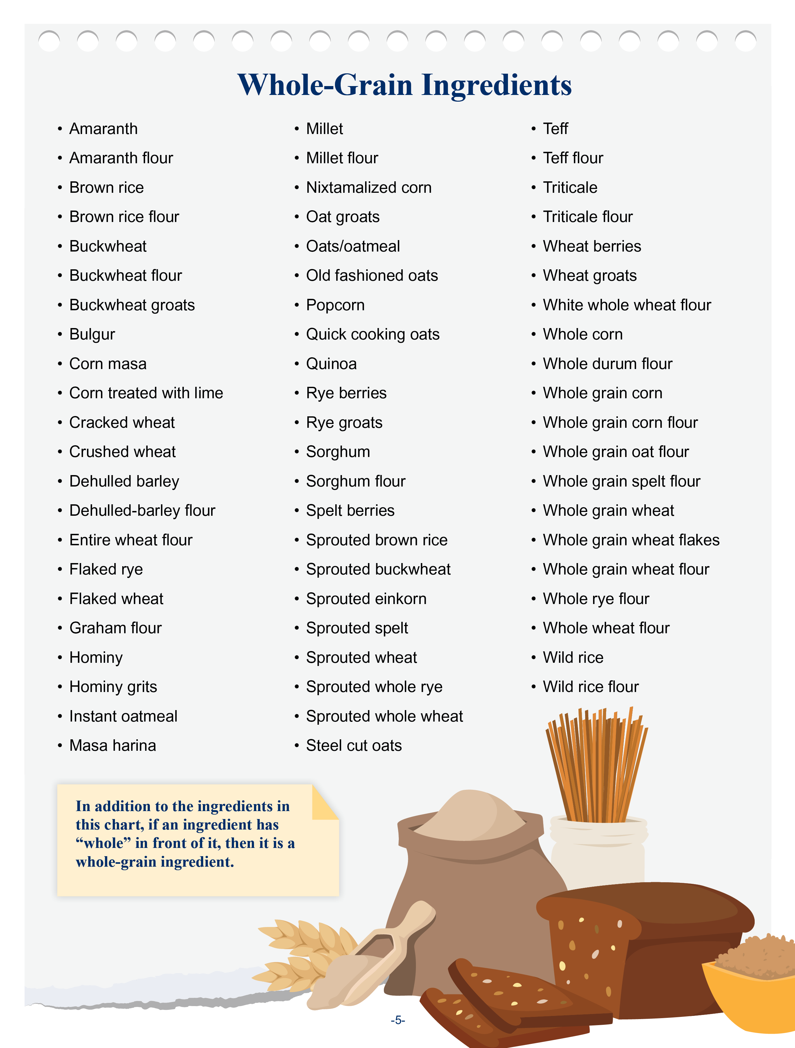
Identifying Whole Grain-Rich Foods for the CACFP Using the Ingredient List
fns.usda.gov/tn/identifying-whole-grain-rich-foods-cacfp
Notes:
We realize this information may be a lot to cover, so this presentation is part one of a two-part presentation on this topic. The USDA’s Team Nutrition initiative has created a worksheet on “Identifying Whole Grain-Rich Foods for the USDA CACFP Using the Ingredient List.” Please download the worksheet from the web address on the slide. We will be using this worksheet throughout today’s presentation.

Slide 6

The Rule of Three
Ingredients: Whole Grain Wheat, Wheat Bran, Enriched Corn Flour, Sugar, Salt, Tripotassium Phosphate, Wheat Starch, Vitamin E.
Vitamins and Minerals: Calcium Carbonate, Iron, Zinc, Vitamin C, Vitamin B6, Vitamin A.
Notes:
Before we begin today, we want to mention that there are many methods that you can use to determine if a grain is whole grain-rich in the CACFP. Today’s presentation will focus on looking at the item’s ingredient list, and applying a method called “The Rule of Three” to see if the item is whole grain-rich. However, we will also provide an overview of the other methods at the end of today’s session.
As many of you know, many foods have ingredient lists on the box, bag, or other packaging that tell you what ingredients are in a food. Ingredients are listed in the order of most to least in a food. For example, the ingredient list on this slide lists “whole grain wheat” as the first ingredient. This means there is more whole grain wheat in this cereal than any other ingredient.

Slide 7
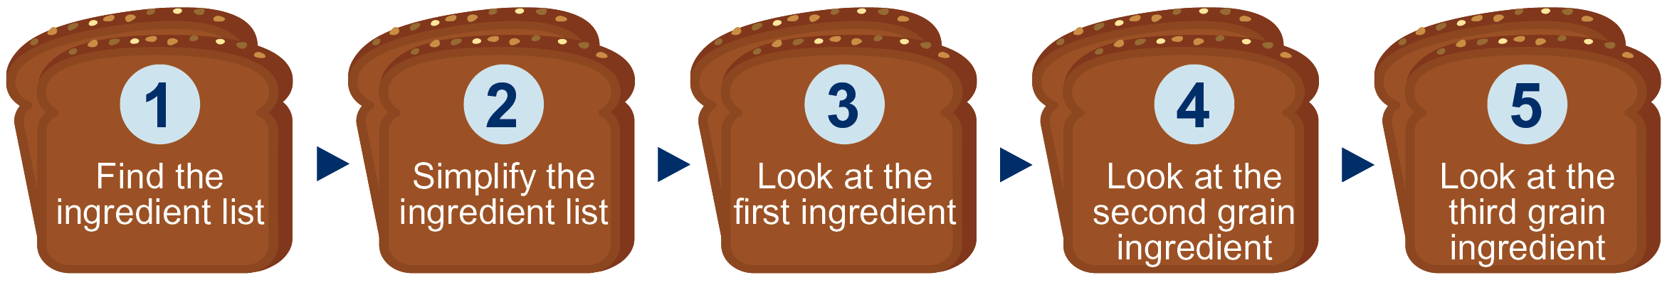
The Rule of Three
Notes:
To use the Rule of Three, the first step is to find the ingredient list on the food package. Then, you can simplify the ingredient list by looking for ingredients that can be disregarded or ignored.

Slide 8
The Rule of Three
Notes:
Then, you look at the first three grain ingredients in the item to see if your food is whole grain-rich. Looking at the first three grain ingredients lets you know if the food is made up of mostly whole grains. You can still use the Rule of Three even if your food has only one or two grain ingredients, or if you have more than three grain ingredients.

Slide 9
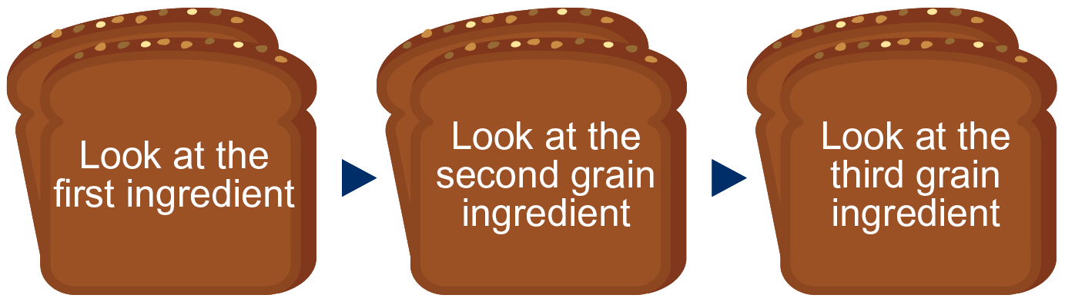
The Rule of Three
Whole-grain
Whole-grain
Enriched
Bran or germ
Whole-grain
Enriched
Bran or germ
Notes:
In the Rule of Three, the first ingredient must be whole-grain. The second grain ingredient, if the food has a second grain ingredient, must be whole-grain, enriched, bran or germ. The third grain ingredient, if the food has a third grain ingredient, must also be whole-grain, enriched, bran or germ.
If your food does not meet this criteria, you will need to use another method to see if your food is whole grain-rich. Again, for today’s training, our focus will be on seeing if a food is whole grain-rich using the Rule of Three.

Slide 10
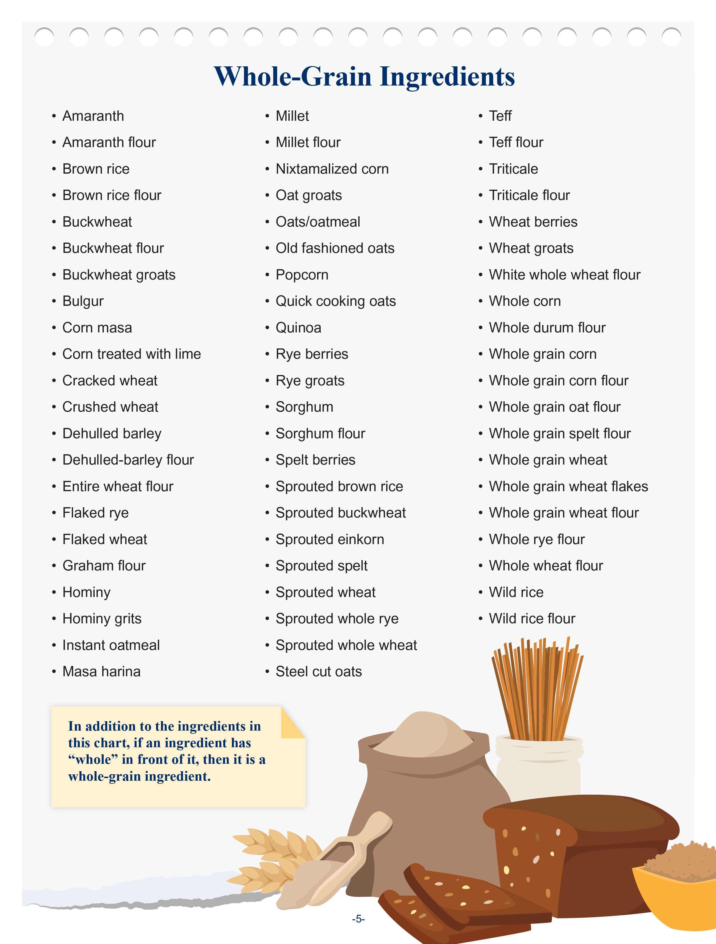
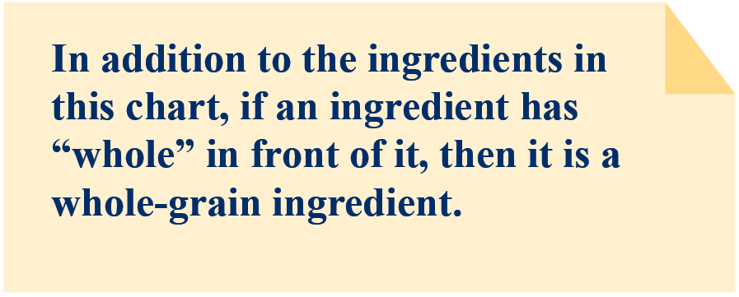
Whole-Grain Ingredients
Notes:
Page 5 of the Identifying Whole Grain-Rich Foods for the CACFP Using the Ingredient List worksheet includes lists of whole-grain ingredients. This list is not meant to be exhaustive, meaning there are other whole-grain ingredients that are not included on this list. Page 5 also includes a note reminding operators that if an ingredient has the word “whole” in front of it, then it is a whole-grain ingredient.

Slide 11
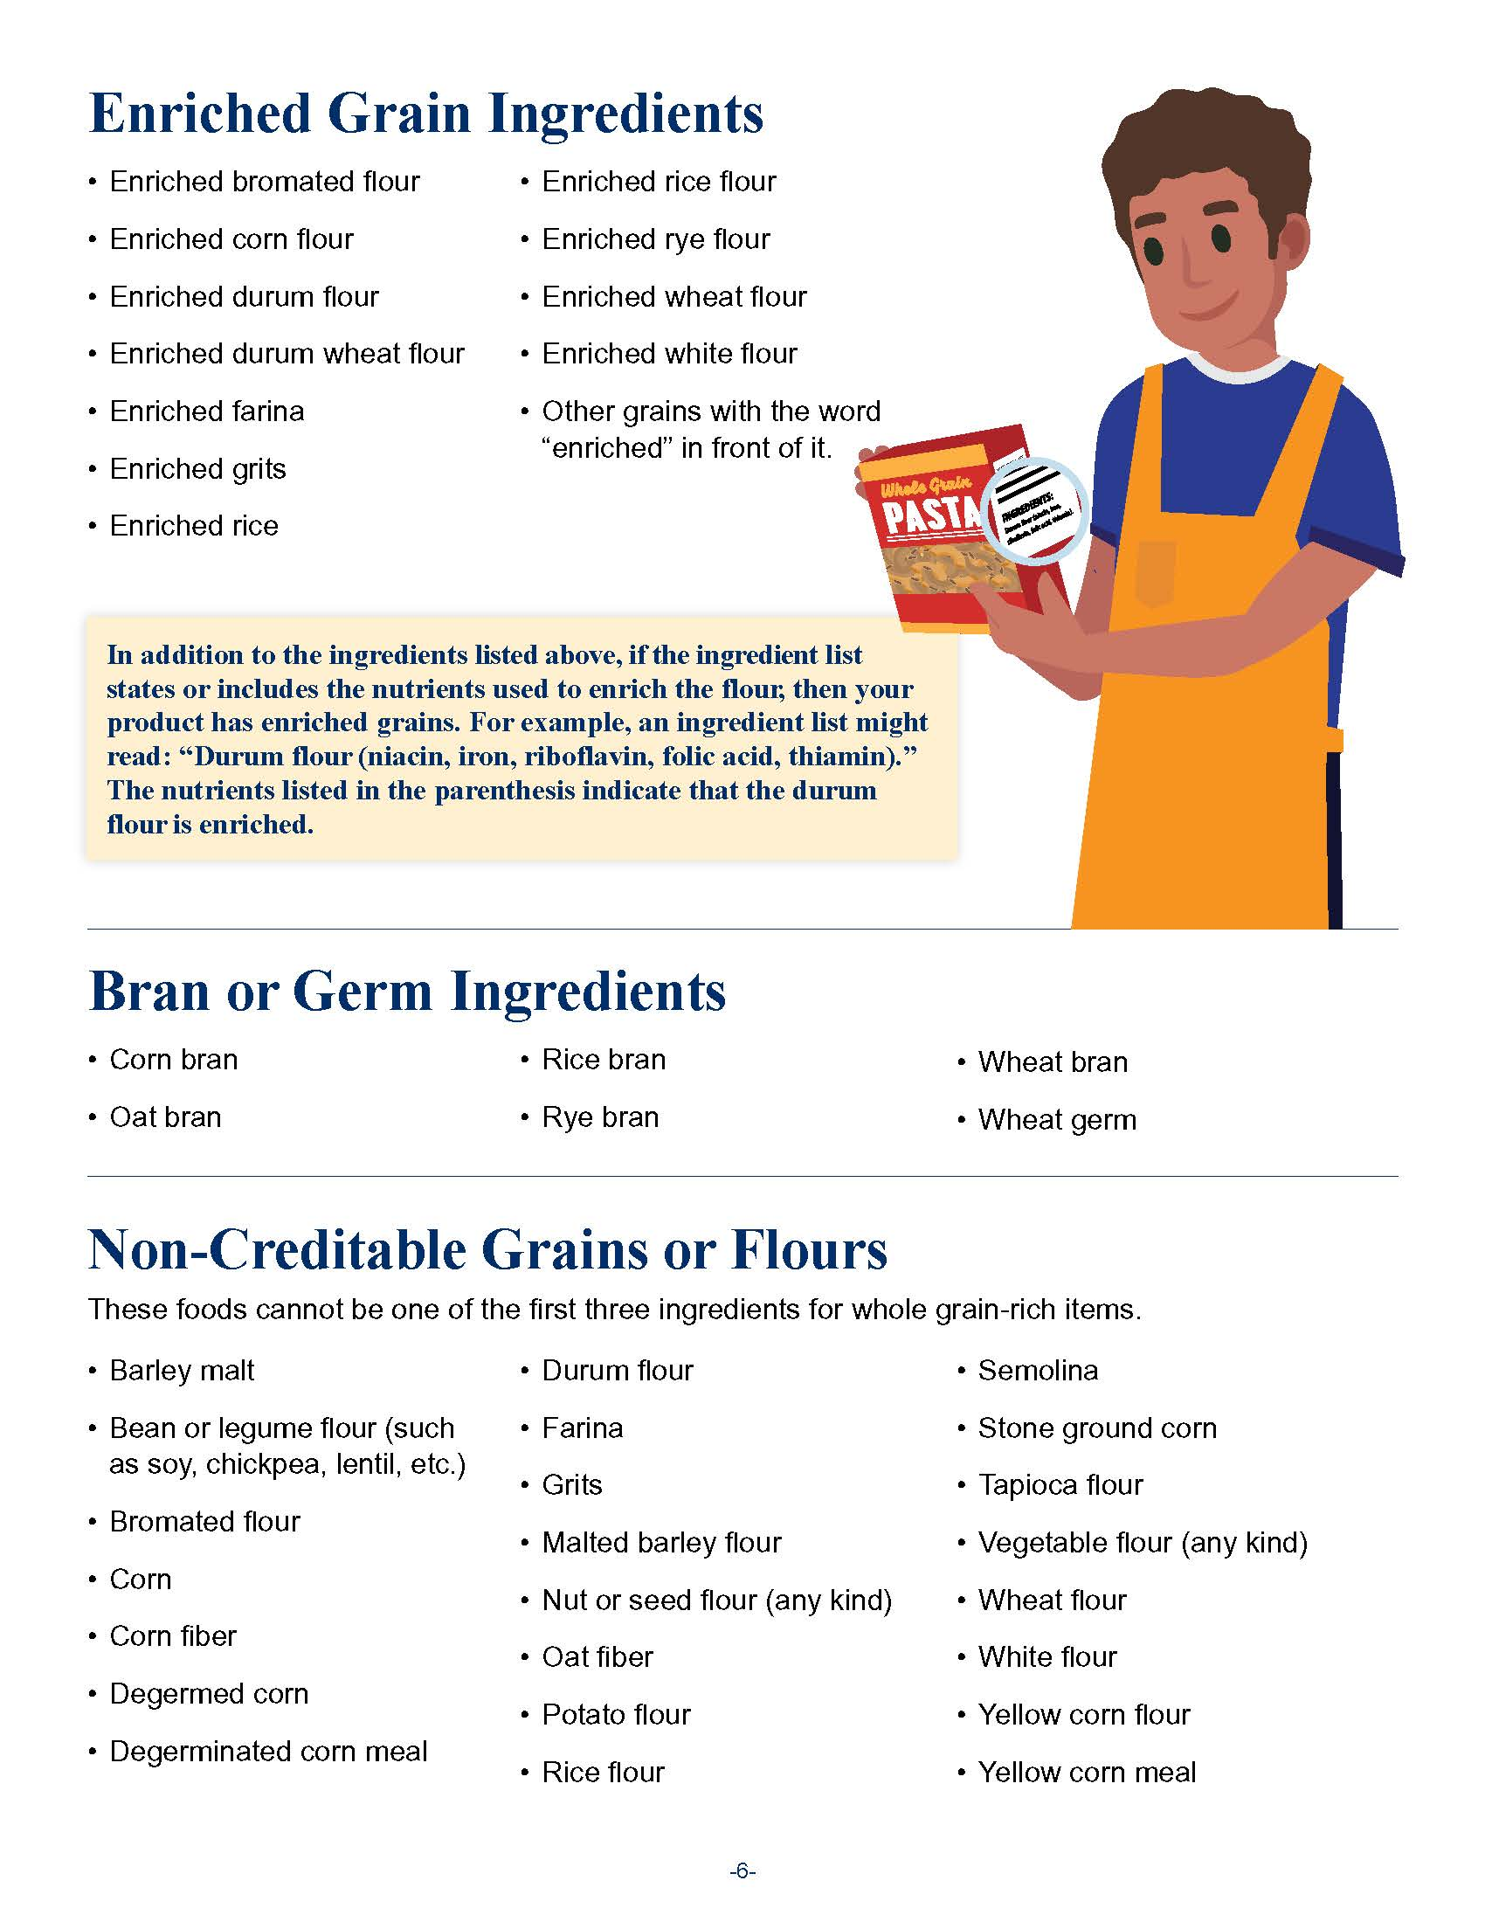
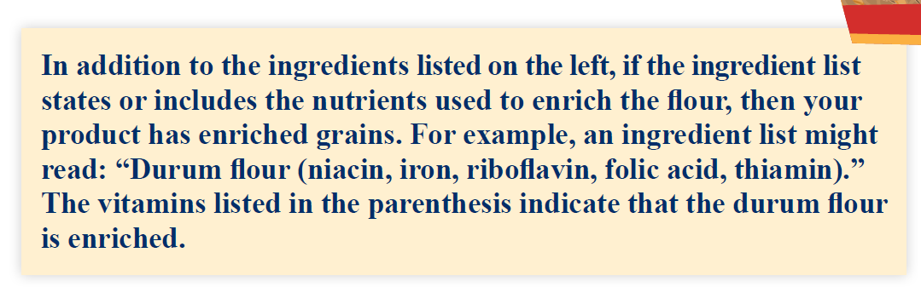
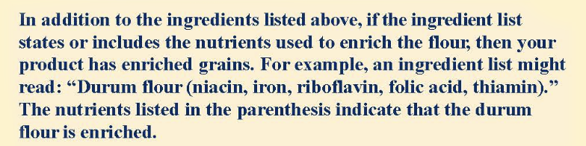
Enriched, Bran, and Germ Ingredients
Notes:
Page 6 of the worksheet includes lists of enriched, bran and germ ingredients. Similarly, these lists are not meant to be exhaustive, meaning there are other enriched, bran and germ ingredients that are not included on this page.
Page 6 also includes a note reminding operators that if an ingredient list states or includes the nutrients used to enrich the ingredient, then the item has enriched grains.

Slide 12
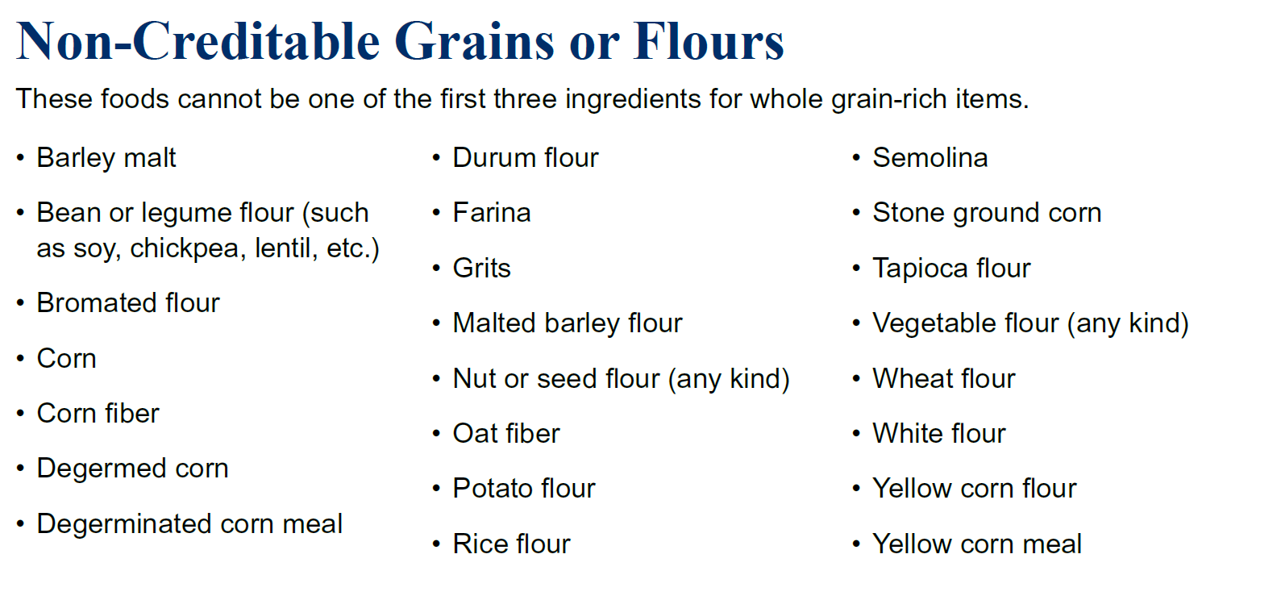
Non-Creditable Grains or Flours
Notes:
Page 6 of the worksheet also includes a list of non-creditable grains or flours. These are ingredients in grain products that are not whole-grain, enriched, bran or germ. If any of these non-creditable grains or flours are the first, second, or third grain ingredients in a grain item, then you cannot use the Rule of Three to determine if the item is whole grain-rich.

Slide 13
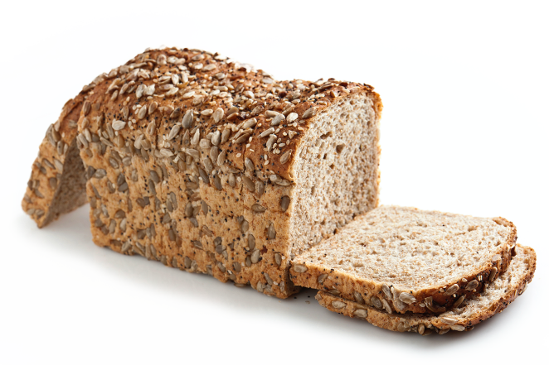
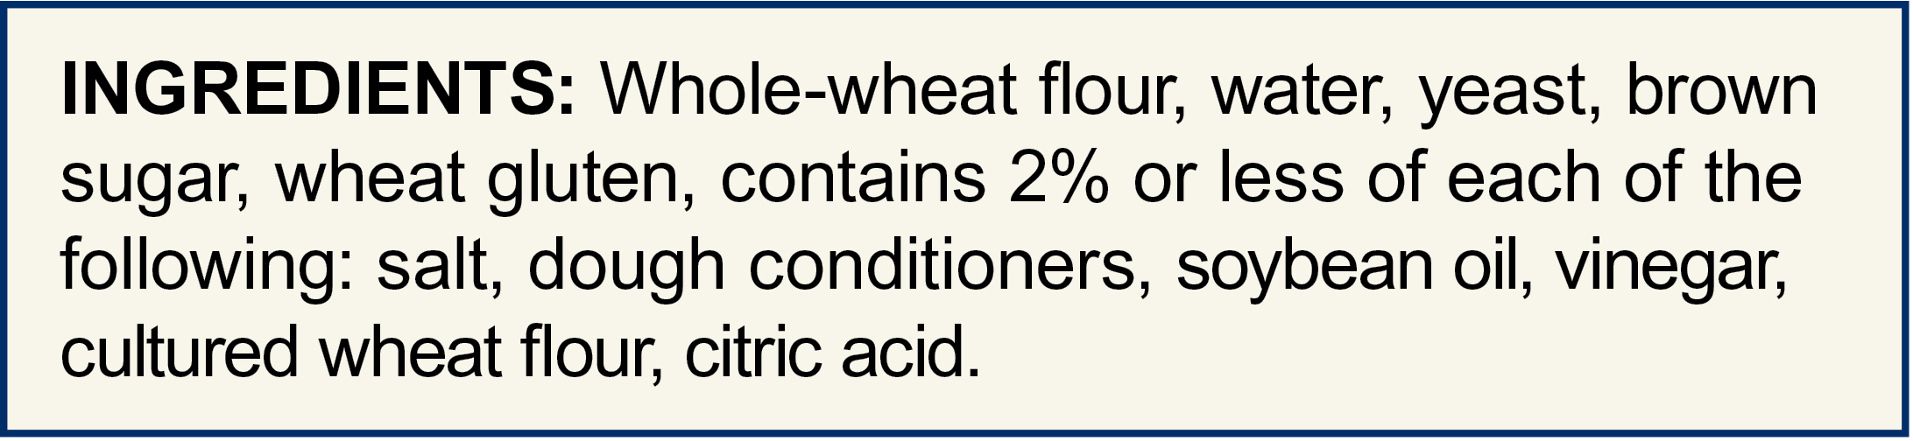
Step 1: Find the Ingredient List
For foods that only contain the grains component, look at the entire ingredient list.
Examples include:
Bread
Pastas
Bagels
Pancakes
Breakfast cereals
Notes:
To use the Rule of Three, start by finding your ingredient list on the package of the item.
For items that will only count toward the grains component in a reimbursable meal or snack, you will want to look at the entire ingredient list. Common examples of these items include bread, pasta, bagels, pancakes, and breakfast cereals, just to name a few.

Slide 14
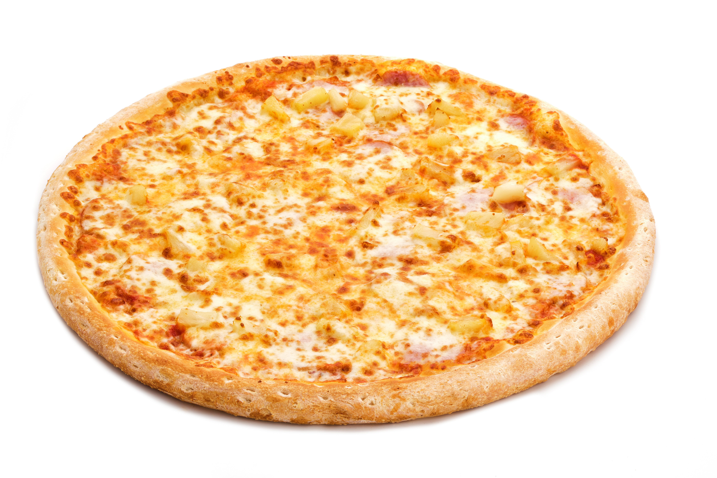
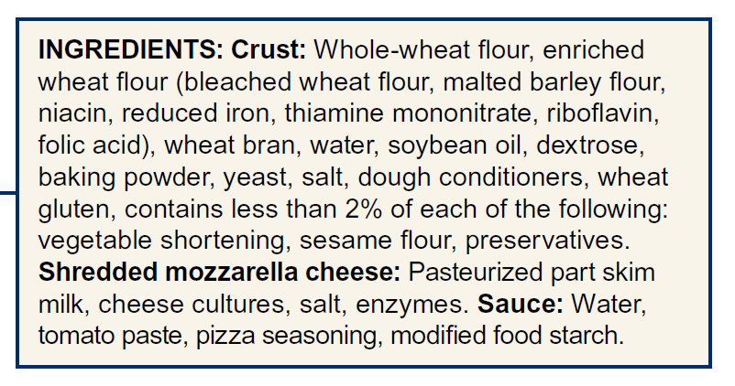
Step 1: Find the Ingredient List (Combination Foods)
For combination foods, look at the ingredients in the grain portion of the food.
Examples include:
The tortilla in a burrito
Wild rice in a chicken and wild rice soup
The crust of a pizza
Notes:
Combination foods are foods that have more than one meal component. For example, a burrito may have a tortilla that counts toward the grains component, cheese that counts toward the meats/meat alternates component, and beans that count toward the vegetables component.
Other examples include:
a chicken and wild rice soup where rice counts toward the grains component, chicken counts toward the meats component, and diced carrots and celery count toward the vegetables component;
A cheese pizza where the wheat crust counts toward the grains component and shredded cheese that counts toward the meats/meat alternates component.
When looking at a combination food to see if it’s whole grain-rich, you only need to look at the part of the ingredient list that applies for the grain food.
Let’s go through a quick example. On the slide you see an ingredient list for the entire cheese pizza. To see if this pizza is whole grain rich…

Slide 15

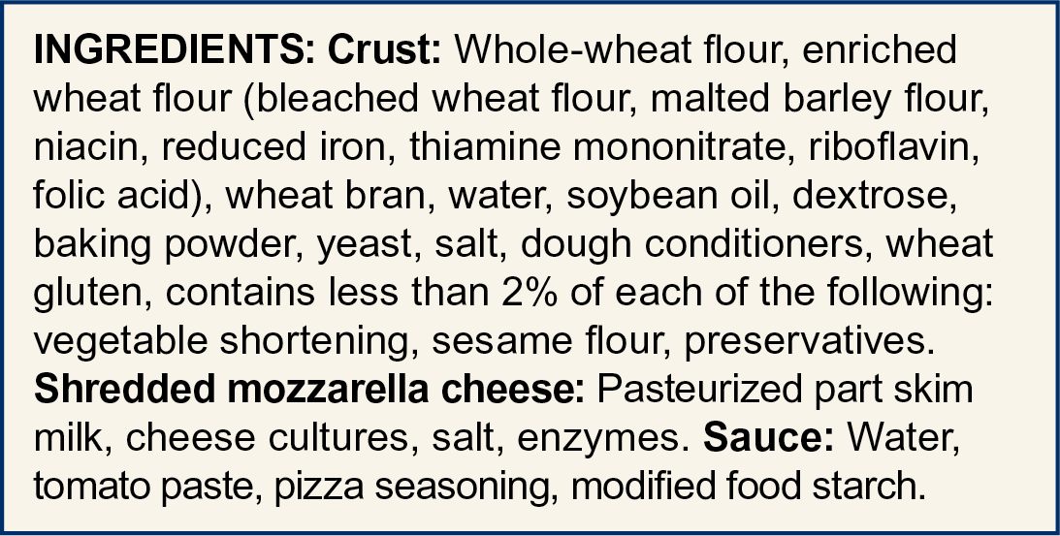
A Closer Look at Combination Foods
Notes:
You only need to look at the parts of the ingredient list for the crust, since that is the part of the pizza that will credit towards the grains component.
Here, the ingredients that make up the crust are outlined in red.

Slide 16
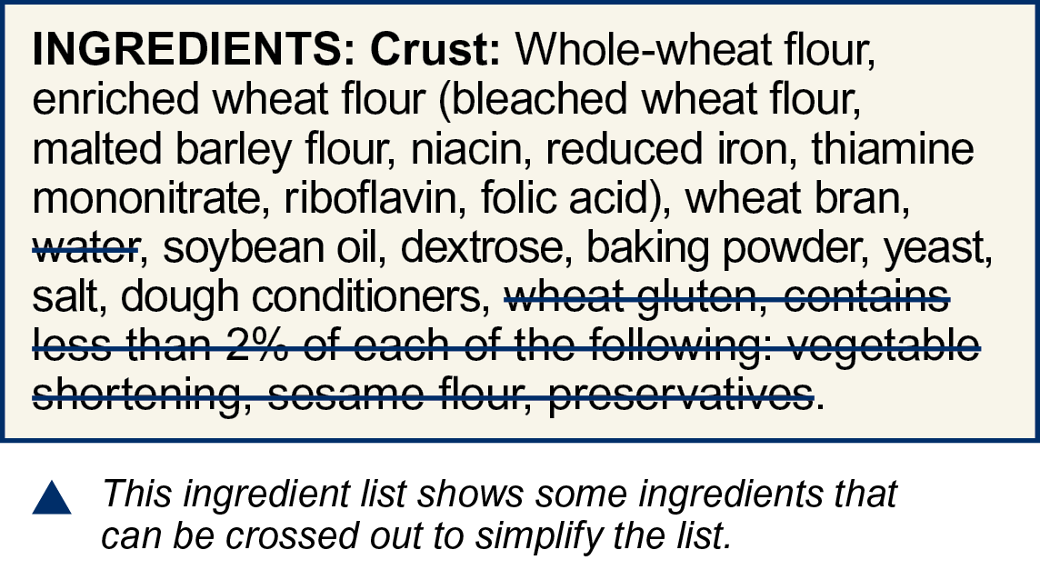
Step 2: Simplify the Ingredient List
See page 2 for list of disregarded ingredients.
Cross out disregarded ingredients on the ingredient list.
Notes:
Sometimes, grain items have “disregarded ingredients.” You can find these disregarded ingredients on page 2 of your worksheet.
Many of these disregarded ingredients are made from grains, but there is usually such a small amount that they can be ignored when using the Rule of Three. Once you have found the ingredient list, you want to look for any disregarded ingredients, and cross them out. Of course, if you are in the store looking at the ingredient list of a food before you buy it, you could put your finger over the disregarded ingredients rather than marking them out.
The ingredient list on the slide shows only the ingredients of the pizza crust. The ingredients for the pizza’s cheese and the pizza’s tomato sauce are not shown. You can see that the ingredients in the crust include water, wheat gluten, and the statement “Contains less than 2% of each of the following.” These items are on the Disregarded Ingredients list on page 2. That means all of these disregarded ingredients can be crossed out.

Slide 17
Step 3: Look at the First Ingredient
Notes:
Now, we are ready to look at our first ingredient, and see if it meets the first step in the Rule of Three.

Slide 18
Try It Out!
What is the first ingredient?
Whole-wheat flour
Enriched wheat flour
Yeast
?
Notes:
Let’s do this together as a Try It Out! question.
Take a look at this ingredient list for the pizza crust. What is the first ingredient? This ingredient list is also shown on the top of page 2, under “Step 2.”
Raise your hand if you think whole-wheat flour is the first ingredient [pause for a show of hands].
Raise your hand if you think enriched wheat flour is the first ingredient [pause for a show of hands].
Raise your hand if you think yeast is the first ingredient [pause for a show of hands].

Slide 19
Try It Out!
Answer
What is the first ingredient?
Whole-wheat flour
Enriched wheat flour
Yeast
?
Notes:
Great job everyone! The first ingredient is whole-wheat flour!

Slide 20
Is the First Ingredient Whole-Grain?
Notes:
When using the Rule of Three in CACFP, the first ingredient must be whole-grain. As we mentioned earlier, some common whole-grain ingredients are listed on page 5 of the training worksheet. Examples include brown rice, bulgur, oats, quinoa, whole wheat flour, wild rice, and more.
Again, this is not an exhaustive list of whole grain ingredients, so if you have any questions about whether an ingredient is whole-grain or not, please check with your sponsor or State agency.

Slide 21
Try It Out!
The first
ingredient is whole-wheat flour. Is the first ingredient whole grain?
?
Yes
No
Notes:
Let’s do a knowledge check to see if the first ingredient is whole grain.
Take a look at the common whole-grain ingredients on page 5 of the handout.
Is the first grain ingredient in this ingredient list, the whole-wheat flour, a whole grain?
Raise your hand if you think that the first ingredient is a whole-grain [pause for a show of hands].
Raise your hand if you do NOT think that the first ingredient is a whole-grain [pause for a show of hands].

Slide 22
Try It Out!
Answer
The first
ingredient is whole-wheat flour. Is the first ingredient whole grain?
?
Yes
No
Whole-wheat flour
Notes:
Nice work everyone! The answer is Yes! The first grain ingredient in this ingredient list is whole-grain.
As we talked mentioned earlier, the first ingredient is whole-wheat flour. Whole-wheat flour is on the list of whole-grain ingredients on page 5, so we know that the first grain ingredient in this ingredient list is whole-grain.
If the first grain ingredient is NOT whole grain, then you will need to use a different method to see if it’s whole grain-rich. Please contact your State agency or sponsor for more information.

Slide 23
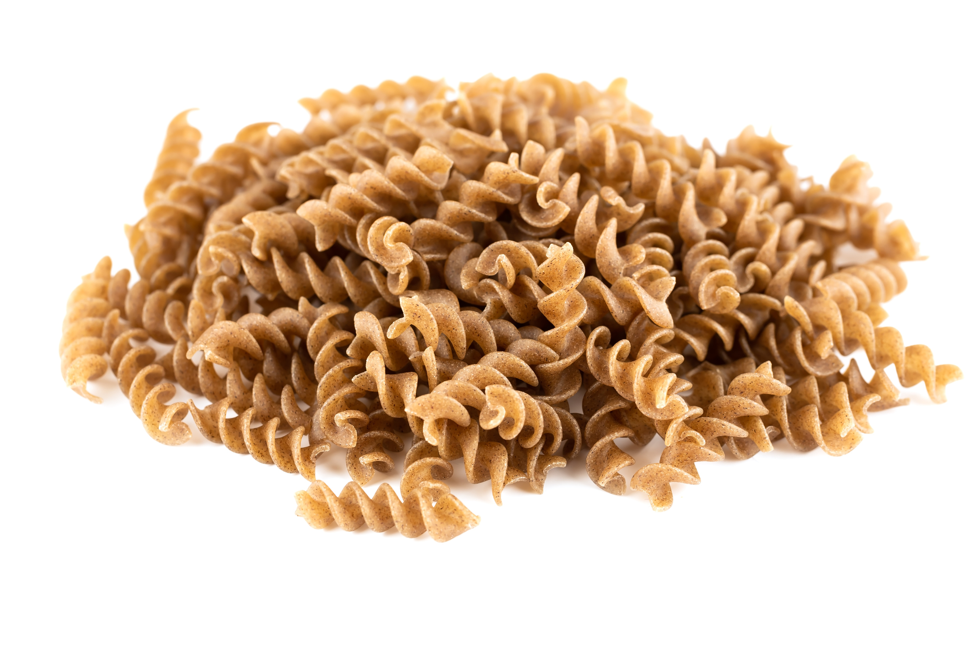
Foods with One Grain Ingredient
Ingredients:
Whole Grain Durum Wheat Flour
Ingredients:
Whole Grain Wheat Flour, Soybean Oil, Sugar, Cornstarch, Malt Syrup, Salt, Refiner’s Syrup, Leavening, Vegetable Color
Notes:
Some grain foods may have only one grain ingredient, like the pasta and the crackers shown on the slide. If the item only has one grain ingredient, and it is a whole-grain ingredient, then you can stop here. Your food is whole grain-rich!

Slide 24
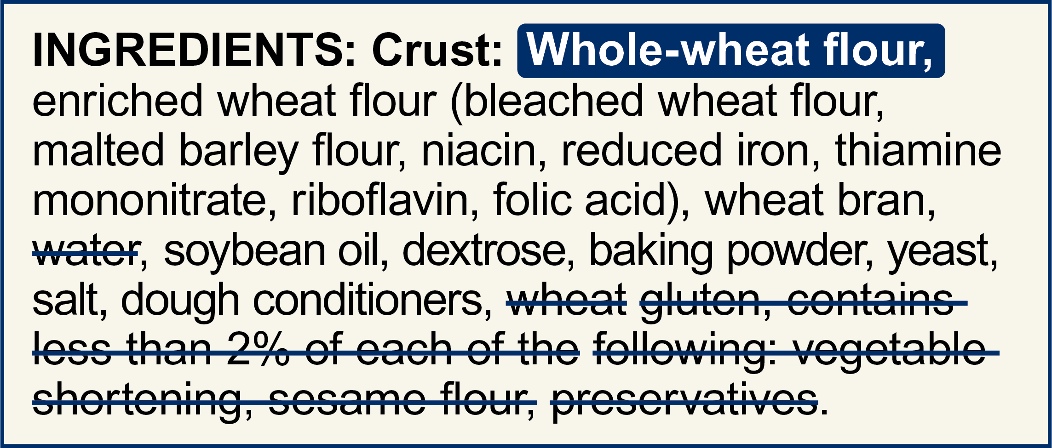
Step 4: Look for the Second Grain Ingredient
Notes:
When we look the ingredient list for the pizza crust, some of the words on the list tell us there may be other grain ingredients in the crust, such as “wheat flour” and “wheat bran,” as outlined in red on the slide. This lets us know that we should move on to the next step in the Rule of Three where we will look for the second grain ingredient.

Slide 25
Try It Out!
What is the second grain ingredient?
Enriched wheat flour
Malted barley flour
Wheat bran
?
Notes:
Let’s look for the second grain ingredient in this pizza crust. We know the first ingredient is whole-wheat flour, which is a whole grain ingredient. What is the second grain ingredient?
Raise your hand if you think the second grain ingredient is enriched wheat flour [pause for a show of hands].
Raise your hand if you think the second grain ingredient is malted barley flour [pause for a show of hands].
Raise your hand if you think the second grain ingredient is wheat bran [pause for a show of hands].

Slide 26
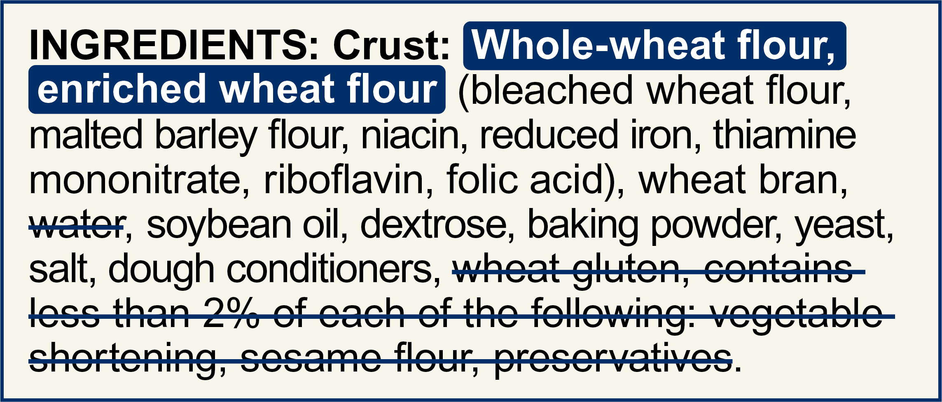
Try It Out!
Answer
What is the second grain ingredient?
Enriched wheat flour
Malted barley flour
Wheat bran
?
Notes:
Nice work everyone! The second grain ingredient is enriched wheat flour.

Slide 27
Try It Out!
The second grain ingredient is enriched wheat flour. Is this ingredient…
?
Whole-grain
Enriched
Bran or germ
Non-creditable
Notes:
When using the Rule of Three in CACFP, the first ingredient must be whole grain, and the second grain ingredient must be whole-grain, enriched, bran, or germ.
We know that the second grain ingredient in this pizza crust is enriched wheat flour. What kind of ingredient is enriched wheat flour? Is it whole-grain, enriched, bran, or germ, or is it none of the above? Take a look at the Whole-Grain Ingredients chart on page 5, as well as the charts of enriched, bran, germ and non-creditable grains on page 6.
Raise your hand if you think that enriched wheat flour is a whole-grain ingredient [pause for a show of hands].
Raise your hand if you think that enriched wheat flour is an enriched ingredient [pause for a show of hands].
Raise your hand if you think that enriched wheat flour is a type of bran or germ [pause for a show of hands].
Raise your hand if you think that enriched wheat flour is a non-creditable ingredient [pause for a show of hands].

Slide 28
Try It Out!
Answer
The second grain ingredient is enriched wheat flour. Is this ingredient…
?
Whole-grain
Enriched
Bran or germ
Non-creditable
Enriched wheat flour
Notes:
Nice work everyone! Enriched wheat flour is an enriched ingredient. Enriched wheat flour is shown on the “Enriched Grain Ingredients” chart on page 6 of the worksheet.
If the second grain ingredient is not whole-grain, enriched, bran, or germ, then you will need to use a different method to see if the food is whole grain-rich. If the second grain ingredient is a non-creditable grain or flour, you will also need to use a different method to see if the food is whole grain-rich. Please contact your State agency or sponsor for more information.

Slide 29
A Closer Look…
Notes:
Let’s take a closer look at the enriched wheat flour. Some of you might have noticed that the enriched wheat flour has a parenthesis next to it, and the parenthesis includes a long list of ingredients that make up the enriched wheat flour. Think of the ingredients in the parenthesis as a part of the ingredient in front of it. In other words, the bleached wheat flour, malted barley flour, the niacin (which is a vitamin), and all the way down to folic acid, are all part of the enriched wheat flour.
When using the Rule of Three, the enriched wheat flour and everything in the parenthesis count as ONE grain ingredient. So, everything inside the red boxes is considered part of the enriched wheat flour.

Slide 30
Step 5: Look for the Third Grain Ingredient
Notes:
Let’s go back to looking at the entire ingredient list for the pizza crust—we talked about how the first grain ingredient, the whole-wheat flour, was a whole grain, and we talked about how the second grain ingredient, the enriched wheat flour, is enriched.
If you had a product that had only two grain ingredients, and the first ingredient was whole grain, and the second grain ingredient was whole grain, enriched, bran or germ, then you could stop here—you know your food is whole grain-rich!
For this pizza crust, we see another word on the list that tells us there may another grain ingredient in the crust—the wheat bran. So, we know that we should move on to the last step in the Rule of Three where we will look for the third grain ingredient.

Slide 31
Try It Out!
What is the third grain ingredient?
Bleached wheat flour
Malted barley flour
Wheat bran
Yeast
?
Notes:
We know the first ingredient is whole-wheat flour, which is a whole grain ingredient. We know the second grain ingredient is enriched wheat flour, and that includes all of the ingredients that are in parenthesis next to “enriched wheat flour.”
What is the third grain ingredient in this pizza crust?
Raise your hand if you think the third grain ingredient is bleached wheat flour [pause for a show of hands].
Raise your hand if you think the third grain ingredient is malted barley flour [pause for a show of hands].
Raise your hand if you think the third grain ingredient is wheat bran [pause for a show of hands].
Raise your hand if you think the third grain ingredient is yeast [pause for a show of hands].

Slide 32
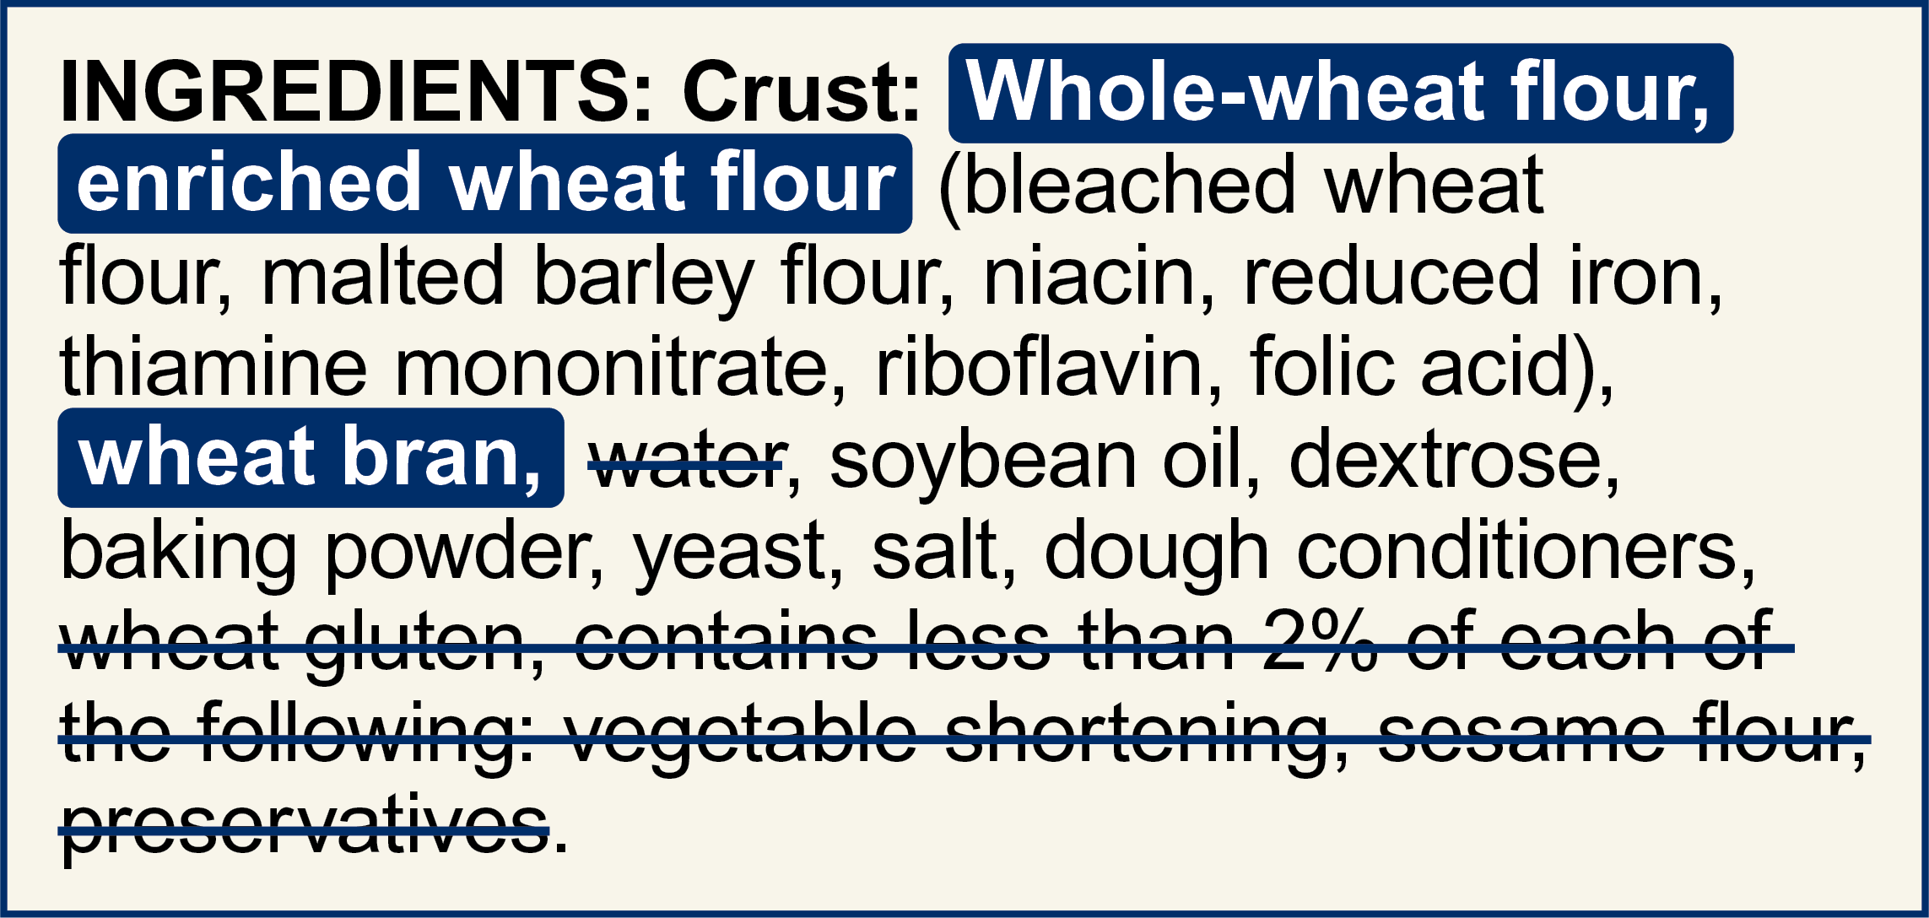
Try It Out!
Answer
What is the third grain ingredient?
Bleached wheat flour
Malted barley flour
Wheat bran
Yeast
?
Notes:
Nice work! The third grain ingredient is wheat bran.

Slide 33
Try It Out!
The third grain ingredient is wheat bran.
Is this ingredient...
?
Whole-grain
Enriched
Bran or germ
Non-creditable
Notes:
When using the Rule of Three in CACFP, the first grain ingredient must be whole grain, and the second and third grain ingredients must be whole-grain, enriched, bran, or germ.
We know that the third grain ingredient in this pizza crust is wheat bran. Take a look at the Whole-Grain Ingredients chart on page 5, as well as the charts of enriched, bran, germ and non-creditable grains on page 6.
What kind of ingredient is wheat bran? Is it whole-grain, enriched, bran, or germ, or is it none of the above?
Raise your hand if you think that wheat bran is a whole-grain ingredient [pause for a show of hands].
Raise your hand if you think that wheat bran is an enriched ingredient [pause for a show of hands].
Raise your hand if you think that wheat bran is a type of bran or germ [pause for a show of hands].
Raise your hand if you think that wheat bran is a non-creditable ingredient [pause for a show of hands].

Slide 34
Try It Out!
Answer
The third grain ingredient is wheat bran.
Is this ingredient...
?
Whole-grain
Enriched
Bran or germ
Non-creditable
Wheat bran
Notes:
Nice work everyone! Wheat bran is a type of bran. Wheat bran is shown on the “Bran or Grain Ingredients” chart on page 6 of the worksheet.
If the third grain ingredient is not whole-grain, enriched, bran, or germ, then you will need to use a different method to see if the food is whole grain-rich. If the third grain ingredient is a non-creditable grain or flour, you will also need to use a different method to see if the food is whole grain-rich. Please contact your State agency or sponsor for more information.

Slide 35
Try It Out!
Rule of Three:
1st ingredient must be whole-grain
2nd ingredient must be whole-grain, enriched, bran, or germ
3rd ingredient must be whole-grain, enriched, bran, or germ
?
Is this pizza crust whole grain-rich?
Yes
No
Notes:
Keeping this in mind, let’s do one last Try It Out! question. Is this pizza crust whole grain-rich?
Remember that for a grain item to be considered whole grain-rich using the Rule of Three, the first ingredient must be whole-grain, the second ingredient must be whole-grain, enriched, bran, or germ, and the third ingredient must be whole-grain, enriched, bran or germ.
Thinking back over the three grain ingredients we talked about today—the whole-wheat flour, the enriched wheat flour, and the wheat bran:
Raise your hand if you think this pizza crust is considered whole grain-rich in the CACFP [pause for a show of hands].
Raise your hand if you think this pizza crust is NOT considered whole grain-rich in the CACFP [pause for a show of hands].

Slide 36
Try It Out!
Answer
Rule of Three:
1st ingredient must be whole-grain
2nd ingredient must be whole-grain, enriched, bran, or germ
3rd ingredient must be whole-grain, enriched, bran, or germ
?
Is this pizza crust whole grain-rich?
Yes
No
Notes:
Nice work everyone! The answer is Yes! This pizza crust is considered whole grain-rich because:
the first grain ingredient, the whole-wheat flour, is whole-grain,
the second grain ingredient, the enriched wheat flour, is enriched; and
the third grain ingredient is wheat bran, which is a type of bran.

Slide 37

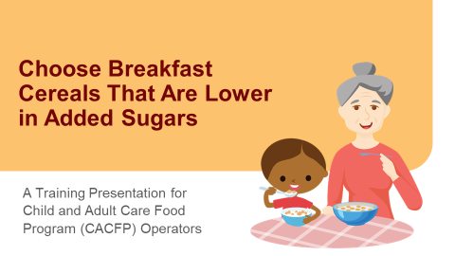
Ready-to-Eat Cereals: Check the Sugar Limit
Make sure the cereal meets the CACFP sugar limit.
For more information, see Team Nutrition’s “Choose Breakfast Cereals That Are Lower in Sugar.
Webinar Recording and Presentation Slides
Training Worksheet
fns.usda.gov/tn/choose-breakfast-cereals-are-lower-sugar
Notes:
Now, let’s talk quickly about ready-to-eat breakfast cereals. For ready-to-eat cereals, you may not always have to look at the first three grain ingredients to tell if it’s whole grain-rich in CACFP.
Before looking at the cereal to see if it’s whole grain-rich, you want to make sure it meets the sugar limit for cereal in the CACFP, which is no more than 6 grams of sugar per one ounce of dry cereal. For more information on the CACFP sugar limit for breakfast cereals, please see Team Nutrition’s “Choose Breakfast Cereals That Are Lower in Sugar” training worksheet, webinar recording, and presentation slides. These resources can be found at the web address at the bottom of this slide.

Slide 38

Ready-to-Eat Cereals:
Look at the First Ingredient
Make sure the first ingredient is whole-grain.
INGREDIENTS: Whole grain oat flour, corn flour, sugar, salt, tripotassium phosphate, vitamin E. Vitamins and Minerals: calcium carbonate, iron and zinc, vitamin C, vitamin B6, vitamin A, vitamin B12.
Whole grain oat flour
Notes:
Once you have made sure your cereal meets the sugar limit, take a look at the first grain ingredient. The first ingredient in the cereal must be a whole grain. If the first ingredient is not a whole grain, then you must use another method to determine if this cereal is whole grain-rich.
The first ingredient in this cereal is whole grain oat flour. The Whole-Grain Ingredients chart on page six shows that whole grain oat flour is a whole grain ingredient, so we can move to the next step.

Slide 39
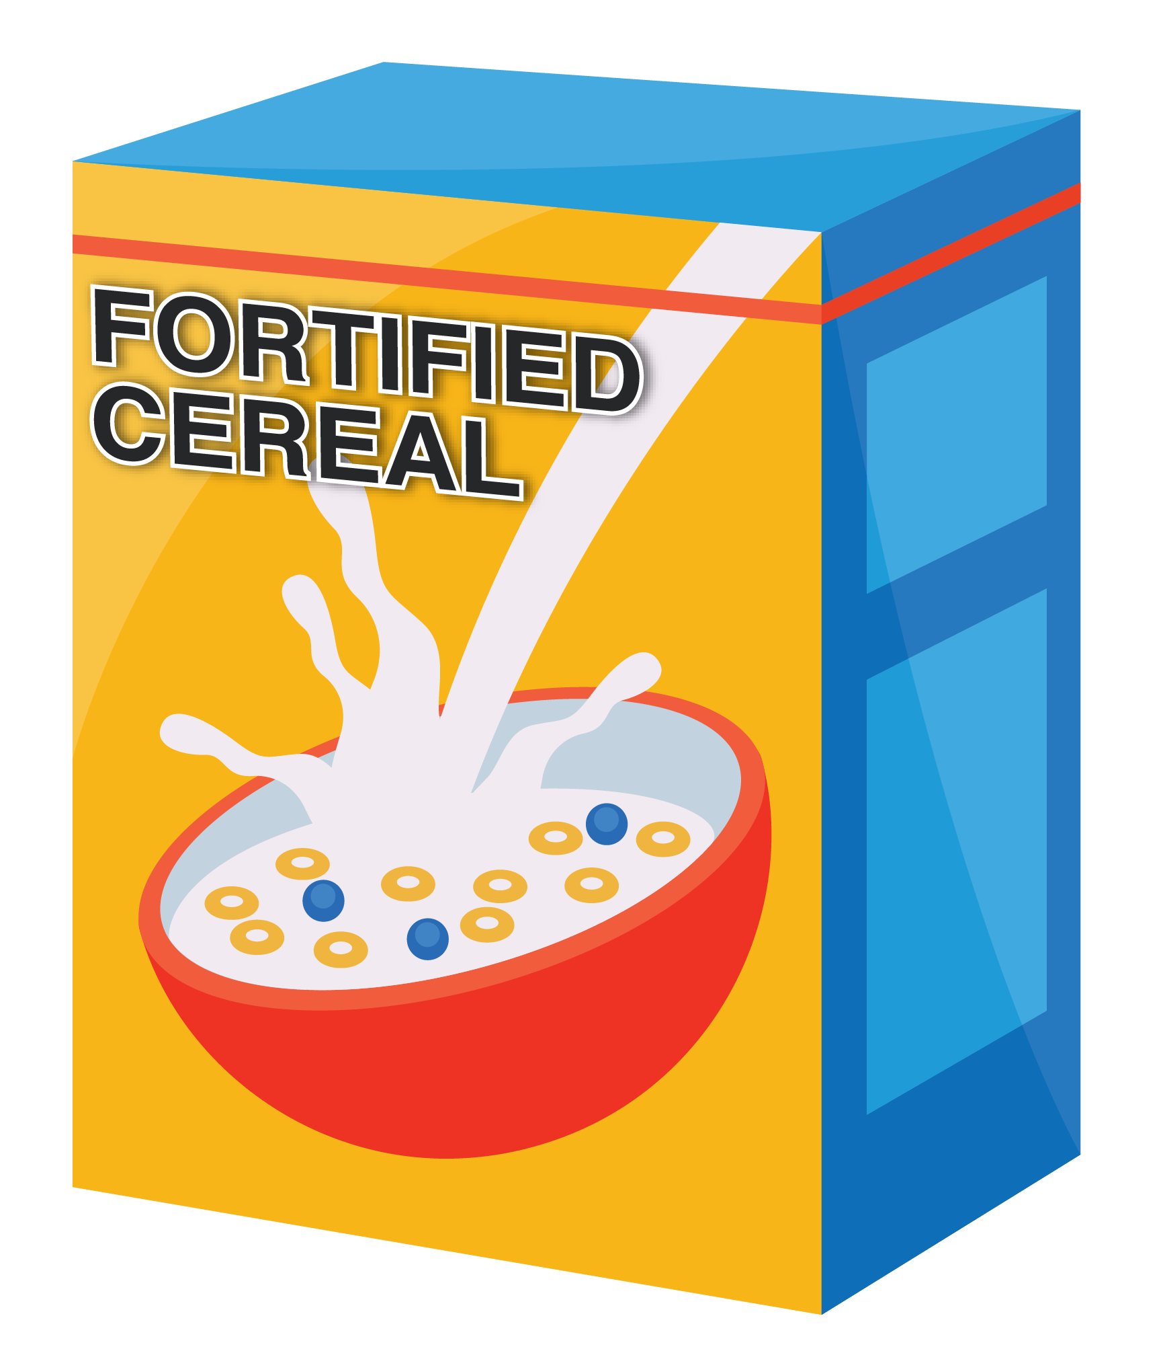
Ready-to-Eat Cereals: Look for Fortification
Look for vitamins and minerals in the ingredient list.
OR
Look for the word “fortified” on the package.
INGREDIENTS: Whole grain oat flour, corn flour, sugar, salt, tripotassium phosphate, vitamin E. Vitamins and Minerals: calcium carbonate, iron and zinc, vitamin C, vitamin B6, vitamin A, vitamin B12.
Notes:
After we have made sure the first ingredient in the cereal is whole grain, the next step is to look for fortification. This means we do not need to look for a second or third grain ingredient, once we make sure the first ingredient in the ingredient list is a whole grain.
To see if the cereal is fortified, look at the ingredient list. If the ingredient list includes any vitamins and minerals that have been added to the product, then the cereal is fortified. Or, you can look for the word “fortified” on the cereal package.

Slide 40
Ready-to-Eat Cereals: Whole Grain-Rich
INGREDIENTS: Whole grain oat flour, corn flour, sugar, salt, tripotassium phosphate, vitamin E. Vitamins and Minerals: calcium carbonate, iron and zinc, vitamin C, vitamin B6, vitamin A, vitamin B12.
Notes:
This ingredient list for cereal on this slide shows that the first ingredient, whole grain oat flour, is whole grain. The ingredient list also shows that there are vitamins and minerals in this cereal. This tells us that the cereal is fortified. Because the first ingredient is whole grain, and the cereal is fortified, this cereal is whole grain-rich in the CACFP.
If the first ingredient is whole-grain, but your cereal is not fortified, or if you don’t know if it’s fortified, then you can use the regular Rule of Three that we just talked about—where we look at the first three grain ingredients—to tell if your cereal is whole grain-rich. Or, you can use another method to see if the cereal is whole grain-rich.

Slide 41
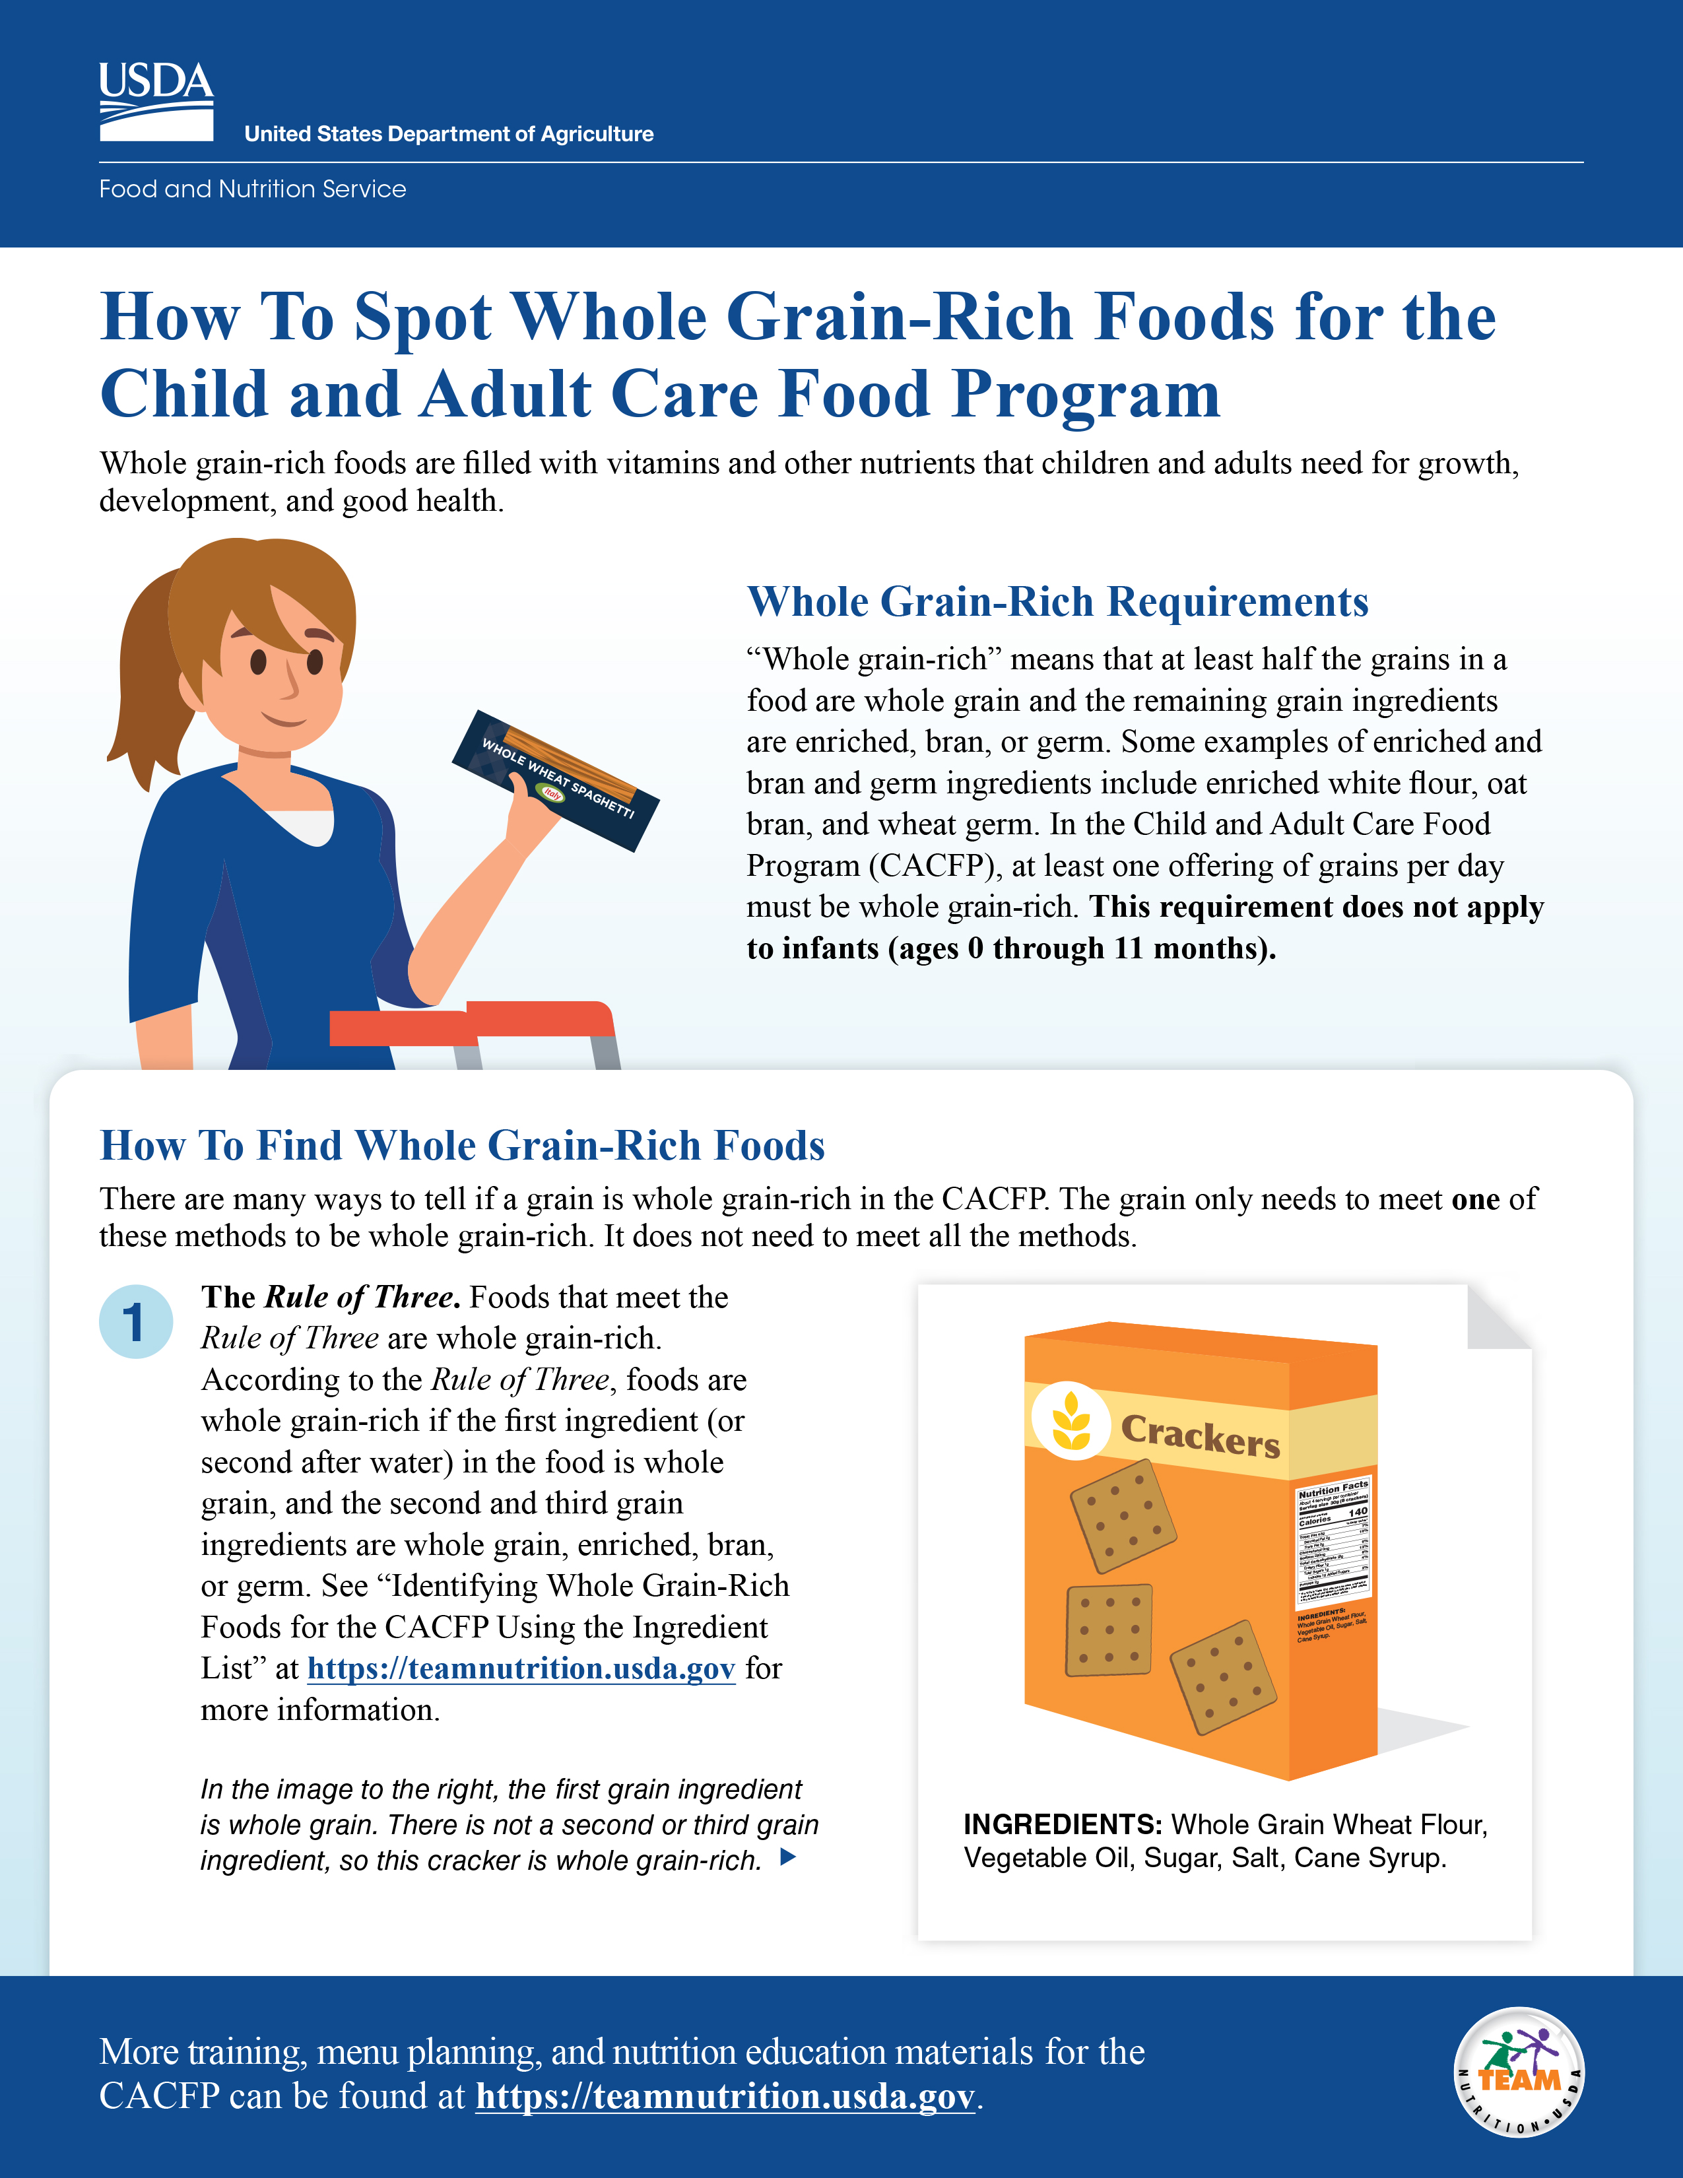
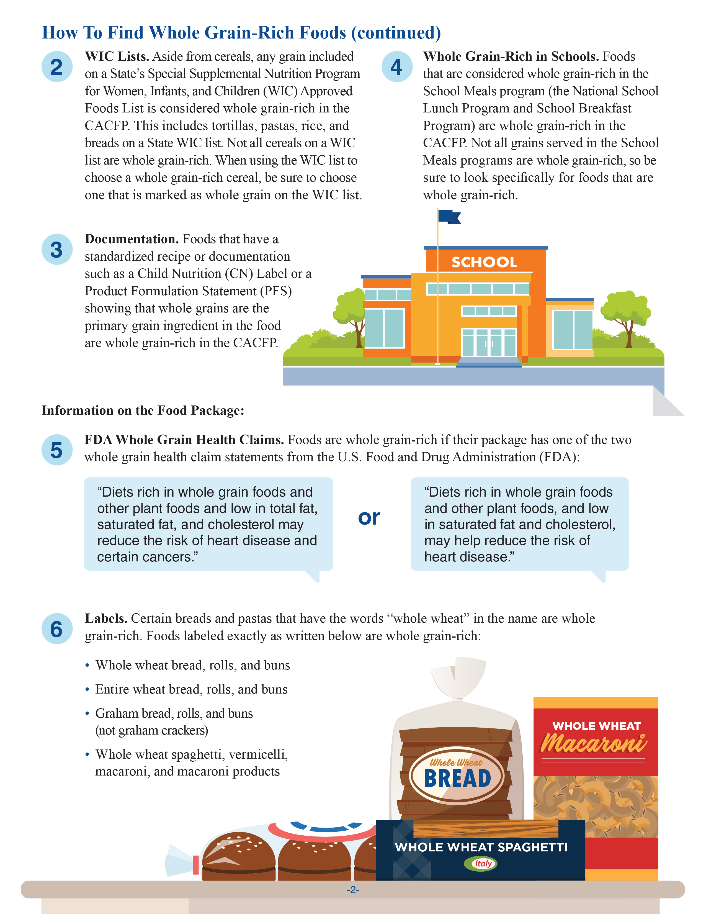
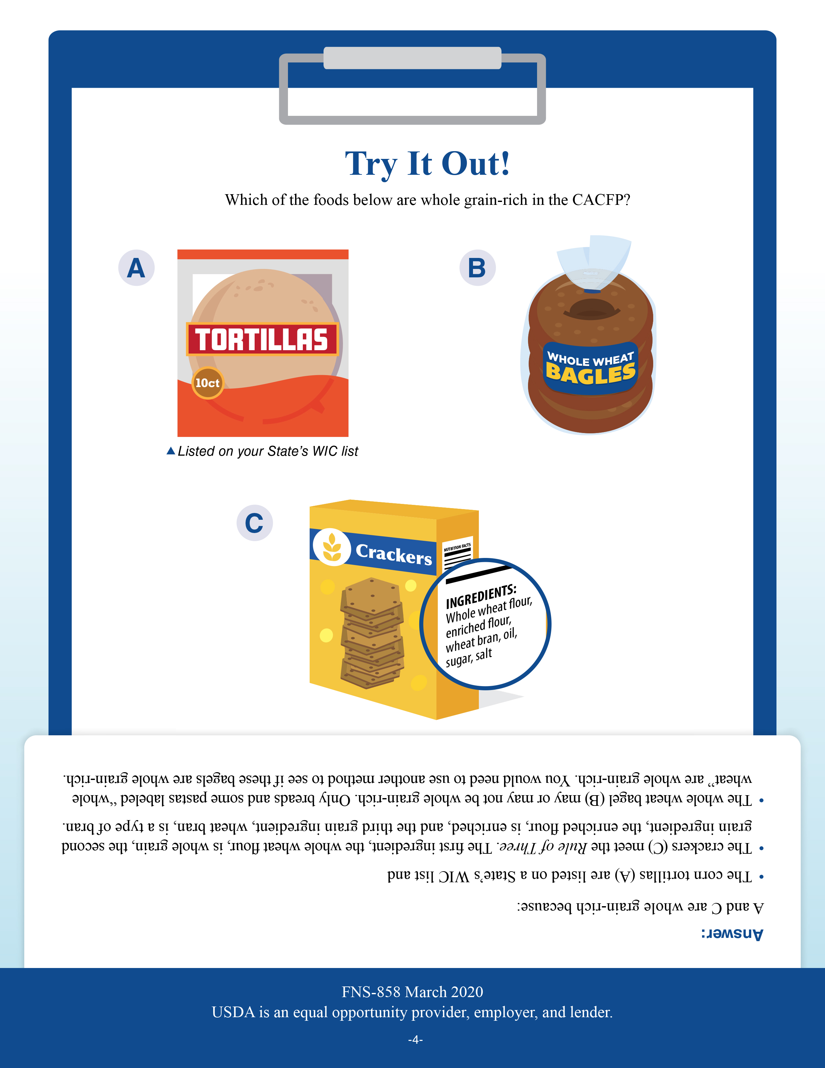
How to Spot Whole Grain-Rich Foods for the CACFP
fns.usda.gov/tn/how-spot-whole-grain-rich-foods-cacfp
Notes:
Finally, let’s take a closer look at other methods you can use to tell if an item is whole grain-rich in the CACFP. You can use any of these methods. The item only needs to meet one of the methods to be considered whole grain-rich. It does not have to meet all the methods.
Team Nutrition has created a training worksheet titled “How to Spot Whole Grain-Rich Foods for the Child and Adult Care Food Program.” This worksheet describes the different methods for determining if an item is whole grain-rich. You can download this worksheet from the web address on the screen if you’d like. You can also just follow along with the pictures shown on the slides.

Slide 42
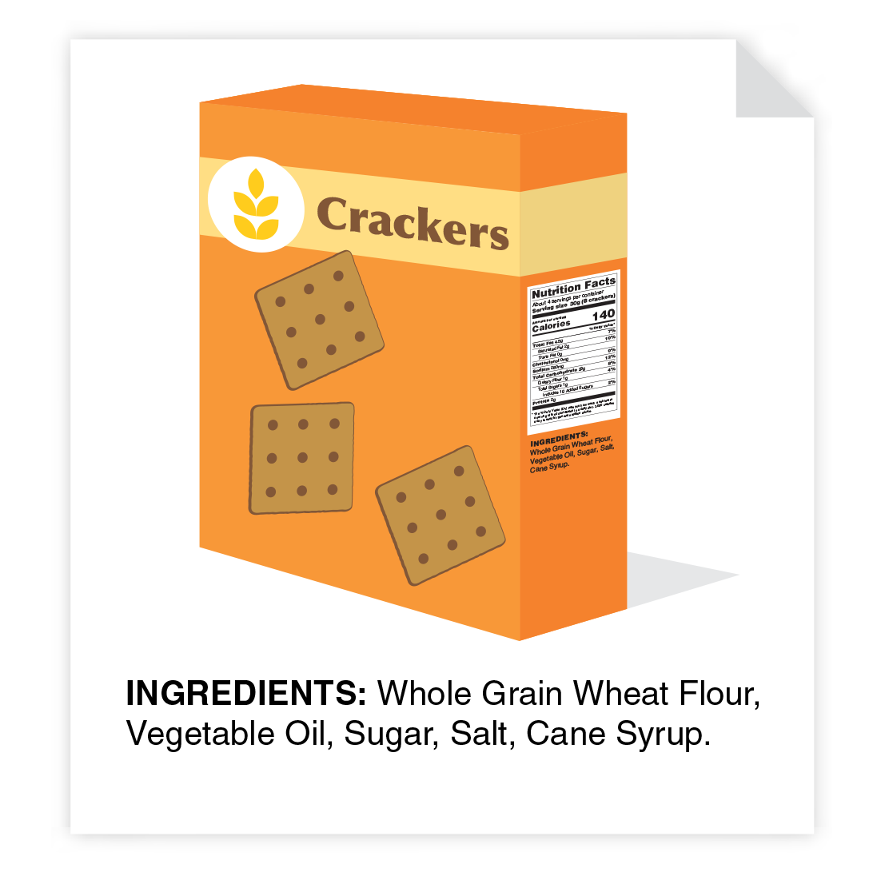
The Rule of Three
The Rule of Three. Foods that meet the Rule of Three are whole grain-rich. According to the Rule of Three, foods are whole grain-rich if the first ingredient (or second after water) in the food is whole grain, and the second and third grain ingredients are whole grain, enriched, bran, or germ. See “Identifying Whole Grain-Rich Foods for the CACFP Using the Ingredient List” at https://teamnutrition.usda.gov for more information.
In the image below, the first grain ingredient is whole grain. There is not a second or third grain ingredient, so this cracker is whole grain-rich.
fns.usda.gov/tn/how-spot-whole-grain-rich-foods-cacfp
Notes:
The first page of this worksheet gives a brief overview of the Rule of Three that we discussed today.

Slide 43
WIC Food Lists
WIC Lists. Aside from cereals, any grain included on a State’s Special Supplemental Nutrition Program for Women, Infants, and Children (WIC) Approved Foods List is considered whole grain-rich in the CACFP. This includes tortillas, pastas, rice, and breads on a State WIC list. Not all cereals on a WIC list are whole grain-rich. When using the WIC list to choose a whole grain-rich cereal, be sure to choose one that is marked as whole grain on the WIC list.
fns.usda.gov/tn/how-spot-whole-grain-rich-foods-cacfp
Notes:
Page 2 of this worksheet states that another way to tell if a food is whole grain-rich is to find it on any State agency’s WIC-approved whole-grains list.
If the food is found on any State agency’s WIC-approved whole-grains list, or marked as a whole-grain food on the list, then the food is whole grain-rich.

Slide 44
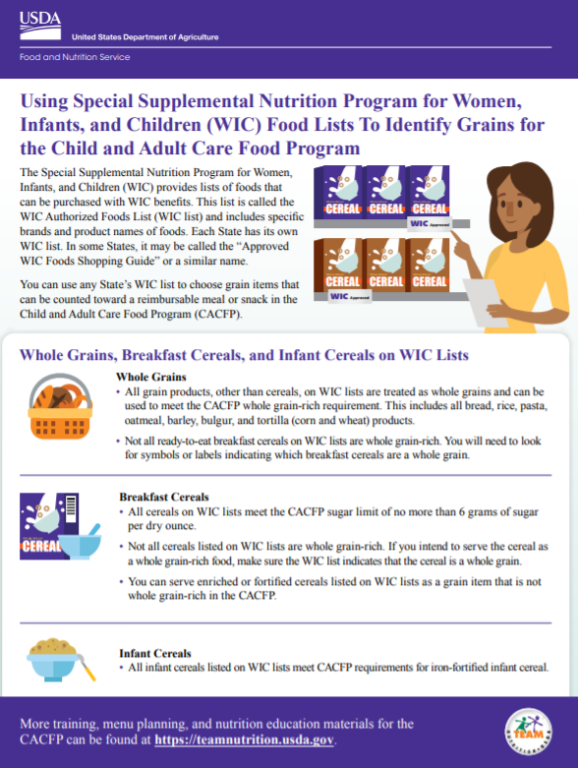

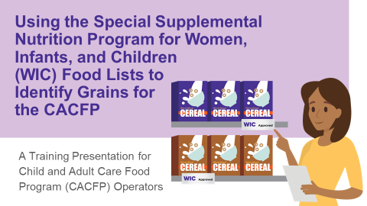
Using WIC Food Lists to Identify Grains for the CACFP
Training Worksheet
Webinar Recording
Presentation Slides
fns.usda.gov/tn/using-wic-food-lists-identify-grains-cacfp
Notes:
Team Nutrition has created a training worksheet, presentation slides, and a 30-minute recorded webinar on how to use the WIC lists to identify whole grain-rich items in the CACFP. You can find these resources at the web address on the bottom of the slide.

Slide 45
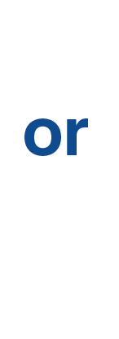
FDA Whole Grain Health Claims
FDA Whole Grain Health Claims. Foods are whole grain-rich if their package has one of the two whole grain health claim statements from the U.S. Food and Drug Administration (FDA):
fns.usda.gov/tn/how-spot-whole-grain-rich-foods-cacfp
Notes:
Another method to tell if an item is whole grain-rich is if it has a U.S. Food and Drug Administration (FDA)-approved whole-grain health claim. The two FDA-approved whole-grain health claims that show that an item is whole grain-rich are shown on the slide. This is also shown on page 2 of the “How to Spot Whole Grain-Rich Foods for the Child and Adult Care Food Program” training worksheet.

Slide 46
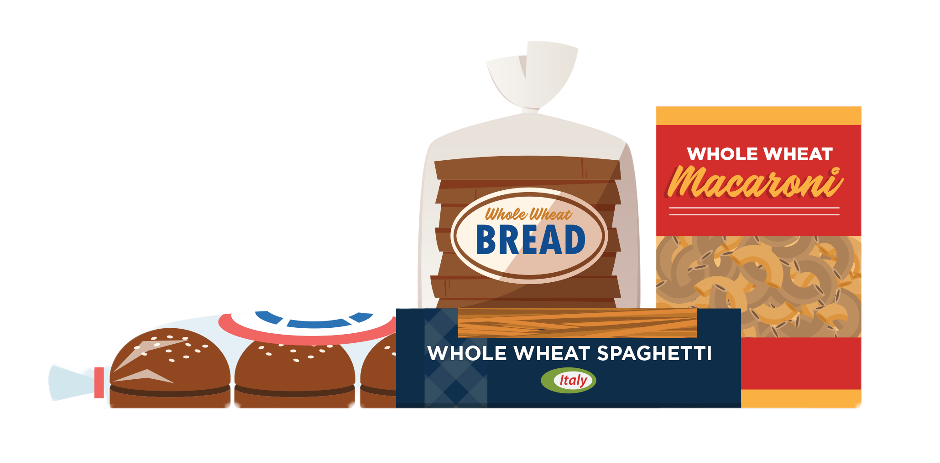
Labels
Labels. Certain breads and pastas that have the words “whole wheat” in the name are wholegrain-rich. Foods labeled exactly as written below are whole grain-rich:
Whole wheat bread, rolls, and buns
Entire wheat bread, rolls, and buns
Graham bread, rolls, and buns
(not graham crackers)
Whole wheat spaghetti,
vermicelli, macaroni, and
macaroni products
fns.usda.gov/tn/how-spot-whole-grain-rich-foods-cacfp
Notes:
Another method to show if an item is whole grain-rich applies to only certain breads and pasta. Foods labeled exactly as written on this slide, or on page 2 of the “How to Spot Whole Grain-Rich Foods for the Child and Adult Care Food Program” training worksheet are considered whole grain-rich:
Whole wheat bread, rolls, and buns.
Entire wheat bread, rolls, and buns.
Graham bread, rolls and buns. Note that this does not include graham crackers.
Whole wheat spaghetti, vermicelli, macaroni and macaroni products.

Slide 47

Whole Grain-Rich in Schools
Whole Grain-Rich in Schools. Foods that are considered whole grain-rich in the School Meals program (the National School Lunch Program and School Breakfast Program) are whole grain-rich in the CACFP. Not all grains served in the School Meals programs are whole grain-rich, so be sure to look specifically for foods that are whole grain-rich.
fns.usda.gov/tn/how-spot-whole-grain-rich-foods-cacfp
Notes:
If an item meets the whole grain-rich criteria for the National School Lunch Program or Breakfast Program, then it is whole grain-rich.

Slide 48
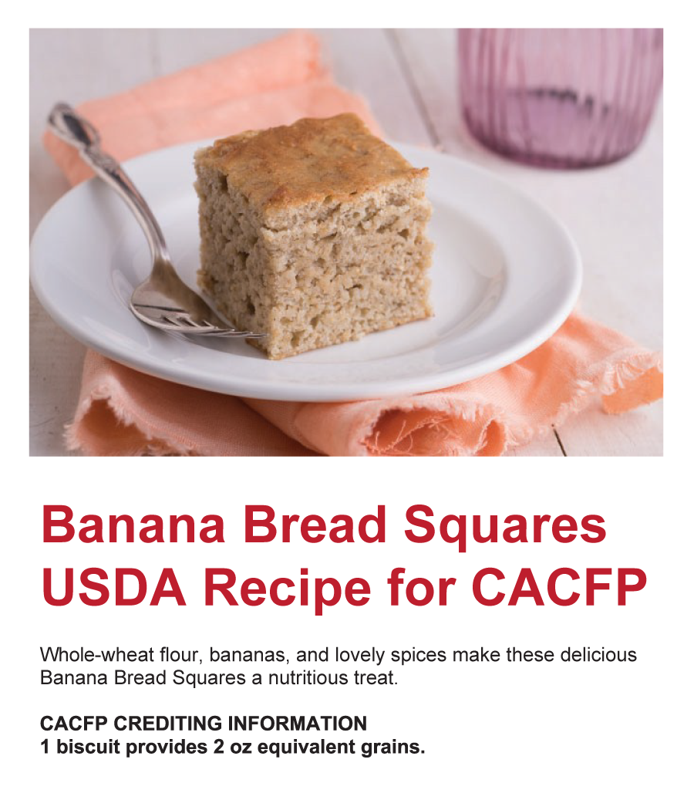
Documentation
Documentation. Foods that have a standardized recipe or documentation such as a Child Nutrition (CN) Label or a Product Formulation Statement (PFS) showing that whole grains are the primary grain ingredient in the food are whole grain-rich in the CACFP.
Notes:
And finally, if you have proper documentation from a manufacturer, or a standardized recipe that shows that whole grains are the main grain ingredient by weight, then the item is whole grain-rich.

Slide 49


How To Order Print Copies
Resource Order Form at TeamNutrition.USDA.gov.
FREE for Child Nutrition operators, while supplies last.
Sponsoring organizations and State agencies can also order in bulk by sending an email to:
TeamNutrition@USDA.gov
Notes:
For all Child Nutrition operators, such as CACFP operators, Team Nutrition’s print materials are free to order.
If program operators would like to order Team Nutrition’s free materials in print, they can go to the “Resource Order Form” link on the Team Nutrition website to order print copies of the materials.
For bulk orders, you can email TeamNutrition@USDA.gov.

Slide 50

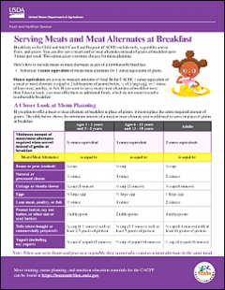
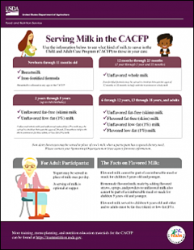
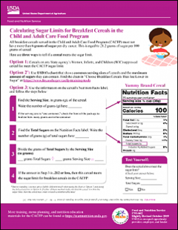
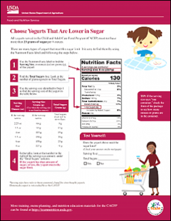
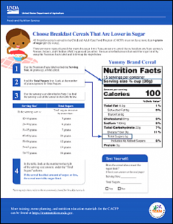
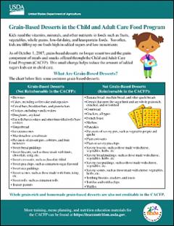
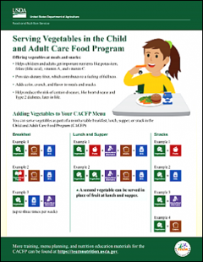
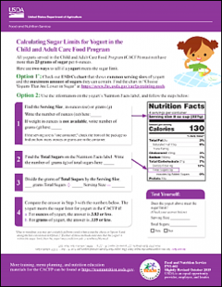
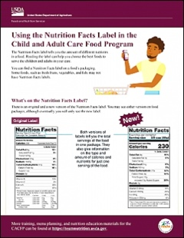
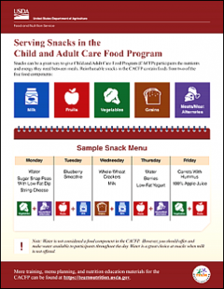
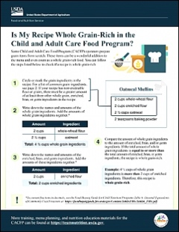
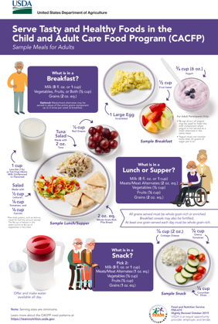
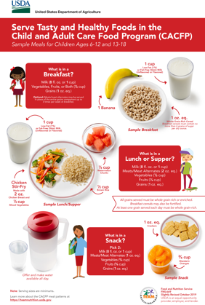
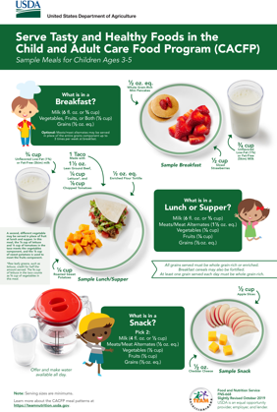
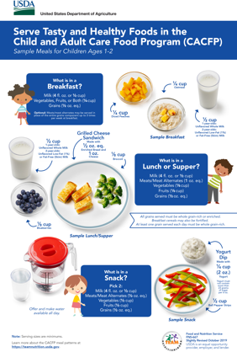
More Team Nutrition Resources!
TeamNutrition.USDA.gov
Notes:
All Team Nutrition materials are available online from Team Nutrition’s website and are available for free download to anybody who is interested.

Slide 51


Thank You!
TeamNutrition.USDA.gov
@TeamNutrition
TeamNutrition@USDA.gov
USDA is an equal opportunity provider, employer, and lender.
Notes:
These training slides were provided by U.S. Department of Agriculture's Team Nutrition. If you would like to learn more about Team Nutrition and additional resources available, please visit their website, subscribe to their e-newsletter, connect with them via email at TeamNutrition@USDA.gov, and follow them on Twitter.
Thank you!

