Slide 1

Identifying Whole Grain-Rich Foods for the CACFP Using the Ingredient List
Part 2
A Training Presentation for
Child and Adult Care Food
Program (CACFP) Operators

Slide 2



Team Nutrition
An initiative of the USDA’s Food and Nutrition Service to support the USDA’s Child Nutrition Programs.
Aims to improve children’s lifelong eating and physical activity habits.
Provides nutrition education and training materials to State agencies, sponsoring organizations, and CACFP sites.
TeamNutrition.USDA.gov
@TeamNutrition
Notes:
Team Nutrition is an initiative of the USDA Food and Nutrition Service that supports the Child Nutrition Programs, including the National School Lunch Program, the School Breakfast Program, and of course, the Child and Adult Care Food Program, or the CACFP.
The goal of Team Nutrition is to improve children's lifelong eating and physical activity habits through nutrition education based on the principles of the Dietary Guidelines for Americans and MyPlate.
It does so through training and technical assistance for those preparing and serving meals, providing nutrition education for children, and building support for healthier school and child care environments.

Slide 3
Let Us Know Who You Are!
I work for a…
?
Child care center
Family child care home
At-risk afterschool care center
Adult day care center
Sponsoring organization
Emergency shelter
School food authority
State agency
USDA Regional Office
Other
Notes:
Before we get started, I want to know who has joined us today.
Please raise your hand if you work for:
a child care center [pause and wait for a show of hands],
a family child care home [pause and wait for a show of hands],
an at-risk afterschool care center [pause and wait for a show of hands],
a sponsoring organization [pause and wait for a show of hands],
an emergency shelter [pause and wait for a show of hands],
a school food authority [pause and wait for a show of hands],
a State agency [pause and wait for a show of hands],
a USDA Regional office [pause and wait for a show of hands], or
other [pause and wait for a show of hands].

Slide 4
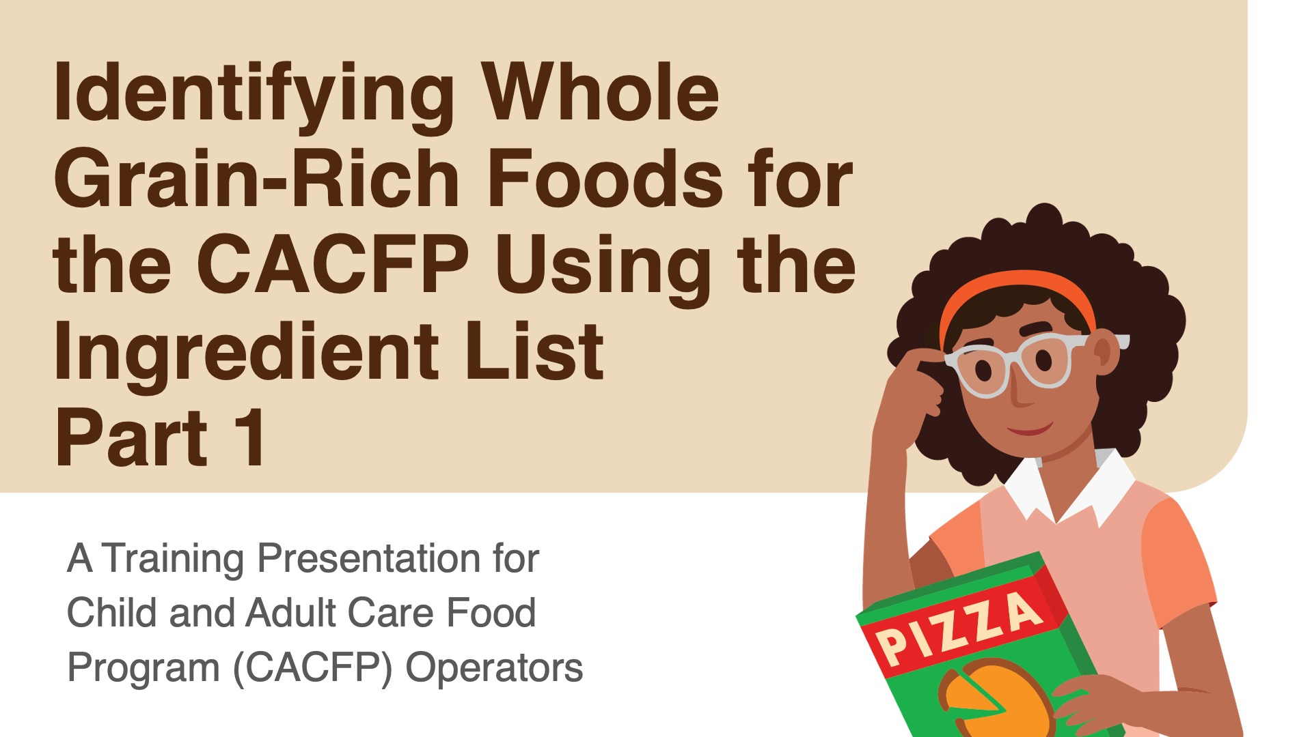
Part 1 of the webinar
fns.usda.gov/tn/meal-pattern-training-slides-cacfp
Notes:
So, let’s get started! Today’s topic is “Identifying Whole Grain-Rich Foods for the CACFP Using the Ingredient List Part 2,“ and we will go into more detail about some topics that were first introduced in Part 1 of our training. Team Nutrition has created slides for Part 1 of this presentation topic. You can download those slides at the web address on the bottom of this slide.

Slide 5
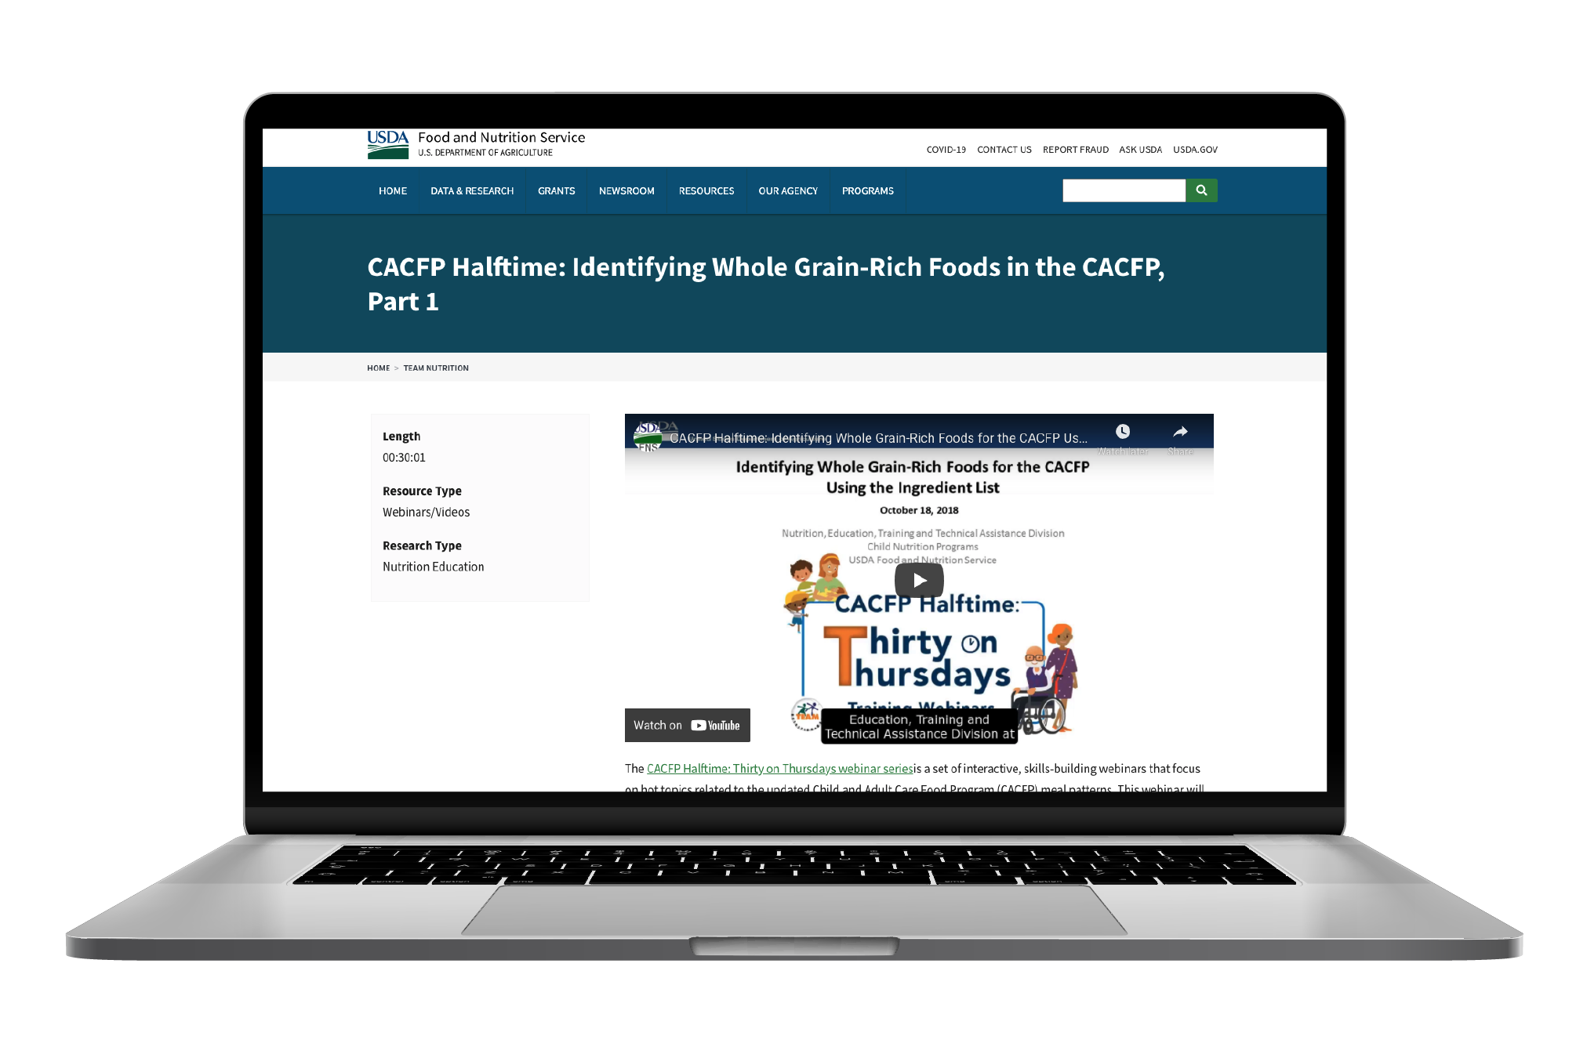
“Identifying Whole Grain-Rich Foods for the CACFP Using the Ingredient List ” webinar
CACFP Halftime: Identifying Whole Grain-Rich
Foods in The CACFP, Part 1
www.fns.usda.gov/tn/identifying-whole-grain-rich-foods-cacfp-using-ingredient-list
Notes:
Team Nutrition also has a recorded webinar that covers Part 1 of this topic. It is titled “Identifying Whole Grain-Rich Foods for the CACFP Using the Ingredient List.” You can find the recording at the web address listed on the slide.

Slide 6
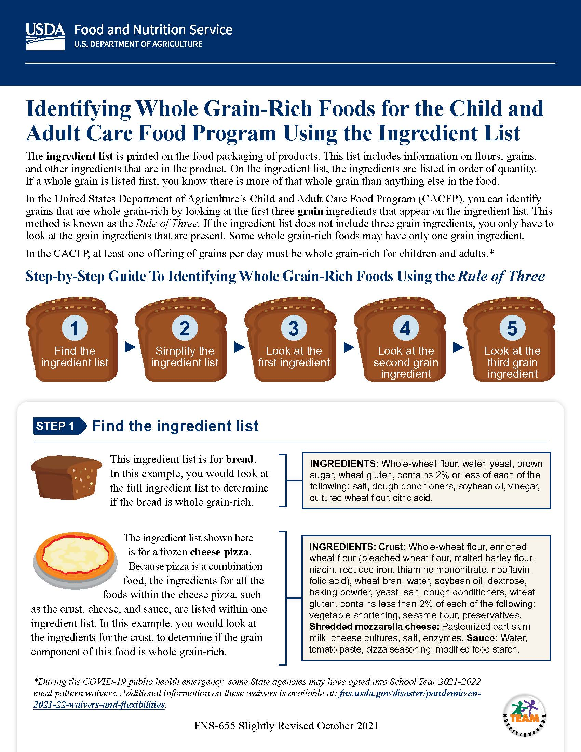
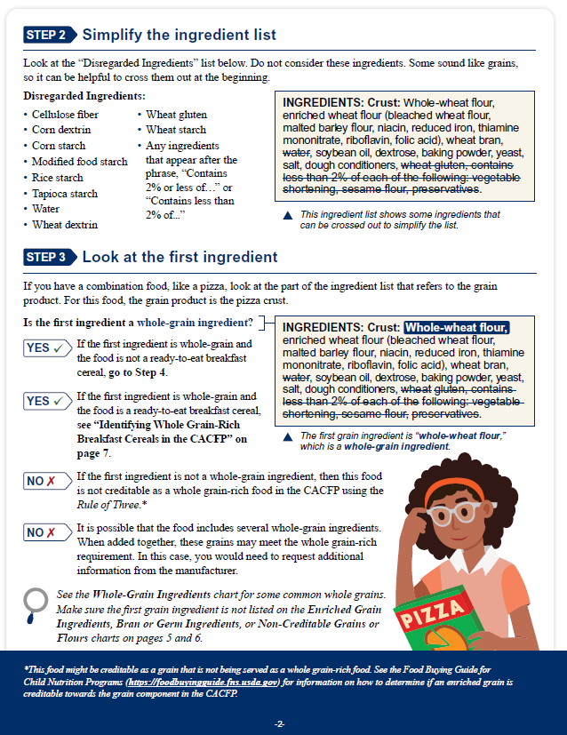
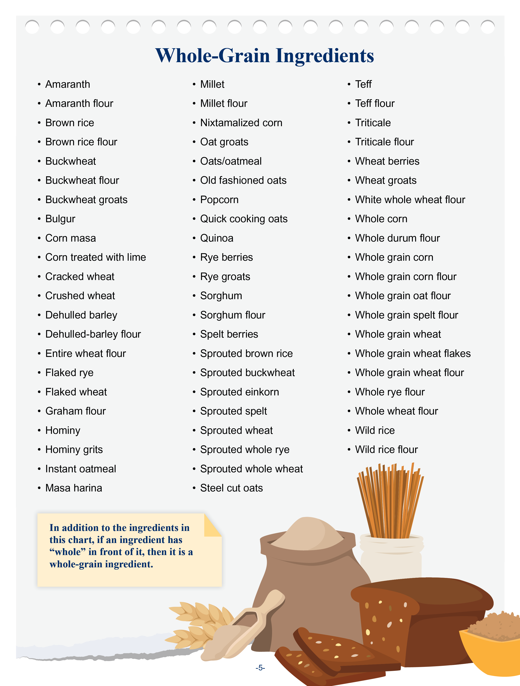
Identifying Whole Grain-Rich Foods for the CACFP Using the Ingredients List
fns.usda.gov/tn/identifying-whole-grain-rich-foods-cacfp
Notes:
The USDA’s Team Nutrition initiative has created a worksheet on “Identifying Whole Grain-Rich Foods for the CACFP using the Ingredients List.” Please download the worksheet from the web address on the slide. We will be using this worksheet throughout today’s presentation.

Slide 7
Today’s Specials
Whole Grain-Rich Overview
Methods for Determining Whole Grain-Rich Foods
Rule of Three Review
Flour Blends
Notes:
Let’s do a very quick overview of whole grain-rich requirements for the CACFP and discuss the different ways to tell if a food is whole grain-rich. We will then do a review of the Rule of Three, which we talked about in detail in Part 1 of this training, and then we will spend the rest of the time talking about how to treat flour blends on an item’s ingredient list when using the Rule of Three.

Slide 8
Whole Grain-Rich Requirements for the CACFP
Anatomy of a Grain
Grains served at one meal or snack every day must be whole grain-rich
Required for child and adult meal patterns only
Whole grain-rich means:
At least half the grain ingredients are whole-grain
Remaining grain ingredients are enriched, bran, or germ
Endosperm
Bran
Germ
Notes:
As many of you know, many of the grains served for at least one snack or meal must be whole grain-rich. This applies only to children and adults in the CACFP. Infants are not required to be offered whole grain-rich foods, but of course you are welcome to serve them to infants if you’d like!
Whole grain-rich means at least half the grain ingredients in a grain food are whole-grain ingredients, and the remaining grain ingredients are enriched grains, bran, or germ. For ready-to-eat cereals, if the first ingredient is whole-grain, and the cereal is fortified, then the breakfast cereal can also be considered whole grain-rich. Foods that only have whole-grain ingredients and no other grain ingredients, such as brown rice, quinoa, oatmeal, etc., are also considered whole grain-rich.
Whole-grain ingredients have all parts of the grain kernel intact. This means that the nutrients that are naturally in the bran and germ are still in the food. Enriched ingredients mean the bran and germ are removed during processing, and then some vitamins and minerals are added back in.

Slide 9
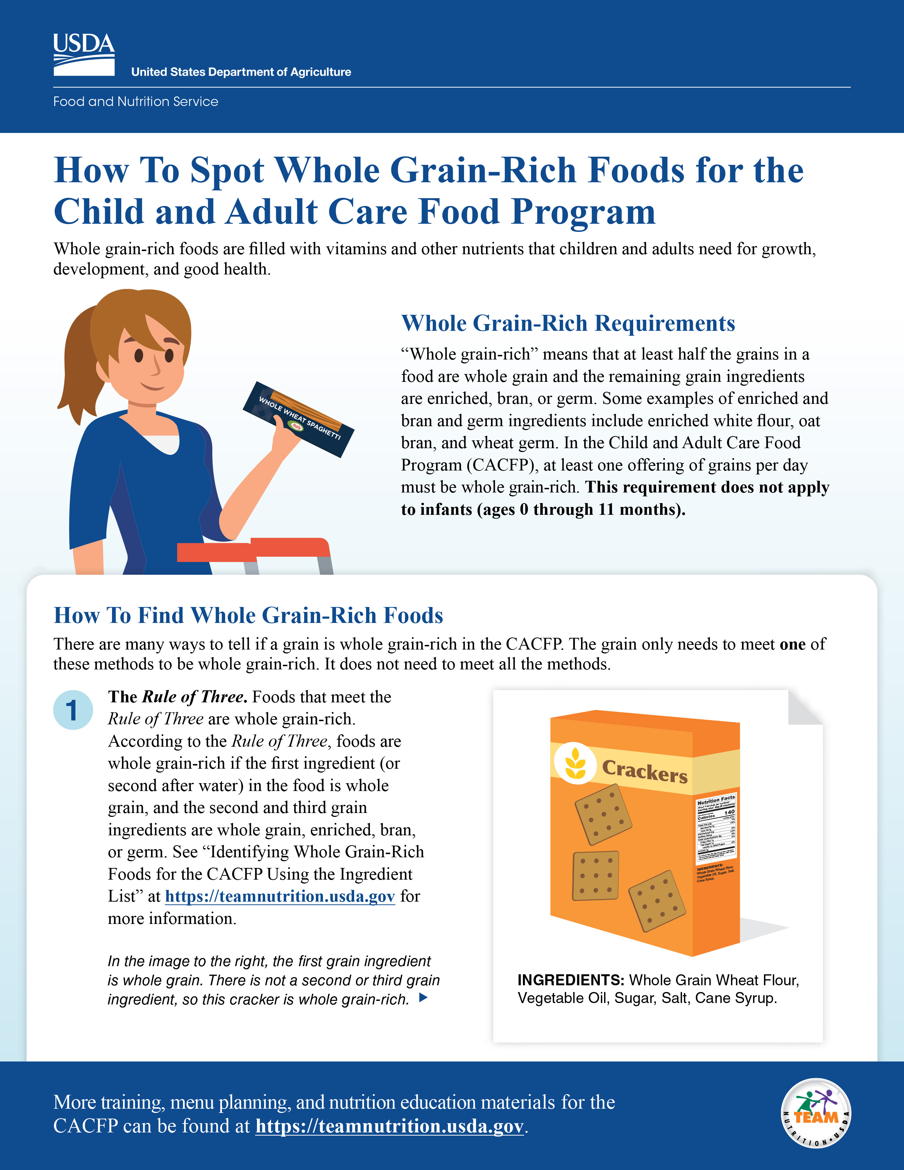
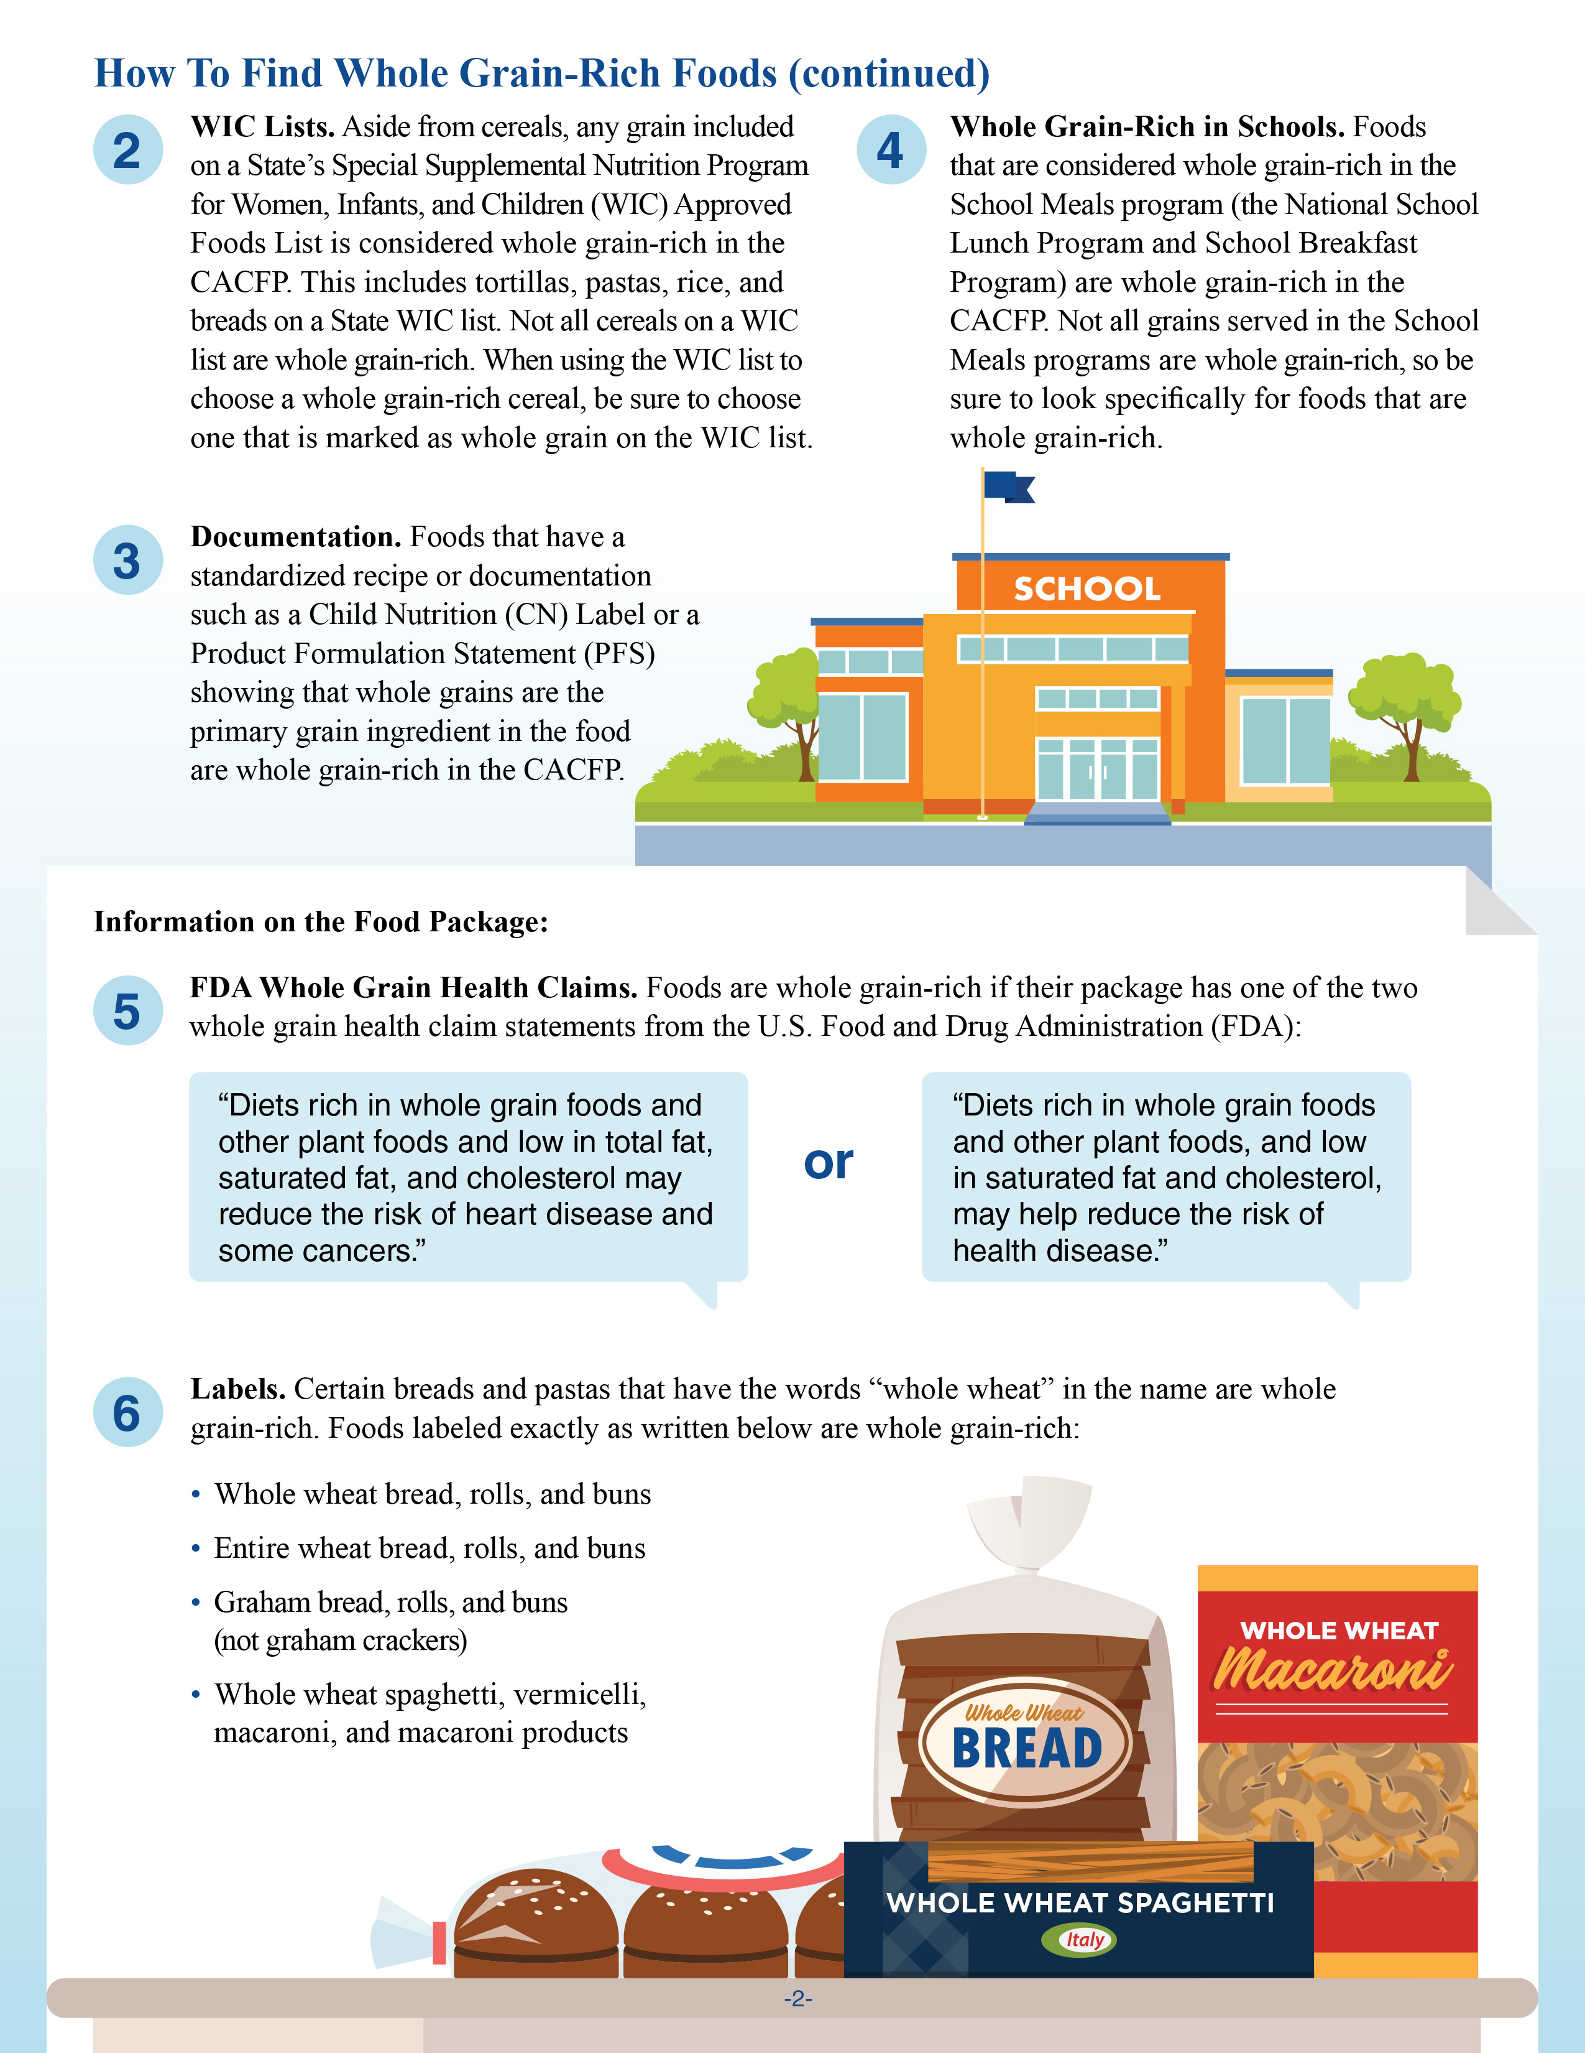
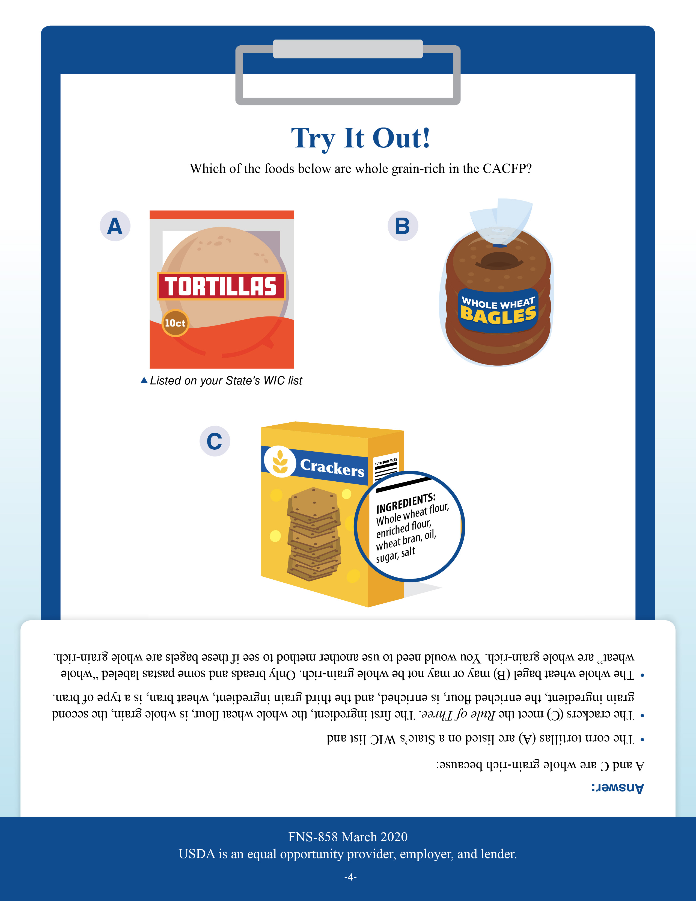
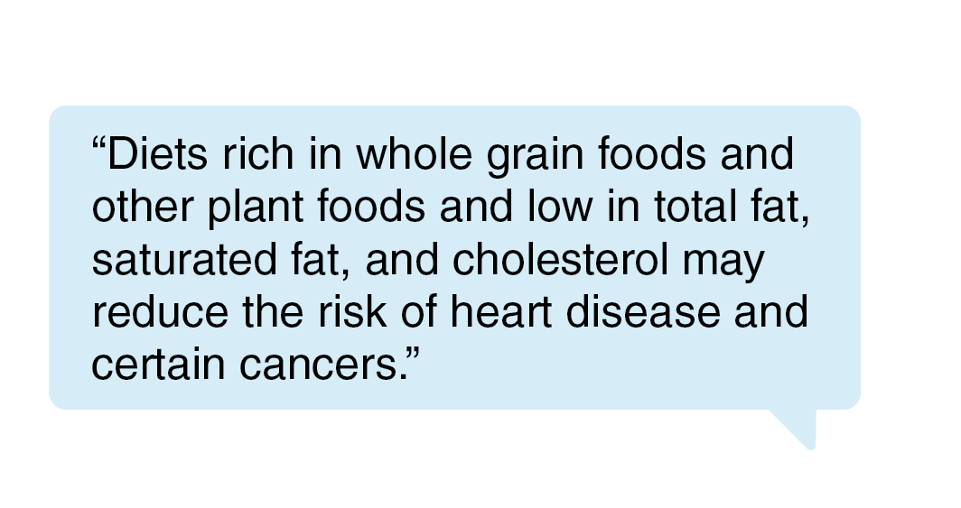
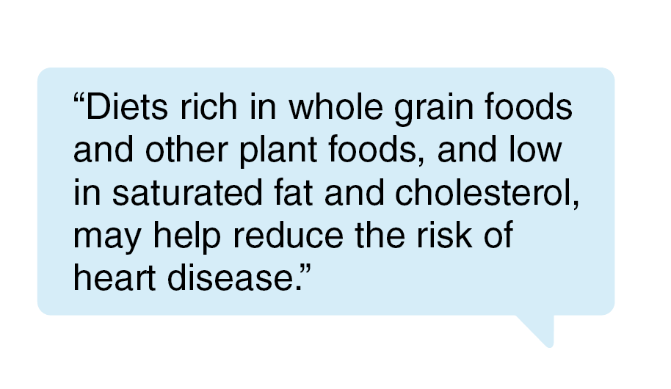
How to Spot Whole Grain-Rich Foods for the CACFP
fns.usda.gov/tn/how-spot-whole-grain-rich-foods-cacfp
Notes:
There are many ways to tell if a food is whole grain-rich in the CACFP, and we will provide an overview of all these methods on the next slide. All of these methods are included in Team Nutrition’s training worksheet titled “How to Spot Whole Grain-Rich Foods for the Child and Adult Care Food Program.” This worksheet can be downloaded from the web address on the screen.

Slide 10
Foods Are Whole Grain-Rich in the CACFP If…
The food is listed as a whole grain on any State’s WIC Authorized Foods List.
OR
If it is listed as “whole wheat” “entire wheat” or “graham” (certain foods only).
OR
The food has an FDA-approved whole-grain health claim.
The food meets the whole grain-rich criteria for the School Meals Programs.
OR
You have proper documentation from a manufacturer, or a standardized recipe that shows whole grains are the main ingredient by weight.
OR
The food meets criteria listed in the Rule of Three.
Notes:
Although there are many different ways to tell if a food is whole grain-rich in the CACFP, you only need to use one of the methods. The food does not have to meet all the methods to be considered whole grain-rich. Some States may have stricter or other standards for identifying if a food is whole grain-rich, so please check with your State agency or sponsoring organizations if you have any questions about which methods you can or should be using.
Some methods you can use to tell if a food is whole grain-rich in the CACFP include if:
The food is listed as a whole grain on any State’s WIC Authorized Foods List.
OR
If a certain food, including bread, rolls, buns, macaroni, spaghetti, or vermicelli are labeled “whole wheat, entire wheat, or graham” such as “whole wheat rolls, entire wheat bread, or graham buns;”
OR
If a food has something called an FDA (US Food and Drug Administration) approved whole-grain health claim;
OR
If it’s considered whole grain-rich in the School Meals Programs, such as the National School Lunch Program or School Breakfast Program;
OR
If you have proper documentation from a manufacturer, or a standardized recipe that shows that whole grains are the main grain ingredient by weight;
OR
Finally, if the ingredients in the food meet the criteria listed in the Rule of Three.

Slide 11
Try It Out!
Brand B whole-grain bread meets the criteria for the Rule of Three, but does not have an FDA-approved whole-grain health claim.
Is this bread whole grain-rich in the CACFP?
?
Yes
No
FDA Whole-Grain Health Claims
“Diets rich in whole grain foods and other plant foods and low in total fat, saturated fat, and cholesterol may reduce the risk of heart disease and certain cancers.”
OR
“Diets rich in whole grain foods and other plant foods, and low in saturated fat and cholesterol, may help reduce the risk of heart disease.”
Notes:
Now, let’s do a quick practice question.
Brand B whole-grain bread meets the criteria for the Rule of Three, but does not have either one of the FDA-approved whole-grain health claims. Is this bread whole grain-rich in the CACFP?
I’ll give you all a minute to think about this. As you can see, the statements written in italics at the bottom of the slide are the two FDA-approved whole-grain health claims that you might find on food packages. Brand B whole-grain bread does not have this claim, but does meet the criteria for Rule of Three.
Raise your hand if you think this bread is whole grain-rich in the CACFP [pause and wait for a show of hands].
Raise your hand if you think this bread is NOT whole grain-rich in the CACFP [pause and wait for a show of hands].

Slide 12
Try It Out!
Answer
Brand B whole-grain bread meets the criteria for the Rule of Three, but does not have an FDA-approved whole-grain health claim.
Is this bread whole grain-rich in the CACFP?
?
Yes
No
Explanation:
Foods that meet the Rule of Three are whole grain-rich in the CACFP.
If one method shows that a food is whole grain-rich, then it is whole grain-rich in the CACFP.
Notes:
Nice work everyone! The answer, as many of you responded, is yes, this bread is whole grain-rich. It meets the Rule of Three, and the Rule of Three is one of the ways that you can tell if a food is whole grain-rich. Remember that if just ONE method shows that a food is whole grain-rich, then it is considered whole grain-rich in the CACFP. The food does NOT need to meet all the methods, it just needs to meet ONE of the methods.

Slide 13
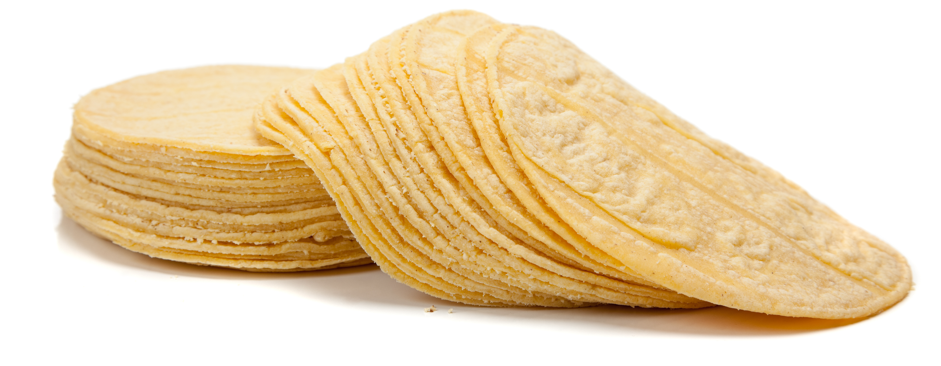
Try It Out!
Brand T tortillas are listed on your State’s WIC Authorized Foods List as an approved whole-grain food, but do not meet the criteria for the Rule of Three.
Are Brand T tortillas whole grain-rich in the CACFP?
?
Yes
No
Notes:
Ok, let’s do another knowledge check.
Brand T tortillas are listed on your State’s WIC Authorized Foods List as an approved whole-grain food, but do not meet the criteria for the Rule of Three. Are Brand T tortillas whole grain-rich in the CACFP?
Raise your hand if you think Brand T tortillas are whole grain-rich in the CACFP [pause and wait for a show of hands].
Raise your hand if you think Brand T tortillas are NOT whole grain-rich in the CACFP [pause and wait for a show of hands].

Slide 14
Try It Out!
Answer
Brand T tortillas are listed on your State’s WIC Authorized Foods List as an approved whole-grain food, but do not meet the criteria for the Rule of Three.
Are Brand T tortillas whole grain-rich in the CACFP?
?
Yes
No
Explanation:
Foods listed on any State’s WIC Authorized Foods List as an approved whole-grain food are whole grain-rich in the CACFP.
If one method shows that a food is whole grain-rich, then it is whole grain-rich in the CACFP.
Notes:
Nice work everyone! The answer is yes, Brand T tortillas would be considered whole grain-rich in the CACFP. It is listed on your State’s WIC Authorized Foods List as an approved whole-grain food. Any foods listed on any State’s WIC Authorized Foods List as an approved whole grain are considered whole grain-rich in the CACFP.
Just like with the previous example, remember that if just ONE method shows that a food is whole grain-rich, then the food is considered whole grain-rich in the CACFP. Again, the food does not need to meet ALL the methods to be considered whole grain-rich—just one is enough!

Slide 15

Keep in Mind…
Some States may have other standards for identifying if a food is whole grain-rich.
Check with your State agency or sponsoring organization if you have questions about which methods you can or should be using.
Notes:
Finally, just another reminder that some States may have other standards for identifying if a food is whole grain-rich. For example, some States require that all ingredients, or all grain ingredients in a whole grain-rich food are whole-grain or enriched, not just the first three ingredients. Please check with your State agency or sponsoring organization if you have questions about which methods you can or should use to determine if a food is whole grain-rich.

Slide 16
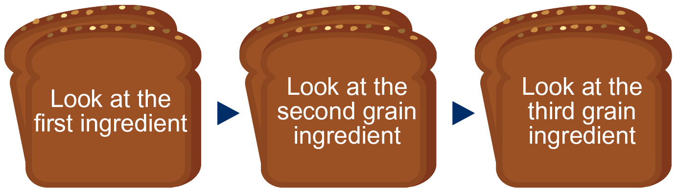
The Rule of Three
Whole-grain
Whole-grain
Enriched
Bran or germ
Whole-grain
Enriched
Bran or germ
Notes:
Now, let’s take a closer look at the Rule of Three. As we mentioned, the Rule of Three was covered on Part 1 of “Identifying Whole Grain-Rich Foods for the CACFP Using the Ingredient List” training.
As a very quick review, in the Rule of Three, you are looking at the first three grain ingredients in your grain food to see if your food is whole grain-rich.
In the Rule of Three, the first ingredient must be whole-grain. If water is the food’s first ingredient, then the next ingredient must be a grain, and must be whole-grain.
If the food has a second grain ingredient, it must be whole-grain, enriched, bran or germ.
If the food has a third grain ingredient, it must also be whole-grain, enriched, bran or germ.

Slide 17
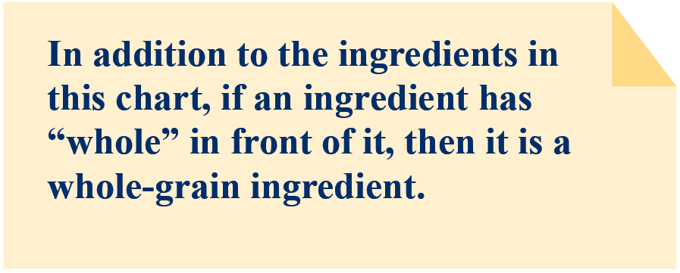
Whole-Grain Ingredients
Notes:
Page 5 of the “Identifying Whole Grain-Rich Foods for the CACFP Using the Ingredient List” worksheet includes a list of whole-grain ingredients. This list is not meant to be exhaustive, meaning there are other whole-grain ingredients that are not included on this list. Page 5 also includes a note reminding operators that if an ingredient has “whole” in front of it, then it is a whole-grain ingredient.

Slide 18
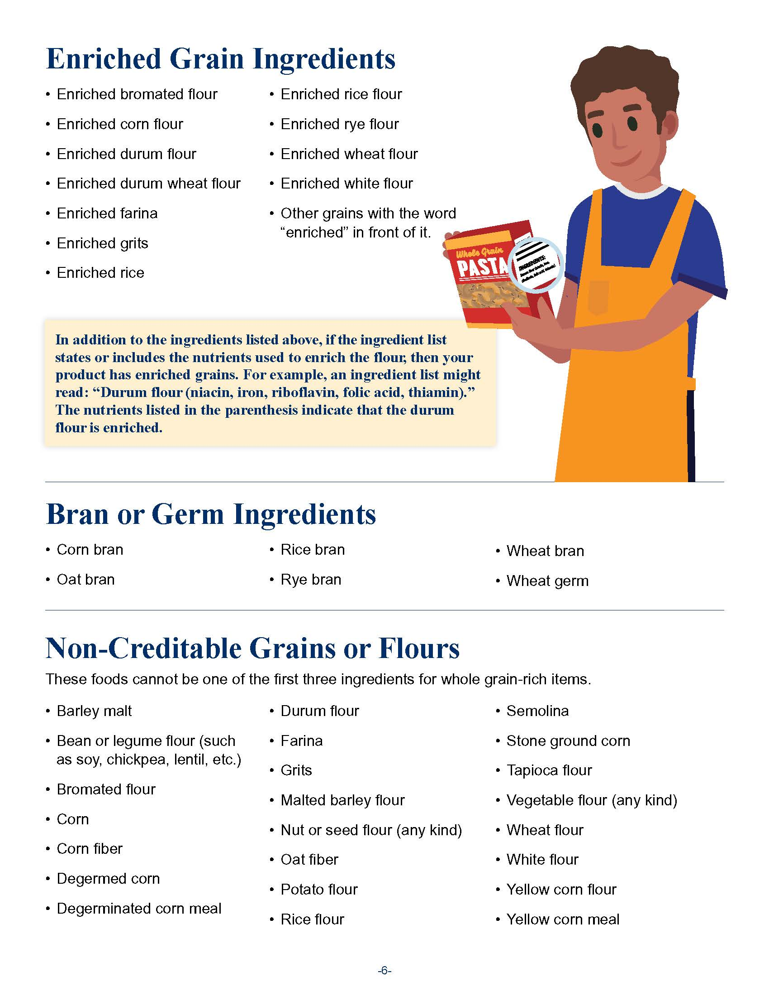
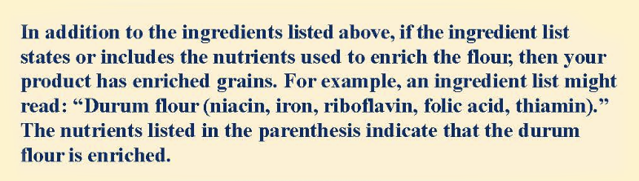
Enriched, Bran, and Germ Ingredients
Notes:
Page 6 of the worksheet includes lists of enriched, bran, and germ ingredients. Similarly, these lists are not meant to be exhaustive, meaning there are other enriched, bran, and germ ingredients that are not included on this list.
Page 6 also includes a note reminding operators that if an ingredient list states or includes the nutrients used to enrich the ingredient, then the item has enriched grains.

Slide 19
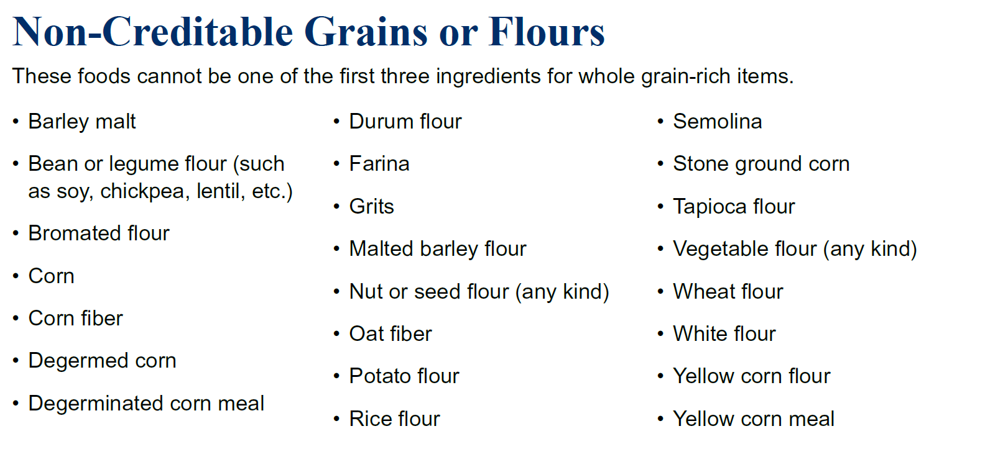
Non-Creditable Grains or Flours
Notes:
Page 6 of the worksheet also includes a chart of non-creditable grains or flours. These are ingredients in grain products that are not whole-grain, enriched, bran, or germ. If any of these non-creditable grains or flours are the first, second, or third grain ingredients in your grain food, then you cannot use the Rule of Three to determine if this food is whole grain-rich.

Slide 20
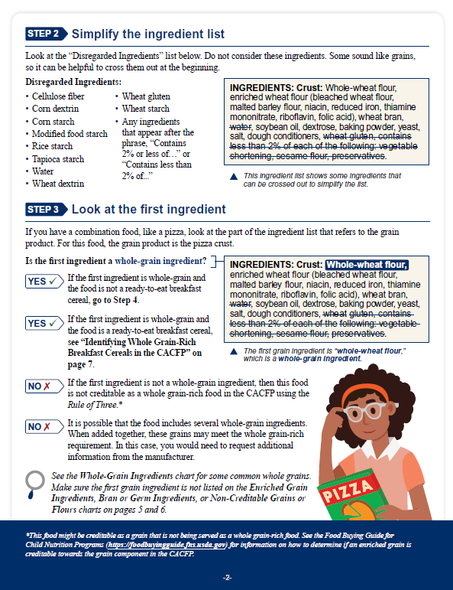
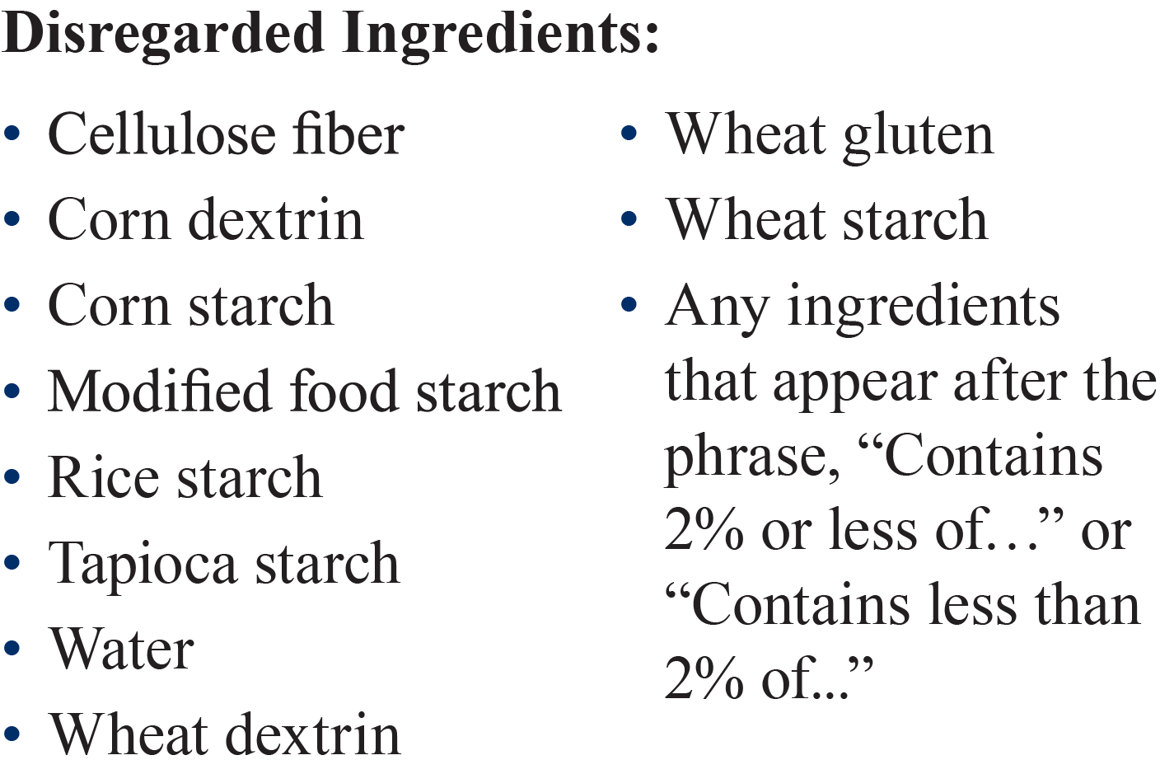
Disregarded Ingredients
Notes:
Sometimes, grain items have what we call “disregarded ingredients.” You can find these disregarded ingredients on page 2 of your handout, under Step 2. Remember that you can ignore these disregarded ingredients when using the Rule of Three.

Slide 21
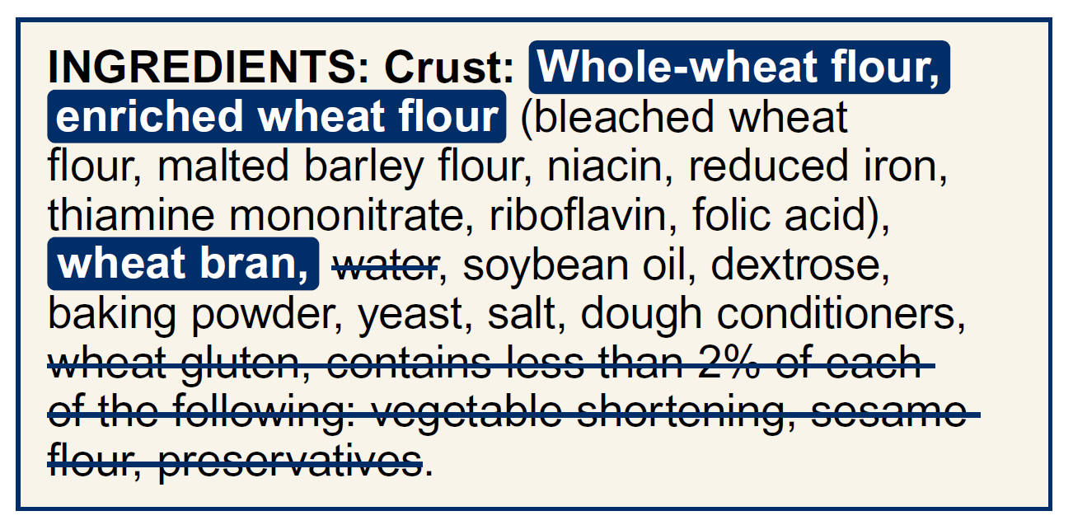
Rule of Three Practice
1st ingredient must be whole-grain: whole-wheat flour
2nd ingredient must be whole-grain, enriched, bran or germ: enriched wheat flour
3rd ingredient must be whole-grain, enriched, bran or germ: wheat bran
This pizza crust is whole grain-rich!
Notes:
So, let’s put the Rule of Three into practice. This is the ingredient list for a pizza. This list shows only the crust of the pizza, since that is the part of the pizza that counts as a grain.
Looking at the Grain Ingredients charts on pages 5 and 6:
We know that this pizza crust is whole grain-rich because the first ingredient, the whole-wheat flour, is whole-grain.
The second grain ingredient is enriched wheat flour, which is an enriched grain ingredient.
The third grain ingredient is wheat bran, which is a type of bran.
This crust meets the criteria for the Rule of Three, so it can be considered whole grain-rich in the CACFP.

Slide 22
Try It Out!
INGREDIENTS: Whole wheat flour, enriched wheat flour (flour, niacin, reduced iron, thiamine mononitrate, riboflavin, folic acid), cheddar cheese ([cultured milk, salt, enzymes], annatto), canola and/or sunflower oil, salt. Contains 2% or less of: yeast extract, paprika, spices, celery, baking soda, monocalcium phosphate, onion powder. Contains: wheat, milk.
?
Are these crackers whole grain-rich in the CACFP using the Rule of Three?
Yes
No
Notes:
Now, let’s practice with a quick knowledge check! Take a look at this ingredient list for crackers. Are these crackers whole grain-rich when using the Rule of Three?
Remember that for the Rule of Three, the first ingredient, or second after water, must be whole-grain, and then the second and third grain ingredients, if the food has them, must be whole-grain, enriched, bran, or germ. Again, you can find the list of grain ingredients on pages 5 and 6 of the handout.
Raise your hand if you think these crackers are whole grain-rich in the CACFP, using the Rule of Three [pause and wait for a show of hands].
Raise your hand if you think these crackers are NOT whole grain-rich in the CACFP using the Rule of Three [pause and wait for a show of hands].

Slide 23
Try It Out!
Answer
INGREDIENTS: Whole wheat flour, enriched wheat flour (flour, niacin, reduced iron, thiamine mononitrate, riboflavin, folic acid), cheddar cheese ([cultured milk, salt, enzymes], annatto), canola and/or sunflower oil, salt. Contains 2% or less of: yeast extract, paprika, spices, celery, baking soda, monocalcium phosphate, onion powder. Contains: wheat, milk.
?
Are these crackers whole grain-rich in the CACFP using the Rule of Three?
Yes
No
1st ingredient must be whole-grain: whole wheat flour
2nd ingredient must be whole-grain, enriched, bran or germ: enriched wheat flour
3rd ingredient must be whole-grain, enriched, bran or germ: no third grain ingredient
Notes:
Nice work everyone! As many of you answered, yes, these crackers are whole grain-rich using the Rule of Three. The first ingredient is whole-wheat flour, which is a whole-grain ingredient. The second grain ingredient is enriched wheat flour, which is an enriched ingredient. Those are the only two grain ingredients in this food, so we do not need to look at a third grain ingredient to determine if these crackers are whole grain-rich.

Slide 24

Focus on Flour Blends
INGREDIENTS: Whole wheat flour, enriched wheat flour (flour, niacin, reduced iron, thiamine mononitrate, riboflavin, folic acid), cheddar cheese ([cultured milk, salt, enzymes], annatto)….
Other Names for Flour Blends:
Enriched flour
Whole-grain flour
Whole grains
Blended flour
Notes:
Let’s take a closer look at the enriched wheat flour.
Some of you might have noticed that the enriched wheat flour has a parenthesis next to it, and the parenthesis includes a long list of ingredients that make up the enriched wheat flour. Think of the ingredients in the parenthesis as a part of the ingredient in front of it.
In other words, the flour, the niacin (which is a vitamin), reduced iron, and all the way down to folic acid, are all part of the enriched wheat flour. This ingredient label lists it as “enriched wheat flour” but you may also see it written as “flour blend,” “enriched flour,” “whole-grain flour,” “whole grains,” “blended flour,” or other similar terms. Treat these flour blends as one grain ingredient when applying the Rule of Three.

Slide 25
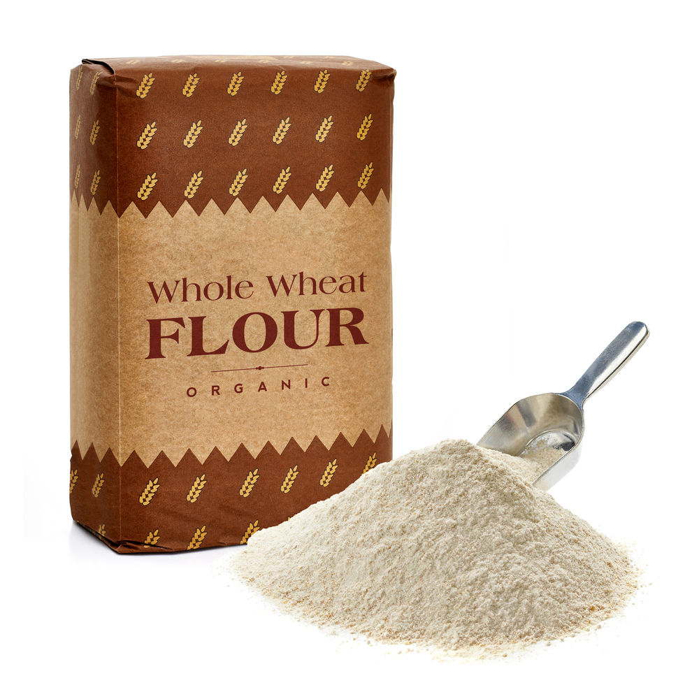
Flour Blends and the Rule of Three
1st ingredient: All ingredients in the flour blend must be whole-grain.
2nd and 3rd grain ingredient: All ingredients in the flour blend must be creditable (i.e. made up of whole-grain, enriched, bran, and/or germ ingredients). Vitamins and minerals are also allowed.
Look for non-creditable ingredients!
Blend
Notes:
If you are using the Rule of Three and see a flour blend, keep in mind that:
If the flour blend is the first grain ingredient on the ingredient list, then all the ingredients in this flour blend must be whole-grain. This means there cannot be any enriched, bran, germ, or non-creditable grain ingredients in this flour blend.
If the flour blend is the second and/or third ingredient, then all the ingredients in the flour blend must be creditable, meaning they are all whole-grain, enriched, bran, and/or germ. Any vitamins and minerals added to the flour are also allowed.
If there are non-creditable ingredients in the flour blend, and the flour blend is the first, second, or third grain ingredient, then the entire flour blend is considered a non-creditable ingredient. That means you must use another method to determine if food is whole grain-rich.

Slide 26
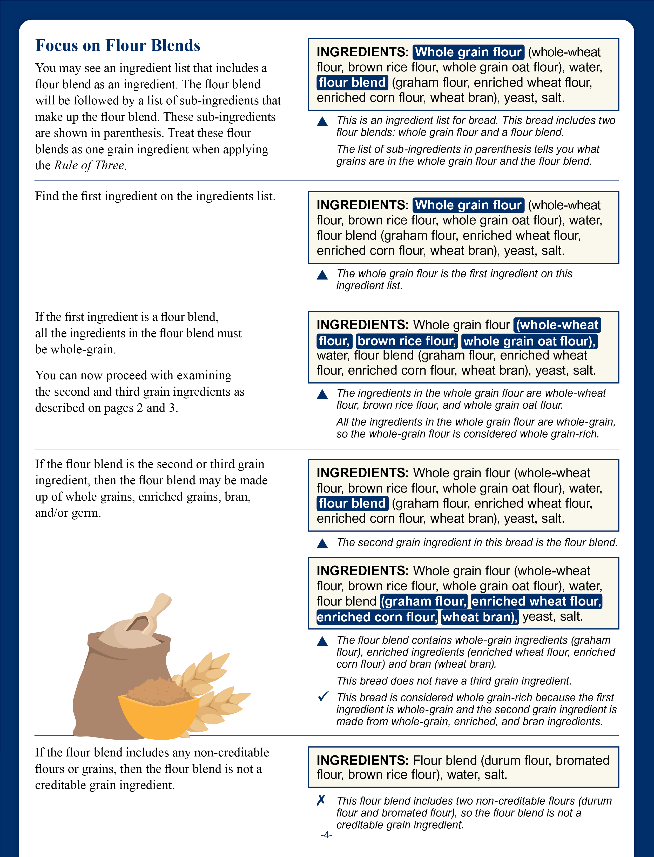
Page 4 of handout
Notes:
Page 4 of your handout looks at flour blends in detail. We will spend the rest of this session going through the information on this page.

Slide 27
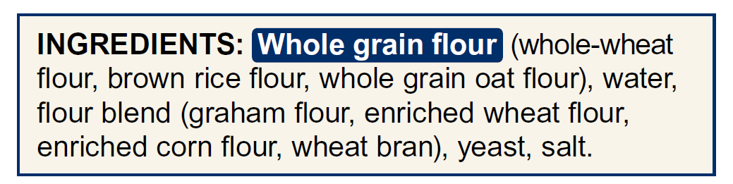
Try It Out!
?
Is the whole grain flour a whole-grain ingredient?
Yes
No
Notes:
Let’s start by looking at the ingredients list for bread shown on the screen. You can also find this ingredients list on page 4 of your handout. The first ingredient is “whole grain flour.” But just because the bread company has called it a “whole grain flour,” it doesn’t automatically mean that the flour blend is whole-grain in the CACFP. A manufacturer can add a tiny sprinkle of a whole grain in a flour blend and call it a “whole grain flour.” That’s why when we see grain ingredients with a parenthesis behind it, we need to make sure the ingredient is truly whole-grain.
Take a minute to go through the ingredients in the “whole grain flour” and decide if it is actually whole-grain. Again, the ingredients for the whole grain flour are shown in the parenthesis after “whole grain flour.”
Remember that for a flour blend to be considered whole-grain, all the ingredients in the blend must be whole-grain. The list of whole-grain ingredients are on page 5 of your handout. You can also look at the list on the slide.
Raise your hand if you think the “whole grain flour” is whole-grain ingredient [pause and wait for a show of hands].
Raise your hand if you think the “whole grain flour” is NOT whole-grain ingredient [pause and wait for a show of hands].

Slide 28
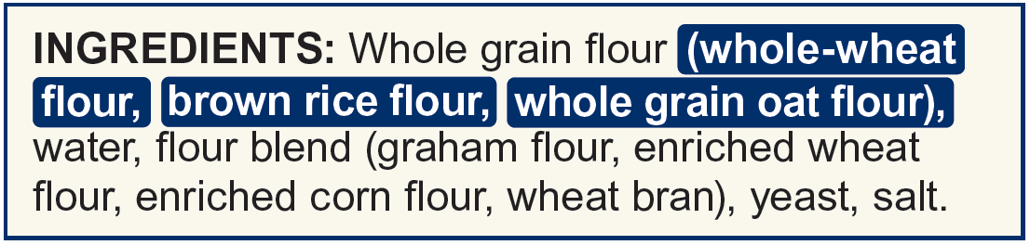
Try It Out!
Answer
?
Is the whole-grain flour a whole-grain ingredient?
Yes
No
Brown rice flour
Whole-grain oat flour
Whole-wheat flour
Notes:
Nice work everyone! The answer is Yes! This flour blend is whole-grain. We know this because the ingredients in the parenthesis next to “whole grain flour”: the whole-wheat flour, brown rice flour, and whole grain oat flour, are all whole-grain ingredients.
Remember that in the Rule of Three, if a flour blend is the first grain ingredient, it must be a whole-grain flour blend. To be considered a whole-grain flour blend, all the ingredients in that flour blend must be whole-grain.
Now that we have verified that the first grain ingredient is whole-grain, we can continue with the Rule of Three and look for a second grain ingredient.

Slide 29
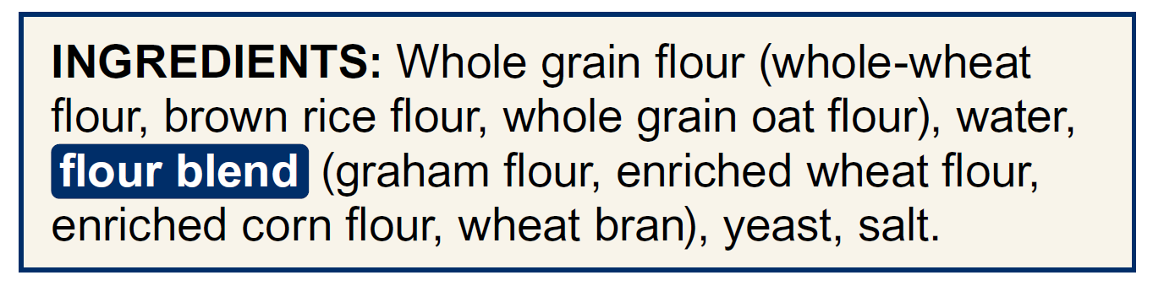
Try It Out!
?
Is the flour blend creditable (contains only whole-grain, enriched, bran, and/or germ ingredients)?
Yes
No
Notes:
We see that this bread has a second grain ingredient, the flour blend, that is highlighted in blue on the screen. If a flour blend is the second or third grain ingredient, then all ingredients in the blend must be creditable. In other words, all ingredients in that flour blend must be whole-grain, enriched, bran, and/or germ.
Take a minute to go through the ingredients in the flour blend and decide if all the ingredients in the parenthesis are whole-grain, enriched, bran, and/or germ. Again, the ingredients for the flour blend are shown in the parenthesis after “flour blend.” Lists of grain ingredients are on pages 5 and 6 of your handout. You can also look at the lists of grain ingredients on the right side of the slide.
Raise your hand if you think the second flour blend is creditable [pause and wait for a show of hands].
Raise your hand if you think the second flour blend is NOT creditable [pause and wait for a show of hands].

Slide 30
Try It Out!
Answer
?
Is the flour blend creditable (contains only whole-grain, enriched, bran, and/or germ ingredients)?
Yes
No
Enriched corn flour
Enriched wheat flour
Wheat bran
Graham flour
Notes:
Nice work everyone! Yes, the second flour blend is creditable.
We know the second flour blend is creditable because it contains graham flour, which is a whole grain. It also contains enriched wheat flour and enriched corn flour, which are enriched ingredients. It also includes wheat bran, which is a bran ingredient. It does not include any non-creditable grains or flours.
Now, we can move to the next step in the Rule of Three, which is to look for a third grain ingredient.

Slide 31
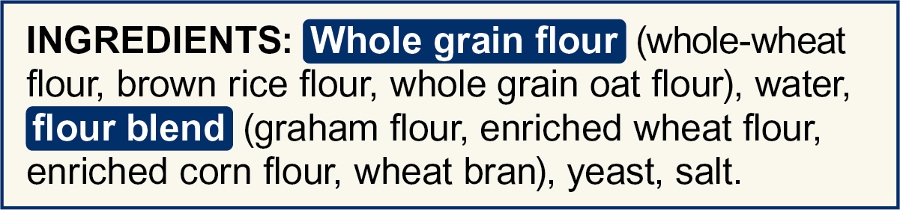
Try It Out!
?
Does this bread contain a third grain ingredient?
Yes
No
Notes:
Let’s take a look at the bread’s ingredients list again. We just talked about whole grain flour, which is the first grain ingredient, as well as the flour blend, which is the second grain ingredient. Does this bread contain a third grain ingredient?
Raise your hand if you think the bread contains a third grain ingredient [pause and wait for a show of hands].
Raise your hand if you think the bread does NOT contain a third grain ingredient [pause and wait for a show of hands].

Slide 32
Try It Out!
Answer
?
Does this bread contain a third grain ingredient?
Yes
No
Notes:
Nice work everyone! This bread does not contain a third grain ingredient.

Slide 33
Try It Out!
?
Is this bread whole grain-rich in the CACFP using the Rule of Three?
Yes
No
1st ingredient/flour blend must be whole-grain
2nd ingredient/flour blend must be whole-grain, enriched, bran, and/or germ
3rd ingredient must be whole-grain, enriched, bran, and/or germ
Notes:
Now, let’s put it all together! Is this bread whole grain-rich in the CACFP?
Remember that we said that the first ingredient, the whole grain flour, is whole grain. The second ingredient, the flour blend, is creditable, because it consists of only whole grain, enriched, and bran ingredients. The bread does not contain a third grain ingredient.
Is this bread whole grain-rich in the CACFP using the Rule of Three?
Raise your hand if this food is whole grain-rich in the CACFP using the Rule of Three [pause and wait for a show of hands].
Raise your hand if this food is NOT whole grain-rich in the CACFP using the Rule of Three [pause and wait for a show of hands].

Slide 34
Try It Out!
Answer
?
Is this bread whole grain-rich in the CACFP using the Rule of Three?
Yes
No
1st ingredient/flour blend must be whole-grain
2nd ingredient/flour blend must be whole-grain, enriched, bran, and/or germ
3rd ingredient must be whole-grain, enriched, bran, and/or germ
Notes:
Nice work everyone! Yes, this bread is whole grain-rich in the CACFP because the first ingredient, the whole grain flour, contains only whole-grain ingredients. The second grain ingredient, a flour blend, contains only creditable ingredients. The bread does not contain a third grain ingredient.
In the Rule of Three, if the first ingredient is a whole grain, and the second and third grain ingredients are creditable, then the item is considered whole grain-rich in the CACFP. This bread matches this criteria, so this bread is considered whole grain-rich in the CACFP.

Slide 35
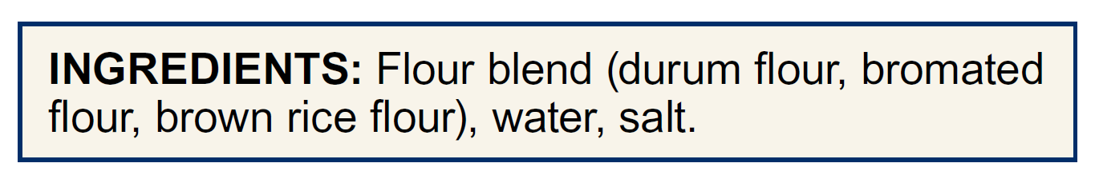
Try It Out!
?
Is this food whole grain-rich in the CACFP using the Rule of Three?
Yes
No
Notes:
Ok everyone. Let’s do one last Try It Out! Question, this time with an ingredient list for pasta.
The first ingredient in this pasta is a flour blend. The flour blend is made of durum flour, bromated flour, and brown rice flour.
Is this pasta whole grain-rich in the CACFP, using the Rule of Three? Remember that in the Rule of Three, the first ingredient must be whole-grain. This means that if the first ingredient is a flour blend, then all the ingredients in that flour blend must be whole-grain.
Take a minute to go through the ingredients in the flour blend and decide if this flour blend is whole-grain. Again, the ingredients for flour blend are shown in the parenthesis after “flour blend.”
Remember that for a flour blend to be considered whole-grain, all the ingredients in the blend must be whole-grain. The list of grain ingredients are on pages 5 and 6 of your handout. You can also look at the lists on the slide.
Raise your hand if you think this food is whole grain-rich in the CACFP using the Rule of Three [pause and wait for a show of hands].
Raise your hand if you think this food is NOT whole grain-rich in the CACFP using the Rule of Three [pause and wait for a show of hands].

Slide 36
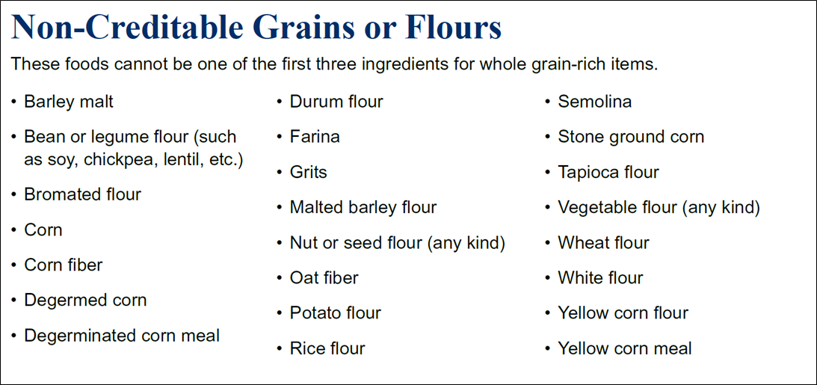
Try It Out!
Answer
?
Is this food whole grain-rich in the CACFP using the Rule of Three?
Yes
No
Durum flour
Bromated flour
Notes:
Nice work everyone! The answer is no. This food would not be considered whole grain-rich in the CACFP using the Rule of Three. We know this because the flour blend includes two non-creditable ingredients: bromated flour and durum flour.
In the Rule of Three, if the flour blend is the first ingredient, then that flour blend can only contain whole-grain ingredients. Because the flour blend is the first ingredient, and it contains two non-creditable ingredients, this item is not considered whole grain-rich in the CACFP.

Slide 37
Page 4 of handout
Notes:
Again, page 4 of the worksheet includes all the information on flour blends that we just discussed. For further questions, please contact your sponsoring organization or State agency.

Slide 38


How To Order Print Copies
Resource Order Form at TeamNutrition.USDA.gov.
FREE for Child Nutrition operators, while supplies last.
Sponsoring organizations and State agencies can also order in bulk by sending an email to:
TeamNutrition@USDA.gov
Notes:
For all Child Nutrition operators, such as the CACFP, Team Nutrition’s print materials are free to order.
If program operators would like to order Team Nutrition’s free materials in print, they can go to the “Resource Order Form” link on the Team Nutrition website to order print copies of the materials.
For bulk orders, you can email TeamNutrition@USDA.gov.

Slide 39

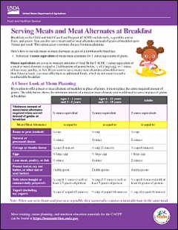
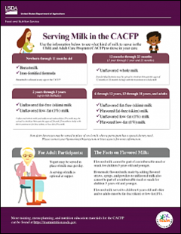
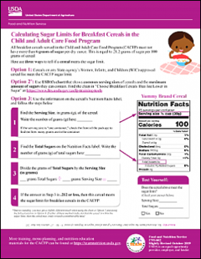
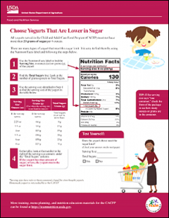
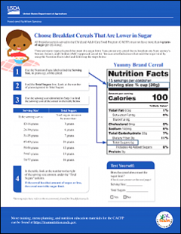
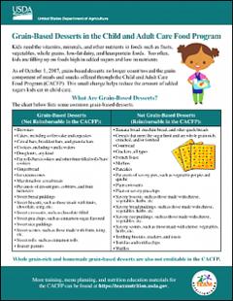
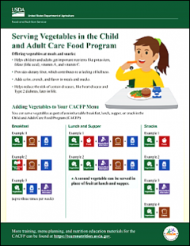
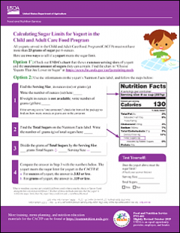
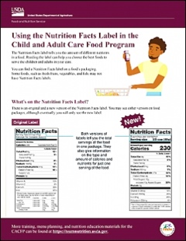
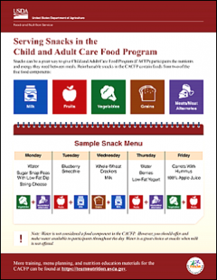
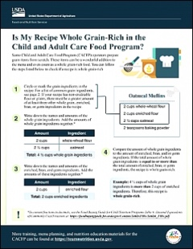
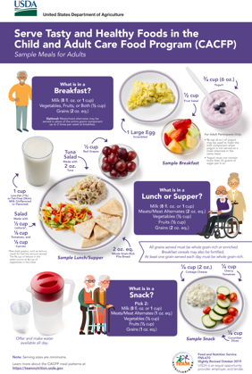
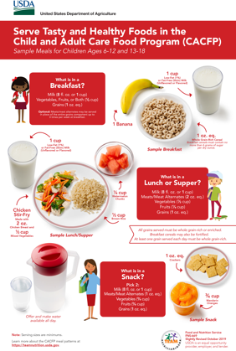
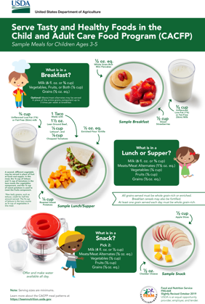
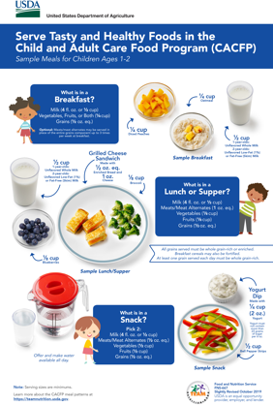
More Team Nutrition Resources!
TeamNutrition.USDA.gov
Notes:
All Team Nutrition materials are available online from Team Nutrition’s website and are available for free download to anybody who is interested.

Slide 40


Thank You!
TeamNutrition.USDA.gov
@TeamNutrition
TeamNutrition@USDA.gov
USDA is an equal opportunity provider, employer, and lender.
Notes:
These training slides were provided by U.S. Department of Agriculture's Team Nutrition. If you would like to learn more about Team Nutrition and additional resources available, please visit their website, subscribe to their monthly e-newsletter, connect with them via email at teamnutrition@USDA.gov, and follow them on Twitter.
Thank you!

