Slide 1

FNS-366B
Program Activity Statement
Revision
(Play as a slide show to hear narration and activate transitions)
7/1/2016

Slide 2
Impetus for the Revision
The current administration, Congress, and Food and Nutrition Service (FNS) and SNAP leadership have all placed an emphasis on fraud control for both SNAP recipients and retailers.
While State agencies have done, and continue to do, great work ensuring recipient integrity, FNS has not been able to fully document that work. This limitation impacts decision making and limits FNS’ ability to portray the full breadth and scale of fraud control activities.
The same is true for some certification information.
The 366B is FNS’ primary means of collecting data on the fraud control and certification activities of State SNAP agencies.

Slide 3
Impetus for the Revision
Collection of this data is required by federal regulations authorized by the Food and Nutrition Act of 2014 and previous legislation.
In August 2014, the U.S. Government Accountability Office (GOA) specifically cited the 366B when concluding that: FNS’ ability to monitor [fraud control activities] and develop [fraud control strategies] was hindered by the lack of consistency and reliability of data.
So, in coordination with other related efforts, FNS revised the 366B to:
  Clarify vague or incomplete instructions and definitions
  Improve monitoring of certification activities
  Distinguish fraud by type: Eligibility Fraud or Trafficking
  Include metrics that provide a view into the differing circumstances fraud units face when dealing with eligibility fraud and trafficking
  Focus on investigation and hearing outcomes
  Allow fraud units to more fully document all cases that have beneficial outcomes

Slide 4
Revision Process
FNS National and Regional personnel coordinated to discuss necessities for beginning the revision process, and drafted questions for 366B users. These questions were posed to State personnel through a Request for Information.
FNS received many useful comments from a number of respondents. These comments informed the initial draft.
Once this draft was completed, it was shared publicly and comments were again solicited.
The comments FNS received on the draft, along with further discussions with State and Regional personnel, led to significant changes to the interim draft of the form.
These changes were finalized into the form we will discuss today.
This form received OMB final approval on 6/8/2016

Slide 5
Implementation
The new form will be used for reporting beginning Federal Fiscal Year 2017
States should be able to track the elements included in this form beginning 10/1/2016
The first reporting period for the new form is 10/1/2016 through 12/31/2016

Slide 6
Regulation Change
Through a separate rulemaking process from the form revision, FNS posted changes to the regulations regarding FNS-366B reporting.
Beginning 10/1/2016, this form will be reported based on the Federal Fiscal Year instead of the current State Fiscal Year basis
Beginning the first quarter after each State’s 2016 State Fiscal Year concludes, reporting of the form will be increased to quarterly from the current annual requirement
Changes will be reflected in 7 CFR 272.2

Slide 7
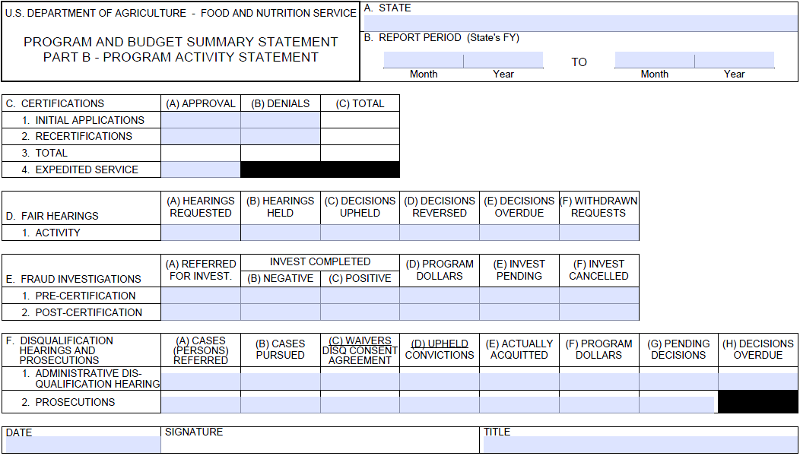
Current Form
Notes:
This is the form version that has been used for about the last 8 years.
It will be used to report data from 9/30/2016 and earlier.

Slide 8
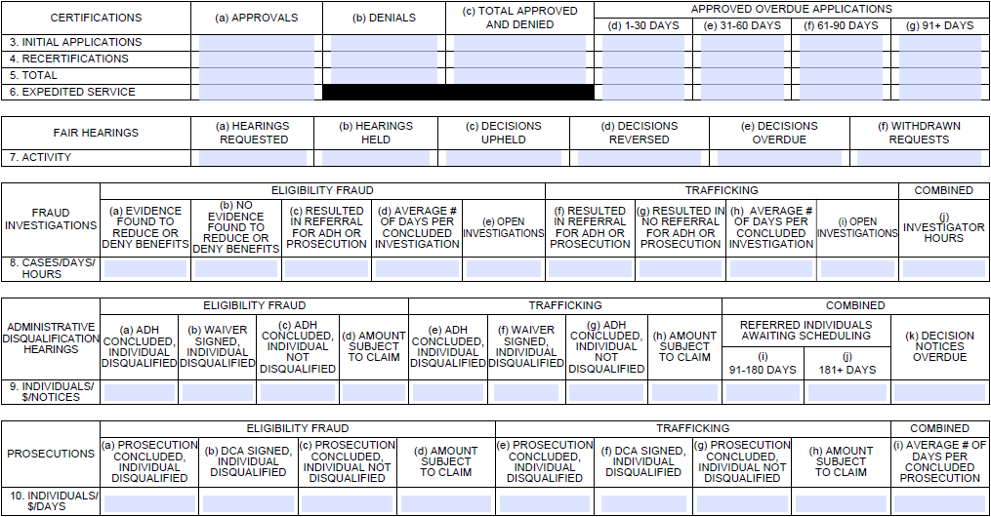
Revised Form
Notes:
This is the form that will be used to report all data from 10/1/2016 and later.
The form looks quite a bit more involved. However, I’d like to point out the majority of the expansion is do the separation of eligibility fraud and trafficking. For the most part, these two sides contain the same data.
Beyond that there are really only 6 new or modified elements in the revision. I will point them out as we go through each section.

Slide 9
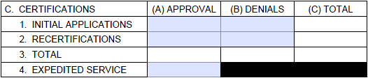
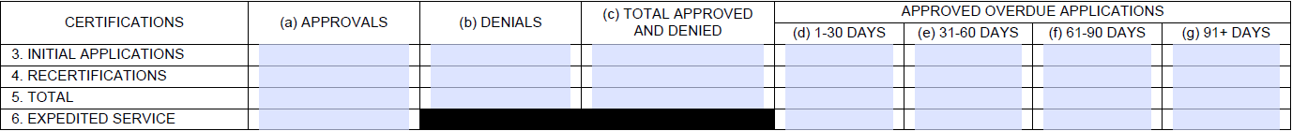
Certifications - Current
Certifications - Revised
Notes:
Here is the current and… here is the revised.
As you can see, the left half consists of only what was is on the current form

Slide 10
Certifications – Unchanged Portion
Columns A through C
  Include only applications processed to a determination.
  Column A - approved applications.
  Column B - denied applications due to ineligibility.
  DO NOT include closed cases.
  DO NOT include withdrawals.
  DO NOT include D SNAP applications.
Notes:
As we take a quick look at the unchanged portion of this section, I would like to stress that along with the form revision, there was a complete revision of the form instructions.
Even for data elements that didn’t change, clarifications were made and definitions were updated and/or expanded.
These instructions are contained in the same PDF document as the revised form, which everyone should have received in the invite update.

Slide 11
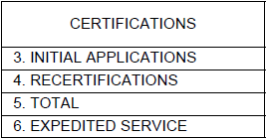
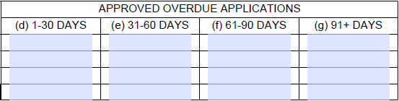
Certifications – Added Portion
Columns D through G
  Include only APPROVED OVERDUE applications
  Do not include D SNAP applications.
  Columns D - approved applications overdue 1-30 days.
  Column E - approved applications overdue 31-60 days.
  Column F - approved applications overdue 61- 90 days.
  Column G – approved applications overdue 91 days or more.
Notes:
So now, on the right side of certifications, is the first element that was added to the form:
Overdue applications
The days overdue options listed across the top of this section refer to the number of days beyond the respective mandated timeframe. For example, if an initial application is approved 43 days after the date of application, and there are no extenuating circumstances, this application should be reported under column (b) 1-30 DAYS.

Slide 12
No Changes to
Fair Hearings
Notes:
So, here’s the easy part: no changes to Fair Hearings

Slide 13
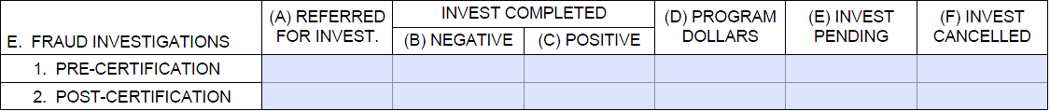
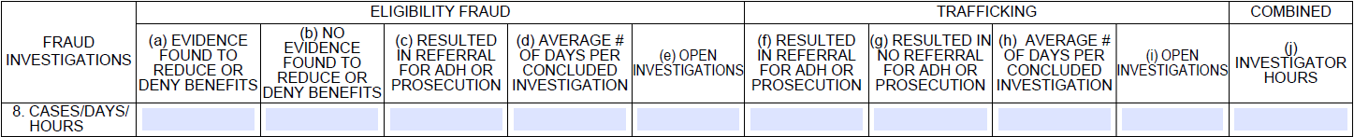
Investigations - Current
Investigations - Revised
Notes:
The Investigations, ADH, and Prosecutions sections have all been split to distinguish between Eligibility Fraud and Trafficking. While these two groups contain very similar subsets of data, there are important differences between some of the subsets in the Investigations section.
But be before we dig into the investigation section revision.
Lets go over the revised and expanded definition of investigations that’s in the new instructions.

Slide 14
Fraud Investigations Definition
This section reflects activity of fraud control unit(s), or similar investigative entities, within a State to investigate individuals suspected of SNAP eligibility fraud and/or trafficking benefits.
1 - Eligibility worker matches all adult applicants against an income database, positive matches are referred for verification, employer is called and match is confirmed, the application is denied and no additional action is taken.
2 – Eligibility worker suspects an applicant is lying about their household, refers the case, someone goes to the house to confirm the household occupants.
Example 1 would not be an investigation, because it is really just a verification of the accuracy of the match.
Example 2 would be and investigation because a suspicion a fraud led the eligibility worker to single out the individual.
Investigations are activities conducted by investigators, or staff designated to assist with investigating, to develop a record of documentary evidence for individuals suspected of past, ongoing or attempted SNAP eligibility fraud or trafficking. This record is developed to confirm or disconfirm a suspicion of fraud and determine if there is sufficient evidence of intent to warrant civil, criminal or administrative action against individuals or deny the eligibility of applicants. Though investigations may result in a claim or reduced eligibility without a fraud finding, the impetus for an investigation should be a suspicion of fraud. Activities to determine whether something warrants an investigation or to verify discrepant information are not, on their own, investigations.
Each investigation (case) must be reported under either Eligibility Fraud or Trafficking, and, when applicable, Combined. The type of fraud that most appropriately reflects the matter investigated must be determined for each investigation. A case wherein multiple people are investigated is counted as one case.
Notes:
One of the most significant aspects of the Investigations section revision is the inclusion of a definition of fraud investigations in the form’s instructions. This definition is not an attempt to define how investigators go about conducting investigation. Instead, it is a framework for identifying which activities should be included in this section. Because there is sometimes a blurry line between eligibility verification and investigations, this definition emphasizes that the activity is the result of a suspicion of fraud. Here are an examples of two certification activities on either side of the blurry line:
1 - Eligibility worker matches all adult applicants against an income database, positive matches are referred for verification, employer is called and match is confirmed, the application is denied and no additional action is taken.
2 – Eligibility worker suspects applicant is lying about their household, refers the case, someone goes to the house to confirm occupants.
Example 1 would not be an investigation, because it is really just verification of the accuracy of the match.
Example 2 would be and investigation because a suspicion a fraud led the eligibility fraud to single out the individual.

Slide 15
Investigations - Revised
Notes:
Changes 2, 3, and 4, and an overall focus on outcomes of investigation. Primary goals of this revision are to agencies to report all the investigations that they conduct that help protect government dollars, but may not result in disqualifications, and to provide insight into the investigative workload in the State.

Slide 16
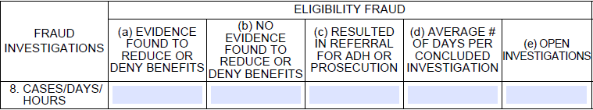
Eligibility Fraud - Investigations
8(a) + 8(b) + 8(e): should total all eligibility fraud cases investigated during the reporting period.
8(c): subset of cell 8(a) that includes only cases resulting in a referral for disqualification.
8(d): the average number of days each concluded eligibility case was open. E.g. 3 Cases: 1 – 8-day, 1 – 1-day, 1 – 90-day = 33 days.
8(e): the total eligibility cases, opened during any reporting period, that were open at the end of the reporting period. If fraud type is unknown, enter wherever seems most appropriate.
Notes:
For the purposes of this form, all eligibility investigations have three possible outcome: evidence found that affects eligibility, no evidence found that affects eligibility, open.
Box (a) should contain all the concluded investigations that resulted in a ‘positive’ outcome. That is, the evidence proves intentional fraud, or, the evidence does not prove intentional fraud, but it results in avoiding or identifying improper payments.
Box (b) should contain all the ‘negative’ cases that do not show fraud or improper payments and are canceled, closed, suspended, etc…
Box (c) should contain the subset of cases in Box (a) that were referred for ADH or Prosecution. This excludes the cases in Box (a) that were ‘positive’ but fell short of proving intentional fraud.
Box (e) should contain all the cases are ongoing/open at the end of the reporting period.
The number of days from, and including, the start date through the end date should be recorded for each case. Sum all of these ranges for investigations concluded during the report period and divide by the total number investigations included. Report this final total in Box (d).
The total reported in Box (d) should be based on actual timeframes recorded during the reporting period, and not an estimate based on the number cases multiplied by a previous average.

Slide 17
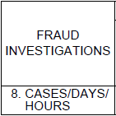
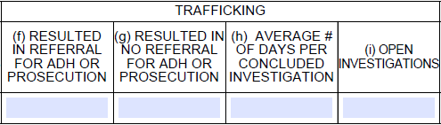
Trafficking - Investigations
8(f) + 8(g) + 8(i) should total all trafficking cases investigated during the reporting period.
8(f):there is no positive-without-referral subset for trafficking because no claim can be pursued without a disqualification.
8(h): is the average number of days each concluded case was open.
E.g. 3 Cases: 1 – 8-day, 1 – 1-day, 1 – 90-day = 33 days.
8(i): the total trafficking cases, opened during any reporting period, that were open at the end of the reporting period. If fraud type is unknown, enter wherever seems most appropriate.
Notes:
Unlike the eligibility side of the Investigations section, the trafficking side does not have a box for ‘positive’ cases where fraud is not proven. Trafficking is, by definition, intentional and, therefore, cannot result in an adverse action until confirmed in an administrative hearing or court of law.

Slide 18
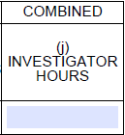
Combined - Investigations
8(j): Report the total investigator hours that were eligible for FNS SNAP 50/50 reimbursement within the State during the report period.
  This amount can be determined by:
    using the actual hours used to calculate FNS reimbursement over the reporting period
    calculating a sum based on the designated percentage of total hours worked in a reporting period that an investigator, or investigators combined, spent on SNAP investigation activity, i.e. total hours for all investigators prorated, or individual hours prorated and totaled
    equivalent means appropriate for the State.
Notes:
The only portion of the Investigations that should not be separated by eligibility and trafficking is Box (j), which collects the total hours investigators spent on SNAP during the reporting period. While there is some flexibility in who is considered an investigator from State to State, this should be limited to individuals whose primary duty with SNAP is to investigate potential SNAP fraud. The primary program of concern, however, does not need to be SNAP. For example, an investigator may spend 80% of their time working for non-SNAP programs, but the time they spend working for the SNAP agency is primarily spent in an investigative role. Oppositely, an eligibility worker that assists with investigations as a small portion of their standard duties would not be considered an investigator. Investigative unit administrative staff should not be considered investigators.
This total should reflect, as closely as possible, the payroll hours used to calculate federal reimbursement. Investigative personnel are not expected to track the exact hours they spend working on SNAP cases beyond what is the normal accounting practice used within the State agency. This means, for example, if 50% of an investigator’s salary is supported by SNAP funds, the agency only needs to report their 50% of their normal work hours, and does not need to account for paid leave, travel time, etc… if they do not affect the reimbursement amount.

Slide 19
Investigations – Key Points
Investigation outcomes should be tracked and reported
Outcomes should be split by eligibility and trafficking
Investigation timeframes should be tracked and reported
Investigator time should be track and reported
Program dollars are no longer in this section
Notes:
Overall key points:
All Investigation outcomes should be tracked and reported.
Timeframes should be averaged and reported.
Investigator time should be reported
Program Dollars are no longer in this section

Slide 20
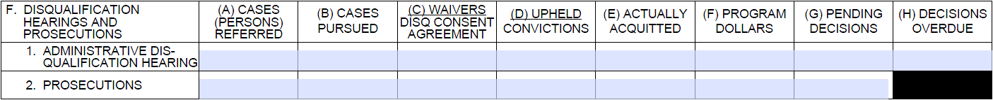
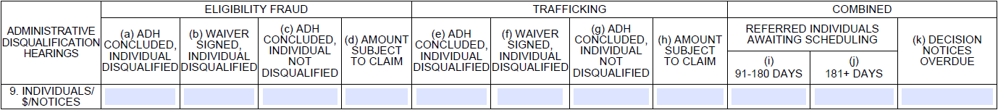
Hearings and Prosecutions - Current
Hearings - Revised
Prosecutions - Revised
Notes:
Administrative disqualification hearings and prosecutions lines have been split into separate sections. Though they are still very similar, there are a couple differences under the combined sections.

Slide 21
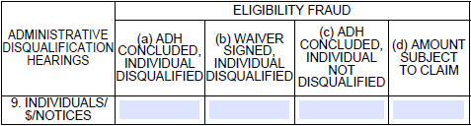
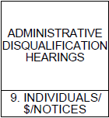
Eligibility – Administrative Disqualification Hearings
Enter total individuals, not cases, that underwent an ADH for eligibility fraud. Enter only hearings during the reporting period where a conclusion was reached by a hearing official, a waiver, or the hearing was discontinued/cancelled:
  9(a): Resulted in a ruling allowing Agency to disqualify individual - Do not include waivers
  9(b): Individual signed a waiver, or similarly enforceable agreement, allowing Agency levy disqualification
  9(c): Concluded without ruling or agreement sufficient for Agency to disqualify individual
9(d): Report the estimated dollar value of benefits that may be recovered due to the eligibility fraud disqualifications reported in 9(a) and 9(b).
Notes:
For the Eligibility and Trafficking portions of both the Hearings and Prosecutions sections, only report individuals whose proceedings concluded during the report period, regardless of when they began. In addition, each individual that is completes an ADH or prosecution should be counted separately even if the hearings are combined or they stem from the same investigation.
For both Hearings and Prosecutions, Program Dollars has been changed to Amount Subject to Claim. This amount should be calculated using the potential amount that can be reclaimed/recouped/intercepted from a household after an IPV ruling. Do not include overpayments that can be established for individuals who are not disqualified. If multiple household members are disqualified, only report the potential total claim against the household.

Slide 22
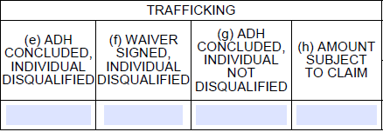
Trafficking – Administrative Disqualification Hearings
Enter total individuals, not cases, that underwent an ADH for trafficking. Enter only hearings during the reporting period where a conclusion was reached by a hearing official or the hearing was discontinued/cancelled:
  9(e): Resulted in a ruling allowing Agency to disqualify individual - Do not include waivers
  9(f): Individual signed a waiver, or similarly enforceable agreement, allowing Agency levy disqualification
  9(g): Concluded without ruling or agreement insufficient for Agency to disqualify individual
9(h): Report the estimated dollar value of benefits that may be recovered due to the trafficking disqualifications reported in 9(e) and 9(f).

Slide 23
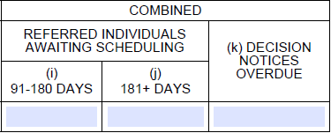
Combined – Administrative Disqualification Hearings
9(i): Report the total number of individuals that were referred for ADH over 90 days before the time of reporting that have not received a scheduled date for their hearing.
9(j): Those waiting over 180 days
9(k): No change from the current form. Report the total number of hearings where the ADH defendant was not notified of the hearing decision within 90 days of the day the hearing was scheduled.
Notes:
The fifth addition to the form:
The addition of Referred Individuals Awaiting Scheduling requires that States track and report individuals whose cases have been referred for an ADH but have not been scheduled or rejected/canceled for over 3 months. These referrals are sometimes known as the ADH backlog. Referrals that have awaited scheduling for over 90 days should be reported under the appropriate box every report period until they are scheduled or rejected/canceled. If no referrals await scheduling for over 90 days, none should be reported here.

Slide 24
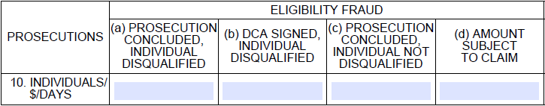
Eligibility Fraud – Prosecutions
Enter total individuals, not cases, prosecuted for eligibility fraud. Enter only prosecutions during the reporting period where a conclusion was reached by a judge/ruling official of proper authority, or an agreement was made:
  10(a): Resulted in a ruling allowing Agency to disqualify individual - Do not include Disqualification Consent Agreements or convictions that are insufficient for a disqualification
  10(b): Individual signed a DCA, or similarly enforceable agreement, sufficient for the Agency disqualify them
  10(c): Concluded without ruling or agreement sufficient for Agency to disqualify individual
10(d): Report the estimated dollar value of benefits that may be recovered due to the eligibility fraud disqualifications reported in 10(a) and 10(b).
Notes:
The only significant difference between the Prosecutions and Hearings Sections’ Eligibility and Trafficking portions is that not all ‘guilty’ rulings are sufficient for the SNAP agency to levy a disqualification. For example, a judge may find an individual guilty of a ‘theft of government property’ law that does not sufficiently reference SNAP to allow the agency to disqualify the individual. Because prosecuted individuals are now reported by whether they can be disqualified, and not whether the charges are upheld, some ‘guilty’ individuals may be reported under Box (c).

Slide 25
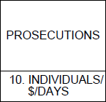
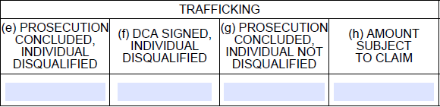
Trafficking – Prosecutions
Enter total individuals, not cases, prosecuted for trafficking. Enter only prosecutions during the reporting period where a conclusion was reached by a judge/ruling official of proper authority, or an agreement was made:
  10(e): Resulted in a ruling allowing Agency to disqualify individual - Do not include Disqualification Consent Agreements or convictions that are insufficient for a disqualification
  10(f): Individual signed a DCA, or similarly enforceable agreement, sufficient for the Agency disqualify them
  10(g): Concluded without ruling or agreement sufficient for Agency to disqualify individual
10(h): Report the estimated dollar value of benefits that may be recovered due to the trafficking disqualifications reported in 9(e) and 9(f).

Slide 26
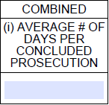
Combined – Prosecutions
10(i): Enter the average number of days form the date each individual was referred for prosecution to the date a decision was rendered or the case was concluded per deferred prosecution, plea agreement, DCA signed, or similar arrangement with the court was reached.
  For cases where a court agreement or DCA is reached, include in average as 1 day.
  For cases where an agreement is rescinded and prosecution reopens, consider the initial agreement date as the final date
Notes:
The final addition:
FNS recognizes that prosecution timeframes are largely out of State agencies’ control. The agency should, however, have a mechanism in place for tracking cases throughout their lifecycle to ensure that appropriate actions are taken when cases are disposed.

Slide 27
Thank You

