Slide 1


Choose Yogurt That Is Lower in Added Sugars in the CACFP
A Training Presentation for
Child and Adult Care Food Program (CACFP) Operators
Notes:
Welcome to today’s training the “Choose Yogurt That Is Lower in Added Sugars in the Child and Adult Care Food Program, or CACFP”. We will use CACFP to refer to the program. My name is ….

Slide 2


USDA’s Team Nutrition
An initiative of the USDA’s Food and Nutrition Service to support the USDA’s Child Nutrition Programs.
Aims to improve children’s lifelong eating and physical activity habits.
Provides nutrition education and training materials to State agencies, sponsoring organizations, and CACFP sites.
TeamNutrition.USDA.gov
Notes:
Team Nutrition is an initiative of the USDA Food and Nutrition Service that supports the Child Nutrition Programs, including the National School Lunch Program, the School Breakfast Program, and of course, the Child and Adult Care Food Program, or the CACFP.
The goal of Team Nutrition is to improve children's lifelong eating and physical activity habits through nutrition education based on the principles of the Dietary Guidelines for Americans and MyPlate.
It does so through training and technical assistance for those preparing and serving meals, providing nutrition education for children, and building support for healthier school and child care environments.

Slide 3
Updated Nutrition Standards for Added Sugars
Sugar limits for breakfast cereals and yogurt will be based on Added Sugars rather than Total Sugars.
Must be implemented by October 1, 2025:
Breakfast cereals
  Must contain no more than 6 grams of added sugars per dry ounce.
Yogurt
  Must contain no more than 12 grams of added sugars per 6 ounces (2 grams of added sugars per ounce).
CACFP operators may continue to use any State’s updated WIC list to help identify allowable breakfast cereals, and now, yogurt.
Notes:
On April 25, 2024, USDA published the Final Rule: Child Nutrition Programs: Meal Patterns Consistent With the 2020-2025 Dietary Guidelines for Americans, which finalized practical, science-based, long-term school nutrition requirements based on the goals of the Dietary Guidelines, extensive stakeholder input, and lessons learned from prior rulemakings. While school meal standards are impacted to the greatest degree through this final rule there are certain provisions that also impact the CACFP operations.
For the CACFP, this final rule updates the current limits on total sugars in breakfast cereals and yogurts to limits on added sugars in those items to align with school meal programs.
CACFP operators have already successfully implemented product-based sugar limits, and this rule updates these limits from total sugars to added sugars based on Dietary Guidelines recommendations and the fact that added sugars information is now available on the Nutrition Facts label.
This change represents a different way of measuring sugar in the CACFP. All breakfast cereals and the majority of yogurts that were able to be served under the total sugars limits will also meet the added sugars limits.
By October 1, 2025, CACFP operators are required to meet the following product-based added sugars limits:
Breakfast cereals must contain no more than 6 grams of added sugars per dry ounce.
Yogurt must contain no more than 12 grams of added sugars per 6 ounces; in other words, 2 grams of added sugars per ounce.
The current total sugars limits for breakfast cereals and yogurts will remain in place through September 30, 2025.
With State agency approval, CACFP operators may choose to implement the added sugars limits early.
I’d also like to point out that earlier this year, USDA published a final rule updating nutrition requirements for the food packages in the Women, Infants, and Children's Program, also known as WIC. The CACFP community was vocal about the desire for CACFP sugar limits to align with WIC product-based sugar limits. USDA listened and collaborated with WIC in the development of both of these final rules, so the limits do align.
Therefore, CACFP operators may continue to use any State’s updated WIC list to help identify allowable breakfast cereals and now yogurt that meet these updated added sugars limits.

Slide 4

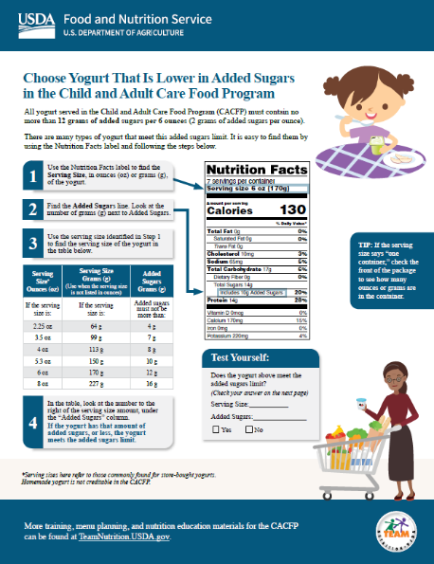

Yogurt Lower in Added Sugars
Tips!
1
By October 1, 2025, yogurt must contain no more than 12 grams of added sugars per 6 ounces.*
2
Find yogurts that meet the added sugars limit by using the “Choose Yogurt That Is Lower in Added Sugars” worksheet.
*For more information about the implementation timeline for the Final Rule–Child Nutrition Programs: Meal Patterns Consistent With the 2020-2025 Dietary Guidelines for Americans, please visit fns.usda.gov/cn/school-nutrition-standards-updates/implementation-timeline-cacfp-sfsp.
Today’s topic is “Choose Yogurts That Are Lower in Added Sugars.” As you all know, the CACFP meal patterns were updated to better align with the Dietary Guidelines for Americans. Part of that update includes lowering added sugars in meals and snacks.
In the CACFP, yogurts must contain no more than 23 grams of sugar per six ounces. You can find yogurts that meet the sugar limit by using the “Choose Yogurts That Are Lower in Added Sugars” worksheet, which will be the focus for the rest of today’s session.
Notes:
So, today’s topic is “Choose Yogurt That Is Lower in Added Sugars in the CACFP.”
As mentioned on the previous slide, by October 1, 2025, yogurt must contain no more than 12 grams of added sugars per 6 ounces. You can use any State’s updated WIC list to find yogurt that meets this added sugars limit.
You can also find yogurts that meet the added sugars limit by using Team Nutrition’s “Choose Yogurt That Is Lower in Added Sugars” worksheet, which will be the focus for the rest of today’s session. This webinar will give you a sneak peek into this updated training worksheet. Unfortunately, this is currently not on our website but will be soon. At the end of today's webinar we will mention how to sign up for our e-newsletter so you can be notified when the training worksheet and others are available.
*For more information about the implementation timeline for the Final Rule–Child Nutrition Programs: Meal Patterns Consistent With the 2020-2025 Dietary Guidelines for Americans, please visit the URL or scan the QR code on the screen now.

Slide 5

Step 1
1 | Use the Nutrition Facts label to find the Serving Size, in ounces (oz) or grams (g), of the yogurt.
Ok, let's get started. With the worksheet in front of you, you will notice there are four steps listed. The first step is to use the Nutrition Facts Label and find the Serving Size of the yogurt, in ounces or grams. As you see here, the serving size on this label is listed in ounces and in grams. Many yogurts will list both, but some containers will only list ounces, while others only list grams.
Notes:
Ok, let's get started. There are 4 steps you can follow to determine if a yogurt meets the added sugars limit.
The first step is to use the Nutrition Facts label and find the Serving Size of the yogurt, in ounces or grams. As you see here, the serving size on this label is listed in ounces and in grams. Many yogurts will list both, but some containers will only list ounces, while others only list grams.

Slide 6
Step 1 continued
Step 1
Tip! | If the serving size says, “one container,” check the front of the package to see how many ounces or grams are in the container.
Sometimes the label may also say “one container”, and then you would have to look at the weight of the container, usually on the front of the yogurt, to find the weight of the yogurt.
Notes:
Sometimes the label may also say “one container”, and then you would have to look at the weight of the container, which is usually on the front of the yogurt.

Slide 7
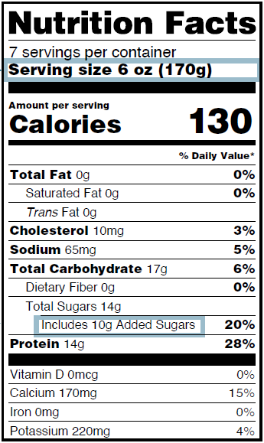

Try It Out!
What is the Serving Size?
?
4 oz
6 oz
8 oz
130 oz
Notes:
Let's try out a practice question. Take a look at the Nutrition Facts label for a yogurt on the screen. What is the serving size of this yogurt?
The answer choices are:
4 ounces,
6 ounces,
8 ounces, or
130 ounces.
Please click on the choice you think it is correct and then click on submit. I will give you 5 seconds to answer, 5, 4, 3, 2, 1. Time is up!
Let’s check your responses!

Slide 8
Answer
What is the Serving Size?
?
4 oz
6 oz
8 oz
130 oz
✓
Great job! The correct answer is 8 ounces. The serving size of this yogurt is 8 ounces.
Notes:
Great job! The correct answer is 6 ounces. The serving size of this yogurt is 6 ounces as indicated on the serving size line of the Nutrition Facts label.

Slide 9
Step 2
2 | Find the Added Sugars line. Look at the number of grams (g) next to Added Sugars.
Notes:
Once you find the serving size, you can move on to the second step, which is to look at the “Added Sugars” line on the Nutrition Facts label to find the amount of added sugars in one serving of this yogurt.

Slide 10
Try It Out! Question
How much added sugar is in one serving of this yogurt?
?
4 g
10 g
21 g
40 g
How much sugar is in one serving of the yogurt?
Raise your hand if you think there are:
4 grams of sugar in one serving [pause and wait for a show of hands],
9 grams [pause and wait for a show of hands],
21 grams [pause and wait for a show of hands], or
40 grams [pause and wait for a show of hands].
Notes:
How much added sugar is in one serving of the yogurt?
The answer choices are:
4 grams of added sugars in one serving,
10 grams,
21 grams, or
40 grams.
Remember to click on the choice you think it is correct and then click submit.
I will give you 5 seconds to answer, 5, 4, 3, 2, 1. Time is up!
Let’s check your responses!

Slide 11
Try It Out! Answer
How much added sugar is in one serving of this yogurt?
?
4 g
10 g
21 g
40 g
✓
Notes:
Great job! The correct answer is 10 grams. There are 10 grams of added sugars in one serving of this yogurt.

Slide 12
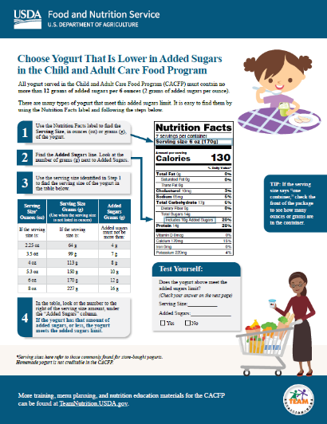
Step 3
3 | Use the serving size identified in Step 1 to find the serving size of your yogurt in the table below.
Serving Size Ounces (oz) | Serving Size Grams (g) (Use when the serving size is not listed in ounces) | Added Sugars Grams (g)
If the serving size is: | If the serving size is: | Added Sugars cannot be more than:
2.25 oz | 64 g | 4 g
3.5 oz | 99 g | 7 g
4 oz | 113 g | 8 g
5.3 oz | 150 g | 10 g
6 oz | 170 g | 12 g
8 oz | 227 g | 16 g
So now, take the serving size of the yogurt, and then see what row it belongs in on the table shown on your worksheet. You see here that the serving sizes are listed in the table in ounces, and the top of that column is circled in blue.
Notes:
So now, take the serving size of the yogurt, and then see what row it belongs in on the table shown on the screen. You see here that the serving sizes are listed in the table in ounces, and the top of that column is circled in blue.

Slide 13
Step 3 continued
Step 3
3 | Use the serving size identified in Step 1 to find the serving size of your yogurt in the table below.
Serving Size Ounces (oz) | Serving Size Grams (g) (Use when the serving size is not listed in ounces) | Added Sugars Grams (g)
If the serving size is: | If the serving size is: | Added Sugars cannot be more than:
2.25 oz | 64 g | 4 g
3.5 oz | 99 g | 7 g
4 oz | 113 g | 8 g
5.3 oz | 150 g | 10 g
6 oz | 170 g | 12 g
8 oz | 227 g | 16 g
This table also lists serving sizes in grams, and there is a red square at the top of that column. You can use either the ounces column OR the grams column in this step. You do not need to use both.
The serving sizes in this table on the first page of the worksheet shows the most common serving sizes for yogurt. A more extensive list of yogurt serving sizes can be found on the second page of the worksheet.
Notes:
This table also lists serving sizes in grams, and there is a red square at the top of that column. You can use either the ounces column OR the grams column in this step. You do not need to use both.
The serving sizes in this table shows the most common serving sizes for yogurt.

Slide 14
Step 3 continued (2)
Step 3
3 | Use the serving size identified in Step 1 to find the serving size of your yogurt in the table below.
Serving Size Ounces (oz) | Serving Size Grams (g) (Use when the serving size is not listed in ounces) | Added Sugars Grams (g)
If the serving size is: | If the serving size is: | Added Sugars cannot be more than:
2.25 oz | 64 g | 4 g
3.5 oz | 99 g | 7 g
4 oz | 113 g | 8 g
5.3 oz | 150 g | 10 g
6 oz | 170 g | 12 g
8 oz | 227 g | 16 g
We know from step one that the serving size of this yogurt is 8 oz, so it is circled here. We will need this for Step 4.
Notes:
We know from step one that the serving size of this yogurt is 6 ounces, so it is circled here. We will need this for Step 4.

Slide 15
Step 4
4 | In the table, look at the number to the right of the serving size amount, under the “Added Sugars” column. If your yogurt has that amount of sugar, or less, the yogurt meets the sugar requirement.
Serving Size Ounces (oz) | Serving Size Grams (g) (Use when the serving size is not listed in ounces) | Added Sugars Grams (g)
If the serving size is: | If the serving size is: | Added Sugars cannot be more than:
2.25 oz | 64 g | 4 g
3.5 oz | 99 g | 7 g
4 oz | 113 g | 8 g
5.3 oz | 150 g | 10 g
6 oz | 170 g | 12 g
8 oz | 227 g | 16 g
Notes:
The last step is to look at the amount of added sugars in the table listed next to the serving size. In this example, the serving size of the yogurt is 6 ounces. So, we find 6 ounces in the table, and then we look at the amount of added sugars in the same row, under the Added Sugars column. For this yogurt, this number is 12 grams.
This means that if the amount of added sugars in this 6 ounces of yogurt is 12 grams, or less, then the yogurt meets the added sugars limit.

Slide 16

Try It Out! Question
Does this yogurt meet the added sugars limit?
?
Serving Size Ounces (oz) | Serving Size Grams (g) (Use when the serving size is not listed in ounces) | Added Sugars Grams (g)
If the serving size is: | If the serving size is: | Added Sugars cannot be more than:
2.25 oz | 64 g | 4 g
3.5 oz | 99 g | 7 g
4 oz | 113 g | 8 g
5.3 oz | 150 g | 10 g
6 oz | 170 g | 12 g
8 oz | 227 g | 16 g
Yes
No
Remember that this yogurt contains 9 grams of sugar, and the maximum amount of sugar this yogurt can contain is 31 grams.
Is this yogurt creditable in the CACFP?
Raise your hand if you think the yogurt is creditable, meaning it meets the sugar limit for yogurts in the CACFP [pause and wait for a show of hands].
Raise your hand if you think the yogurt is not creditable, meaning it does not meet the sugar limit for yogurts in the CACFP [pause and wait for a show of hands].
Notes:
Remember from Step 2 and shown on the Nutrition Facts label on the screen, that there are 10 grams of added sugars in this yogurt, and the maximum amount of added sugars this yogurt can contain is 12 grams.
Does this yogurt meet the added sugars limit?
Click “Yes” in the poll if you think the yogurt meets the added sugars limit for yogurt in the CACFP.
Click “No” in the poll if you think the yogurt does not meet the added sugars limit for yogurt in the CACFP.
Remember to click on submit to register your answer. I will give you 5 seconds to answer, 5, 4, 3, 2, 1. Time is up!
Let’s check your responses!

Slide 17
Try It Out! Answer
Does this yogurt meet the added sugars limit?
?
Serving Size Ounces (oz) | Serving Size Grams (g) (Use when the serving size is not listed in ounces) | Added Sugars Grams (g)
If the serving size is: | If the serving size is: | Added Sugars cannot be more than:
2.25 oz | 64 g | 4 g
3.5 oz | 99 g | 7 g
4 oz | 113 g | 8 g
5.3 oz | 150 g | 10 g
6 oz | 170 g | 12 g
8 oz | 227 g | 16 g
✓
Yes
No
Nice work everyone! The answer is Yes, this yogurt is creditable/meets the sugar limit for yogurts in the CACFP.
Notes:
Nice work everyone! The answer is Yes, this yogurt meets the added sugars limit for yogurt in the CACFP.

Slide 18
Choose Yogurt That Is Lower in Added Sugars
Serving Size Ounces (oz) | Serving Size Grams (g) (Use when the serving size is not listed in ounces) | Added Sugars Grams (g)
If the serving size is: | If the serving size is: | Added Sugars cannot be more than:
2.25 oz | 64 g | 4 g
3.5 oz | 99 g | 7 g
4 oz | 113 g | 8 g
5.3 oz | 150 g | 10 g
6 oz | 170 g | 12 g
8 oz | 227 g | 16 g
Test Yourself:
Does the cereal above meet the sugar requirement? (Check your answer on the next page) Serving Size: 6 oz/170 grams Sugars: 10 grams ☐ Yes ☐ No
As you can see on the table, the maximum amount of sugar allowed in 8 ounces of yogurt is 31 grams. Because this yogurt only has 9 grams of sugar per 8 oz serving, it is below the limit of 31 grams of sugar. Therefore, it meets the sugar limit for yogurt in CACFP.
✓
Notes:
As you can see on the table, the maximum amount of added sugars allowed in 6 ounces of yogurt is 12 grams. Because this yogurt only has 10 grams of sugar per 6 ounces, it is below the limit of 12 grams of added sugars. Therefore, it meets the added sugars limit for yogurt in the CACFP.

Slide 19
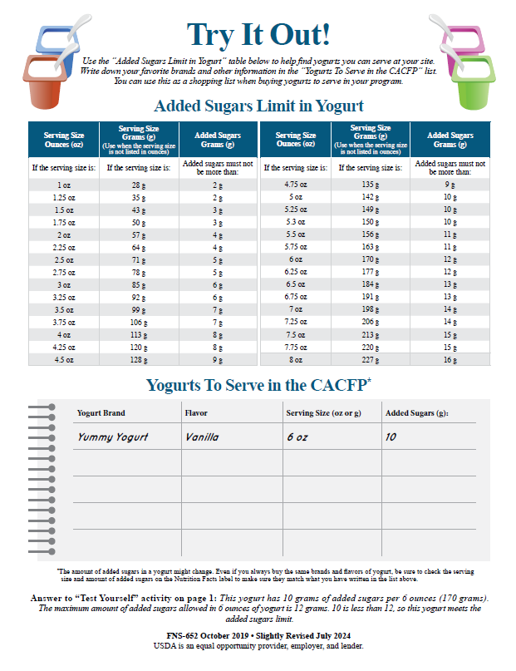
Answer to “Test Yourself” activity on page 1:
Answer to “Test Yourself” activity on page 1: This yogurt has 10 grams of added sugars per 6 ounces (170 grams). The maximum amount of added sugars allowed in 6 ounces of yogurt is 12 grams. 10 is less than 12, so this yogurt is creditable.
This answer is also on the back of this worksheet at the bottom of the page so you can check your work on your own.
Notes:
This answer is also on the back of this worksheet at the bottom of the page so you can check your work on your own once this worksheet is available.

Slide 20
Extensive List of Serving Sizes in Yogurts
The back of the worksheet also has a more extensive list of serving sizes than what’s on the front. On the bottom, you can also write down the brand and type of creditable yogurts that you have found and would like to serve.
Notes:
The back of the worksheet also has a more extensive list of serving sizes than what’s on the front. On the bottom, you can also write down the brand and type of creditable yogurts that you have found and would like to serve.

Slide 21

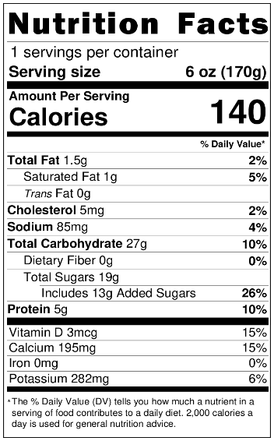

Try It Out!
Which Yogurts Can
You Add to Your List?
A Brand
Strawberry Yogurt
Notes:
You all did such a great job that I want to give you some time to practice with another example.
Here you see the Nutrition Facts label for a yogurt that we are calling, “A Brand Strawberry Yogurt”. Take a look at the Nutrition Facts label on the screen. Does this yogurt meet the added sugars limit of 12 grams of added sugars per 6 ounces?

Slide 22
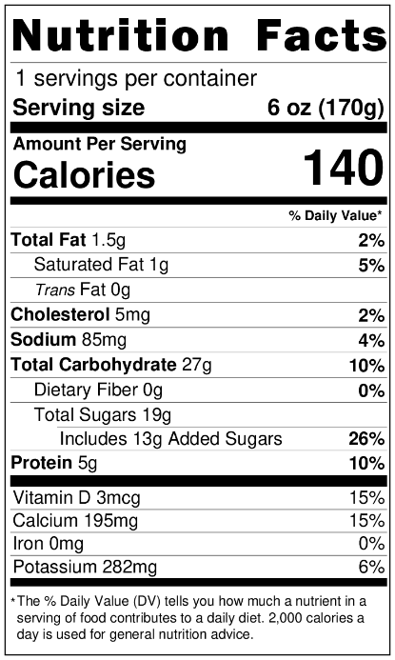
Try It Out! Question
Does this strawberry yogurt meet the added sugars limit?
?
A Brand
Strawberry Yogurt
Raise your hand if you think this yogurt is creditable/meets the sugar limit for yogurts in the CACFP [pause and wait for a show of hands].
Raise your hand if you think this yogurt is not creditable/does not meet the sugar limit for yogurts in the CACFP [pause and wait for a show of hands].
Yes
No
Notes:
Does this yogurt meet the added sugars limit in the CACFP?
Click “Yes” in the poll if you think the yogurt meets the added sugars limit for yogurt in the CACFP.
Click “No” in the poll if you think the yogurt does not meet the added sugars limit for yogurt in the CACFP.
Remember to click submit to send your answer. I will give you 5 seconds to answer, 5, 4, 3, 2, 1. Time is up!
Let’s check your responses!

Slide 23
Try It Out! Answer
Does this strawberry yogurt meet the added sugars limit?
?
A Brand
Strawberry Yogurt
Nice work everyone!! Yes, A Brand Strawberry Yogurt is creditable because it meets the CACFP sugar limit of 23 grams of sugars per ounce.
Yes
No
✓
Notes:
Nice work everyone!! No, A Brand Strawberry Yogurt is not creditable because it does not meet the CACFP added sugars limit as it has more than 12 grams of added sugars per 6 ounces.

Slide 24

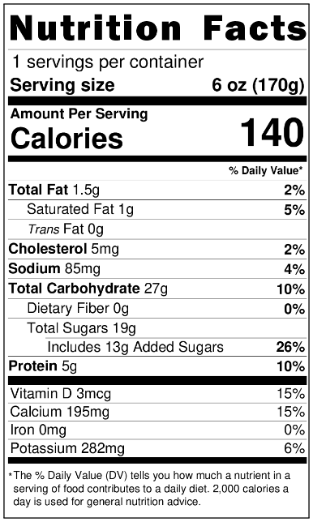
Try It Out!
Which Yogurts Can You Add to Your List?
A Brand Strawberry Yogurt
Serving Size Ounces (oz) | Serving Size Grams (g) (Use when the serving size is not listed in ounces) | Added Sugars Grams (g)
If the serving size is: | If the serving size is: | Added Sugars cannot be more than:
2.25 oz | 64 g | 4 g
3.5 oz | 99 g | 7 g
4 oz | 113 g | 8 g
5.3 oz | 150 g | 10 g
6 oz | 170 g | 12 g
8 oz | 227 g | 16 g
To figure out if this yogurt meets the sugar limit, we looked at the serving size on the Nutrition Facts label which is 5.3 ounces, as shown in the blue circle. We then looked at the “Sugars” line on the Nutrition Facts label to determine how much sugar is in one serving of this yogurt, which is 15 grams. This is shown by green rectangle on the Nutrition Facts label.
We then looked at the table on the worksheet to find the serving size of this yogurt. This serving of this yogurt is 5.3 ounces, so the maximum amount of sugar allowed is 20 grams. Since this yogurt has 15 grams of sugar, and 15 is less than 20, we know that this yogurt is creditable/meets the sugar limit for yogurts in the CACFP.
Notes:
To figure out if this yogurt meets the added sugars limit, we looked at the serving size on the Nutrition Facts label which is 6 ounces, as shown in the blue circle. We then looked at the “Added Sugars” line on the Nutrition Facts label to determine how much added sugar is in one serving of this yogurt, which is 13 grams. This is shown by the green rectangle on the Nutrition Facts label.
We then looked at the table to find the serving size of this yogurt. A serving of this yogurt is 6 ounces, so the maximum amount of added sugars allowed is 12 grams. Since this yogurt has 13 grams of added sugars, and 13 is more than 12, we know that this yogurt does not meet the added sugars limit for yogurt in the CACFP.

Slide 25
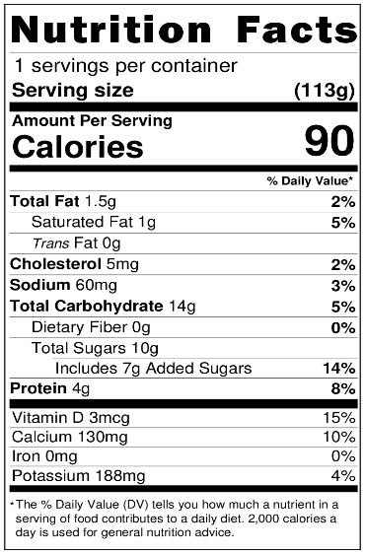
Try It Out!
Which Yogurts Can
You Add to Your List?
B Brand
Peach Yogurt
Notes:
Let’s do another example. This time, the serving size of the yogurt is in grams.

Slide 26
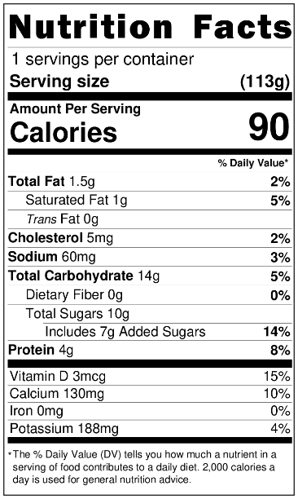
Try It Out! Question
Does this peach yogurt meet the added sugars limit?
?
B Brand
Peach Yogurt
Raise your hand if you think this yogurt is creditable/meets the sugar limit for yogurt in the CACFP [pause and wait for a show of hands].
Raise your hand if you think this yogurt is not creditable/does not meet the sugar limit for yogurt in the CACFP [pause and wait for a show of hands].
Yes
No
Notes:
The yogurt of this question has 7 grams of added sugars in a serving size of 113 grams.
Does this yogurt meet the added sugars limit?
Click “Yes” in the poll if you think the yogurt meets the sugar limit for yogurts in the CACFP.
Click “No” in the poll if you think the yogurt does not meet the sugar limit for yogurts in the CACFP.
Again, do not forget to submit your answer. I will give you 5 seconds to answer, 5, 4, 3, 2, 1. Time is up!
Let’s check your responses!

Slide 27
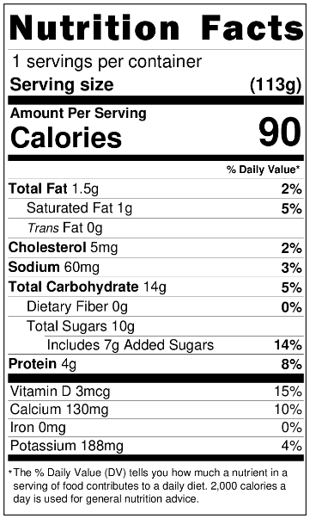
Try It out! Answer
Does this peach yogurt meet the added sugars limit?
?
B Brand
Peach Yogurt
You are correct! B Brand Peach Yogurt is creditable!
✓
Yes
No
Notes:
You are correct! B Brand Peach Yogurt meets the added sugars limit! I will explain this answer in the next slide.

Slide 28
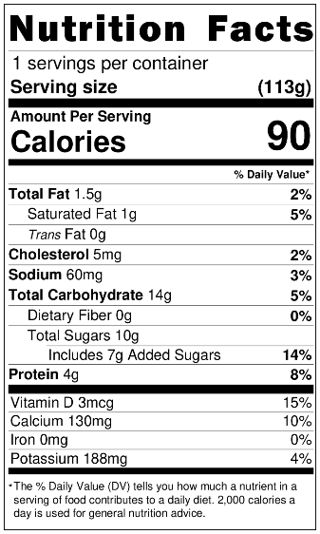
Try It Out!
Which Yogurts Can You Add to Your List?
B Brand Peach Yogurt
Serving Size Ounces (oz) | Serving Size Grams (g) (Use when the serving size is not listed in ounces) | Added Sugars Grams (g)
If the serving size is: | If the serving size is: | Added Sugars cannot be more than:
2.25 oz | 64 g | 4 g
3.5 oz | 99 g | 7 g
4 oz | 113 g | 8 g
5.3 oz | 150 g | 10 g
6 oz | 170 g | 12 g
8 oz | 227 g | 16 g
To figure out if this yogurt was creditable, we looked at the serving size on the Nutrition Facts label. The serving size is 170 grams, as shown in the blue circle. We then looked at the “Sugars” line on the Nutrition Facts label to see how much sugar is in one serving of this yogurt, which is 14 grams. This is shown by the green rectangle.
We then looked at the table on the worksheet to find the serving size of this yogurt. This serving of this yogurt is 170 grams, so the maximum amount of sugar allowed is 23 grams. Since this yogurt has 14 grams of sugar, and 14 is less than 23, we know that this yogurt is creditable/meets the sugar limit for yogurts in the CACFP.
Notes:
To figure out if this yogurt met the added sugars limit, we looked at the serving size on the Nutrition Facts label. The serving size is 113 grams, as shown in the blue circle. We then looked at the “Added Sugars” line on the Nutrition Facts label to see how much added sugar is in one serving of this yogurt, which is 7 grams. This is shown by the green rectangle.
We then looked at the table to find the serving size of this yogurt. A serving of this yogurt is 113 grams, so the maximum amount of added sugars allowed is 8 grams. Since this yogurt has 7 grams of added sugars, and 7 is less than 8, we know that this yogurt meets the added sugars limit for yogurt in the CACFP.

Slide 29
Yogurts To Serve in the CACFP*
 | Yogurt Brand | Flavor | Serving Size (oz or g) | Added Sugars (g)
 | Yummy yogurt | Vanilla | 6 oz | 10
 | B Brand | Peach | 113 g | 7
This is what your worksheet might look like after this activity. You can continue to add to this list as you find additional creditable yogurts you may serve in your program.
Because we know that yogurt formulations can change from time to time, we also include a note on the worksheet reminding users to check the Nutrition Facts label on the yogurt every time to make sure the yogurt meets the sugar limit.
Notes:
This is what your worksheet might look like after this activity. You can continue to add to this list as you find additional creditable yogurts you may serve in your program.
You will notice that we did not add A Brand Strawberry Yogurt to this list since it did not meet the added sugars limit.
Because we know that yogurt formulations can change from time to time, we also include a note on the worksheet reminding users to check the Nutrition Facts label on the yogurt often to make sure the yogurt meets the added sugars limit.

Slide 30
Servings Per Container
Shows the total number of servings in the entire food package or container.
One package of food may contain more than one serving.
Notes:
Now, let’s take a second to talk about servings per container on a Nutrition Facts label. The first line of the Nutrition Facts label is “servings per container.” This shows the total number of servings in the entire food package or container. Be aware that one package of food may contain more than one serving.
For example, when you look at the “servings per container” line highlighted on the slide it shows that there are 2 servings of yogurt in this container.

Slide 31

Serving Sizes Explained
1 serving
6 ounces
2 servings
12 ounces
120 calories and
9 grams of added sugars
240 calories and
18 grams of added sugars
Notes:
So, if you serve more than one serving, you are also serving more calories, added sugars, and other nutrients.
For example, a 1 serving of the 6-ounce yogurt shown on the left of the slide contains 120 calories and 9 grams of added sugars.
However, if you serve 2 servings or 12 ounces of that same yogurt shown on the right of the slide, then the 2 servings contains 240 calories and 18 grams of added sugars.
So again, if you serve more than what the serving size is on the Nutrition Facts label, then you are also serving more calories, added sugars, and other nutrients so be sure to take that into consideration.

Slide 32

Team Nutrition Resources
All Team Nutrition materials are available online from Team Nutrition’s website and are available for free download to anybody who is interested.
TeamNutrition.USDA.gov
Notes:
All Team Nutrition materials are available online from Team Nutrition’s website and are available for free download to anybody who is interested.

Slide 33


How To Order Print Copies
Resource Order Form at TeamNutrition.USDA.gov.
FREE for those participating in a USDA’s Child Nutrition Program while supplies last.
Sponsoring Organizations and State agencies can also order in bulk by sending an email to:
TeamNutrition@USDA.gov
For all participating in a Child Nutrition Program, such as the CACFP, Team Nutrition’s print materials are free to order.
If you would like to order Team Nutrition’s free materials in print, you can go to the “Resource Order Form” link on the Team Nutrition website to order print copies of the materials.
For bulk orders, you can email teamnutrition@usda.gov.
Notes:
For all participating in a Child Nutrition Programs, such as the CACFP, Team Nutrition’s print materials are free to order.
If you would like to order Team Nutrition’s free materials in print, you can go to the “Resource Order Form” link on the Team Nutrition website to order print copies of the materials.
For bulk orders, you can email TeamNutrition@USDA.gov.

Slide 34



Thank you!
These training slides were provided by U.S. Department of Agriculture's Team Nutrition. If you would like to learn more about Team Nutrition and additional resources available, please visit their website, subscribe to their monthly e-newsletter, connect with them via email at teamnutrition@usda.gov, and follow them on Twitter.
Thank you!
TeamNutrition.USDA.gov
TeamNutrition@USDA.gov
USDA is an equal opportunity provider, employer, and lender.
Notes:
These training slides were provided by U.S. Department of Agriculture's Team Nutrition. If you would like to learn more about Team Nutrition and additional resources available, please visit their website, subscribe to their monthly e-newsletter, and connect with them via email at TeamNutrition@USDA.gov.
Thank you!

