Slide 1


Reducing Added Sugars in School Meals

Slide 2

Today’s Speakers
Kaylyn Padovani
USDA Child Nutrition Programs
Caralyn Mendoza
Newman-Crows Landing Unified School District
Phylicia Burford
Thornton Fractional TWP District 215
Allison Butler
USDA Child Nutrition Programs
Carrie Scheidel
USDA Child Nutrition Programs

Slide 3


Certificates
Certificate of participation
USDA School Nutrition Professional Standards for
  Key Area 1000: Nutrition
  Training Topic 1100: Menu Planning

Slide 4

The Team Nutrition Initiative Supports the
Child Nutrition Programs by:
Providing training and technical assistance for child nutrition professionals to enable them to prepare and serve nutritious meals that appeal to participants
Developing nutrition education resources to help children make healthy food and physical activity choices as part of a healthy lifestyle
Providing technical resources to support healthy school & child care environments
1
2
3

Slide 5

Learning Objectives
Identify strategies to reduce added sugars in school meals that reflect local food preparation practices and taste preferences
Summarize best practices for incorporating menu items to reduce added sugars in school meals
Discuss how Team Nutrition resources can help improve the nutritional quality of school meals and meet added sugars limits

Slide 6

What menu planning strategies have you implemented to reduce added sugars in school meals?
Choose all that apply
Offer unflavored, low-fat and fat-free milks only
Offer grain-based desserts less frequently
Offer breakfast cereals and yogurts lower in added sugars
Offer more fresh fruit or unsweetened frozen fruit
Other

Slide 7
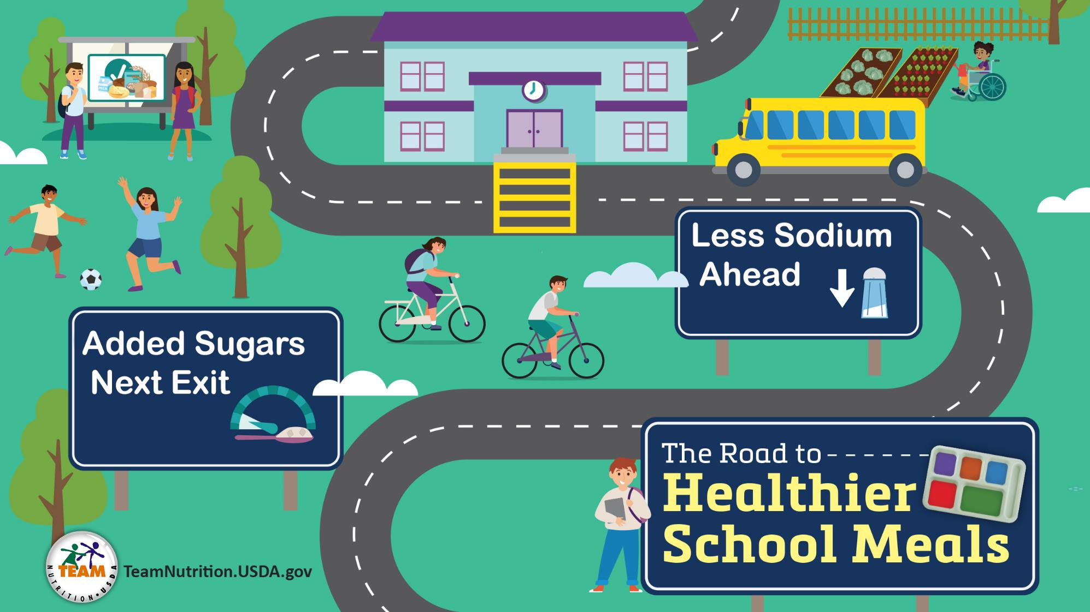
The road to healthier school meals

Slide 8
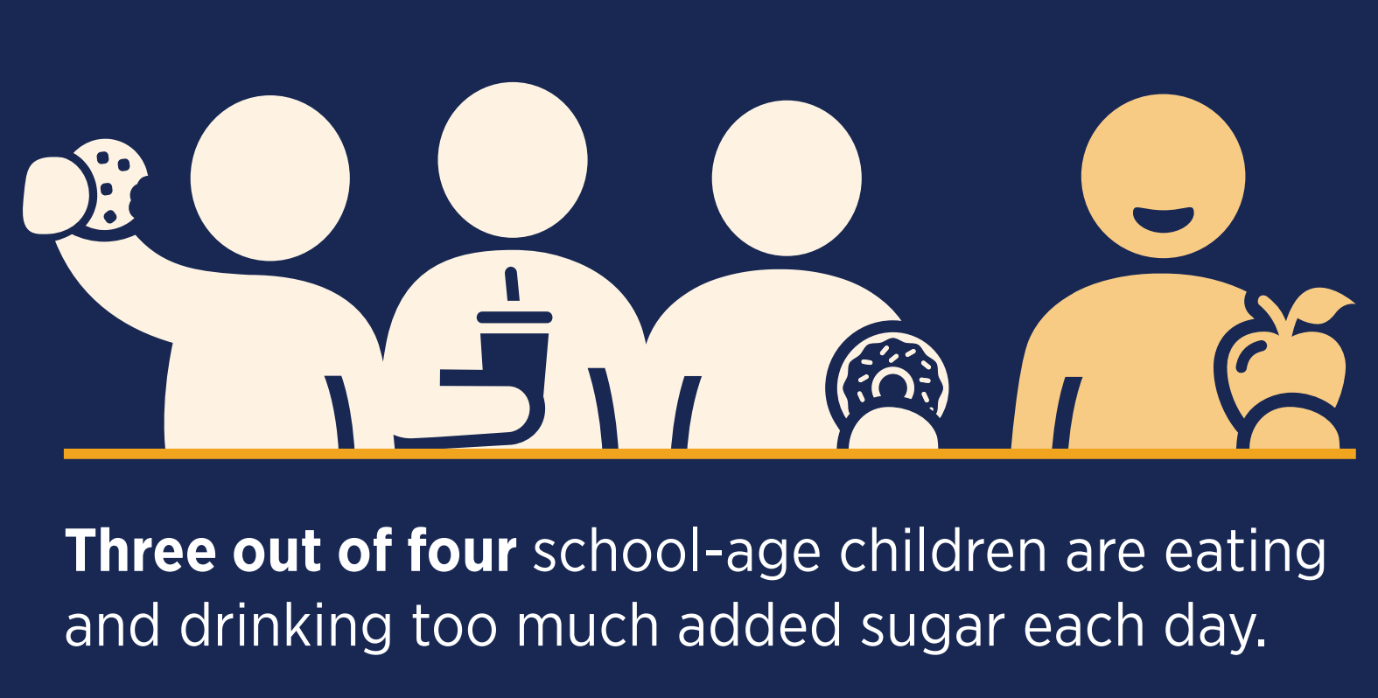
Why Limit Added Sugars?

Slide 9
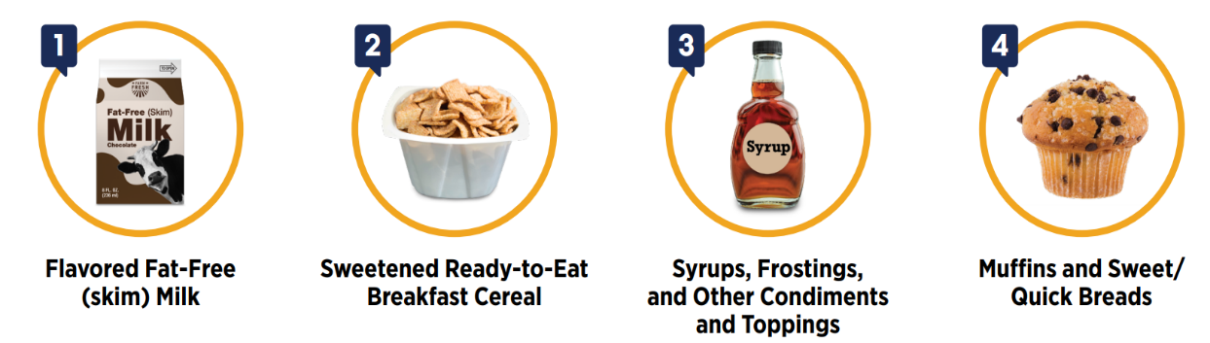

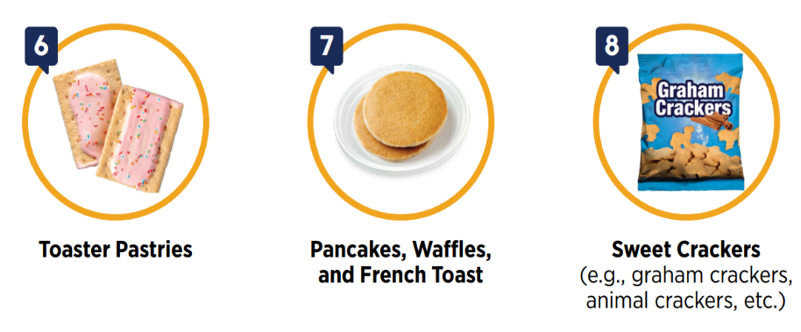
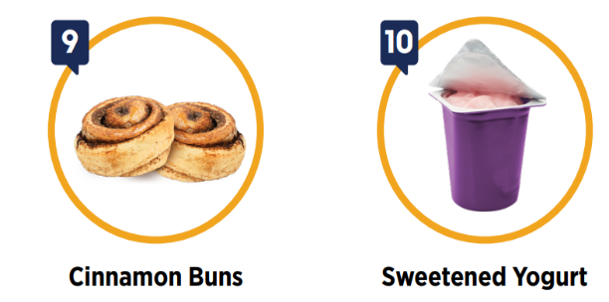
Top 10 Sources of Added Sugars at School Breakfast

Slide 10

Added Sugars Limits

Slide 11
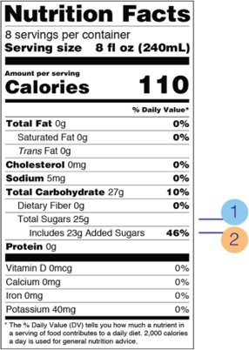

Phase 1: Added Sugars Limits to Certain Products
Breakfast Cereals
No more than 6 grams of added sugars per dry ounce​
Yogurt:
No more than 12 grams of added sugars per 6 ounces
(2 grams of added sugars per ounce)​
Flavored Milk
No more than 10 grams of added sugars per 8 fluid ounces​

Slide 12


Phase 2: Overall Weekly Added Sugars Limits
Overall weekly limits in addition to product-based limits​
Limits added sugars to less than 10 percent of calories per week in the school lunch and breakfast programs​

Slide 13
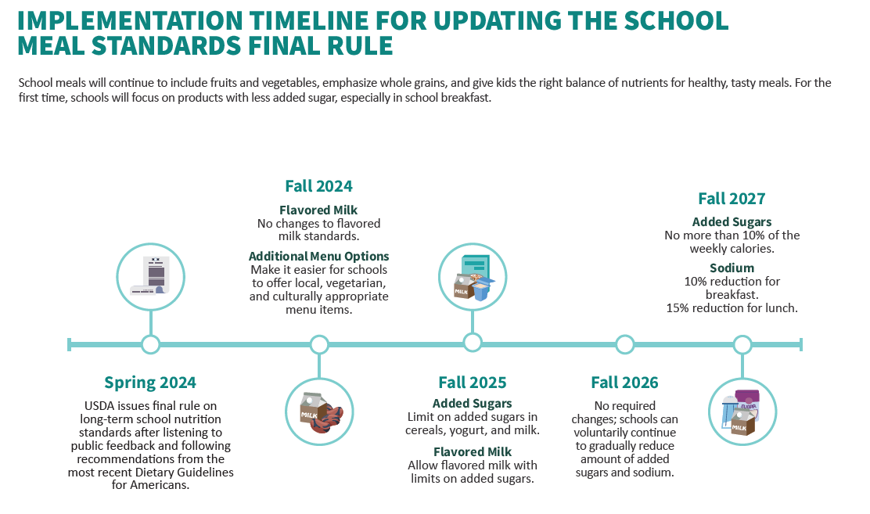
Implementation Timeline for updating the school meal standards final rule

Slide 14
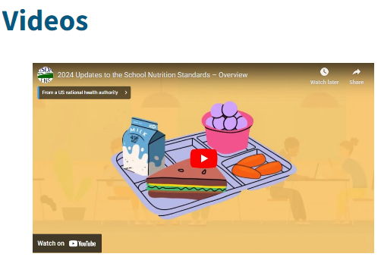

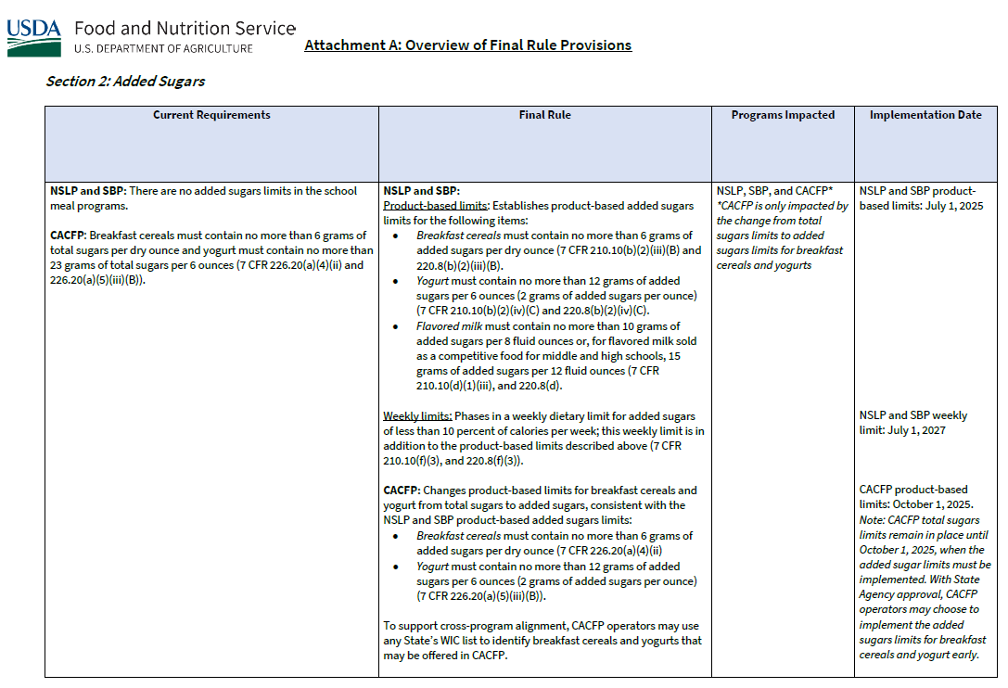
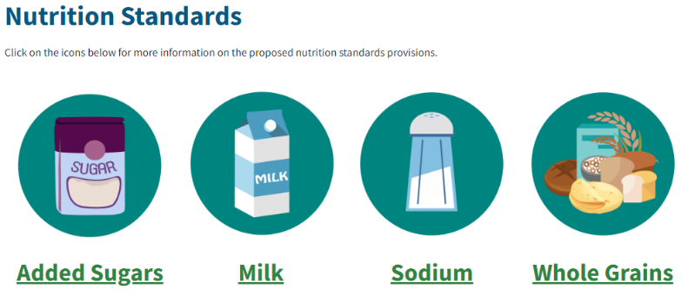
Final Rule Resources
​ Website
​Initial Implementation Memorandum​
fns.usda.gov/cn/school-nutrition-standards-updates

Slide 15


Reducing Added
Sugars in Action
Please direct your questions to “All Panelists” in the drop-down menu under the Q&A section of your screen.

Slide 16
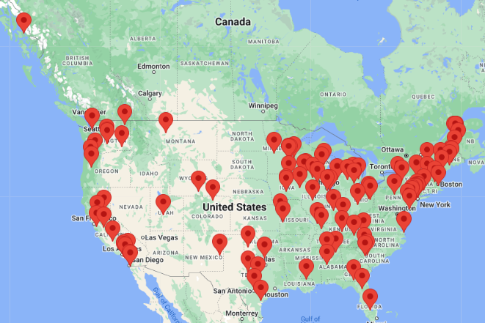
Healthy Meals Incentives Recognition Awards
Awardee toolkit
National and local recognition
Attend the national Healthy Meals Summit in Fall 2025
Celebrate your school nutrition team
Share best practices
Apply Today!
healthymealsincentives.org/awardee-spotlight

Slide 17

Panel Presenters

Slide 18


Caralyn Mendoza
Newman-Crows Landing
Unified School District

Slide 19


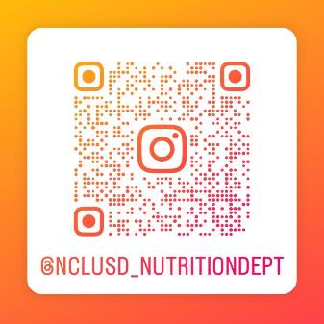
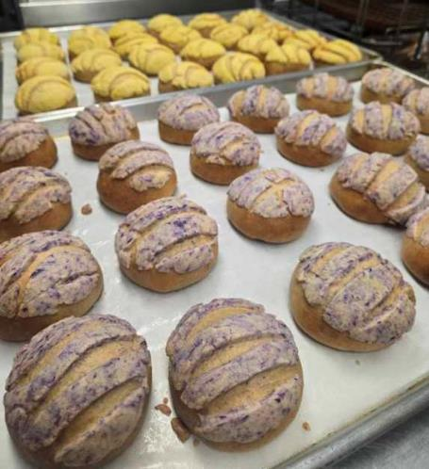

Newman-Crows Landing Unified School District
California
Student Enrollment: 3,200
Number of Schools: 7
  4 elementary, 1 middle, 1 high school,
  1 alternative program
Free/Reduced: 74%
School Breakfast Participation
  Elementary: 67.24%
  Middle/High: 40.72%
  District-wide: 51.85%
School Lunch Participation:
  Elementary: 79.64%
  Middle/High: 49.25%
  District-wide: 65.44%

Slide 20

Phylicia Burford Thornton Fractional TWP District 215

Slide 21

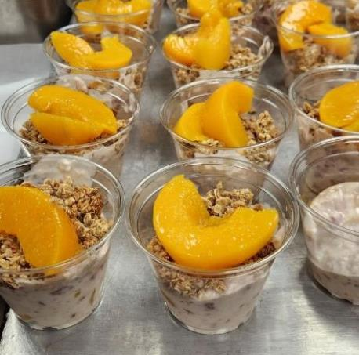
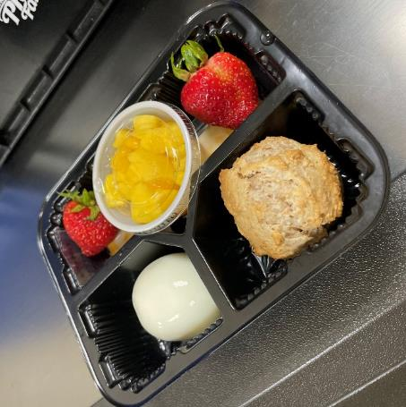
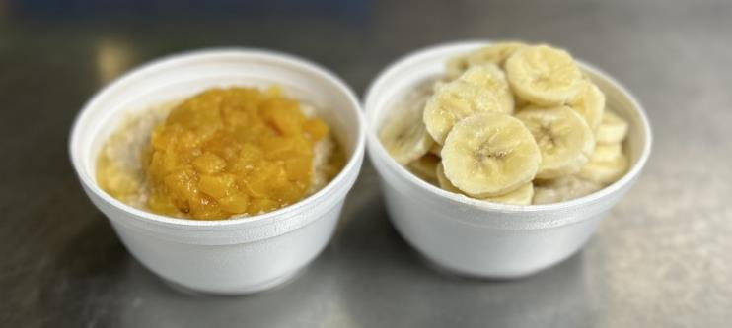
Thornton Fractional TWP District 215 Profile
Illinois
Student Enrollment: 3,232
Number of Schools: 3
School Breakfast Participation 12%
School Lunch Participation 57%
Free/Reduced %: All CEP
Notes:
Phylicia Burford to present information on her district.

Slide 22
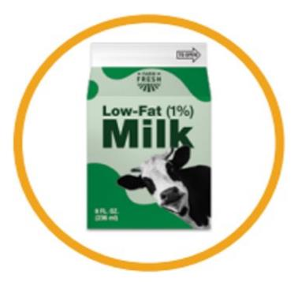


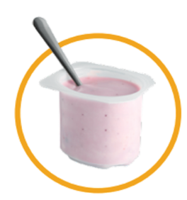


Strategies to Reduce Added Sugars
MILK
Offer only unflavored milk or offer flavored milk less often
Pair flavored milk with entrees with less added sugars
GRAINS
Offer less often grains high in added sugars or not at all
Offer breakfast cereals that contain less added sugars
GRAINS and MEATS/MEAT ALTERNATES
Offer yogurts that contain less added sugars
Offer savory options
FRUITS
Offer fresh and unsweetened frozen fruit
Use as a topping

Slide 23

Resources

Slide 24

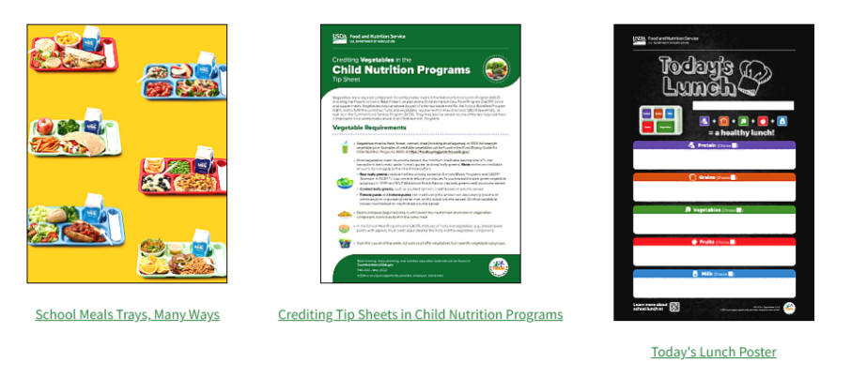

Team Nutrition Back to School Webpage
fns.usda.gov/tn/back-school

Slide 25

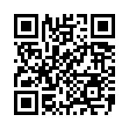
Reducing Added Sugars at School Breakfast Guide
Includes:
How to determine added sugars in foods and drinks
Sources of added sugars at school breakfast
Added sugars requirements
Simple swaps
Tips for reducing added sugars
Talking with families and caregivers
fns.usda.gov/tn/sbp/reducing-added-sugars

Slide 26
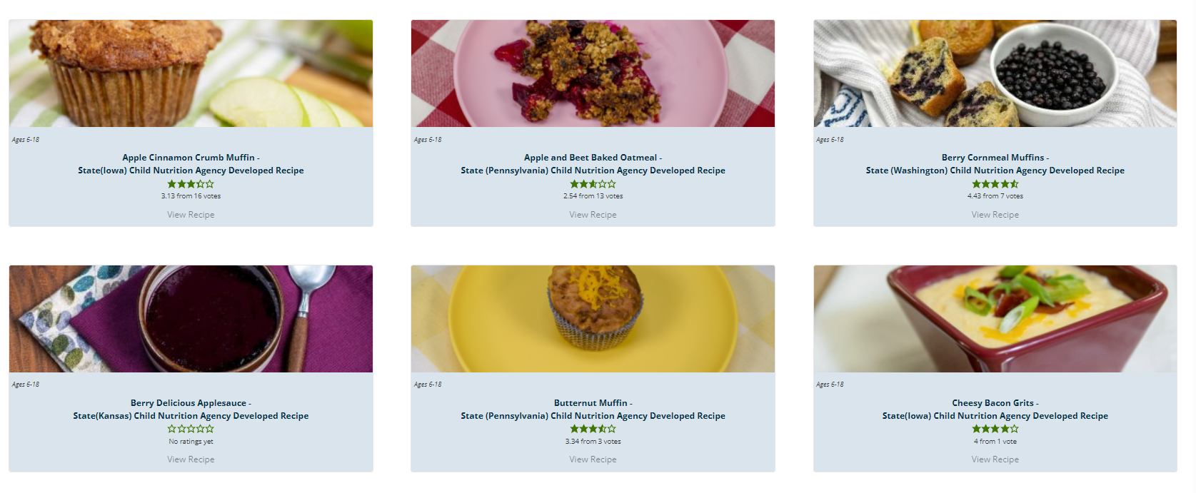

State Agency Standardized Recipes
theicn.org/cnrb/state-agency-developed-recipes/

Slide 27


USDA Standardized Recipes

Slide 28

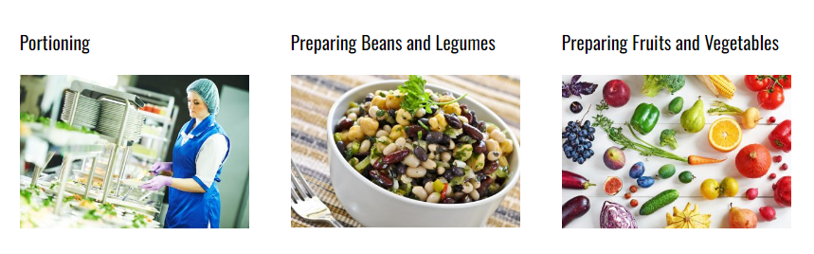
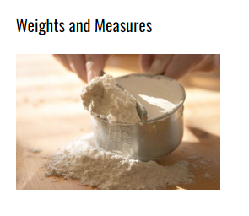
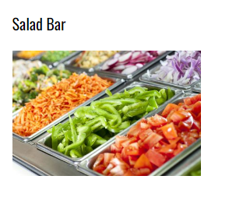

Culinary Institute of Child Nutrition (CICN)
theicn.org/cicn/

Slide 29

Added Sugars for Nutrient Analysis
USDA-Approved Nutrient Analysis Software
Analyzes nutrients in menus and recipes
Starting in school year 2024-2025, all USDA-approved nutrient analysis software are required to show added sugars information.
Other sources of added sugars values (when not using an USDA-Approved Software):
USDA Foods Database is a resource for menu planners to access up-to-date, vendor-specific nutrition, allergen and ingredient information for direct delivered USDA Foods.
FoodData Central is a free database of food products, that provides nutrient information and may include added sugars values. FoodData Central is not a nutrient analysis software.

Slide 30

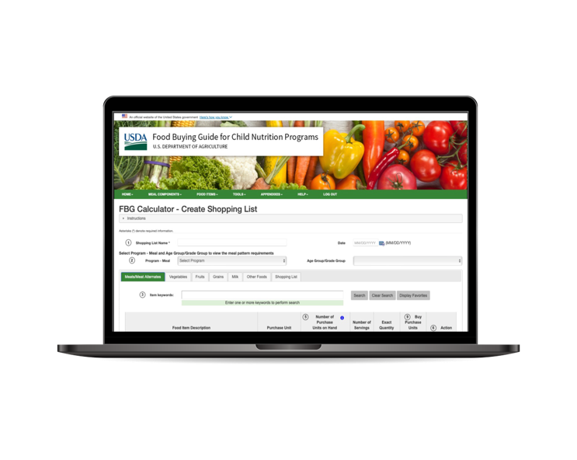
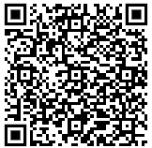
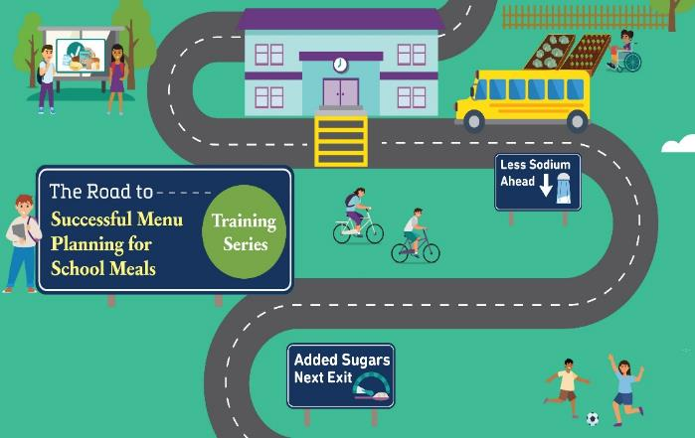

The Road to Successful Menu Planning for School Meals
Training Series
Live, quarterly webinars co-hosted with the Institute of Child Nutrition
Short, on-demand trainings (about 15 minutes in length)
“Creating Your Road Map to
School Menu Planning Success”
September 19, 2024
3:00-4:00pm EST

Slide 31

Questions
Please direct your questions to “All Panelists” in the drop-down menu under the Q&A section of your screen.

Slide 32
What steps do you plan to take after attending today’s webinar?
Choose all that apply
Identify breakfast items that are high in added sugars on my breakfast menu.
Discuss product needs with vendors.
Explore recipes that are lower in added sugars.
Seek student input via taste-testing and surveys.
Apply for a Breakfast Trailblazer Award!

Slide 33


After today’s webinar….
September 13: All who registered for this webinar will receive an email with the websites mentioned today.
September 26: All who attended this entire webinar will receive a certificate of attendance via email.
  If you watched this webinar with others, you may print out a certificate for each person.
  This webinar counts toward USDA Professional Standards for School Nutrition Programs, Key Area 1000: Nutrition and Training Topic 1100: Menu Planning.
All who registered for this webinar will receive an email once the webinar has
been made available on the Team Nutrition website.

Slide 34







Find More Information Here
TeamNutrition.USDA.gov
TeamNutrition@USDA.gov
This institution is an equal opportunity provider, employer, and lender.

