Slide 1

Feeding Infants in the CACFP
Lesson 1
Overview of the CACFP Infant Meal Pattern Requirements
Notes:
Information in this lesson comes from Chapter 1: Giving Babies a Healthy Start With the CACFP in the Feeding Infants in the Child and Adult Care Food Program guide. This lesson provides participants with information about the CACFP infant meal pattern.
Learning Objectives
At the end of this lesson, participants should be able to:
Describe how a baby’s usual eating habits fit within the CACFP infant meal pattern.
Lesson Description
The Overview of the CACFP Infant Meal Pattern Requirements lesson takes approximately 22 minutes to deliver. If the pre-test and post-test are administered, total session time will be approximately 28 minutes. Playing the Baby Food Line Up game will add approximately 20 minutes to the total training time.
Welcome and Trainer Introduction
Welcome participants to the training and introduce yourself by providing:
Your name
Your position title
Your experience with the CACFP, infant nutrition, and/or child care

Slide 2
Agenda
Feeding Infants in the CACFP Guide
CACFP Infant Meal Pattern Requirements
Communicating With Parents
Summary
Notes:
In this lesson, you will learn about the Child and Adult Care Food Program, or CACFP, infant meal pattern requirements and some resources you can use to start conversations with parents about their baby’s eating habits and development.

Slide 3
Pre-Test #1
1
True or False?
Responsive feeding means that you feed a baby when they show signs of being hungry and stop feeding when the baby shows signs of
being full.
Notes:
True or False?
Responsive feeding means that you feed a baby they show signs of being hungry and stop feeding when the baby shows signs of being full.
Trainer Note: You can conduct the pre-test as a group activity or distribute a paper test. There are three question slides.
For a group activity, ask participants what they think the answer is for each question.
Do not give the answer.
Tell participants the answers will be provided at the end of the lesson in the post-test slides.
For paper-based testing, distribute the pre-test and pencils. Tell participants how much time they have to complete the assessment.
If you will not administer the test, skip the slide.

Slide 4
Pre-Test #2
2
A father brings in organic pureed carrots for his 6-month-old baby to have at lunch. The baby is eating foods from all meal components. As the child care provider, what foods do you need to offer to the baby to claim reimbursement for lunch?
Iron-fortified infant formula
Crackers
Iron-fortified infant cereal and/or a meat/meat alternate
A and C
Notes:
A father brings in organic pureed carrots for his 6-month-old baby to have at lunch. The baby is eating foods from all meal components. As the child care provider, what foods do you need to offer to the baby to claim reimbursement for lunch?
Iron-fortified infant formula
Crackers
Iron-fortified infant cereal and/or a meat/meat alternate
A and C
Trainer Note: The answer to the question is provided in the post-test slide.

Slide 5
Pre-Test #3
3
Yes or No?
A parent breastfeeds their 3-month-old baby before bringing them to child care. The baby is asleep upon arrival and stays asleep until 10 a.m. You did not offer the baby breakfast since they were asleep. At 10:15 a.m. they show signs of hunger. Can you claim the breakfast meal if you offer the baby 4-6 fluid ounces of breastmilk at 10:15 a.m.?
Notes:
Yes or No?
A parent breastfeeds their 3-month-old baby before bringing them to child care. The baby is asleep upon arrival and stays asleep until 10 a.m. You did not offer the baby breakfast since they were asleep. At 10:15 a.m. they show signs of hunger. Can you claim the breakfast meal if you offer the baby 4-6 fluid ounces of breastmilk at 10:15 a.m.?
Trainer Note: The answer to the question is provided in the post-test slide.

Slide 6

Video: Overview of the Child and Adult Care Food Program Infant Meal Pattern
Notes:
Next, we will watch a short video that describes how CACFP meals and snacks support infant growth and development.
Trainer Note: The Overview of the Child and Adult Care Food Program Infant Meal Pattern video is embedded in the PowerPoint slide. Runtime is 2 minutes and 51 seconds.
There are a few options for playing the video.
The video is embedded in the PowerPoint presentation. You can use your mouse to select the video on the slide or press “Enter” on your keyboard to start the video. Or,
If you have an internet connection, you can play the video directly from the USDA Team Nutrition website at TeamNutrition.USDA.gov.
Trainer Note: The video can be viewed with closed-captioning and audio description at fns.usda.gov/tn/overview-child-and-adult-care-food-program-infant-meal-pattern-cacfp-trainers-tools.
Trainer Note: After the video plays, summarize the information presented or ask participants the following questions. You can do this activity as a group discussion or break participants into smaller groups or pairs.
What is the CACFP infant meal pattern?
The United States Department of Agriculture’s Child and Adult Care Food Program, also known as the CACFP, is a great way to help ensure the babies you care for get the nutrition they need for growth and development.
The program provides for good nutrition—critical for the growth and development that occurs during a baby’s first year—and provides opportunities to introduce healthy eating habits.
All operators participating in the CACFP need to follow the CACFP infant meal pattern and communicate with parents about types of foods the infant has eaten at home.
What are the three main ways (presented in the video) the CACFP infant meal pattern allows you to provide meals in a way that supports a baby's development?
Feed babies solid foods when they are developmentally ready.
Feed babies when they show signs of being hungry, and stop the feeding when they show signs of being full.
You can still be reimbursed for meals when the mother provides pumped breastmilk or stops in to breastfeed onsite, as long as you provide all other meal components when the baby is developmentally ready.

Slide 7
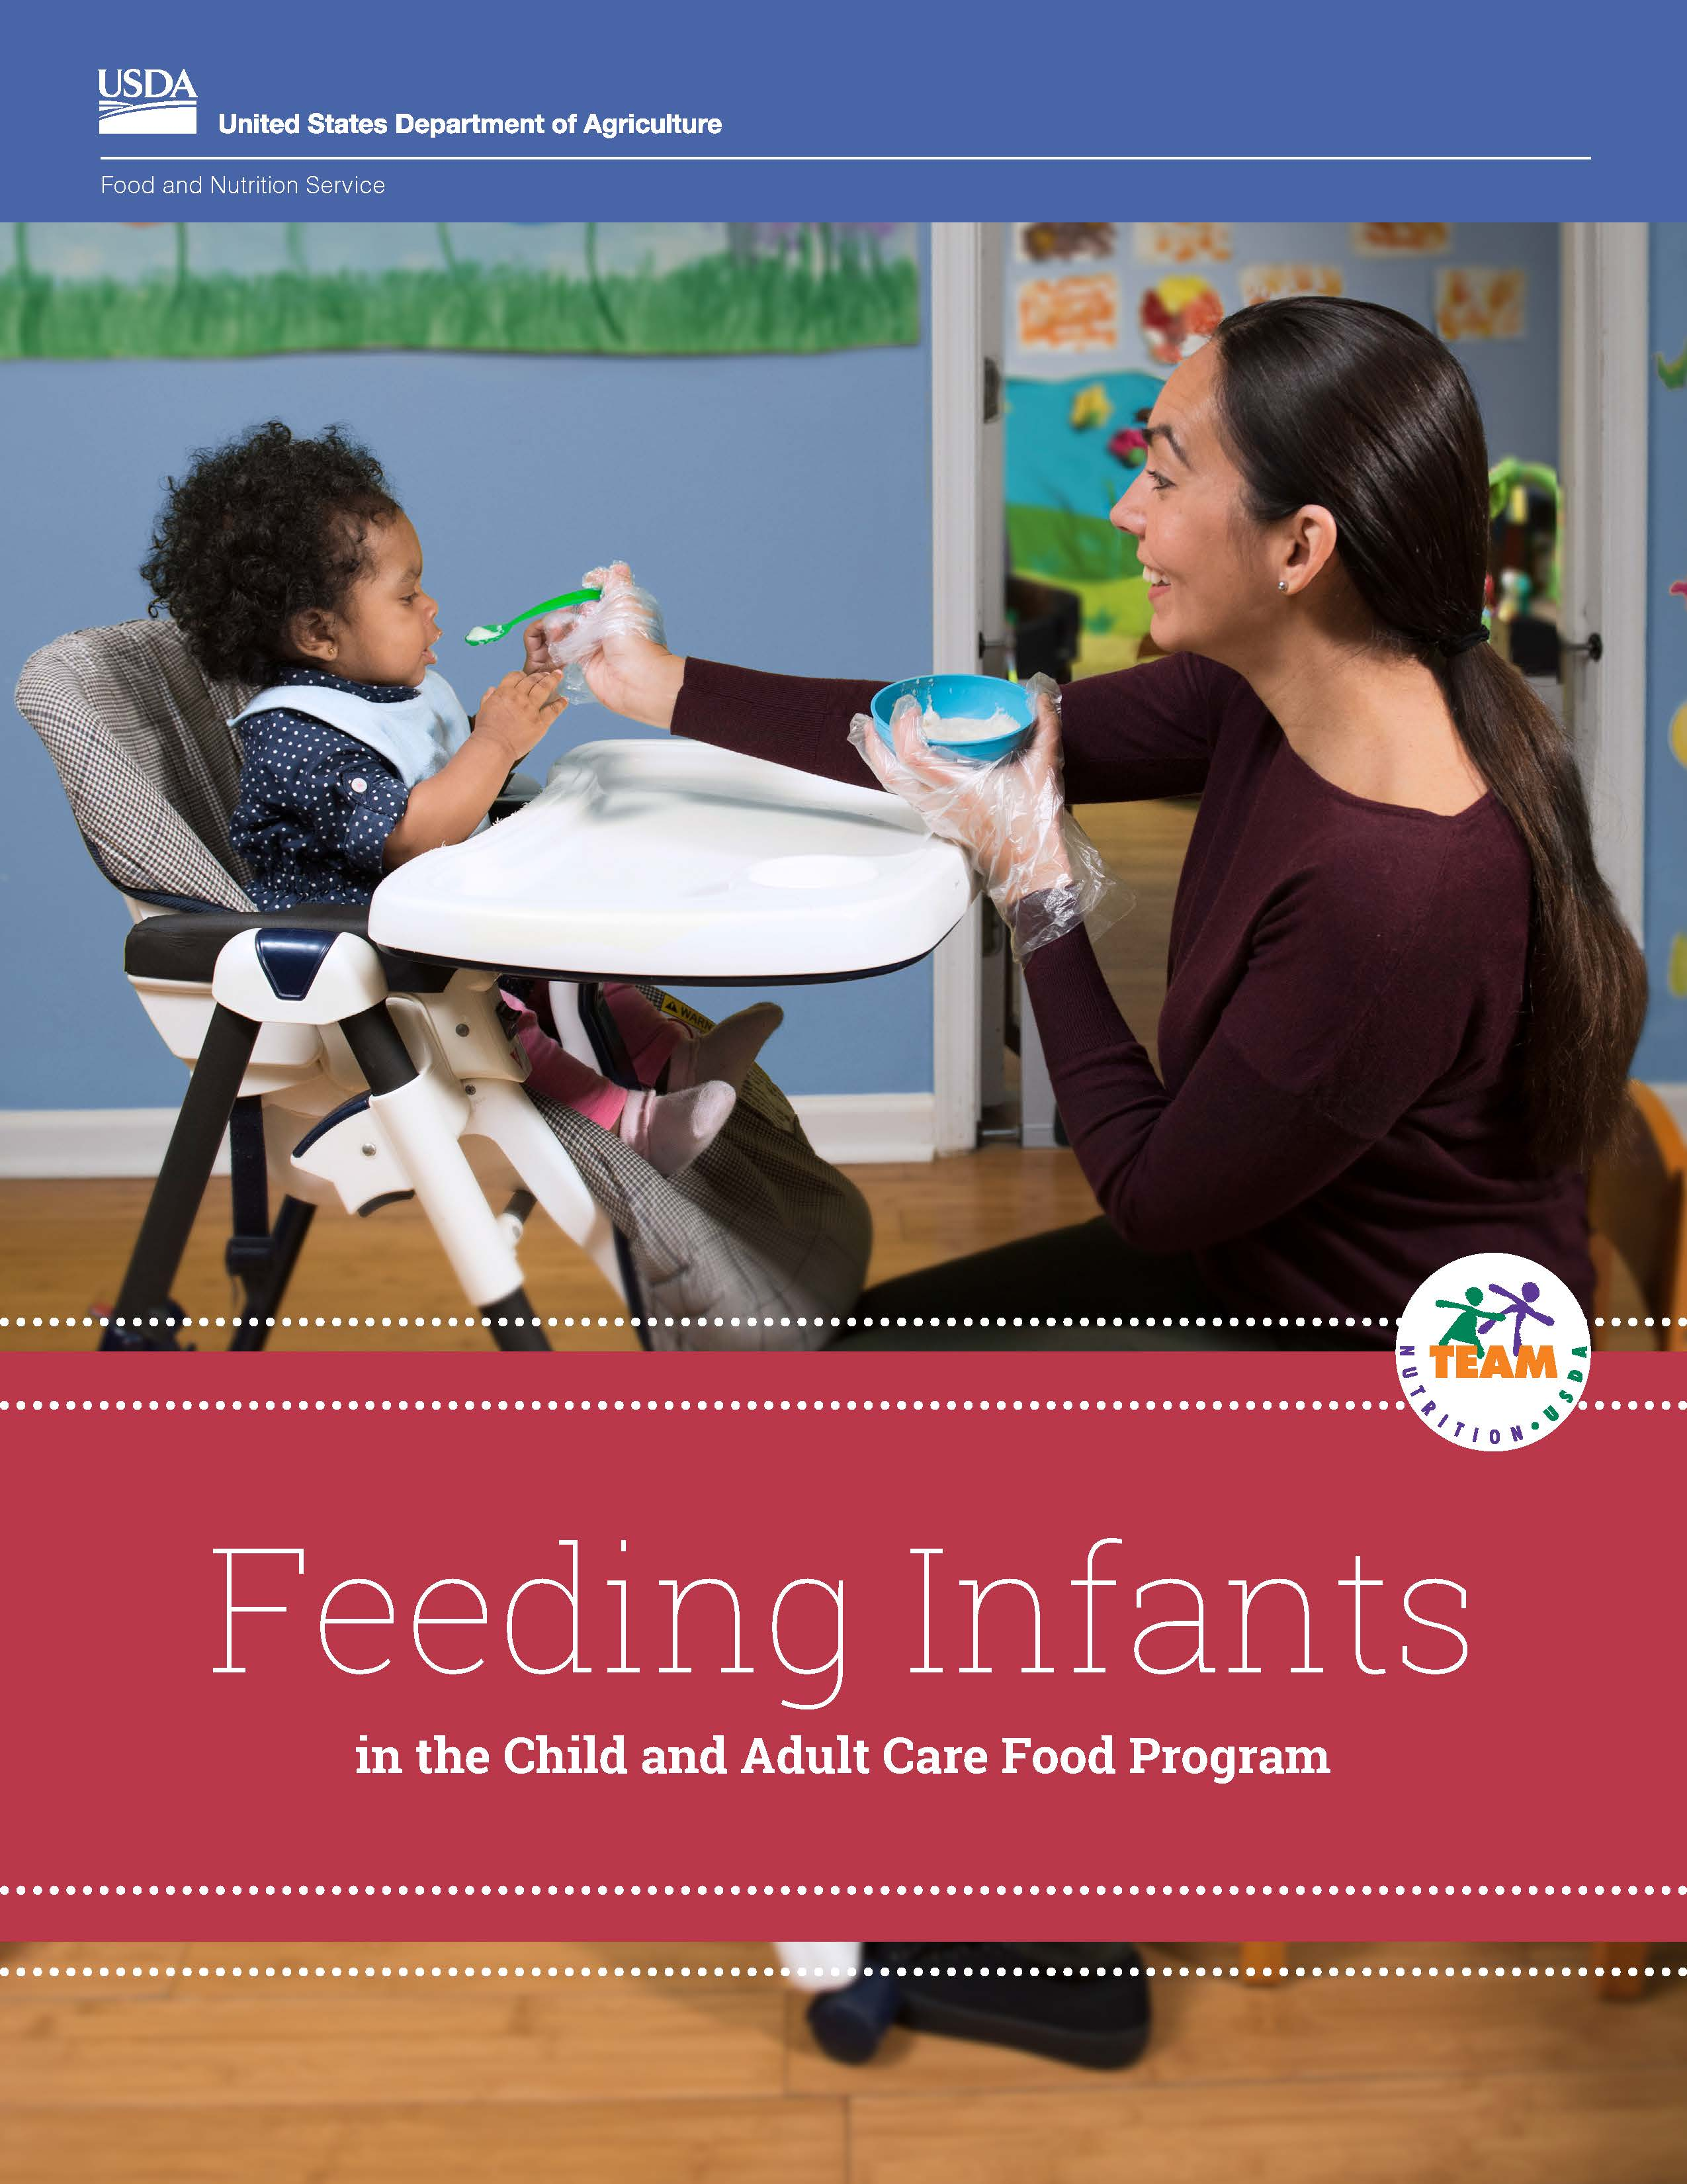
Feeding Infants in the CACFP Guide
This guide contains information on:
CACFP infant meal pattern,
Hunger and fullness signs,
Handling and storing breastmilk and infant formula,
Developmental readiness for solid foods,
What is creditable,
And more!
Notes:
The Feeding Infants in the Child and Adult Care Food Program guide is your go-to resource for understanding the CACFP infant meal pattern. Each baby in your care has their own eating abilities. This is because babies grow and develop at different rates. The guide contains information on how to offer meals that are reimbursable in the CACFP.
You will also find in the guide resources you can use to start a conversation with parents. This will help you learn about their baby’s eating habits so you know when to give certain foods to a baby and which foods to avoid. You can make sure the babies are getting the best care possible by speaking with parents regularly and working together as a team.

Slide 8
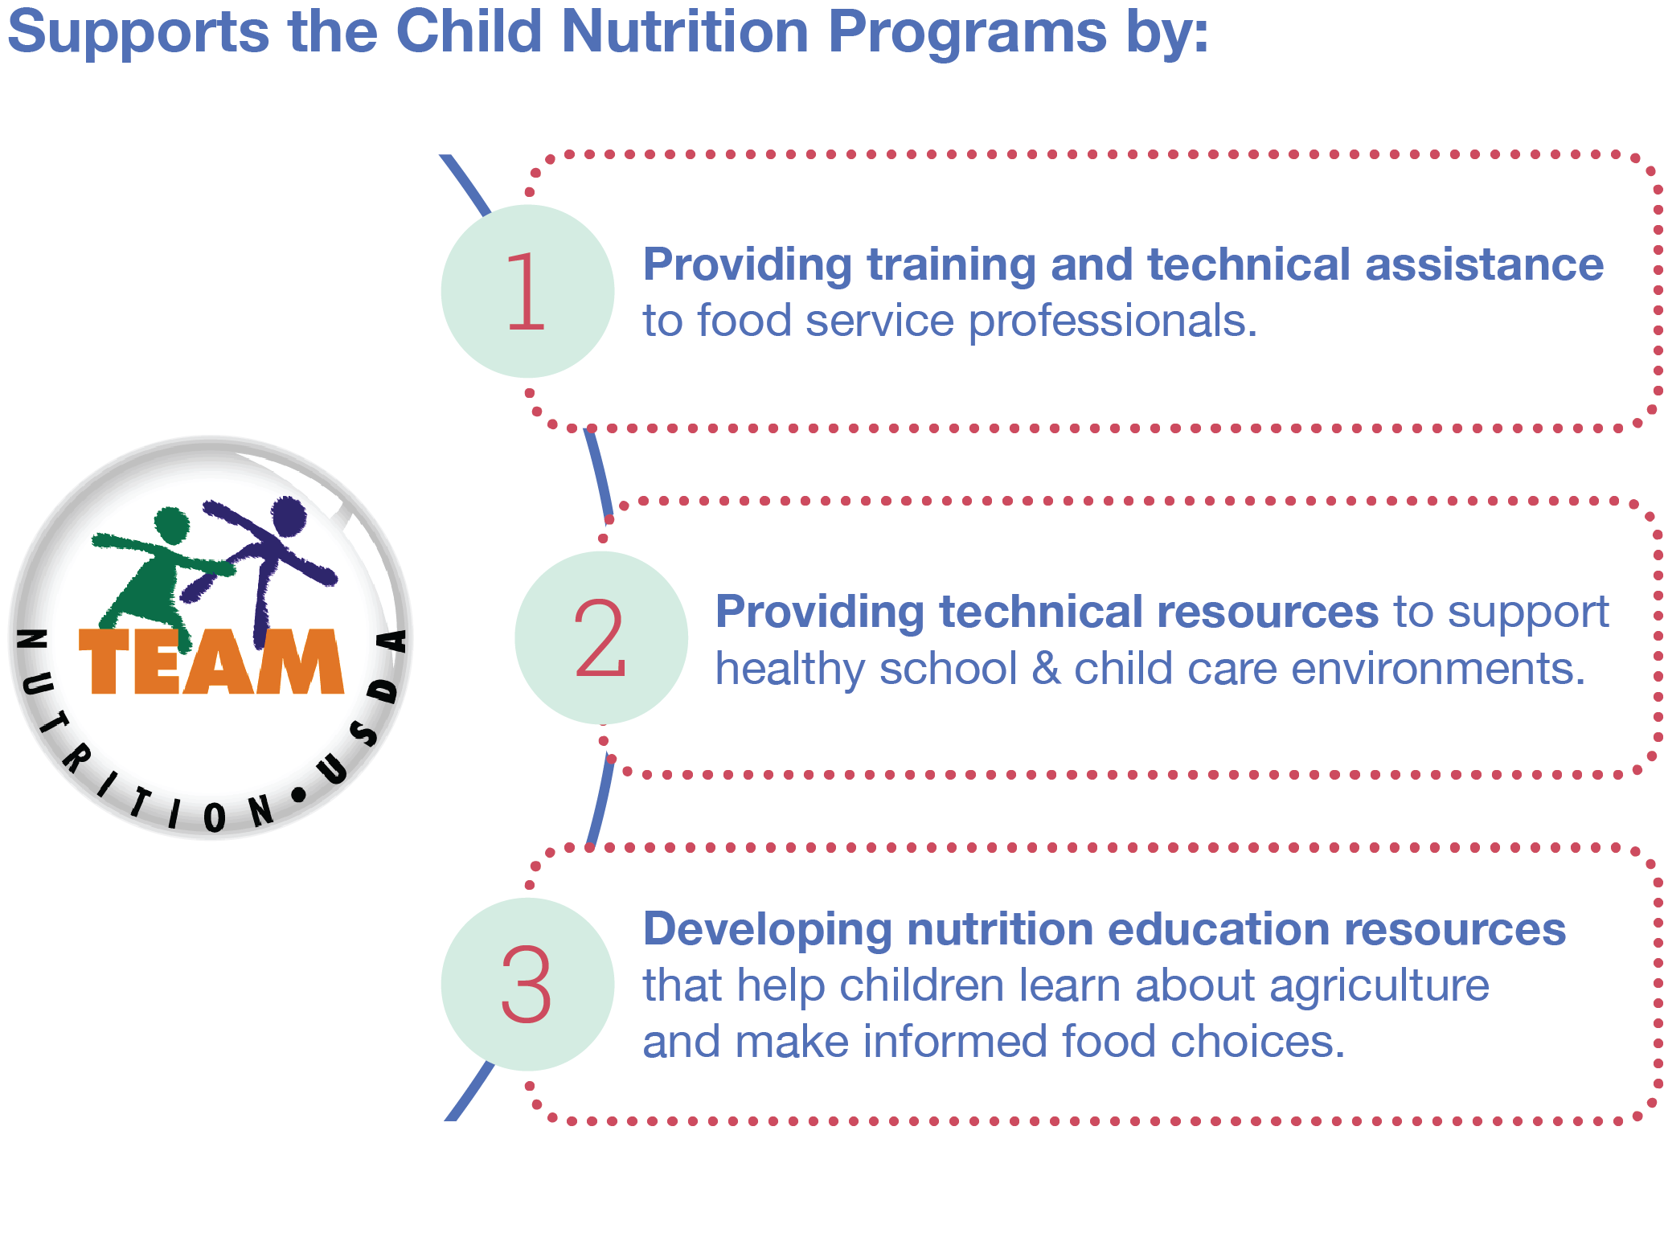
The Team Nutrition Initiative
Notes:
The Team Nutrition initiative supports the Child and Adult Care Food Program by:
Providing training and technical assistance to food service professionals that prepare meals for the programs,
Providing the programs with technical resources to support healthy school and child care environments, and
Developing nutrition education resources that help children learn about agriculture and become self‐sufficient in making informed food choices.
To support the growth and development of the babies in your care, follow the CACFP infant meal pattern to prepare and serve nutritious meals.

Slide 9
Words To Know
On-demand feeding
Responsive feeding
Solid foods
Reimbursable meal
Meal components
Developmental readiness
Name of a group of foods in a CACFP reimbursable meal.
When a baby can control the muscles needed to eat solid foods.
Meal or snack that meets CACFP meal pattern requirements.
Understanding when a baby is hungry or full and responding to those signs.
Foods other than breastmilk or infant formula that provide nutrients to the baby.
Feeding a baby when they show signs of being hungry.
Notes:
Trainer Note: Tell participants that there are some words they need to know. Ask them to choose the definition they think best matches each word. To reveal the answer for each word (starting at the top of the list), click your mouse or press the “Enter” key on your keyboard.
Trainer Note: After all words have been matched, invite participants to turn to the Words To Know chart on page 1 in their Feeding Infants in the Child and Adult Care Program guide. Provide the definition and explanation for each word.
Answers:
On-demand feeding: Feeding a baby when they show signs of being hungry.
Responsive feeding: Understanding when a baby is hungry or full and responding to those signs.
Similar to on-demand feeding, you feed the baby when they are hungry and let the baby stop eating when they are full. This gives the baby control over how much they eat during a feeding and helps the baby learn when they are hungry and to stop when they are full.
Solid foods: Foods other than breastmilk or infant formula that provide nutrients to the baby.
Reimbursable foods: Meal or snack that meets CACFP meal pattern requirements.
A meal or snack is reimbursable as long as all required meal components are offered to the baby during the course of the day.
Meal components: Name of a group of foods in a CACFP reimbursable meal.
Each meal and snack under the infant meal pattern is made up of meal components, such as breastmilk or formula and vegetables and fruits.
Vegetables and fruits are considered one meal component in the infant meal pattern.
Developmental readiness: When a baby can control the muscles needed to eat solid foods.
A baby is “developmentally ready” to eat solid foods when they are able to open their mouth when foods come their way or reach for food, sit in a high chair with good head control, and use their tongue to move food from the spoon into their mouth.

Slide 10


CACFP Infant Meal Pattern—Infant Age Groups
Two infant age groups:
Birth through 5 months
6 through 11 months
Notes:
The CACFP infant meal pattern reflects how babies grow and develop and when they are typically ready to eat solid foods. There are two infant age groups under the infant meal pattern. They are birth through 5 months and 6 through 11 months.

Slide 11
Food Components
Abbreviations
fl oz = fluid ounces
oz = ounces
tbsp = tablespoons
oz eq = ounce equivalents
Breakfast | 0 through 5 Months | 6 through 11 Months
Breastmilk or infant formula | 4–6 fl oz breastmilk or formula | 6–8 fl oz breastmilk or formula
Grains or meats/meat alternates, or a combination |  | 0–½ oz eq infant cereal; or 0–4 tbsp meat, fish, poultry, whole eggs, cooked dry beans or peas; or 0–2 oz cheese; or 0–4 oz cottage cheese; or 0–4 oz (½ cup) yogurt; or a combination of the above
Vegetables, fruit, or both |  | 0–2 tbsp vegetable, fruit, or both
Meal
Component
Notes:
Explain the concept of a meal component in the infant meal pattern and summarize the meal components and serving sizes for each age group shown on the slide.
Trainer Note: If you include Lesson 7: Developmental Readiness for Solid Foods in the training session, tell participants that you will discuss developmental readiness in the Developmental Readiness for Solid Foods lesson.
Meal Component
Each meal and snack under the infant meal pattern is made up of meal components, such as breastmilk or formula and vegetables and fruits.
Vegetables and fruits are considered one meal component in the infant meal pattern.

Slide 12
Serving Size
Abbreviations
fl oz = fluid ounces
oz = ounces
tbsp = tablespoons
oz eq = ounce equivalents
Breakfast | 0 through 5 Months | 6 though 11 Months
Breastmilk or infant formula | 4–6 fl oz breastmilk or formula | 6–8 fl oz breastmilk or formula
Grains or meats/meat alternates, or a combination |  | 0–½ oz eq infant cereal; or 0–4 tbsp meat, fish, poultry, whole eggs, cooked dry beans or peas; or 0–2 oz cheese; or 0–4 oz cottage cheese; or 0–4 oz (½ cup) yogurt; or a combination of the above
Vegetables, fruit, or both |  | 0–2 tbsp vegetable, fruit, or both
Minimum
Serving Size
Notes:
Serving Size
The infant meal pattern lists minimum serving sizes of breastmilk, infant formula, and solid foods as a range of numbers, rather than one specific number.
Example: For vegetables and fruits, the serving size for infants 6 through 11 months is 0–2 tablespoons. This is because infants may not be developmentally ready for solid foods or all of the components exactly at 6 months, and infants who have just started eating solids may not eat much.
A baby that has not yet started solid foods would receive a serving size of 0 tablespoons. A baby that has just started eating a food may be served 1 tablespoon. A baby that has been introduced to the food multiple times would receive the full 2 tablespoons. In all of these instances the meals would be reimbursable.
Infants who are just beginning to eat solid foods may not eat all of the required meal components at meals and snacks. The baby does not have to eat the entire amount served for the meal to be reimbursed.

Slide 13
CACFP Infant Meal Pattern—Breakfast
Abbreviations
fl oz = fluid ounces
oz = ounces
tbsp = tablespoons
oz eq = ounce equivalents
Breakfast | 0 through 5 Months | 6 through 11 Months
Breastmilk or infant formula | 4–6 fl oz breastmilk or formula | 6–8 fl oz breastmilk or formula
Grains or meats/meat alternates, or a combination |  | 0–½ oz eq infant cereal; or 0–4 tbsp meat, fish, poultry, whole eggs, cooked dry beans or peas; or 0–2 oz cheese; or 0–4 oz cottage cheese; or 0–4 oz (½ cup) yogurt; or a combination of the above
Vegetables, fruit, or both |  | 0–2 tbsp vegetable, fruit, or both
Notes:
In some cases, there are several foods you may offer to meet the meal component; these are indicated by the use of the word “or” after each component in the table.
For example, under the Grains/Meats/Meat Alternates component, you may offer:
0–½ ounce equivalents of infant cereal; or
0–4 tablespoons of meat, fish, poultry, whole eggs, cooked dry beans or peas; or
0–2 ounces of cheese; or
0–4 ounces of cottage cheese; or
0–4 ounces of yogurt, or
A combination of the above.

Slide 14
CACFP Infant Meal Pattern—Lunch / Supper
Abbreviations
fl oz = fluid ounces
oz = ounces
tbsp = tablespoons
oz eq = ounce equivalents
Lunch / Supper | 0 through 5 Months | 6 through 11 Months
Breastmilk or infant formula | 4–6 fl oz breastmilk or formula | 6–8 fl oz breastmilk or formula
Grains or meats/meat alternates, or a combination |  | 0–½ oz eq infant cereal; or 0–4 tbsp meat, fish, poultry, whole eggs, cooked dry beans or peas; or 0–2 oz cheese; or 0–4 oz cottage cheese; or 0–4 oz (½ cup) yogurt; or a combination of the above
Vegetables, fruit, or both |  | 0–2 tbsp vegetable, fruit, or both
Notes:
What are the meal components for a lunch or supper for a 6- to 11-month-old baby?
Just like at breakfast, they are: breastmilk or iron-fortified infant formula; infant cereal; and/or meats or meat alternates; and vegetables and fruits, or both.
The serving sizes are also the same.

Slide 15
CACFP Infant Meal Pattern—Snack
Abbreviations
fl oz = fluid ounces
oz = ounces
tbsp = tablespoons
oz eq = ounce equivalents
Snack | 0 through 5 Months | 6 through 11 Months
Breastmilk or infant formula | 4–6 fl oz breastmilk or formula | 2–4 fl oz breastmilk or formula
Grains |  | 0–½ oz eq bread; or 0–¼ oz eq crackers; or 0–½ oz eq infant cereal; or 0–¼ oz eq ready-to-eat breakfast cereal
Vegetables, fruit, or both |  | 0–2 tbsp vegetable, fruit, or both
Notes:
What are the meal components at snack?
They are breastmilk or iron-fortified infant formula; grains; and vegetables and fruits, or both.
This is different from breakfast, lunch, and supper. A meat/meat alternate is not an option at snack.
At snack only, certain grains may be offered, such as bread or bread-like items including pancakes and tortilla strips; crackers; and ready-to-eat breakfast cereals that meet the CACFP sugar limit.

Slide 16
Timing of Meals and Snacks
Breakfast | 0 through 5 Months | 6 through 11 Months
Breastmilk or infant formula | 4–6 fl oz breastmilk or formula | 6–8 fl oz breastmilk or formula
Grains or meat/meat alternates, or a combination |  | 0–½ oz eq infant cereal; or 0–4 tbsp meat, fish, poultry, whole eggs, cooked dry beans or peas; or 0–2 oz cheese; or 0–4 oz cottage cheese; or 0–4 oz (½ cup) yogurt; or a combination of the above
Vegetables, fruit, or both |  | 0–2 tbsp vegetable, fruit, or both
Meal
Component
Minimum
Serving Size
A meal or snack is reimbursable as long as all required meal components are offered to the baby during the course of the day while the baby is in your care.
Notes:
Recall from the Words To Know slide earlier that responsive feeding is “understanding when a baby is hungry or full and responding to those signs.”
A meal or snack is reimbursable as long as all of the required meal components and amounts are offered to the baby during the course of the day while the baby is in your care.
So, if the baby is not hungry for breakfast at 9 a.m. but is hungry and is provided a reimbursable breakfast at 10:15 a.m., you can still claim that meal as breakfast.

Slide 17

Parent-Provided Meal Component
Parents can provide one creditable meal component to count towards a reimbursable meal.
Parent: breastmilk or creditable infant formula
You: all other meal components
Parent: one creditable solid food
You: A creditable iron-fortified infant formula
and
all other meal components
Notes:
Parents may bring in one creditable meal component for their baby that can count towards a reimbursable meal or snack in the CACFP. For the meal or snack to be reimbursable, the child care provider must offer the baby all of the other meal components.
For babies who are eating solid foods, there are two options to claim reimbursement:
If the parent provides breastmilk or a creditable infant formula for their baby, then the child care site must provide all of the meal components in order for the meal to be reimbursable. Remember, if the parent brings in formula for their child, it must be a creditable iron-fortified formula in the CACFP for it to count towards the reimbursable meal.
If the parent provides a solid food for their baby, then the child care site must provide a creditable iron-fortified infant formula and all other meal components in order for the meal to be reimbursable.

Slide 18


Communicating With Parents
You can download For Parents handouts from:
TeamNutrition.USDA.gov
Notes:
Developing positive relationships with parents is critical to providing the best care possible for their baby. Frequent communication is one way to foster this relationship. The Feeding Infants in the Child and Adult Care Food Program guide contains a number of tools participants can use to start a conversation.
There are several parent handouts in the Feeding Infants in the Child and Adult Care Food Program guide. As a best practice, you can use the handouts to communicate with parents on a variety of topics such as a baby’s eating habits and developmental readiness for solid foods.
Trainer Note: Tell participants that the handouts are also available for free download from the USDA Team Nutrition website at TeamNutrition.USDA.gov.

Slide 19
Communicating With Parents (continued)
Bite-Size Nutrition Messages
“Feeding your baby breastmilk?
Ask us how we can support you!”
Notes:
As a busy child care provider, sometimes you want to make sure you’re getting the same message out to parents at the same time. Short nutrition messages can be used to engage parents using bite-size information. Some ways to connect with parents are through your child care site’s social media page, tweets, emails, bulletin boards, flyers, or other parent communication systems.
Trainer Note: Chapter 12: Partnering With Families of their Feeding Infants in the Child and Adult Care Food Program guide contains sample bite-size nutrition messages they can use.

Slide 20
Summary
The CACFP infant meal pattern:
Provides nutrition babies need to grow and develop.
Meals and snack are made up of meal components.
Serving sizes are listed as a range of numbers.
Meals and snacks are reimbursable when all meal components are offered based on a baby’s usual eating habits.
Offer solid foods when baby is developmentally ready.
Look for creative ways to communicate with parents!
  TeamNutrition.USDA.gov
Notes:
Trainer Note: Review the key concepts covered in the lesson. Allow participants to ask questions.
The CACFP infant meal pattern provides for good nutrition—critical for the growth and development that occurs during a baby’s first year—and provides opportunities to introduce healthy eating habits.
All operators participating in the CACFP need to follow the CACFP infant meal pattern and communicate with parents about types of foods the infant has eaten at home.
Each meal and snack under the infant meal pattern is made up of meal components, such as breastmilk or formula and vegetables and fruits.
The infant meal pattern lists minimum serving sizes of breastmilk, infant formula, and solid foods as a range of numbers, rather than one specific number.
You can offer a baby food outside of regular meal times and still receive reimbursement for the meal—as long as all meal components are offered to the baby during the day.
The baby does not have to eat the entire amount served for the meal to be reimbursed.
Offer solid foods when the parent tells you their baby is developmentally ready and eating solid foods at home.
Look for creative ways to communicate with parents about their baby.
You can use the tools in the Feeding Infants in the Child and Adult Care Food Program guide: Handouts and Bite-Sized Nutrition Messages.
The For Parents handouts are available for free download from the USDA Team Nutrition website at TeamNutrition.USDA.gov.

Slide 21
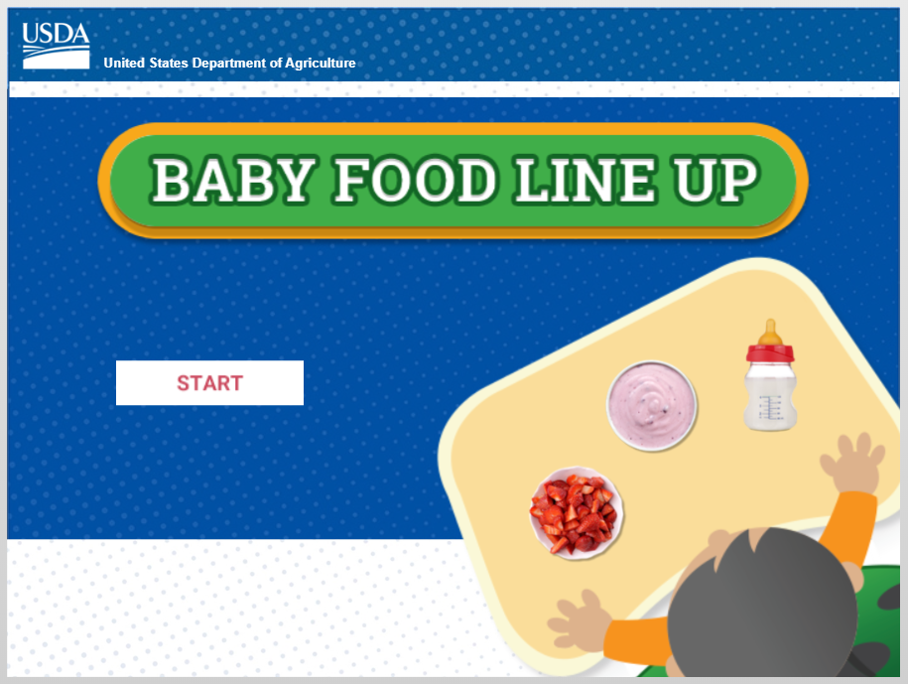
Baby Food Line Up
Notes:
Trainer Note: You can now play the Baby Food Line Up digital interactive game.
There are a few options for playing the game:
You can use your mouse to select the game image on the slide or press the “Enter” key on your keyboard to start the game. Or,
If you have an internet connection, you can play the game directly from the USDA Team Nutrition website at TeamNutrition.USDA.gov.
If you will not play the game, use your mouse to select any part of the screen outside of the game image. This will advance the slide to the first post-test question.
Trainer Note: As of April 2024, this digital interactive game is currently under revision to update “servings” to “ounce equivalents.”

Slide 22
Post-Test #1
1
True or False?
Responsive feeding means that you feed a baby when they show signs of being hungry and stop feeding when the baby shows signs of
being full.
True
Notes:
True or False?
Responsive feeding means that you feed a baby when they show signs of being hungry and stop feeding when the baby shows signs of being full.
Answer: True
Trainer Note: You can conduct the post-test as a group activity or distribute a paper test. There are three question slides.
For a group activity, ask participants what they think the answer is for each question. Allow time for multiple responses before you give the answer.
To reveal the answer, click your mouse or press the “Enter” key on your keyboard.
For paper-based testing, distribute the post-test and pencils. Tell participants how much time they have to complete the assessment.
After you have collected the tests, you can show participants the answers.
If you will not administer the test, skip the slide.

Slide 23
Post-Test #2
2
A father brings in organic pureed carrots for his 6-month-old baby to have at lunch. The baby is eating foods from all food components. As the child care provider, what foods do you need to offer to the baby to claim reimbursement for lunch?
Iron-fortified infant formula
Crackers
Iron-fortified infant cereal and/or a meat/meat alternate
A and C
A father brings in organic pureed carrots for his 6-month-old baby to have at lunch. The baby is eating foods from all meal components. As the child care provider, what foods do you need to offer to the baby to claim reimbursement for lunch?
Iron-fortified infant formula
Crackers
Iron-fortified infant cereal and/or a meat/meat alternate
A and C
Notes:
A father brings in organic pureed carrots for his 6-month-old baby to have at lunch. The baby is eating foods from all meal components. As the child care provider, what foods do you need to offer to the baby to claim reimbursement for lunch?
Iron-fortified infant formula
Crackers
Iron-fortified infant cereal and/or a meat/meat alternate
A and C
Answer: D
Trainer Note: Click your mouse or press the “Enter” key on your keyboard to reveal the answer.

Slide 24
Post-Test #3
3
Yes or No?
A parent breastfeeds their 3-month-old baby before bringing them to child care. The baby is asleep upon arrival and stays asleep until 10 a.m. You did not offer the baby breakfast since they were asleep. At 10:15 a.m. they show signs of hunger. Can you claim the breakfast meal if you offer the baby 4-6 fluid ounces of breastmilk at 10:15 a.m.?
Yes
If the baby shows signs of being hungry when waking up at 10 a.m., offer them the breakfast you would have offered earlier that morning. Babies do not eat on a set schedule, so feeding them when they are hungry is okay. As long as you offer the breastmilk or infant formula once the baby shows signs of being hungry, you can claim reimbursement for the breakfast meal.
Notes:
Yes or No?
A parent breastfeeds their 3-month-old baby before bringing them to child care. The baby is asleep when upon arrival and stays asleep until 10 a.m. You did not offer the baby breakfast since they were asleep. At 10:15 a.m. they show signs of hunger. Can you claim the breakfast meal if you offer the baby 4-6 fluid ounces of breastmilk at 10:15 a.m.?
Answer: Yes
If the baby shows signs of being hungry when waking up at 10 a.m., offer them the breakfast you would have offered earlier that morning. Babies do not eat on a set schedule, so feeding them when they are hungry is okay. As long as you offer the breastmilk or infant formula once the baby shows signs of being hungry, you can claim reimbursement for the breakfast meal.
Trainer Note: Click your mouse or press the “Enter” key on your keyboard to reveal the answer.

Slide 25




Presentation End
To learn more about the CACFP
or access materials, visit:
TeamNutrition.USDA.gov
In accordance with Federal civil rights law and U.S. Department of Agriculture (USDA) civil rights regulations and policies, the USDA, its Agencies, offices, and employees, and institutions participating in or administering USDA programs are prohibited from discriminating based on race, color, national origin, religion, sex, gender identity (including gender expression), sexual orientation, disability, age, marital status, family/parental status, income derived from a public assistance program, political beliefs, or reprisal or retaliation for prior civil rights activity, in any program or activity conducted or funded by USDA (not all bases apply to all programs). Remedies and complaint filing deadlines vary by program or incident.
Persons with disabilities who require alternative means of communication for program information (e.g., Braille, large print, audiotape, American Sign Language, etc.) should contact the responsible Agency or USDA’s TARGET Center at (202) 720-2600 (voice and TTY) or contact USDA through the Federal Relay Service at (800) 877-8339. Additionally, program information may be made available in languages other than English.
To file a program discrimination complaint, complete the USDA Program Discrimination Complaint Form, AD-3027, found online at http://www.ascr.usda.gov/complaint_filing_cust.htmland at any USDA office or write a letter addressed to USDA and provide in the letter all of the information requested in the form. To request a copy of the complaint form, call (866) 632-9992. Submit your completed form or letter to USDA by: (1) mail: U.S. Department of Agriculture, Office of the Assistant Secretary for Civil Rights, 1400 Independence Avenue, SW, Washington, D.C. 20250-9410; (2) fax: (202) 690-7442; or (3) email: program.intake@usda.gov.
USDA is an equal opportunity provider, employer, and lender.
United States Department of Agriculture – Food and Nutrition Service – November 2019 – Slightly Revised April 2024 – FNS-785

