Slide 1
Using the Nutrition Facts Label in the CACFP
A Training Presentation for
Child and Adult Care Food Program
(CACFP) Operators

Slide 2



USDA’s Team Nutrition
An initiative of the USDA’s Food and Nutrition Service to support the USDA’s Child Nutrition Programs.
Aims to improve children’s lifelong eating and physical activity habits.
Provides nutrition education and training materials to State agencies, sponsoring organizations, and CACFP sites.
TeamNutrition.usda.gov
@TeamNutrition
Notes:
Team Nutrition is an initiative of the USDA Food and Nutrition Service that supports the Child Nutrition Programs, including the National School Lunch Program, the School Breakfast Program, and of course, the Child and Adult Care Food Program, or the CACFP.
It does so through training and technical assistance for those preparing and serving meals, providing nutrition education for children, and building support for healthier school and child care environments.

Slide 3
Let Us Know Who You Are!
I work for a…
?
Child care center
Family child care home
At-risk afterschool care center
Adult day care center
Sponsoring organization
Emergency shelter
School food authority
State agency
USDA Regional Office
Other
Notes:
Before we get started, I want to know who has joined us today.
Please raise your hand if you work for:
a child care center [pause and wait for a show of hands],
a family child care home [pause and wait for a show of hands],
an at-risk afterschool care center [pause and wait for a show of hands],
an adult day care center [pause and wait for a show of hands],
a sponsoring organization [pause and wait for a show of hands],
an emergency shelter [pause and wait for a show of hands],
a school food authority [pause and wait for a show of hands],
a State agency [pause and wait for a show of hands],
A USDA Regional office [pause and wait for a show of hands], or
other [pause and wait for a show of hands].

Slide 4
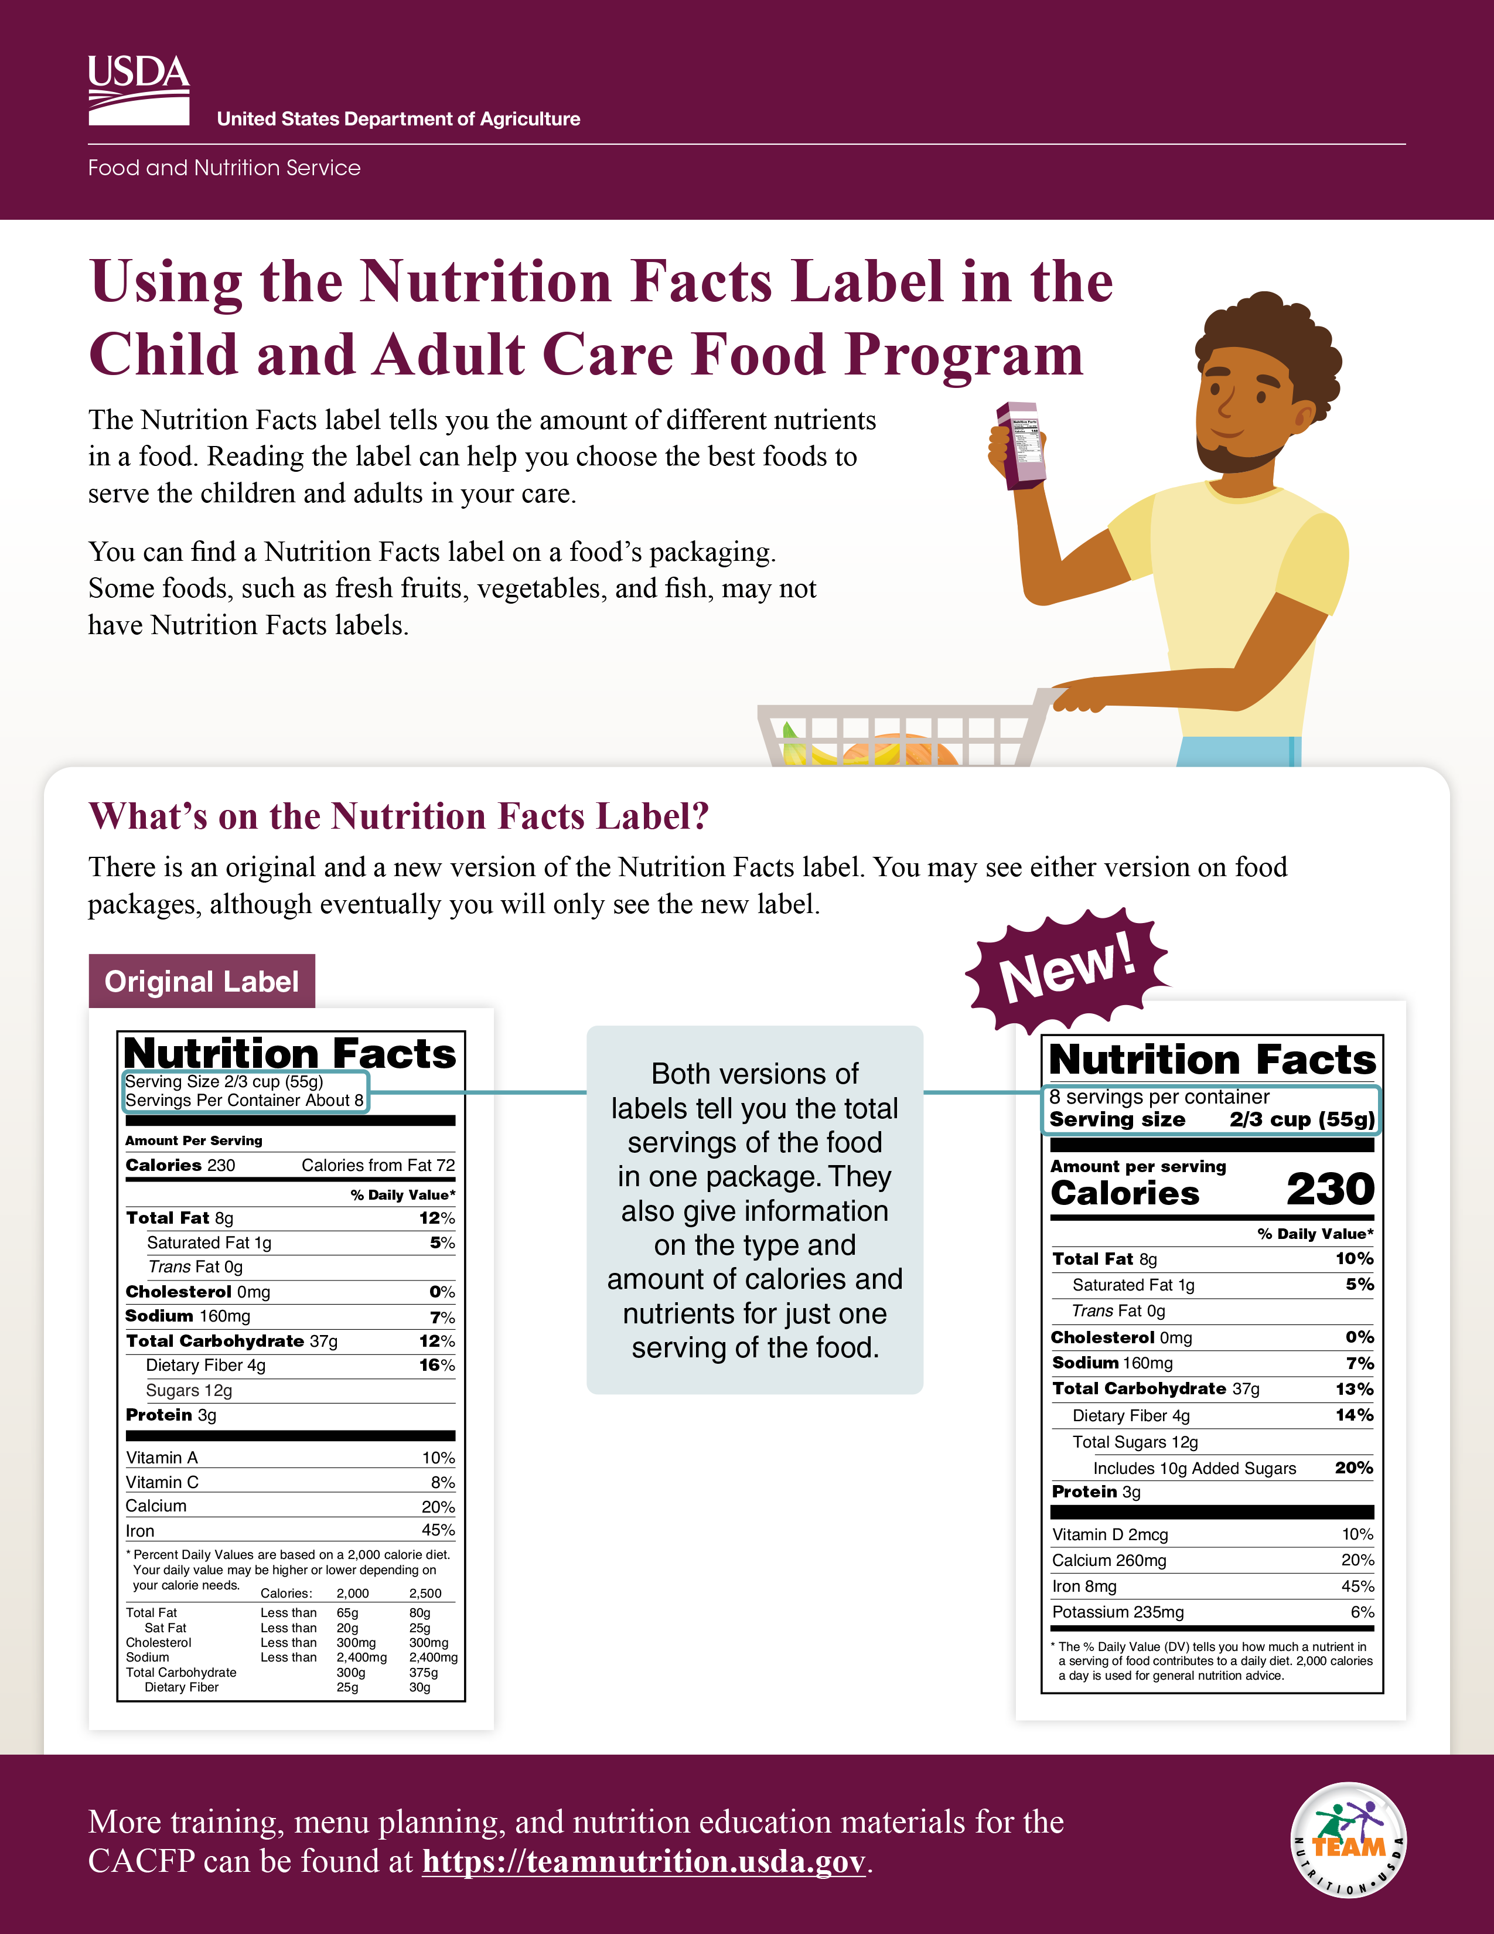

Using the Nutrition Facts Label in the CACFP
fns.usda.gov/tn/using-nutrition-facts-label-cacfp
Notes:
Today’s webinar focuses on how to use the Nutrition Facts label in the CACFP.
This slide shows the first page of the worksheet we will be talking about today.
You can download the worksheet from the web address on the screen, if you’d like. You can also download the worksheet by scanning the QR code on the screen. To do this, open the camera or QR code reader on your smartphone if you have one and point your device at the QR code on the screen to scan. It will then either take you directly to the worksheet webpage or ask you to click the pop-up notification to take you to the worksheet webpage. Click the pop-up notification, if one appears, and you should be taken to the worksheet.
Or, you can also just follow along with the pictures shown on the slides.

Slide 5
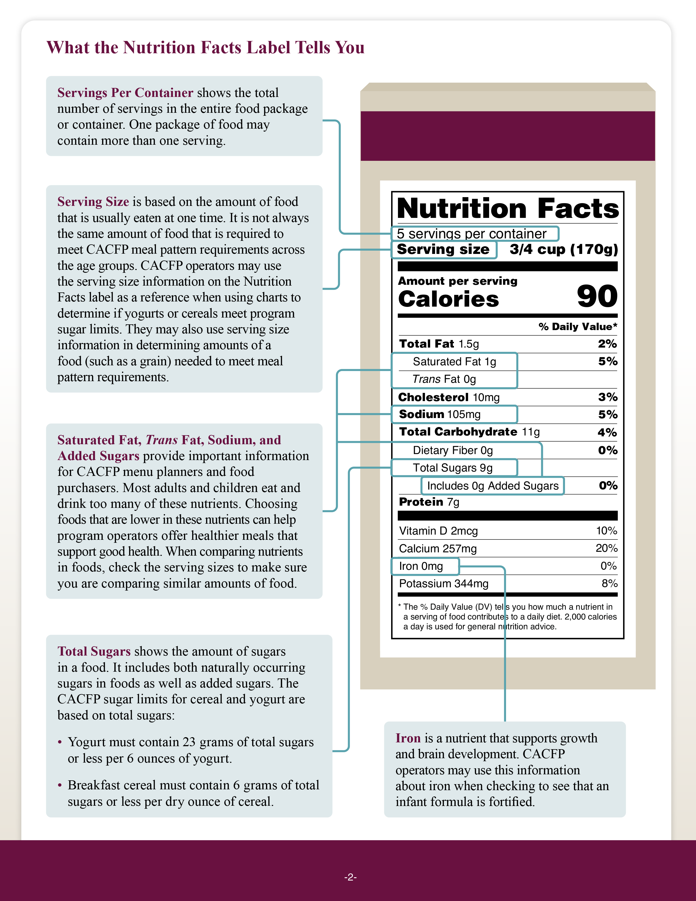
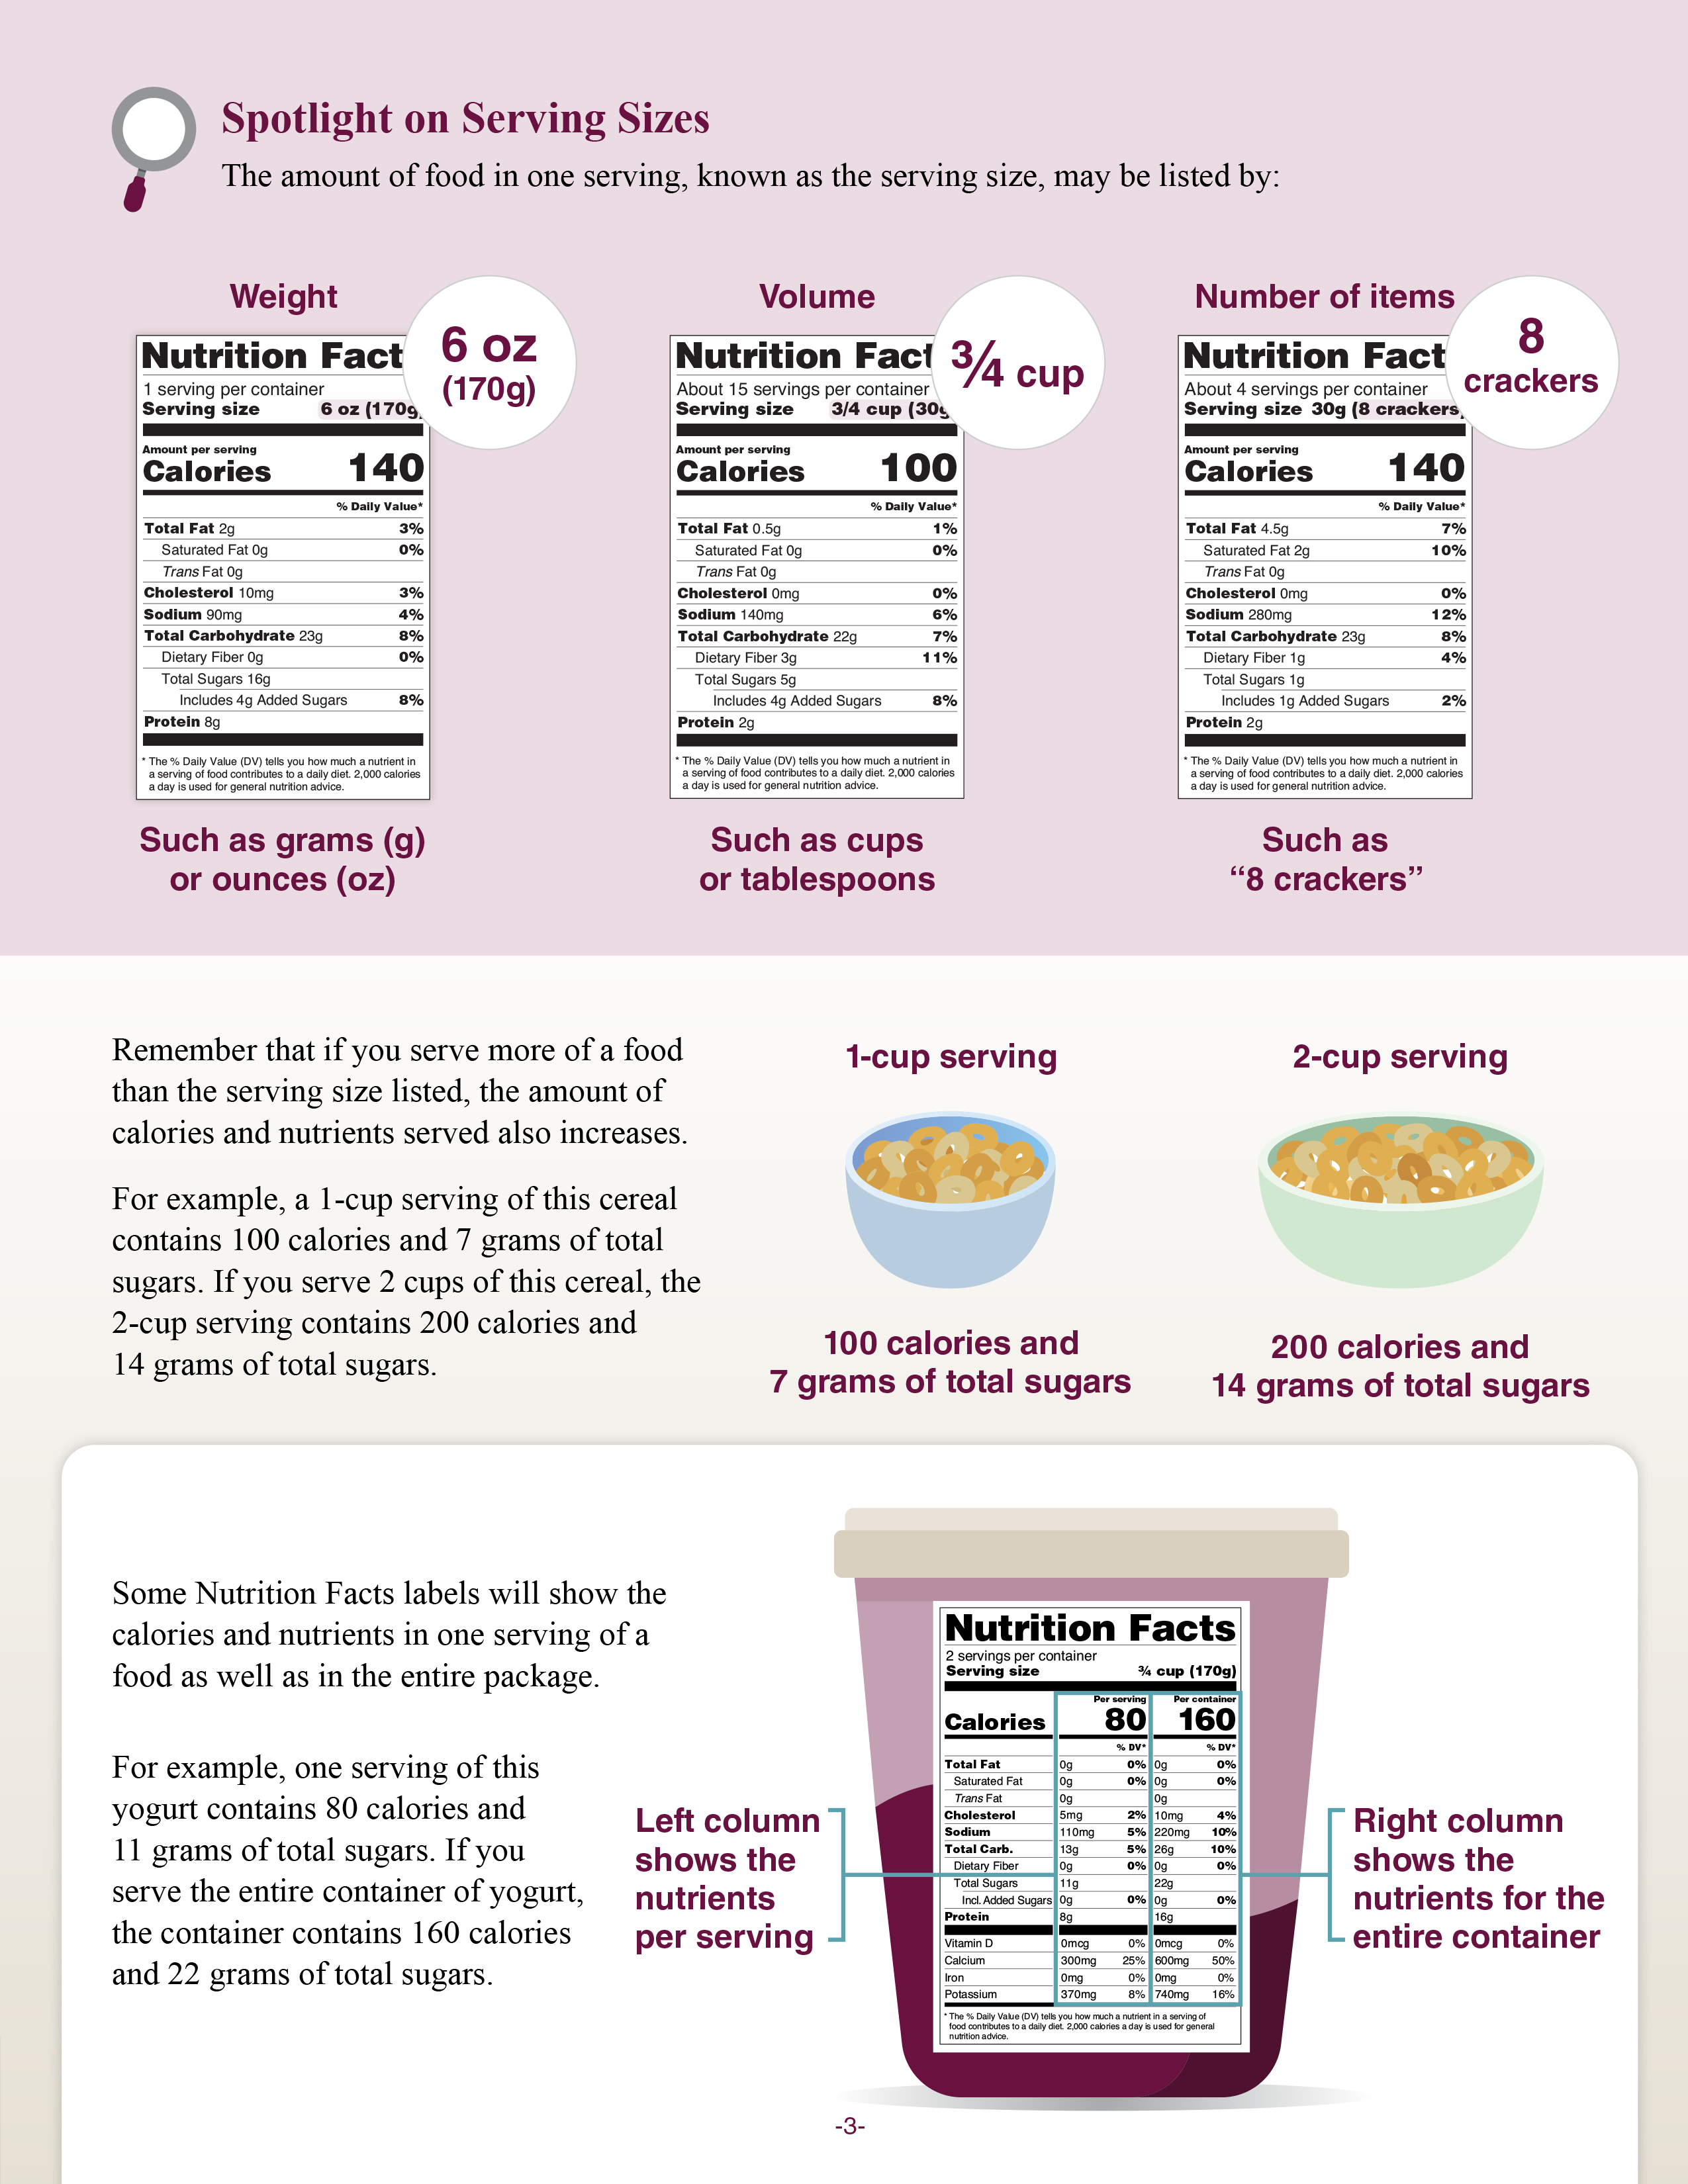
Using the Nutrition Facts Label in the CACFP (Cont.)
Notes:
The slide here shows pages 2 and 3 of the worksheet. You will notice that page 2, shown on the left of this slide, explains different parts of the Nutrition Facts label, including servings per container, serving size, total sugars, and more. We will talk about that more in the next few slides.
The 3rd page gives a great overview of serving sizes.
The 4th page of the worksheet is dedicated to an activity where you can “Try It Out” and apply the knowledge you’ve learned from the worksheet.

Slide 6
When Do We Use the Nutrition Facts Label?
The Nutrition Facts label can help you:
Determine the amount of different nutrients in a food.
Choose the best foods to offer children and adults in your care.
Some foods may not have a Nutrition Facts label, including fresh:
Vegetables
Fruits
Fish
Notes:
So, when do we use the Nutrition Facts label?
You may want to use the Nutrition Facts label when determining the amount of different nutrients in a food and to help you choose the best foods to offer children and adults in your care.
For example, you may use the Nutrition Facts label to see if a certain cereal or yogurt meets the CACFP sugar limit, determine how much of a grain item or meat/meat alternate to serve to meet ounce equivalent requirements, or to see if a fortified infant formula contains enough iron.
Some foods may not have a Nutrition Facts label, including fresh vegetables, fruits, and fish.

Slide 7
Comparison Between the original and the new label
Both versions of
labels tell you the total servings of the food in one package. They also give information on the type and amount of calories and nutrients for just one serving of the food.
1
1
2
2
3
4
3
4
Notes:
You’ll see on page 1 of the worksheet that there are currently two versions of the Nutrition Facts label you may see on food packages. The one on the left of the slide is the original label. The one on the right is the new label.
Most manufacturers are now using the new label on their products.
What’s different about the new label? Let’s talk about a few of the changes. Starting at the top of the new label in orange with the number 1 on the right side of slide, you’ll notice that the serving size line is larger and bolder type, the calories line in blue with the number 2 next to it also has larger type, the serving size and daily values in green with the number 3 have been updated, and there is a new line for “added sugars” under “total sugars,” which is shown in purple with the number 4 next to it.
Both versions of the labels tell you the total servings of the food in one package. They also give information on the type and amount of calories and nutrients for just one serving of the food.

Slide 8
Servings Per Container
Shows the total number of servings in the entire food package or container.
One package of food may contain more than one serving.
Notes:
Now, let’s take a closer look at page 2 of the worksheet to see what is on the new Nutrition Facts label and what it means for choosing foods. The label we will be looking at is from a large container of low-fat yogurt.
The first line of the Nutrition Facts label that is mentioned on the worksheet and on the slide here is “servings per container.” This shows the total number of servings in the entire food package or container. Be aware that one package of food may contain more than one serving.
For example, when you look at the “servings per container” line highlighted on the slide it shows that there are 5 servings of yogurt in this container.

Slide 9
Try It Out!
How many servings of cereal are in this box?
?
1 serving
12 servings
43 servings
150 servings
Notes:
Ok, let’s pause and do our first practice question. This is the Nutrition Facts label for a box of cereal.
The question says, “How many servings of cereal are in this box?”
Raise your hand if you think there are:
1 serving of cereal in this box [pause and wait for a show of hands],
12 servings [pause and wait for a show of hands],
43 servings [pause and wait for a show of hands], or
150 servings [pause and wait for a show of hands].

Slide 10
Answer
How many servings of cereal are in this box?
?
1 serving
12 servings
43 servings
150 servings
✓
Notes:
Great job, everyone! The answer is “12 servings.” If you look at the top of the Nutrition Facts label shown on the right of this slide, you can see that it says “12 servings per container.”

Slide 11
Serving Size
Based on the amount of food that is
typically eaten at one time.
Not always the same amount of food that is required to meet CACFP meal pattern requirements at each age group.
Use this to determine if:
  Yogurts or cereals meet CACFP sugar limits.
  The amount of a grain meets meal
  pattern requirements.
Notes:
Next, let’s talk about the “Serving size” line on the Nutrition Facts label.
The serving size is based on the amount of food that is typically eaten at one time. The serving size is not always the same amount of food that is required to meet CACFP meal pattern requirements for each age group. For example, the Nutrition Facts label on the slide is for a large container of yogurt. You’ll notice that the serving size highlighted on the slide is ¾ cup. However, if you’re serving yogurt to 1-2 year olds, the CACFP meal pattern requirement is only
½ cup at lunch or supper. Always follow the CACFP meal pattern requirements to determine how much to serve the children and adults in your care.
You may use the serving size information on the Nutrition Facts label to help you decide if a yogurt or cereal meets CACFP sugar limits.
You may also use the serving size information to see how much of a food, such as a grain, to serve to each participant in order to meet meal pattern requirements.

Slide 12
Spotlight on Serving Sizes
Number of
items
Weight
Volume
8
crackers
6 oz
(170g)
3/4 cup
Such as grams (g)
or ounces (oz)
Such as cups
or tablespoons
Such as
“8 crackers”
Notes:
On Nutrition Facts labels, you may see serving sizes listed as a weight, such as in ounces or grams. For example, one serving of yogurt might weigh 6 ounces or 170 grams.
You may also see serving sizes listed by volume, such as cups, tablespoons, or fluid ounces. For example, the serving size for one serving of cereal might be ¾ cup.
Finally, you may see serving sizes listed as a number of items. For example, one serving of saltines might be shown as 8 crackers.
Please note that ounces are not the same as ounce equivalents. Ounces tell us how much one serving of that food weighs. Ounce equivalents tell you the amount of grains or meats/meat alternates in a product. Ounce equivalents are not shown on the Nutrition Facts label, but you can use information on the Nutrition Facts label to determine the ounce equivalents of grains in a product.
Again, the serving size listed on the Nutrition Facts label may be different than the amount of food required at a CACFP meal or snack. But, the serving size on the Nutrition Facts label can help you make sure you are choosing foods that are creditable, and to determine how much of a food to serve to meet meal pattern requirements.

Slide 13
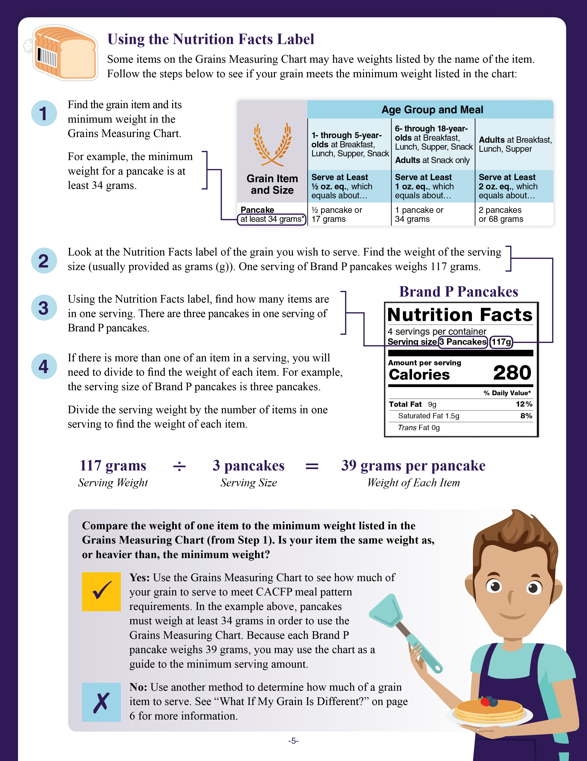
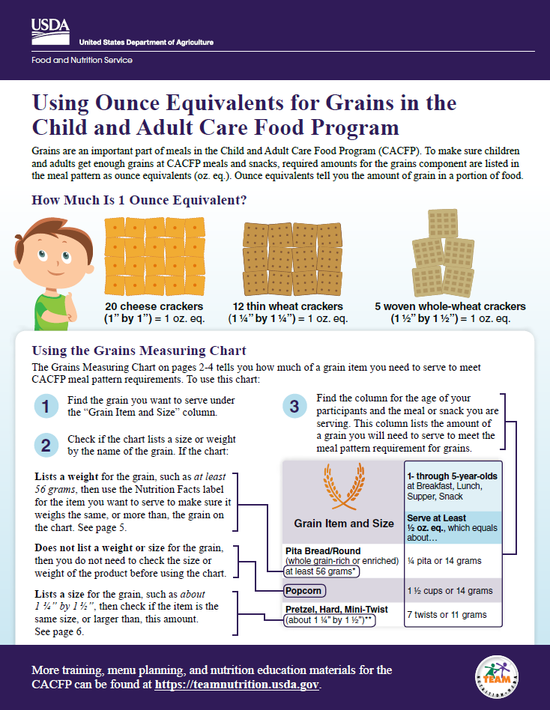
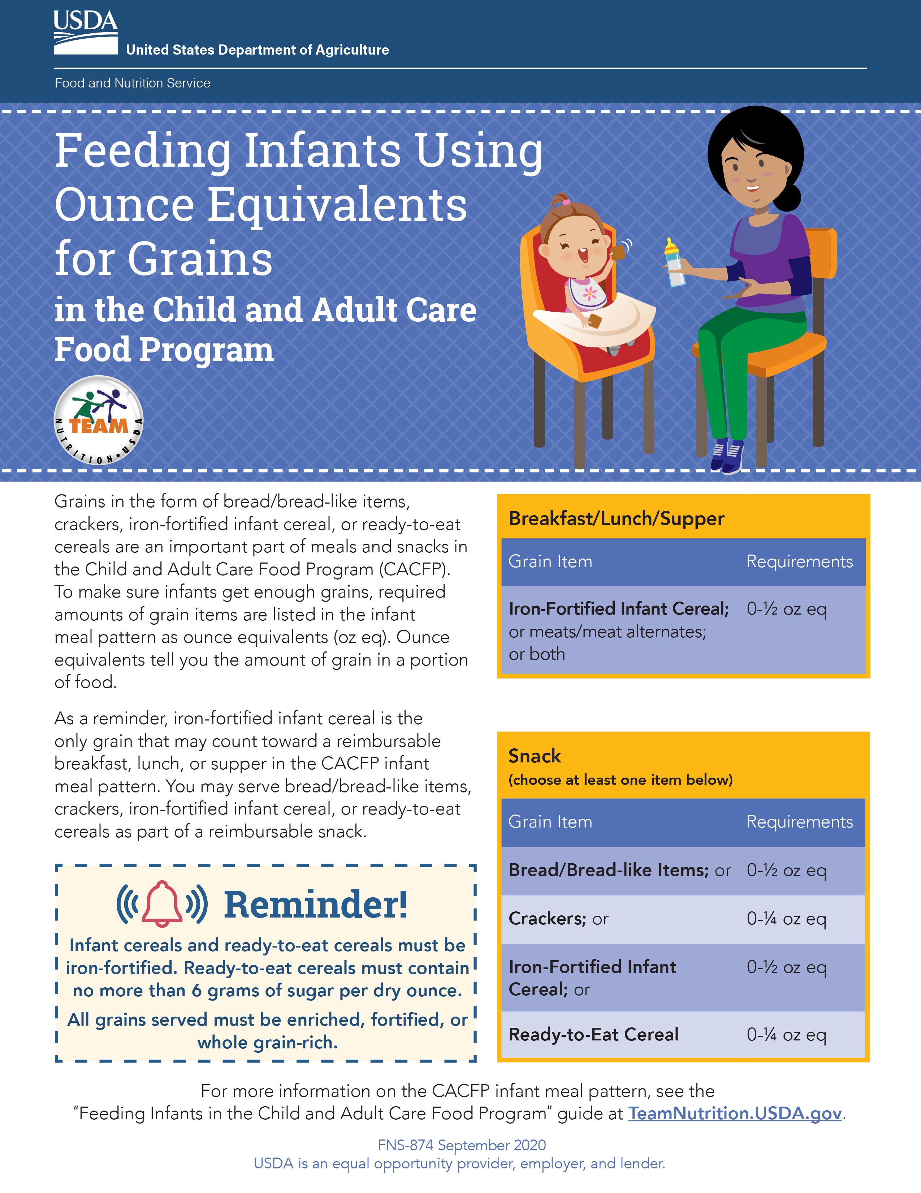
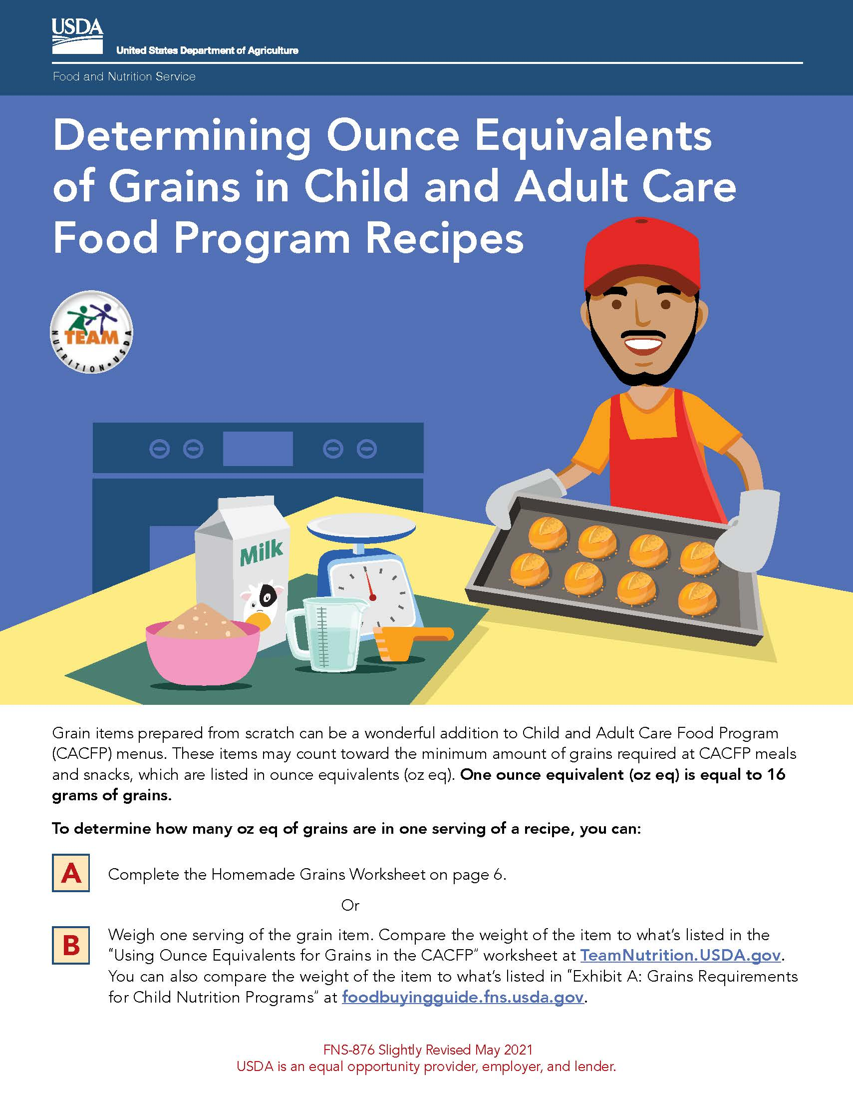
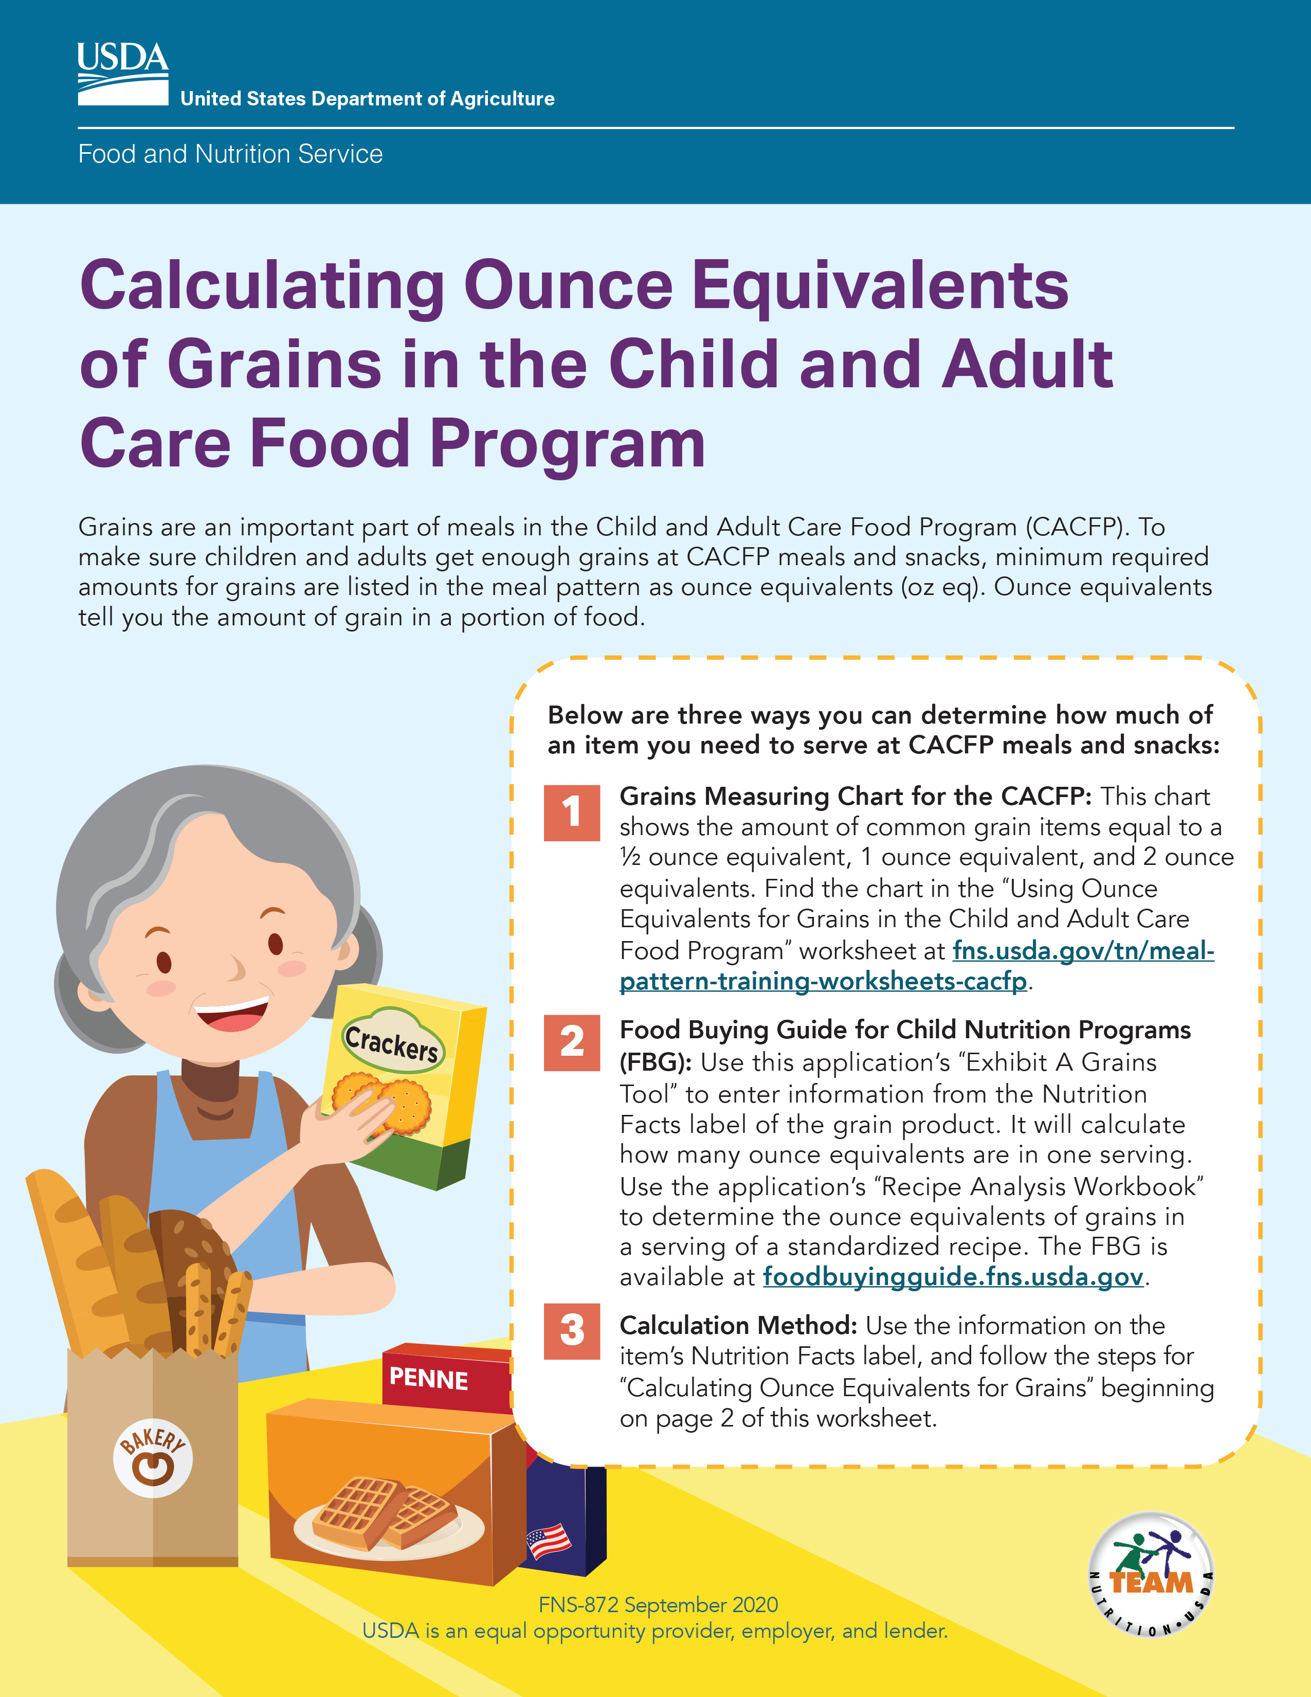

Team Nutrition Resources on Oz Eq for Grains
fns.usda.gov/tn/grains-ounce-equivalents-resources-cacfp
Notes:
For more information on ounce equivalents for grains, please visit Team Nutrition's “CACFP Grains Ounce Equivalents Resources” webpage at the web address on the slide.

Slide 14
Try It Out!
According to this Nutrition Facts label, what is the serving size of 1 serving of cereal?
?
12 cups
150 grams
43 ounces
1 cup
Notes:
Let’s do another practice question. This is the same Nutrition Facts label for a box of cereal we saw in the last polling question. We know from the first polling question that this box of cereal has 12 servings.
This time, our question looks at the size of the serving. The question is, “According to this Nutrition Facts label, what is the serving size of 1 serving of cereal?”
Raise your hand if you think the serving size of 1 serving of cereal is:
12 cups [pause and wait for a show of hands],
150 grams [pause and wait for a show of hands],
43 ounces [pause and wait for a show of hands], or
1 cup [pause and wait for a show of hands].

Slide 15
Answer
According to this Nutrition Facts label, what is the serving size of 1 serving of cereal?
?
12 cups
150 grams
43 ounces
1 cup
✓
Notes:
Great job, everyone! The answer is 1 cup. If you look at the top of the Nutrition Facts label shown on the right of this slide, you can see next to “Serving size” it says “1 cup.”
So, one serving of this cereal is 1 cup.

Slide 16
Total Sugars
Shows the amount of sugars in a food.
Includes both naturally occurring sugars and added sugars.
The CACFP sugar limits are based on total sugars.
  Yogurt must contain 23 grams of total sugars or less per 6 ounces of yogurt.
  Breakfast cereal must contain 6 grams or less of total sugars per dry ounce of cereal.
Notes:
Next, let’s talk about “Total Sugars.” The “Total Sugars” line shows the amount of sugars in one serving of the food. It includes both naturally occurring sugars in foods, like in fruit, as well as added sugars.
The CACFP sugar limits for cereal and yogurt are based on the amount of total sugars in the product.
Remember, yogurt must contain 23 grams of total sugars or less per 6 ounces of yogurt to serve as part of a reimbursable meal or snack in the CACFP.
Breakfast cereal must contain 6 grams or less of total sugars per dry ounce of cereal.

Slide 17
A Note About Sugars
Notes:
You might be used to looking at the “Sugars” line on the original label when determining if a yogurt or cereal meets sugar limits in the CACFP.
On the new Nutrition Facts label, “Sugars” is now listed as “Total Sugars.” Use the amount of “Total Sugars” to determine if the item meets the sugar limit.
Let's practice a few examples to look at the amount of “Total Sugars” now.

Slide 18
Try It Out!
How many grams of total sugars are in 1 serving of this cereal?
?
28 grams
1.5 grams
22 grams
9 grams
Notes:
Let’s do another practice question.
The question says, “How many grams of total sugars are in 1 serving of this cereal?
Raise your hand if you think there are:
28 grams of total sugars in 1 serving of this cereal [pause and wait for a show of hands],
1.5 grams [pause and wait for a show of hands],
22 grams [pause and wait for a show of hands], or
9 grams [pause and wait for a show of hands].

Slide 19
Answer
How many grams of total sugars are in 1 serving of this cereal?
?
28 grams
1.5 grams
22 grams
9 grams
✓
Notes:
Great work, everyone! The answer is 9 grams.
To get this answer, we find “Total Sugars” on the Nutrition Facts label and next to that we find “9 g” or “9 grams.” You’ll see that outlined in blue on the slide.

Slide 20
Try It Out!
Does this cereal meet the CACFP sugar limit*?
?
Yes
No
*Breakfast cereals must contain 6 grams of total sugars or less per dry ounce of cereal.
Notes:
Let’s do another practice question. Using the same Nutrition Facts label for a container of cereal, let’s answer this question.
The question says, “Does this cereal meet the CACFP sugar limit?” Remember, cereal must contain no more than 6 grams of total sugars
per dry ounce of cereal to serve as part of a reimbursable meal or snack in the CACFP.
Raise your hand if you think the answer is:
Yes, this cereal meets the CACFP sugar limit. That means it can be served as part of a reimbursable meal or snack. [pause and wait for a show of hands], or
No, this cereal does not meet the sugar limit [pause and wait for a show of hands].

Slide 21
Answer
Does this cereal meet the CACFP sugar limit*?
?
Yes
No
✓
*Breakfast cereals must contain 6 grams of total sugars or less per dry ounce of cereal.
Notes:
Nice work, everyone! The answer is “No, the cereal does not meet the sugar limit.” This means it cannot be served as part of a reimbursable meal or snack.
This was a tricky one, so let’s walk through how to get the answer together. First, we go up to the “Serving Size” line and see that it’s “1 ounce.” Next, we go down to the “Total Sugars” line to see that a 1-ounce serving of cereal contains 9 grams of total sugars. Nine grams is more than 6 grams of sugar, so this cereal cannot be served as part of a reimbursable meal or snack.

Slide 22
Try It Out!
How many grams of total sugars are in 1 serving of this yogurt?
?
170 grams
16 grams
4 grams
140 grams
Notes:
Let’s do another practice question. This one is about yogurt.
The question says, “How many grams of total sugars are in 1 serving of this yogurt?
Raise your hand if you think there are:
170 grams of total sugars in 1 serving of this yogurt [pause and wait for a show of hands],
16 grams [pause and wait for a show of hands],
4 grams [pause and wait for a show of hands], or
140 grams [pause and wait for a show of hands].

Slide 23
Answer
How many grams of total sugars are in 1 serving of this yogurt?
?
170 grams
16 grams
4 grams
140 grams
✓
Notes:
Nice work, everyone! The answer is 16 grams of total sugars.
To get this answer, we find “Total Sugars” on the Nutrition Facts label and next to that we find “16 grams.” You’ll see that outlined in blue on the slide.

Slide 24
Try It Out!
Does this yogurt meet the CACFP sugar limit*?
?
Yes
No
*Yogurt must contain 23 grams of total sugars or less per 6 ounces of yogurt.
Notes:
Let’s do one more practice question on total sugars. Using the same Nutrition Facts label for a container of yogurt, let’s answer this question.
The question says, “Does this yogurt meet the CACFP sugar limit?” Remember, yogurt must contain 23 grams of total sugars or less per 6 ounces of yogurt to serve as part of a reimbursable meal or snack in the CACFP.
Raise your hand if you think the answer is:
Yes, the yogurt does meet the sugar limit and can be served as part of a reimbursable meal or snack [pause and wait for a show of hands]; or
No, it does not meet the sugar limit [pause and wait for a show of hands].

Slide 25
Answer
Does this yogurt meet the CACFP sugar limit*?
?
✓
Yes
No
*Yogurt must contain 23 grams of total sugars or less per 6 ounces of yogurt.
Notes:
Nice work, everyone! The answer is “Yes, the yogurt does meet the sugar limit and can be served as part of a reimbursable meal or snack.”
Let’s talk through how we got the answer. First, we go up to the “Serving size” line and see that it’s “6 ounces.” Next, we go down to the “Total Sugars” line to see that a 6-ounce serving of yogurt contains 16 grams of total sugars. Sixteen grams is less than 23 grams of sugar, so this yogurt can be served as part of a reimbursable meal or snack.

Slide 26
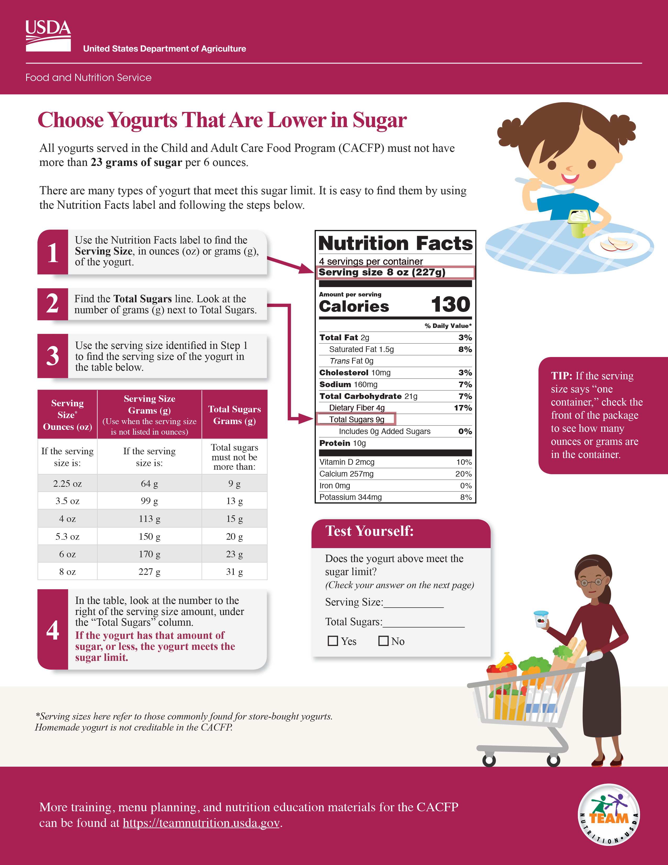
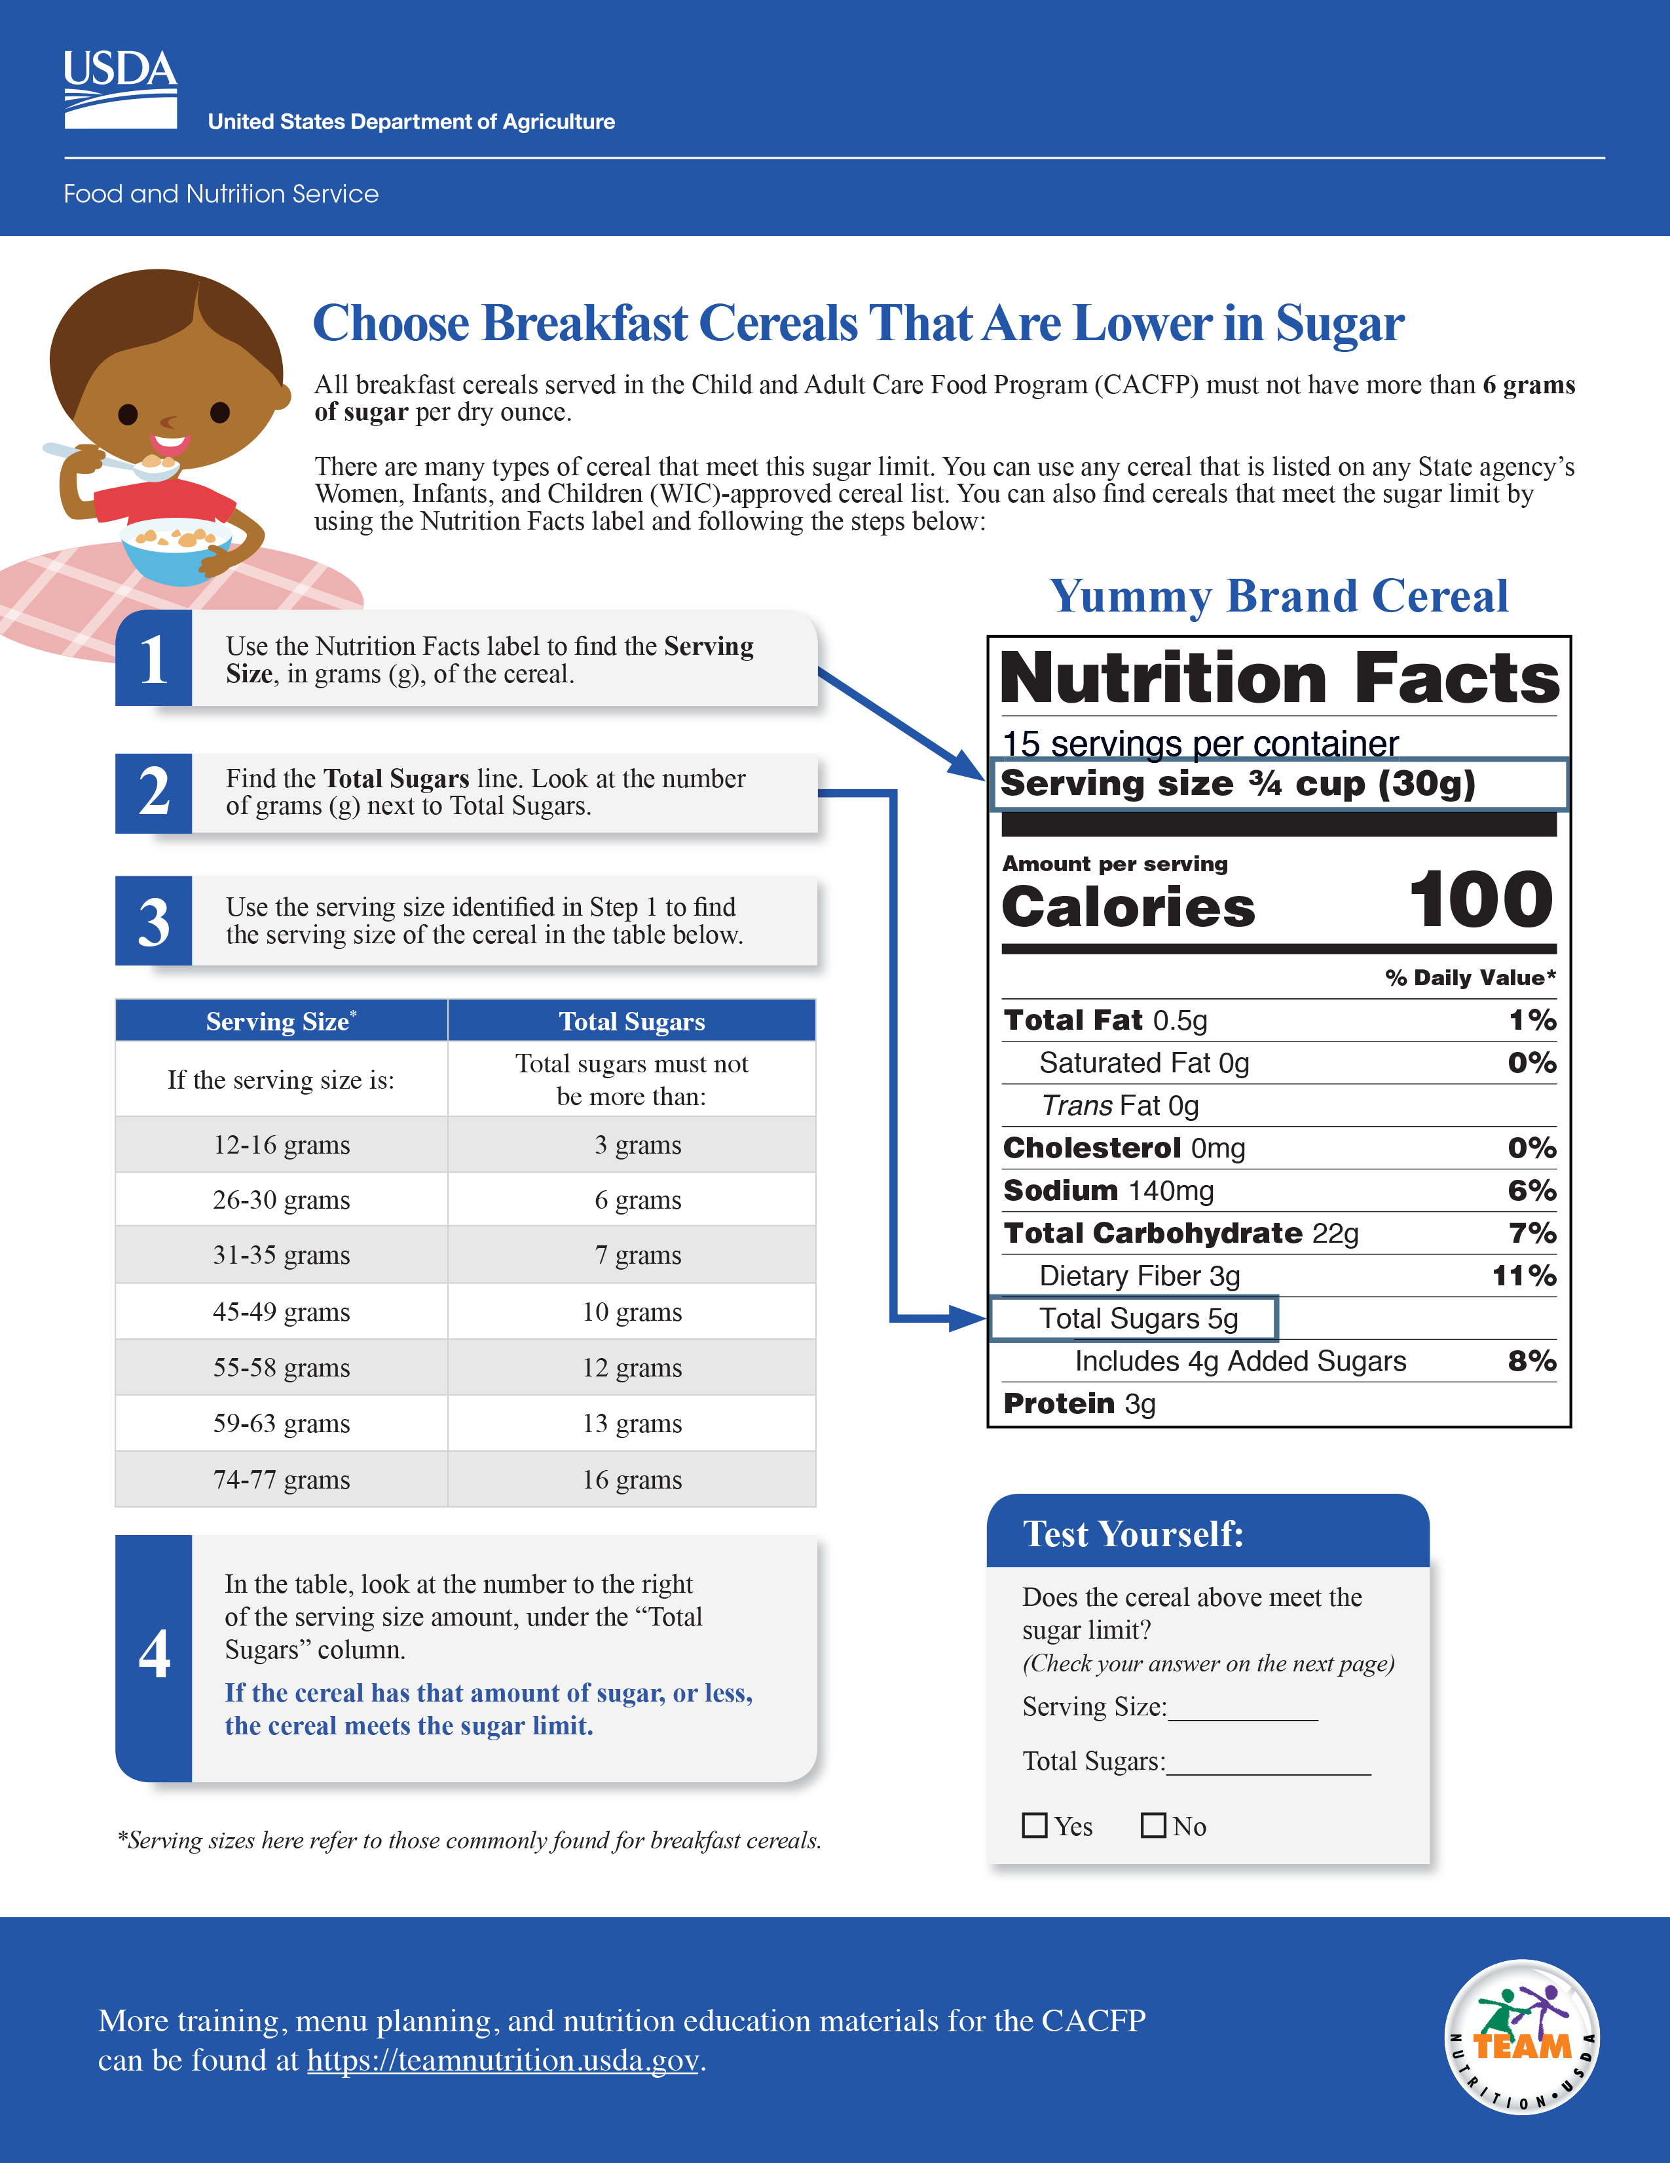
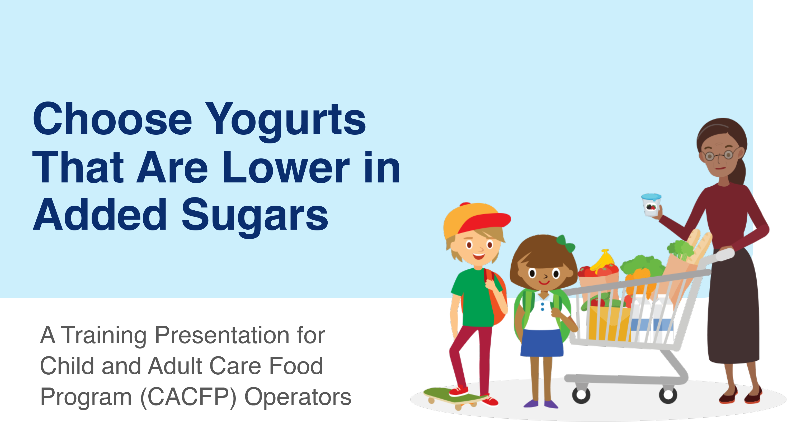
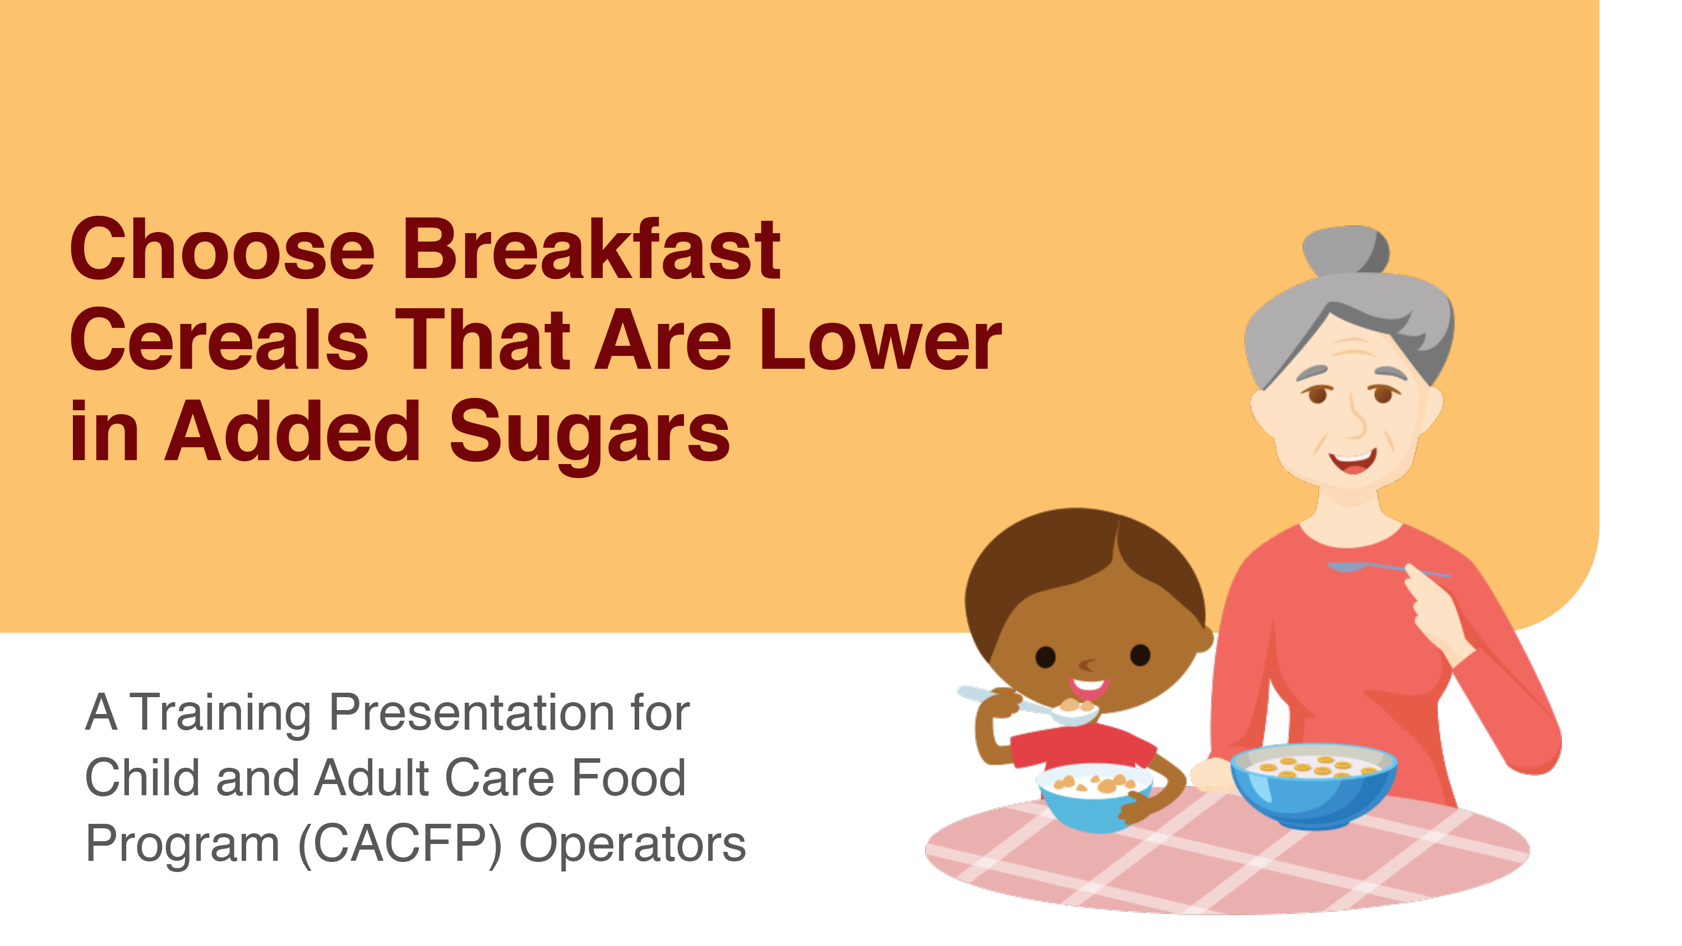

More Team Nutrition Resources
fns.usda.gov/tn/training-tools-cacfp
Notes:
You may be wondering, what if the serving size of a container of cereal is not 1 ounce OR what if the yogurt is not 6 ounces? How do I know if it meets the sugar limit in the CACFP?
Well, Team Nutrition has more resources to help you answer that question. They have worksheets, recorded webinars, and training slides on choosing yogurts that are lower in sugar and choosing breakfast cereals that are lower in sugar. Those resources help you determine if both yogurts and cereals meet the CACFP sugar limits, so I encourage you to check those out on the Team Nutrition website.

Slide 27
Serving Sizes Explained
1-cup serving
2-cup serving
100 calories and
7 grams of total sugars
200 calories and
14 grams of total sugars
Notes:
Before we move on to another nutrient, I want to mention something about serving sizes. Remember, that the Nutrition Facts label lists the amount of calories and nutrients in one serving of the food. So, if you serve more than one serving, you are also serving more calories, sugars, and other nutrients.
For example, a 1-cup serving of the cereal shown on the left of the slide contains 100 calories and 7 grams of total sugars.
However, if you serve 2 cups of that same cereal shown on the right of the slide, then the 2-cup serving contains 200 calories and 14 grams of total sugars.

Slide 28
Try It Out!
How many grams of total sugars are in 2 servings of this cereal?
?
14 grams
3 grams
12 grams
7 grams
Notes:
Okay, let’s do another practice question.
The question is, “How many grams of total sugars are in 2 servings of this cereal?” This is the same cereal we just looked at, but instead of 1 serving we are going to serve 2 servings.
Raise your hand if you think there are:
14 grams of total sugars in 2 servings of this cereal [pause and wait for a show of hands],
3 grams [pause and wait for a show of hands],
12 grams [pause and wait for a show of hands], or
7 grams [pause and wait for a show of hands].

Slide 29
Try It Out!
How many grams of total sugars are in 2 servings of this cereal?
?
✓
14 grams
3 grams
12 grams
7 grams
7 grams x 2 servings = 14 grams
Notes:
Great work, everyone! The answer is 14 grams.
To get this answer, we find “Total Sugars” on the Nutrition Facts label and next to that we find “7 g” or “7 grams”. You’ll see that outlined in blue on the slide. However, we are giving participants 2 servings of this cereal, so the amount of nutrients would double.
7 grams x 2 servings of cereal = 14 grams of total sugars

Slide 30
One Serving and Entire Container
Left column shows the nutrients
per serving
Right column shows the
nutrients for the
entire container
Notes:
One last note about the serving size of a container –
Most times, the Nutrition Facts label shows the calories and nutrients in one serving of the food. But, you may find some products that show the calories and nutrients in one serving of the food and the calories and nutrients in the entire container.
For these types of Nutrition Facts labels, you can look at the heading on the top of the column to see the serving amount. In the example on the screen (which is also on page 3 of the worksheet), you can see that there is a heading that says “one serving” above where it says “80 calories.” This means the middle column shows the calories and nutrients for one serving of the food.
The heading on the right column, above 160 calories, says “per container.” This means the right column shows the calories and nutrients for the entire container.

Slide 31
Iron
A nutrient that supports growth and brain development.
Use this to see that an infant formula is iron-fortified.
Notes:
Now, let’s talk about a nutrient called “iron.”
Iron is a nutrient that supports growth and brain development. You may use the Nutrition Facts label when checking to see that an infant formula is fortified with iron.

Slide 32
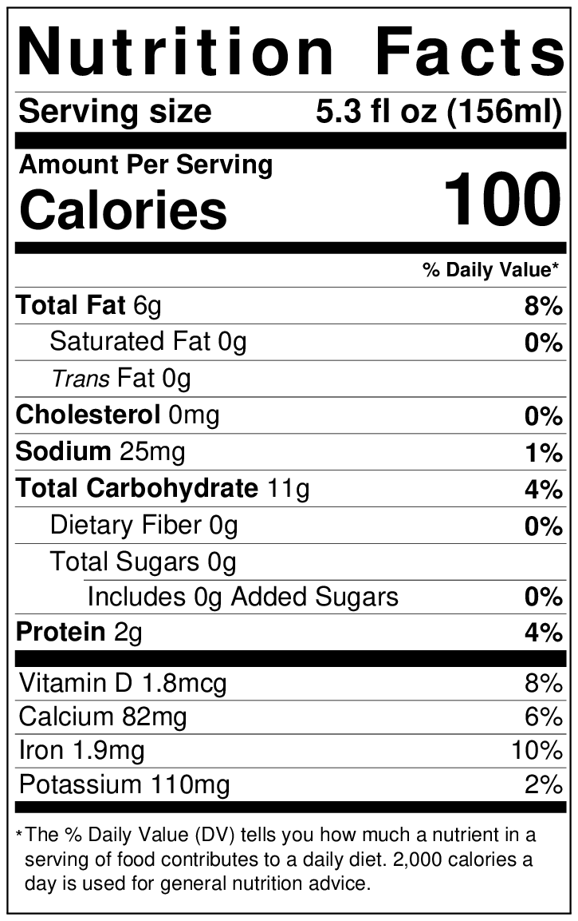
Iron-Fortified Infant Formula
Choose a creditable iron-fortified infant formula by:
Looking for “infant formula with iron” or a similar statement on the package, and
Making sure it contains 1 milligram of iron or more per 100 calories.
  Look at “Calories” to make sure it says “100” or more, then
  Look at “Iron” to make sure it says
  “1 mg” or more.
Notes:
As a reminder, iron-fortified infant formula is required in the CACFP for babies who are not breastfed or are partially breastfed.
To make sure the iron-fortified infant formula you offer is creditable in the CACFP, you should:
Look for “infant formula with iron” or a similar statement on the front of the formula package and make sure it contains 1 milligram of iron or more per 100 calories of formula when prepared using the label instructions.
You can use the Nutrition Facts label as a guide to make sure the formula has enough iron. First look at the line that says “Calories” and make sure it says “100” or more. Then, look at the line that says “iron.” This should have “1 milligram” or more listed.
If you have an infant formula that contains less than 100 calories, you'd have to take additional steps to determine if it is creditable in the CACFP.

Slide 33
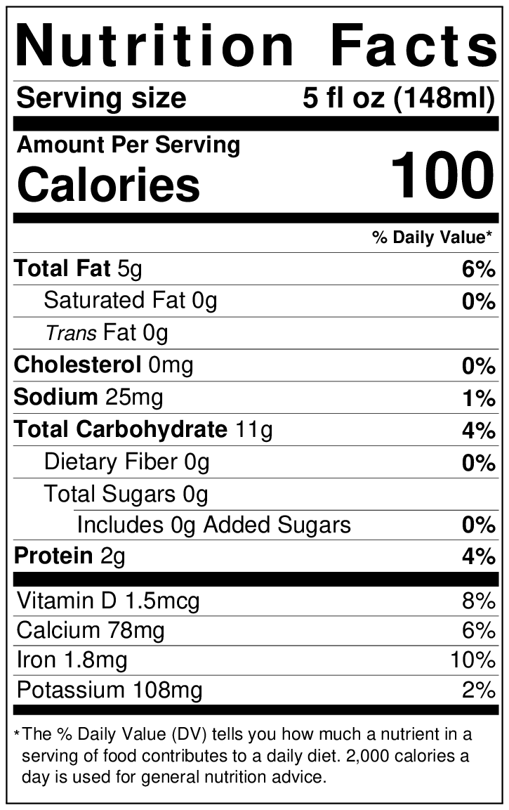
Try It Out!
Is this infant formula creditable in the CACFP*?
?
Yes
No
*Iron-fortified infant formula must contain
1 milligram of iron or more per 100 calories.
Notes:
Ok, let’s do one last practice question.
Using the Nutrition Facts label of an iron-fortified infant formula on the slide here, let’s answer this question:
The question says, “Is this infant formula creditable in the CACFP?” Remember from the previous slide, we need to make sure it contains
1 milligram of iron or more per 100 calories of formula to be creditable in the CACFP.
Raise your hand if you think the answer is:
Yes, it is creditable in the CACFP [pause and wait for a show of hands], or
No, it is not creditable in the CACFP.

Slide 34
Answer
Is this infant formula creditable in the CACFP*?
?
✓
Yes
No
*Iron-fortified infant formula must contain
1 milligram of iron or more per 100 calories.
Notes:
Great job, everyone! The answer is “Yes,” this infant formula is creditable in the CACFP.
We know this, because we find “Calories” on the Nutrition Facts label and it says 100 calories. Then, we look at the line for “Iron” and see that it contains 1.8 milligrams of iron. 1.8 milligrams of iron is more than the 1 milligram of iron required, so this iron-fortified infant formula can be served as part of a reimbursable meal.

Slide 35
Saturated Fat, Trans Fat, Sodium, and Added Sugars
Most adults and children eat and drink too many of these nutrients.
Choose foods that are lower in these nutrients.
Notes:
Finally, let's talk briefly about some of the other nutrients on the Nutrition Facts label: saturated fat; trans fat; sodium; and added sugars. The Nutrition Facts label lists the amount of each of these nutrients for one serving of this food.
According to the Dietary Guidelines for Americans, we should limit foods and beverages higher in added sugars, saturated fat, trans fat, and sodium.
Most adults and children eat and drink too many of these nutrients. Choosing foods that are lower in these nutrients can help you offer healthier meals that support good health. When comparing nutrients in foods, check the serving sizes to make sure you are comparing similar amounts of food.

Slide 36
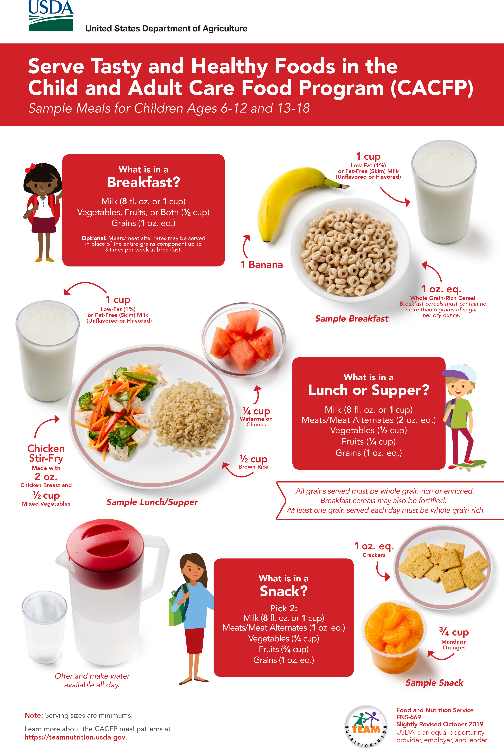

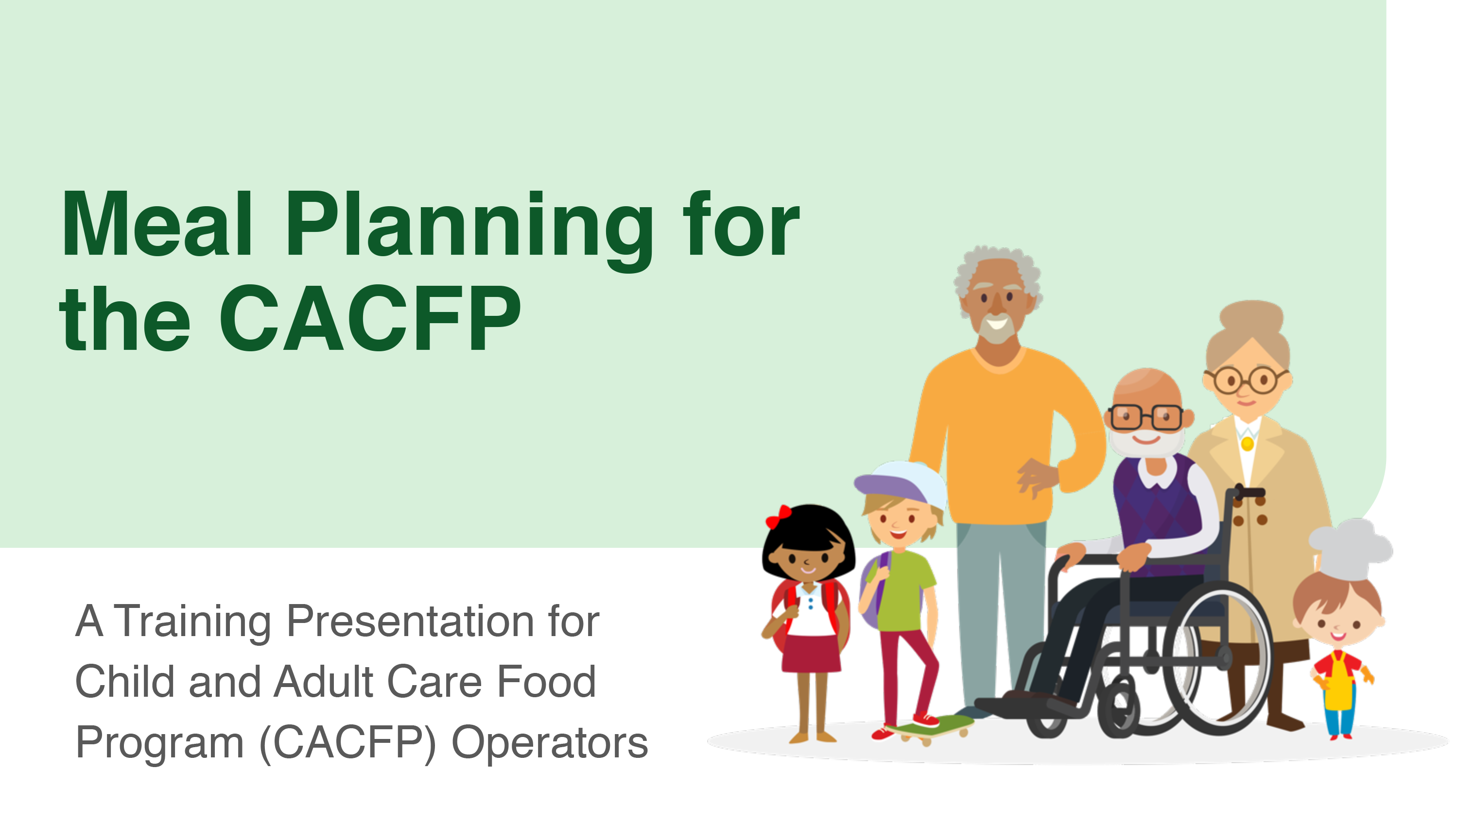


More Team Nutrition Resources!
Training Worksheets
Training Toolkits
Posters
Training Slides
CACFP Grains Oz Eq Resources
TeamNutrition.usda.gov
Notes:
All Team Nutrition materials are available online from Team Nutrition’s website and are available for free download to anybody who is interested. You can also find many other resources for the CACFP on Team Nutrition’s website.

Slide 37
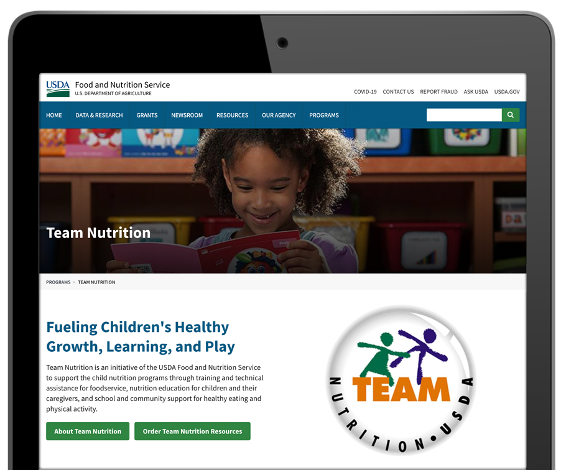

How To Order Print Copies
Resource Order Form at TeamNutrition.usda.gov.
FREE for those participating in a USDA Child Nutrition Program, while supplies last.
Sponsoring organizations and State agencies can also order in bulk by sending an email to:
TeamNutrition@usda.gov
Notes:
For program operators in a Child Nutrition Program, such as the Child and Adult Care Food Program, Team Nutrition’s print materials are free to order.
If you would like to order Team Nutrition’s free materials in print, you can go to the “Resource Order Form” link on the Team Nutrition website to order print copies of the materials.
For bulk orders, you can email TeamNutrition@usda.gov.

Slide 38




Thank you!
TeamNutrition.usda.gov
@TeamNutrition
TeamNutrition@usda.gov
USDA is an equal opportunity provider, employer, and lender.
Notes:
These training slides were provided by U.S. Department of Agriculture's Team Nutrition. If you would like to learn more about Team Nutrition and additional resources available, please visit their website, subscribe to their e-newsletter, connect with them via email at TeamNutrition@usda.gov, and follow them on Twitter.
Thank you!

