Slide 1
Growing Healthy Habits for Life: The Importance of School Breakfast

Slide 2
Presentation Overview
Breakfast matters
Current situation
Goal: increase participation
Addressing concerns
Next steps

Slide 3


Breakfast Matters!
Nutritional Benefits
Academic Benefits
Notes:
There are a number of benefits associated with breakfast. Here, we’ve broken them down into two categories:
Nutritional Benefits
Academic Benefits

Slide 4

Nutritional Benefits
Energy for mental and physical activities
Higher nutrient intake
Fewer visits to school nurse
Notes:
There are many nutritional benefits that are associated with breakfast.
First, children who eat breakfast have energy for mental and physical activities. Whether studying in class or playing sports, all children need energy to succeed.
By eating breakfast, students get more of the important vitamins and nutrients they need for proper growth and development
Updated nutrition standards require daily offerings of fruit, whole grain-rich items, low-fat and fat free milk, and limitations on saturated fat, trans-fat, sodium, and calories. These new standards are being phased in over time, with most changes occurring during SY 2013-14 and SY 2014-15.
Schools participating in the school breakfast program often report fewer student visits to the school nurse after implementation of the program, higher academic performance, and more attentive students

Slide 5

Academic Benefits
Increased test scores
Enhanced cognitive functions
Increased attentiveness in class
Improved behavior
Decreased absences
Notes:
Here is a list of some of the academic benefits associated with breakfast.
Increased test scores
Studies have shown that students can increase test scores when they eat breakfast in the morning – Some principals have responded to this by providing snacks to students on testing days. Ideally, all our children should be alert and ready to learn every day.
Enhanced Cognitive functions
Studies have shown that children who eat breakfast perform better when tested on cognitive functions such as short-term memory, arithmetic, and logical reasoning. All of these are essential for success in school.
Increased Attentiveness in class
Teachers surveyed after participating in school breakfast programs noted an increased level of attentiveness in their students, as well as improved behavior
Decreased Absences
Studies have shown that making school breakfast convenient and accessible at school can be an incentive for getting kids to class

Slide 6
Healthy Kids = Healthy Schools
Improved behavior and concentration contributes to positive learning environment
Helping students learn and perform better
Promoting breakfast promotes school health
Improving breakfast quality and participation can become a part of local wellness policies
Notes:
The benefits of breakfast extend beyond the children who are receiving it and into their surrounding environment. Children who eat breakfast demonstrate improved behavior and concentration. When children are well-behaved in school, class time is more productive.
Breakfast helps students learn and perform better, and when students are doing better, schools are expected to do better as well. This is the logic behind initiatives to ensure that students eat breakfast on test days – Why not give them the same boost for learning every day?
Eating breakfast is a healthy habit to teach children beginning at a young age.
Breakfast also can contribute to achieving nutrition goals that are established in schools’ wellness policies.

Slide 7
Why No Breakfast?
Tight budgets
Busy lives
Not hungry yet
Long commute
Notes:
Unfortunately, not all kids start the day with a nutritious breakfast.
There are many reasons why children don’t eat breakfast. Some come from families who can’t afford to put a nutritious meal on the table, others are busy and rushed in the morning. Oftentimes children will assert that they aren’t hungry when they wake up, finding that they first become hungry once they get to school and then they have to wait through morning classes before going to lunch. Even children who do eat breakfast in the morning might face a long commute to school or have lunch later in the day so that they become hungry before they have the chance to eat again.
No matter what the case, when children are hungry, they are facing a barrier to achievement. Studies have consistently shown that not only are there benefits to breakfast, such as the academic and nutritional benefits previously noted, but that skipping breakfast can actually have negative effects on children’s learning abilities, such as diminished memory and problem solving skills.
There’s no reason why children should miss out on breakfast – With breakfast offered at over 91,000 schools across America (Note to the speaker: You can mention here what percentage of schools in your district offer school breakfast) Every child in these schools should have the opportunity and be encouraged to eat breakfast in the morning.

Slide 8
Eligibility and Participation
Approximately 13 million children participated in the School Breakfast Program in SY 2012-13
Nearly 11 million of those children eligible for free and reduced price meals
Breakfast participation has risen from previous years but still lags behind NSLP participation
Notes:
It is surprising, then, to learn that participation rates in breakfast are so low.
Nationally, approximately 13 million children participate in breakfast each day. 10.8 million of these children receive free- and reduced-price breakfasts.
Breakfast participation has risen significantlyyears with over 5% year over year growth, but participation rates still notably lag behind NSLP.

Slide 9
Free & Reduced Participation
Notes:
Low participation rates are particularly distressing in respect to low-income children. Approximately 21.5 million students who receive free and reduced price meals participate in school lunch, while just under 11 million participate in breakfast. If we compare these numbers, we see that only half of low income children who benefit from the National School Lunch Program also participate in the School Breakfast Program.

Slide 10
Eligibility and Participation
In XYZ State/district:
Notes:
To the presenter: At this point in the presentation, you are given the opportunity to provide your audience with statistics related to your own district. We believe if you provide this information it will make your case for expanding school breakfast more compelling. Please feel free to provide the data in whatever form you have available to you. Also, if data is unavailable at your district level, you may choose to provide data for your state. This state data is available and can be found by contacting your state agency, usually the Department of Education.

Slide 11
Free & Reduced Participation
Notes:
To the speaker: Feel free to incorporate this graph into your district- or state-specific data.

Slide 12
Barriers to Participation
Not enough time
Bus schedule
Lack of personnel to supervise
Students prefer socializing outside
Lack of administrative support
Stigma
Notes:
Certain barriers to school breakfast have been identified. The results of studies conducted by the Food Research and Action Center (FRAC) showed that:
There is often a lack of sufficient time allowed for eating breakfast, either before school or in class
Bus schedules can eliminate or limit the time that students have to eat breakfast when they arrive at school
Some schools have a lack of adequate personnel to supervise students during school breakfast, either in the cafeteria or in the classrooms
Students prefer to be outside of the building with friends instead of inside eating breakfast before the start of the school day
There can be a lack of administrative support for expanding the school breakfast program
There is a stigma felt by students in relation to school breakfast – especially when school breakfast is only offered before school in the cafeteria.
Note to the speaker: Please feel free to include barriers that you have observed in your own community. You may use the “Assessing Barriers to School Breakfast Expansion” checklist included in the School Breakfast Toolkit as a guide to assessing barriers.

Slide 13
Goal: Increase Participation
Direct certification
Enhance outreach
Provisions 2 and 3
Implement alternative serving methods
  Breakfast in the classroom
  Grab 'n' Go
  Breakfast after first period
Notes:
Our goal is to raise the number of students who benefit from school breakfast and reduce the gap between lunch and breakfast participation. There are many approaches to consider while doing this:
Schools should look at improving direct certification. Direct certification allows schools to automatically qualify students for free meals based on their participation in the Supplemental Nutrition Assistance Program, or SNAP (formerly known as the Food Stamp Program). Direct Certification is optional but highly recommended for other categorically eligible children, such as those who are homeless, runaway, or migrant, or those whose households participate in Temporary Assistance for Needy Families, or TANF. Determining which students are eligible for free meals then allows you to target some of your outreach efforts specifically to these families.
Enhance outreach is another strategy. This encompasses efforts just mentioned, such as targeting families who qualify for direct certification, as well as building support from administrators and key stakeholders, providing information to parents, and finding ways to get kids excited about breakfast
Provisions 2 and 3 are other methods used by schools to increase participation. Each are options provided at the federal level that allows schools to reduce paperwork and administrative costs while providing breakfast to all students at no cost. We’ll explain more about this in a moment.
Providing breakfast through alternate service methods has been shown to be an effective way of increasing participation in school breakfast programs. The most common methods are: Breakfast in the classroom, Grab 'n' Go, and breakfast after first period. Now let’s discuss each of these.

Slide 14
Breakfast in the Classroom
Children have time after arriving at school
Increases participation
Reduces stigma
Teachers can accomplish administrative tasks or nutrition education while students eat
Notes:
Breakfast in the classroom allows students to eat breakfast in their classroom early in the school day.
Breakfast in the classroom addresses barriers that children face in eating breakfast at school, namely the limited amount of time that children have to eat before school starts.
Providing breakfast in the classroom increases participation by making breakfast more convenient for students. It also reduces the stigma associated with eating breakfast at school because breakfast is made readily available to all students.
During breakfast time in the classroom, teachers can accomplish administrative tasks, conduct nutrition education, or read a story.
Breakfast can be served during homeroom or an advisory period for middle and high school students so that it fits into existing schedules.

Slide 15
Breakfast in the Classroom
Planning and coordination make breakfast in the classroom run smoothly
Important to gain support from key players such as principals, teachers, food service staff and custodians
Notes:
With breakfast in the classroom, it is essential to gain support from key staff such as teachers, principals, and custodians. One barrier to implementing breakfast in the classroom can be staff hesitance. In order to gain support for breakfast expansion, presenting a well thought-out plan while promoting the importance of breakfast can ease tensions.
Teachers, for instance, may be concerned about the loss of instructional time. However, some teachers claim that the increased attentiveness on the part of the students after eating breakfast makes up for the 5-10 minutes spent eating breakfast. In some states, breakfast in the morning counts as instructional time.
Getting administrators and staff to agree to a pilot program will give them a chance to see the benefits of breakfast.

Slide 16
Teachers Say
“I felt I had enough to do with preparing for teaching that to have
breakfast in my classroom would just be extra work and a big
mess, but I found that I barely have to do any work at all.”
“The kids are so much better behaved that my lessons go much
smoother.”
“I would want to tell other teachers that it may seem like a hassle,
but it really is minimal work with a lot of positive payoffs…I would
be upset now if they took the breakfast program away.”
- Maryland Public School District
Notes:
One effective strategy in building support for breakfast in the classroom is giving our teachers, custodians, administrators and other staff members the opportunity to speak with people from schools where breakfast in the classroom has been implemented. Hearing about the positive experiences from their counterparts in other schools can often ease reservations about testing it in our own schools.
Here is a testimonial of teachers’ experiences implementing breakfast in the classroom in Maryland.

Slide 17


Grab ‘n' Go
Quick and easy
Can reduce tardiness
Requires minimal staff
Unconstrained by cafeteria space
Can be adapted for use in conjunction with mobile carts or meal service on school busses
Notes:
Grab 'n' Go is exactly what it sounds like – Children are provided with conveniently pre-packaged breakfasts that they can take with them to designated areas such as: the classroom, cafeteria, or outside.
Meals contain easy-to-eat items such as granola bars, bananas, yogurt, french toast sticks, and other items. Foods can be served hot or cold.
Grab 'n' Go has been a success in many schools because it is quick and easy.
Allowing students to receive their breakfasts quickly and efficiently also may reduce tardiness in some schools. When lines are eliminated and foods consumed are simple students can have time to eat and start the school day.

Slide 18

Grab 'n' Go
Meals prepared and packaged before start of school day
Carts conveniently located
May be provided on school bus if special arrangements are made
Students responsible for placing trash in designated bins
Notes:
Grab 'n' Go bags are prepared by food service workers before the start of the school day and take a comparable or lesser amount of time than cafeteria breakfasts.
Meals are often placed on carts that are positioned in conveniently located areas such as in the hallway, cafeteria, near where the students come in from the buses.
Making sure that trash bins are easily available to students minimizes waste concerns. Schools generally find that when students are responsible for placing their trash in designated bins that trash is not an issue

Slide 19

Breakfast After First Period
Bus schedules not an issue
Students enjoy breakfast
  In the cafeteria
  In the classroom
  Grab 'n' Go
A “nutrition break”
Notes:
Breakfast after first period gives students the chance to obtain their breakfast after starting the school day. When students have not eaten breakfast, or must wait a long time for lunch, providing breakfast after first period gives them a needed nutritional boost to help them focus in class.
Bus schedules, often a problem when trying to get children in and eating before school, are not an issue with breakfast after first period.
Breakfast after first period can be presented in various forms: served in the cafeteria, in the classroom, or through Grab 'n' Go. Often using alternative serving methods is helpful to deal with time constraints.
Some schools have called breakfast after first period a “nutrition break” and found ways to incorporate nutrition education into that time period

Slide 20
Breakfast After First Period
Scheduling is important
“Second chance” breakfast for students who miss out in the morning
Particularly helpful in high schools where teenagers start early and don’t feel hungry until later in the day
Notes:
Scheduling is important with breakfast after first period. Principals have to make sure that students are given sufficient time to eat in between classes.
Breakfast after first period is sometimes offered as an either/or option. Some students who arrive at school on time choose to eat breakfast before school starts, students who arrive late or who aren’t hungry yet when breakfast is first served wait until after first period to eat.
Breakfast after first period is particularly helpful in high schools where teenagers start early and don’t feel hungry until later in the day

Slide 21
Provision 2 and 3
Allow schools to offer breakfast at no charge to all students regardless of income.
May be implemented only for breakfast, if school desires
Notes:
Provision 2 and 3 were created to facilitate counting and claiming procedures for school meal reimbursements.
Schools establish the percentage of free and reduced price meals served by collecting applications during a base year. They then apply those percentages to the number of meals served during subsequent years without having to process applications.
P2/3 are both highly flexible---schools may implement a special counting and claiming provision only for breakfast, only for lunch, or for both meals

Slide 22
Provision 2 and 3
Simplify paperwork
Streamline meal service
Give all children in school access to a nutritious breakfast
Increase participation
Reduce stigma
Notes:
Provision 2 and 3 create a reduction of paperwork and streamlined meal service
All children have access to a nutritious breakfast because any student can receive a meal at no charge
Since it simpler for students to participate, Provision 2 and 3 can raise participation rates
Also, when breakfast is provided at no-charge to all students, it reduces the stigma that is often associated with school breakfast participants

Slide 23
Provision 2 and 3
Most useful in schools with high percentages of free and reduced price students
Potential sources of additional funding include: state agencies, district governments, foundations
Notes:
Provision 2 and 3 are most useful in schools with high percentages of free and reduced price students. The break even point is typically when about 75% (or more) of children qualify for free or reduced price meals
This is because with Provision 2 and 3 schools will cover the costs of providing breakfast to students who do not receive free or reduced price meals. Schools and districts can make up for additional costs associated with providing breakfast at no-charge to all students with the reduced administrative costs and economies of scale. Additional costs are minimal if the majority of students are eligible for free and reduced price meals.
Any additional costs must be covered by non-federal funds. District governments, state agencies, and foundations may also help cover additional costs so that all students are able to benefit from School Breakfast Programs.

Slide 24
Outreach Efforts
Involving key stakeholders
Involving the community
Forming partnerships
Using local wellness committees
Marketing
Notes:
Outreach can be an important component of successfully expanding participation in the School Breakfast Program.
Piloting alternative service methods, implementing Provision 2 and 3, and maximizing direct certification all require the support of a wide range of stakeholders – Having the buy-in of administrators, principals, superintendents makes a huge difference when expanding breakfast programs. It is also important to make sure that parents, students, and the community are aware of School Breakfast Programs and the important benefits that they offer.
State agencies, including state Extension agencies, and anti-hunger organizations are available to provide technical support. Local wellness committees are already formed and looking at ways to prioritize the health and nutrition of students within districts.
The program needs to be marketed consistently to parents and students, and promoted in the community.

Slide 25
Goal: Increase Participation
Current Strategies
[example: we use Provision 2]
[example: we post announcements in school bulletins]
Notes:
To the presenter: Again, in the following three slides you are given a template for to present your own ideas on how to expand breakfast participation as it relates to your specific school or district. This is an opportunity to show your audience where your School Breakfast Program currently stands, where you’d like to see it go, and ideas for getting there. On this slide, you may mention current strategies that are being employed to promote breakfast participation. Perhaps you already have implemented Provision 2 in your school, offer alternative serving methods, or have incorporated breakfast expansion into your wellness policy. Mention the groundwork that you have already laid for expanding breakfast.

Slide 26
Goal: Increase Participation
Challenges
[example: participation rates are low]
[example: need more staff/administrative support]
[example: kids don’t have time to eat]
Notes:
To the presenter: On this slide, you have the opportunity to discuss challenges that you are still facing despite current strategies.

Slide 27
Goal: Increase Participation
Future Strategies
[example: pilot breakfast in the classroom]
[example: meetings with key stakeholders]
[example: send home flyers in Spanish]
Notes:
To the presenter: Here you may discuss potential future strategies for building participation in the school breakfast program, drawing from examples mentioned previously in the power point.

Slide 28

Next Steps
Notes:
To the presenter: Outline the next steps you would like to see taken by your audience. Forming a committee to address breakfast participation, making this presentation to principals or teachers, improving the direct certification process, implementing or piloting alternative service methods.
The SBP is a great program, but to be successful, like any endeavor, it requires commitment and consistent effort. As we examine barriers to participation and identify solutions, it is important that key stakeholders are consistently involved, the community is involved, and partnerships are formed with individuals and organizations that share the goal of providing children with a healthy start to each day.

Slide 29
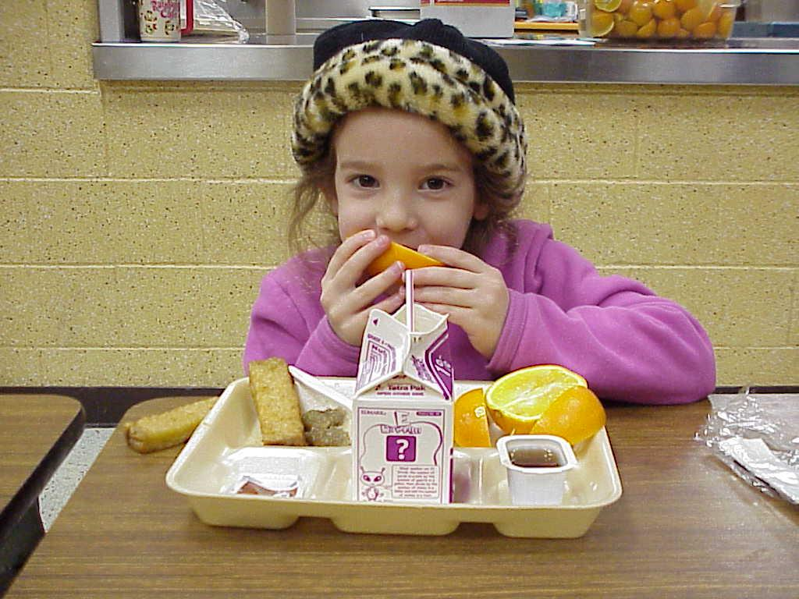
Thoughts?

